Slide 1

ATLAS and DPNC
18 June 2012
Marzio Nessi

Slide 2
23 years of dreams …. starting in 1989 …
2012 promises to be a decisive discovery year !!!

Slide 3
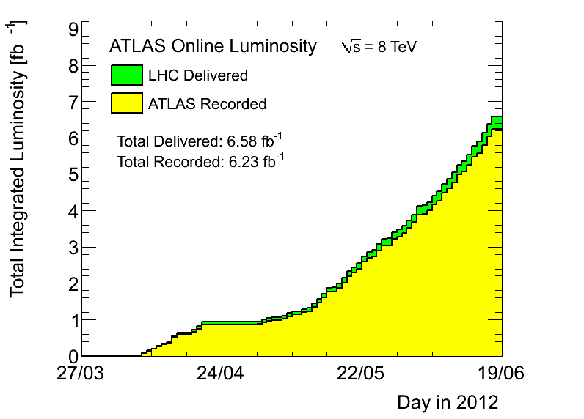
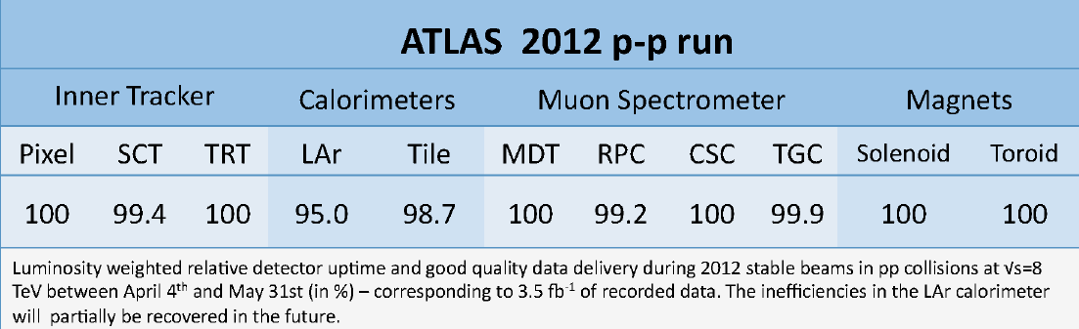
Detector and trigger in excellent shape !
94.7 % eff.
L1 |  |  | HLT
Muon | Calo | CTP | electron | photon | muon | tau | jet | b-jet | missing E_{T}
99.0 | 100 | 99.8 | 99.3 | 99.3 | 100 | 99.9 | 98.6 | 99.9 | 99.3
Luminosity weighted relative trigger quality delivery during 2011 stable beams in pp collisions at √s=7 TeV between 13 March and 31 October (in %).
Recorded:
2010 @ 7 TeV : 0.05 fb⁻¹
2011 @ 7 TeV : 5.25 fb⁻¹
2012 @ 8 TeV : 6.23 fb⁻¹
11.53 fb⁻¹ in proton runs
166. μb⁻¹ in HI runs
More then 91% of all data good for any type of analysis

Slide 4
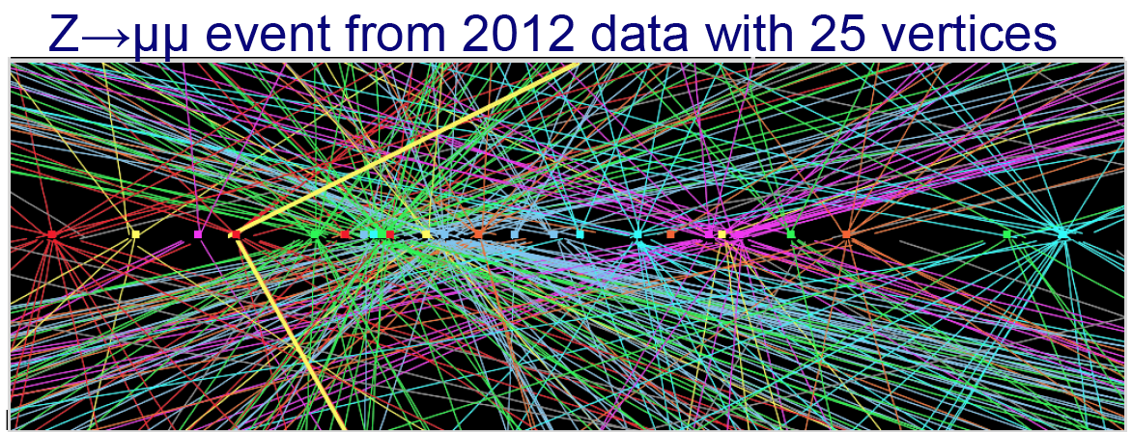
Detector performing already above design specifications
Lpeak ~ 7.10³³ cm⁻² sec⁻¹
@ 50 ns bunch spacing
We designed ATLAS for 25 pile up events (average)
~ 32 event/bncx at the beginning of the fill, with fluctuations up to 41
@ 14 TeV, 25 ns we will be for sure ok up to Lpeak ~ 1.3.10³⁴ cm⁻² sec⁻¹

Slide 5
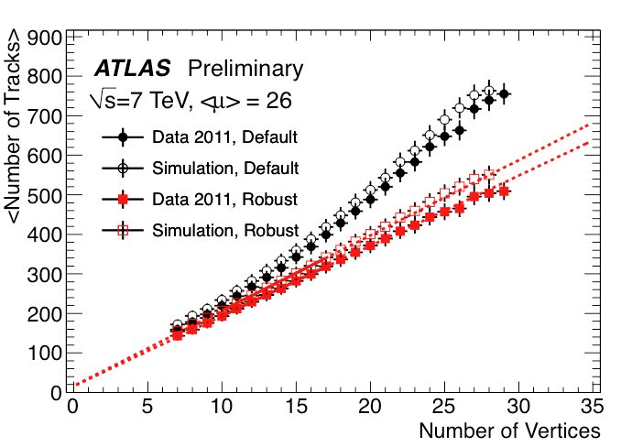
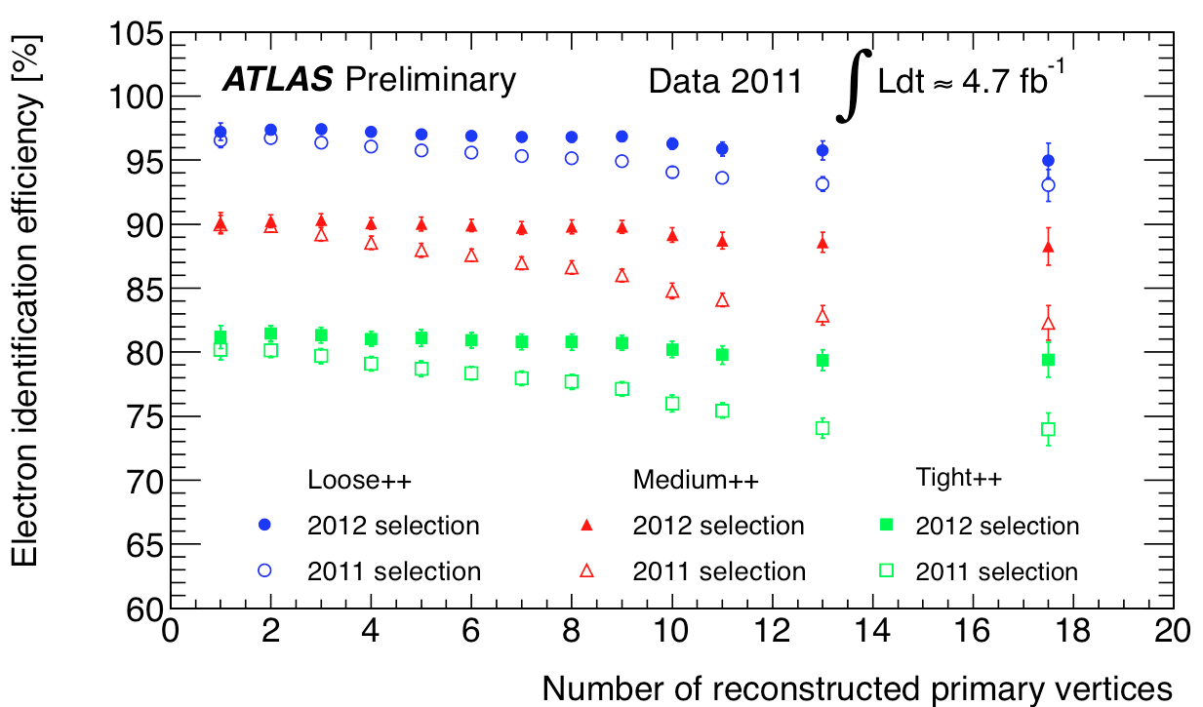
Does the detector really work on such extreme conditions? (1)
Electron identification efficiency before and after retuning the reconstruction algorithms (cuts in particular)
Number of tracks scales linearly with pileup
Fakes increase but can be recovered with “robust” cuts

Slide 6
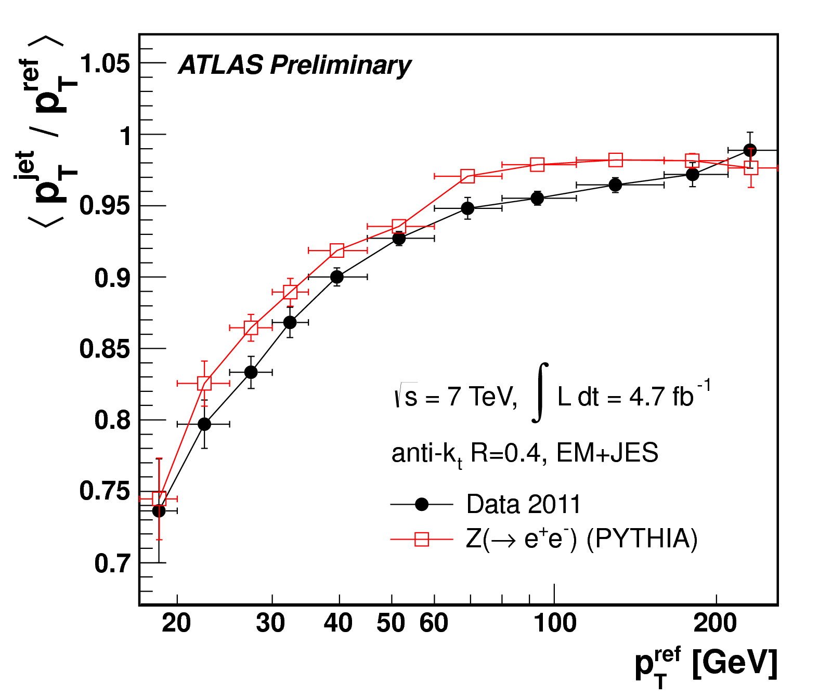
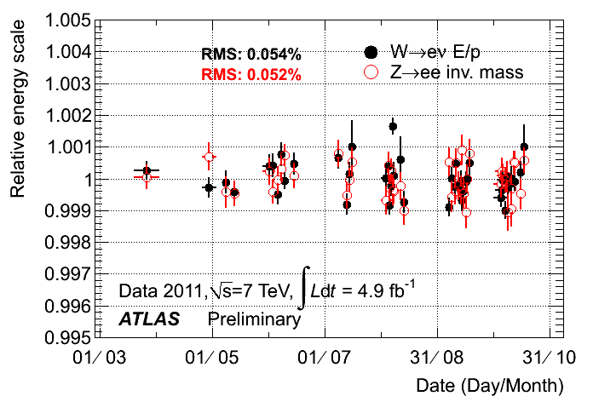

Does the detector really work on such extreme conditions? (2)
Stability of the EM calorimeter E-scale
vs time during the run (pile up changes)
Uncertainty less than 2% for p_{t} > 25 GeV
Jet E-scale calibration with Z+jet events
(jet E-scale known to better than ~1% in some p_{T}/η ranges)
η coverage | 2011 resolution (GeV) | 2010 resolution (GeV)
|η| < 2.47 | 1.76 ± 0.01 | 1.88 ± 0.08
|η| < 1.37 | 1.60 ± 0.01 | 1.62 ± 0.09
2.47 < |η| < 1.37 | 1.99 ± 0.02 | 1.99 ±0.22
Z->ee mass resolution stable as a function of pile up

Slide 7
Does the detector really work on such extreme conditions? (3)
 | Offline Selection | Trigger Selection |  | L1 Peak (kHz) L_{peak}= 7e33 | EF Ave (Hz) L_{ave}= 5e33
 |  | L1 | EF
Single leptons | Single muon > 25GeV | 15 GeV | 24 GeV | 8 | 45
 | Single electron > 25GeV | 18 GeV | 24 GeV | 17 | 60
Two leptons | 2 muons >15 2 muons > 20,10 GeV | 2x10 GeV 15GeV | 2 x 13 GeV 18,8 GeV | 1 8 | 5 8
 | 2 electrons, each > 15GeV | 2x10 GeV | 2x12 GeV | 6 | 8
 | 2 taus > 45, 30GeV | 15,11 GeV | 29,20 GeV | 12 | 12
Two photons | 2 photons, each > 25GeV 2 loose photons, > 40,30 | 2 x10 GeV 12,16 GeV | 2 x 20 GeV 35, 25 GeV | 6 6 | 10 7
Single jet | Jet pT > 360 GeV | 75 GeV | 360 GeV | 2 | 5
MET | MET > 120 GeV | 40 GeV | 80GeV | 2 | 17
Multi-jets | 5 jets, each pT > 55 GeV | 4x15GeV | 5x55GeV | 1 | 8
b-jets | b + 3 other jets pT>45 GeV | 4x15GeV | 4x45GeV+btag | 1 | 4
TOTAL |  |  |  | <75 | ~400 (mean)
Tracking based isolation applied to single leptons at EF to limit rate
Above triggers are used by most analyses, currently 564 items in the menu
Many Specialized triggers, e.g. J/ψ -> e⁺e⁻ for efficiency studies.

Slide 8
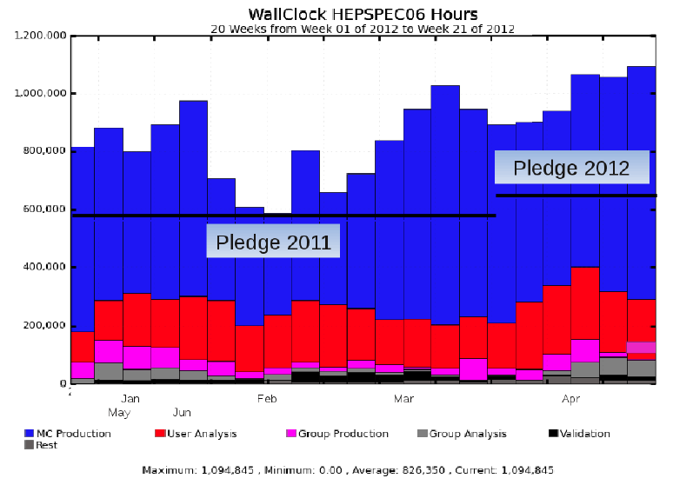
And computing follows
Number of concurrent jobs at all ATLAS Tiers: CERN, 10 Tier1-s,~ 70 Tier2 federations → > 80 sites
Available resources fully used (stressed ...)
ATLAS Computing Model has proven to be very flexible, adapting to data-taking and analysis demands (e.g. dynamic data placement, less reprocessing than foreseen,
very intense simulation)

Slide 9
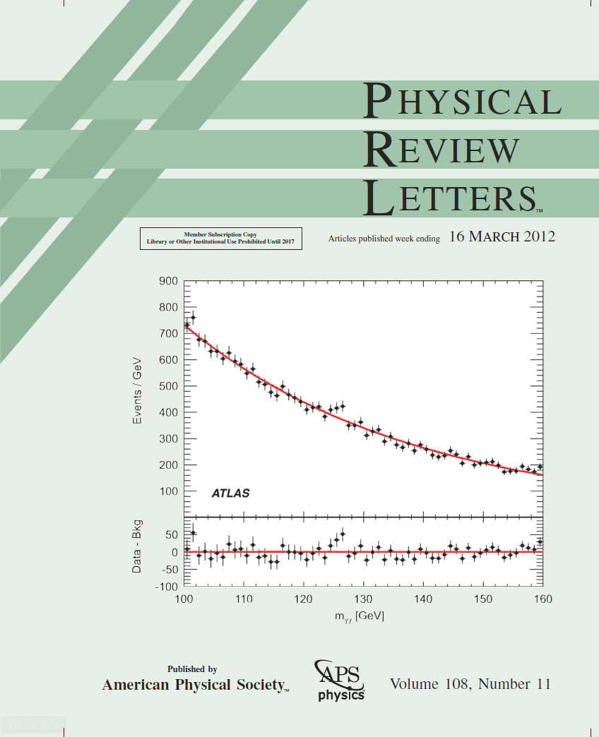



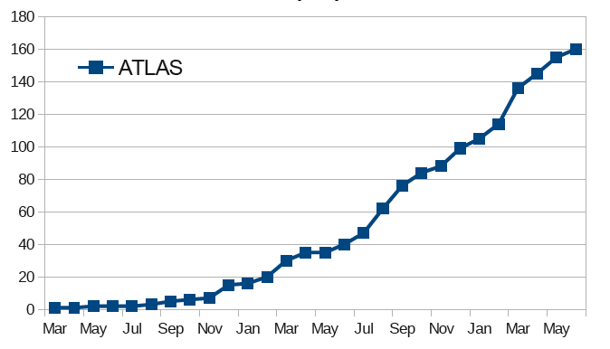


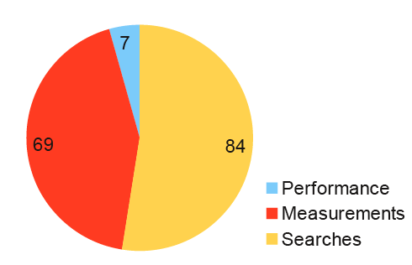


And publications
160 papers on collision data
325 conference notes, 60 in 2012
~2 papers/week in the last months

Slide 10
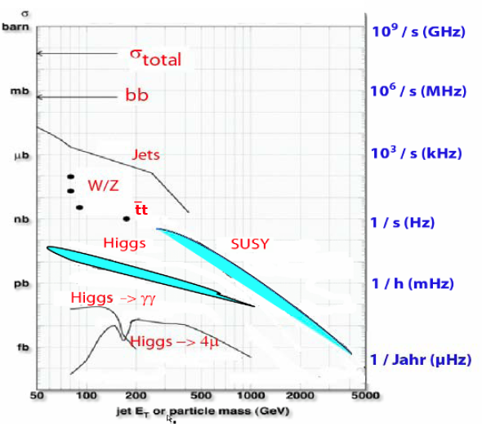
Great sensitivity to physics
Probing the few TeV mass regime
Measuring cross-sections down to few fb

Slide 11
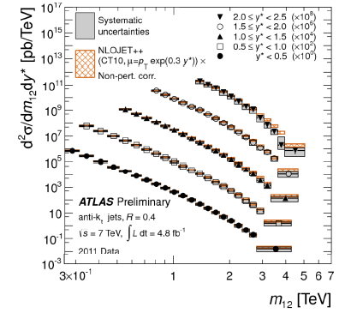
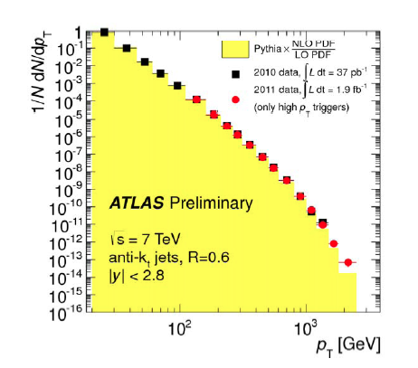
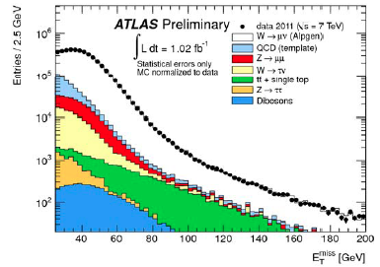
First on QCD
p_{T}, E_{T}^{miss}, di-jet masses, ….
understood over many orders of magnitude

Slide 12
Summary of main electroweak and top cross-section measurements
SM expectations agree with measurements (within present uncertainties)
Experimental precision (~6%) starts to challenge theory for e.g. tt (background to most searches)
Measuring cross-sections down to few fb (including leptonic branching ratios)
σxBR(ZZ→ 4l) ~ 40 fb

Slide 13





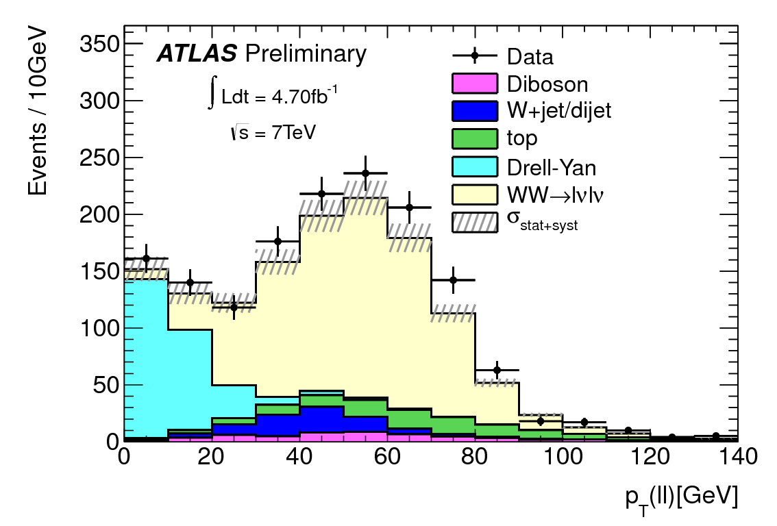
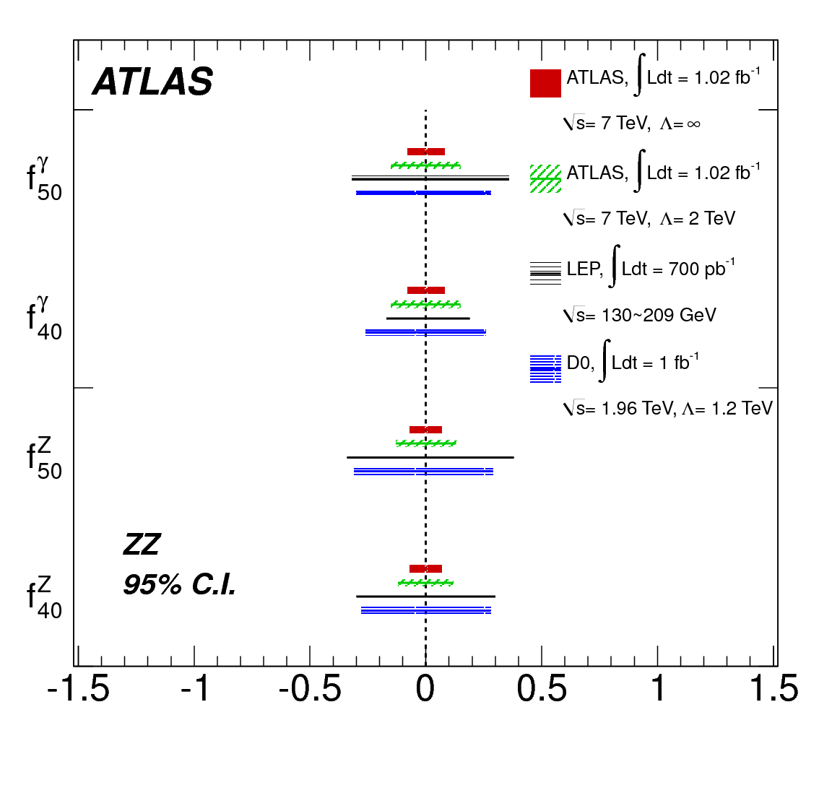
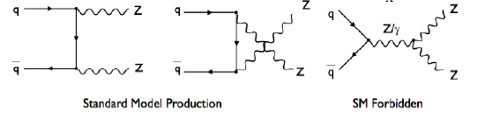
Diboson production : WW, WZ, ZZ
Process Final state Measured total cross-section Theory (NLO SM)
WW lνlν
ZZ 4l
ZZ llνν
Backgrounds to Higgs searches
Give access to triple gauge couplings and New Physics

Slide 14
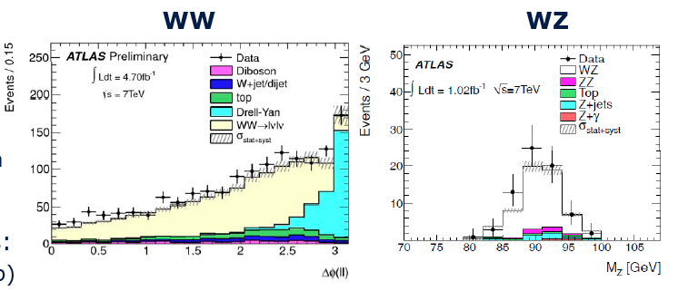

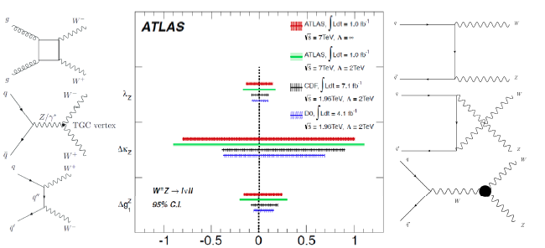
Diboson production : WW, WZ, ZZ

Slide 15
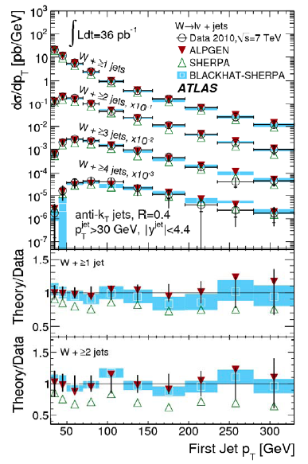
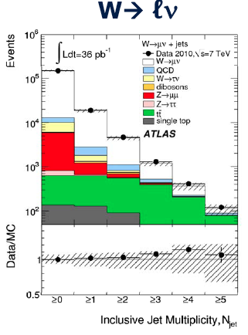
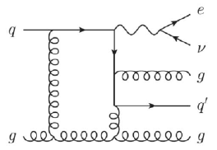
Understanding Z/W+Jets
Pushes limits on W and Z total cross-sections
W/Z, W+/W- ratios, or extra jets (up to 5)
Enable test of
- MC generators
- proton pdfs

Slide 16
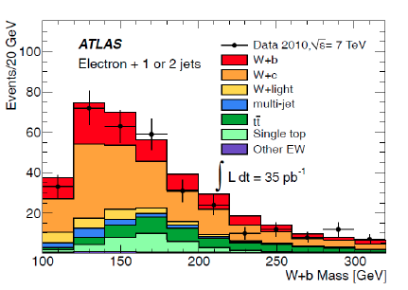
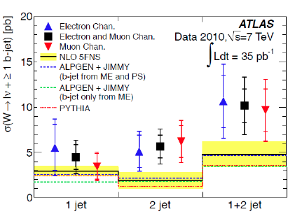
W+b and Z+b cross-sections
~ 1/100 of all jets expected to be b-jets
crucial for b-pdfs
background to many searches
W+b somewhat larger than expected

Slide 17
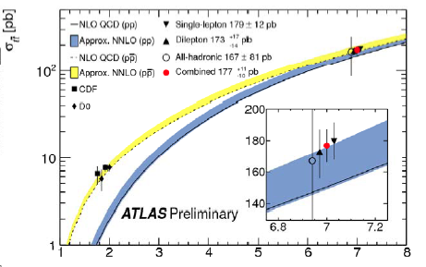
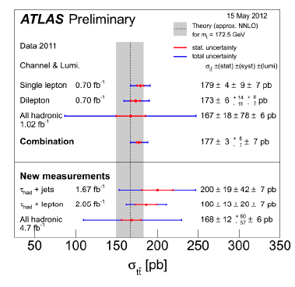
TOP physics
Measurement more precise than theory:
ATLAS: _{tt} (7 TeV) = 177⁺¹¹ ₋₁₀ pb
Theory: _{tt} (7 TeV) = 165⁺¹¹ ₋₁₆ pb

Slide 18
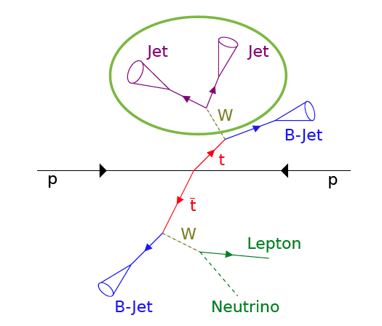
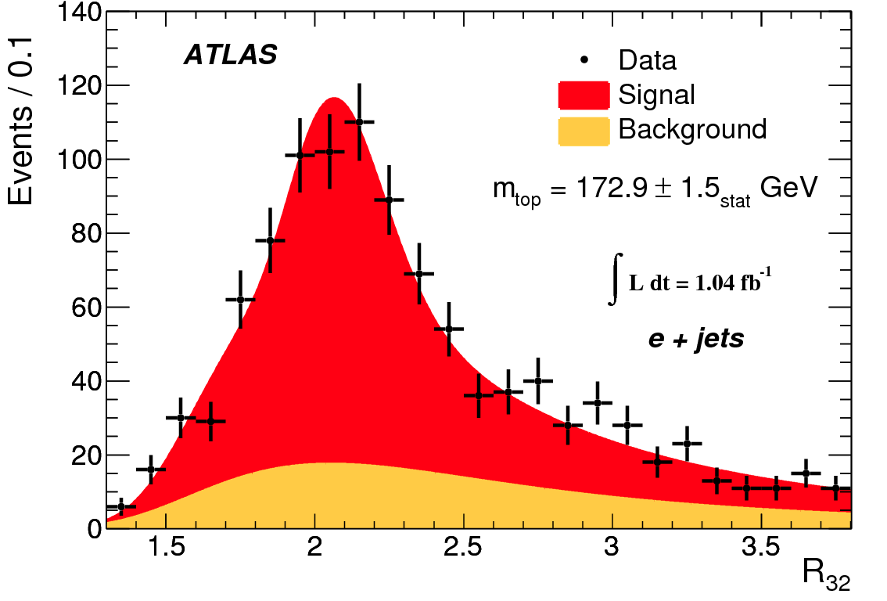
TOP mass

Slide 19
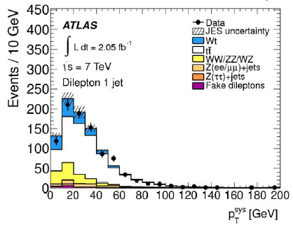
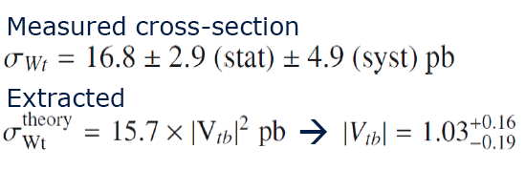
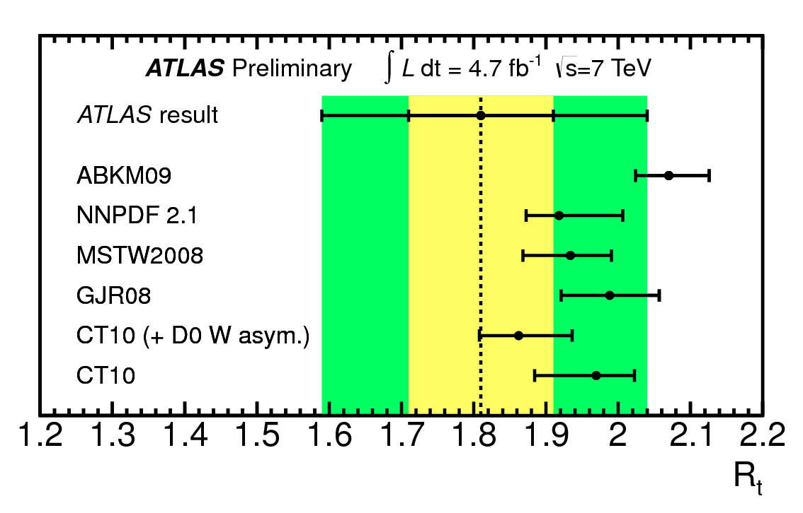
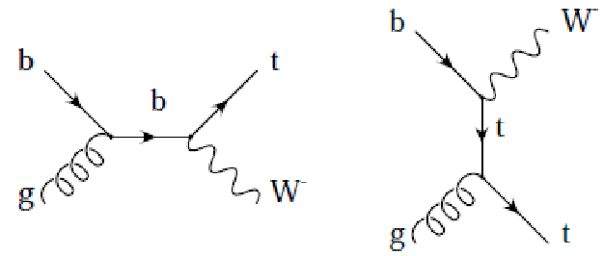
Single top measurements
ATLAS sees evidence for single top in Wt-channel (3.3σ,V_{tb}=1.03+0.16-0.19)
t-channel has been measured separately for top and anti-top
Individual channels agree with SM, ratio starts to be sensitive to u/d ratio

Slide 20
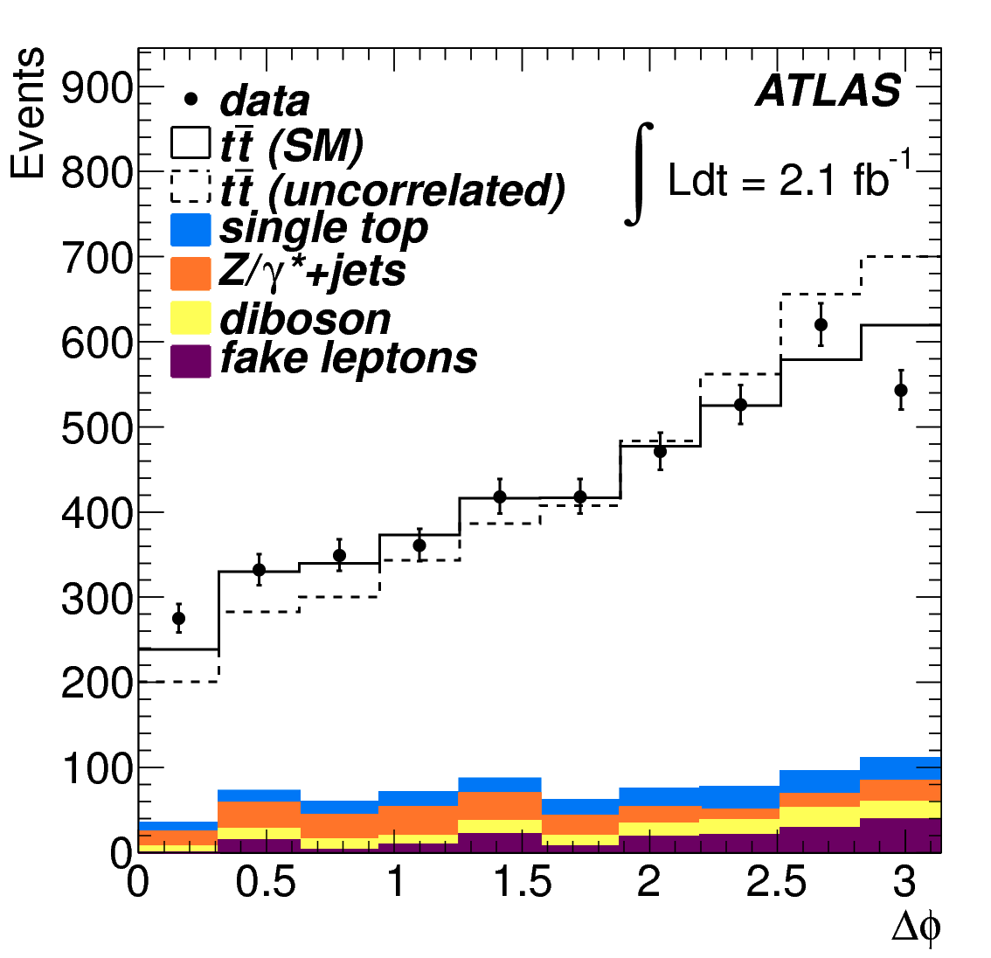
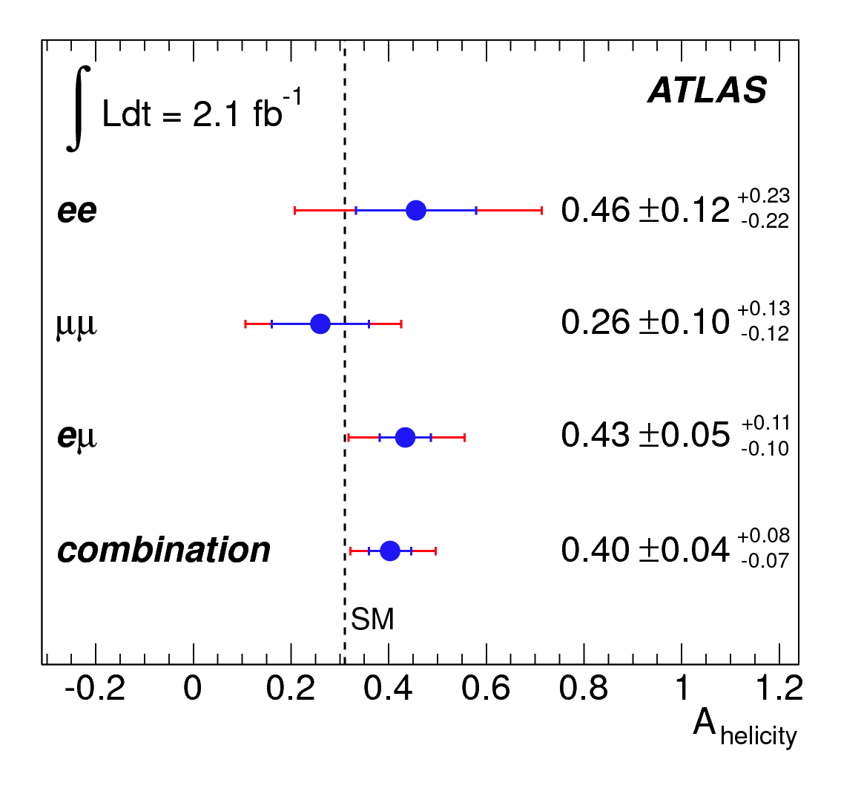
Measurement of tt spin correlations
-
In strong production the tops are unpolarised
However the tt spins are correlated due to the
production process
ATLAS measurement establishes spin correlation to 5.1σ (4.2σ expected)

Slide 21
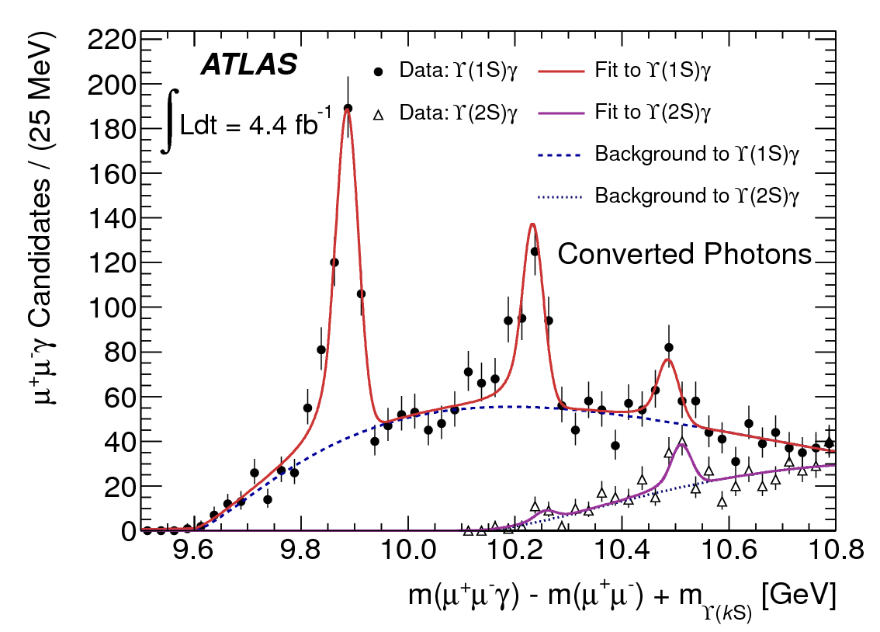
A new particle state discovered
Χ_{b}(3P) → Υ(1s,2s) γ
χ_{b}(nP) → Υ(1s,2s) γ → μμ γ
Χ_{b}(1P) m= 9.9 GeV and Χ_{b}(2P)
m= 10.2 GeV states clearly visible
New structure at 10.5 GeV observed
→ Χ_{b}(3P)
Confirmed with Υ(2s) data and with converted photons
Significance > 6 σ
M [χ_{b}(3P)] =10.539 ± 0.004 (stat) ± 0.008 (syst) GeV
χ_{b}(3P) interpretation consistent with theoretical predictions

Slide 22
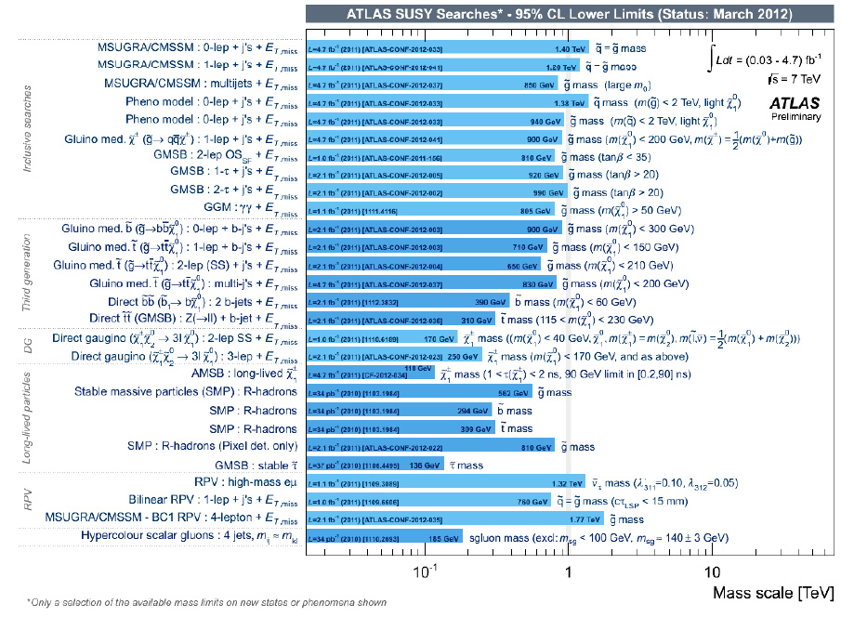
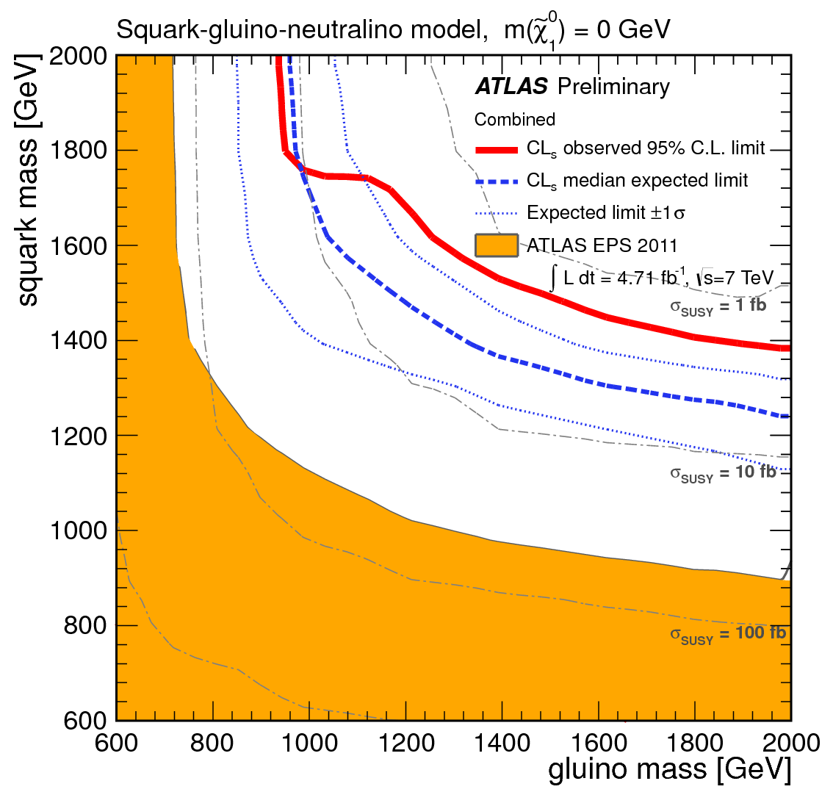
SUSY
Larger luminosity allows searches for : Higher masses, >1TeV covered for “standard” scenarios
Rarer processes
Search for rarer Processes cover
scenarios with larger mass splitting
inclusive searches
third generation
direct gaugino
long-lived particles
….
Now: ~ 5 fb⁻¹
July 2011:
~ 1 fb⁻¹
Minimal models

Slide 23
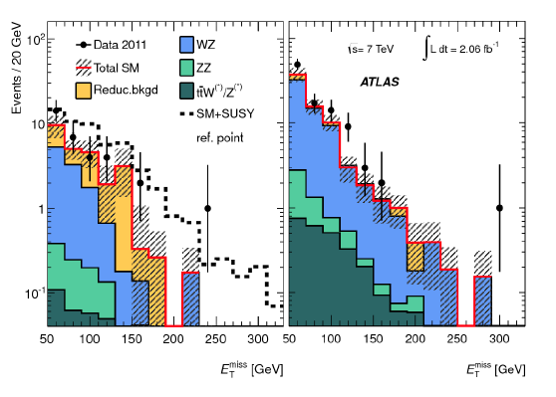
Searches for charginos/neutralinos
Direct chargino/neutralino production has cross-section in the pb range
ATLAS has searched for this in 3-lepton final state
Limits in the m(χ±₁,χ⁰₂) ~ 150GeV region have been set

Slide 24
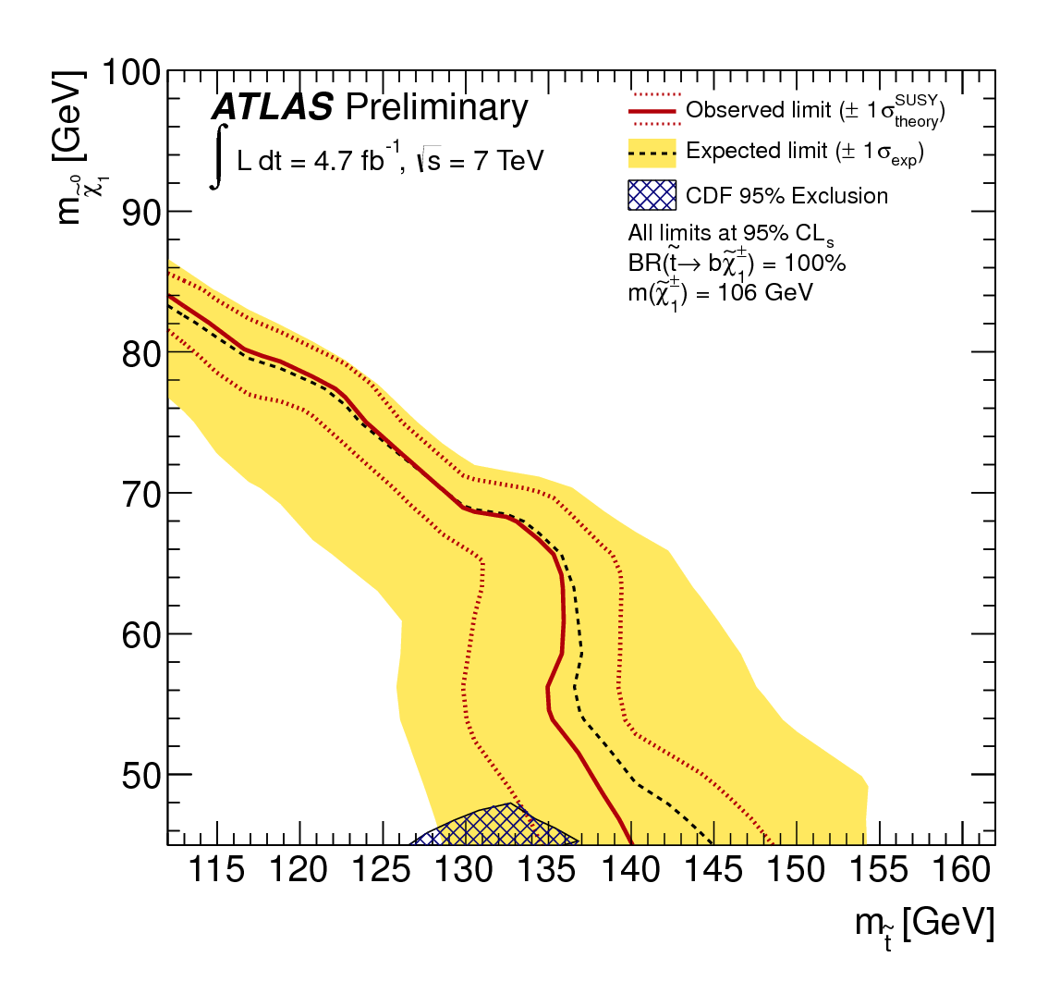
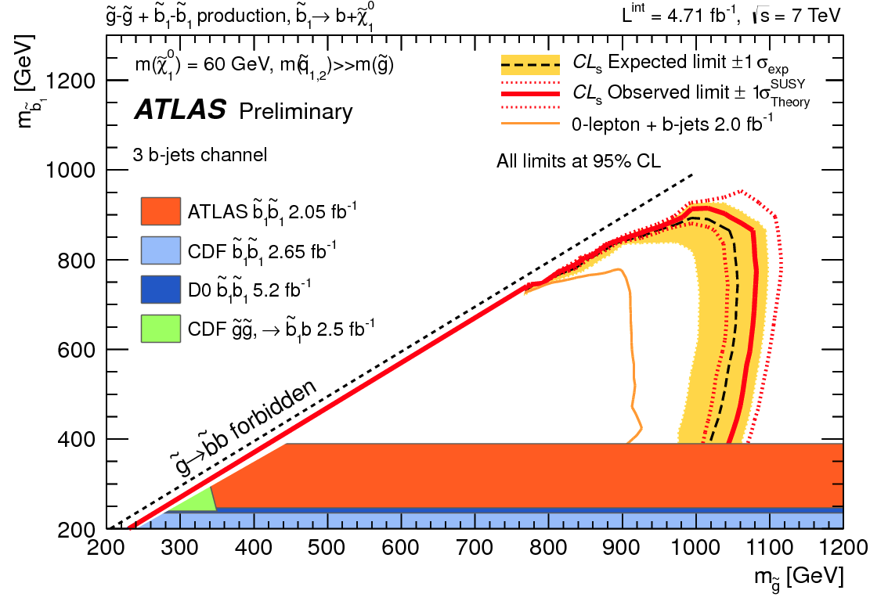
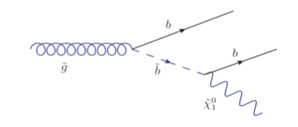
Searches for 3rd generation squarks
ATLAS has searched for
very light stops in direct
production using
2 leptons+MET
and
In gluino mediated production for stops and sbottom using events
with ≥3 b-jets+MET
No signal found

Slide 25
Exotics

Slide 26
Exotics
Most recent results among many.
Searches for Exotics physics states decaying to leptonic final states
Searches for Exotics physics states in jets and boosted objects final states
Quantum black holes (centrality of di-jets spectrum)
ADD extra dimensions (monojets + E_{T}^{miss})
Contact Interactions (Non resonant dilepton final state searches)
A Search for ttbar Resonances in the di-lepton channel
Search for Heavy Neutrinos
Search for mono-jet plus missing transverse energy
4th generation searches

Slide 27
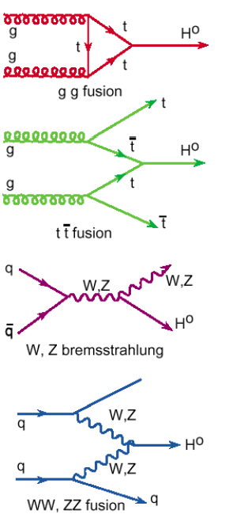
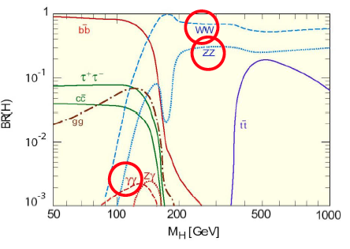
SM HIGGS search
At the moment just these 3 channels have enough sensitivity !!

Slide 28
M > 130 GeV excluded
Region between 130 and 486 GeV excluded at 99%C.L

Slide 29
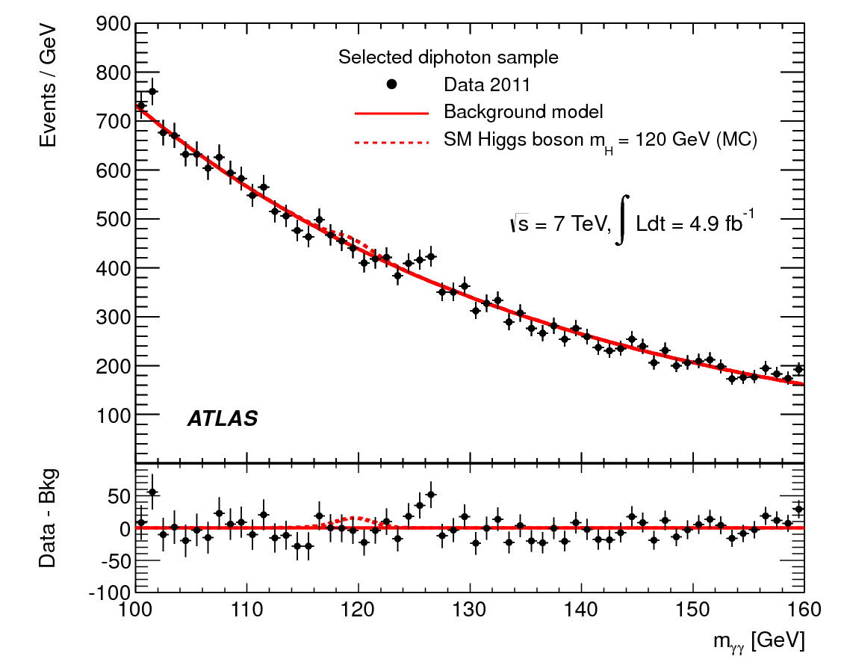
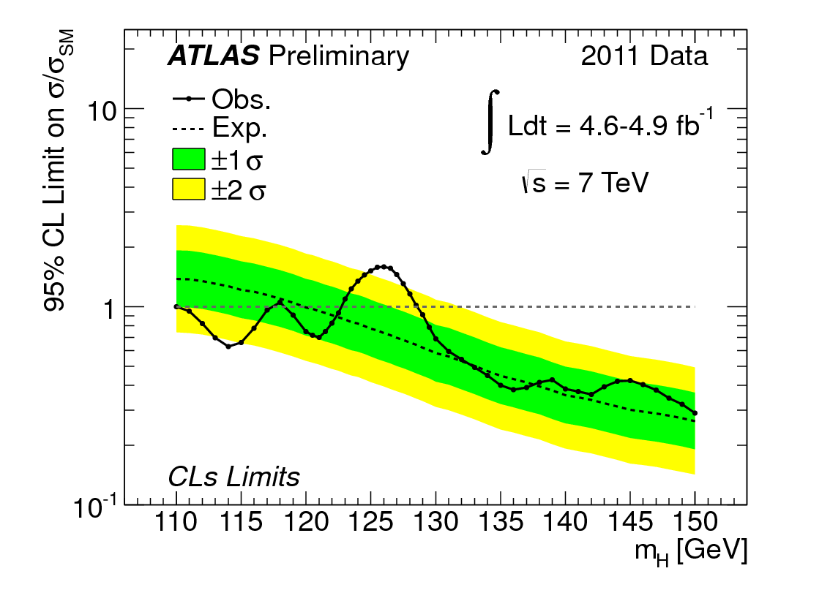
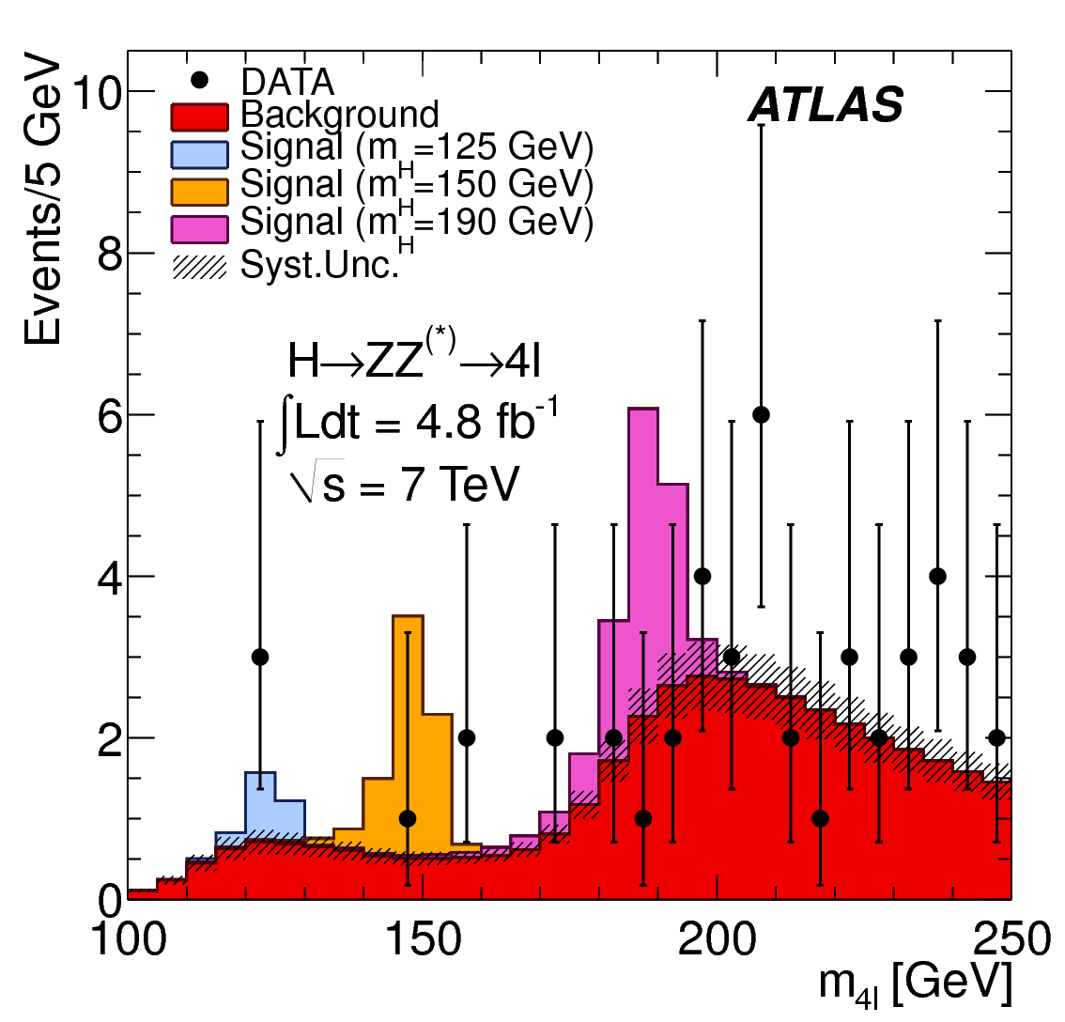
M ~125 GeV still possible !
H→ γγ:
for m_{H} ~ 125 GeV, ~70 signal events expected
after all cuts, and ~ 3000 background events in signal mass window → S/B ~ 0.02
H→ 4l:
in the region m_{H} < 141 GeV (not excluded at 99% CL
by ATLAS+CMS combination) 3 events are observed:
two 2e2μ events (m=123.6 GeV, m=124.3 GeV) and
one 4μ event (m=124.6 GeV)

Slide 30
What next ?
2012 statistics x 2
Not all analysis un-blinded yet. First results are just discussed now in the collaboration (sorry!).
Make sure to be ready with full statistics on
4l and gamma gamma
for ICHEP
→ Next 2 weeks very hot!

Slide 31
Future strategy
if m_{H}~ 125 GeV exists → measure properties: mass, couplings, self-couplings (!?), spin and CP; look for rare decays (e.g. H→ μμ). This will start in the coming years but higher statistics needed in some cases (e.g. rare decays)
V_{L}V_{L} scattering: if Higgs exists → confirm “regularization” of cross-section; if not → understand what keeps cross-section finite. Note: marginal with O(100 fb⁻¹)
extend mass reach for New Physics (typically by ~ 30% going to 3000 fb⁻¹)
if New Physics discovered at the LHC/HL-LHC → explore the new scenario:
extend/complete spectrum; measurements (require high-statistics)
  Example: SUSY: extend reach towards higher squark and gluino masses (~3 TeV); third generation; low cross-section processes (gauginos, sleptons); isolate exclusive (rare) decay chains for precision measurements

Slide 32
Future strategy
A fundamental question to be addressed: trade-off between pile-up and integrated luminosity:
-- what physics processes are marginally affected by pile-up and benefit from as much statistics as possible ? In general, all high-mass searches …
-- what physics processes are affected by pile-up → less integrated luminosity in cleaner conditions may be a better choice (e.g. coupling measurements for VBF H→ ττ) ?
This potential “tension” will affect the LHC / HL-LHC operation program

Slide 33
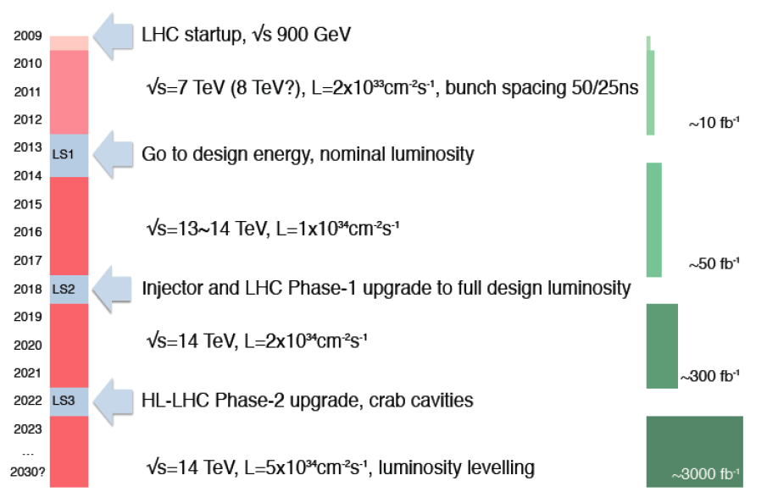
A long way in front of us !
LHC startup, √ s = 900 GeV
√ s=7~8 TeV, L=6x10³³ cm⁻² s⁻¹, bunch spacing 50 ns
4x
, bunch spacing 50 ns
~20-25 fb⁻¹
(Phase-0)
Go to design energy, nominal luminosity
√s=13~14 TeV, L~1x10³⁴ cm⁻² s⁻¹, bunch spacing 25 ns
~75-100 fb⁻¹
Injector and LHC Phase-1 upgrade to full design luminosity
√ s=14 TeV, L~2x10³⁴ cm⁻² s⁻¹, bunch spacing 25 ns
~350 fb⁻¹
HL-LHC Phase-2 upgrade, IR, crab cavities?
?, IR
√ s=14 TeV, L=5x10³⁴ cm⁻² s⁻¹, luminosity leveling

Slide 34
Looking at short, medium and long term!
We have to make sure that we are able to adapt to the challenges offered by the LHC accelerator in all its phases, also because our detector technology is aging if not evolving properly (including radiation damage!)
  Phase 0: To nominal energy and nominal peak Luminosity
  Phase 1: To ultimate peak Luminosity : 2 x nominal peak Luminosity
  Phase 2: To HL-LHC mode : 5 x nominal peak Luminosity + Luminosity leveling, to maximize the integrated Luminosity (~ 300 fb⁻¹/year)
In addition we have to make sure we maintain the infrastructure efficient and operational over decades, minimizing single points of failure

Slide 35
PHASE 0 up to the 2013/2014 shutdown (LS1):
Plans worked out since a few years through regular interactions within the Collaboration (CB), National Contact Physicists, RRB scrutiny group, CERN and the various service providers:
  long list of maintenance/consolidations/repairs that we are preparing since a few years
  Anticipate the 4th pixel layer installation (IBL)….. LS2 installation in 2018 would be too late!
  Prepare detector for optimal data taking at nominal Luminosity !!!
Detector consolidation:
New ID evaporative cooling plant
New Calorimeters LV power
Magnets cryogenics consolidation
Muon spectrometer consolidation
Infrastructure consolidation (electr, ventilation, radiation protection,…)
Maintenance and repairs everywhere
Detector upgrade:
New Aluminum beam pipes
New small radius central Be pipe
IBL: pixel 4th layer
NSQP : Improved pixel services layout ? (decision during 2012)
New chambers in the muon spectrometer to improve geometrical coverage

Slide 36
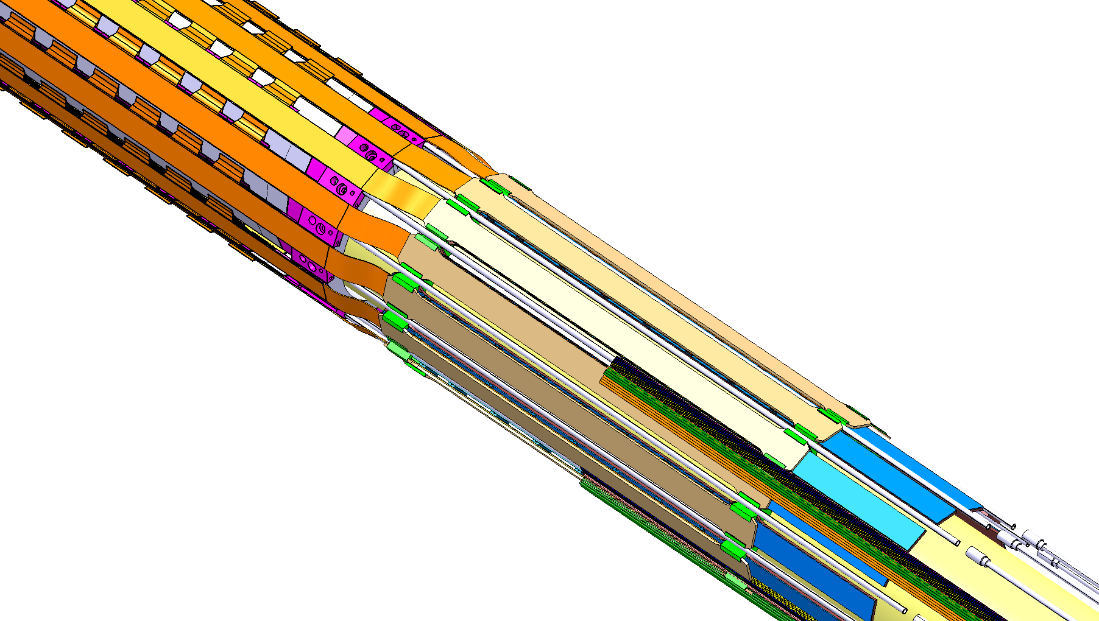
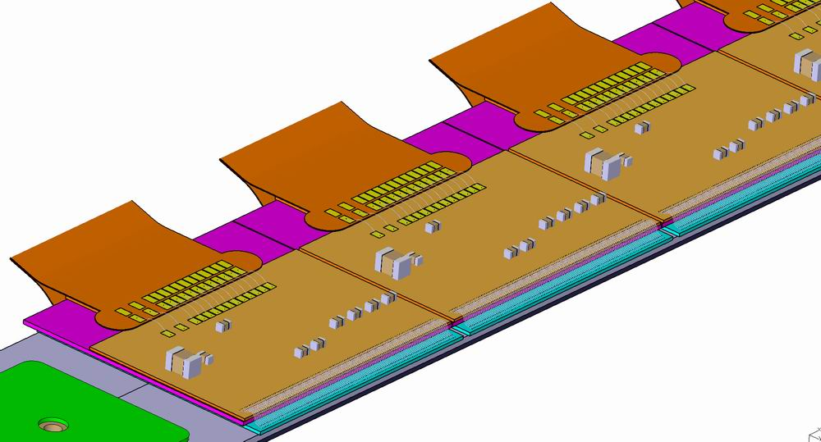



ATLAS is preparing for a 4 layer pixel in SL1 : IBL
IP
Staves
IBL key Specs / Params
14 staves, <R> = 33.25 mm
CO₂ cooling, T < -15ºC @ 0.2 W/cm²
X/X₀ < 1.5 % (B-layer is 2.7 %)
50 µm x 250 µm pixels (planar and 3D)
1.8º overlap in ϕ, < 2% gaps in Z
32/16 single/double FE-I4 modules per stave
Radiation tolerance 5x10¹⁵ n_{eq}/cm²
New Be beam pipe of smaller radius
Transition to cables
Underside of stave: IBL modules
36

Slide 37

Phase 1 challenge:
Physics will continue to require Level-1 single lepton thresholds with p_{T} of order 20 GeV even with pile-up as high as ~50 (L =2 10³⁴ cm⁻²s⁻¹, 25ns) or even ~75 (L =3 10³⁴cm⁻²s⁻¹, 25ns)
Need to preserve nominal luminosity trigger acceptance even for L >10³⁴cm⁻²s⁻¹
Retain some “simple” triggers in the menu to avoid and/or understand physics biases
Keep acceptances high and similar between barrel and forward
In addition, aim at using secondary vertexing and track information to retain high purity, good efficiency samples of interesting channels at the HLT level
Wherever feasible retain sensitivity to beyond the SM physics with as little model dependence as possible
https://cdsweb.cern.ch/record/1402470/ (CERN-LHCC-2011-012 )

Slide 38



New muon small wheels (more granularity)
Plan to replace muon small wheels with improved trigger capability: need <1mrad angular resolution and associated trigger vector capability
Status:
Converging on the choice of the technology for precision tracking and trigger
MicroMegas for precision coordinates and TGC for trigger the main candidates
Vigorous milestone plan for 2012 to demonstrate feasibility
TDR to be ready for early 2013
Project being setup for ATLAS internal approval in October 2012
Trigger rate reduction
studied using
data
~ 1/6
in 1.3<η<2.5

Slide 39



New LVL1 Calorimeter trigger (more granularity)
Plan to better use in the LVL1 trigger the available detector granularity in the LAr Calorimeter. Develop a new front-end digital chain (trigger leg for phase I )
GOAL:
Preserve un-prescaled LVL1 theresholds for single electron trigger at PT ~ 25 GeV for LHC operation beyond the nominal design (Phase 1 LHC, HL-LHC)
Use, at the LVL1 trigger level, a new shower shape: Ratio of energy (2nd layer of the EM calorimeter) in clusters of two sizes

Slide 40



AFP : ATLAS Forward Physics
Tag and measure protons at ± 210 m
Trigger: rely on ATLAS high-P_{T} LVL1 trigger
Detectors: radiation hard “edgeless” 3D Silicon as tracker, 10 ps timing detectors
Allows running in high pileup conditions with association with the primary vertex → access to RARE processes

Slide 41
PHASE 2: 2021/22 shutdown (LS3) or HL-LHC upgrade:
We assume that by then the LHC will have delivered 300-350 fb⁻¹
The LHC will be made ready to run at L_{p}=5*10³⁴ with Luminosity leveling
  → The main activity is the construction of a new inner detector for which today the collaboration is very active with R&D, prototypes and engineering work
  The Calorimeter readouts will need a substantial upgrade, part of it will be done in a staged way in the 2018 shutdown (digital LVL1 trigger)
  If proven necessary, the end-cap LAr might need to be opened and FCAL and HEC electronics fixed. A decision will be taken in a few years from now
  The muon spectrometer will be upgraded in particular in the big wheel region
  Most of the existing electronics/computing/TDAQ will need to be upgraded and modernized to face additional 8-10 years of running in extreme conditions
ALL this will require ~2 years shutdown to prepare ATLAS for its new phase !!!

Slide 42


PHASE 2 : LOI in preparation
Today’s plans :
Editorial board active
LOI will be presented in December 2012
Approved by the ATLAS CB in January 2013
March 2013 looking for positive LHCC outcome
Today’s cost estimations (to be revised for the LOI) :
= 291 MCHF

Slide 43
Overall Strategy
2013/2014 shutdown (LS1):
  long list of maintenance/consolidations/repairs that we are preparing since a few years
  IBL installation, eventually entire pixel detector consolidation (nSQP project)
  Prepare detector for optimal data taking at nominal Luminosity and Energy !!!
2017/18 shutdown (LS2):
  Prepare detector for ultimate luminosity, upgrades mostly to inputs for LVL1 trigger
  Possible additional consolidations/repairs after ~10 years of detector readiness
  LOI presented and well received. First cost estimation included.
  Next steps: TDRs/MOUs 2013-2014 depending on the projects(5)
2022/23 shutdown (LS3=HL-LHC):
  ID aged mostly by radiation, complete construction of a new ID to be tested on surface in 2021
  Upgrade the detector where technology will be obsolete (mostly electronics)
  Prepare the detector for HL-LHC and 8-10 years of additional running
  TDRs/MOUs 2014-2016 once LHC physics established and HL-CERN plans better known

Slide 44
How do we fit on all this as DPNC ?
ATLAS DPNC students (M=master/P=PhD, y=term)
ALEXANDRE Gauthier (P,2012)
BACKES Moritz (P,2013)
BARONE Gaetano (P,2015)
BENHAR NOCCIOLI Eleonora (P,2015)
BERNASCONI,Tancredi (M,2012)
BILBAO DE MENDIZABAL Javier (P,2017)
BUCCI Francesca (P,2012)
DAO Valerio (P,2013)
GRAMLING Johanna Lena (P,2017)
GUESCINI Francesco (P,2016)
KATRE Akshay (P,2017)
MORA HERRERA Clemencia (P,2012)
MIUCCI Antonello (P,2016)
NEKTARIJEVIC Snezana (P,2014)
NIKOLICS Katalin (P,2013)
PICAZIO Attilio (P-2016)
ROSBACH Kilian (P,2015)
WATSON Ian (P,2013)
Group very well integrated in ATLAS
3-4 thesis /year in the next future

Slide 45
How do we fit on all this as DPNC ?
ATLAS DPNC physicists
BELL Paul
BELL William
CLARK Allan
DOGLIONI Caterina
FERRERE Didier
GADOMSKI Szymon
GONZALEZ SEVILLA Sergio
GOULETTE Marc
IACOBUCCI Giuseppe
LA ROSA Alessandro
LISTER Alison
MARTIN dit LATOUR Bertrand
MERMOD Philippe
NESSI Marzio
PASZTOR Gabriella
POHL Martin
WU Xin
Bell.P. Deputy convener of the Egamma trigger signature group
Doglioni.C. Contact person for the high-mass di-jet exo analysis call energy scale
Gadomski.S. Member of the ATLAS international computing board
Lister.A. Top reconstruction subgroup convener
Mermod,Ph. Long living particles subgroup convener
Clark, A. Member of the ITK subcommittee (future inner detector)
Iacobucci, G. ATLAS Swiss Contact Physicist
Iacobucci, G. Convener of the physics upgrade simulation subgroup and member of the upgrade steering committee
Cadoux,F. Co-convener of the IBL integration&installation w. group
Debieu, S. Co-convener of the IBL off detector w.group
Nessi,M. ATLAS technical coordinator

Slide 46
THANK YOU!

