Slide 1


The ESS Cryomodules
2012 December, 5th
Christine Darve
Cryomodules Lead Engineer

Slide 2
Outlines
ESS accelerator context for a Globe of Science and Innovation
Main parameters and milestones
Cryomodule stakeholders
Cryomodule strategy
Functions and constraints
Technology Demonstrators
Spoke cavities technologies
Elliptical cavities technologies

Slide 3
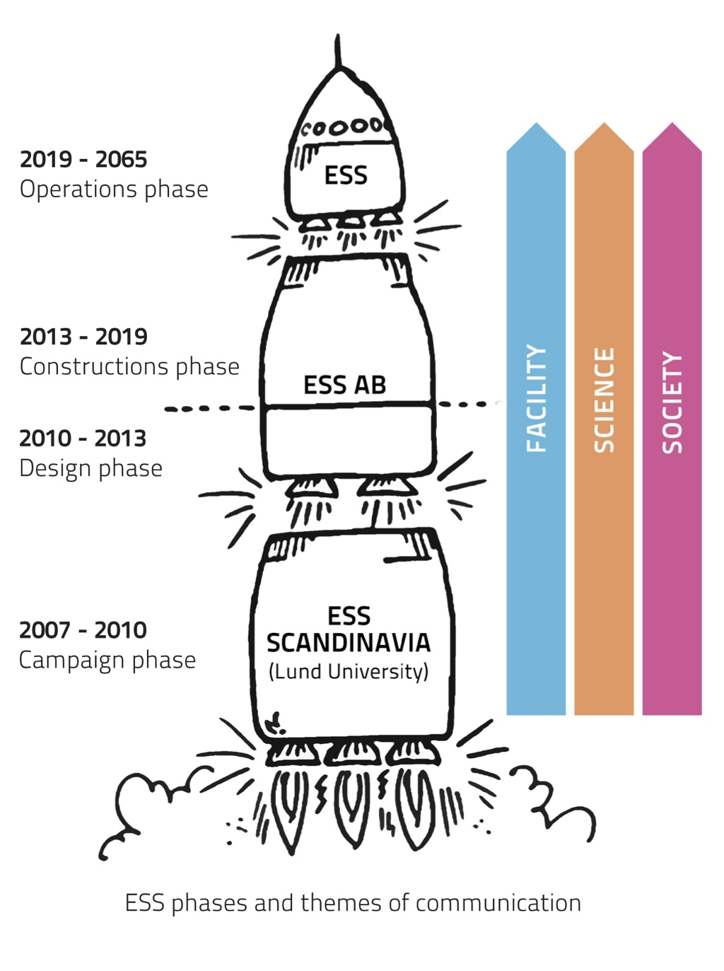
The ESS philosophy
See Giobatta Lanfranco’s talk
Vision & Raison d’etre: Science for Society
Mission:
  Design, construct and operate
  the worlds-leading neutron source
  Manage the company business
Core Values:
  Excellence; Openness; Sustainability
ESS philosophy:
  “Greenfield thinking on a greenfield site”
Goal: to deliver first neutrons before this decade is out
→ Goal oriented project
Notes:
Openness (emotional value)
- trust, transparency and adaptiveness
= successful innovation culture
Excellence (visionary value)
- elicit the very best that people have to give = world-class outcome of science and engineering

Slide 4
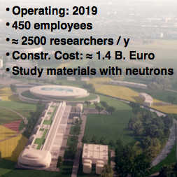
ESS – some numbers
Superconducting Proton Linear Accelerator (500 m )
  2.5 GeV Proton Energy
50 mA (2 mA) peak (average) proton current
  357 kJ/pulse
2.86 msec pulse length
  14 Hz pulse frequency
71.4 msec periods between pulses
  5MW proton beam power
Single Target Station
  Rotating Tungsten, helium cooled
22 instruments
  High reliability, low losses
Notes:
Separation of accele et target et instrumen ➔ 3 division techn

Slide 5
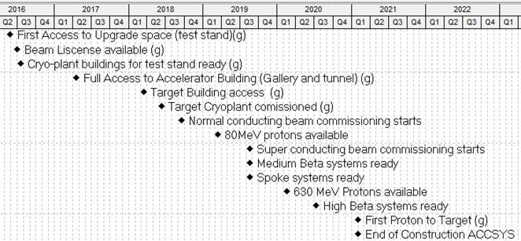
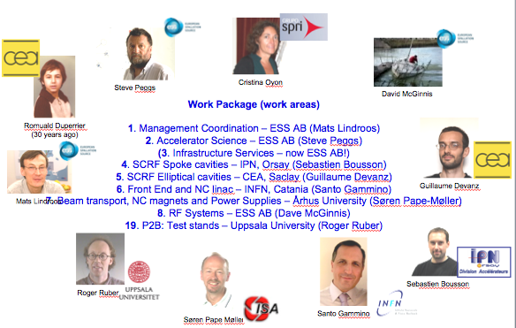

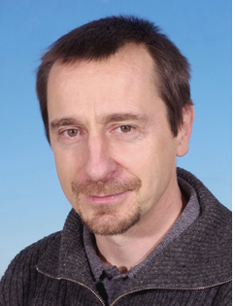
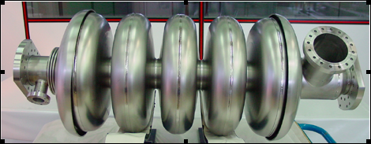

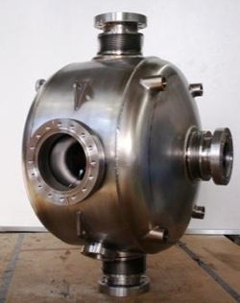

ESS Accelerator context
=
The Planning
The Goal for WP4 and WP5
From design, procurement to test of spoke,
high-beta and medium-beta elliptical:
Technology demonstrators
Series cavity packages
Series cryomodule packages
ADU WP (2010-2012)
+
The People
Pierre Bosland

Slide 6
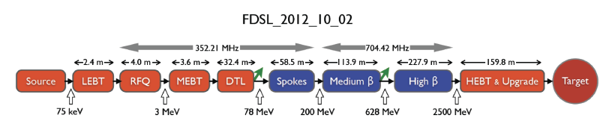
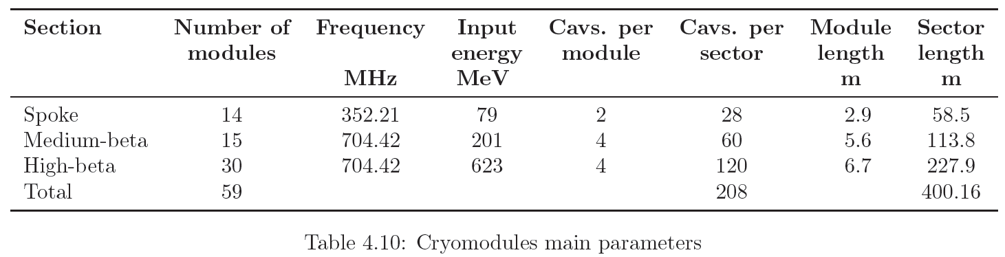
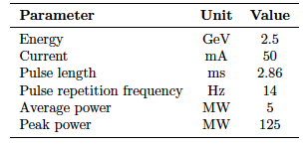
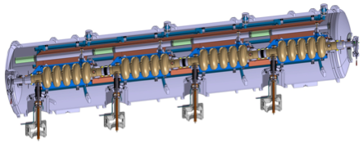
Accelerator
See Sebastien Bousson’s talk
➔ 98 % of the accelerator is superconducting

Slide 7
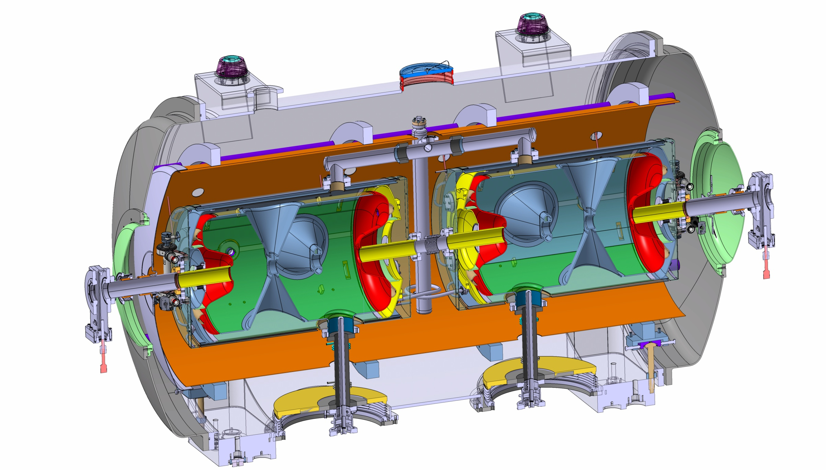
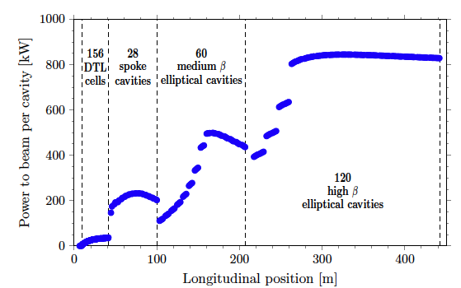
Cryomodule stakeholders - Interfaces
ESS cold linac integrators (e.g. cryogenics, vacuum, conventional facilities)
Safety team
Cryomodule designers
Cavity package designers
Control and instrumentation teams
Component assembly teams
Test teams
ESS system engineer
Survey experts
Toolings
Transport
Cryogenic distridution
Cryogenic distribution
Beam Diagnostic
Beam Optics
Beam Vacuum
Radio-frequency

Slide 8
Outlines
ESS accelerator context for a Globe of Science and Innovation
Main parameters and milestones
Cryomodule stakeholders
Cryomodule strategy
Functions and constraints
Technology Demonstrators
Spoke cavities technologies
Elliptical cavities technologies

Slide 9
Cryomodule Functions
Cavity package (incl. SRF cavity, Ti helium tank, cold tuning system, and fundamental power coupler)
Cryomodule package :
  The supporting and mechanical systems that interface the cavity packages in the test area than in the tunnel
  The vacuum vessel, thermal and magnetic shieldings that insulate the cavity packages from the ambient condition
  The cryogenic distribution (hydraulic circuits, jumper connection) that interfaces the cavity packages with the cryogenic valve box (CTL, cryoplant)
  The instrumentation, control valves and the safety devices

Slide 10
Construction phase (2013 – 2019)
Technology demonstrators to proof the series production technologies
Cavity package
Cryomodule package
Design to complete following the Accelerator Design Update (ADU phase)
Procurement
  - Product Breakdown Structure, materials
Conditioning and Assembly
- Power coupler conditioning, surface processing, clean room and hall assembly
Test with cryogenics and RF environment
Tunnel installation
Commissioning
Operation

Slide 11
Constraints
Integrated hazards due to operating environment:
  Radiation environment (high intensity proton beam)
  Cryogenic temperature: 2 K (Helium II), cryogenic vessel, pressure vessel
  Sub atmospheric condition (31 mbar saturated), leak-tightness
  Magnetic environment (14 mGauss)
Main challenges:
  Quality: science and innovative using the SRF cavities
  Quantity: 208 cavities and 59 cryomodules
  Short project time scale
  Limited budget
  Series to ease and enable industrialization process
Staged Approach:
  630 MeV protons to target 3Q 2019
  Staged to nominal power will occur in 3 shutdowns in 2020-2022

Slide 12
Standards and Safety Culture
Engineering standards
CEN, European Committee for standardization
SIS, Swedish Standard Institute
ISO, International Organization for standardization
  → e.g. European Directive 97/23/CE; EN ISO 4126, PED
  → ESS guidelines for pressure vessel modeled after FNAL , CERN expertise
Radio-Protection and Rad-hard equipment
As low as reasonable achievable (ALARA)
Passive and active safety measures (safety barrier)
Personnel Protection System, Machine Protection System (IEC61508)
  Risk analysis and reliability study
  Safety reviews
  Quality Assurance

Slide 13




ESS Radiation Safety - Time Schedule
Courtesy of Peter Jacobsson - Head of ESS safety
2012-04-01 2012-07-01 2013-01-01 2013-07-01 2014-01-01
PSAR
Preliminary
Safety
Analysis
Report
SSM
Swedish Radiation Safety Authority
Radiation Protection Act
SSM
Permit to construct
Application
EIA
Environmental
Impact
Assessment
Court Hearing
EC
Environmental
Court
Environmental Code
EC
Construction
and
Operation
Permit
Application
Swedish Gov.
LM
Lund
Municipality
Planning &
Building Act
Come
into force
Consultation
Proposal
Public
Display
Local
Plan
LM
Appeals
Building
Application
(ESS)
Building Permit

Slide 14
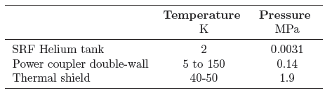
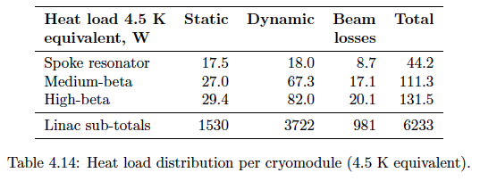
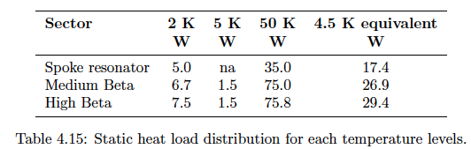
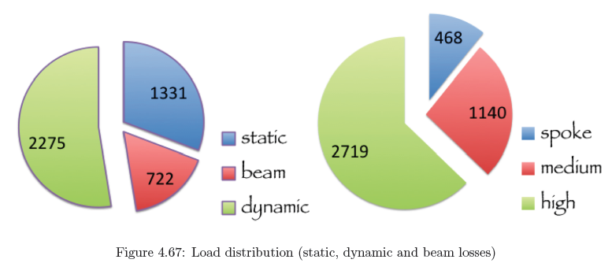
TDR data

Slide 15
Cryomodule instrumentation
* Instrumentation function
  Monitoring
  Control
  Interlock
  Alarms
Expected categories
  temperature transmitter: Cernox and PT100
  vacuum gauge
  pressure gauge
  level gage
  control valve
  * flowmeter
  * pick up coil
  * heaters

Slide 16
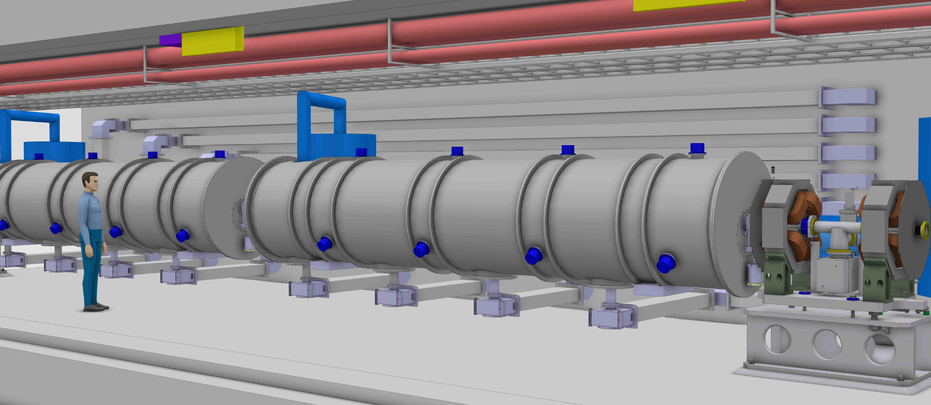
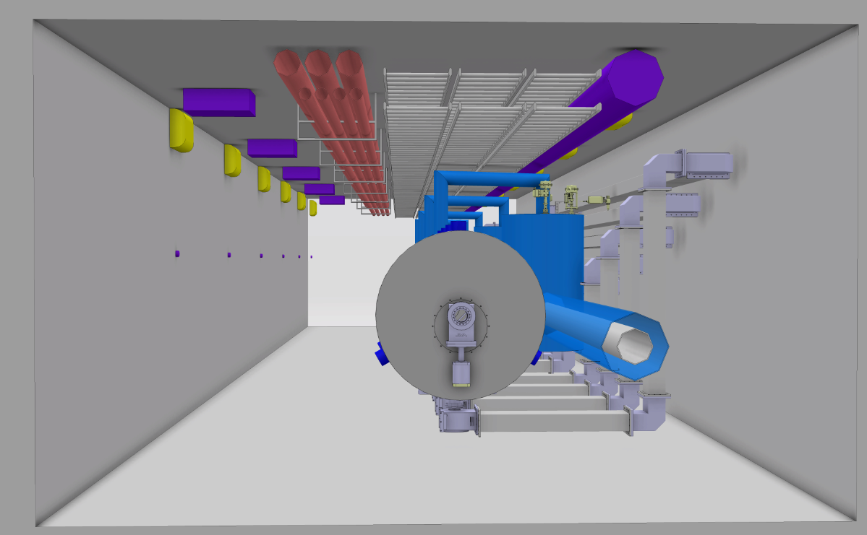
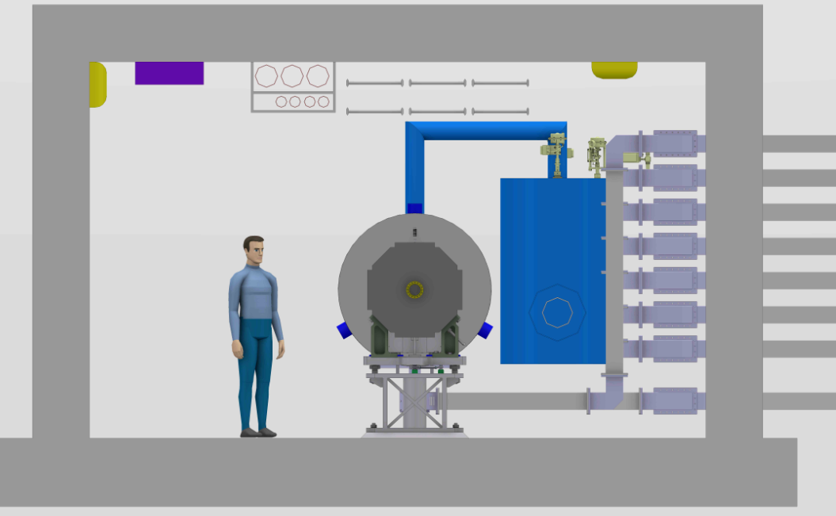
Tunnel integration

Slide 17

Cavity Cryomodule Technology Demonstrators
→ One Technology Demonstrator per cavity family to validate:
Fabrication and industrialization of the cryomodule:
e.g. cleaning, tooling, assy procedures, QA;
The performance of the RF design:
e.g. characterize the cavity RF signature; validate RF results obtained in vertical cryostat;
The performance of the thermal and vacuum design:
eg. cool-down rate, operating conditions; heat loads; cooling scheme efficiency, leak tightness;
The performance of the mechanical design: e.g. MAWP, stability, alignment;
The safe operation of the cryomodules:
e.g. process variables, control loops, operating modes, relieving system and interlock;
Training: e.g. to assemble, to operate.

Slide 18
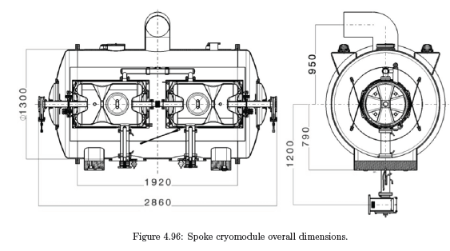
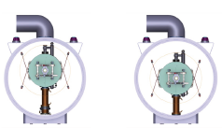
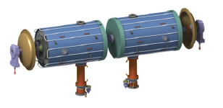
Spoke cavity string and cryomodule package
Technical design results:
  Position coupler
  Supporting system
  Thermal shielding
  Magnetic shielding
Spoke cryomodule overall dimensions
Position cavity string during cryostating step
Cavity string and its cooled magnetic shielding

Slide 19
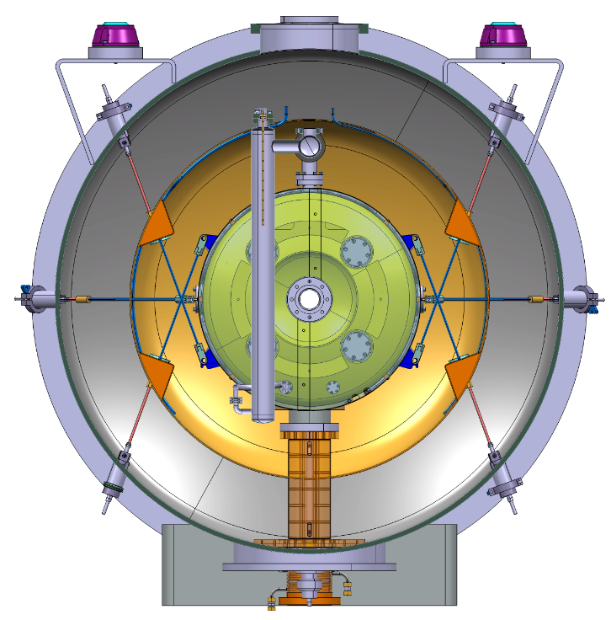
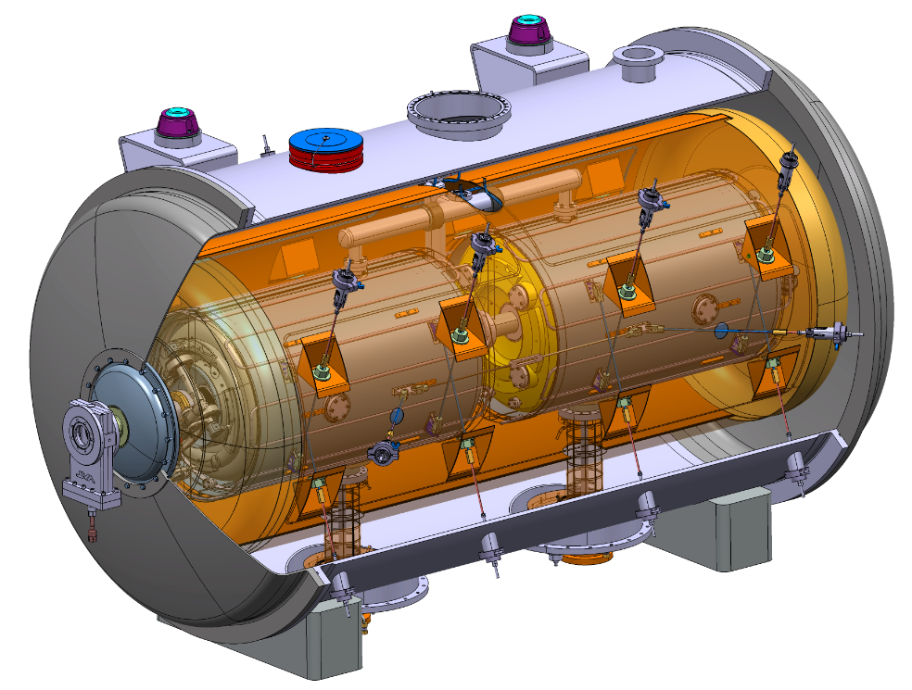
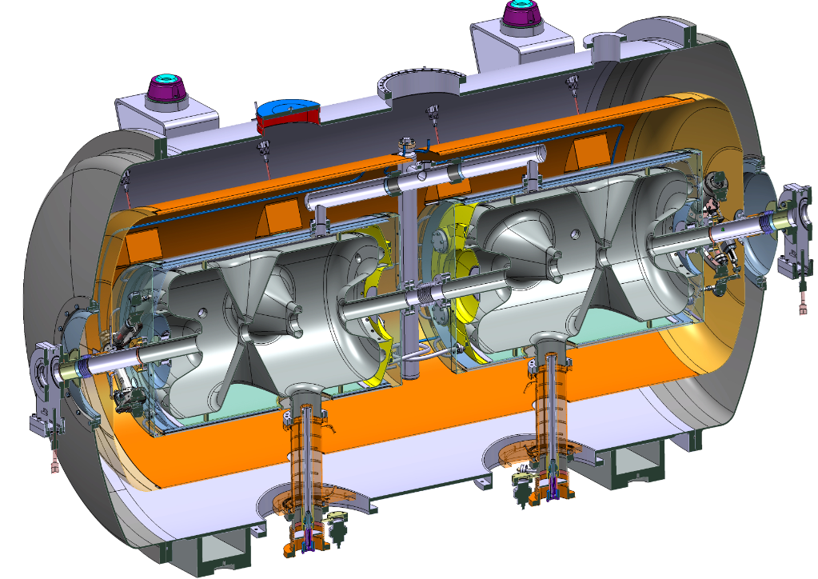
Spoke cavity string and cryomodule package

Slide 20
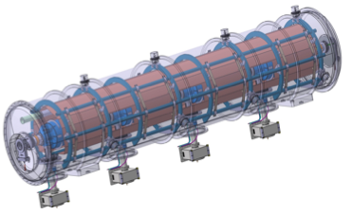
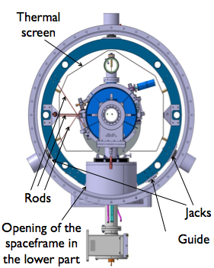
Elliptical cavity string and cryomodule package
Space-frame
5-cell elliptical cavity
Helium tank
Power coupler
Cold tuner
  Elliptical Cavities Cryomodule Technology Demonstrator results by the end of 2015 → start pre-series
Notes:
ii) Plans for the remaining part of 2012 (and beginning of 2013 if appropriate)
Cryo → Freeze the cold Linac operating parameters
→ ESS Linac flow scheme
→ Sizing of components (e.g. distribution lines)
Spokes → Complete technical design detail (proto test expected 2015)
Elliptical →Develop component stand alone test to verify the expected heat load
→ Complete the conceptual design and Initiate the fabrication drawing
iii) Issue that needs attention
Spoke → Prototype development depends on the availability of resonator
Elliptical → Critical path for current ESS schedule
e.g. availability of the infrastructure
→ Freeze the parameters of the medium- and high-beta cavities packages in order to freeze the cryomodule design
e.g. HOM use

Slide 21
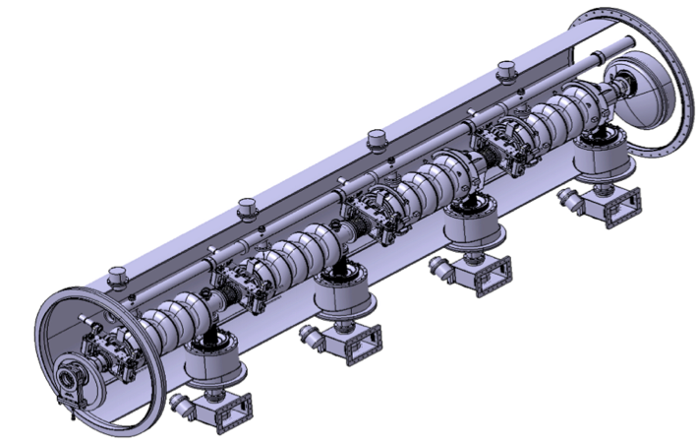
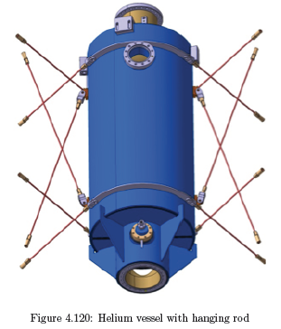
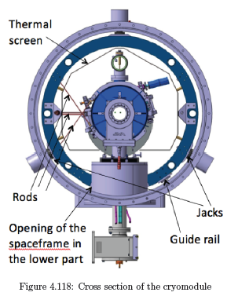
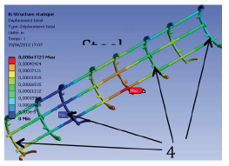
Elliptical cavity cryomodule design
  Space frame stress analysis and material choice

Slide 22
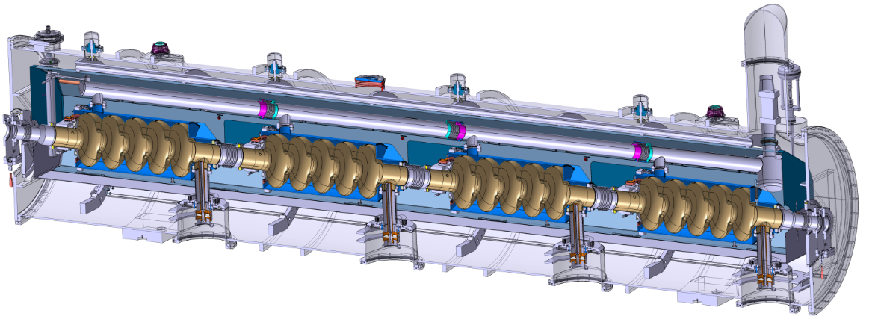
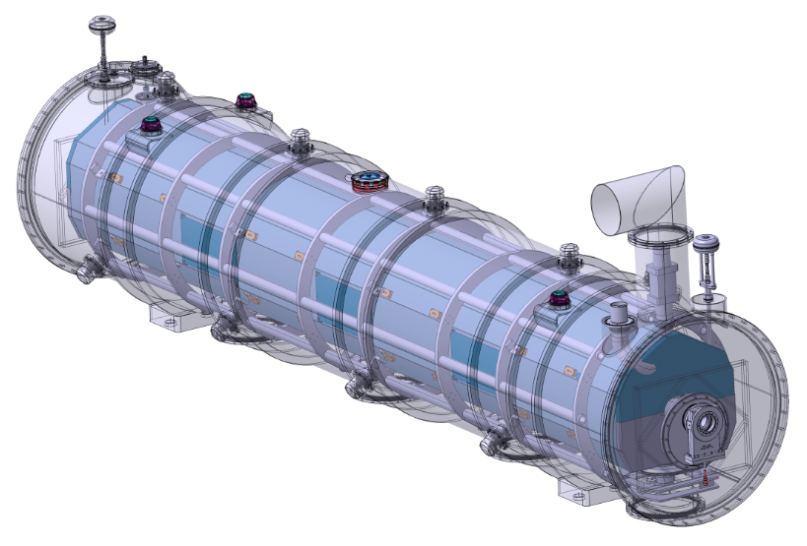
Elliptical Cavity Cryomodule Technology Demonstrator - ECCTD

Slide 23
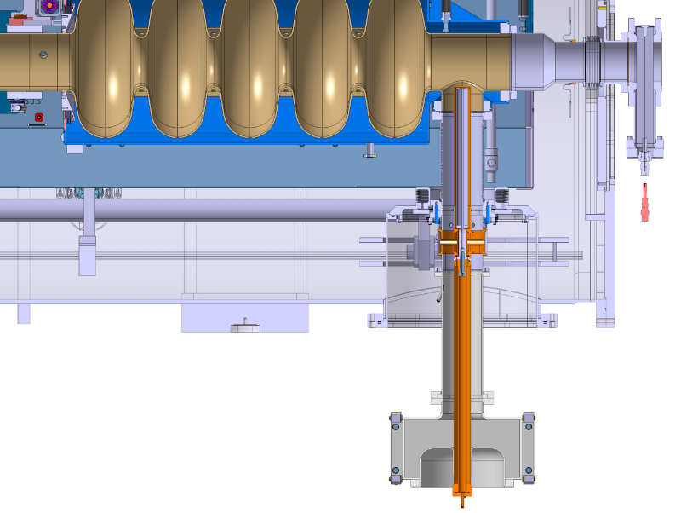
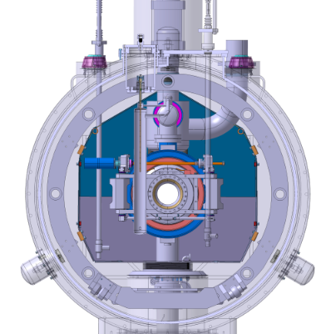
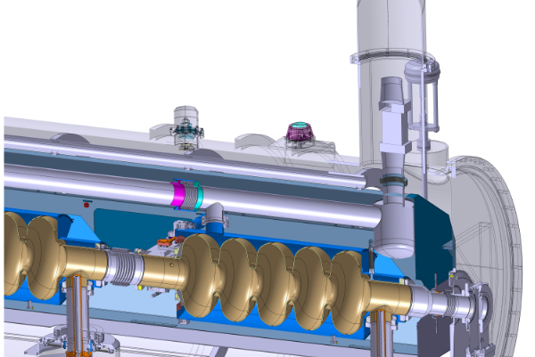
ECCTD

Slide 24
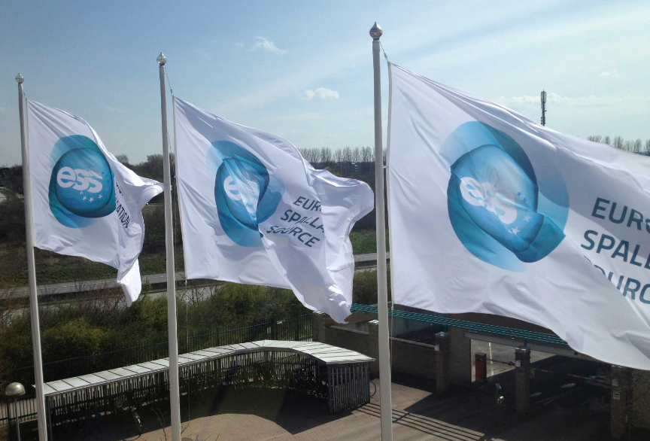
Conclusion
The ESS cryomodules to validate innovation applied to the next generation of accelerators
Challenging schedule for a green field neutron source
Effective and expertise thanks to European collaborations

Slide 25
EXTRA slides

Slide 26
Cryomodule Break Down Structure and Interface
Cryomodule
Tunnel
SRF Cavity Package
SRF cavity (spoke or elliptical) in helium tank
Vacuum station
Safety equipment
Fundamental Power Coupler
HOM Couplers
Supporting system
Alignment system
Coupler cooling Sys.
Cold tuning system
Cryo-distribution Lines
Cryo valve box
Waveguide and RF eq.
Magnetic shielding
Thermal shielding
Diagnostic Inst. & Valves
Diagnostic Inst. & Valves
Instrum., BPM etc.
Corrector magnet
Jumper connection
Beam pipe
Beam pipe
Safety equipment
Safety equipment
Ext. supporting system
Control system eq.
Notes:
Mechanical interface using bellows, flanges, etc…

Slide 27
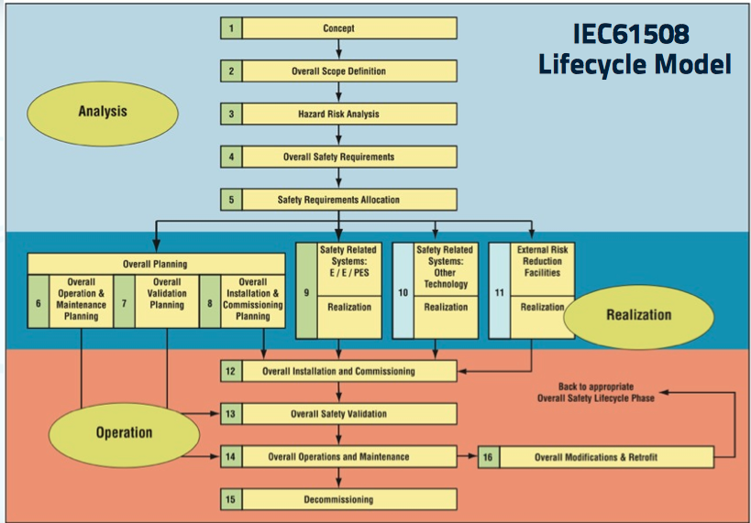

Slide 28
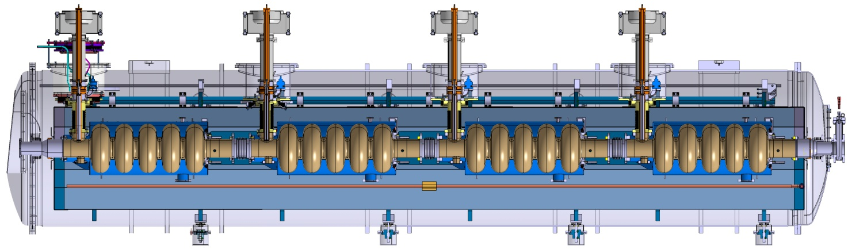
Current development

Slide 29
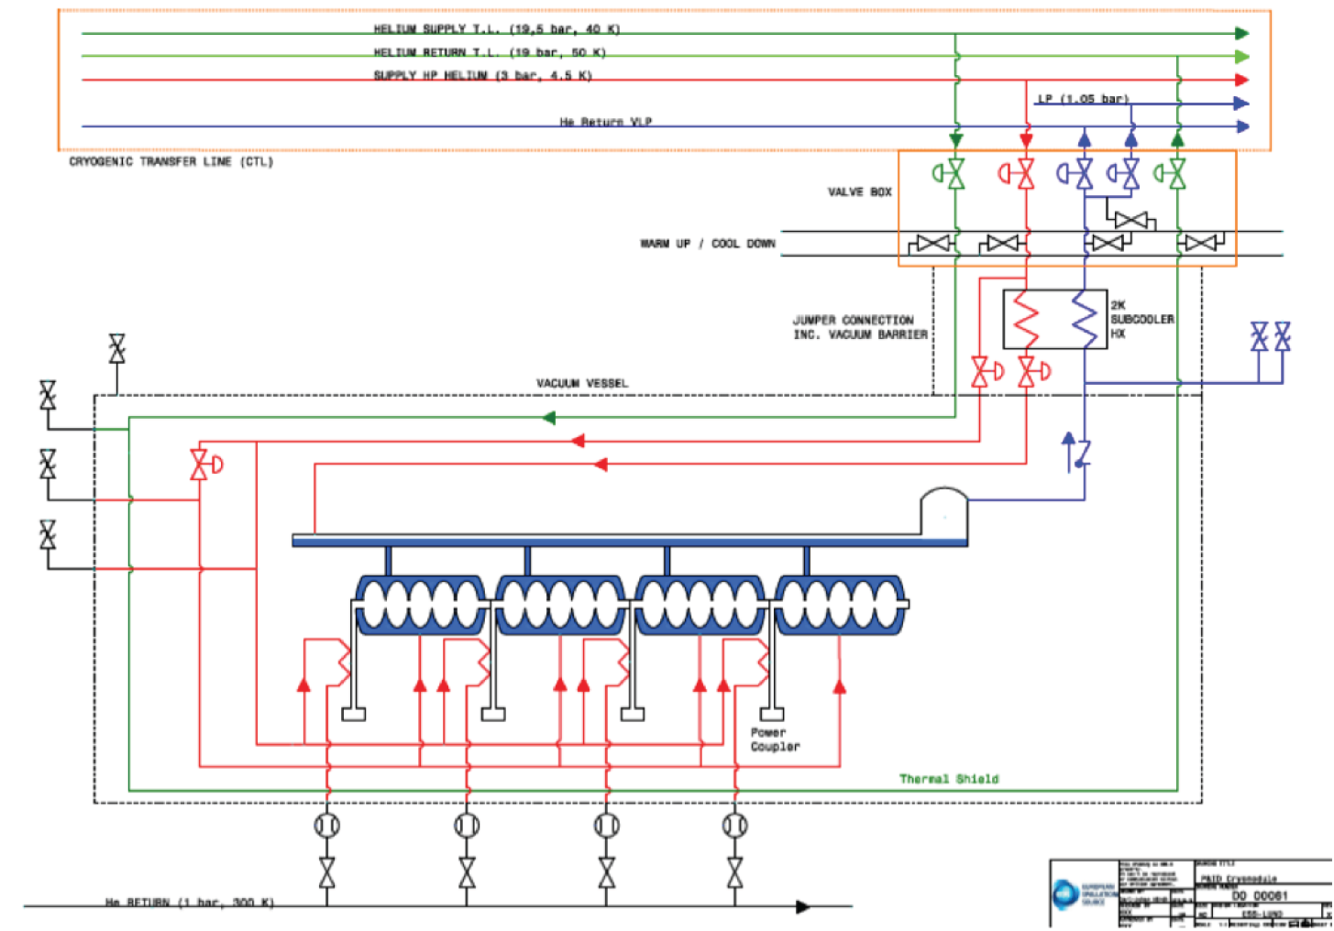
Elliptical cryomodule – flow process

