Slide 1
Task 2.3 organisation
M. Giovannozzi
Introduction and a bit of history
Tools
Approach
Work packages
Feedback is more than welcome!
  Partners: BINP, CEA, CERN, CSIC-IFIC, EPFL, INFN-Frascati, SLAC, Uni-Liv, Uni-Man

Slide 2
Introduction
The need of an upgrade for LHC has been studied through the years:
  Special task force: 2001.
  HHH (FP6 Programme), USLARP: between 2003-7.
  LHC Phase I upgrade: between 2007-10.
  HL-LHC: after June 2010.
  HiLumi (FP7 Programme): after November 2011.

Slide 3
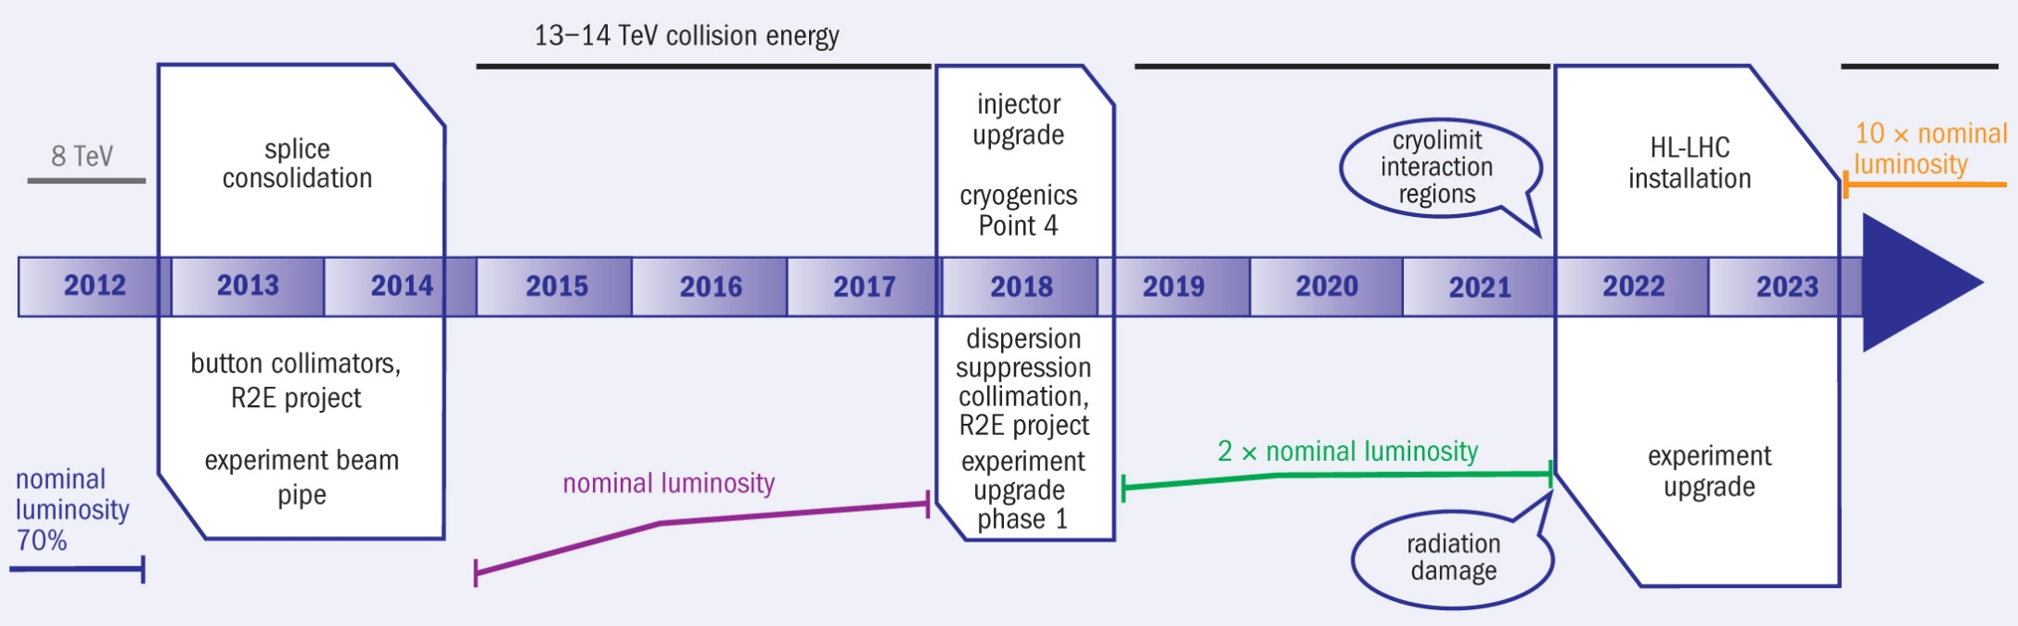
LHC programme for the next 10 years
LS1
LS2
LS3
Courtesy L. Rossi

Slide 4
Scope of High-Luminosity upgrade of LHC
Targets:
  A peak luminosity of 5×10³⁴ cm⁻²s⁻¹ with leveling
  An integrated luminosity of 250 fb⁻¹ per year, enabling the goal of 3000 fb⁻¹ in twelve years.
Courtesy E. Todesco

Slide 5
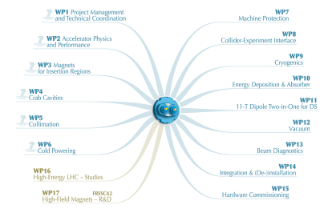
HiLumi structure
PL: Lucio Rossi; DPL: Oliver Brüning;
WP2 - Accelerator Physics and Performance: Stephane Fartoukh
Deputy: Andy Wolski
  Task 2.2 Optics and Layout
    B. Holzer
  Task 2.3 Particle Simulations
    MG
  Task 2.4 Collective Effects
    E. Métral
  Task 2.5 Beam-Beam Effects
    A. Valishev (T. Pieloni CERN link)
  Task 2.6 Beam Parameter
    O. Brüning
  Task 2.7 Intensity limitation
  from existing LHC hardware
    TBA
Official kick off meeting: November 2011

Slide 6
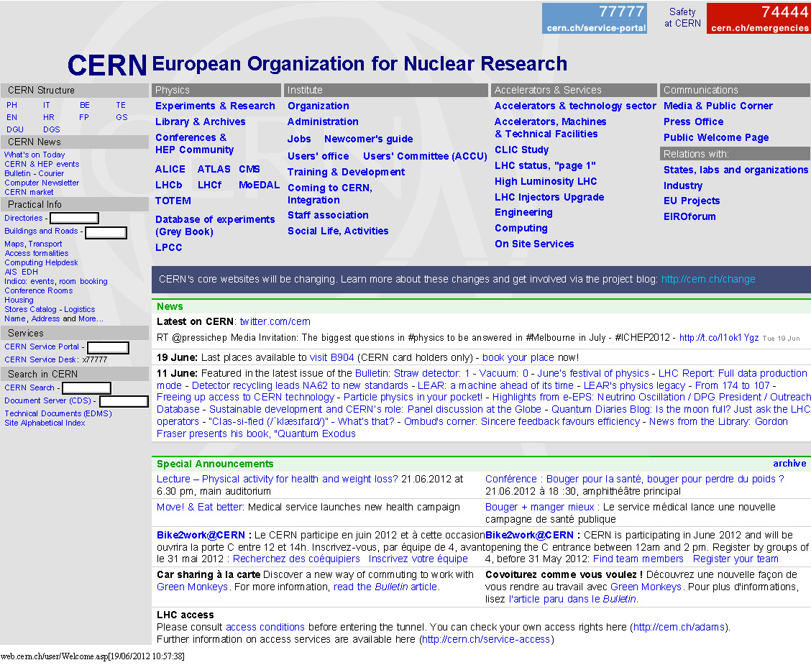

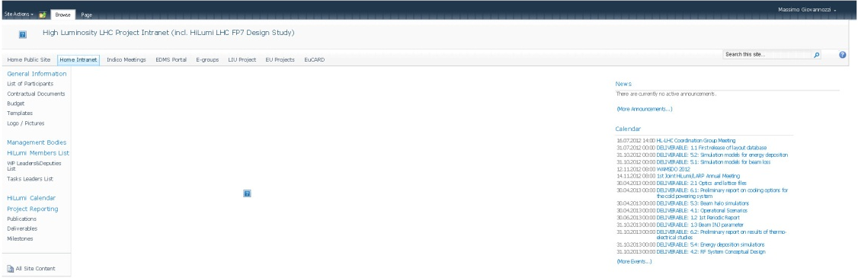
Information exchange
Login as CERN account needed
Goto WP2 web space

Slide 7
Task 2.3 objectives
To study the field quality tolerances for new magnetic elements for the LHC upgrade.
To specify the circuits for the non-linear correction of the triplets field quality.

Slide 8
Tools - I
Tools
  MAD-X: used to generate the lattice, optics, and files for subsequent simulations (SixTrack).
    Large set of tools for dealing with (HL-)LHC studies.
    All optical configurations stored under afs:
    /afs/cern.ch/eng/lhc/optics/SLHCV3.01
    /afs/cern.ch/eng/lhc/optics/SLHCV3.1b
  SixTrack: workhorse of LHC simulation studies (single particle, weak-strong beam-beam, collimation)
  Tracking environment: adapted environment to run massive numerical simulations.

Slide 9
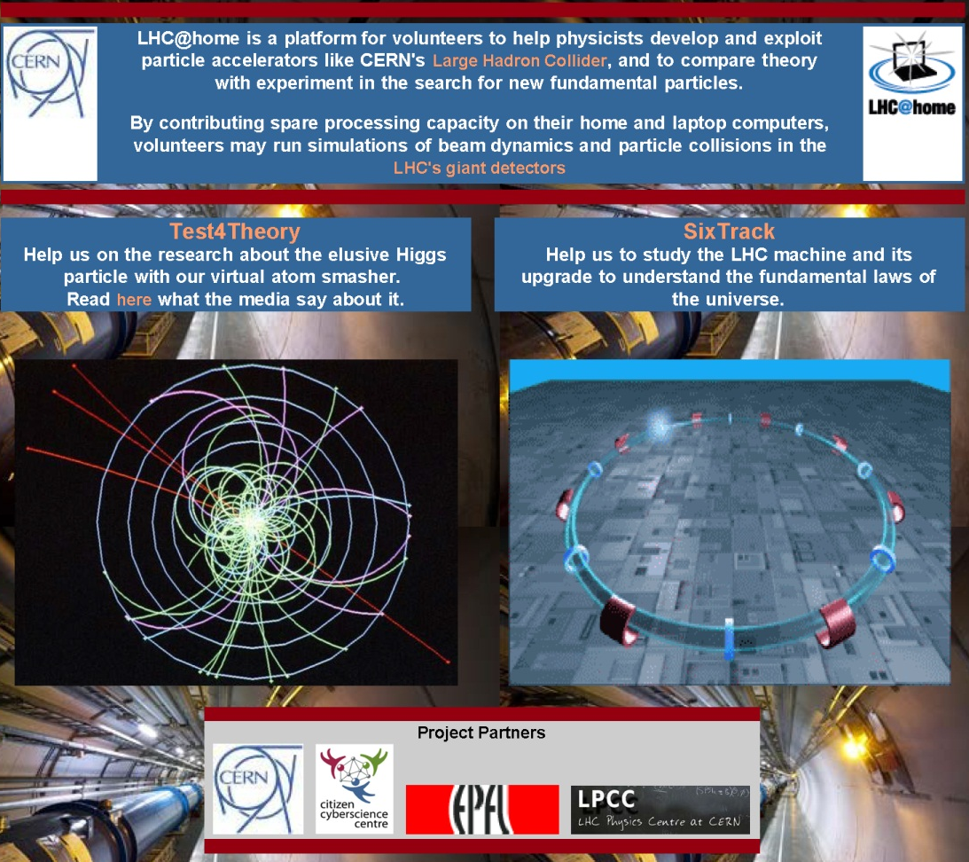
Tools - II
Tracking resources:
  CERN batch system (LSF)
  Volunteers’ based tracking system
  LHC@home (based on Boinc architecture).
Well-tested chain of tools: it is proposed to use our tools (apart for few exceptions).
This implies having a CERN account to work in the same environment as CERN staff (easier debugging)
Please, communicate your afs CERN user ID to me to set-up details (e.g., batch privileges).
Instructions to install the running environment will be prepared.

Slide 10
Approach
Dynamic aperture (DA)
is the figure-of-merit for
single-particle performance.
It has been used to derive field quality specification for the magnets of the nominal LHC.
It will be used also for HL-LHC studies and field quality specification.
However:
  DA is a global quantity -> the details of the dynamics should be looked at. Therefore:
    Tune footprint
    Tune scans
    Phase space topology
Should all be considered with care to spot possible pathological behaviours

Slide 11
General organisation guidelines
Weak-strong beam-beam activities moved to Task 2.5.
Attempt to re-arrange activities “by magnet” classes, instead than “by layout”.
  This is also triggered by the fact that there is a convergence towards two configurations:
    IT at 123 T/m (ex-Phase I) -> SLHCV3.01
    IT at 150 T/m -> SLHCV3.1b
The approach “by layout” has been kept for SLHCV3.01 studies.
Information about workflow in Task 2.2 (optics and layout) has been taken into account in the organisation of Task 2.3.

Slide 12
Work packages break down - I
MAD-X tools: S. Fartoukh, R. de Maria
General infrastructure: M. Giovannozzi
IT, D1, D2, Q4, Q5, field quality for layout with IT (123 T/m), round and flat: Y. Cai,Y. Jao, Y. Nosochkov, M. Wang
IT correctors specifications for layout with IT (123 T/m): S. Fartoukh, R. de Maria
Tune scans and phase space analysis with layout with IT (123 T/m): Y. Cai,Y. Jao, Y. Nosochkov, M. Wang
IT and D1 field quality specification for layout with IT (150 T/m), round and flat: J. Payet, A. Chancé
D2, Q4, Q5 field quality specification for layout with IT (150 T/m): M. Korostelev, K. Hock
IT correctors specifications for layout with IT (150 T/m): S. Fartoukh, R. de Maria
Tune scans and phase space analysis for layout with IT (150 T/m): E. Levichev, P. Piminov

Slide 13
Work packages break down - I
Analytical estimates of fringe fields: A. Bogomyagkov
Implementation of fringe fields and assessment with layout with IT (150 T/m): B. Dalena
Tools for crab cavity studies: R. Tomas
Preliminary specification of crab cavity field quality: R. Appleby, M. Giovannozzi, R. Tomas
Final specification of crab cavity field quality: PDRA, M. Giovannozzi, R. Tomas
Tune scans and phase space analysis for layout with IT (150 T/m) with crab cavity: E. Levichev, P. Pimonov
The deliverable is field quality specifications for IT, separation dipoles and insertion quadrupoles on 1/11/2014

Slide 14
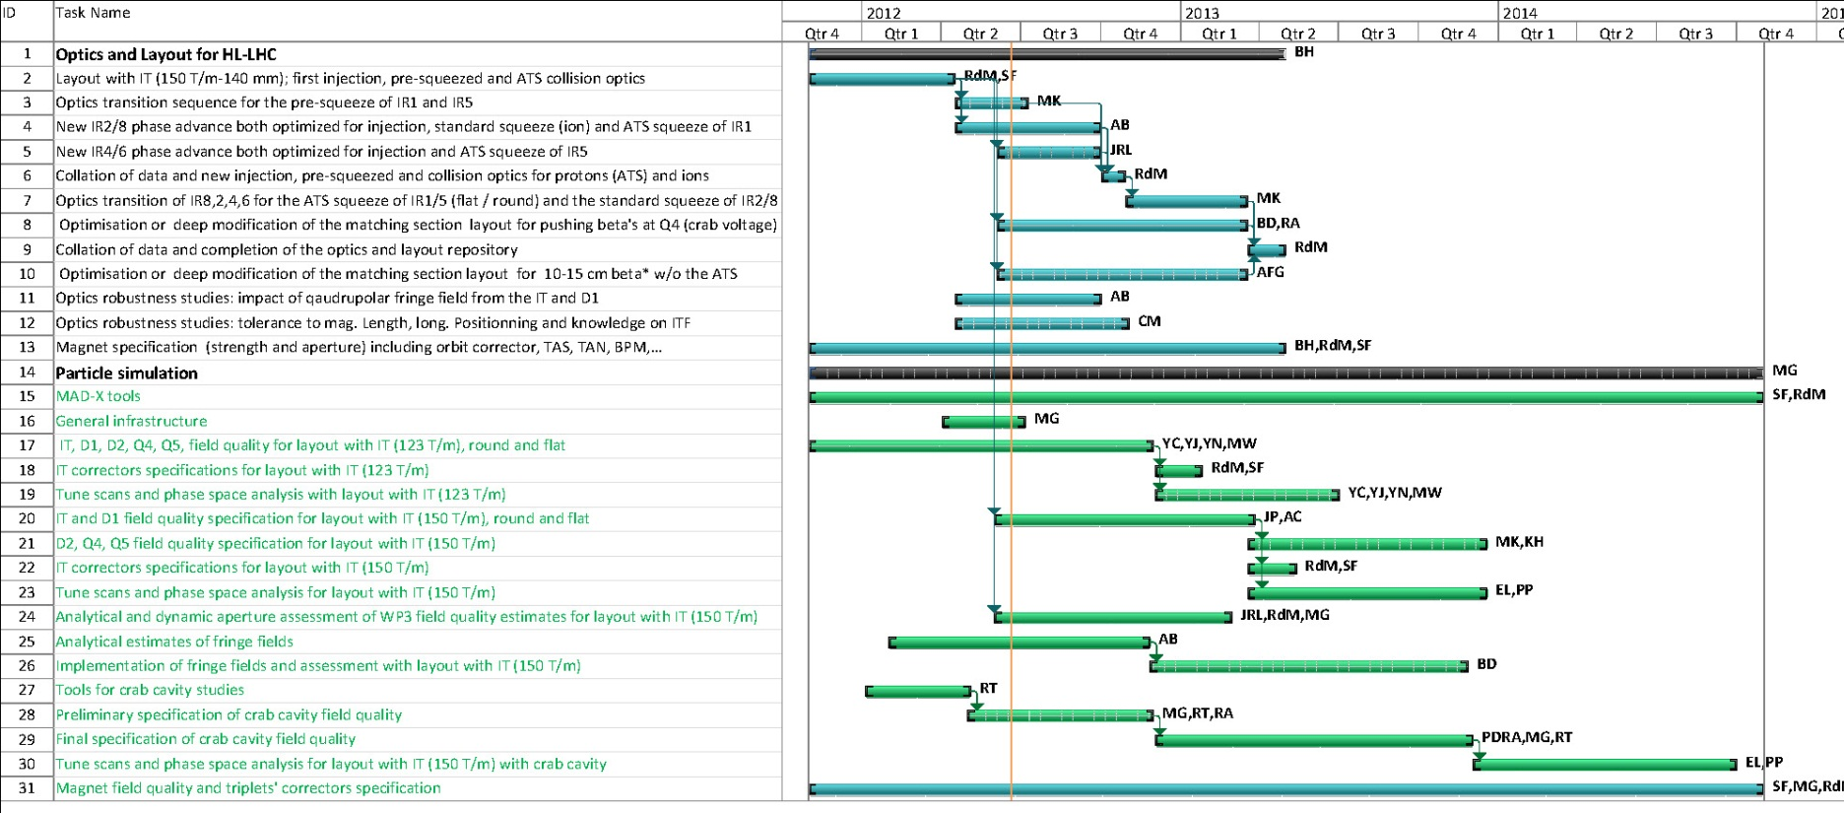
Gantt chart
Disclaimer: next to impossible to represent actual resources (in FTE or ppm) to a Gantt chart. Time line is indicative and not to be used to evaluate allocated resources.

