Slide 1
LHC Superconducting Cavities
P. Maesen
CWRF2008, 25 March’08

Slide 2
Content
Presentation
Building
Low level & full power tests
Problems
Installation in LHC PT 4
Commissioning
Status & conclusions

Slide 3
Presentation
Module main parameters
  4 single cell cavities Cryo-module
  Modular design from 2 to 6 cavities
  Cell-to-cell distance 3λ/2 at 400 MHz
  3 main He connections : L He inlet, gas outlet and warm recovery line
  Cone extremities He capillaries
  Temperature probes redundancy
  150 W static losses at 4.5 Kelvin
  2 ion pumps at each ends with vacuum valves
  Second beam tube inside cryostat, 420 mm spacing

Slide 4
Presentation
He tank
Cavity
Cryostat

Slide 5
Presentation
Cavities main parameters
  1-2 μm Niobium film sputtered on 3 mm Co Cavity
  Cavity length λ/2
  R/Q = 44 Ω, 300mm diameter beam tube
  Acceleration field : 1 MV at injection & 2 MV at high energy
  300 kW CW Main Coupler with polarization, variable antenna length :10000 < Ext Q > 200000
  External tuner motor, range 400.790 MHz +- 90 kHz
  4 SC HOMs of 2 types ; dipole and broad band
  80 liters of L He at 4.5 Kelvin in He tank
  He dome for safety valve & He level probe

Slide 6
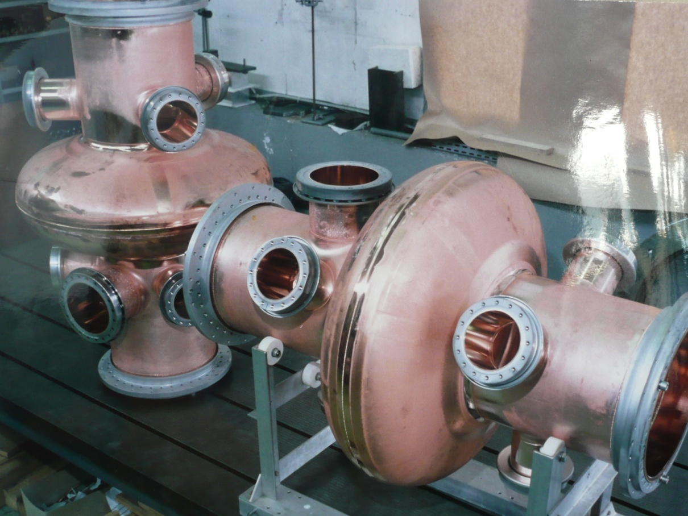
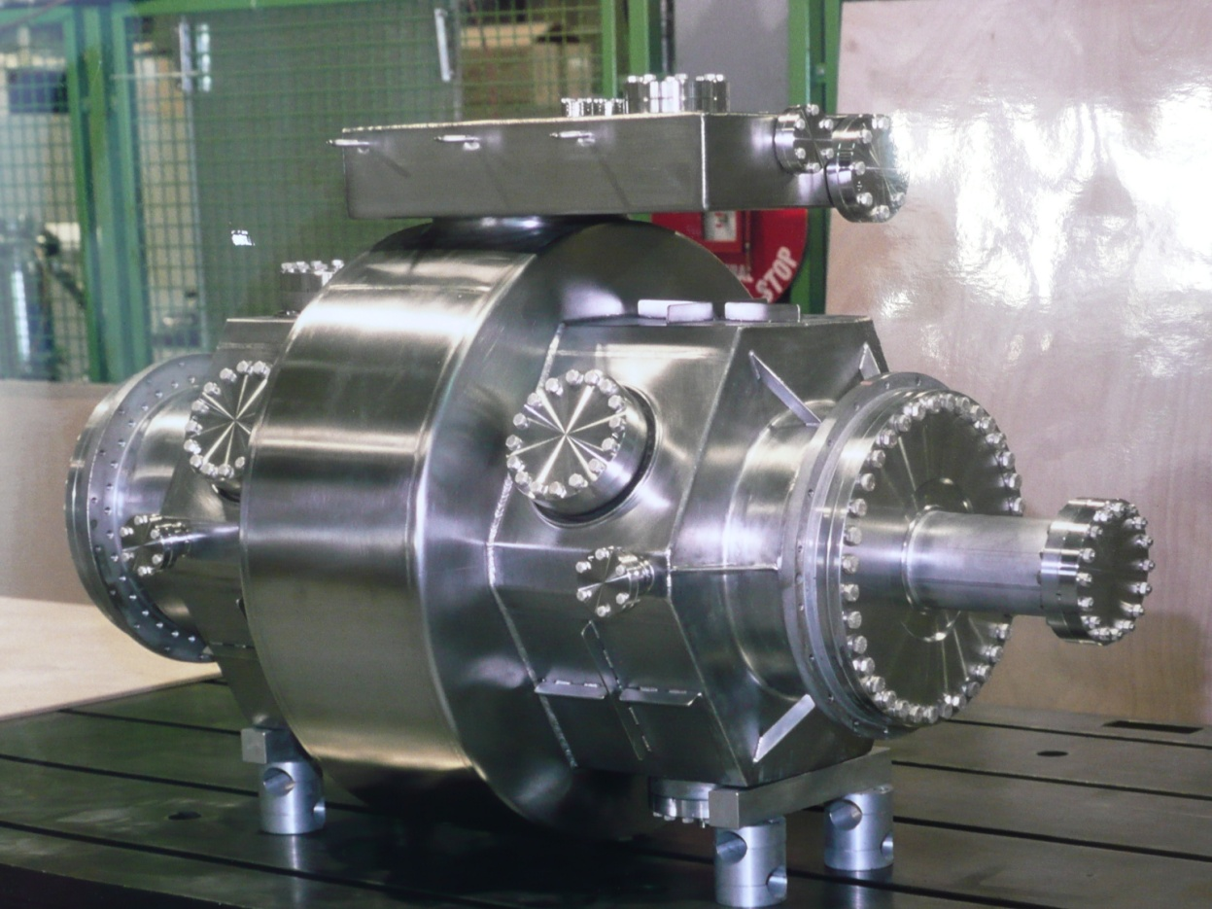
Building
Hole for Main Coupler
e- beam welding
Copper 400 MHz single cell cavity
  4 HOMs
Vapor / liquid level
Hole for HOM
In its He tank
  Vapor / liquid separation vessel
6
Notes:
Availability for the powering phase for sector 7-8 and expected one for the coming sectors

Slide 7
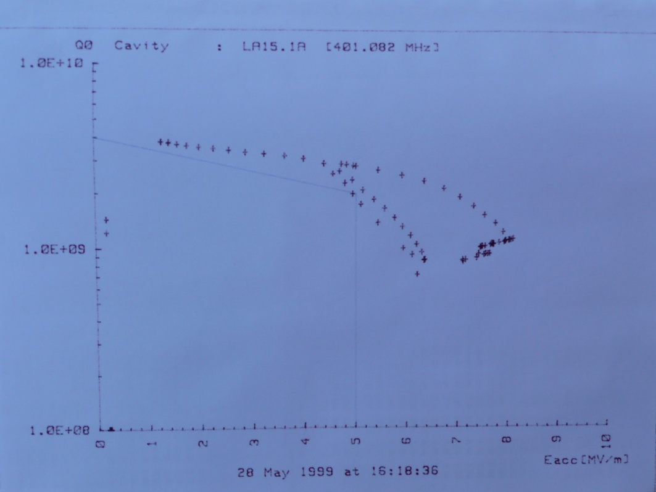
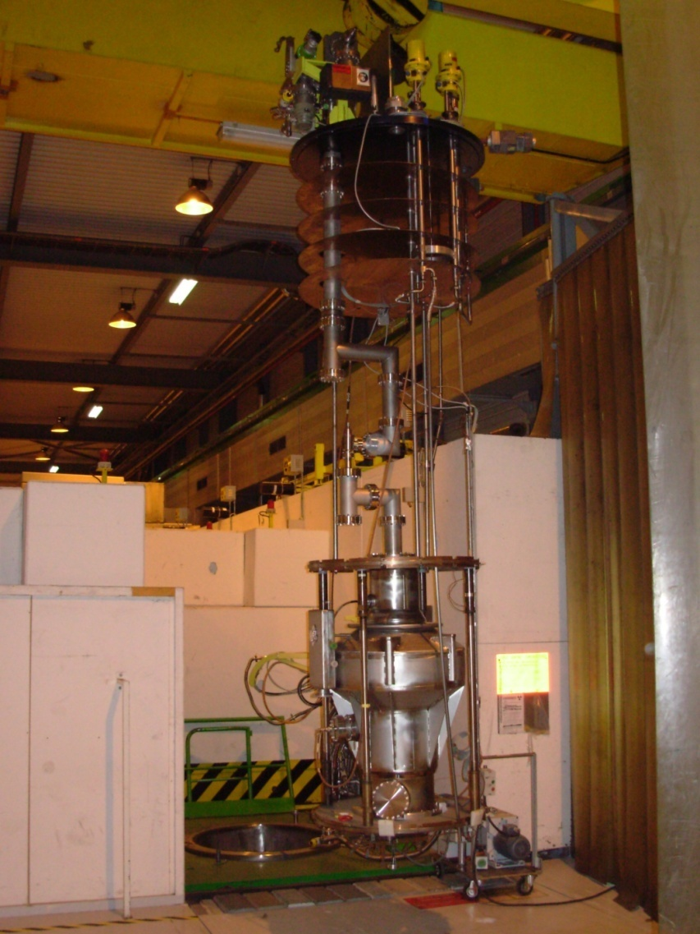
Building
From bare Co cavity :
  Chemical treatment, rinsing
  Niobium sputtering
  Pure water rinsing
  Cavity validation in vertical cryostat by measurement of Q/Eacc. Half of them with He processing
  He tank welding
  Mounting in frame
  Tuning by plastic deformation
  Vacuum tightness
Helium Processing
Cavity
VerticalCryostat
Notes:
Availability for the powering phase for sector 7-8 and expected one for the coming sectors

Slide 8
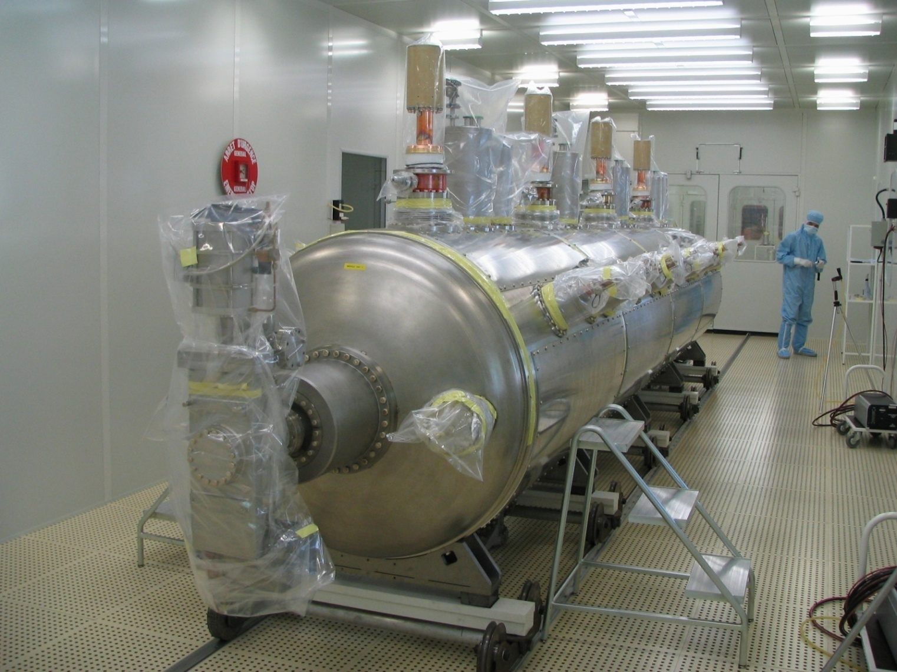
Building
Assembling 4 Cavities and accessories in Clean Room
Main
Coupler
Vacuum
Valve
HOM
Second Beam
Ion pump
Notes:
Availability for the powering phase for sector 7-8 and expected one for the coming sectors

Slide 9
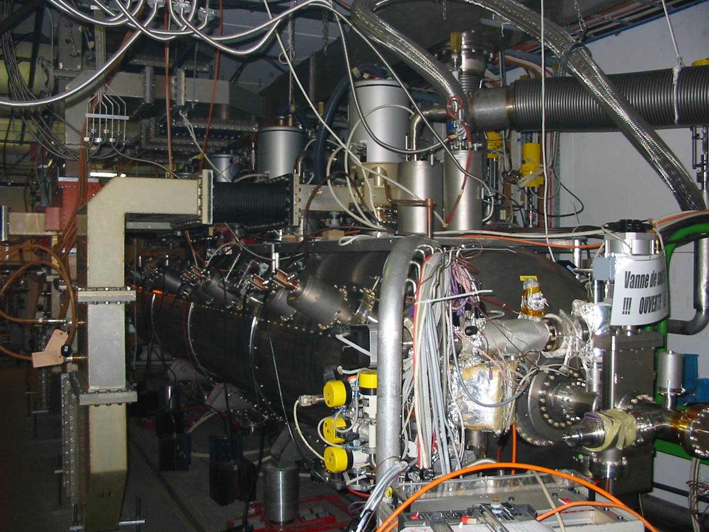
Low level & full power test
Transfer of modules to radiation safe bunker
Connections with cryogenic, RF, controls, e- stoppers
He gas return
RF From Klystron
Electron
Stopper
Wave
Guide

Slide 10
Low level & full power test
Module Cool down in SM18
  Measurement of frequency and tuner range
Q ext versus power coupler position
Calibration of antenna signal

Slide 11
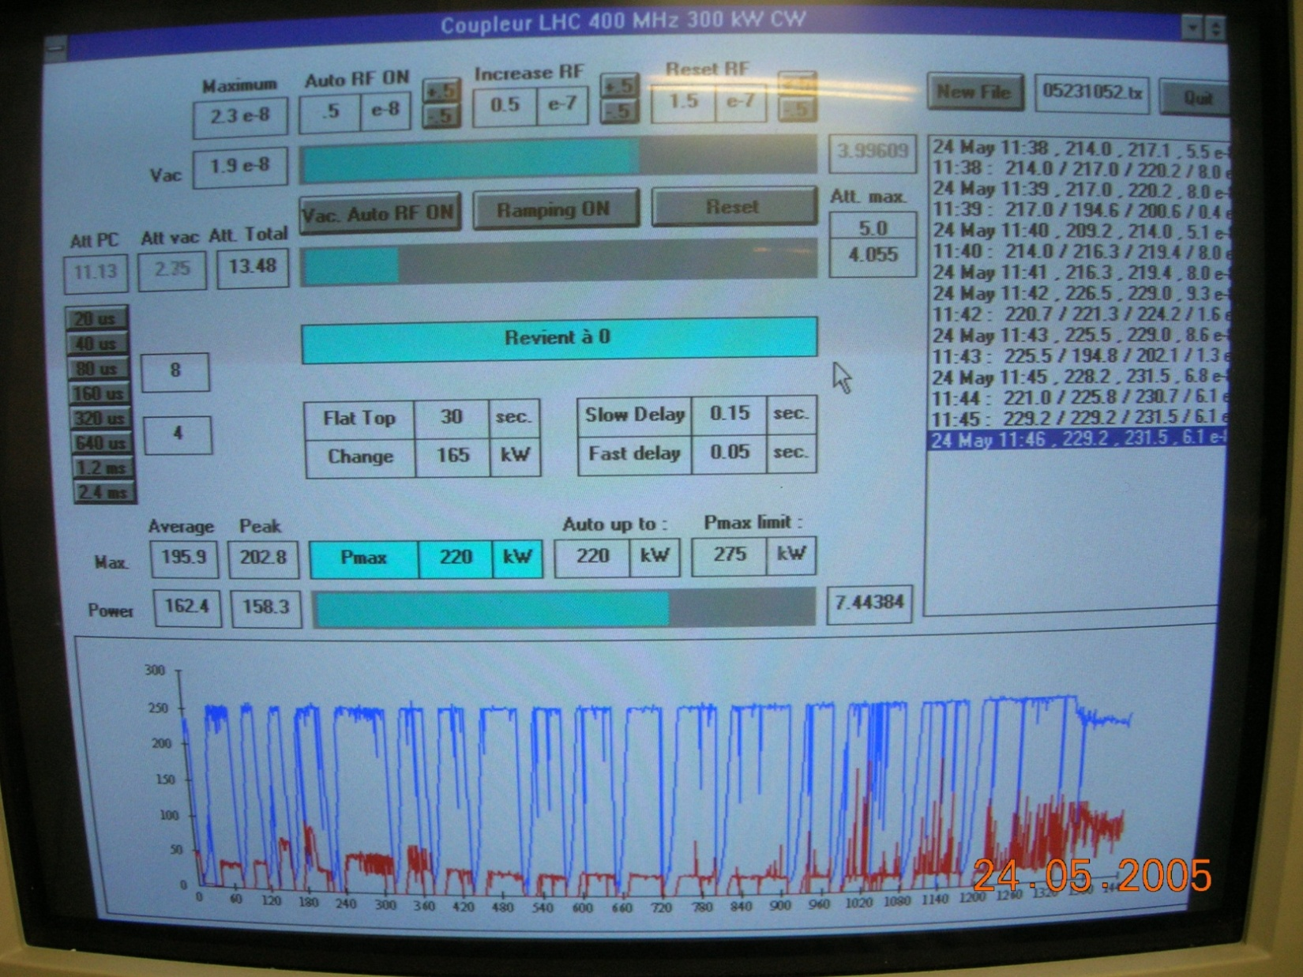
Low level & full power test
Conditioning to coupler full power 300kW CW.
Raising acceleration field to 1.5 times nominal
2 weeks/ Cavity
Power
Vacuum

Slide 12
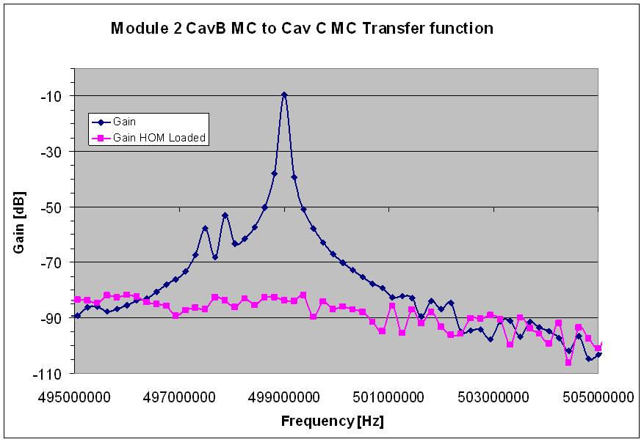
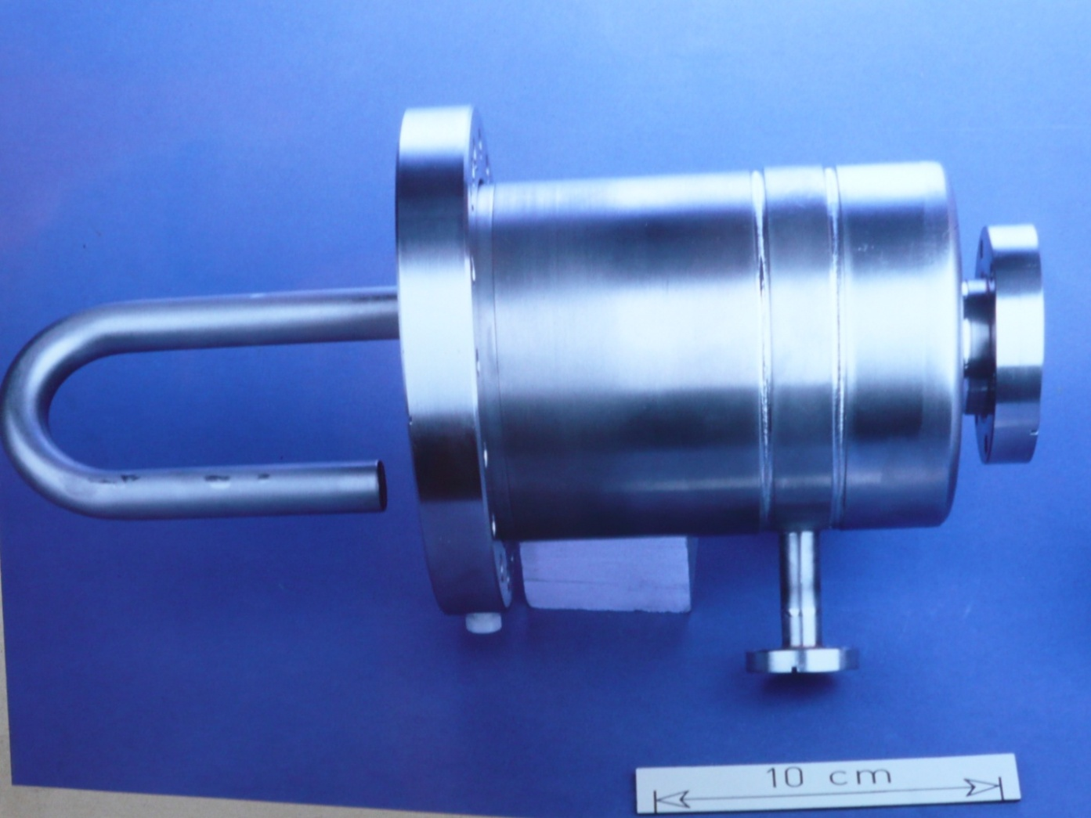
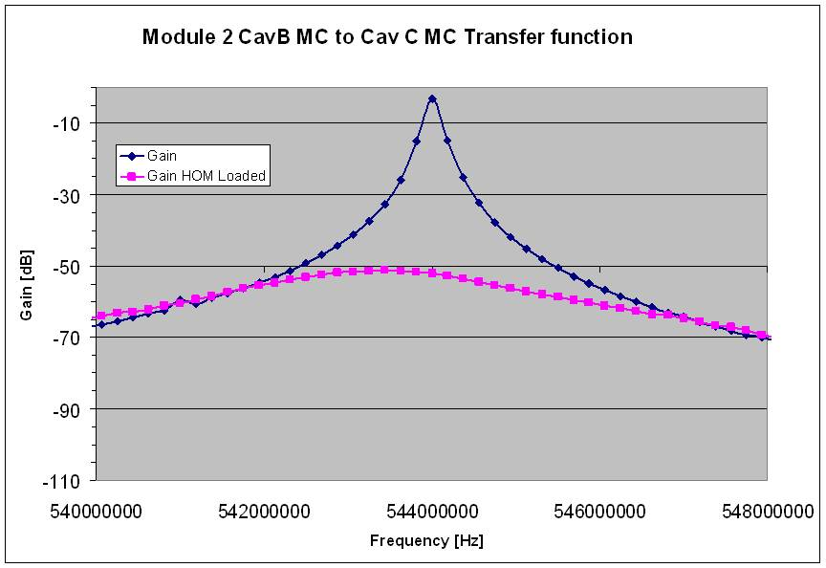
Low level & full power test
Dipole Mode (TE111) HOM damping efficiency
Bulk Niobium

Slide 13
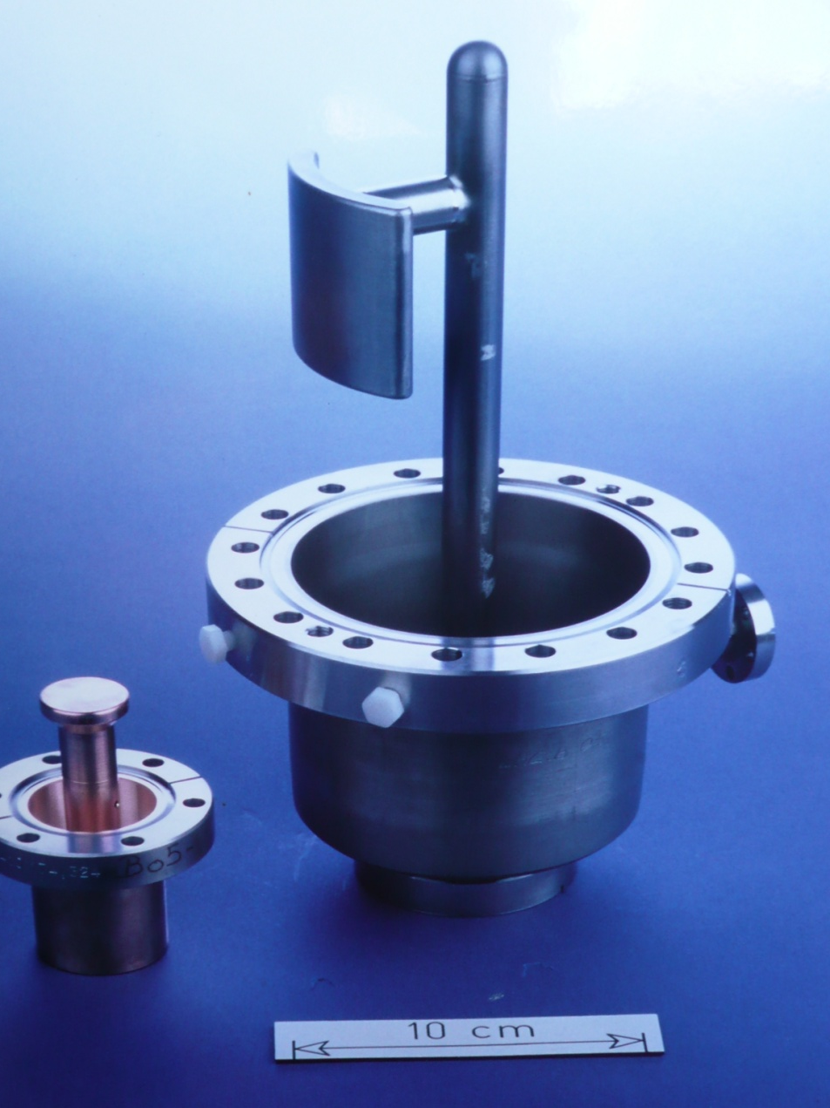
Low level & full power test
Broad-band HOMs for higher modes
Bulk Niobium
Copper plated

Slide 14
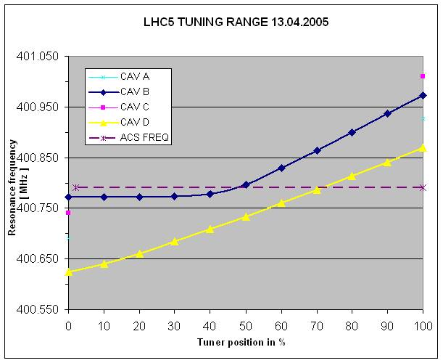
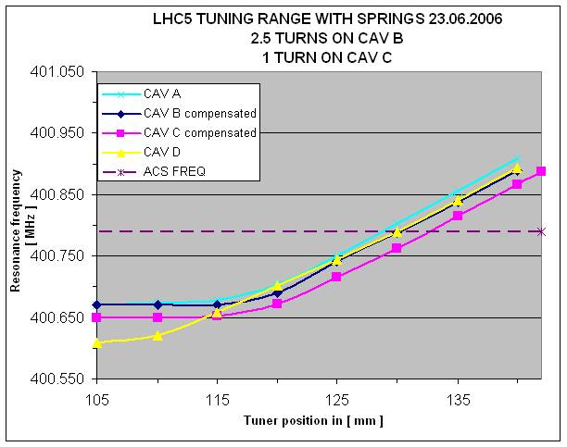
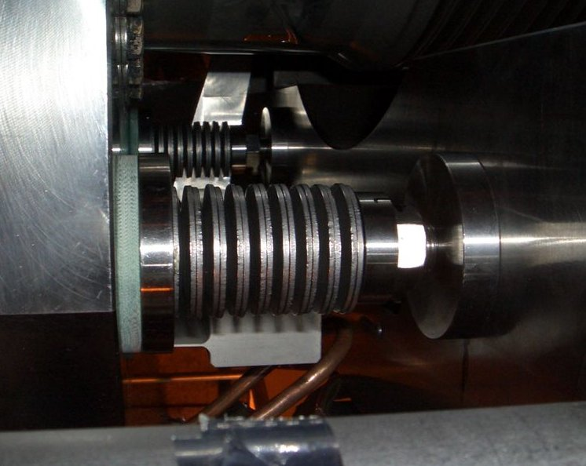
Problems
Tuning range: too high natural frequency of half of the cavities
  Despite warm plastic deformation, after a series of thermal cycling, some of the cavities went back to a too high frequency at rest
LHC working freq
Freq too low
  Corrected by adjustable tuning springs compensation

Slide 15
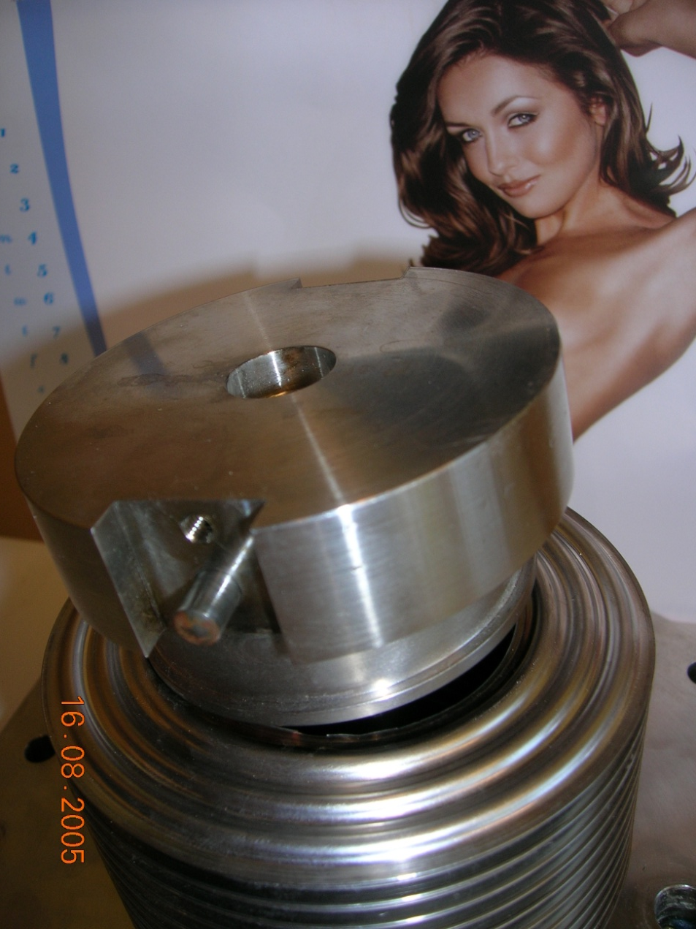
Problems
OUUUPS !
Broken Tuner bellow during tests
  Due to bad design
  Found good ones certified by life test
  Replaced just in time
Please don’t look here !
Fatigue break down
He domes to be modified
  Old LEP design
  Modified by longer tubing and replacing several seals by welding

Slide 16
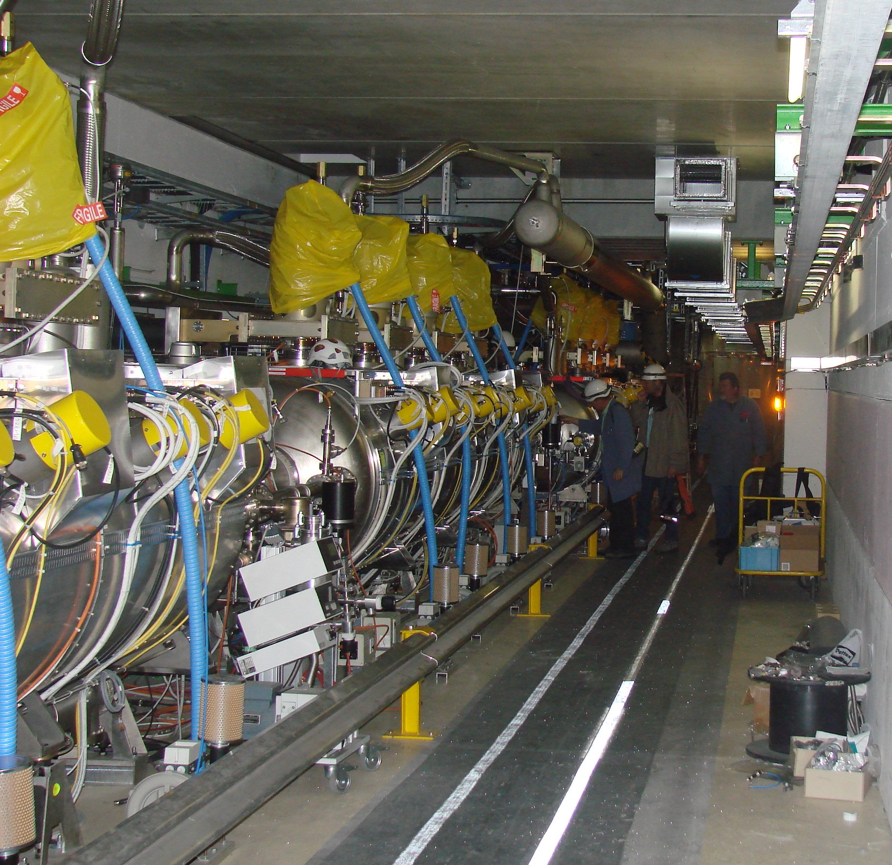
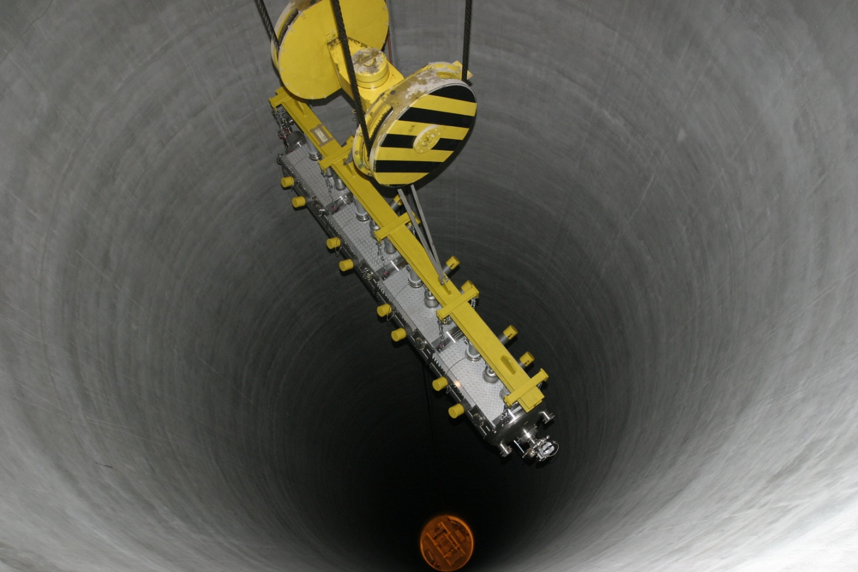
Installation in LHC PT 4
QRL Extension
Transport from SM18 to LHC PT 4
  Cavities & insulation under static vacuum
  Shock log, alarm if acceleration > 0.2 G
  10 km/h max speed on air suspended truck
  Modules at horizontal 15% max slope
Modules alignment
Connections to Cryo feeding lines, vacuum pipes, wave guides, RF cabling
3 modules in LHC PT 4

Slide 17
Commissioning
Interlocks full check (4weeks)
  300 kW main coupler very sensible !
  Remember : in case of ceramic break down, pollution of the whole module to be replaced !
  Fast RF shut off with vacuum increase, arc detectors, He pressure, RP alarm, RF zone access etc.
Careful setting up of cryogenic processes (2w)
Modules cooling down ( 24hrs )
  But lost already 4 times all the He through safety valves !

Slide 18
Commissioning
Conditioning
  On one module, almost no degassing, just a few quenches, 2 min for recovering
  On the other one, 1 week of conditioning per cavity
    Parallel operation, 16 klystrons for 16 cavities
Low level tuning and amplitude loops closed
As well as Klystron polar loop
SUCCESS

Slide 19
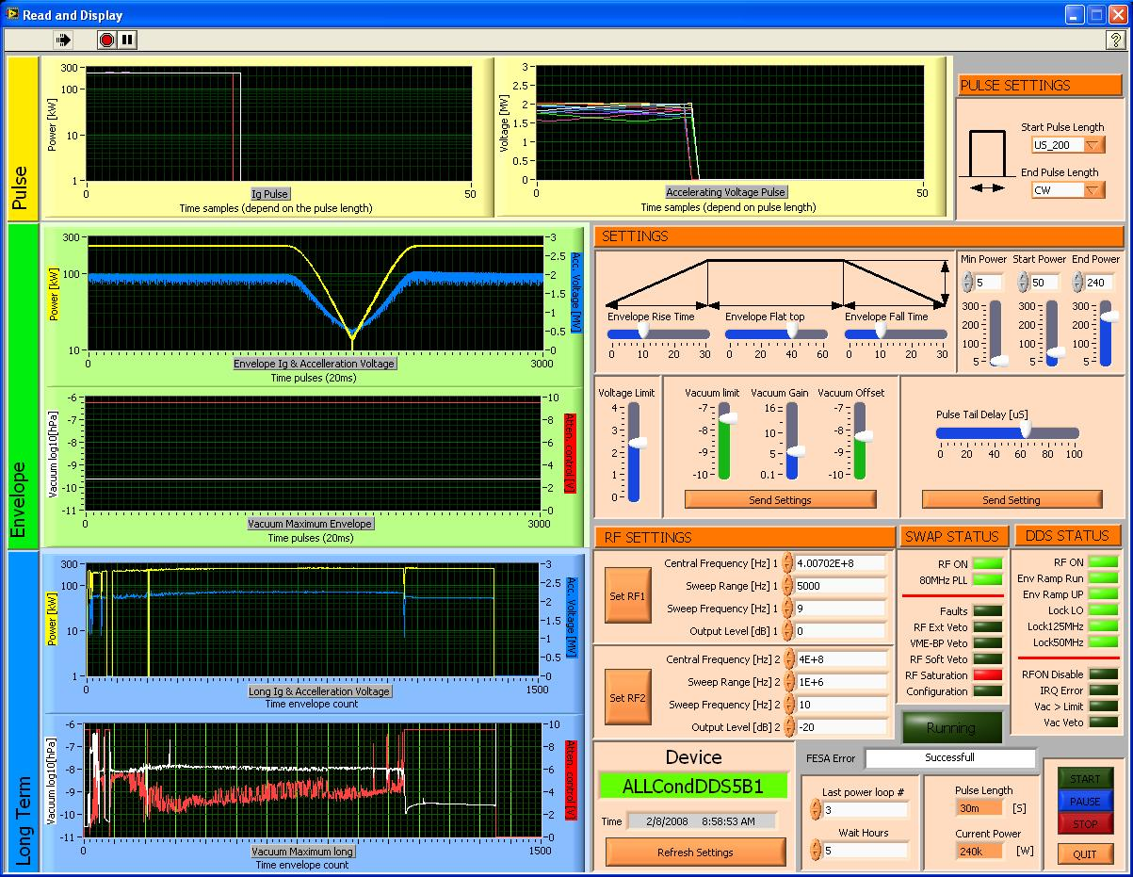
Commissioning
Remote conditioning up to 2 MV

Slide 20
Status & conclusions
4 Modules installed in LHC PT4 Sept ‘06
Fully connected mid ‘07
Cool down of 2 Modules Nov ‘07
  Special care on cryo safety devices & process control
  Successful validation in full power and field Feb ’08
  Modules warm now with sector 4-5 for Triplets
Cool down of the 2 other ones foreseen June ’08
Beam commissioning ..’08

Slide 21
Acknowledgement
All AB/RF group members participating
AT/ACR , AT/VAC and TS/RP
AB/ATB group, Transport
Enrico Chiaveri, Oliver Aberle, Raymond Hanni and Roberto Losito
REFERENCES
D. Boussard et al., “The LHC superconducting cavities”, PAC’99, New York, 1999.
R. Losito, E. Chiaveri, J. Tuckmantel, S. Calatroni, D. Valuch, “Report on Superconducting RF Activities at CERN in 2001/2003”, SRF Workshop 2003
E. Montesinos, “Construction and Processing of the Variable RF Power Couplers for the LHC Superconducting Cavities”, SRF 2007
L. Arnaudon, M. Disdier, P. Maesen, M. Prax “Control of the LHC 400 MHz RF system (ACS)”, EPAC’2004, Lucerne, Switzerland, July 2004.
E. Haebel, V. Rodel, F. Gerigk, CERN, Z.T. Zhao, IHEP, Beijing, P.R. China “The Higher-Order Mode Dampers of the 400 MHz Superconducting LHC Cavities”, CERN-SL-98-008 RF.
S. Claudet, et al.. "The cryogenics system in pt 4: possible options",. LHC Project Workshop Chamonix XIV, CERN, Geneva, Switzerland, 17-21 Jan 2005.
P. Maesen,E. Ciapala and G. Pechaud, “ Final tests and commissioning of the 400 MHz LHC superconducting cavities”, SRF 2007

