Slide 1
RAL Tier1 Review
Intervention History & Plans
Availabilities
Gareth Smith
20th June 2012

Slide 2
Interventions Aug/Sep 2011
Site firewall reboot
Atlas to write to T10KC tapes
Oracle patches LFC/FTS/3D DBs
Aug
Sep
Brief site firewall outage

Slide 3
Interventions Oct/Nov/Dec 11
Tape library microcode update
firmware update batch disk servers
SAR -firewall link bounce; Tape robot microcode update
Update to RAL DNS servers
FTS re-config
Oct
Nov
Dec
CIP update
Update disk ctrl firmware
Roll-out UMD Top & Site BDIIs
Convert final CE to Cream
RAL firewall outage

Slide 4
Interventions Jan/Feb/Mar 12
Update rest RAL DNS servers
SRM 2.11 updates
MyProxy to UMD
Oracle patches Atlas & LHCb 3D/LFC
OS patching for SRMs; Update disk array on Castor stndby RAC.
SRM update
Atlas move LFC
1 UI to UMD
Jan
Feb
Mar
CIP update
APEL to UMD
Castor 2.1.11-8 & H/W refresh
Intervention on part of UPS infrastrc.
Castor DB Migrtn(1); Rack moves
Castor DB Migrtn(2); FTS 2.2.8; OPN addr extn.
Netwk update (Move C300, fix probs in UPS room) Move to UMD batch server
Atlas 3D to Oracle 11

Slide 5
Interventions Apr/May/Jun 12
LHCb LFC Front ends to v1.8.2-2
Remaining LFC Front ends to v1.8.2-2
Site netwk (SAR)
Castor use Transfer Manager
Apr
May
Jun
Oracle 11 update for Castor
Castor Repack to 2.1.11-9
CIP update
Castor use Tape Gateway
Intervention on part of UPS infrastrc.
Castor 2.1.11-9; Oracle 11 for FTS & LFC
All BDIIs updated

Slide 6
Still To Do:
Completion of Network Changes:
  Site Network:
    Replacement (elimination) of UKLight Router (by end July)
  Tier1 Network:
    Insert new switches/routers into network & Enable routing for communication with new Border routers.
    Insert new ‘spine’ layer (may well be transparent)
Castor:
  2.1.12-4 Update (Will get “Repack” to 2.1.12 first). ~Jul – Sep.
  2.1.13?? Depends on CERN…
Databases:
  Move of LFC/FTS/3D RACs to new hardware/OS.
Infrastructure:
  Main Power Feeds to Site being updated (Jun – Dec)
Notes:
Servers would have had to be replaced anyway
Move to 64 bit , gives more memory to play with (matches CERNs config)
Increased memory (from 3GB in Oracle to 20GB)
Enables up to date copies of important systems in the event of a power outage or hardware failure, switchover can be done anytime and only requires ~10 minute outage
Although hardware is duplicated for standbys, they are simpler to administer at each side due to less machines, simpler storage config

Slide 7
Availabilities - 1
Atlas:
CMS:

Slide 8
Availabilities - 2
LHCb:
OPS:

Slide 9
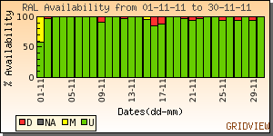
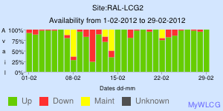
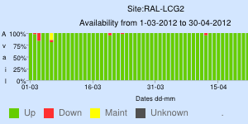
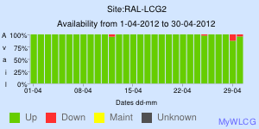
Atlas Availabilities
Nov ‘11
Feb ‘12
Mar ‘12
Apr ‘12

