Slide 1
Tier1 Databases
GridPP Review
20th June 2012
Richard Sinclair
Database Services Team Leader

Slide 2
Highlights
CASTOR Hardware Refresh
  Improved Performance
  Data Guard Standby Systems
3D Systems Upgraded to 11g
  Successful Despite Going First
  Guiding of Other Sites
Smooth Running of non-CASTOR DB’s
Improved Metric Collection and Reporting

Slide 3
Non-CASTOR Availability 2011
Service | Availability (%)
LFC/FTS | 99.68
ATLAS 3D | 99.79
LHCB 3D | 99.82
ATLAS TAGS | 99.83

Slide 4
Non-CASTOR Availability 2012
Service | Availability (%)
LFC/FTS | 98.79
ATLAS 3D | 99.92
LHCB 3D | 99.91
ATLAS TAGS | 99.94
CASTOR | 99.1
NOTE: CASTOR Figures Post Migration (March – June)

Slide 5
CASTOR Throughput 2011-12
Average Transactions Per Second

Slide 6
Lowlights
CASTOR DB Performance Before Hardware Refresh
  Particularly bad during January and February 2012
  Had Reached the Limit of Hardware Capability
  Interim Configuration Performed Poorly
  Required Frequent Manual Tuning
Delays in Implementing Migration Plan
  Hardware Problems Delayed Initial Deployment
Move of ATLAS LFC to CERN

Slide 7
Database Migration Plan
Started Testing Summer 2011
8 Step Process (Tracked by Change Control Meetings)
Aims:
  Refresh Hardware
  Provide Off Site Resilience
  Simplify Database Architecture
  Improve Performance

Slide 8
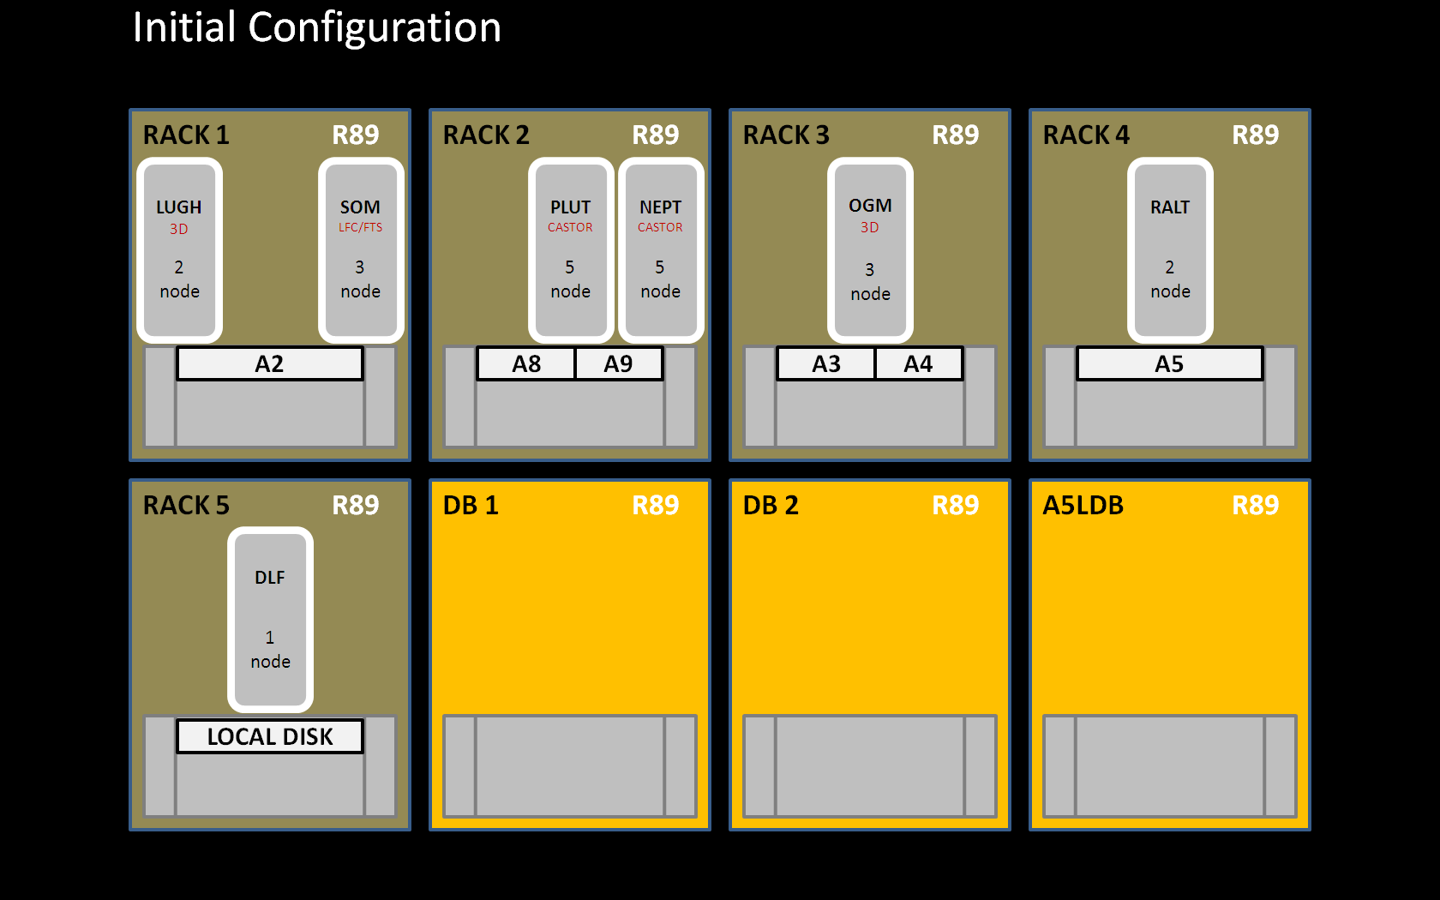

Slide 9
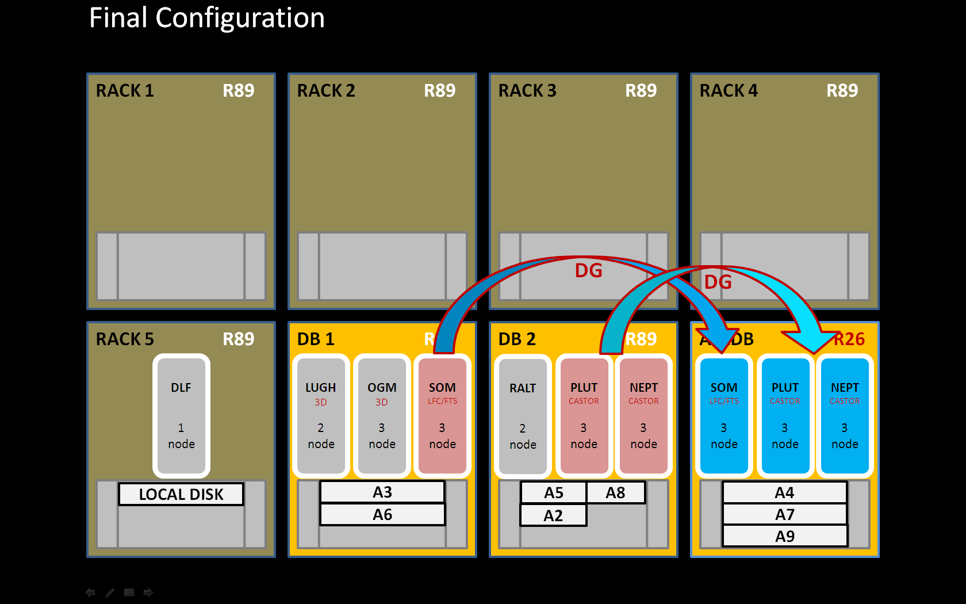

Slide 10
Plans for 2012
Complete Database Migration
Retirement of Oracle 10g Systems
Refresh Testing and Development Kit
Introduce Standby Systems for Tier1 MySQL Databases
Investigate Non-Oracle Solutions for More Services
Potential Retirement of LHCB 3D, LFC

