Slide 1
Setting up a Security Team
The CERN CERT as an example
Dr. Stefan Lüders
(CERN Computer Security Officer)
Openlab Summer Student Lectures, July 3rd 2012
Notes:
Timing: 90mins (incl. questions)

Slide 2
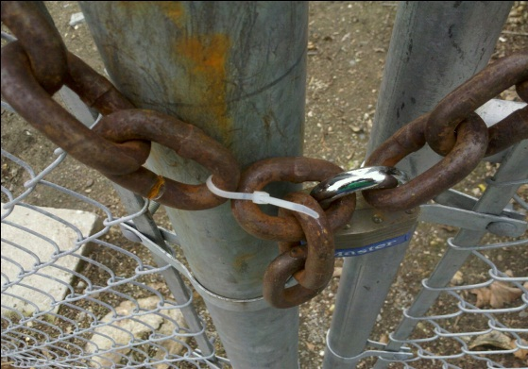
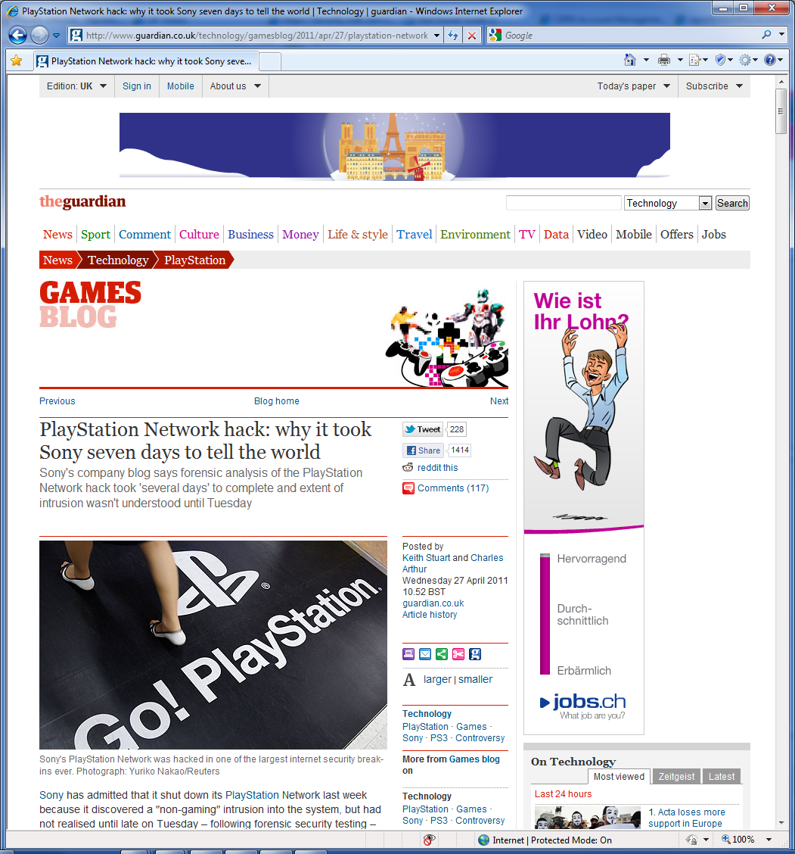
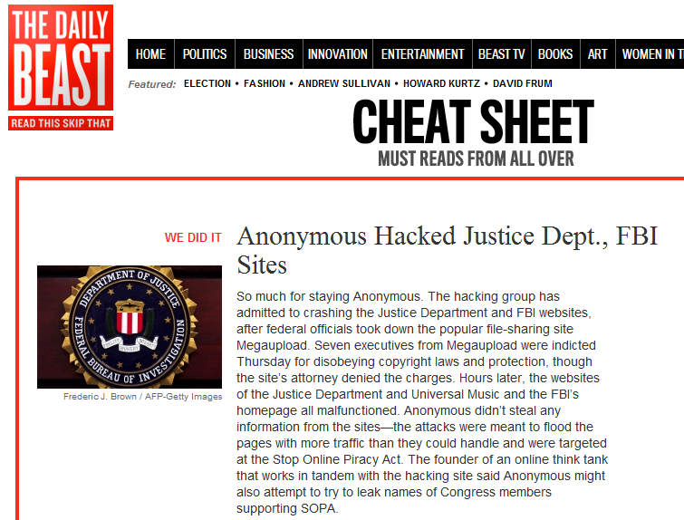
Attackers vs. Defense
There is no 100% security.
Security is as good as weakest link:
Attacker chooses time, place, method
Defender needs to protect against all…

Slide 3
Attackers vs. Defense
There is no 100% security.
Security is as good as weakest link:
Attacker chooses time, place, method
Defender needs to protect against all…
Targeted attackers (APTs) are focused and keen,
have better skills/networks, are better financed/resourced
The untargeted/stupid
attackers might be caught…
Automatisms, at least, can be fought.
Defense usually lacks money/resources/networks.
(International) Law is always a step behind.
“Anonymous is a handful of geniuses
surrounded by a legion of idiots.”
Cole Stryker

Slide 4
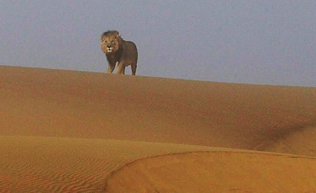
Attackers vs. Defense

Slide 5
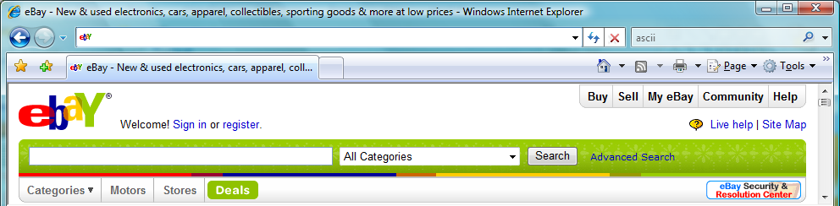
A small quiz.
  Quiz: Which URL leads you to www.ebay.com ?
http://www.ebay.com\cgi-bin\login?ds=1%204324@%31%33%37 %2e%31%33%38%2e%31%33%37%2e%31%37%37/p?uh3f223d
http://www.ebaỵ.com/ws/eBayISAPI.dll?SignIn
http://scgi.ebay.com/ws/eBayISAPI.dll?RegisterEnterInfo&siteid=0&
co_partnerid=2&usage=0&ru=http%3A%2F%2Fwww.ebay.com&rafId=0
&encRafId=default
http://secure-ebay.com
✗
✗
✓
✗
Notes:
OPTIONAL

Slide 6

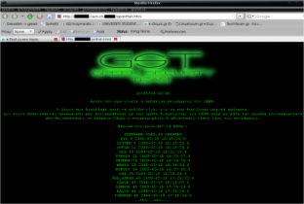


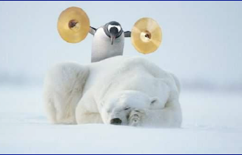
Overview
1. Understand your environment
& security footprint.
2. Assess your threats!
3. Develop your security paradigm.
4. The Permanent Mitigation Cycle
5. Set up your Team

Slide 7
1. Understand your environment
& security footprint.

Slide 8
Do you know your environment?
?

Slide 9
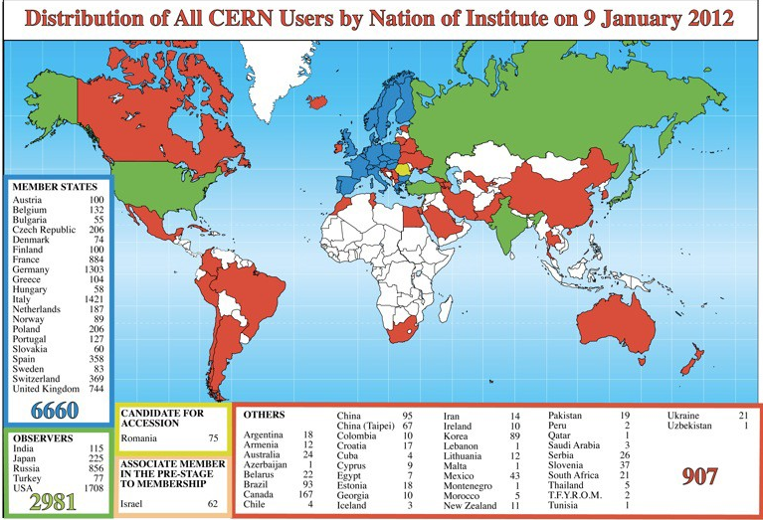
Academic Freedom at CERN
CERN’s Users:
  …from 100s of universities worldwide
  Pupils, students, post-docs, professors,
  technicians, engineers, physicists, …
  High turn-over (~10k per year)
  Merge of professional and private life:
  Social Networks, Dropbox, Gmail,
  LinkedIn, …
Academic Freedom in Research:
  No limitations and boundaries if possible
  Free communication & freedom to publish
  Difficult to change people, impossible to force them
  Trial of the new, no/very fast life-cycles, all-time prototypes
  Open campus attitude: I consider CERN being an ISP!

Slide 10
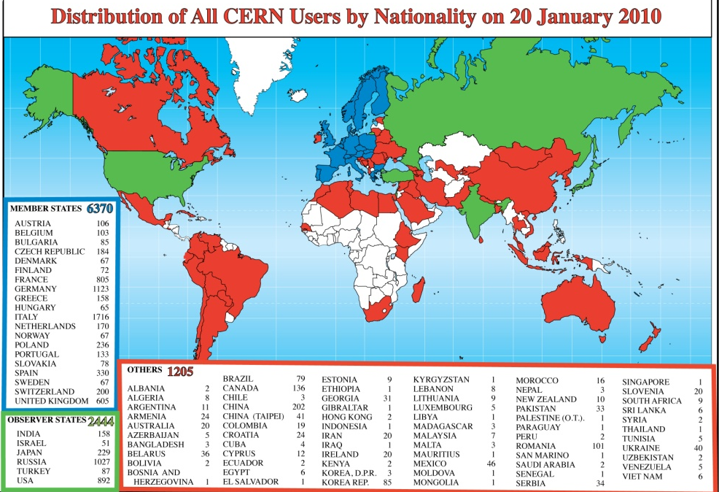
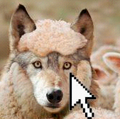
Academic Freedom at CERN
CERN’s Users:
  …from 100s of universities worldwide
  Pupils, students, post-docs, professors,
  technicians, engineers, physicists, …
  High turn-over (~10k per year)
  Merge of professional and private life:
  Social Networks, Dropbox, Gmail,
  LinkedIn, …
Academic Freedom in Research:
  No limitations and boundaries if possible
  Free communication & freedom to publish
  Difficult to change people, impossible to force them
  Trial of the new, no/very fast life-cycles, all-time prototypes
  Open campus attitude: I consider CERN being an ISP!
The threat is already inside.
A good security paradigm must
balance this “Academic Freedom”

Slide 11
Do you know your security foot-print?
?

Slide 12
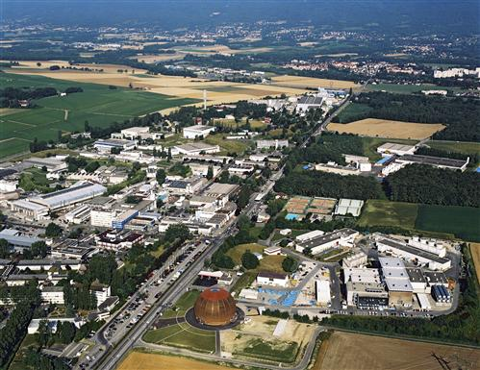
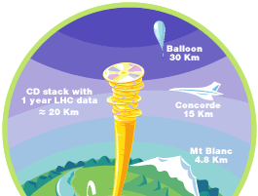
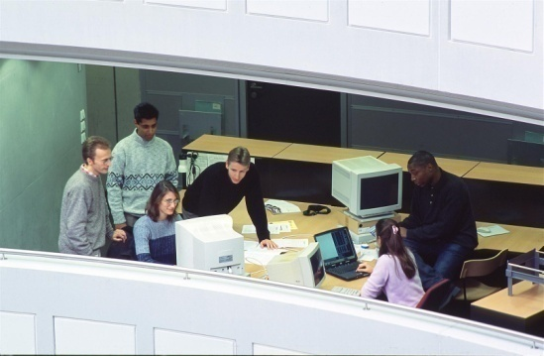
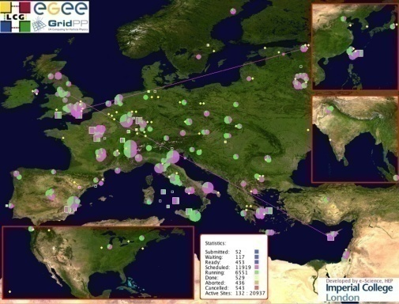
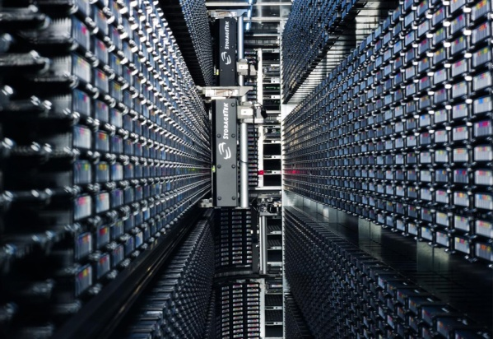
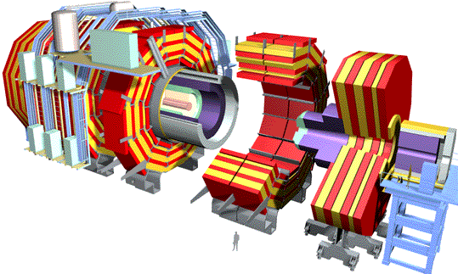
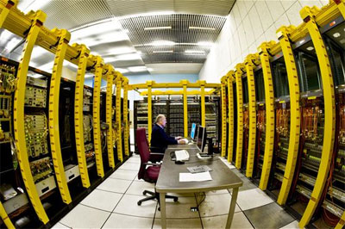
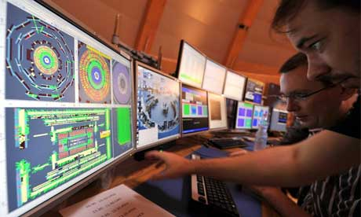
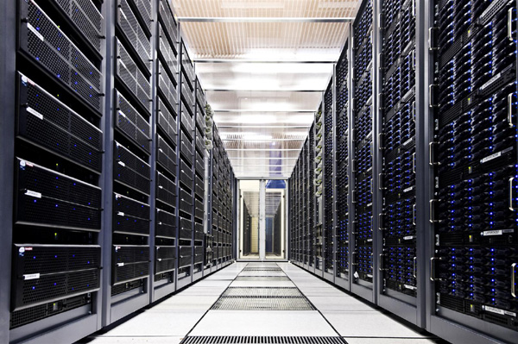
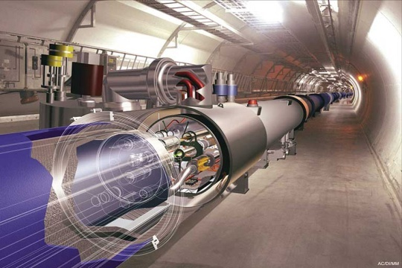
CERN Sectors of Operations
Office Computing Security
Grid Computing Security
Computing Services Security
Control Systems Security

Slide 13
Office Computing Footprint
General network architecture for all sectors:
  3 Class-B IP networks with >20 Gbps bandwidth incl. DHCP/wireless
  Several non-routable Class-B IP networks with >20 Gbps bandwidth
  >3000 switches, ~40k devices on Ethernet/DHCP/wireless networks
  6k firewall openings
One flat office / wireless network…
  Visitor’s laptops and office PCs on same network
…for a liberal (i.e. heterogeneous) user world
  Any type of personal/external laptops, PCs, PDAs, phones, devices, ...
  Any type of O/S: Mac OSX, Debian, Ubuntu, Windows 98, RedHat, …
  Any type of application, programming language, tools, Web sites, ...
  Hundreds of Web servers for dedicated purposes
  ~23k user accounts

Slide 14
Computer Services Footprint
7 computer centers
  each with up to ~10k nodes (~64k cores, ~64k HDDs)
  for central computing, accelerator operations, and physics experiments
Serving a multitude of services & systems…
  Central O/S: Windows XP/7 (~6500 PCs), Windows Server 2008++, Scientific Linux 5/6, Mac OS X
  ~2M mails per day: 95% SPAM, 1% unidentified SPAM, 4% regular
  AV, file systems (AFS, DFS), disk pools (~63PB), tape stores (~15PB/yr), DBs, versioning systems, document servers, HR/FI/engineering app’s, collaboration tools, PaaS virtualization service (~4k VMs), …
  ~10k Web sites on 50 Web servers + many more for dedicated purposes
  CERN Internet Exchange Point (22 European ISPs + Telcom providers)
…incl. GRID Computing
  Tier-0 (~7k nodes), Tier-1, and Tier-2

Slide 15
Control Systems Footprint
Experiment:
ALICE, ATLAS, CMS, LHCb, LHCf and TOTEM
ALPHA (AD-5), Cast, Collaps, Compass, Dirac, Gamma Irradiation Facility, ISOLTRAP, MICE R&D, Miniball, Mistral, NA48/3, NA49, NA60, nTOF, Witch, …
GCS, MCS, MSS, and Cryogenics System
Safety:
ACIS, AC PS1, AC PS2, AC SPS1, AC SPS2, Alarm Repeater, ARCON, ADS, CSA, SGGAZ, SFDIN, CSAM, CESAR, DSS, LACS, LASS, LASER, Radmon, RAMSES, MSAT, Radio Protection Service, Sniffer System, SUSI, TIM, and Video Surveillance
Infrastructure:
CV, ENS, FM, DBR, Gamma Spectroscopy, TS/CSE, and YAMS
Accelerators:
AB/OP, AD, CNGS, CCC, CLIC, ISOLDE, ISOLDE offline, LEIR, LHC, Linac 2, Linac 3, PS, PS Booster, REX, SM18, and SPS
Accelerator Infrastructure:
ADT, ACS, BQE, BPAWT, BDI, BIC, BLM, BOF, BPM, BOB, BSRT, BTV, BRA, CWAT, Cryo (Frigo, SM18 & Tunnel), BCTDC, BCTF, FGC, LEIR Low Level RF, LHC Beam Control System, LBDS, HC, LHC Logging Service, LTI, MKQA, APWL, BPL, OASIS, PIC, QDS/QPS, BQS, SPS BT, BQK, Vacuum System, WIC, and BWS

Slide 16
1. Understand your environment
& security footprint.
2. Assess your threats!

Slide 17
Do you know your threats?
?

Slide 18
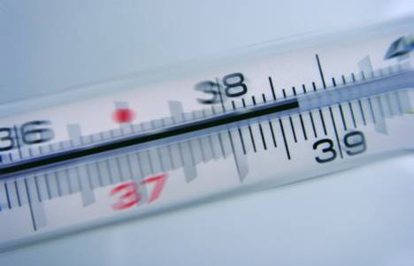
Under Permanent Attack
CERN is under permanent attack… even now.
Servers accessible from Internet are permanently probed:
  …attackers trying to brute-force passwords;
  …attackers trying to break Web applications;
  …attackers trying to break-in servers and obtain administrator rights.
  Users are not always aware/cautious/proactive enough:
  …attackers trying to harvest credentials outside CERN;
  …attackers trying to “phish” user passwords.
  Security events happen:
  Web sites & web servers, data-base interfaces,
  computing nodes, mail accounts, …
  The office network is very liberal: free connection policy and lots of visitors.
  Thus, there are always devices being infected/compromised.

Slide 19
Under Permanent Attack
CERN is under permanent attack… even now.
Servers accessible from Internet are permanently probed:
  …attackers trying to brute-force passwords;
  …attackers trying to break Web applications;
  …attackers trying to break-in servers and obtain administrator rights.
  Users are not always aware/cautious/proactive enough:
  …attackers trying to harvest credentials outside CERN;
  …attackers trying to “phish” user passwords.
  Security events happen:
  Web sites & web servers, data-base interfaces,
  computing nodes, mail accounts, …
  The office network is very liberal: free connection policy and lots of visitors.
  Thus, there are always devices being infected/compromised.
Coming up:
My top-12 security events of the last 5yrs
(There weren’t much more)

Slide 20
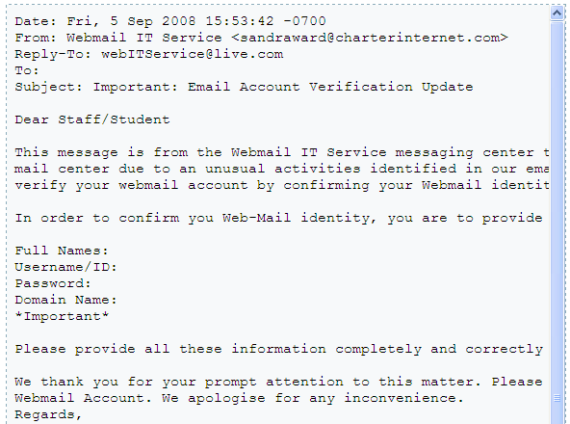

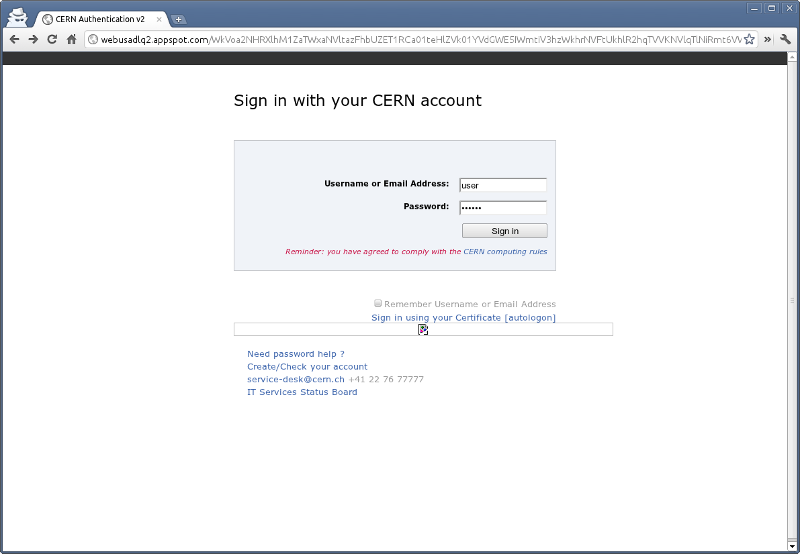
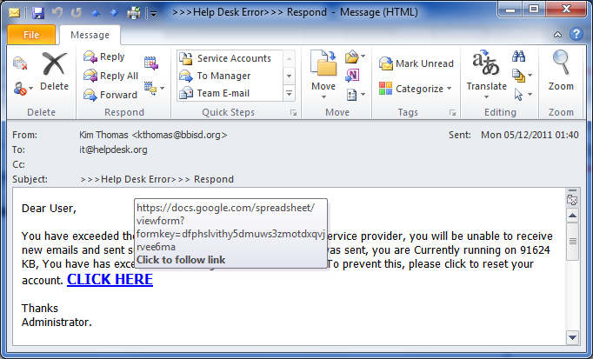
Phishing (1)
Targeted and untargeted “Phishing” attacks in English & French…
Spoofed login pages…
…on “trusted” hoster!

Slide 21
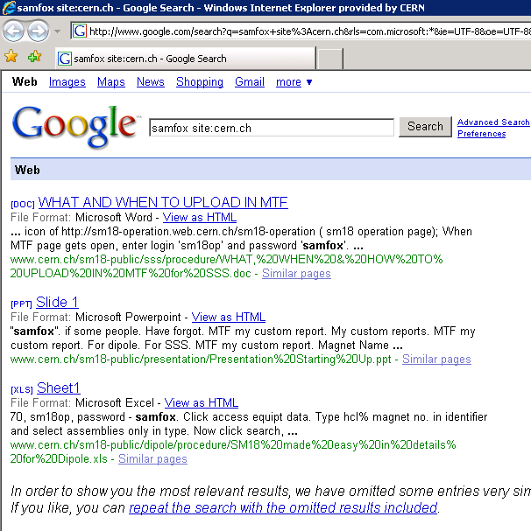
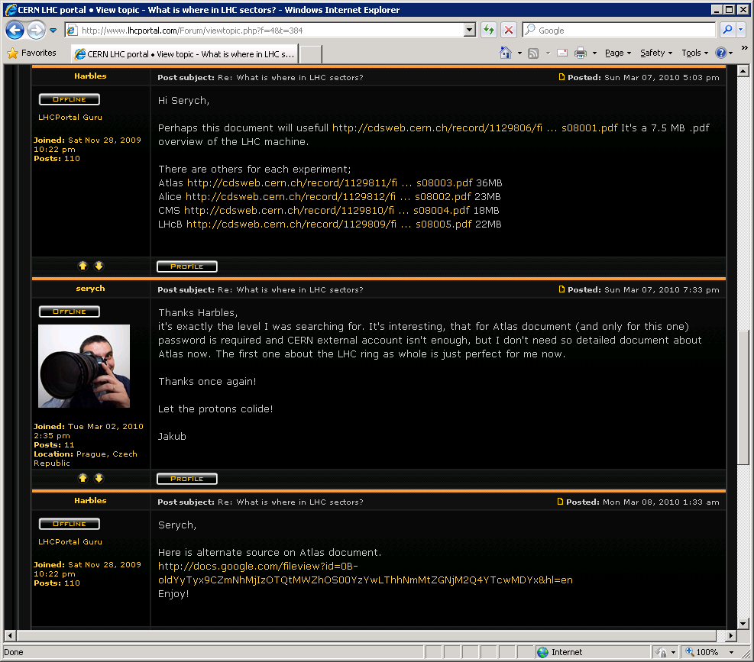
Data Leakage (1)
Confidential data on
Wikis, Webs, CVS…
Sensitivity levels are
user dependent!

Slide 22
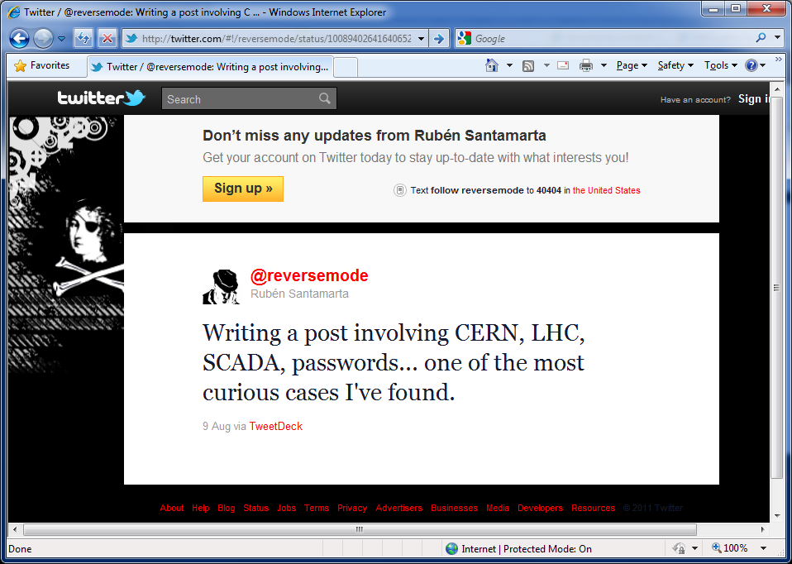
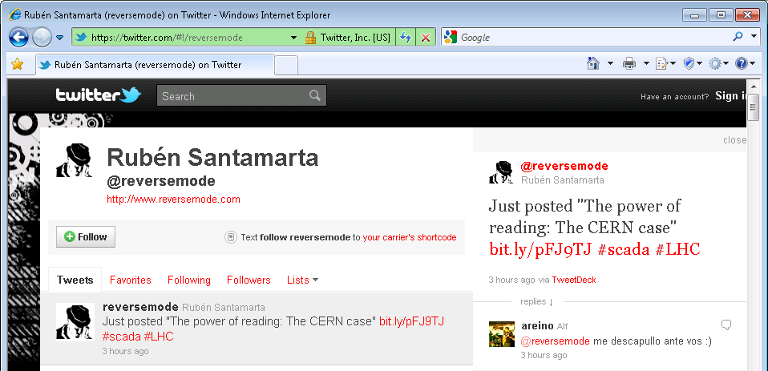
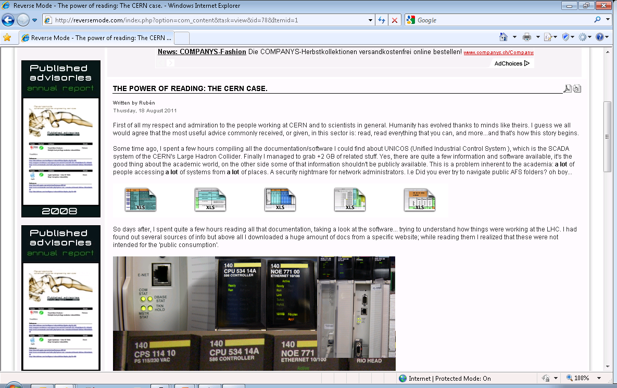
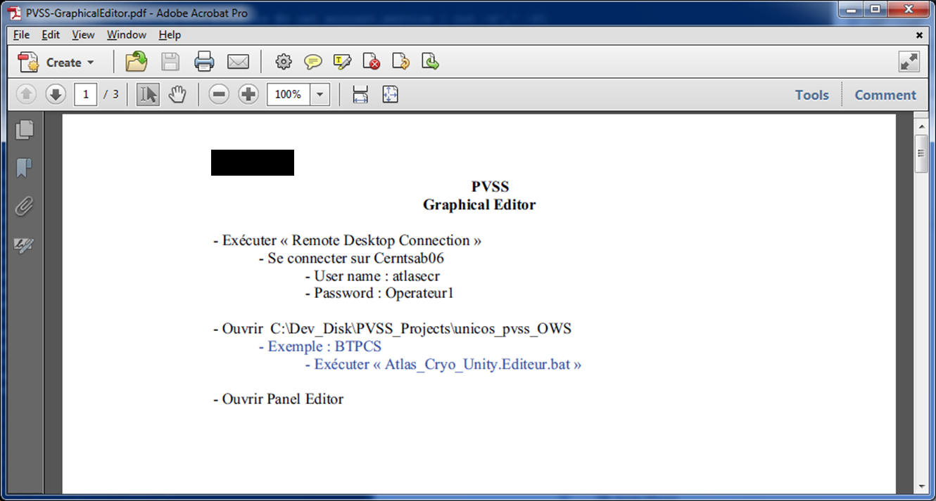
Data Leakage (2)
A month earlier, he reported to the
U.S. Department of Homeland Security
who informed us plus SWITCH and MELANI.

Slide 23
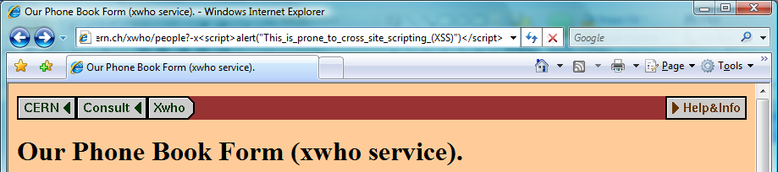
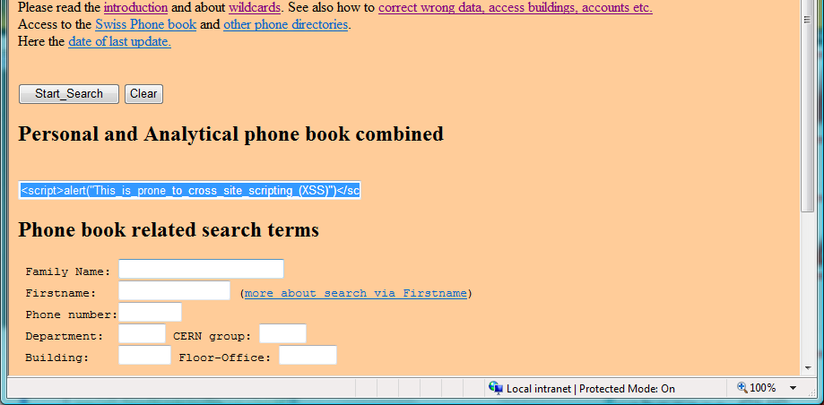

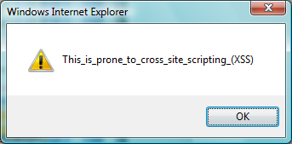
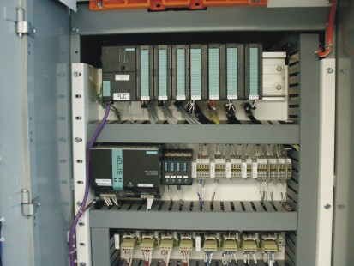
Suboptimal configuration (1)
Lack of input
validation/sanitization
CERN 2007
Lack of robustness ☹

Slide 24

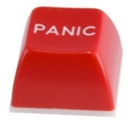
Suboptimal configuration (2)
A defaced
(added)
web-page…
Oops !!???
…a user listing

Slide 25
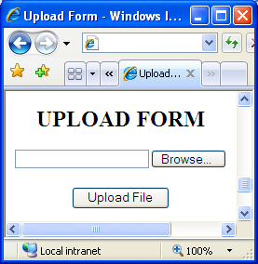
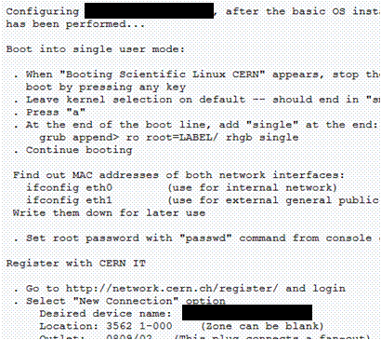
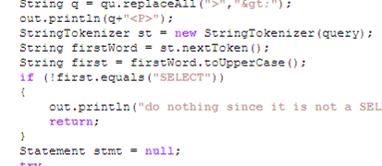
Suboptimal configuration (3)
Neglected “Rule of Least Privileges”:
Everyone could upload
whatever he/she wants…
Configuration well
documented in Google…
Lack of input
validation & sanitization
Notes:
OPTIONAL/TECHNICAL

Slide 26
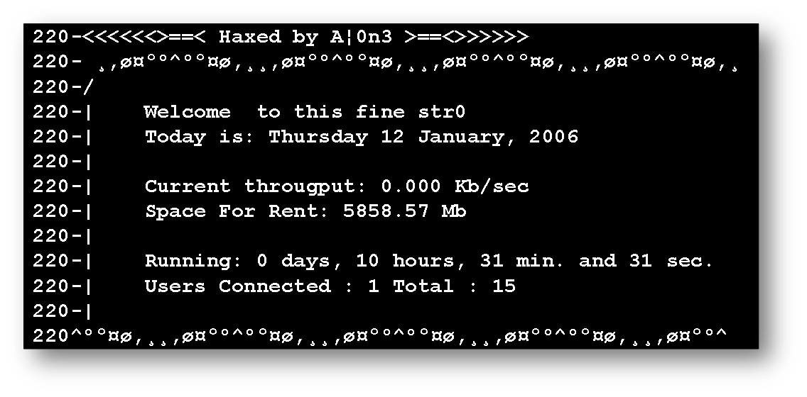
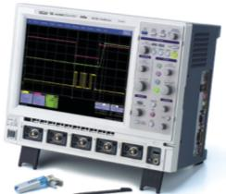
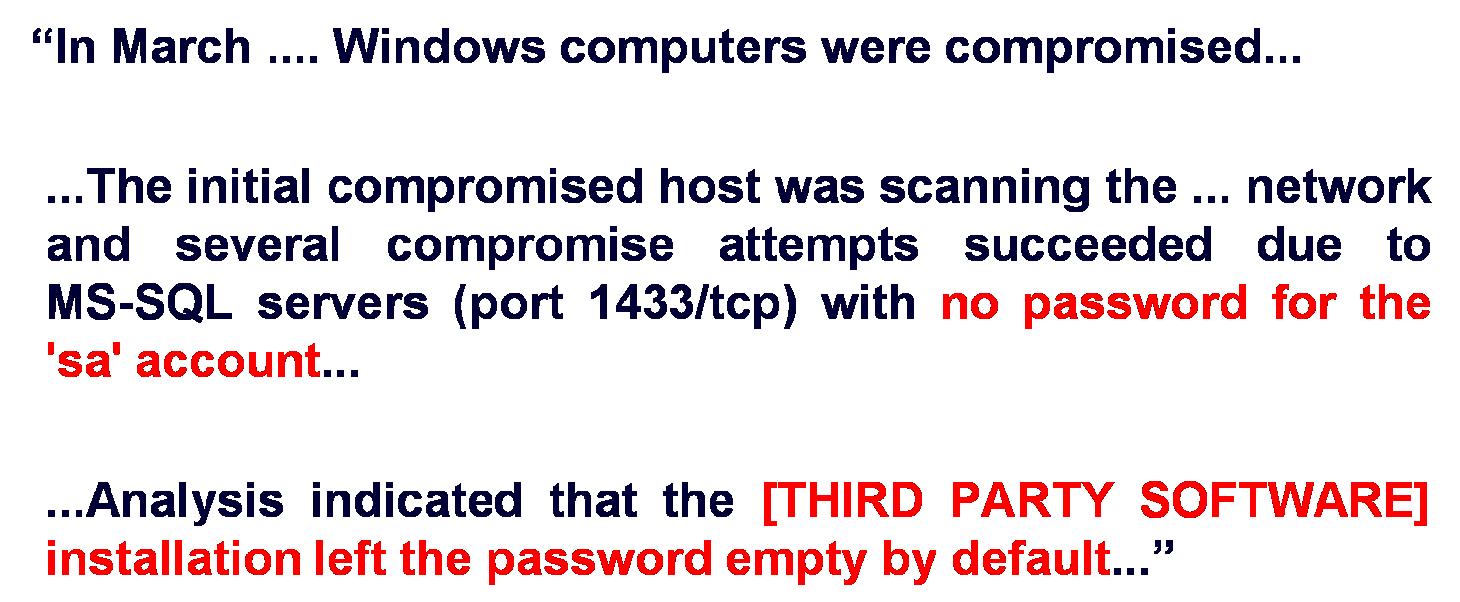
Break-Ins (1)
Unpatched oscilloscope
(running Win XP SP2)
Undocumented feature
in SCADA application

Slide 27
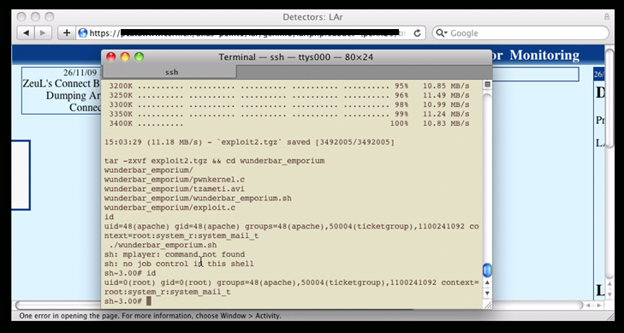
Break-Ins (2)
Lack of input
validation & sanitization
Unpatched web server
(running LX)

Slide 28
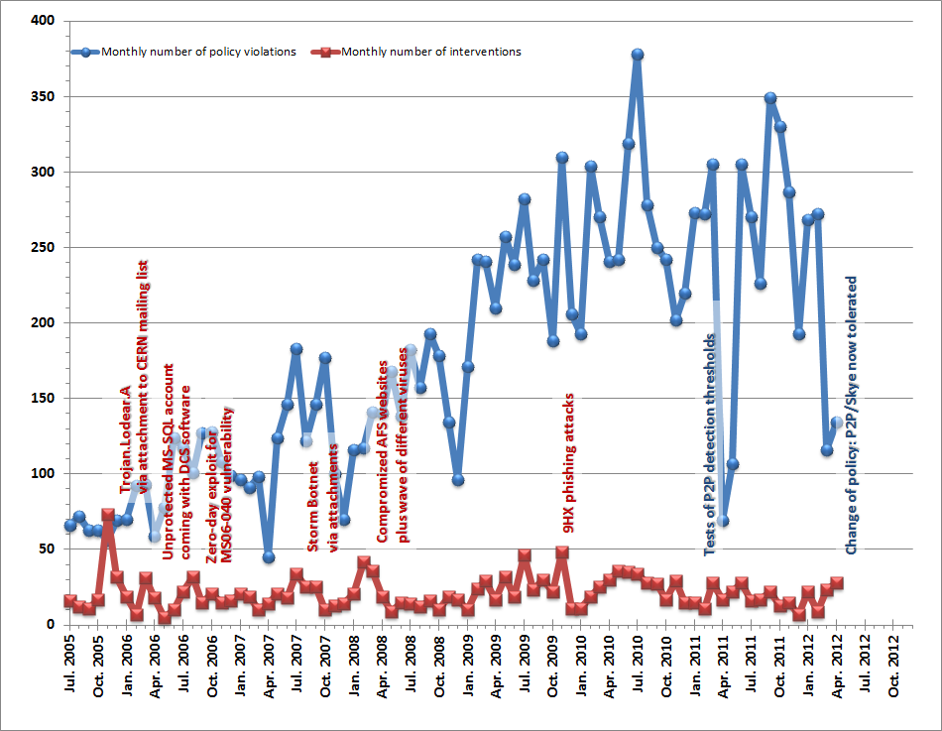
Policy Violations & Events

Slide 29
1. Understand your environment
& security footprint.
2. Assess your threats!
3. Develop your security paradigm.

Slide 30
What would be your strategy?
?

Slide 31

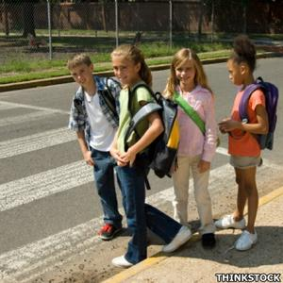
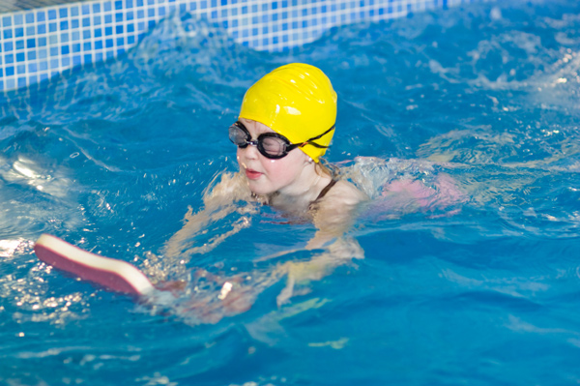
CERN Security Paradigm
Find balance between “Academic Freedom”,
“Operations” and “Computer Security”
“Academic Freedom” means “Responsibility”
  (I, as Security Officer, decline to accept that responsibility)
  Instead, computer security at CERN is delegated
  to all users of computing resources.
  If they don’t feel ready,
  they can pass that responsibility to the
  IT department using central services.
Change of culture & a new mind set:
  Enable users to fully assume this responsibility.
  Make security integral part of the overall.
(Plus a Defense-In-Depth approach, still.)

Slide 32
CERN Security Paradigm
Find balance between “Academic Freedom”,
“Operations” and “Computer Security”
“Academic Freedom” means “Responsibility”
  (I, as Security Officer, decline to accept that responsibility)
  Instead, computer security at CERN is delegated
  to all users of computing resources.
  If they don’t feel ready,
  they can pass that responsibility to the
  IT department using central services.
Change of culture & a new mind set:
  Enable users to fully assume this responsibility.
  Make security integral part of the overall.
(Plus a Defense-In-Depth approach, still.)
This is a “people” problem!
A good Security Team becomes
facilitator and enabler!

Slide 33
1. Understand your environment
& security footprint.
2. Assess your threats!
3. Develop your security paradigm.
4. The Permanent Mitigation Cycle

Slide 34

Permanent Mitigation Cycle

Slide 35
Examples for “Prevention“?
?

Slide 36





Permanent Mitigation Cycle (1)
Prevention:
Definition and communication of security policies
Security Baselining for systems & services:
Contract between owner & Security Officer
Assessments & reviews
Training for secure coding & configuration practices
Provisioning of static code analyzers
Vulnerability scanning:
w3af/Wapiti/Skipfish (Web apps), Nessus/nmap (hosts), John the Ripper (passwords), “Prodder”-scans (e.g. for Open Shares, MyPhpAdmin)…
“Credential hunts” (e.g. unprotected clear text passwords on AFS)
Plus:
Deployment of an integrated identity management system, AuthZ & AuthN
Central PC management & immediate patching
Active research (e.g. Siemens/CERN openlab collaboration)
Prevention
Protection
Response
Detection

Slide 37
Examples for “Protection“?
?

Slide 38
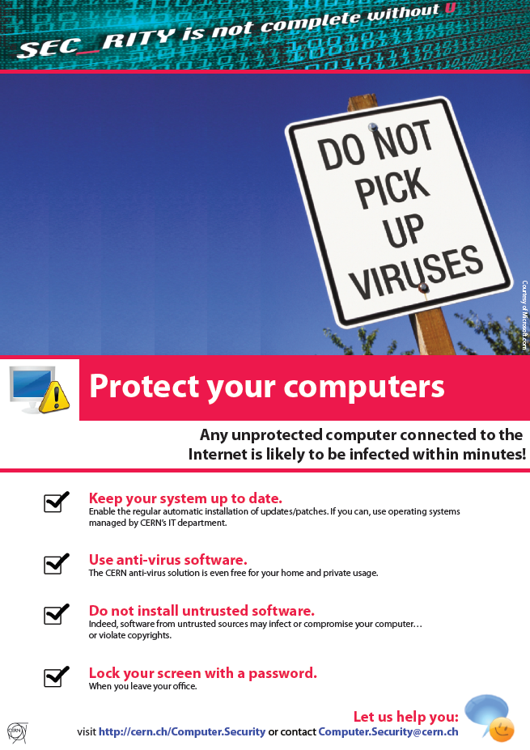
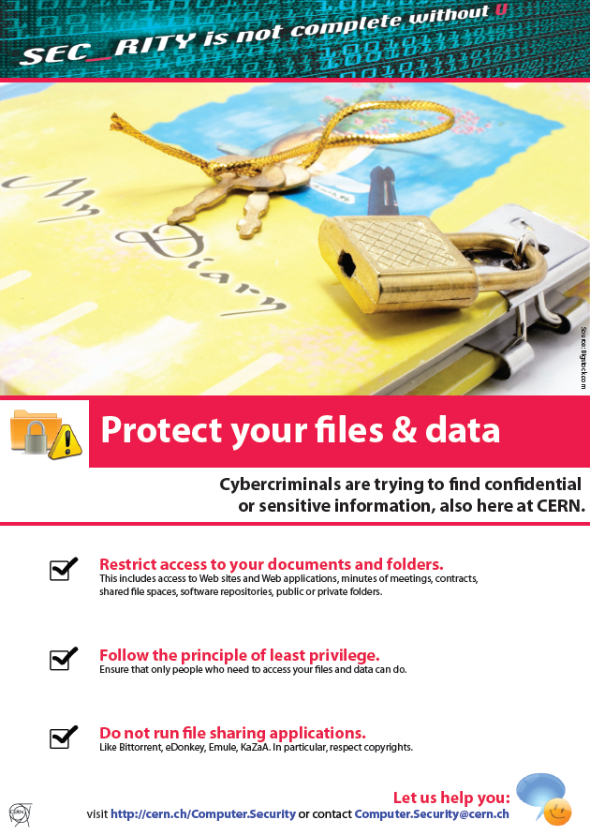
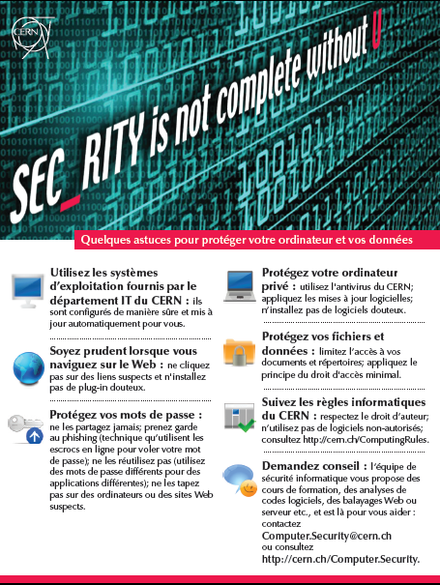


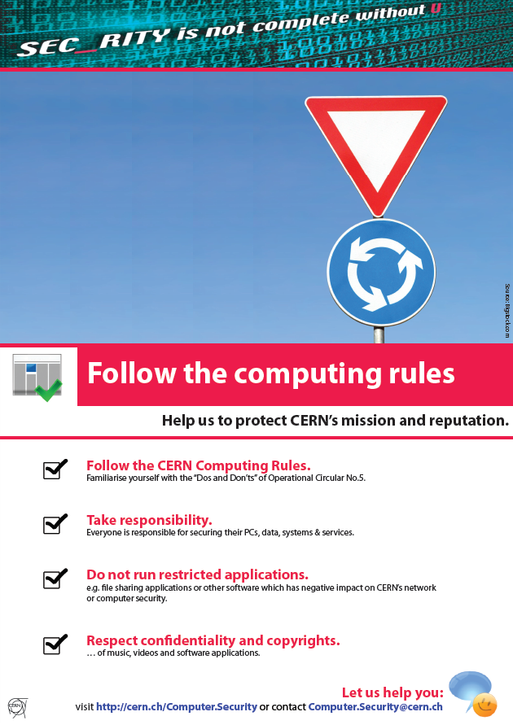
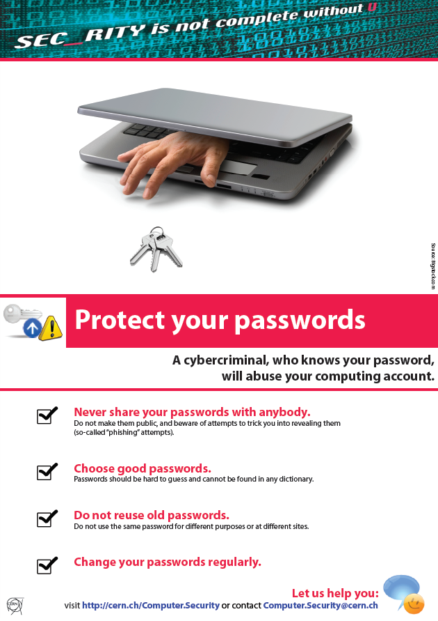




Permanent Mitigation Cycle (2)
Protection:
“Defense-in-Depth”,
in particular for control systems
Tightened outer perimeter firewall
with life-cycle, scanning & opening approval
Awareness raising:
Dedicated awareness sessions,
Introduction sessions for newcomers,
Leaf sheets & posters
Plus:
Segregated networks for dedicated purposes
Inter-network filtering and access control
Deployment of local firewalls
Centralized anti-virus software
(on IT managed Windows PCs & servers)
Prevention
Protection
Response
Detection

Slide 39
Examples for “Detection“?
?

Slide 40

Permanent Mitigation Cycle (3)
Detection:
                Statistical analysis of network flows:
                e.g. number of peers (→ P2P),
                multiple SSH/SNMP/Web connections,
                infected devices (ports 137/tcp, 139/tcp, 445/tcp)
Analysis of DNS queries (→ Conficker worm)
Packet inspection IDS:
~12k rules from VRT and ET for
detection of e.g. IRC, …
Automatic log analysis:
logins, kernel panic, critical commands (“uname –a; id”), …
“SSH receipts” for remote connections from “strange” locations
Training of users to report phishing emails
Plus:
Centralized anti-virus software (on IT managed Windows PCs & servers)
Prevention
Protection
Response
Detection

Slide 41
How to do “Response“?
?

Slide 42
Permanent Mitigation Cycle (4)
Response:
Provisioning of CSIRT/CERT, and
WLCG Grid Security Officer
Containment
Impact analysis / classification / prioritization
Incident forensics (above a certain impact)
Interaction with third parties: e.g. universities, SWITCH
Recovery (i.e. usually reinstallation)
Application of lessons learned
Costing
Plus:
Business continuity planning / Disaster recovery planning
Verification: Annual Security Challenges inside the WLCG Grid
Prevention
Protection
Response
Detection

Slide 43
1. Understand your environment
& security footprint.
2. Assess your threats!
3. Develop your security paradigm.
4. The Permanent Mitigation Cycle
5. Set up your Team

Slide 44
What makes a good Security Team?
?

Slide 45
A good Security Team
A good Security Team is mainly facilitator and enabler,
sometime enforcer, and (hopefully) rarely punisher.
Members of the Team cover all social and technical aspects: (see Belbin Team Role Inventory)
  “Resource Investigator” to reach out into the environment;
  “Co-ordinator” to manage the Team and its priorities;
  “Evaluator” to develop and deploy security policies;
  “Team Worker” to run security audits and provide consulting;
  “Implementer” to maintain the infrastructure;
  “Specialist” to dig into the forensics and deal with challenging technicalities.
Of course,
any key function can be assumed by anyone anytime!

Slide 46

CERN Computer Security Team
CSO: Computer Security Officer
SEC: Security Escalator
GoD: first line support (“Guy on Duty”)
Manpower:
  4 staff
  i.e. CSO and SEC
  1 fellow
  2-3 students
  5 external contributions
  of 10% for first line
Pipeline:
  About 40 different on-going and pending projects
  incl. coordination of external efforts (Web services, comp’g clusters, …)
Notes:
https://service-cert.web.cern.ch/service-cert/wiki/doku.php?id=documents:team-structure

Slide 47
CERN Computer Security Team
CSO: Computer Security Officer
SEC: Security Escalator
GoD: first line support (“Guy on Duty”)
Manpower:
  4 staff
  i.e. CSO and SEC
  1 fellow
  2-3 students
  5 external contributions
  of 10% for first line
Pipeline:
  About 40 different on-going and pending projects
  incl. coordination of external efforts (Web services, comp’g clusters, …)
Eight — but not more!
Better having the Team “spread” over all computing services and sectors of operation.
Notes:
https://service-cert.web.cern.ch/service-cert/wiki/doku.php?id=documents:team-structure

Slide 48
Summary
CERN’s Security Footprint
is heterogeneous and vast
However, security events happen
and will continue to happen
Iterate on the right balance:
Academic Freedom vs. Operation vs. Security
Lot’s of efforts on prevention & protection
while maintaining good detection & response
Enable users assuming responsibility.
Provoke a Change-of-Mind!!!

Slide 49
Summary
CERN’s Security Footprint
is heterogeneous and vast
However, security events happen
and will continue to happen
Iterate on the right balance:
Academic Freedom vs. Operation vs. Security
“Computer Security” is rather a
sociological problem, less a technical one!
Lot’s of efforts on prevention & protection
while maintaining good detection & response
Enable users assuming responsibility.
Provoke a Change-of-Mind!!!

Slide 50




Literature
…and, of course,
there are plenty of (good) books on computer security!!!

