Slide 1

Control Systems Under Attack !?
…about the Cyber-Security
of modern Control Systems
Dr. Stefan Lüders (CERN Computer Security Officer)
Openlab Summer Student Lectures
July 23rd 2012

Slide 2
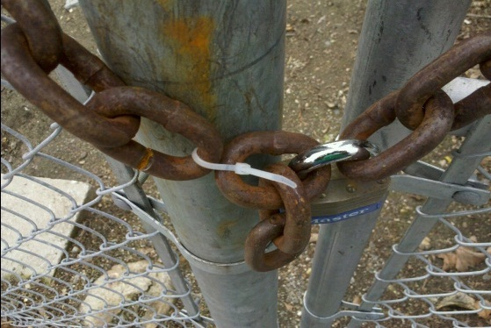
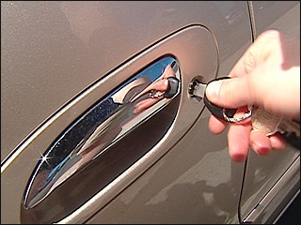
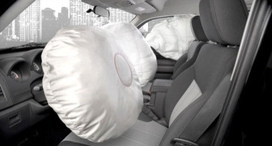
Security in a Nutshell
Security is as good as the weakest link:
  Attacker chooses the time, place, method
  Defender needs to protect against all possible attacks
  (currently known, and those yet to be discovered)
  Security is a system property (not a feature)
  Security is a permanent process (not a product)
  Security cannot be proven (phase-space-problem)
Security is difficult to achieve, and only to 100%-ε.
  At CERN, every single computing resource owner defines ε !!!
BTW:
Security is not a synonym for safety.

Slide 3

Security in a Nutshell
Security is as good as the weakest link:
  Attacker chooses the time, place, method
  Defender needs to protect against all possible attacks
  (currently known, and those yet to be discovered)
  Security is a system property (not a feature)
  Security is a permanent process (not a product)
  Security cannot be proven (phase-space-problem)
Security is difficult to achieve, and only to 100%-ε.
  At CERN, every single computing resource owner defines ε !!!
YOU are responsible for securing your services & systems:
  As user, developer, system expert or administrator
  As a project manager or line manager
  As part of the CERN or your experiment hierarchy
BTW:
Security is not a synonym for safety.

Slide 4
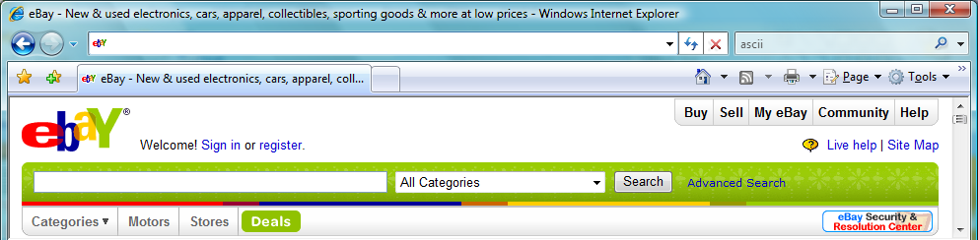

Warm-Up: A small quiz
  What links to www.ebay.com?
http://www.ebay.com\cgi-bin\login?ds=1%204324@%31%33%37 %2e%31%33%38%2e%31%33%37%2e%31%37%37/p?uh3f223d
http://www.ebaỵ.com/ws/eBayISAPI.dll?SignIn
http://scgi.ebay.com/ws/eBayISAPI.dll?RegisterEnterInfo&siteid=0&
co_partnerid=2&usage=0&ru=http%3A%2F%2Fwww.ebay.com&rafId=0
&encRafId=default
http://secure-ebay.com
✗
✗
This IS Not EVEN obvious
FOR professionals!
✓
✗

Slide 5
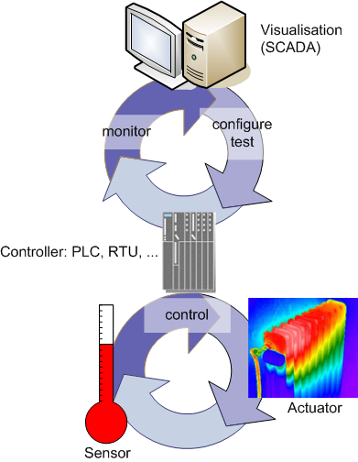
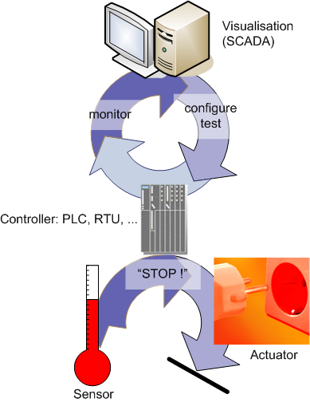
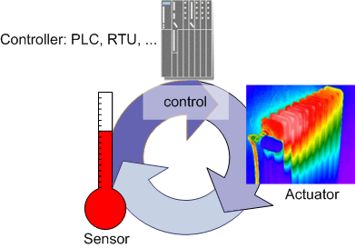
“Control Systems” in a Nutshell
Process Control System (PCS)
Safety System

Slide 6



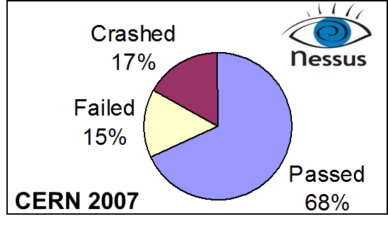
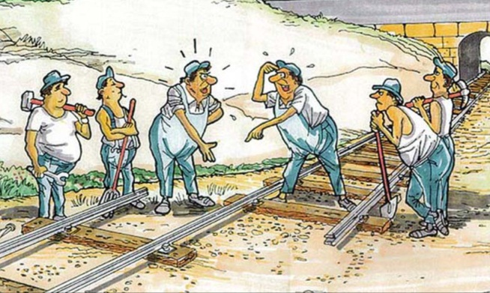
Roadmap for Today

Slide 7

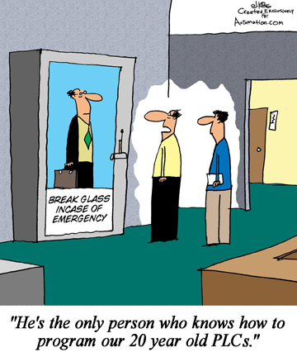
“Control Systems” go “IT”...
In the past, PCS were
  largely proprietary
  stand-alone & interconnected using proprietary networks only
  accessed via modems, if at all
  using own standards,
  technologies & means
Today, PCS
  base on custom-of-the-shelf hardware and software (“office IT”)
  are highly inter-connected
  determine & impact widely
  on our daily life
Notes:
7

Slide 8
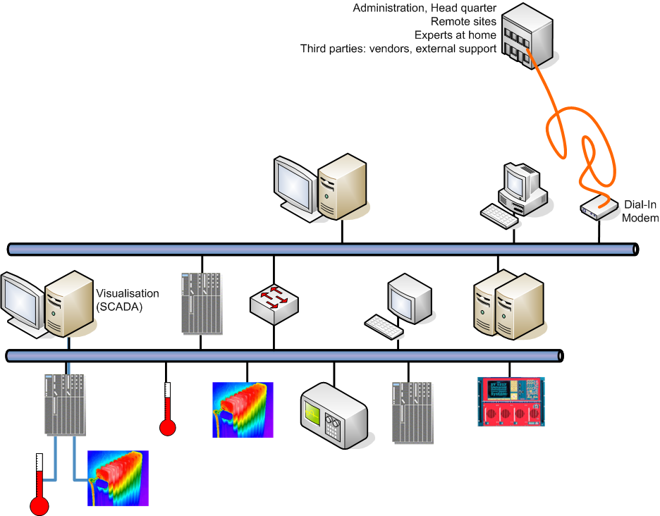
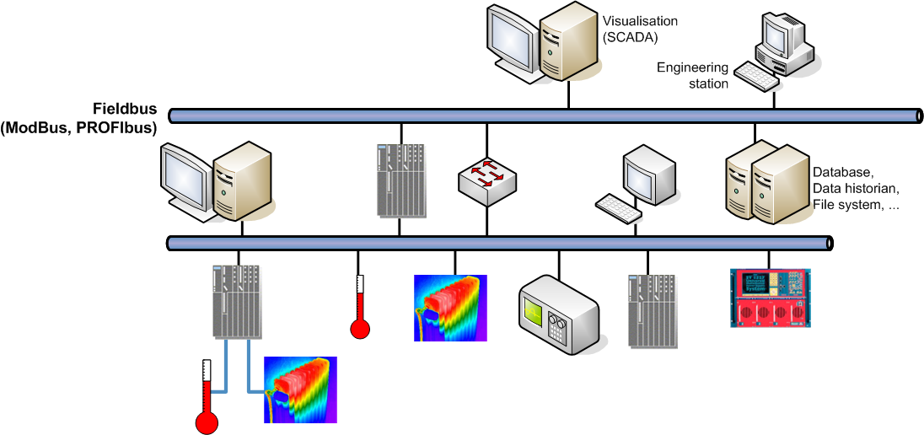
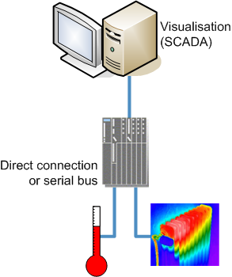
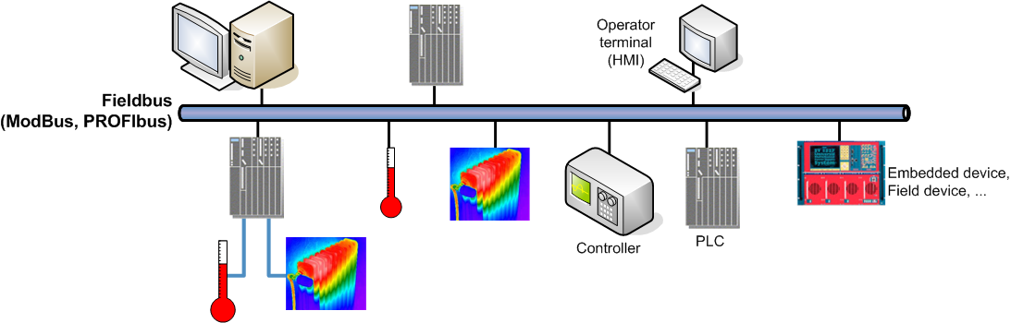
(R)Evolution: The Past

Slide 9
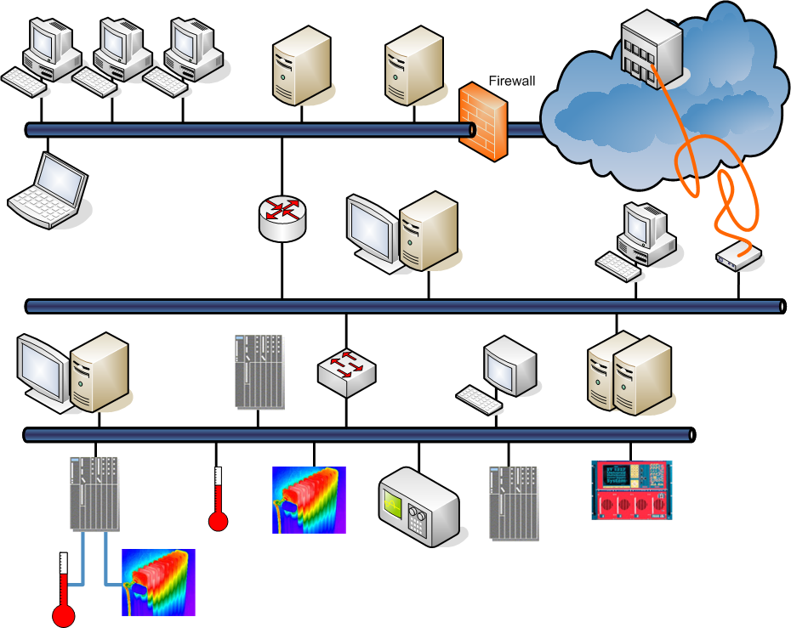
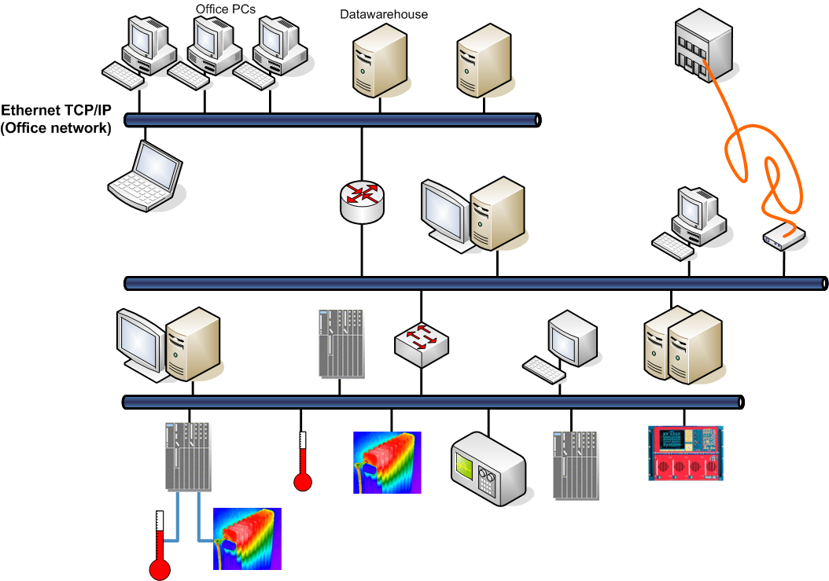
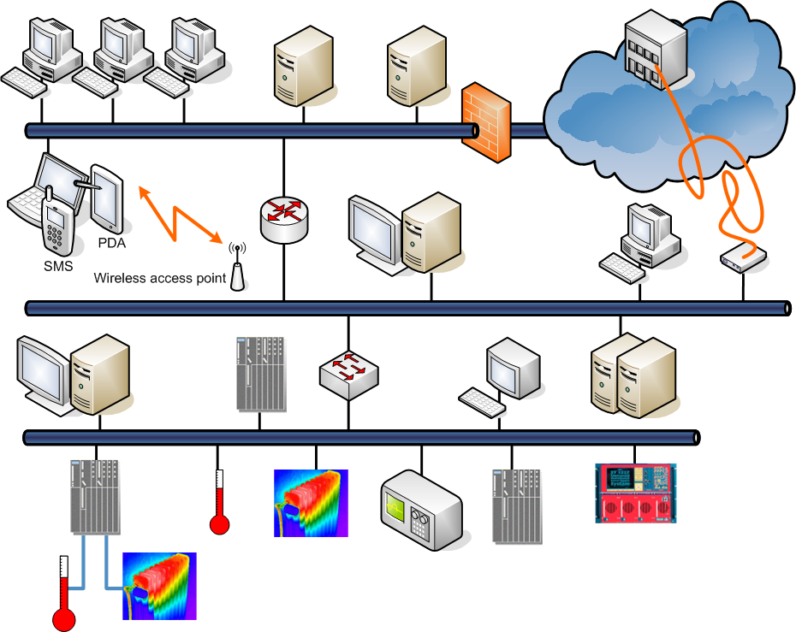

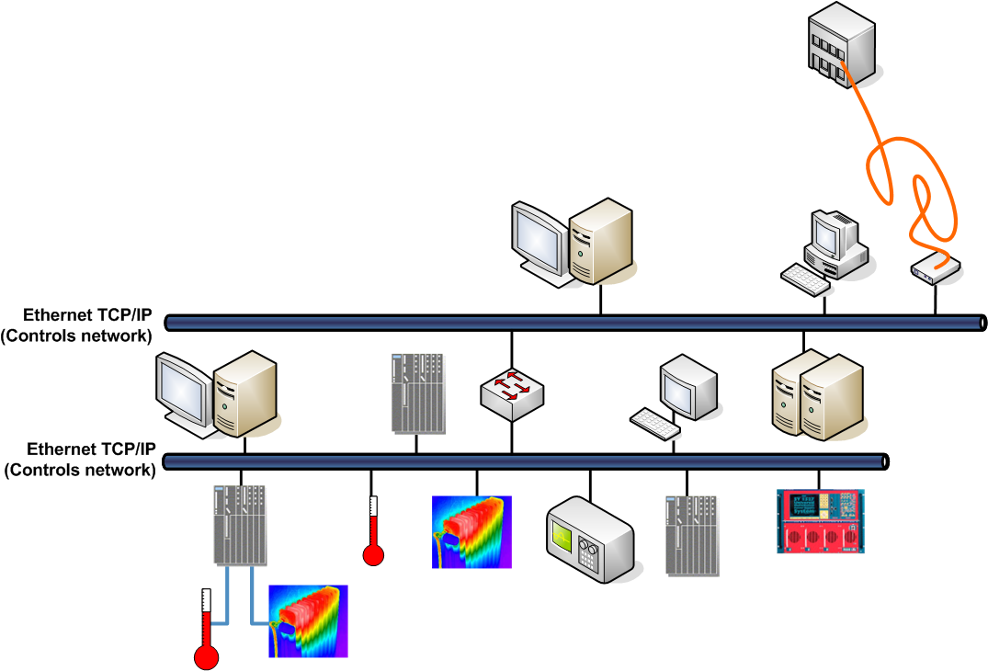
(R)Evolution: Today

Slide 10
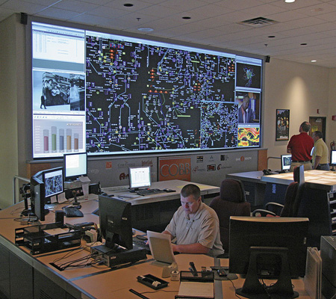
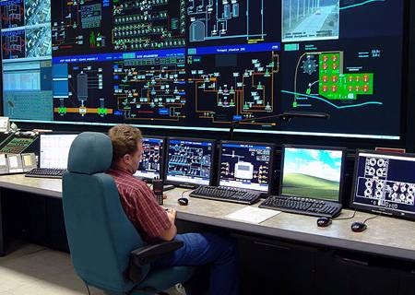
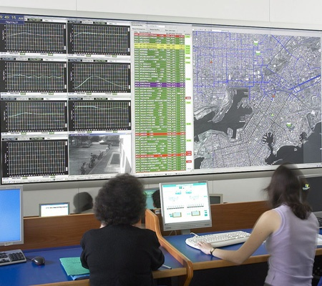
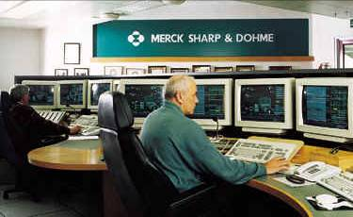
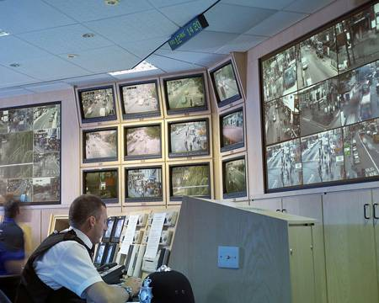

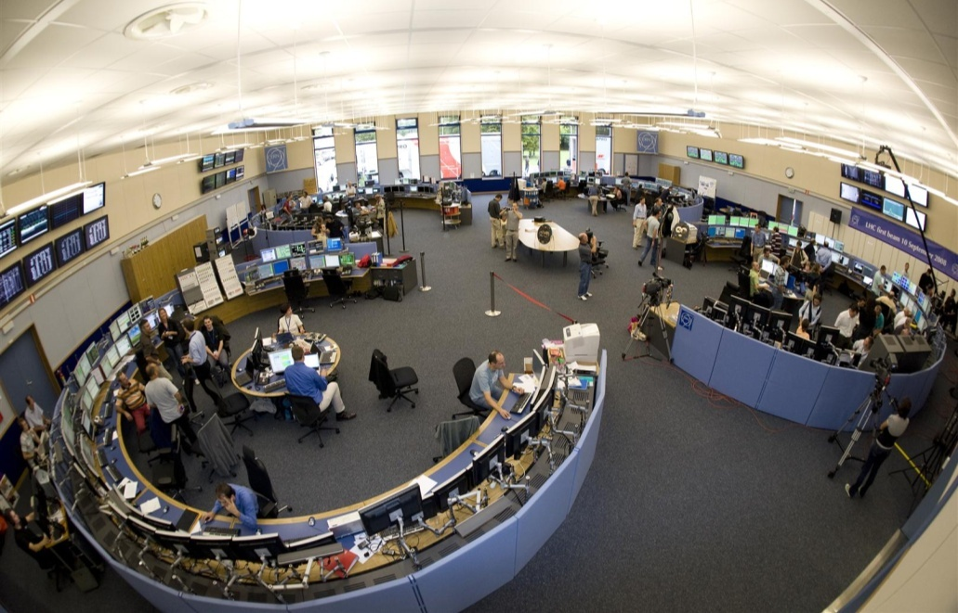
Control Systems for Living
…in the electricity sector
…in the oil & gas sector
…in the water & waste sector
…in the chemical and
pharmaceutical industry
…in the transport sector
…for production:
  e.g. cars, planes, clothes, news
…in supermarkets
  e.g. scales, fridges
…for facility management
  electricity, water, C&V
…for accelerator controls
COBB County Electric, Georgia
Middle European Raw Oil, Czech Republic
Athens Water Supply & Sewage
Merck Sharp & Dohme, Ireland
CCTV Control Room, UK
Reuters TV Master Control Room
CERN Control Centre
The claimed No. 1 goal for cyber-security in the 21st century:
Critical Infrastructure Protection (CIP)

Slide 11
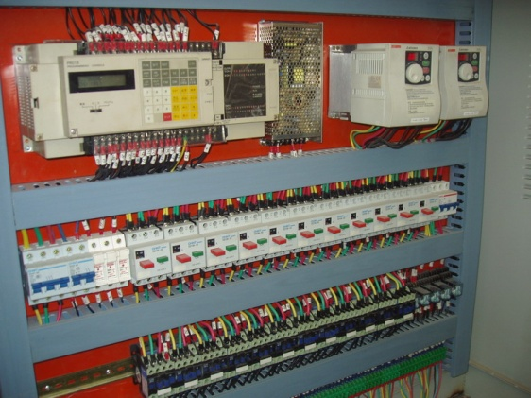
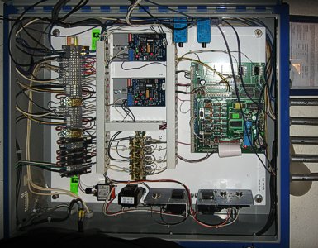
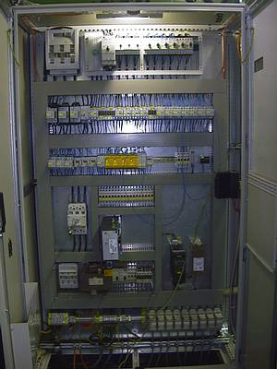
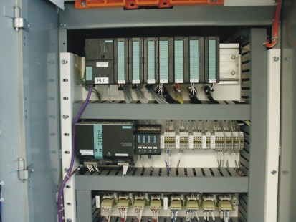
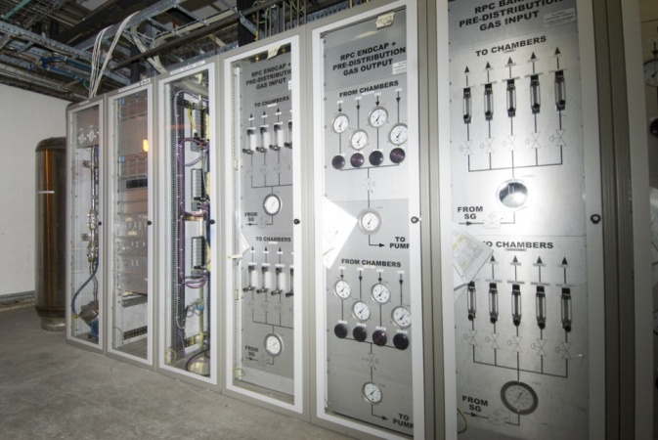
This is how PCS can look like
Controller
Connections to
sensors & actuators
Controller
Sensors & actuators

Slide 12
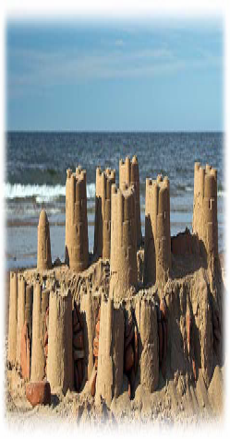
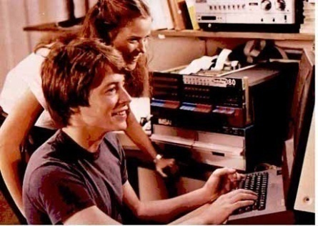

PCS omitted security aspects!
In the past, PCS security was
  hidden (“security through obscurity”)
  never a real concern
  a target for nerds
Today,
  Same “office IT”-risks
  inherent in PCS (TCP/IP, Windows PCs, WWW & mail, C++, …)
  Same “office IT”-attackers
  targeting PCS (viruses/worms, saboteurs, attacker, stupidity, …)
Notes:
12

Slide 13

Why worry? The Risk Equation
Risk =
Threat
× Vulnerability
× Consequence

Slide 14
Who is the threat?
Attacks performed by…
  Disgruntled (ex-)employees or saboteurs
  Attackers and terrorists, but also since “Stuxnet”: (Western) countries
  (step-by-step instructions on BlackHat conferences;
  freeware hacking tools for “Script Kiddies”)
  Trojans, viruses, worms, …
Lack of robustness & lots of stupidity
  Mal-configured or broken devices flood the network
  Developer / operator “finger trouble”
Lack of procedures
  Flawed updates or patches provided by third parties
  Inappropriate test & maintenance rules / procedures

Slide 15
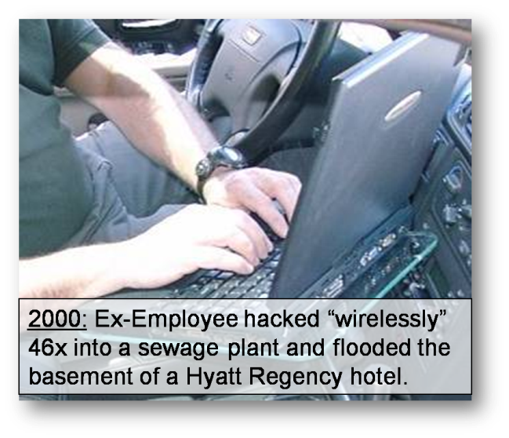
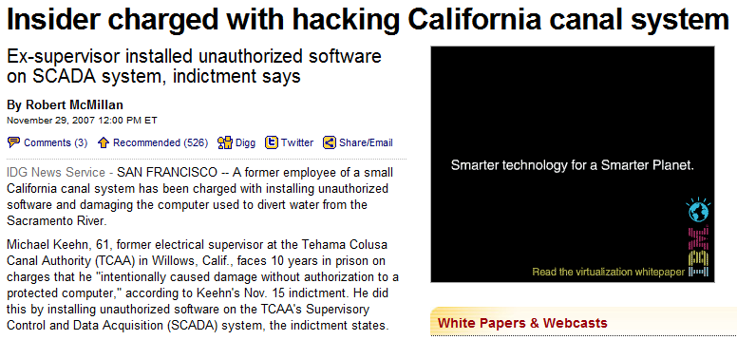


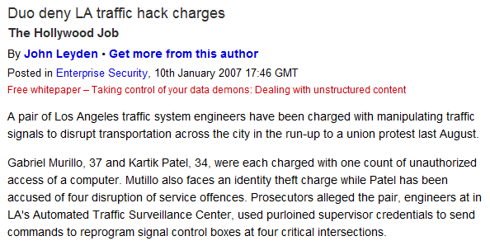
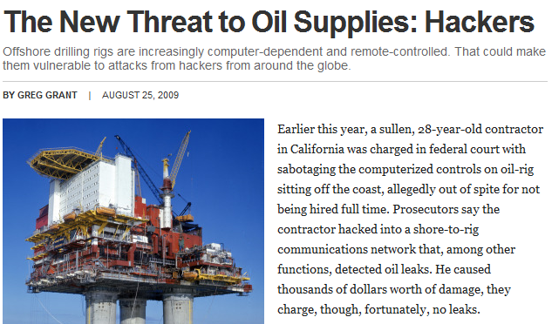

Damage by Insiders?

Slide 16

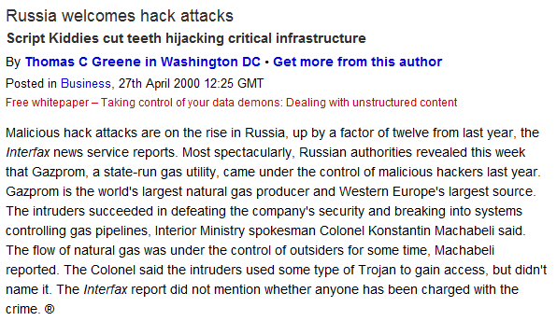

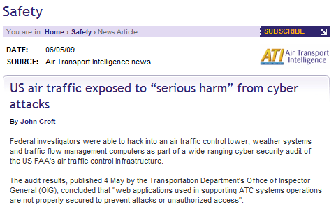
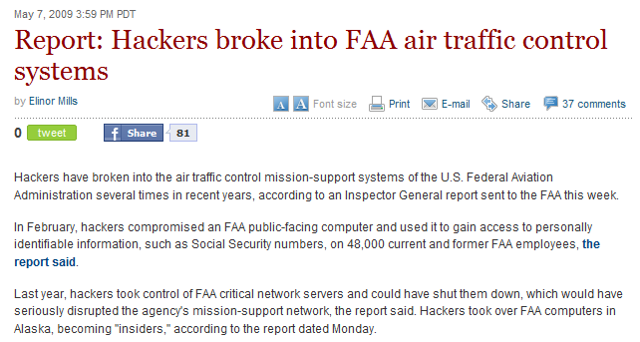

Damage by Attacker?

Slide 17
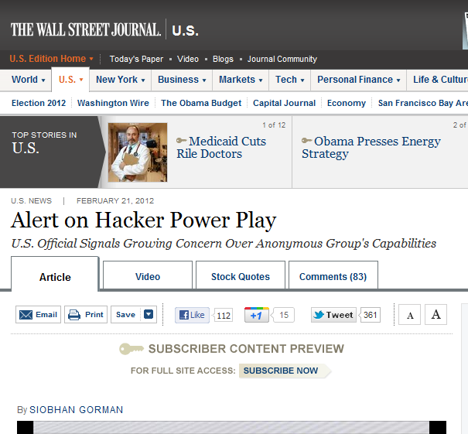
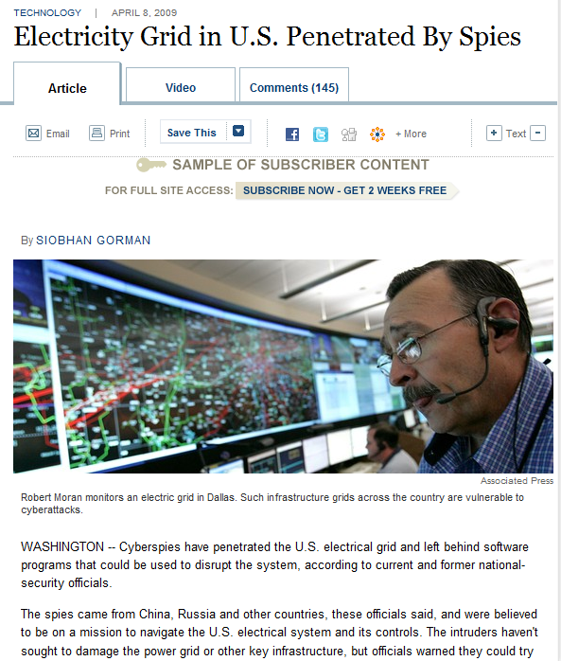

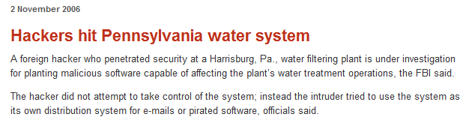

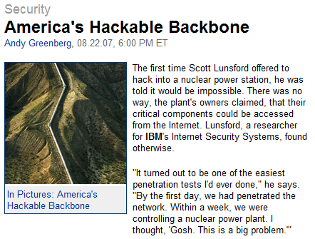
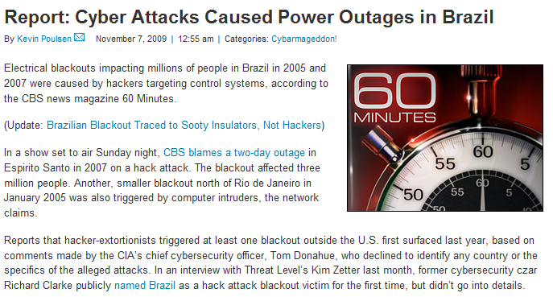
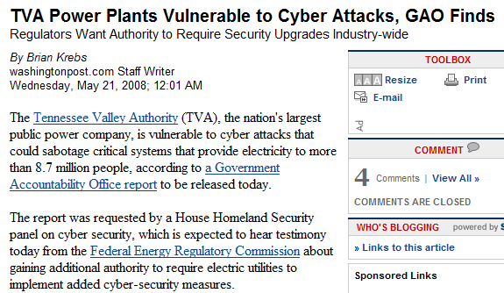
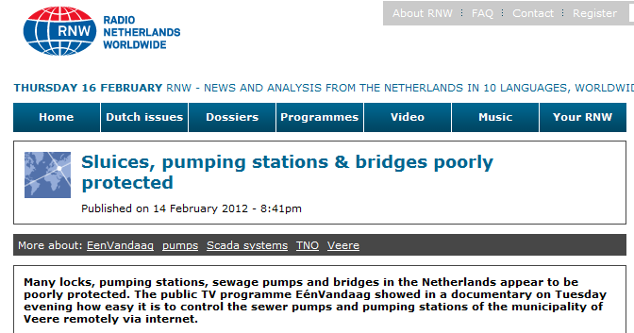
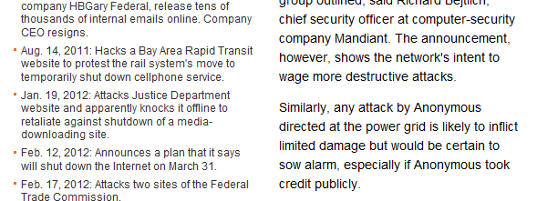

Damage due to CI No-P?

Slide 18
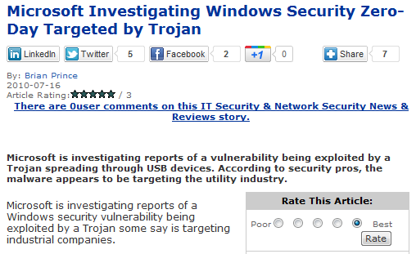
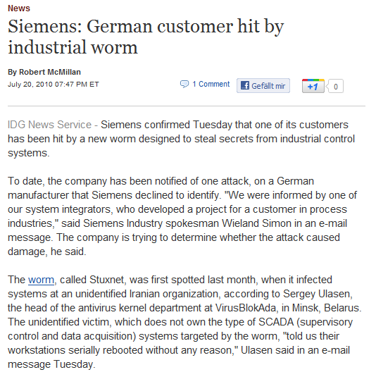



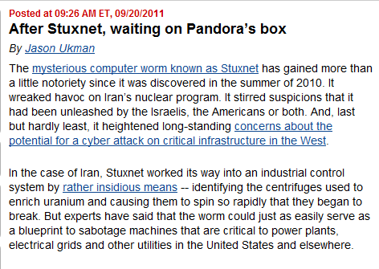
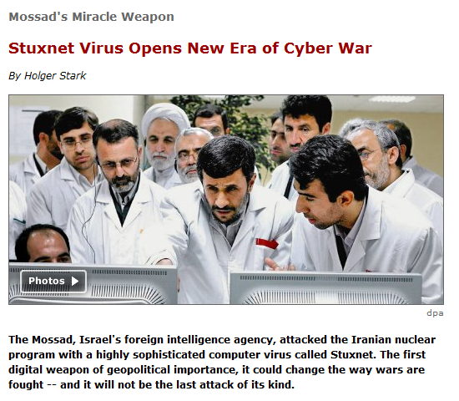


Natanz, we have a problem.

Slide 19




Stuxnet
  SCADA PC infected via USB stick
  with 4(!) zero-day exploits (worth $100k-500k)
  Hide, spread & listen
  Look for STEP7. If so, BINGO
  Replace S7 drivers to hide & start exploiting
  Fingerprint PLC
  If right configuration, download additional code
  (Insider knowledge necessary!!!)
  Vary rotational speed of centrifuges to wear them out. GAME OVER.
  Lots of hype in media (“First Cyberwar”)
  but just logical consequence of the past
  Nothing new, apart from level of
  sophistication
  Stay tuned for similar attacks!!!!
Notes:
Short version of the next three slides.

Slide 20


The Workings of Stuxnet (I)
  An infected USB stick was infiltrated
  into the plant either by malicious act
  or through social engineering.
  Once inserted into a Windows PC, the stick
  tried to compromize the O/S with up to
  4(!) zero-day exploits (worth >$100k).
  There were 4-5 evolutions starting 6/2009.
  Infected 100.000 PCs (60% Iran,10% Indonesia).
  Using “rootkit” technologies and two stolen certificates, it hid from being detected.
  It tried to infect other hosts and
  establish a P2P connection “home”.
So far, nothing new:
A standard,
but expensive virus!

Slide 21


The Workings of Stuxnet (II)
  Stuxnet then checked the local configuration
  looking for the presence of Siemens
  PCS7/STEP7/WINCC SCADA software.
  If so, it copied itself into the local
  STEP7 project folder (to propagate further).
  It replaced the S7 communication libraries
  (DLLs) used for exchanging data with a PLC.
  Stuxnet can now manipulate values to be
  send to the PLC or displayed by the SCADA.
  If not, Stuxnet got idle and would expire on 2012/06/24.
Stuxnet is now the
“Man in the Middle”
controlling the communication between SCADA & PLC.

Slide 22



The Workings of Stuxnet (III)
  Next, Stuxnet was
  “fingerprinting” connected PLCs.
  If right PLC configuration, it
  downloaded/replaced code
  between 17 and 32 FBs & DBs.
This code varied the rotational speed of the centrifuges over months wearing them out and inhibiting uranium enrichment.
The “Man in the Middle”
made everything looked fine at the SCADA level…

Slide 23

Stuxnet was not the first one!

Slide 24



Smart Meters: Nothing Learned?
  Use case:
  Measuring your consumption at home
  Online with the grid: Optimizing the power usage
  Publicly accessible, off-the-shelf, open networks
Risks:
  Exploitation of meter vulnerabilities:
  registration process, firmware, data, …
  Loss of confidentiality:
  customer data available to others
  Loss of integrity:
  manipulation of reading data
  Loss of availability:
  data not available in a timely manner
  Misuse as attack platform
courtesy of M. Tritschler (KEMA)

Slide 25
Smart Meters: Nothing Learned?
  Use case:
  Measuring your consumption at home
  Online with the grid: Optimizing the power usage
  Publicly accessible, off-the-shelf, open networks
Risks:
  Exploitation of meter vulnerabilities:
  registration process, firmware, data, …
  Loss of confidentiality:
  customer data available to others
  Loss of integrity:
  manipulation of reading data
  Loss of availability:
  data not available in a timely manner
  Misuse as attack platform
We had this before ☹:
Modems in the 80’s
Windows PCs in the 90’s (before XP SP2)
courtesy of M. Tritschler (KEMA)

Slide 26


Why care?

Slide 27


Mitigation: Today’s Cacophony
Using “office-IT” must also mean using “office-security technology”:
  Apply same security measures
  Inherent differences need to be taken care of separately
  Defence-in-Depth as a basis
  Influence your vendor!!!
Too many stakeholders:
  A cacophony in
  standards & guidelines
  A cacophony in interest
  No real directions by legislators
Notes:
27

Slide 28
Myths about Cyber-Security
"Network security, that's it !"
"The firewall makes you secure..."
"Encryption protects you..."
"VPNs protect you..."
"Field devices can't be hacked..."
"IDSs can identify possible control system attacks..."
"You are secure if attackers can’t get in..."
"You can keep hackers out..."
"More and better gadgets can solve security problems..."
"Everything can be solved by technique !"

Slide 29
Ground Rules for Cyber-Security
“Defence-in-Depth” protection on every layer:
device/hardware/network firmware/operating systems/network protocols software/applications user/integrator/developer/vendor
Segregate
networks
Patch,
patch,
patch!!!
Control
(remote)
access
Increase
robustness
Review
development
life-cycle
Deepen
collaboration
& policies

Slide 30

Ground Rules for Cyber-Security
“Defence-in-Depth” protection on every layer:
device/hardware/network firmware/operating systems/network protocols software/applications user/integrator/developer/vendor
Control Systems use COTS IT hard/software.
Control System Cyber-Security must
employ/allow for COTS IT security measures, too!
Segregate
networks
Patch,
patch,
patch!!!
Control
(remote)
access
Increase
robustness
Review
development
life-cycle
Deepen
collaboration
& policies

Slide 31



Damage due to Interconnectivity?

Slide 32

Network Segregation at CERN
Different networks
for different purposes:
  …for accelerator operations
  …and for experiments
  Campus network for office computing
  Additional protective measures
  where needed (“VPNs”, ACLs, …)
Restrictions on Controls Networks:
  Assignment of responsibilities and usage of authorization procedures
  No Internet, no (GPRS) modems, no wireless access points or laptops
  Controlled inter-communication between networks
  Blocked incoming emails & control over visible web pages
  Controlled remote access, e.g. for maintenance, development & testing
  Traffic monitoring & intrusion detection at the gates

Slide 33












Damage by Viruses & Worms?

Slide 34

Patch, Patch, Patch!!!
Prompt patching essential…
but problematic:
  Compliance statement needed (vendor-side testing)
  Integrator might decline responsibility if PCS is touched
  PCS might need to be re-certified (e.g. SILx)
  True impact on PCS unknown: thorough on-site testing!
  Difficult (impossible?) to patch embedded devices!
CERN delegates patching:
  Passing flexibility and responsibility to the experts
  They decide when to install what on which control PC
  NOT patching is NOT an option, but delays are tolerated
  Running up-to-date anti-virus software and local firewalls is a must
  However, processes are still not optimal:
  Applications still depend too much on the O/S!

Slide 35

Patch, Patch, Patch!!!
Prompt patching essential…
but problematic:
  Compliance statement needed (vendor-side testing)
  Integrator might decline responsibility if PCS is touched
  PCS might need to be re-certified (e.g. SILx)
  True impact on PCS unknown: thorough on-site testing!
  Difficult (impossible?) to patch embedded devices!
CERN delegates patching:
  Passing flexibility and responsibility to the experts
  They decide when to install what on which control PC
  NOT patching is NOT an option, but delays are tolerated
  Running up-to-date anti-virus software and local firewalls is a must
  However, processes are still not optimal:
  Applications still depend too much on the O/S!
Review you PCS.
How can you make patching easier/quicker?
Do you have test systems in place?

Slide 36









Damage due to Openness?

Slide 37
Apply the Rule of Least Privilege
Can’t follow the “Rule of Least Privilege”:
  Default passwords still widely used – not incentive/force to change
  Backdoors might be present – not communicated to user
  Still need for shared accounts instead of personal accounts
  No modern access protection for PLCs and field devices like certificates, challenge/response, granular access control, …
  (The RUN-P key switch disappeared again from Siemens S7-400 PLCs)
  Difficult to integrate into standard IdM: OIM, FIM, LDAP/AD/Kerberos
  Cacophony of different solutions for remote access:
  Is this user or vendor driven???
CERN uses PVSS (ETM/Siemens):
  Full integration with CERN SSO/AD/LDAP (i.e. central IdP)
  Multi-factor to come (SmartChip certificates, mobile apps, Yubikeys)
  More difficult with home-grown SCADA software ☹

Slide 38

Apply the Rule of Least Privilege
Can’t follow the “Rule of Least Privilege”:
  Default passwords still widely used – not incentive/force to change
  Backdoors might be present – not communicated to user
  Still need for shared accounts instead of personal accounts
  No modern access protection for PLCs and field devices like certificates, challenge/response, granular access control, …
  (The RUN-P key switch disappeared again from Siemens S7-400 PLCs)
  Difficult to integrate into standard IdM: OIM, FIM, LDAP/AD/Kerberos
  Cacophony of different solutions for remote access:
  Is this user or vendor driven???
CERN uses PVSS (ETM/Siemens):
  Full integration with CERN SSO/AD/LDAP (i.e. central IdM)
  Multi-factor to come (SmartChip certificates, mobile apps, Yubikeys)
  More difficult with home-grown SCADA software ☹
Review & restrict access rights.
Access should be personalized.
Keep passwords secret!
Ask your vendor of default/hidden accounts.

Slide 39







Damage due to lack of resilience?
CERN 2007

Slide 40
Robustify!
Many PLCs, etc. are completely unprotected:
  Legacy & even today’s systems fail basic security scans (nmap, Nessus).
  No firewall, no anti-virus, nothing.
  Wrong defaults: everything should be disabled, first.
  Violating standards: They fulfill use-cases, but not abuse-cases.
  No data sheets of default configuration, open ports, default accounts.
  There is no certification. Nothing mandatory.
  (INL & Wurldtech/Archilles procedures & results are proprietary to vendors)
Understanding is the key at CERN:
  Building asset inventory & understanding dependencies
  Running vulnerability tools on everything
  Applying “Security Baselines”
  i.e. a contract on security with recommendations
  for configuration settings, protective means, procedures & training

Slide 41
Robustify!
Many PLCs, etc. are completely unprotected:
  Legacy & even today’s systems fail basic security scans (nmap, Nessus).
  No firewall, no anti-virus, nothing.
  Wrong defaults: everything should be disabled, first.
  Violating standards: They fulfill use-cases, but not abuse-cases.
  No data sheets of default configuration, open ports, default accounts.
  There is no certification. Nothing mandatory.
  (INL & Wurldtech/Archilles procedures & results are proprietary to vendors)
Understanding is the key at CERN:
  Building asset inventory & understanding dependencies
  Running vulnerability tools on everything
  Applying “Security Baselines”
  i.e. a contract on security with recommendations
  for configuration settings, protective means, procedures & training
Review you field devices.
Scan them (if not in production ;-).
Return failing ones to your vendor!

Slide 42










Damage due missing procedures?
A Boeing 777 uses similar technologies
to Process Control Systems

Slide 43

Review Development Life-Cycle
Reviewing procedures for
  ...development of
  hardware & applications
  ...system testing
  ...deployment
  ...operations
  ...maintenance & bug fixing
  Use of software versioning systems,
  configuration management, and
  integration frameworks (e.g. Git)
Protecting operations
  Keeping development separated from operations
  (eventually debugging might need access to full hardware)
  Avoiding online changes for the sake of safe operations:
  Online changes must be authorized

Slide 44



Damage due to Unawareness?

Slide 45

This is a People Problem! (I)
Bringing together experts:
  Control system experts know their systems
  by heart – but IT concepts?
  IT people (should) know IT security
  – but don’t know controls!
  Synergy between both is often poorly/not
  really exploited!
Openly discuss vulnerabilities:
  Attackers are better networked than we are!
  Attackers know of vuln’s probably long before we do.
  “Responsible disclosure” also for PCS vulnerabilities.
  Create “SCADA_BugTraq” (ideally join BugTraq, CVE, & Co.).
  Deploy/train CERT/CSIRTs to understand PCS.
  More activism of the vendors needed (outside standardization bodies)!

Slide 46



This is a People Problem! (II)
CERN aims to for a “change of culture” & “a new mind set”
  Basic awareness training to everyone, esp. newcomers
  Every owner of a computer account must follow
  an online security course every 3 years.
  Provisioning of static code analyzers
  Dedicated training on secure development
  (Java, C/C++, Perl, Python, PHP, web, ...)
  Baselines & consulting
  The Security Team as facilitator and enabler:
  Making security part of the overall.

Slide 47
This is a People Problem! (II)
CERN aims to for a “change of culture” & “a new mind set”
  Basic awareness training to everyone, esp. newcomers
  Every owner of a computer account must follow
  an online security course every 3 years.
  Provisioning of static code analyzers
  Dedicated training on secure development
  (Java, C/C++, Perl, Python, PHP, web, ...)
  Baselines & consulting
  The Security Team as facilitator and enabler:
  Making security part of the overall.
Communication is the key.
Bring together experts.
Change the culture & the mind set.
Make “security” part of the overall!

Slide 48

Today’s only(?) regulation
NIST 800-53 & 53A
  Help to identify,
  control, mitigate risks
  to information and information systems
  Recommendations and guidelines for selecting and specifying
  safeguards & countermeasures
  Foundation for risk assessment
  …how does this apply to PCS
  (e.g. NIST SP800-82)?
http://csrc.nist.gov/publications/drafts/800-82/draft_sp800-82-fpd.pdf

Slide 49

(Too) Many Standards...? (I)

Slide 50
(Too) Many Standards...? (II)
  “Good Practice Guidelines Parts 1-7”
  U.K. Centre for the Protection of National Infrastructure (CPNI)
  http://www.cpni.gov.uk/Products/guidelines.aspx
  “Manufacturing and Control Systems Security”
  ANSI/ISA SP99 TR99.00.01-04
  http://www.isa.org/MSTemplate.cfm?MicrositeID=988&
  CommitteeID=6821
  “Guide to SCADA and Industrial Control Systems Security”
  NIST SP800-82
  http://csrc.nist.gov/publications/drafts/800-82/draft_sp800-82-fpd.pdf
  “Critical Infrastructure Protection CIP-002 to CIP-009”
  U.S. Federal Energy Regulatory Commission (FERC)
  http://www.nerc.com/page.php?cid=2%7C20
  “Information Technology ― Security Techniques”
  ISO/IEC 27001:2005 and following
  Plus standards of:
  American Gas Association (AGA) Int’l Society for Pharmaceutical Engineering (ISPE)
  U.S. Chemical Industry (CIDX) Norwegian Oil Industry Association (OLF)
  German Federal Association of the Gas and Water Industries ...

Slide 51
(Too) Many Standards...? (II)
  “Good Practice Guidelines Parts 1-7”
  U.K. Centre for the Protection of National Infrastructure (CPNI)
  http://www.cpni.gov.uk/Products/guidelines.aspx
  “Manufacturing and Control Systems Security”
  ANSI/ISA SP99 TR99.00.01-04
  http://www.isa.org/MSTemplate.cfm?MicrositeID=988&
  CommitteeID=6821
  “Guide to SCADA and Industrial Control Systems Security”
  NIST SP800-82
  http://csrc.nist.gov/publications/drafts/800-82/draft_sp800-82-fpd.pdf
  “Critical Infrastructure Protection CIP-002 to CIP-009”
  U.S. Federal Energy Regulatory Commission (FERC)
  http://www.nerc.com/page.php?cid=2%7C20
  “Information Technology ― Security Techniques”
  ISO/IEC 27001:2005 and following
  Plus standards of:
  American Gas Association (AGA) Int’l Society for Pharmaceutical Engineering (ISPE)
  U.S. Chemical Industry (CIDX) Norwegian Oil Industry Association (OLF)
  German Federal Association of the Gas and Water Industries ...
Pick one. It doesn’t really matter which one.
Apply its recommendations.
Note down where you can’t.
Cross-check with a second one.
http://www.msisac.org/scada

Slide 52



















Some keyplayers…
  Government Initiatives:
  Global Key Players:
  Mixed Communities:
  (This list is not intended to be complete.)
EuroSCSIE

Slide 53



Stuxnet: Protective Measures (I)
  Deploy a Defense-in-Depth protection
  Establish security cells on your network
  Forbid usage of USB keys or use Epoxy ☺;
  restrict usage of CDs, open shares & DFS
  Teach your experts about “Social Engineering”
  Screen your experts: alcohol/drugs,
  financial, psychological/social/family, …
  Patch, patch, patch…
  …and run up-to-date antivirus software
  (wouldn’t have helped here ☹)
Apply Defense-in-Depth!!!
…and follow a standard.

Slide 54


Stuxnet: Protective Measures (II)
  Scan you PLCs on
  vulnerabilities & robustness
  Lock down the PLC configuration:
  Enable firewall, disable unneeded services
  Enable PLC intrusion detection
Talk to your vendor!
Accept the residual risk.

Slide 55

Summary
PCS are (still) not designed to be secure.
They fulfill use-cases but not abuse cases.
Defence-in-Depth is the key.
Protective means must be applied on every layer.
Control System Cyber-Security should align with IT security.
Patch procedures, access protection, robustness,
security certification & documentation
need significant improvement.
Open communication, e.g. on vuln’s, is essential.
Get your vendors/integrators/IT people on board.
There was (is?) lots of hype on PCS security since Stuxnet.
Many vendors quickly rolled out “security solutions”.
Assess first. Choose a standard and apply.

Slide 56

Thanks a lot !

