Slide 1

Oracle at CERN
Database technologies
Eric Grancher
eric.grancher@cern.ch
CERN IT department
Image courtesy of Forschungszentrum Jülich / Seitenplan, with material from NASA, ESA and AURA/Caltech

Slide 2
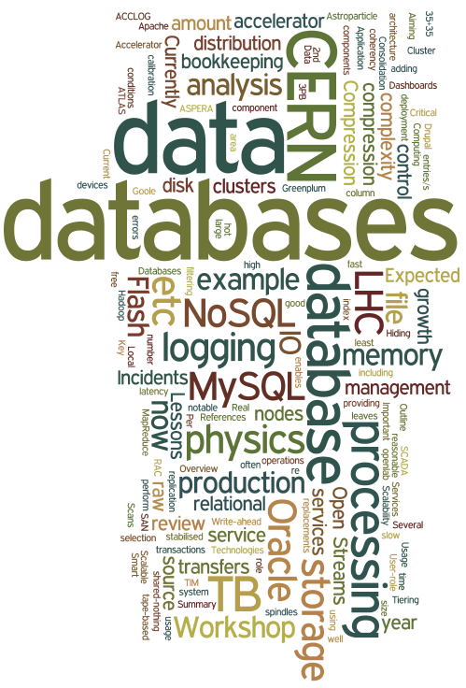
Outline
Experience at CERN
  Current usage and
  deployment
  Replication
  Lessons from last 15 years
Oracle and MySQL
Trends
  Flash
  Compression
  Open source “relational”
  databases
  NoSQL databases
http://www.wordle.net/

Slide 3
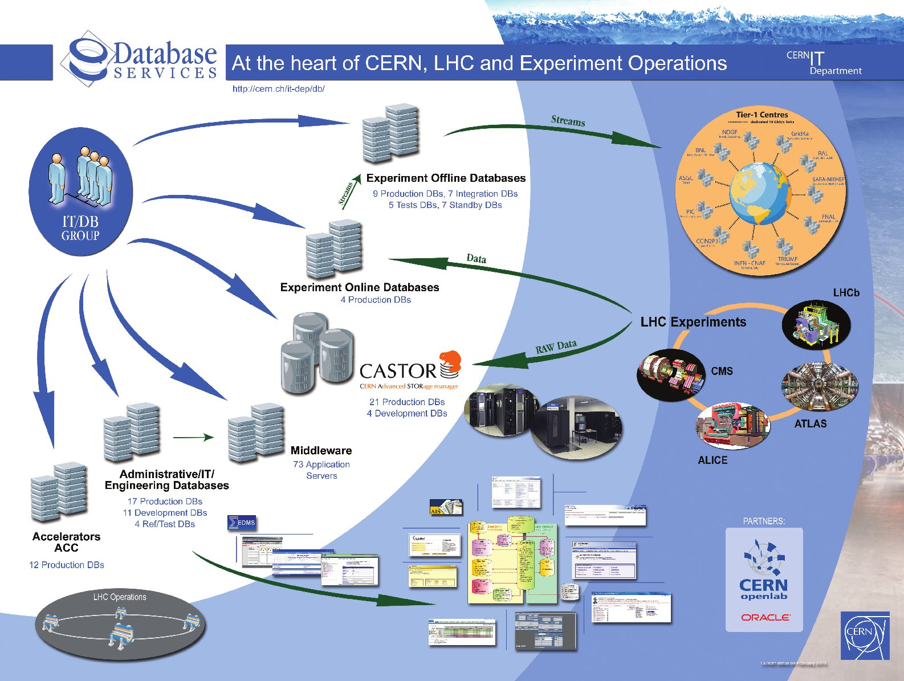
Notes:
Databases at CERN

Slide 4
CERN databases in numbers
original slide by Luca Canali
CERN databases services
  ~130 databases, most of them database clusters
  (Oracle RAC technology RAC, 2 – 6 nodes)
  Currently over 3000 disk spindles providing more than ~3PB raw disk space (NAS and SAN)
  MySQL service
Some notable databases at CERN
  Experiments’ databases – 14 production databases
    Currently between 1 and 12 TB in size
    Expected growth between 1 and 10 TB / year
  LHC accelerator logging database (ACCLOG) – ~120TB, >3.8.10¹² rows, expected growth up to 70TB / year
  ... Several more DBs in the 1-2 TB range

Slide 5
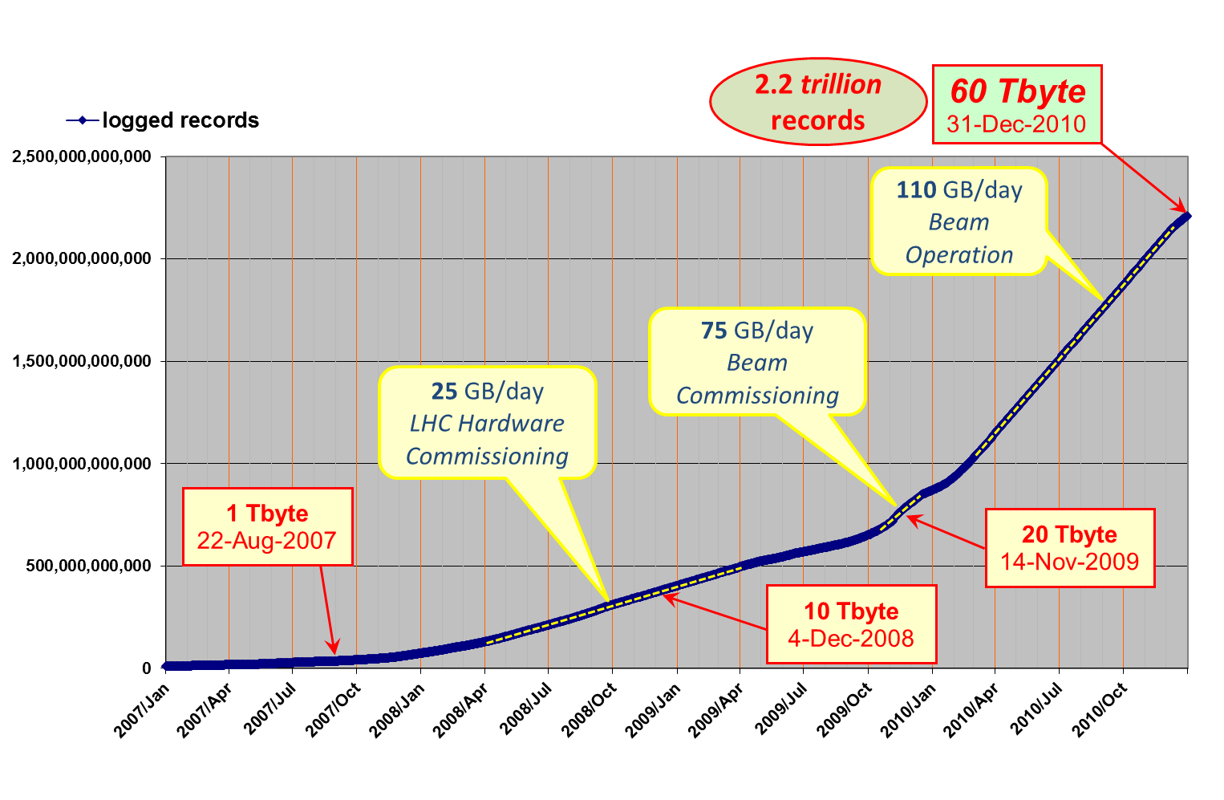
LHC logging service, >2.10¹²
graph by Ronny Billen

Slide 6
Key role for LHC physics data processing
Online acquisition, offline production, data (re)processing, data distribution, analysis
    SCADA, conditions, geometry, alignment, calibration, file bookkeeping, file transfers, etc..
Grid Infrastructure and Operation services
    Monitoring, Dashboards, User-role management, ..
Data Management Services
    File catalogues, file transfers and storage management, …
Metadata and transaction processing for custom tape-based storage system of physics data
Accelerator control and logging systems
AMS as well: data/mc production bookkeeping and slow control data
original slide by Luca Canali

Slide 7
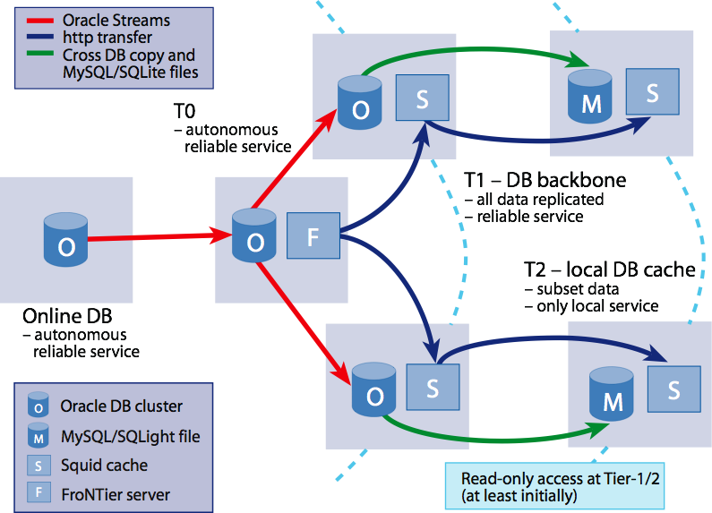
CERN openlab and Oracle Streams
Worldwide distribution of experimental physics data using Oracle Streams
Huge effort, successful outcome
slide by Eva Dafonte Pérez

Slide 8
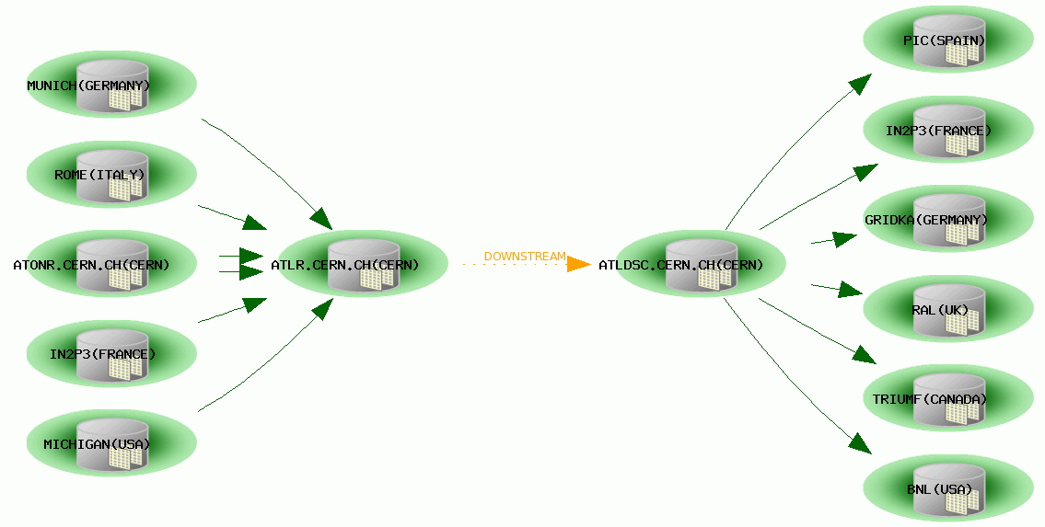
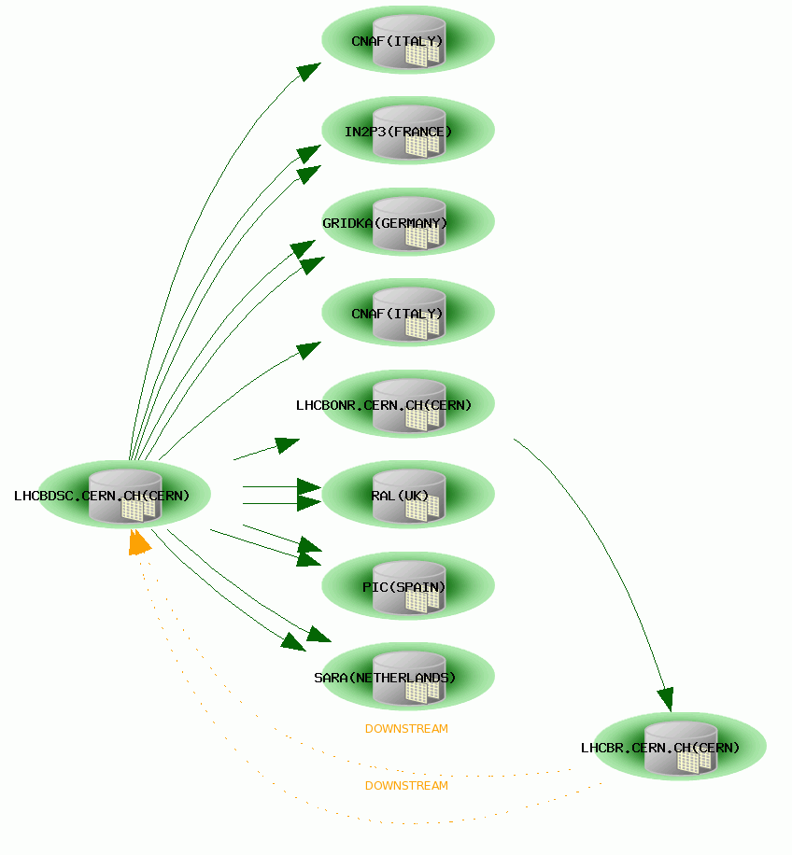



ATLAS
LHCb
CMS
ALICE
COMPASS
slide by Eva Dafonte Pérez

Slide 9
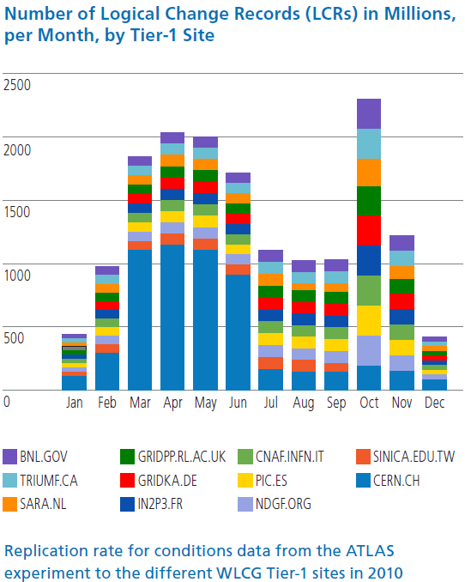

Slide 10
Oracle is fully instrumented
All actions
  Network related
  IO related
  Internals (cluster communication, space management, etc.)
  Application related (transaction locks, etc.)
  etc.
Key for “scientific” performance understanding.

Slide 11
The Tuning Process
1. run the workload, gather ASH/AWR information, 10046…
2. find the top event that slows down
the processing
4. modify client code, database schema, database code, hardware configuration
3. understand why time is spent on this event

Slide 12
Demo 1
DEMO
Single.java
  Tanel Poder’s snapper.sql
  Disable autocommit
  Tanel Poder’s snapper.sql
Batch.java

Slide 13
Program | Time per row | Top wait event | Notable statistics
Single | 0.76 ms / row | log file sync 57.1% | User commits=user calls=1.4k/s
Single autocommit=false | 0.31 ms/row | SQL*Net message from client 69.9% | Requests to/from client = execute count= 3.69k/s
Batch | 0.00116 ms | log file sync 18.4%, SQL*Net message from client 19.0%
* 2.45
* 267

Slide 14
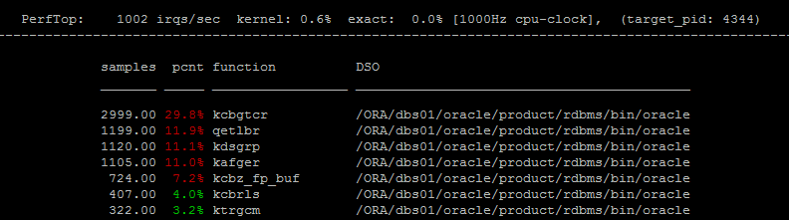
Oracle Linux “perf top”

Slide 15
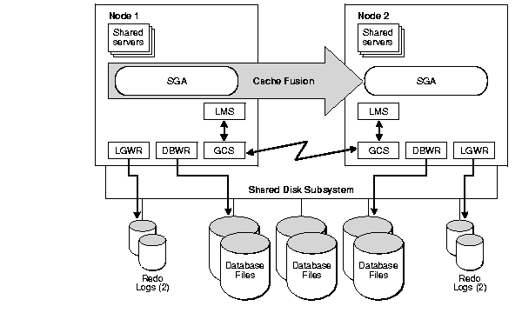
Oracle Real Application Cluster
from Oracle9i Real Application Clusters Deployment and Performance

Slide 16
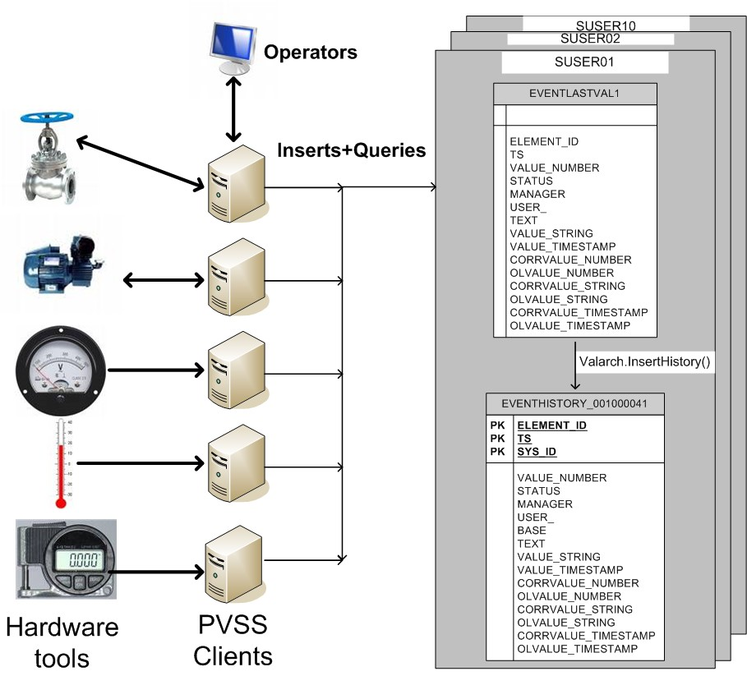
PVSS Oracle scalability
Target = 150 000 changes per second (tested with 160k)
3 000 changes per client
5 nodes RAC 10.2.0.4
2 NAS 3040, each
with one aggregate of
13 disks (10k rpm FC)

Slide 17



PVSS Tuning (1/6)
Table
event
lastval
trigger on
update eventlast
… merge (…)
Update eventlastval set …
Update eventlastval set …
Table
events_
history
150 Clients
DB Servers
Storage
Shared resource:
  EVENTS_HISTORY (ELEMENT_ID, VALUE…)
Each client “measures” input and registers history with a “merge” operation in the EVENTS_HISTORY table
Performance:
100 “changes” per second

Slide 18
PVSS Tuning (2/6)
Initial state observation:
database is waiting on the clients
  “SQL*Net message from client”
Use of a generic library C++/DB
Individual insert (one statement per entry)
Update of a table which keeps “latest state” through a trigger

Slide 19
PVSS Tuning (3/6)
Changes:
bulk insert to a temporary table with OCCI, then call PL/SQL to load data into history table
Performance:
2000 changes per second
Now top event: “db file sequential read”
awrrpt_1_5489_5490.html
Event | Waits | Time(s) | Percent Total DB Time | Wait Class
db file sequential read | 29,242 | 137 | 42.56 | User I/O
enq: TX - contention | 41 | 120 | 37.22 | Other
CPU time |  | 61 | 18.88
log file parallel write | 1,133 | 19 | 5.81 | System I/O
db file parallel write | 3,951 | 12 | 3.73 | System I/O
Notes:
Db file sequential read = DB does the single I/O

Slide 20
PVSS Tuning (4/6)
Changes:
Index usage analysis and reduction
Table structure changes. IOT.
Replacement of merge by insert.
Use of “direct path load” with ETL
Performance:
16 000 “changes” per second
Now top event: cluster related wait event
test5_rac_node1_8709_8710.html
Event | Waits | Time(s) | Avg Wait(ms) | % Total Call Time | Wait Class
gc buffer busy | 27,883 | 728 | 26 | 31.6 | Cluster
CPU time |  | 369 |  | 16.0
gc current block busy | 6,818 | 255 | 37 | 11.1 | Cluster
gc current grant busy | 24,370 | 228 | 9 | 9.9 | Cluster
gc current block 2-way | 118,454 | 198 | 2 | 8.6 | Cluster
Notes:
ETL = Extraction Transforming and Loading
Gc buffer busy = Instance waits to get a block from other isntance cache.

Slide 21
PVSS Tuning (5/6)
Changes:
Each “client” receives a unique number.
Partitioned table.
Use of “direct path load” to the partition with ETL
Performance:
150 000 changes per second
Now top event : “freezes” once upon a while
rate75000_awrrpt_2_872_873.html
Event | Waits | Time(s) | Avg Wait(ms) | % Total Call Time | Wait Class
row cache lock | 813 | 665 | 818 | 27.6 | Concurrency
gc current multi block request | 7,218 | 155 | 22 | 6.4 | Cluster
CPU time |  | 123 |  | 5.1
log file parallel write | 1,542 | 109 | 71 | 4.5 | System I/O
undo segment extension | 785,439 | 88 | 0 | 3.6 | Configuration

Slide 22
PVSS Tuning (6/6)
Problem investigation:
Link between foreground process and ASM processes
Difficult to interpret ASH report, 10046 trace
Problem identification:
ASM space allocation is blocking some operations
Changes:
Space pre-allocation, background task.
Result:
Stable 150 000 “changes” per second.
Notes:
This part was maybe the most difficult,
Due to a lack of instrumentation

Slide 23
PVSS Tuning Schema
Table
event
lastval
trigger on
update eventlast
… merge (…)
Update eventlastval set …
Update eventlastval set …
Table
events_
history
150 Clients
DB Servers
Storage
PL/SQL:
insert /*+ APPEND */
into eventh (…)
partition
PARTITION (1)
select …
from temp
Bulk insert into temp table
Temp
table
Table
events_
history
Bulk insert into temp table

Slide 24
PVSS Tuning Summary
Conclusion:
from 100 changes per second to 150 000 “changes” per second
6 nodes RAC (dual CPU, 4GB RAM), 32 disks SATA with FCP link to host
4 months effort:
  Re-writing of part of the application with changes interface (C++ code)
  Changes of the database code (PL/SQL)
  Schema change
  Numerous work sessions, joint work with other CERN IT groups
Notes:
A difficult but key improvement
Mostly in the application,
We had to add hw (disks, servers) to have the correct setup
Joint work with colleagues from the IT physics database team as well as the controls group

Slide 25
Overload at CPU level (1/)
Observed many times: “the storage is slow” (and storage administrators/specialists say “storage is fine / not loaded”)
Typically happens that observed (from Oracle rdbms point of view) IO wait times are long if CPU load is high
Instrumentation / on-off cpu

Slide 26
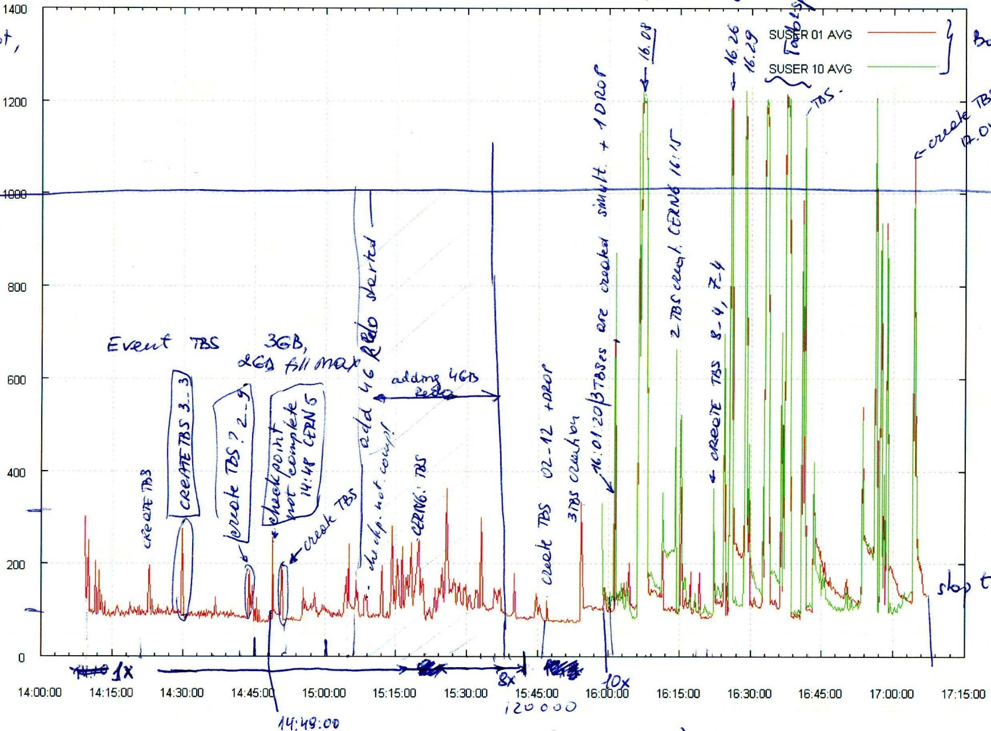
Overload at CPU level (2/) example
load growing
hit load limit !
Insertion time (ms), has to be less than 1000ms
15k... 30k ... 60k... 90k... 120k ...135k... || 150k (insertions per second)

Slide 27
OS level / high-load
t1
t2
t1
t2
t1
t2
Oracle
OS
Acceptable
load
IO
time
t1
t2
t1
t2
Oracle
OS
High load
Off cpu
IO

Slide 28
Overload at CPU level (3/), Dtrace
Dtrace (Solaris) can be used at OS level to get (detailed) information at OS level
syscall::pread:entry
/pid == $target && self->traceme == 0 /
{
self->traceme = 1;
self->on = timestamp;
self->off= timestamp;
self->io_start=timestamp;
}
syscall::pread:entry
/self->traceme == 1 /
{
self->io_start=timestamp;
}
syscall::pread:return
/self->traceme == 1 /
{
@avgs["avg_io"] = avg(timestamp-self->io_start);
@[tid,"time_io"] = quantize(timestamp-self->io_start);
@counts["count_io"] = count();
}

Slide 29
Dtrace
sched:::on-cpu
/pid == $target && self->traceme == 1 /
{
self->on = timestamp;
@[tid,"off-cpu"] = quantize(self->on - self->off);
@totals["total_cpu_off"] = sum(self->on - self->off);
@avgs["avg_cpu_off"] = avg (self->on - self->off);
@counts["count_cpu_on"] = count();
}
sched:::off-cpu
/self->traceme == 1/
{
self->off= timestamp;
@totals["total_cpu_on"] = sum(self->off - self->on);
@avgs["avg_cpu_on"] = avg(self->off - self->on);
@[tid,"on-cpu"] = quantize(self->off - self->on);
@counts["count_cpu_off"] = count();
}
tick-1sec
/i++ >= 5/
{
exit(0);
}

Slide 30
Dtrace, “normal load”
-bash-3.00$ sudo ./cpu.d4 -p 15854
dtrace: script './cpu.d4' matched 7 probes
CPU ID FUNCTION:NAME
3 52078 :tick-1sec
avg_cpu_on 169114
avg_cpu_off 6768876
avg_io 6850397
[...]
1 off-cpu
value ------------- Distribution ------------- count
524288 | 0
1048576 | 2
2097152 |@@@@ 86
4194304 |@@@@@@@@@@@@@@@@@@@@@@@@@@@ 577
8388608 |@@@@@@@@@ 189
16777216 | 2
33554432 | 0
[...]
count_cpu_on 856
count_io 856
count_cpu_off 857
total_cpu_on 144931300
total_cpu_off 5794158700

Slide 31
Dtrace, “high load”
-bash-3.00$ sudo ./cpu.d4 -p 15854
dtrace: script './cpu.d4' matched 7 probes
CPU ID FUNCTION:NAME
2 52078 :tick-1sec
avg_cpu_on 210391
avg_cpu_off 10409057
avg_io 10889597
[...]
1 off-cpu
value ------------- Distribution ------------- count
8192 | 0
16384 | 4
32768 |@ 11
65536 | 2
131072 | 0
262144 | 0
524288 | 0
1048576 | 0
2097152 |@ 15
4194304 |@@@@@@@@@@@@@@ 177
8388608 |@@@@@@@@@@@@@@@@@@@@ 249
16777216 |@@@ 41
33554432 | 4
67108864 | 0
[...]
count_io 486
count_cpu_on 503
count_cpu_off 504
total_cpu_on 106037500
total_cpu_off 5235756100

Slide 32
Lessons learnt
Aiming for high-availability is (often) adding complexity… and complexity is the enemy of availability
Scalability can be achieved with Oracle Real Application Cluster (150k entries/s for PVSS)
Database / application instrumentation is key for understanding/improving performance
NFS/D-NFS/pNFS are solutions to be considered for stability and scalability (very positive experience with NetApp, snapshots, scrubbing, etc.)
Database independence is very complex if performance is required
Hiding IO errors from the database leaves the database handle what it is best at (transactions, query optimisation, coherency, etc.)

Slide 33
Storage operations
Demo2

Slide 34
Evolution
Flash
Large memory systems
Compression
Open source “relational” databases
NoSQL databases

Slide 35
Flash, memory and compression
Flash changes the picture in the database area IO
  Sizing for IO Operations Per Second
  Usage of fast disks for high number of IOPS and latency
Large amount of memory
  Enables consolidation and virtualisation (less nodes)
  Some databases fully in memory
Compression is gaining momentum for databases
  For example Oracle’s hybrid columnar compression
  Tiering of storage

Slide 36
Exadata Hybrid Columnar Compression on Oracle 11gR2
Compression factor
slide by Svetozar Kapusta
Notes:
Compass PVSS columns: 6 number, 4 TS(9) , 5 varchar2 , 3 binary_double
LCG SERVICESTATUS columns: 5 number
LCG TESTDATA 2007 columns: 6 number(38), 1 varchar2, 1 CLOB
ATLAS PANDA FILESTABLE columns: 3 number, 12 varchar2, 2 date, 2 char
LCG MESSAGES columns: 5 number, 7 varchar2, 1 TS

Slide 37
Local analysis of data
“Big Data”, analysis of large amount of data in reasonable of time
Goole MapReduce, Apache Hadoop implementation
Oracle Exadata
  Storage cells perform some of the operations locally (Smart Scans, storage index, column filtering, etc.)
Greenplum
  shared-nothing massively parallel processing architecture for Business Intelligence and analytical processing
Important direction for at least the first level of selection

Slide 38
Physics Analysis in SQL
Done using SQL-query making temporary tables for different selections and joining data from different tables via “EventNumber”
with selectedmuon as (select "muon_i","EventNumber","RunNumber","E","px","py","pz" from "muon" where MLIMPER.PHYSANALYSIS.IS_MUON("muon_i", "pt", "eta", "phi", "E", "me_qoverp_exPV", "id_qoverp_exPV","me_theta_exPV", "id_theta_exPV", "id_theta","isCombinedMuon", "isLowPtReconstructedMuon","tight","expectBLayerHit", "nBLHits", "nPixHits","nPixelDeadSensors", "nPixHoles", "nSCTHits","nSCTDeadSensors", "nSCTHoles","nTRTHits", "nTRTOutliers",0,20000.,2.4) = 1 ),
with selectedmuon as (select "muon_i","EventNumber","RunNumber","E","px","py","pz" from "muon" where MLIMPER.PHYSANALYSIS.IS_MUON("muon_i", "pt", "eta", "phi", "E", "me_qoverp_exPV", "id_qoverp_exPV","me_theta_exPV", "id_theta_exPV", "id_theta","isCombinedMuon", "isLowPtReconstructedMuon","tight","expectBLayerHit", "nBLHits", "nPixHits","nPixelDeadSensors", "nPixHoles", "nSCTHits","nSCTDeadSensors", "nSCTHoles","nTRTHits", "nTRTOutliers",0,20000.,2.4) = 1 ),
selectedeventsmuon as (select "EventNumber", COUNT(*) as "mu_sel_n" from selectedmuon group by "EventNumber" HAVING COUNT(*)=2),
selectedeventsmuon as (select "EventNumber", COUNT(*) as "mu_sel_n" from selectedmuon group by "EventNumber" HAVING COUNT(*)=2),
selectedbjet as (select "jet_i","EventNumber","RunNumber","E","pt","phi","eta" from "jet" INNER JOIN selectedeventsmuon USING("EventNumber") where "pt"/1000>25 and abs("eta")<2.5 and "fl_w_Comb">1.55 ),
selectedbjet as (select "jet_i","EventNumber","RunNumber","E","pt","phi","eta" from "jet" INNER JOIN selectedeventsmuon USING("EventNumber") where "pt"/1000>25 and abs("eta")<2.5 and "fl_w_Comb">1.55 ),
selectedevents as (select "EventNumber", COUNT(*) as "jet_sel_n" from selectedbjet group by "EventNumber" HAVING COUNT(*)=2)
selectedevents as (select "EventNumber", COUNT(*) as "jet_sel_n" from selectedbjet group by "EventNumber" HAVING COUNT(*)=2)
select MLIMPER.PHYSANALYSIS.INV_MASS_LEPTONS(mu1."E",mu2."E",mu1."px",mu2."px",mu1."py", mu2."py",mu1."pz",mu2."pz")/1000. as "DiMuonMass", MLIMPER.PHYSANALYSIS.INV_MASS_JETS(jet1."E",jet2."E",jet1."pt",jet2."pt",jet1."phi",jet2."phi",jet1."eta",jet2."eta")/1000. as "DiJetMass" from selectedmuon mu1, selectedmuon mu2, selectedbjet jet1, selectedbjet jet2, selectedevents evSel
where mu1."muon_i"<mu2."muon_i" and mu1."EventNumber"=evSel."EventNumber" and mu2."EventNumber"=evSel."EventNumber" and jet1."jet_i"<jet2."jet_i" and jet1."EventNumber"=evSel."EventNumber" and jet2."EventNumber"=evSel."EventNumber" and jet1."pt"/1000.>45.
select MLIMPER.PHYSANALYSIS.INV_MASS_LEPTONS(mu1."E",mu2."E",mu1."px",mu2."px",mu1."py", mu2."py",mu1."pz",mu2."pz")/1000. as "DiMuonMass", MLIMPER.PHYSANALYSIS.INV_MASS_JETS(jet1."E",jet2."E",jet1."pt",jet2."pt",jet1."phi",jet2."phi",jet1."eta",jet2."eta")/1000. as "DiJetMass" from selectedmuon mu1, selectedmuon mu2, selectedbjet jet1, selectedbjet jet2, selectedevents evSel
where mu1."muon_i"<mu2."muon_i" and mu1."EventNumber"=evSel."EventNumber" and mu2."EventNumber"=evSel."EventNumber" and jet1."jet_i"<jet2."jet_i" and jet1."EventNumber"=evSel."EventNumber" and jet2."EventNumber"=evSel."EventNumber" and jet1."pt"/1000.>45.
Notes:
38

Slide 39
Physics Analysis in DB
First implementation of Physics Analysis in Oracle DB
Data in multiple tables
SQL-query can reproduce selection in loop over events
Analysis from DB slower than original ntuple-analysis and many complexities still not implemented…
Possible space-gain for DB version of analysis data:
Each physics group optimized their own ntuple-size based on physics and level of detail required for their analysis, but sum of different ntuple contains duplicate info
Physics Analysis DB would contains all physics objects, divided over multiple tables, each physics group can choose which tables to use
analysis objects
(extracted per physics topic)
event
summary
data
ntuple1
ntuple2
ntupleN
Notes:
39

Slide 40
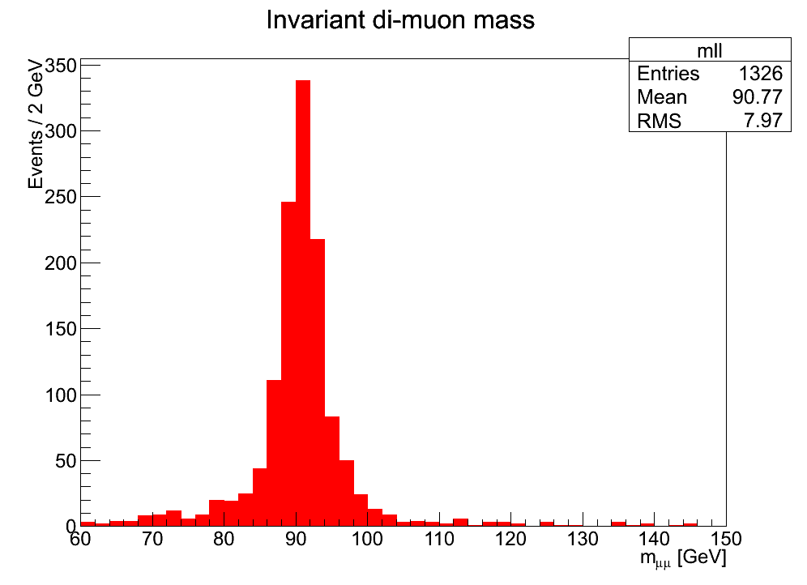
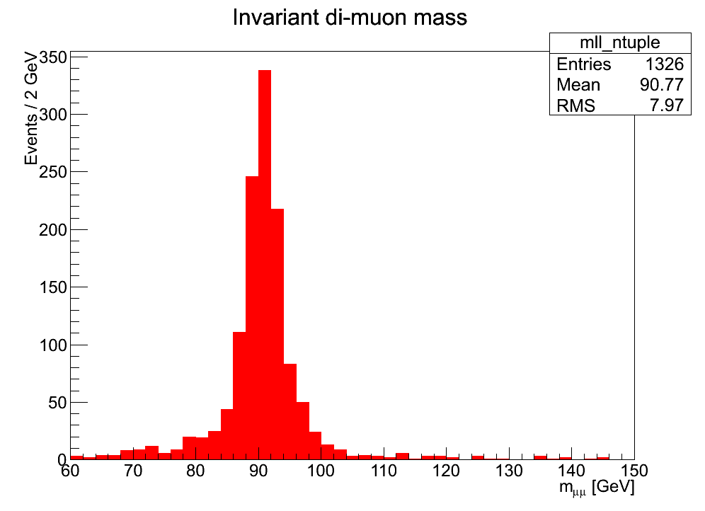
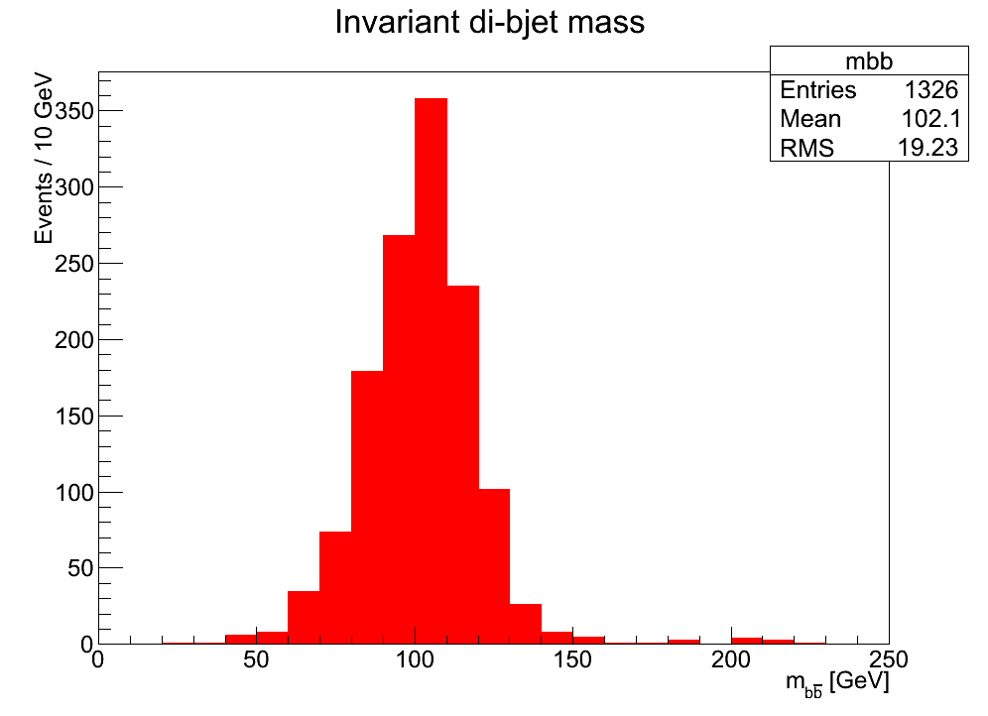

Physics Analysis benchmark
Output of SQL-query send to ROOT to produce standard root-histograms:
ROOT-macro using original ntuples as input produces identical histograms:
Notes:
40

Slide 41
Summary
Oracle
  Critical component for LHC accelerator and physics data processing
  Scalable and stable, including data replication
CERN central services run on Oracle, for which we have components and experience to build high availability, guaranteed data, scalability
MySQL as a “DataBase On Demand” service
  Nice features and light, lacks some scalability and High-Availability features for some service requirements
NoSQL is being considered
  Ecosystem is evolving rapidly (architecture, designs and interfaces subject to change!)

Slide 42
References
NoSQL ecosystem, http://www.aosabook.org/en/nosql.html
Database workshop at CERN https://indico.cern.ch/conferenceDisplay.py?confId=130874 and ATLAS Computing Technical Interchange Meeting https://indico.cern.ch/event/132486
Eva Dafonte Pérez, UKOUG 2009 “Worldwide distribution of experimental physics data using Oracle Streams”
Luca Canali, CERN IT-DB Deployment, Status, Outlook http://canali.web.cern.ch/canali/docs/CERN_IT-DB_deployment_GAIA_Workshop_March2011.pptx
CERN openlab, http://cern.ch/openlab/
CAP theorem, http://portal.acm.org/citation.cfm?id=564601
ACID, http://portal.acm.org/citation.cfm?id=291

Slide 43
Backup slides

Slide 44
Oracle
EU director for research, Monica Marinucci
Strong collaboration with CERN and universities
Well known solution, easy to find database administrators and developers, training available
Support and licensing

