Slide 1
WP7 HFM task 1
Gijs de Rijk & Francois Kircher
18th September 2012
LASA
Milano

Slide 2
Task 1 Activities in the last 6 months
Regular (2-3 weeks) phone meetings
Preparation of this collaboration meeting
Second period report to EC in May 2012
Budget reshuffling discussions

Slide 3
Task 1 Activities for the near future
Organize 3rd task 3 ( combined with task 4) review begin of 2013
Organize 11th (and last official) collaboration meeting in March 2013at CERN
Assist tasks in the redefinition of Deliverables where needed (they still need to be formalized)

Slide 4
Budget reshuffle (1)
Following the discussions during the first half of the year on budget spending we propose the following reshuffle:
Task 2
  CERN has still to use (until 31.03.2012) 50 k€ from the EC contribution. As PWR is doing the irradiations and not CERN they should be transfereed from CERN to PWR.
Task 4
  KIT has spent so far (until 31.03.2012) 158 k€ out of 350 k€ total budget. They have requested so far an EC contribution of 54 k€ out of 121 k€ (max.). Therefore, they have “at disposal” some 67 k€ of EC contribution which – if they agree – should be transferred to CEA. (or 57 k€ to CEA and 10 k€ to CNRS-INPG)
  TUT has spent so far (until 31.03.2012) 60 k€ out of 90 k€ total budget. They have requested so far an EC contribution of 22.8 k€ out of 26.7 k€ (max.). Therefore, they have “at disposal” some 3.9 k€ of EC contribution which – if they agree – should be transferred to CNRS-INPG.

Slide 5
Budget reshuffle (2)
Actions to get this implemented:
KIT and TUT should let us and Svet Stavrev know if they agree to transfer these “remaining” EC contributions to CEA and INPG, respectively. This approval we need to have before 15 October
Svet will prepare the documents for the governing board in December

Slide 6
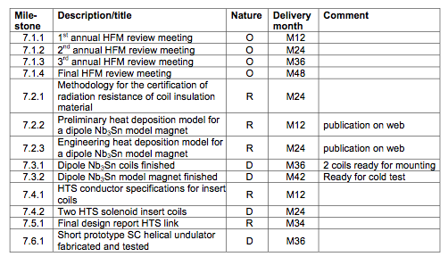
Milestones
done
done
done
done
done
done
obsolete
obsolete
done
done
done
6

Slide 7
Deliverables
done
done

