Slide 1
WP 7.4 : Insert design and construction
M. Devaux
J-M Rey, M. Durante, P. Tixador, C. Pes

Slide 2
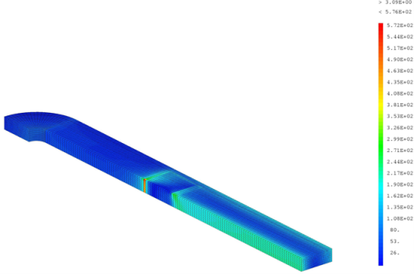
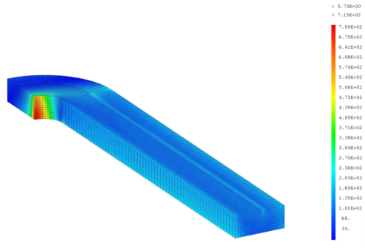
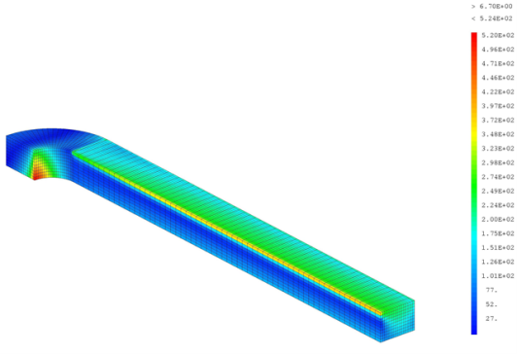
SUMMARY
Modifications in the design
  Target: decrease the stress on the conductors, especially in the heads
  Results of the last HFM collaboration meeting - Warsaw
Construction
572
300
0
700
400
300
0
520
300
0

Slide 3
DESIGN MODIFICATIONS

Slide 4
MODIFICATION OF COILS LENGTH
New length for coils 2 and 3 :
  Coil 3 is now longer than coil 2 in order to keep the possibility to have flared coil 1 heads to clear the aperture
  Maximal length of coil 3 = 290 mm (dimension of the prototype which will be built and tested soon)
  Inclination angle of coils 1 heads will be at least 45 °: it imposes the length of coils 2, at least 2 x height of conductor (12 mm) less than coils 3. It has been chosen to have a length of coils 2 of 260 mm
  Coils 1 stay at 700 mm
Inter coil distance = 0,5 mm
12 mm
Coil 3 (290 mm)
12 mm
Coil 2 (260 mm)
45°
12 mm
Coil 1(700 mm)

Slide 5
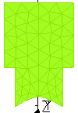
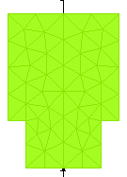
MODIFICATION OF IRON POLE GEOMTRY
Suppression of circle arc :
Easier manufacturing

Slide 6
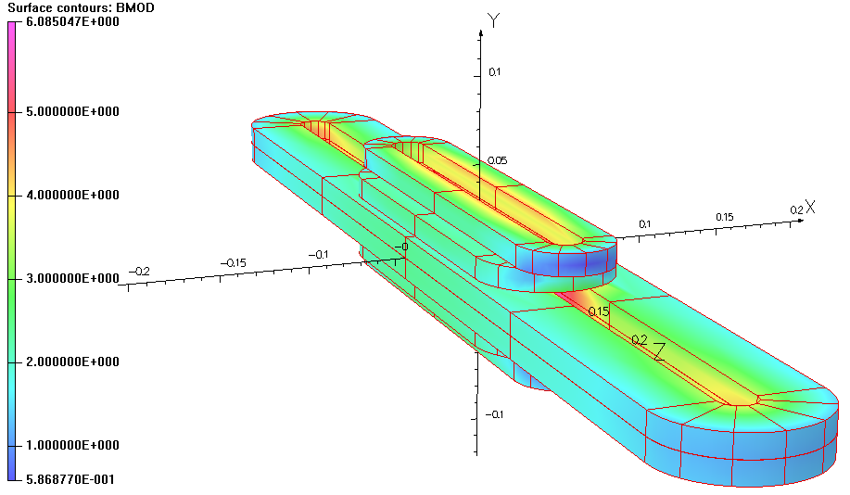
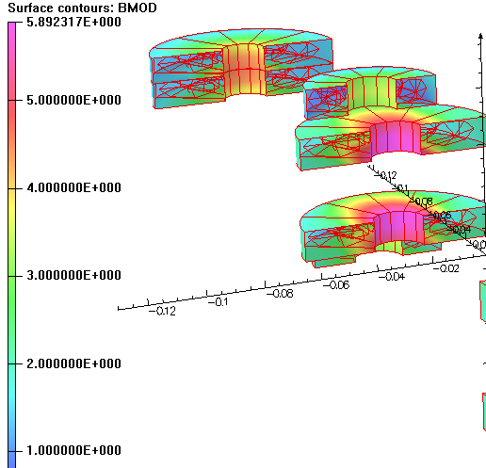
MAGNETIC DESIGN
Iron post with a length equals to the straight section of coils 2
Je= 250 A/mm²
Fields in the heads of coils 2 et 3
B0 | Bmax | Bhead max
6,11 | 6,08 | 5,89 (2nd coils)

Slide 7
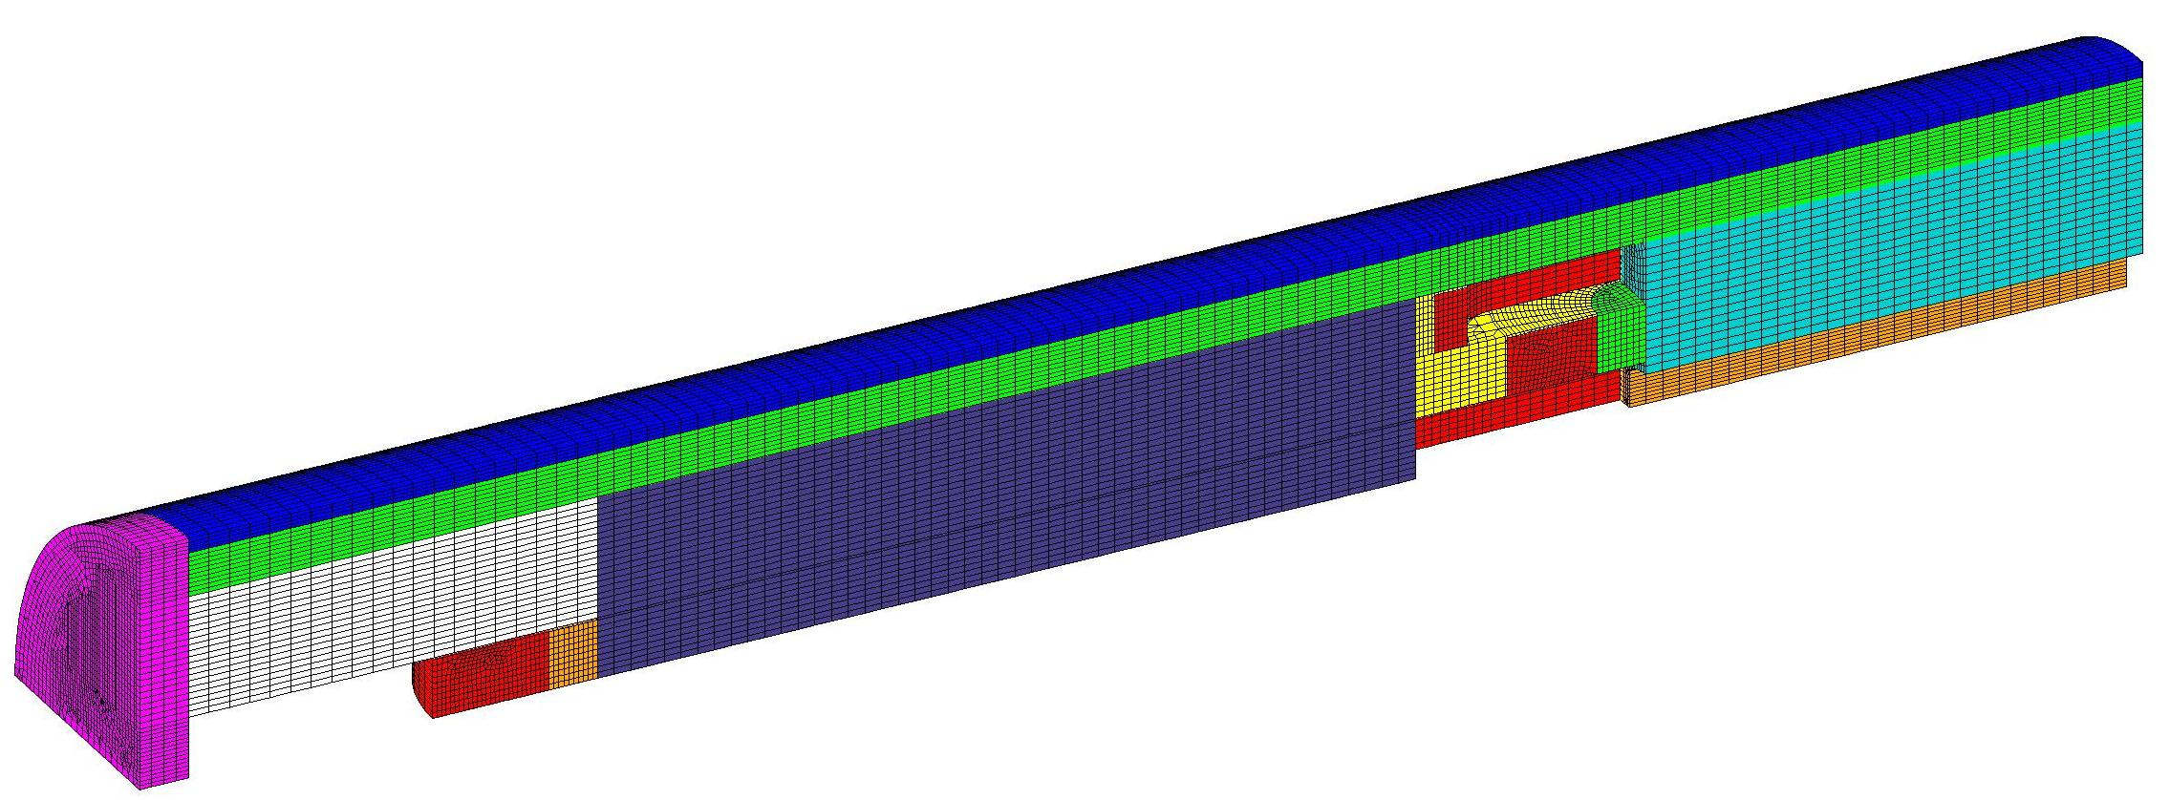
STRUCTURE (C. Pes)
Steel piece
Compression plate
Iron pole
Calculations of the stresses in progress :
Some artefact calculations in the coils to be corrected
Will confirm that stresses on the conductor < 400 MPa
Solution to decrease the stresses on the conductor have been studied:
  Adding a wedge on the coils
  Lenght of the iron pole

Slide 8
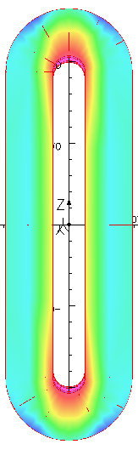
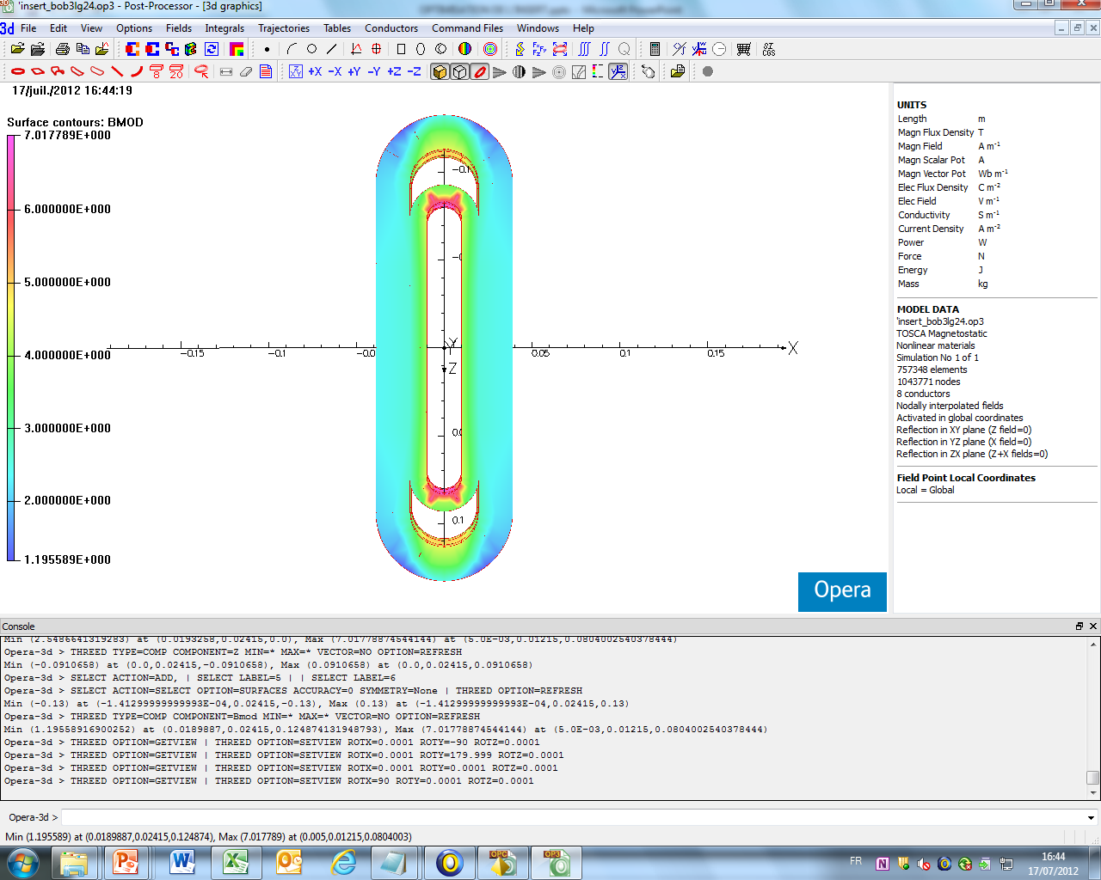
ADDING A WEDGE IN THE MIDDLE OF THE HEADS
Heads of the second coils are clearly the most exposed to the field
A solution to reduce the fields at this place can be adding a wedge in the heads of the second coils. Other coils does not change.
The length of the second coils is always the same: 260 mm
je= 250 A/mm² without iron post to begin
3 studies:
No wedge in the heads of second coil
A wedge after one third of the winding of the second coil
A wedge at the mid-winding of the second coil
260 mm
2nd coil

Slide 9
WEDGE IN THE HEADS OF THE SECOND COIL (no iron pole)
Characteristics wedge | B0 (T) | Bmax (T) | Btete 2nd coil (T)
No wedge | 5,55 | 6,08 | 6,08
Wedge after one third of winding Size : 10 mm | 5,56 | 5,88 | 5,88
Wedge after the half of winding Size: 10 mm | 5,56 | 5,96 | 5,96
Wedge after one third of winding Size: 15 mm | 5,56 | 5,82 | 5,82
Wedge after one third of winding Size: 20 mm | 5,56 | 5,79 | 5,79
The benefit of adding a wedge in the head is to decrease the maximal field of the head
Maximal effect at one third of the winding
The bigger the size of the wedge, the better its effect on the peak field
We impose a wedge of 15 mm

Slide 10
LENGTH OF THE IRON POLE
Hyp: We keep a wedge of 15 mm after one third of winding in the second coil and we play we the length of the iron pole.
Lpole (mm) | B0 (T) | Bmax (T) | B max head 2nd coil (T)
No pole (previous study) | 5,56 | 5,82 | 5,82
Iron pole all along the straight section of the second coil (153 mm) | 6,12 | 5,9 | 5,66
120 mm | 6,14 | 5,92 | 5,71
80 mm | 6,17 | 5,95 | 5,75
Benefit of the iron pole on B0 (10%)
The effect of the pole is greater compared to the field return of the heads: the peak field is not on the heads
When the length of the pole decreases:
The field return of the heads is greater and the field in the heads increases
B0 increases: the fields lines concentrate towards the center
The solution to decrease the length of the pole to decrease the field in the heads is not efficient

Slide 11
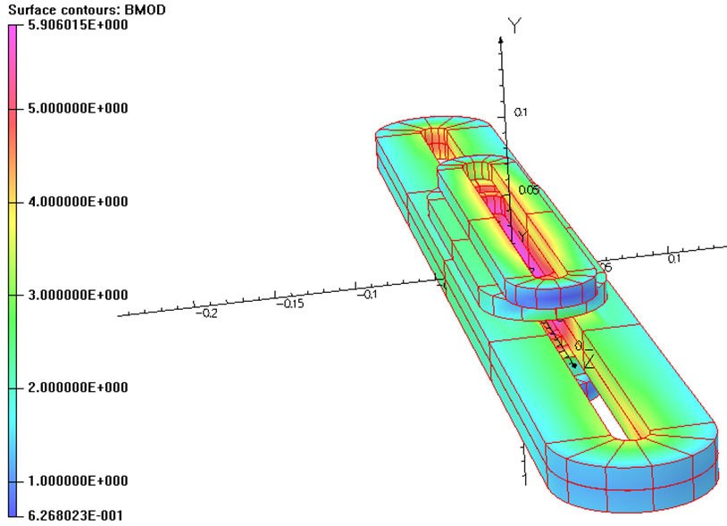
VALUES : IRON POLE + WEDGE
 | je | Bmax | B0 | Bmax heads (2nd coil) | B_{┴ straight section} | B_{┴ heads}
Iron pole alone | 250A/mm² I= 2800 A | 6,08 T | 6,11 T | 5,89 T | 2,7 T | 1,47 T
Iron pole+ wedge | 250A/mm² I= 2800 A | 5,9 T | 6,12 T | 5,66 T | 2,33 T | 2 T
The wedge can be a solution to decrease the field in the heads, and the stress if mechanical solutions are not found.

Slide 12
CONSTRUCTION

Slide 13
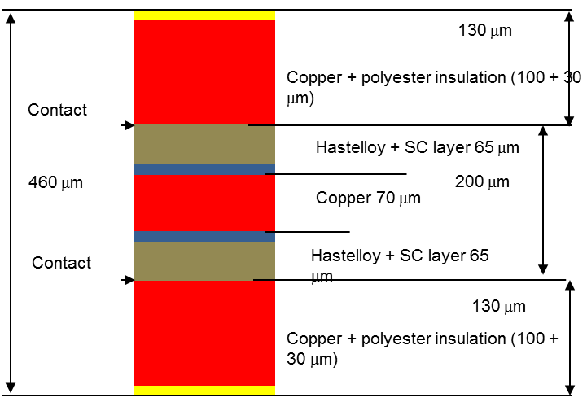
ASSEMBLY : WINDING (1/2)
  The conductor will be in 3 parts:
  - 1 Cu (+CuBe?) insulated ribbon
  - 1 SC + Cu + SC ribbon
  - 1 Cu (+CuBe?) insulated ribbon
Winding in pairs → 6 ribbons to wind → cable unreelers to study
Contact between the ribbons (magnetic efforts are sufficient to maintain themselves)

Slide 14
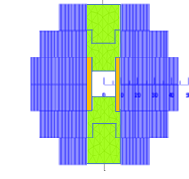
ASSEMBLY : WINDING (2/2)
  Coils 1 winded together around the compression plates
  Other coils are winded separately around the iron pole and piled on the first coils
  0,5 mm of G 10 between each coils and around the finished coils
  Winding in pairs with 2 junctions on the coils:
Starting of the first conductor for half a turn alone
Starting of cowinding in pairs with the second conductor

Slide 15
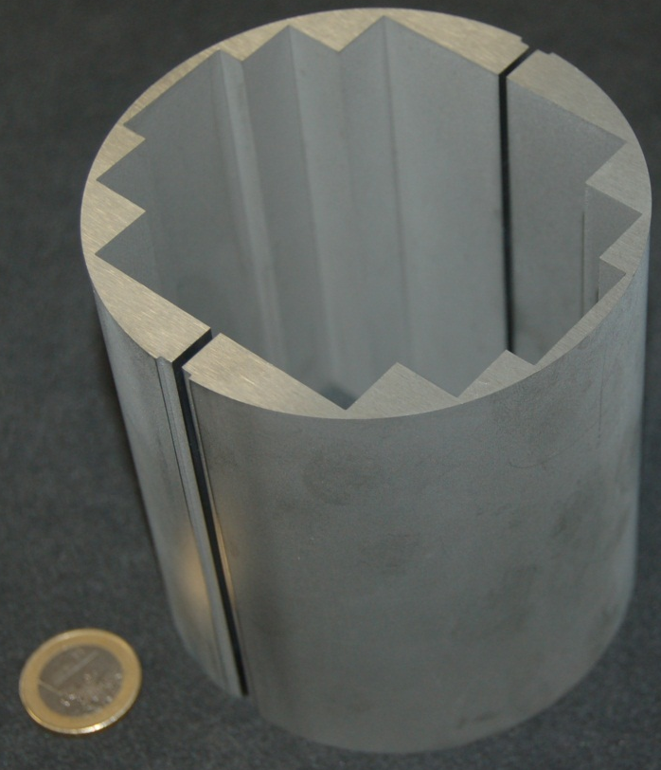
ASSEMBLING THE PADS
Pads of 100 mm are fit in staggered rows of 50 mm all along the coils (or steel pieces when there is no more coils)
Then they are electron beam welded longitudinaly
Pads will be cut by electro erosion at
LNCMI- Grenoble :
  First successful test of a size of
  100 mm this summer
  Test for the electron beam
  welding at Cern in the
  following weeks

Slide 16
ASSEMBLING THE EXTERNALTUBE
The external tube is divided in parts of 100 mm to be thermally shrinked over the pads.
Tubes are heated over 500 K and then slided vertically (and quickly) over the pads

Slide 17
INSTRUMENTATION
No instrumentation inside the magnet*, only in the exit of conductors
*Only 1 or 2 hall sensors in the central gap: the connexion will be maintained all along the internal compression plates
Exit on the same side of the conductors (same side of the conductors of Fresca 2)

Slide 18
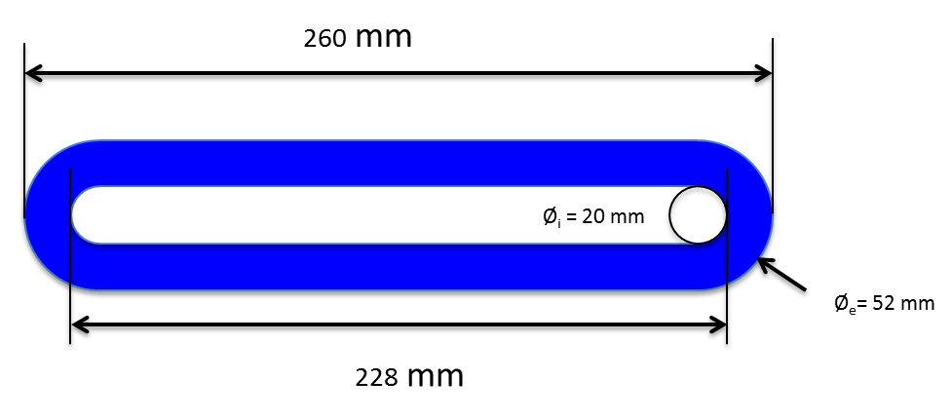
PROTOTYPE
Critical current measurements on a pancake winding as a function of field orientation to estimate the perpendicular field contribution
Will be winded at Saclay and tested at Grenoble in a cryostat of ᶲ = 300 mm
35 spires as the third coil of the insert (or less depending on force calculations)
Reduce the straight section of all the coils of the insert of 30 mm to have a prototype exactly the same as the third coil?
Can be used to assess the benefit of co-winding process on protection scheme

Slide 19
CONCLUSION
Several options have been studied to decrease the stresses on the conductors
Need to complete mechanical structure, however in good way
Protection will be presented tomorrow
Study of the assembly in progress
Fabrication of the prototype in progress

Slide 20
Thank you for your attention

