Slide 1
HFM Conductor Status
C. Berriaud, L Oberli
and Co

Slide 2
Outline
Status of the strand order
Main Characteristics of the FRESCA II strand
Performances of the RRP strand

Slide 3
Status of the Fresca II strand orders (∅=1mm)
Order | Call | Length [km] | To | Delivery
CERN | R&D | 13 | Bruker (PIT) | March 2011
CERN | Qualification | 15 | Bruker (PIT) | Jun 2011
‘’ | ‘’ | 10 | OST (RRP) | May 2012
CEA | Pilot | 15 | Bruker (PIT) | March 2012
‘’ | ‘’ | 15 +10 (optional) | OST (RRP) | September December 2012
CEA | Production | 20 +20 (optional) | OST (RRP) | September December 2013
CERN | ‘’ | 45 | Bruker | ~ July 2013
Total = |  | 148 km | 88 km PIT | + 75 km RRP

Slide 4
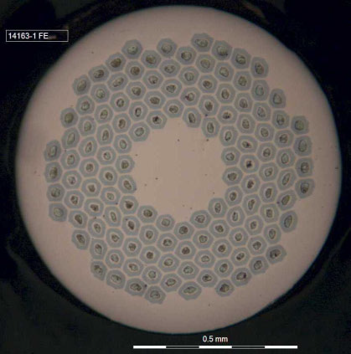
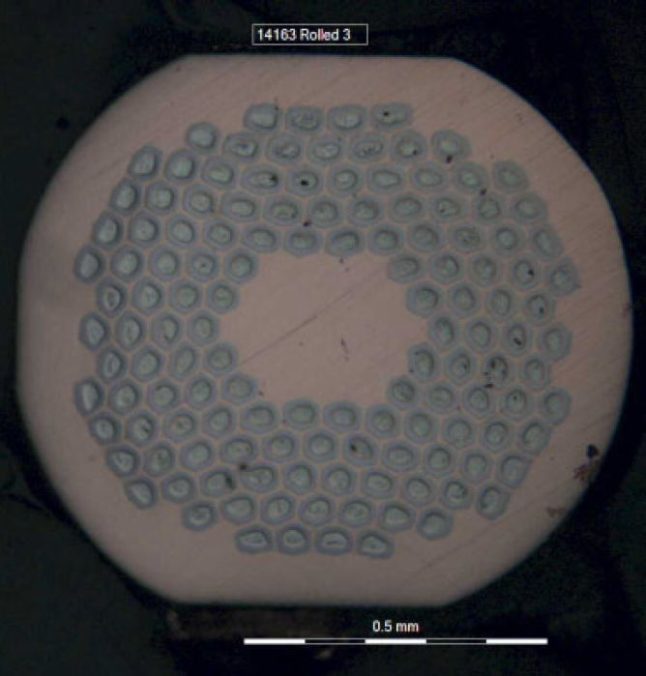
OST strands (RRP)
Reacted strand
Unreacted rolled strand

Slide 5
Main strand production parameters
 |  | FRESCA2 specification | PIT | RRP
Strand diameter | (mm) | 1.00 | 1.00 | 1.00
Strand layout | - |  | 192 filaments | 132/169 stack
Sub-element diameter | (μm) | < 50 | ~ 48 | ~ 52
Copper to non-Copper volume ratio | - | 1.25 +/- 0.1 | 1.25 +/- 0.1 | 1.30 +/- 0.1
J_{C}(12 T, 4.2 K) | (A/mm²) | 2500 | 2450 | 3050
J_{C}(15 T, 4.2 K) | (A/mm²) | 1250 | 1350 | 1525
n-value @15 T & 4.2 K | - | > 30 | 41 | 46
RRR (Pilot) | - | > 150 | 198 (av.) 168 (min.) | 244 ( av.) 193 (min.)
Piece length (Pilot) | (m) | > 400 m | 2 100 (av.) 404 (min.) | 1 000 (av.) 502 (min.)

Slide 6
Lengths of delivery units
OST billet efficiency
n° billet | Efficiency | Min. lg
14153 | 95% | >150m
14108 | 100% | >150m
14310 | 52% | >400m
14311 | 68% | >400m
14312 | 75% | >400m
14393 | 23% | Partial delivery

Slide 7
RRR evolution
The main change between both productions is the last step of the Heat Treatment:
48h/210°C + 48h/400°C + 50h/X°C
with X =
Minimal specified RRR
Order | X
Qualif. | 665°C
Pilot | 650°C

Slide 8
OST critical current results

Slide 9
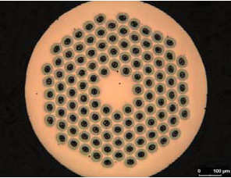
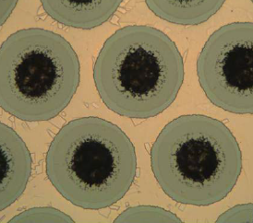
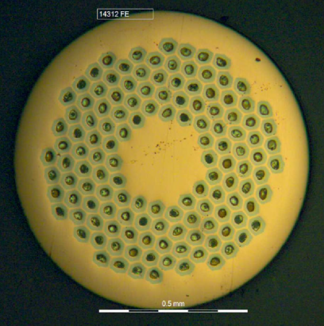
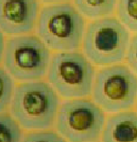
PIT and RRP Magnetization Cycles
PIT 192 ref.: 10S00904
RRR = 235
J_{c@12T} = 2500 A/mm²
∅_{f} = 48 µm
Cu/nonCU= 1,25
RRP 132/169 ref.: 14393
RRR = 212
J_{c@12T} = 3055 A/mm²
∅_{f} = 52 µm
Cu/nonCu= 1,30

Slide 10
Ic measurement comparison between OST & CERN
Precision < 2%
Adjacent ~ 2%
The average critical current variation between qualification and pilot productions are :
- 1% CERN,
- 4% OST.

Slide 11
Conclusions
OST, as Bruker, has succeed to produce good HFM strands. OST has still to improve its industrial process to reduced the wire breakage during the production, as long lengths are required in the production contract (70% more than 1600 m).
OST had invested $10M in a new building to allow the manufacture of Nb₃Sn billet of 60 kg (instead of 35 kg) and processing material in full length. But it should not ready (midi 2013) for Fresca II order but further HEP need.
Strand production is nearly in its industrial phase and should be not more a problem.
But Bruker price was 2.4 time more expensive for the CEA wire production tender…
Cabling degradation get better and better: 4% RRP and 5% PIT…

Slide 12
Thanks for the attention

