Slide 1
EuCard-WP7-HFM
10th Collaboration Meeting
Fresca2 Dipole construction status, assembly and tooling
J.C Perez
on behalf of Fresca2 collaboration team

Slide 2
Outline
Fresca 2 components delivery status
Assembly procedure and tooling
Traces fabrication
Heat treatment furnace
Vacuum Impregnation system
Next steps
Conclusion

Slide 3
Components delivery status
Price inquiry for the structure launched in September 2011
The order placed in November 2011 has been split between 3 European companies
  Cold-mass to Aratz (Spain)
  Coil-pack (& dummy coil) to Boessenkool (Netherland)
  Axial compression system to Mectalent (Finland)
All components have been delivered and accepted

Slide 4
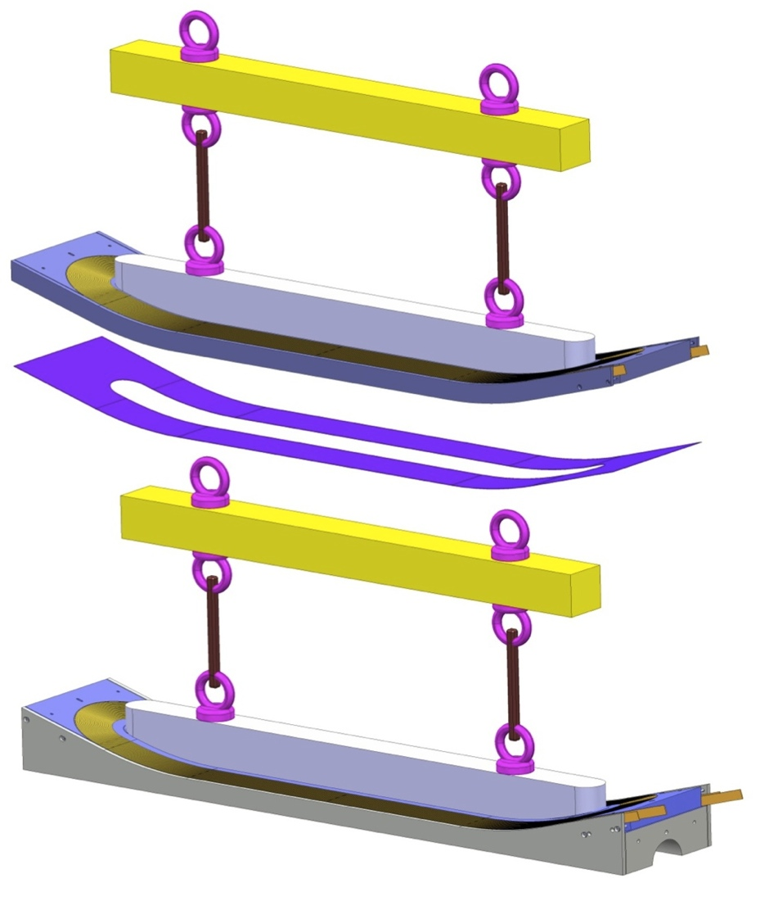
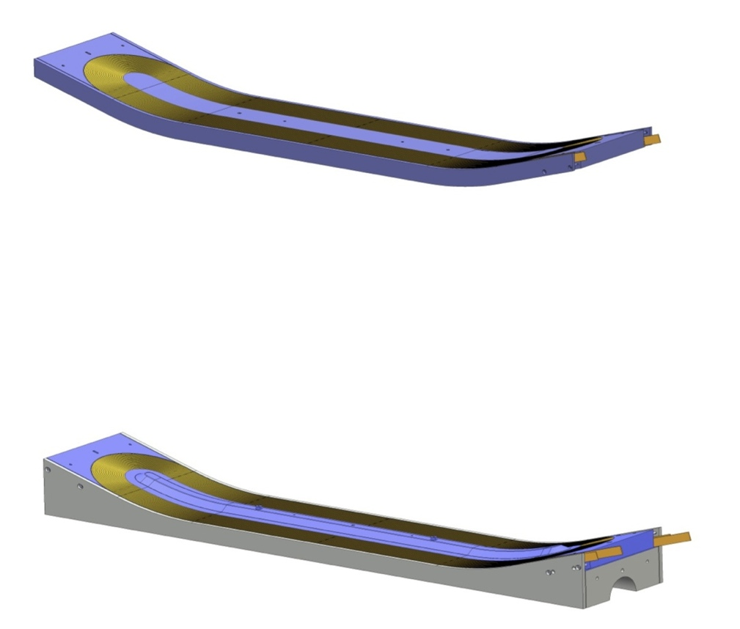
Assembly procedure
Coil layer 3-4
Fiber glass cloth filler
Coil layer 1-2

Slide 5
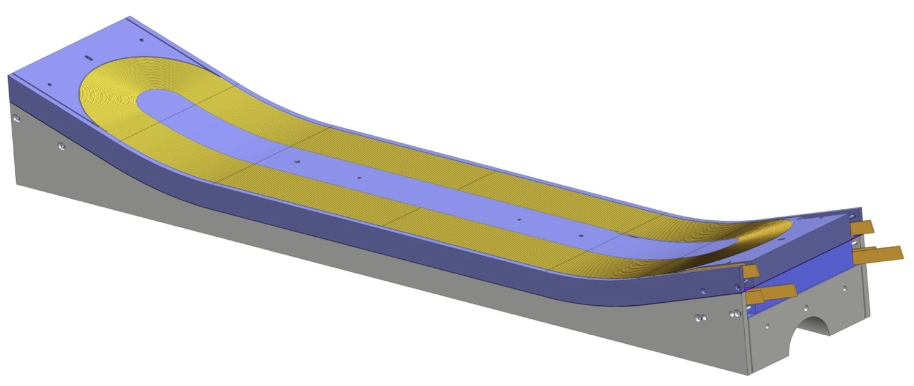
Gap impregnation
2 facing surfaces of the coils will be mold released
Gap between coils will be filled with 0.9 mm fiber glass cloth
Impregnation of the fiber glass using the coils as cavity
This will guarantee a perfect contact between the 2 coils
This technique will allow to separate the coils in case of failure of one coil
Tests performed at CERN polymer laboratory confirm the feasibility

Slide 6
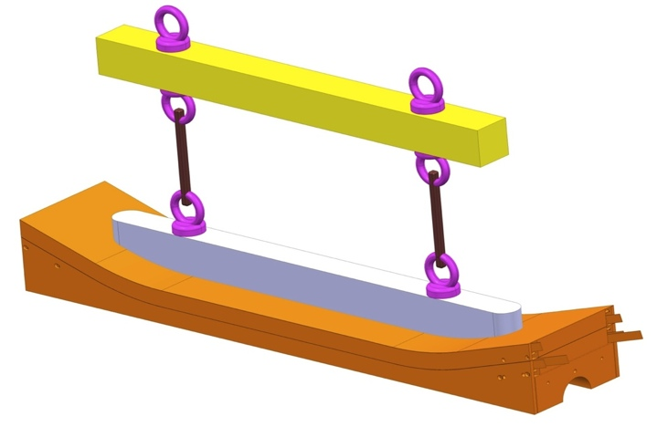
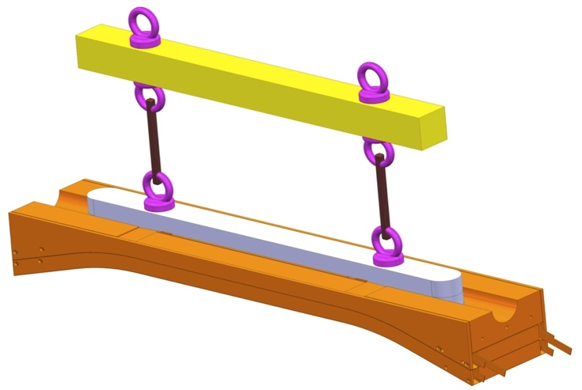
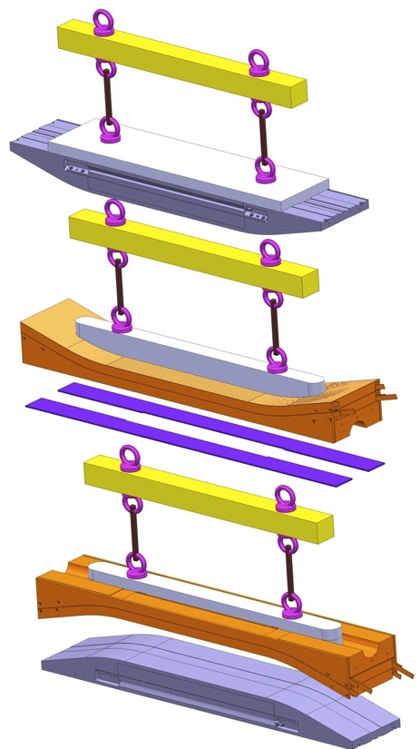
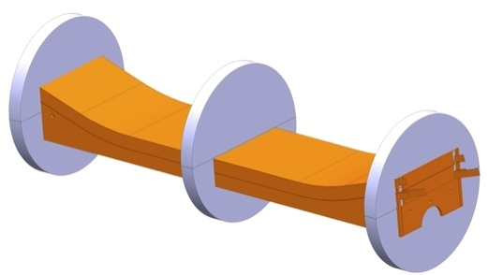
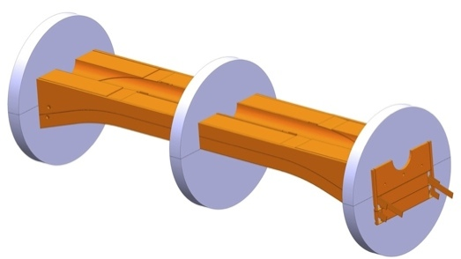
Coils assembly sequence
Coil lifting tool
Coil rotation tooling

Slide 7
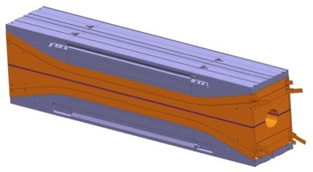
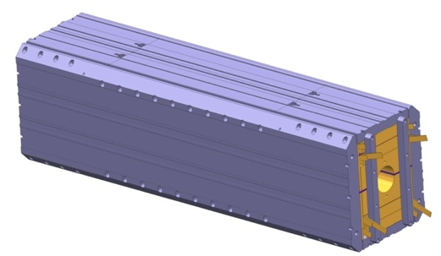
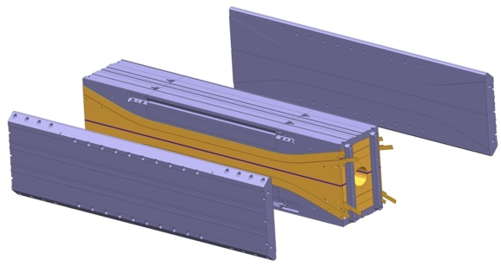
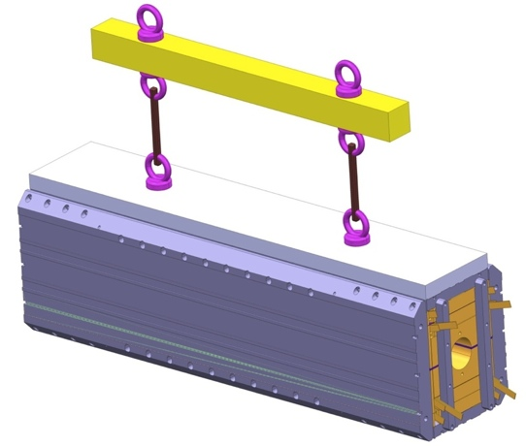
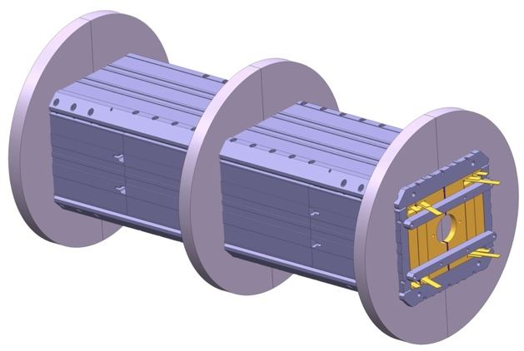
Coil pack assembly
Coil-pack assembly
Horizontal pads
Coil-pack assembly lifting tool
Conceptual design of all lifting tools is ready and price offers received. The official order will be placed end of September. Delivery scheduled for November 2012.
Coil-pack rotating tooling

Slide 8
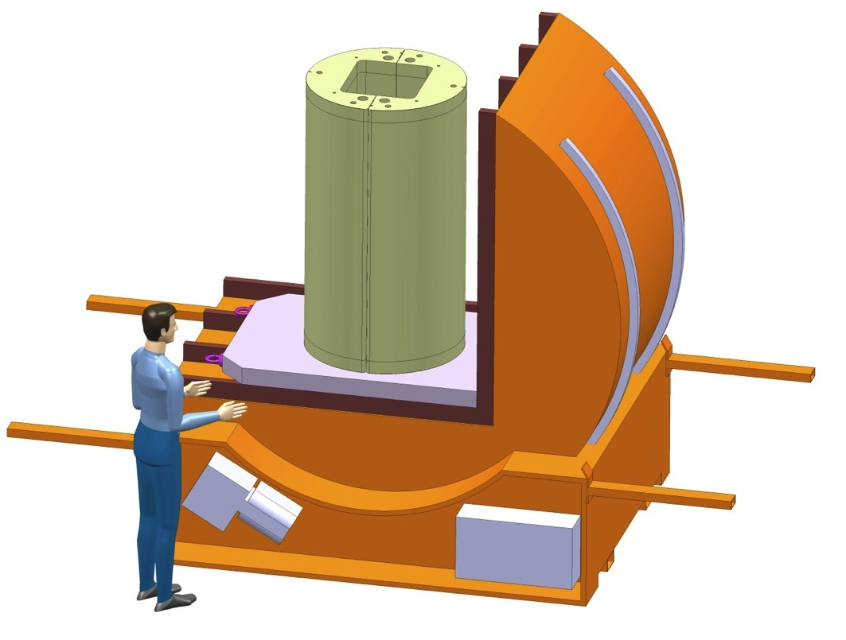
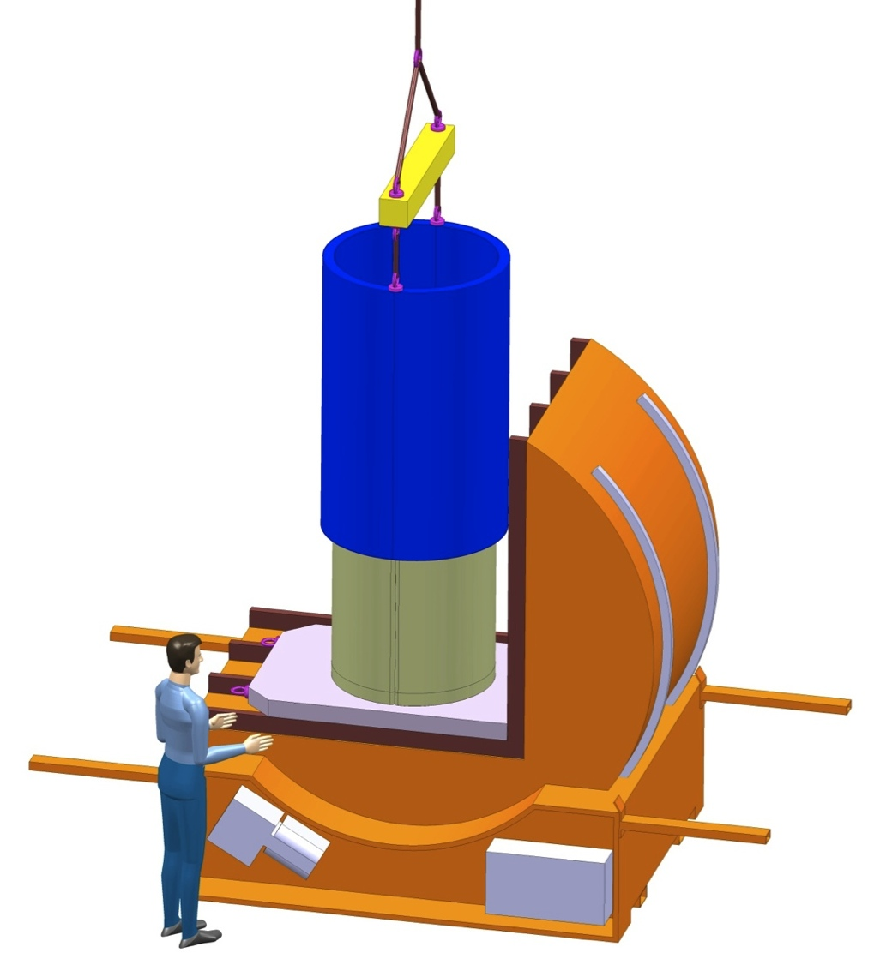
Shell and Yoke assembly
A CERN standard rotating device will be used to turn the magnet
Sliding the aluminum shell
The 2 half yokes will be aligned with no gap in between

Slide 9
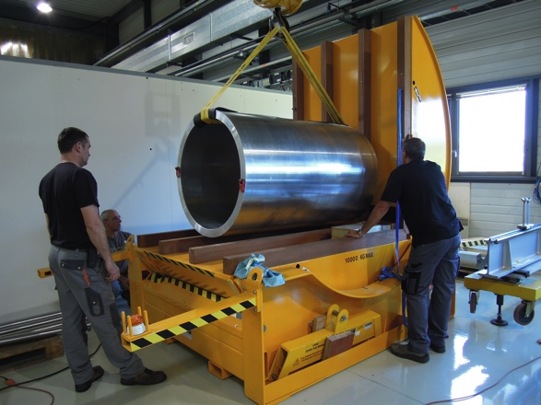
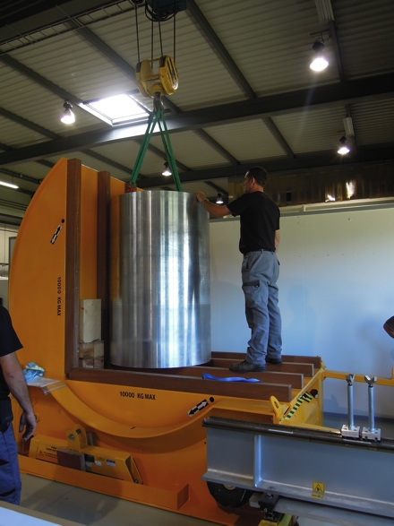
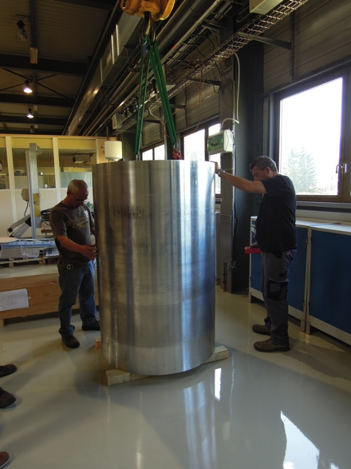
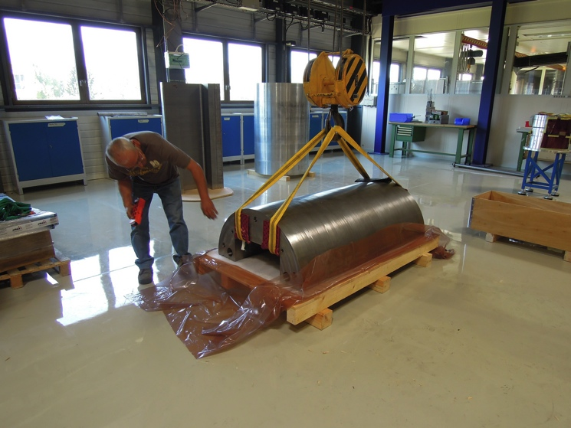
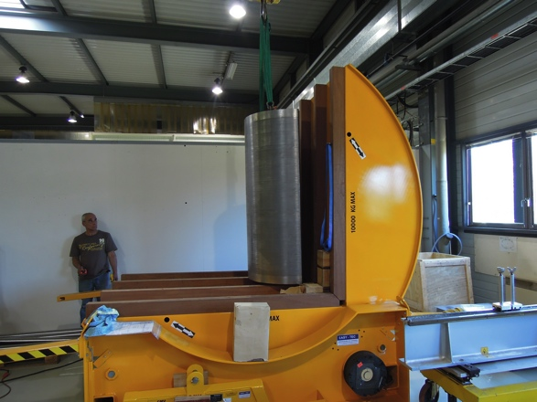
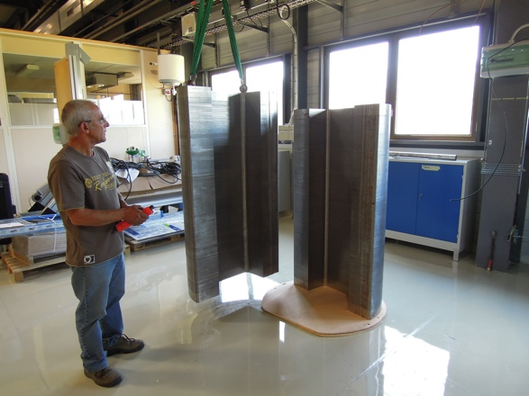
Real shell and yoke assembly (1/2)

Slide 10
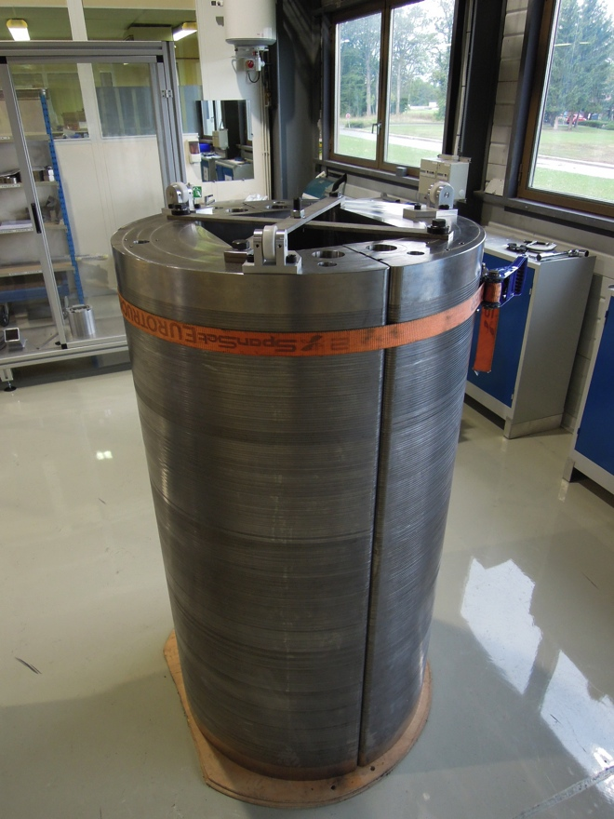
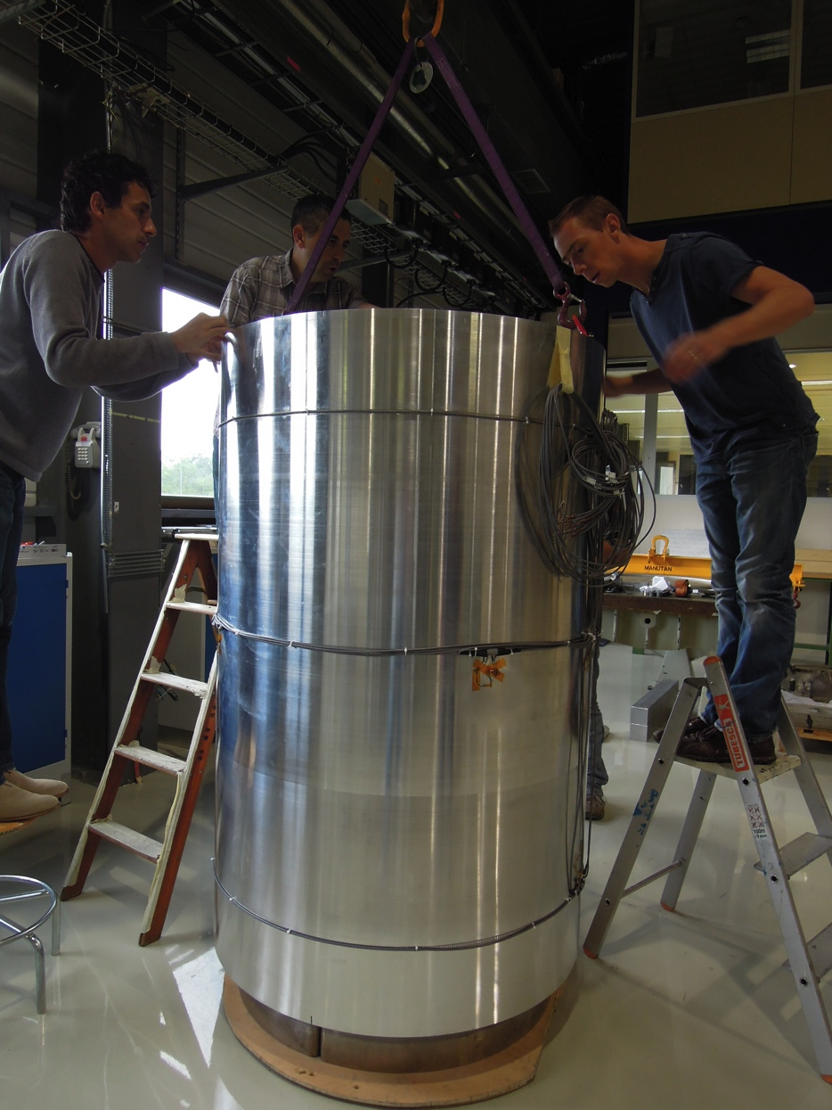
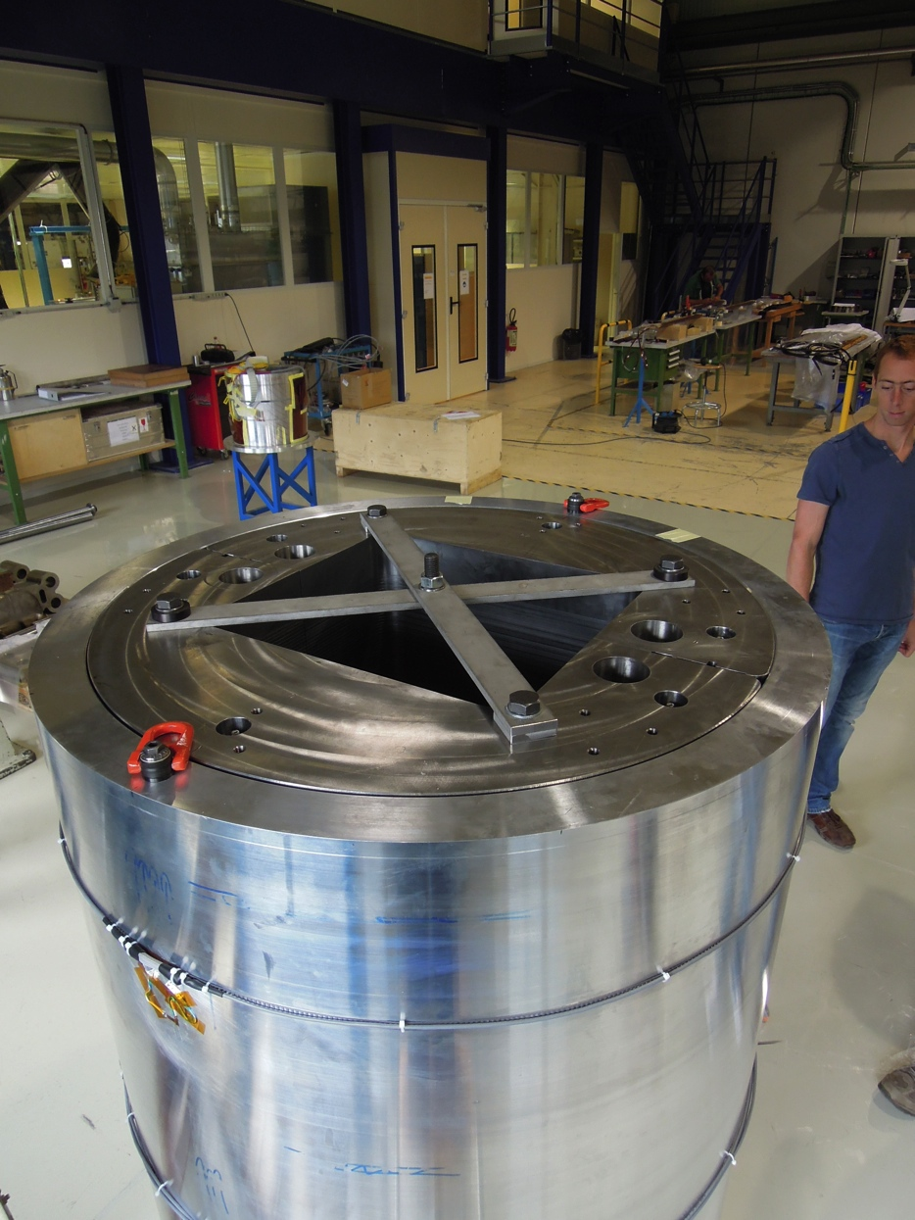
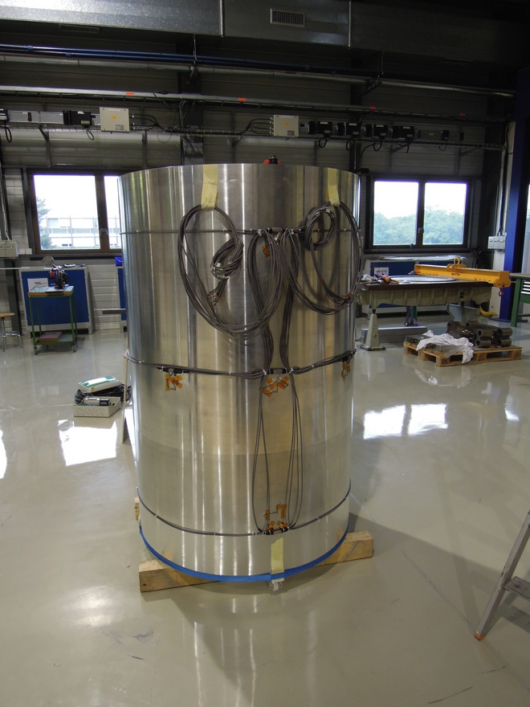
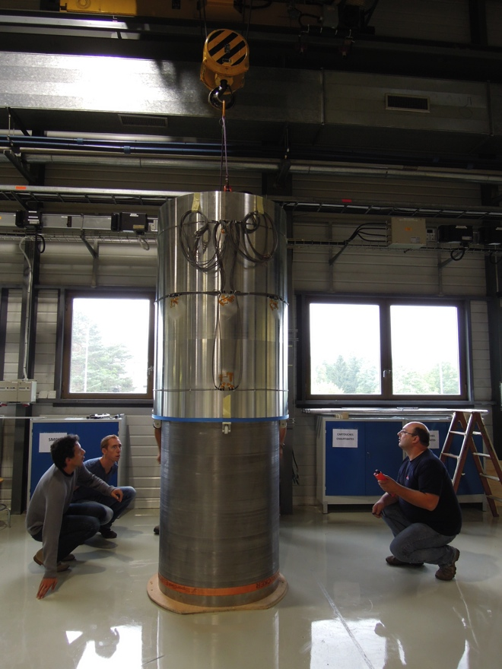
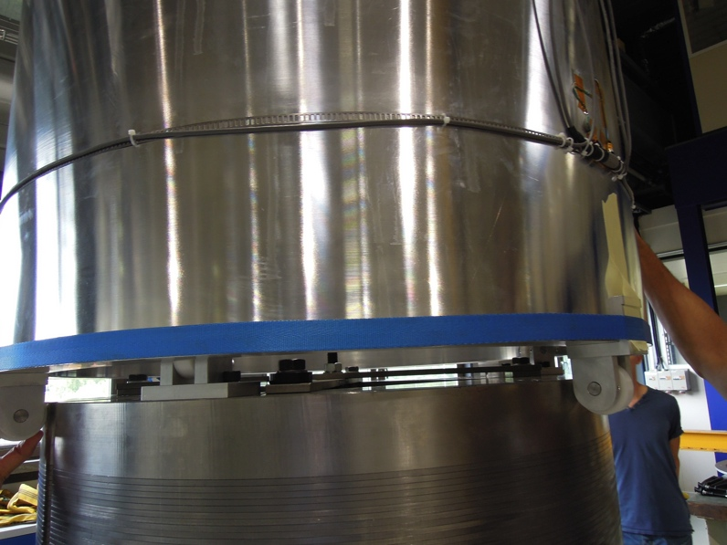
Real shell and yoke assembly (2/2)
½ yokes assembly
Guiding system
Instrumented Shell
Sliding the shell
Assembly completed

Slide 11
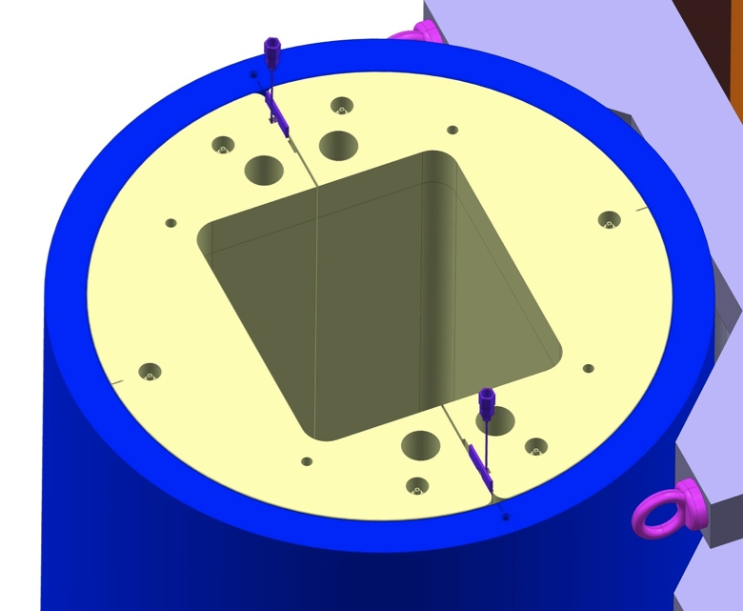
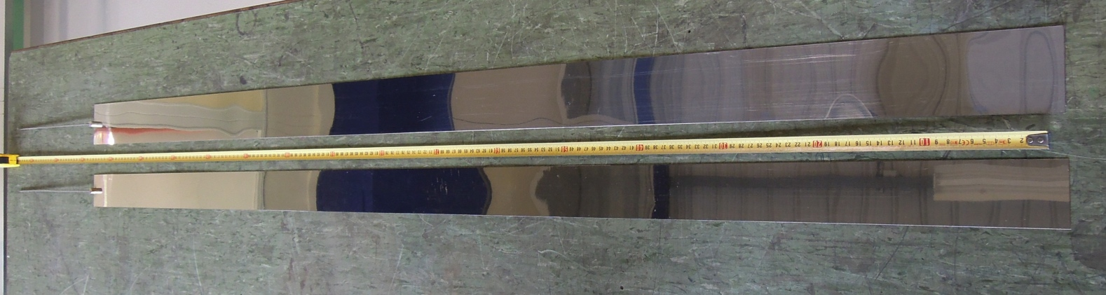
Shell pre-loading
Two bladders will be used to push the ½ yokes towards the shell inner radius to allow gap keys insertion
Standard hydraulic jacks can be used instead of bladders to perform this operation
Bladders have been produced @ CERN

Slide 12
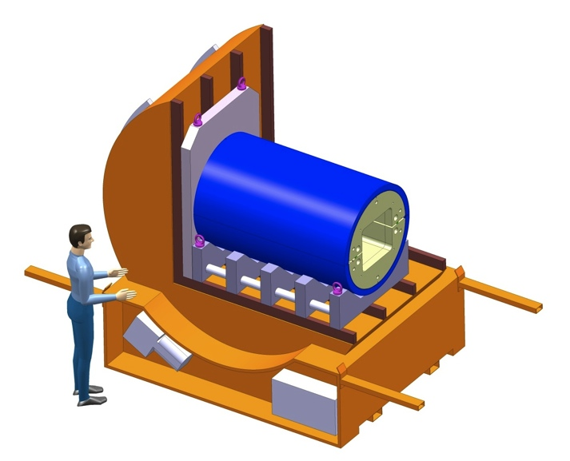
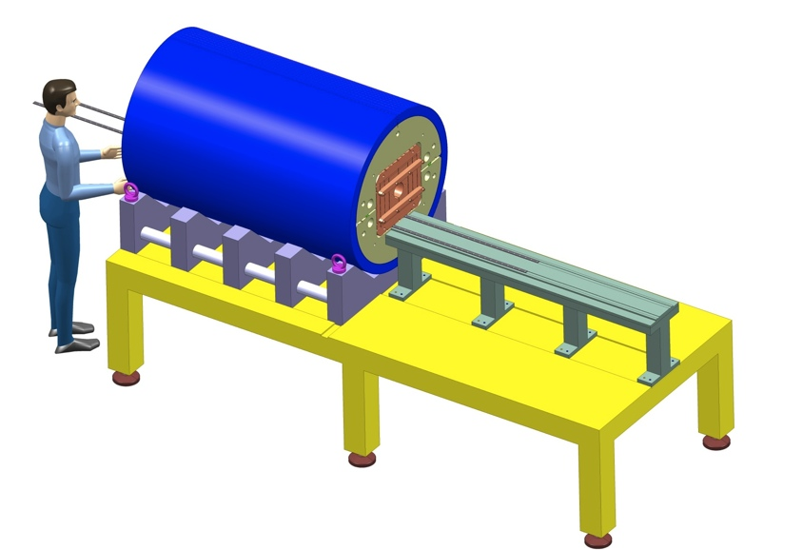
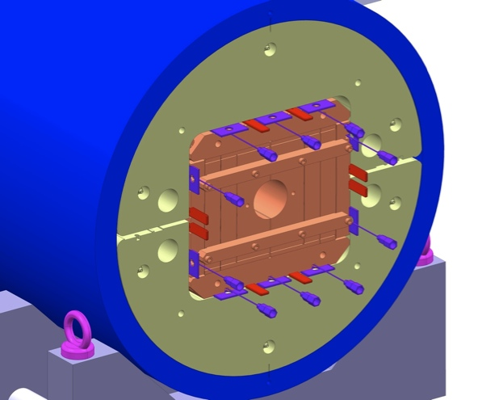
Sliding the coil pack in the structure
The coil-pack will be pushed into the yoke aperture
The assembled parts will be rotated to horizontal position
Pumping bladders & insertion of keys

Slide 13
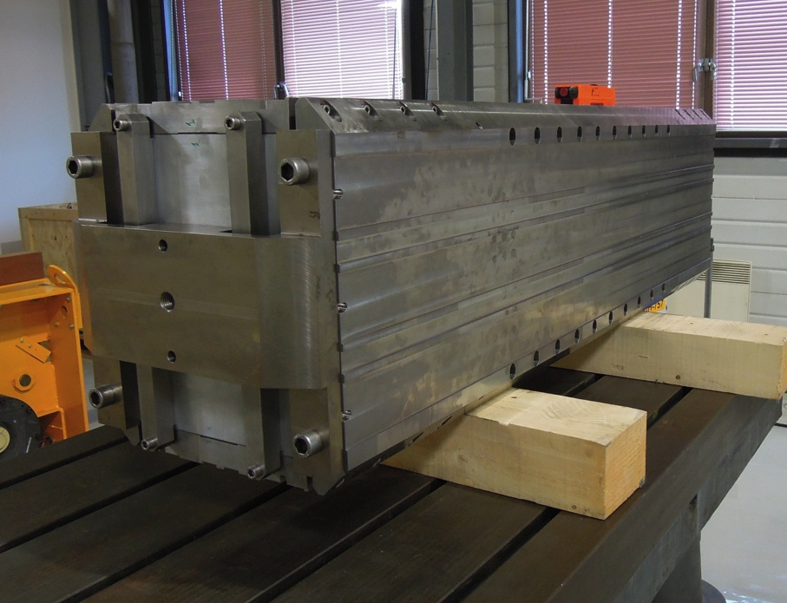
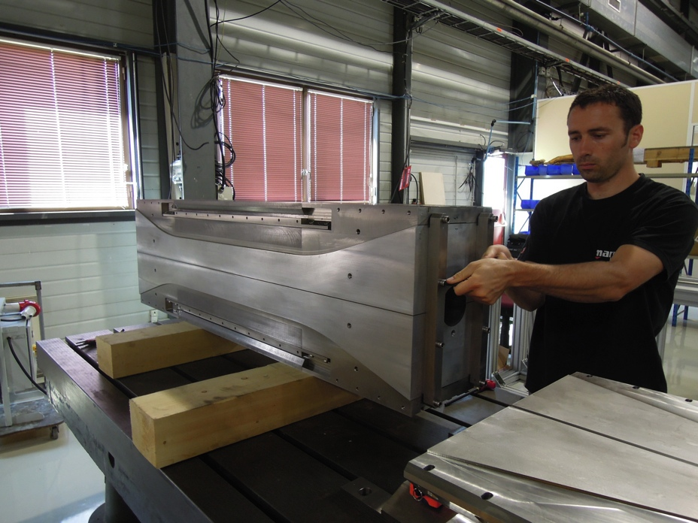
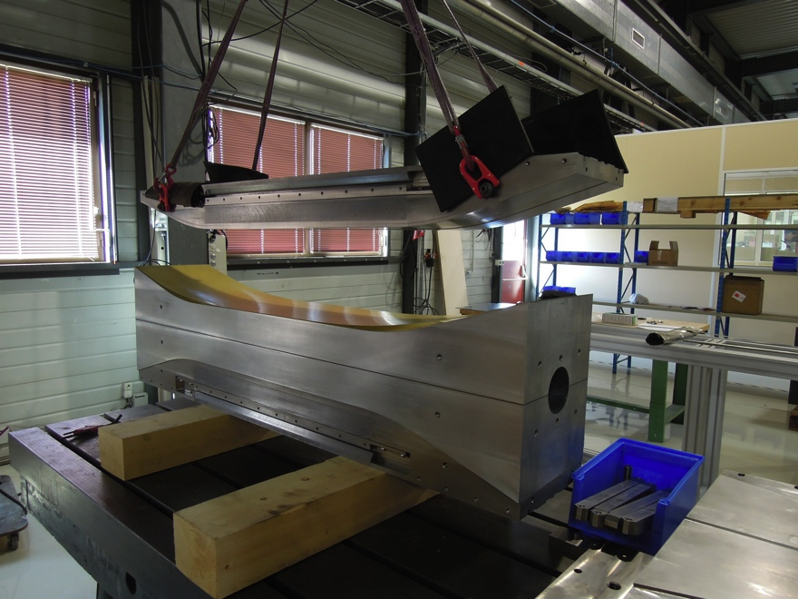
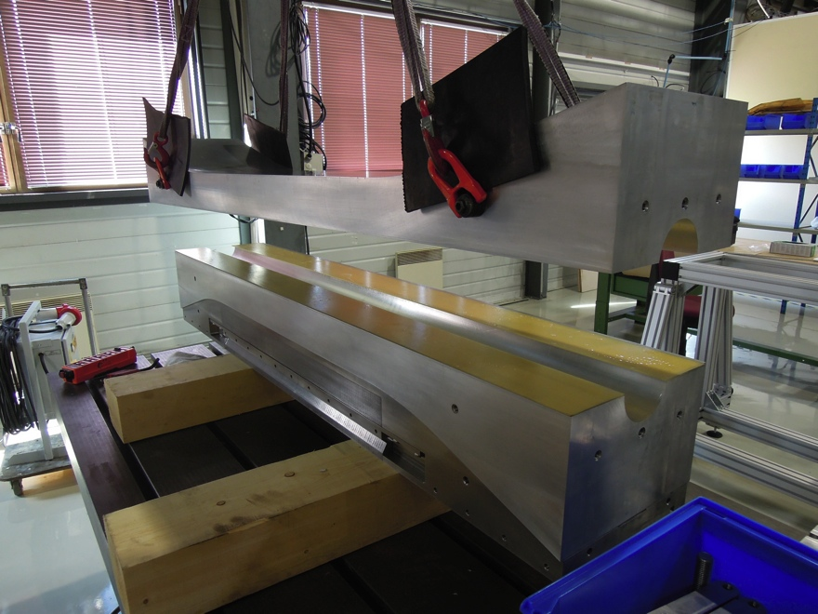
Pictures of the coil-pack

Slide 14
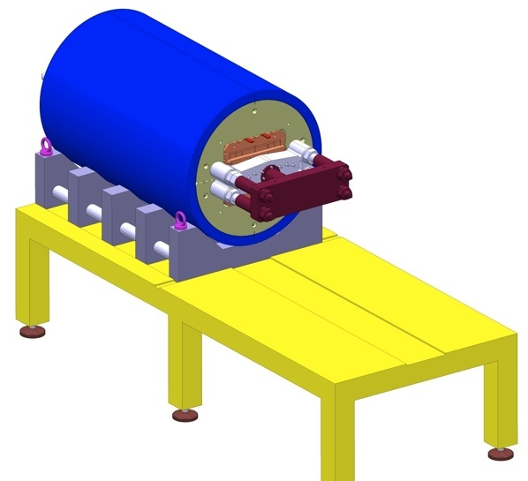
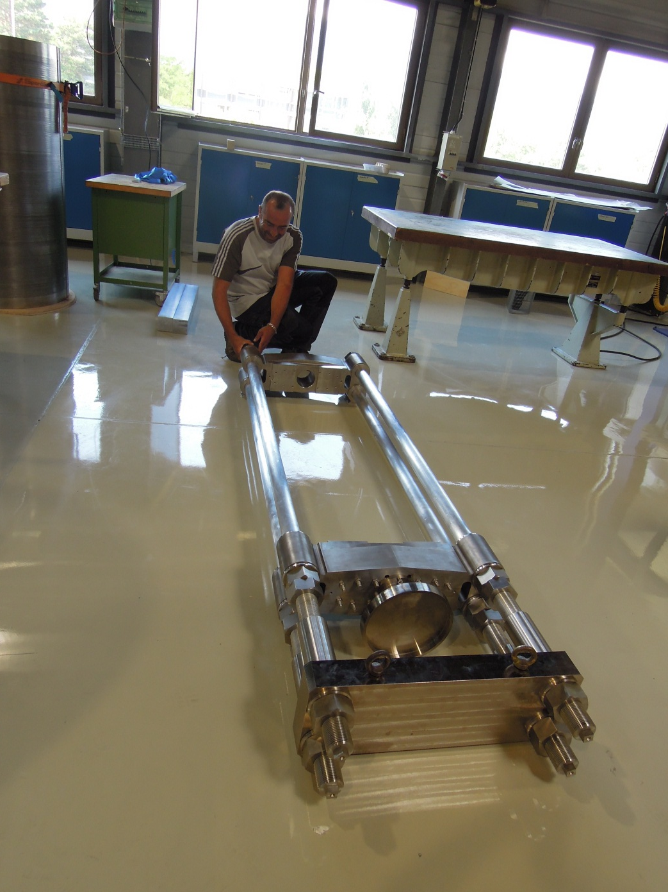
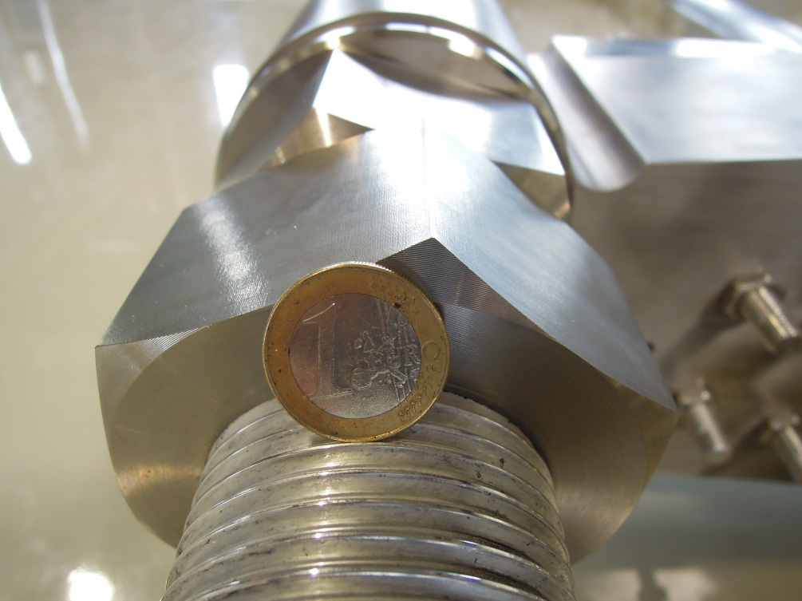
Axial compression system

Slide 15
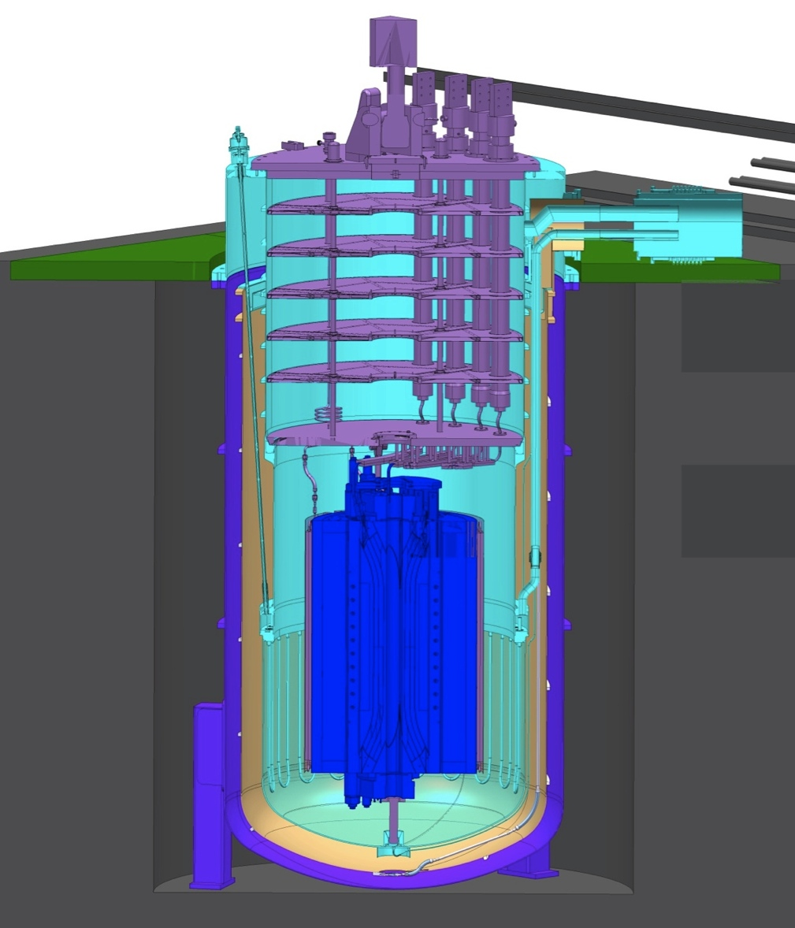
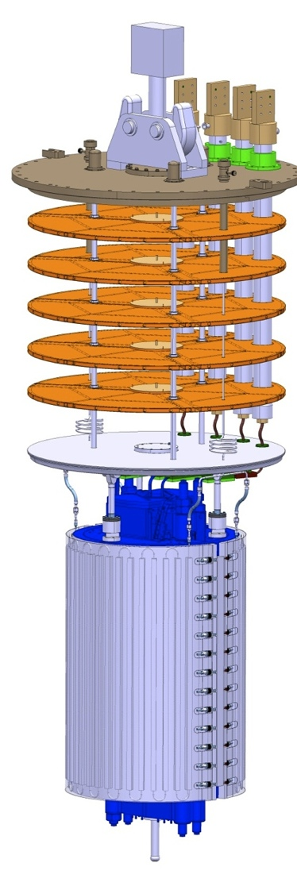
Magnet in the cryostat

Slide 16
Aluminium dummy coil assembly
The first mechanical assembly will be performed using aluminum blocks replacing the real coils
This will qualify the support structure, the assembly and loading procedure and validate the FEM
6 stations will be placed on the shell mid-plane and 4 at 45° (20 gauges). See detailed presentation from J.E. Muñoz Garcia
The aluminum dummy coils will be instrumented with 14 strain gauges stations measuring along azimuthal and longitudinal direction
Axial roads will be instrumented (longitudinal direction)
The way to cool-down the structure to 77 K in LN2 is under investigation

Slide 17
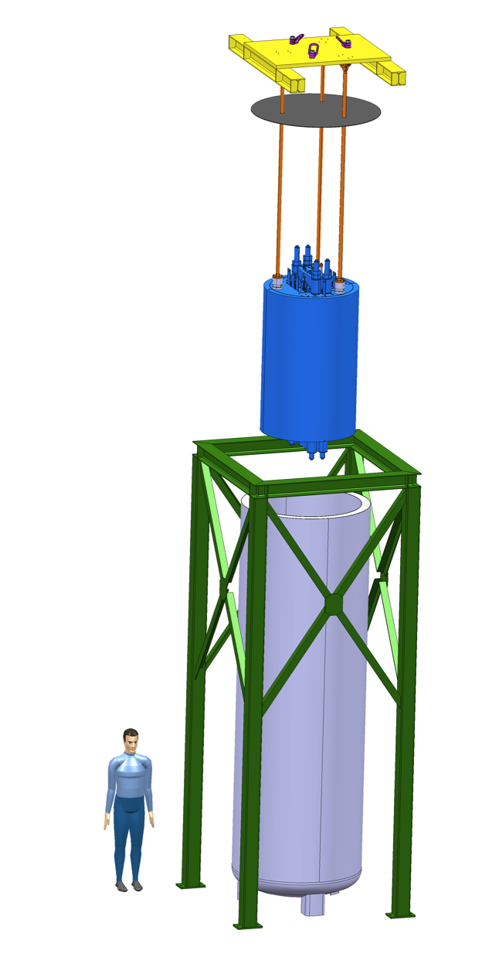
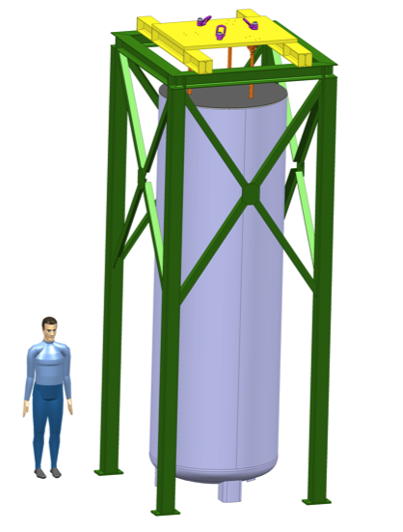
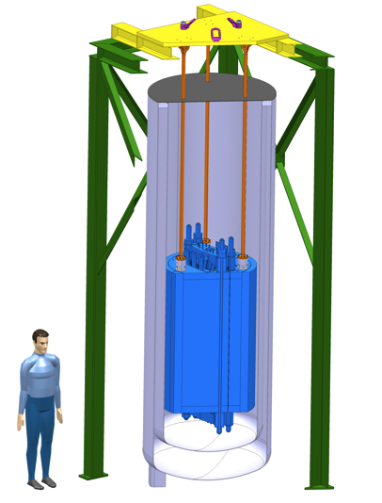
Mechanical tests @ 77 K
An existing cryostat will be used to cool-down the structure to 77 K
A dedicated structure has been designed to support the instrumented mechanical structure (delivery expected October 2012)
Shell, yokes, aluminium dummy coils and longitudinal rods will be equipped with temperature sensors
During cool-down the temperature gradient on different pieces will not exceed 20 K
A dedicated cooling control will be developed

Slide 18
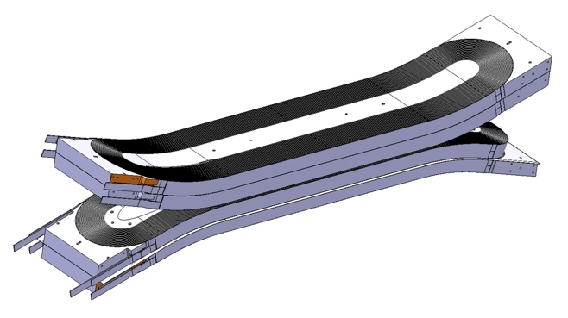
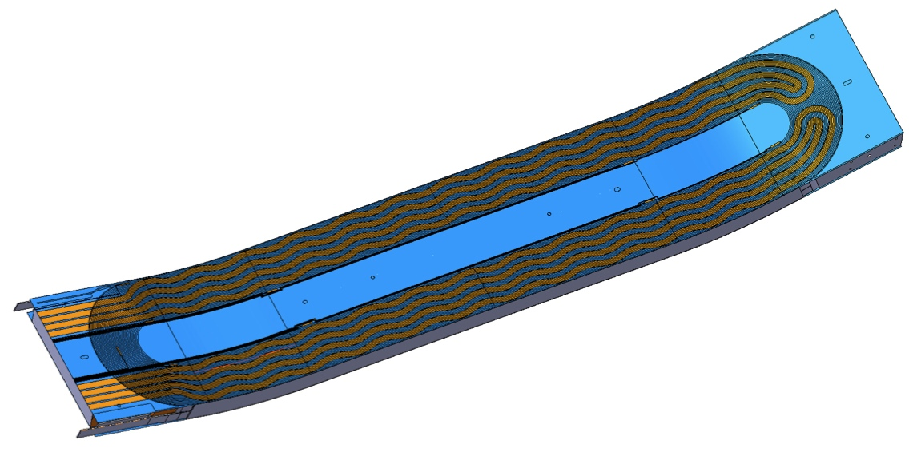
Coils instrumentation and protection
Each double pancake will be equipped with 2 traces
New traces have been designed and will be produced at CERN
Each coil layer will be protected by 2 independent quench-heater circuits
Voltages across the coil will be monitored thanks to 9 V_{taps} per side

Slide 19
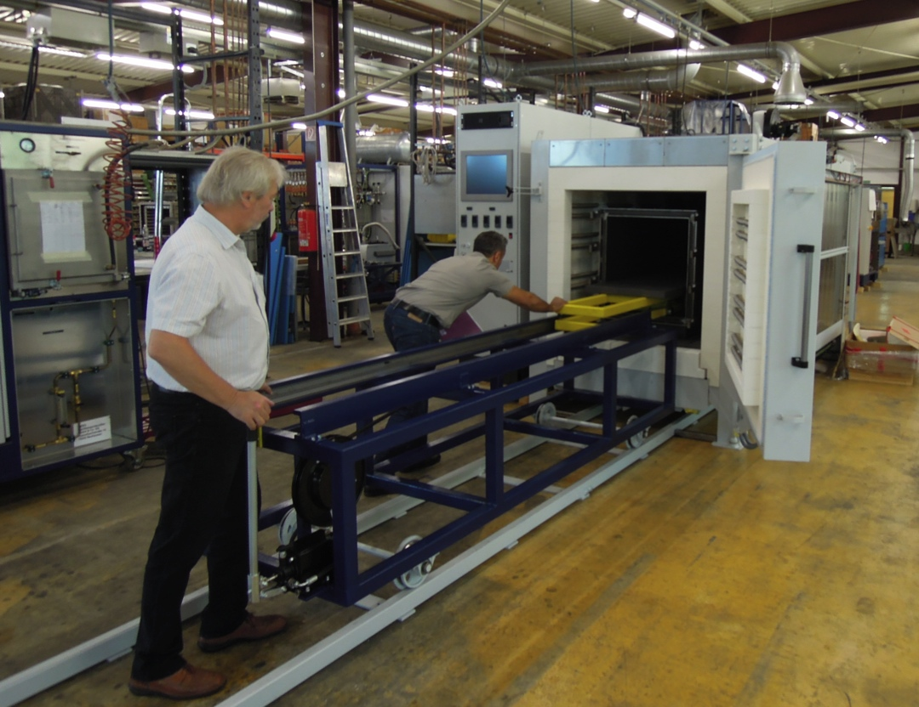
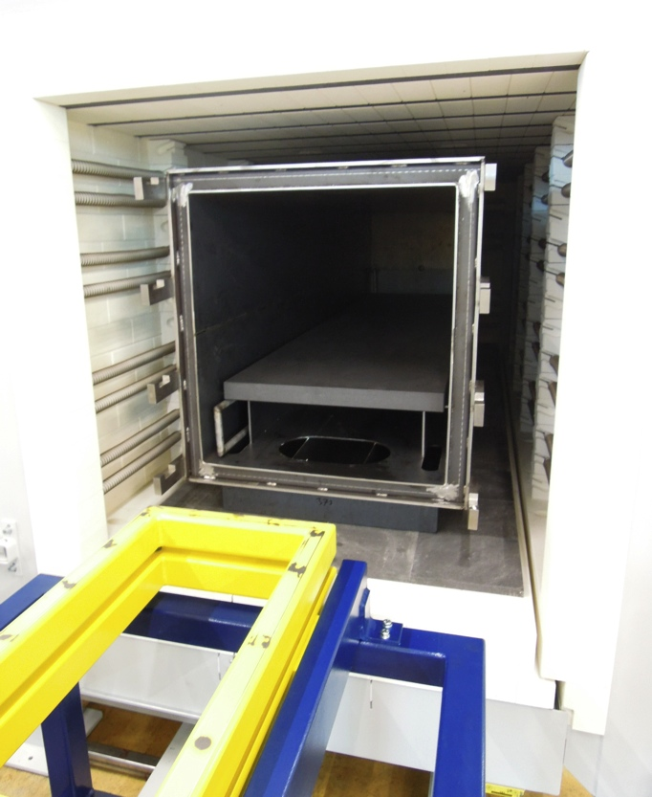
Heat treatment furnace
The heat treatment furnace ordered to GERO will be commissioned at the contractor premises by end of September 2012
Delivery to CERN is scheduled in October 2012

Slide 20
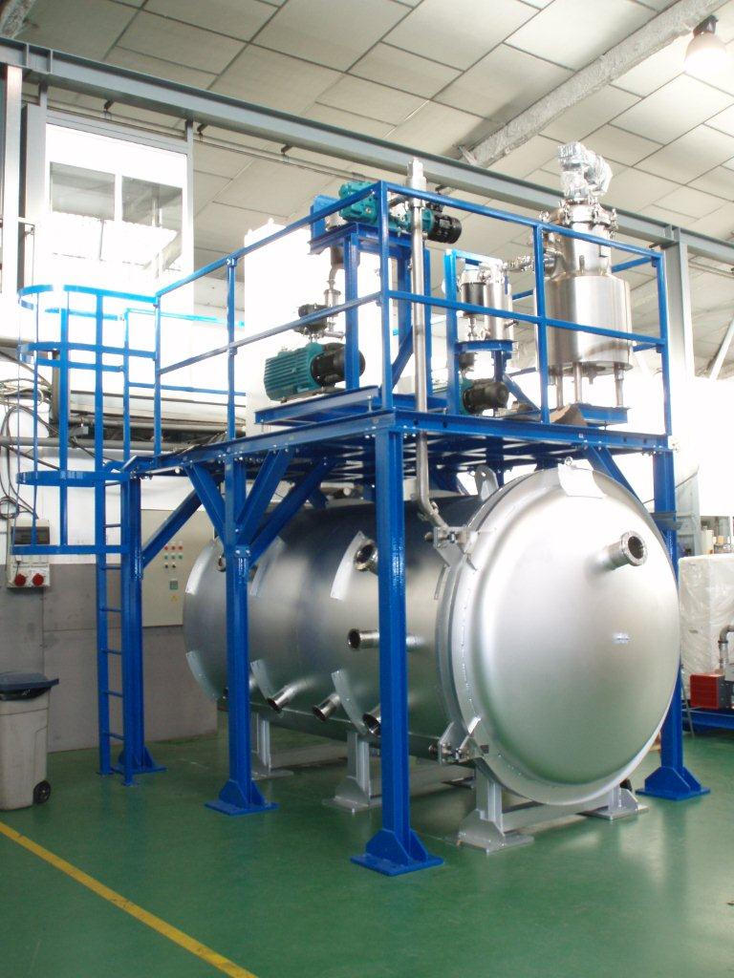
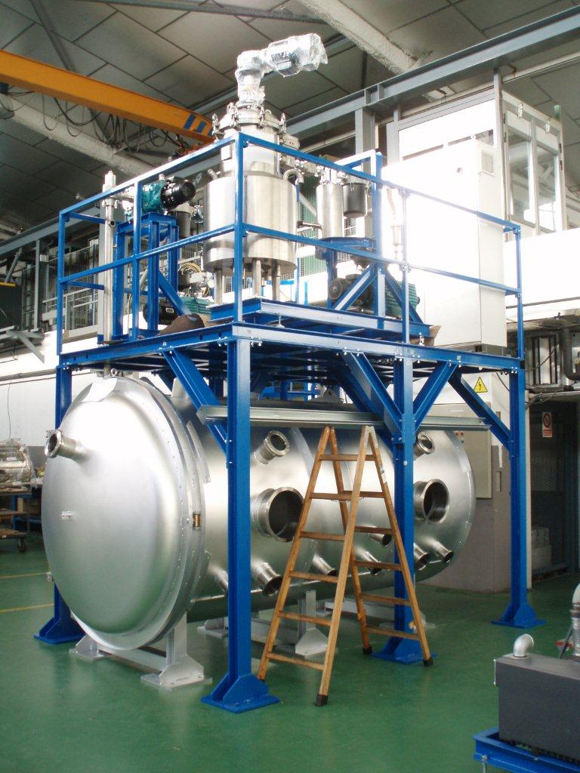

Vacuum impregnation system
The acceptance tests for the new vacuum impregnation tank will be held in Spain in October 2012
The system will be installed in 927 laboratory and commissioned in November 2012

Slide 21
Next steps
Pre-load shell-yoke sub-assembly and check gauges
Coil pack assembly with pressure sensitive paper
Rotation of shell-yoke
Coil pack re-assembly and insertion in the shell-yoke
Bladder operation
Axial loading operation
Cool-down to 77 K

Slide 22
Conclusions
All structure components have been delivered to CERN
Shell, rods and aluminium dummy coil are being instrumented
The shell has been slid around the yoke
First mechanical assembly using aluminium dummy coils planed in October 2012
The structure to support the magnet in the cryostat for cool-down using Ln will be delivered in November 2012
First cool-down of the structure to 77 K scheduled for end 2012
The heat treatment furnace will be operational in October 2012
The vacuum impregnation tank will be operational November 2012
First set of traces scheduled for December 2012

Slide 23
Fresca2 Collaboration Team
CEA/Saclay:
  M. Durante, P. Manil, J.F. Millot, J.M. Rifflet, F. Rondeaux,
CERN:
  P. Ferracin, G. de Rijk, E. Fornassiere, J. Humbert, A. Milanese,
  L. Oberli, M. Timmins, G. Villiger , TE/MSC-MDT Section
Thanks for your attention

