Slide 1
EUCARD WP7 HFM collaboration meeting
Dipole coil fabrication and tooling
F. Rondeaux
CEA-Irfu-SACM-LEAS

Slide 2
Outline
Status of fabrication for the prototype 3-4 with Cu cable
  Components
  Winding tooling
  Reaction tooling
  Impregnation tooling
Design of the coil 1-2
Tests program
  Conductor behavior studies
  Mechanical tests
Conclusion

Slide 3
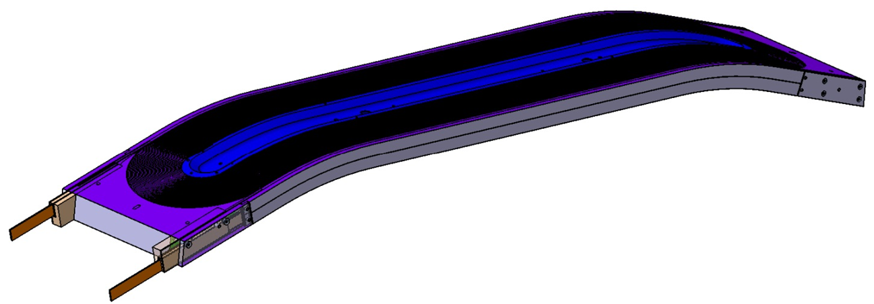
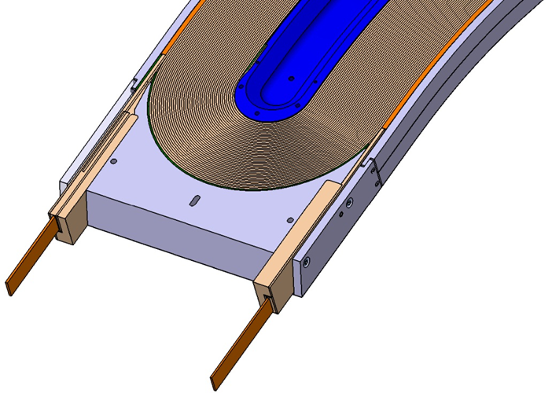
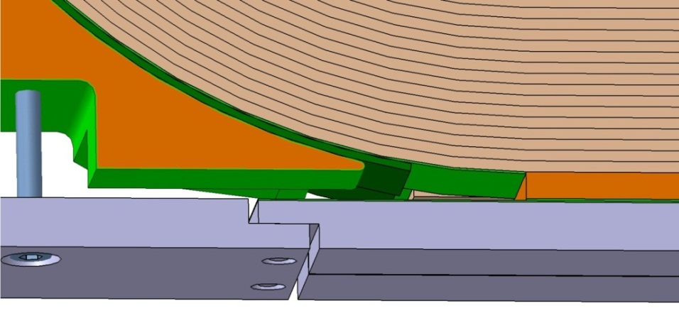
Prototype fabrication
View of the double pancake 3-4 with its components:
Horseshoes
Central post
Rails
Nb3Sn NbTi
Splices region
Reserved space ⬄ max dimension of the reacted coil : see how to fill the residual space

Slide 4
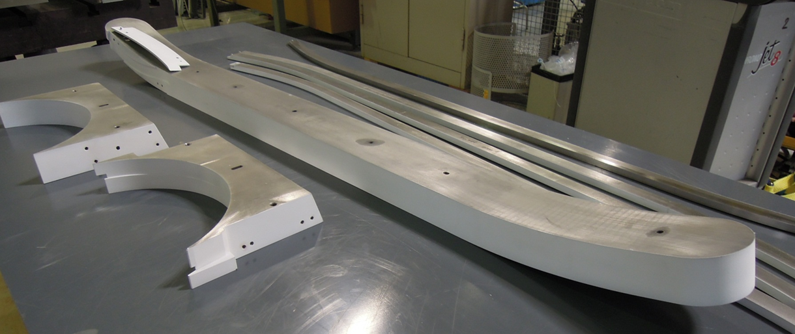
Components delivery
Cu cable 20.9 * 1.82 mm insulated with glass fiber braid ➔ in October.
Coil parts have been treated with plasma coating:
  Central post, layer jump shim, horseshoes : delivered at CERN in July.
  Rails : internal faces not treated, returned to the company: at CERN now.
Tests on interlayer insulation OK : glass fiber sheets with binder flexible enough to be prepared flat.
2 sets of components for the coils 3-4 ordered in August.

Slide 5
Fabrication process – main steps
Conductor insulation
Conductor preparation
Winding
Preparation for the heat treatment:
  Assembly of the reaction mold around the wound coil
  Transport to CERN
Heat treatment
Preparation for impregnation :
  Nb₃Sn/NbTi splice soldering
  Instrumentation, ground insulation and quench heaters integration
Impregnation
Coil assembly
Magnet assembly
At Saclay
At CERN

Slide 6
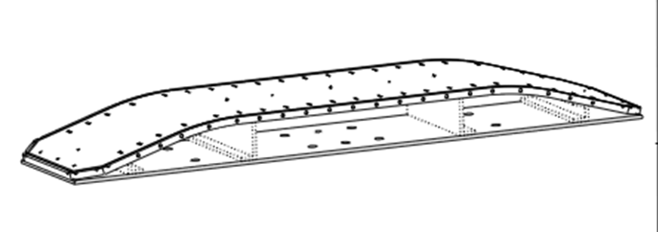
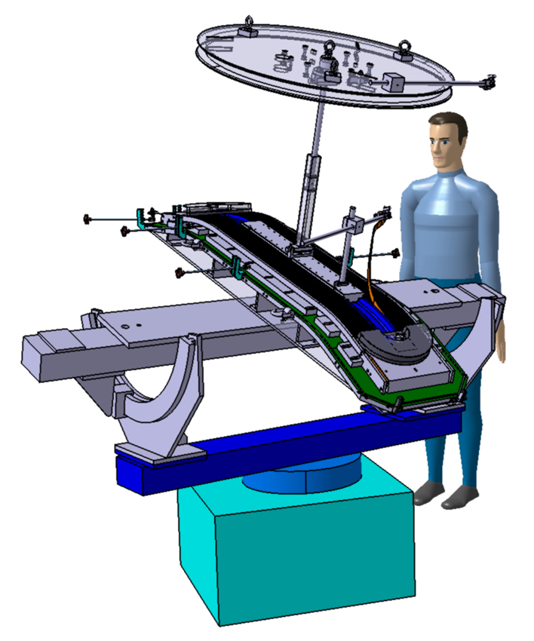
Winding tooling
Reception the 22th of June: OK, excepted for the winding table:
  Table made with welded plates
  Problem appear during heat treatment after welding : irreversible damage to the table has been introduced.
  ➔ a new winding table has to be machined
Mica sheets received at Saclay

Slide 7
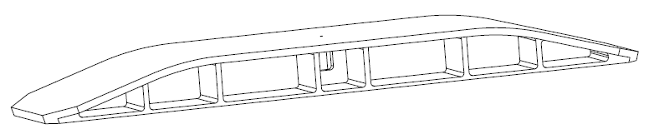
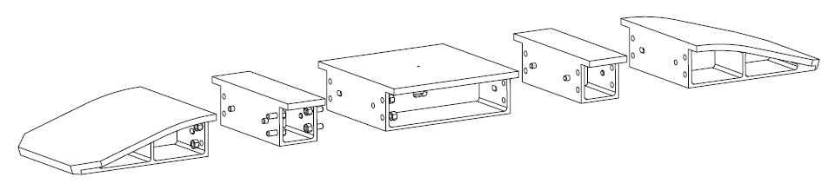
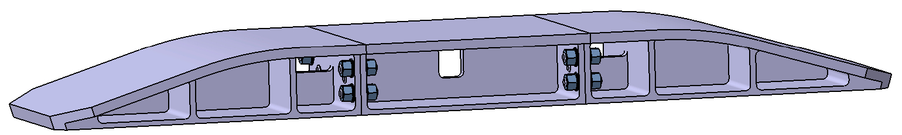
Winding tooling
Backup solution = machining in block(s) of 304 L forged 3D.
3 options have been studied : 3-block option chosen.
Material for the new winding table has been ordered and a call for tender was launched for the machining. Delay = 5 + 5? weeks.
Annealing cycles to be confirmed.
1 block
5 blocks
3 blocks

Slide 8
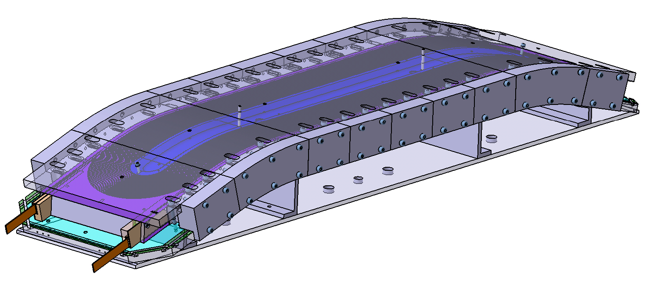
Reaction tooling
Delivery expected for mi-September at Saclay.

Slide 9
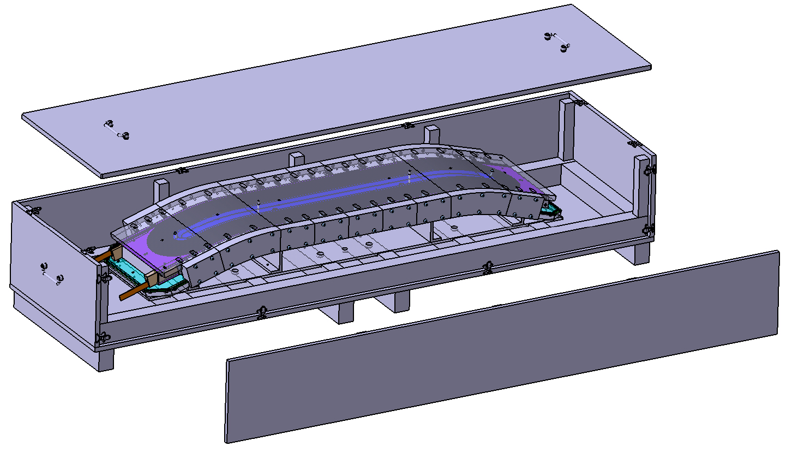
Transport to CERN
Draft of the transport box
Don’t forget handling tools : M ~ 600 kg
Coil ~ 130 - 150 kg
Table ~ 220 kg
Reaction mold = 203 kg

Slide 10
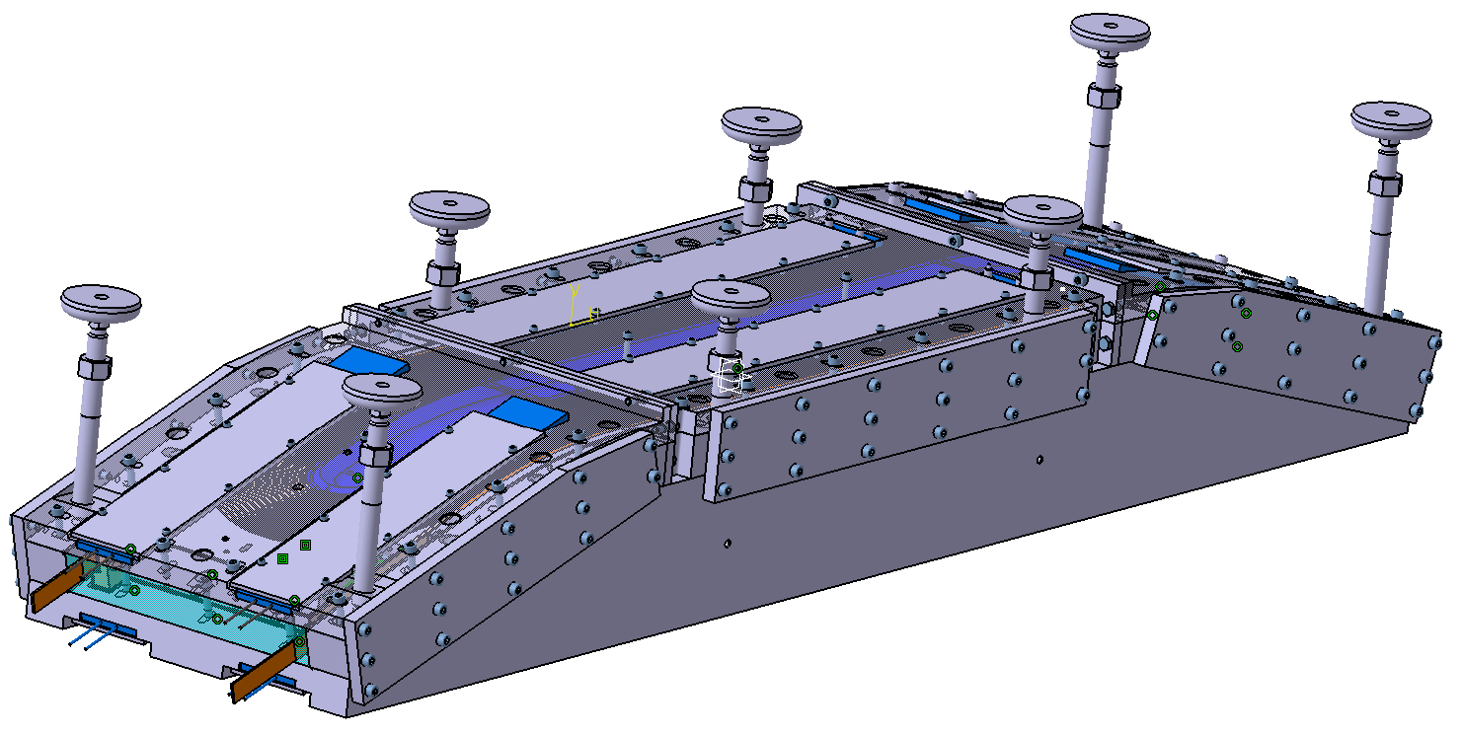
Impregnation tooling
Drawings completed – integration of the interconnection pieces
To be order by CERN

Slide 11
Outline
Status of fabrication for the prototype 3-4 with Cu cable
  Components
  Winding tooling
  Reaction tooling
  Impregnation tooling
Design of the coil 1-2
Tests program
  Conductor behavior studies
  Mechanical tests
Conclusion

Slide 12
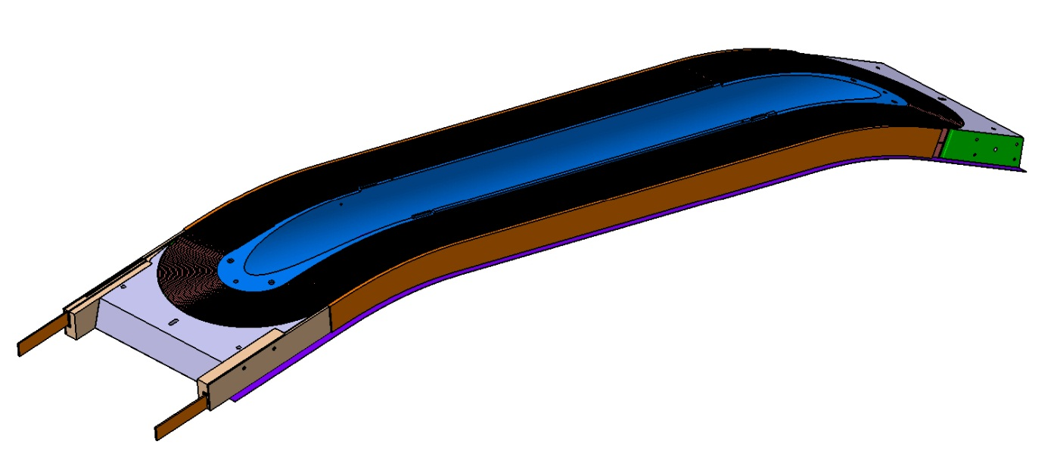
Design of coil 1-2
Preliminary view of the double pancake 1-2 with part of its components:
Coil 1-2 + coil 3-4 :

Slide 13
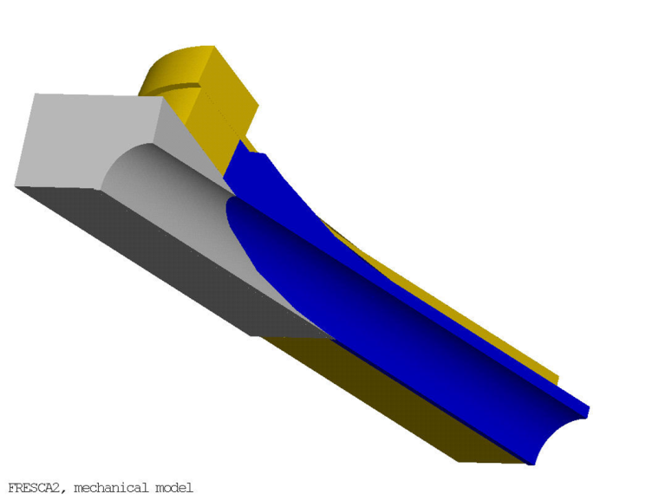
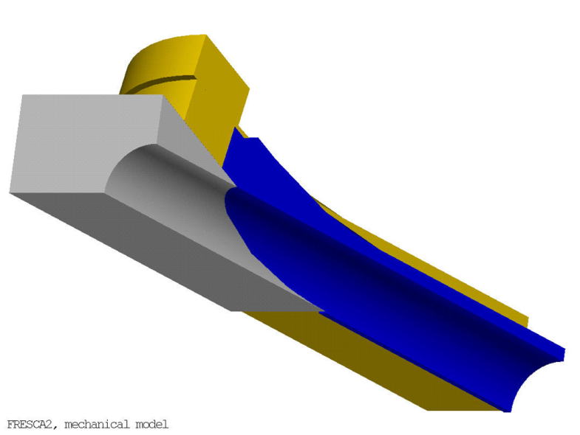
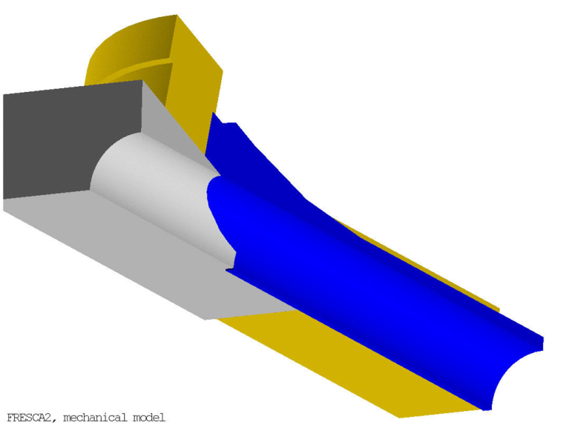
Wegdes
How to adjust the contacts between coil, central post and wedges?
Wedges impregnated with coil?
Option 1
Option 2
Option 2
Option 3
From P.Ferracin

Slide 14
Outline
Status of fabrication for the prototype 3-4 with Cu cable
  Components
  Winding tooling
  Reaction tooling
  Impregnation tooling
Design of the coil 1-2
Tests program
  Conductor behavior studies
  Mechanical tests
Conclusion

Slide 15
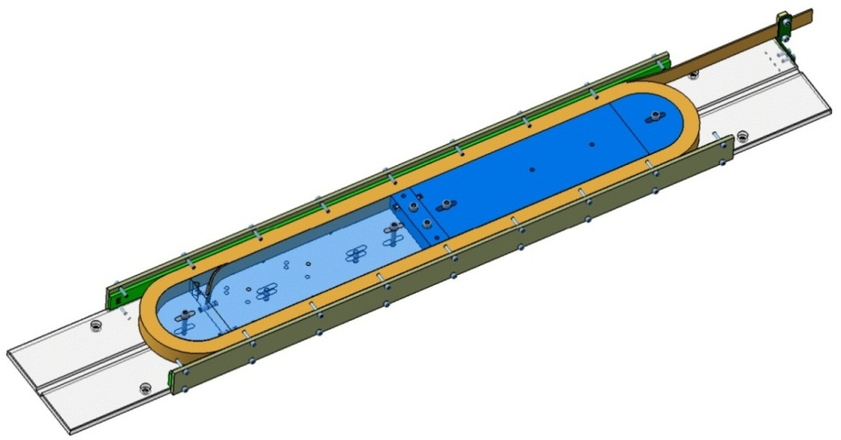
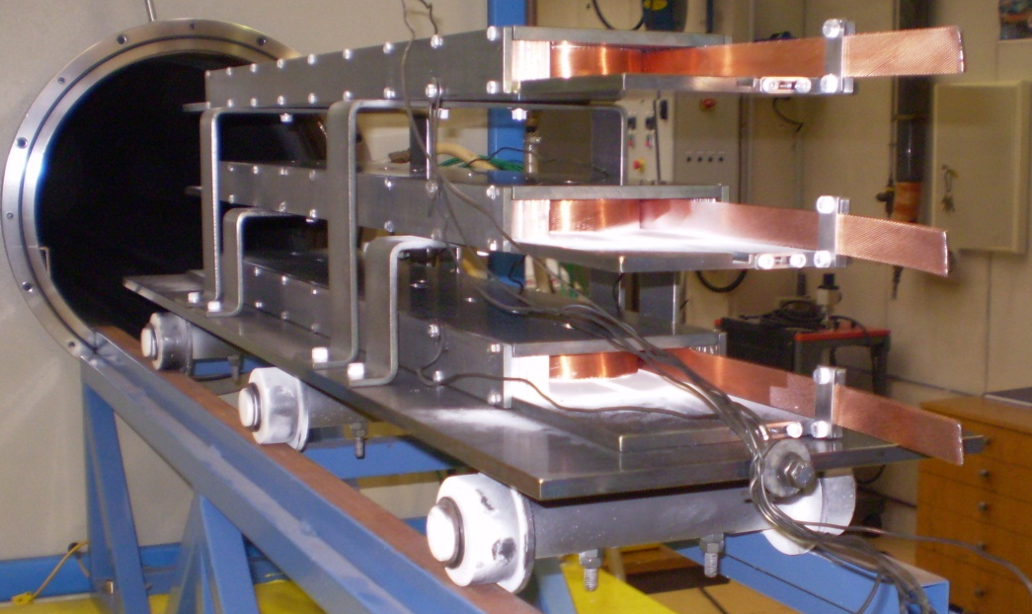
Conductor behavior studies
Multi-turn dilatation tests tooling with mandrel made up to 5 parts with removable central one.
3 materials available for the mandrel :
stainless steel, magnetic steel, titanium
Set-up to react 3 molds at same time

Slide 16
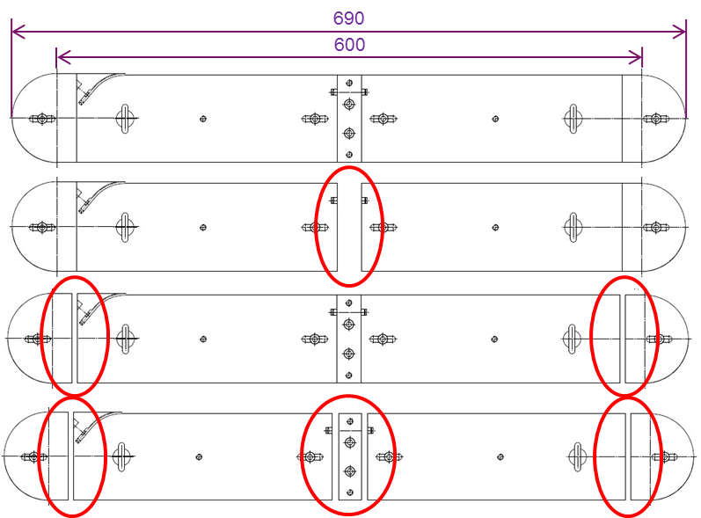


Conductor behavior studies
Several possible configurations for the mandrel:
  Configuration 0
  Configuration 1
  Configuration 2
  Configuration 3
Thermal treatment #1 (in July):
  Stainless steel mandrel configuration 0 (1.5 turns)
  Ti mandrel configuration 0 (1.5 turns)➔ choice of the central post 1-2 material after the treatment.
  Iron mandrel configuration 1 (1.5 turns) ➔ to measure the maximum displacement.
TT : ramp at 50°C/h, 120 h at 620°C + 90 h at 650°C, Ar

Slide 17
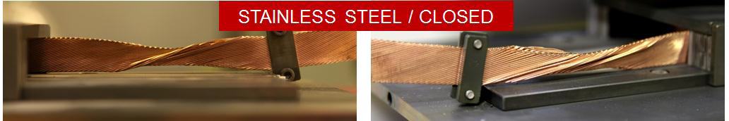
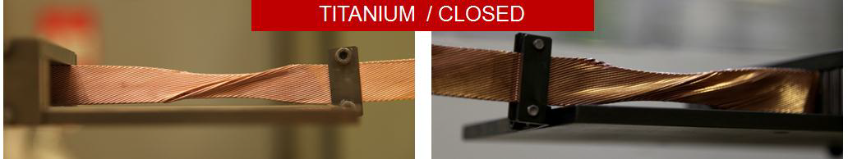
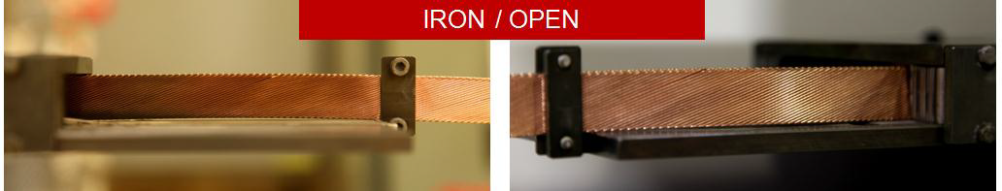
Conductor behavior studies
First observations: deformation of the ends of conductors

Slide 18
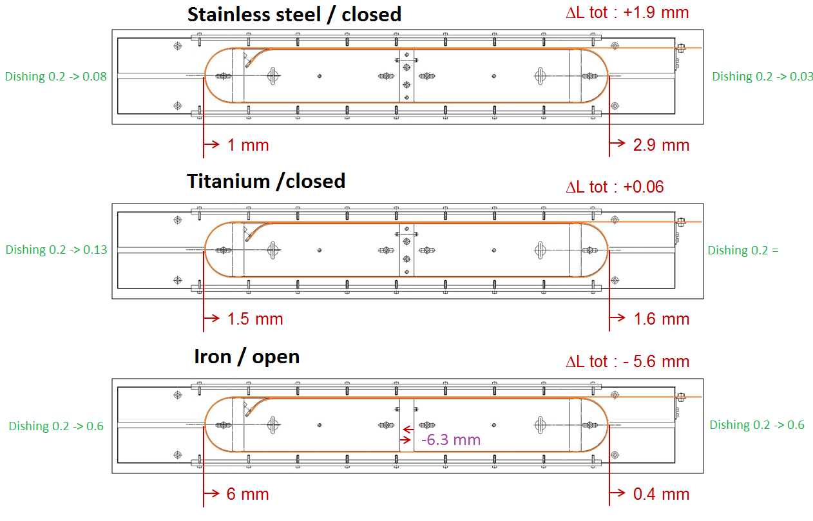
Conductor behavior studies

Slide 19
Conductor behavior studies
Next treatments :
  thermal treatment #2 (under preparation):
    Ti mandrel configuration 1 (1.5 turns) ➔ to compare with LBNL results.
    Stainless steel mandrel configuration 1 (1.5 turns)
    Iron mandrel configuration 2 (1.5 turns) ➔ influence of the gap position.
  thermal treatment #3 (in Oct.):
    Iron mandrel configuration 0 ➔ to compare open / closed mandrel.
    Other samples to be defined:
      Mandrel coil 1-2 in configuration 2?
      2-3 turns?
      Modify the cavity size?
      Repeat an already tested configuration with mica sheet?
      Test on RRP cable
      …

Slide 20
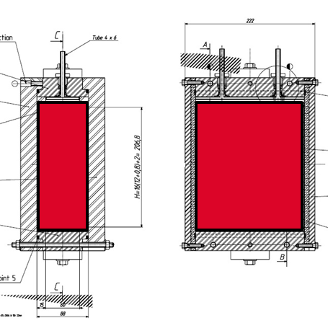
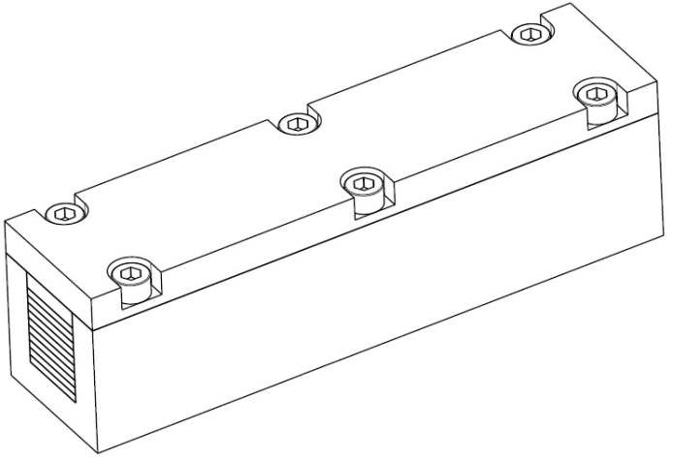
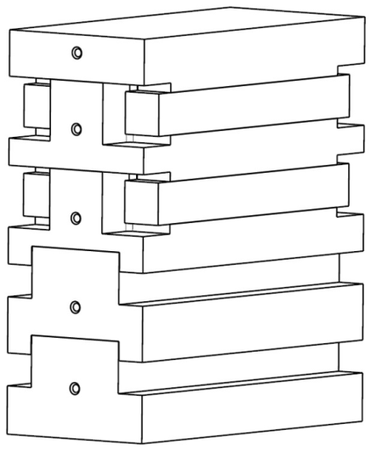
Mechanical tests
Compression tests on ten-stacks at room temperature and at 4.2 K.
Measure the thickness of the reacted insulation.
Reaction tooling: ready.
Impregnation tooling : return of call for tender for the insert mid-Sept.
Conductor delivery : October.

Slide 21
Conclusion
Actual process plan foresees to manufacture :
  1 full scale type 3-4 copper coil,
  2 full scale type 1-2 copper coils,
  4 Nb3Sn coils, 1st one type 3-4,
  1st type 3-4 Nb3Sn coil will be assembled and tested in LHe with the 3 copper coils,
  Cable and components for one spare coil are foreseen.
Material for the new winding table has been ordered and a call for tender was launched for the machining.
The winding of the first full scale prototype is foreseen for December or early January.
The delivery of the reaction mold is expected for mi-September.
The impregnation tooling drawings are completed.
The 3D model for the coil 1-2 will be soon available.
The next dilatation test with 1.5 turn is under preparation.
We are waiting the impregnation tooling for the ten-stacks preparation.

