Slide 2
HFM Test Station
Main Cryostat
Arnaud Vande Craen (TE-MSC)
EUCARD : HFM Collaboration Meeting – LASA Milano

Slide 3
Summary
Introduction
Design
Status
Conclusion

Slide 4
Introduction

Slide 5
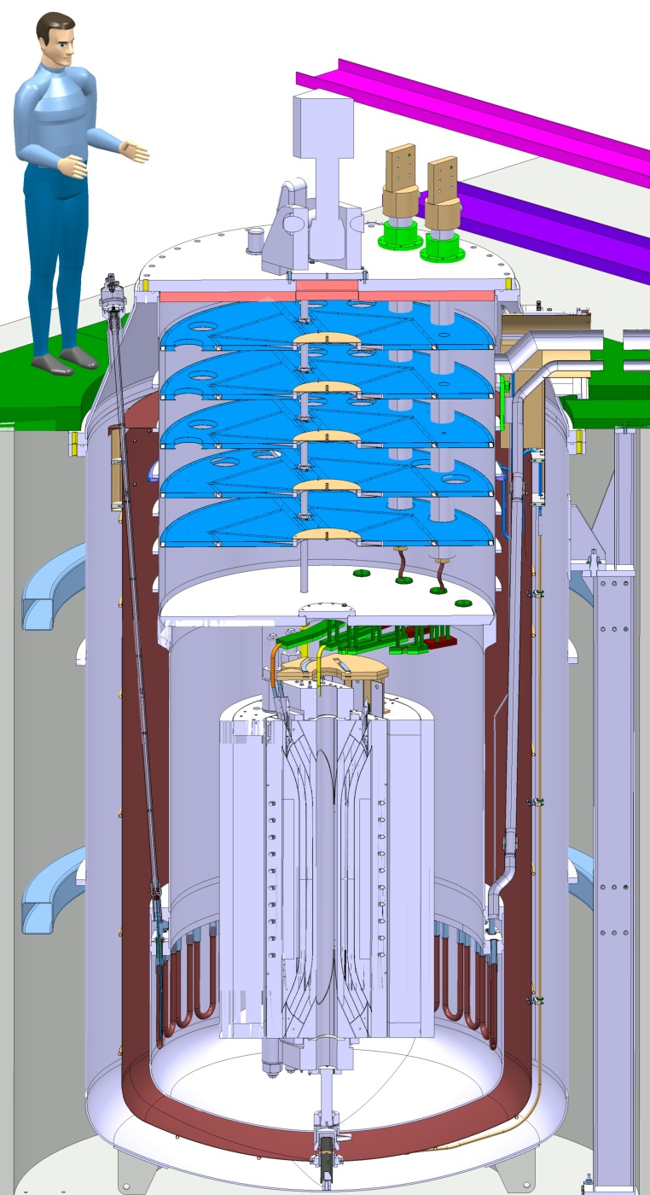
Overview
Vertical cryostat
  “Claudet bath” principle
  Few cryogenic connections
4 parts
  Vacuum vessel
  Helium vessel
  Thermal shield
  Insert
Support structure in pit
Courtesy P. Minginette

Slide 6
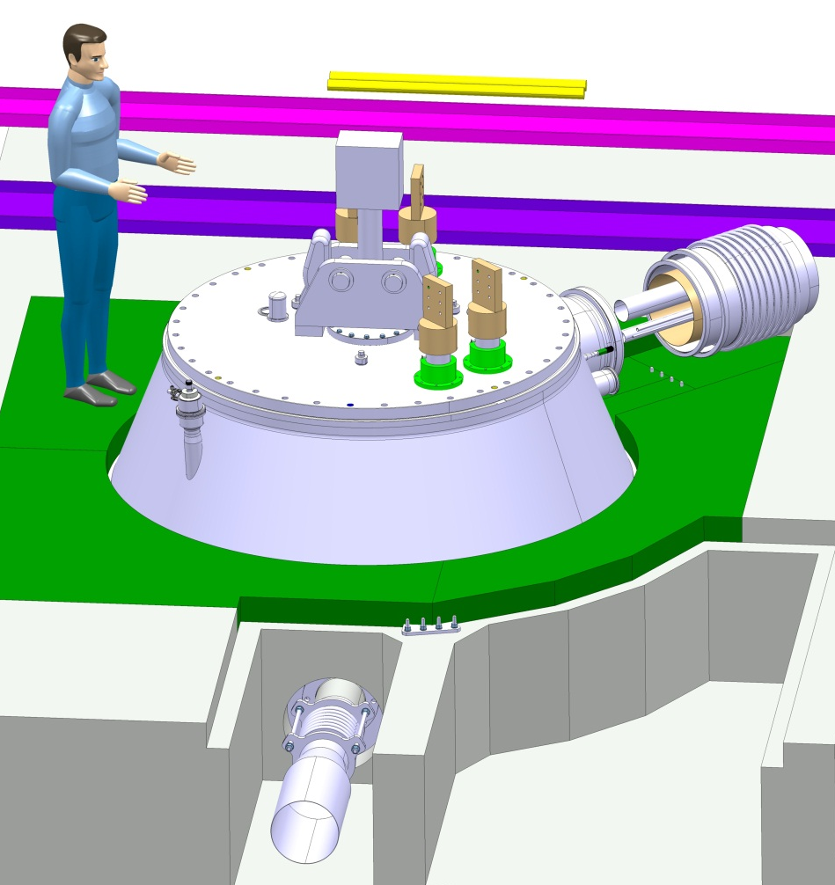
Integration
Exhaust line
  Burst disc
  DN 300
Current leads
  20 kA
  10 kA
Jumper
Courtesy P. Minginette

Slide 7
Design

Slide 8
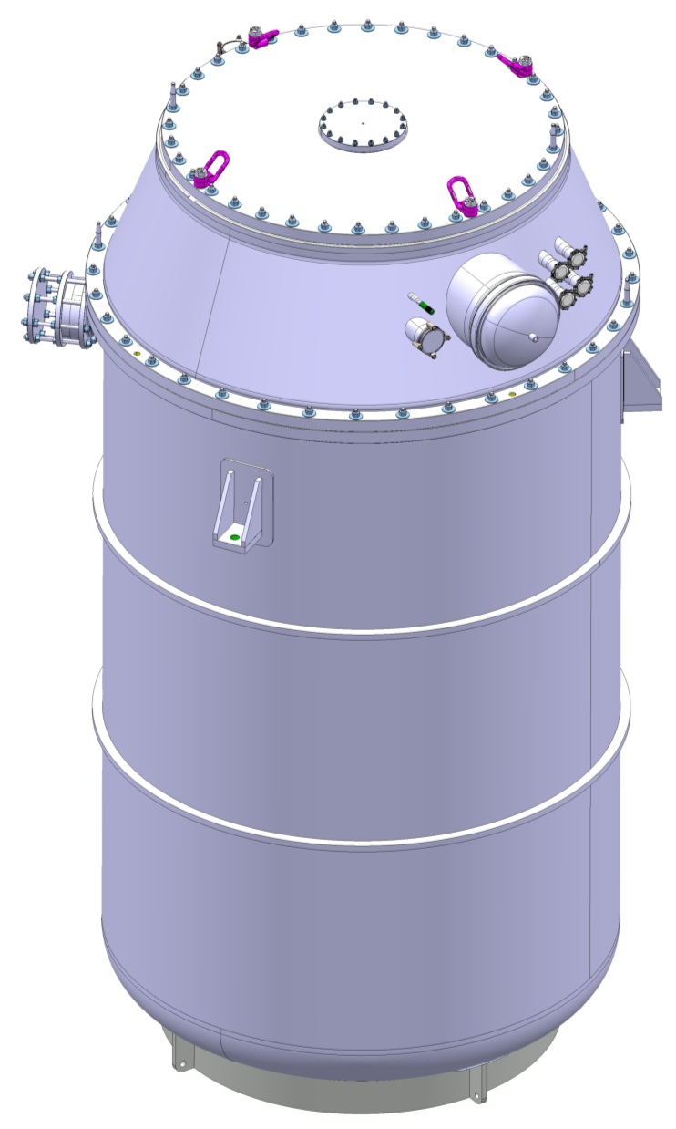
Vacuum vessel
Dimensions
  4.6 m height
  2.3 m diameter
  4.8 tons
Stainless steel
Conical cover
3 supports
Static vacuum
Courtesy P. Minginette

Slide 9
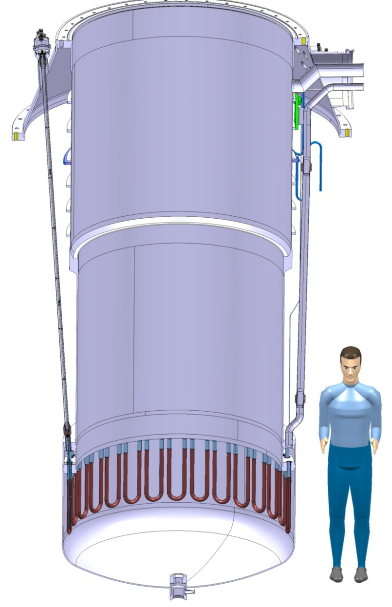
Helium vessel
Neck
  3 mm thick
  1.6 m diameter
  1.6 m long
Lower volume
  6 mm thick
  1.5 m diameter
  2.5 m long
Max pressure : 4 bar
Heat exchanger
  30 x U shape
  OFE Copper
  Cooling power ≈ 100 W @ 1.9K (1.5 day Cool-Down)
    (25W nom, ; 40W dyn. )
Courtesy P. Minginette

Slide 10
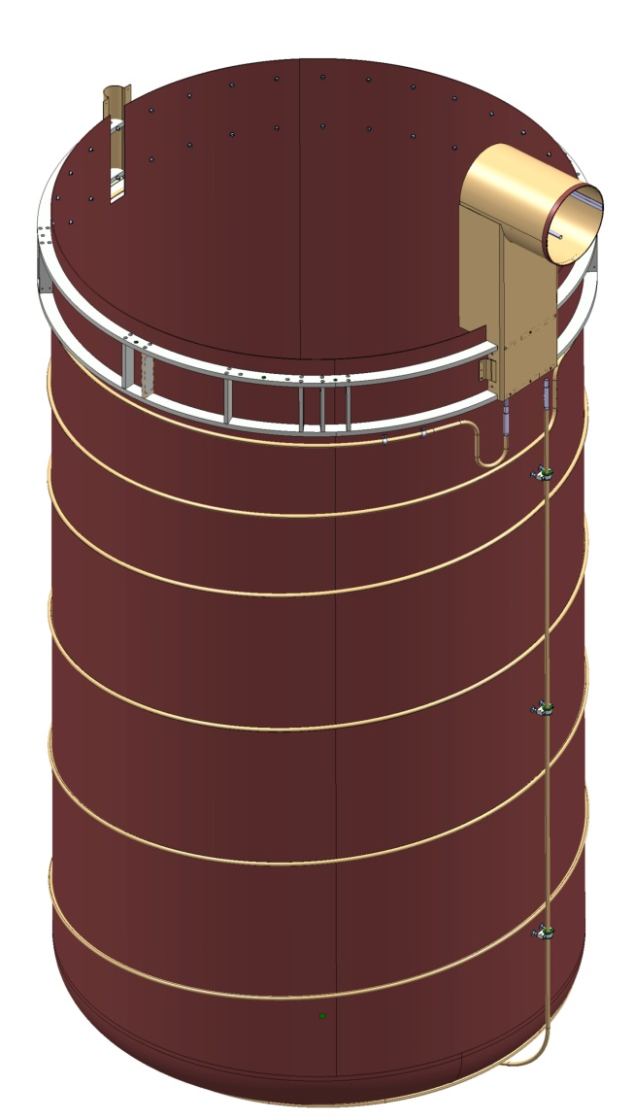
Thermal shield
Actively cooled
Supported from above
Stainless steel structure
Copper
  Sheet
  Pipe
Courtesy P. Minginette

Slide 11
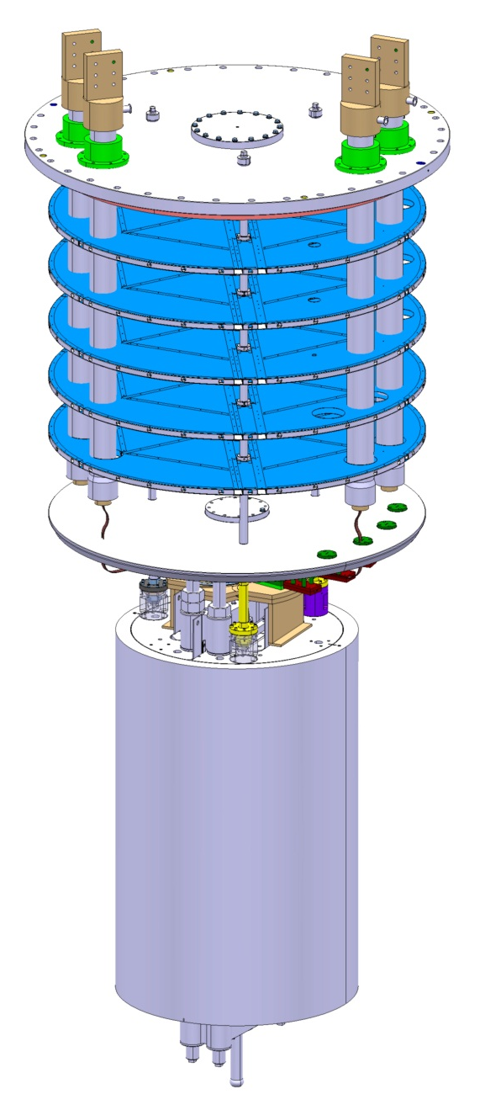
Insert
Top plate
  Current leads
    20 kA
    10 kA
  Instrumentation
Radiative screens
Lambda plate
  Lambda valve
  Splices
  Instrumentation
Mechanical support
  Lambda plate
  Magnet (15 tons)
Courtesy P. Minginette

Slide 12
Status

Slide 13
Vacuum vessel
Design : Finished
Call for tender :
  Answers received
  Selection in progress
Order : October
Delivery : 6 months after order (May ?)

Slide 14
Helium vessel
Design : October
Call for tender : November
Order : December
Delivery : 6-7 months after order (August ?)

Slide 15
Thermal shield and Insert
Thermal Shield
  Design in progress
  Construction in the shadow of helium vessel
Insert
  Design in progress
  Construction at CERN

Slide 16
Conclusion

Slide 17
Conclusion
Design well advanced
Components at CERN for next summer
Assembly phase to be planned (during LS1)
  Assembly of the cryostat
  Connection to other components

Slide 18
Acknowledgment
M. Bajko (TE-TF)
V. Benda (TE-CRG)
G. De Rijk (TE-MSC)
C. Giloux (TE-TF)
P. Minginette (EN-MME)
V. Parma (TE-MSC)
P. Perret (EN-MME)
P. Viret (TE-TF)

Slide 19
Grazie !

