Slide 1
EuCARD-WP7-HFM Collaboration Meeting
18/09/2012
Task 3 : High Field Magnet

Slide 2
Outline
Nb3Sn Conductor
One word on SMC/RMC programs
Studies status
Engineering and Realizations status
Deliverables status
Planning

Slide 3
Nb3Sn Conductor
See Christophe’s presentation
Strand ordered in sufficient quantity and in time for the project (see Christophe presentation)
Cable dimension fixed (bare) : 20.9 x 1.82
    The cabling degradation is now mastered and well under 10 % (5% achieved)
Insulation thickness (fiber glass braid) =0.2 mm. Could be 0.15 mm → adaptation of the tooling and revision of magnetic calculations (Not an issue)
Cable dimension after reaction 21.4 x 1.90
    Cross section increased by 2% in width and 4% in thickness
    Axial contraction of the order of 3mm/m (Berkeley) But…

Slide 4
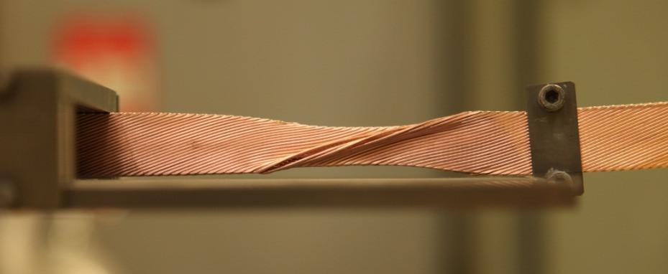
Nb3Sn Conductor
Recent experiment (See Françoise’s presentation) shows that axial contraction could be ~1%
    More analysis and more tests are needed and in course
    Could have a strong impact on winding, reaction and impregnation tooling
Reacted conductor (with closed titanium mandrel)

Slide 5
SMC & RMC Programs
See Juan Carlos’s presentation
These 2 programs are of first importance for the preparation of HFM Fresca2 dipole
I feel that there is a lack of communication on this subject
How can we improve this situation, although everyone is already very busy?

Slide 6
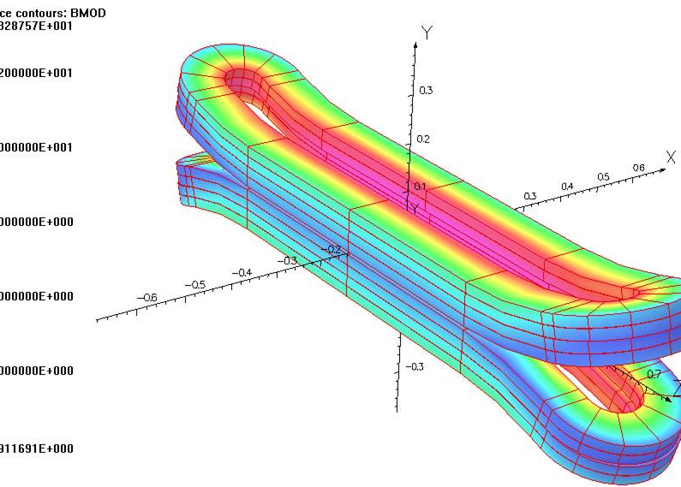
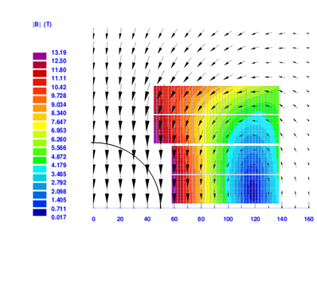
Magnetic studies
Calculations already done
Final adjustment with real insulated conductor dimensions
    Easy for 2D calculations (Roxie)
    A little more work for 3D calculations (Tosca)

Slide 7
Protection studies
See Philippe’s presentation
Studies shows that the FRESCA2 magnet protection is mastered
Study of the effect of adaptation of external resistance during discharge
Design of trace with potential wires and quench heaters to be finalized

Slide 8
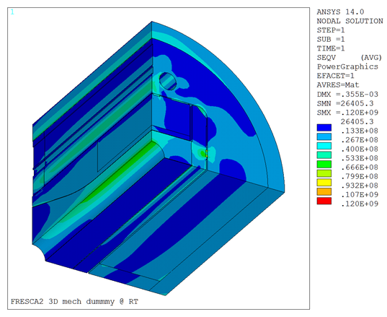
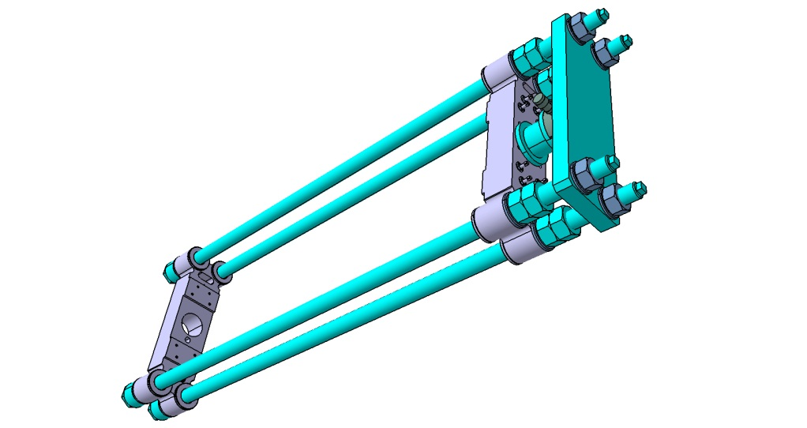
Mechanical studies
The coil and magnet structure was already made before last meeting in Warsaw → no major news
Extensive studies by Jorge Enrique (See Jorge Enrique’s presentation) to prepare the structure test (stress calculations, choice of strain gages position, …)
The prestress of axial rods is still to be discussed (reaction through coils or through iron )

Slide 9
Thermal studies
No new study since last collaboration meeting
The studies made as part of HFM task 7.2.2 will be included in the magnet design report

Slide 10
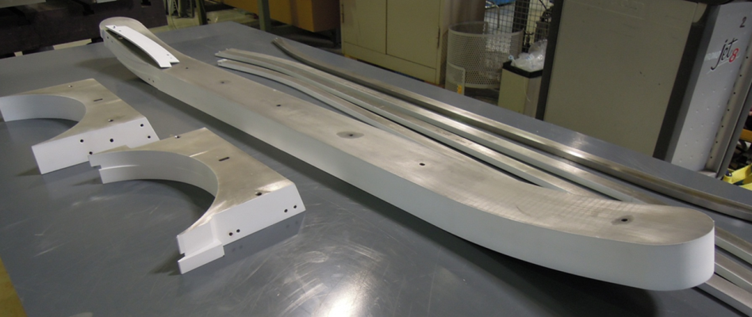
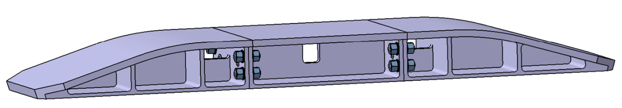
Engineering and Realizations
Winding tooling and components for 1st CU coil were ordered in view of winding operation in summer
But (see Françoise’s talk), due to huge deformations during last heat treatment of fabrication process,
    New material has to be ordered
    Winding table split in 3 parts (possible in 1 part with a 10 weeks additional delay)
Cu winding could only start in December or early January

Slide 11
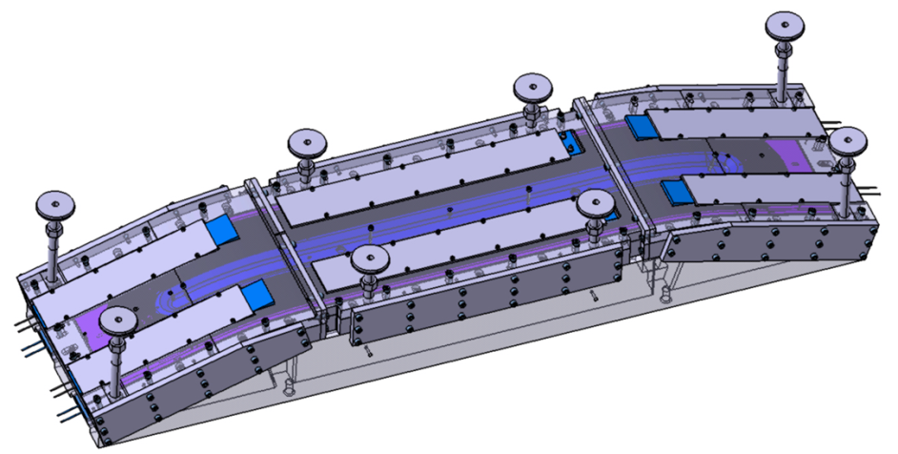
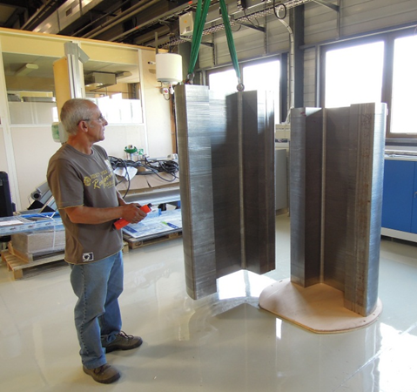
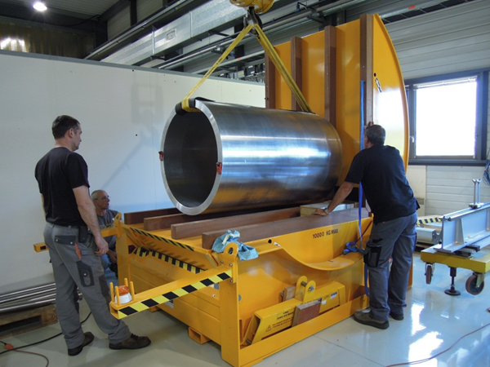
Engineering and Realizations
Tooling studies are well advanced:
    Reaction tooling
    Transport tooling
    Impregnation tooling
Structure parts are delivered

Slide 12
Deliverables
Design report by M45 (December 2012) :
  Studies almost finished
  We have 3 months to do the work : sufficient but we should start now
All components procured for the single sc coil magnet M48 (March 2013) :
  Partly ordered (coated parts) or call for tender issued
  No problem if parts not modified (to manage axial contraction of conductor)
LN2 test of structure M48 (March 2013):
  Work well in progress at CERN → should be OK

Slide 13
Realization and tests steps
Structure test : Aluminum parts to simulate the coils
    → LN2 test
2 Cu coils mounted with 1 Al dummy pole in the structure.
    → LN2 test ?
    Is this step really necessary? (or can we stop if the pole assembly made with 2 Cu coils is correct ?)
1 Nb3Sn coil (3-4) mounted with 3 Cu coils. Tested at cryogenic temperature
    → LHe test
4 Nb3Sn coils : 1st real magnet → LHe test
4 Nb3Sn coils : 2nd real magnet → LHe test

Slide 14
Global Planning

Slide 15
Conclusions
Fresca2 magnet design is quite finished. The design report will be issued this year
Winding has been delayed due to a fabrication issue.
Winding will start (Cu coil) end of 2012 or early 2013
The axial behaviour of Nb3Sn could induce tooling and components modification.
  It should be quantified (work in progress)
  Clear solution to manage this effect must be studied soon
EuCARD HFM deliverables should be OK
The work must continue after EuCARD:
  French contribution to CERN → end of 2013
  Discussion have started to organise the collaboration after 2013

