Slide 1
Speedup and Problems in Parallelization of Event Loop
Pratick Chokhani
LNMIIT

Slide 2
Software Used
AliRoot (branches/v5-02-Release)
Root (tags/v5-33-02b)
Intel's Advisor XE Beta 2013
Run Number: 180131
Data: LHC12c/180131/raw/12000180131010.22.root
CDB Storage: Local copy of year 2012
Reconstruction Macro: rec.C

Slide 3
Steps in Parallelizing using
Intel Advisor
Using the survey report check which sites of code is consuming substantial amount of time.
Annotate sites which consume substantial amount of time and run suitability test on them.
Using the suitability report check if parallelizing the annotated site in beneficial or not.
If suitability tests shows positive result, then run correctness test.
Remove all the problems shown in correctness report
Run suitability test again to check the speedup after all the lock and synchronization is done.
Finally, add parallel framework by replacing annotations with parallel framework code.

Slide 4
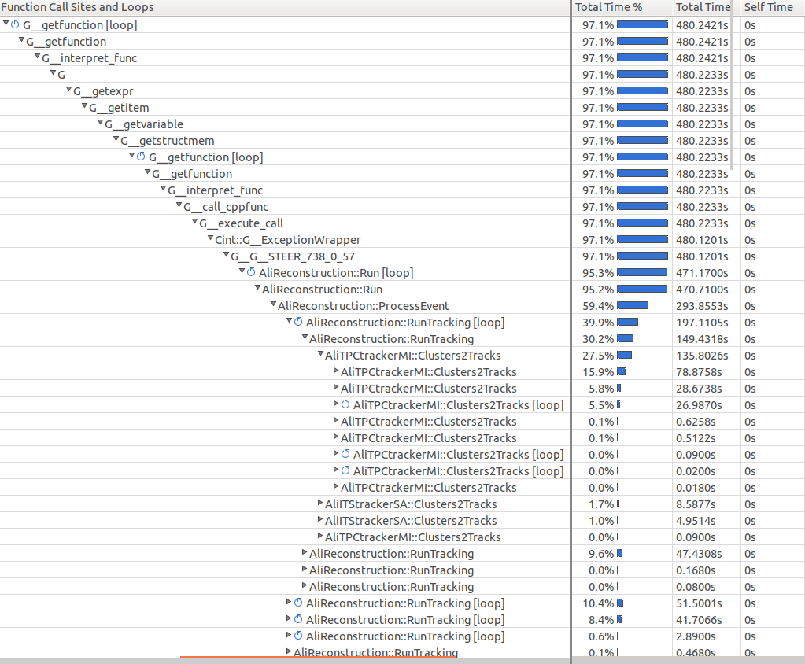
Survey Report

Slide 5
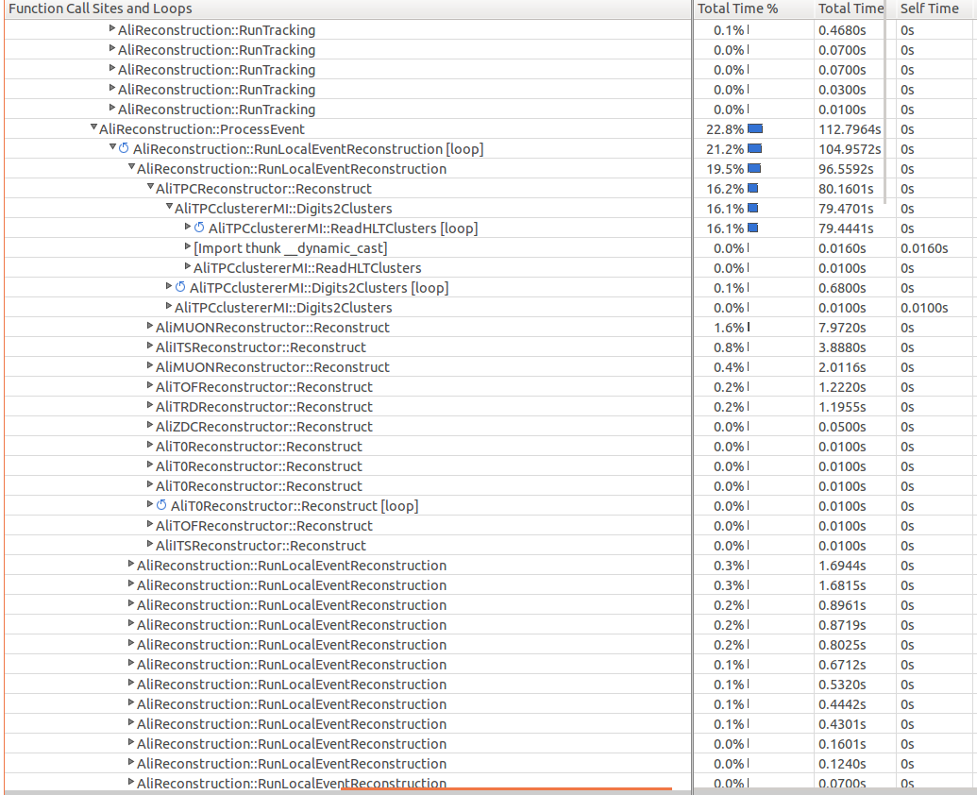
Survey Report (cont..)

Slide 6
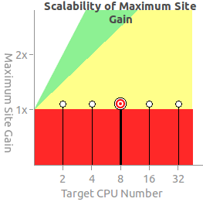

Annotations in AliReconstruction.cxx
1. Call of RunMuonTracking method
2. Loop for loading of clusters
Max Site Gain: 1.08x
Max Total Gain: 1.00x
Max Site Gain: 1.06x
Max Total Gain: 1.00x

Slide 7
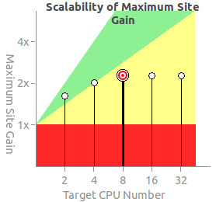
Annotations in AliReconstruction.cxx (cont..)
3. Detectors Loop in RunTracking method
Max Site Gain: 2.29x
Max Total Gain: 1.06x

Slide 8
Annotations in AliReconstruction.cxx for Event Loop

Slide 9
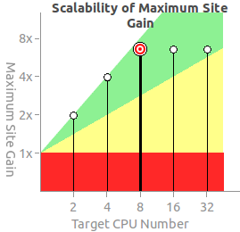
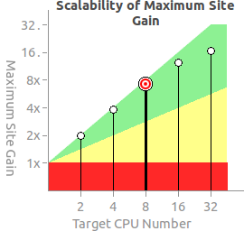
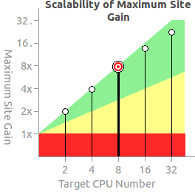
Suitability Test for Event Loop
1. No. of Events = 10
2. No. of Events = 100
Max Site Gain: 6.54x
Max Total Gain: 1.94x
Max Site Gain: 7.22x
Max Total Gain: 4.47x
3. No. of Events = 1000
Max Site Gain: 7.73x
Max Total Gain: 6.95x

Slide 10
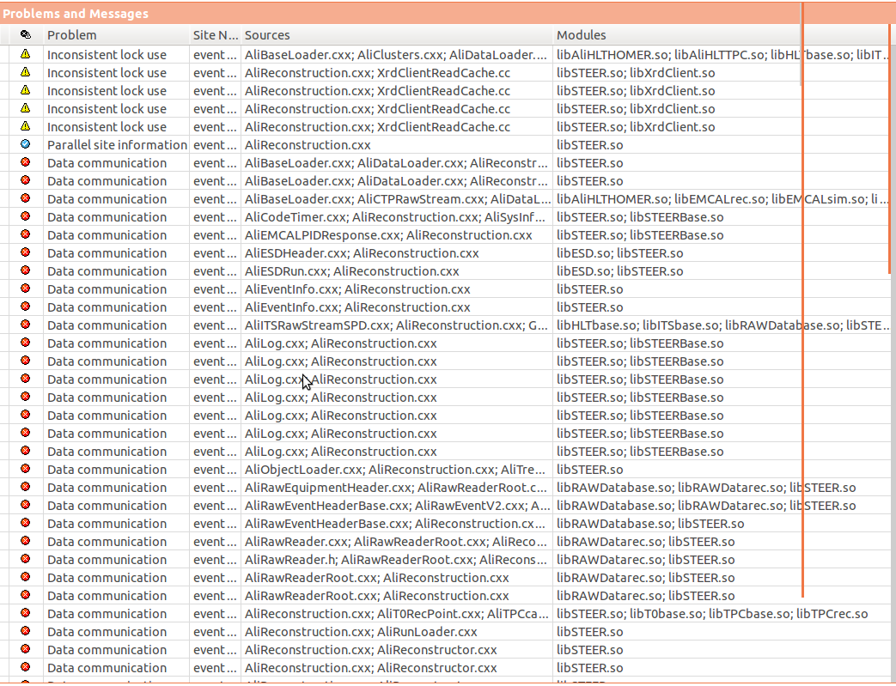
Correctness Report for Event Loop

Slide 11
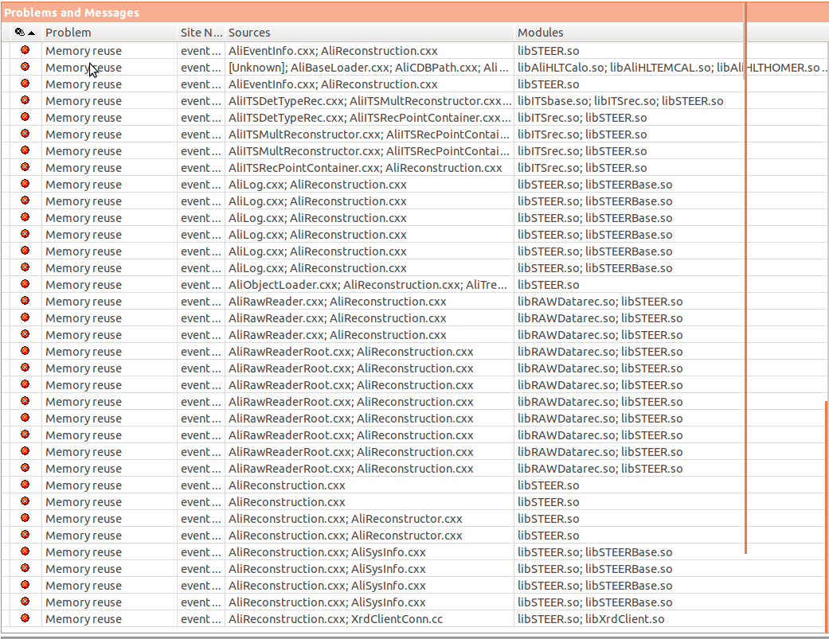
Correctness Report for Event Loop (cont…)

Slide 12
Thank You

