Slide 1
Guardian Jobs
The Digital Journey
Nigel Bicknell – Director of Business and Product Development
Josh Smith – Commercial and Schools Business Manager

Slide 2
Our Digital Journey
Guardian overview
Recruitment market
Strategy
  Response
  Innovation/Data/Mobile
Intelligent targeting
  Professional networks
  Social media
Notes:
2

Slide 3

The Guardian has an ‘open’ strategy

Slide 4
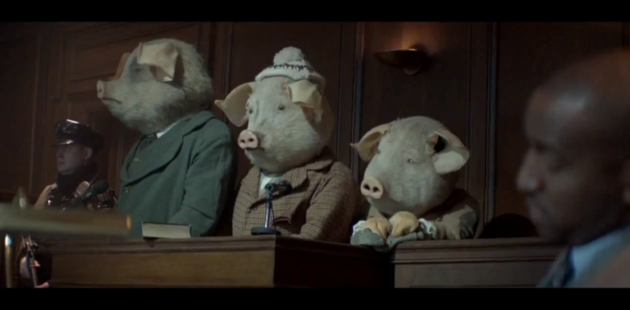
The Guardian has an ‘open’ strategy

Slide 5
Largest UK quality news brand
Weekly reach of UK adults across print and desktop (000s)
Guardian
5,248
Telegraph
5,031
Times
4,771
Independent
3,574
FT
1,169
Source: NRS PADD September 2012

Slide 6





World’s third largest English newspaper site
Global traffic
Source: Comscore December 2012 data, Global
Comscore, ranked categories, newspapers
Monthly unique users (000’s)

Slide 7
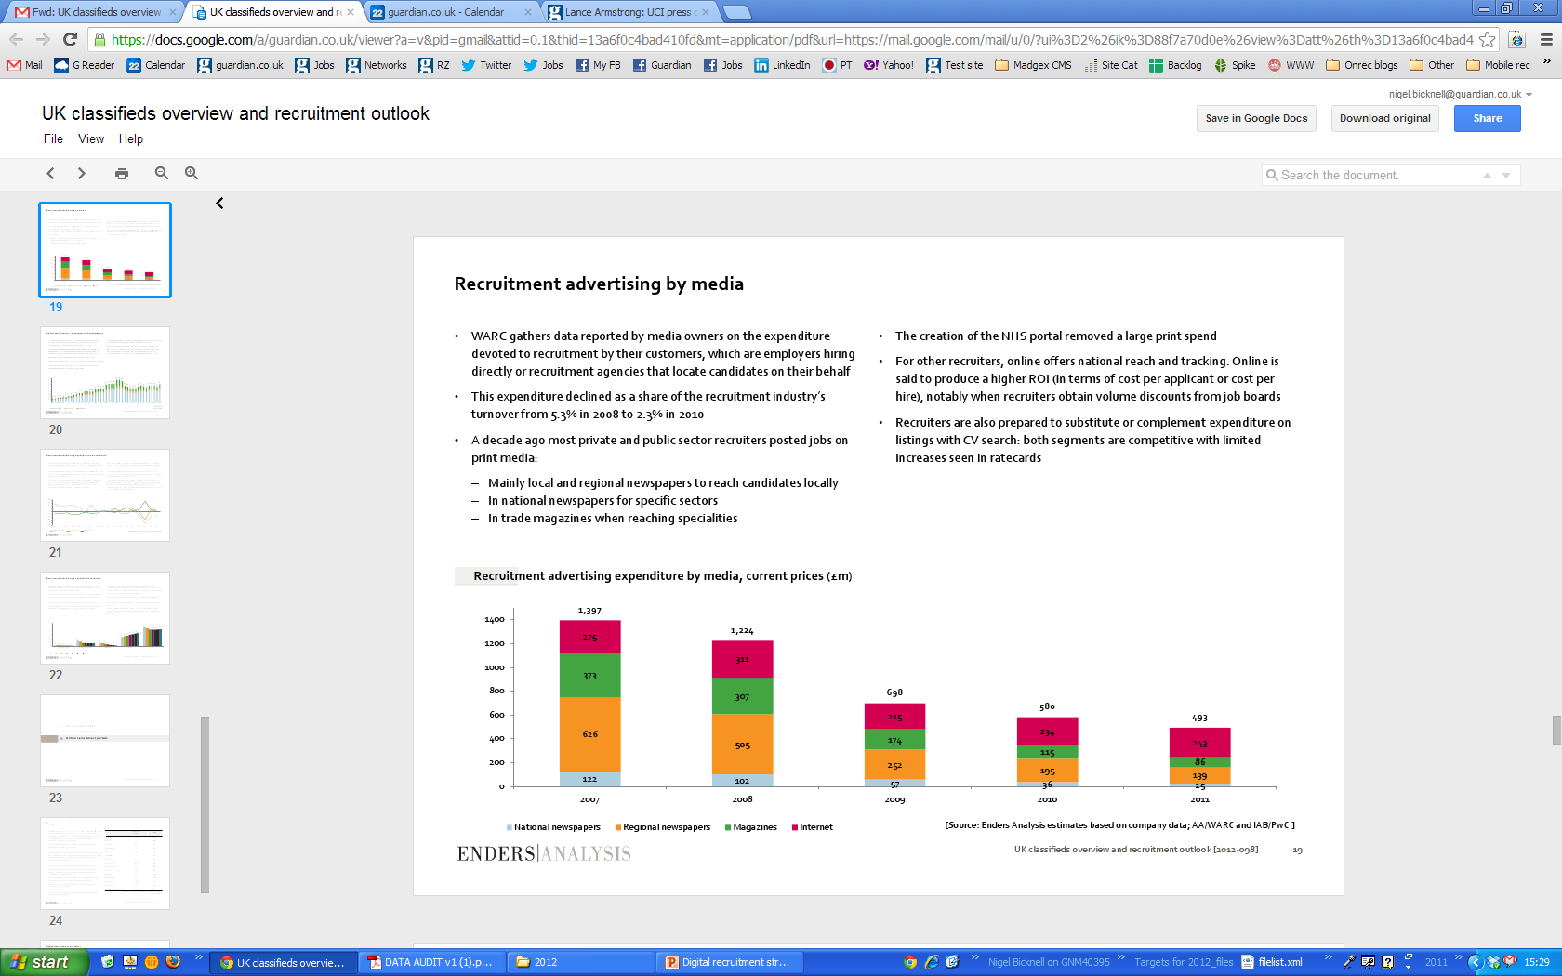
Recruitment market in decline?

Slide 8
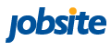
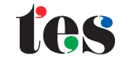

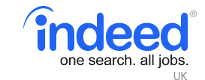
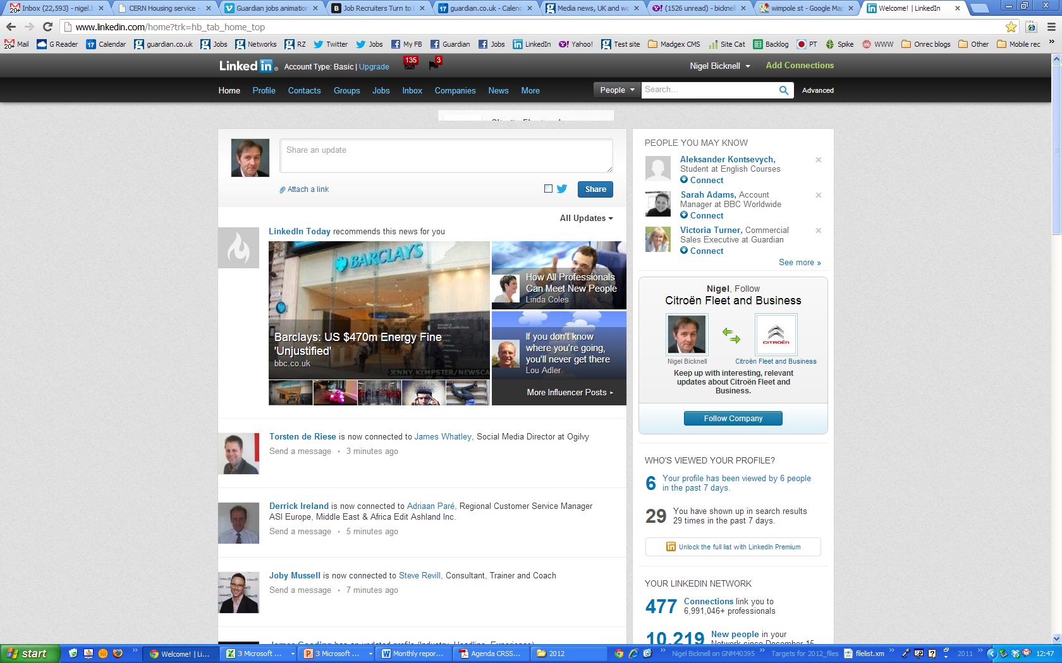
And consolidating

Slide 9
But criteria for selecting a job site unchanged

Slide 10
We are up-scaling our response operation
TECHNOLOGY
Usability & targeting
QUALITY
RESPONSE
CANDIDATES
Professional progressives
RECRUITERS
Client service & response
MARKETING
Grow, deepen, retain

Slide 11
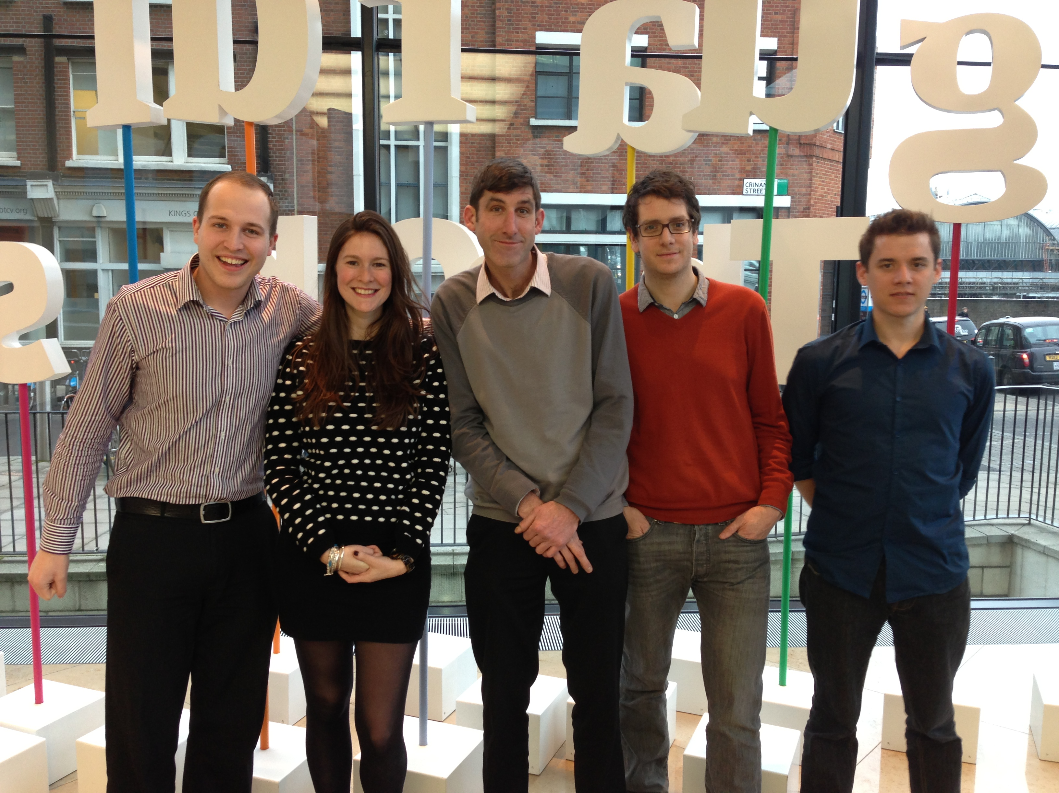
Response team

Slide 12
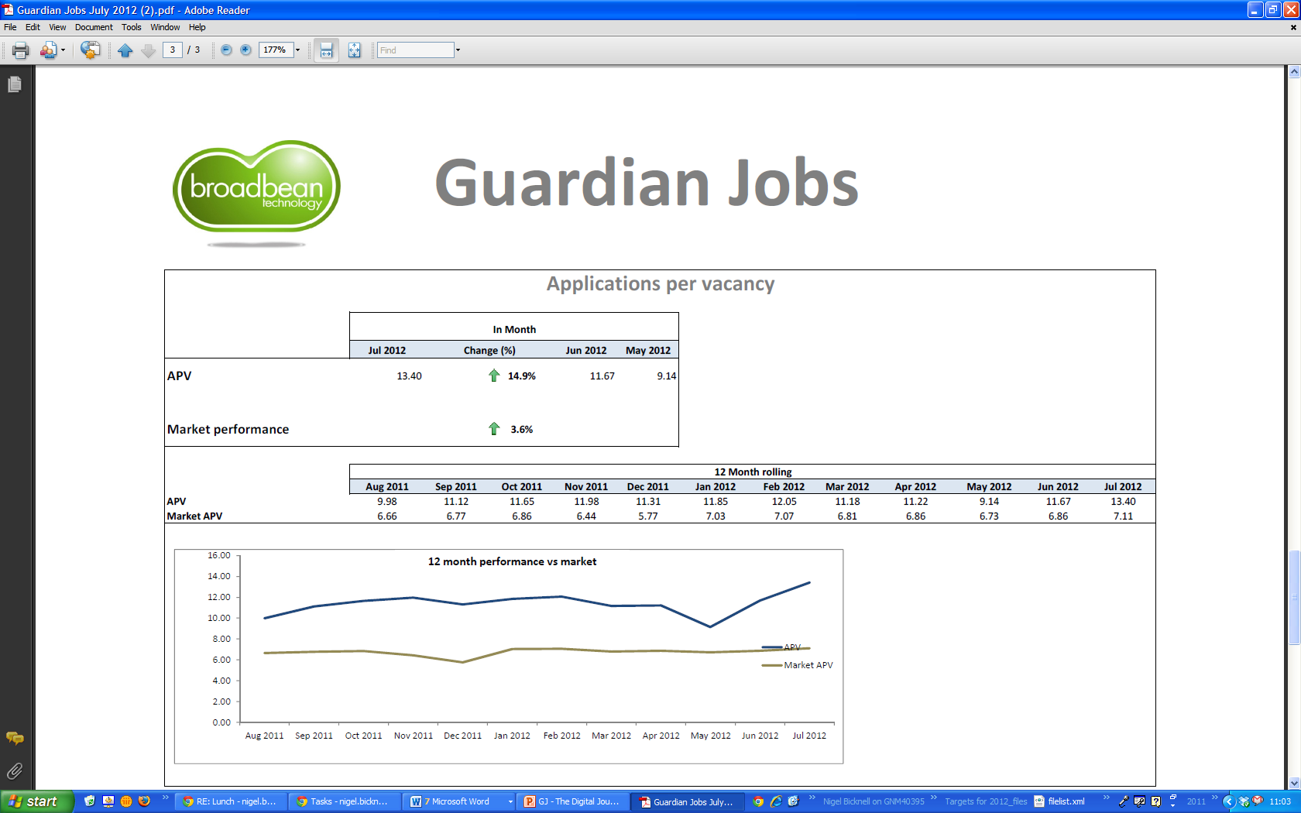
Applications up 20% and outperforming

Slide 13
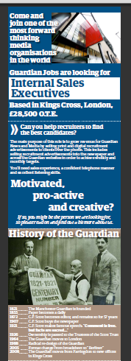
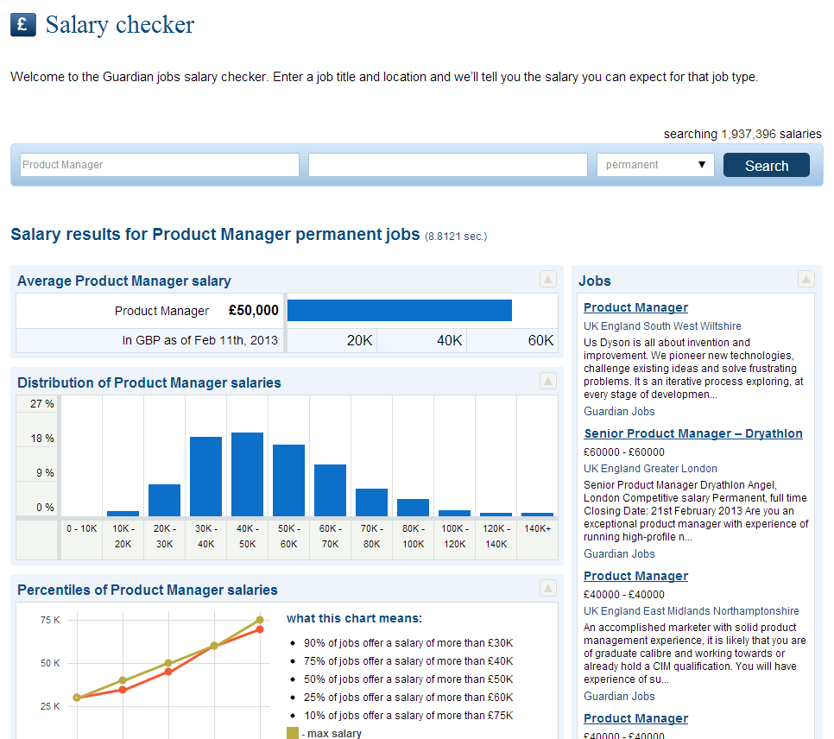
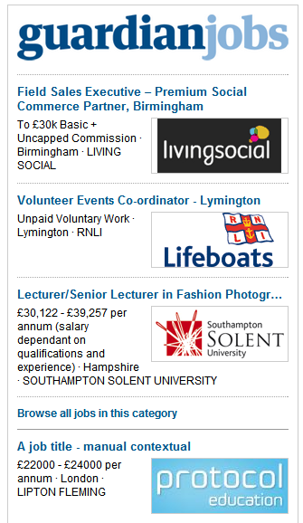
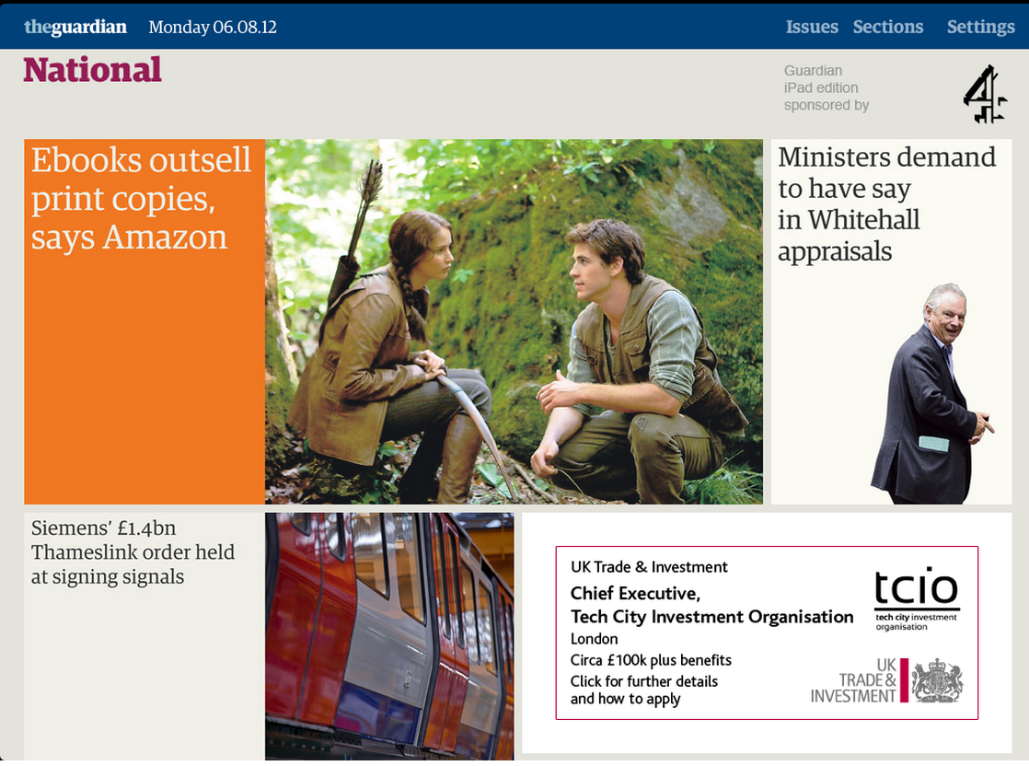
NPD to increase UX and conversion

Slide 14
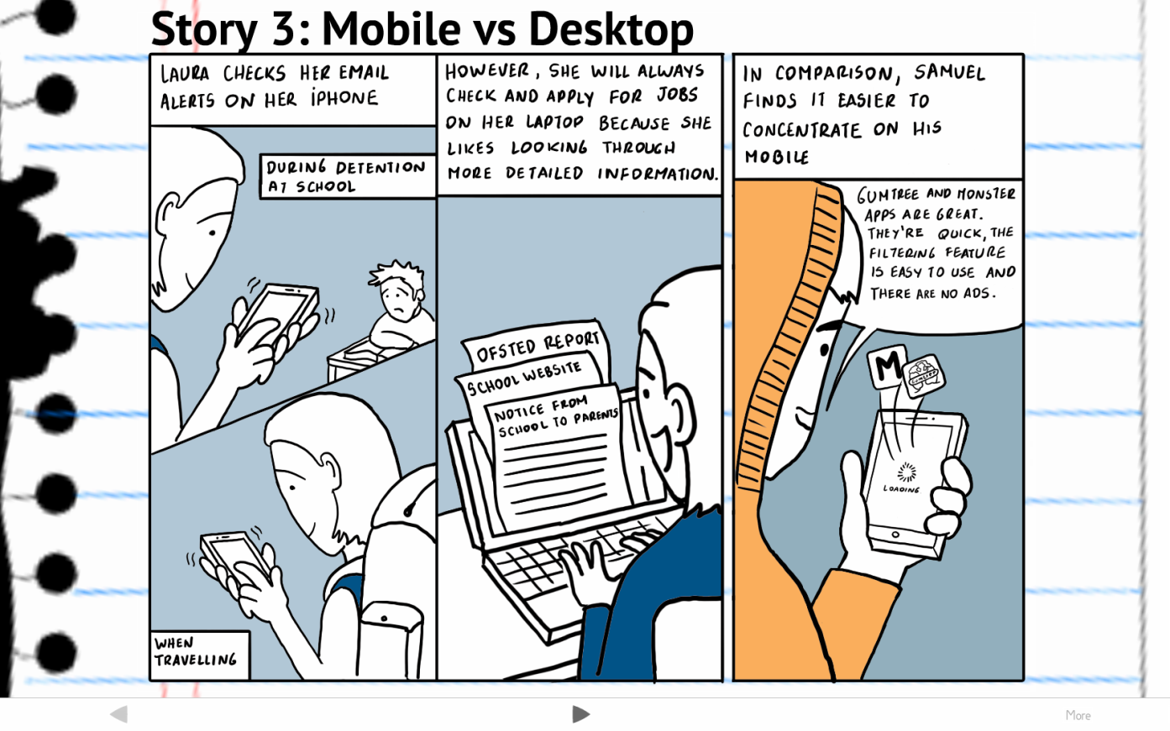
Jobs is data-driven business
Quant and qual research to uncover user needs

Slide 15
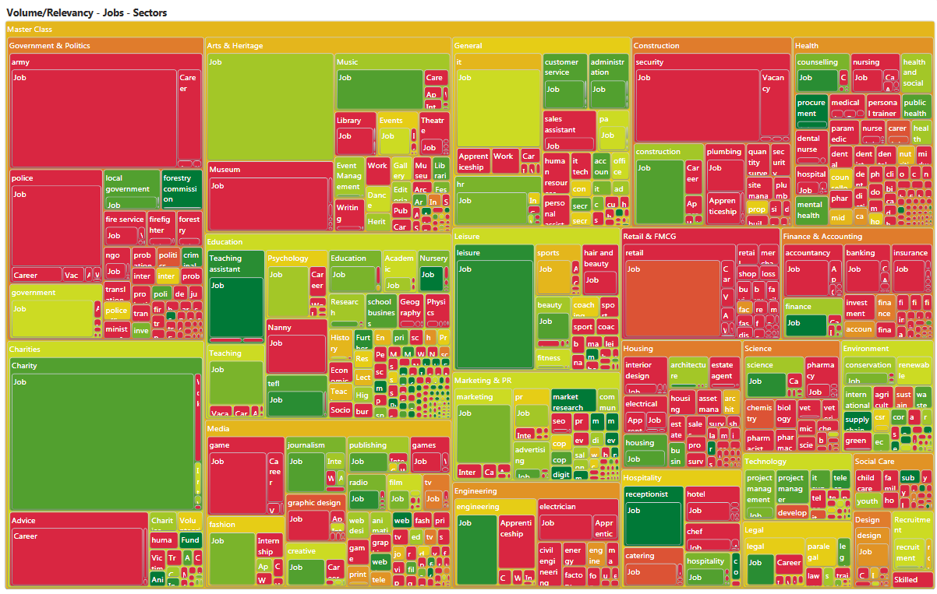
Notes:
Analysed so far…
408 different industries and sectors – 681,000 keywords
2,873 locations – 360,000 keywords
Next: the combination of sectors with locations!

Slide 16
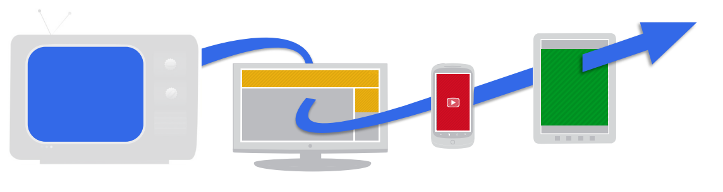
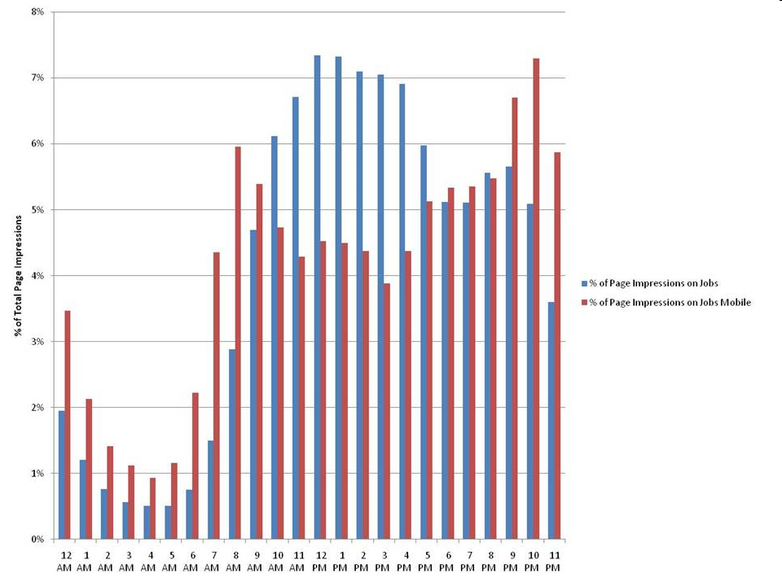
Digital job hunting is multi-device experience

Slide 17
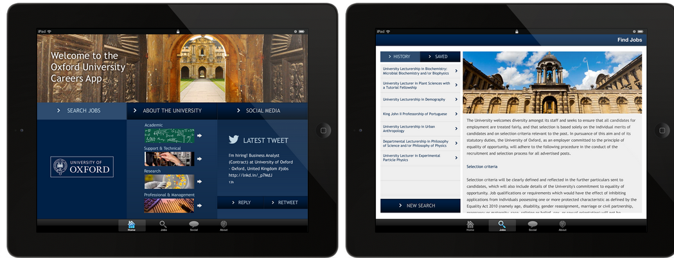
Guardian Mobile Recruitment
Mobile recruitment technology with ATS integration

Slide 18
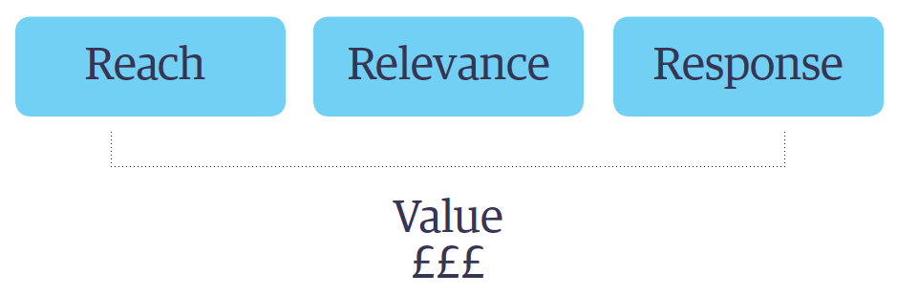
What advertisers want is still the same
Reach | Relevance | Response
Notes:
Approximation using ONS/ DWP July 2011 figures and Ipsos MORI poll on behalf of Aspire Global Network 2011/2012. Base: ALL those currently working (UK1419)
^{What has changed is} the data that is available to us to do that targetting.
18

Slide 19
29m UK workforce July 2012
30%
‘active
job-seekers’
37%
‘job receptives’
33%
‘job
satisfied’
Reach | Relevance | Response
Office of National Statistics / DWP
Notes:
Approximation using ONS/ DWP July 2012 figures and Ipsos MORI poll on behalf of Aspire Global Network 2012/2013. Base: ALL those currently working (UK1419)
^{Worth} talking about why people want to target off a job board.
19

Slide 20
What advertisers want
Reach | Relevance | Response
Notes:
Approximation using ONS/ DWP July 2011 figures and Ipsos MORI poll on behalf of Aspire Global Network 2011/2012. Base: ALL those currently working (UK1419)
20

Slide 21
What advertisers want
+ Simplicity
Reach | Relevance | Response
Notes:
Approximation using ONS/ DWP July 2011 figures and Ipsos MORI poll on behalf of Aspire Global Network 2011/2012. Base: ALL those currently working (UK1419)
^{Let’s look} at reach first.
21

Slide 22

Reach - through: ‘Audience Match’
970,000
Reach | Relevance | Response
Notes:
Ironically a fairly Complicated proposition, not in terms of the hadron collider, but in relation to buying a simple text listing….

Slide 23
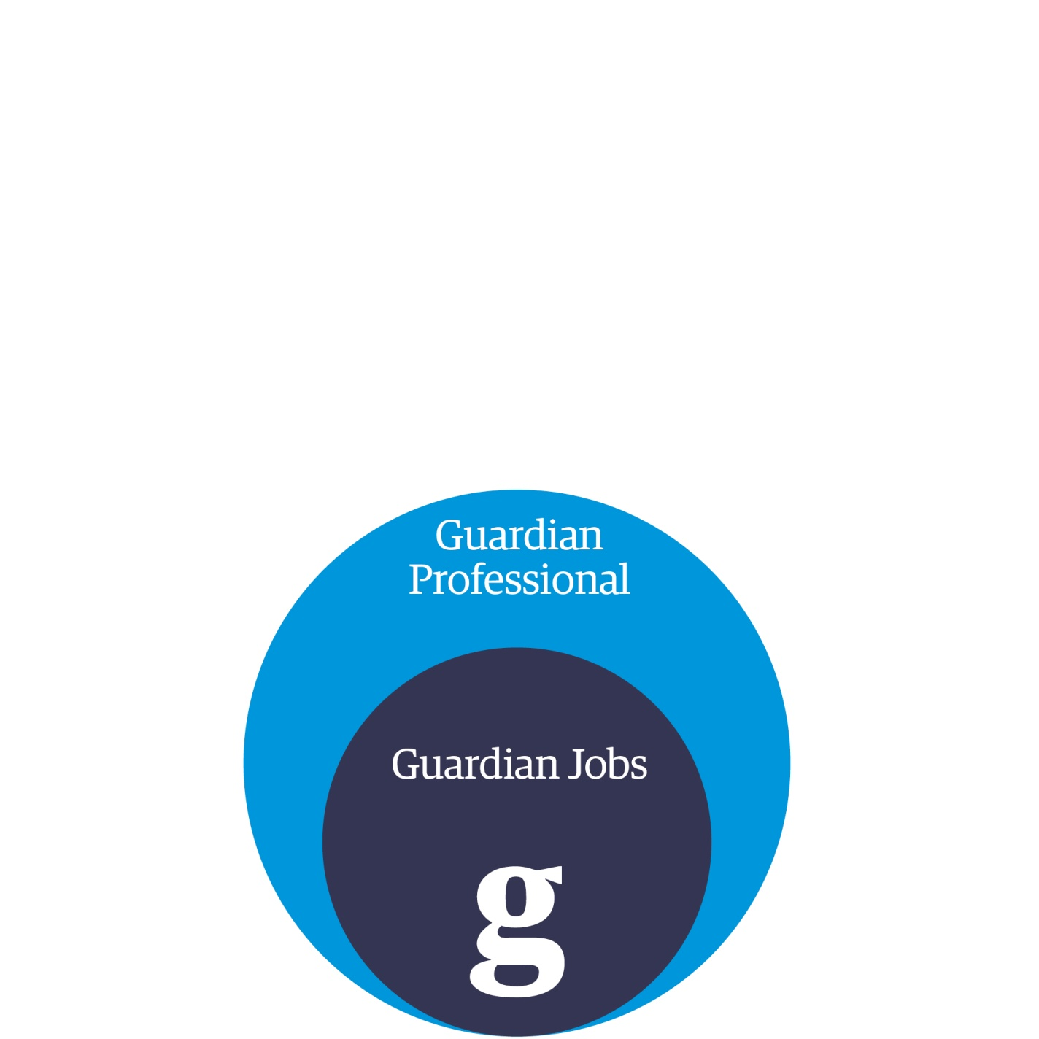
15 Networks
300,000 members
300,000
970,000
Reach | Relevance | Response

Slide 24
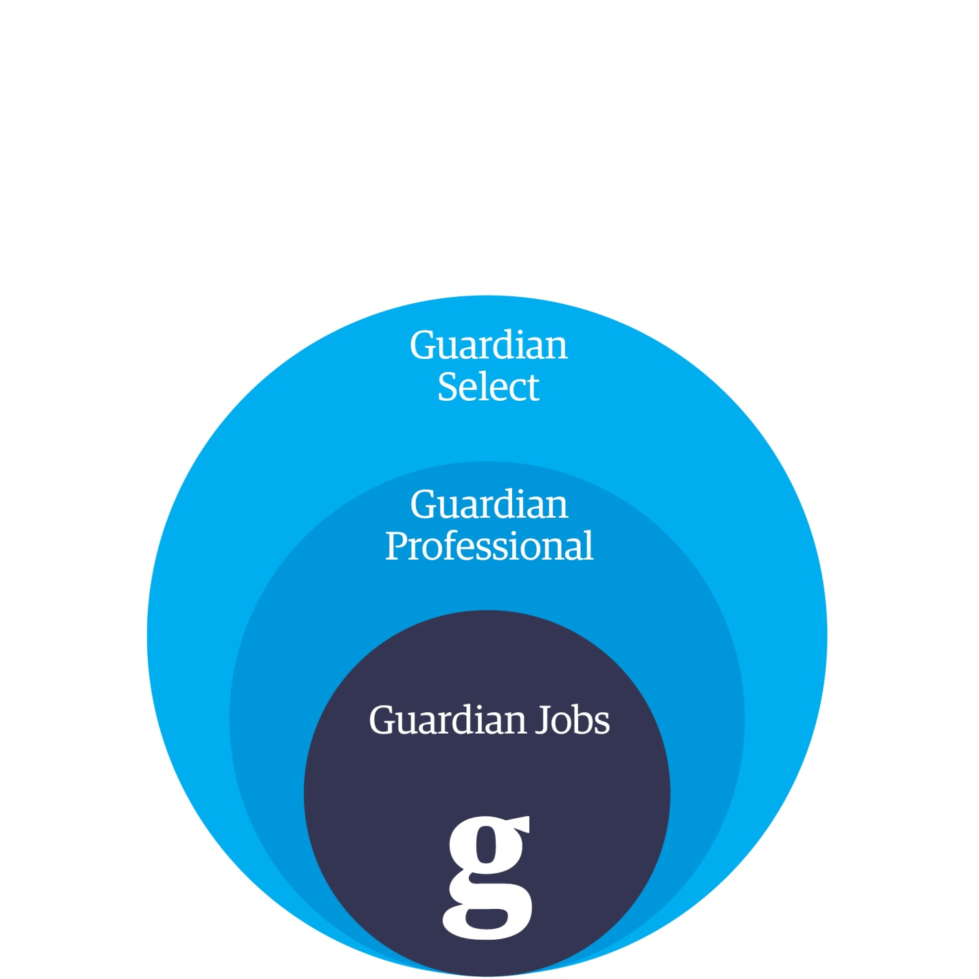
A collection of the best independent blogs and websites across the UK
5 million
224,000
970,000
Reach | Relevance | Response

Slide 25
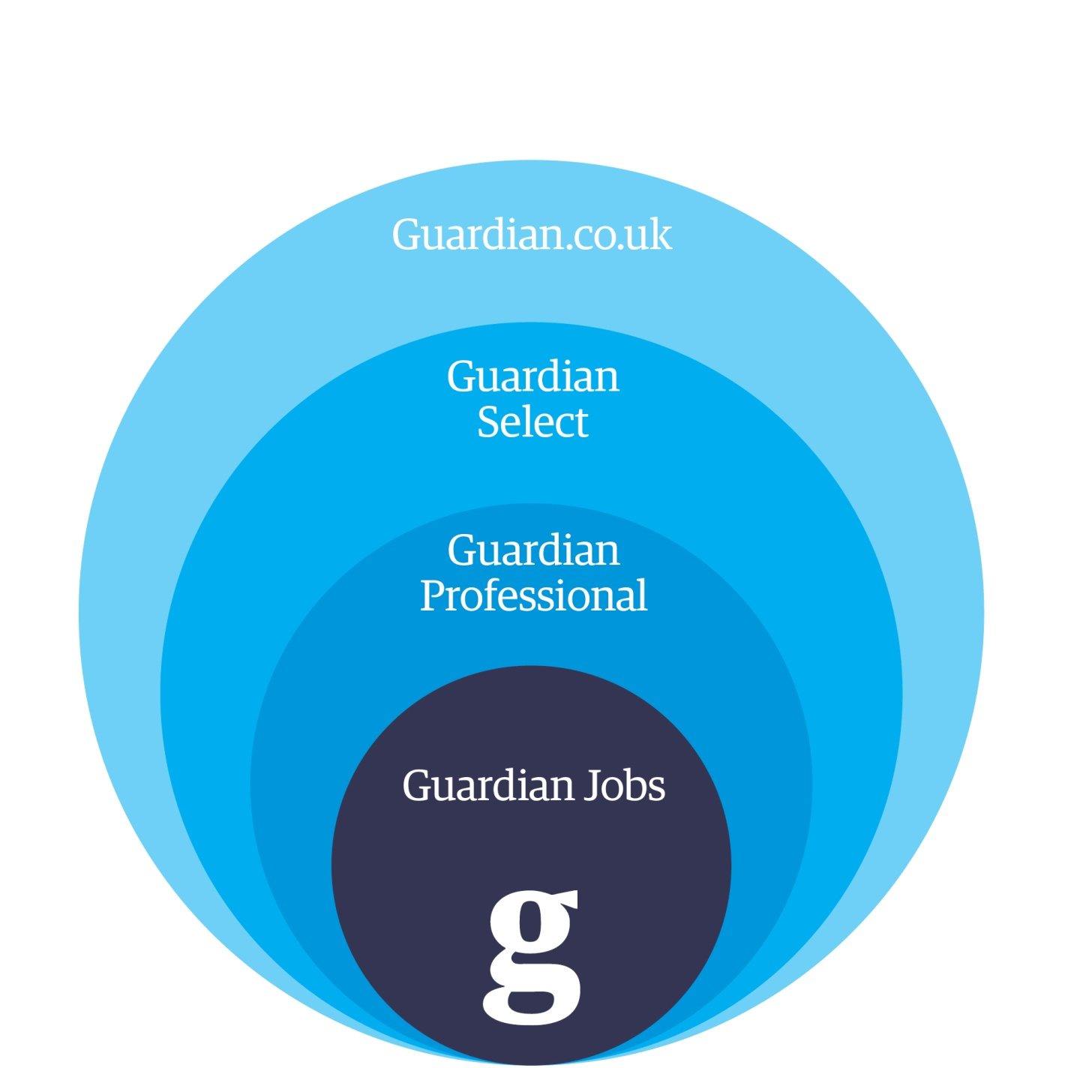
11 million
5 million
224,000
970,000
Reach | Relevance | Response

Slide 26
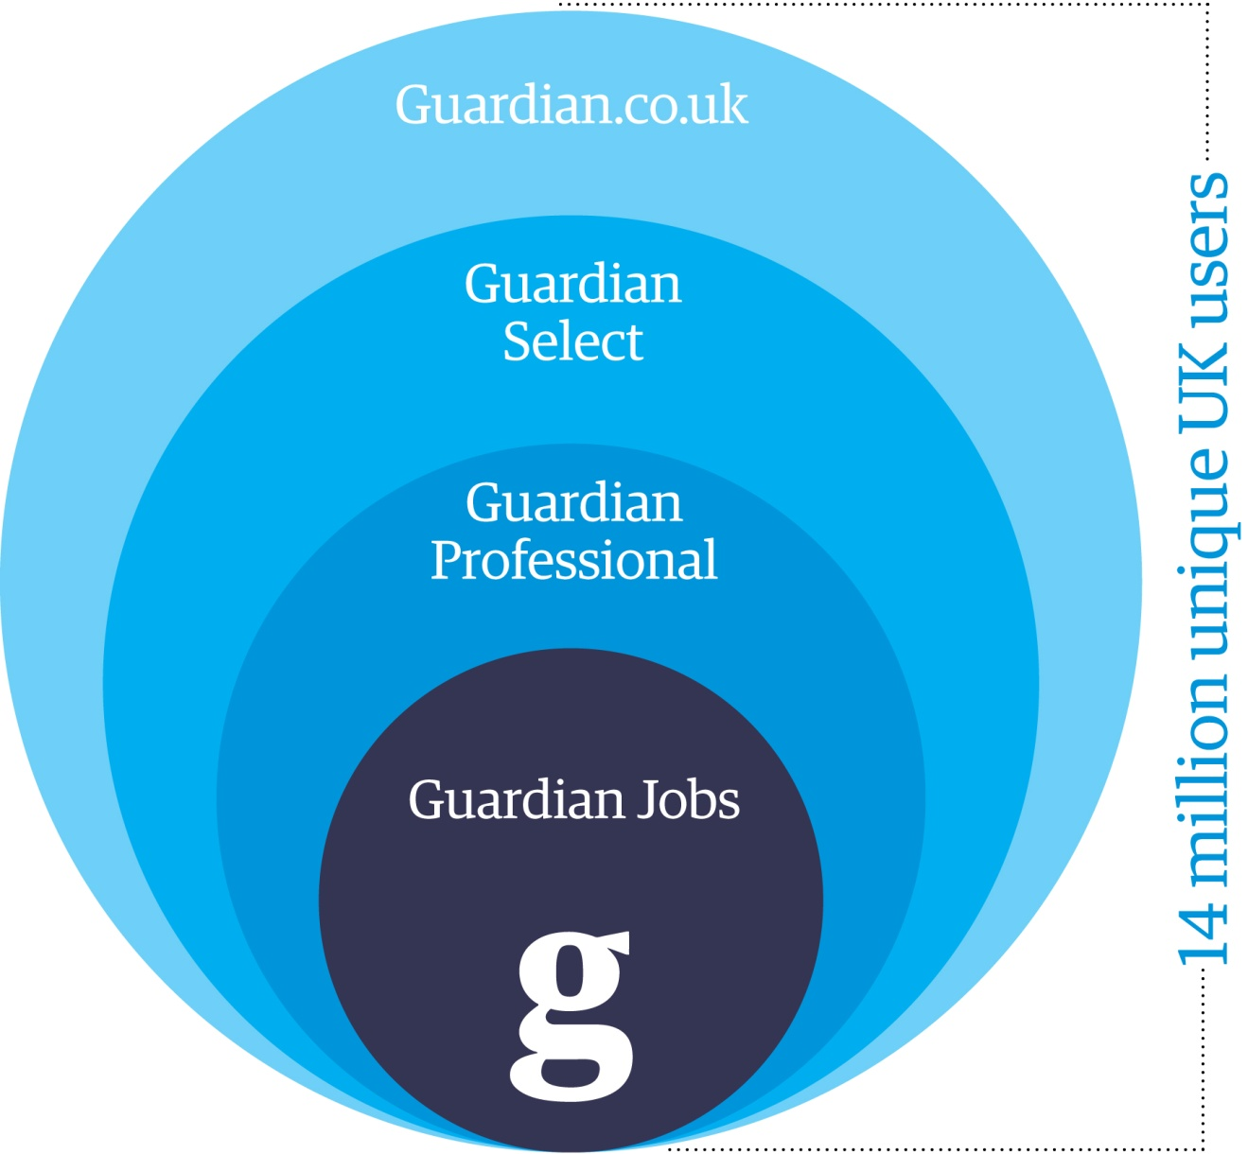
11 million
5 million
224,000
970,000
Reach | Relevance | Response

Slide 27

Reach | Relevance | Response
Notes:
Global coverage stat + fb linked in
27

Slide 28
Plenty of big digital networks out there…
So why are we different?

Slide 29
Relevance
Through:
  Multiple Data Sources
  Technology (in-house and partnerships)
  In house dedicated performance team

Slide 30
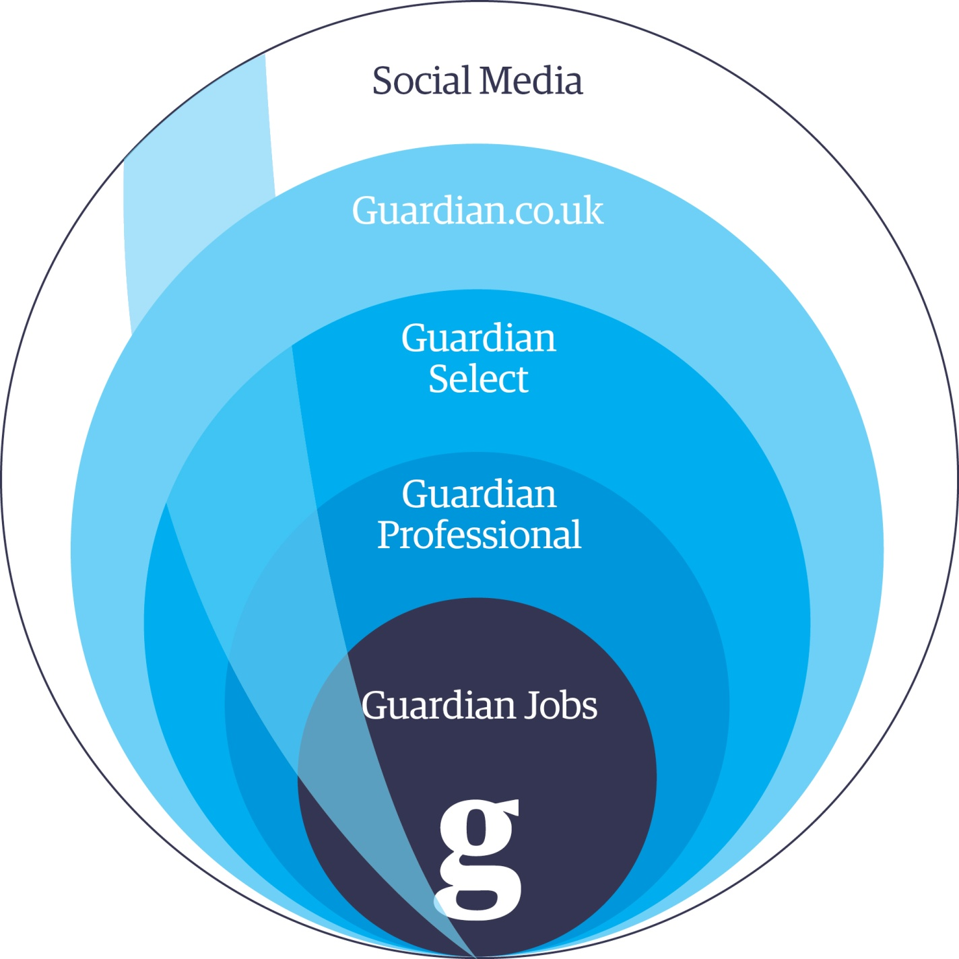
Target
Audience
Segment
Reach | Relevance | Response

Slide 31
Our selection of Audience Match segments
Government & Public | Overseas | Commercial | All sector
Central Government | Charities | Retail | Graduates
Civil service | Education | Retail management | Careers
Local Government | Environment | Sales | HR
Public Leaders | Fundraising | Publishing | Training
Government Computing | Diversity | Journalism | Environment
Finance | Graduate | Marketing | Senior Exec (£100k +)
Environment | MBA | Media | Admin
Housing | Schools | IT &Tech | SME
Social Enterprise | Senior Exec | SME
Sustainable Business | Sustainable Business | Law
Courses | TEFL | PR | Education
UK | Charities & Not for Profit | Finance | HE Lecturer
Overseas | Voluntary sector | Energy | HE Support
Student | Volunteering | Social care | Teachers
Health | Fundraiser | Social Care (general) | Research & Academic
Nursing | Housing | Adult | Education
Health Management | Trustee | CYP | FE
Health | Arts and Heritage | Elderly | Teaching Support
Reach | Relevance | Response
Notes:
Circle Law
31

Slide 32
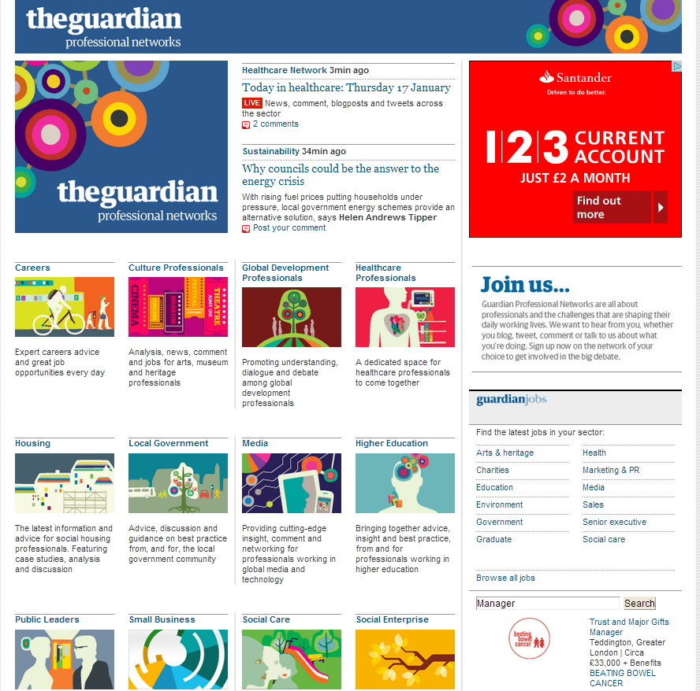
Professional Networks – 300k members across 16 Networks

Slide 33
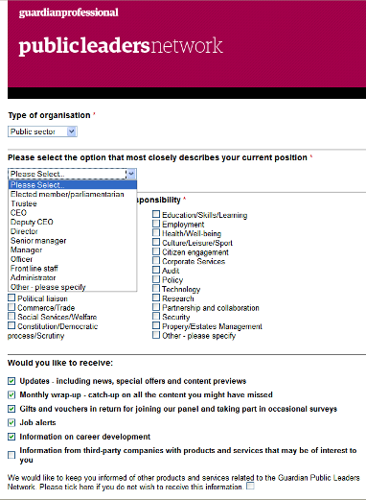
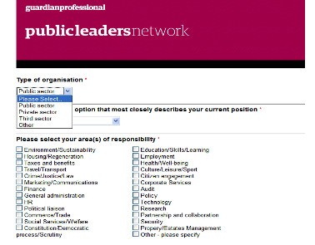
Member data
Professional Networks
Type of organisation – e.g Law firm
Seniority
Areas of responsibility e.g Legal
Location
Are they an active job seeker?
Notes:
Reaching an engaged
Professional Communities where senior professionals can network, share ideas and keep up with the latest sector news and reports.
33

Slide 34

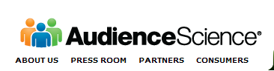
But not everyone is a member
300,000 members/36,000,000 global users
Combining member data with online data
Keywords
contained within an article, relevant to the job sector, provides a degree of certainty to target the user.
IP addresses
Firm details help
clarify target user
+
Sections of
the site visited
Within job sector
+
+
Search terms
used online
=
A cookie is then created on the user’s computer ensuring that when the user next visits the Guardian network he or she is served job ads for the relevant positions using behavioural targeting technology.

Slide 35


How are these sets defined?
Example target set = LAW
User domains + sic codes:
cliffordchance.com
linklaters.com
freshfields.com
allenovery.com
dlapiper.com
lovells.com
herbertsmith.com
slaughterandmay.com
eversheds.com
ashurst.com
nortonrose.com
simmons-simmons.com
cms-cmck.com
sjberwin.com
pinsentmasons.com
addleshawgoddard.com
blplaw.com
bakermckenzie.com
Viewed guardian.co.uk sections:
/law
/law/afua-hirsch-law-blog
/law/baby-barista-blog
/uk/series/justice-on-trial
/commentisfree/libertycentral
/law/series/guardian-legal-network
law/series/the-bundle
Keyword tags:
‘Law’‘Legal’
‘Contract Law’
‘Civil Law’
‘Property Law’
‘Contract Law’
‘Religious Law’
‘Constitutional and Administrative Law’
‘New Media Law’
‘Media Law’
Jobs category
jobs.guardian.co.uk/
jobs/legal
+
+
+
+
Search terms
Law jobs
Legal jobs
Law
Solicitor
Legal
etc
=
Targeted
cookie

Slide 36
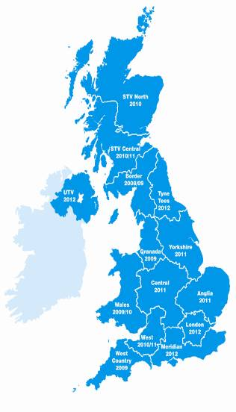
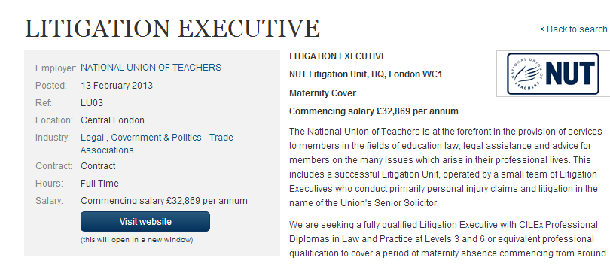
Geo-targeting by country, TV region or town.
Notes:
Law job from Laurence

Slide 37
However….
This all relies on our assumptions of who your candidates are.
What if we are missing things out?

Slide 38

We can now find people who look EXACTLY like your last applicants
We track 1,000 applicants to legal roles anonymously across 100 million websites and analyse their behaviour across 600 points of data.
Behaviours such as:
  URLs
  Content
  Analysis of the page
  Interactions with the site
  Page flow
  Site flow
  Dwell time
  Page depth
  Time of day
  Browser

Slide 39
Candidate look-alikes
You are left with a segment of users that are almost identical in their online behaviour to your previous job applicants.
When someone matching this criteria lands on guardian.co.uk or one of our partner sites we show them your latest Law job.
Every time it does this, it learns from the successes of previous campaigns and refines the following targeting segments.
Why do recruiters care?
Help them get in front of a high calibre audience they would otherwise have to pay head-hunters to target.
Notes:
The reverse of this is happening simultaneously by tracking those that look at these jobs but don’t apply and then removing these behaviours from the set.
Every time it does this it learns from the success’s of previous campaigns and refines the following targeting segments.
You are left with a segment of users that are almost identical in their online behaviour to your previous job applicants and don’t look like the people who viewed your jobs previously but DIDN’T apply.
When someone lands on guardian.co.uk or one of our partner sites we show them your latest Law job.

Slide 40
Social media
How does Social Media fit into this picture?
Should a media company operate on Social Media?
Why would a company with 70 million monthly users need to be on social media?

Slide 41
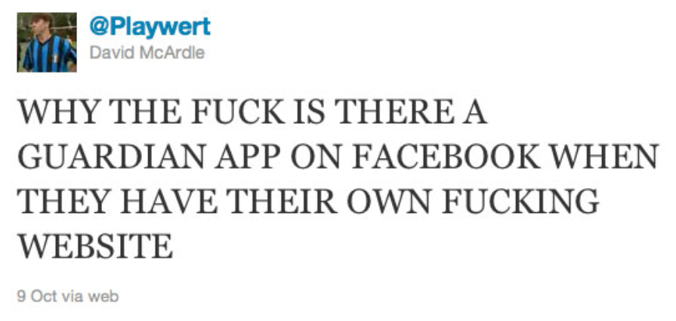

Slide 42



Guardian extends both reach and targeting by using Facebook and other platforms.
71 million
1 Billion

Slide 43
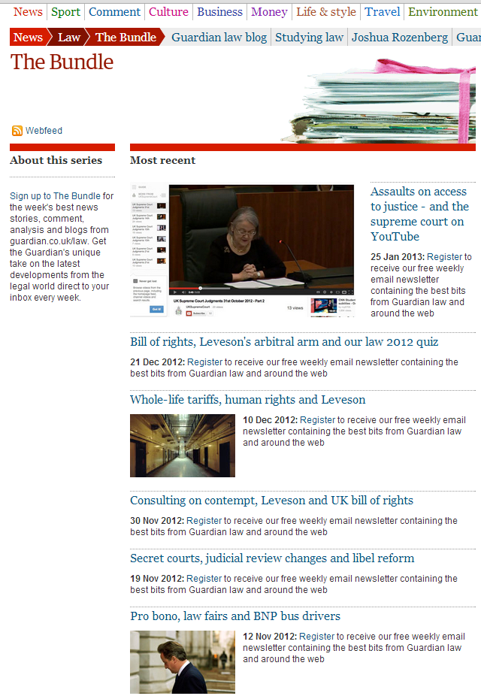
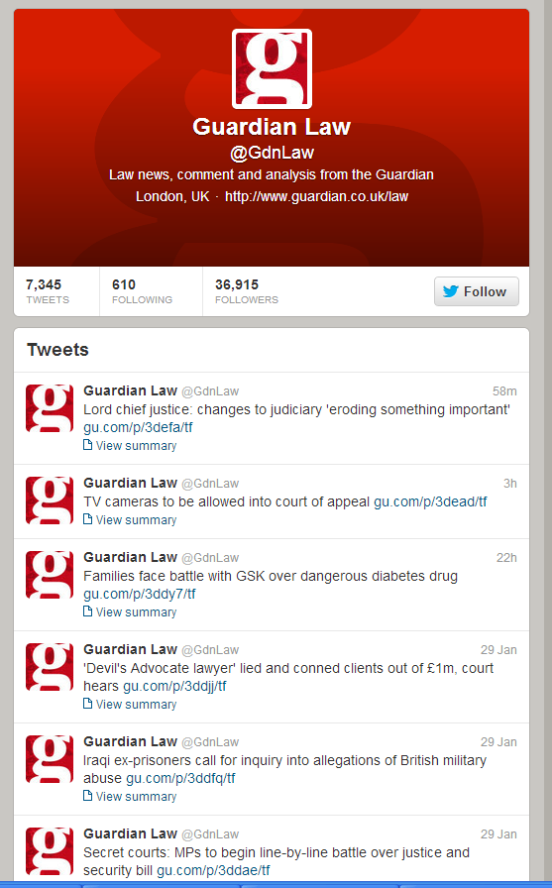
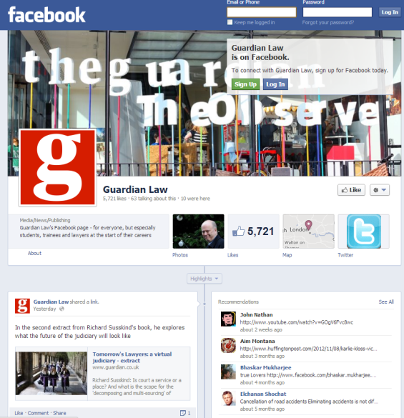
Social Media
Enables us to do more targeted activity.
We can send Law Jobs out to these people
Guardian Law Facebook Page – 6,000 likes
Guardian Law Twitter Following – 37,000 followers
The Bundle subscribers – 8,000 subscribers

Slide 44
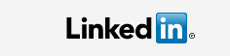
We run targeted ads on Linked in
Job function – e.g. Legal
Job title – e.g. Lawyer
Location e.g. UK - London
Company name e.g. – e.g. Clifford Chance
Company Industry –e.g. Legal
Skillset – e.g. criminal Law
Group membership –e.g. UK solicitors
Notes:
You need to burn a lot of money before you can see what works.

Slide 45
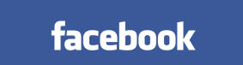
We run targeted ads on Facebook
Interests - Law
Job titles - Lawyer
Company names – Slaughter and May
Locations - London
Connections – People who have liked the Guardian Law Facebook page and their friends.

Slide 46
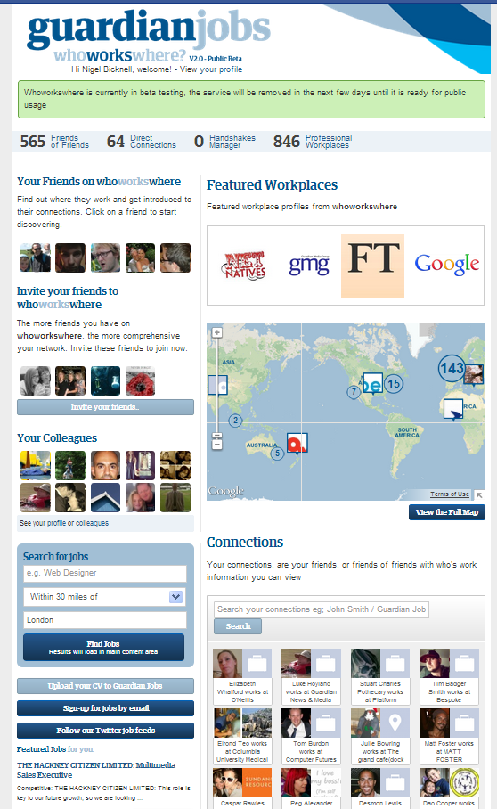
Next phase of targeting on Facebook
  Who Works Where
  Facebook Custom audiences
  Using our member data such as email addresses to target users when they are on Facebook.
  e.g. the 8,000 subscribers to The Bundle.

Slide 47
So what?
We put your roles in front of relevant candidates that you would otherwise have to use head-hunters for.
We even help you reach those candidates on Social Media through our technology and expertise.

Slide 48
Response
Approaching 500,000,000 recruitment page impressions for over 1,000 recruitment campaigns.
One of our most successful product launches

Slide 49
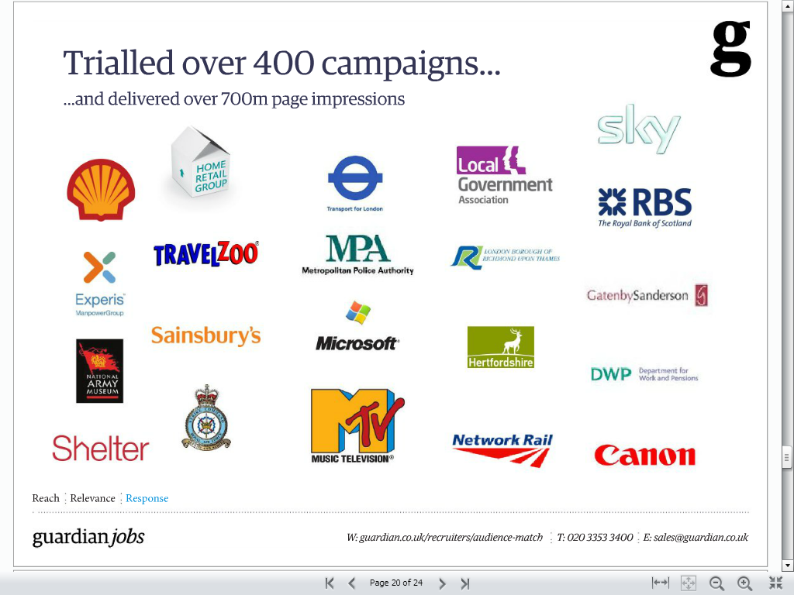














Our clients…

Slide 50
Ne
Next Steps
Work with us to help you recruit staff in Europe or the UK?
  Grab me
Work with us on a cost per hire/cpc model?
  Grab me
See some case studies
  Grab me
Let us build a mobile enabled recruitment site for you?
  Grab Nigel
Strategic Partnerships?
  Grab Nigel

Slide 51
