Slide 1
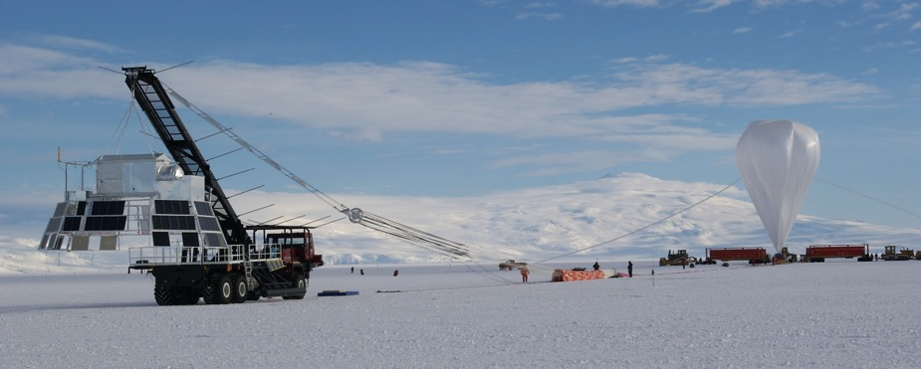
Search for Primary Antiparticles and Cosmological Antimatter with BESS
  Akira Yamamoto (KEK) and John W. Mitchell (NASA-GSFC)
  for the BESS Collaboration
  To be presented at SpacePart12, held at CERN, November 5-7, 2012

Slide 2





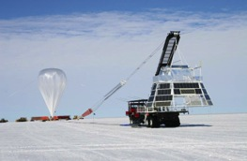



BESS Collaboration
High Energy Accelerator
Research Organization(KEK)
National Aeronautical and
Space Administration
Goddard Space Flight Center
BESS
Collaboration
The University
of Tokyo
University of Maryland
Kobe University
University of Denver
Institute of Space and
Astronautical Science/JAXA
Balloon-borne Experiment with a Superconducting Spectrometer

Slide 3
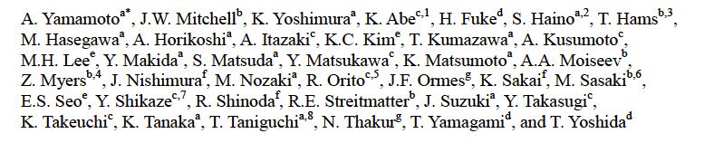
BESS Collaboration
High Energy Accelerator
Research Organization(KEK)
National Aeronautical and
Space Administration
Goddard Space Flight Center
BESS
Collaboration
The University
of Tokyo
University of Maryland
Kobe University
University of Denver
Institute of Space and
Astronautical Science/JAXA
Balloon-borne Experiment with a Superconducting Spectrometer

Slide 4
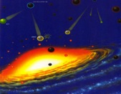
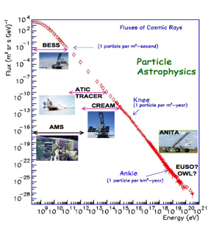
BESS Objectives
Balloon-borne Experiment with a Superconducting Spectrometer
Search for Antiparticle/Antimatter
  p, D Novel、primary cosmic origins
    Evaporation of Primordial Black Holes (PBHs)
    Annihilation of super-symmetric particles
  He Baryon asymmetry in Universe
Provide Fundamental Cosmic-ray Data
  Precise p, He, μ spectra
    Propagation, solar modulation,
    Atmospheric secondaries,
    Atmospheric neutrinos
  Light isotopes
p
p
Galaxy
Anti
Galaxy

Slide 5
Outline
Introduction
      Cosmic-ray antiparticles
      BESS history and progress
New results from BESS-Polar
      Low-energy Antiproton Measurement
      Antihelium Search
      Antidueteron Search in progress
      Proton flux and annual/daily variation during flight (not covered, in this talk)
Summary

Slide 6
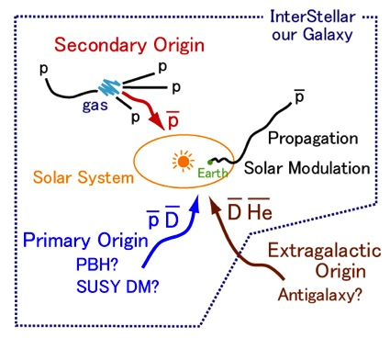
Cosmic-ray Antiparticles
Provide Unique Information
  Elementary particle phenomena in the early universe
  Matter/Antimatter asymmetry,
  SUSY dark matter,
  Primordial black hole (PBH), etc.
Fundamental Cosmic-ray data
  Production, propagation
  Solar modulation
  Interaction in the atmosphere

Slide 7
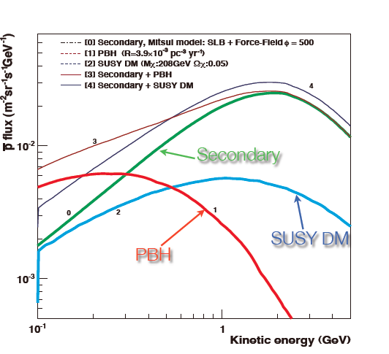

Possible Origin of Antiprotons
Collision Origin (Secondary)
  Kinematically suppressed in low energy
Primary Origin
  Evaporation of primordial black holes (PBH)
  Annihilation of SUSY DM
  Could be probed by spectral shape
6
Notes:
Among these antiparticles, antiproton is easiest to observe. It is produced in the primary cosmic-ray interatction with intersellar gas in this reaction. Left figure shows theoretical calcuration of secondary antiproton. This process requires threshold energy, the low energy production was kinematically suppressed as shown here. So it is good probe to search any process to produce low energy antiproton such as evaporation of primordial black hole.

Slide 8
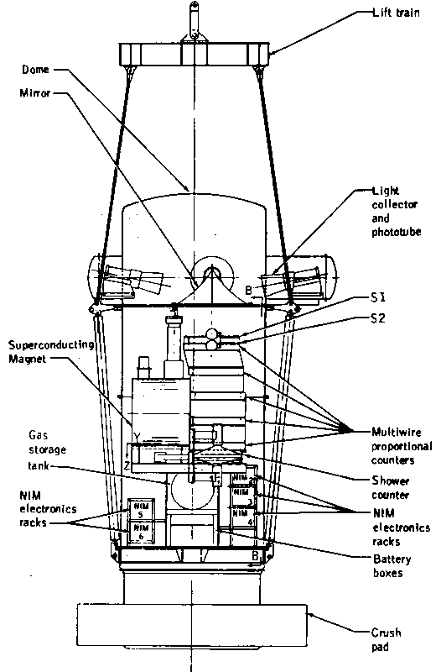
Search for Antiparticle/Antimatter
Novel Cosmic Origin
1979: p-bar first observation
(Golden et al, , Bogomolov et al.)
1981: Anomalous excess (Buffington et al)
1985: ASTROMAG proposed
1987: LEAP, PBAR
1988: Astromag frozen
1991: MASS
1992: IMAX
1993: BESS, TS93
1994: CAPRICE, HEAT
1996: Solar minimum
1998: CAPRICE, AMS-01
2000/2: Heat-pbar
2004: BESS-Polar I
2006-present PAMELA (Polar-orbit)
2007: BESS-Polar II - Solar minimum
2011-present: AMS-02 (ISS)

Slide 9
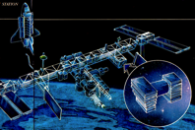
Search for Antiparticle/Antimatter
Novel Cosmic Origin
1979: p-bar first observation
(Golden et al, , Bogomolov et al.)
1981: Anomalous excess (Buffington et al)
1985: ASTROMAG proposed
1987: LEAP, PBAR
1988: Astromag frozen
1991: MASS
1992: IMAX
1993: BESS, TS93
1994: CAPRICE, HEAT
1996: Solar minimum
1998: CAPRICE, AMS-01
2000/2: Heat-pbar
2004: BESS-Polar I
2006-present PAMELA (Polar-orbit)
2007: BESS-Polar II - Solar minimum
2011-present: AMS-02 (ISS)

Slide 10
Search for Antiparticle/Antimatter
Novel Cosmic Origin
1979: p-bar first observation
(Golden et al, , Bogomolov et al.)
1981: Anomalous excess (Buffington et al)
1985: ASTROMAG studied
1987: LEAP, PBAR
1988: Astromag frozen
1991: MASS
1992: IMAX
1993: TS93,BESS first flight
1994: CAPRICE, HEAT
1996: Solar minimum
1998: CAPRICE, AMS-01
2000/2: Heat-pbar
2004: BESS-Polar I
2006-present: PAMELA (Polar-orbit)
2007: BESS-Polar II Solar minimum
2011-present: AMS-02 (ISS)
BESS:
1985 Thin Solenoid conf. proposed
U.Tokyo started preparation
1987: Collaboration formed
1993: First flight, p-bar mass identified
1995: Distinctive peak observed at 2 GeV
1998: Spectrum up to 4.2 GeV
Precise p spectrum: ~ 120 GeV
2000: Charge dependence, p-bar/p
2001: Atmospheric p and p-bar, mu
2002: BESS-TeV: p spectrum: ~ 500 GeV
2004: BESS-Polar I
2007/8 BESS-Polar II
Consistent
11 flights
successful

Slide 11
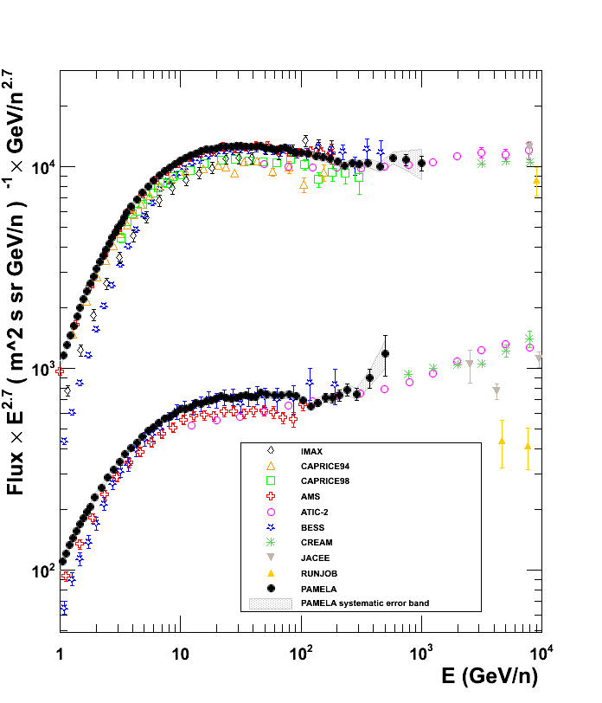
Search for Antiparticle/Antimatter
Novel Cosmic Origin
1979: p-bar first observation
(Golden et al, , Bogomolov et al.)
1981: Anomalous excess (Buffington et al)
1985: ASTROMAG studied
1987: LEAP, PBAR
1988: Astromag frozen
1991: MASS
1992: IMAX
1993: BESS first flight
1994: CAPRICE, HEAT
1996: Solar minimum
1998: CARPRICE, AMS-01
2000/2: Heat-pbar
2004: BESS-Polar I
2006-present: PAMELA (Polar)
2007: BESS-Polar II Solar minimum
2011-present: AMS-02 (ISS)
BESS:
1985 Thin Solenoid conf. proposed
U.Tokyo started preparation
1987: Collaboration formed
1993: First flight, p-bar mass identified
1995: Distinctive peak observed at 2 GeV
1998: Spectrum up to 4.2 GeV
Precise p spectrum: ~ 120 GeV
2000: Charge dependence, p-bar/p
2001: Atmospheric p and p-bar, mu
2002: BESS-TeV: p spectrum: ~ 500 GeV
2004: BESS-Polar I
2007/8 BESS-Polar II
Courtesy: M. Casolino
Consistent
11 flights
successful

Slide 12
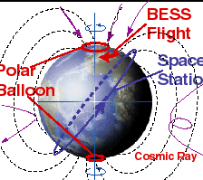
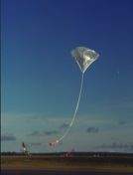
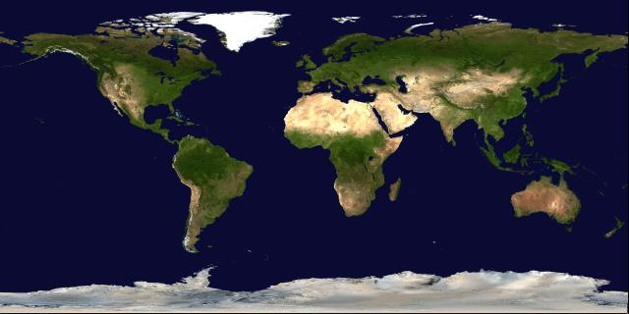
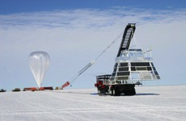
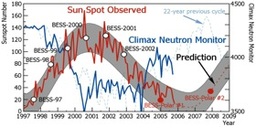
BESS Ballooning
1993~ 2000, BESS, North Canada
2002, BESS-TeV
1999, 2001, BESS-Ground, Japan
2001, BESS-TeV, Fort Sumner
2004, 2007 /08: BESS-Polar, Antarctica
11 scientific balloon flights2004

Slide 13
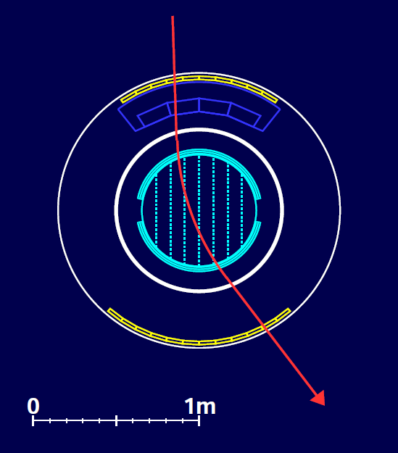
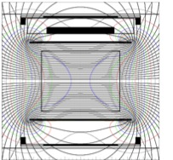
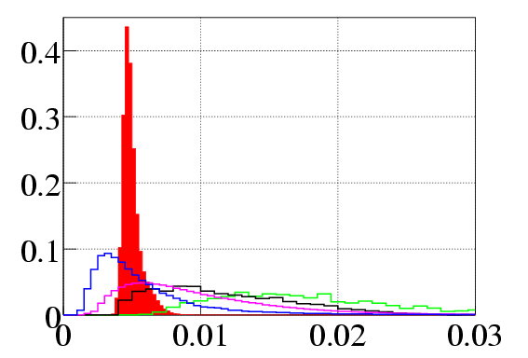
BESS Spectrometer: Concept
  Rigidity measurement
  SC Solenoid (L=~1m, B=~1T)
  Transparent
  Min. material (5 g/cm²)
  Uniform field
  Large acceptance
  Central tracker
  Drift chamber
      Minimize scattering
  δ ~150μm
  Z, m measurement
  R, β --> m = ZeR 1/β²-1
  dE/dx --> Z
  JET/IDC
  Rigidity
TOF
β, dE/dx
√

Slide 14
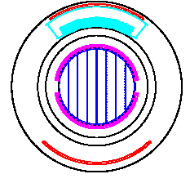
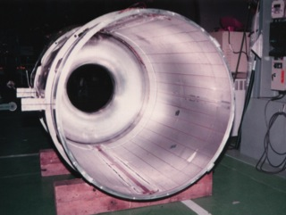
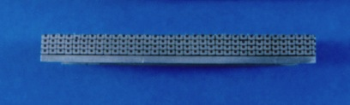
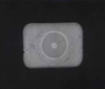
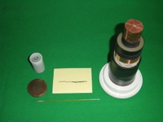
Transparent Superconducting Magnet
・Strong magnetic field with thin coil
・Persistent current
BESS:
Diameter: 1 m
Coil thickness: 8 mm
B: 1.0 T
r
B
1.2 x 1.8 mm²
Al, NbTi/Cu

Slide 15
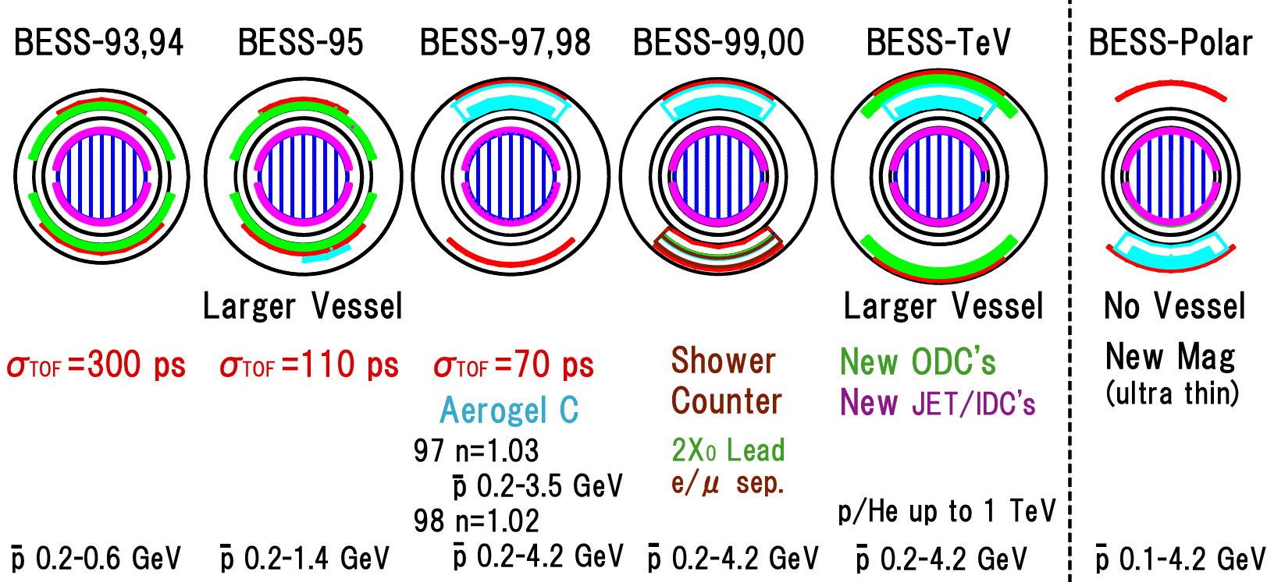
Evolution of BESS
Nine northern latitude flights (1+ days) 1993-2002 and two Antarctic flights in 2004 (8.5 days) and 2007 (24.5 days)
Including BESS-Polar I and II: 11,643 antiprotons reported 0.2 - 4.2 GeV
2001, 2002 2004, 2007
p 6, 2 43 415, 398 668, 558 147 1,512, 7,886
Maximizing advantages with balloon experiments

Slide 16
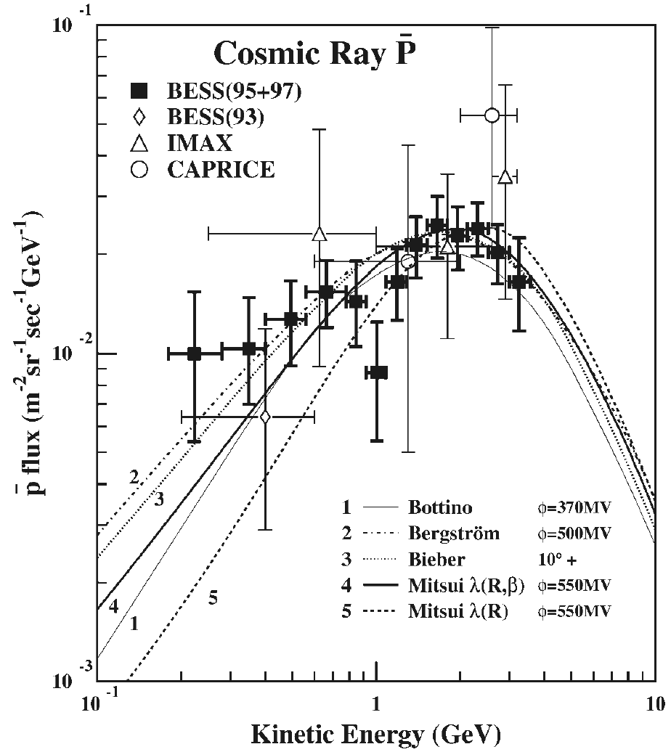
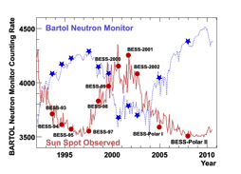
Antiproton Spectrum Measured at
Solar Minimum in 1995 - 1997
Peak for Secondary
Flatter in low energy?
  Primary Origin?
More statistics necessary at solar minimum
S. Orito et al. PRL, Vol. 84, No, 6, 2000

Slide 17
Antiproton Spectrum Measured at
Solar Minimum in 1995 - 1997
Peak for Secondary
Flatter in low energy?
  Primary Origin?
More statistics necessary at solar minimum
S. Orito et al. PRL, Vol. 84, No, 6, 2000

Slide 18
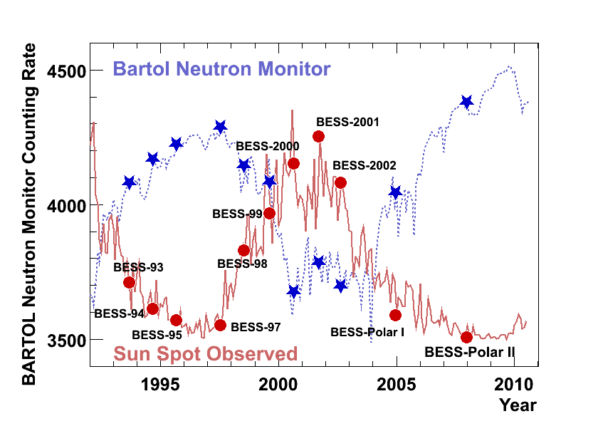
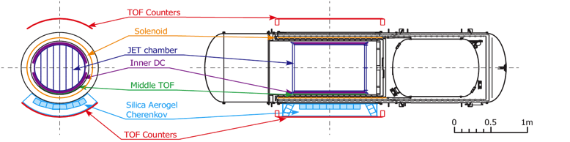
BESS-Polar Experiment
  - Very precise measurement
  at solar minimum
  - Antarctica Long duration flight
  at high latitude,
  low rigidity cut-off,
  - Large AΩ and transparent
  with a new high-resolution
  spectrometer

Slide 19
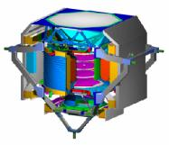
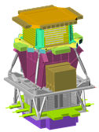
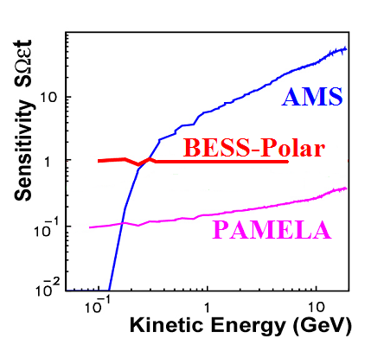
BESS-Polar Feature
(3 years)
(10+20 days)
AMS02
PAMELA
BESS-Polar provides
the best sensitivity in low energy
(3 years)
Acceptance
(m²sr)
Flight Time
Latitude
Altitude
(km)
Launch
AMS
0.5
TBD
< 51.7
690
2011
PAMELA
0.0021
>6 years
<70.4
320-390
2006
BESS-Polar II
0.3
25 days
> 75
36
2007

Slide 20
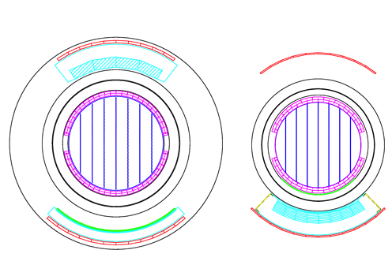
BESS-Polar Spectrometer
Minimizing Material in particle path
BESS-2000
BESS-Polar
TOF Upper
Coil
JET/IDC
MTOF
5 g/cm²
ACC
18 g/cm²
TOF Lower
10 g/cm2
Minimize material in spectrometer
New detector (Middle TOF)
Energy range extended
down to 0.1 GeV
Low power electronics
Solar Power System, Longer life of LHe cryogen
Long duration flight

Slide 21

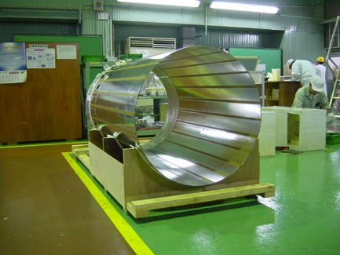
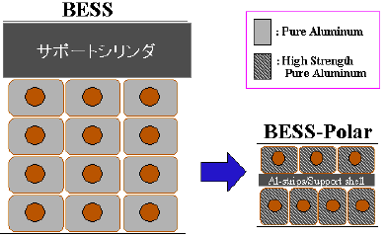
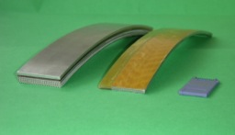
BESS-Polar：Superconducting Magnet: much thinner and more transparent
Support Cyl.

Slide 22
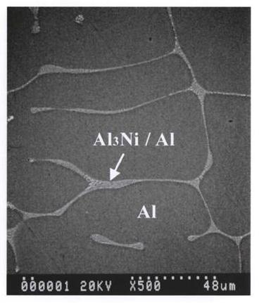
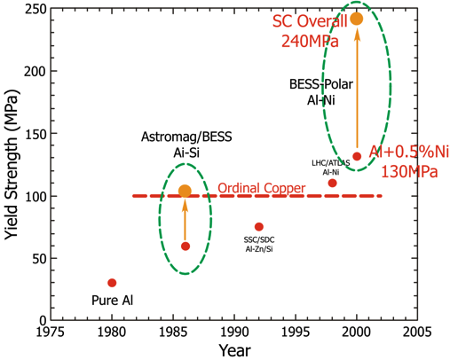
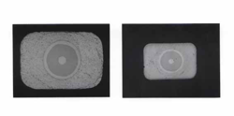
A Key: High-Strength Al stabilized Superconductor
Micro alloying Al+Ni 0.5%
Cold-work hardening 15~20%
Structure
Conductor
BESS
BESS–Polar
1.2 1.8
0.8⋅ 1.1

Slide 23
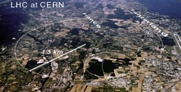
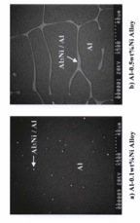
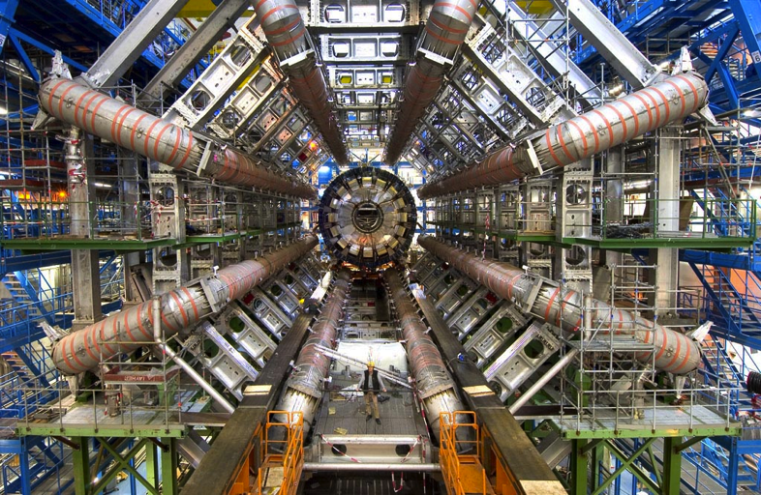
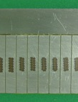
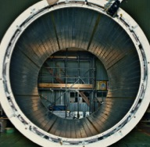
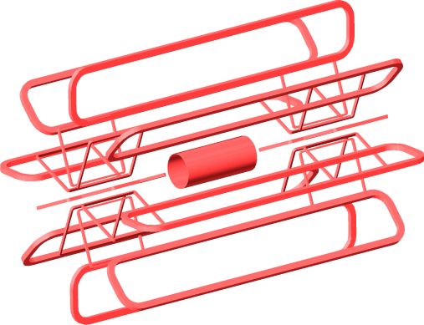
LHC: ATLAS Central Solenoid using the same technology
Solenoid

Slide 24
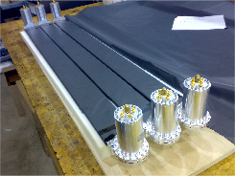
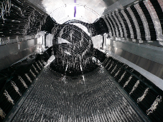
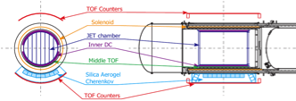
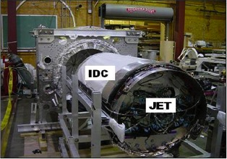
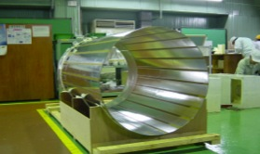
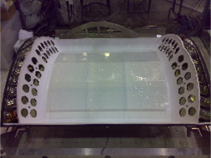
BESS Polar II Spectrometer
Large acceptance
  Uniform B field ~0.8Tesla
  Cylindrical coaxial layout
  0.3 m²sr
Transparency for low E particles
  Thin solenoid 0.1 X0/wall
Precise momentum measurement
  Central Tracker σ=100 ~150um 52 points
  MDR ~ 270 GV
Redundant Particle ID
  dE/dX (JET, TOF, MTOF)
  TOF, ACC
TOF
MTOF
ACC

Slide 25





BESS-Polar II
- Launch -

Slide 26


BESS-Polar II Flight summary
Launch date | Dec. 23, 2007
Observation time | 24.5 days
Cosmic-ray observed | 4.7 G events
Data size | 13.5 Tb
Flight altitude | ~36 km (6~5g/cm²)
Data recovery Detector recovery | Feb. 3, 2008 Jan. 16, 2010
BESS-Polar II flight
realized at
solar minimum

Slide 27



BESS Recovered from Antarctica in 2010
Ski-way building team
Payload recovery team
Magnet performance fully resumed.
It may fly again, and ready for a new science proposal, with next generation , …
33

Slide 28


Particle Identification in BESS-Polar II
w/o ACC Veto

Slide 29

Particle Identification in BESS-Polar II

Slide 30

BESS-Polar II Antiproton Spectrum
Compared with
BESS’95+’97:
x 14 statistics at < 1 GeV
Flux peak consistent at 2 GeV,
Spectral shape different at low energies.
Result published:
Ref. for BESS’95+’97:
S. Orito et al. PRL, Vol. 84, No, 6, 2000

Slide 31

Comparison with secondary models
BESS-Polar II results
- generally
consistent with
secondary p-bar
calculations under
solar minimum
conditions.
Secondary p-bar flux
calculated using:
Propagation model
× Solar modulation
Phys. Rev. Lett., 108,
051102 (2012)

Slide 32

Comparison of Spectral Shapes
Favored Models
no low energy enhancement
ID | Model | C² ^{(<1.0GeV)}
1 | Mitsui(600MV) | 0.57
2 | Bieber | 0.56
3 | Bergstrom | 1.24
4 | Donato | 1.59
5 | Galprop(PD) | 0.63
Calculations normalized
near peak
The shaded band indicates
the small variation that results
from uncertainty in
the modulation parameter.
Phys. Rev. Lett., 108, 051102 (2012)

Slide 33

Evaluation of PBH Antiproton
PBH antiproton evaluated by:
  {p-bar flux observed}
  - {Secondary flux*}
    *calculated by using
    Mitsui: SLB+Fisk model,
PBH evaporation rate, R :
  BESS’95+’97:
    4.2 x 10⁻³/pc³/yr
  BESS-Polar II:
    5.2 x 10⁻⁴/pc³/yr
  Upper limit (90% C.L.):
    1.2 x 10⁻³/pc³/yr
No evidence of primary p from PBH evaporation
Phys. Rev. Lett., 108, 051102 (2012).

Slide 34



32nd International Cosmic Ray Conference, Beijing 2011
Anti-He Search
The figure below shows remaining events after all selections applied.
Particle Identification using the TOF information
After all selection
TOF-β selection
|Z| = 2 selection
Upper TOF
-14GV
No He candidate
|Z| = 2 selection
Lower TOF
No antihelium candidate was found between -14 and -1 GV after all selection among 4 x 10⁷ Helium events.

Slide 35



Search for Antihelium: in Previous Flights
Survival probability in the
residual air for He (He)
x 1/10
Single track efficiency
for He (He)
X 1/100
x 1/ 20
Selection efficiency for He (He)
BESS-Polar I results:
He-bar/He Upper limit:
4.4 x 10⁻⁷

Slide 36

Search for Anti-He: BESS & BESS-Polar
BESS-Polar I:
Upper limit: 4.4 x 10⁻⁷.
BESS-Polar II
Upper limit: 9.4 x 10⁻⁸
All-BESS results combined:
Upper limit: 6.9x 10⁻⁸
(1x10⁻⁷ w/o spectrum assumption)
This limit is improved by three orders of magnitude over first reported limits
x 1/10
X 1/100
X 1/100
PRL 108, 131301 (2012)

Slide 37





BESS has accomplished many of the
Scientific Objectives expected from ASTROMAG in 1980s
Balloon Experiments are a very useful approach for Astroparticle physics

Slide 38
BESS has accomplished many of the
Scientific Objectives expected from ASTROMAG in 1980s and they are extended to AMS
AMS
Balloon Experiments are a very useful approach for Astro-particle physics

Slide 39


Search for Antideuteron
Large Exposure and
Superior PID
Essential:
Capable detectors:
- BESS-Polar
- GAPS
- AMS
Secondary antideuteron:
  strongly suppressed due to strict kinematical constraint.
Separation from antiproton:
  essentially important, and
  antiprotons would be a background.
Model calculations for decay of
supersymmetric particles
Notes:
Antideuteron is promissing target. Detail explanation will be presented by the next speaker.
In short, there are less background than pbar because of stricter kinematical constraint.
This curve indicate collision origin background. Essetially these area is background free.
So single event obaservation would be of primary origin. However, experiment with large exposure and superior PID to separate from antiproton.

Slide 40


Further Data Analysis in progress
Improvement of JET (Central Tracker) dE/dx
BESS-Polar I
BESS-Polar II
Further calibration
achieved!
d
He
p
t
BESS-Polar II p, p-bar / p ratio, and d-bar analysis, in progress

Slide 41
Summary
BESS-Polar II at Solar Minimum:
  Gathered cosmic-ray data with >10 times statistics to the previous solar minimum (’95 + ’97).
  Antiproton spectrum observed is consistent with secondary antiproton calculations.
  Result shows no evidence of primary antiprotons,
    An evaporation rate, upper limit set: 1.2 x 10⁻³/pc³/yr (90% C.L.).
All BESS (1993 ~ 2007/8):
  Indicates no antihelium candidate, and
  Sets He-bar/He upper limit 6.9x 10⁻⁸, and
  1x10⁻⁷ (with no spectrum assumption).
BESS Polar I and II (in analysis):
  Proton flux and the annual/daily time-variation.
  Anti-deuteron search and Light-isotopes.

Slide 42
Acknowledgements
Our sincere thanks to:
NASA-Headquarters,
NASA-Balloon Project Office and Columbia Scientific Balloon Facility,
National Science Foundation and Raytheon Polar Services Company,
NASA-GSFC, ISAS-JAXA, KEK, U-TOKYO/RESCEU,
All BESS collaborators
  Special thanks to all PhD students (24 PhDs since 1993) for their hardest effort to bring BESS to science frontier.

