Slide 1

ELENA LAYOUT MACHINE status

Slide 2
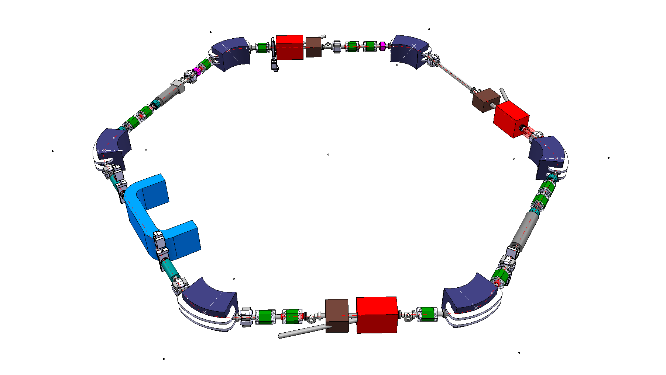
ELENA – LAYOUT machine
WHO WE ARE ? HOW IT WORKS ?
STATUS of ELENA LAYOUT MACHINE
ACCESS TO 3D CAD DATA : CAD VIEWER CONNECTED TO EDMS

Slide 3
ELENA – LAYOUT machine
WHO WE ARE ?
(EN/MEF): MACHINE &EXP. FACILITY group
Responsible for ELENA PROJET: Francois Butin
INTEGRATION OF AD ZONE : Olivier Choisnet
3D MODELISATION OF AD FACILITY &
STUDY INTEGRATION OF ELENA
ELENA TRANSFERT LINE : Jean-Michel Lacroix (EN/MEF/INT):
ELENA LAYOUT MACHINE : Stephane Maridor (EN/MEF/INT):

Slide 4
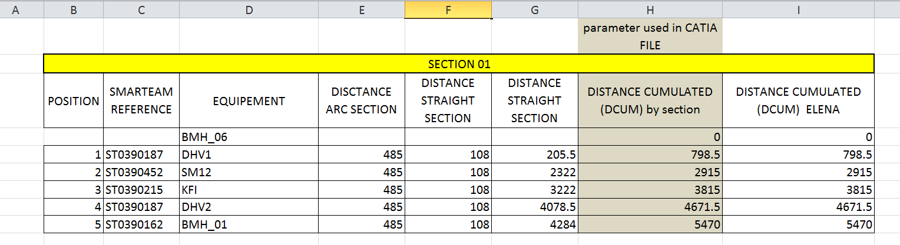
ELENA – LAYOUT machine
HOW IT WORKS ?
TO CREATE THE LAYOUT MACHINE WITH OUR CAD SOFTWARE CATIA / SMARTEAM
WE NEED “OPTIC” machine input (thanks to Pavel Belochitskii) to extract parameter of position (distance cumulated “DCUM”) &
Dimensions of equipment to draw 3d simplified model

Slide 5
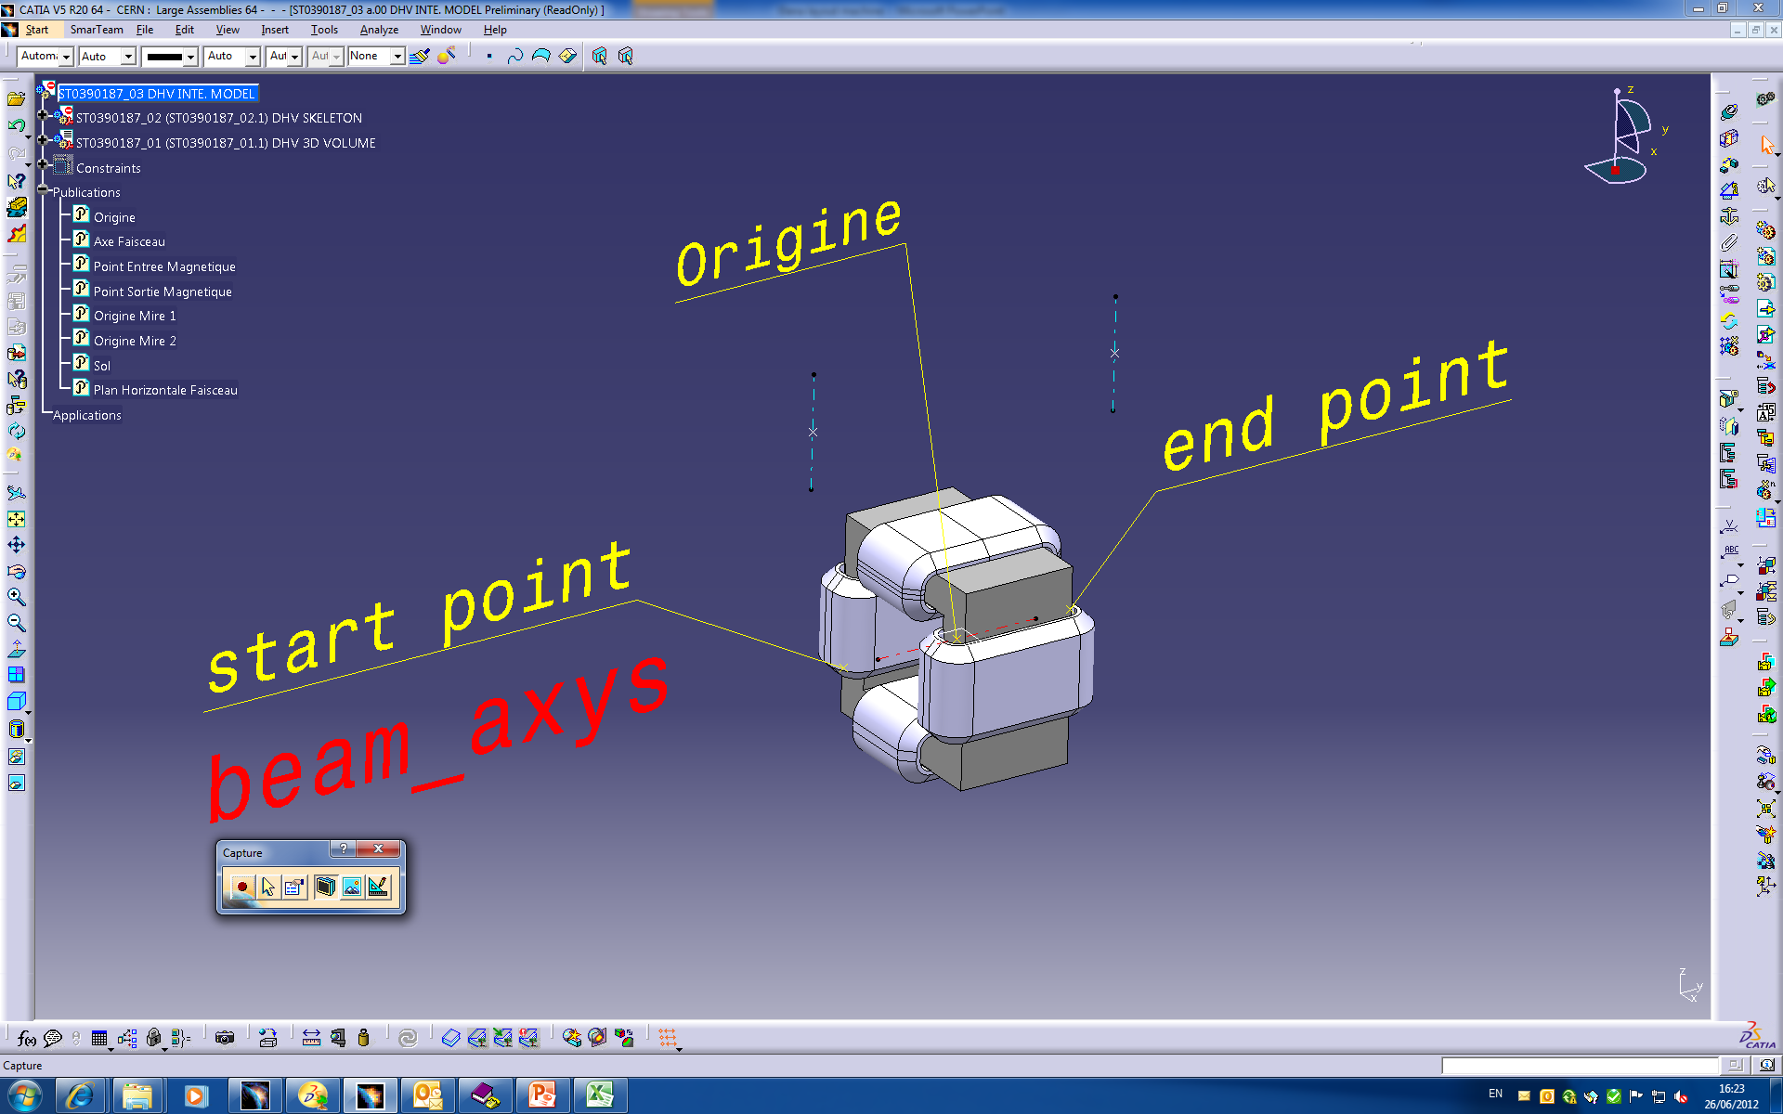
ELENA – LAYOUT machine
create simplified 3d model for each equipment

Slide 6
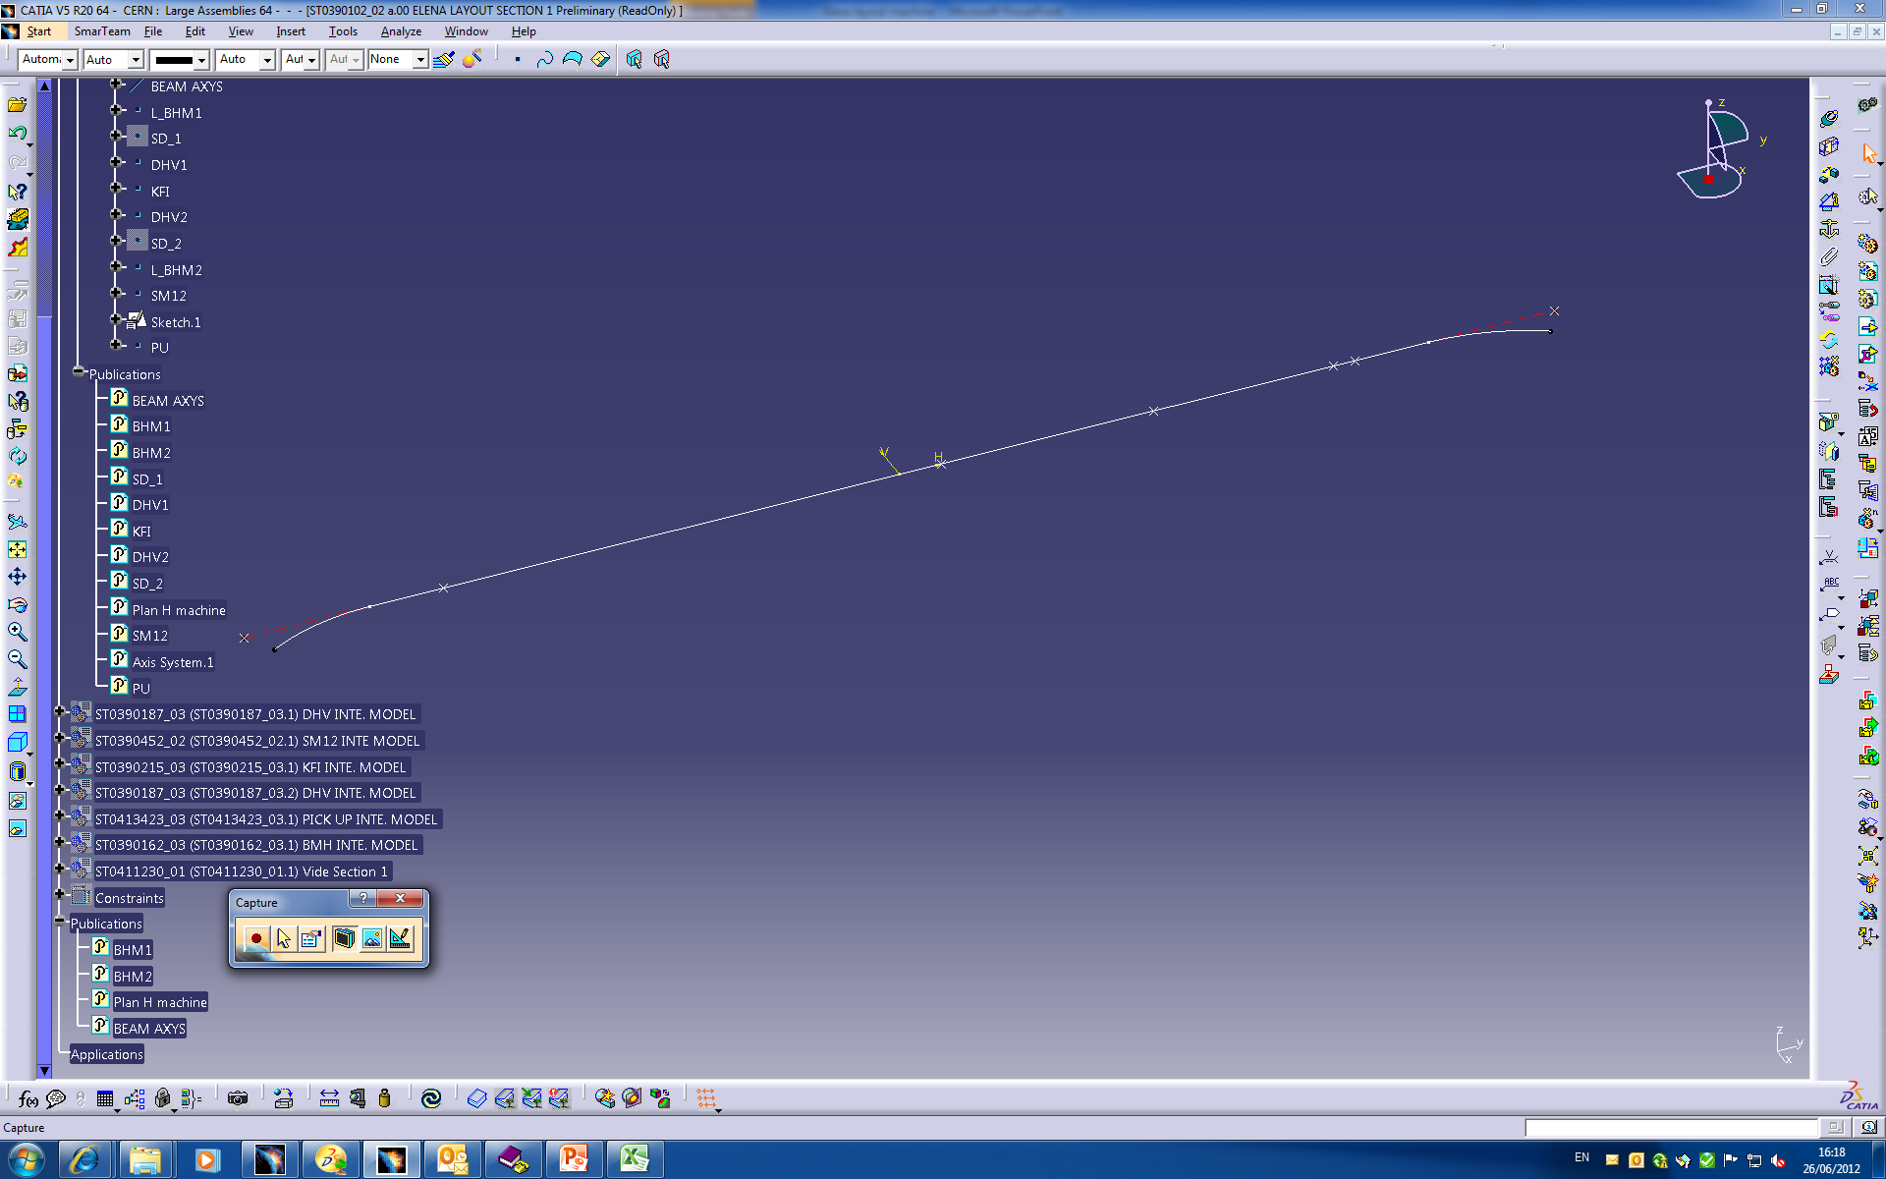
ELENA – LAYOUT machine
create skeleton of each section beam with middle position of element
ELENA SKELETON SECTION 1
Position of DHV

Slide 7
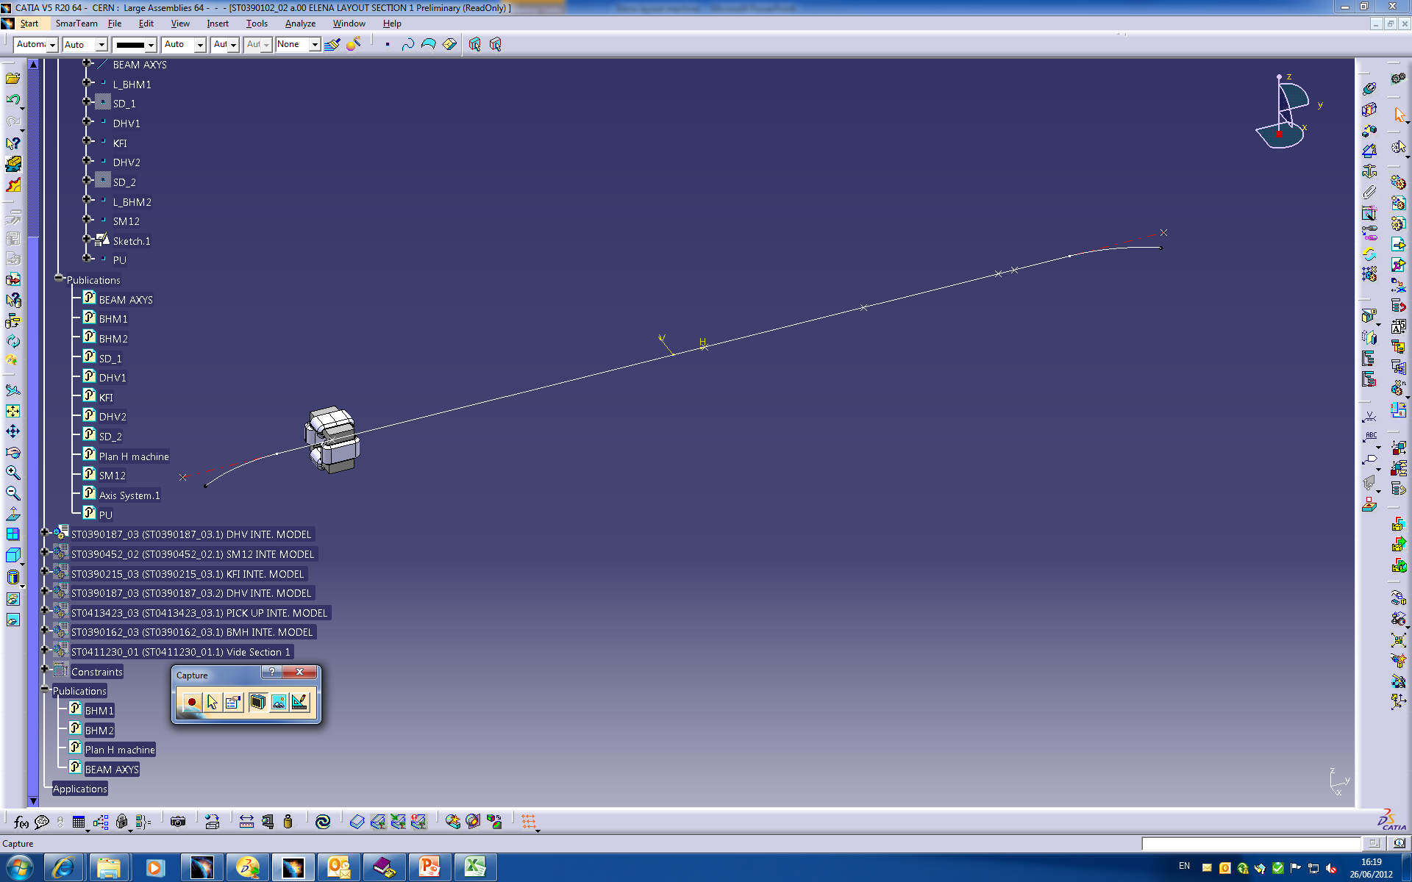
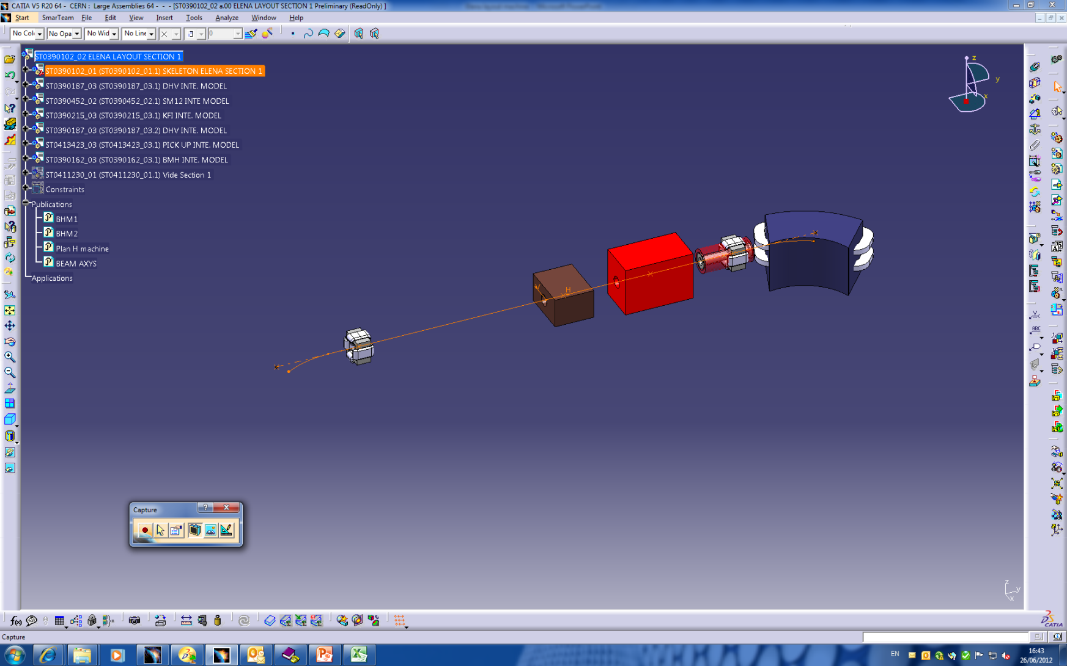
ELENA – LAYOUT machine
Add the elements of machine linked to their position : SKELETON DRIVE THE POSITION

Slide 8
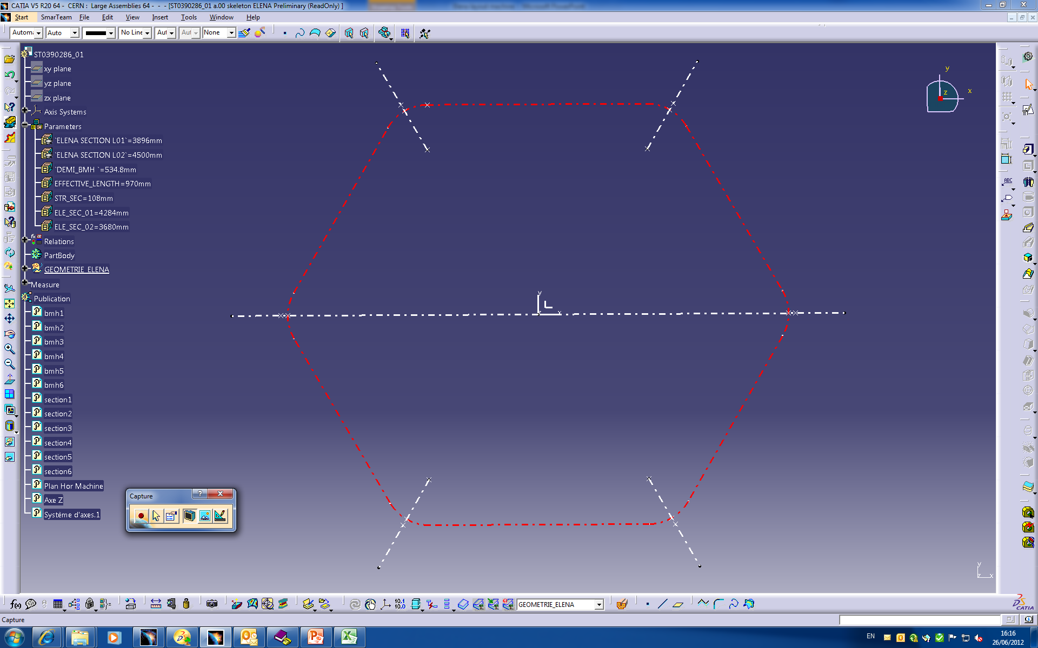
ELENA – LAYOUT machine
Define the global shape of the beam :
parameter

Slide 9
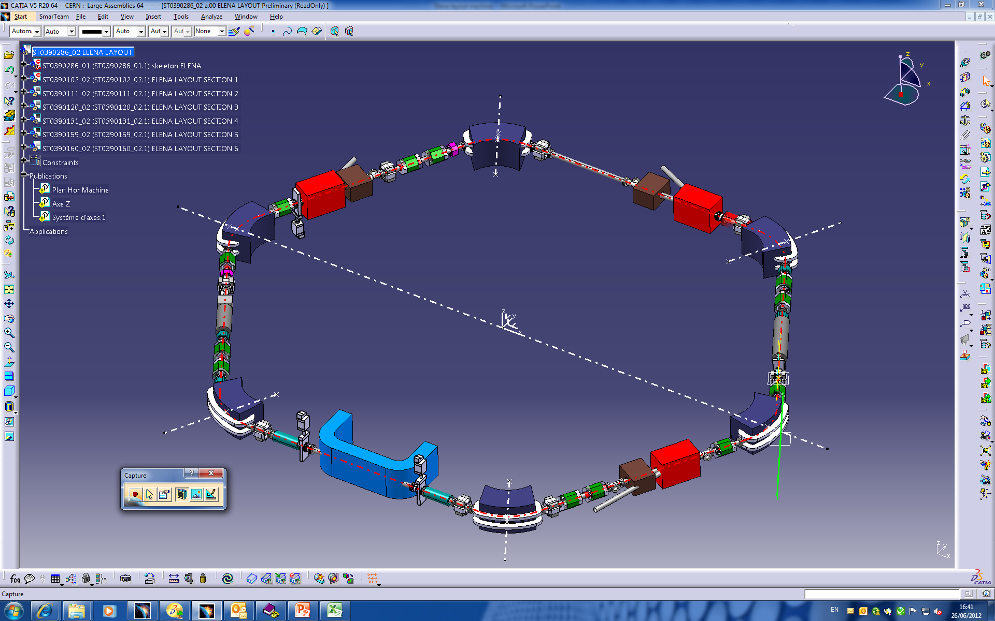
ELENA – LAYOUT machine
CREATE THE ELENA LAYOUT

Slide 10
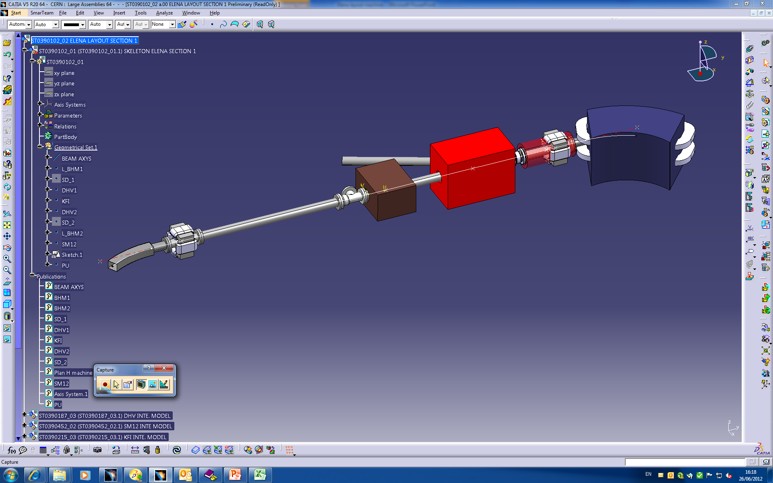
ELENA – LAYOUT machine
ADD VACCUM EQUIPMENT (PIPE,BELOW,FLANGE,..) TO THE LAYOUT SECTION (simplified model)

Slide 11
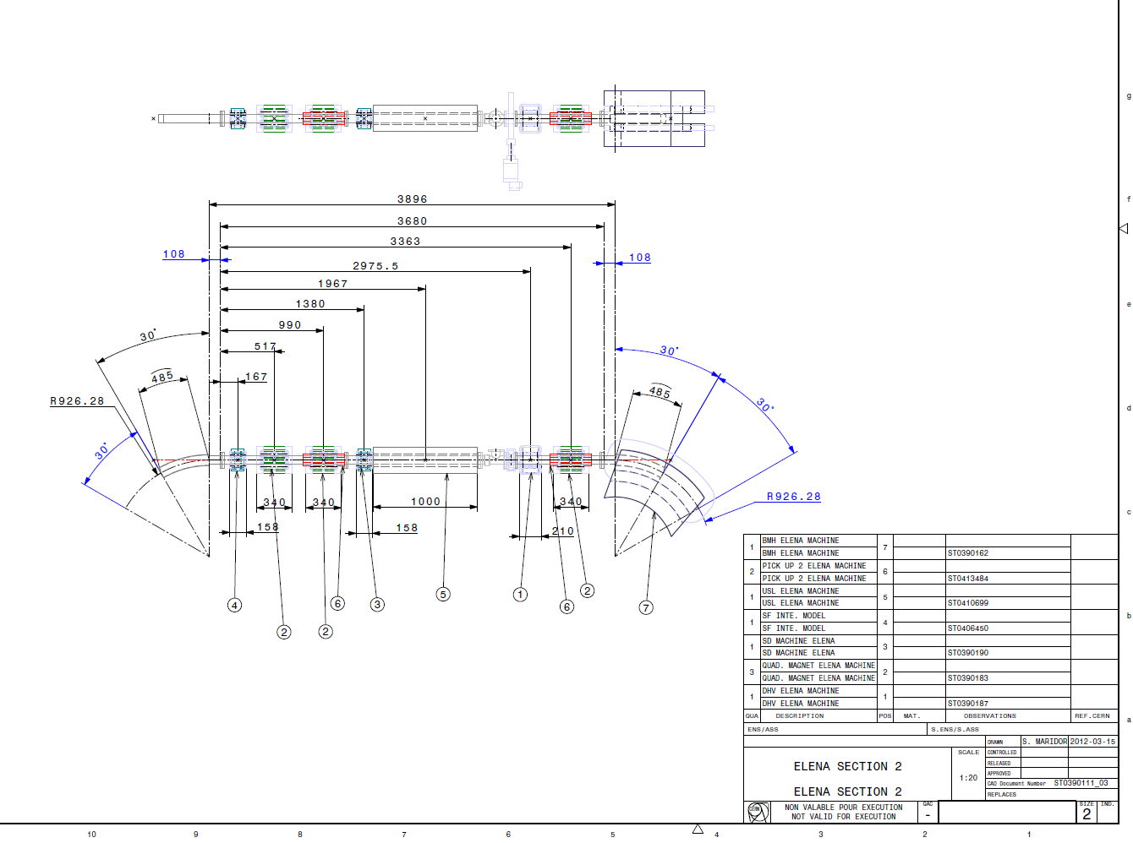
ELENA – LAYOUT machine
STATUS of ELENA LAYOUT MACHINE
3D LAYOUT OF ELENA IS WELL ADVANCED,
(CAD STRUCTURE IS READY)
PARAMETER OF POSITION’S EQUIPMENT ARE DEFINED:
(“DCUM” PARAMETER)
DRAFT OF 2D DRAWING OF ELENA LAYOUT ARE READY
INTEGRATION OF SIMPLIFIED 3D MODEL OF VACCUM EQUIPMENT IS DONE

Slide 12
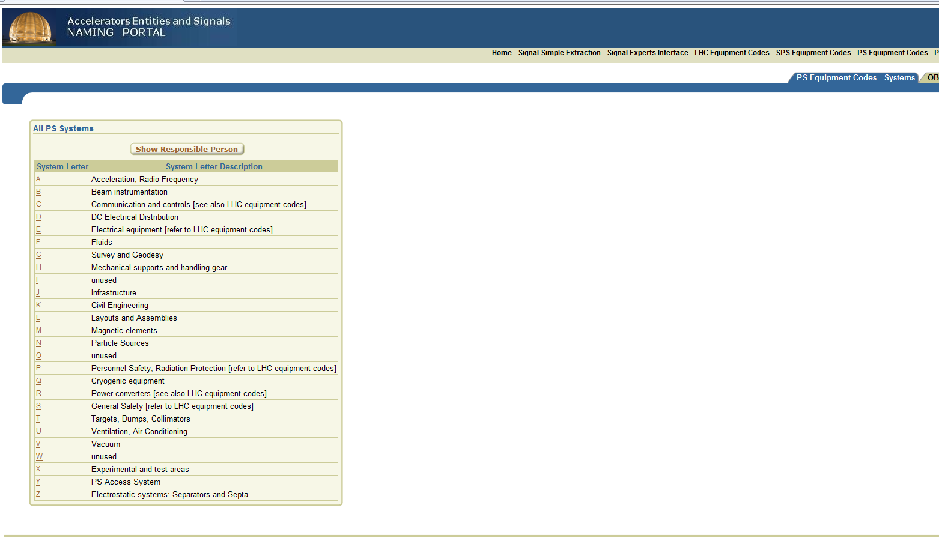
ELENA – LAYOUT machine
TO DO
RENAME ELEMENT AND CREATE EQUIPMENT CODE
FOLLOWING “PS Equipment Codes” systems
OWNER OF EQUIPMENT WITH (DESIGN OFFICE)

Slide 13
ELENA – LAYOUT machine
TO DO
CONCERNING 3D CAD DATA (CATIA / SMARTEAM)
SAVE LAYOUT DRAWING IN EDMS/CDD :
WHEN EDMS document: “Naming conventions” for layout of ELENA become valid
EDMS NO: 1209975
ADD SUPPORT EQUIPMENT : DESIGN STUDY SHOULD START IN AUGUST
MANAGE & FOLLOW THE MODIFICATION& EVOLUTION DURING DESIGN STAGE

Slide 14
ELENA – LAYOUT machine
ACCESS TO 3D CAD DATA : CAD VIEWER CONNECTED TO EDMS
INSTAL 3DVIA VIEWER BEFORE

Slide 15
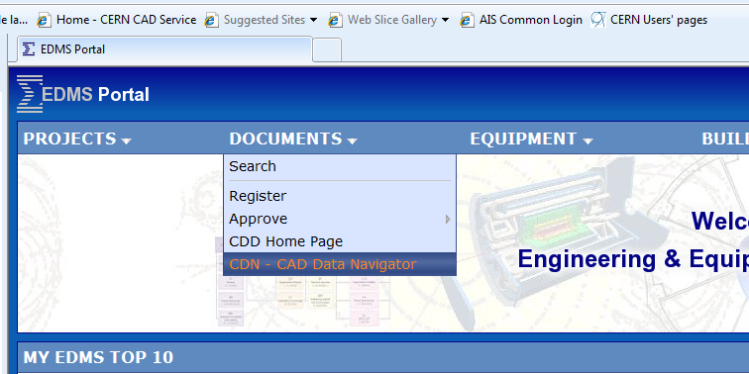
ELENA – LAYOUT machine
NOW YOU CAN HAVE ACCESS TO OUR 3D MODEL (ON DEMAND)
LINK FROM EDMS PORTAL
TOOL IN EDMS PORTAL : CDN “CAD DATA NAVIGATOR”

Slide 16
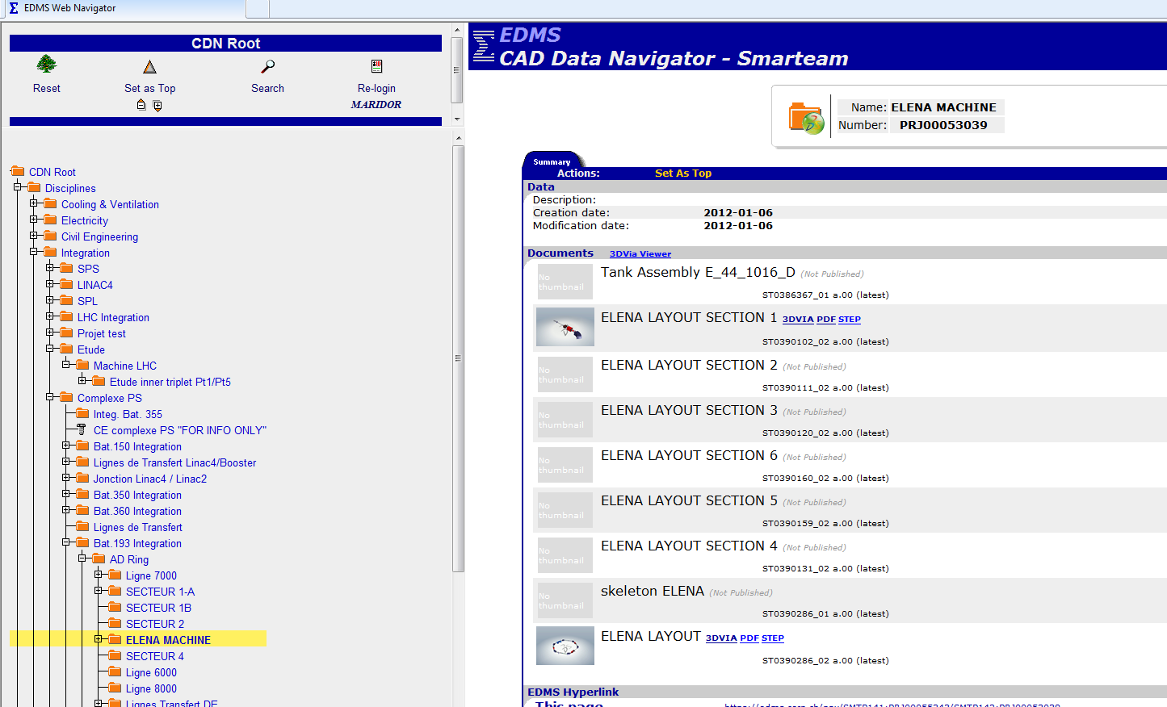
ELENA – LAYOUT machine
1
2

Slide 17
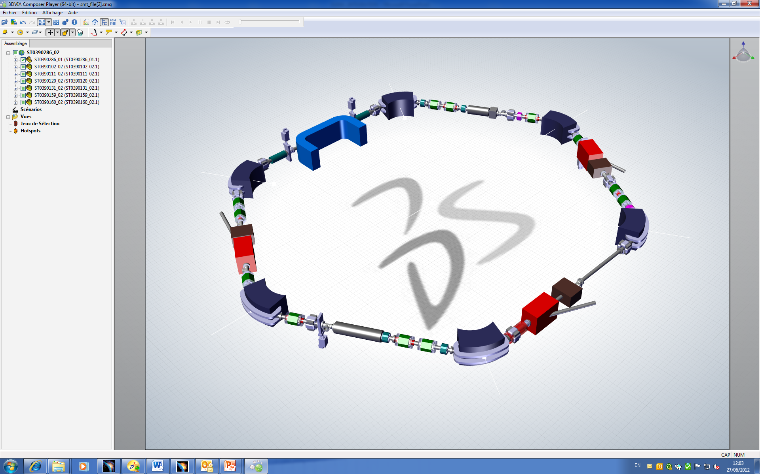
ELENA – LAYOUT machine
3
3D VIA VIEWER
ELENA LAYOUT MACHINE

Slide 18
ELENA – LAYOUT machine
THANK YOU

Slide 19
