Slide 1

AD extension building
B. 393

Slide 2
Where we are
Soil tests taken 21 May
New extension building was approved 30th May
Contract for CE construction drawings production awarded 13th June
Definition sketch under approval in EDMS on 22nd June
Currently slightly revising main dimensions to optimize usable surface
Checking impact of CV/EL/HE systems on CE

Slide 3
Building sketch being revised

Slide 4
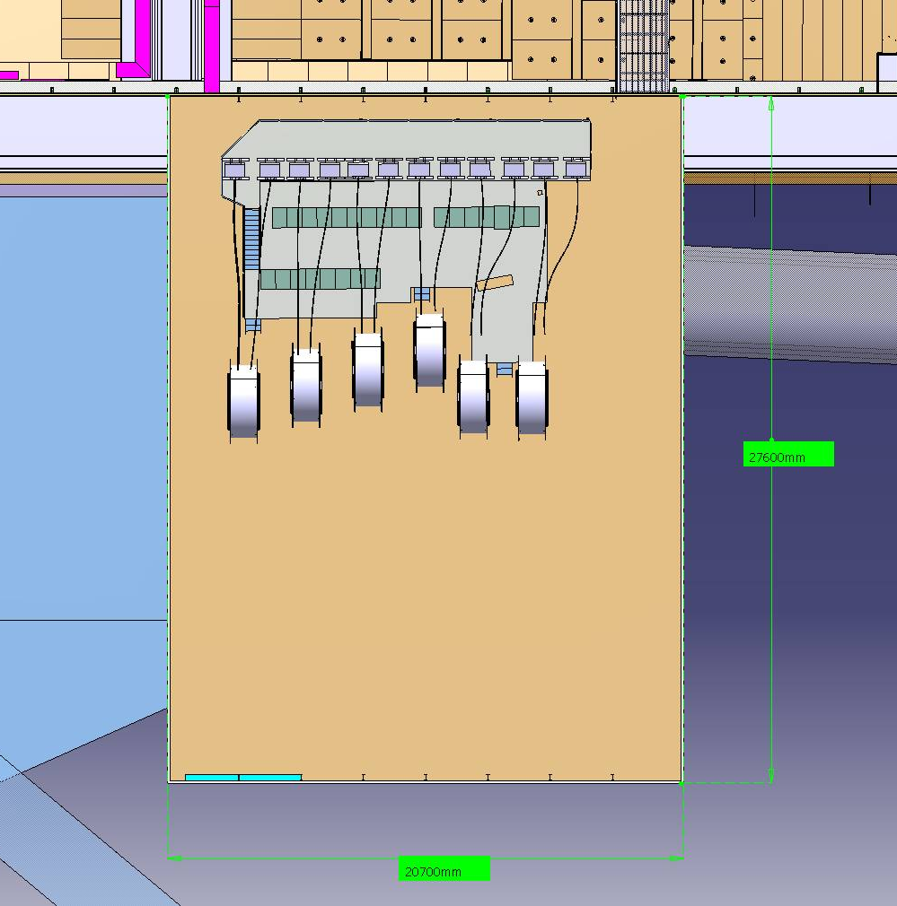
Porte 2,5x 3m2
EL
Kickers 12.7 x 14.7 m2
Storage (7x2 m2)
CV 6x1,5 m2
Storage (7x4 m2)
Storage
(5 x 9 m2)
Workshop
(5 x 10 m2)
Offloading area
(8x4.6 m2)
Storage (7x4 m2)
Magnetic horns test bench
(10 x 7 m2)
Test bench
7 x 10 m2
Porte 6x 6 m2

Slide 5
Scheduling

