Slide 1
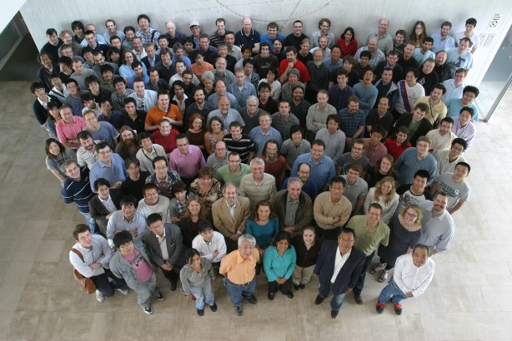
Highlights from the T2K Experiment
Tetsuro Sekiguchi
KEK, IPNS
for T2K collaboration
Contents
Introduction of T2K
Experimental Setup
Status of Experiment
Analysis Results
Future Prospects
Summary

Slide 2
Introduction of T2K

Slide 3
Neutrino Oscillation
Flavor oscillation described by Pentecorvo-Maki-Nakagawa-Sakata matrix.
Parameterized by 3 mixing angles and CP-violating phase δ_{CP}
“Atmospheric sector”
θ₂₃
ν_{μ} disappearance
(SuperK, K2K, MINOS)
ν_{τ} appearance
(OPERA, SuperK)
0.92 < sin²2θ₂₃ < 1.0
2.3×10⁻³ < |Δm²₂₃| (eV²) < 2.56×10⁻³
“Solar sector”
θ₁₂
ν_{e} disappearance
(SNO, KamLAND,
SuperK and others)
0.84 < sin²2θ₁₂ < 0.89
7.38×10⁻⁵ < |Δm²₁₂| (eV²) < 7.80×10⁻⁵

Slide 4
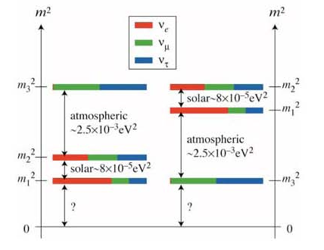
Neutrino Oscillation
Flavor oscillation described by Pentecorvo-Maki-Nakagawa-Sakata matrix.
Parameterized by 3 mixing angles and CP-violating phase δ_{CP}
θ₁₃
only upper limit known
sin²2θ₁₃ < 0.13 @90%CL (2010)
(CHOOZ, MINOS)
Reactor experiment L=~1km
oscillation
( disappearance)
Accelerator experiment
L=O(100km)
Observation of ν_{μ}→ν_{e} oscillation
(ν_{e} appearance)
normal or inverted?
if θ₁₃ is non-zero, open the possibility to measure
Mass Hierarchy
δ_{CP}

Slide 5
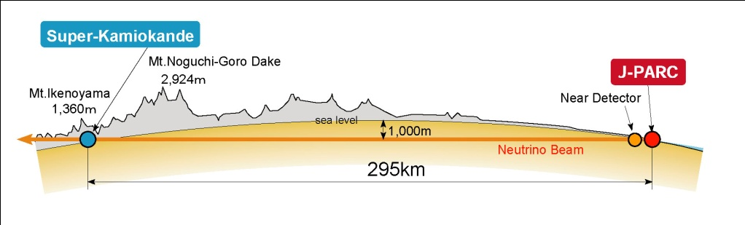
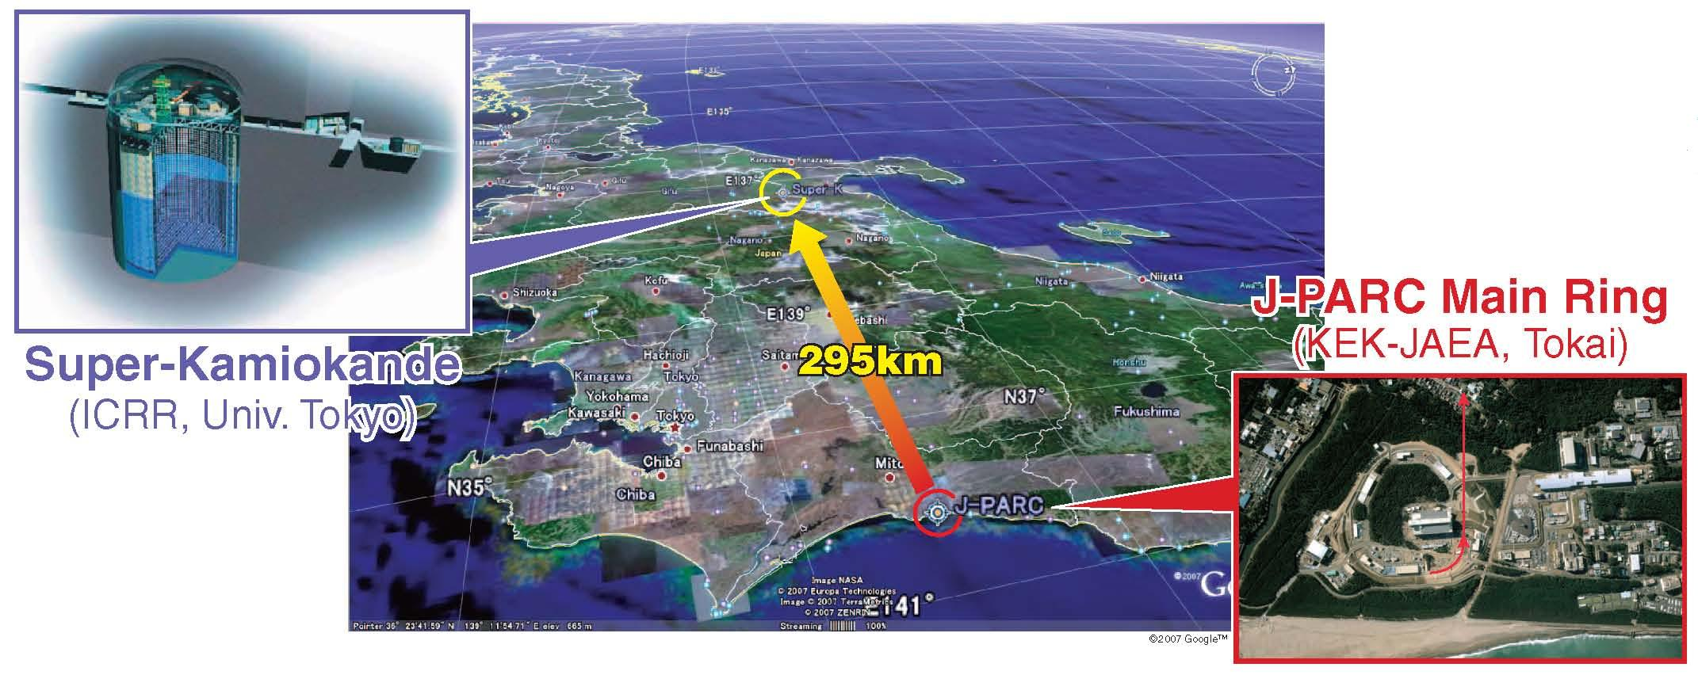
The T2K Experiment
Tokai to Kamioka Long Baseline Neutrino Oscillation Experiment
  Accelerator-based neutrino experiment.
Physics Motivation
  Discovery of ν_{μ}→ν_{e} conversion phenomena and the measurement of parameter θ₁₃ which controls this phenomena.
  Precise measurement of the parameters θ₂₃ and Δm₂₃ in ν_{μ}→ν_{μ} oscillation.

Slide 6
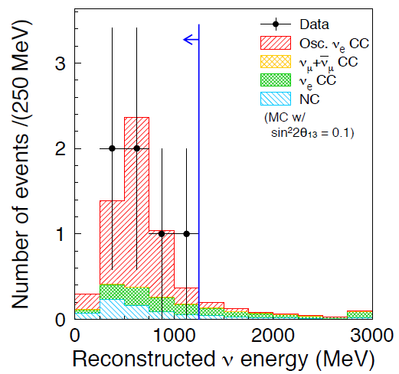
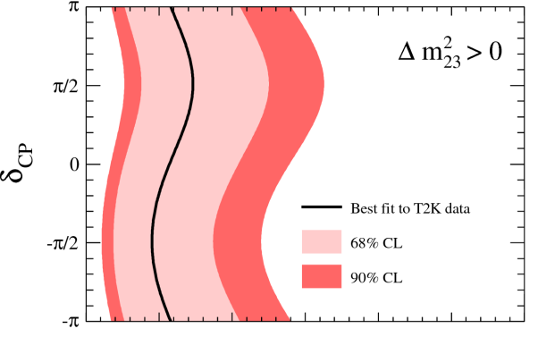

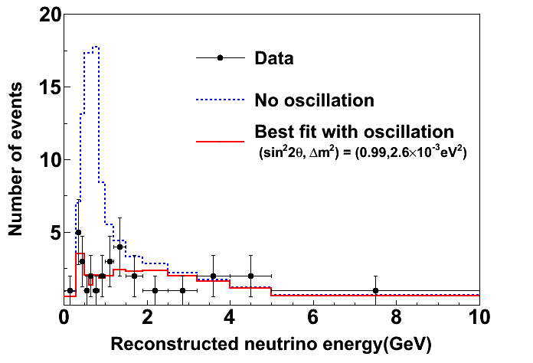
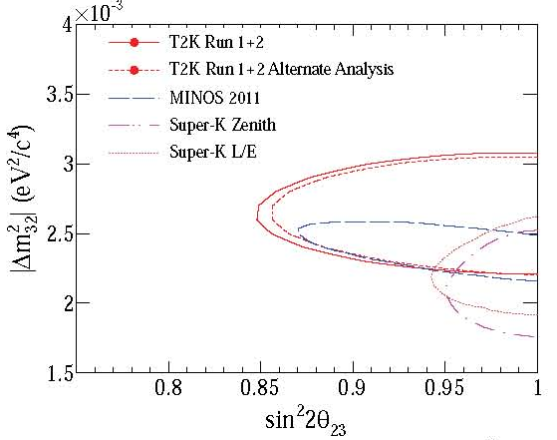
First T2K Results
Data collected until Mar. 2011: 1.43×10²⁰ POT
ν_{e} appearance result (15/June/2011) →PRL 107, 041801 (2011)
6 ν_{e} events observed !! ↔ Background(BG): 1.5±0.3events
  Probability to observe 6 or more BG events = 0.7% (2.5σ)
θ₁₃ measurement (90%CL)
  0.03<sin²2θ₁₃<0.28 (cent. val.=0.11) for Δm²₂₃>0, δ_{CP}=0
  0.04<sin²2θ₁₃<0.34 (cent. val.=0.14) for Δm²₂₃<0, δ_{CP}=0
  → First indication of non-zero θ₁₃.
ν_{μ} disappearance result →PR D85, 031103(R) (2012)
31 ν_{μ} events observed ↔ 103.6^{+13.8}(syst.) expected w/o oscillation.
sin²2θ₂₃ = 0.99, |Δm²₂₃| = 2.63×10⁻³ eV² (best fit values)
→Consistent with MINOS and SK results.
−13.4
Best fit
This talk = Updated ν_{e} appearance result
90% CL

Slide 7
Experimental Setup

Slide 8
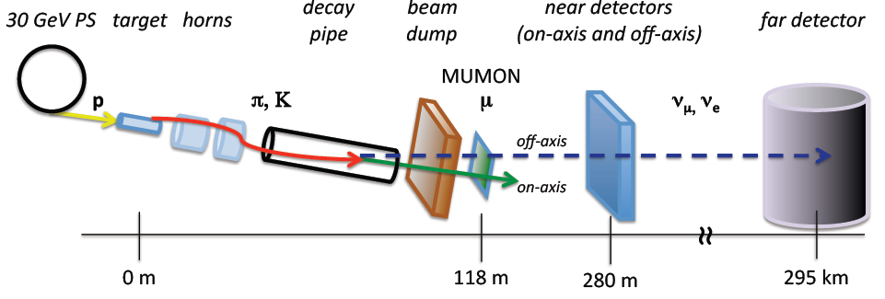

T2K Neutrino Beam
High intensity neutrino beam
30 GeV ~10¹⁴ protons extracted every 2.5sec.
Protons hit the target: graphite rod (φ2.6cm×90cm)
Secondary π⁺(and K⁺) focused by three magnetic horns (250kA/200kA)
Decay Volume (96m long, He~1atm.)
  ν_{μ} from mainly π⁺→μ⁺+ν_{μ}
  ν_{e} in the beam come from K and μ decay
Beam Dump: stop all the hadrons and muons with p_{μ}<5GeV/c.
Muon Monitors: measure the intensity and profile of the muons (p_{μ}>5GeV/c) bunch by bunch

Slide 9
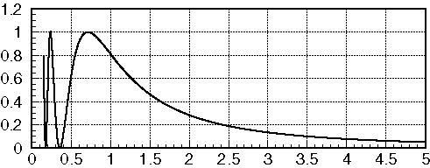
T2K Neutrino Beam
Oscillation probability
for Δm²~2.5×10⁻³,
L=295km
Off-Axis (2.5º) ν_{μ} beam
Intense, low energy narrow-band.
Peak E_{ν} tuned for oscillation max. (~0.6 GeV)
Reduce BG from high energy tail.
Small ν_{e} fraction (~1%).
OA= 0◦
OA=2◦
OA=2.5◦
OA=3◦
2.5º
Neutrino Energy @ SK

Slide 10
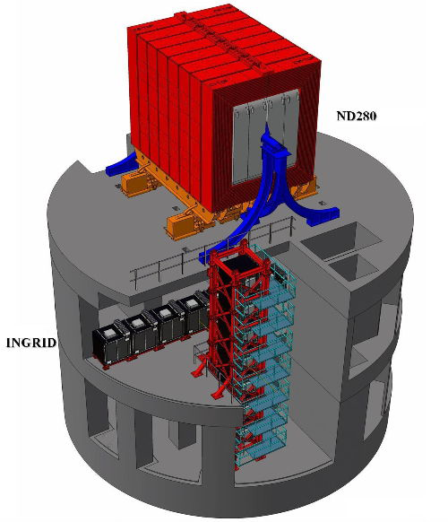
Near Detectors
On-axis: INGRID
Array of Fe/Scintillator tracking detectors
→Monitor the ν’s
− beam profile,
− direction,
− intensity
Off-Axis: ND280
Fine grained detector complex
in 0.2T magnetic field
→Characterization of the ν beam
before oscillations
− ν_{μ} flux/Energy spectrum
− ν_{e} contamination
  →bkg to ν_{e} appearance
→Measurement of ν_{μ} interactions
− ν_{μ} induced π⁰ production
→bkg to ν_{e} appearance
Off-axis
ν beam
On-axis

Slide 11
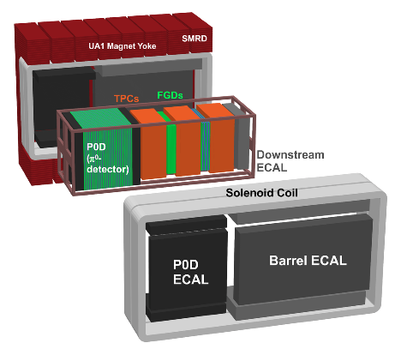
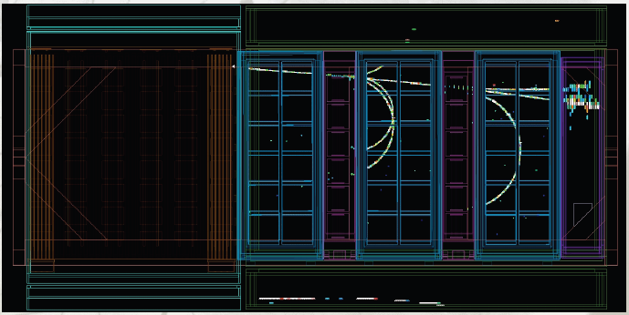
Near Detector ND280 (Off-Axis)
ND280 @ 2.5 degree off-axis
ND280 consists of:
  Dipole magnet with 0.2T field
  Fine Grain Detectors FGD’s (×2):
  2.2 tons scintillator bars active ν target
  Time Projection Chambers TPC’s (×3):
  <10% dE/dx resolution
  <10% δp/p @ 1 GeV/c
  P0D: π⁰ Detector
  ECAL (Electromagnetic CALorimeters)
  SMRD (Side Muon Range Detector)
FGD
Example of
ND280 ν event
P0D
TPC

Slide 12
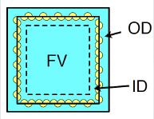
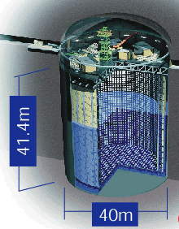
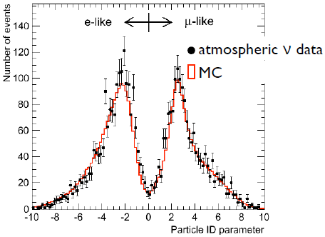
Super Kamiokande as T2K Far Detector
Super Kamiokande (SK)
Water Cherenkov detector
  Total Mass: 50 kton
    Fiducial Volume: 22.5 kton
  Inner Detector(ID): ~11k PMTs facing inward
  Outer Detector(OD): ~2k PMTs facing outward (OD)
    veto for cosmic and background
Particle ID using
ring shape & opening angle
Excellent identification of μ/e: ~99% efficiency.

Slide 13
Status of Experiment

Slide 14
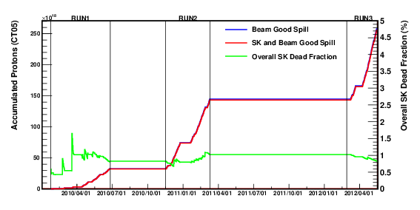
Data Collected and Analyzed
Beam Power increased up to 190kW w/ 1×10¹⁴ protons per pulse (world record)
Analyzed data: up to May 15th, 2012: 2.56×10²⁰ POT (Protons On Target)
  RUN1 (2010): 0.32×10²⁰ POT
  RUN2 (2010-2011): 1.11×10²⁰ POT
    ND280 RUN 1+2 data used for oscillation analysis
  RUN 3 (2012): 1.14×10²⁰ POT
    including 0.21×10²⁰ POT with 200kA horn operation (13% flux reduction at peak)
    ND280 RUN 3 data for checking the RUN 1+2 measurement
RUN1
RUN2
RUN3
50kW
135kW
190kW
Recovery from
earthquake

Slide 15
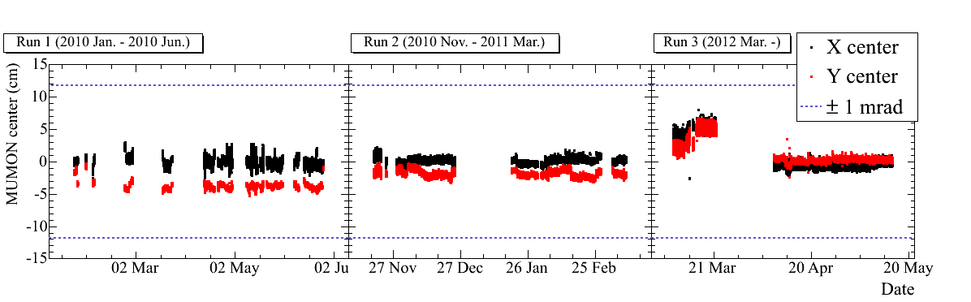
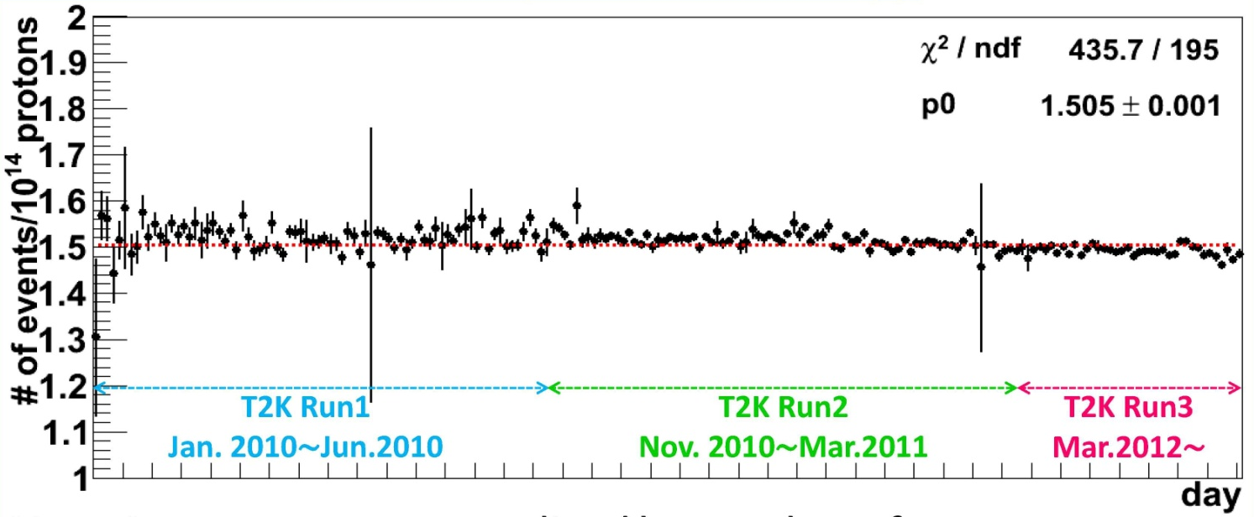
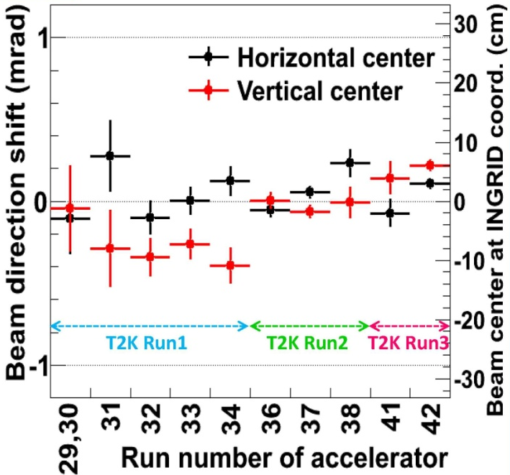
Neutrino Beam Quality
Muon Monitor: Beam center (X, Y) and direction stability (<1mrad)
1 mrad shift of the beam direction = 2% shift of the E_{ν} peak at SK
+1mrad
Run 1
Run 2
Run 3
200kA
250kA
-1mrad
INGRID interaction rate stability: 1.5events/10¹⁴ POT
INGRID: beam direction

Slide 16
Analysis Results

Slide 17
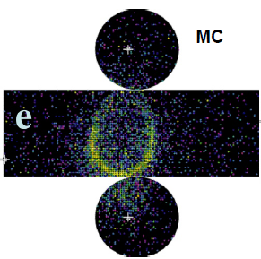
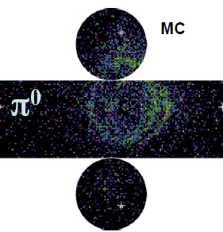
Signal and Background for T2K ν_{e} Appearance Search
SIGNALS
BACKGROUND
Charged current quasi-elastic scattering
(CCQE)
ν_{e} + n → e⁻ + p
Intrinsic ν_{e} contamination in the beam (<1%)
→wider energy dist.
Neutral current π⁰ production
(NC π⁰)
ν_{μ} + N → ν_{μ} + π⁰ + N’
ν_{μ}
ν_{e}
e
n
p
γ
Electromagnetic shower and
multiple scattering
→Ring has fuzzy edge
Electron is relativistic
→ Opening angle is maximal
ν_{x}
π⁰
γ
ν_{x}
Electromagnetic shower of γ’s from π⁰ can fake an electron

Slide 18
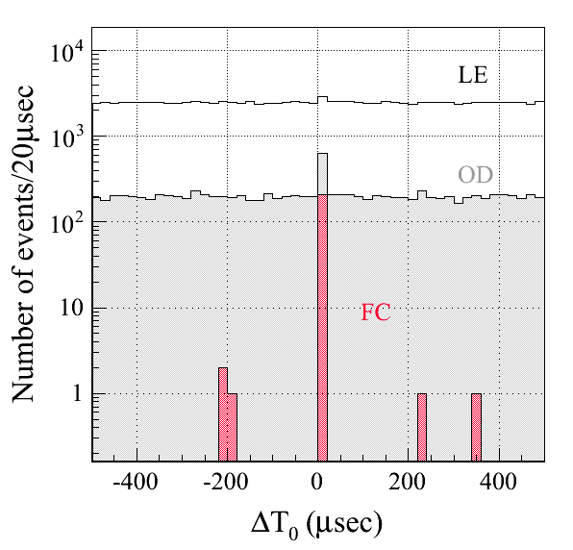
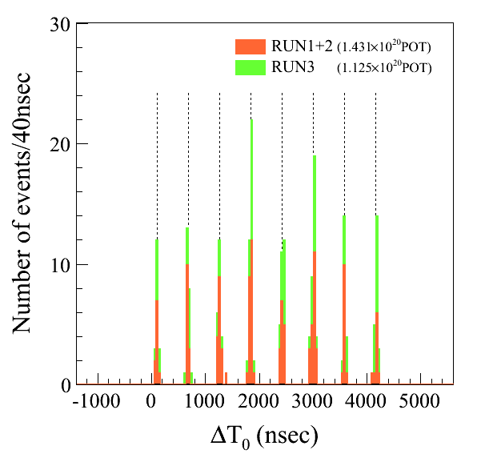
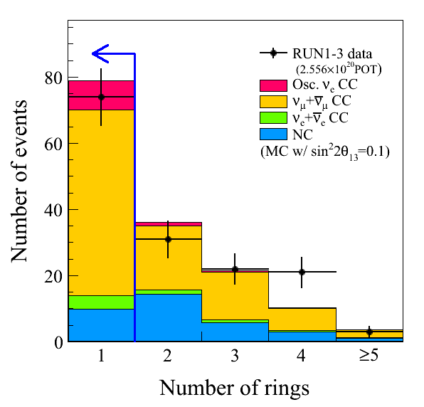
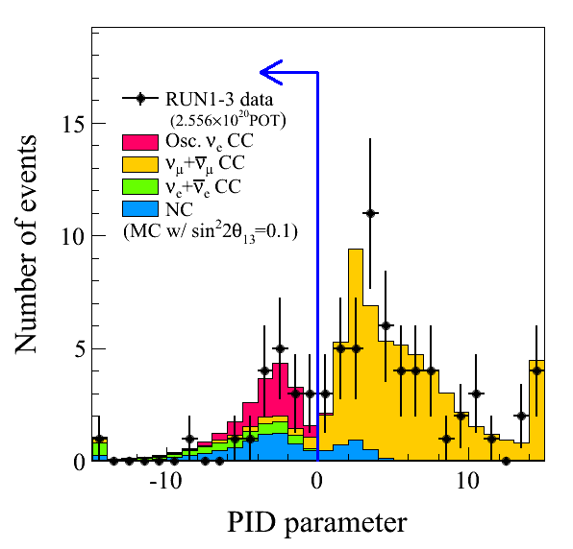
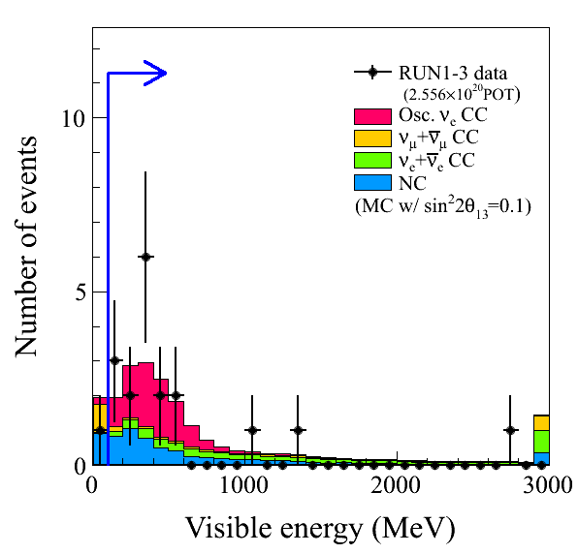
T2K Event Selection
Selection Criteria
(determined before data analysis):
T2K beam timing
Fully contained (FC) event,
Vertex is in Fiducial Volume (FV)
A single e-like Cherenkov ring
Visible energy > 100 MeV
No decay electrons
π⁰ mass cut, M_{inv} < 105 MeV/c²
Reconstructed E_{ν} < 1250 MeV
FC: 209 events
FCFV: 151 events
74 events
e-like
μ-like
18 events
Single ring to select
CCQE events
19 events
Reject low-E
backgrounds

Slide 19
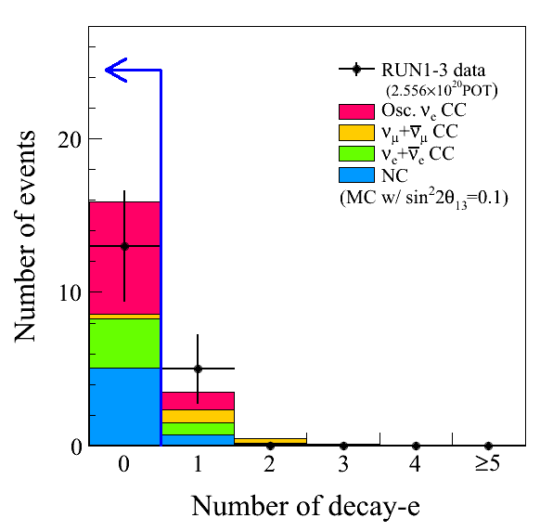
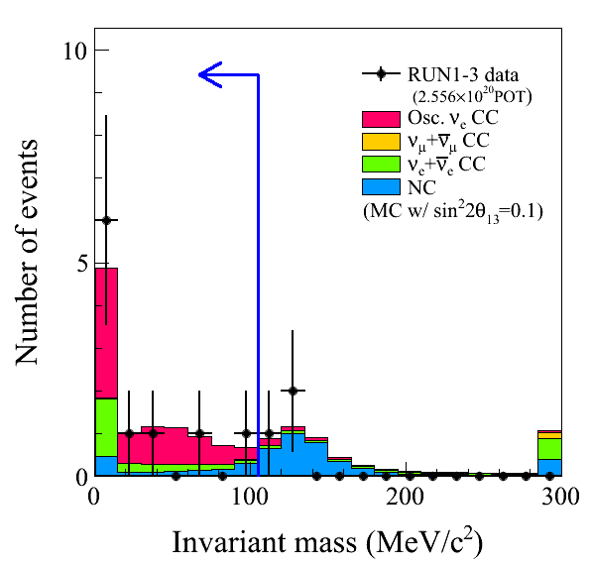
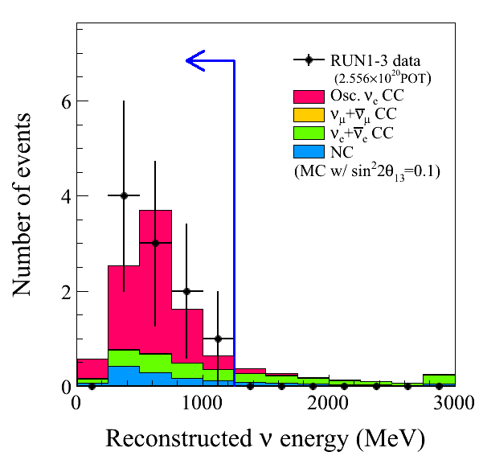
Further ν_{e} Selection
Selection Criteria
(determined before data analysis):
T2K beam timing
Fully contained (FC) event,
Vertex is in Fiducial Volume (FV)
A single e-like Cherenkov ring
Visible energy > 100 MeV
No decay electrons
π⁰ mass cut, M_{inv} < 105 MeV/c²
Reconstructed E_{ν} < 1250 MeV
Run 1+2+3 2.56×10²⁰ POT | Data | MC Expectation w/ sin²2θ₁₃=0.1
 |  | Signal ν_{μ}→ν_{e} | BG total | ν_{μ}+ν_{μ} CC | ν_{e}+ν_{e} CC | NC
e-like | 19 | 8.70 | 13.23 | 2.30 | 4.07 | 6.86
E_{vis}>100MeV | 18 | 8.50 | 11.47 | 1.49 | 4.03 | 5.94
No decay-e | 13 | 7.31 | 8.56 | 0.28 | 3.19 | 5.09
π⁰ mass cut | 10 | 6.82 | 3.67 | 0.07 | 2.21 | 1.39
E_{ν}^{rec}<1250MeV (MC sin²2θ₁₃=0 case) | 10 | 6.61 (0.15) | 2.47 (2.58) | 0.05 (0.05) | 1.36 (1.47) | 1.06 (1.06)
Efficiency [%] |  | 60.7 | 1.0 | 0.0 | 20.0 | 0.9
13 events
10 events
10 events
Reject mis-identified μ
Reject NC events
by finding π⁰
Reject high energy
ν_{e} beam and NC
backgrounds

Slide 20
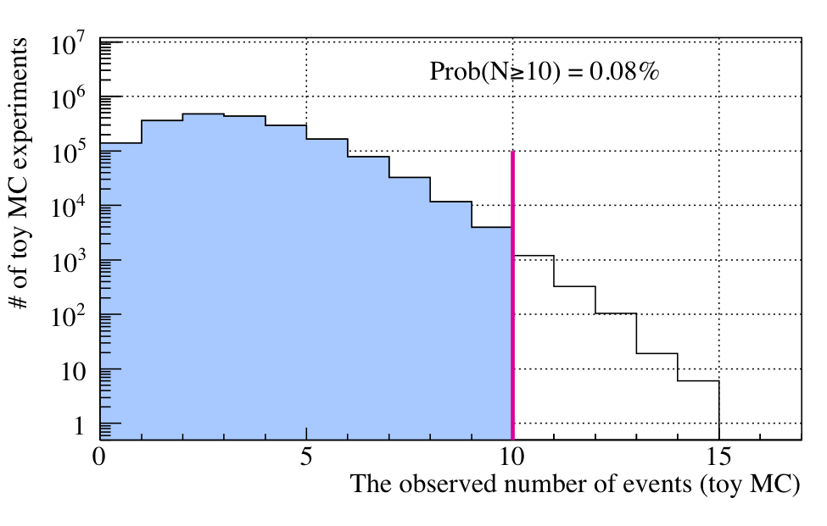
Evidence of ν_{e} Appearance
10 events
0.08%
10 ν_{e} candidates found!
Probability (p-value) to observe 10 or more events with 2.73±0.37(sys.) BG events is 0.08% (3.2 σ)
  Confirm the T2K 2011 results [PRL 107, 041801 (2011)] !!
  We find the Evidence of “Electron Neutrino Appearance”.

Slide 21
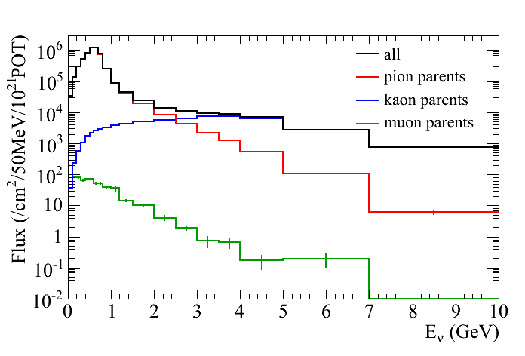
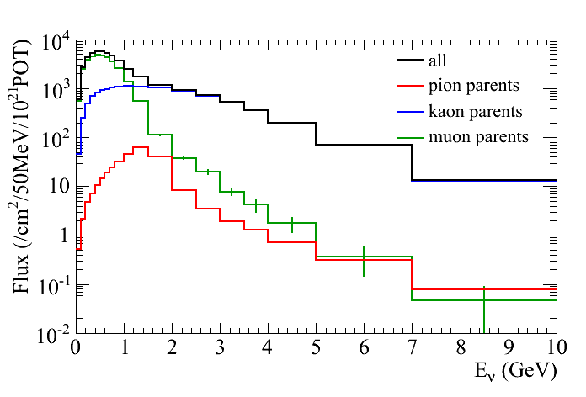
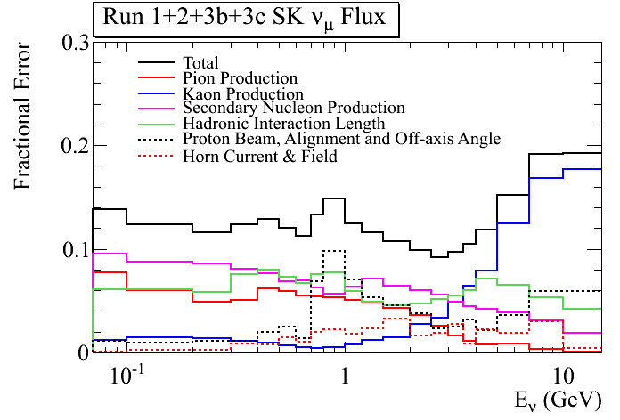
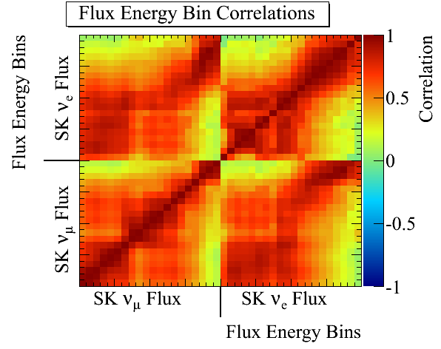
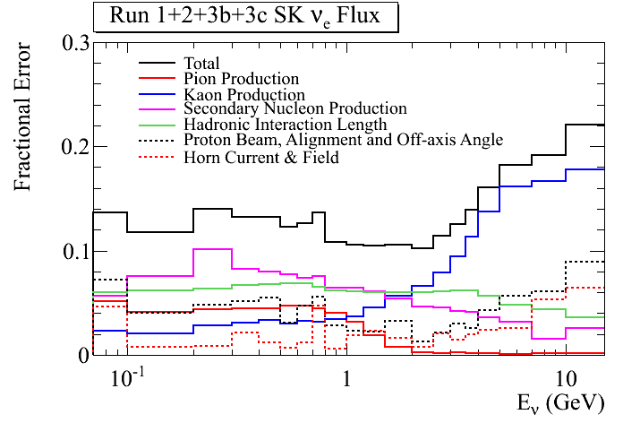
Neutrino Flux Prediction w/ CERN NA61
ν_{e}@SK
ν_{μ}@SK
ν_{μ}, ν_{e}, anti-ν_{μ}, anti-ν_{e} energy dependent errors with full correlations @SK and @ND280 are taken in the FIT!
ν_{μ} and ν_{e} Flux Energy Correlations
Errors: ~15%
Errors: <~15%
Errors: 10~15%

Slide 22
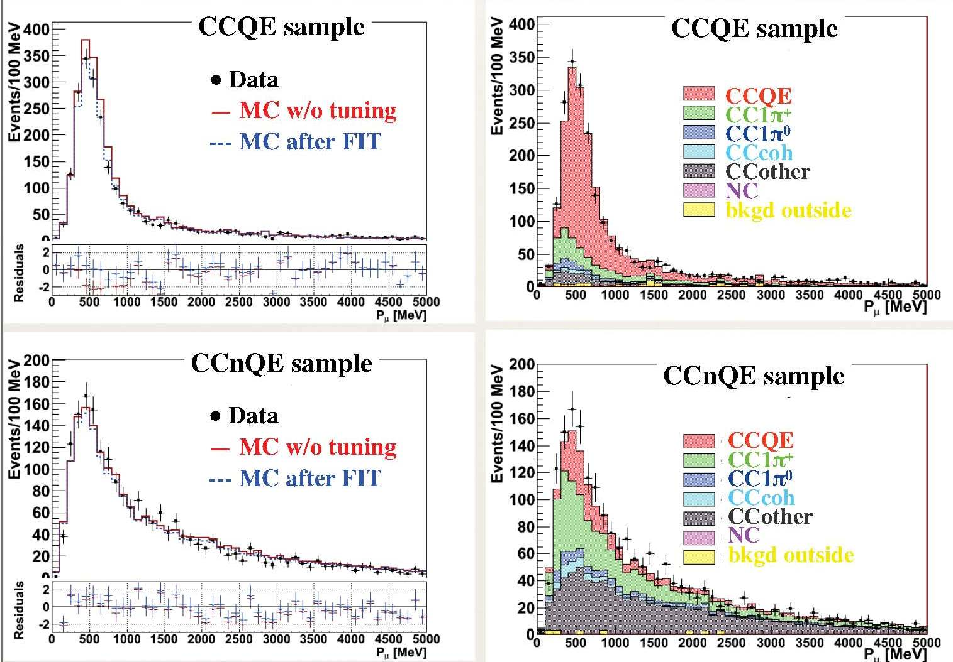
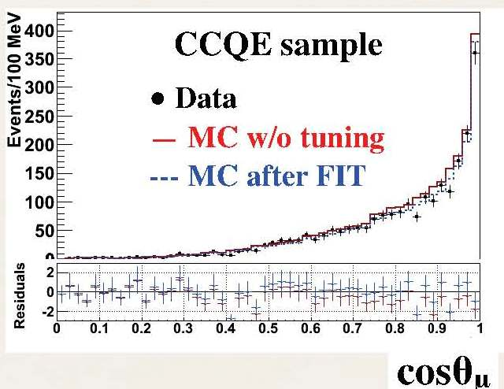
ND280 ν_{μ} Measurement (RUN1+2 Data)
# of Events in P_{μ} vs. θ_{μ} are used in FIT to constrain the flux and ν cross sections (MC predictions at ND280 and SK)
Good negative track in FV
Upstream TPC veto
muon ID by TPC for CCQE
  1 FGD-TPC track
  No decay-e FGD
For CCQE selection
40% eff. w/ 72% purity.

Slide 23
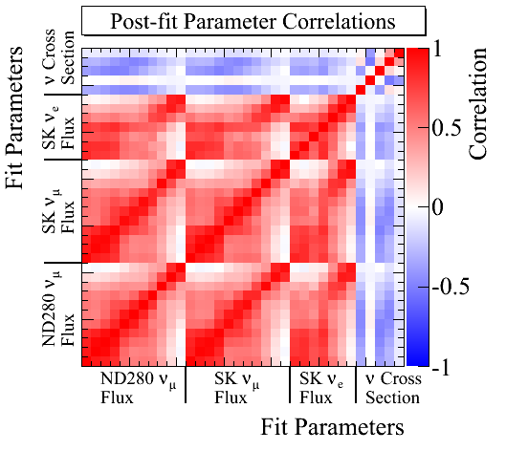
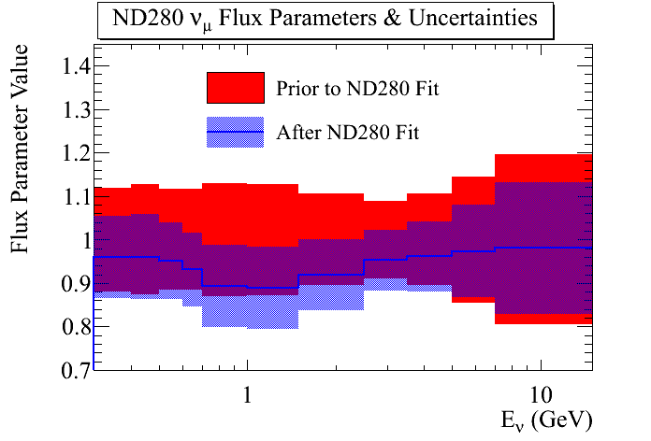

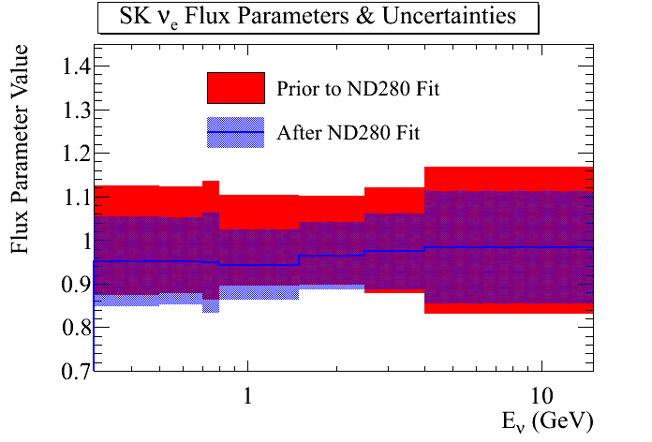
Flux + Cross Section FIT output

Slide 24
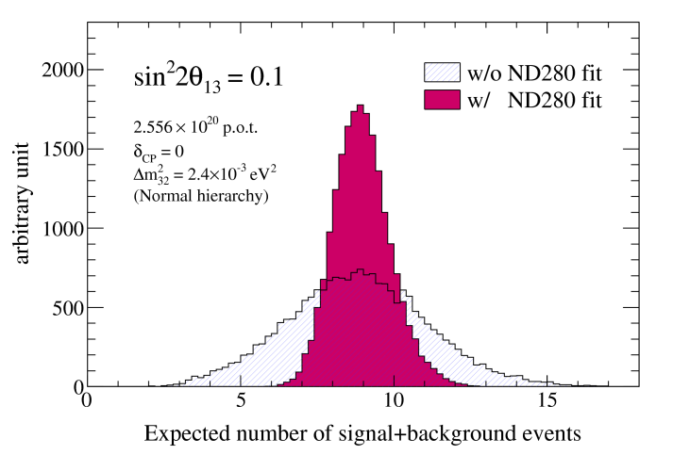
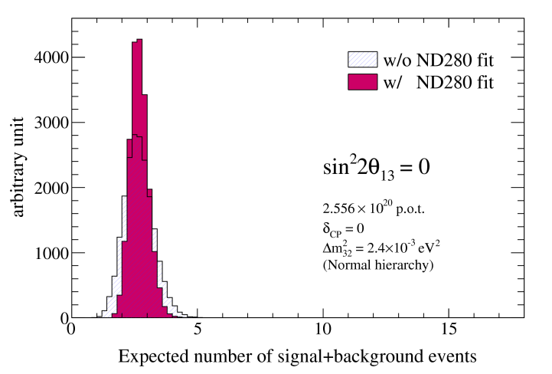
# of Events Predictions at T2K w/ Sys. Error
(Note: 10 ν_{e} Candidates observed)
# of Events prediction
Systematic Errors
 | sin²2θ₁₃ = 0.1 | sin²2θ₁₃ = 0
Total | 9.07±0.93 | 2.73±0.37
ν_{e} signal | 6.60 | 0.15
ν_{e} bkg. (beam org.) | 1.32 | 1.42
ν_{μ} bkg. (~NCπ⁰) | 1.02 | 1.02
anti-ν bkg. | 0.13 | 0.14
Error Source | sin²2θ₁₃ = 0.1 | sin²2θ₁₃ = 0
ND fit | 5.7% | 8.7%
Cross section (from other exp.) | 7.5% | 5.9%
SK + FSI | 3.9% | 7.7%
Total | 10.3% | 13.4%
Error (2011 result) | ~18% | ~23%

Slide 25
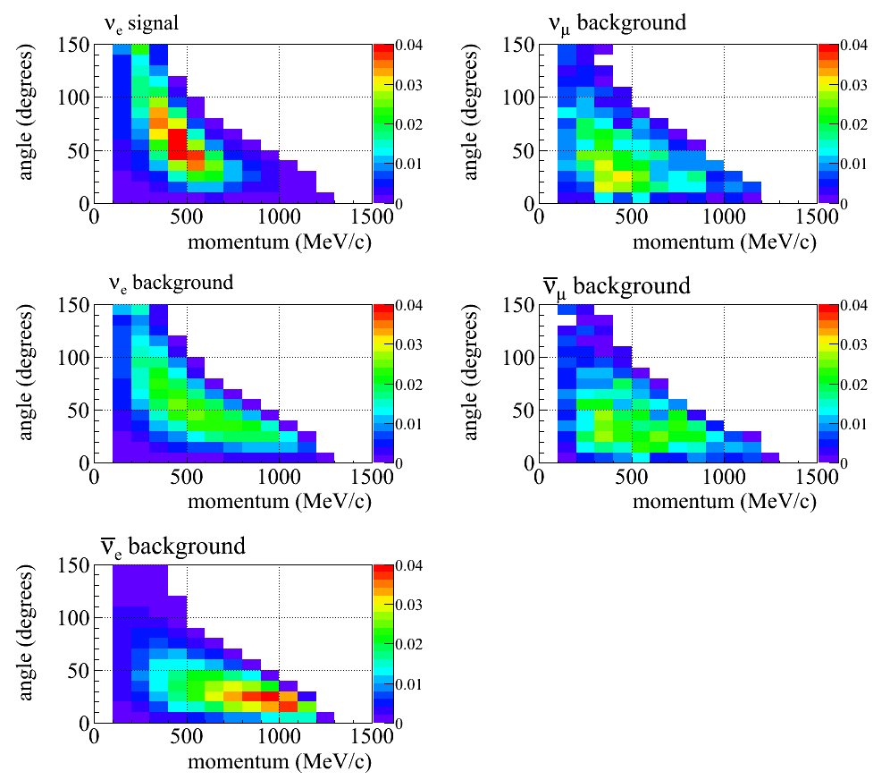
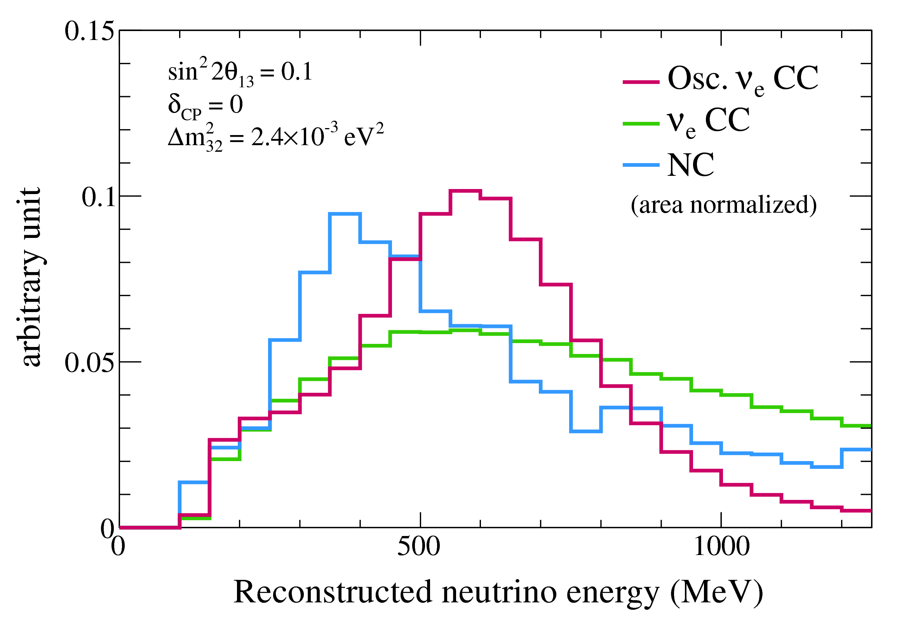
Oscillation Analysis FIT (3 methods)
Method-1: Maximum Likelihood Fit w/ Rate + (p_{e}, θ_{e})
Method-2: Maximum Likelihood Fit w/ Rate + reconstructed E_{ν}
Method-3: Feldman&Cousins for Rate only (used in previous analysis)
Method-1
Signal
NC BG
Method-2
Signal
BG ν_{e}
NC BG
NC BG
BG ν_{e}
BG anti-ν_{e}
Data is fit to signal + 4 BG 2-D curves
Data is fit to signal + 2 BG 1-D curves

Slide 26
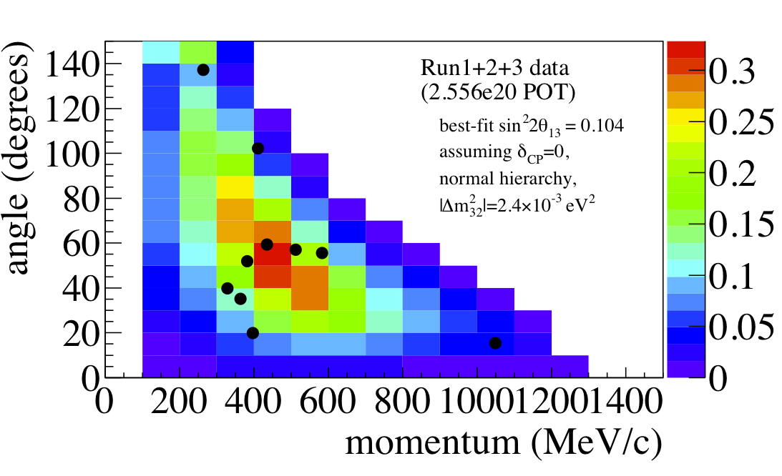
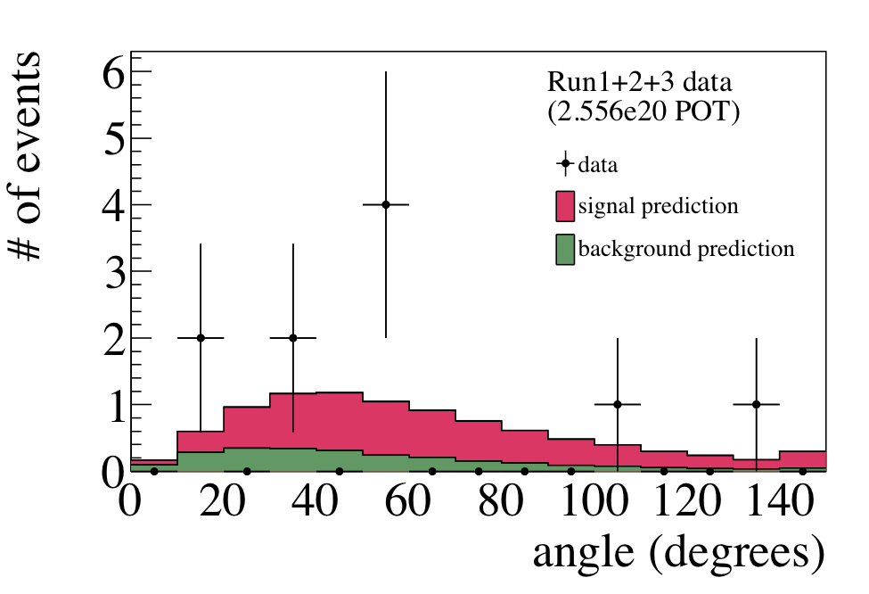
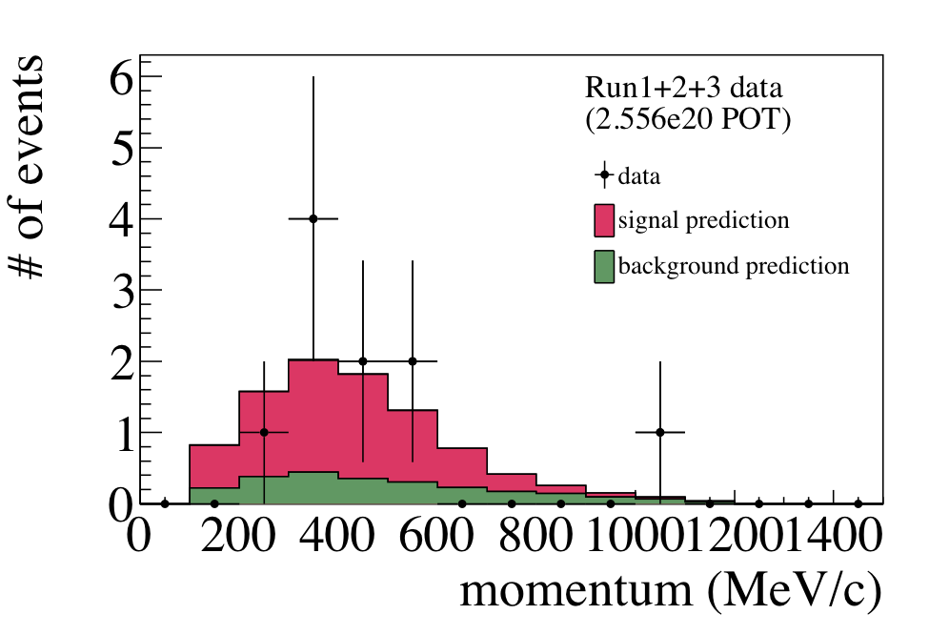
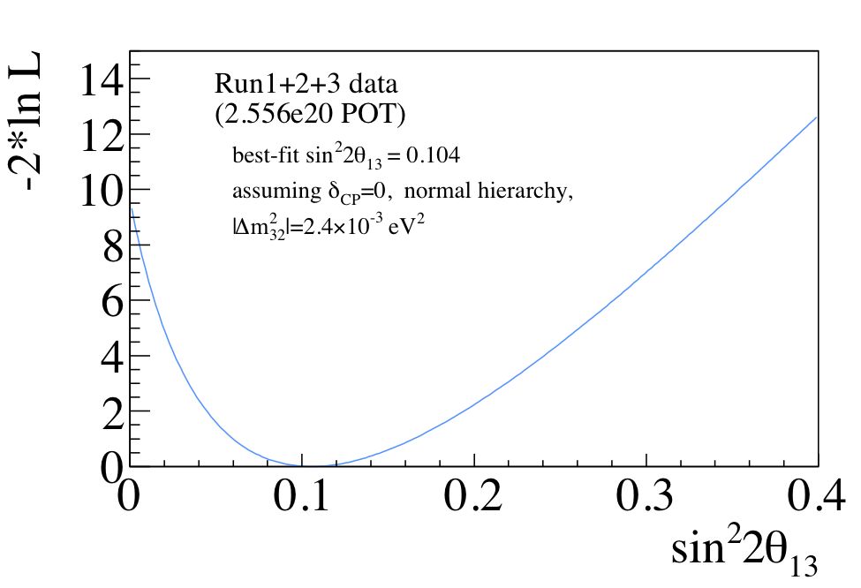
Method-1: Rate + (p_{e}, θ_{e})
Best fit: sin²2θ₁₃ = 0.104^{+0.060}
−0.045

Slide 27
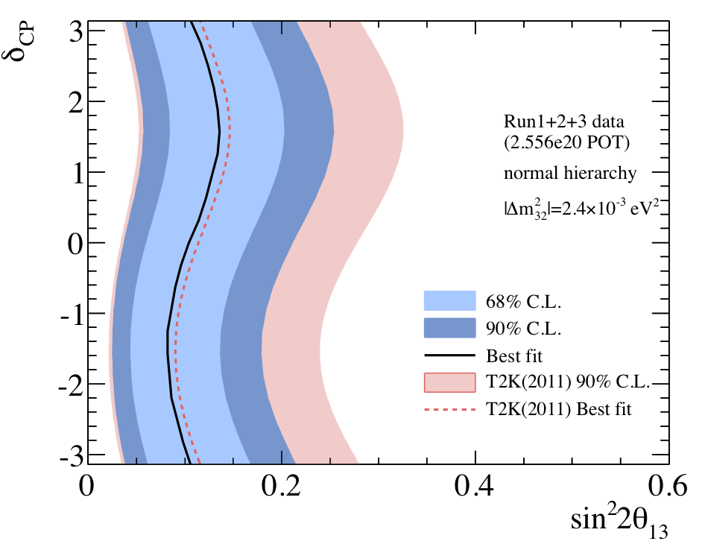

Method-1: Rate + (p_{e}, θ_{e})
90% CL: 0.036 < sin²2θ₁₃ < 0.211 for Normal Hierarchy (Δm²₂₃>0)
90% CL: 0.045 < sin²2θ₁₃ < 0.253 for Inverted Hierarchy (Δm²₂₃<0)
Normal Hierarchy
Inverted Hierarchy
@ δ_{CP}=0

Slide 28



Method-2 and -3
Method-2: Rate + E_{ν}^{rec}
Method-3: Rate only
All three results are consistent.

Slide 29
Future Prospect

Slide 30
Future Prospect
Results with all data collected by June 2012 is expected soon.
Updated ν_{μ} disappearance result is coming soon for θ₂₃ measurement.
  The precision of θ₂₃ with the reactor θ₁₃ value is also important to explore the sub-leading term.
Precise measurement of P(ν_{μ}→ν_{e}) is important to search for the sub-leading effects [ CP violation, matter effect, new physics, etc] in ν_{e} appearance.
The data will increase in each new run with higher beam power.
  ~8×10²⁰ POT (2013)→~1.2×10²¹ POT (2014)→~1.8×10²¹ POT (2015)
P(ν_{μ}→ν_{e})=sin²θ₂₃sin²2θ₁₃sin²(1.27Δm²₂₃L/E) + CPV + matter effect + …

Slide 31
Summary
Updated ν_{e} appearance results with 2.56×10²⁰ POT
  Systematic uncertainties reduced from the previous analysis: 23%→13%.
  10 ν_{e} candidates observed.
  2.73±0.73 events with sin²2θ₁₃=0 assumption
  Probability to observe 10 or more events = 0.08% (3.2 σ)
  Evidence of ν_{e} appearance!!
θ₁₃ measurement
  sin²2θ₁₃ = 0.104^{+0.060} (normal hierarchy, δ_{CP}=0)
  sin²2θ₁₃ = 0.128^{+0.070} (inverted hierarchy, δ_{CP}=0)
Results with all the collected data by June 2012 will be coming soon.
  ν_{e} appearance
  ν_{μ} disappearance
−0.045
−0.055

Slide 32
Backup Slides

Slide 33

Neutrino Oscillations as of 2012 May
Normal Hierachy
68% CL region
Inverted Hierachy
T2K
T2K
first indication of θ13 ≠ 0 with 2.5 σ significance
June 15, 2011
MINOS
MINOS
θ13 =0 disfavored @1.7 σ
June 24, 2011
Nov, 2011
Double Chooz
θ13 ≠ 0 @3σ combined with T2K and MINOS
Double Chooz
Daya Bay
Daya Bay
March, 2012
sin²2θ13=0.092 ± 0.016(stat) ± 0.005(syst)
5.2σ significance
RENO
April, 2012
RENO
sin²2θ13=0.113 ± 0.013(stat) ± 0.019(syst)
4.9σ significance

Slide 34
Neutrino Oscillations as of 2012 June
68% CL region
Normal Hierachy
T2K
Inverted Hierachy
T2K
June 5, 2012
MINOS
θ13 =0 disfavored @96% CL
MINOS
June 5, 2012
Double Chooz
Double Chooz
June 4, 2012
sin²2θ13=0.109 ± 0.030(stat) ± 0.025(syst)
Daya Bay
Daya Bay
June 4, 2012
sin²2θ13=0.089 ± 0.010(stat) ± 0.005(syst)
RENO
RENO
April, 2012
sin²2θ13=0.113 ± 0.013(stat) ± 0.019(syst)

Slide 35

ν_{μ}→ν_{e} Oscillation Probability
CP violating
Leading term
CPC
CPV
Solar
Matter
Matter effect
For , δ → –δ, a → −a
θ₁₃≠0 is necessary for CP violation.

Slide 36


Future Neutrino Physics
Search for CP violation & mass hierarchy
  θ₁₃ from reactor measurement : higher precision
  Precise measurement of ν_{e} appearance
  Comparison with reactor measurement
  → hint for CP phase δ & Mass Hierarchy
By courtesy of Suekane

Slide 37
T2K Neutrino Event Category
RUN1+2+3 2.56×10²⁰ POT | Data | MC Expectation |  |  | Accidental (12μs window)
 |  | sin²2θ₁₃=0.1 | sin²2θ₁₃=0 | No Osc.
FC | 209 | 213.6 | 199.7 | 429.6 | 0.034
FCFV | 151 | 150.7 | 140.9 | 297.0 | 0.0042
Single ring | 74 | 79.0 | 70.6 | 205.4 | -
μ-like (p_{μ}>200MeV/c) | 55(54) | 57.0(56.7) | 57.0(56.7) | 185.7(184.6) | -
e-like (p_{e}>100MeV/c) | 19(18) | 21.9(20.0) | 13.6(11.8) | 19.7(13.6) | -
Multi ring | 77 | 71.8 | 70.3 | 91.5 | -
Observation is consistent with sin²2θ₁₃=0.1 case.

Slide 38
MC Expectation for Signal and Background
RUN1+2+3 2.56×10²⁰POT | MC Expectation with sin²2θ₁₃=0.1 |  |  |  |  | Data
 | ν_{μ}+ν_{μ} CC | ν_{e}+ν_{e} CC | NC | BG total | Signal
True FV | 130.99 | 6.82 | 112.61 | 250.41 | 10.89 | -
FCFV | 99.43 | 6.51 | 34.31 | 140.26 | 10.46 | 151
One-ring | 56.27 | 4.09 | 9.78 | 70.15 | 8.81 | 74
e-like | 2.30 | 4.07 | 6.86 | 13.23 | 8.70 | 19
E_{vis}>100MeV | 1.49 | 4.03 | 5.94 | 11.47 | 8.50 | 18
No decay-e | 0.28 | 3.19 | 5.09 | 8.56 | 7.31 | 13
M_{inv}<105MeV | 0.07 | 2.21 | 1.39 | 3.67 | 6.82 | 10
E_{ν}^{rec}<1250MeV | 0.05 | 1.36 | 1.06 | 2.47 | 6.61 | 10
Efficiency [%] | 0.0 | 20.0 | 0.9 | 1.0 | 60.7 | -

Slide 39



ν_{e} Appearance Candidates
Check for candidate events
  Candidate event observation rate vs. POT
    Kolmogorov-Smirnov (KS) test →probability = 53.3%
  Momentum vs. angle between electron and incident ν for candidates
  →consistent with signal.
  Timing difference from nearest bunch
  →all candidates are inside bunch width.
Candidate event rate vs POT
angle vs. momentum
Timing distribution

Slide 40




Vertex Distribution
Vertex distribution of FC sample and final sample
FC sample
Event vertex evenly distributed.
→No event cluster near the edge of ID
Final sample

Slide 41

Contamination from Outside ID
MC estimation to check contamination of events with true vertex outside ID
→MC expectation = 0.018 events inside FV.
Distance from vertex to ID wall
Linear scale
Log scale
BG contamination from outside ID is very small

Slide 42






Vertex Distribution Test
KS test for vertex distributions of candidate events.
  Low probability for distance from wall parallel to beam.
  Low probability from RUN1+2. ↔RUN3 looks fine.
Vertex Fromwall beam||
Need to check with more statistics

Slide 43









T2K Neutrino Beamline Facility
Target-Horn System
Near Neutrino detectors
・On-axis detectors
・Off-axis detectors
muon
π-meson
Muon neutrino
Proton

Slide 44


Recovery from Earthquake
Subsidence outside buildings → Many water pipes and cables damaged.
All the functionality were back after recovery work.
→Beam operation resumed on Dec. 9th, 2011 after 9 months recovery work.
Subsidence around Beam Dump
After Earthquake (Mar. 24th)
After recovery (May 13th)

Slide 45



Realignment of Beamline Magnets
Beamline magnets moved by ~10mm
  Realignment was done.
  →All the magnets aligned within 1mm.
Residual from ideal beam orbit
15mm
Before realignment
15mm
After realignment
10mm
10mm
Vertical
5mm
5mm
Vertical
0mm
0mm
Horizontal
-5mm
Horizontal
-5mm
-10mm
-10mm
-15mm
upstream
downstream
-15mm
upstream
downstream

