Slide 1
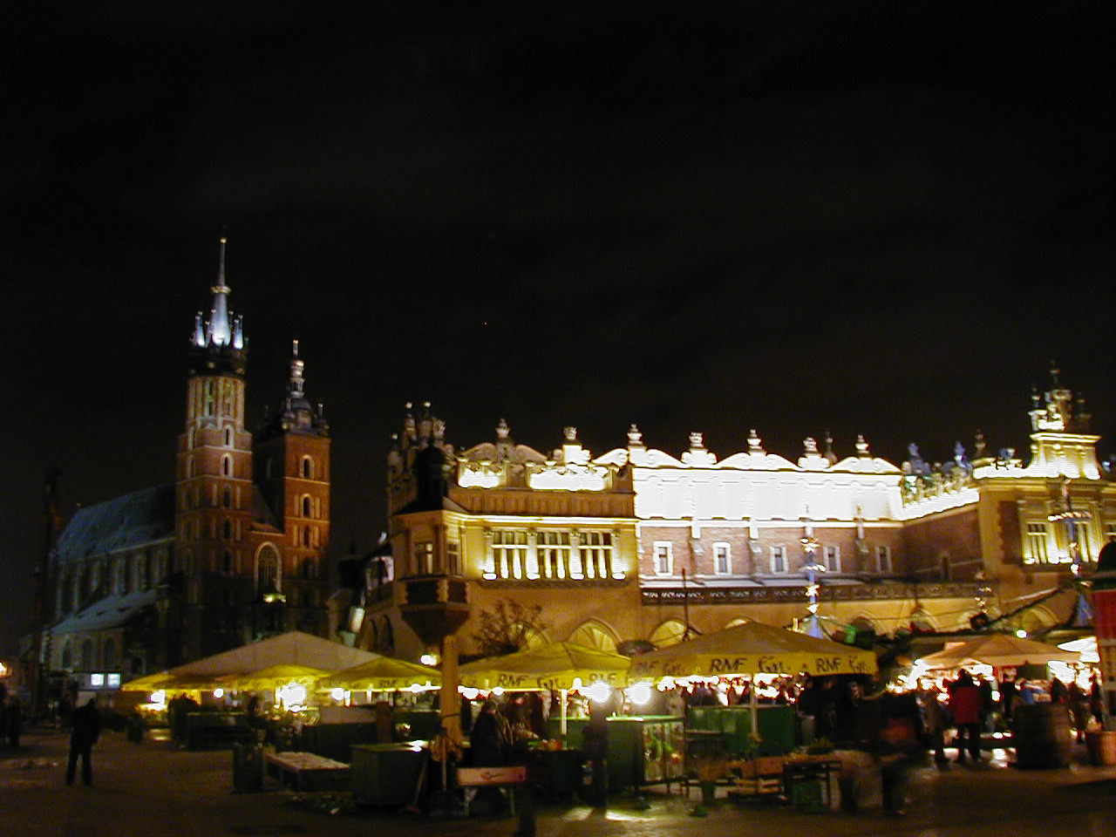
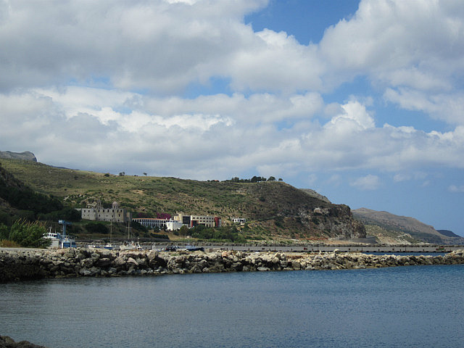
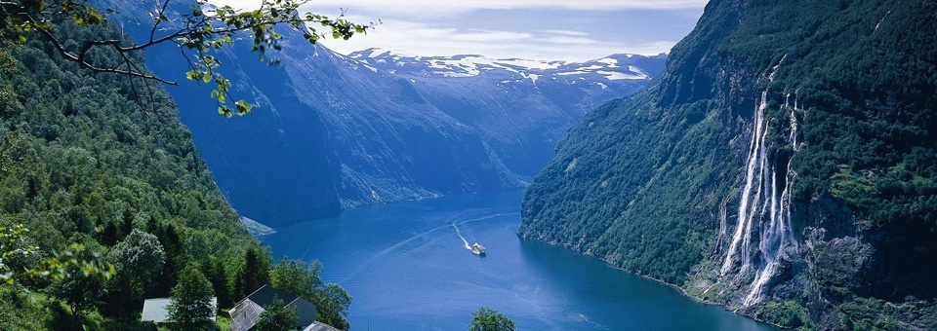
New Physics at LHC
pp Physics At LHC
pp Physics At LHC
L. Bravina (UiO),
in collaboration with
A.B.Kaidalov, K. Boreskov, O.V. Kancheli, K.Tywoniuk, I. Arsene,
J. Bleibel, G. Eyyubova, R.Kolevatov,
L. Malinina, M.S. Nilsson, E. Zabrodin
1sr International Conference on New Frontiers in Physics 2012, OAC, Kolymbari, Crete

Slide 2
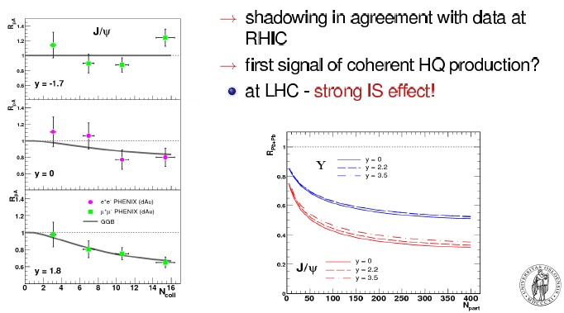
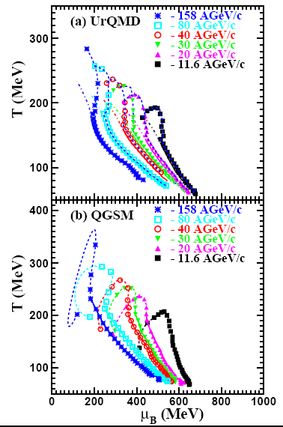
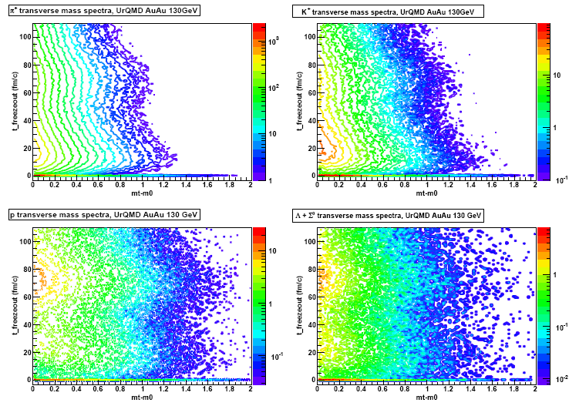
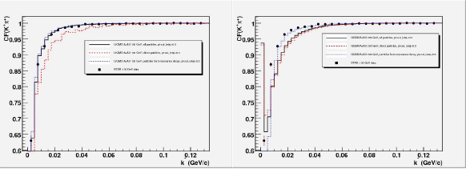
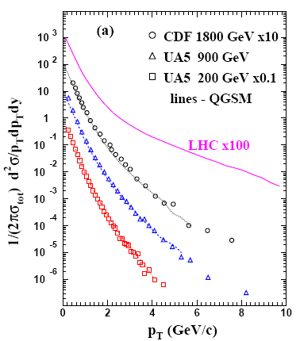

OSLO Theory Group
1. Gluon shadowing
6. Equation of State
4. Freeze-out
2. Elliptic flow
5. HBT correlations
7. Predictions for pp
3. HYDJET++
8. Flow in pp 9. Regge field theory and stochastic model
10. Di-hadron azimuthal correlations and ridge.

Slide 3
Content:
1. Motivations
2. Quark Gluon String Model for pp collisions at LHC: spectra, multiplicity distributions, forward-backward correlations
3. Freeze-out and Femptoscopic correlations in pp collisions: influence of resonances, minijets and formation time
4. Flow in pp and AA : as initial state effect
Conclusions

Slide 4
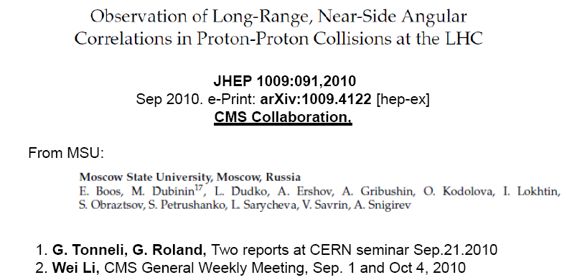
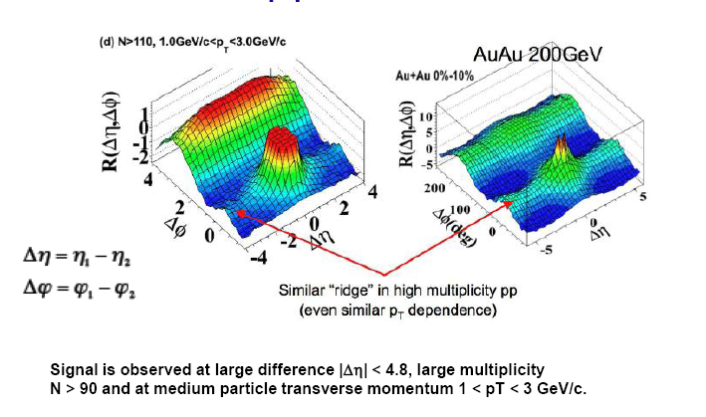
Helena Bialkowska for CMS : SQM 21.09.2011

Slide 5
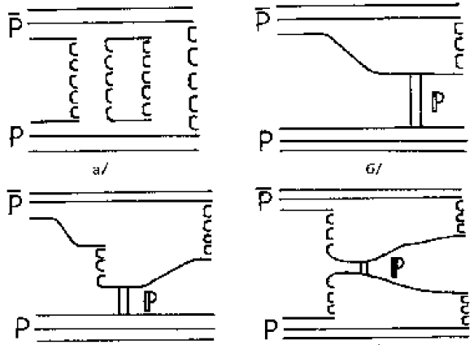
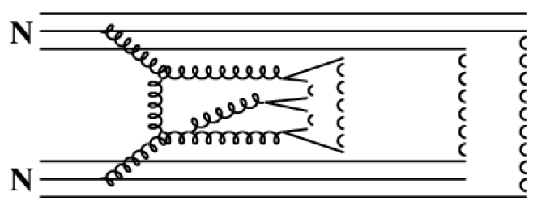
2. QGSM PREDICTIONS FOR PP AT LHC
A.B. Kaidalov, K.A.Ter-Martirosyan, PLB 117 (1982) N.S.Amelin, L.B., Sov.J.Nucl.Phys. 51 (1990) 133
N.S.Amelin, E.F.Staubo, L.P.Csernai, PRD 46 (1992) 4873
At ultra-relativistic energies: multi-Pomeron scattering, single and double
diffraction, and jets (hard Pomeron exchange)
Gribov’s Reggeon Calculus + string phenomenology

Slide 6
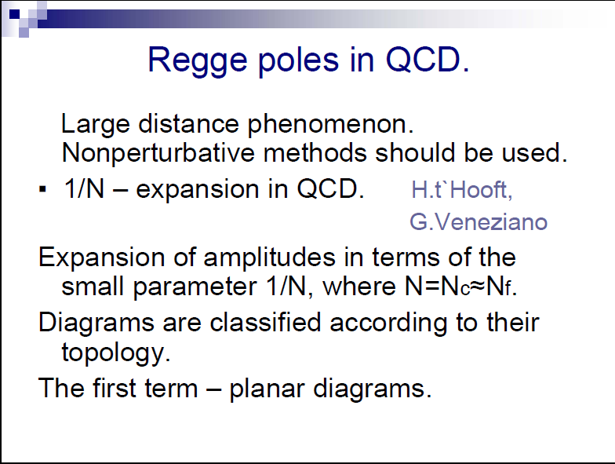

Slide 7
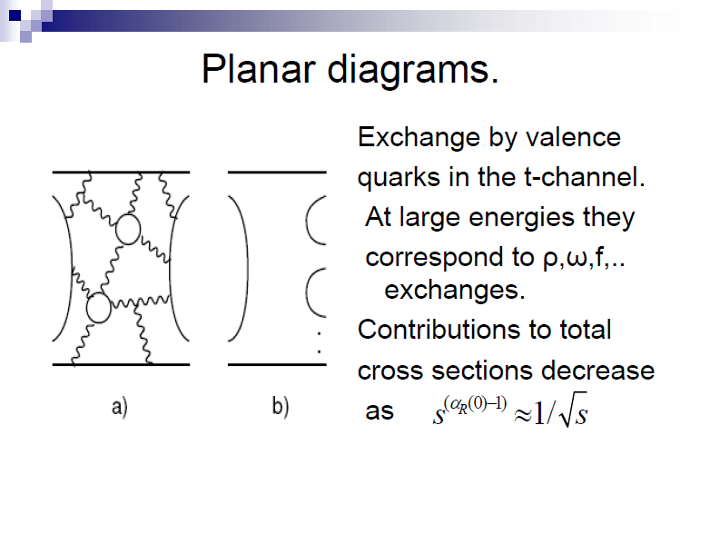

Slide 8
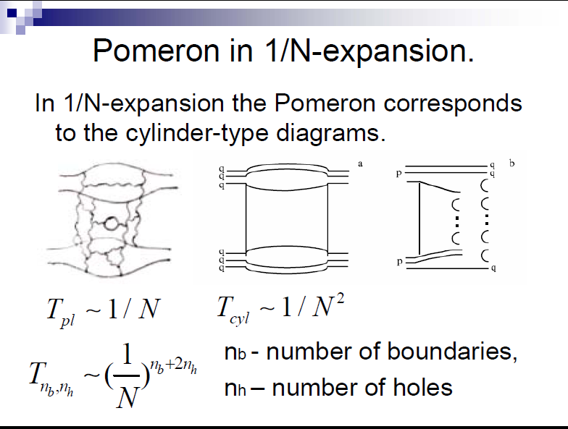

Slide 9
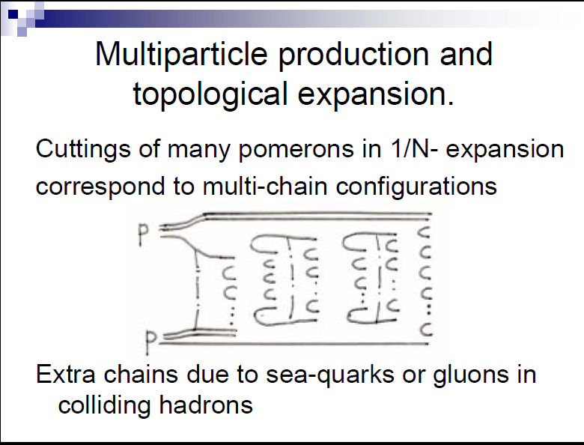

Slide 10
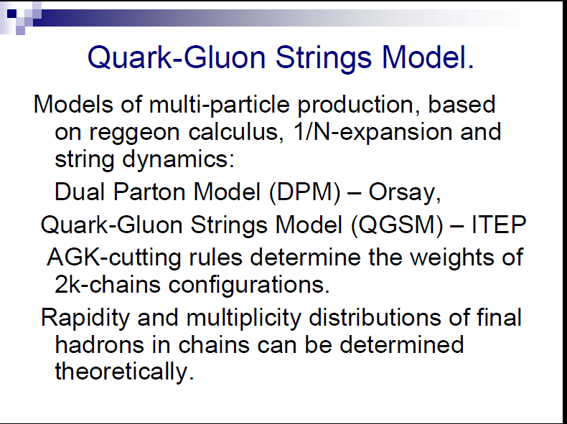

Slide 11
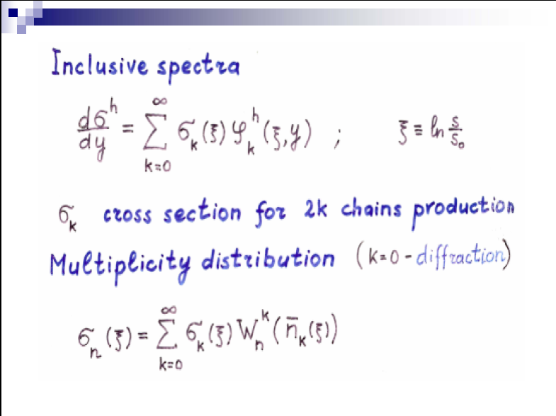

Slide 12
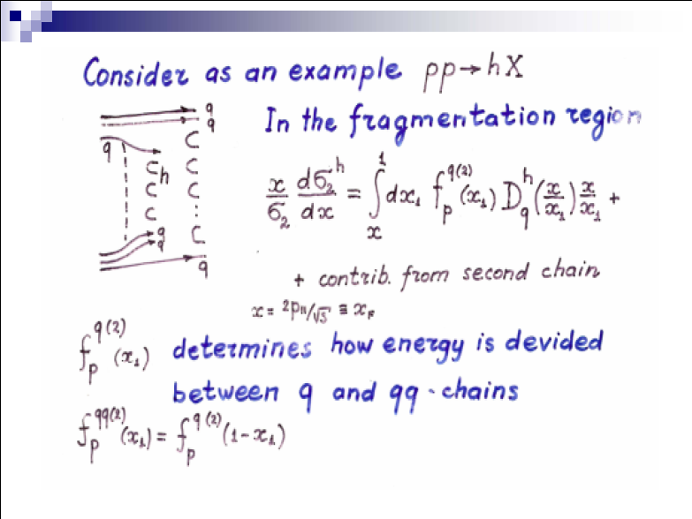

Slide 13
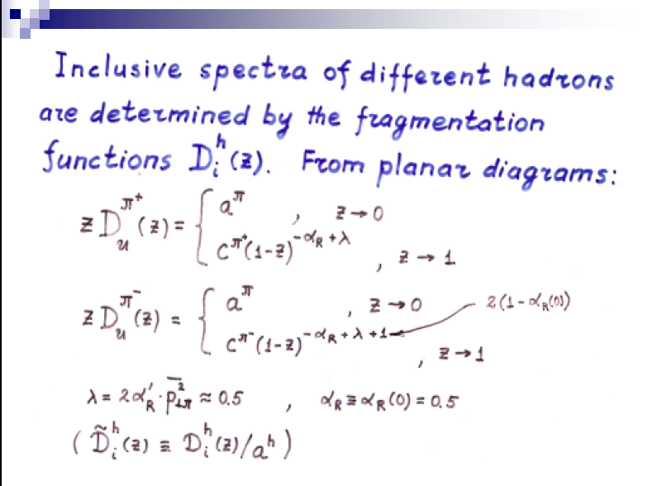

Slide 14
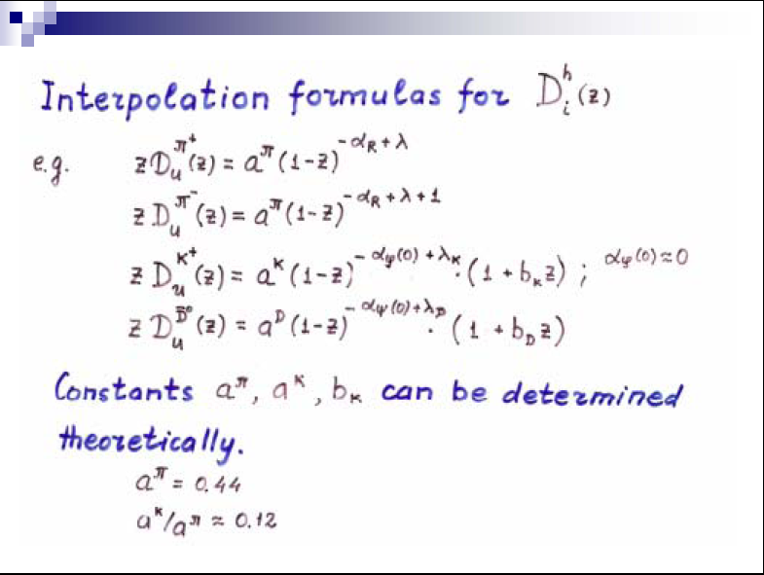

Slide 15
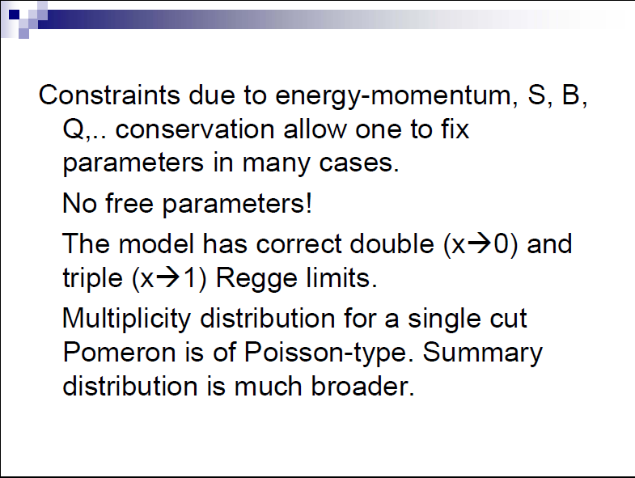

Slide 16
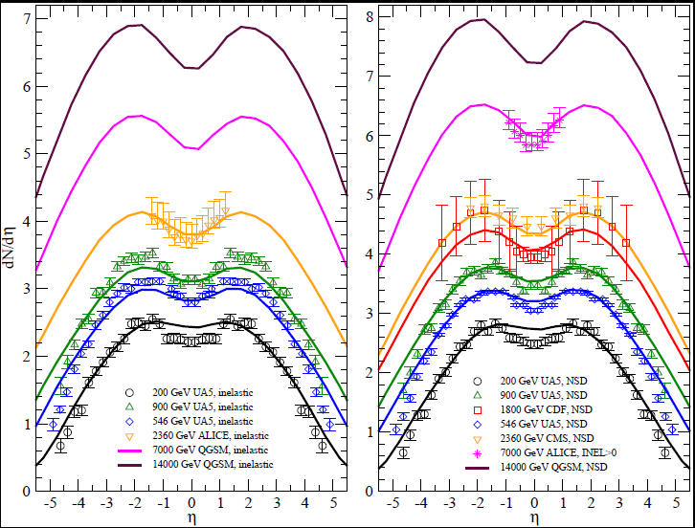
QGSM PREDICTIONS and RESULTS FOR LHC
Inelastic collisions
NSD collisions
J.Bleibel. L.B. et al., (work in progress)

Slide 17
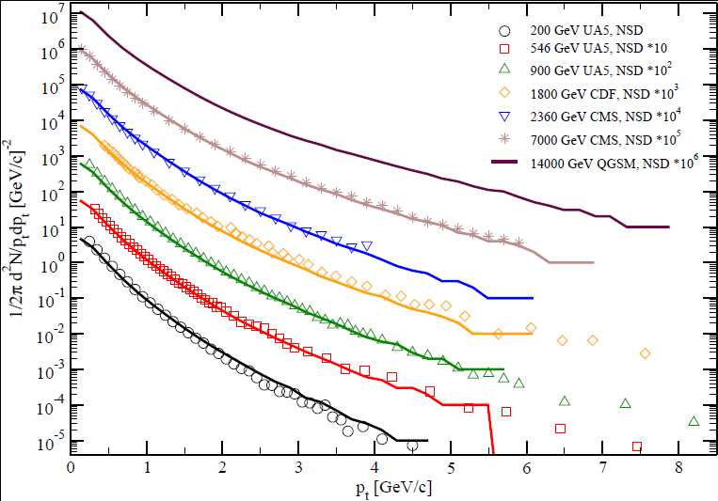
QGSM PREDICTIONS and RESULTS FOR LHC
Transverse momentum distributions
J.Bleibel, L.B. et al. (work in progress)

Slide 18
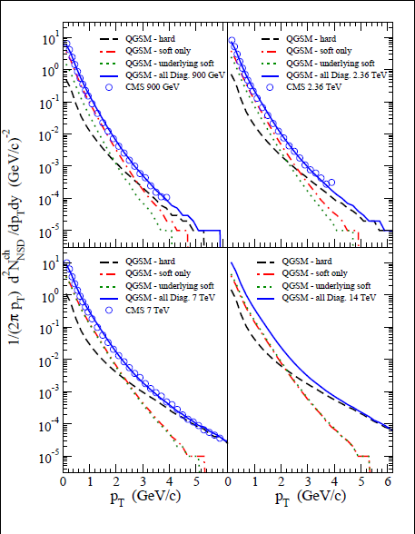
QGSM PREDICTIONS and RESULTS FOR LHC
Transverse momentum distributions
J.Bleibel, L.B. et al. (work in progress)

Slide 19
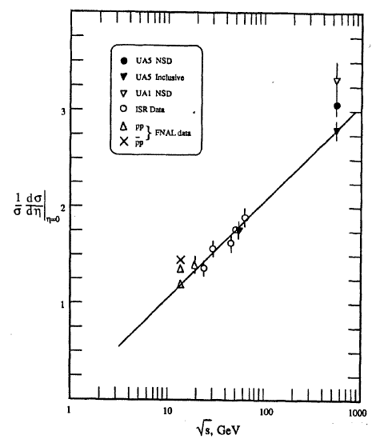
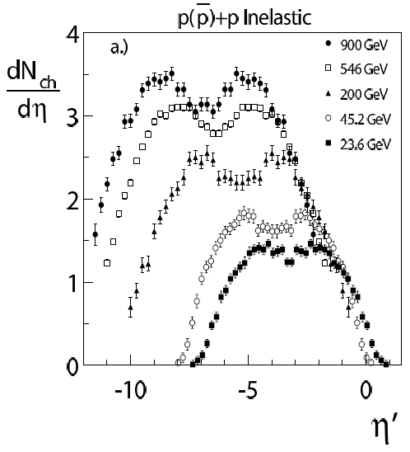
violation of Feynman scaling
UA5 Collab., Phys. Rep. 154 (1987) 247
W. Busza, JPG 35 (2008) 044040
Violation of Feynman scaling,
but ext. long. scaling holds?!
Charged particle pseudorapidity
density at h = 0 as a function of √s

Slide 20
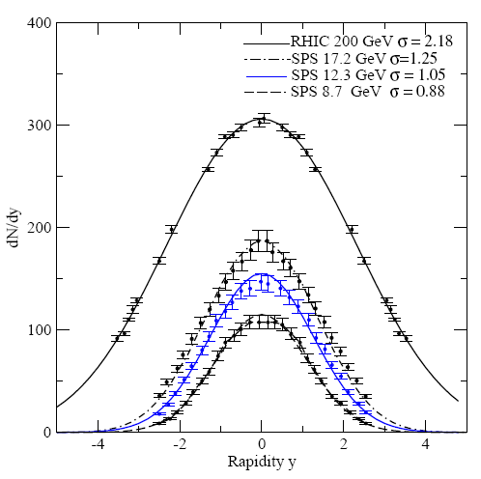
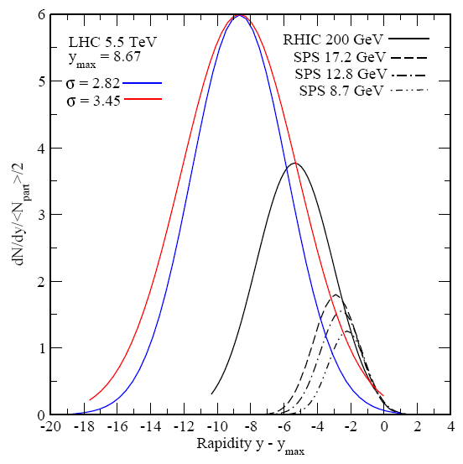
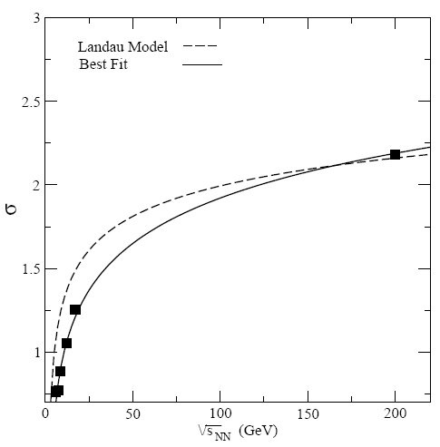
VIOLATION OF Extended Longitudinal Scaling
IN HEAVY-ION COLLISIONS AT LHC?
J. Cleymans, J.Struempfer, L.Turko, PRC 78 (2008) 017901
s
Statistical thermal model: ELS will be violated in A+A @ LHC. What about p+p ?

Slide 21
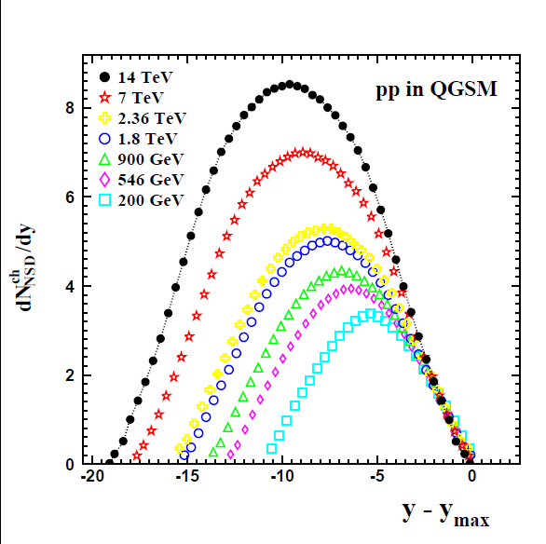
PREDICTIONS FOR PP @ LHC
QGSM: extended longitudinal scaling in p+p collisions holds

Slide 22
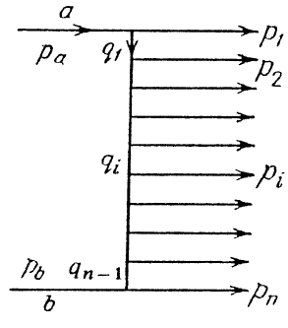
WHY SCALING HOLDS IN THE MODEL?
Short range correlations
In string models both FS and ELS holds in the fragmentation regions

Slide 23
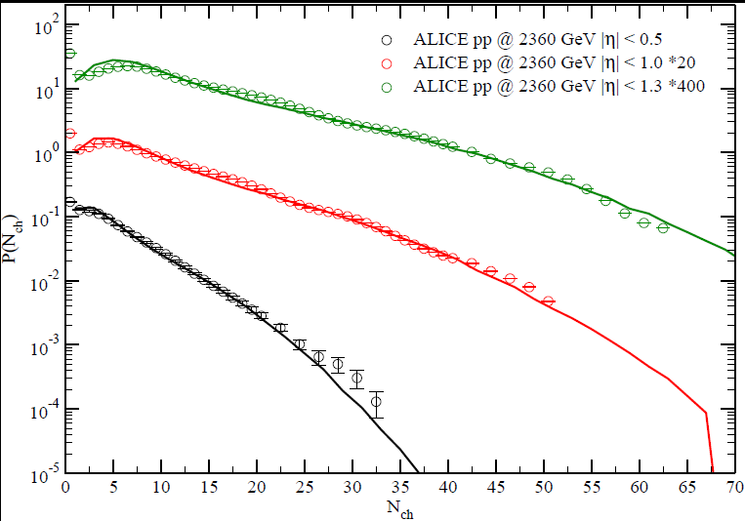
QGSM PREDICTIONS and RESULTS FOR LHC
Multiplicity distributions
J.Bleibel, L.B. et al. (work in progress)

Slide 24
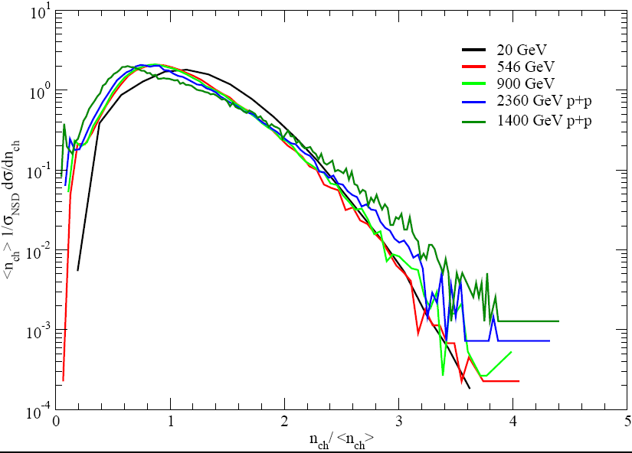
VIOLATION OF KNO SCALING AT LHC
High-multiplicity tail is pushed up, whereas maximum of the distribution is shifted towards small values of z
At energies below 100 GeV different contributions overlap strongly, whereas at higher energies – more multi-string processes
2
4
6
8
=> Enhancement of high multiplicities

Slide 25
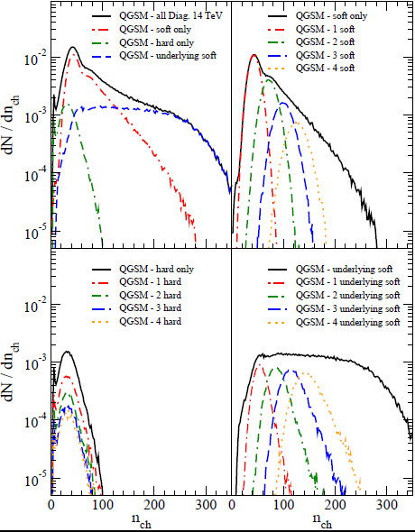
QGSM PREDICTIONS and RESULTS FOR LHC
Violation of KNO scaling at LHC
J.Bleibel, L.B. et al. (work in progress)

Slide 26
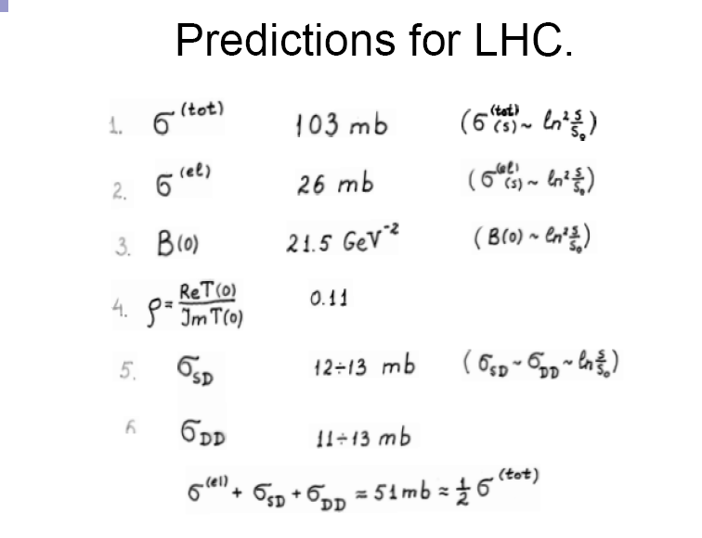
QGSM:
(14 TeV)

Slide 27
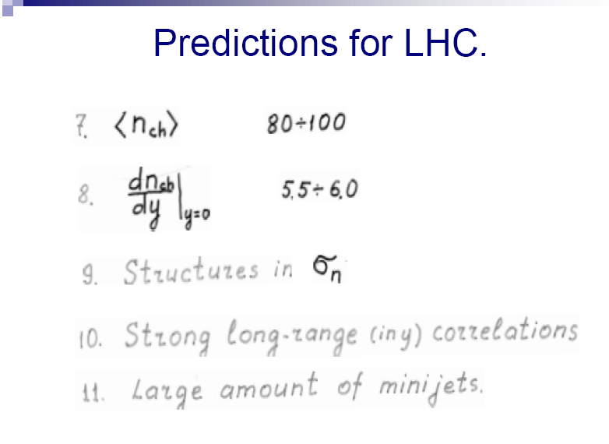
QGSM:

Slide 28
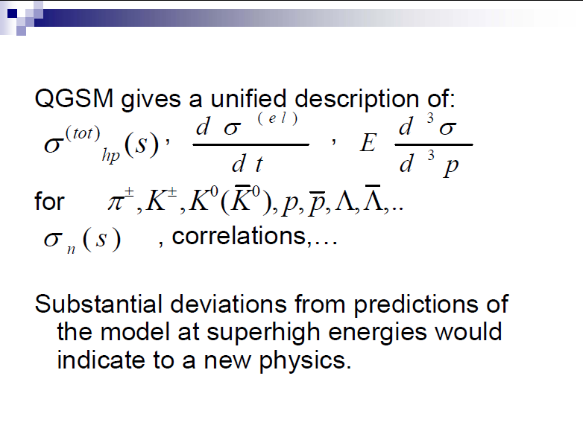

Slide 29
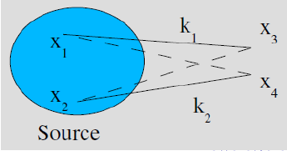
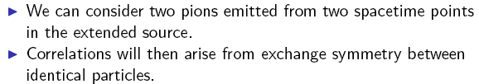
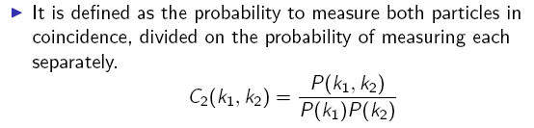

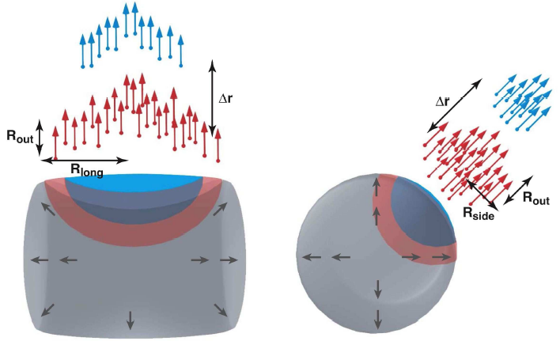

3.Hanbury-Brown—Twiss correlations
Detector
Detector

Slide 30
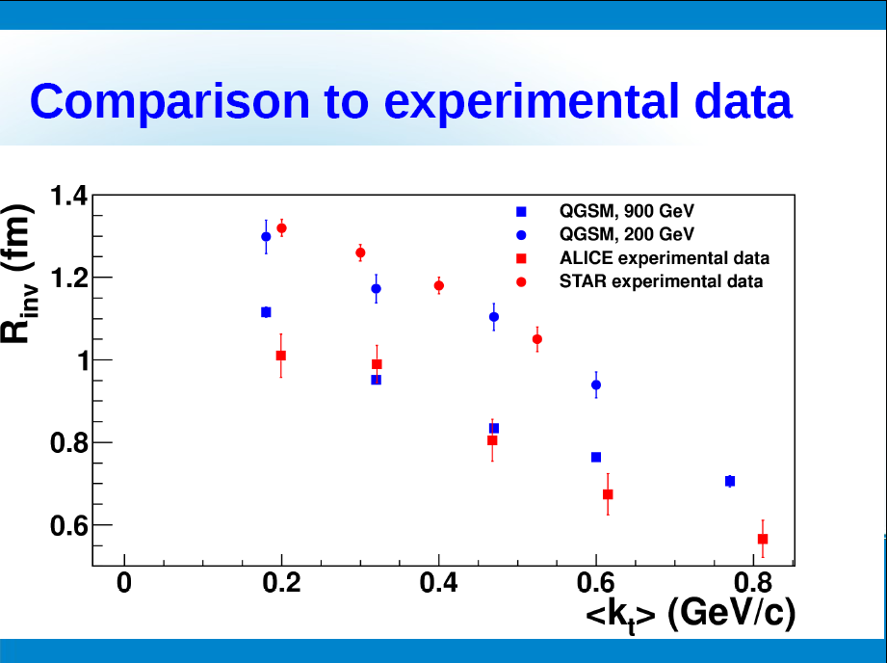

Slide 31
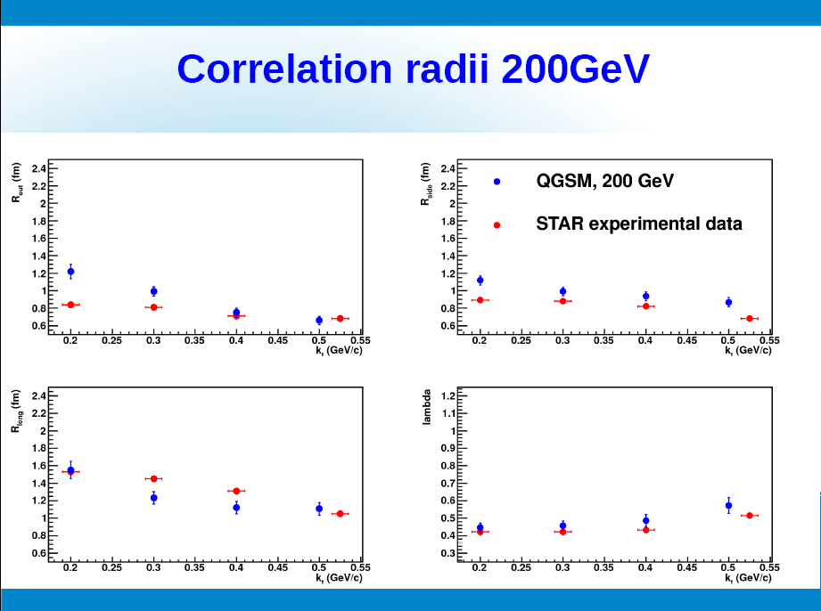

Slide 32
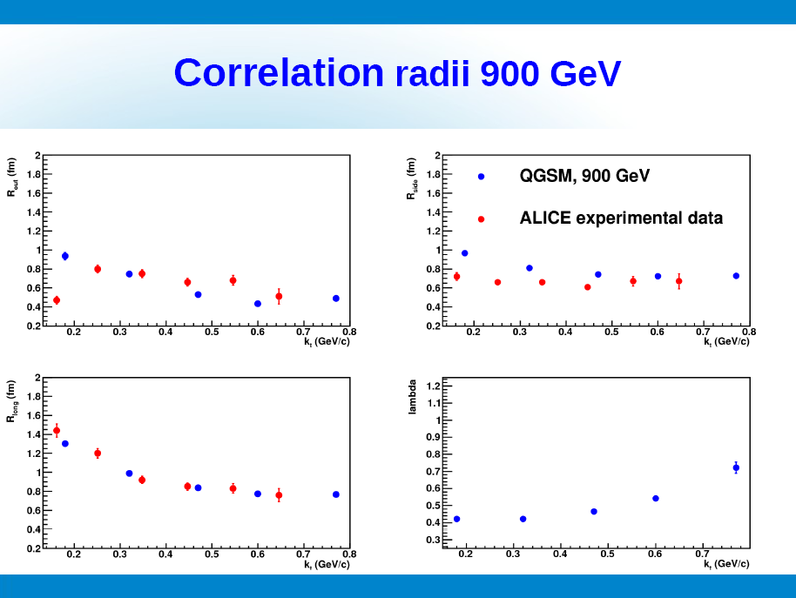

Slide 33
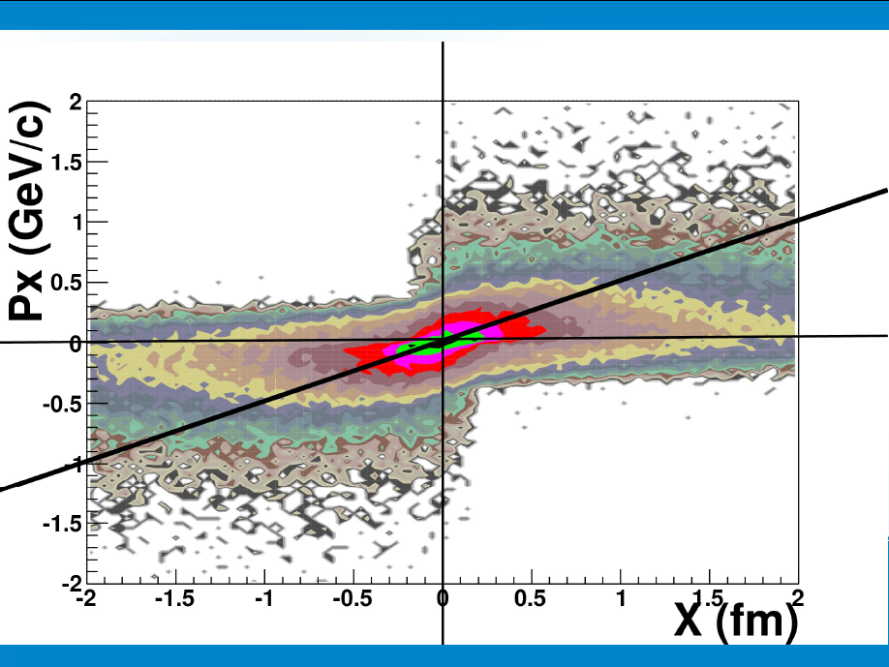

Slide 34
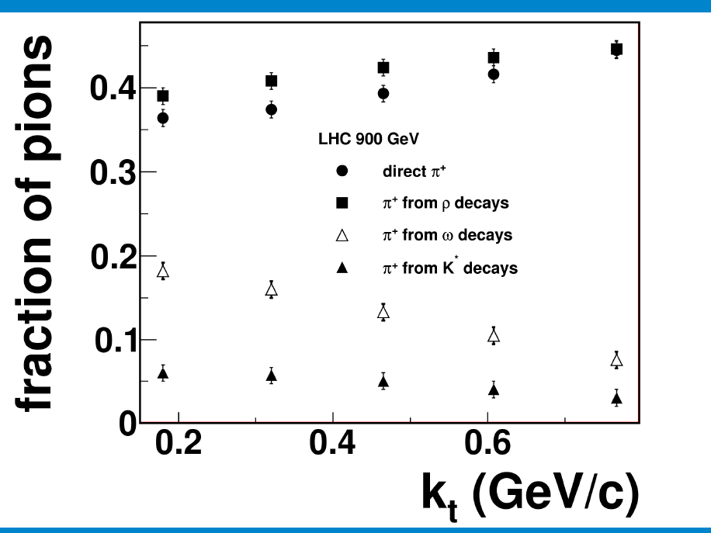

Slide 35
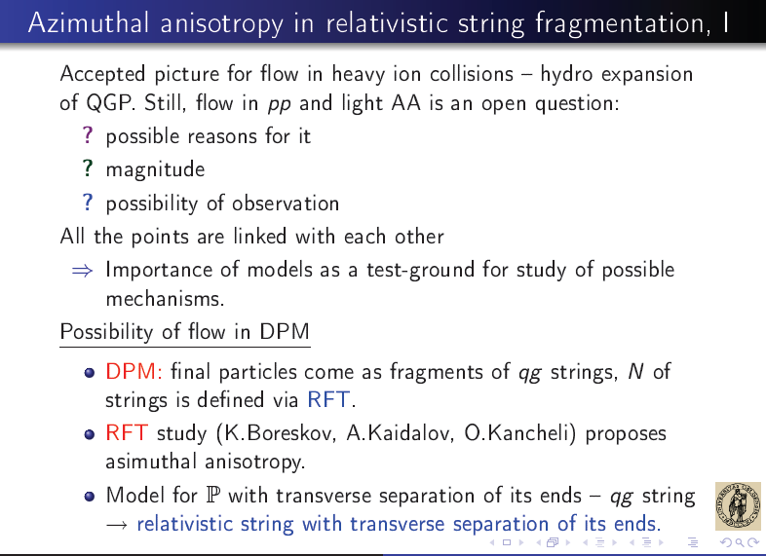
4. Anisotropic flow in pp

Slide 36
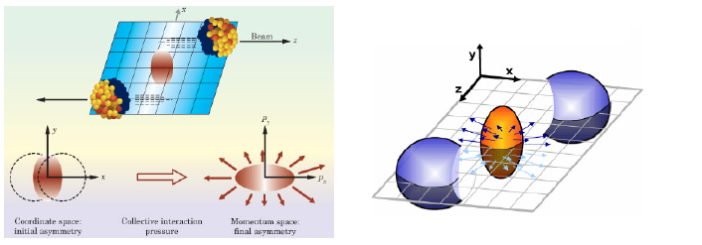
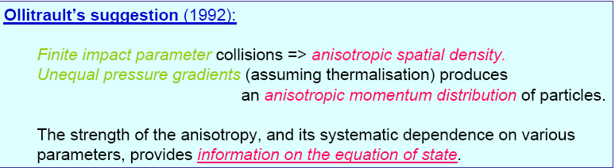

Status of anisotropic flow in AA (and in pp)
Fourie expansion of invariant cross section:

Slide 37




it depends on – energy, centrality,rapidity, pt, particle id:
Results on anisotropic flow in AA

Slide 38

Anisotropic flow in pp
Estimates of hadron azimuthal anisotropy from multiparton interactions in proton-proton collisions at sqrt(s) = 14 TeV. D. d'Enterria , G.Kh. Eyyubova, et al Eur.Ph ys.J.C66:173,2010.

Slide 39


Anisotropic flow in pp
Anisotropic flows from initial state of a fast nucleus.
K.G. Boreskov, A.B. Kaidalov, O.V. Kancheli, (Moscow, ITEP) . Sep 2008. 16pp.
Published in Eur.Phys.J.C58:445-453,2008.
e-Print: arXiv:0809.0625 [hep-ph]
Anisotropic flows from initial state of a fast nucleus.
K.G. Boreskov, A.B. Kaidalov, O.V. Kancheli, Eur.Phys.J.C58:445-453,2008.
In Regge theory it appears as initial state effect and inversely proportional to the radius of the object: for pp it could be larger then for AA :
In Gauss approximation

Slide 40

Anisotropic flow in pp

Slide 41

Anisotropic flow in pp
Eur.Phys.J. C68 (2010) 513-521

Slide 42

Summary and outlook
LHC is a discovery machine for both hard and soft physics in HI collisions
Event generators are an indispensable tool for planing the experiments and analysis of data
=> Further development of existing MC generators
HI theory groups in Oslo utilizes it to study : EOS, elliptic flow, particle freeze-out, HBT correlations of unlike particles, particle-jet correlations, heavy quark production in a large pT range, scaling properties …

Slide 43


Many Thanks to oAC for hospitality!!!

Slide 44



Slide 45


Slide 46

Interpretation of ridge in pp

Slide 47


8. Anisotropic flow in pp
And connected with EOS and final state interactions.

Slide 48



Jet Quenching at LHC?

Slide 49




Slide 50

Jet quenching observed by CMS in heavy-ion collisions – 271110 http://press.web.cern.ch/press/pressreleases/releases2010/pr23.10e.html
Pt=70 GeV
Pt=205 GeV
Figure 1 LHC lead-lead collision in the CMS detector showing particles
(yellow and red tracks) radiating from the collision point. The particles
deposit their energy in the calorimeters (salmon, mauve, red and blue towers,
with a height proportional to energy). Two back-to-back jets are seen
with a large energy asymmetry, as expected from the jet-quenching mechanism.

Slide 51




HI collision - Nuclear Modification Factor R_{AA}
A+A
p+p
n x m ≈ ⟨N_{binary}⟩
varies with impact parameter b

Slide 52

R. Kolevatov:

Slide 53


Slide 54


Slide 55


Slide 56

MC realization:Correlations in double parton distributions at
small x. Ch. Flensburg, G. Gustafson, L. Lonnblad, A. Ster JHEP 1106 (2011) 066 .1103.4320 [hep-ph]

