Slide 1
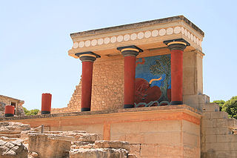
Clustering of Color Sources
&
Equation of State of the QGP
Brijesh K Srivastava
Department of Physics
Purdue University
USA
ICFP2012
June 10-16, 2012
Kolymbari, Crete, Greece

Slide 2
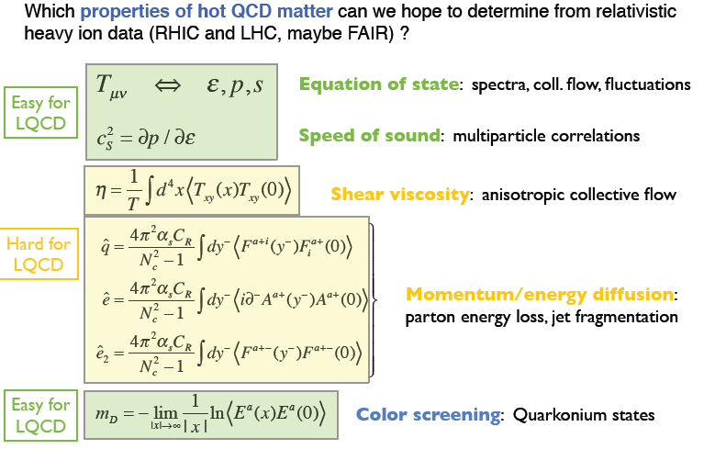
Exploration of Hot QCD Matter
The Next Decade
Berndt Muller
CERN Theory Institute (HIC10)
Aug.16- Sept.10, 2010

Slide 3
Color Strings
Multiparticle production at high energies is currently described
in terms of color strings stretched between the projectile and target. Hadronizing these strings produce the observed hadrons.
The no. of strings grow with energy and the no. of participating nuclei and one expects that interaction between them becomes essential.
This problem acquires even more importance, considering the idea that at very high energy collisions of heavy nuclei (RHIC) may produce Quark-gluon Plasma (QGP).
The interaction between strings then has to make the system evolve towards the QGP state.

Slide 4
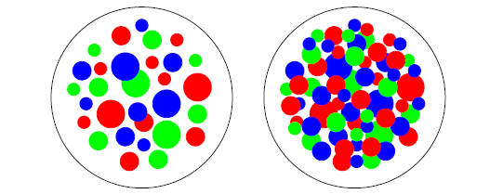
Clustering of Color Sources
De-confinement is expected when the density of quarks and gluons becomes so
high that it no longer makes sense to partition them into color-neutral hadrons,
since these would overlap strongly.
We have clusters within which color is not confined : De-confinement is thus
related to cluster formation very much similar to cluster formation in
percolation theory and hence a connection between percolation and
de-confinement seems very likely.
Parton distributions in the
transverse plane of nucleus-nucleus
collisions
In two dimensions, for uniform string density, the percolation threshold for overlapping discs is:
H. Satz, Rep. Prog. Phys. 63, 1511(2000).
H. Satz , hep-ph/0212046
Critical Percolation Density

Slide 5
Color Strings + Percolation = CSPM
Multiplicity and <p_{T}² > of particles produced by a cluster of n strings
Multiplicity (μ_{n})
Average Transverse Momentum
= Color suppression factor
(due to overlapping of discs).
N^{s} = # of strings
S₁ = disc area
S_{N} = total nuclear overlap area
ξ is the percolation density parameter.
M. A. Braun and C. Pajares, Eur.Phys. J. C16,349 (2000)
M. A. Braun et al, Phys. Rev. C65, 024907 (2002)

Slide 6
Percolation and Color Glass Condensate
Both are based on parton coherence phenomena.
Percolation : Clustering of strings
CGC : Gluon saturation
Many of the results obtained in the framework of percolation of strings
are very similar to the one obtained in the CGC.
In particular , very similar scaling laws are obtained for the product and
the ratio of the multiplicities and transverse momentum.
Both provide explanation for multiplicity suppression and <p_{t}>
scaling with dN/dy.

Slide 7
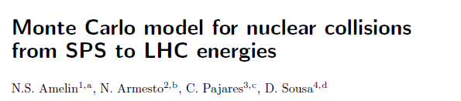

Elementary partonic collisions
Partonic wave functions of the colliding hadrons
Formation of Color String
Transverse momentum of both partons at the
string ends
Given by Gaussian-> pt -broadening
Collectivity ->string fusion/percolation
SU(3) random summation of charges
Reduction in color charge
Increase in the string tension
String breaking leads to formation of secondaries
Probability rate ->Schwinger
Fragmentation proceeds in an iterative way
Multiplicity
pt distribution
Particle ratios
Elliptic flow
Suppression of high pt particles R_{AA}
J/ψ production
Forward-Backward Multiplicity Correlations at RHIC
Color String Percolation Model for Nuclear Collisions
from
SPS-RHIC-LHC

Slide 8
CSPM
Using the p_{T} spectrum to calculate ξ
To compute the p_{T} distribution, a parameterization of the pp data is used:
a, p₀ and n are parameters fit to the data.
This parameterization can be used for nucleus-nucleus collisions, accounting for percolation by:
In pp at low energy, <nS₁/S_{n}>_{pp} = 1 ± 0.1, due to low string overlap probability in pp collisions.
M. A. Braun, et al. hep-ph/0208182.

Slide 9
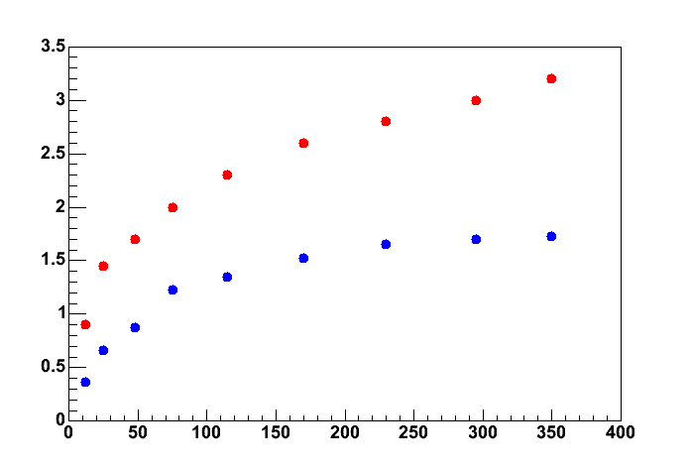
STAR Collaboration, Nukleonika 51, S109 (2006)
Au+Au
200 GeV
62 GeV
Percolation density parameter ξ
ξ_{c}=1.2
STAR Preliminary
Npart
Now the aim is to connect F(ξ) with Temperature and Energy density

Slide 10
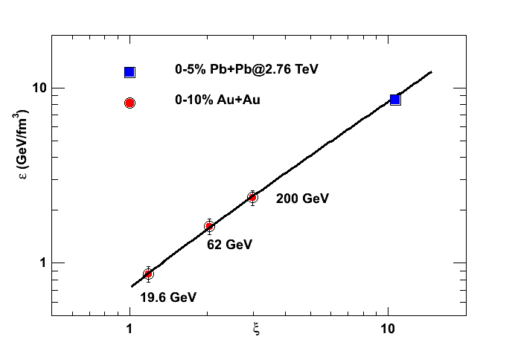
Energy Density
STAR Collaboration has published charged particle multiplicities and
transverse momentum of particles in for Au+Au collisions at various energies.
It is found that
D. Cebra , STAR Collaboration, QM08
B. I. Abelev et al, STAR Collaboration, Phys. Rev.C79, 34909 (2009)
B. I. Abelev et al, STAR Collaboration, Phys. Rev.C81, 24911(2010)

Slide 11
Temperature & Thermalization
Schwinger
p_{t} distribution of the produced quarks
It is shown that quantum fluctuations of the string tension can account for the thermal distributions of hadrons created in the decay of color string.
2. The tension of the macroscopic cluster fluctuates around its
mean value because the chromoelectric field is not
constant . Assuming a Gaussian form for these fluctuations
one arrives at the probability distribution of transverse
momentum.
1. Fluctuations of the string and transverse mass distribution
A. Bialas, Phys. Lett., B 466 (1999) 301.
Percolation of color sources and critical temperature
J. Dias de Deus and C. Pajares, Phys.Lett , B 642 (2006) 455

Slide 12
Temperature
Schwinger
p_{t} distribution of the produced quarks
Thermal Distribution
which gives rise to thermal distribution
Temperature of primary
partons/cluster

Slide 13
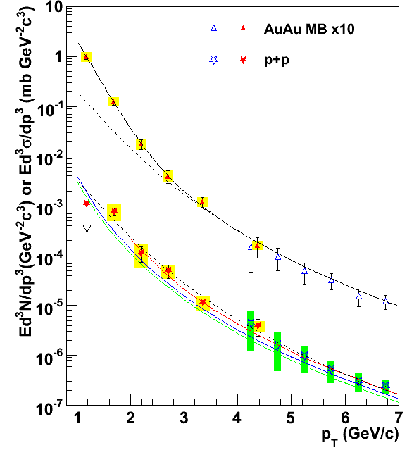
Temperature
At the critical percolation density
Au+Au
min. bias
= 167 MeV
For Au+Au@ 200 GeV
0-10% centrality ξ = 2.88 T ~ 195 MeV
√sNN = 200 GeV
1. Chemical freeze out temperature
P. Braun-Munzinger et al., Phys. Lett. B596, 61 (2006)
2. Universal chemical freeze out temperature
F. Becattini et al, Eur. Phys. J. C66, 377 (2010).
Direct photon excess in Au+Au above p+p spectrum
Exponential (consistent with thermal) Inverse slope = 220 ± 20 MeV
PRL 104, 132301 (2010)

Slide 14
Thermodynamic Relations
Equation of State
The QGP in the clustering of color sources is born in local thermal
equilibrium because the temperature is determined at string level.
This can be coupled to hydrodynamics to obtain energy density,
pressure , entropy density and sound velocity
J. D. Bjorken, Phys. Rev. D27, 140 (1983).
An analytic function of ξ for the EOS of QGP for T≥ T_{c}
Finally, we have energy density, temperature and sound velocity
as a function of color suppression factor F(ξ) or percolation density
parameter ξ.

Slide 15
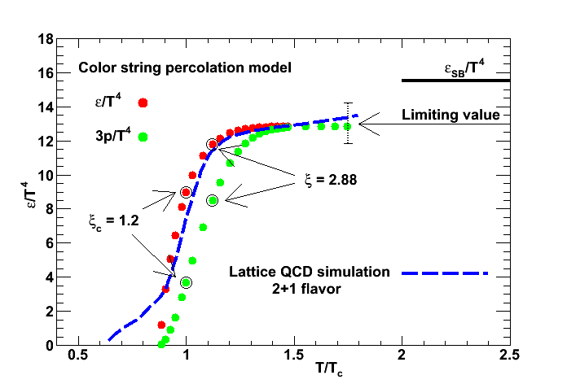
Energy Density
0-10% centrality
Lattice QCD : Bazavov et al, Phys. Rev. D 80, 014504(2009).

Slide 16
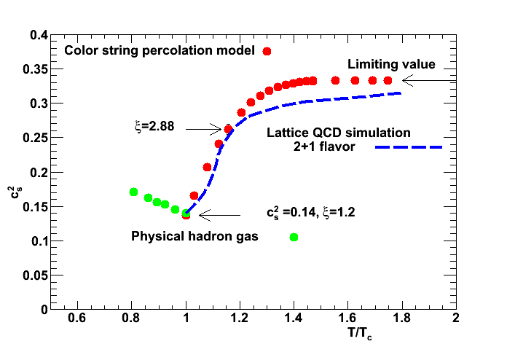
Velocity of Sound expressed as
Lattice QCD : Bazavov et al, Phys. Rev. D 80, 014504(2009).
Physical hadron gas: Castorina et al, arXiv:0906.2289/hep-ph

Slide 17
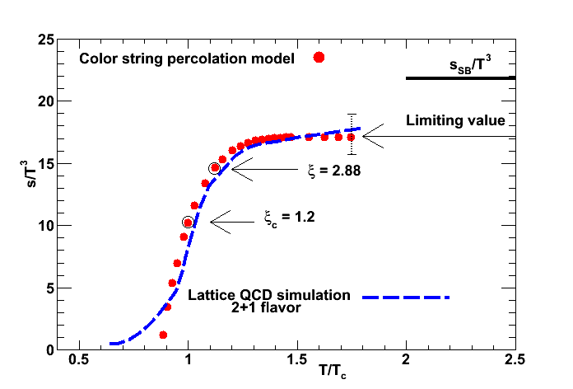
Entropy Density
0-10% centrality
Lattice QCD : Bazavov et al, Phys. Rev. D 80, 014504(2009).

Slide 18
Transport Coefficient of QCD Matter
Shear Viscosity/Entropy η/s

Slide 19
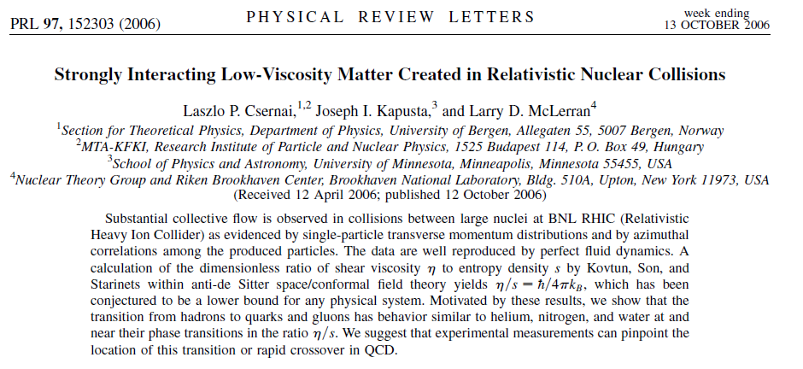

Slide 20
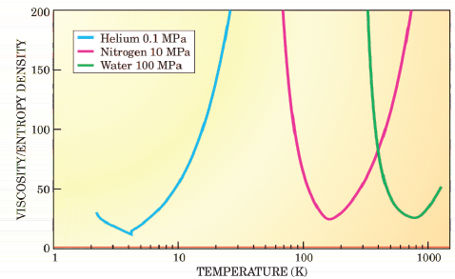
η/s for He, N₂ and H₂O

Slide 21
The viscosity can be estimated from kinetic theory to be
ε
Energy density
s Entropy density
n the number density
Mean free path
Transport cross section
Average transverse momentum of the single string
Hirano & Gyulassy, Nucl. Phys. A769, 71(2006)
L is Longitudinal extension of
the source 1 fm

Slide 22
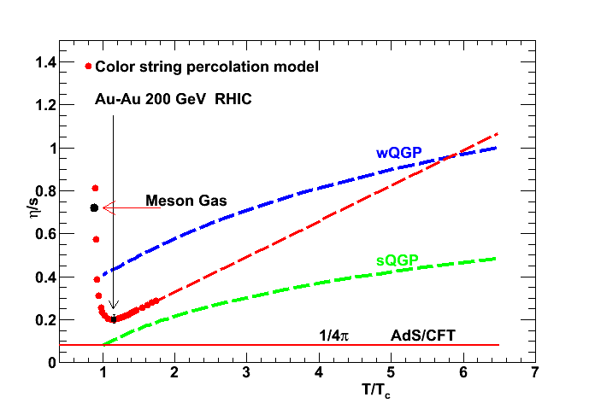
Shear viscosity to Entropy ratio

Slide 23
Prediction for Pb+Pb at LHC Energy 2.76 TeV

Slide 24
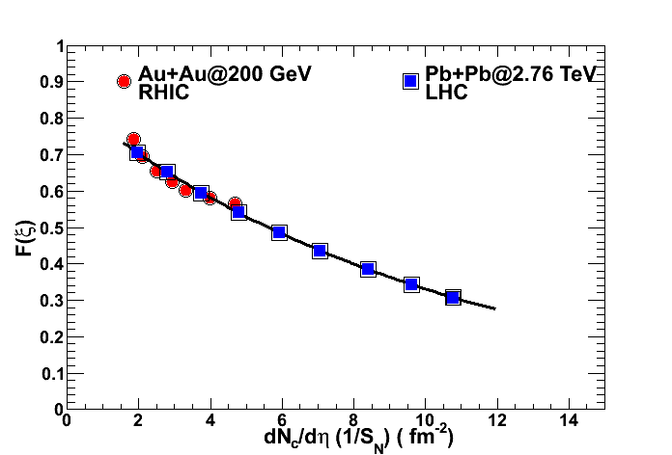
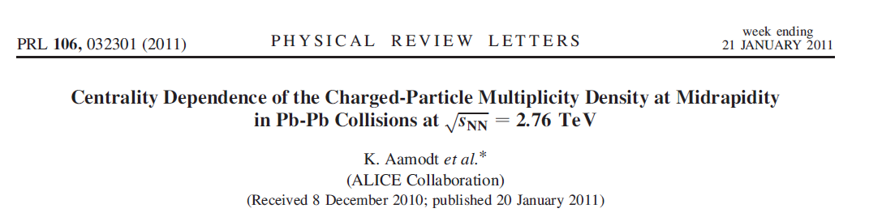

Slide 25
Temperature
Pb+Pb @ 2.76TeV for 0-5%
T ~265 MeV
Temperature has increased by 35% from Au+Au @ 0.2 TeV
A “Little Bang “ arrives at the LHC
E Shuryk
Physics 3, 105 (2010)
First Results from Pb+Pb Collisions at the LHC
Muller, Schukraft and Wyslouch
arXiv:1202.3233, To appear in Ann. Rev. Nucl. & Part. Sci, Oct. 2012
The initial temp increases by 30% to T~300 MeV

Slide 26
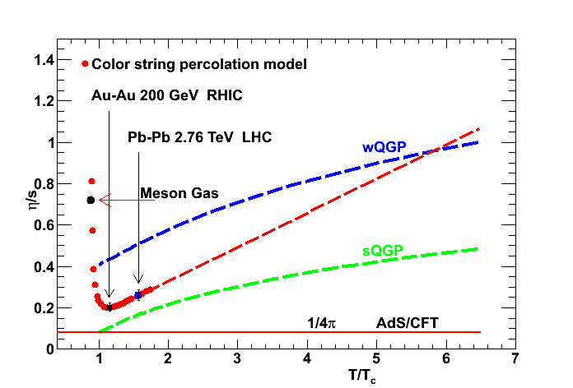
Shear viscosity to Entropy ratio

Slide 27
Exploration of Hot QCD Matter
The Next Decade
Berndt Muller
CERN Theory Institute (HIC10)
Aug.16- Sept.10, 2010

Slide 28
Summary
The Percolation analysis of Clustering of Color Sources
at RHIC Energy provides a compelling argument that QGP
is produced in all soft events.
The minimum in η/s can be studied as a function of the beam energy
at RHIC that could locate the critical point/crossover in QCD phase
diagram as seen in substances like He, N₂ and H₂O.
The STAR experiment is conducting this analysis.
A further definitive test of clustering phenomena can be made at LHC
energies by comparing h-h and A-A collisions.
H. Satz : Quantum Field Theory in Extreme Environments, Paris , April 2009
Clustering and percolation can provide a conceptual basis for the QCD phase diagram which is more general than symmetry breaking .

Slide 29
Many Thanks to Organizers
for arranging this Conference in
such a beautiful place

Slide 30
Color Strings + Percolation = CSPM
Multiplicity and <p_{T}² > of particles produced by a cluster of n strings
Multiplicity (μ_{n})
Average Transverse Momentum
= Color suppression factor
(due to overlapping of discs).
N^{s} = # of strings
S₁ = disc area
S_{N} = total nuclear overlap area
ξ is the percolation density parameter.
M. A. Braun and C. Pajares, Eur.Phys. J. C16,349 (2000)
M. A. Braun et al, Phys. Rev. C65, 024907 (2002)

