Slide 1

Antinucleus Production at STAR
2001 data: better statistics for anti-³He
2007 data: discovery of anti-hypertriton
2010 data: discovery of anti-α
new data: what’s next?
Declan Keane
Kent State University

Slide 2
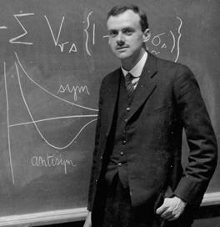
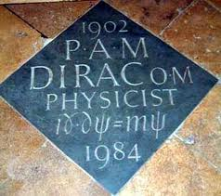
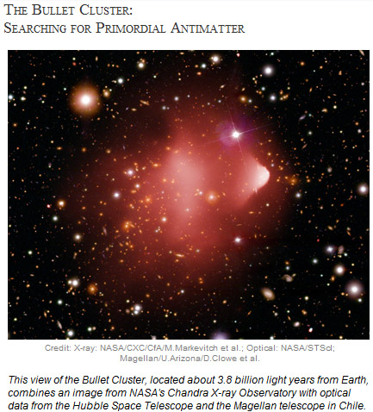
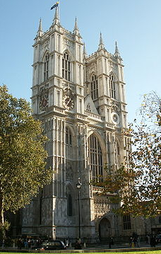
Antimatter 101
The Dirac equation (1928) predicted the existence of antimatter. It was confirmed 4 years later by Anderson’s discovery of the positron.
Many antiparticles and several antinuclei followed since (more on this later).
Big Bang initially produced matter & antimatter in equal abundance – so does any primordial antimatter still persist in isolated regions of the cosmos?
Notes:
Dirac’s memorial stone in Westminster Abbey is near the graves of Newton & Darwin. Maxwell & Faraday also have memorial stones nearby. Dirac’s stone is the only one with an equation.

Slide 3
Collisions at RHIC
Hadronization & freeze-out
RHIC generates hot and dense matter, where matter & antimatter decouple quickly:
Ideal factory for antinuclei

Slide 4

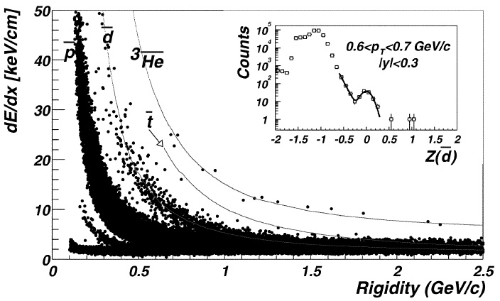
First STAR results for antinuclei
PRL 87, 262301 (2001)
14 anti-³He based on 0.6M central AuAu at 130 GeV

Slide 5
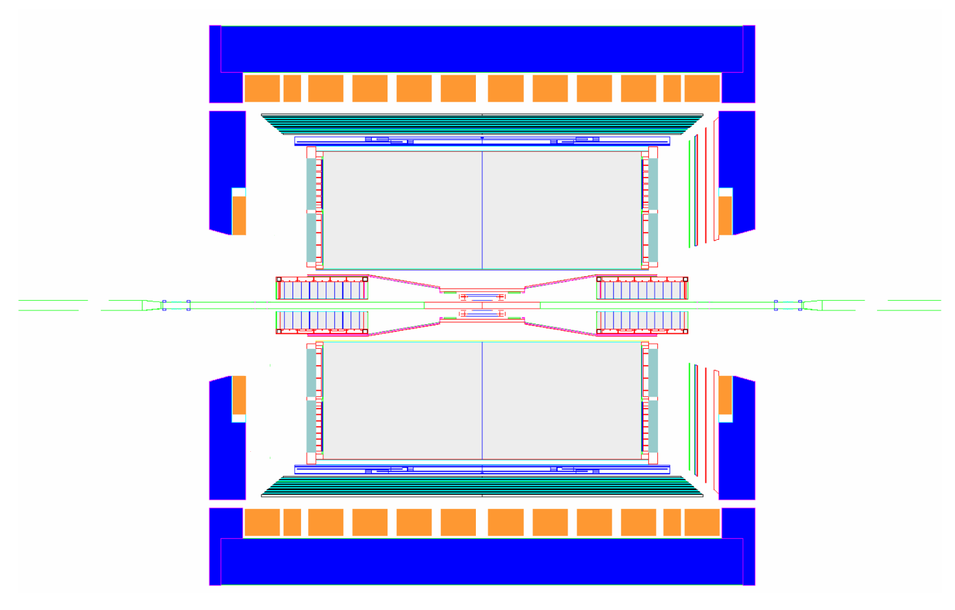
STAR Subsystem Status – 2010
MRPC ToF Barrel + VPD
MTD
EMC Barrel
EMC End Cap
FMS
BBC
FHC
FPD
TPC
pp2pp’
pp2pp’
PMD
FTPC
trigger
computing
DAQ1000
COMPLETE
HLT
HFT
FGT
Ongoing
R&D
2010 run provided ~ a billion events with greatly enhanced PID
Full 2π in azimuth at ~ 2 units in midrapidity

Slide 6
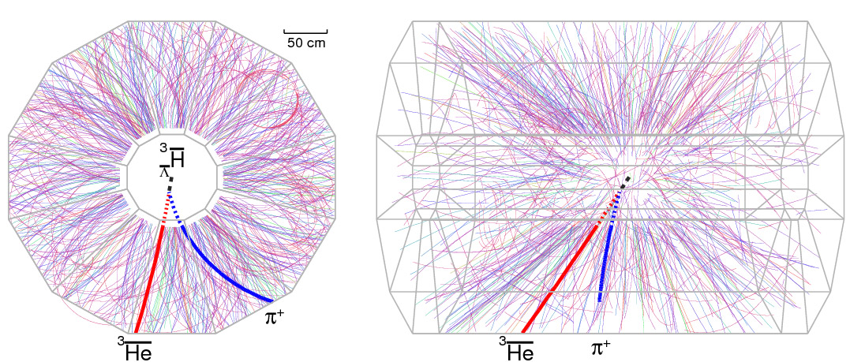
Results from Data up to 2007
Anti-hypertriton: anti-proton, anti-neutron & anti-Λ – the first antinucleus with strangeness, and the heaviest antinucleus so far.
After searching >100 million AuAu collisions, found 70 anti-hypertritons.
Published in Science in March 2010; much favorable PR for STAR & RHIC. News stories in Nature, Scientific American, National Geographic, many news outlets worldwide.
STAR Collaboration, Science 328, 58 (2010)

Slide 7
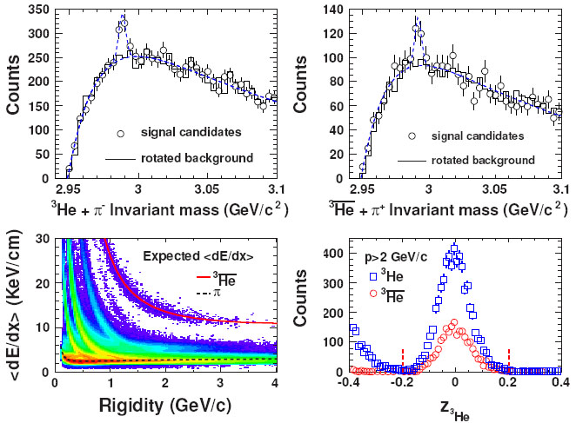
Signal & Background
157±30
70 ±17
2168 ³He
counts
Hypertriton signal is 5.2σ while anti-hypertriton signal is 4.1σ
STAR Collaboration, Science 328, 58 (2010)

Slide 8
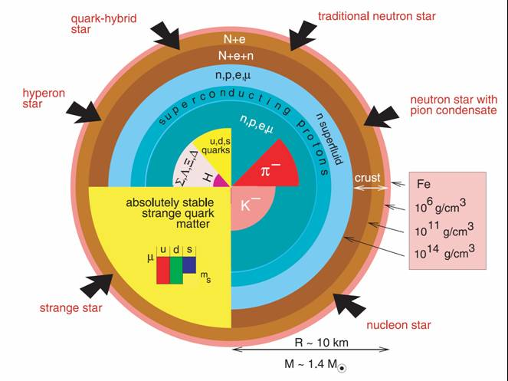
Competing Neutron Star Models
Better Y-N interaction constraints (combining lifetime measurements from
anti-hypernuclei and hypernuclei) should help distinguish among models

Slide 9
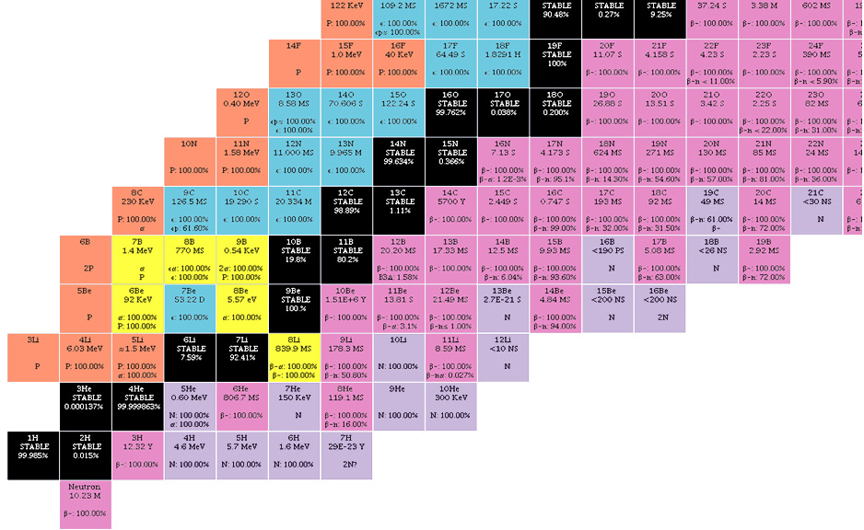
Chart of the Nuclides
Protons
(Z)
Neutrons (N)
Antinuclei extend chart to negative Z & negative N
Hypernuclei add 3rd axis for strangeness S
Antihypernuclei S axis also flips sign

Slide 10
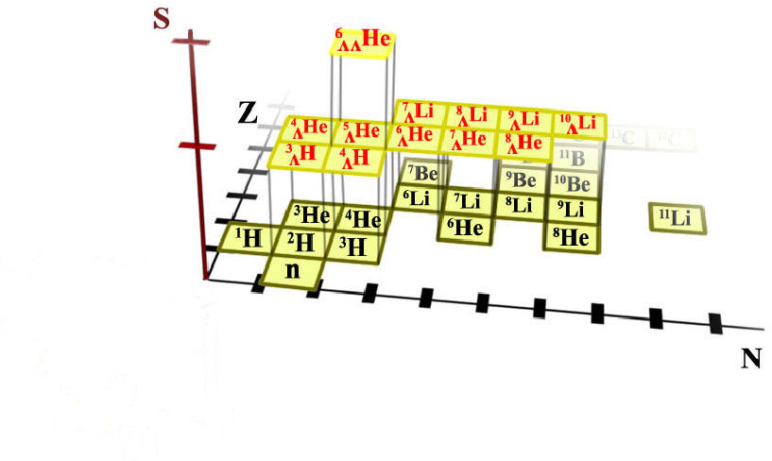
3-D Chart of the Nuclides

Slide 11
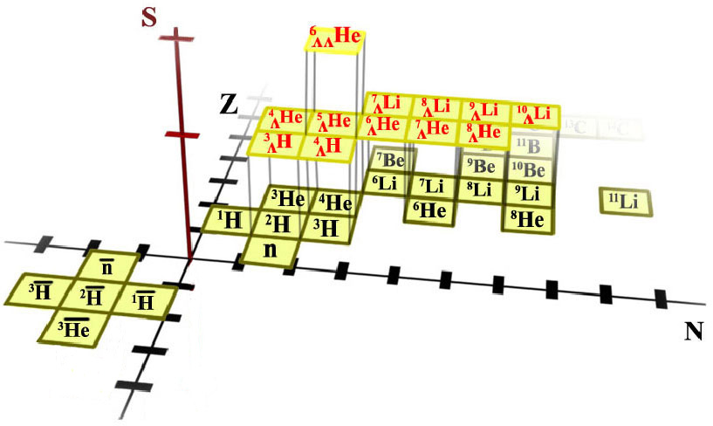
3-D Chart of the Nuclides

Slide 12
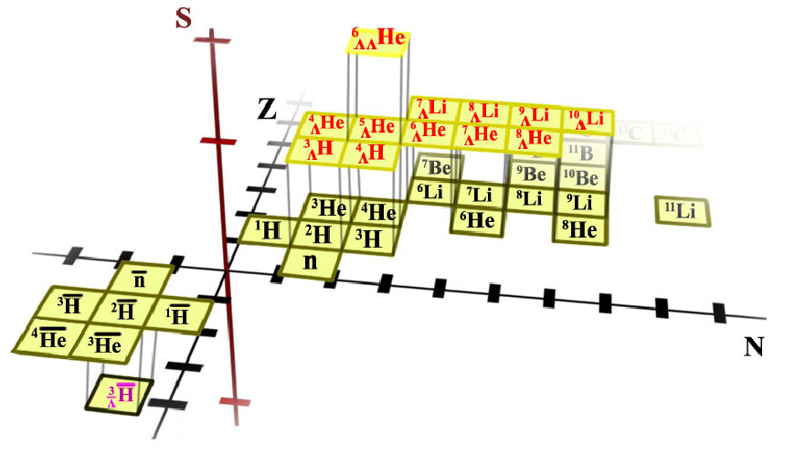
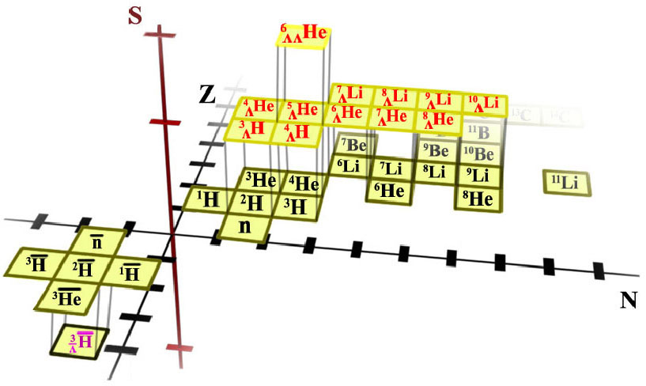
3-D Chart of the Nuclides
Broader issues addressed by these studies:
What type of matter is in interior of collapsed stars?
What happened to antimatter created in the Big Bang?
Implications for cosmic ray searches for new physics.

Slide 13
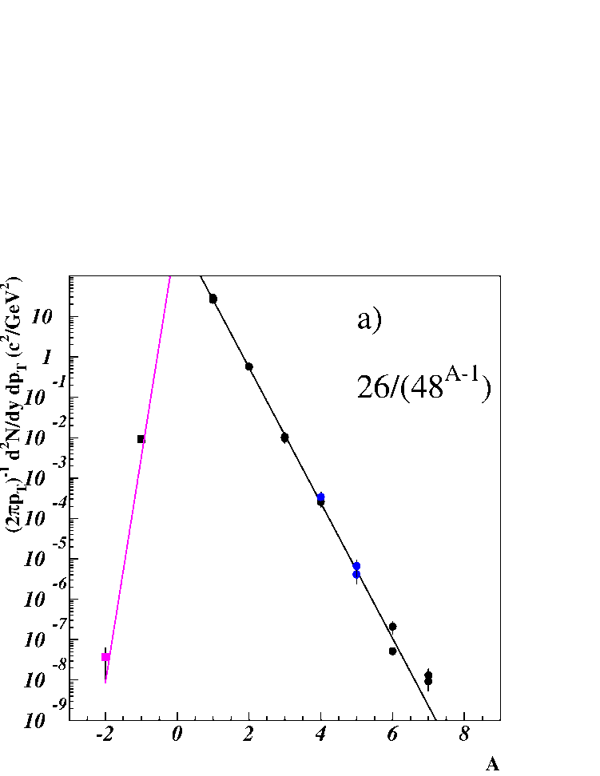
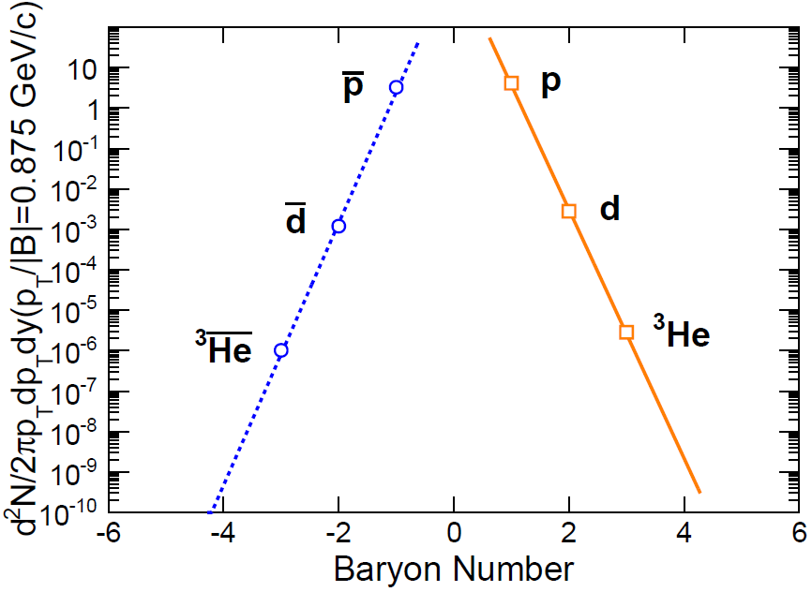
Production Rate for Antinuclei
So far, production rates for (anti)nuclei of mass # A are consistent with [(anti)nucleon density]^{A} i.e.,
consistent with statistical coalescence
At AGS (and in cosmic rays):
2 X 10⁻⁴
etc.
AGS
At max RHIC energy, already close to high energy limit:
A
: SPS
: RHIC
100M events (up to 2007) yielded 2.2K anti-³He. 2010 run contains ~a billion AuAu events & upgraded PID. Thus
RHIC
we expect >10‾α. Biggest challenge: reconstruction of > 0.5 trillion tracks.

Slide 14
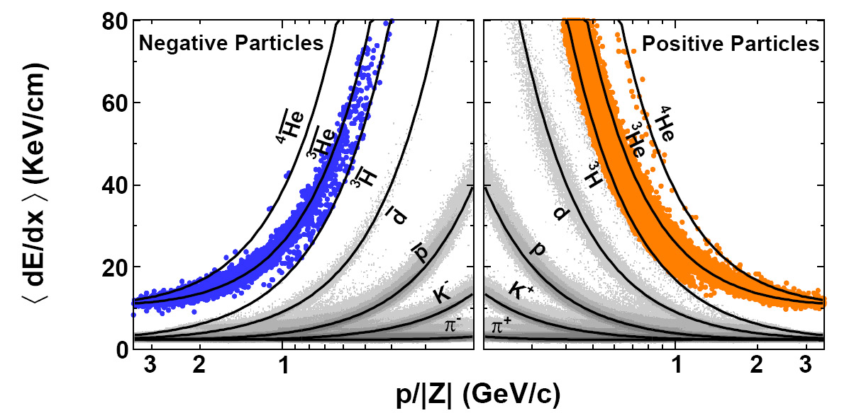
High Level Trigger & Anti-α Search
HLT has processing power to do rudimentary event reconstruction in real time, allowing events with a |Z| = 2 track to be tagged and fast-tracked via the normal offline calibration & reconstruction chain.
H. Agakishiev et al. (STAR collaboration)
Nature 473, 353 (2011);
arXiv:1103.3312
Many anti-αs lie where <dE/dx> band merges with anti-³He, so TOF is needed

Slide 15
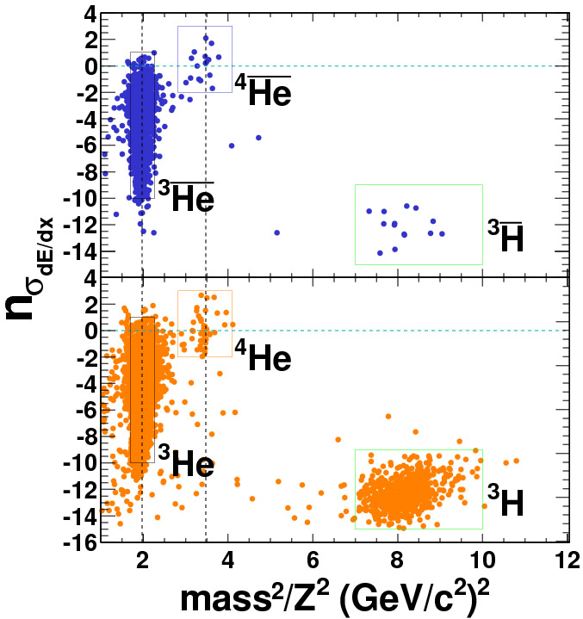
Anti-α PID from <dE/dx>, p & TOF
Combining measured magnetic rigidity & time-of-flight, we can determine mass/Z
~1.4 background counts
within anti-α signal cuts;
misident. prob. ~ 10⁻¹¹

Slide 16
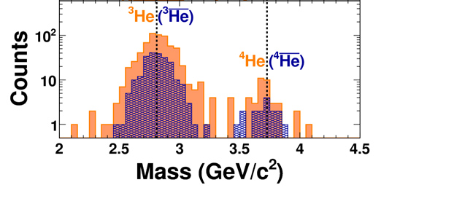
Anti-α PID from <dE/dx>, p & TOF
Projecting to mass axis, we find 16+2 anti-αs:
H. Agakishiev et al. (STAR collaboration)
Nature 473, 353 (2011);
arXiv:1103.3312
Very clean identification after search of > half-trillion tracks from about one billion gold-gold collisions

Slide 17
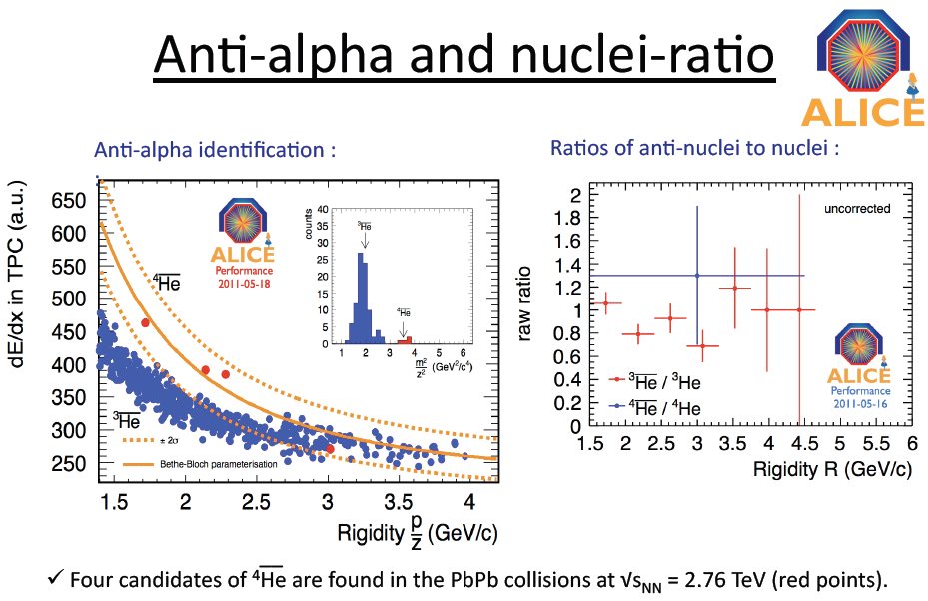
Anti-α at the LHC
A. Kalweit for the ALICE Collaboration, J. Phys. G 38,124073 (2011) .
Notes:
On March 25th, Peter Braun-Munzinger is quoted in http://physicsworld.com/cws/article/news/45544 "Meanwhile, researchers at the ALICE experiment on CERN's Large HadronCollider have revealed that they also detected antihelium-4 incollisions of lead ions last November. Braun-Munzinger, a member of the ALICE team, says that these results should appear on arXiv in a week or so."

Slide 18
What’s in the Pipeline?
published analysis is based on ~100M events.
Current statistics include ~1000M events for 200 GeV AuAu, & a further 210M at lower energies where signal/background is still strong. Plus, new TOF barrel further improves PID.
New results for based on ³He + π decays will be reported by Yuhui Zhu at Quark Matter (Aug 2012).
Three-body decays with higher branching fractions are also forthcoming.

Slide 19
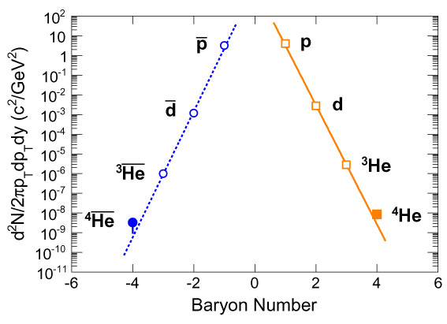
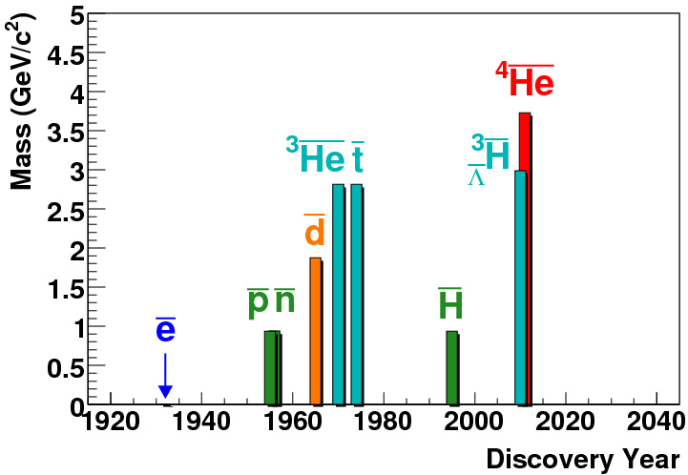
Prospects for A > 4 Antinuclei?
Anti-α yields continue to follow, within errors, exponential predicted by both thermal model and statistical coalescence.
STAR collaboration
Nature 473, 353 (2011);
If we add one extra antinucleon, production rate drops ~ 1/1600
(called the “penalty factor”)
arXiv:1103.3312
Prospects beyond A = 4?
Next stable antinucleus has A = 6;
(penalty factor)² ~ (1600)²
– out of reach for foreseeable future,
unless…..

Slide 20
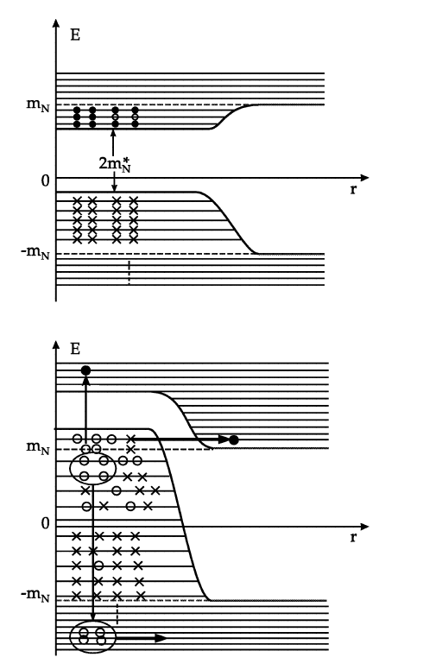
Correlations in the Vacuum
Idea from Walter Greiner*: correlations are present in vacuum, allowing antinucleus like anti-α to be directly excited from the vacuum. Rate for such antinuclei could be much larger than low value predicted by statistical coalescence.
No evidence so far.
* Int. J. Mod. Phys. E 5, 1–90 (1996).

Slide 21
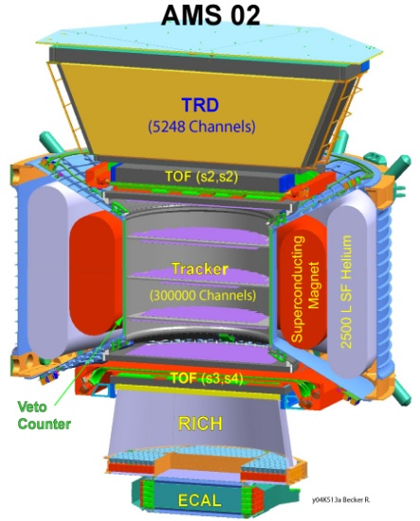
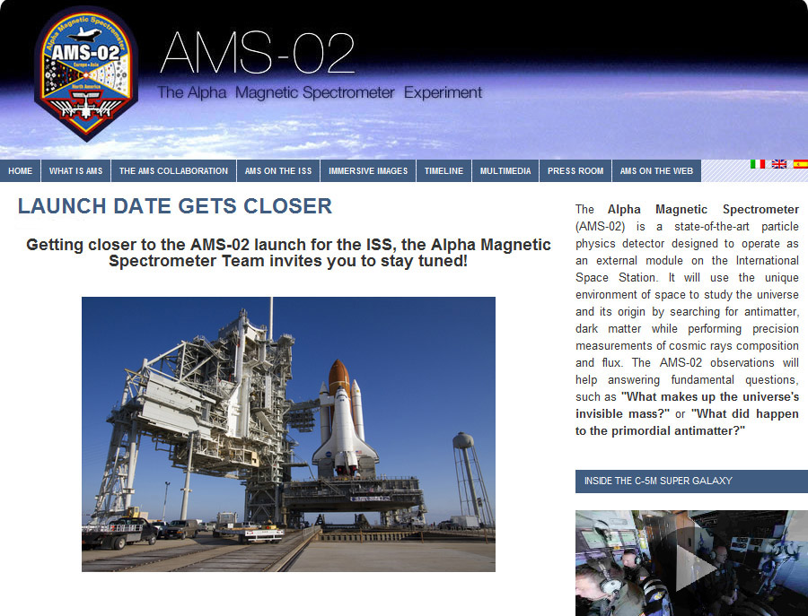

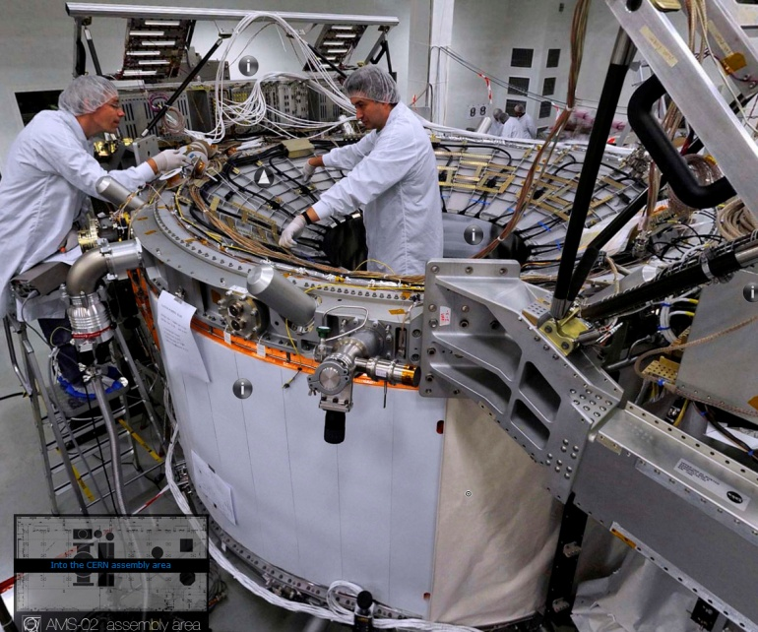
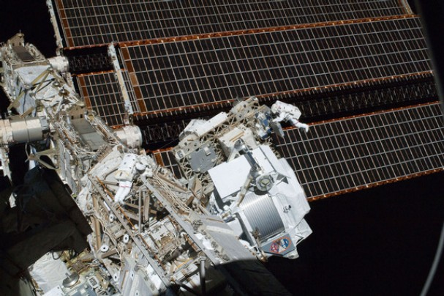
Search for Antinuclei in Space
If there is bulk antimatter in the cosmos, AMS could detect anti-α; rate from matter-matter collisions in space is too low

Slide 22
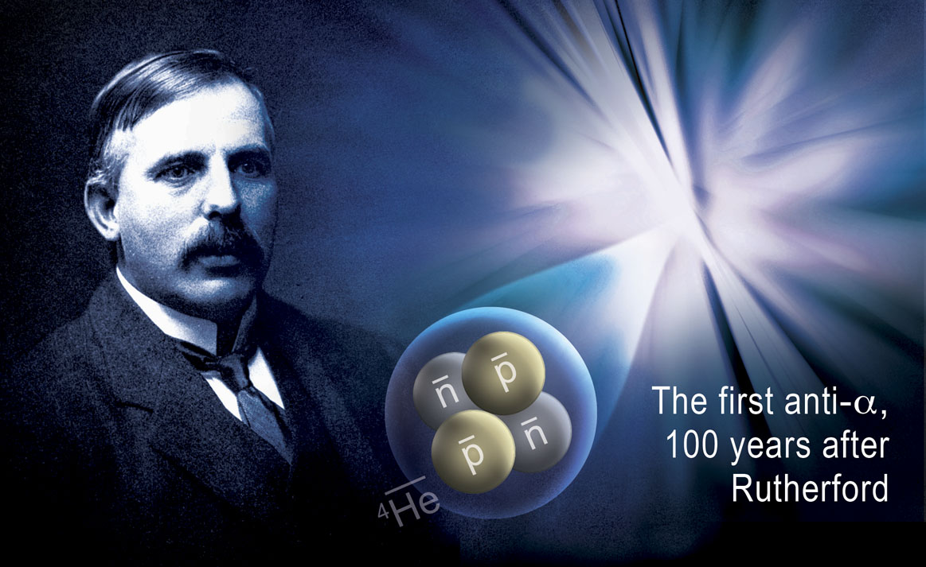
From Physics to Aesthetics…..
Proposed cover art for print version of Nature
“Illustrations should be selected more for their aesthetic appeal than for their scientific content”
– guidance from editors
(Synergy with centennial of use of α + gold to discover the nucleus)

Slide 23
Summary & Outlook – I
has been published in 2010; 70 candidates based on
data up to 2007, with significance ~4σ.
Consistency check has been done on analysis; 157
candidates, with significance better than 5σ.
The measured lifetime is ps, shorter than
the free Λ lifetime (263 ps) but consistent with it.
analysis nearing release with >10X statistics, better
PID, & more decay modes.
High Level Trigger has allowed fast-track search for anti-α among >0.5 trillion tracks of 2010 data; 18 anti-αs found, with mis-ID probability ~ 10⁻¹¹. Published in Nature in 2011.

Slide 24
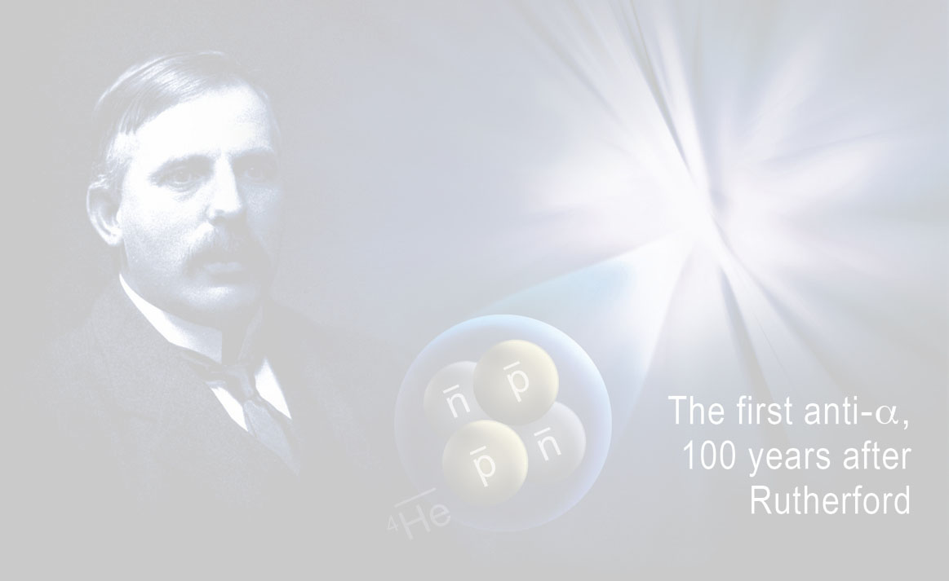
Summary & Outlook – II
Antinucleus yields up to A = 4 remain consistent within errors with thermal & statistical coalescence models. This has important implications for the AMS experiment & for other searches for new phenomena in the cosmos.
The next stable antinucleus after anti-α has A = 6. Penalty factor > 2 million means new record for heaviest stable antinucleus is likely to stand for a very long time.

Slide 25
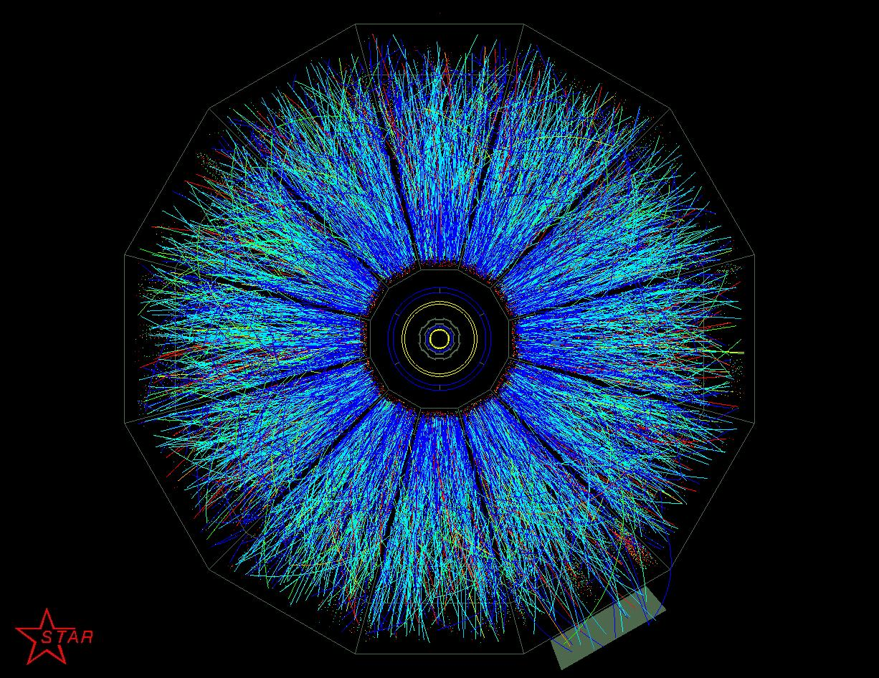
EXTRA SLIDES
OSU Seminar, March 6, 2008
25

Slide 26
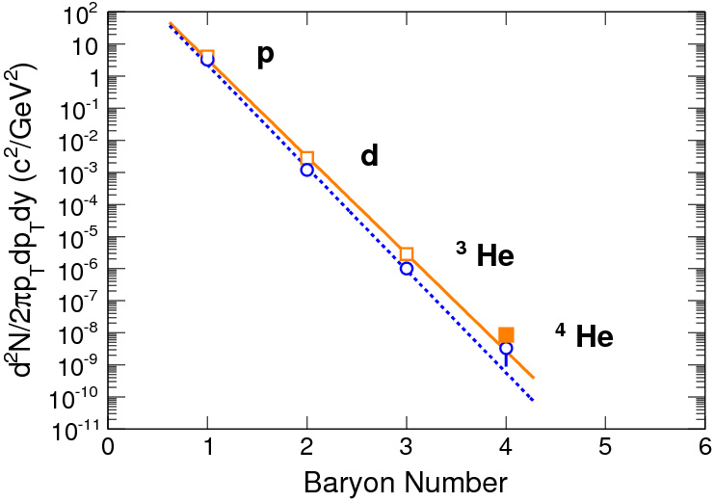
Yields: Nuclei & Antinuclei Compared

Slide 27
Lifetime Measurement
2010 data (~10 times statistics) coming
ps
We measure τ_{Λ} = 267 ± 5 ps
PDG value τ_{Λ} = 263 ± 2 ps
STAR Collaboration, Science 328, 58 (2010)

Slide 28
Predictability is a shock
If I told you that:
create a state of matter at 4x10¹² degrees
out of a few thousands of particles
Matter and antimatter do not annihilate at
energy density 100 times the normal nuclear density
Anti-nuclei and nuclei with weak binding energy
carry information from the QGP phase transition
(Temperature = 160MeV)
All particles maintain statistical equilibrium
(no sign of annihilation but coalescence)
Models that assume thermal equilibrium correctly account for
yields spanning 11 orders of magnitude.
(1000 π, 10⁻⁸ ⁴He)
±0.00000000001
How many of you would say that “I expect that!”?
That is what we did when we found all these
Heavy antimatter nuclei!
From a talk by
Zhangbu Xu

