Slide 1
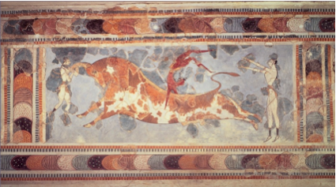


Highlights of Heavy Ion Physics with ATLAS
בס"ד
Zvi Citron
for the ATLAS Collaboration

Slide 2
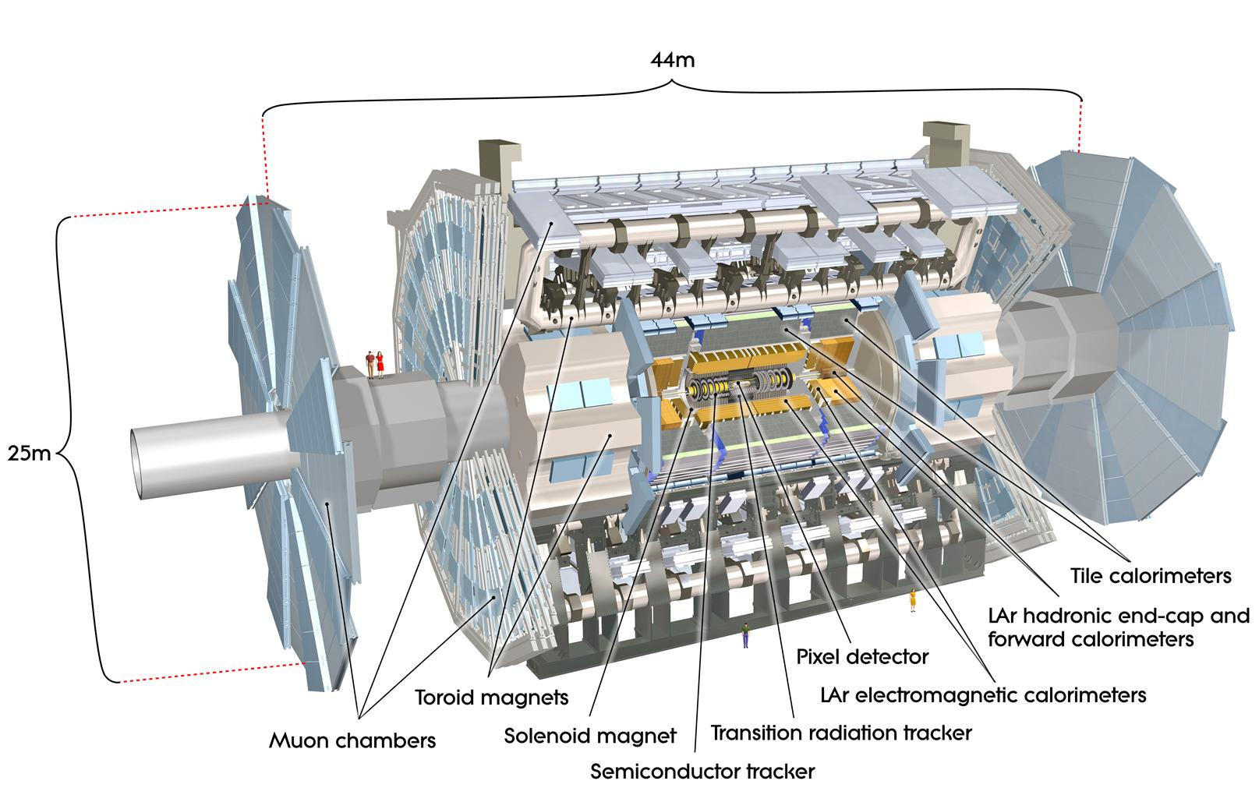
Introduction
In addition to the high energy p+p program LHC and ATLAS have a robust Heavy Ion program
Muon spectrometry, calorimetry, and charged tracking are well suited for HI
2010 and 2011 included Pb+Pb runs at √s=2.76 TeV
ATLAS HI measurements include:
  Bulk yield
  Particle Flow
  High momentum charged particles
  Jets and jet properties
  Direct Photons
  Z→ee, Z→μμ

Slide 3
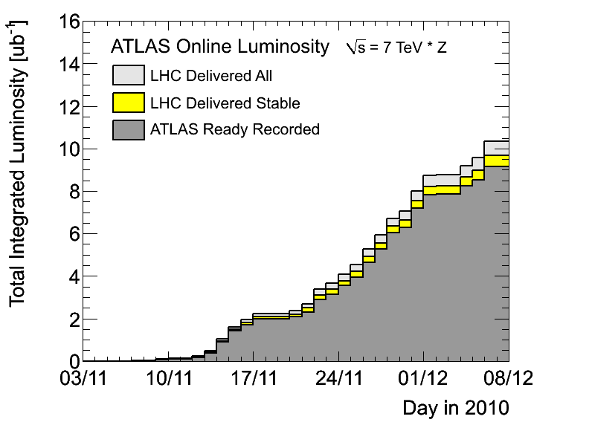
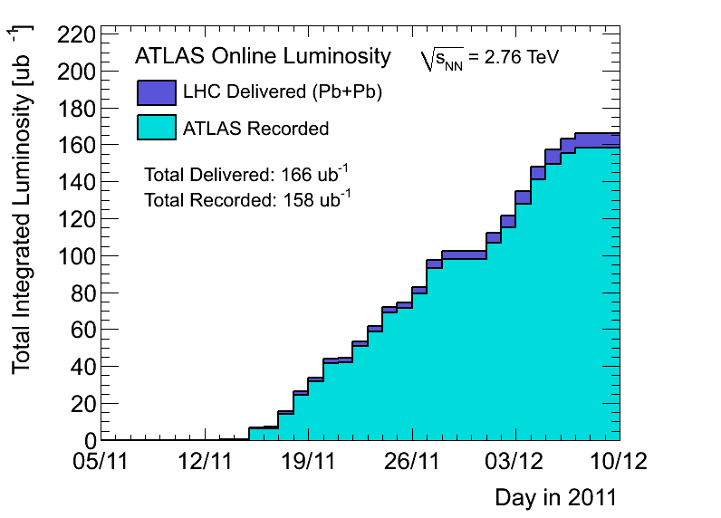
Data samples
2010
2011
Run: | 2010 | 2011
L_{int} | 8ub⁻¹ | 0.15nb⁻¹
Triggers | Min Bias | γ(e), μ, jets, Min Bias, UPC
N_{events} (0-80)% | 30-40M | 750-800M

Slide 4
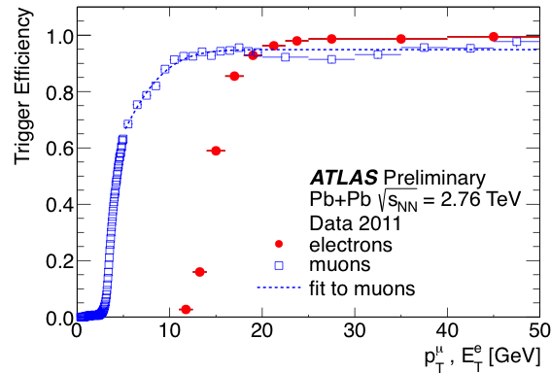
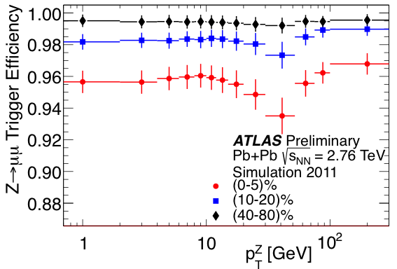
Triggers in Run 2011
Photon (e) triggers are based on LAr
For E_{T}>20 GeV, efficiency = 98.1 ± 0.1%
Pair efficiency:
99.9 ± 0.1%
Muon triggers is a combination:
L1 trigger with p_{T}>4 GeV
HLT trigger with p_{T}>10GeV
95-99% weak centrality dependence
>90%
MB triggers: (LAr E_{T}>50GeV) OR (ZDC & track)

Slide 5
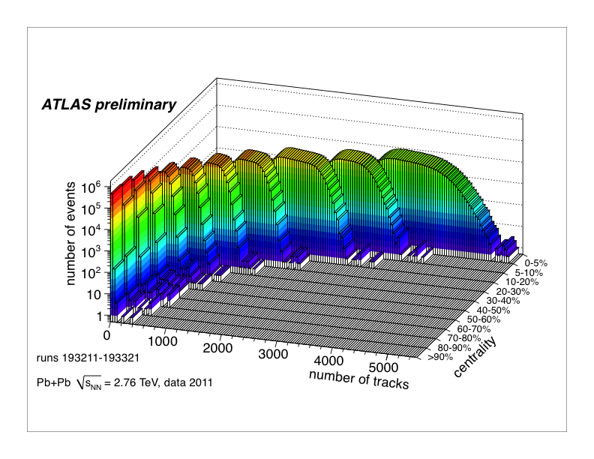
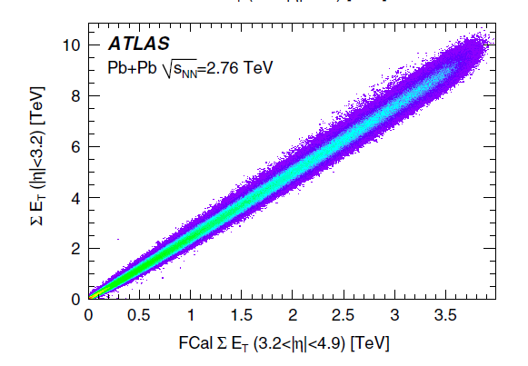
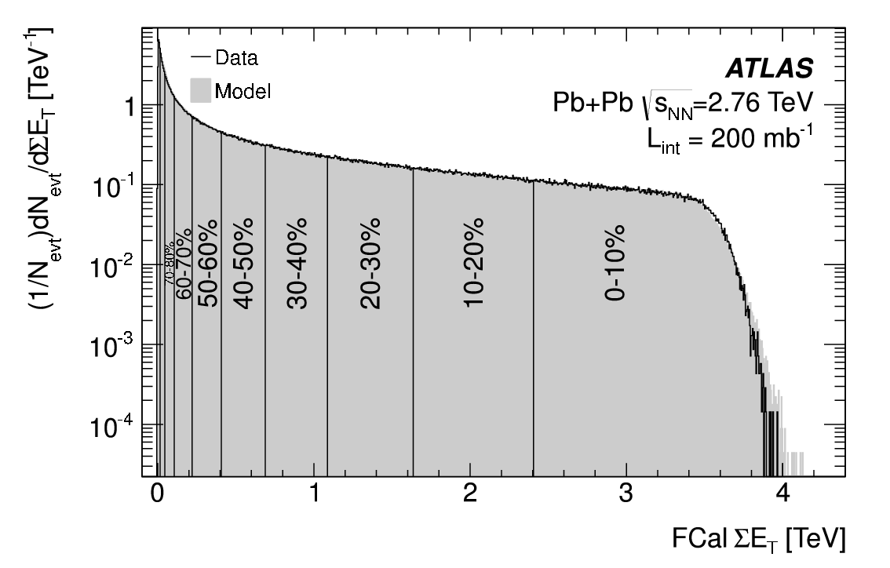
Centrality
log Z
 | <N_{part}> | <N_{coll}>
0-5% | 382±0.7% | 1683±8%
5-10% | 330±1% | 1318±8%
10-20% | 261±1.5% | 923±7%
20-40% | 158±2.5% | 441±7%
40-80% | 46±6% | 78±9%
MB fraction 98 ± 2%
Glauber model MC to estimate <N_{part}>, <N_{coll}>

Slide 6
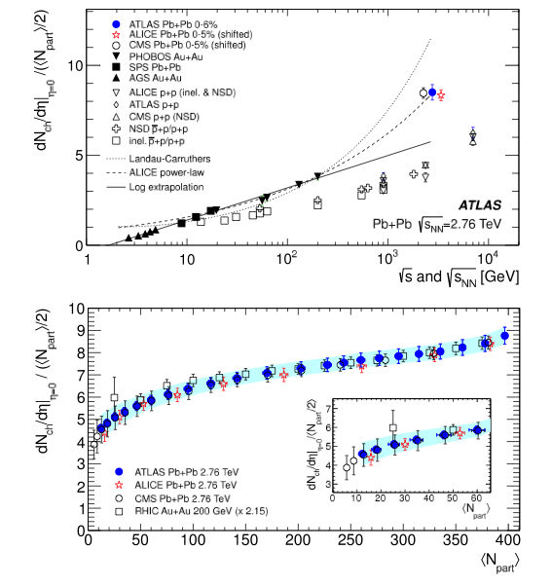
Charged Particle Multiplicity
Central A+A multiplicity grows faster with √s_{NN} than p+p
log – scaling (seen up to RHIC energies) is ruled out
Shape consistent between LHC and RHIC, lower energies
Phys.Lett.B710 (2012) 363-382

Slide 7
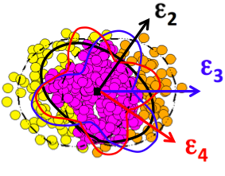
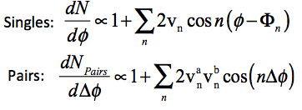
Particle Flow in HI Collisions
Initial geometry (and fluctuations) lead to n moments of deformation of the fireball
Spatial anisotropies observable in momentum space due to collective flow
Study of the moments, v_{n}, and correlations between reaction planes, Φ_{n}, teaches us about the initial geometry and expansion
Reaction plane

Slide 8
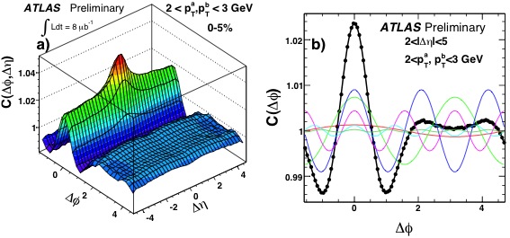
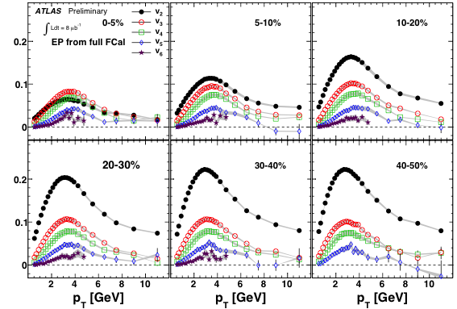
Measurement of v_{n}
Measured to n=6
arXiv:1203.3087

Slide 9
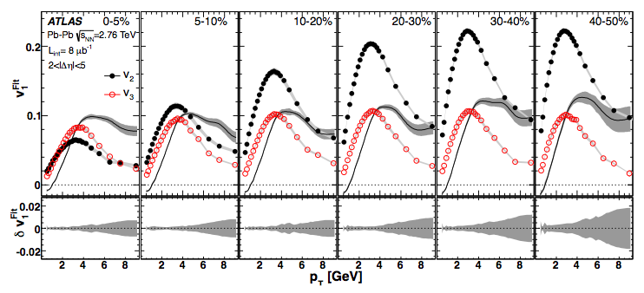
Measurement of dipolar v₁
v₁ is influenced by global momentum conservation (higher order terms have multi-fold symmetry “locally” conserve momentum)
Rapidity odd component of v₁ from sideward deflection of the colliding ions
Rapidity even component from dipole asymmetry due to initial geometry fluctuations
Significant v₁ values observed, p_{T} dependence similar to other harmonics
Value is comparable to v₃, showing significant dipole moment in initial state
arXiv:1203.3087
Notes:
The dipolar v1 is an even function of pseudorapidity and comes from initial geometry, as opposed to the directed v1 which is pseudorapidity odd and comes from sideward deflection of the colliding nuclei,
The directed v1 has been measured by previous experiments at RHIC and
also by ALICE, but this ATLAS result is the first time the dipolar v1
has been measured)

Slide 10
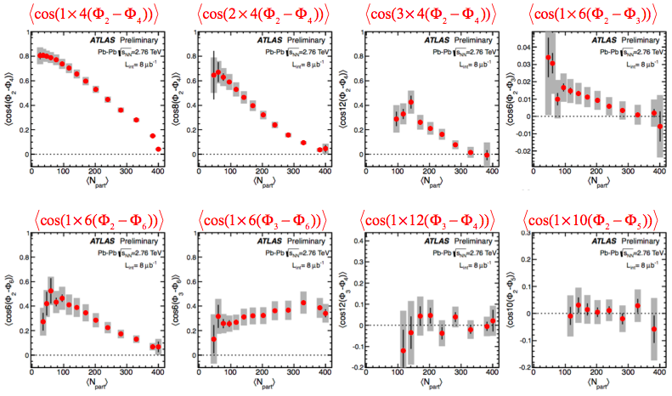
Reaction Plane Correlations
Consider a “flow matrix”- v_{n} are the diagonal elements, reaction plane correlations come from off diagonal elements
Different planes “know” about each other!
http://cdsweb.cern.ch/record/1451882

Slide 11
What do Hard Probes Teach Us
Electroweak Bosons
Hadrons, Jets, HF
Color Neutral
Do not interact with the QCD medium
No energy loss expected, should scale with <N_{coll}>
Check pQCD predictions
Check for modification, effects of nuclear PDF
Access to quarks, glouns
Interact with the QCD medium
Energy loss observed
Quantify and understand where energy goes, what happens in medium interactions

Slide 12
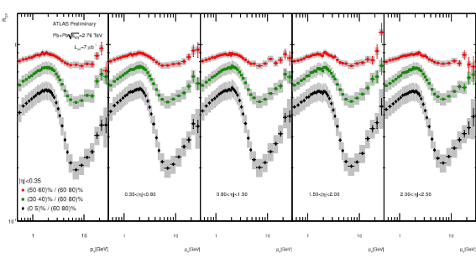
Charged Hadron Suppression
Charged particle suppression
Stronger with centrality
Similar to RHIC
If HI peripheral≈p+p
https://cdsweb.cern.ch/record/1355702

Slide 13
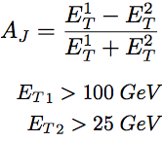
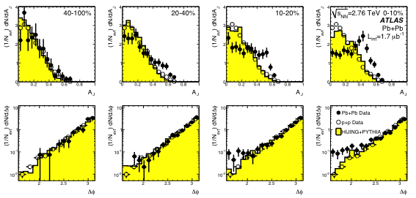
Di-Jet Asymmetry
p+p, MC, and peripheral Pb+Pb consistent – asymmetry peaked at zero
Central Pb+Pb has peak away from zero
Momentum balance from hard scattering not kept within di-jets
Direct observation of jet quenching
Phys. Rev. Lett. 105, 252303 (2010)

Slide 14
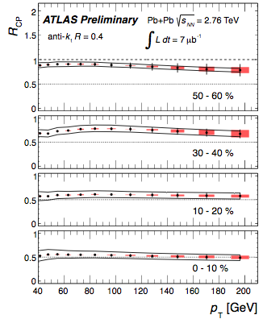
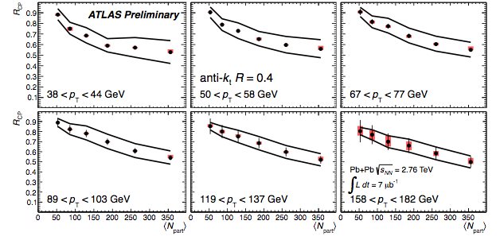
Jet Nuclear Modification Factor
Suppression similar to charged hadrons
Roughly flat in p_{T} for central events
Some deviation from flat in more peripheral events

Slide 15
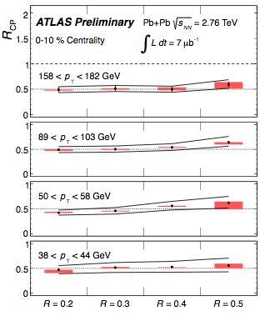
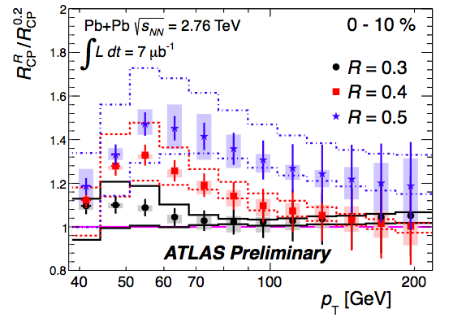
Jet Cone Size Dependence
Is lost energy hiding in larger cones?
Increase in R_{CP} with larger cone size

Slide 16
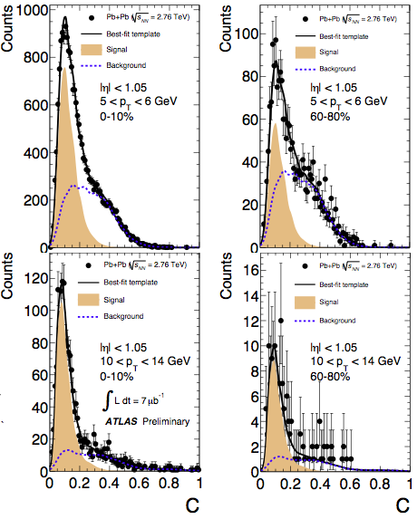
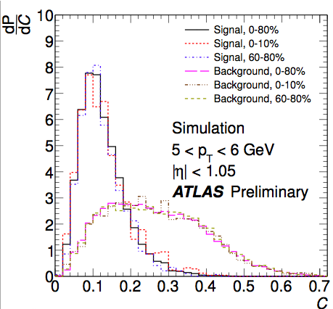
Heavy Quark Measurement with μ
Inclusive muon spectrum dominated by heavy flavor decays
Decompose muons (4<p_{T}<14 GeV) into those from HF and background
Use discriminant based on momentum loss and scattering angle significance
https://cdsweb.cern.ch/record/1451883

Slide 17
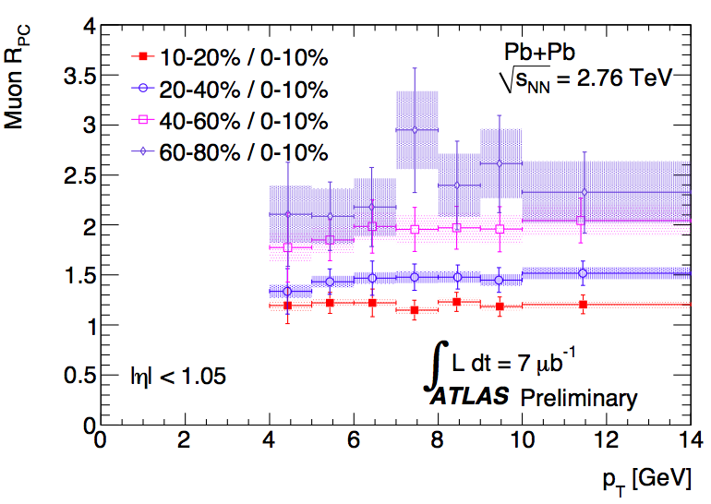
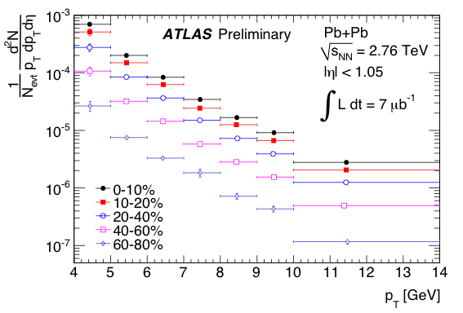
Heavy Quark Yield
Use R_{PC} rather than R_{CP} to minimize impact of fluctuations in reference bin
Suppression significant
Roughly flat in p_{T} (somewhat different from inclusive hadrons)
https://cdsweb.cern.ch/record/1451883

Slide 18
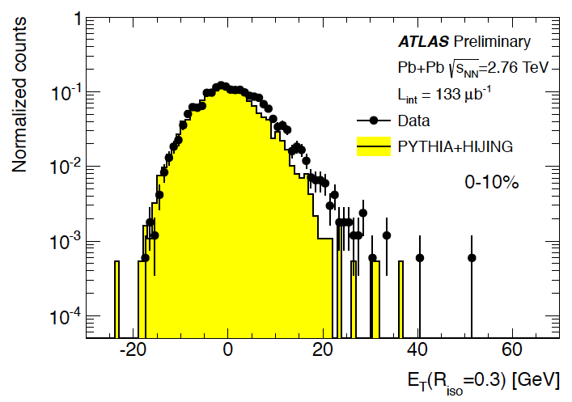
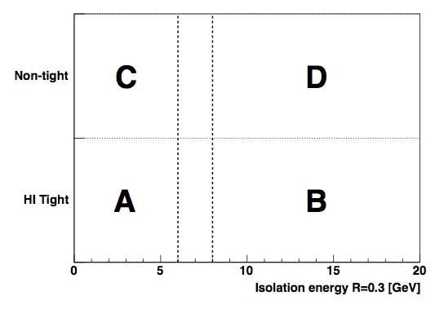
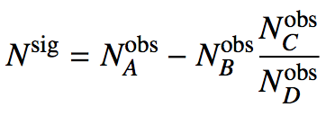
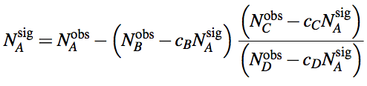
Direct Photon Measurement
Subtract underlying event
  Iterative subtraction in Δη=0.1 slices, excluding jets
  Elliptic flow sensitive
Isolated photons
  Cut on a maximum energy in cone around photon
  Fragmentation photons reduced
Shower shape cuts
  Multiple layers of EM calorimeter, and hadronic calorimeter
  Rejection of jet fakes
Signal Extraction
  “Double sideband” method
Isolation E
https://cdsweb.cern.ch/record/1451913

Slide 19
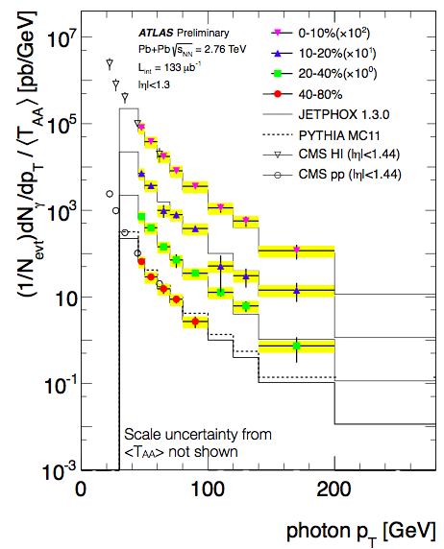
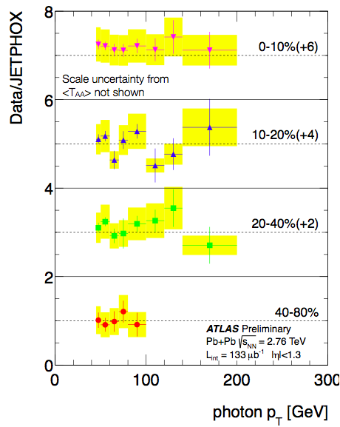
Direct Photon Spectra
Corrected yield scaled by nuclear thickness ~ <N_{coll}>, and compared to JETPHOX predictions
https://cdsweb.cern.ch/record/1451913

Slide 20
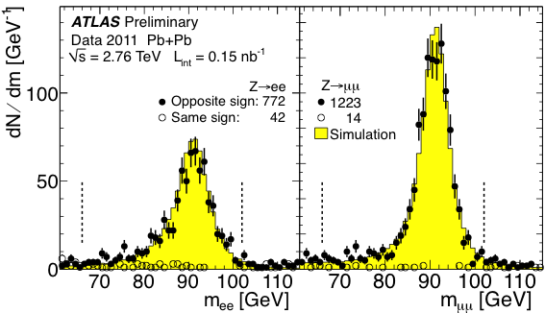
Z→ee, Z→μμ Mass
Select leptons (underlying event subtraction for electrons)
Pair the selected leptons
Select Z boson in mass window 66-102 GeV
Signal Purity ~ 95% in Z➔ee and ~99% in Z➔μμ
Simulation is PYTHIA in HIJING events, reconstructed
https://cdsweb.cern.ch/record/1451930

Slide 21
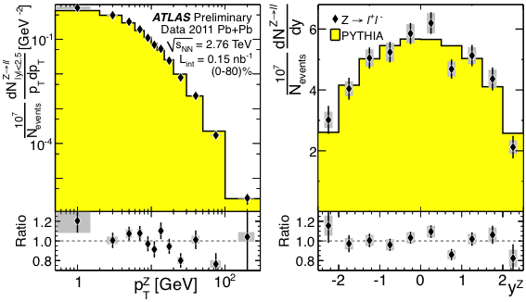
Z→ll Corrected Yields
Each decay channel corrected and background subtracted
Channels combined according to uncertainties (uncorrelated across channels)
PYTHIA normalized by area for shape comparison – agrees well
https://cdsweb.cern.ch/record/1451930

Slide 22
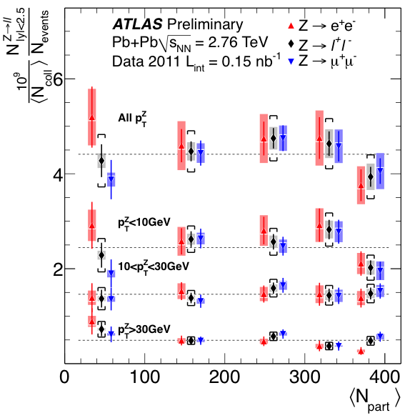
Z→ll Corrected Yields
Fully corrected Z boson Yield scaled by <N_{coll}>
Statistical uncertainty bars, systematics in boxes, and brackets combined (including <N_{coll}>
Dashed lines are flat line fits to combined channel yields
Consistent with binary collision scaling
https://cdsweb.cern.ch/record/1451930

Slide 23
Summary
ATLAS Heavy Ion has had two successful years of data taking
Charged particle multiplicity –
  √s_{NN} log scaling broken,
  centrality shape consistent with lower energy
Flow measurements –
  initial geometry explains correlation function structure
  filling in our knowledge of geometry and expansion
Suppression of particles sensitive to color interactions
  Inclusive hadrons
  Di-Jet asymmetry, jet rate suppression, cone size dependence
  Muons from heavy flavor suppressed
Electroweak bosons
  First use of 2011 data
  Direct photons, and Z➔ee,μμ measured
  Consistent with binary collision scaling

Slide 24
Backup Information

Slide 25
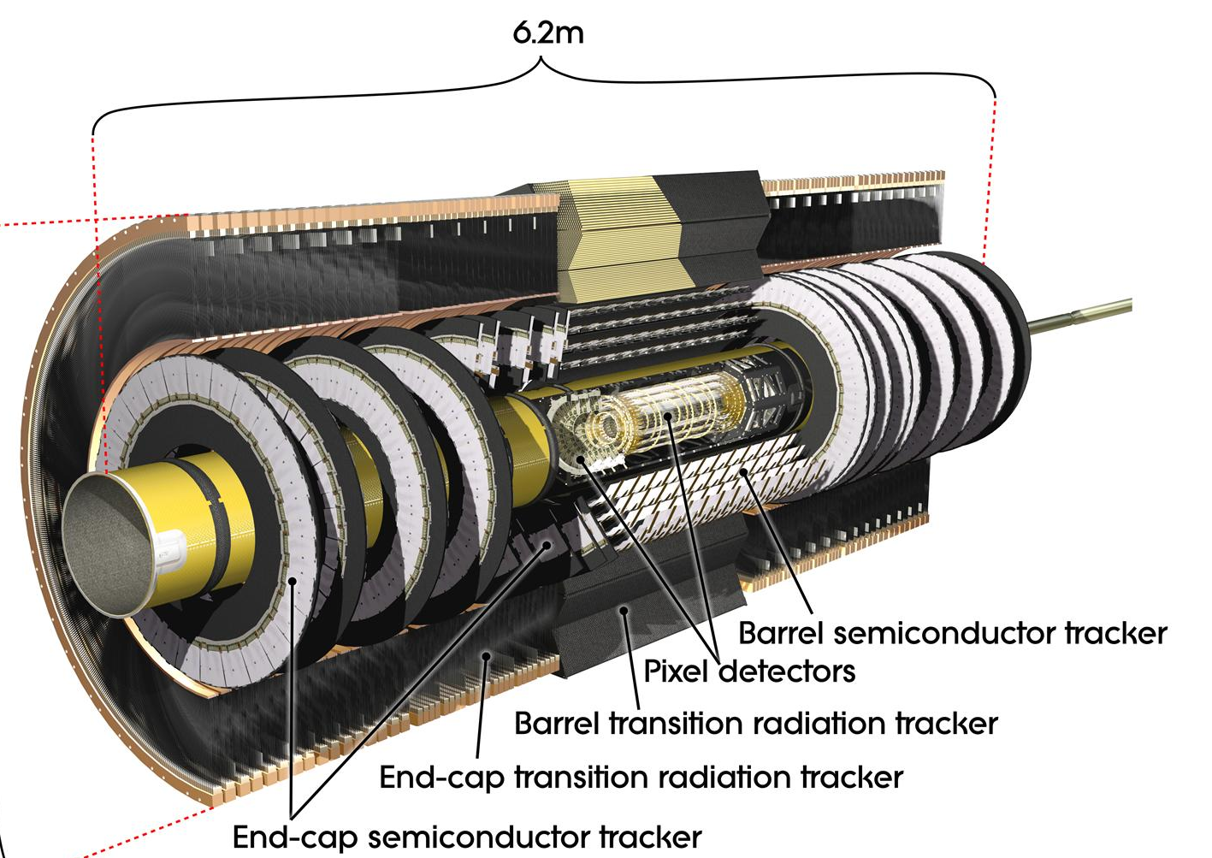
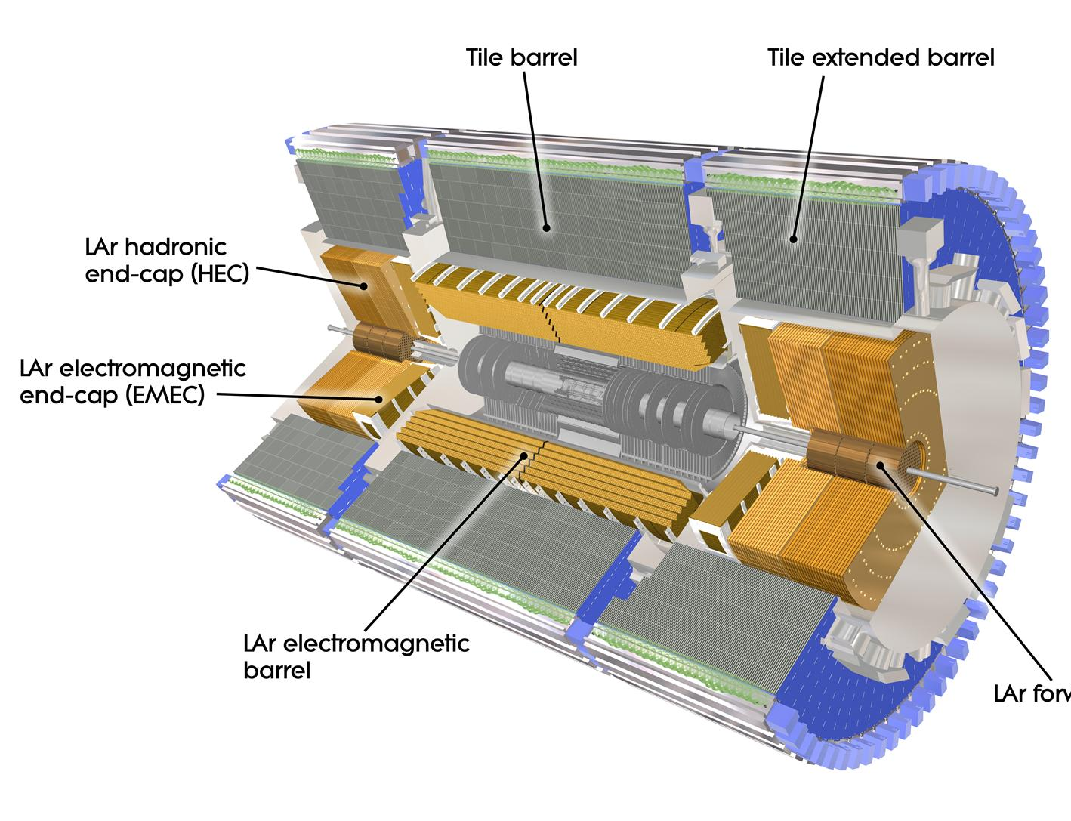
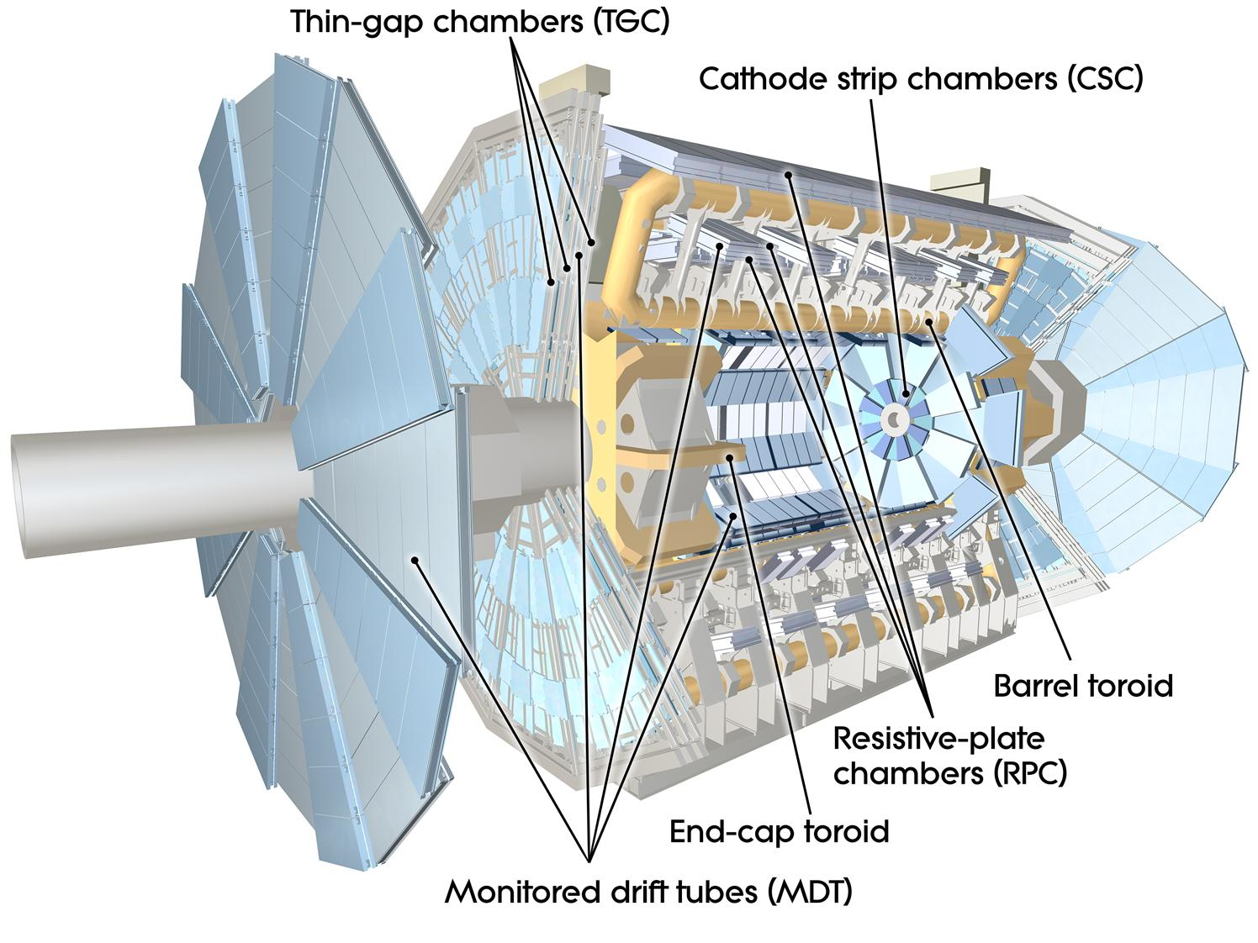
The ATLAS detector
EM calorimeter (LAr)
|η|<3.2, 3 layers + presampler, 22X₀
e/γ trigger, identification;
Granularity: 0.025x0.025 180x10³ chan.
Muon spectrometer (MS)
|η|<2.7
Shielded by Calorimeter
Tracking in torroidal B field
Inner Detectors (ID)
|η|<2.5 B (axial) =2T
Pixels (Si): σ = 10 μm [rφ]
80M channels; 3 layers and 3 disks;
SCT (106 Si strips ): σ = 17 μm [rφ]
4 double layers, 9 disks

Slide 26
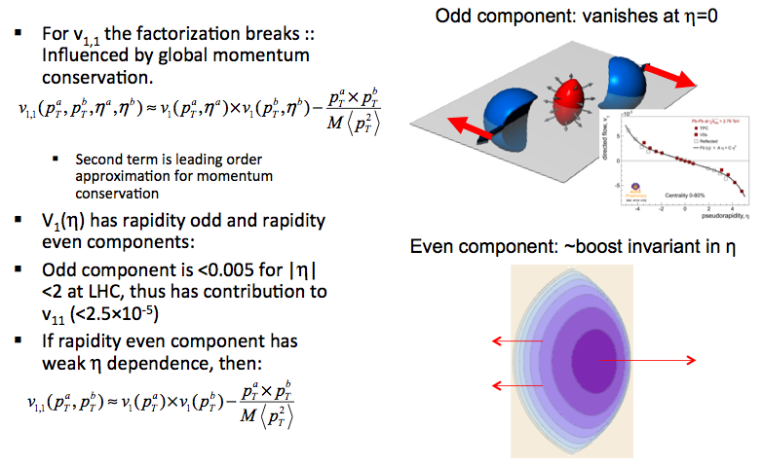
Dipolar v₁
multiplicity

Slide 27
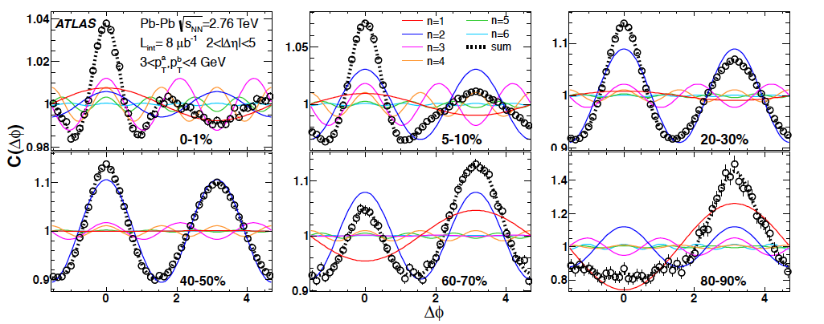
Correlations Explained by v_{n}
Two particle correlation structure is explained by sum of v_{n} terms

Slide 28
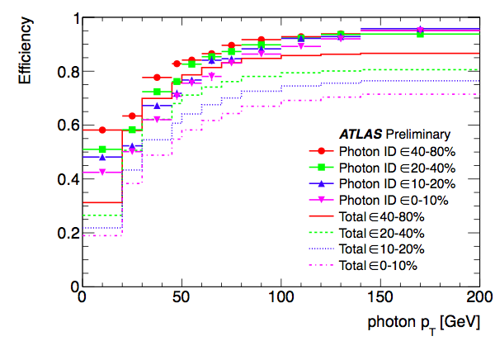
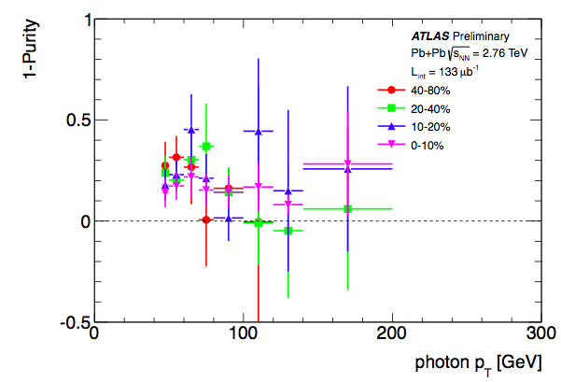
Direct Photon Efficiency & Purity
Efficiency for reconstruction, identification, and isolation
1-Purity = 1-NsigA/NobsA, correction for residual background

Slide 29
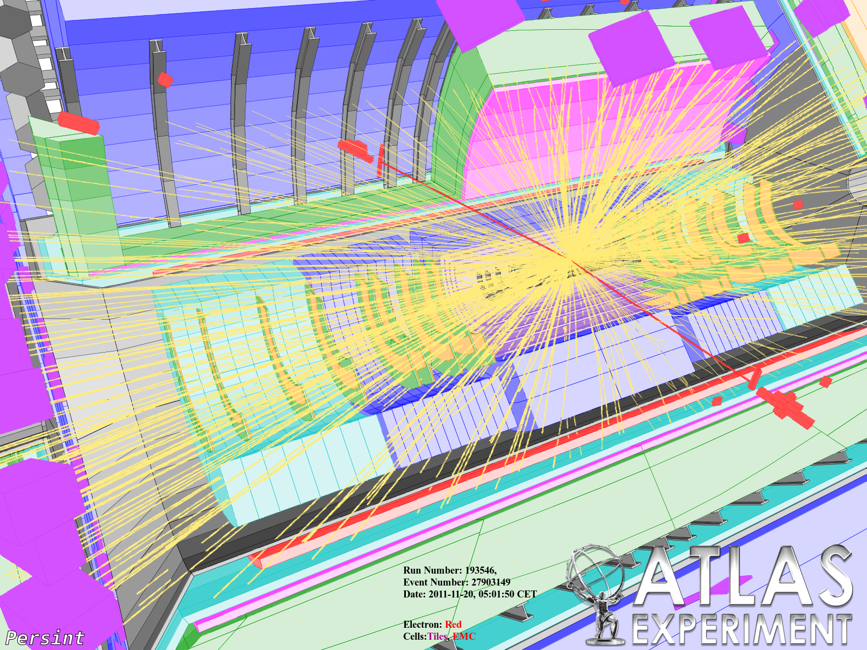
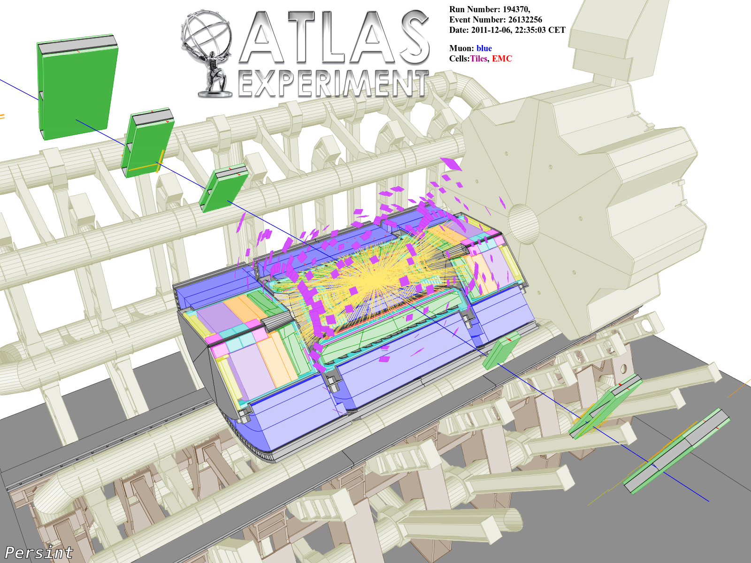
Z→ee, Z→μμ Measurement
10-20% Centrality, m_{ee} = 92.2 GeV, p_{T}^{Z} = 4.8 GeV
10-20% Centrality, m_{ee} = 102 GeV, p_{T}^{Z} = 5.0 GeV
Electron Selection
  E_{T} >20 GeV
  |η|<2.5
  Shower shape and energy cuts in calorimeter
  Subtract underlying event energy from each electron
Muon Selection
  p_{T} > 10 GeV
  |η|<2.7
  Track quality cuts

Slide 30
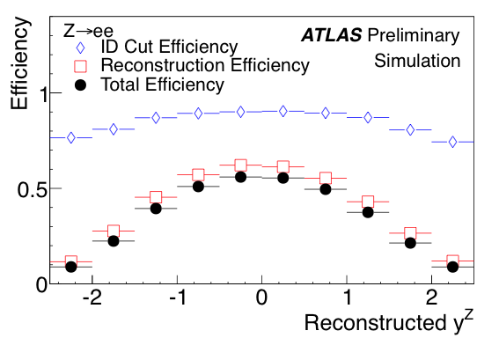
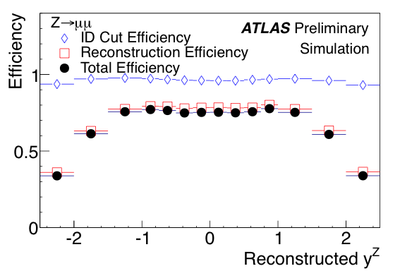
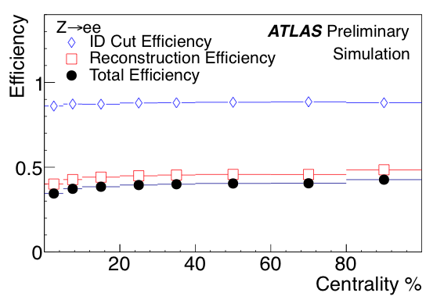
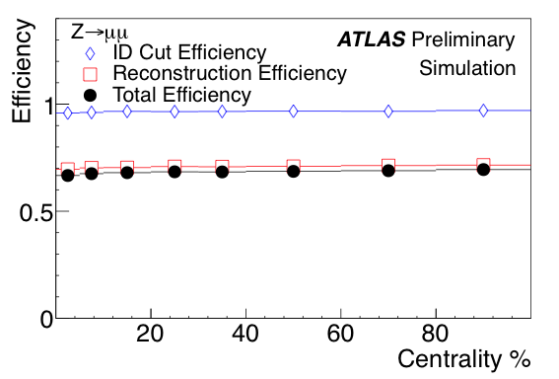
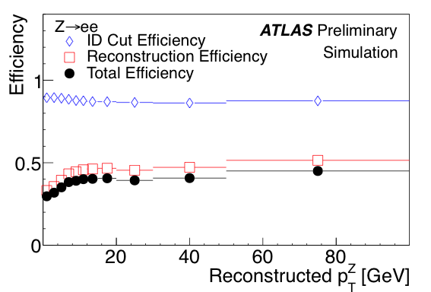

Z→ee, Z→μμ Corrections
Use PYTHIA Z➔ll embedded into HIJING to calculate corrections:
  Look in centrality, momentum, and rapidity
  Bin-by-bin unfolding
  Reconstruction efficiency (including minimum p_{T}^{lepton}, and mass)
  Lepton identification cuts efficiency
  Correct up to mass window 66-116 GeV

