Slide 1
International Conference on New Frontiers in Physics
10-16 June 2012
Kolymbari, Crete, Greece
QFT in a de Sitter Universe: an Approach to Quantum Theory and Cosmological non-locality
Ignazio Licata
ISEM- Inst. For Scientific Methodology- Palermo-Italy

Slide 2
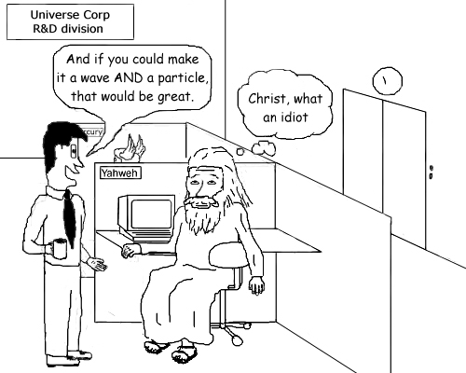
Why are peoples, magazines (and philosophers too) still back to 1927 and talk about “interpretations” of waves and particles, while the theoretical physicists talk about quantum field theory?

Slide 3
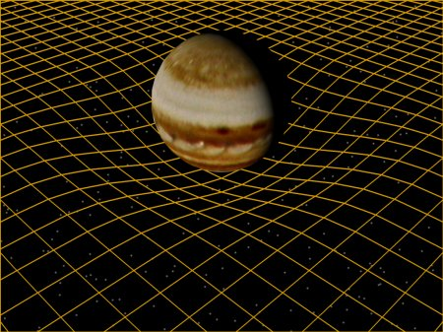
Since the non-local correlations
do not transport energy, they do not violate Relativity but nonetheless remain
outside the bounds of the classical picture of the world. This situation goes under the
name of “pacific coexistence” between Relativity and Quantum Physics (Shimony).
Quantum Geometrodynamics: Forcing quantum physics in an "extended" space-time arena! It takes its inspiration from the philosophy of General Relativity.

Slide 4


The early David Bohm: the quantum potential. The picture is that of a continuous motion along trajectories with non-local influences mediated by the quantum potential
Last David Bohm. “My vision is a quantum non-mechanics purely algebraic”!!!

Slide 5
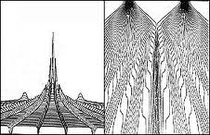
Quantum potential contains global information of physical processes we can say that the evolution of the state of a quantum system changes active global information, and this in turn influences the state of the quantum system, redesigning the non-local geometry of the universe.
See :
Licata, Effective Physical Processes and Active Information in Quantum Computing, 2007, http://arxiv.org/abs/0705.1173
D. Fiscaletti, I. Licata, Weyl Geometries, Fisher Information and Quantum Entropy in Quantum Mechanics, 2012, Int. Jour. of Theor. Phys

Slide 6
Some interesting results……
geometrize quantum mechanics based on Weyl space (W. R. Wood and G. Papini -1995)
The geometry subtending quantum potential (see for ex. Carroll, Fluctuation, Information , Gravity and the Quantum Potential, Springer, 2006)
M. Novello, J. M. Salim and F. T. Falciano, “On a geometrical description of quantum mechanics” , IJGMMP 8, 1, 87-98 (2011) , “Geometrizing Relativistic Quantum Mechanics”, Found. Of Phys. 40, 1885–1901 (2010). Bohm Potential & Weyl Geometry
Shojai, A., Shojai, F. (2004), Constraint algebra and equations of motion in the Bohmian interpretation of quantum gravity, Class. Quantum Grav. 21 1-9- connection with gravity

Slide 7
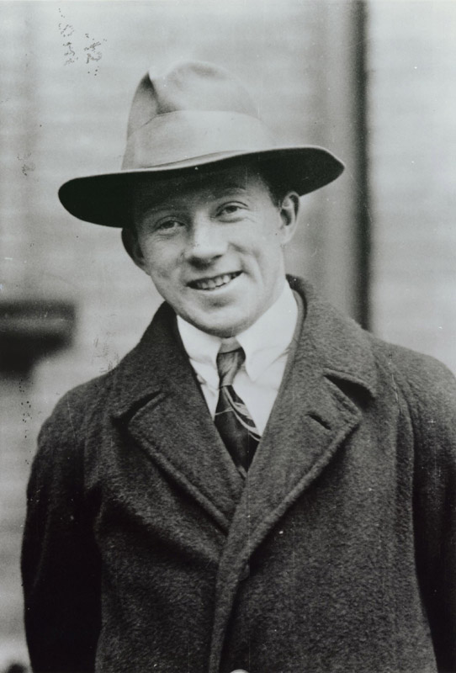
A radical Heisenberg and not so a “pacific coexistence”
Non-locality remains a phenomenon that rests uncomfortably on a “mechanical” vision of the universe, and it is not by chance that Bohm referred to his vision of QM as quantum non-mechanics, just to point out that quantum concepts could not be understood as a return to the classical view. As Heisenberg observed at the dawning of quantum theory, the quantum events are radically a-causal, and cannot therefore be retraced to a space-time vision

Slide 8
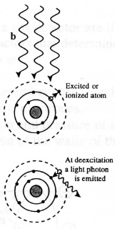
Non-Locality is at the bottom and at the beginning of the Quantum Theory
Quantum Mechanics
Quantum Field Theories
Quantum Jump! ( Bohr , 1913)

Slide 9
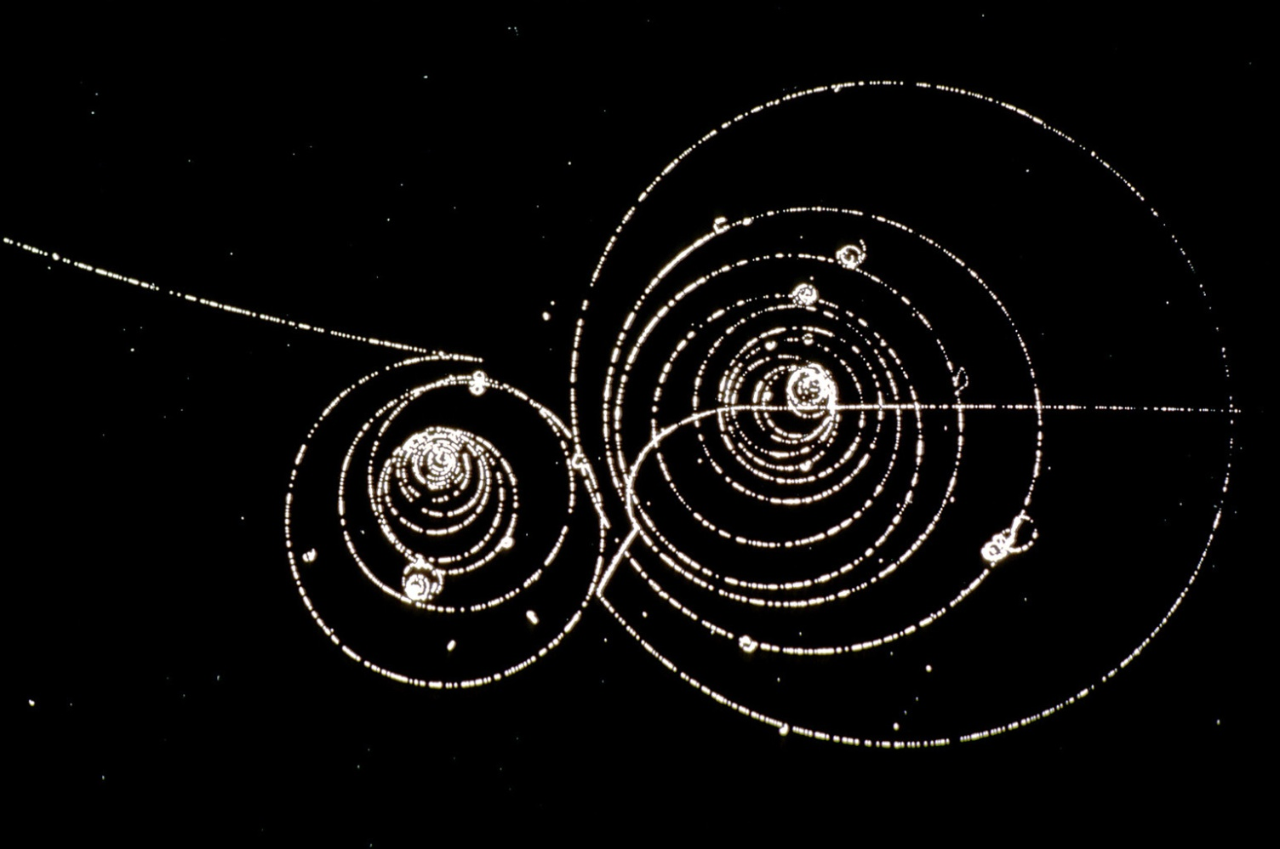
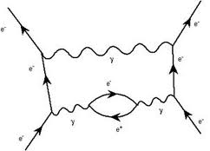
Quantum Field Theory: Nor Particles neither waves but “intertwined” field modes

Slide 10
QFT and the “fabric” of Vacuum
a) The physical world is described as a discrete set of interaction vertices where some properties (space-time position, quadri-impulse, spin) are destroyed and created in the vacuum.
b) Heisenberg uncertainty principle in its more general and “right” form - phase x number of quanta – indicate that in the phenomena involving few interaction vertices the concept of a space-time/environment is no more applicable;
c) Motion is no more a continuous phenomenon, but a discontinuous process in the space-time coordinates, like a dislocation in a crystal. In general, if i indicates the creation event and j the destruction event for a X quantity, only if X (i,j) is diagonal the interaction will leave the X value unchanged and a measurement will be possible.
d) The particles are not “persistent object” but network of transactions.
It follows that the quantum laws have generally a matrix-like form and also the existence of quantities not simultaneously defined.
This frame modifies quite widely the semi-classical vision associated to QM.

Slide 11
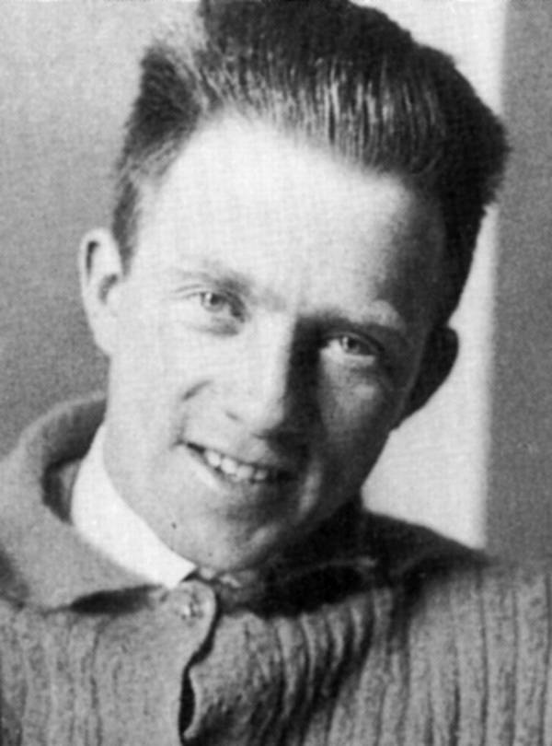

Heisenberg Principle – naive form
Heisenberg Principle -” noble” version
n: number of quanta
φ: phase

Slide 12
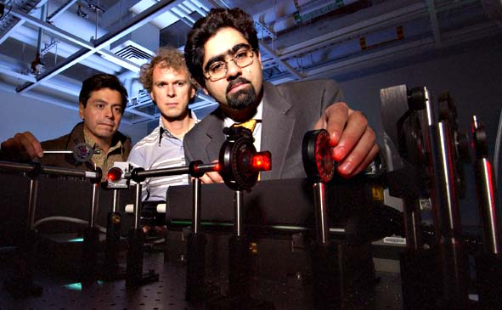
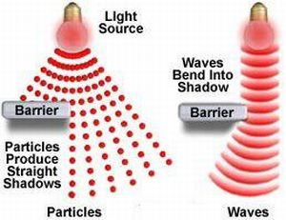
No Wave/Particles no mysteries in Afshar Experiment!
QFT: Correlated field modes with low intensity!

Slide 13
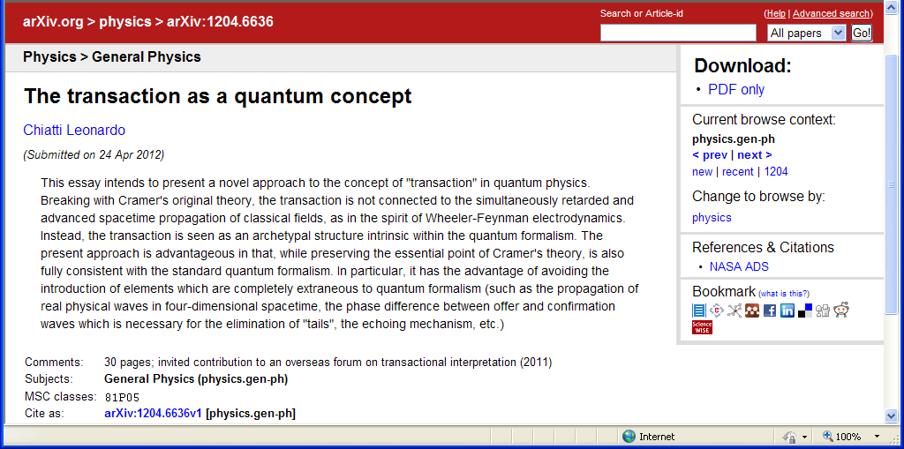
What QM is fixed by QFT?
A general framework for R processes (“clicks”)

Slide 14

?
The QM wave function is nothing but a statistical coverage of a great amount of QFT elementary transactions.

Slide 15

Dynamic vacuum as eigenstate of minimum energy
in space and time
The strength of gentle virtual events!

Slide 16
Trajectories emerge from Quantum Field Theory

Slide 17
Vacuum as Timeless “informational matrix” or pre-space
We can imagine the Vacuum not only as an eigenstate of minimum energy, but also as the network of all the possible transactions of the field modes in an undivided Oneness, and it has to be regarded as a radical non-local and event-symmetric state. Planck constant is then the measure of the fabric’s “elasticity”. The vacuum constrains and conveys the dynamical processes we observe. It is a fabric from which patterns emerge by R processes and such patterns influence the vacuum activity, in a quantum feedback

Slide 18
Some Clues in search for an Informational Matrix……….
Bohm, David (1980), Wholeness and the Implicate Order, London: Routledge
F. A. M. Frescura and B. J. Hiley (1984) Algebras, Quantum Theory and pre-space, Revista Brasileira de Fisica, pp. 49-86.
F. A. M. Frescura and B. J. Hiley (1980) The implicate order, algebras, and the spinor, Found. of Phys. Volume 10, Numbers 1-2, 7-3
N. A. M. Monk, B. J. Hiley (1998) A Unified Algebraic Approach to Quantum Theory, Foundations of Physics Letters, Volume 11, Number 4, 371-377
David Ritz Finkelstein: Quantum relativity: a synthesis of the ideas of Einstein and Heisenberg, Springer, 1996
G. Chew (1987) Gentle Quantum Events as the source of explicate order, in Quantum Implication (Peat & Hiley Eds), Routledge
Michael Silberstein, W.M. Stuckey & Timothy McDevitt (2012), Being, Becoming and the Undivided Universe: A Dialogue between Relational Blockworld and the Implicate Order Concerning the Unification of Relativity and Quantum Theory, To appear in Foundations of Physics (2012).
http://arxiv.org/abs/1108.2261 . Appeared online 4 May 2012.

Slide 19
Explicate Order
Locality
Determinism
Continuity
Shannon-Turing Information
Implicate Order
Non-locality
Indeterminism
Quantum Jumps
“Active” information
Space-time geometry
Transitions in Vacuun

Slide 21
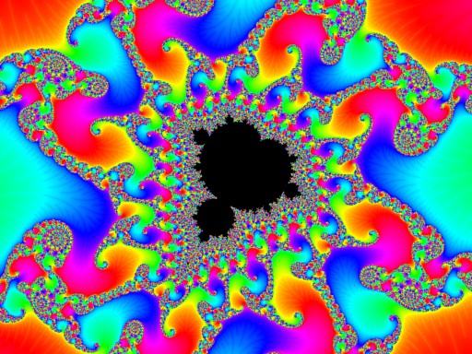
Non-locality as formal causality: changing a single value will affect the wholeness’ structure

Slide 22
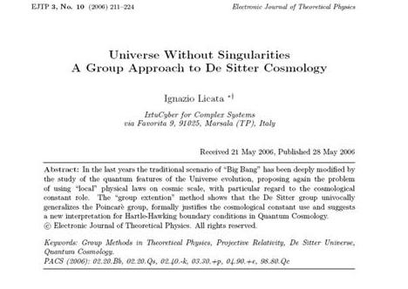
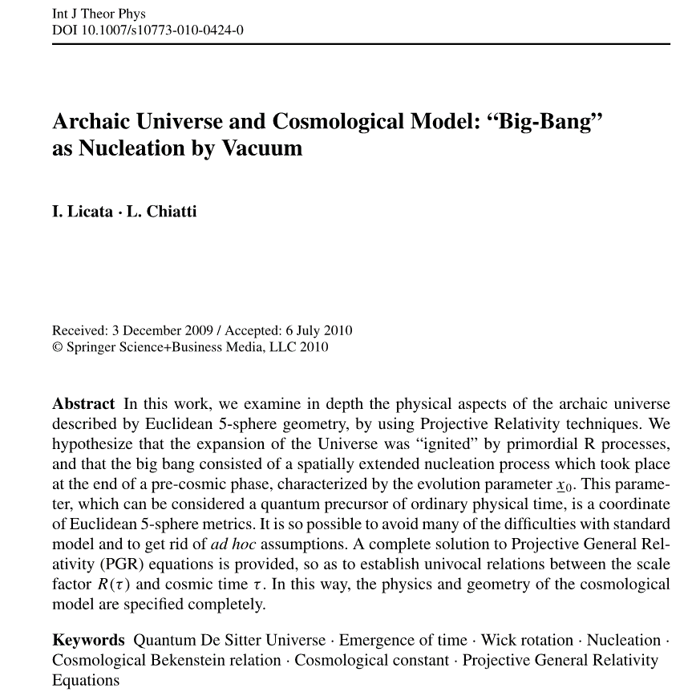
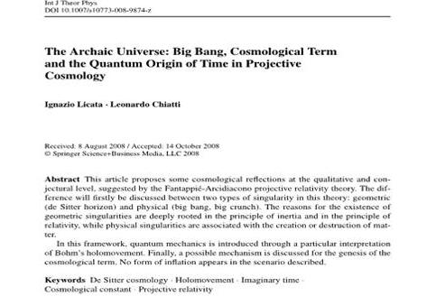

Slide 23
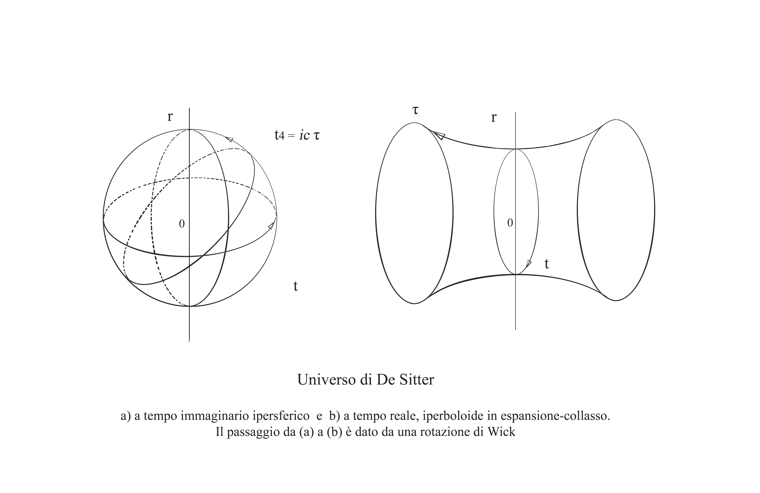
The De Sitter Universe is the geometrical form of Quantum Vacuum!

