Slide 1



Can a Future Choice Affect a Past Measurement’s Outcome?
Yakir Aharonov¹, Eliahu Cohen^{1*}, Doron Grossman², Avshalom C. Elitzur³
¹School of Physics and Astronomy, Tel Aviv University, Tel-Aviv 69978, Israel
²Racah Institute of Physics, Hebrew University of Jerusalem, Givat Ram, Jerusalem 91904, Israel
³Iyar, The Israeli Institute for Advanced Research, Rehovot, Israel
*eliahuco@post.tau.ac.il
ICFP 2012, Greece
14.06.12

Slide 2
ABL
In their 1964 paper Aharonov, Bergmann and Lebowitz introduced a time symmetric quantum theory.
By performing both pre- and postselection ( and
respectively) they were able to form a symmetric formula for the probability of measuring the eigenvalue c_{j} of the observable c:

Slide 3
TSVF
This idea was later widened to a new formalism of quantum mechanics: the Two-State-Vector Formalism (TSVF).
The TSVF suggests that in every moment, probabilities are determined by two state vectors which evolved (one from the past and one from the future) towards the present.
This is a hidden variables theory, in that it completes quantum mechanics, but a very subtle one as we shall see.

Slide 4

Strong Measurement
?
efficient detectors
(very low momentum uncertainty)
Stern-Gerlach magnet

Slide 5
Weak Measurement - I
inefficient detectors
(high momentum uncertainty)
?
?
Stern-Gerlach magnet

Slide 6
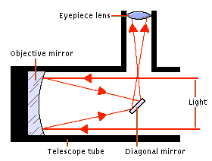
Why Weak Measurement?
?
?
n

Slide 7
Weak Measurement - II
The Weak Measurement can be described by the Hamiltonian:
In order to get blurred results we choose a pointer with zero expectation and standard deviation.
In that way, when measuring a single spin we get most results within the wide range , but when summing up the results, most of them appear in the narrow range agreeing with the strong results when choosing .
N/2↑

Slide 8
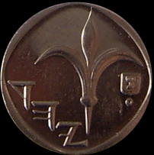

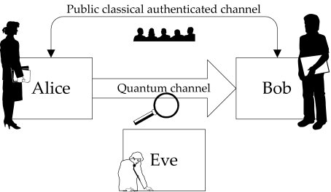
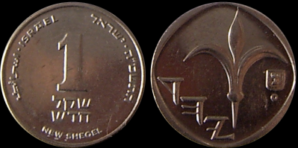
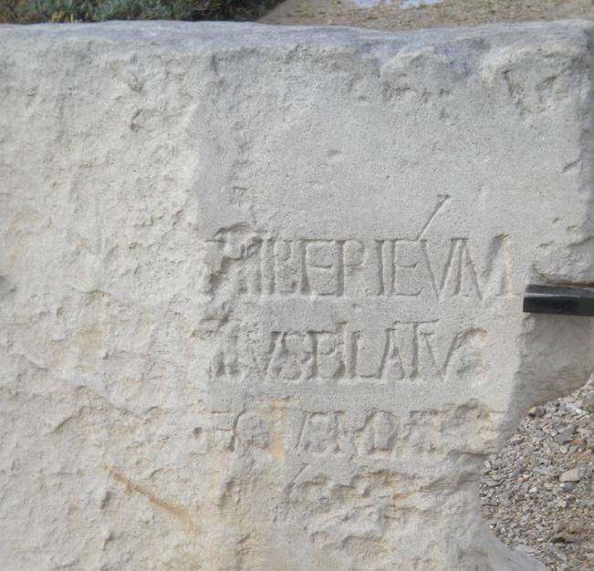

A Classical Experiment with Causality: Coins
Weighing results on evening:
highly accurate, sliced into I/II
N/2 = 500,000
I
1=t 2=h 3=h 4=t 5=h 6=t 7=h 8=h 9=h …n=t
II
N/2 = 500,000
“head”
or
“tail”?
N/2 = 500,000
1=h 2=t 3=h 4=t 5=t 6=t 7=h 8=h 9=t …n=h
Flipping results on morning:
inaccurate but engraved in stone
1 2 3 4 … n
N = 1,000,000
N/2 = 500,000
P( ) = P( )

Slide 9
A Quantum Experiment With Causality - Spins
498,688
1=↑ 2=↓ 3=↓ 4=↑ 5=↓ 6=↑ 7=↓ 8=↓ 9=↓ …n=↑
Strong measurements’ results on evening: highly accurate, sliced into I/II
I
II
501,312
498,688
Weak measurements’ results on morning:
inaccurate but engraved in stone
1=↑ 2=↓ 3=↓ 4=↑ 5=↓ 6=↓ 7=↑ 8=↓ 9=↓ …n=↑
501,312
~ N/2 =~ N/2
“up”
or
“down”?
N = 1,000,000

Slide 10
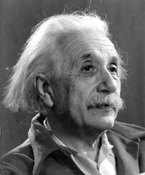
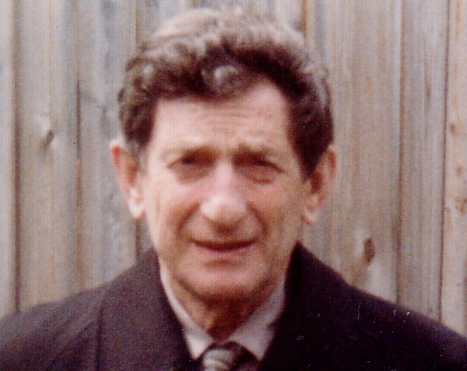
Hidden Variables?
Yes, but of a very subtle kind

Slide 11

The EPR Experiment
A pre-existing spin, only to be passively detected?
or
A superposed state,
to become definite upon measurement?

Slide 12
J.S Bell’s Proof
Alice and Bob can freely choose at the last moment
the spin orientation to be measured.
α
α
γ
β
γ
β
Correlations or anti-correlations will emerge
depending on the relative angle between magnets
Conclusion:
No pre-established spins can exist for every possible pair of choices

Slide 13
The TSVF – New Account Of Time
Tuesday
β
Monday
time
Sunday
α
space

Slide 14

Quantum Experiment with Causality:
EPR Pairs
?
?
time
Non Locality?
space

Slide 15
A Quantum Experiment with Causality
γ
γ
β
Last minute choice!
β
Evening
γ
γ
γ
γ
50-50%
α
β
β
β
α
β
β
50-50%
γ
β
γ
No counterfactuals!
α
β
β
Morning
γ
α
time
γ
50-50%
space

Slide 16
A Quantum Experiment with Causality
498,688
I
1=↑ 2=↓ 3=↓ 4=↑ 5=↓ 6=↑ 7=↓ 8=↓ 9=↓ …n=↑
II
501,312
498,688
1=↑ 2=↓ 3=↓ 4=↑ 5=↓ 6=↓ 7=↑ 8=↓ 9=↓ …n=↑
501,312
The spins “knew” Bob’s specific choices and their results but couldn’t tell us!

Slide 17
Control Experiments
Time reversing the measurement’s order.
Bob tries to cheat Alice.
Alice tries to predict Bob’s results using her data.
GHZ experiment.

Slide 18
Interpretation
Collapse???
Collapse??
Subtle Collapse?
1-Vector?
Superdeterminism?
TSVF!
Free-Will

Slide 19


Slide 20
Acknowledgements
Prof. Marius Usher
Paz Beniamini
Einav Friedman
Shay Ben-Moshe
Shahar Dolev

Slide 21

Questions

Slide 22
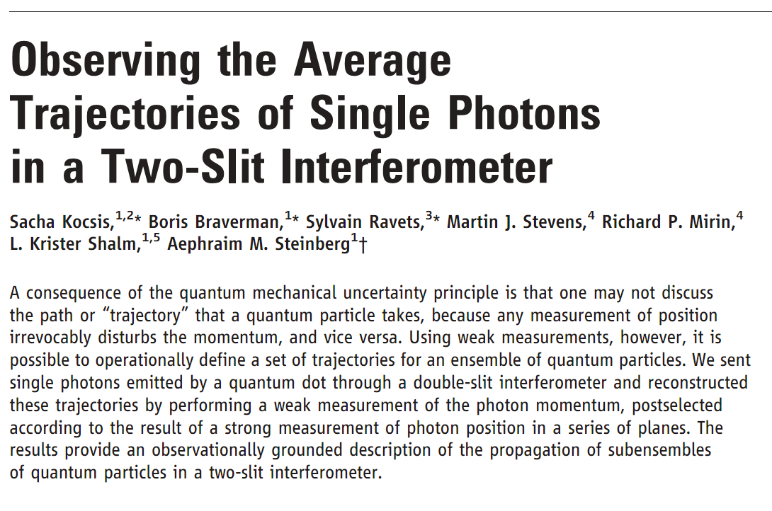
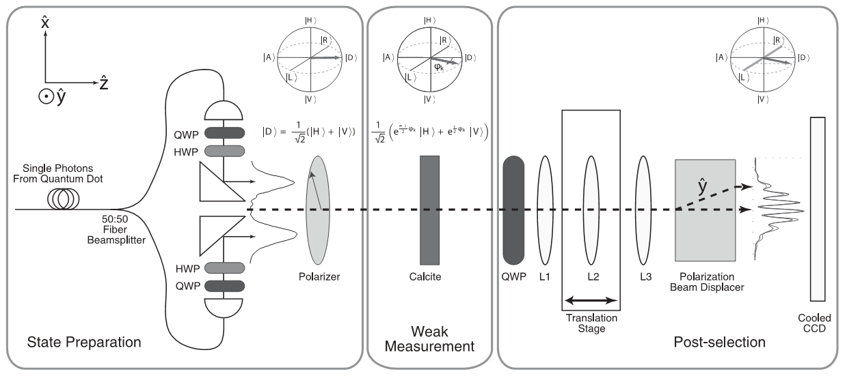
Which Path Measurement Followed by Interference
50%
50%
L_{f}
R _{f}
L₂
R₂
λ²/2
100% - λ²/2
L₁
R ₁
50%
50%
L₀

Slide 23
How should the Weak Measurement’s Outcomes be Summed Up?
1) Let the detector gather all individual effects and then yield their combined final output.
2) Calibrate the detector after every measurement, write down each individual outcome and finally sum them up yourself.
1=↓ 2=↑ 3=↑ 4=↓ 5=↑ 6=↓ 7=↑ 8=↑ 9=↑ … n=↓
+ + + + + + + + +
We shall opt for (2) because it enables also slicing the results as we choose.

