Slide 1

Unusual Interactions of Pre- and Post-Selected Particles
Yakir Aharonov¹, Eliahu Cohen^{1*}
¹School of Physics and Astronomy, Tel Aviv University, Tel-Aviv 69978, Israel
*eliahuco@post.tau.ac.il
ICFP 2012, Greece
14.06.12

Slide 2
ABL
In their 1964 paper Aharonov, Bergmann and Lebowitz introduced a time symmetric quantum theory.
By performing both pre- and postselection ( and
respectively) they were able to form a symmetric formula for the probability of measuring the eigenvalue c_{j} of the observable c:

Slide 3
TSVF
This idea was later widened to a new formalism of quantum mechanics: the Two-State-Vector Formalism (TSVF).
The TSVF suggests that in every moment, probabilities are determined by two state vectors which evolved (one from the past and one from the future) towards the present.
This is a hidden variables theory, in that it completes quantum mechanics, but a very subtle one as we shall see.

Slide 4

Strong Measurement
?
efficient detectors
(very low momentum uncertainty)
Stern-Gerlach magnet

Slide 5
Weak Measurement - I
inefficient detectors
(high momentum uncertainty)
?
?
Stern-Gerlach magnet

Slide 6
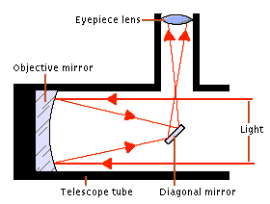
Why Weak Measurement?
?
?
n

Slide 7
Weak Measurement - II
The Weak Measurement can be described by the Hamiltonian:
In order to get blurred results we choose a pointer with zero expectation and standard deviation.
In that way, when measuring a single spin we get most results within the wide range , but when summing up the results, most of them appear in the narrow range agreeing with the strong results when choosing .
N/2↑

Slide 8
Weak Value
The “Weak Value” for a pre- and postselected (PPS) ensemble:
It can be shown that when measuring weakly a PPS ensemble, the pointer is displaced by this value:
No counterfactuals!

Slide 9
The Weak Interaction
We generalize the concept of weak measurement to the broader “weak interaction”.
It can be shown that the Hamiltonian
, when particle 1 is pre- and post- selected, results, to first order in , in the weak interaction :

Slide 10
Which Path - I
Can we outsmart the “which path” uncertainty?
Interference
0%
100%
Notes:
Add one stage, where the photon goes only from the left

Slide 11
Which Path - II
Can we outsmart the “which path” uncertainty?
50%
50%
50%
Notes:
Add one stage, where the photon goes only from the left

Slide 12
Which Path - III
Can we outsmart the “which path” uncertainty?
50%
50%
50%
Notes:
Add one stage, where the photon goes only from the left

Slide 13
Which Path - IV
Can we outsmart the “which path” uncertainty?
Interference
0%
100%
50%
Notes:
Add one stage, where the photon goes only from the left

Slide 14
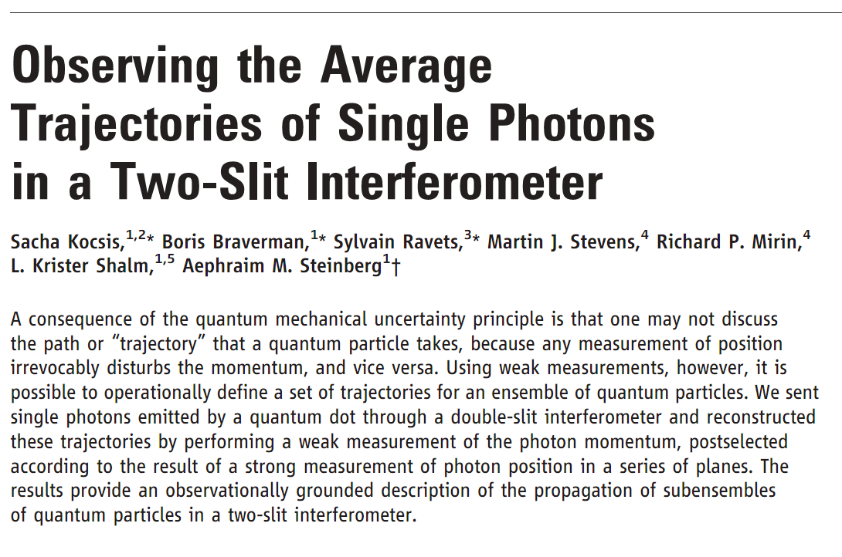
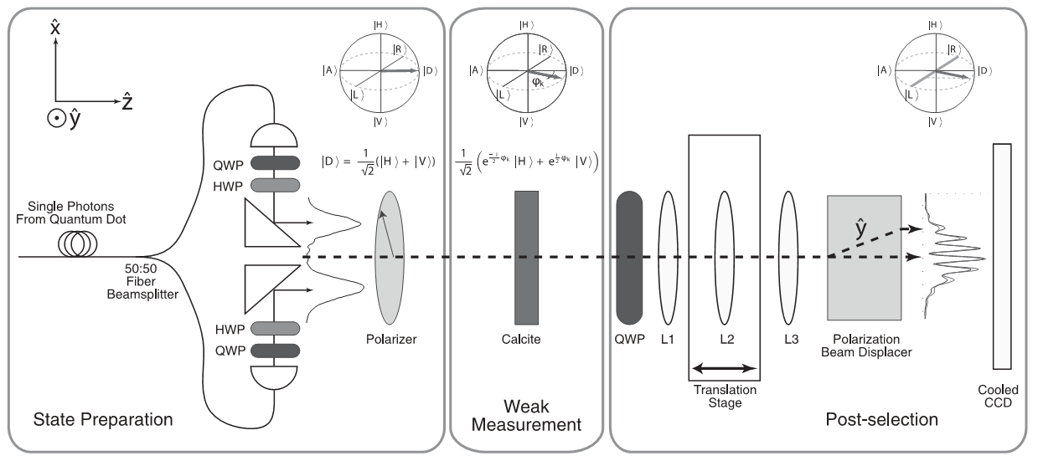
Which Path Measurement Followed by Interference
50%
50%
L_{f}
R _{f}
L₂
R₂
Also for one particle
λ²/2
100% - λ²/2
L₁
R ₁
50%
50%
L₀

Slide 15
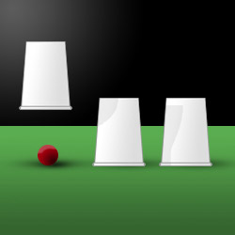
A Quantum Shell Game
Aharonov Y., Rohrlich D., “Quantum Paradoxes”, Wiley-VCH (2004)

Slide 16
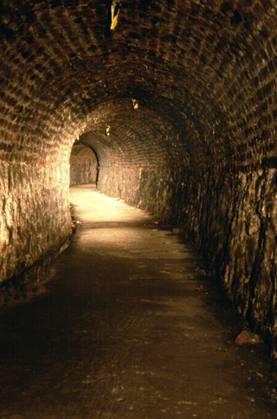
Tunneling
Aharonov Y., Rohrlich D., “Quantum Paradoxes”, Wiley-VCH (2004)

Slide 17
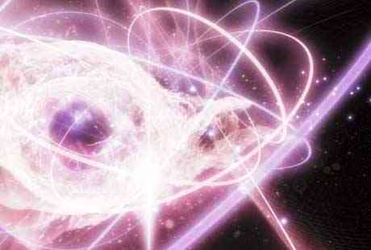
The Correspondence Principle
Every quantum system is described by quantum numbers.
When they become large, the system approaches its classical limit.
This correspondence was first described by Bohr in the 1920’ regarding the atom, but has a broader meaning.
For example, the appropriate quantum number for the classical energy of an oscillator
High excitations

Slide 18
Challenging The Correspondence Principle
Let
We Pre- and Post-select :
and where , .
The weak values can be calculated to be:
and .
-x₀
+x₀

Slide 19
Challenging The Correspondence Principle
We argue that using the idea of weak interaction, this weird result gets a very clear physical meaning.
When interacting with another oscillator
through , it changes its momentum rather then its position:

Slide 20
Summary
Weak measurements enable us to see and feel the TSVF.
They also present the uniqueness of quantum mechanics.
By using them we overcome the uncertainty principle in a subtle way and enjoy both which-path measurement and interference.
Weak values, as strange as they are, have physical meaning:
  In case of many measurements followed by proper postselections: Weak interaction or deviation of the measuring device.
  Otherwise: An error due to the noise of the measurement device.
In that way we avoid counterfactuals and obtain determinism in retrospect.

Slide 21


Slide 22
Acknowledgements
Dr. Avshalom C. Elitzur
Paz Beniamini
Doron Grossman
Shay Ben-Moshe

Slide 23

Questions

