Slide 1
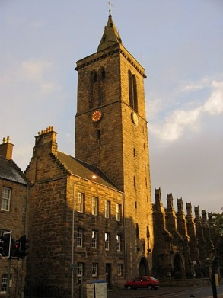
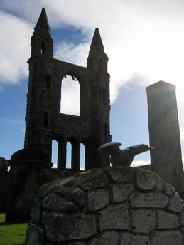




Quantum entanglement and beyond:
Entanglement, discord and harnessing noise
Natalia Korolkova
St Andrews, UK

Slide 2
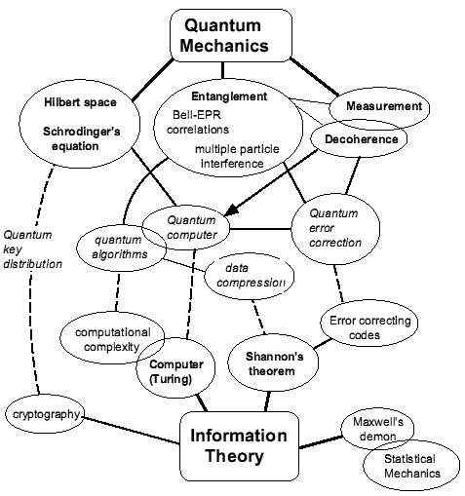
QUANTUM
INFORMATION

Slide 3
Quantum entanglement: definition and some textbook examples
Going macroscopic: quantum information in infinite-dimensional
Hilbert space
Quantum correlations beyond entanglement: quantum mixed states,
quantum discord
Role of dissipation: harnessing noise

Slide 4
Quantum entanglement: definition and some textbook examples

Slide 5
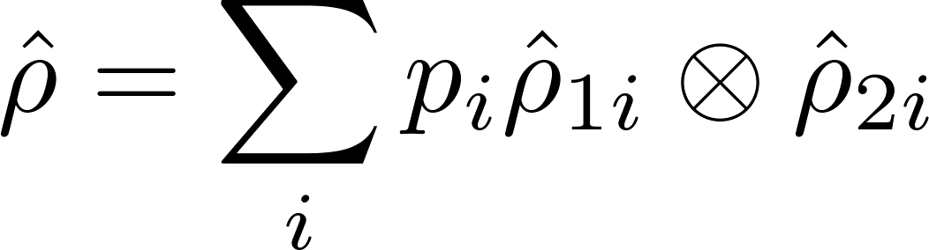
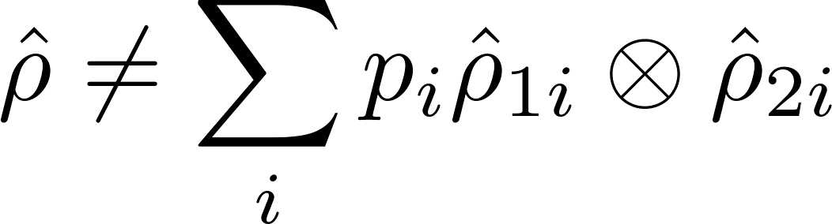
Entanglement – nonlocal bi-partite superposition state
- separable
- entangled

Slide 6
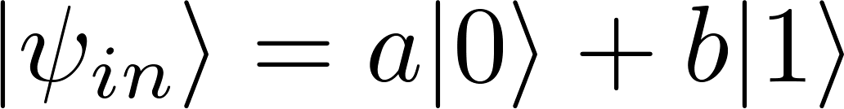
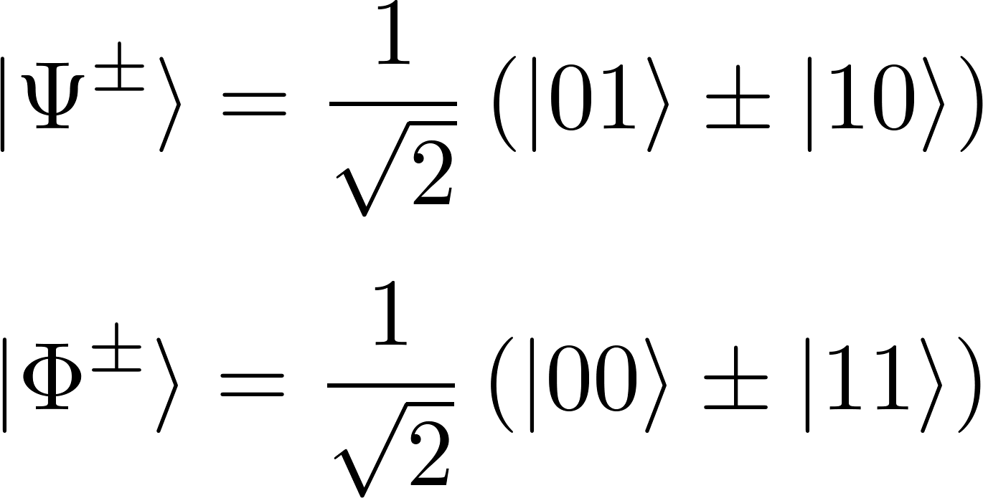
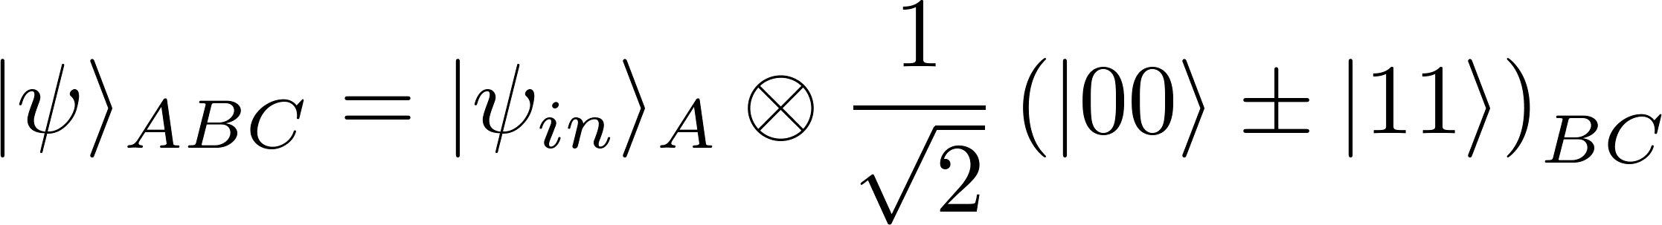


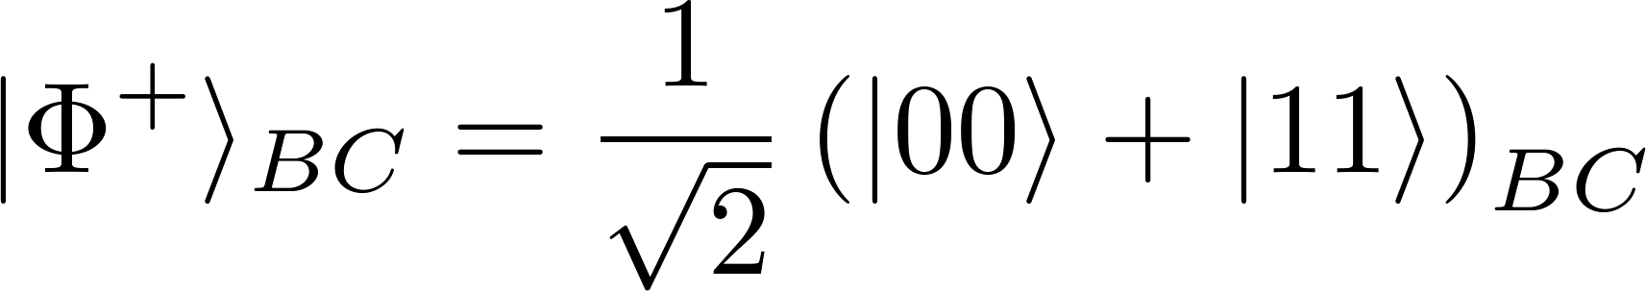
Bell basis
- state to teleport
Initial global state
classical comm
Quantum teleportation
in few lines
Bell
unitary

Slide 7
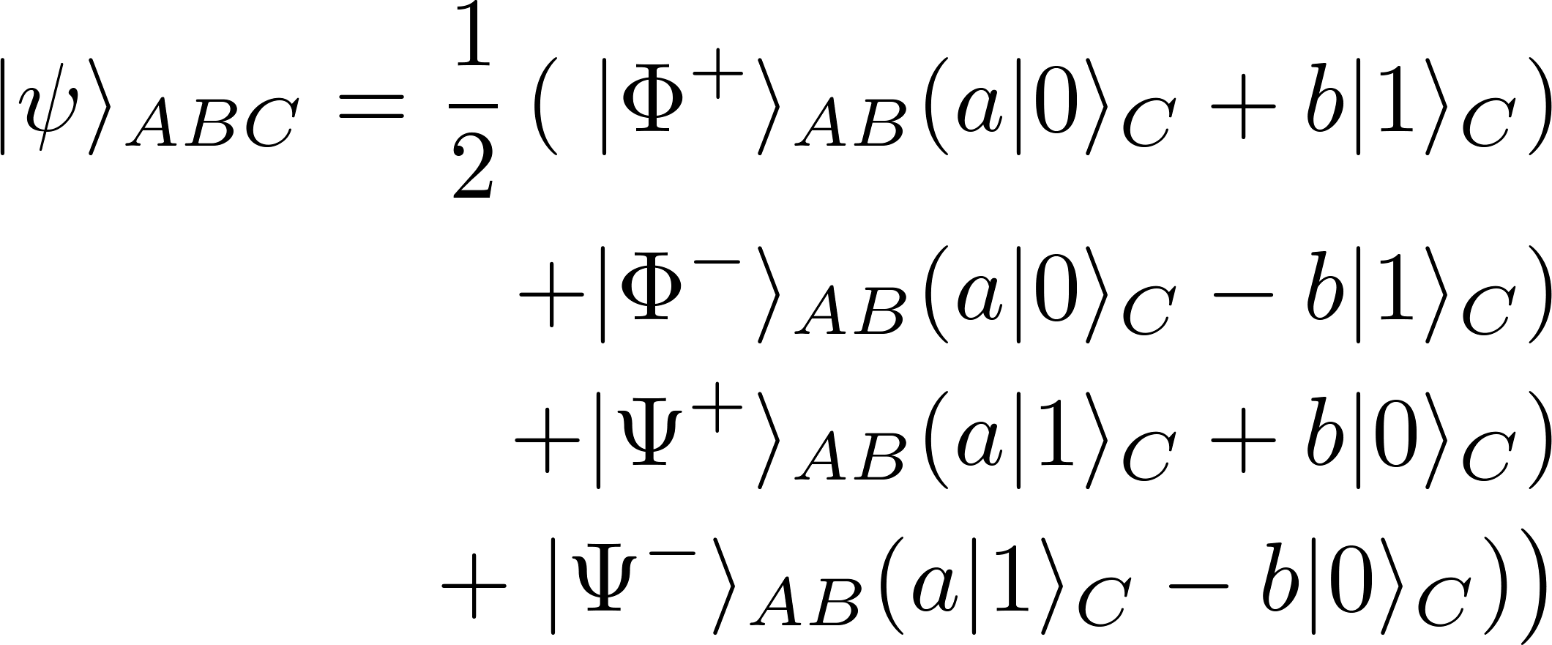
classical comm
Bell
unitary

Slide 8
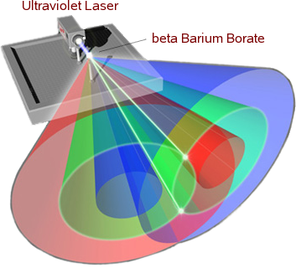
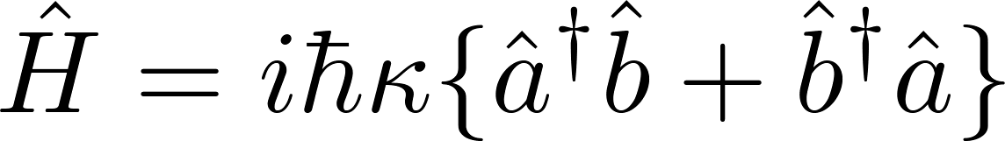
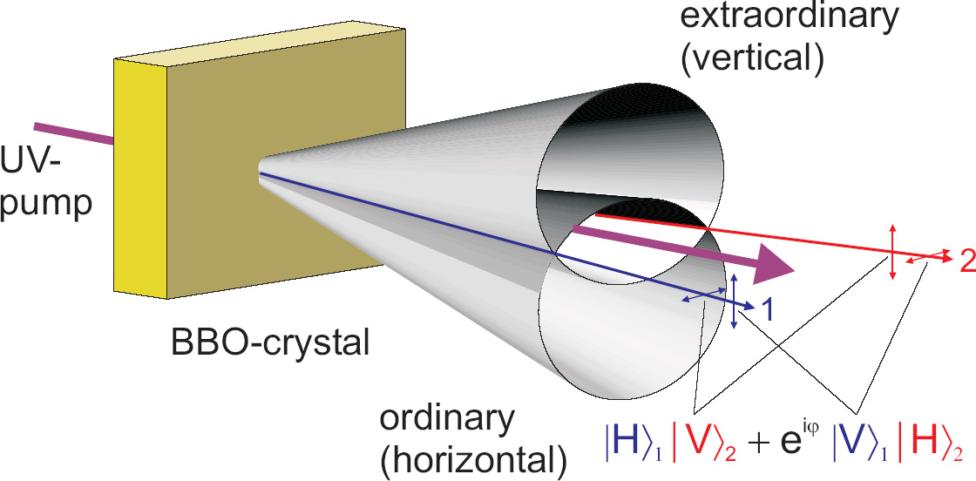
Example of photonic entanglement

Slide 9

Going macroscopic:
quantum information in infinite-dimensional Hilbert space
Not only single quanta are quantum:
Quiet light, tangled atoms and beating eavesdropper with merely a laser beam

Slide 10
Not only single quanta are quantum

Slide 11
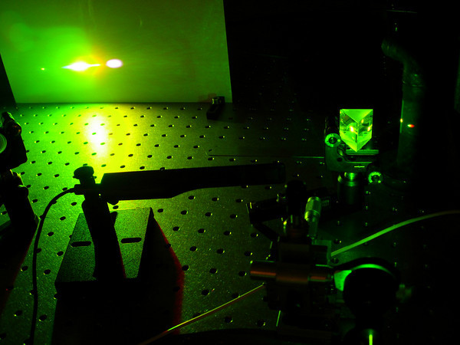
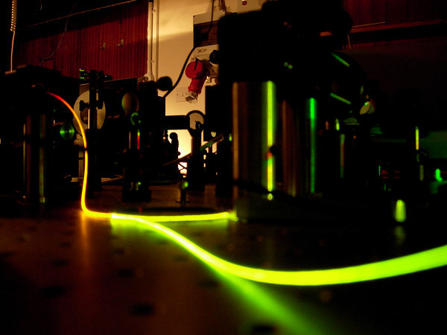
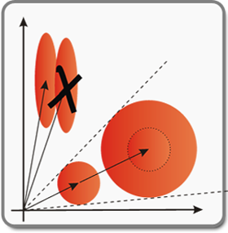
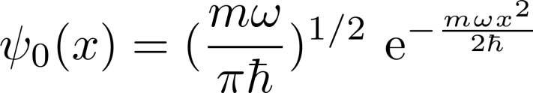
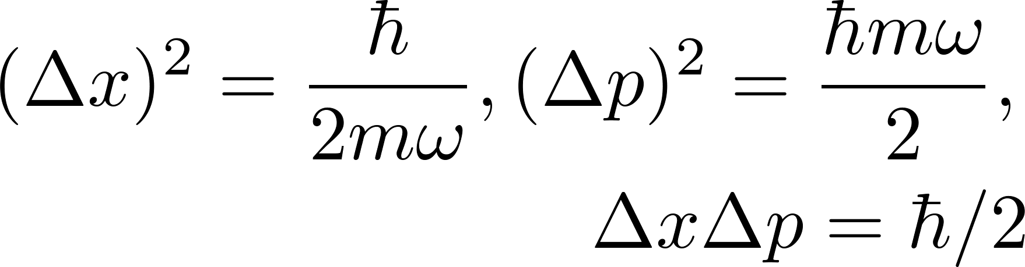
Is laser light quantum or classical?
p
Good laser = quantum coherent state
x
Simple Harmonic Oscillator
p
x
Min uncertainty wave packet
Coherent light cannot be amplified without
introducing additional noise – Q info!

Slide 12
Quantum information:
cannot be copied (non-cloning theorem)
cannot be read/manipulated without disturbance
This holds also for such macroscopic states as bright
laser beams or atomic ensemble with millions atoms

Slide 13
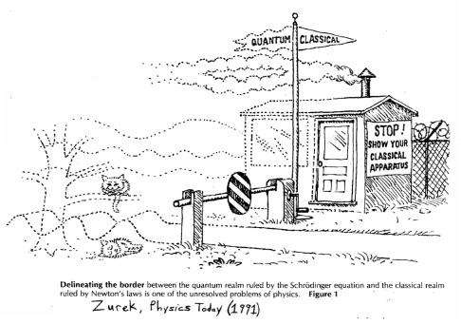

Slide 14
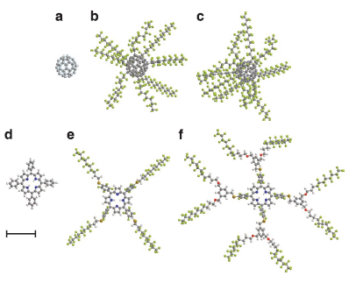

Our experiments prove the quantum wave nature and delocalization of
compounds composed of up to 430 atoms, with a maximal size of up to 60 Å, masses up to m = 6,910 AMU We show that even complex systems, with more than 1,000 internal degrees of freedom, can be prepared in
quantum states that are sufficiently well isolated from their environment to avoid decoherence and to show almost perfect coherence.
Quantum interference of large organic molecules,
group of Markus Arndt, Vienna; see also talk on Thu

Slide 15
Quiet and strange light

Slide 16
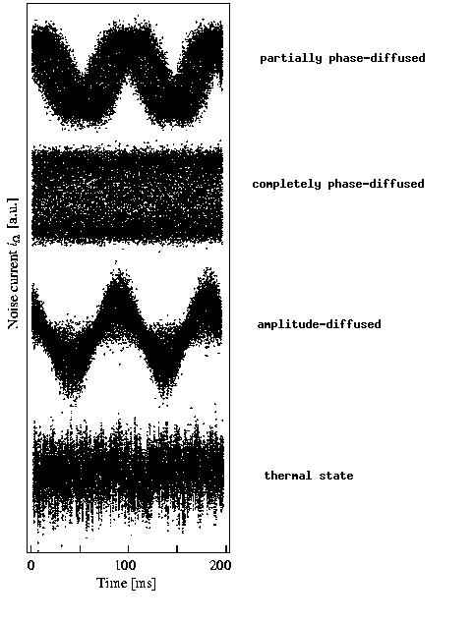
Normally light is quite loud and noisy
p
x
Minimum uncertainty
wave packet
and thermal light

Slide 17
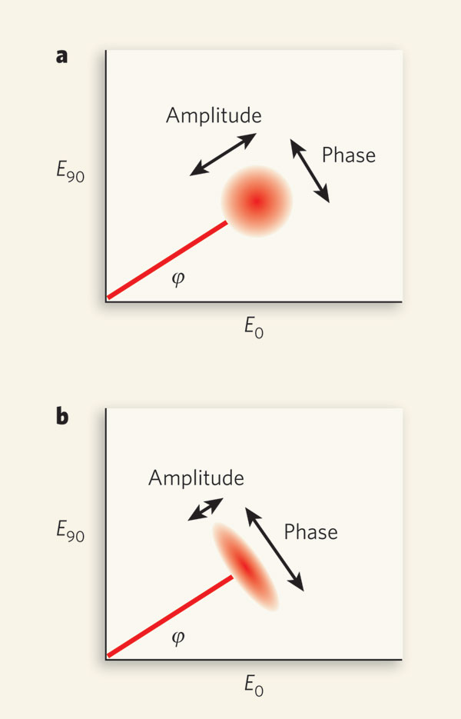
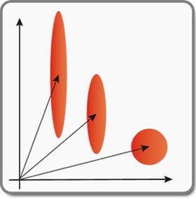
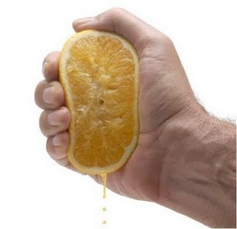
Quantum squeezing: Cheating QM
coherent
squeezed
Quiet light

Slide 18
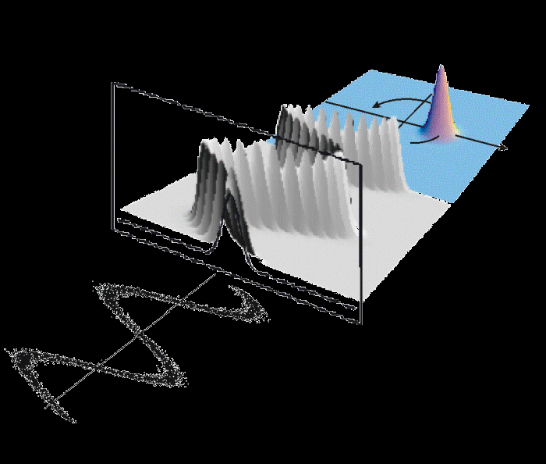
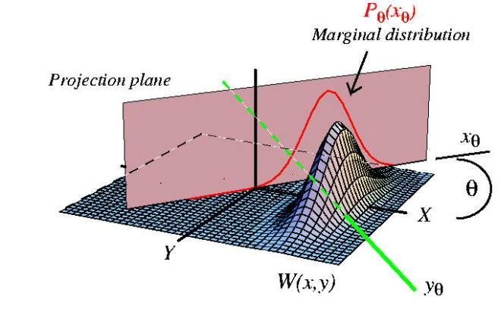
Description:
- Evolution of a wave packet;
- Phase-space quasi-probability
distributions (e.g. Wigner)

Slide 19
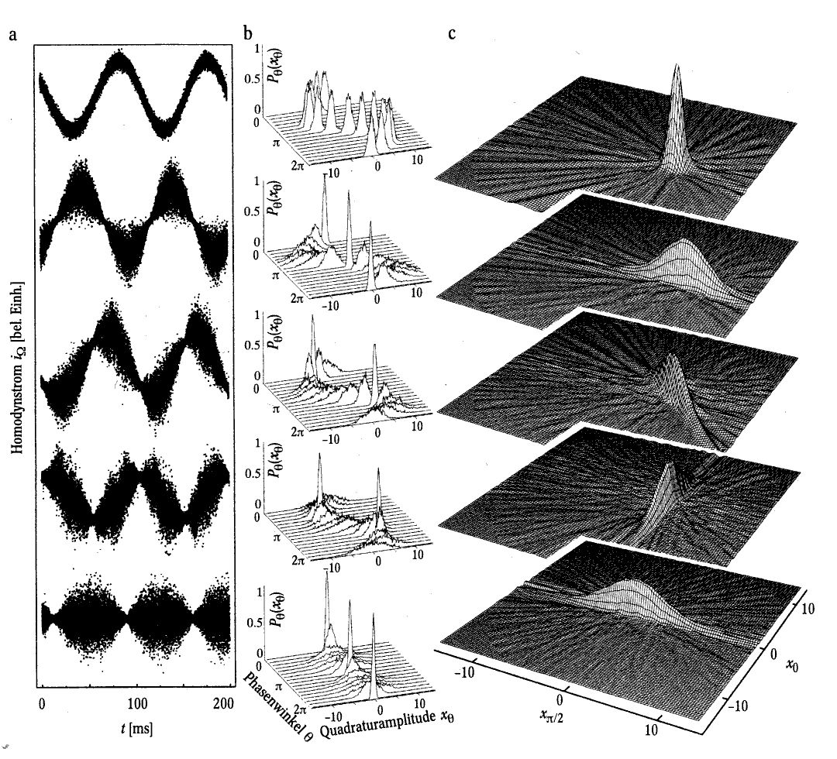
Quiet light
Gallery of quantum states

Slide 20
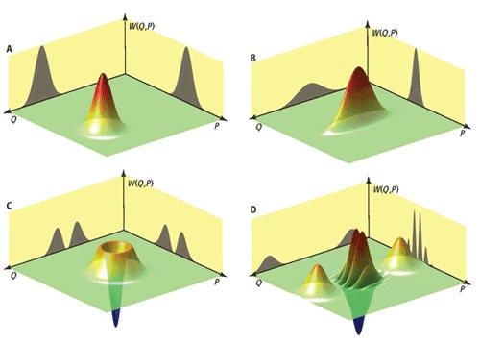
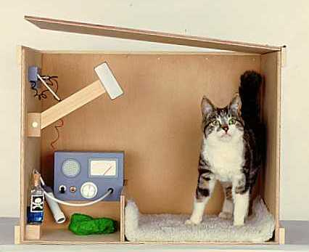
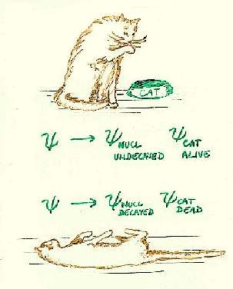
p
x
Schroedinger cat-like state:
Macroscopically distinguishable superposition

Slide 21
Strange light
P Grangier et al, Science 2011;332:313-314
the coherent state, (B) a squeezed state,
(C) the single-photon state, and (D) a Schrödinger's-cat state.

Slide 22
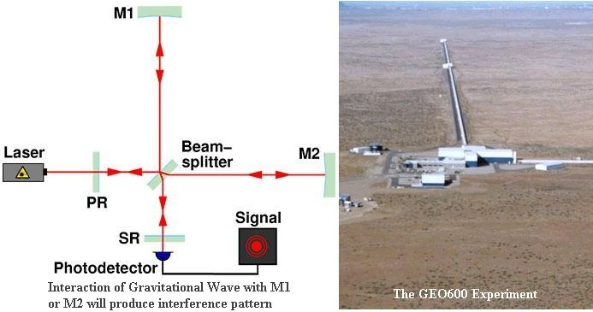
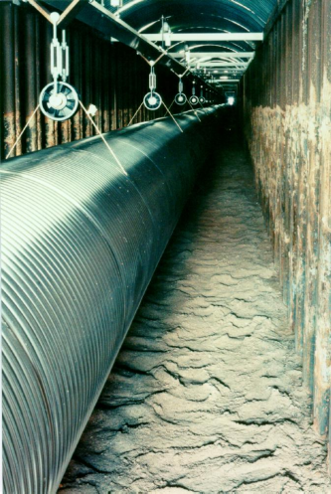
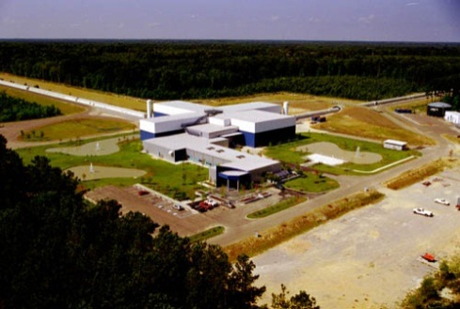
Applications of
quiet and strange light:
Metrology:
High-precision measurement (interferometry)
including gravitional wave detection (GEO600)
Quantum information:
entanglement generation,
quantum computation (e.g. with cluster states),
quantum (secure) communication
Quantum teleportation, dense coding etc

Slide 23
Mesoscopic entanglement
(continuous variable or infinite dimensional entanglement)

Slide 24
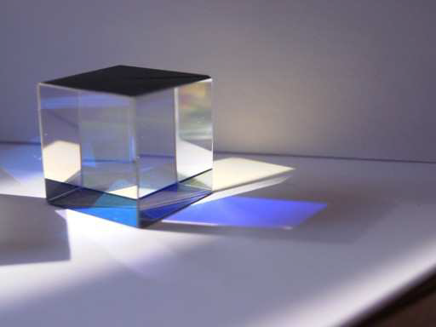
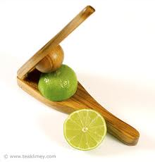
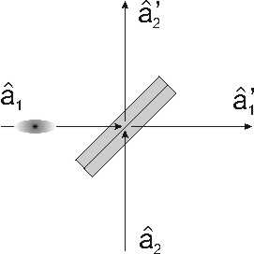

Tools:
Squeezers, beamsplitters …
Optical fiber,
Nonlinear cristal etc

Slide 25
Macroscopic EPR entanglement
Example:
Entangled femtosecond pulses 10^8 photons each (optical soliton pulses in fibers)

Slide 26
p
p
x
x
p
p
x
x
Idea: G. Leuchs, T. Ralph, Ch. Silberhorn, N. Korolkova (1999)
First realization: Ch. Silberhorn, P. K. Lam, O. Weiss, F. Koenig, N. Korolkova, G. Leuchs
Phys. Rev. Lett. (2001)

Slide 27
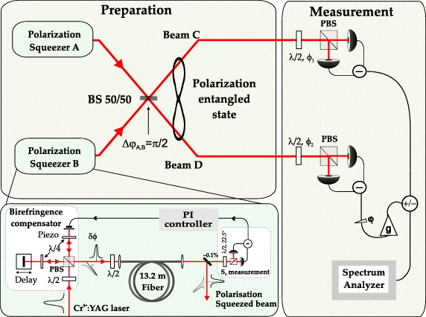
Resord quantum
noise supression:
factor 10
Realization of a
macroscopic
triplet-like state
New J. Phys. 11 (2009) 113040
Triplet-like correlation symmetry of continuous variable entangled states
Gerd Leuchs, Ruifang Dong and Denis Sych

Slide 28
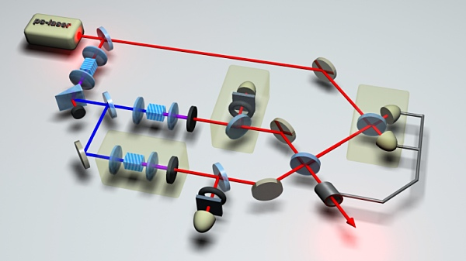
Applications: Quantum information:
quantum computation
quantum simulations
quantum teleportation
quantum (secure) communication

Slide 29
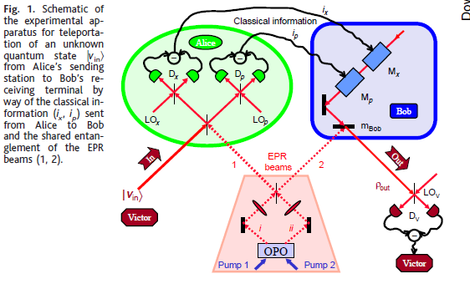

Slide 30
Beating eavesdropper with merely a laser light

Slide 31
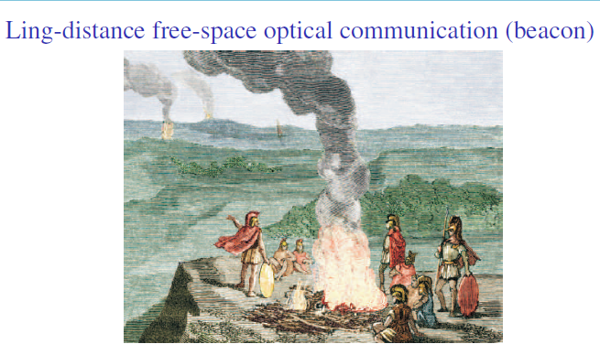

Slide 32
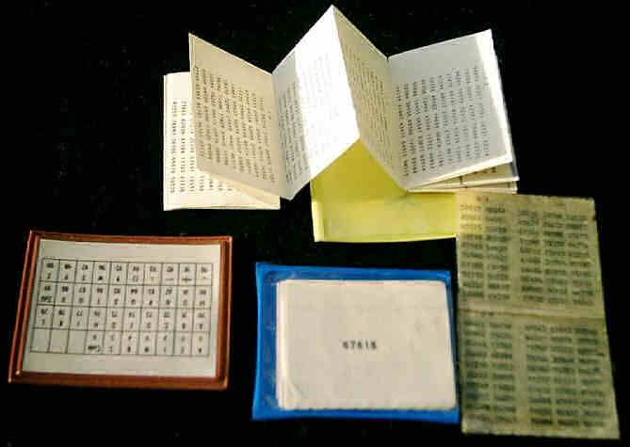
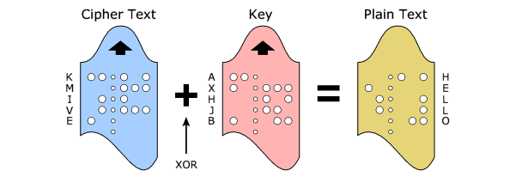
Vernam cipher: one-time pad; Unconditionally secure but
needs large amounts of “key”
(same length as message and used only one time)
Quantum cryptography is actually quantum key distribution
QKD

Slide 33
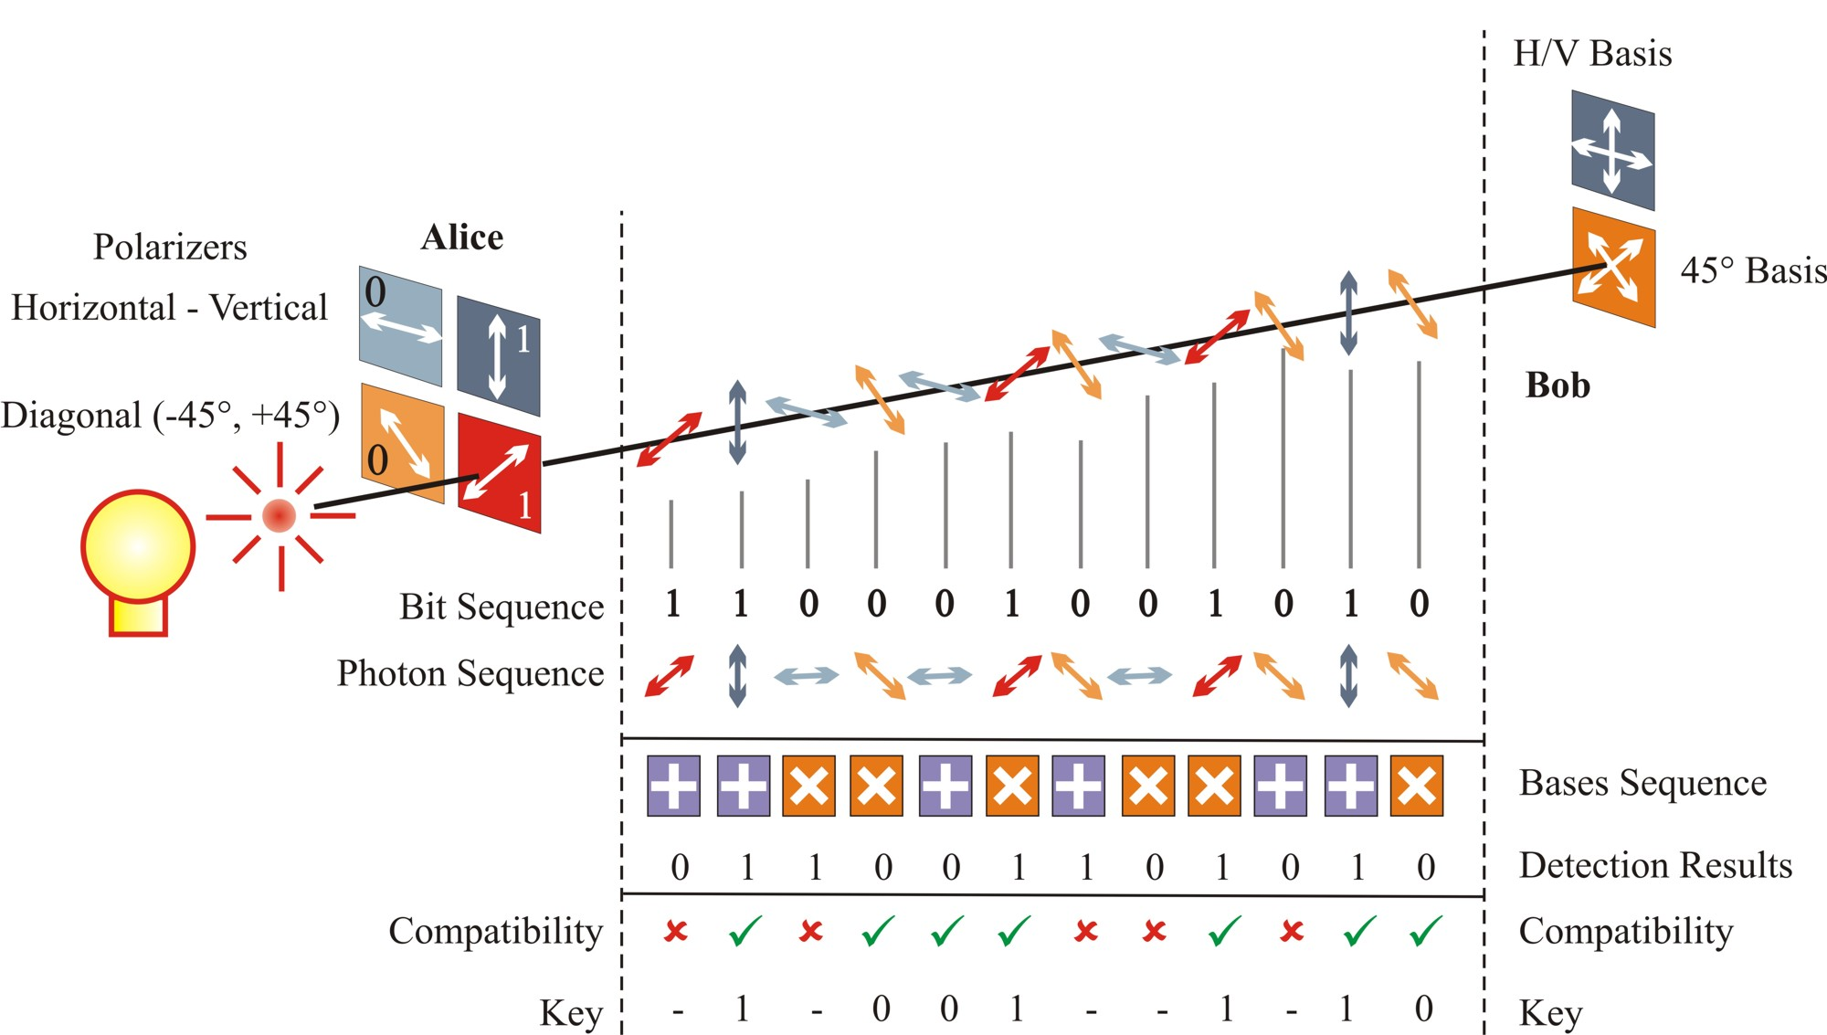
Quantum key distribution using single (nearly!) photons

Slide 34
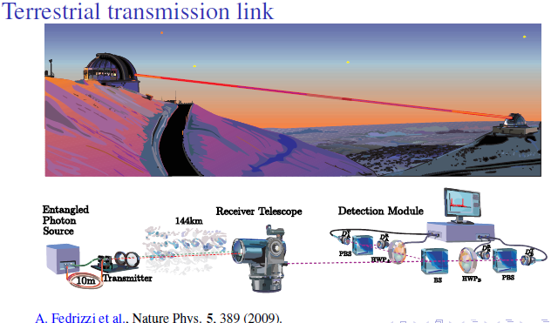

Slide 35
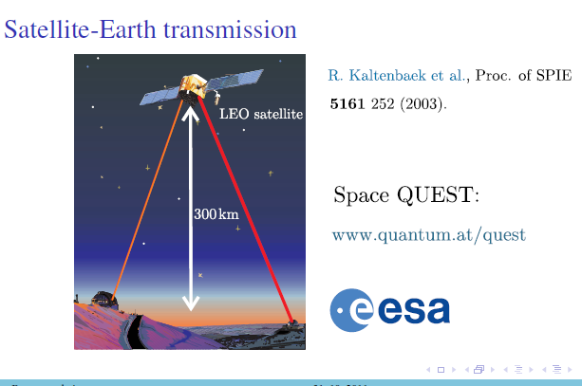

Slide 36
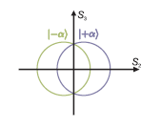
Key ingredient: incompatible measurements
If somebody “reads” quantum info, he leaves a trace
Do we really need troublesome single photons?
Amplitude and phase of quantum light
are also subject to commutation relation;
Coherent states overlap –
Gaussian bells have infinite “tails”

Slide 37
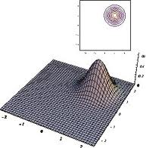
Protocol based on Gaussian distributed coherent states
Grangier group
p
“0”
“1”
x

Slide 38
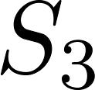
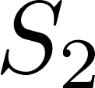
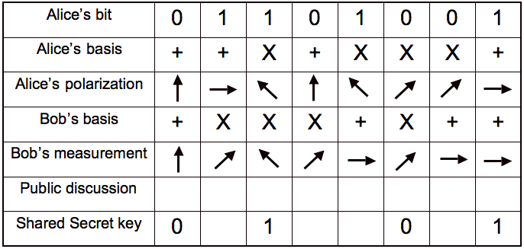
Protocol
“0”
“1”
“0”
“1”
Korolkova, Lorenz, Leuchs,
Appl. Phys. B (2003)

Slide 39


Max Plank Insititute for the Science of Light,
Erlangen, Germany
Free-space urban link over 2 km

Slide 40
Quantum correlations beyond entanglement:
quantum mixed states, quantum discord
Role of dissipation

Slide 41





Pure states: entangled or separable
The world of mixed quantum states is richer and
closer to real-world QIP applications
How good do we know quantum resources there?
Mixed states can be arbitrary more non-classical …
(e.g. Piani et al, Phys. Rev. Lett.
106, 220403 (2011) )

Slide 42


Pure states: quantum correlations entanglement
Mixed states: quantum correlations entanglement
Entanglement
Superposition
Quantumness
Noncommutativity of observables
measurements !

Slide 43




Classically - equivalent definitions
of mutual information:
Shannon entropy:
Conditional:
Quantum – they are not equivalent;
mutual information:
von Neumann entropy:
Quantum discord:
(quantum mutual information) -
(one way classical correlation)

Slide 44
Protocols without entanglement outperforming classical ones???
For mixed states:
- NMR computing;
- DQC1 - deterministic quantum computation with one quantum bit,
Knill and Laflamme, Phys. Rev. Lett. 81, 5672 (1998).
NB: For pure-state:
To achieve exponential speed up over classical computation
the unbounded growth of entanglement with the system size is required (Jozsa, Linden 2003)

Slide 45

Zoology of the non-classicality measures
Quantum discord
Measurement-induced disturbance (MID)
Ameliorated MID (AMID)
etc ….
H. Ollivier and W. H. Zurek, Phys. Rev. Lett. 88, 017901 (2001);
L. Henderson and V. Vedral, J. Phys. A 34, 6899 (2001)
G. Adesso and A. Datta, Phys. Rev. Lett. 105, 030501 (2010) - CV
P. Giorda and M. G. A. Paris, Phys. Rev. Lett. 105, 020503 (2010)
S. Luo, Phys. Rev. A 77, 022301 (2008)
CV -L. Mista, R. Tatham, D. Girolami, N. Korolkova, G. Adesso,
quant-ph (2010), accepted by Phys. Rev. A (2011)

Slide 46
Quantifiers of non-classical correlations (quantum discord, etc):
link coherence with disspipation
link the emergence of quantum correlations with changes in entropy in quantum systems coupled to the environment

Slide 47
Koashi-Winter inequality:
Koashi, Winter, PRA 69, 022309 (2004)
Monogamy of entanglement: a quantum system being entangled with another one
limits its possible entanglement with a third system
Interplay between entanglement and classical correlation.
Perfect entanglement and perfect classical correlation are mutually exclusive

Slide 48
A simple but counterintuitive example:
Emergence of quantum correlations under local non-unitary measurement
Local noisy channels, nonunital (!) – e.g. dissipation.
DV: Streltsov, Kampermann, Bruss, PRL 107, 170502 (2011);
CV: Ciccarello, Giovannetti, PRA 85, 010102 (2012)
A
C
Streltsov et al paper: “Are there any noisy channels that might even increase the amount of quantum correlations? How does dissipation influence quantum correlations, and how are they affected by decoherence?”
Tatham, Quinn, Korolkova, in preparation

Slide 49
A mixed state is not a fundamental object, but a sign of our ignorance.
Purification:
every mixed state acting on finite dimensional Hilbert spaces can be viewed as the reduced state of some pure state.
Ansatz: mixed quantum state + environment = pure quantum state

Slide 50



Local non-unitary measurement
after measurement on C:
B
A
C
with
Purification:
- GHZ – state, max entangled

Slide 51


Initially: entanglement across any bipartition (GHZ)
Now: any subsystem traced out –
no entanglement btw two remaining ones:
B
A
C
classical correlations btw those are maximal:
Koashi-Winter:
The entropy of marginal quantifies
capacity of Alice’s state to form correlations

Slide 52


Local non-unitary measurement on C
Alice’s and Bob’s capacities
to create correlations remain
unchanged
B
A
C
Charlie’s capacity to create correlations decrease upon the measurement on C:
(using Koashi-Winter)

Slide 53


After non-unitary measurement on C:
classical correlations decrease
capacity for Alice’s correlations
must be filled up
Alice and Bob become entangled
The discord between A and C arises as a side effect of this entanglement formation
between the subsystem unaffected by the measurement and environment
Tatham, Quinn, Korolkova, in preparation

Slide 54


Koashi-Winter inequality:
- for pure tripartite system
- min taken over all ensembles satisfying this
Quantum Discord:

Slide 55

The discord between A and C arises as a side effect of the entanglement formation
between the subsystem unaffected by the measurement and environment
correlated
entangled
B
A
C
Quantum discord is not really a fundamental phenomenon but a side effect of all the changes in local entropy in a quantum system coupled to the environment

Slide 56
Dissipation-induced coherence
non-classical correlations, such as quantified by quantum discord, unite coherence
with changes in entropy in quantum systems coupled to the environment
link coherent and dissipative dynamics together
Quantum optics: correlations, coherence, correlation functions, ability to interfere ….
Quantum information: quantum entropy, entropy of entanglement ….
Quantum discord:
correlations via changes in local entropy across dissipative system
linking coherence and correlations to the entropy flow in a global system

Slide 57
Quantum resource:
correlations induced by controlled dissipation
Tailored dissipation as a tool:
(quantum)
environment becoming your friend

Slide 58
Emerging new field:
Entanglement via dissipation
Correlations via dissipation
Correlated noise to counteract decoherence
Dissipatevely-driven quantum computation

Slide 59


Quantum Optics
Quantum Information
in St. Andrews
www.st-andrews.ac.uk/~qoi
Theoretical Quantum Optics group
(U. Leonhardt, S. Horsley, T. Philbin, S. Sahebdivani, W. Simpson)
Theoretical Quantum Information group
(N. Korolkova, S. Ivanov, D. Vasylyev, L. Mista*, D. Milne, R. Tatham, N. Quinn)
Experimental Quantum Optics group
(F. Koenig, S. Kehr, J. McLenaghan, M. Rybak)
*- regular visitor from Olomouc

Slide 60

Experimental set-up for teleportation of light onto an atomic ensemble (Polzik group, NBI, Copenhagen)

Slide 62




Slide 63

Mutual information = total correlations btw A and B
Classically - equivalent definitions of mutual information:
Shannon entropy:
Conditional:
Quantum – they are not equivalent; mutual information:
von Neumann entropy:
measurements!

Slide 64






- one way classical correlation
Total info
about A
Quantum correlation:
Info about A inferred via quantum measurement on B
Quantum conditional entropy related
to upon POVM on B.
Infimum: optimization to single out the least disturbing measurement on B

Slide 65

Quantum discord:
quantum mutual information
one way classical correlation
- classical
- quantum, separable
- entangled

Slide 66
quantum mutual information
one way classical correlation
QD = quantum mutual info - the classical mutual info of outcomes;
QD = total correlations - classical correlations;
+ operational; conceptually easy; optimized over POVMs
- hard to compute; asymmetric
not unique
DV: H. Ollivier and W. H. Zurek, Phys. Rev. Lett. 88, 017901 (2001);
L. Henderson and V. Vedral, J. Phys. A 34, 6899 (2001)
CV: G. Adesso and A. Datta, Phys. Rev. Lett. 105, 030501 (2010)
P. Giorda and M. G. A. Paris, Phys. Rev. Lett. 105, 020503 (2010)
L. Mista, R. Tatham, D. Girolami, N. Korolkova, G. Adesso, Phys. Rev. A. (2011)

Slide 67

quantum mutual information
non-Gaussian classical correlation
MID = quantum mutual info - the classical mutual info of outcomes of local Fock-state detectors;
+ symmetric
- no optimizations over local measurements
often overestimates quantum correlations
Measurement-induced disturbance (MID)
S. Luo, Phys. Rev. A 77, 022301 (2008)

Slide 68

quantum mutual information
maximal classical correlation
extractable by local (Gaussian) processing
AMID (Gaussian) = quantum mutual info - the maximal classical mutual info
obtainable by (Gaussian) local measurements
AMID – optimized as discord and symmetric as MID
L. Mista, R. Tatham, D. Girolami, N. Korolkova, G. Adesso, Phys. Rev. A (2011)

Slide 69
Protocols without entanglement outperforming classical ones???
For mixed states:
- NMR computing;
- DQC1 - deterministic quantum computation with one quantum bit,
Knill and Laflamme, Phys. Rev. Lett. 81, 5672 (1998).
NB: For pure-state:
To achieve exponential speed up over classical computation
the unbounded growth of entanglement with the system size is required (Jozsa, Linden 2003)

Slide 70
Symmetrical nonclassicality indicators: comparison
- “two-way discord”
- measurement-induced disturbance
amelorated MID:
- Gaussian amelorated MID
L. Mista, R. Tatham, D. Girolami, N. Korolkova, G. Adesso, Phys. Rev. A (2011)

Slide 71

Entanglement distribution using separable ancilla
This term correspond
to CM of specially
designed (classically
correlated) noise
L. Mista and N. Korolkova Phys. Rev. A 80, 032310 (2009).

Slide 72

Entanglement Secrecy
J. Bae, T. S. Cubitt, A. Acin, Phys. Rev. A 79, 032304 (2009);
P. W. Shor, J. Preskill, Phys. Rev. Lett. 85, 441 (2000); etc
Quantum correlations beyond entanglement
can be used for distribution of secrecy

Slide 73


Non-secret correlations can be used to distribute secrecy
Probability distribution contains secret correlations iff it cannot be distributed using only local operations and public communication.
All entangled states can be mapped by single copy
measurements onto P(A,B,C) with secret correlations
A. Acin and N. Gisin, Phys. Rev. Lett. 94, 020501 (2005)
Consider Eve;
The distribution is secret if:

Slide 74
Gaussian multipartite bound information
Analog of bound entanglement; cannot be distilled but can be activated:
A Gaussian distribution can be distilled to a secret key using
reversed reconciliation protocol (Van Assche, Grosshans, Grangier, Cerf) if
L. Mista, N. Korolkova, Gaussian multipartite bound information, submitted (2010)

Slide 75

Distribution of secrecy by non-secret correlations
Step 1: construct purification:
A, B, C modes as above + two Eve modes
map it onto Gaussian probability distribution with no secret correlations across
any bipartition of honest parties by measuring x-quadrature on all 5 modes
+ 2 Eve’s modes

Slide 76



Step 2: Alice transforms
her random variables (BS)
The new distribution contains Gaussian bound information!
no secret correlations across B-(AC) and C-(AB).
any two honest parties cannot to establish a secret key
(even when Alice is allowed to collaborate either with Bob or Clare)
But the distribution cannot be created by LOPC (secret correlations A-(BC)).
The correlations are not detected by the criterion
Bound information can be activated

Slide 77


Step 3: Alice transforms
her random variables (2nd BS)

Slide 78



Can distil a secret key using the reverse reconciliation:
Gaussian bound information
can be activated and used
for secret communication!
Q correlations beyond entanglement in step 2 are responsible for creation of BI
and can be used to distribute secrecy
L. Mista, N. Korolkova, Gaussian multipartite bound information, submitted (2010)
See also:
M. Piani et al, All non-classical correlations can be activated into distillable entanglement,
Phys. Rev. Lett. 106, 220403 (2011); A. Streltsov, H. Kampermann, D. Bruss, Linking
Quantum Discord to Entanglement in a Measurement, Phys. Rev. Lett. 106, 160401 (2011)

Slide 79

3-partite
mixed
fully separable
state
(2) Separable state
with non-zero quantum
correlations
(3) Separable ancilla C
renders entanglement
between A and B
(2) Bound information
is created
(3) Bound information
is activated into secret key

Slide 80
Gaussian ameliorated measurement-induced disturbance
accurate measure of quantum correlations for mixed and strongly correlated states
Entanglement distribution by separable ancilla
C never entangled but non-zero quantum correlations
Distribution of secrecy using non-secret correlations
uses quantum correlations beyond entanglement
Gaussian multipartite bound information
can be activated into secret correlations/entanglement
Quantum correlations beyond entanglement for Gaussian states
Thank you!

Slide 81

Quantum Optics
Quantum Information
in St. Andrews
www.st-andrews.ac.uk/~qoi
Theoretical Quantum Optics group
(U. Leonhardt, S. Horsley, T. Philbin, S. Sahebdivani, W. Simpson)
Theoretical Quantum Information group
(N. Korolkova, L. Mista*, D. Milne, R. Tatham, N. Quinn, NN – postdoc
position open)
Experimental Quantum Optics group
(F. Koenig, S. Kehr, J. McLenaghan, S. Rohr)
*- regular visitor from Olomouc

