Slide 1



ICFP 2012, 10-16th of June, Kolymbari, Crete, Greece
Realization of electronic systems operating on dynamical physical signals
Elena Hammari, | Francky Catthoor, | Leonidas Iasemidis,
Per Gunnar Kjeldsberg, | Jos Huisken, | Konstantinos Tsakalis
1. Norwegian University of Science and Technology, Trondheim, Norway
2. IMEC, Leuven, Belgium and Eindhoven, The Netherlands
3. Arizona State University, Tempe, AZ, USA
Notes:
Good afternoon. My name is Elena Hammari, I come from the Electronics field, Circuits and Systems group at the Norwegian University of Science and Technology and will today give a slightly different talk from the topic of this conference. My talk will be about dynamical electronic systems and the state-of-the-art methodology for buildning such systems. The methodology was originally developed at the Inter University Micro Electronics Center and targeted multimedia electronic systems. We extended the methodology for a new type of systems, characterized by a widely changing behavior and applied it to build an electronic system for prediction of seizures in patients suffering from epilepsy. The algorithm for epileptic seizure predicton was developed by our collaborators from the Arizona State University.

Slide 2
Outline
Dynamical electronic systems
    Definition, comparison to physical dynamical systems
    Example from epileptic seizure prediction
Design methodology for dynamical electronic systems
    Typical design flow, goals and challenges
    System scenarios
    Methodology overview
    Proposed top-down scenario clustering approach
System scenarios for Lyapunov exponent calculation
  Energy saving results
  Comparison to theoretically best solution
Notes:
Here is the overview of my talk. In the first part I will introduce you to the dynamical electronic systems and compare them to the physical dynamical systems.
I will also say some words about the epileptic seizure predictor that we have used as our design example.
In the main part of the talk I will give an overview of the methodology and our extension, and present the energy saving results for the epileptic seizure predictor when designed by our methodology.
I will end the talk with conclusions and directions for our future work.
Let’s first start with the terminology that differs in our fields and clarify it before we continue.

Slide 3
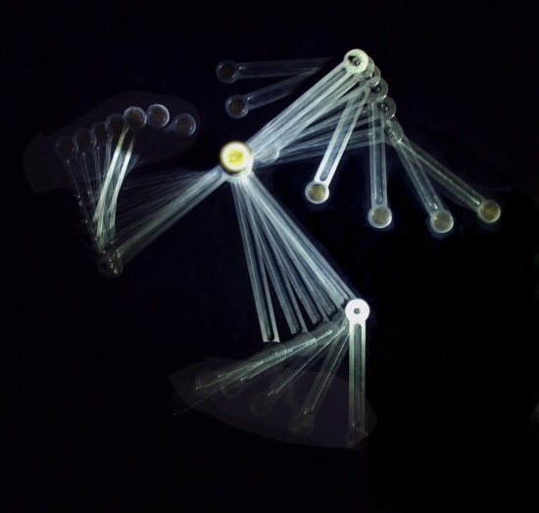
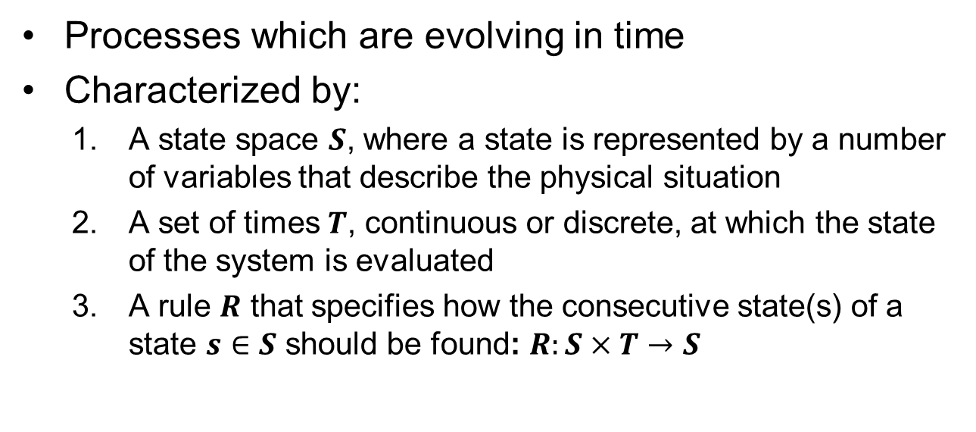
Dynamical physical systems
Processes which are evolving in time
Characterized by:
  A state space $S$, where a state is represented by a number of variables that describe the physical situation
  A set of times $T$, continuous or discrete, at which the state of the system is evaluated
  A rule $R$ that specifies how the consecutive state(s) of a state $s∈S$ should be found: $R:S×T→S$
Double pendulum
Notes:
Definition, comparison to physical dynamical systems
In Physics, the theory of dynamical systems studies processes which are evolving in time. A dynamical system is characterized: 1) by its state space S, where a state is represented by a number of variables that describe the physical situation, 2) a set of times T, continuous or discrete, at which the state of the system is evaluated, and 3) a rule R that specifies how the consecutive state(s) of a state s ∈S should be found: R:S×T→S.
http://www.scholarpedia.org/article/Dynamical_systems

Slide 4

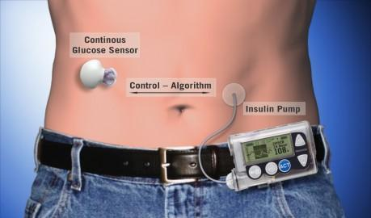


Dynamical electronic systems
In Electronics:
“Dynamism is the system property that enables the system behavior to adapt at run-time under the influence of changing environmental stimuli.”
Smartphones
Mobile healthcare systems
Wireless network devices
Mobile audio-visual media devices
Ma et al., Systematic Methodology for Real-Time Cost Effective Mapping of Dynamic Concurrent Task-Based Systems on Heterogeneous Platforms, 2007.
Notes:
In contrast, in Electronics, dynamism is the system property that enables the system behavior to adapt at run-time under the influence of changing environmental stimuli. Examples of dynamical electronic systems are:
Wireless mobile systems that react to changing channel and user demands and utilize different communication protocols.
Upcoming multimedia systems like audio and video players that adjust their output to different context and quality-of-service requirements
New 3D graphics systems, that can scale their graphics content in run-time to match available hardware resources
Healthcare systems for monitoring of patients suffering from chronic diseases such as diabetes, asthma, heart attacks and epilepsy and performing a preventing action.
Any physical phenomenon may be observed by an electronic system, and whenever the behavior of the electronic system changes with the signals it observes, the electronic system will be dynamical. A dynamical electronic system can also be a part of a larger system, containing other parts, for instance mechanical parts.
In addition to be dynamical in the sense defined on this slide, we will consider the electronic systems that perform a specific function. In Electronics, systems that perform a specific function are called embedded systems, because they are typically included or embedded in a larger system. Embedded electronic systems have typically strict constraints on their size, weight, prize and exploitation costs, for instance the time and energy it requires to execute its function.
Another class of electronic systems that we do not consider are called general purpose electronic systems which are usually standalone systems and are made as generic as possible in order to perform many different functions or tasks. An example of a general purpose electronic system is a personal computer. General purpose electronic systems do not have the same strict design constraints and another design methodology is used to build them.
Here we will concentrate on design methodology for dynamic embedded electronic systems.
In this work we have investigated construction of an electronic epileptic seizure predictor.

Slide 5
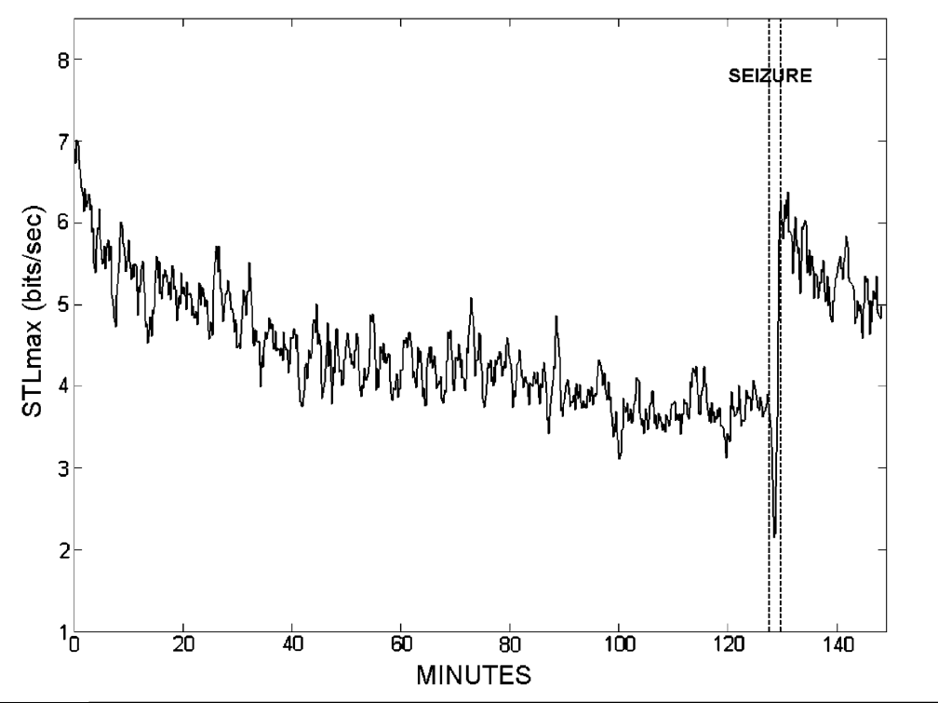

Epileptic seizure predictor
Software algorithm developed by Prof. L. Iasemidis et al., Arizona State University, Tempe, USA
Long-term prospective on-line real-time prediction of seizures
Based on maximum short-term Lyapunov exponent (STLmax) estimated from EEG signals
Warning! You are going to
have a seizure within
the next three hours!
Iasemidis et al. Seizure prediction and its applications, 2011
Notes:
Epilepsy is a group of disorders characterized by recurrent paroxysmal electrical discharges of the cerebral cortex in the brain that result in intermittent disturbances of brain function (Niedermeyer, 1987; Spencer et al., 1992), also called epileptic seizures.
In the late 1980s some researchers proposed a theory that epileptic seizures may result from spontaneous state transitions in a chaotic nonlinear system. Motivated by this theory, they began to apply mathematical techniques from nonlinear dynamics to analyze EEGs for characteristics unique to the transition into and out of seizures. As the result, the researches reported measurable changes in EEG dynamics (temporal and spatiotemporal) that preceded seizures by periods ranging from seconds to hours. Among other dynamical measures, short-term maximum Lyapunov exponent (STLmax) has been applied. It was found that the dynamical transition of a brain into a seizure state is characterized by a progressive convergence of STLmax at specific anatomical areas in the brain. This research has led to the development of automated seizure prediction algorithms.
We have been working with the algorithm developed by Prof. Leonidas Iasemidis et al. at the Arizona State University. More specifically we investigated the front-end part of the algorithm which estimates the short-term maximum Lyapunov exponents (STLmax) from the EEG signals.

Slide 6
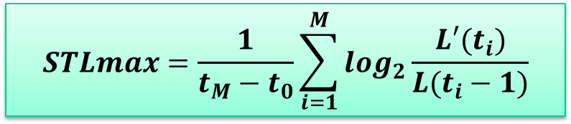
Estimation of STLmax from experimental time series
$$STLmax=\frac{1}{t_{M}−t_{0}}\sum_{i=1}^{M}{\log_{2}\frac{L′(t_{i})}{L(t_{i}−1)}}$$
Notes:
This slide shows how the short-term maximum Lyapunov exponent (STLmax) is estimated in the epilepsy predicton algorithm of Prof. Iasemidis.
Lyapunov exponents are the average exponential rates of divergence or convergence of nearby orbits in phase space.
For systems whose equations are explicitly known there exists straightforward technique for computing a complete Lyapunov spectrum. This method however cannot be applied directly to experimental data due to external noise coming from environmental fluctuations and limited experimental resolution.
Instead, another technique is used.
A single pair of nearby orbits is followed in time. One starts with an initial point at t0 and locates the nearest neighbor to the initial point. The distance between the two points is denoted L(t0). At a later time t1, the initial length will have evolved to length L’ prime (t1). One now looks for a new data point that satisfies two criteria 1) its distance L(t1) from the evolved fiducial point is small, and the angular separation between the evolved and replacement elements is small. If an adequate replacement point cannot be found, the existing points are retained. This procedure is repeated until the fiducial trajectory has traversed the EEG data segment under consideration, at which point the maximum short-term Lyapunov exponent is estimated according to the formula on the slide.
What is important to notice here is that the algorithm spends most of the time and energy doing the replacement point search and checking whether candidates for the new replacement point satisfy the length and angle criteria.

Slide 7
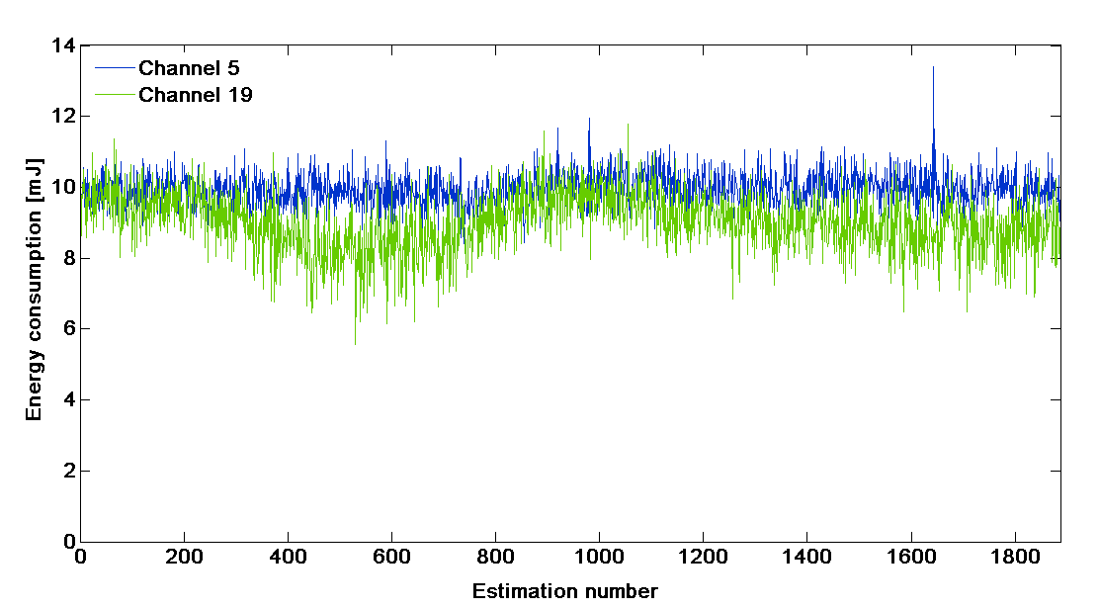
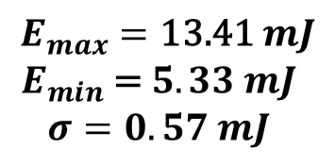
Dynamism in STLmax estimation
Experiments performed on CoolBio DSP processor:
$$E_{max}=\text{13.41} mJ$$
$$E_{min}\text{ =} 5.33 mJ$$
$$σ=0.57 mJ$$
Notes:
While trying to design an electronic system for STLmax calculation, we have noticed that the time of calculation and the energy it requires varies with the input EEG signal, indicating that this is a dynamical electronic system.
In the next part of the presentation I will give an overview of the state-of-the-art methodology for building a dynamical electronic system like this.

Slide 8

The Embedded System Design Process
Identification of requirements
Specification
Design of architecture
Design of components
Integration of components
Hardware
Software
Final system
W. Wolf. Computers as Components, Principles of Embedded Computer System Design 2005
Notes:
A standard embedded system design process is presented on this slide. It starts with identification of requirements, both functional (what function the system will perform, inputs and outputs, its purpose) and nonfunctional: constraints imposed on the system from its environment, other parts in the system or the system user, for example the speed of the system, physical size and weight, power consumption, manufacturing cost. The requirements are in the next step, called Specification, converted to a formal description of the system that can be verified when the system is designed. A special formal language called UML (unified modelling language) is typically used. In the next step, the overall architecture of the system is developed, consisting of blocks performing major operations and the data flows between them. At this step it is also decided which parts of the system will be implemented as hardware electronic circuits and which as software programs, and also the hardware and software architecture are decided. Then the hardware and the software engineers design all the components of the architecture and finally, the components are put together into a final system in the Integration step and the system is verified against the specification. If the requirements are not fulfilled, some redesigning might be needed.
When designing a dynamic embedded system, the designer is faced with a design that has varying exploitation costs depending on the input signals of the system.
In addition, the functions describing the variations are not known at the time the system is designed. As a result, the architecture of the system is designed to accommodate for the worst case exploitation costs which, however, rapidly exceed the available resources (as battery life) when accumulated over time.
So it may be challenging or even impossible to satisfy the specification without special methodology taking the dynamic properties of the system into consideration.

Slide 9
System scenario concept
«System scenarios group system behaviors
that are similar from the multidimensional cost perspective,
such as resource requirements, delay and energy consumption,
in such a way that the system can be configured
to exploit this cost similarity.»
Gheorghita et al. System Scenario based Design of Dynamic Embedded Systems, 2008
Notes:
To solve this problem a concept of cost-related system scenarios is used.
Definition.
I will now illustrate this more thouroughly.

Slide 10
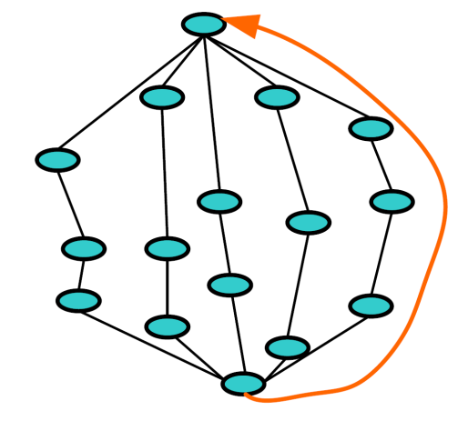
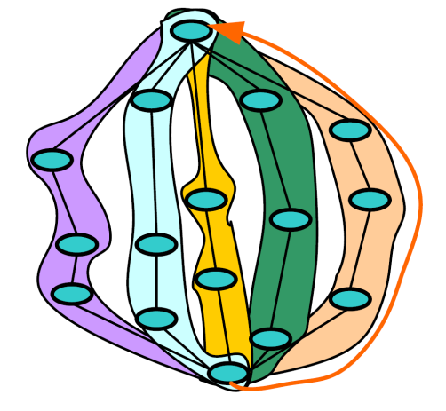
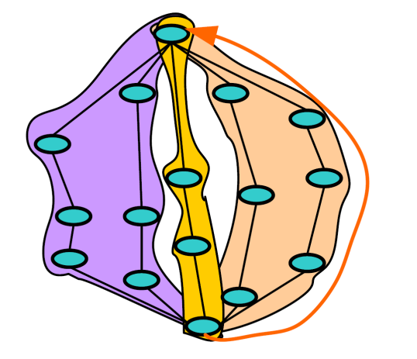
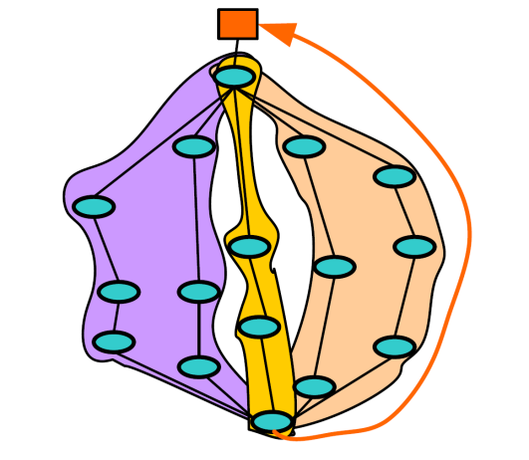


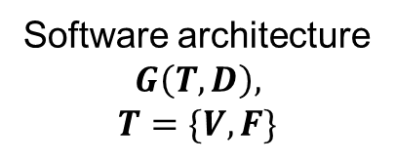
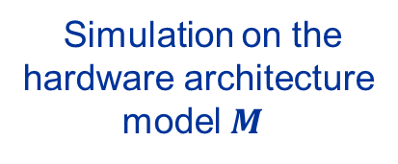
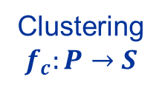
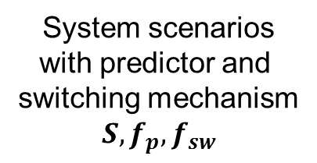
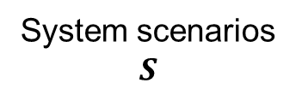
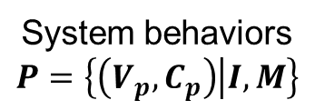
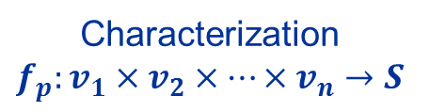
System scenario concept
System scenarios
with predictor and
switching mechanism
$$S, f_{p}, f_{sw}$$
Software architecture
$$G\left(T,D\right),$$
$$T=\{V, F\}$$
System behaviors
$$P=\left\{\left(V_{p},C_{p}\right) | I,M\right\}$$
System scenarios
$$S$$
Simulation on the
hardware architecture
model $M$
cost 2
Clustering
$$f_{c}:P→S$$
Characterization
$$f_{p}:v_{1}×v_{2}×⋯×v_{n}→S$$
Input set $I$
cost 1
Notes:
Given the system software architecture, a graph G of Tasks T and Dependences between them D, where each task consists of a set of variables V and a set of operations on them F. By running a simulation of this software on the model of the selected hardware architecture using a set of all possible inputs I, we identify a set of system behaviors P. Each behavior represents one unique path through the software task graph which is activated by specific values of the variables inside the tasks along the path. We call the set of variables that activate a path Vp and the cost to perform all calculations along the path Cp.
For a dynamic electronic system we select flexible software and hardware architectures, that can be tuned with different settings at the time the system is running. Examples of possible settings include different versions of the software code, different compiler optimizations being applied to the software code, changing voltage and frequency of processing elements on the run, using of a different number and type of available hardware components for a given calculation. Exploring these possibilities for each system behavior will result in a set of costs instead of a single cost.
The next step is to cluster system behaviors with similar costs into a managable set of groups, which are called system scenarios S. System scenarios are stored in the system and are used when the system is running to take a decision about when and how to switch the system to a different setting in order to lower the cost of calculation.
The system architecture is extended with components fp and fsw (double-u) to predict system scenarios from existing variable values and the input signals and switch the system between different settings at run-time.
Since each particular setting optimizes the use of system resources for the given system scenario, the overall exploitation costs of the system are reduced.

Slide 11


System scenario based design methodology
System
Identification
Prediction
Exploitation
Switching
Calibration
System
scenarios
System
scenarios
+
Predictor
Optimized
system scenarios
+
Predictor
Optimized system
scenarios
+
Predictor
+
Switching
mechanism
Final
system
DESIGN-TIME
Gheorghita et al. System Scenario based Design of Dynamic Embedded Systems, 2008
Notes:
The overview of the full methodology to design a system scenario based electronic system is shown on this slide.
First system senarios are identified and a scenario predictor is designed.
For each system scenario, the system is optimized in the exploitation step. Also, the cost of switching between different system settings is estimated and the scenarios are optimized to take these costs in the account.
Next, the switching mechanism is designed.
The calibration step is added for the more complex systems, where an additional calibration mechanism is added to adjust scenarios, predictors and switching at run-time if the system detects that any of these components do not work properly anymore due to the change in the statistical properties of the input signals.

Slide 12
Overview of completely designed system
Selected scenario
System settings
Input signal
Prediction
Switching
Exploitation
Information
gathering
Variable values
and cost measurements
Calibration
System settings:
  Processor voltage
  Processor frequency
  Use of processing resources
  Code version
  etc...
RUN-TIME
Notes:
When the system is completely designed and put into the field, it works in the following way. It receives the input signals. Then the system predicts what scenario it is about to enter. If it is the same scenario as before, it starts directly executing its system function (denoted as exploitation step). If the system is entering a new scenario, for which more cost-efficient system settings exist, a system switch is performed to adjust the system settings. After the switch, the system executes its system function.
Finally, for more complex systems, the information is gathered to evaluate whether the existing scenarios still provide a cost-efficient exploitation. If not, a calibration step is performed.
The work in our group is concentrated on efficient clustering of system behaviors into scenarios and on proving that the additional components for prediction of scenarios and system switching do not introduce unreasonably high costs. There is no publicly available results for the second part yet,
while the last three slides show the results for the clustering part.

Slide 13






















Scenario clustering and characterization approaches
Bottom-up
Top-down
$$S_{1}$$
$$S_{1}$$
$$S_{2}$$
$$S_{2}$$
$$S_{3}$$
$$S_{4}$$
$$S_{5}$$
$$S_{1}$$
$$S_{2}$$
$$p_{1}$$
$$p_{2}$$
$$p_{3}$$
$$p_{4}$$
$$p_{5}$$
$$⋯$$
$$p_{N}$$
$$S_{3}$$
$$S_{4}$$
$$S_{5}$$
Small $N$
Large $N$
Notes:
The figure shows two different approaches to cluster system behaviors into system scenarios. The traditional approach dealt with few system behaviors and performed clustering in a bottom-up way. It compared system behaviors pairwise with each other and clustered those having a similar cost. Then it compared the pair-clusters pairwise with each other and clustered those with similar costs and so on until the acceptable number of clusters was achieved.
The resulting tree was also used to find a predictor for the system. For a given input, it was known what system behavior it activates and following the tree up – which scenario it belongs to.
However this approach didn’t work for systems having thousands of different system behaviors, as it would require an unreasonably large predictor that would severely impact the exploitation costs of the system. So we have developed another approach that clusters system behaviors in a top-down way. It first sorts all system behaviors according to their cost (here represented by color). Then it splits up the behaviors into approximately equally sized groups, and finally it finds polygonal borders of the groups, which are used to design the predictor. The predictor checks which polygon the newly started system behavior belongs to and in this way finds the upcoming scenario.

Slide 14
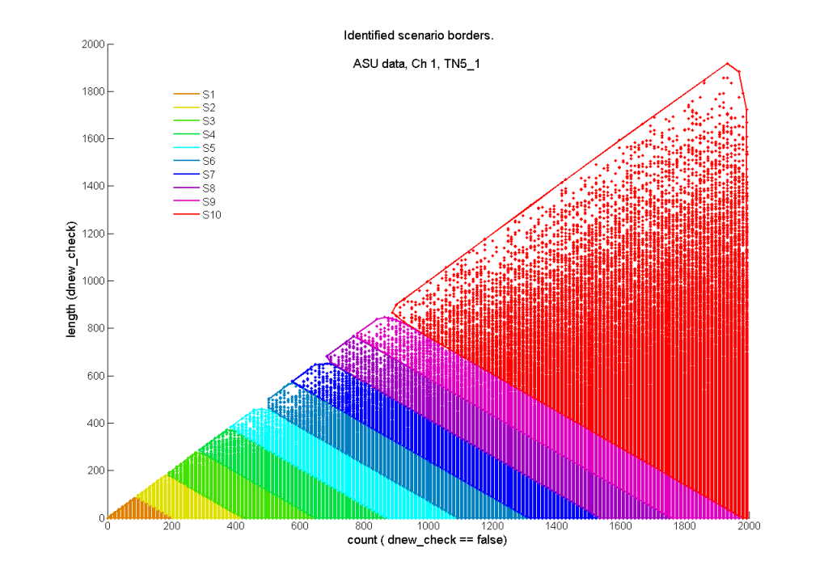






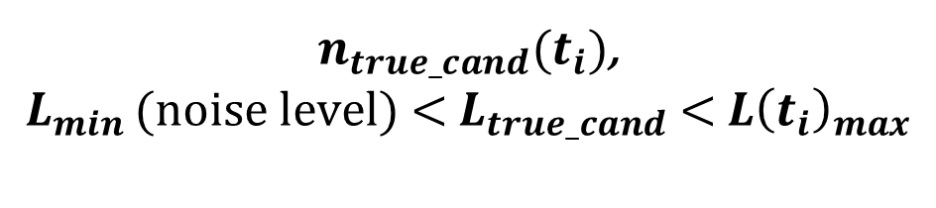





System scenarios for STLmax calculation
Increasing energy
$$n_{cand}(t_{i})$$
$$S_{10}$$
$$S_{9}$$
$$S_{8}$$
$$S_{7}$$
$$S_{6}$$
$$S_{5}$$
$$S_{4}$$
$$S_{3}$$
$$S_{2}$$
$$S_{1}$$
$n_{true_cand}(t_{i})$,
$${L_{min }(\text{noise} \text{level}\text{) < }L_{true_cand} \text{< }L\left(t_{i}\right)}_{max}$$
Notes:
The resulting scenarios for STLmax calculation are presented here. The points show the different system behaviors that are activated by two internal variables in the algorithm: 1) nr of candidate replacement points n_cand at each time step ti, and 2) nr of true candidates at each time step, i.e. candidates having appropriate distance L to the evolved fiducial point. In the algorithm the nearest search is done concurrently on two regions of the phase space, and the number of candidates in each region changes with time. Also, the number of true candidates changes with the input data. Whenever a seizure is approaching, it becomes harder to find a replacement point and the number of true candidates decreases. Since each true candidate requires an extra calculation step (checking the angle change), each system behavior requires different energy to execute its function. Using a top-down clustering approach, the system behaviors have been clustered into 10 scenarios represented by different colors and their borders have been found.

Slide 15
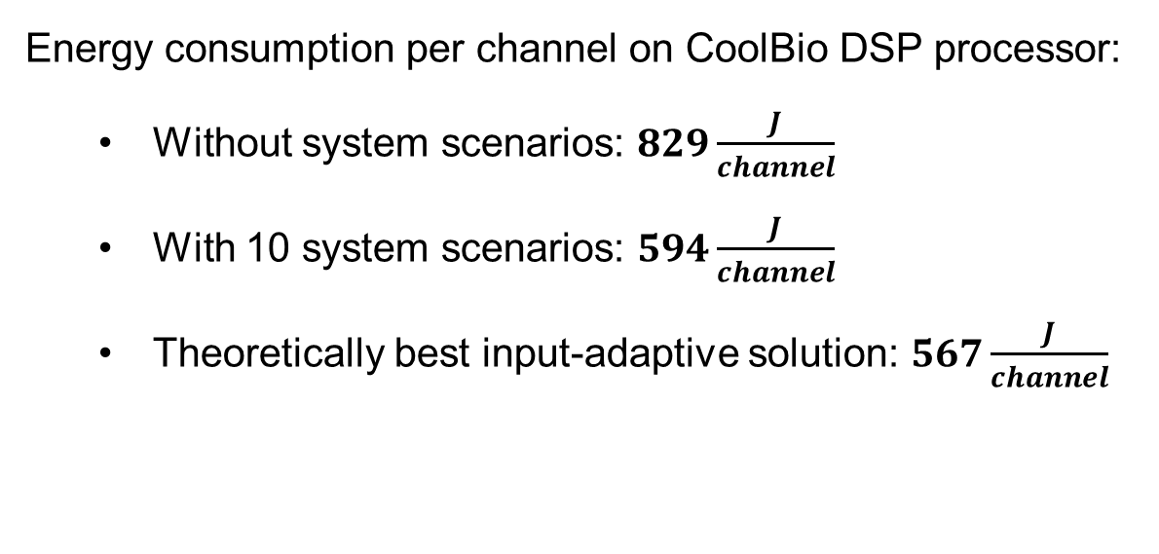
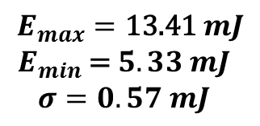
System scenarios for STLmax calculation
$$E_{max}=\text{13.41} mJ$$
$$E_{min}\text{ =} 5.33 mJ$$
$$σ=0.57 mJ$$
Energy consumption per channel on CoolBio DSP processor:
  Without system scenarios: $829\frac{J}{channel}$
  With 10 system scenarios: $594\frac{J}{channel}$
  Theoretically best input-adaptive solution: $567\frac{J}{channel}$
(6 hours patient monitoring)
Notes:
Energy consumption have been estimated on a CoolBio DSP processor for a 6 hours patient monitoring.
Without system scenarios, 829 J of energy were required for each EEG channel (12 AA batteries each day / 4 batteries for 10 channels)
With 10 system scenarios, 594 J of energy were required, which is a 28% improvement (9 AA batteries each day / 3 batteries for 10 channels)
And the theoretically best input-adaptive solution, where the system is switched for every system behavior and switching costs are assumed to be zero, 567 J of energy are required. Thus, our result is within 5% of this theoretically best solution (8 AA batteries each day / 3 batteries for 10 channels)
1 AA Alkaline Longlife = 9360 J
http://www.allaboutbatteries.com/Energy-tables.html
To summirize we have developed a methodology for systems with clear dynamism or variations in the exploitation costs. The methodology uses system scenarios to reduce the exploitation costs of the system. System scenarios represent different behaviors of the system with the corresponding exploitation costs. Scenarios are predicted at run time, and the system is switched to run the system functionality in the coming scenario in a cost-efficient way.
The switching is done by changing system settings.
The evaluation have proved that the scenario-based design methodology with top-down clustering of scenarios is efficient in reducing the energy in the system for STLmax calculation. Already with few scenarios, considerable energy reduction can be achieved as long the scenario predictor and switching mechanism do not introduce too high additional costs. It is an ongoing work in our group to prove this. It is also clear that this methodology is efficient only for systems with enough dynamsim or variations in the exploitation costs and that it should be used in combination with other optimization methodologies to provide a system that satisfies the specification.

Slide 16
Thank you!

