Slide 1
Experimental perspectives of atom photon-interactions:
From fundamental tests to quantum simulations
Jiří Minář
Centre for Quantum Technologies
National University of Singapore
ICFP 2012 Kolymv(b,p?)ari, Greece

Slide 2




People
Q Information, Q Optics
group of Valerio Scarani
Q Gases
Benoît Grémaud
Christian Miniatura
David Wilkowski (Exp.)

Slide 3
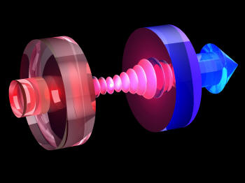
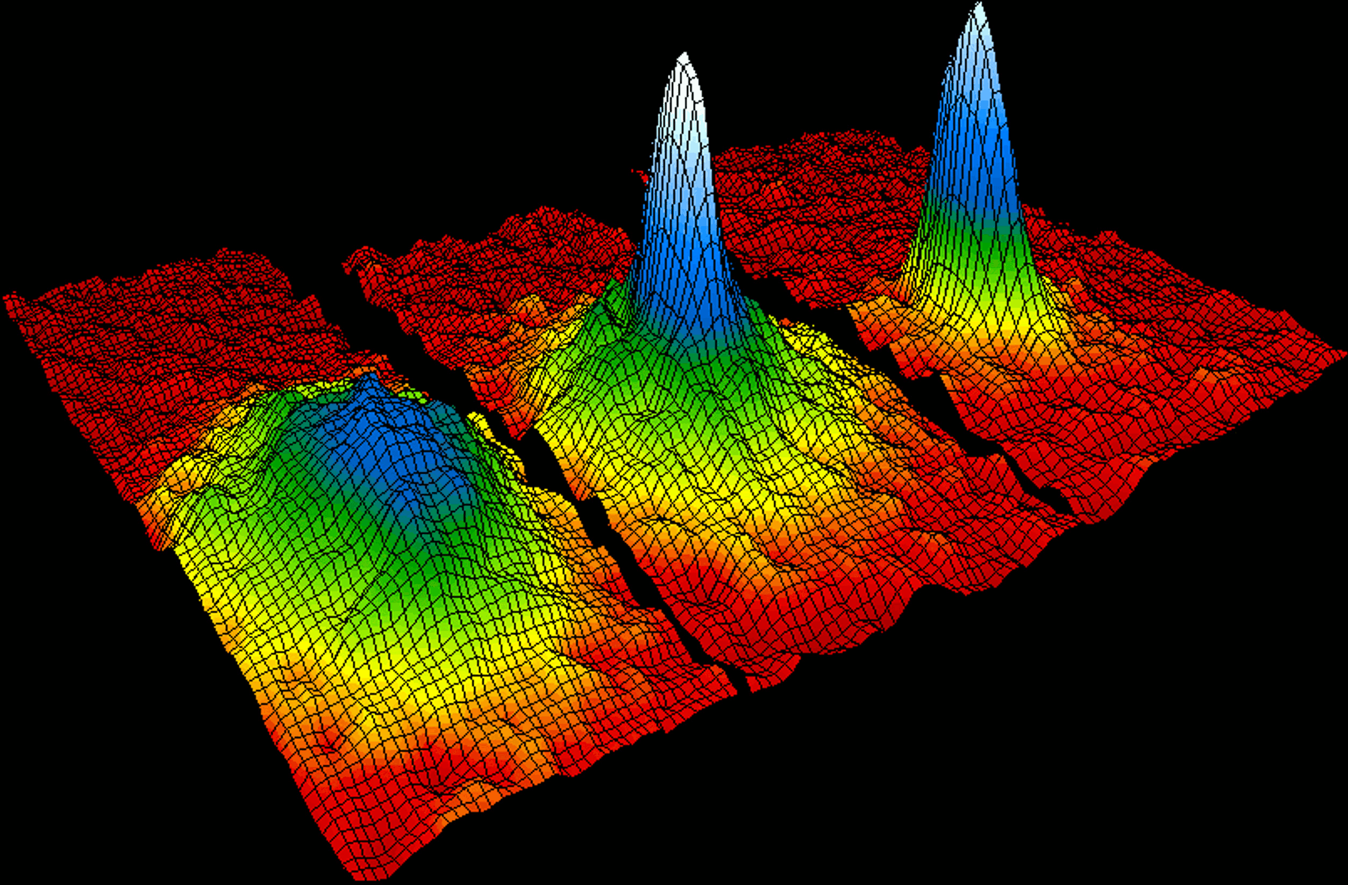
Introduction
AMO: lasers + atoms → trapping, cooling, precision manipulation and measurements
  strong interaction at single particle level: quantum communication
  and many body level (quantum gases): quantum simulators
Quantum communication:
Device independent scenarios
Quantum simulations:
Artificial gauge fields for cold atoms

Slide 4
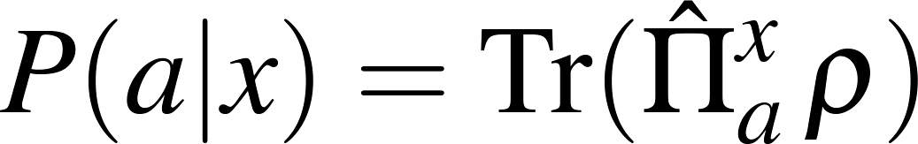
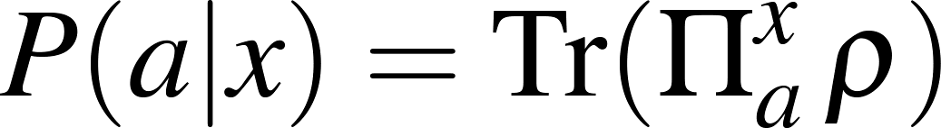
Device Independent
Goal of q. communication – communicate q. information; what does this mean ?
Example: Simulation of quantum statistics with competent students
Measurement device (FREE choice of measurement)
x
x
Quantum system
Ψ
“Ψ “
a
a
Outcome
Measured statistics:
yields (conditional) probability distribution, nothing quantum

Slide 5


Device Independent
What about correlations ?
x
y
Quantum state
Ψ
a
b
The students cannot simulate this experiment, even if they have shared in advance some common strategy λ.
x
y
“Ψ “
“Ψ “
a
b

Slide 6


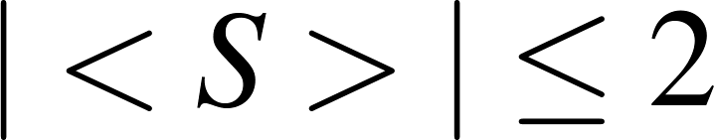

Device Independent
Message: use the correlations → quantitative criterion: Bell test
x
y
Ψ
a
b
Classically, one can show, that with arbitrary local strategies
while for quantum states
All one needs is the probability distribution → no specific assumption about the physical system being used = Device Independent certification of “quantumness”
Typical application: Quantum Key Distribution, . . .
Acin, A. et al., PRL 230501 (2007), Pironio et al., Nature 464, 1021(2010) , Rabelo, R. et al., PRL 107, 050502 (2011)

Slide 7
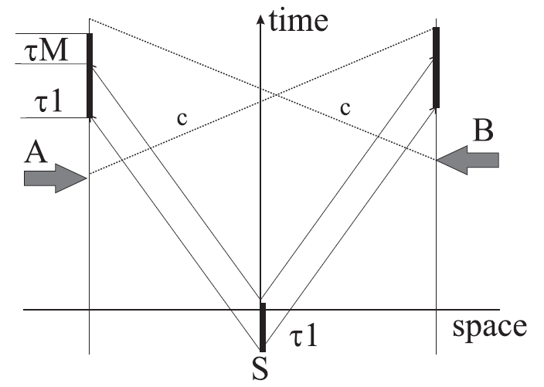

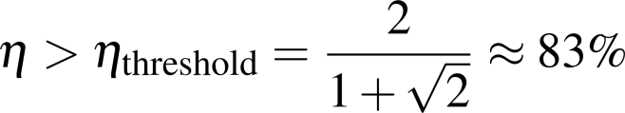
Loopholes
Not the end of the story: detection + locality loophole
locality loophole requires spacelike separated measurements
detection loophole requires a min. detector efficiency (one requires that the total statistics violate Bell inequality)
detection efficiency
if no detection,
output = +1
in principle, one needs to close both loopholes in order to certify Device Independent “quantumess”.

Slide 8
Loopholes – what has been done
Series of various Bell experiments:
  Photons
  polarization qubits, Aspect 1982 (locality loophole ✓)
  time-bin qubits, Tittel 1998
  qutrits, Thew 2004
  hyper-entanglement, Ceccareli 2009
  etc....
  Ions & others
  two ions, Matsukevich 2008 (detection loophole ✓)
  atom-photon entanglement, Moehring 2004
  atomic ensemble-photon entanglement, Matsukevich 2005
  SC qubits, Ansmann 2009
  etc...
In principle “just” a technological challenge; Now a race for the 1st closing of both loopholes at the same time => feasible experimental proposal matching current technologies
Engineering of hybrid quantum states

Slide 9
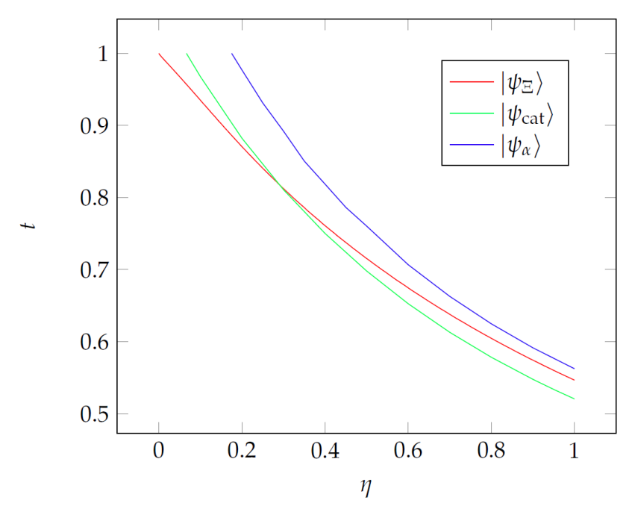
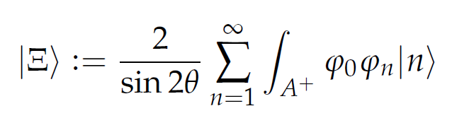

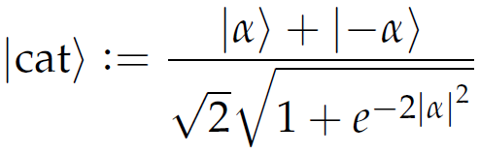
Q state engineering
Sometimes unfeasible states
Threshold for Bell violation
violation
no violation
Which of these states can be engineered?
Asymmetric test: atom + photon →
efficient detection on atomic side + propagation of the photon
possible implementation using CQED
Araújo, M. et al., arXiv:1112.1719

Slide 10











Experimental realization
Reminder of Cavity QED
The system is described by the Jaynes – Cummings Hamiltonian
not exactly solvable (with inputs and outputs), but becomes so under the approximation , i.e. atom in the ground state (this is what we want!)
cavity acts as a linear filter with transmission dependent on the atomic state: coherent state remains coherent !

Slide 11







Experimental realization
Reminder of Cavity QED
better picture of the situation looking at the cavity transmission
Transmission
transmission in s channel ≠ transmission in g channel

Slide 12
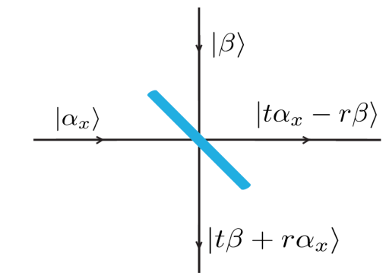
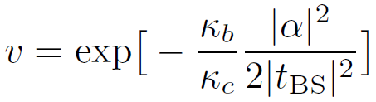
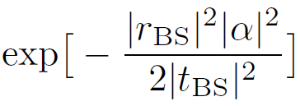



Experimental realization
Back to the state preparation
using the cavity, one gets
we want to bring this to zero: easy for coherent states – displacement using a beam splitter
+ one traces out the “environmental modes”
the final visibility does not depend on the details of the laser spectrum
in principle one can get the state in the limit ,
Teo, C. et al., arXiv:1206.0074

Slide 13
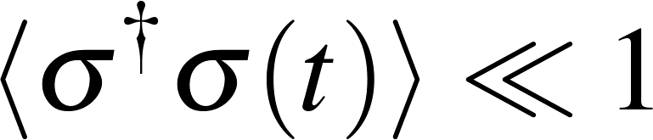
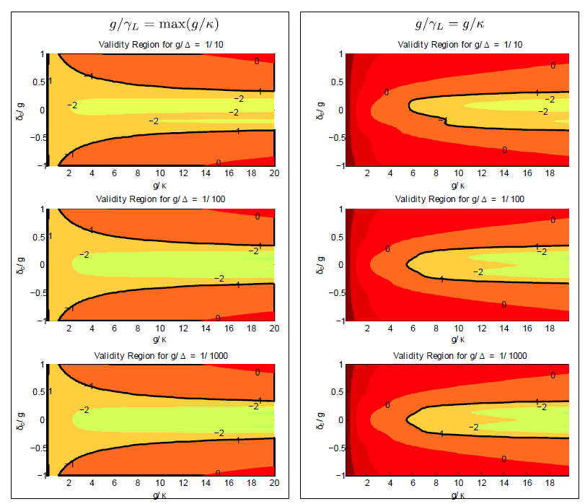


Experimental realization
Check the validity – the atom has to be in the ground state!
yellow – good
red – bad
long pulse limit
short pulse limit
Teo, C. et al., arXiv:1206.0074

Slide 14


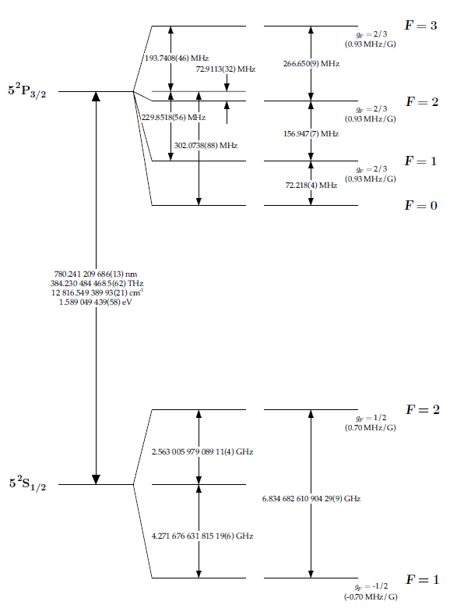




Experimental realization
Implementations (what experimentalists need and like)
Example of ⁸⁷Rb (used in number of cavity experiments)
  identify the relevant levels, use (polarization) selection rules
Teo, C. et al., arXiv:1206.0074

Slide 15
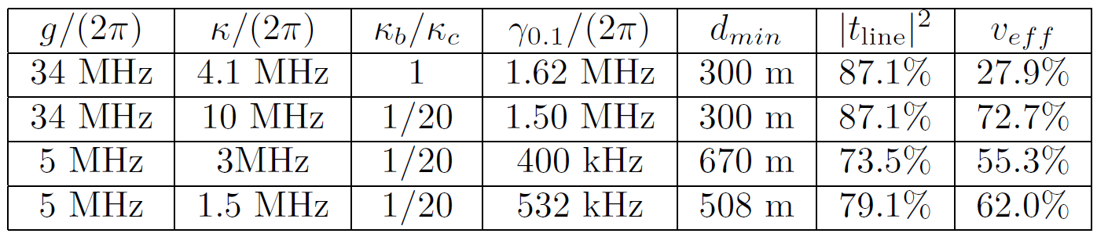
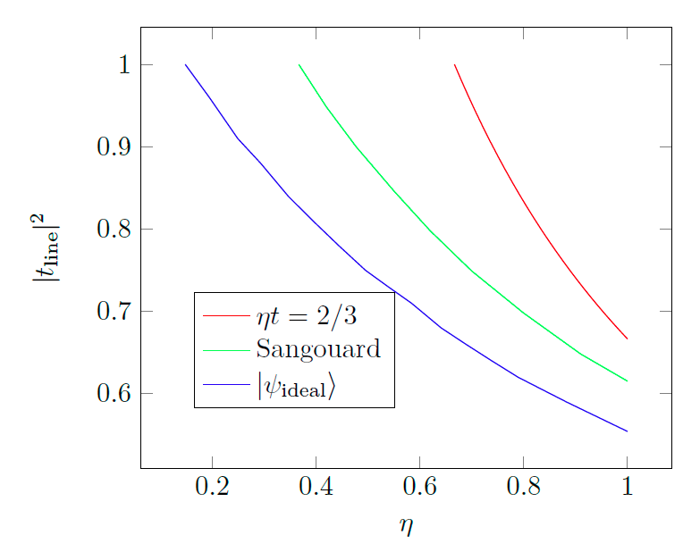
Performance
Implementations (what experimentalists need and like)
Example of ⁸⁷Rb (used in number of cavity experiments)
propagation distance
available parameters
Possible implementations in circuit QED ? (Fast operations – short propagation distances (~ 10 m) vs. problems with detection and transmission)
Teo, C. et al., arXiv:1206.0074

Slide 16
Conclusion I
Bell tests are essential in Device Independent applications
Hybrid atom-photon entangled states are particularly interesting
What other kind of states is one able to produce ?

Slide 17
Artificial gauge fields with cold atoms
excellent platforms for simulating various physical phenomena
why cold? → quantum degeneracy (BEC, …)
high tunability – scattering length (via Feshbach resonances), various atomic species (bosons, fermions), lattice/bulk configurations, one can tune the dimensionality
one “problem” – they’re neutral → artificial gauge fields

Slide 18
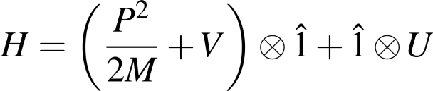




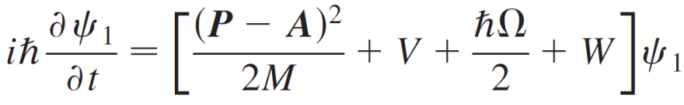

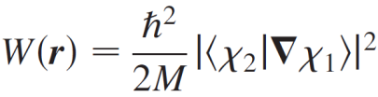

Artificial gauge fields with cold atoms
Bulk
Idea: Dress the internal atomic states with laser light
acts on center of mass
acts on the internal states
U given by the laser field → the atom is dressed in the new eigenbasis of U
Assuming adiabatic evolution of the atom initially in the state , one obtains the equation of motion of the center of mass of the atom
vector potential
scalar potential
→ Emergence of geometric gauge potentials
Dalibard et. al, Rev. Mod. Phys. 83, 1523 (2011)

Slide 19
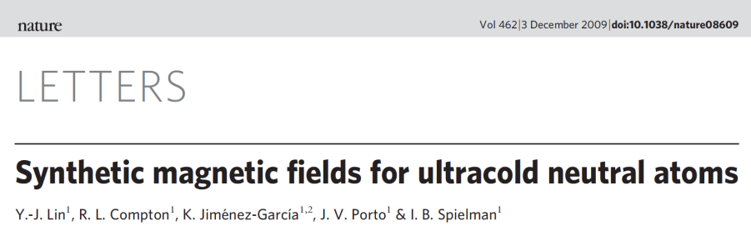
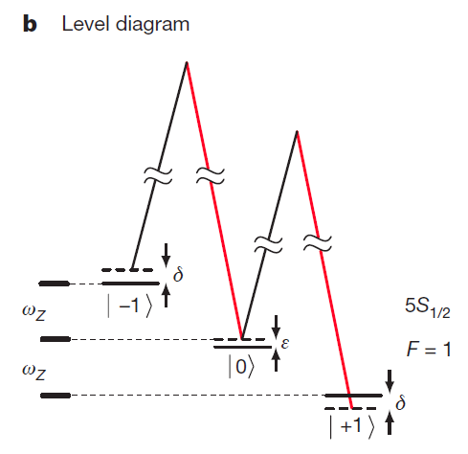
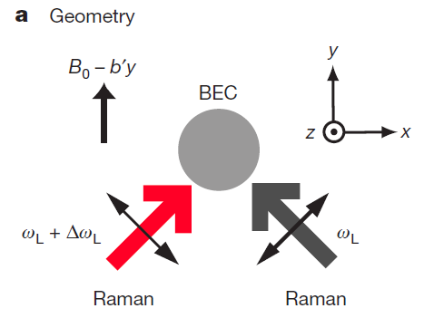
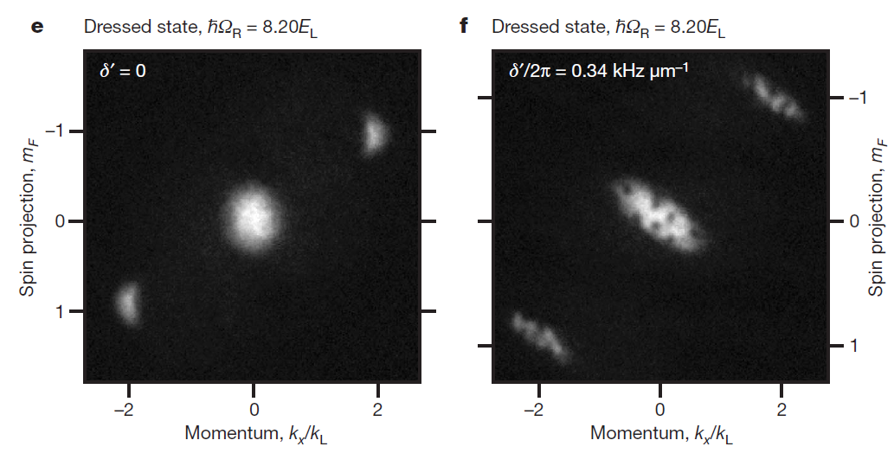




Artificial gauge fields with cold atoms
Bulk
Yes
Experimental realization?
Recipe for the vector potential: BEC of ⁸⁷Rb + Raman laser coupling F=1 ground state manifold + spatially variable (2-photon) detuning (achieved by a gradient of a true magnetic field)
Experimental signature → vortices

Slide 20
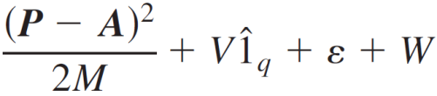



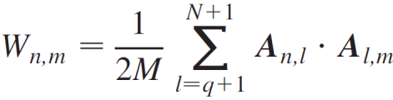

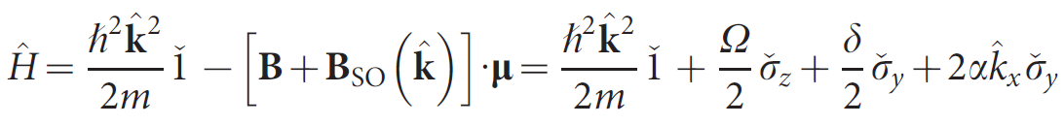
Artificial gauge fields with cold atoms
Bulk
So far Abelian gauge fields: Generalization to non-Abelian gauge fields using multiple levels
Hamiltonian in the subspace of q degenerate states
. . . .
q x q matrices
Non abelian potentials
Yes
Experimental realization?
But only with specific form of the potentials allowed by the simple implementation – spin orbit coupling
Lin, Y.-J. et al., Nature 471, 83 (2011), Chen, S. et al., Arxiv:1201.6018

Slide 21
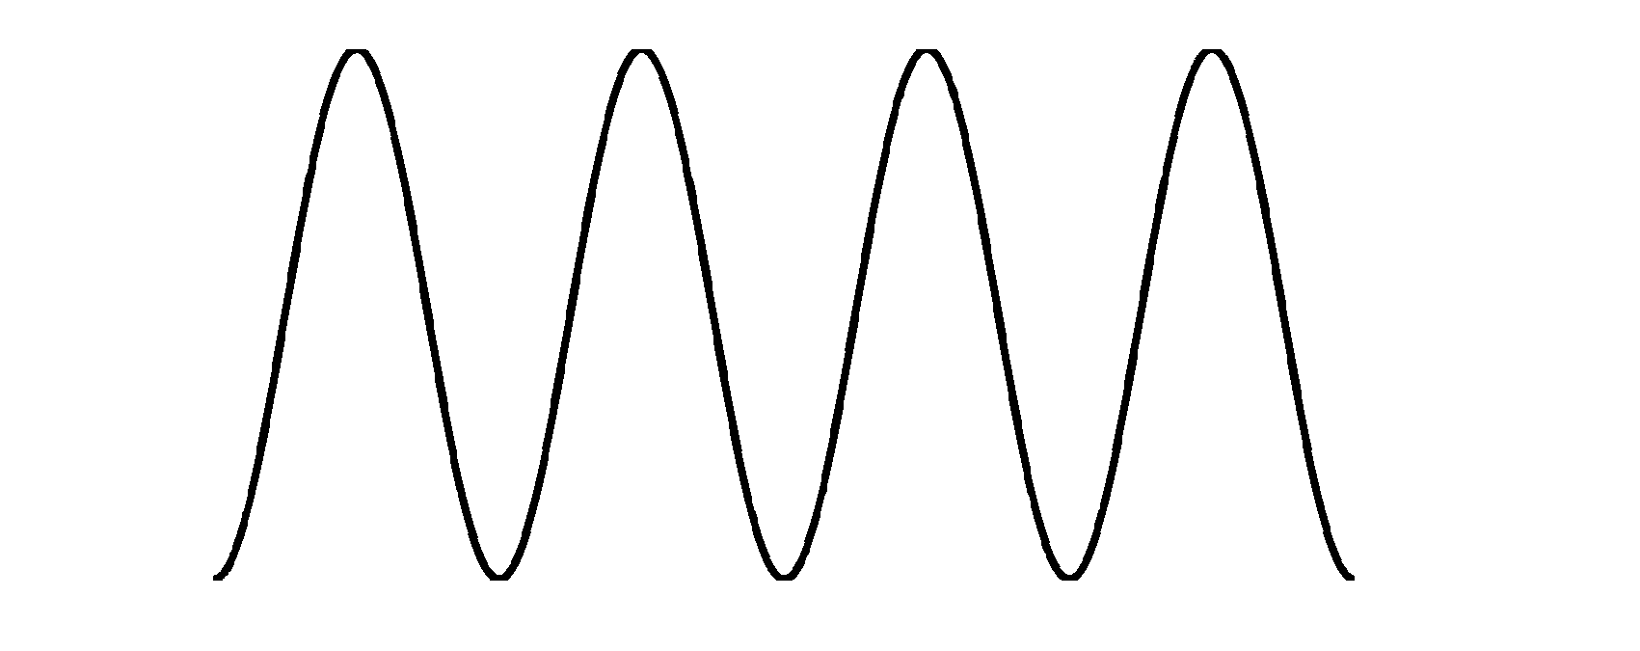
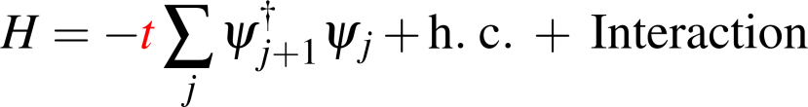
Artificial gauge fields with cold atoms
Lattice
key element: hopping
Interaction
(on-site)
t
j
j+1

Slide 22
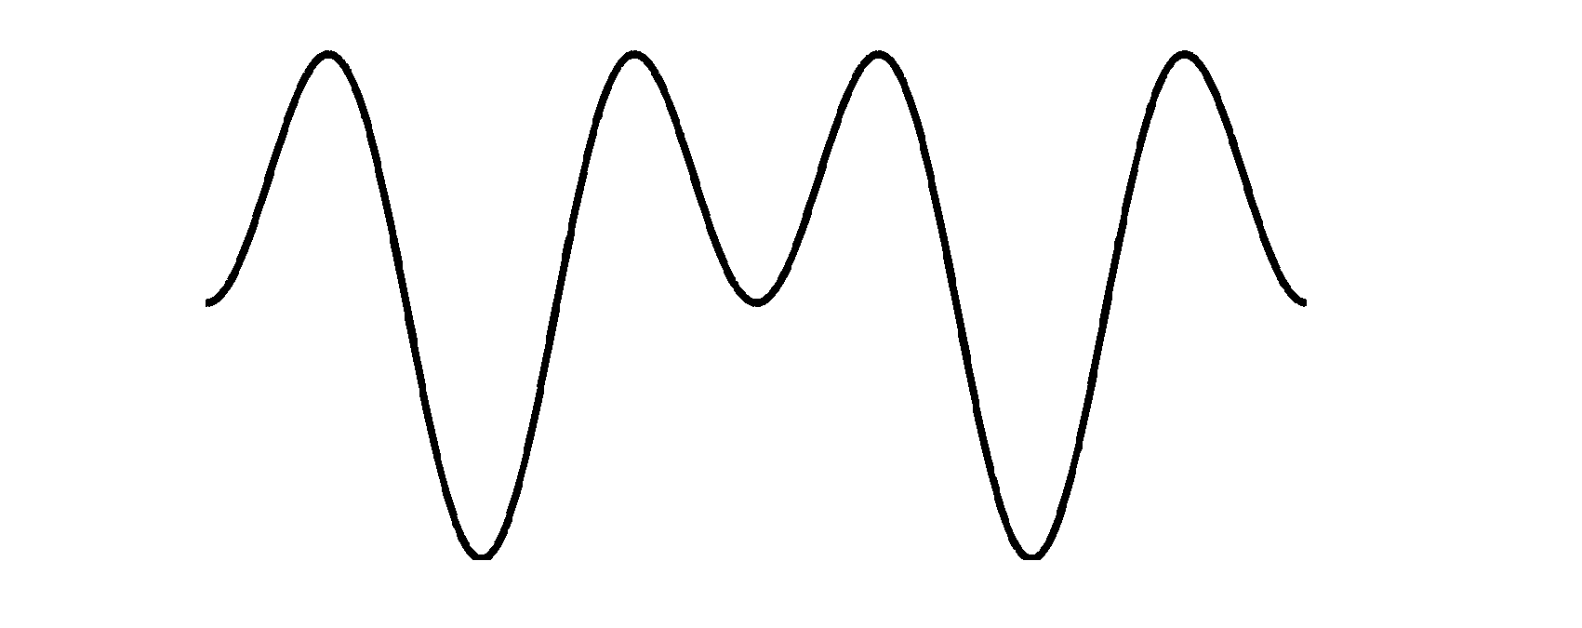
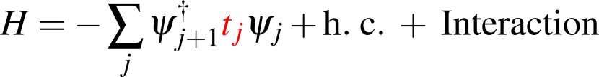
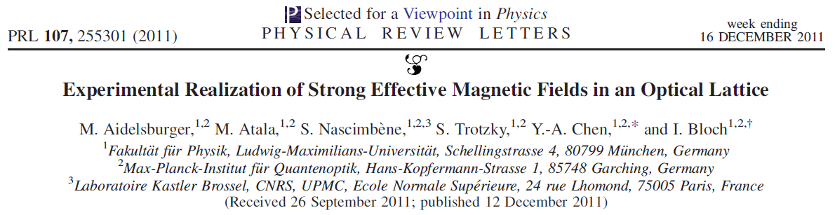
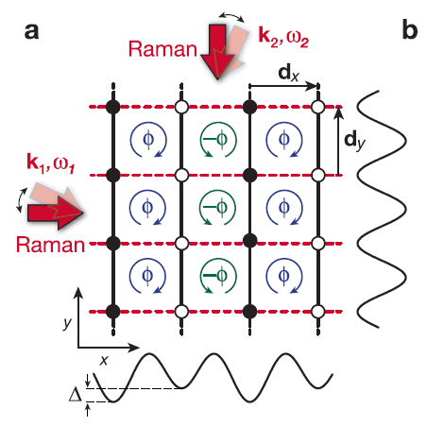
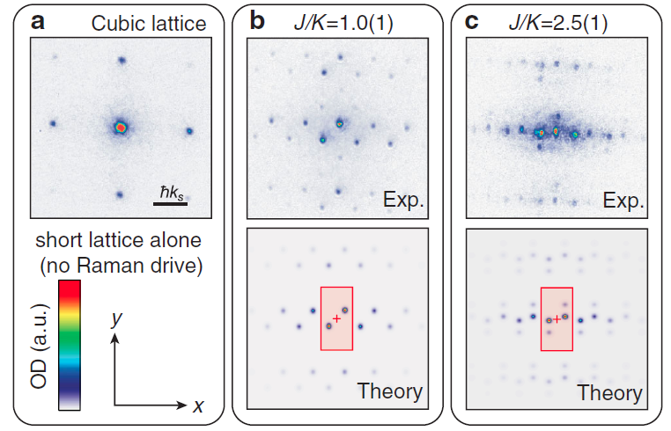
Artificial gauge fields with cold atoms
Lattice
Raman coupling
assisted hopping
Interaction
(on-site)
emergence of effective Abelian gauge field
j
j+1
Yes
Experimental realization?

Slide 23
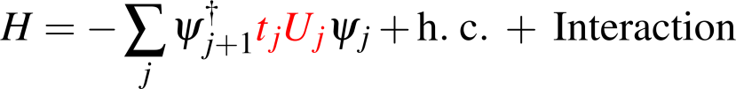




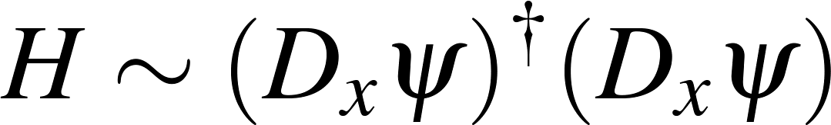
Artificial gauge fields with cold atoms
Lattice
assisted hopping
Raman coupling
Interaction
(on-site)
N component spinor
j
j+1
emergence of effective non Abelian gauge field
?
Experimental realization?
Osterloh, K. et al., PRL 95, 010403 (2005)

Slide 24
Conclusion II
So far only external gauge fields (given by the laser configuration)
Proposals of dynamical gauge fields (lattice and bulk)
  U(1) → work in progress
  U(N>1) ???
Exciting future of simulations of quantum many body systems with artificial gauge fields
Outlook

Slide 25
Thank You !

