Slide 1

The Compact Muon Solenoid at the CERN LHC:
Recent results
Κολυμπάρι, June 12th 2012
Tommaso Dorigo
INFN Padova
On Behalf of the CMS Collaboration

Slide 2
Overview
The LHC and its Scientific Goals
The CMS Detector
B physics highlights
The search for the Higgs boson
Top physics highlights
New Physics Searches
Conclusions
Note: this will only be a summary of selected recent results.
CMS Higgs searches have been discussed in detail by S. Choudgury in plenary session yesterday.
For detailed information on all CMS analyses please refer to the following presentations:
  N. Saoulidou, SUSY searches (Monday, in “Higgs boson” p.s.)
  M. Meneghelli, H→ZZ→4 leptons (Monday, in “Higgs boson p.s.)
  M. Gouzevich, QCD results (Tuesday, 7.25PM in “experiments, detector performances” p.s.)
  T.J. Kim, Top physics results (Friday, 3.55PM in “particle physics” p.s.)
  C. Grab, B physics results (Friday 5.05PM in “particle physics” p.s.)
and also:
  A. Penzo, CMS Upgrades (Friday, 5.55PM in “perspectives” p.s.)

Slide 3


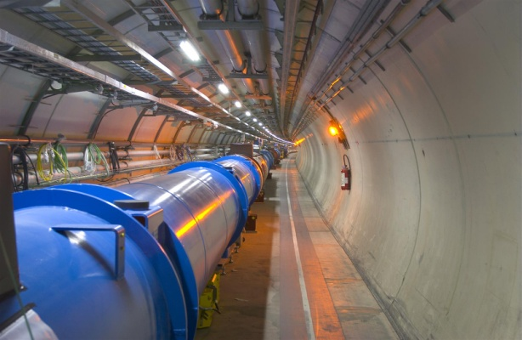
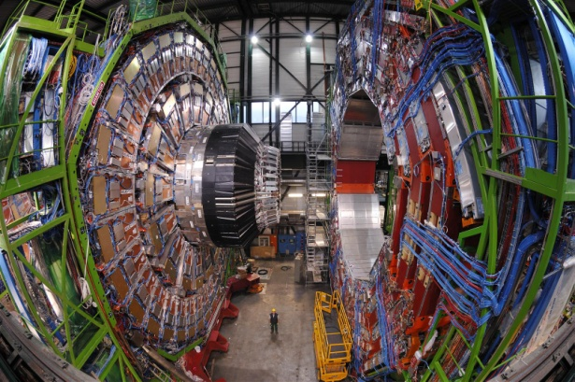
The Large Hadron Collider
CMS
LHC

Slide 4
The LHC And Its Scientific Goals
!
Original goal: discover the mechanism of EWSB;
extend our knowledge in the High-Energy frontier
  → Find the Higgs boson!!
Also targeting heavy ion physics (ALICE) and precision B physics and CP violation (LHCb)
Many other targets of exceptional interest:
  Supersymmetry
  Dark Matter particles
  Large Extra Dimensions
  Microscopic Black Holes
  New particles ? New forces ?
  (Note: as B.Anastasiou put it yesterday: “Anything beyond the Higgs boson is a present of Nature we haven’t paid the bill for.” But Nature is a bitch ! )
Plus the potential to improve by one order of magnitude the precision of our SM measurements
  W mass, diboson physics, QCD measurements
  Rare decays
?
→ ←

Slide 5
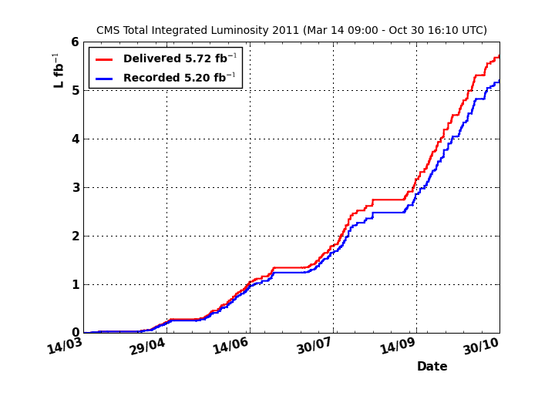
Review of the 2011 Run
LHC delivered high-quality, high-intensity data in 2011
  surpassed by x5 the goals for integrated luminosity delivered to experiments
Smooth running conditions, smooth curve in instantaneous luminosity
    Allowed experiments to gradually understand triggers / tune them / tighten thresholds
    Optimal turnaround in terms of studies of high-xs phenomena, then “rediscovery” of known EW physics, and finally searches of rare processes
  Also collected small dataset of pp collisions at 2.76 TeV for xs comparisons to PbPb data
  End-of-year heavy-ion running (Pb-Pb, 2.76 TeV/nucleon) allows to extend measurements in high-energy nuclear collisions
    150/μb: x20 statistics wrt2010
5.72 fb⁻¹ delivered by LHC
5.2 fb⁻¹ recorded by CMS.
→ 140 times more data than 2010
Average fraction of operational channels per subsystem >98.5% in CMS

Slide 6
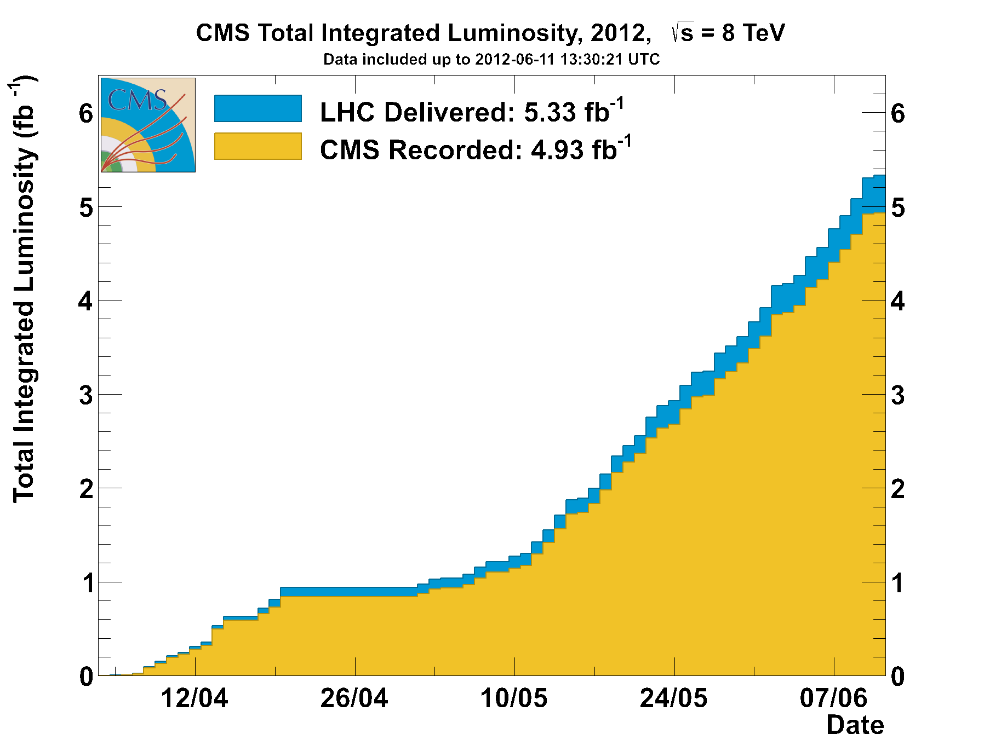
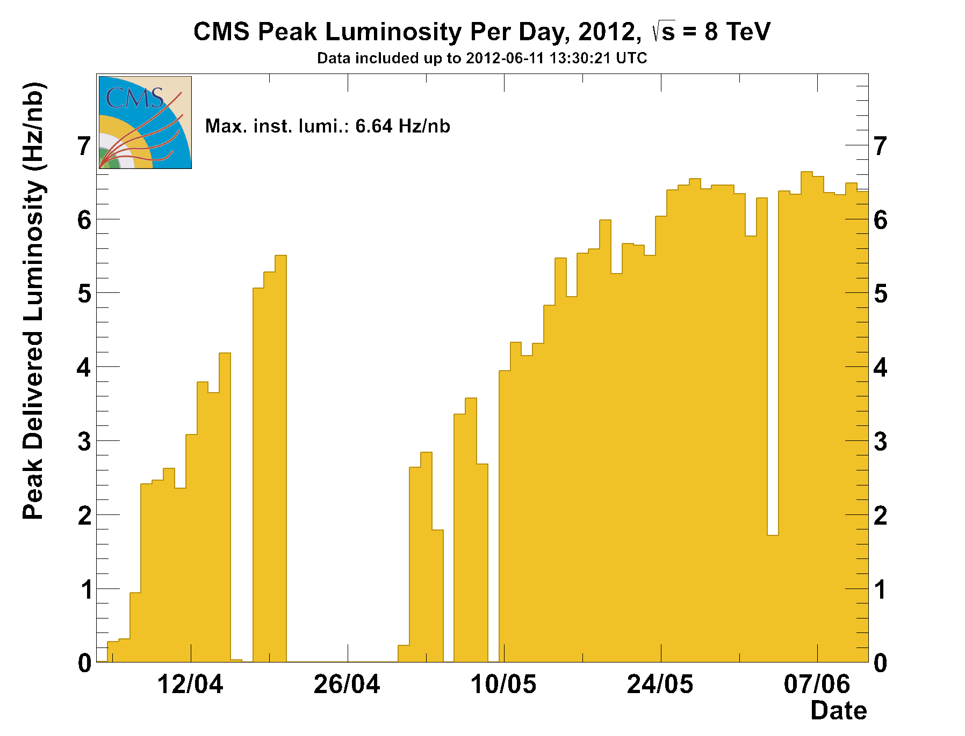
The 2012 Run so far
In 2012 the LHC is running with 4-TeV beams → 8-TeV collisions
  higher reach to high-mass resonances
  sizable increase in Higgs and top cross sections
The goal is to deliver 15/fb to ATLAS and CMS
Run started in April, performance as expected; collected 5/fb until 6/12.
Peak luminosity reached 6.8E33 cm⁻² s⁻¹
  running with max number of filled bunches (1380) at 50 ns spacing
  only minor further rate increases possible
Pileup is higher than in 2011 → slight worsening of per-femtobarn sensitivity on experimental signatures, largely addressed by improvements in software reconstruction algorithms
8 TeV

Slide 7
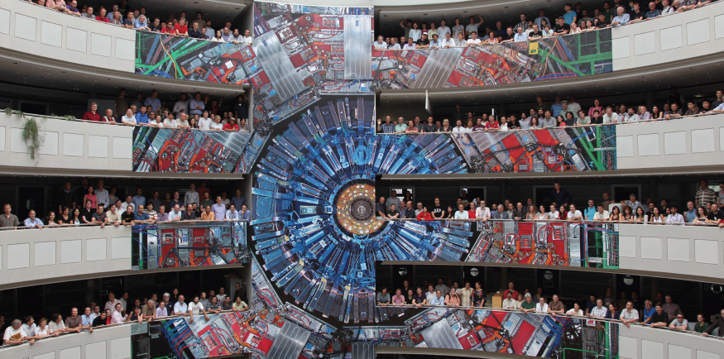
The CMS Collaboration
3381 scientists and engineers (including ~840 students) from 173 institutes in 40 countries

Slide 8
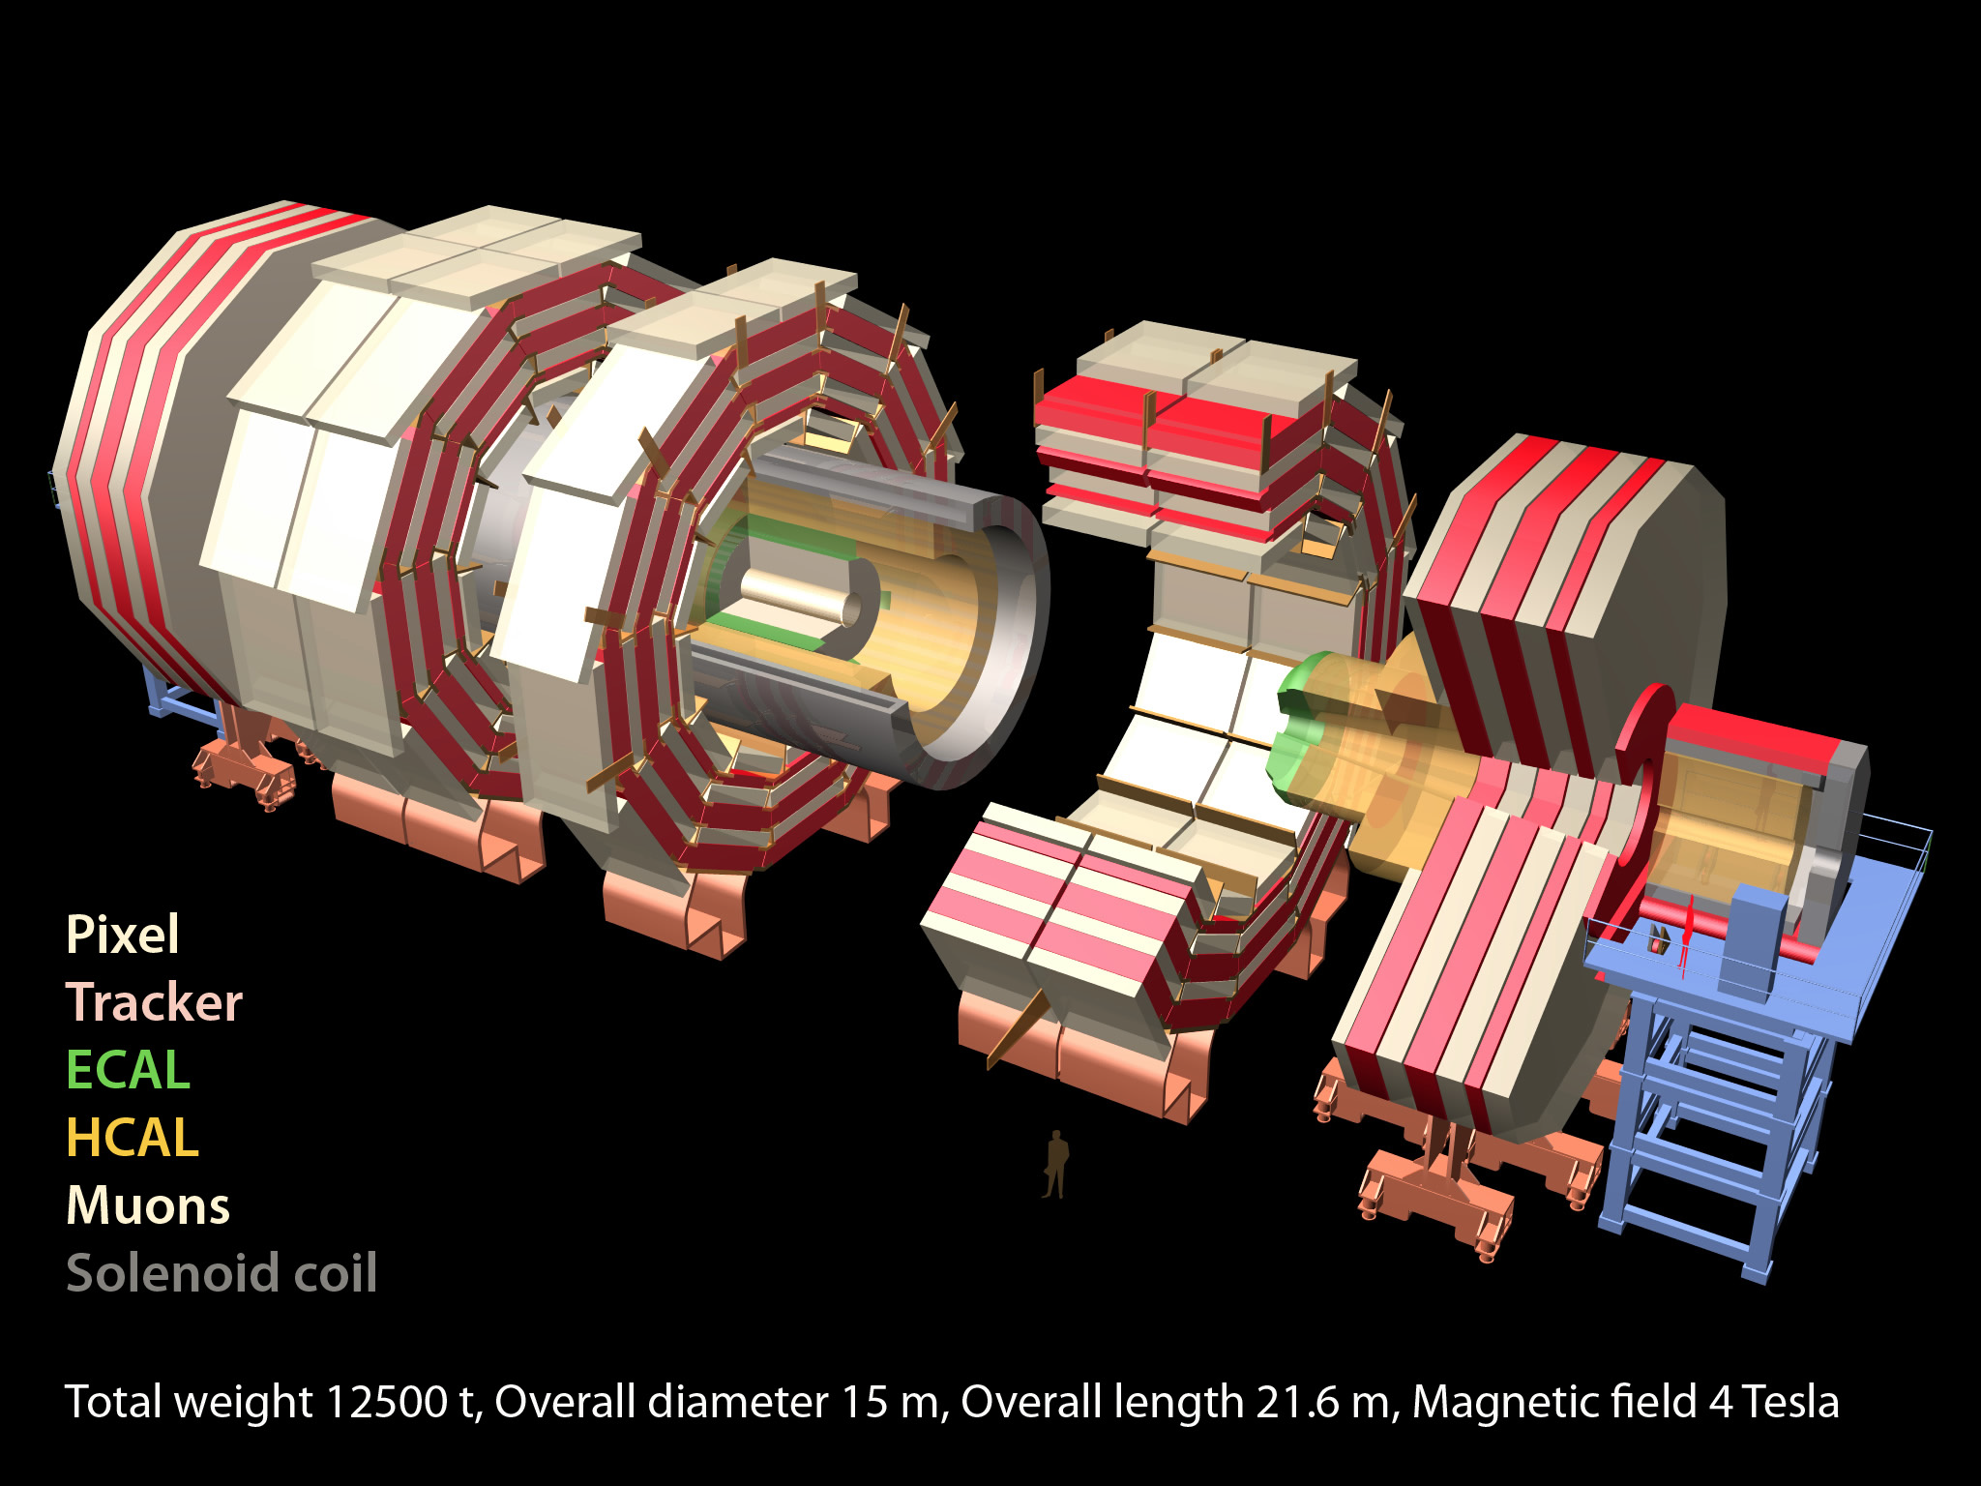
The CMS Detector
10k CPU cores,
2M lines of code
Muon system:
Drift tubes (170k wires), RPC,
Cathode Strip Ch.(200k wires)
Silicon tracker:
66M pixel channels
9.6M strips, 210 m²
ECAL: 76k PbWO₄ crystals
HCAL: 15k scint/brass ch.

Slide 9
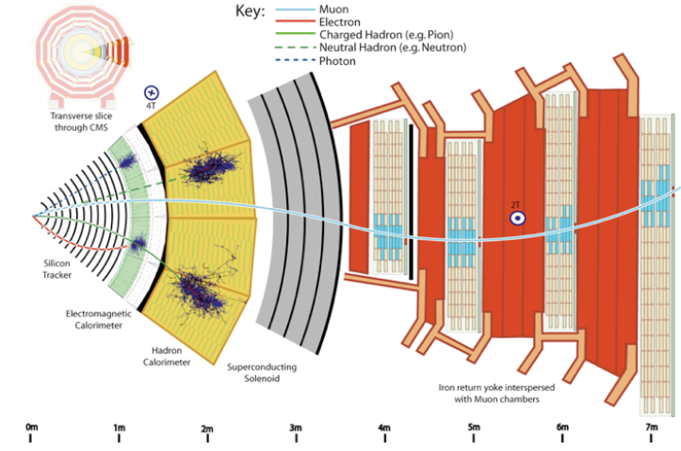
Particle Detection in CMS

Slide 10
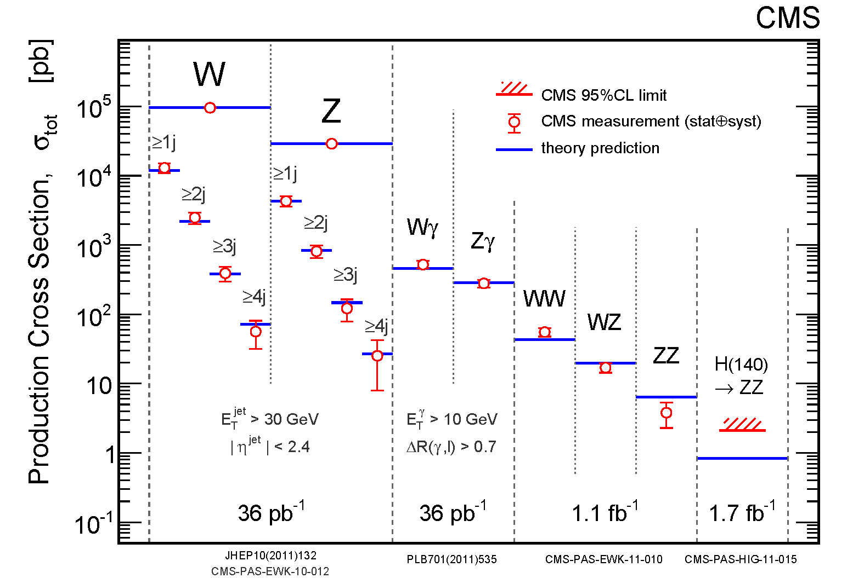
Rates of Electroweak processes
Measurements of V+jets and diboson yields in excellent agreement with theory predictions
at NLO and NNLO → backgrounds to rare physics searches well under control

Slide 11
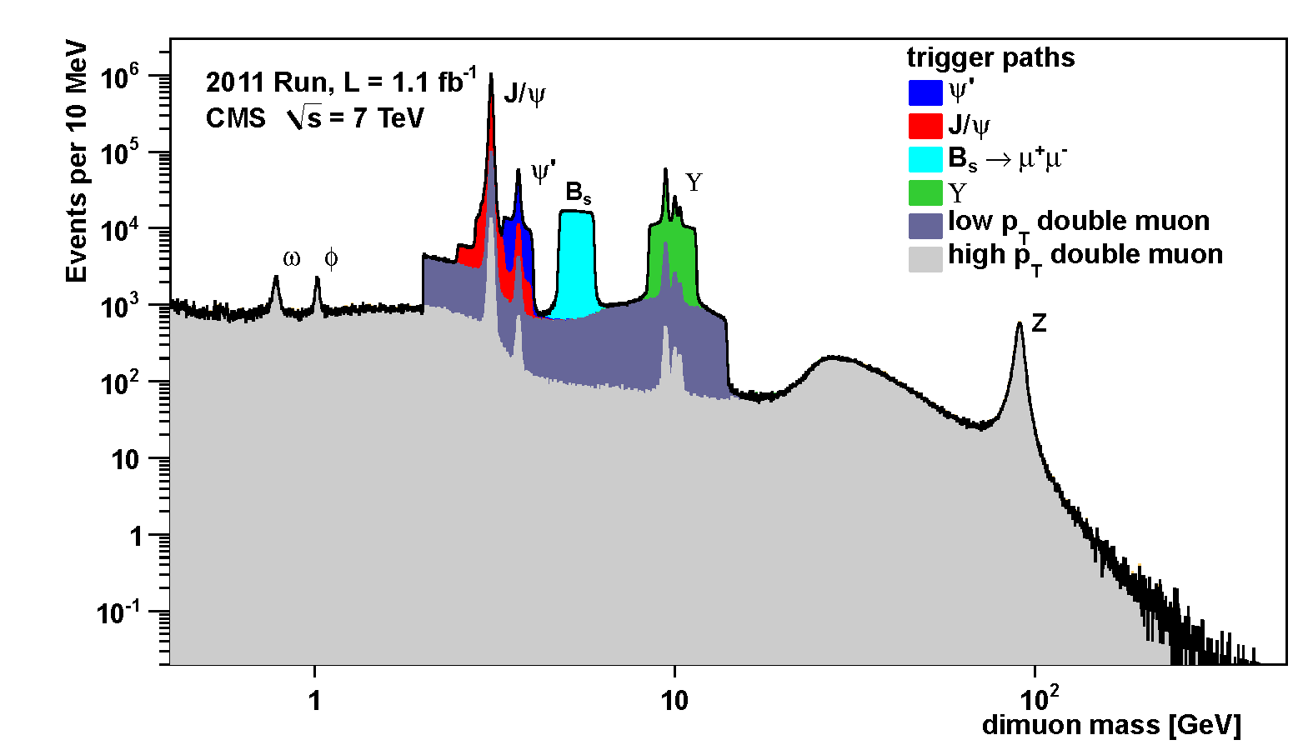
40 Years of Physics In One Spectrum
CMS is a superb muon detector → muon triggers yield important signals for calibration as well as for searches
Dedicated dimuon trigger paths further increase acceptance to specific resonances

Slide 12
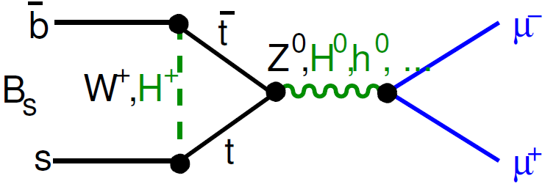

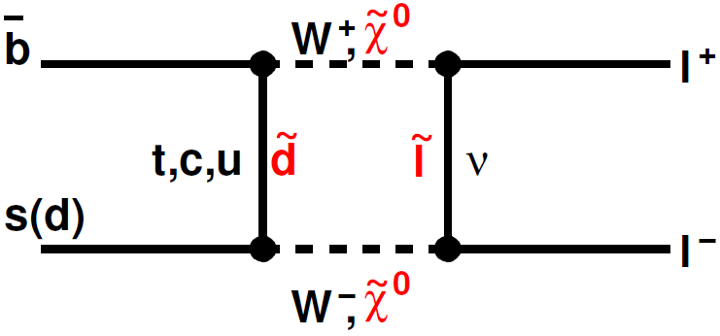
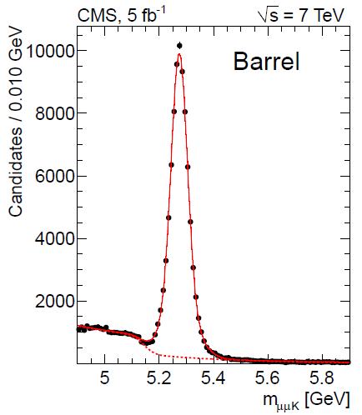
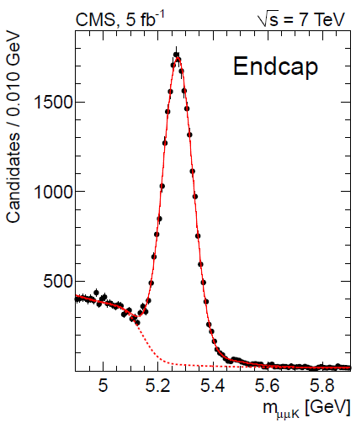
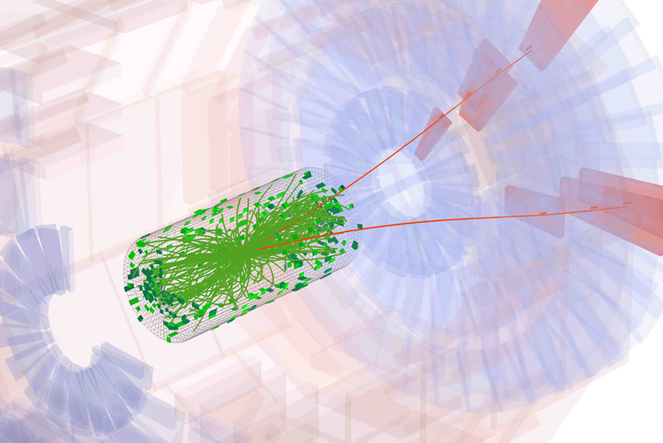
Search for B_{s(d)}→μμ
Highly suppressed decays
in the SM: no FCNC; helicity
suppression (m_{μ}/m_{B})²; form-factor
reductions from annihilation (f_{b}/m_{b})²
The search for these rare decays to muon pairs is close to become sensitive to SM box diagrams, and might hit enhancements due to loop of heavy SUSY particles. The SM predicts:
Sensitivity to SUSY is proportional to powers of tanβ
Analysis technique:
  Use muon isolation, L_{xy} of decay vertex, kinematics to improve S/N
  Normalization to unsuppressed decay channel B⁺→J/ψ K⁺
  MC modeling tested in orthogonal sample B→J/ψφ

Slide 13
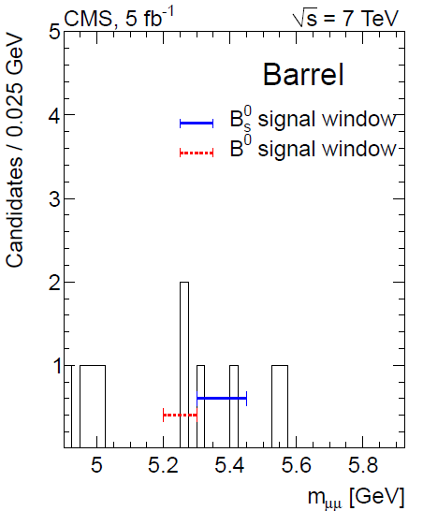
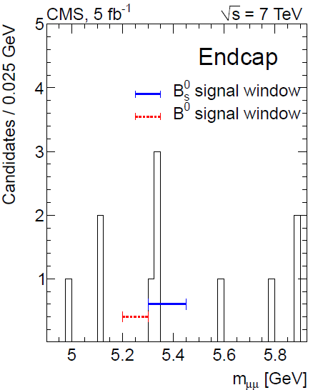
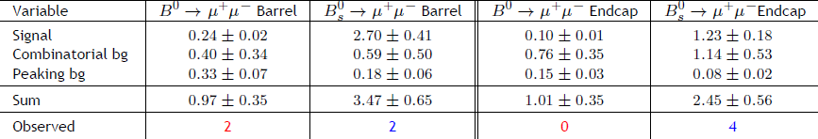
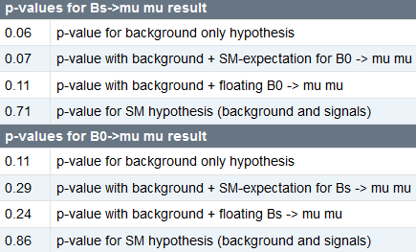

5/fb Results
The search is blind and simultaneous for the two decay signals; in part one is in the sidebands of the other so each may contribute to the background expectation of the other
The results of the search in the full 2011 dataset allow to set very stringent upper limits – World’s best until LHCb produced their result
CMS has bright prospects on these signals due to small backgrounds: more luminosity will improve significantly the reach

Slide 14
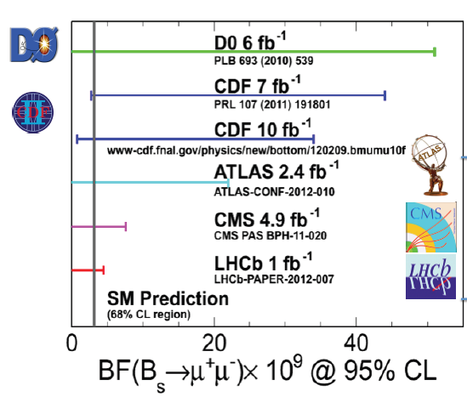
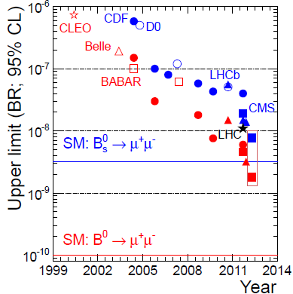
Summaries of the chase
The best result is now the one obtained by LHCb (1/fb of data)
(but CMS has brighter prospects !)
A decade-long search is coming to a close !!

Slide 15


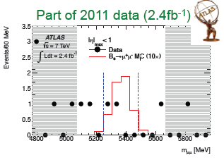
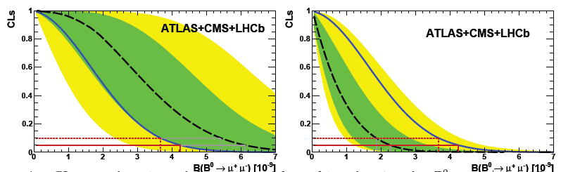
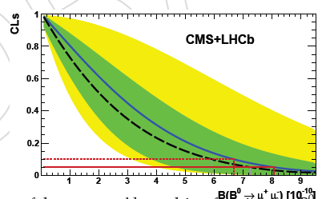
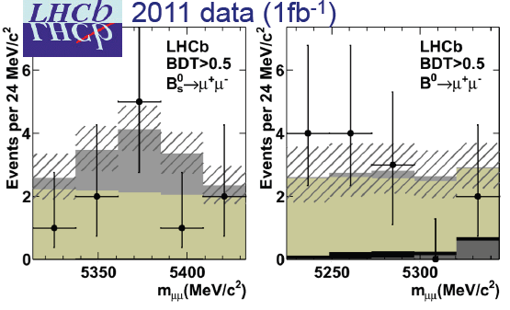
Combination with LHCb and ATLAS
The 2012 combination of CMS search results of the B_{s} meson with the ATLAS and LHCb results is performed using a likelihood ratio test statistic,
with integration over nuisances. The resulting CL_{s} values are used to set the upper limit.
B_{d}
B_{s}
The B_{s} limit is affected by the possible presence of real SM decays in the experimental samples.
The SM contribution is providing an “excess” over backgrounds at the 2σ level, while the compatibility with
the SM is at the 84% level.

Slide 16
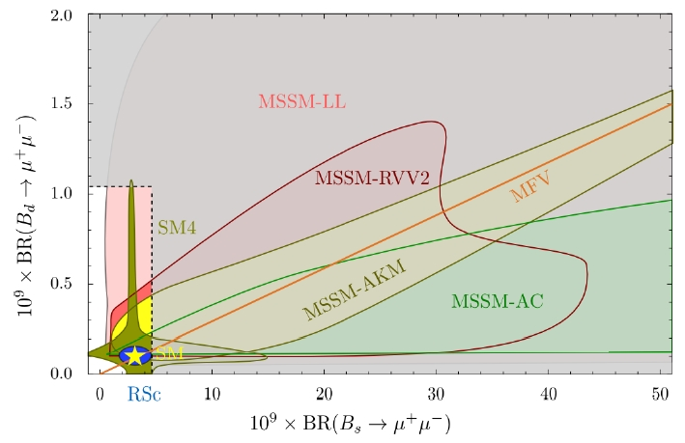
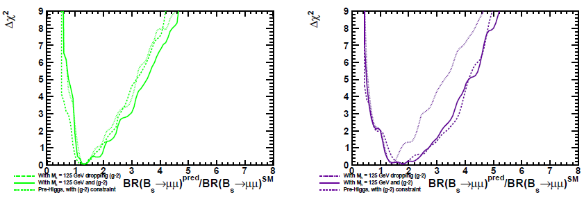
What does that mean for NP models ?
The new constraints can be used to place tighter constraints on the allowed regions of parameter space of SUSY and other theories.
Some results are already available:
  D. Straub (arxiv:1205.6094) takes the LHCb and CMS limits and compares them to range of BR allowed by open parameter space of NP models affecting them
  One may also compare limits to e.g. S. Heinemeyer et al. (arxiv:1112.3564)’s Δχ² curves vs B(B_{s}→μμ) (see bottom)
Most models compatible with no enhancing the BR of B mesons, yet the view is striking – new physics could have well shown up here already !
CMSSM
NUHM1

Slide 17
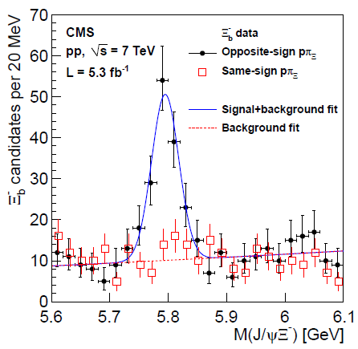
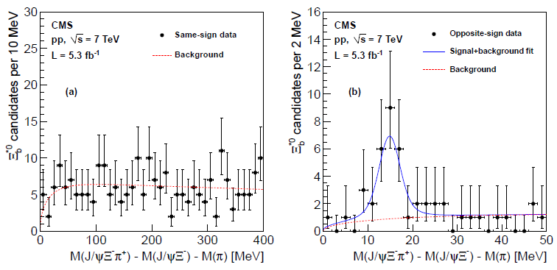
A Discovery!
The new Ξ_{b}* Baryon
Outstanding CMS tracking capabilities allow the full reconstruction of decays of Ξ⁻_{b} baryons through the chain
Ξ⁻_{b}→J/ψΞ⁻ followed by J/ψ→μμ and Ξ⁻→Λπ⁻→pπ⁻π⁻
One can then search for excited states with decay Ξ_{b}*→Ξ⁻_{b}π⁺
The signal of the excited new state is found in the distribution of the mass difference between
the J/ψΞ_{b}π system and the two supposed products of the two-body decay. The background
shape is a phase space model checked in data with same-sign pions.
http://arxiv.org/pdf/1204.5955.pdf
The significance of the
observed signal is much
larger than 5σ even accounting
for the trials factor
The mass of the new state
is measured to be
M_{Ξb*}=5945+-0.3+-0.7+-2.3 MeV

Slide 18

Higgs Boson Searches

Slide 19
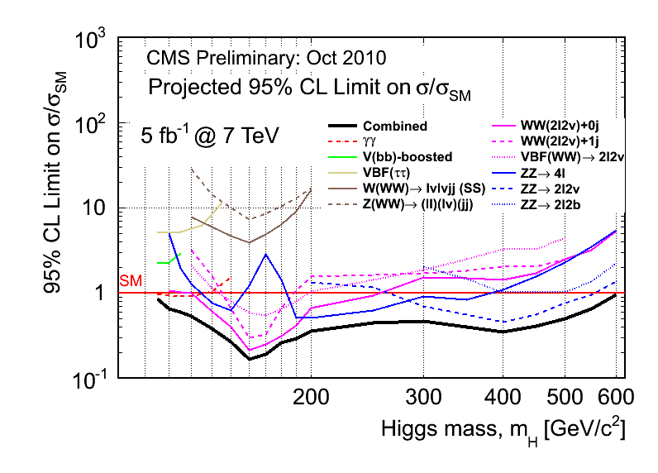
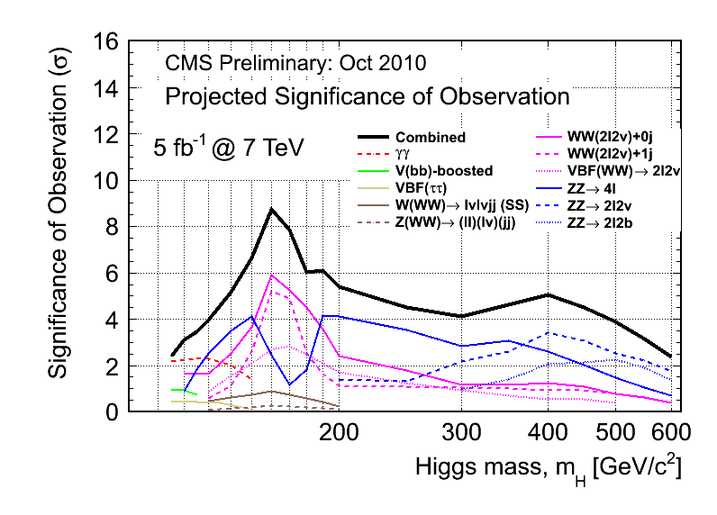
Fall 2010 forecasts
One of the main goals of LHC
In 2010, CMS predicted that 5/fb of 7-TeV data would provide:
  a 95% exclusion across the full mass range, if the Higgs is not there
  At low mass, reliance on γγ decay mode found crucial for this
  Or a discovery, for 137<M_{H}<220 GeV
  At low mass, γγ and ZZ decay modes both necessary to achieve that goal
  Or at least firm (>3σ) evidence, for all other mass values below 600 GeV…

Slide 20
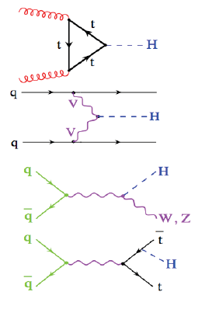
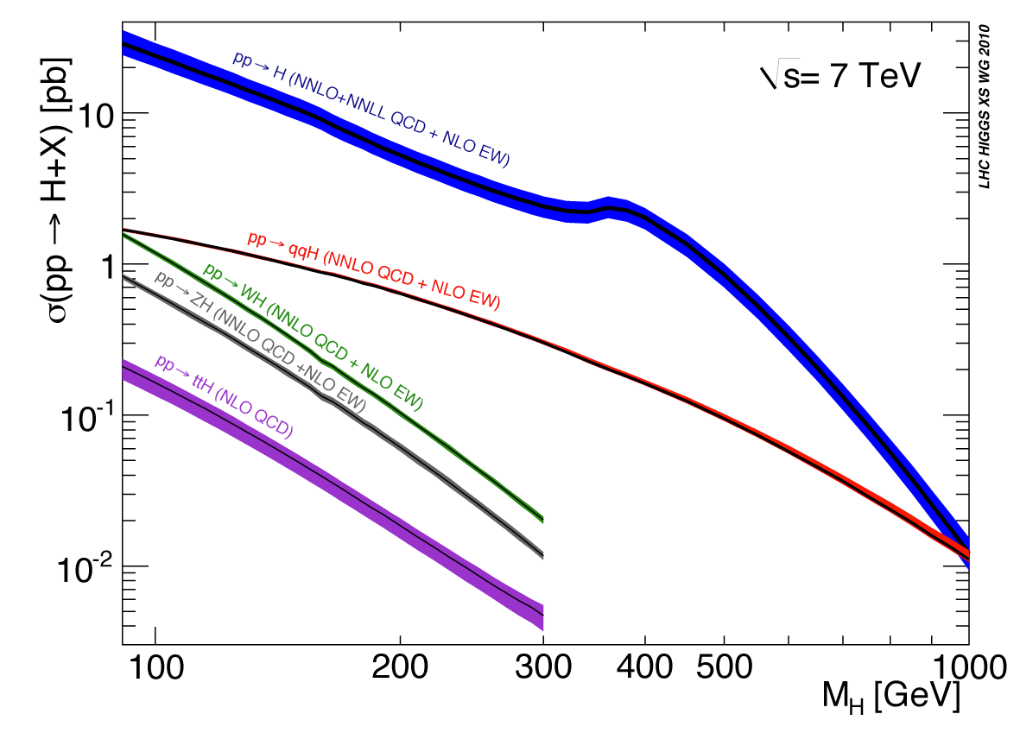
Higgs Production in pp Collisions
Direct production
by gluon fusion
VBF: fusion of vector
bosons
Higgsstrahlung from
off-mass-shell
vector bosons
Higgsstrahlung from
top quarks
In 7-TeV pp collisions the Higgs boson has a significant production cross section via several production mechanisms
Gluon-gluon fusion is the dominant one, but VBF processes are also above 1pb and less dependent on M_{H}.
Bremsstrahlung from EW bosons possible but huge rate of QCD backgrounds make it less profitable WRT Tevatron
The spectacular production in association to top pairs is small and not pursued yet

Slide 21
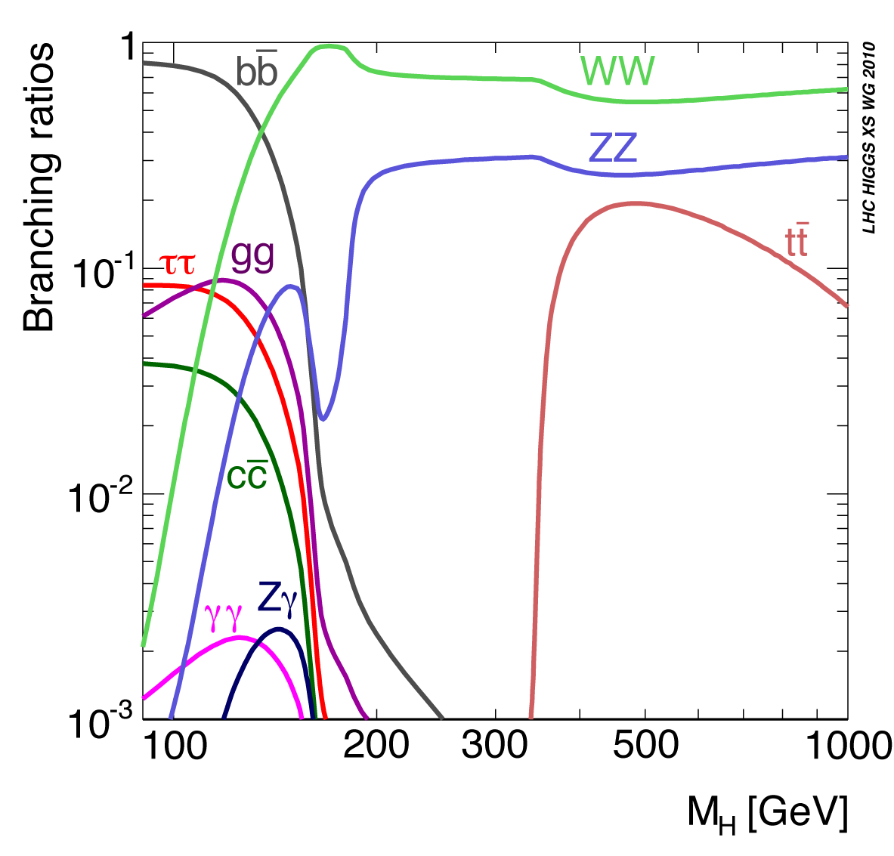
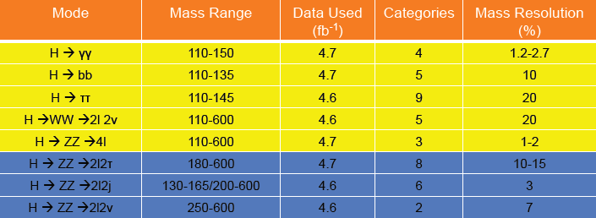
Higgs decays
H couples to all massive particles directly, plus to photons indirectly
→ rich decay phenomenology!
The value of branching ratios depend on Higgs mass. All open decays fight each other
  WW “peak” suppresses everything else at 165 GeV
  clear division between “low-mass” and “high-mass” regimes at 135 GeV
  Note “lucky” M_{H}=125 GeV point gives sizable BR to many interesting accessible final states !
CMS pursued most decay modes in 2011.
The further division in sub-classes improves sensitivity
Document
Document
HIG-11-030
HIG-11-031
HIG-11-029
HIG-11-024
HIG-11-025
HIG-11-028
HIG-11-027
HIG-11-026

Slide 22
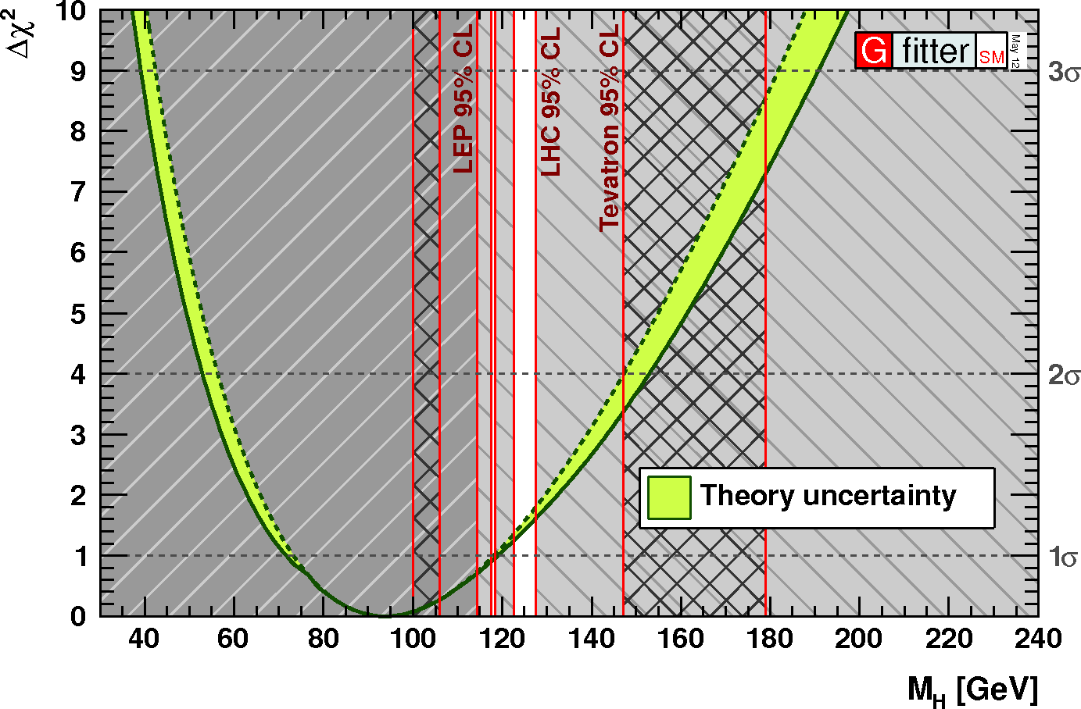
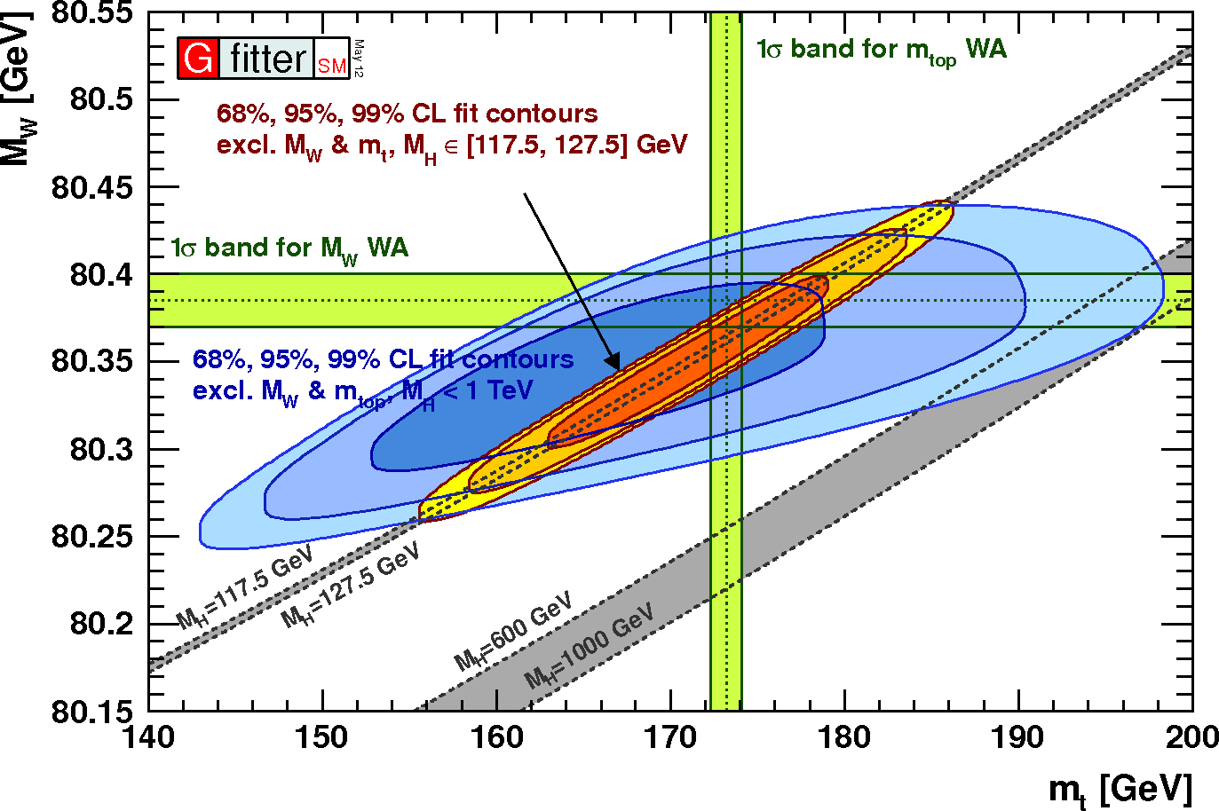
What do Electroweak fits say ?
Radiative corrections to electroweak parameters values provide a means of inferring the unknown mass of the Higgs boson with the precise measurements of EW observables at LEP/SLD and the Tevatron
Particularly sensitive: top and W masses
  M_{t} now known to 0.9 GeV accuracy (CDF, DZERO) → not going to change much in near future
  M_{W} known to 15 MeV accuracy
The fits to all information are consistent with a low-mass Higgs boson. Now, however, direct searches are leaving only a tiny window for the possible mass range.

Slide 23

Nuts and Bolts of Higgs results
All Higgs searches from CMS follow the recipe of a joint working group with ATLAS.
The method is CL_{s} and the test statistics is a profile log-likelihood ratio. The recipe is as follows:
One writes a global likelihood function, whose parameter of interest is the “signal strength modifier” μ=σ/σ_{SM}. If s and b denote signal and background, and θ is a vector of systematic uncertainties, one can generically write for a single channel:
Note that θ has a “prior” coming from (sometimes hypothetical) auxiliary measurements.
In L one may combine many different search channels; e.g., where counting experiments are performed one includes the product of the Poisson factors:

Slide 24

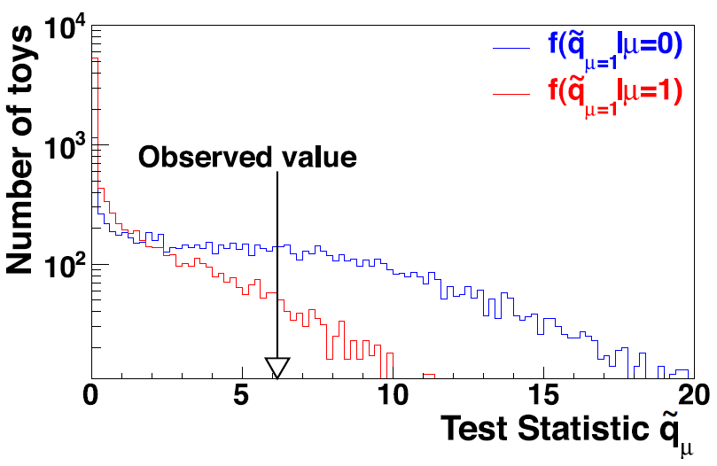


2) A profile likelihood test statistics q_{μ} is defined as
A constraint is posed on the MLE μ^ to be confined in 0<=μ^<=μ, which avoids negative solutions and ensures that best-fit values above the signal hypothesis μ are not counted as evidence against it.
3) ML estimates θ_{μ} for H₁ and θ₀ for H₀ are then computed, given the data
4) Pseudo-data is then generated for the two hypotheses, using the above MLE
of the nuisance parameters. With the pseudo-data, one constructs the pdf of the test statistics given a signal of strength μ (H₁) and μ=0 (H₀).
5) One can then compute the integrals defining p-values for the two hypotheses:
6) Finally one obtains:
CL_{s} = p_{μ}/(1-p_{b})
→Mass hypotheses are excluded if CL_{s} < 0.05

Slide 25
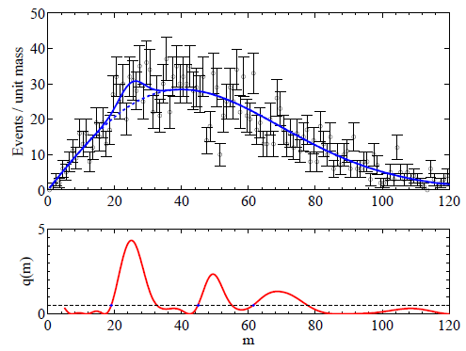

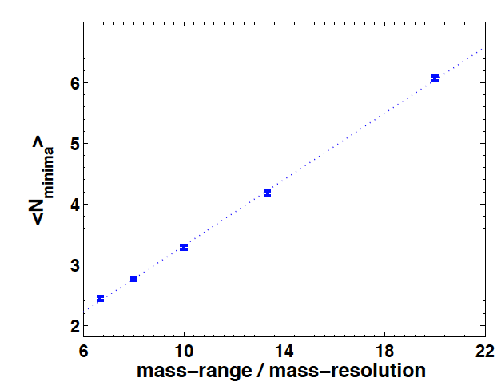
Significance: LEE and upcrossings
The look-elsewhere effect is well-known and rules of thumb or toys are often used to “rescale” the significance of a background fluctuation.
In complex cases such as the Higgs combination the above are insufficient or cumbersome measures. At the LHC we count the number of “upcrossings” of the distribution of p-value (or the value of the test statistics itself) above some reference value, as a function of mass. Its wiggling tells one how many places one has been searching in
The number of times that the test statistics crosses some reference point is a measure of the trials factor. One estimates the global p-value with the number N₀ of upcrossings from a minimal value of the q₀ test statistics (for which p=p₀) by the formula
E. Gross and O. Vitells, “Trials factors for the look elsewhere effects in High-Energy Physics”, Eur.Phys.J.C70:525-530 (2010)
  The number of local minima is closely connected to the freedom of the fit to pick signal-like fluctuations in the investigated range

Slide 26
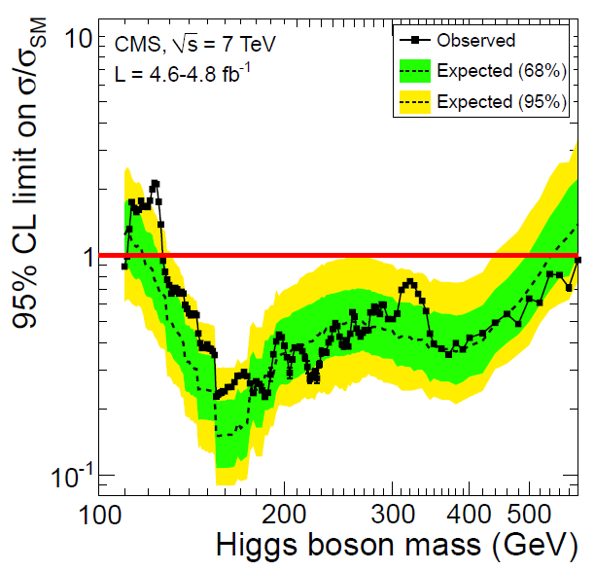
Combination of Higgs Search Results
The combination of the eight sets of upper limits on the ratio μ=σ/σ_{SM} is performed with the same technique used for the summer 2011 ATLAS-CMS combination
The result is a full exclusion of the high-mass range: CMS data is only compatible with the existence of a Higgs boson if its mass is in the narrow window between the LEP II limit and 127 GeV
95% CL expected sensitivity: 117—543 GeV
95% CL observed limits: 127—600 GeV

Slide 27
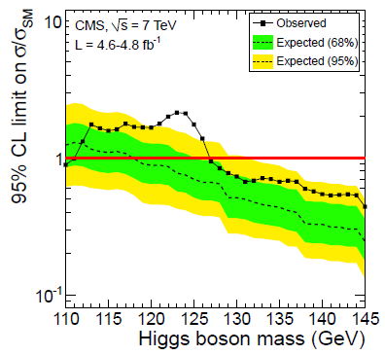
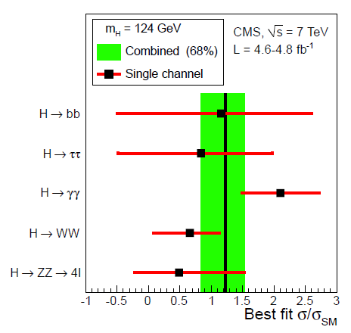
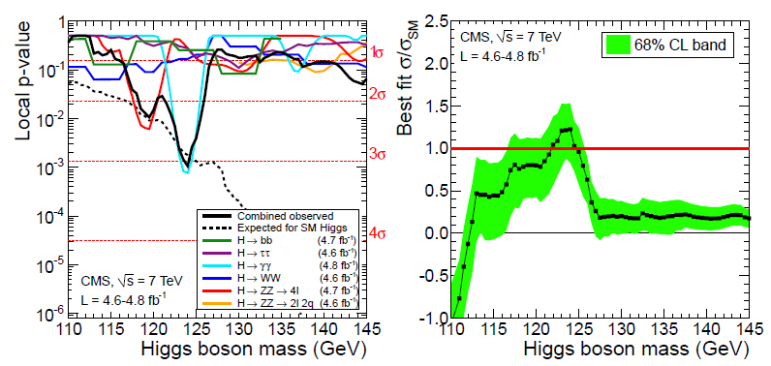
Compatibility with a Higgs signal
The 124-GeV effect is compatible with a SM Higgs boson – the p-value and best-fit cross section agree with predictions
  CMS finds globally a local significance of 3.1σ; a trials-factor corrected one is 2.1σ when considering the search range 110/145 GeV
  More data is necessary to ascertain the origin of the effect → 2012 data will tell !

Slide 28
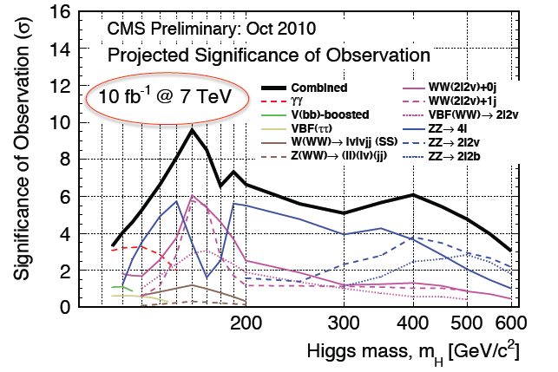
Forecast for 2012
The October 2010 predictions for the sensitivity to a SM Higgs boson were on par with results, given 5/fb of data
→ We may turn to the 10/fb 7-TeV prediction to have a rough idea of what CMS might be able to produce for summer conferences (eg. ICHEP) with 2012 8-TeV data already in hand
In the 125 GeV region
the local significance should
be close to 5 standard
deviations with 10/fb
→Very likely crossing the
5σ mark by combining with
ATLAS or by just collecting
some additional few/fb.
125

Slide 29
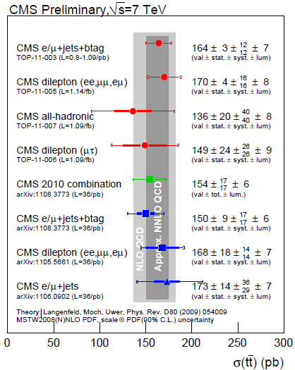
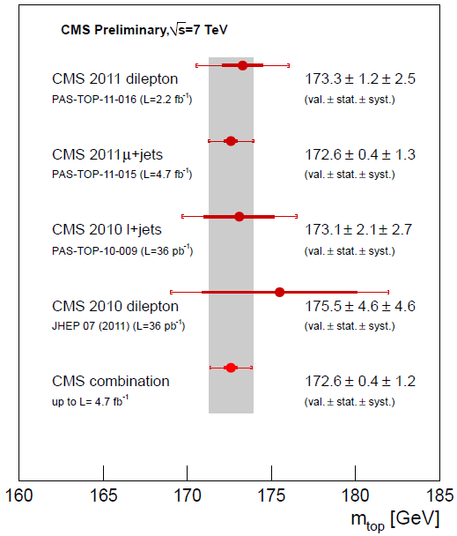
Top Physics Results
CROSS SECTIONS
Top pair production cross sections are measured in all main decay channels
Results agree well with NLO QCD and approximate NNLO calculations
Top mass measurements not yet matching the precision of excellent Tevatron results (Δm=0.9 GeV) but the CMS average is getting very close (Δm=1.25 GeV!)
MASS MEASUREMENTS

Slide 30
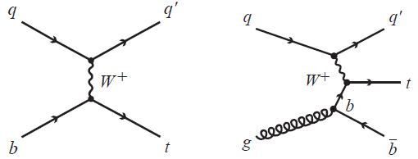
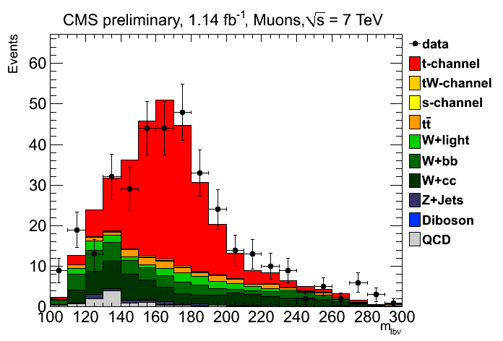
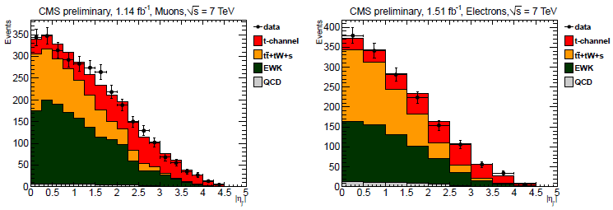
Single top t-channel production
Events with a high-p_{T} lepton (e or μ), two jets (one of them b-tagged) and missing E_{T} are selected for this measurement
The top mass is reconstructed using the b-tagged jet and the W candidate
  A signal region is defined to include events with 130<M_{blν}<220 GeV
The pseudorapidity of the untagged jet is used in a combined fit to the e and μ samples (see below) to extract the signal contribution
Result:
  σ(t)=70.2+-5.2(stat)+-10.4(syst)+3.4(lum) pb
At high light-jet rapidity (|η|>2.8)
the signal contribution is dominant

Slide 31


Cross sections vs energy plots
The cross section is perfectly in line with predictions at NNLO for both top quark pairs (right) and t-channel single top production (below)

Slide 32


Two More Recent Top Results
Top-antitop mass difference: measured in 5/fb of l+jets events by looking at lepton charge. Many systematics cancel in difference; the result is a three-times more precise measurement than previous determinations. See arxiv:1204.2807.
Δm=-0.44+-0.46 (stat)+-0.27(syst) GeV
The top cross section has been measured using 2.2/fb in the “tau-dilepton” final state (which includes one e or μ and one hadronically-decaying tau lepton).
Result:
σ(tt) = 143+-14+-22+-3 pb ,
in agrement with SM prediction. See arxiv:1203.6810.

Slide 33

Search for FCNC top decays
FCNC top decays are very rare in the SM: O(10⁻¹⁴)
NP models (topcolor-assisted technicolor, RPV SUSY) predict enhancements up to O(10⁻⁴)
CMS searched for neutral-current decays of top quarks in tt→WbZj→3l+jets events
The signature is very clean, with only electroweak backgrounds to fight against
The mass of top candidate combinations is used to search for candidates
95% CL upper limits are placed on the branching fraction of t→Zj at B<0.34%
This is three times more precise than existing limits
Top row: HT-based selection; bottom: b-tagged events

Slide 34



Search for t’ quarks
A fourth generation of matter fields is not inconsistent with precision EW data; quark masses are experimentally constrained to be above 358 GeV
The mass splitting between fourth-generation quarks t’, b’ is expected to be smaller than m_{W} → the t’ is assumed to decay to Wb
A search for pair-production of fourth generation quarks was made in 4.6/fb of lepton+jets events
The three-body mass and the H_{T} are fit simultaneously to search for a t’ component
Limits are set with CLs:
M_{t’} > 560 GeV at 95% CL

Slide 35


Measurement of R=B(Wb)/B(Wq)
The analysis studies the fraction of jets from top decay that contain b-quarks, a number which is >99% according to present knowledge of the CKM matrix
A very pure sample of candidate top quark pairs are selected in the dilepton topology (ee, eμ, or μμ) with missing E_{T}>30 GeV for the same-lepton category, and two jets. The three-body masses are used to verify the hypothesis that jets come from the top decay
The b-content of the jet is determined looking at the impact parameter significance of the tracks in the jet
The observed ratio of events with identified b-jets allows to set a lower limit R>0.85 at 95% CL using the Feldman-Cousins unified approach

Slide 36


Search for Z’→tt
In topcolor-assisted technicolor models a dynamical mechanism for electroweak symmetry breaking is generated. A prediction of the model is the existence of a Z’ boson with preferential coupling to 3rd generation fermions
Events with two charged leptons, two jets (one of
which b-tagged) and missing E_{T} are selected.
The top mass is reconstructed in the ttbar hypothesis
by setting neutrino longitudinal momenta to zero.
17 variables are used in a Bayesian Neural Network
to discriminate the Z’(750) signal from backgrounds
The resulting limits in the signal cross section
allow to exclude a leptophobic Z’ boson with mass
below 1.1 TeV (for width 0.012 M_{Z’})

Slide 37




Search for Boosted Z bosons
Boosted Z bosons are a signature of contact interactions, as well as other models of BSM physics
CMS studied the signature of high-P_{T} Z→μμ pairs, optimizing the search for q*→qZ decays. This signature is practically background-free given the very clean Z signal
The 1/p_{T} distribution of the muon pair is studied, looking for enhancements at the low end
Cross section limits are obtained for several classes of models predicting high-P_{T} enhancements – See EXO-11-025-PAS for details
95% CL limits: m_{q*}>1.94 (2.14) TeV for new gauge interactions (contact interactions)

Slide 38



Search for V+jj Bumps
Two years ago CDF published a >4σ evidence of a structure in the mass distribution of jet pairs produced with a W or Z boson (the “Vivianonium”), see top left
CMS looked for this dijet resonance with 2011 data (e/μ with missing E_{T} and two jets)
No signal is observed above W+jets/top background→ 95% CL upper limits exclude the CDF effect and place constraints on similar models (see arxiv:1107.4771)

Slide 39

SUSY searches
CMSSM limits extracted by many different searches highlight the absence of any new
signal of SUSY particles in the many pursued signatures
For more details and channel-by-channel results please see the slides of yesterday’s talk
by N. Saolidou, or visit the CMS SUSY public page

Slide 40


SUSY Limits in simplified models
A summary of the limits on the mass of gluinos and squarks can be obtained in simplified scenarios.
  These predict specific mass spectra for superpartners, so they cannot be taken to represent the full range of SUSY theories
The produced “limits” are indicative of the current
reach of the CMS analyses considered in the combination,
given the production modes and decay signatures

Slide 41
Other Exotics Searches
So much to discuss, so little time...
Executive summary: Many new physics signatures sought, none found
Please visit the CMS public web pages of Exotics results for information on searches for
  Large extra dimensions (limits from searches in γγ, jet plus MET, dileptons...)
  vector-like quarks
  dijet mass resonances
  leptoquarks (first,second,third generation)
  microscopic black holes
  W’, Z’ bosons
  heavy stable charged particles
  fourth generation quarks
  colorons, and similar jet resonances
  etcetera

Slide 42








An invitation to give a look at CMS results on Exotica

Slide 43
Conclusions
The CMS experiment used over 5/fb of pp collisions delivered in 2011 by the LHC at 7 TeV cm energy for a large number of physics measurements and searches
  The new limits on rare B meson decays strongly constrain the parameter space of SUSY models
  the Higgs boson has been sought in 8 different final states (for a total of 42 independent sub-channels)
    Excluded mass hypotheses from 127 GeV to 600 GeV at 95% CL
    Observed slight excesses at low mass (119-125 GeV) not significant but compatible with signal hypothesis
  Electroweak measurements provide precision probes of the SM in 7 TeV collisions
  A new hadron resonance, the Ξ_{b}*, has been discovered by CMS
  Large swaths of SUSY parameter space have been excluded by inclusive and exclusive searches
  Produced limits on Large Extra Dimensions, new resonances, and other exotica models vastly improve over previous knowledge
The LHC physics program is continuing in 2012 with the goal of tripling the 2011 data at 8 TeV
  This will give the final word on the existence of a light Higgs boson
  Expect to soon reach the sensitivity to SM B_{S}→μμ production

Slide 44
BACKUP

Slide 45

1994: LHC project approved
1999: CMS MoU signed
2004: The CMS Cavern is ready
2009: First Physics !

Slide 46

November 2006

Slide 47

February 2007

Slide 48

December 2007

Slide 49






Physics Objects Reconstruction
Jets are reconstructed with anti-kT clustering and corrected with Particle-flow algorithm
W and Z decays to leptons provide calibration of the reconstruction of electrons, muons, taus, and missing energy from neutrinos
Tag-and-probe techniques using Z decays allow to reduce systematics on efficiency estimates
B-tagging well understood – studied in jets up to 500 GeV

Slide 50


Cross Sections at a glance
The increase in centre-of-mass energy causes all cross sections to grow
Rare, high-energy phenomena grow faster
e.g. top quark pair production: x25 WRT Tevatron
Some backgrounds also grow bigger and nastier, e.g.
b cross section grows by x10
large growth in jet and multijet cross sections

Slide 51



Sample Searches: H→WW
The WW channel is the one with highest rate for masses around 2M_{W}
Backgrounds are essentially due to SM WW production
Mass resolution is poor → use kinematics to discriminate from irreducible backgrounds
  Use zero spin of H → charged leptons correlated in azimuth
  Anti-btag /SL veto to remove top-pair background; veto Z-peak candidates
  Classify by jet multiplicity (sensitive to VBF topologies)
  Classify by lepton flavor (DY contributes more to OF)
Two strategies:
  Counting experiment: five categories (N_{j}=0, SF/OF; N_{j}=1, SF/OF; N_{j}=2)
  BDT classifier (ignores low-sensitivity N_{j}=2 category)
Most backgrounds estimated with data (except WZ,ZZ, high-mass WW)

Slide 52


H→WW results
0-jet SF 1-jet SF
Division in categories allows to tailor selection to the different characteristics of signal wrt background – e.g. ME_{T} criteria are optimized class by class
Further cuts are optimized differently for each mass point
The BDT method is found to be marginally more sensitive
Backgrounds are well modeled in all categories; most are estimated from the data in control samples
Upper 95% CL limits: 132<M_{H}<238 GeV (cut-based), 128<M_{H}<300 GeV (BDT)
0-jet OF 1-jet OF

Slide 53



H→ZZ→4 leptons: the golden channel
This search is discussed in M.Meneghelli’s parallel session talk in more detail.
The four-lepton final state is one of the two targets driving the design of CMS
We can study high-mass Higgs production with excellent mass resolution
We can also search for M<180 GeV when one Z is off-mass shell → very significant sensitivity down to 110 GeV!
Three topologies: 4e, 4μ, 2e2μ
Only require well-identified, isolated leptons
M_{μμμμ}=201 GeV
CMS collectively observes 72 events, expects 67.1
from known backgrounds (ZZ, Z+bb)

Slide 54

Mass distributions
The search exploits the fine mass resolution of the 4l final state
At low mass O(few) event signals are expected. CMS observes 13, expects 9.5+-1.3 in [100,160] GeV region
Three 4μ events are seen with mass around 119 GeV, two more at 126 GeV

Slide 55

H→ZZ→4l results
The ZZ→4l channel alone allows to exclude most of the M_{H}>180 GeV region at 95%CL:
  Expected exclusion: 130 < M_{H} < 160 GeV; 182 < M_{H} < 420 GeV
  Observed exclusion: 134 < M_{H} < 158 GeV; 180 < M_{H} < 305 GeV; 340 < M_{H} < 465 GeV
The local p-value of background-only hypothesis show a 2.7σ dip at 119 GeV, a smaller 1.5σ dip at 125 GeV

Slide 56



8 - H→γγ searches
The signal of H→γγ decays is a pair of isolated photons with little additional energetic activity
The electromagnetic calorimeter plays a crucial role in the search
Energy resolution and scale studies are made with Z→ee, W→eν, π⁰ and E/p as well as laser signals for transparency corrections.
After corrections, the energy scale is stable to a 0.1% level in 2011.

Slide 57


Mass distribution and limit
Events are classified according to the way photons are detected, to exploit the different resolutions and background contaminations
Each category is fit separately and results are then combined. Shown below is the total dataset for illustrative purpose only
The resulting observed upper limit
shows a 2-sigma fluctuation at 124 GeV
Quantified in next slide

Slide 58

H→γγ p-value
Probability of 124-GeV fluctuation in γγ final state can be quantified at the 1% level
Accounting for LEE trials factor this is not significant

Slide 59


Observation of Z→4l decays
As a “sideline” of the search for H→ZZ decays, the four-lepton final state provides a chance to observe the peculiar decay of a single Z boson to four leptons.
Note: the (4e), (4μ),and (2e2μ) final states are not in a 1:1:2 proportion for this decay as would happen to uncorrelated pairs, due to additional Feynman diagrams contributing to the same-flavour final states
CMS observes a large peak (8.9σ significance) due to the radiative decay
The branching ratio B(Z→4l) is measured at
  B = (4.4^{+1.0}_{-0.8} +-0.2) 10 ⁻⁶
Below: signal (left) and background (right)
processes contributing to the selected dataset

Slide 60


2 – H→ZZ→llνν
The final state including a Z→ll signal and large missing transverse energy is hard to mimic by backgrounds. Main contributions: Z+jets, tt, WZ/ZZ SM production
Compute a “transverse mass” (7% resolution) by assuming ME_{T} due to neutrinos:
Two categories: Z→ee, Z→μμ; both a cut-based
and a M_{T}-shape analysis are performed
Events are selected with a M_{ll} cut and p_{T}^{ll} > 25 GeV.
Require large ME_{T}, not aligned with jets (ΔR>0.5)
or leptons (>70->150 GeV cut-based, >80 GeV M_{T} shape) → reduce Z+jets by 10⁵
Anti-b-tag suppresses top production

Slide 61


H→ZZ→llνν results
The search has good sensitivity in the high-mass region, particularly for M_{H}>350 (where the expected limit is lower than that of the ZZ→4-lepton analysis, due to the larger branching fraction of the mixed decay)
Excluded at 95% CL:
270 < M_{H} < 440 GeV
Transverse mass spectrum for events
accepted by M_{H}=300 GeV selection

Slide 62



3 – H→ZZ→llqq search
Less sensitive despite higher BR, because of huge Z+jets background
6 categories: Z→ee,μμ and 0,1,2 b-tags
Good mass resolution (3%) thanks to Z-mass constraints
To select the data, use an angular discriminant based on 5 production and decay angles
Backgrounds mainly due to Z+jets, top production, and dibosons
Jets E_{T}:
207,114 GeV
electrons E_{T}:
177,114 GeV
M₄=580 GeV

Slide 63

H→ZZ→llqq: mass distributions

Slide 64

H→ZZ→llqq Upper Limits
Results by themselves insensitive to SM Higgs with 5/fb – but help the combination, particularly at high mass

Slide 65



4 - H→ZZ→llττ
Search only performed in high-mass region
10 observed events, 10.3 expected background
Background shapes are taken from MC simulation
and normalized to the values obtained using data-driven
techniques.

Slide 66


5 – H→bb search in Higgsstrahlung
H→bb decay mode is impossible to extract from huge QCD background in the absence of other features
Only searchable in association with vector boson (W,Z) – even then, at a disadvantage WRT Tevatron due to large increase in V+jet background
Use back-to-back topology: Δφ_{VH}>3, large boost (p_{T}^{V}>100-160 GeV)
Tight b-tagging, ME_{T} cut
Search in 5 sub-channels: Z→ee, μμ; W→eν, μν; Z→νν
Backgrounds estimated from control regions
Vbb: estimated from data
V+jets: from data, inverting b-tag requirement
top pairs: from data, requiring extra jet
QCD: from data, requiring small Δϕ (ME_{T}, j)
W+Z(bb) and Z+Z(bb): estimated from MC
The dijet mass resolution is 10%

Slide 67



WH,ZH BDT Distributions

Slide 68


H→bb Results
The BDT analysis is found marginally superior to the mass shape analysis (expected limits slightly lower)
Results not jet binding SM cross section at low mass, but surprisingly close to do so

Slide 69



6 - H→ττ searches
H→ττ decays can be searched both in direct H production, and in VBF qqH→qqττ final states
In direct production more kinematic handles are needed to separate from DY → require large boost of H candidate
Three ττ topologies: μ+τ_{had}, e+τ_{had}, μe
BDT mass distributions are divided for the
three categories of ττ candidates

Slide 70




H→ττ results
The three final states have different sensitivities – the first one is a “proof of principle” and
is sensitive to MSSM H→ττ signals (see later).
The channel has best
sensitivity for M_{H}=120 GeV
The mass resolution of
ττ channels is poor
A 1-σ excess is observed
throughout the investigated
mass range

Slide 71

H→ZZ→4l: Excess and p-value
By itself, the local p-value of the 119 GeV mass hypothesis corresponds to a 2.4 standard deviations effect
But trial factor for full-mass search is ~40

Slide 72



More detail in H→γγ reconstruction
Photon-photon mass for central-central pairs has resolution close to 1 GeV
Primary vertex is chosen with BDT discriminant – performance improves with diphoton p_{T}
Four categories kept separate to profit from differences in signal and background shapes and normalizations

Slide 73


Mass distributions in the five classes of H→γγ

Slide 74

Channel-by-channel view

Slide 75

Best fit cross section, channel by channel
Although not significant, the slight excesses observed in most search channels appear compatible with the expected contribution from SM Higgs production, both for M_{H}=119.5 and for M_{H}=124 GeV

Slide 76

Summary of Higgs Searches:
Where are we ?

Slide 77


Slide 78

The Future of the LHC

Slide 79


ATLAS Higgs Results
Atlas observes a 3.5 standard deviation effect at MH=126 GeV (local significance)

Slide 80

p-value compared with H hypothesis

Slide 81

H→γγ p-values

Slide 82


p-values and best-fit cross section

Slide 83
Forecast for 2012
The October 2010 predictions for the sensitivity to a SM Higgs boson were on par with results, given 5/fb of data → high reliance on results achievable with doubled statistics
In the 120-125 GeV region
the local significance should
exceed 4 standard deviations
with 10/fb at 7 TeV
Likely crossing 5σ mark by
combining with ATLAS or
if delivered luminosity
reaches 15/fb

Slide 84

PDF and Parton Luminosities
Kinematical range spans largely unknown regions of (x,Q²) → PDF uncertainties
  Gluon luminosity grows much faster than quark luminosity below effective masses of 500 GeV
  The implication for searches is generally a strong advantage WRT lower-energy machines (TeVatron) in production of massive particles, particularly at high end

Slide 85



Z production in HI collisions
Z production is a useful benchmark at the LHC, not accessible to lower energies (where direct γ production is studied, but is plagued by π⁰ backgrounds and contributed by fragmentation processes also affected by the environment)
The yields, scaled by the number of participating nucleons, are observed to be in agreement with NLO calculations
This also confirms the validity of the Glauber scaling

Slide 86


Heavy Ion Results: 1 – Jet Quenching
A study of jet quenching was performed on 6.7/μb of PbPb data at cm energy of 2.76 TeV/nucleon
Events are selected with a jet of p_{T}>120 GeV in |η|<2.0; their correlation with a second jet with p_{T}>50 GeV, |η|<2 is studied as a function of the centrality of the collision
The latter quantity is determined from the energy deposited in the forward calorimeters

Slide 87

Imbalance growing with centrality
Dijet asymmetry ratio for leading jets of p_{T,1} > 120 GeV/c, subleading jets of p_{T,2} >50 GeV/c, and φ₁₂ >2π/3 for 7 TeV pp collisions (a) and 2.76 TeV PbPb collisions in several centrality bins
Data are shown as black points, while the histograms show (a) PYTHIA events and (b)–(f) PYTHIA events embedded into PbPb data.

Slide 88

Summary of Jet quenching studies
The observed strong quenching of jets probes QCD dynamics at high temperature and density
Energy is transferred to low p_{T} particles emitted at large angle, challenging traditional energy loss models.
Quenching found independent on leading jet p_{T}
For more details see
Phys. Rev. C84: 024906, 2011
Above: fraction of events with a leading jet
with p_{T,1} > 120 GeV for which a subleading jet with A_{J} < 0.15 and φ₁₂ > 2π/3 was found, as a function of N_{part}

Slide 89


Quarkonium and Z production
With single muon triggers sizable signals of J/Psi, Y, and Z decays have been collected in the PbPb run
Comparisons of the yields with pp collisions exposes the suppression of quarkonium production
Studies are performed on the variation of yields with the number of nucleons participating in the collisions. The latter allows to compare to pp collisions by acting as a normalization factor: T_{AA}=N_{part}/σ_{pp}. It is determined from the centrality of the event as in the Jet Quenching analysis

Slide 90




Left: T_{AA}-normalized yield of J/Psi decays (inclusive and
prompt, left; non-prompt, right) as a function
of the number of participants in the collision, N_{part}
Below:
Y signals in pp and PbPb collisions
pp yield extrapolated- large uncertainty due to lack of high-p_{T} data
The yield drops by a factor 2.6 for the most central collisions.
The yield of the non-prompt component is not showing apparent variation with N_{part}
The suppression of 2S and 3S states with respect to the 1S is quantified by comparing the yields to those of pp interactions
The probability to observe a double ratio as low or lower than this, if the true value is unity, is less than 1%
The Y(1S) is also found to be suppressed by 40% with respect to pp collisions

Slide 91

Quarkonium production in HI: details
The figure shows the extraction of the non-prompt component of J/ψ decays to dimuon pairs in pp collisions using the HI algorithm

Slide 92

The figure illustrates the Y yields in pp collisions at 2.76 and 7 TeV center-of-mass energy

Slide 93

The figure shows the fraction of J/Psi decays to dimuon pairs attributed to B meson decays for different data samples, and compared to CDF measurements of the same quantity

Slide 94

Details of 2011 running
Large, but smooth growth in instantaneous luminosity
50ns bunches → already explored pileup conditions with <n> up to 15-20

Slide 95


Parton Luminosities
The PDF uncertainties have a large impact in the prediction of cross sections in the low- and high- “effective mass” domains
Running at higher energy rapidly improves the reach – at M=1 TeV the improvement of 10 over 7 TeV cms energy is already a factor of two for q-qbar annihilation processes

Slide 96


QCD: Jet Cross Sections
2010 data was used for a double-differential cross section for inclusive-jet production
Jets are clustered with the Anti-K_{T} calgorithm (R=0.5)
Momentum scale and resolution dominate total uncertainty
Results agree very well – over 12 orders of magnitude! - with NLO predictions corrected for non-perturbative effects (hadronization, multiple-parton interaction effects: Pythia 6.422, Herwig++ 2.4.2) and using the PDF4LHC recommendations

Slide 97


Slide 98


Slide 99


Slide 100


Slide 101


Slide 102


Slide 103


