Slide 1
Overview of results from ALICE at the LHC
Panos Christakoglou
Nikhef
for the ALICE Collaboration

Slide 2
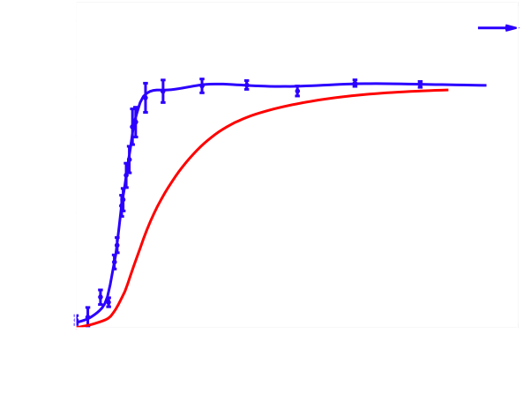
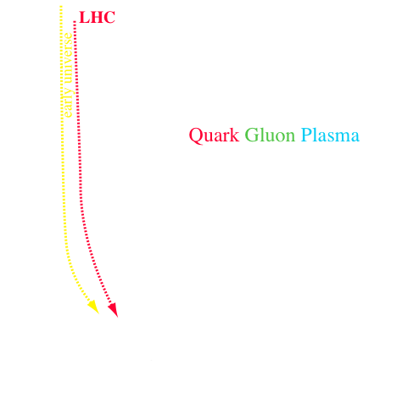
Introduction
Lattice QCD
Explore the properties of the Quark Gluon Plasma
What happens when you heat and compress matter to very high temperatures and densities?
The macroscopic quantities of the QGP will give us better understanding of the underlying microscopic theory (QCD) in the non-perturbative regime
Different accelerators have contributed to the mapping of the “experimental phase diagram”
F. Karsch, E. Laermann and A. Peikert, PLB 478 (2000) 447
At the critical temperature a strong increase in the degrees of freedom
  gluons, quarks ➔ deconfinement
Transition expected to occur around 0.5 GeV/fm³
Borsanyi et al. JHEP 11 (2010) 077

Slide 3
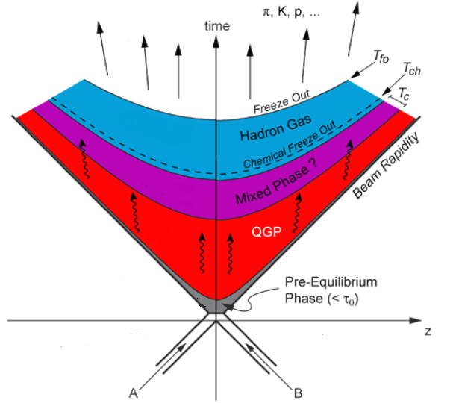
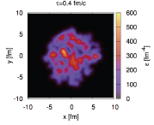
Outline: Experimental tools covered in this talk
Elliptic flow
Bulk: Radial flow
Initial state fluctuations
High p_{t} probes

Slide 4
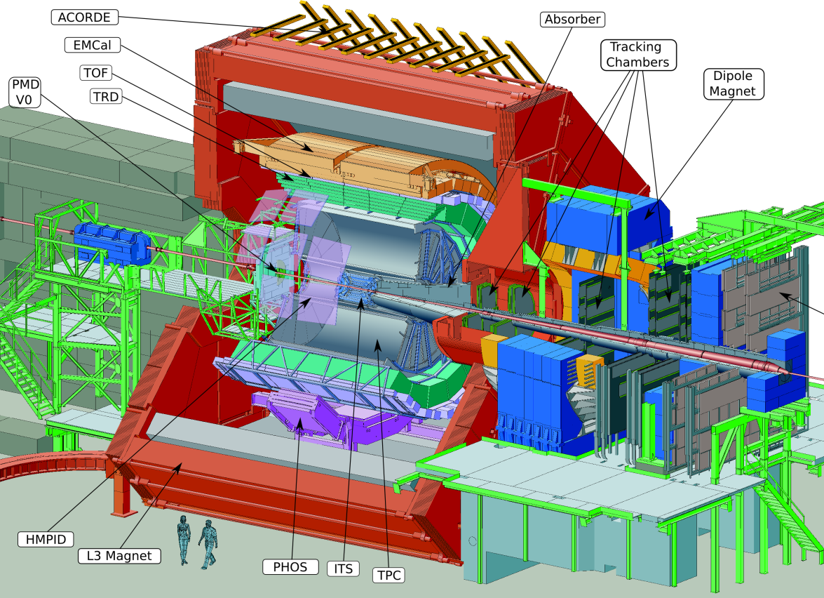
The ALICE detector
Not shown: ZDC
~116m from I.P.

Slide 5
Multiplicity measurement
dN_{ch}/dη = 1584 ± 4 (stat.) ± 76 (syst.)
Increase of (dN_{ch}/dη) larger than ln√s as initially suggested by the RHIC measurements
Increase of (dN_{ch}/dη)/<Ν_{part}>/2) with √s faster in AA than in p-p
  ~s^{0.11} for pp
  ~s^{0.15} for Pb-Pb
Larger value than most models predicted
Centrality dependence at the LHC similar to the one reported at RHIC energies
  RHIC points scaled by ~2.1
  Similarity due to centrality dependent shadowing of the nuclear PDF?
Phys. Rev. Lett. 105, 252301 (2010)
Phys. Rev. Lett. 106, 032301 (2011)

Slide 6
Identified particle spectra
Reconstruction and PID in ALICE:
Jouri Belikov, Tuesday@19:00, Parallel I
Particle spectra in pp used to
  constrain phenomenological models (many input parameters)
  reference for Pb-Pb (to be discussed later)
Particle spectra/ratios in A-A described by statistical models with only a handful of parameters (e.g. T_{kin}, T_{chem},μ_{Β}, γ_{s})
ALICE uses all available PID techniques to provide identification on a track-by-track basis (low momentum) and with statistical approaches (e.g. dE/dx in the relativistic rise)
TPC (σ_{dE/dx} ~ 5%)
combined TPC and TOF information
TOF (σ ~ 80 ps)

Slide 7
Identified particle spectra: collective radial flow
Strongly interacting medium + pressure gradient: isotropic radial flow
Stronger boost for heavier particles
Harder spectra at the LHC compared to RHIC
Blast wave fit ➔ average radial velocity and kinetic freeze-out temperature
  Central Pb-Pb collisions at the LHC <β>~0.66c
  ~10% larger <β> at the LHC compared to RHIC
Spectra compared to hydro calculations
  Inclusion of the rescattering phase (via UrQMD) essential to describe the spectra for the most central collisions
Particle spectra: Martha Spyropoulou Stassinaki, Monday@20:15, Parallel II

Slide 8
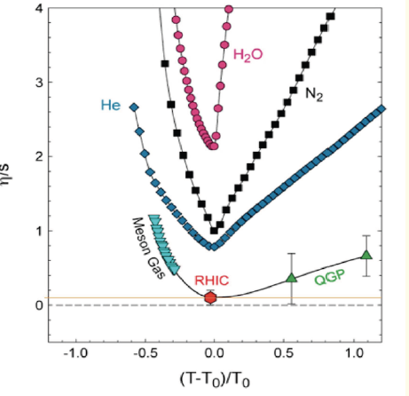
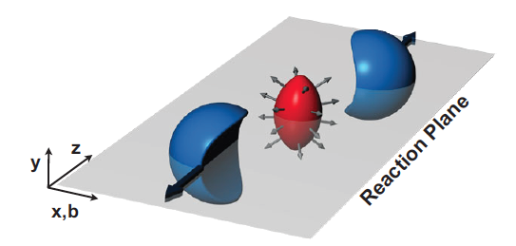
Elliptic flow
Flow from RHIC to LHC:
Raimond Snellings, Monday@11:20, Plenary II
Pressure gradient transforms the initial spatial anisotropy into the observed momentum-space anisotropy
Superposition of independent pp collisions:
momenta pointed at random
relative to reaction plane
Evolution as a bulk system:
Pressure gradients (larger in-plane) push bulk “out” → “flow”
Azimuthal distribution described by a Fourier expansion
Connection to η/s ➔ RHIC values close to the lower bound of 1/4π (hbar=c=1)
S. Voloshin and Y. Zhang, Z. Phys. C70, 665 (1996)

Slide 9
Elliptic flow: results
Phys. Rev. Lett. 105, 252302 (2010)
Similar centrality dependence but ~30% higher integrated v₂ value wrt RHIC
Predicted by hydro for a liquid with small value of shear viscosity
  “perfect liquid” picture applies also at the LHC
Particle mass dependence well reproduced by hydro calculations
  Stronger push for heavier particles by radial flow
Inclusion of a hadronic afterburner essential to match the differential v₂ of protons
Pure hydro gives reasonable for Ξ and Ω

Slide 10
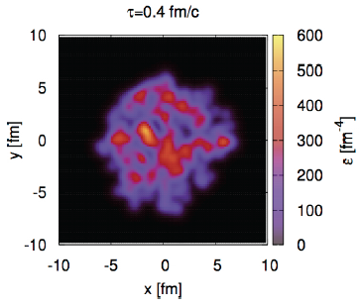
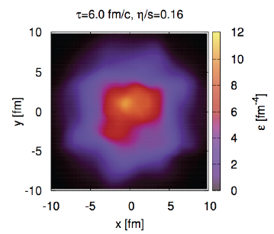
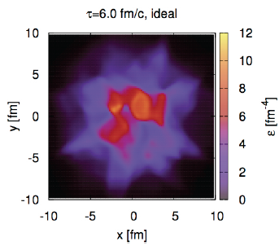
Initial state
Initial geometry not described by the ideal almond shape
  Fluctuations of initial energy/pressure distributions lead to “irregular” shapes that fluctuate event-by-event
  Higher (odd) harmonics each having its one symmetry plane
Higher harmonics more sensitive to the value of shear viscosity
But…initial conditions not known precisely enough (model dependent)
  Data can be described by different combinations of initial conditions + η/s

Slide 11
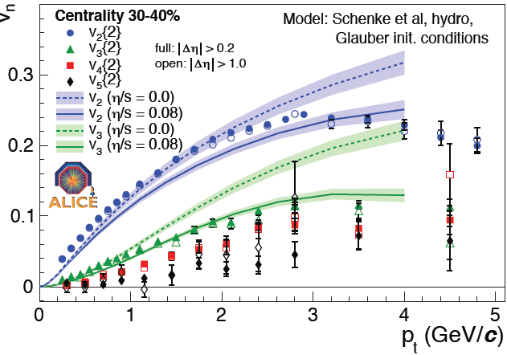
Triangular flow: results
Phys. Rev. Lett. 107, 032301 (2011)
Models can not describe successfully the elliptic and triangular flow with the same values of η/s
Similar mass splitting expected by hydro

Slide 12
High pt probes
LHC offers the possibility to study hard processes
  larger cross sections for high-p_{t} and larger mass particles
Two ways of studying the medium effects
  Compare yields of high-p_{t} particles in A-A to pp collisions
  Jet reconstruction
leading particle
leading particle
parton
parton
parton
parton
Modifications induced by the in-medium interactions

Slide 13
Nuclear modification factor
At low p_{t}: R_{AA} < 1 and rising due to thermal production
At high p_{t}: R_{AA} = 1 in case there are no modifications from the medium
Clear deviation of R_{AA} from unity, even for peripheral events
Larger suppression for central collisions
Consistent with the picture of radiative energy loss due to increasing path length of partons in the medium

Slide 14
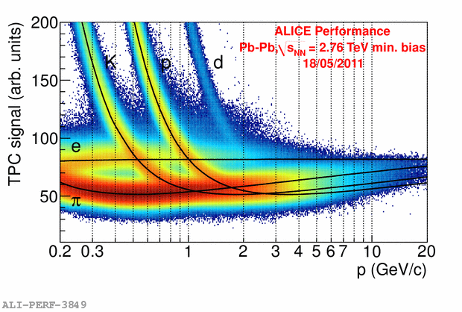
Nuclear modification factor (PID)
Select pions/protons using the dE/dx in the relativistic rise

Slide 15
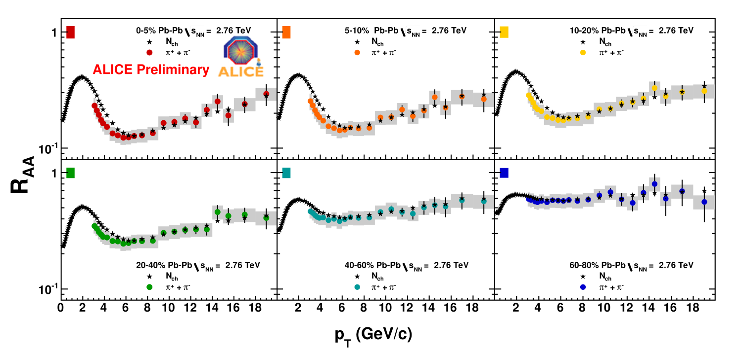
Nuclear modification factor (π): results
Smaller R_{AA} than the non-identified particles for p_{t} < 6GeV/c
Compatible with the R_{AA} of non-identified particles for p_{t} > 6GeV/c

Slide 16
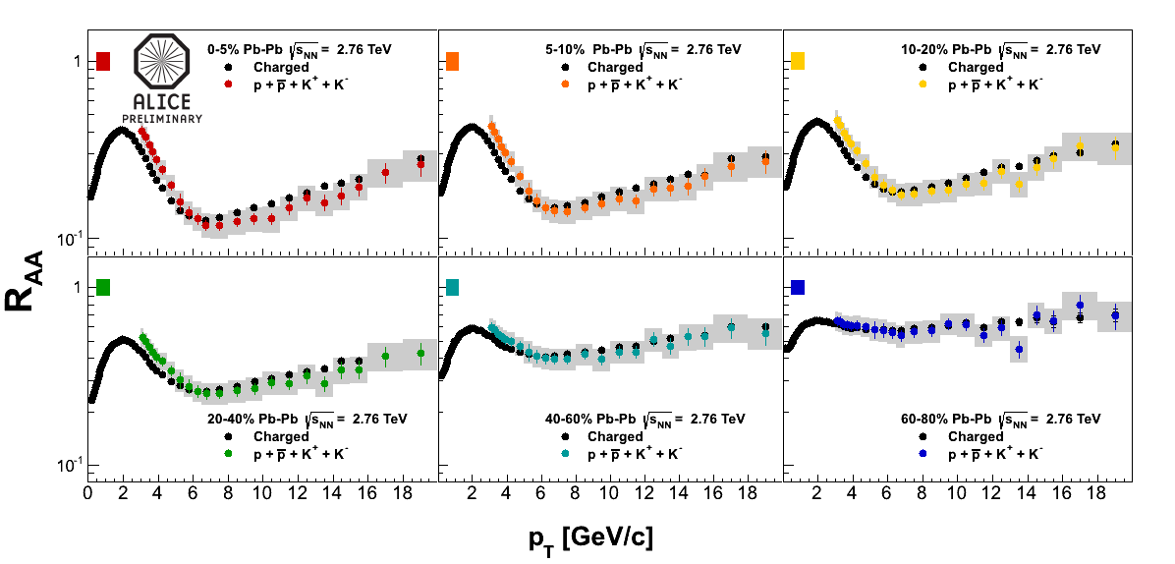
Nuclear modification factor (K+p): results
Larger R_{AA} than the non-identified particles for p_{t} < 6GeV/c
Compatible with the R_{AA} of non-identified particles for p_{t} > 6GeV/c

Slide 17
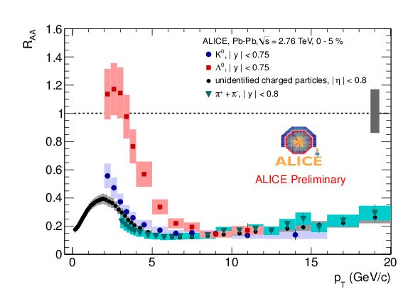
Nuclear modification factor: Summary
Larger R_{AA} than the non-identified particles for p_{t} < 6GeV/c for K⁰_{s} and Λ
  Manifestation of radial flow?
R_{AA} for K⁰_{s} and Λ compatible with the one for non-identified particles for p_{t} > 6GeV/c

Slide 18
Heavy flavors
Theory predicts a hierarchy in the energy loss for gluons, light and heavy quarks
  ΔΕg > ΔΕ(u,d,s) > ΔΕ(c,b) ➔ R_{AA}(π) < R_{AA}(D) < R_{AA}(B) (dead cone effect)
At the LHC, we can profit from the higher production cross-section for c and b quarks to test this prediction
D⁰->Κπ
Open heavy-flavor measurements: Sarah Louise Lapointe, Thursday@19:00, Parallel IV

Slide 19
Nuclear modification factor: D-mesons
arXiv:1203.2160 [nucl-ex]
D⁰, D⁺, D* R_{AA} compatible within statistical uncertainties
For 0-20% a suppression of ~3-4 for p_{t} > 5GeV/c
For 40-80% a suppression of ~1-3 for p_{t} > 5GeV/c
Similar R_{AA} with non-identified charges but systematically higher

Slide 20
Heavy flavor elliptic flow
Elliptic flow measured with the event plane method at two centralities
First indication of a non-vanishing v₂ for D⁰
Elliptic flow values compatible with the charged hadrons within the large uncertainties.

Slide 21
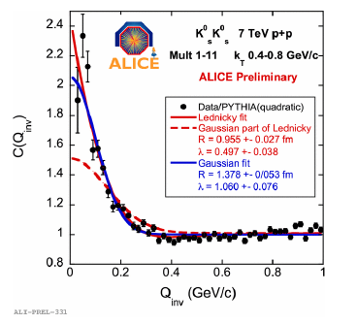
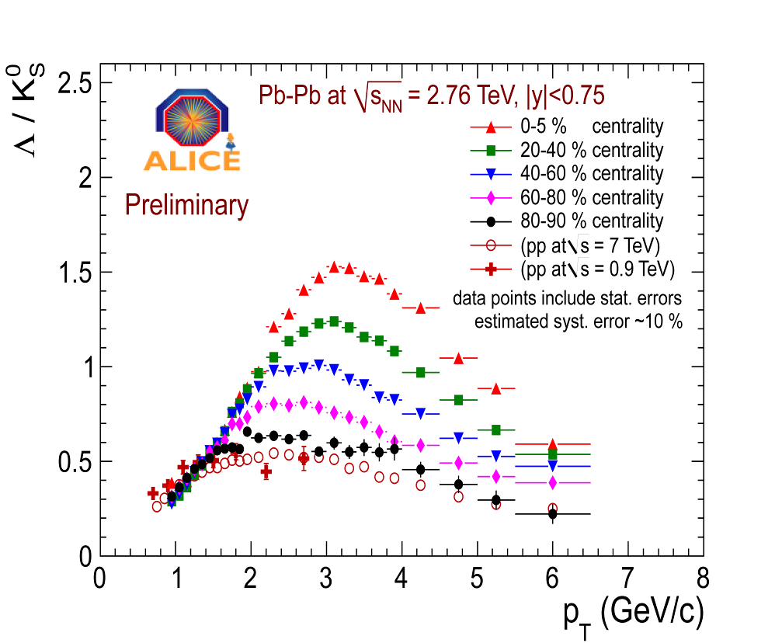
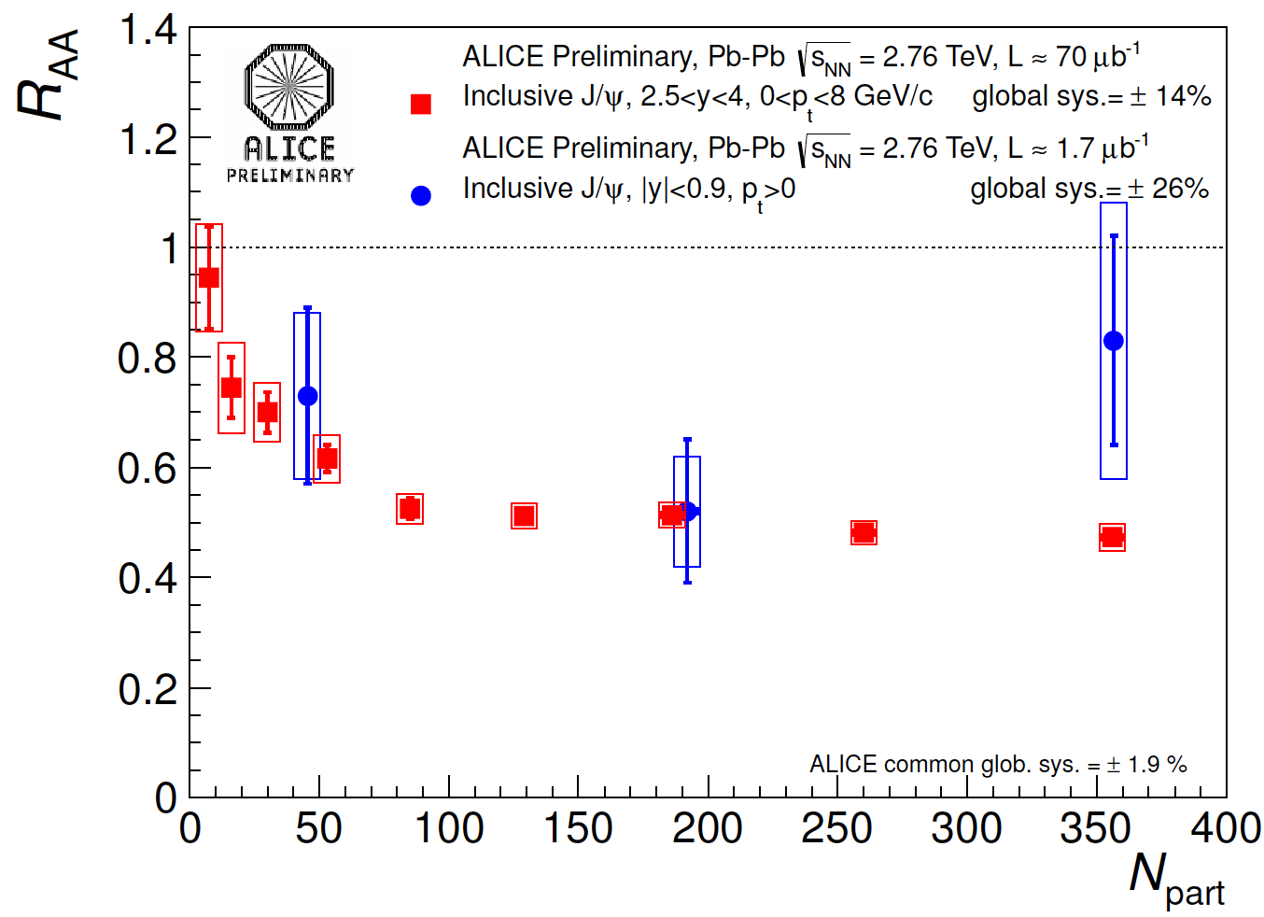
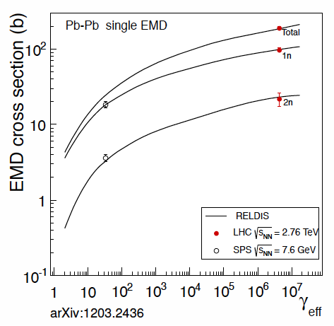
ALICE topics @ ICFP not covered in this talk
Femtoscopic results: Dhevan Gangadharan, Friday@18:45, Parallel I
Directed flow: Gyulnara Eyyubova, Friday@19:35, Parallel I
Baryon/meson “anomaly”: Christian Kuhn, Friday@16:20, Parallel I-1
J/Ψ measurements: Christoph Blume, Thursday@19:25, Parallel IV
E/M dissociation: Pietro Cortese, Friday@16:20, Parallel IV-1

Slide 22
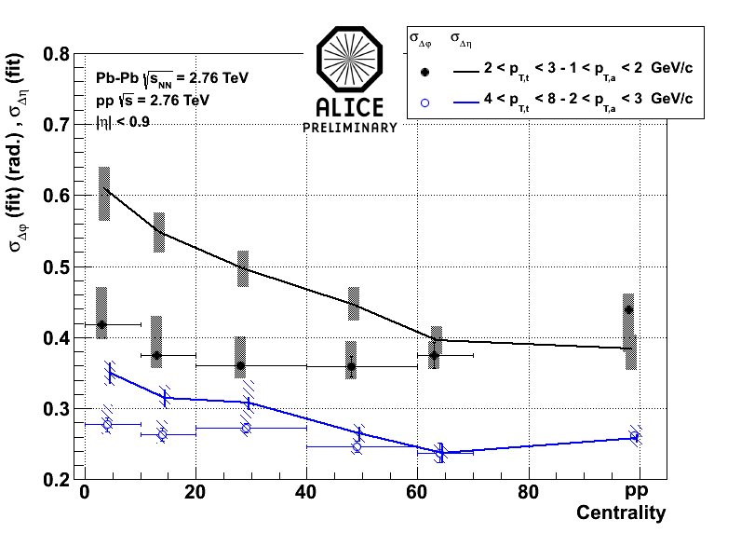
Instead of a summary…
p/π in the jet vs bulk
Charged particle jet
charged hadron correlations
And many more…
Chiral magnetic effect studies
Charged hadron correlations with the balance functions
Fluctuations: electric charge, transverse momentum, multiplicity
p-Pb running in 2012

Slide 23
BACKUP

Slide 24
Transverse energy

Slide 25
Thermal model
sdd

Slide 26
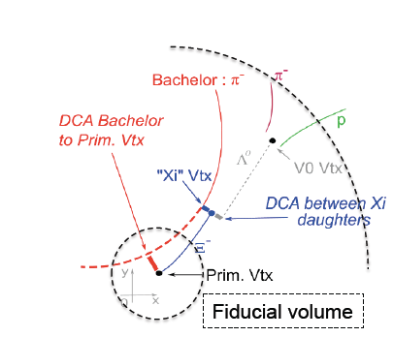
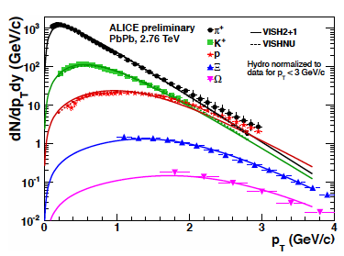
Identified particle spectra (cont.)
Spectra compared to hydro calculations
  VISH2+1: pure hydro
  VISHNU: hydro coupled to the hadronic afterburner
Reasonable description from pure hydro

Slide 27
Nuclear modification factor

Slide 28
I_{AA}

Slide 29
Elliptic flow at high pt
arXiv:1205.5761 [nucl-ex]
Sensitive to path length dependence of jet quenching
Finite v₂ and v₃ even for p_{t} > 8GeV/c
Quadrangular flow (v₄) ~ 0 for p_{t} > 8GeV/c

Slide 30
Elliptic flow at high pt
Mass dependence visible even at high pt

