Slide 1

Search for permanent
Electric Dipole Moments of light ions
(p, d, 3He) in storage rings
June 14, 2012 Frank Rathmann
On behalf of the JEDI collaboration
International Conference on New Frontiers in Physics
10-16 June 2012
Kolymbari, Crete, Greece

Slide 2
Topics
  Why EDMs?
  Search for EDMs using storage rings
  Two projects, at BNL and Jülich
  Spin coherence time
  First direct measurement
    Resonance Method with RF E(B) -fields
  Summary

Slide 3
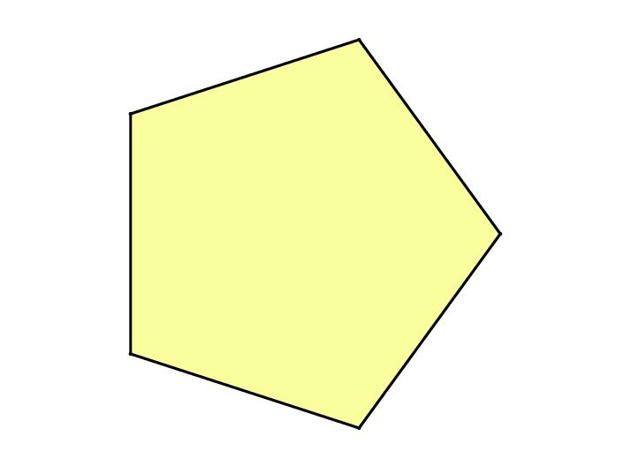
Mega-ton
Detectors
Stability (p-decay)
Neutrino physics
LHC
Super-beam
Factories
Intensity
Mass (Higgs)
Supersymmetry
Extra Dimensions
The
Scientific
Frontiers
to address
well-defined questions
about the physics
of our World
Energy
CKM
ν Mass
QGP
Cosmic Particles
Dark Matter
Dark Energy
Dedicated
Small-scale
Facilities
Precision
Cosmic
Underground
Labs,
Non-accelerator
Symmetries
(TRV, EDM)
Complexity
RHIC
Matter → Materials
QCD phase diagram
Radiation Facilities

Slide 4

What caused the Baryon asymmetry?
Carina Nebula: Largest-seen star-birth regions in the galaxy
Observed | 6×10⁻¹⁰ | WMAP+COBE (2003)
SM expectation | ~10⁻¹⁸
Sakharov (1967): Three conditions for baryogenesis
B number conservation violated sufficiently strongly
C and CP violated, B and anti-Bs with different rates
Evolution of universe outside thermal equilibrium

Slide 5
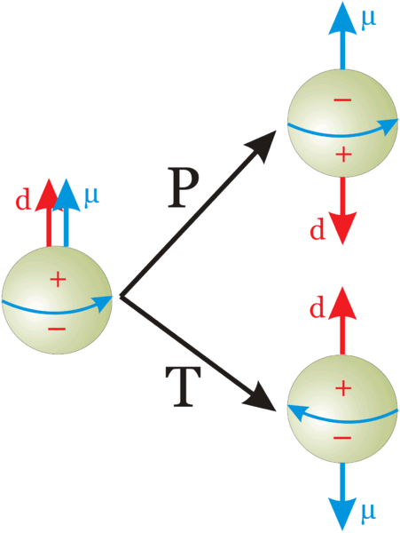
Electric Dipole Moments (EDMs)
Permanent EDMs violate parity P and time reversal symmetry T
Assuming CPT to hold,
combined symmetry CP violated as well.
EDMs are candidates to solve mystery of matter-antimatter asymmetry
→ may explain why we are here!
Notes:
5
5

Slide 6
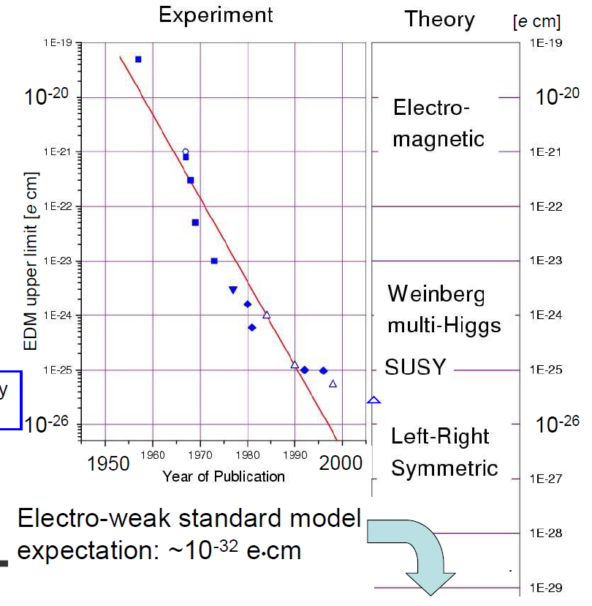
History of neutron EDM limits
Smith, Purcell, Ramsey
PR 108, 120 (1957)
RAL-Sussex-ILL
(d_{n} < 2.9 ×10⁻²⁶ e⋅cm)
PRL 97,131801 (2006)
Adopted from K. Kirch

Slide 7
Limits for Electric Dipole Moments
EDM searches - only upper limits up to now (in e⋅cm):
Particle/Atom | Current EDM Limit | Future Goal | ∼ d_{n} equivalent
Neutron | < 3 ×10⁻²⁶ | ∼10⁻²⁸ | 10⁻²⁸
¹⁹⁹Hg | < 3.1 ×10⁻²⁹ | ∼10⁻²⁹ | 10⁻²⁶
¹²⁹Xe | < 6 ×10⁻²⁷ | ∼10⁻³⁰ – 10⁻³³ | ∼10⁻²⁶ – 10⁻²⁹
Proton | < 7.9 ×10⁻²⁵ | ∼10⁻²⁹ | 10⁻²⁹
Deuteron | ? | ∼10⁻²⁹ | 3 ×10⁻²⁹ – 5 ×10⁻³³
Huge efforts underway to improve limits / find EDMs
Sensitivity to NEW PHYSICS beyond the Standard Model
485. WE-Heraeus-Seminar (July 04−06, 2011)
Search for Electric Dipole Moments (EDMs) at Storage Rings
http://www2.fz-juelich.de/ikp/edm/en/
Notes:
7
7

Slide 8
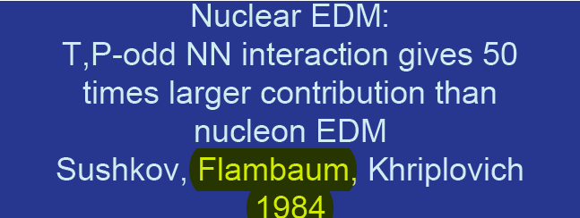
Why also EDMs of protons and deuterons?
Proton and deuteron EDM experiments may provide one order higher sensitivity.
In particular the deuteron may provide a much higher sensitivity than protons.
Consensus in the theoretical community:
Essential to perform EDM measurements on different targets (p, d, ³He) with similar sensitivity:
unfold the underlying physics,
explain the baryogenesis.

Slide 9
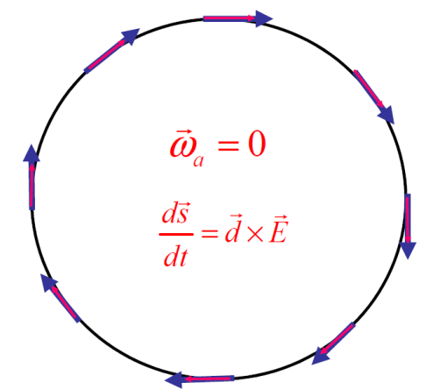
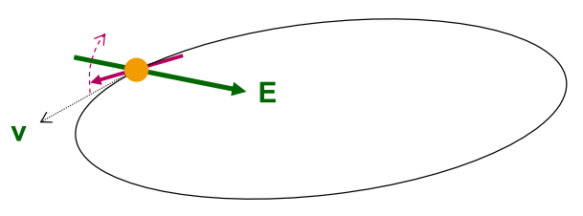
Search for Electric Dipole Moments
NEW: EDM search in time development of spin in a storage ring:
“Freeze“ horizontal spin precession; watch
for development of a vertical component !
Notes:
9
9

Slide 10
The frozen spin Method
For transverse electric and magnetic fields in a ring ( ),
anomalous spin precession is described by
x
Magic condition: Spin along momentum vector
For any sign of G, in a combined electric and magnetic machine
For G>0 (protons) in an all electric ring
(magic)

Slide 11
Magic condition: Protons
E-field only

Slide 12
Magic condition: Deuterons
E and B fields

Slide 13
Magic condition: Helions
E and B fields

Slide 14
Search for Electric Dipole Moments
NEW: EDM search in time development of spin in a storage ring:
“Freeze“ horizontal spin precession; watch
for development of a vertical component !
A magic storage ring for protons (electrostatic), deuterons, …
particle | p (GeV/c) | E (MV/m) | B (T)
proton | 0.701 | 16.789 | 0.000
deuteron | 1.000 | -3.983 | 0.160
³He | 1.285 | 17.158 | -0.051
One machine with r ~ 30 m
Notes:
14
14

Slide 15
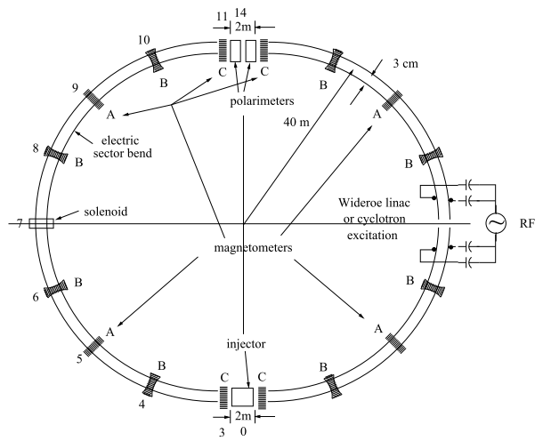
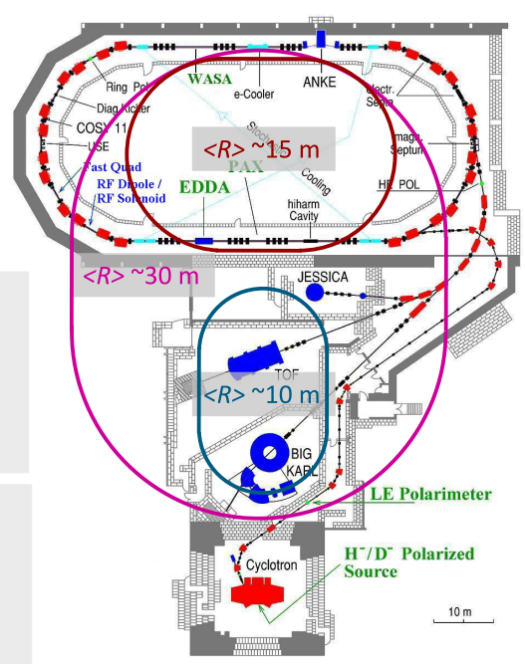
Two storage ring projects being pursued
BNL for protons all electric machine
Jülich, focus on deuterons,
or a combined machine
CW and CCW propagating beams
(from R. Talman)
(from A. Lehrach)

Slide 16
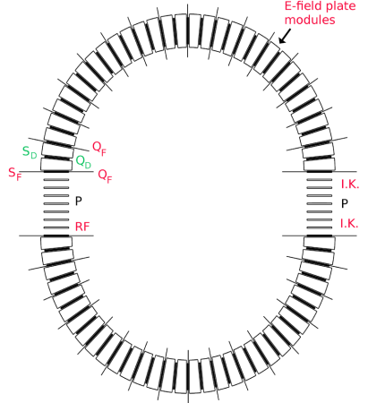
BNL Proposal
2 beams simultaneously rotating in a ring (CW, CCW)
Approved BNL-Proposal
Submitted to DOE
Goal for protons
Circumference
~ 200 m
Technological challenges !
Spin coherence time (1000 s)
Beam positioning (10 nm)
Continuous polarimetry (< 1ppm)
E - field gradients (~ 17MV/m at 2 cm)
Carry out proof of principle experiments (demonstrators) at COSY
Notes:
16
16

Slide 17
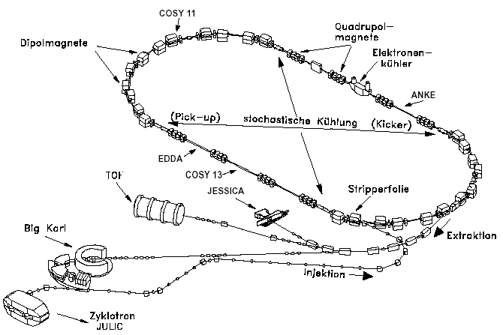
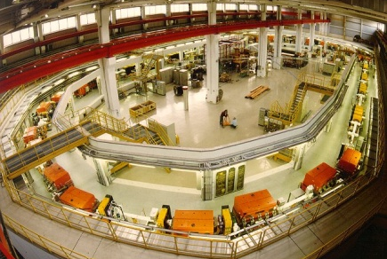
EDM at COSY – COoler SYnchrotron
Cooler and storage ring for (polarized) protons and deuterons
p = 0.3 – 3.7 GeV/c
Phase space
cooled internal &
extracted beams
COSY
… the spin-physics machine
for hadron physics
Injector cyclotron
Notes:
17

Slide 18
EDM at COSY – COoler SYnchrotron
Cooler and storage ring for (polarized) protons and deuterons
p = 0.3 – 3.7 GeV/c
Phase space
cooled internal &
extracted beams
COSY
… an ideal starting point
for a srEDM search
Injector cyclotron
Notes:
18

Slide 19
Spin closed orbit
one particle with
magnetic moment
makes one turn
“spin closed orbit vector”
“spin tune”
stable polarization
ring
if ║
A
Adopted from H.O. Meyer

Slide 20
Spin coherence
We usually don‘t worry about coherence of spins along
Polarization not affected!
At injection all
spin vectors aligned (coherent)
After some time, spin vectors get out of phase and fully populate the cone
Situation very different, when you deal with ⊥
Longitudinal polarization vanishes!
At injection all spin vectors aligned
After some time, the spin vectors are all out of phase and in the horizontal plane
In an EDM machine with frozen spin, observation time is limited.

Slide 21
Estimate of spin coherence times (N.N. Nikolaev)
One source of spin coherence are random variations of the spin tune
due to the momentum spread in the beam
and
is randomized by e.g., electron cooling
Estimate:
Spin coherence time for deuterons may be ~100 larger than for protons

Slide 22
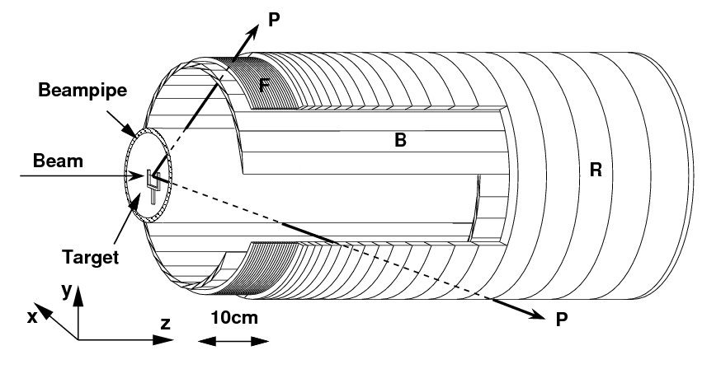
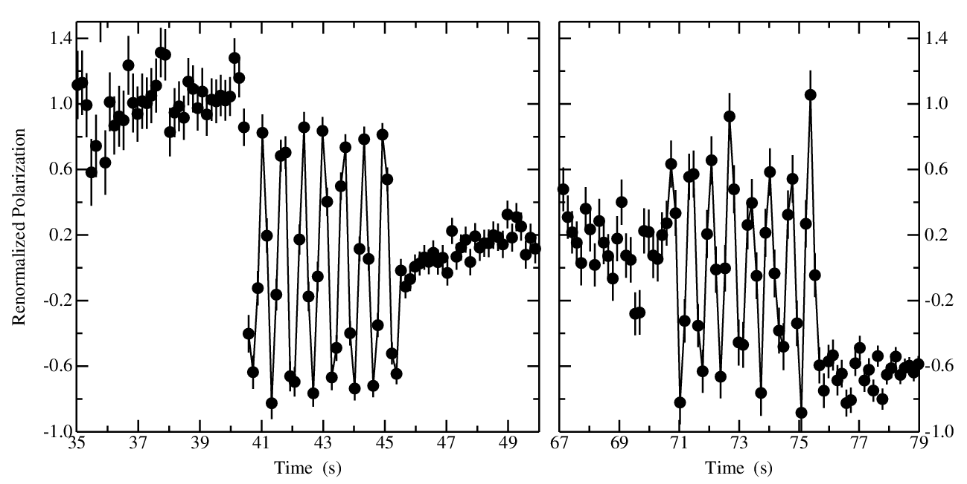
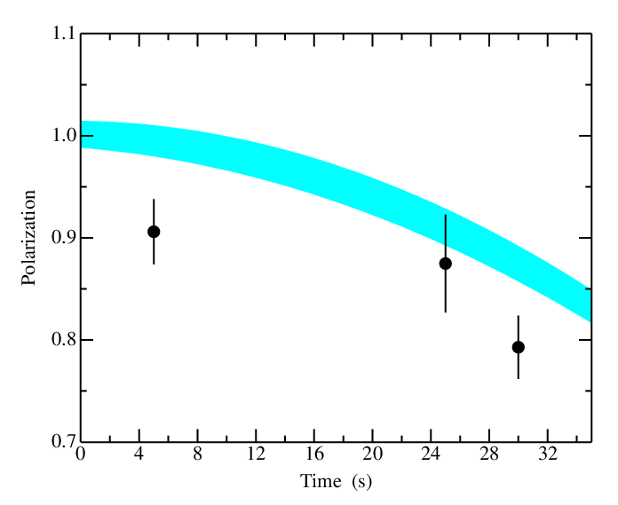
First measurement of spin coherence time
2011 Test measurements at COSY
Polarimetry:
Spin coherence time:
5 s
25 s
5 s
decoherence
time
oscillation
capture
from E. Stephenson

Slide 23
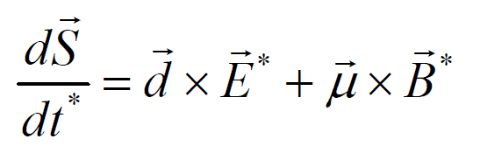
Resonance Method with RF E-fields
spin precession governed by:
(* rest frame)
Two situations:
  B*=0 ⇒ B_{y} = β×E_{R} (= 70 G for E_{R}=30 kV/cm) EDM effect
  E*=0 ⇒ E_{R} = -β× B_{y} no EDM effect
vertical polarization
RF E-field
stored d
Polarimeter (dp elastic)
This way, the Edm signal gets accumulated during the cycle.
Statistical improvement over single turn effect is about: .
Brings us in the 10⁻²⁴ e⋅cm range for d_{d}

Slide 24
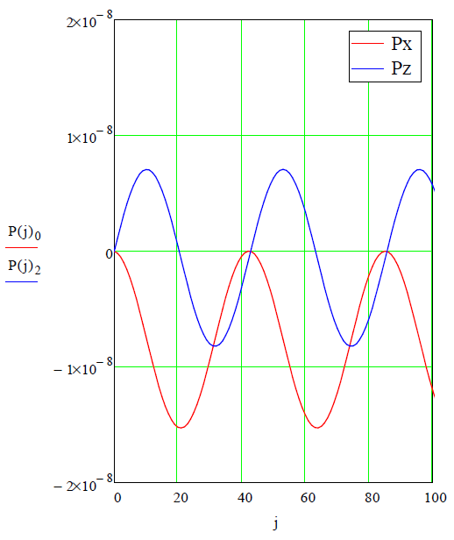
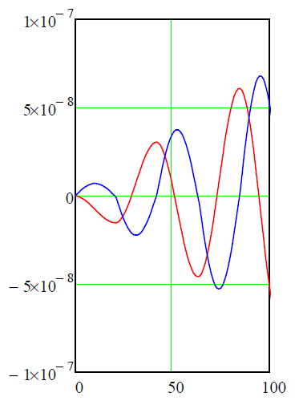
Simulation of resonance Method with RF E-fields for deuterons at COSY
Parameters: beam energy T_{d}=50 MeV
assumed EDM d_{d}=10⁻²⁰ e⋅cm
E-field 10 kV/cm
E-field reversed every
-π/(G⋅γ) ∼ 21 turns
Constant E-field
Number of turns
Number of turns

Slide 25
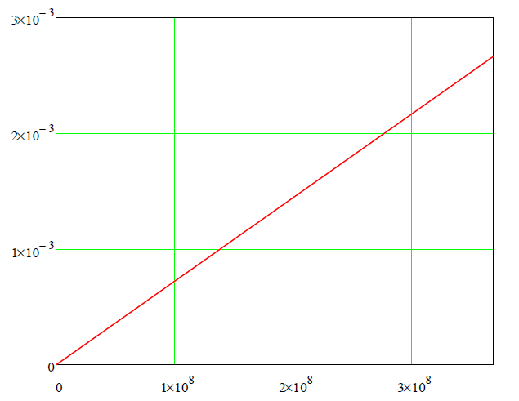
Simulation of resonance Method with RF E-fields for deuterons at COSY
Parameters: beam energy T_{d}=50 MeV
assumed EDM d_{d}=10⁻²⁰ e⋅cm
E-field 10 kV/cm
Linear extrapolation of for a time period of τ_{sc}=1000 s (=3.7⋅10⁸ turns)
EDM effect accumulates
Polarimeter determines
P_{x}, P_{y} and P_{z}
Number of turns

Slide 26
Resonance Method with RF E(B)-fields
Approach pursued for a first direct measurement at COSY
Radial RF-E and vertical RF-B fields to observe spin rotation due to EDM
Two situations:
  B*=0 ⇒ B_{y} = β×E_{R} (= 70 G for E_{R}=30 kV/cm) „Direct“ EDM effect
  E*=0 ⇒ E_{R} = -β× B_{y} „Magic RF Wien Filter“ no Lorentz force
„Indirect“ EDM effect
Tilt of precession plane
due to EDM
RF E(B)-field
Transverse polarization
Observable:
Accumulation of vertical
polarization during spin
coherence time
stored d
Polarimeter (dp elastic)
Statistical sensitivity for d_{d} in the range 10⁻²³ to 10⁻²⁴ e⋅cm range possible
Alignment and field stability of ring magnets
Imperfection of RF-E(B) flipper

Slide 27
Technically driven timeline for pEDM at BNL
12
13
14
15
16
17
18
19
20
21
Two years R&D/preparation
One year final ring design
Two years ring/beam-line construction
Two years installation
One year “string test”

Slide 28
Stepwise approach in the JEDI project
Step | Aim / Scientific goal | Device / Tool | Storage ring
1 | Spin coherence time studies | Horizontal RF-B spin flipper | COSY
 | Systematic error studies | Vertical RF-B spin flipper | COSY
2 | COSY upgrade | Orbit control, magnets, … | COSY
 | First direct EDM measurement at 10⁻²⁴ e⋅cm | RF-E(B) spin flipper | Modified COSY
3 | Built dedicated all-in-one ring for p, d, ³He | Common magnetic-electrostatic deflectors | Dedicated ring
4 | EDM measurement of p, d, ³He at at 10⁻²⁴ e⋅cm |  | Dedicated ring
Time scale: Steps 1 and 2: < 5 years
Steps 3 and 4: > 5 years

Slide 29
srEDM cooperations
International srEDM Network
Institutional (MoU) and Personal (Spokespersons …) Cooperation, Coordination
srEDM Collaboration (BNL)
(spokesperson Yannis Semertzidis)
JEDI Collaboration (FZJ)
(spokespersons: A. Lehrach, J. Pretz, F.R.)
Common R&D
      RHIC EDM-at-COSY
  Beam Position Monitors Polarimetry
  (…) Spin Coherence Time
  Cooling
Spin Tracking (…)
Study Group
DOE-Proposal (submitted)
First direct measurement
Ring Design
CD0, 1, …
HGF Application(s)
pEDM Ring at BNL
JEDI

Slide 30
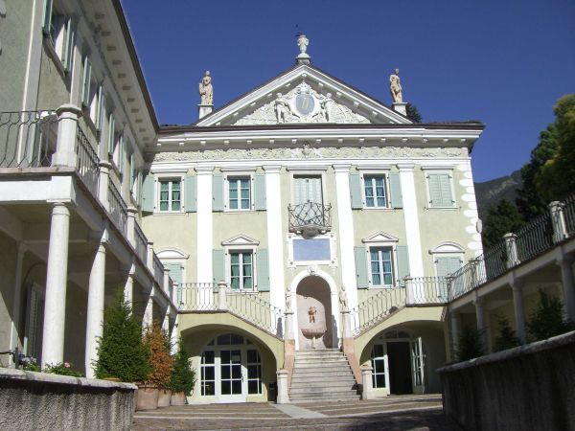
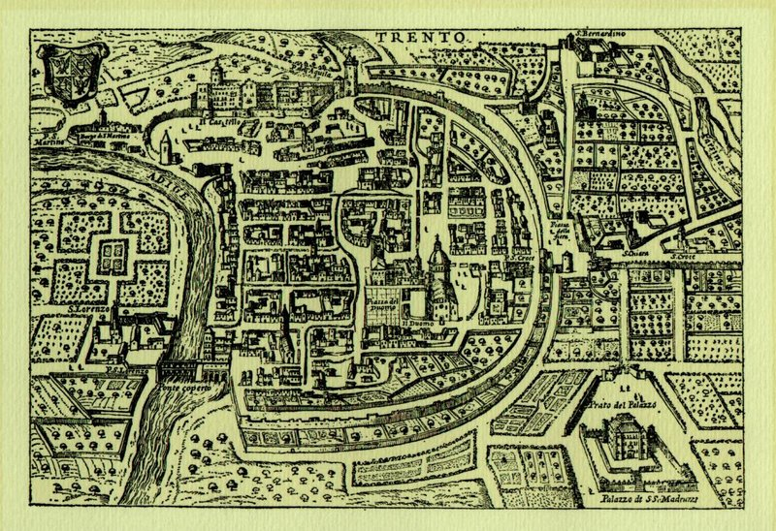
EDM Workshop at ECT* (Trento)
October 1-5, 2012
http://www.ectstar.eu/
Organizing committee
Jülich
Hans Ströher h.stroeher@fz-juelich.de
Frank Rathmann f.rathmann@fz-juelich.de
Andreas Wirzba a.wirzba@fz-juelich.de
Brookhaven
Mei Bai mbai@bnl.gov
William Marciano marciano@bnl.gov
Yannis Semertzidis yannis@bnl.gov

Slide 31
Summary
Measurement of EDMs extremely difficult,
but the physics is fantastic!
Two storage ring projects, at BNL and Jülich
Pursue spin coherence time measurements at COSY
First direct measurement at COSY
    Resonance Method with RF E(B) -fields
New JEDI collaboration established

Slide 32
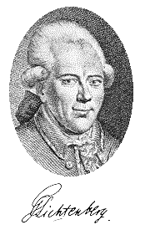
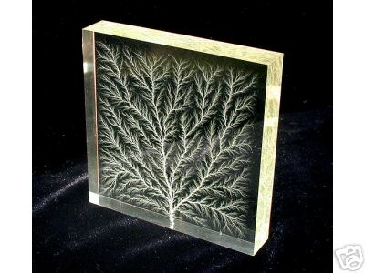
Georg Christoph Lichtenberg (1742-1799)
“Man muß etwas Neues machen, um etwas Neues zu sehen.”
“You have to make (create) something new,
if you want to see something new”

Slide 33
Spare transparencies
Notes:
33
33

Slide 34
COSY: Concept for Snake
Should allow for flexible use at two locations
Fast ramping (< 30s), with injection of P_{y}
Cryogen-free system
Should be available in 2012
ANKE
ANKE
PAX
PAX
 | B⋅dl (Tm)
pn→{pp}_{s}π⁻ at 353 MeV | 3.329
PAX at COSY 140 MeV | 1.994
PAX at AD 500 MeV | 4.090
T_{max} at COSY 2.88 GeV | 13.887

Slide 35
One backup slide for olrov

Slide 36
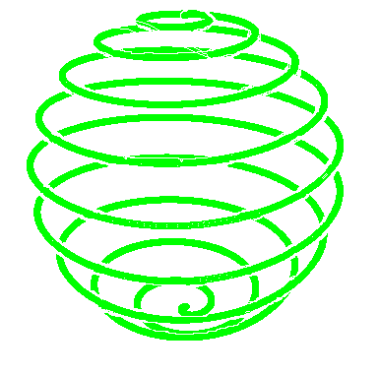
spin manipulation
180º
snakes
there is an for every point of the orbit
Snakes (non-vertical B field) affect
flippers
spin closed orbit
ramping through a resonance reverses

Slide 37
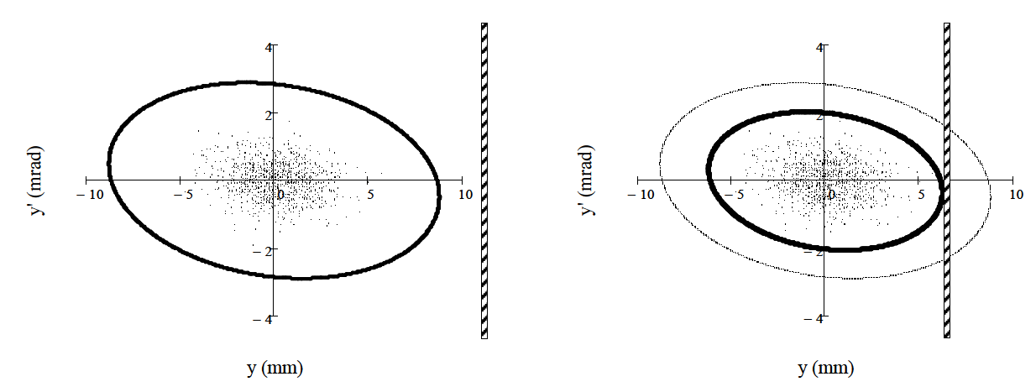
Machine acceptance
In an ideal machine (like TSR-HD)
→ Single-Coulomb scattering at the target dominates beam loss
cooled
beam
ring acceptance
target
lost
K. Grigoriev et al., NIMA 599,130 (2009)
Notes:
Vertical phase space: A_{y} = 25 π mm mrad, and a beam emittance of ε_{y} = 3.8 π mm mrad

Slide 38
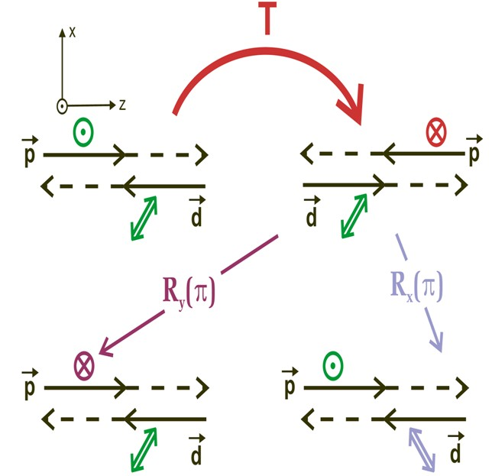
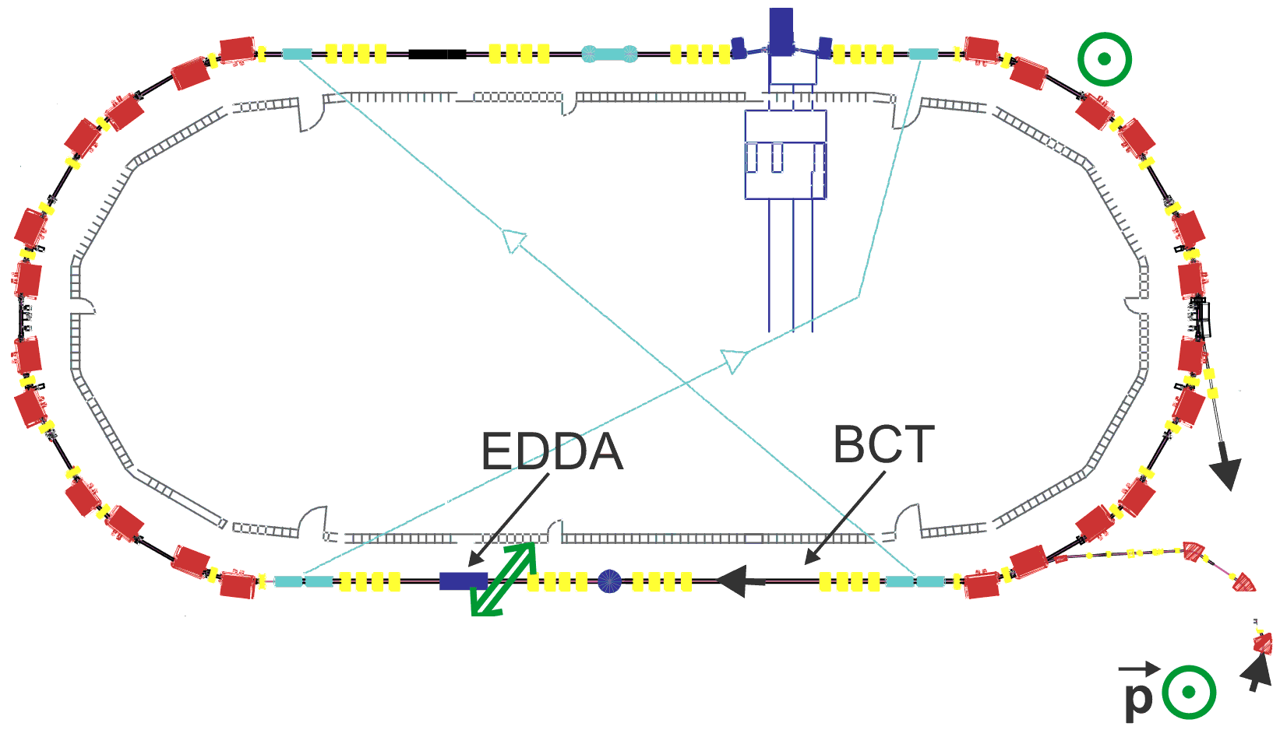
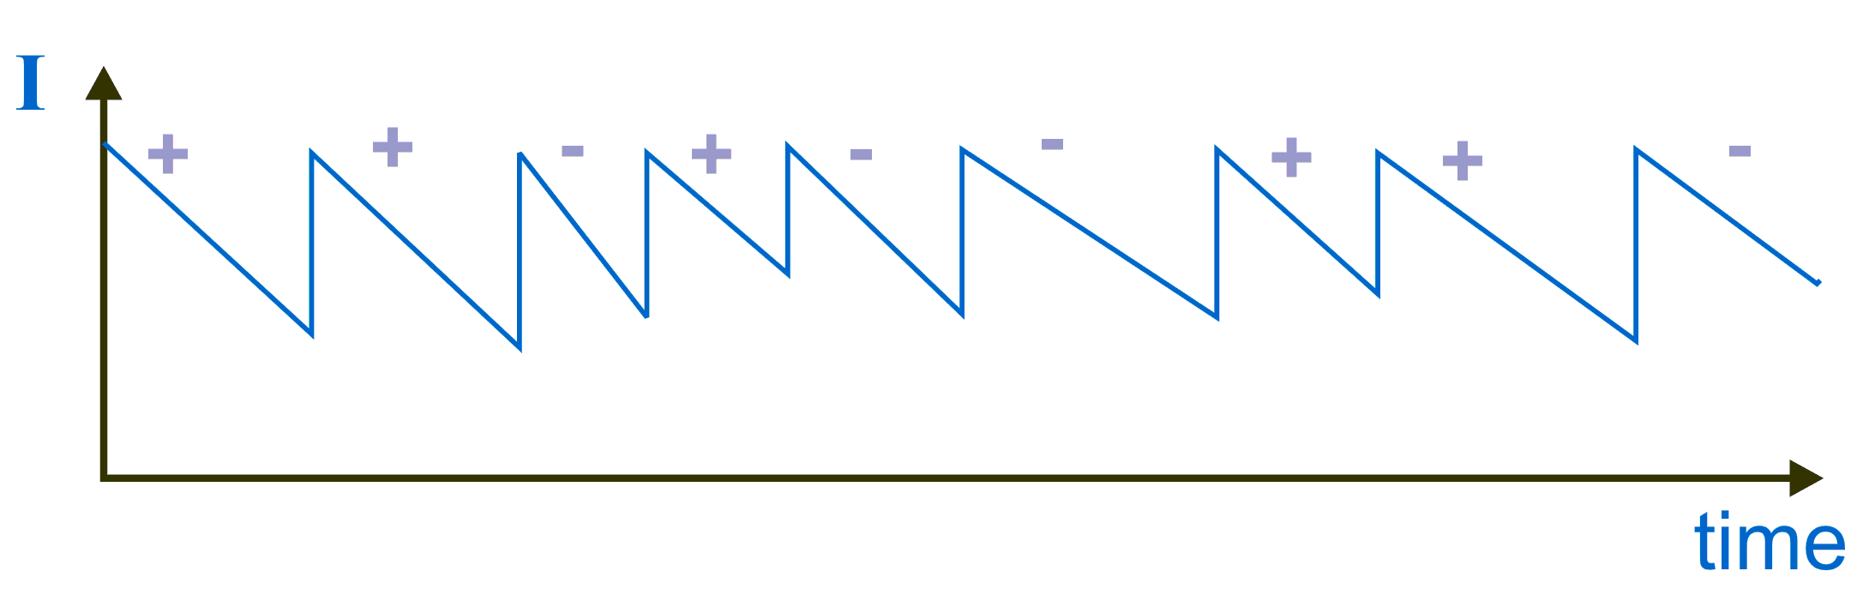
Future: Time Reversal Invariance Test
COSY-TRIC: P-even, T-odd
COSY used as accelerator and detector:
Total polarization correlation coefficient A_{y,xz} leads to relative difference of current slopes
I_{Beam}
time
PAX
Milestone: Operation of Precision BCT with ΔI/I<10⁻⁴

Slide 39
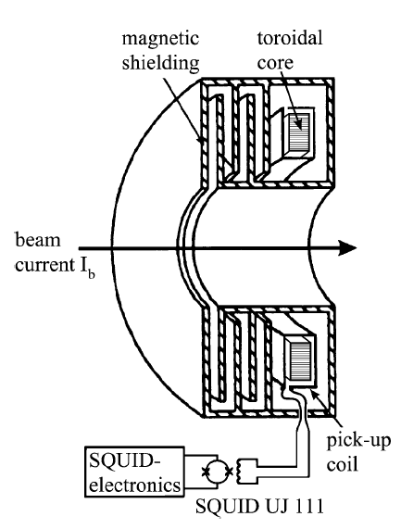
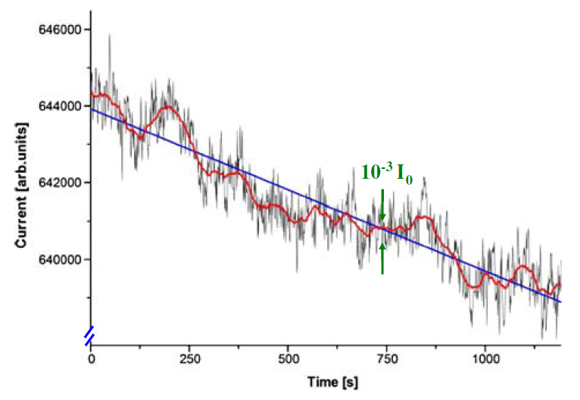
Need for a high precision BCT
Status TRI Test at COSY
Slow fluctuations in the measured BCT signal exceed the noise band at higher frequencies
Possible solution:
Cryogenic Current Comparator,
read out by low-temperature super-conducting quantum interference device
D. Eversheim Hyperfine Interact 193 (2009)
A. Steppke, IEEE Trans. Appl. Superc. (2009)
Highest resolution achieved: 250 pA/√Hz

Slide 40
Freezing Spin Precession with E-Fields
G > 0 for γ > 1, if only electric fields are applied
Magic momentum for protons: p = 700.74 MeV/c
μ_{p} / μ_{N} = 2.792 847 356 (23) → G_{p} = 1.7928473565
μ_{d} / μ_{N} = 0.857 438 2308 (72) → G_{d} = -0.14298727202
μ_{He-3} / μ_{N} = -2.127 497 718 (25) → G_{3He}= -4.1839627399
Nuclear magneton: μ_{N} = eħ / (2m_{p}c) = 5.050 783 24 (13) · 10⁻²⁷ J T⁻¹

