Slide 1
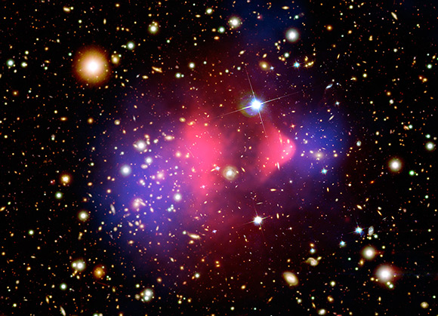



Indirect search for Dark Matter with the
ANTARES neutrino telescope
Paolo Fermani
on behalf of the ANTARES collaboration
Conference on New Frontier in Physics – ICFP 2012, Kolymbari, Crete

Slide 2
Outline
Dark Matter
The ANTARES experiment
Dark Matter analysis in ANTARES
Conclusions and Future prospects
On going analysis: search towards the Sun (reported here) and the Galactic Centre.
Description and characteristics;
See talk by Andreas Gleixner.
Results from the Sun and search towards the Galactic Centre, Earth and Dwarf galaxies.
The WIMPs scenario.

Slide 3
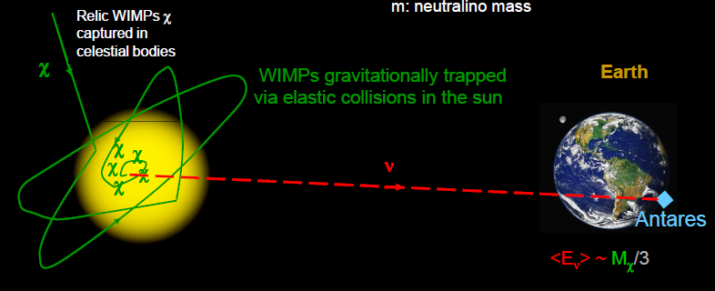
Dark Matter
Astrophysical evidences (galaxy rotational velocity, existence of galaxy clusters, lensing, CMB...)
Several models and DM candidates were proposed in different scenarios (WIMPs, KK particles…)
This presentation focuses on the WIMP (Weakly Interacting Massive Particles) model of Dark Matter arising from SUSY CMSSM theory.
WIMPs gravitationally captured in massive objects (Sun, Earth) or present in Galactic Centre or Dwarf Galaxies, self-annihilate producing neutrinos that can be detected on Earth with large Neutrino Telescopes like ANTARES.

Slide 4
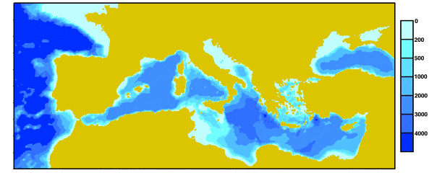
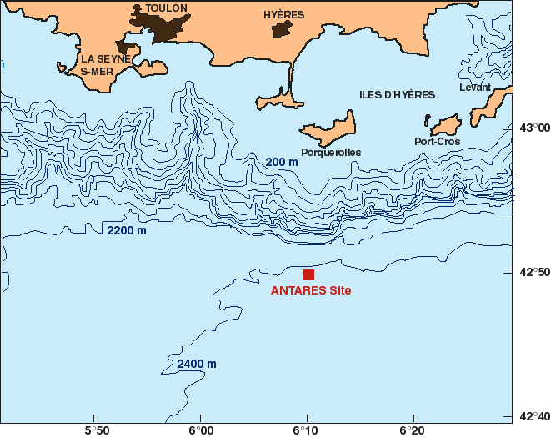
The ANTARES detector
The ANTARES deep submarine Cherenkov detector is located in the Mediterranean Sea in the south coast of France (Toulon) at ≈ 2500 m depth.
The detector construction started in 2006 and was
COMPLETED in 2008.
During the construction period the detector was able to take data, although in reduced configuration.
The analysis presented here uses data collected in 2007-2008.
In year 2007 → 5 operative lines;
In year 2008 → 9,10,12 operative lines.
In this period ≈ 1000 up-going neutrino candidates were collected
(for a livetime ≈ 295 days).

Slide 5
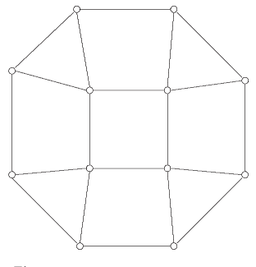
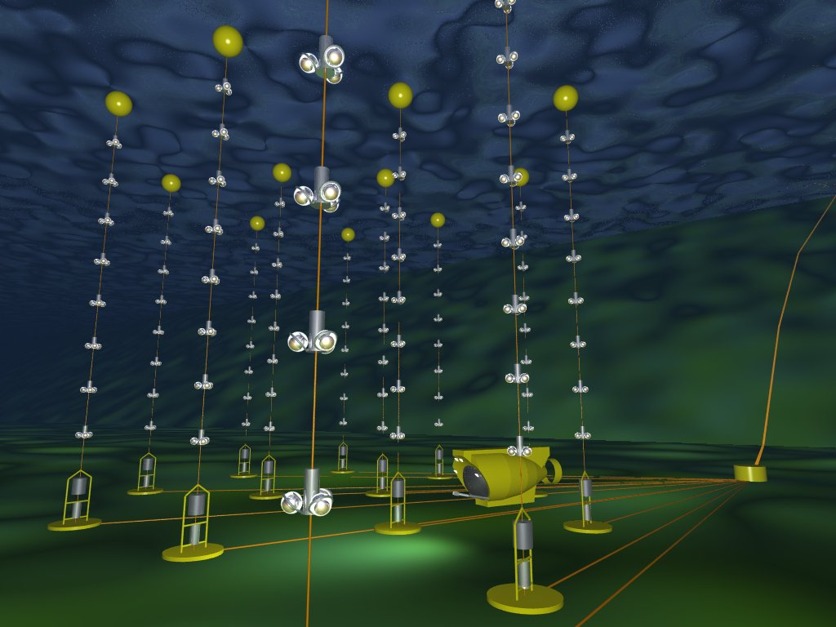
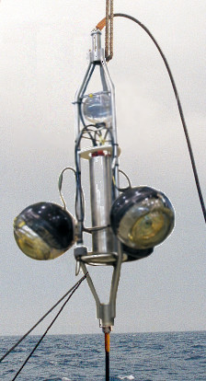
12 lines (875 PMTs)
25 storeys / line
3 PMT / storey
Buoy
Horizontal layout
14.5 m
Storey
350 m
100 m
Junction
box
~60-75 m
Electro-optical cable
Readout cables

Slide 6
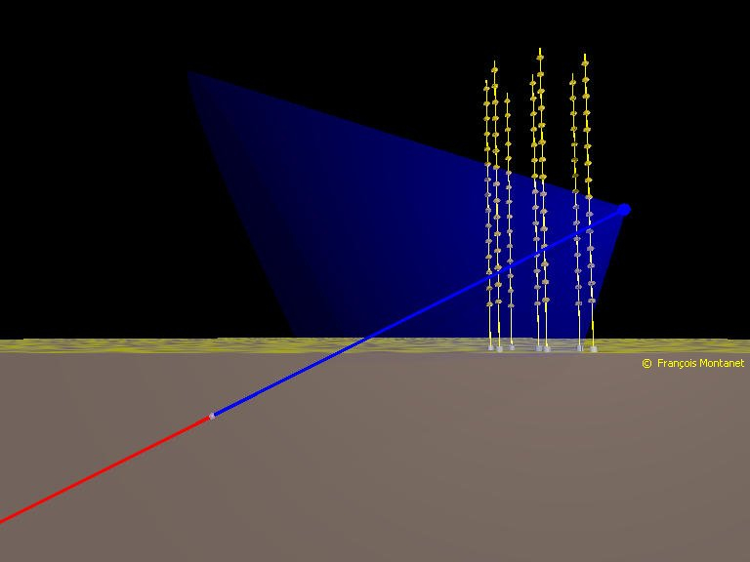
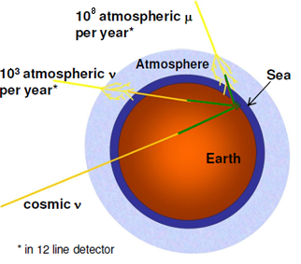
Neutrino event reconstruction
The event selection and reconstruction are based on fast and reliable algorithms (J.A. Aguilar et al., Astropart. Phys. 34 (2011) 652-662, arXiv:1105.4116);
The main background sources are atmospheric neutrinos (down going and up going) and muons (down going), which distributions can be modeled through Monte Carlo simulations.
PMT array lines of the detector
Cherenkov cone
Sea floor
μ
ν_{μ}
Interaction in the Earth
(M. Ageron et al., Nucl. Instrum. Meth. A 656 (2011) 11-38, arXiv:1104.1607)

Slide 7
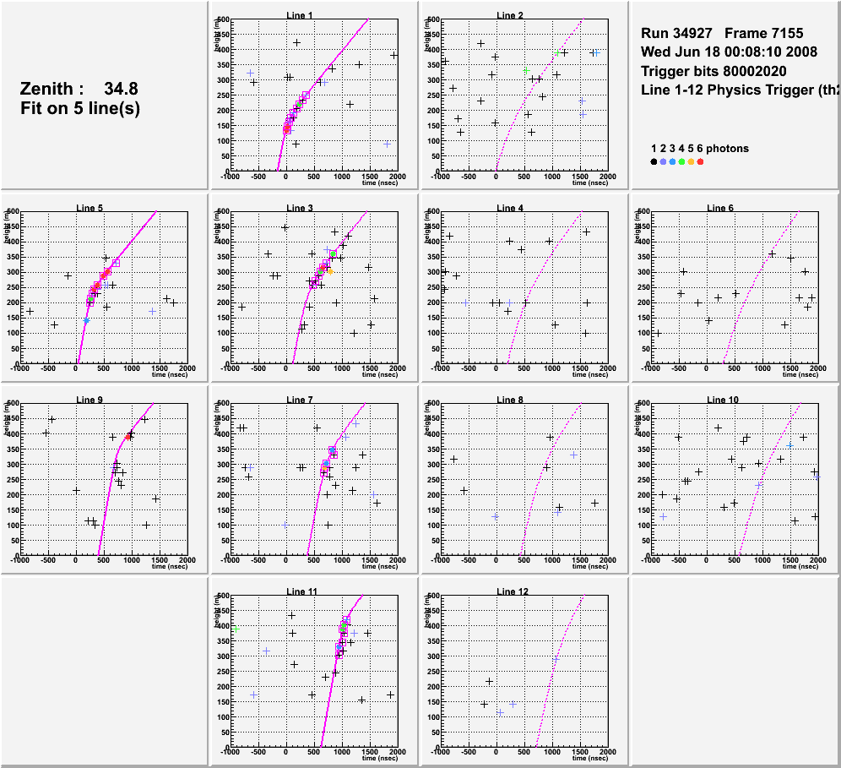
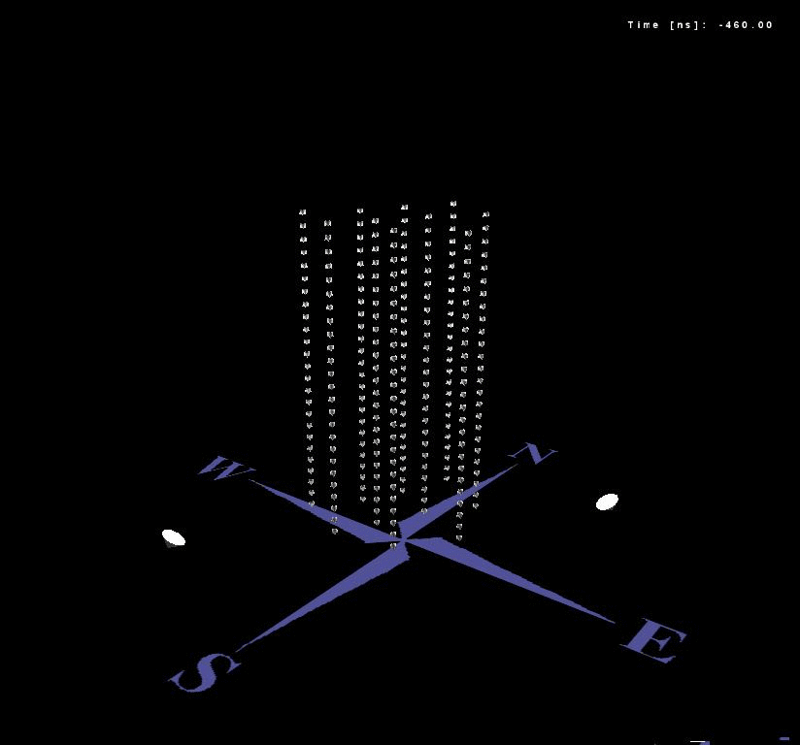
Neutrino event reconstruction
Height (m) →
Time (ns) →

Slide 8
Indirect Dark Matter search
The indirect Dark Matter search with the ANTARES detector is a binned search.
This search is performed towards the direction of some important astrophysical objects that are candidate goals for dark matter:
the Earth, the Sun, the Galactic Centre and the Dwarf galaxies.
All objects must have a large exposure time below the horizon to reduce the atmospheric muons background.
DM from SUN: very advanced state → UNBLINDED;
DM from Galactic Centre: on going;
DM from the Earth: on going;
DM from Dwarf galaxies: just started.
In the following I will talk about the Sun analysis with 07-08 data

Slide 9
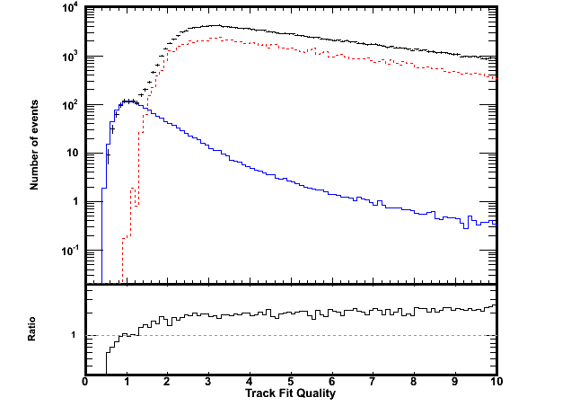
Data-MC: track fit quality
Searching for up-going events
horizon
elevation
Muons
Neutrinos
Data
elevation < 0
Since tracks are selected with elevation < 0, the muon contribution is due to badly reconstructed down going muons.
For low values of the track fit quality parameter (tchi2) the muon background is negligible.

Slide 10
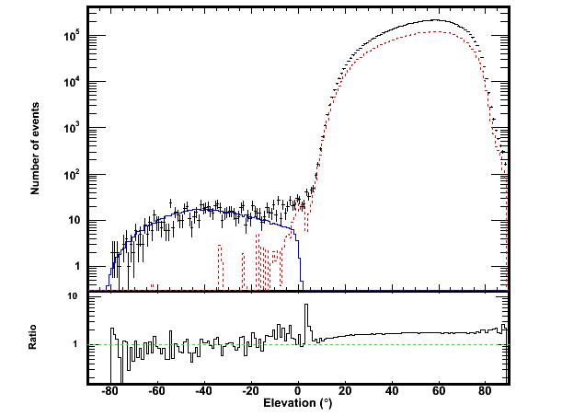
Data-MC: elevation
Searching for up-going events
Good agreement between data and Monte Carlo below the horizon.
Muons
Neutrinos
Data
Track fit quality cuts applied
horizon
elevation
The muon contribution to the up going sample is negligible (after the track fit quality cuts)

Slide 11
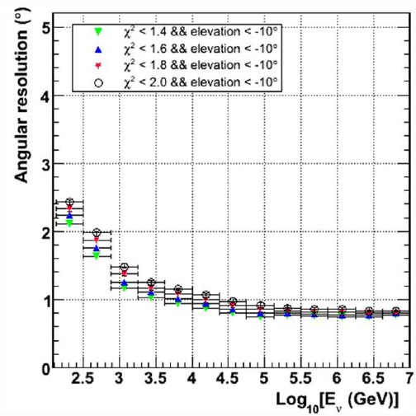
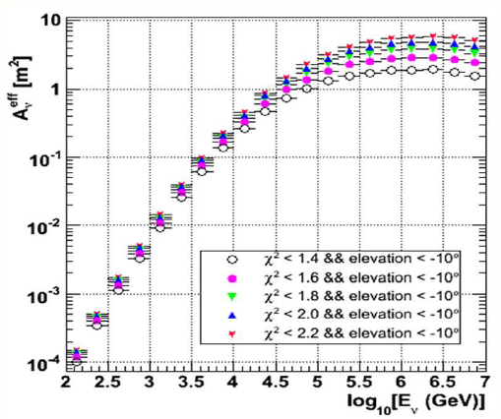
Angular resolution and Effective area
On the left plot: the Θ_{μν} angular resolution of the ANTARES detector for selected up-going events as a function of E_{ν}(GeV);
On the right plot: the effective area, A_{ν}^{eff}, as a function of E_{ν}(GeV).
A_{ν}^{eff}(E_{ν}) allows to evaluate the detector acceptance and then the
sensitivity to neutrino fluxes.
By J. Brunner
By J. Brunner
Notes:
Angular resol = mediana

Slide 12
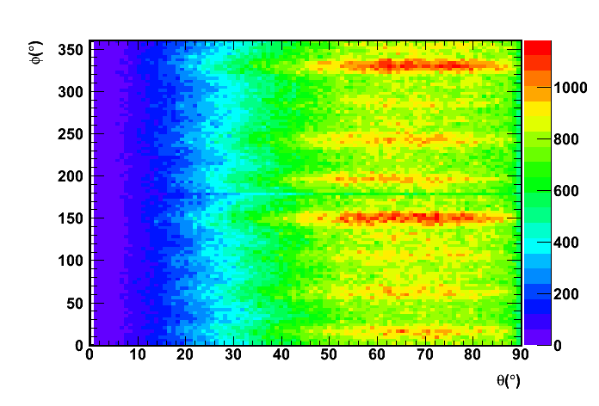
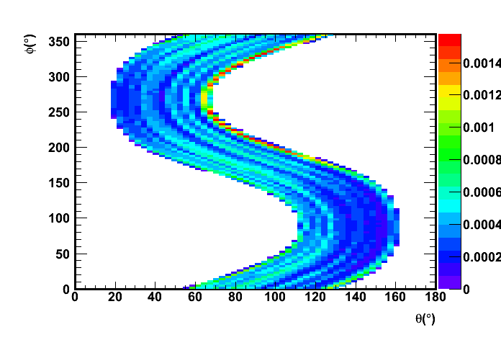
Background in the Sun direction
θ
Left plot is reported the distribution of up-going background events (scrambled data) in the local coordinate system (θ,φ).
Right plot an example of the Sun visibility (on the ANTARES location) in the period of data taking 2007-2008 in the same coordinates.
horizon
φ
above the horizon
below the horizon
All up-going events in 2007-2008 data
By G. Lambard
Example of Sun tracking
Notes:
Background due to neutrinos from the CR interaction in the Sun’s corona negligible (<1% of the atmospheric neutrinos)

Slide 13
Dark Matter signal: WIMPSim
In this analysis the WIMPSim package (Blennow, Edsjö, Ohlsson, JCAP 0801:021,2008, arXiv:0709.3898) was used to simulate the neutrino flux from
the Sun in a model independent way:
Large statistics with 3×10⁶ WIMPs annihilation;
Capture rate and annihilations in equilibrium at the Sun core;
Annihilations in c, b and t quarks, τ leptons, WW, ZZ bosons and direct channels
Neutrino interactions in the Sun’s medium taken into account;
Three flavors oscillation, regeneration of τ leptons in the Sun’s medium (Bahcall et al.)
Available parameters: WIMPs mass, oscillation parameters…
(http://copsosx03.physto.se/wimpsim/)

Slide 14
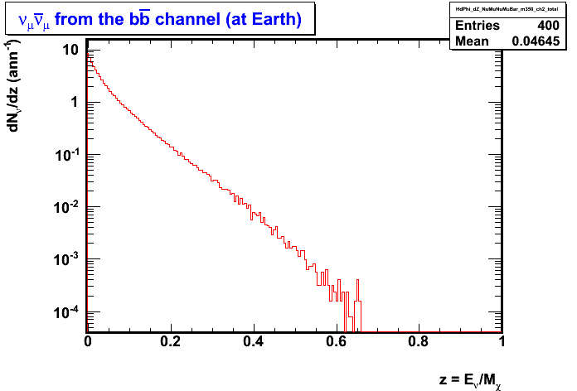
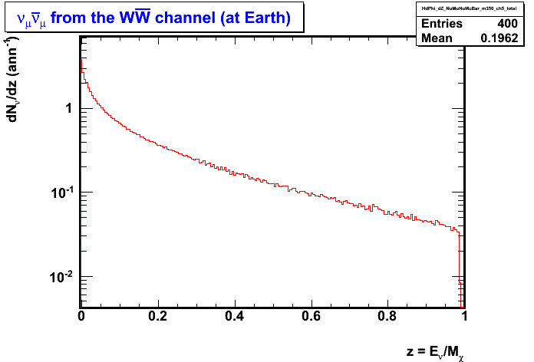
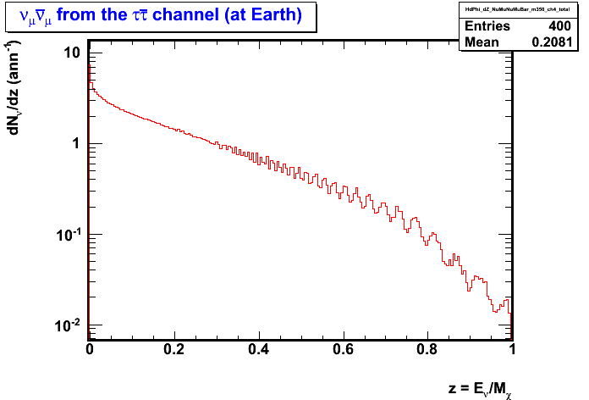
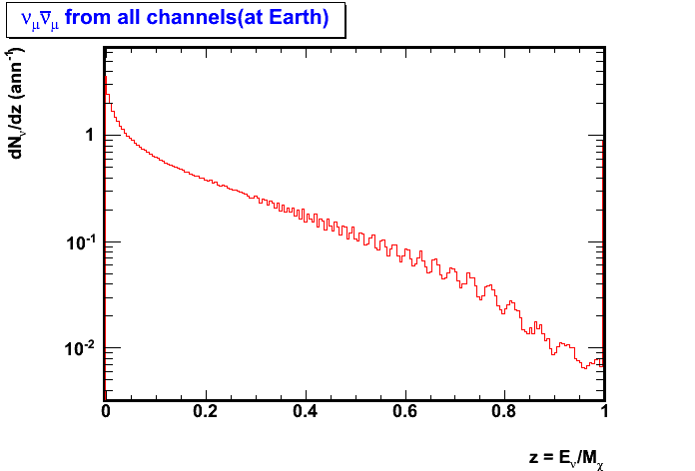
ν spectra of main annihilation channels
M_{WIMP} = 350 GeV
ν_{μ}ν_{μ} from the bb channel of SUSY (at Earth)
ν_{μ}ν_{μ} from the W⁺W⁻ channel of SUSY (at Earth)
dN/dz(ann⁻¹)
z = E_{ν}/M_{χ}
ν_{μ}ν_{μ} from the τ⁺τ⁻ channel of SUSY (at Earth)
ν_{μ}ν_{μ} from all channels of mUED (at Earth)
By G. Lambard

Slide 15

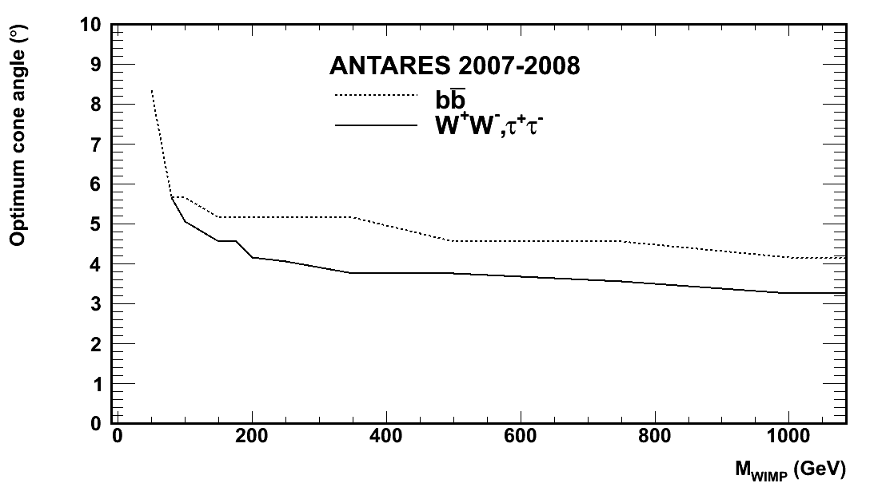
Optimization and efficiency
Neutrino fluxes at the Earth, from the Dark Matter annihilation, are convoluted with the detector efficiency for a selected set of parameters (track fit quality, half-cone angle);
Neutrino background given by the scrambled data in the Sun direction is evaluated for the same selection set;
Optimization (following Feldman&Cousins statistics) of the sensitivity is obtained minimizing this quantity:
By G. Lambard
By G. Lambard
By G. Lambard
Effective area (efficiency) evaluated for different DM models
Optimum cone angle as a function of WIMP mass

Slide 16
Sensitivity for neutrino flux
Neutrino flux sensitivity for ANTARES 2007-2008 unblinded data
PRELIMINARY
For CMSSM:
Branching ratios = 1
(WW, bb, ττ).
(High dependence of branching ratios over the CMSSM parameter space).
For mUED:
Theoretical branching ratios taken into account.
By G. Lambard

Slide 17
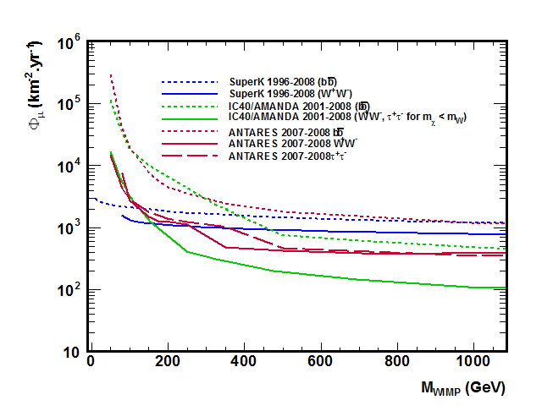
Sensitivity for muon flux
Muon flux sensitivity for ANTARES 2007-2008 unblinded data
PRELIMINARY
Flux Φ_{μ}
Annihilation rate Γ
Capture rate C
Cross-section
σ_{SD}
By G. Lambard

Slide 18
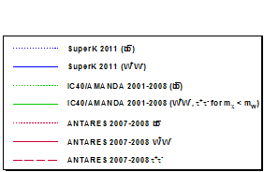
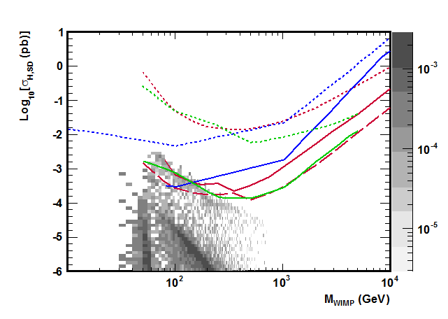
Sensitivity for SD CMSSM cross-section
Spin-dependent cross-section flux sensitivity for ANTARES 2007-2008 unblinded data
PRELIMINARY
Compare the ANTARES limits on SUSY predictions together with other experiments results: IceCube/Amanda, SuperK
SuperBayes
(Feroz et al. JHEP 1106:042,2011,arXiv:1101.3296)
By G. Lambard

Slide 19
Sensitivity for SD mUED cross-section
Spin-dependent cross-section flux sensitivity for ANTARES 2007-2008 unblinded data
PRELIMINARY
Compare the ANTARES limits on SUSY predictions together with the IceCube experiments results.
SuperBayes
modified version
(Bertone et al., Phys.Rev.D83:036008,
2011, arXiv:1010.2023)
1σ
2σ
By G. Lambard

Slide 20
Conclusions and Future prospects
Indirect search for Dark Matter is a goal for the large neutrino telescopes like ANTARES;
Complementarity with the direct search.
In the Sun analysis with 2007-2008 data presented here, the detector efficiency for two common Dark Matter models (CMSSM, mUED) was computed, evaluating the background in the Sun direction in a 2D parameter space;
For the same models the sensitivity was evaluated also in the spin dependent case.
The Sun analysis with 2007-2010 data is ready for results;
The Galactic Centre analysis with 2007-2010 data is in progress;
On going the Earth and Dwarf galaxies analysis.

Slide 21
Thank you
for
your attention!
Paolo Fermani for ICFP 10-16 June 2012
Kolymbari - Crete (Greece)

