Slide 1





Higgs Searches at the Tevatron
Alexei N. Safonov
Texas A&M University
(for CDF & D0 Collaborations)

Slide 2
Outline
Higgs searches at the Tevatron
  Channels, strategies, relevance in the overall landscape
Improvements since Summer 2011
  Focus on H→bb channels
Winter 2012 results and combination
Plans and summary

Slide 3
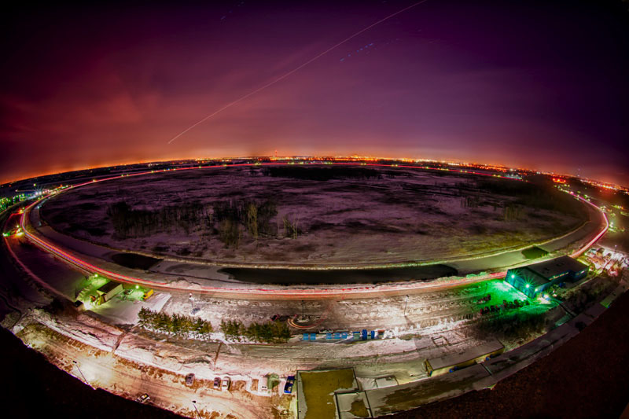
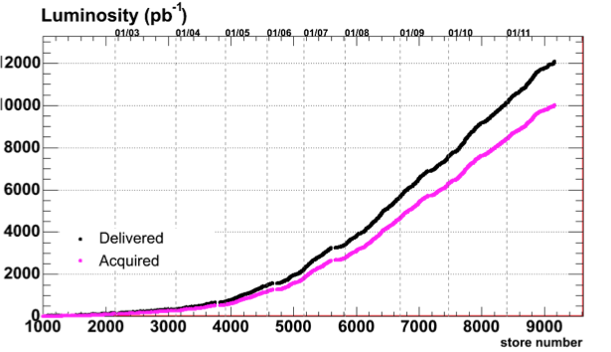
Tevatron Collider (1983-2011)
pp collider at E_{cm} = 1.96 TeV
  Two detectors: CDF & D0
Records:
  Peak lumi:4.3x10³²cm⁻²s⁻¹
  Best week: 85 pb⁻¹
Run II: 2001-2011
  12 fb⁻¹ delivered
  10 fb⁻¹ collected (per exp.)
Delivered 12 fb⁻¹
Collected > 10 fb⁻¹
Last collision on Sep 30th 2011
Over 25 years of data-taking and exciting physics results
  Top discovery, B_{S} oscillations, single top, W mass etc.
Data →
Time →

Slide 4
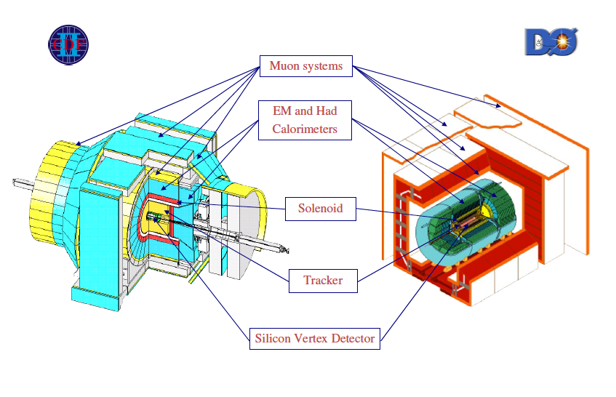
The Experiments

Slide 5
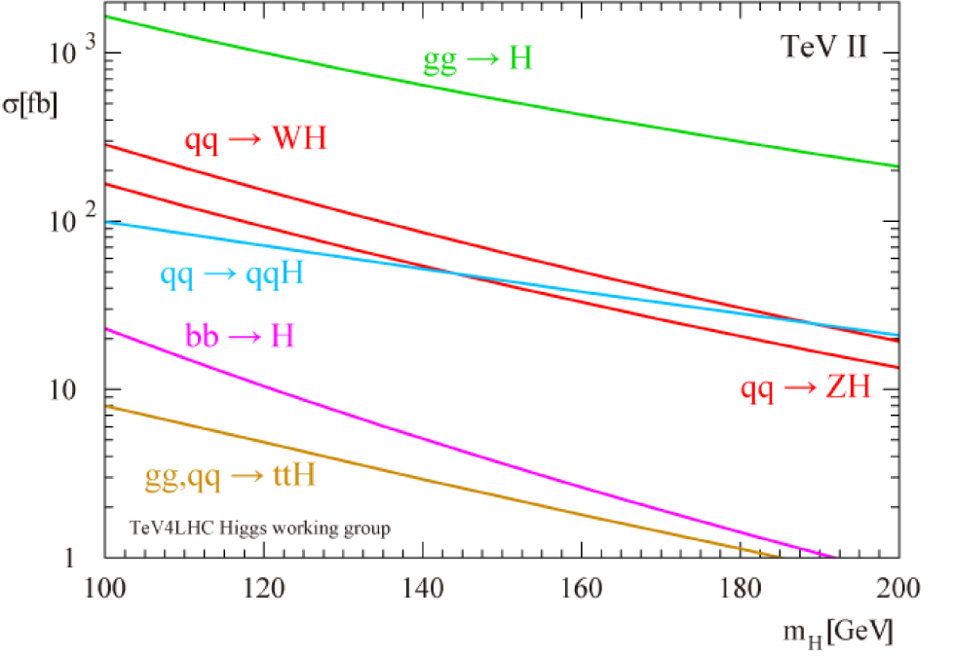
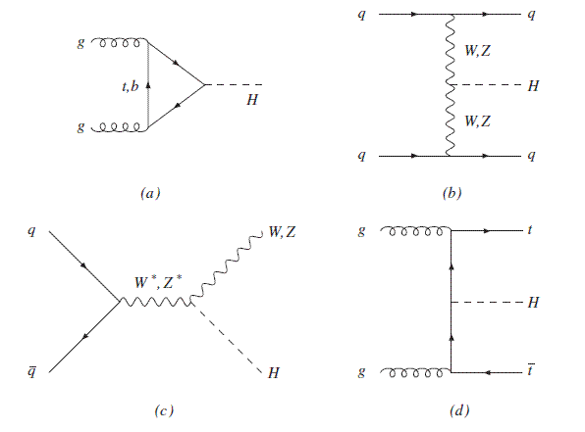
Higgs Production at Tevatron
Dominated by gluon fusion
  But large decay modes often come with large backgrounds
Associated Production
  While smaller cross section, offers cleaner final states
Vector Boson Fusion (VBF)
  Even smaller cross-section, but can help increase the overall sensitivity
Have to use all accessible modes and many decay channels
  Improving analysis techniques

Slide 6
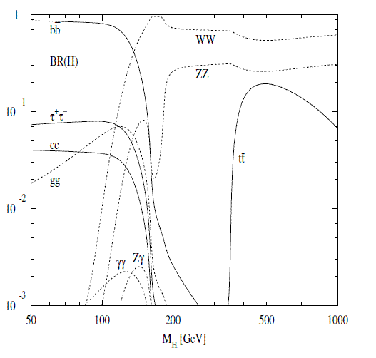
Higgs Search Strategies
Sensitivity strongly depends on backgrounds for a specific channel:
“High mass” m > ~135 GeV:
  WW (and ZZ) decay modes
    Clean final states with leptons, any production mode will do
“Low mass” m < ~135 GeV:
  Associated production WH/ZH:
    Rely on leptons/neutrinos to reduce background, go after all decay modes (but bb dominates)
  Gluon fusion:
    H→bb overwhelmed by backgrounds
    H→ττ: ok, but small BR and close in mass to large Z→ττ background
    H→γγ: too small branching, cross section not large enough to overpower it (c.f. to LHC)

Slide 7
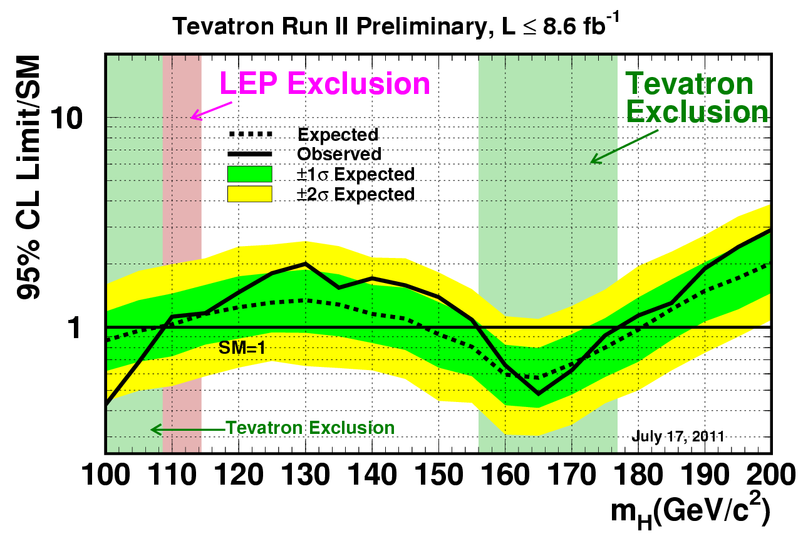
Summer 2011 Combination
LHC results since excluded top 2/3 of the mass range above
  m_{H} <117.5, 118.5<m_{H}<122.5, 127<m_{H}<600 excluded at 95% C.L.

Slide 8
Why Tevatron Still Relevant?
It’s the associated production with H→bb:
  LHC wins big in gluon-gluon fusion (16 times increase in cross-section at m_{H}=125 GeV)
    H→γγ and H→WW are clean channels driving LHC Higgs sensitivity
  Not as much win for the associated production (WH/ZH) where the increase is only about a factor of ~4
    Effective win becomes about x2 as Tevatron still has more luminosity
    Relatively lower W+jet backgrounds at the Tevatron
    Wealth of experience reconstructing H→bb, recently improved even further
Probes coupling to b-quark
  High sensitivity LHC signatures probe coupling to top only (in gluon fusion production), decays are driven by gauge couplings
Production (m_{H}=125 GeV/c²) | LHC (√s=7 TeV) | Tevatron
gg→H | 15.3 pb | 0.95 pb
WH | 0.57 pb | 0.13 pb
ZH | 0.31 pb | 0.08 pb

Slide 9
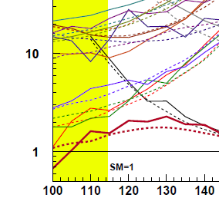
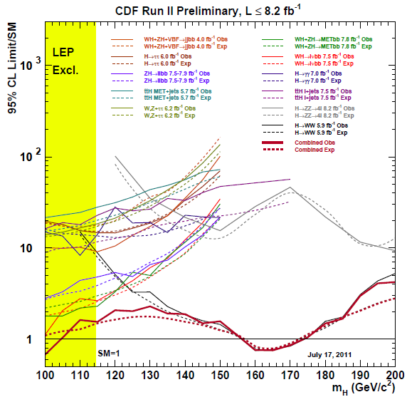
Ingredients of the Combination
High mass region dominated by H→WW
Low mass region:
  WH+ZH→MET+bb
  WH→lνbb
  ZH→llbb
  H→WW: large impact above 120 GeV
Note: this plot is an illustration only (CDF Summer 2011)
ZH→llbb
WH→lνbb
H→WW
VH→MET+bb

Slide 10
Improvements Since Summer 2011
More data
  Also enhance acceptance by combining triggers
Better tools
  b-tagging, optimization of MET for MET+bb channel
Better categorization to boost senstivity

Slide 11
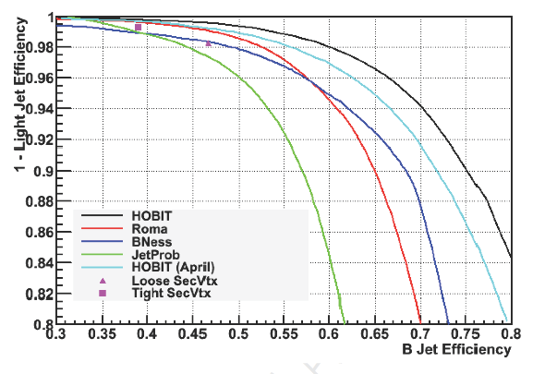
CDF HOBIT B-Tagger
CDF new Higgs Optimized B-jet Identification Tagger (HOBIT)
Multivariate, continuous output
25 input variables (most sensitive inputs of 5 existing taggers)
Trained with jets from H→bb MC
Validated with ttbar and soft electron samples
mistag rate | SecVtx efficiency | HOBIT efficiency
~1% | 39% | 54%
~2% | 47% | 59%

Slide 12
CDF HOBIT in WH->lνbb
NEW - HOBIT
OLD – Multiple Taggers
Tagging Category | S/√B
Tight-Tight | 0.266
Tight-Loose | 0.200
Single Tight | 0.143
Loose-Loose | 0.053
Single Loose | 0.044
Sum | 0.369
Tagging Category | S/√B
SecVtx+SecVtx | 0.228
SecVtx+JetProb | 0.160
SecVtx+Roma | 0.103
Single SecVtx | 0.146
Sum | 0.331
Significant effort to optimize tagging categories and thresholds for loose/tight HOBIT selections
11% gain in S/√B translates directly into increase in overall search sensitivity

Slide 13
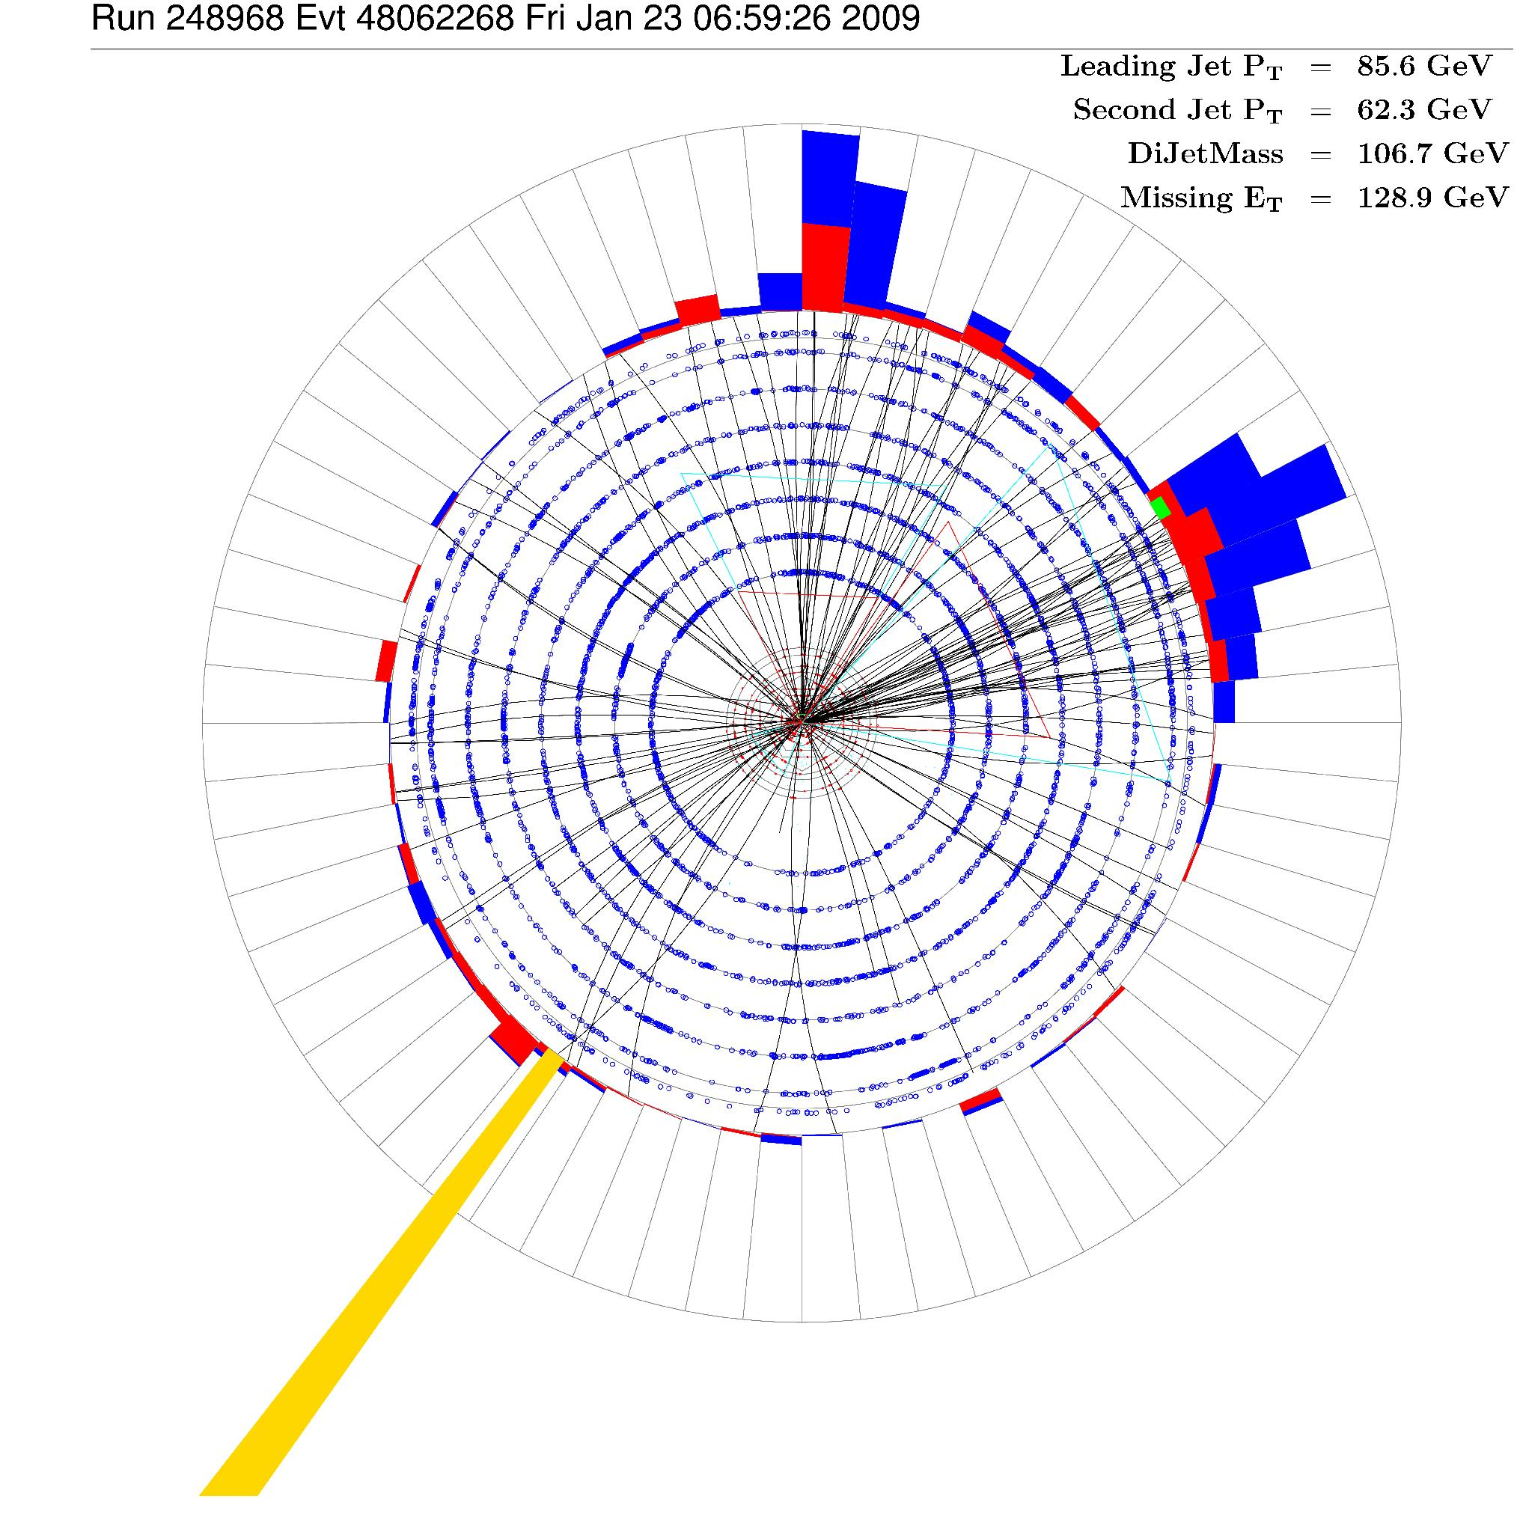
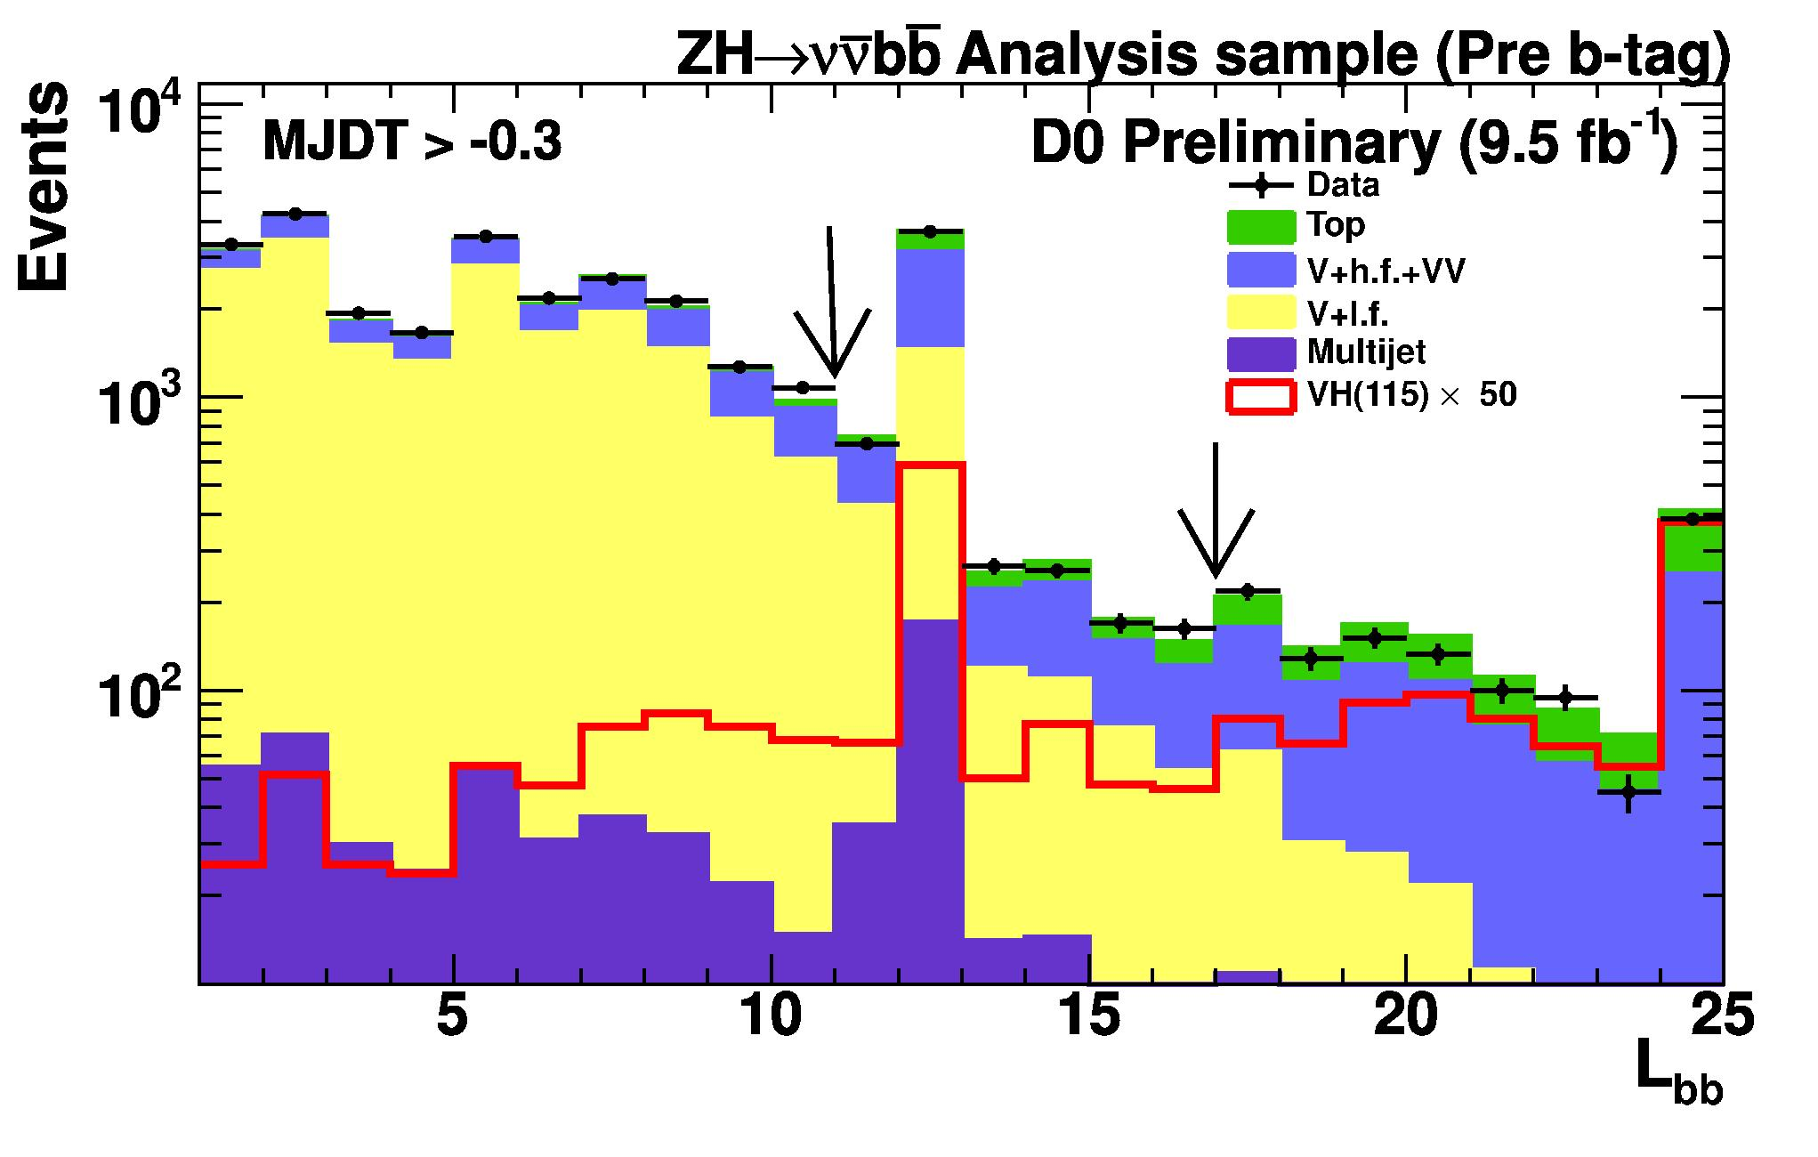

D0:Improve Acceptance in E_{T}+bb
50% of signal is from WH with lost leptons
Use p_{T}^{TRK} to suppress multijet background
Exclude isolated tracks from p_{T}^{TRK} to improve WH acceptance by 10%
Event level b-tagging
Add together b-taggger outputs for both jets
Cut on the sum instead of per jet cuts
Jet
Jet
E_{T}
p_{T}^{TRK}
/
/

Slide 14
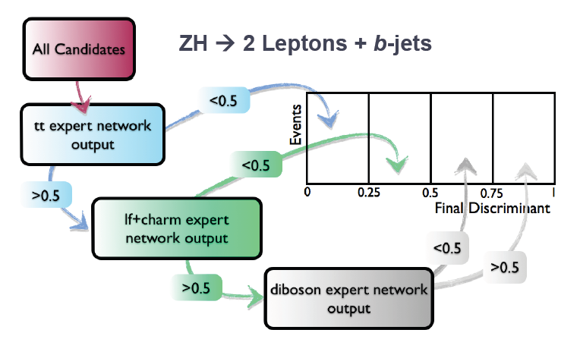
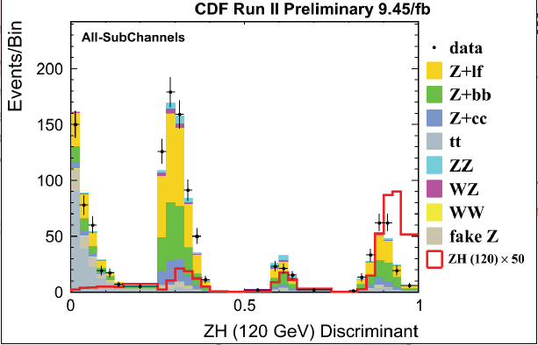
Signal-background separation
CDF: Re-classify events in regions with increasing S/B ratio
Use MVA to discriminate background from signal
+ 15% in sensitivity

Slide 15
2012 Combination

Slide 16

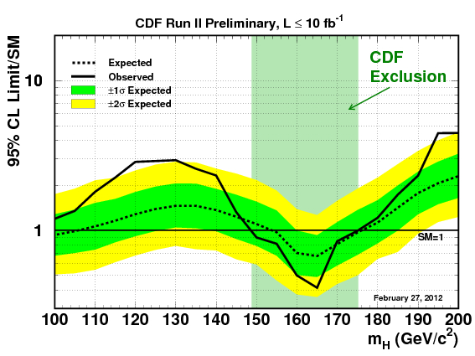
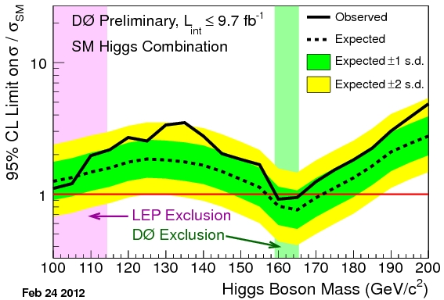
Limits from CDF/D0

Slide 17
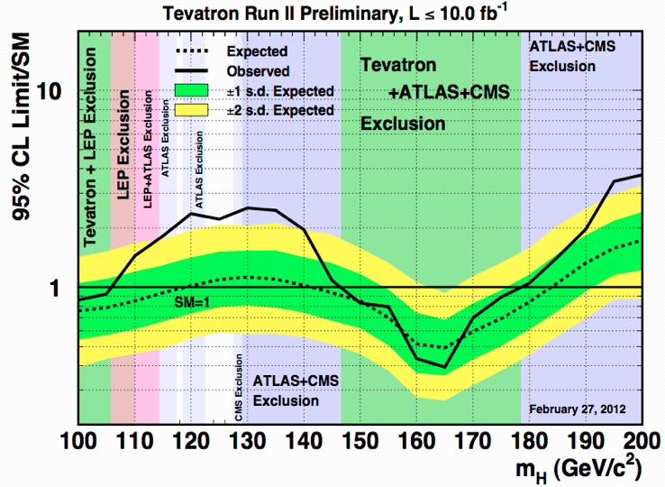
Tevatron Exclusion-Winter’12
Expected sensitivity <1.15×SM for m_{H} < 185 GeV/c²
We should have excluded Higgs below 120 and above 141, but there is an excess in data

Slide 18
Validation
Before digging and slicing the excess, it would be good to convince ourselves that our techniques are working for real on a Higgs-like signal

Slide 19
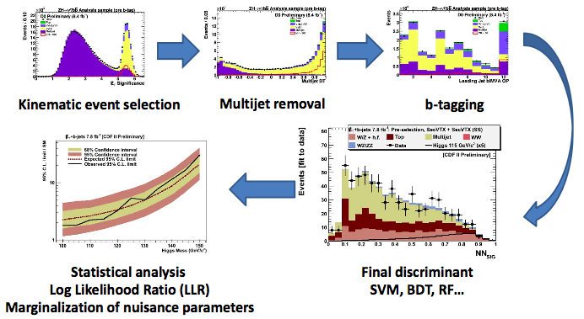
Validation of Higgs Searches
Our searches rely on small signal contribution from many channels, there is no single and clear “bump”, easy to get fooled
Search for WZ+ZZ instead of WH+ZH using the same steps and the same techniques
Small Higgs-like signal (only x4 larger than Higgs), large backgrounds, both analyses either work or they don’t

Slide 20
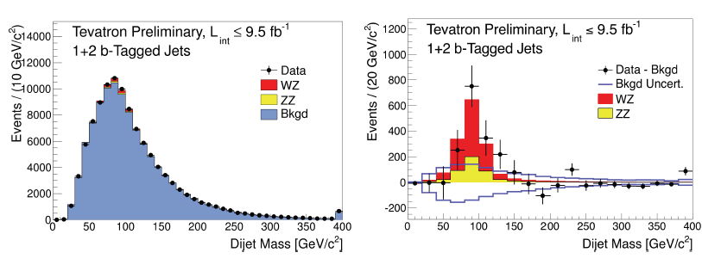
Can We See Small Signals?
Validation of Higgs searches
Fitted signal +bkg
Significance 4.6 σ
Yes we can. Excellent agreement and 4.6σ significant excess
σ(WZ + ZZ) = 4.47 ± 0.64 (stat) ± 0.73 (stat) pb
Consistent with the SM prediction of 4.4 ± 0.3 pb

Slide 21
What Does The Excess Look Like?

Slide 22
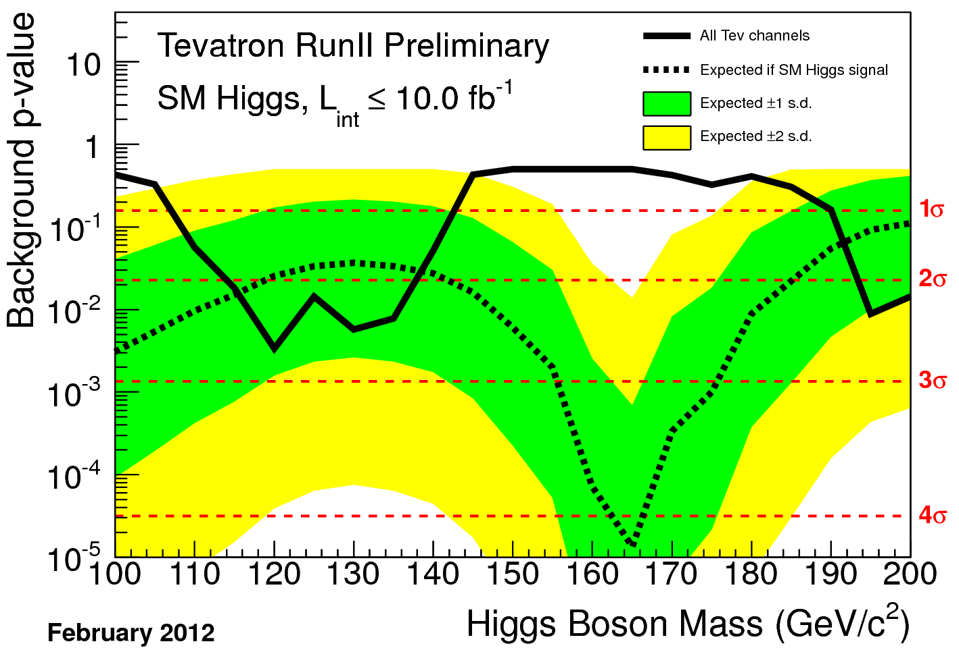
Background p-value
First question: if there is no signal there, how likely to see what we observe?
  In the region between 118-135, such fluctuations should happen less than 1% of the time (solid line)
Second question: If the signal were to be there, what would the p-value look like?
  In the region of interest signal would look pretty similar to what we see in data (compare black line with the dashed line and bands)
 | Local | Global
Tevatron | 2.7σ | 2.2σ
CMS | 2.8σ | 2.1σ
Atlas | 3.5σ | 2.2σ

Slide 23
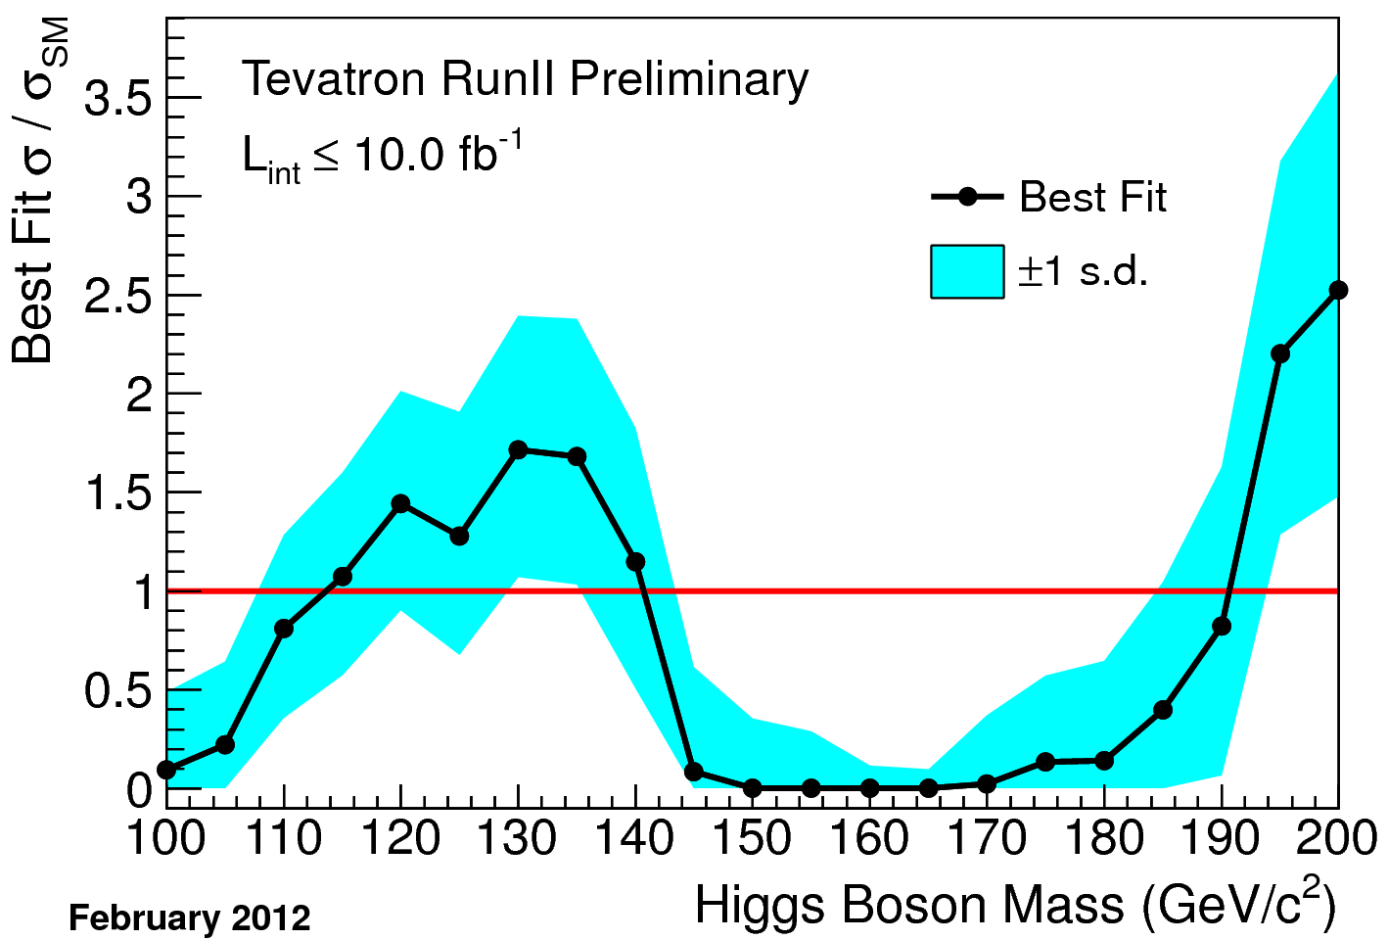
Best σ_{H} fit
If the excess were to be due to signal, what Higgs cross-section does it correspond to?
  The cross-section comes out consistent with SM to within 1σ in the region of interest

Slide 24
Summary
CDF and D0 have updated the results to include the full 10 fb⁻¹ dataset
  Numerous improvements to analysis techniques to enhance the amount and purity of the data
The low mass excess became more significant
  Consistent with Higgs but can’t rule out a rare background fluctuation
  H→bb channel dominates sensitivity
    Verification of Higgs coupling to fermions
More analysis improvements for the Summer:
  Apply new CDF b-tagger for MET+bb final state
  Several substantial improvements in D0 analyses

