Slide 1





STRINGY COSMOLOGY
& THE LHC
NICK E. MAVROMATOS
KING’S COLLEGE LONDON & CERN-PH-TH
London Centre
for Terauniverse
Studies (LCTS)
AdV 267352

Slide 2
OUTLINE
MOTIVATION: CURRENT STATUS OF COSMOLOGICAL & COLLIDER (LHC) DATA ON DARK SECTOR OF UNIVERSE
GENERIC ASPECTS OF STRING COSMOLOGIES - THE ROLE OF MODULI FIELDS
DILATON DOMINANCE IN EARLY UNIVERSE
MODIFICATION OF DARK MATTER ABUNDANCES vs STANDARD COSMOLOGY
LHC SEARCHES OF SUPERSYMMETRY AND DILATON COSMOLOGIES
LORENTZ & CPT VIOLATING STRINGY COSMOLOGIES & THE OBSERVED BARYON ASYMMETRY IN THE UNIVERSE – D-FOAM
D-FOAM & THE UNIVERSE DARK SECTOR

Slide 3
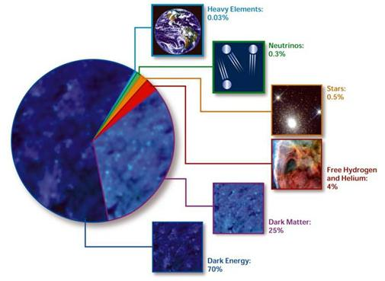

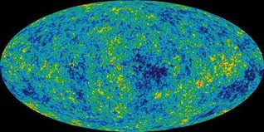

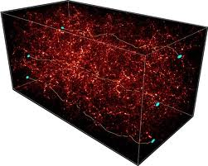
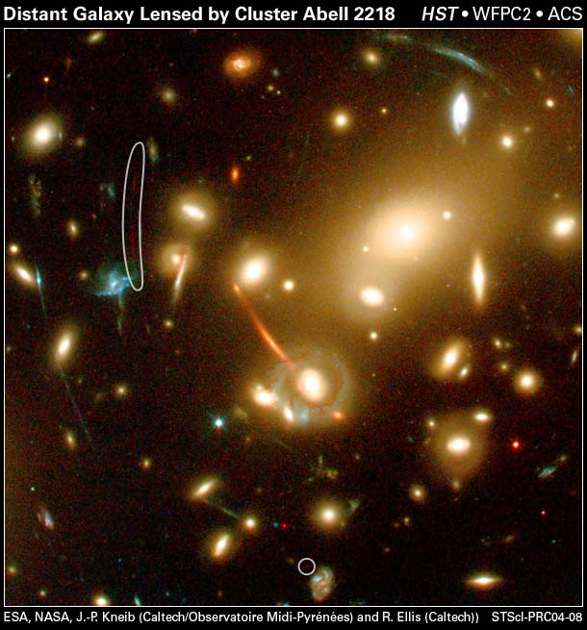
THE DARK SECTOR OF THE UNIVERSE
Current Energy Budget
of the Cosmos
Observations from:
Supernovae Ia
CMB
Baryon Acoustic Oscillations
Galaxy Surveys
Structure Formation data
Strong & Weak
lensing
Active ν

Slide 4
THE DARK SECTOR OF THE UNIVERSE
Current Energy Budget
of the Cosmos
Observations from:
Supernovae Ia
CMB
Baryon Acoustic Oscillations
Galaxy Surveys
Structure Formation data
Strong & Weak
lensing
Active ν
HOT
WARM
COLD

Slide 5
THE DARK SECTOR OF THE UNIVERSE
Current Energy Budget
of the Cosmos
Observations from:
Supernovae Ia
CMB
Baryon Acoustic Oscillations
Galaxy Surveys
Structure Formation data
Strong & Weak
lensing
Active ν
HOT
WARM
COLD

Slide 6
THE DARK SECTOR OF THE UNIVERSE
Current Energy Budget
of the Cosmos
Observations from:
Supernovae Ia
CMB
Baryon Acoustic Oscillations
Galaxy Surveys
Structure Formation data
Strong & Weak
lensing
Active ν
Alternative
theories of
Gravity?

Slide 7

THE DARK SECTOR OF THE UNIVERSE
Current Energy Budget
of the Cosmos
Observations from:
Supernovae Ia
CMB
Baryon Acoustic Oscillations
Galaxy Surveys
Structure Formation data
Strong & Weak
lensing
Active ν
Alternative
theories of
Gravity?
Rule out simplest Alternative Gravity Models ?

Slide 8
Several Candidates for Dark Matter (DM) – NO CONCRETE EXPLANATION YET!
PARTICLE PHYSICS
CANDIDATES:
SUSY PARTNERS – MODEL DEPENDENT
(LSP: Neutralinos, Gravitinos …)
AXIONS
STERILE (LIGHT keV) NEUTRINOS in νMSM
D-MATTER (STRINGY) …

Slide 9
Several Candidates for Dark Matter (DM) – NO CONCRETE EXPLANATION YET!
PARTICLE PHYSICS
CANDIDATES:
SUSY PARTNERS – MODEL DEPENDENT
(LSP: Neutralinos, Gravitinos …)
AXIONS
STERILE (LIGHT keV) NEUTRINOS in νMSM
D-MATTER (STRINGY) …

Slide 10
SUSY PARTICLE SPECTRUM
(□ = superpartners)
charginos
neutralinos
graviton (spin 2) ↔ gravitino (spin 3/2)
+1, for SM particles
–1, for superpartners
R-parity: R = (-1)^{3(B-L)+2s} → R=
  R-parity conservation hinted
  but not required by proton stability
  not a fundamental symmetry
If R-parity is conserved:
  SUSY-partners are always produced in pairs
  (R is a multiplicative quantum number)
  Lightest SUSY-particle (LSP) is stable
    should be colorless and neutral
    weakly interacting → escapes the detector undetectable
    → large missing energy
    dark matter candidate

Slide 11
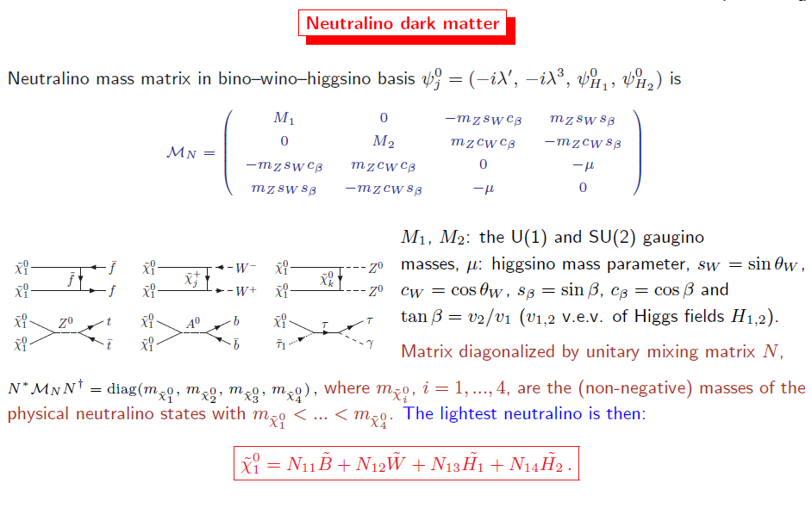

Slide 12
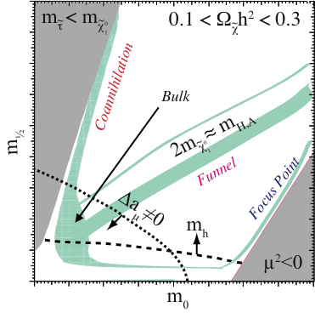

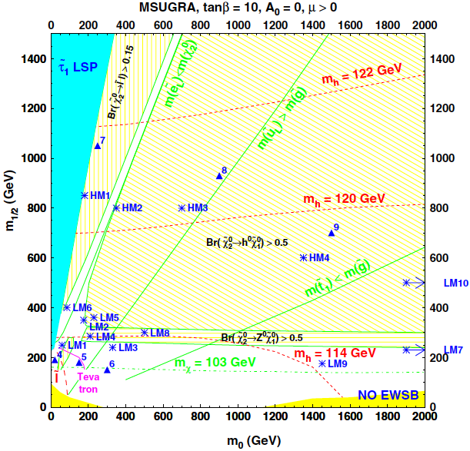

SUSY model framework
Minimal SuperSymmetric Standard Model
(MSSM) contains >100 free parameters
→ assume specific physically-motivated model (Э gravity) for systematic studies
Simplest: minimal SuperGravity (mSUGRA)
  local SUSY with soft breaking mediated
  by gravitational interactions
  universal masses and couplings at GUT scale
  → 5 free parameters: m₀, m_{1/2}, tanβ, A₀, sgn(μ)
qualitative picture – no mass scale
SU8.1
SU1
SU3
SU6
SU2
SU4
(g – 2)_{μ}
measurements
Benchmark points
for detailed studies
WMAP constraints on neutralino relic density
Other models also investigated
(not presented here)
  GMSB: gauge messengers; light gravitino LSP
  AMSB: anomalies in SUGRA L; no flavour problem

Slide 13
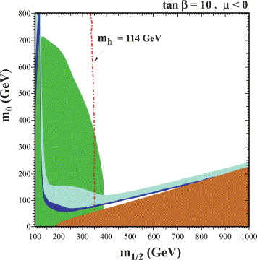
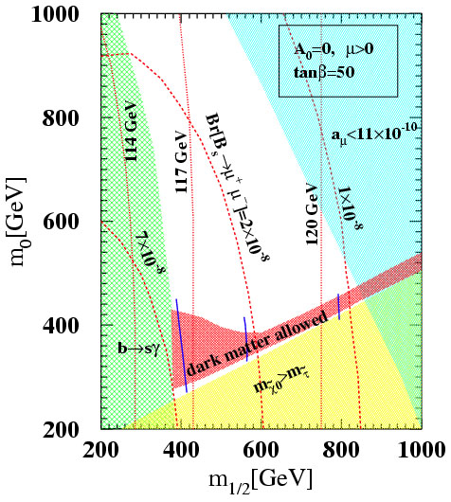
COSMOLOGICALLY-ALLOWED MSSM REGIONS
DM allowed

Slide 14

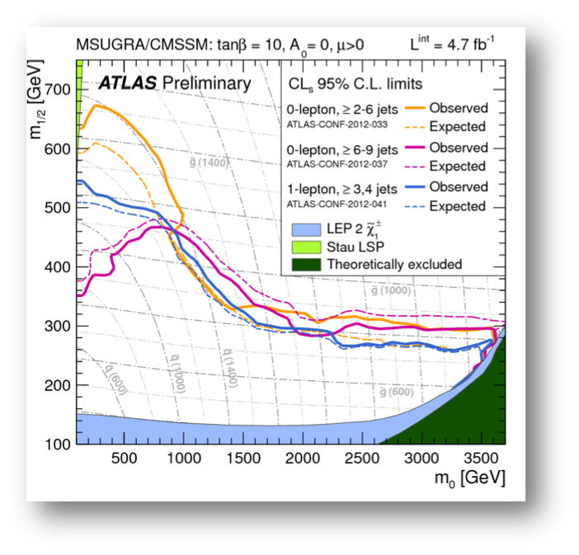
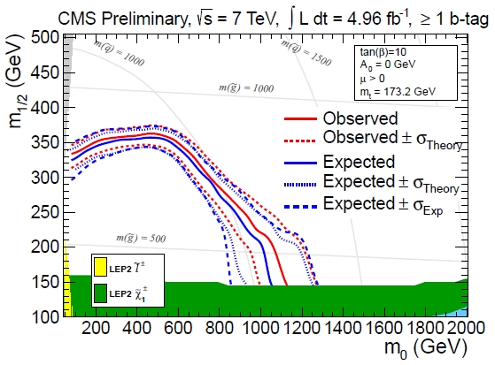

Several Candidates for Dark Matter (DM)–NO CONCRETE EXPLANATION YET !
LHC SEARCHES FOR MSSM: SEEM TO RULE OUT @ PRESENT
COSMOLOGICALLY-ALLOWED REGIMES FOR SUSY DM

Slide 15
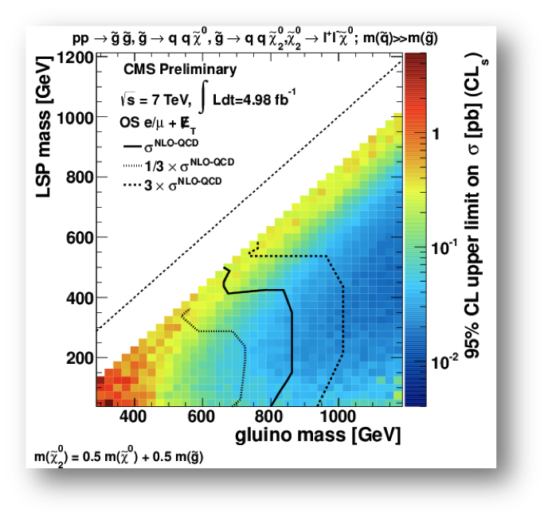
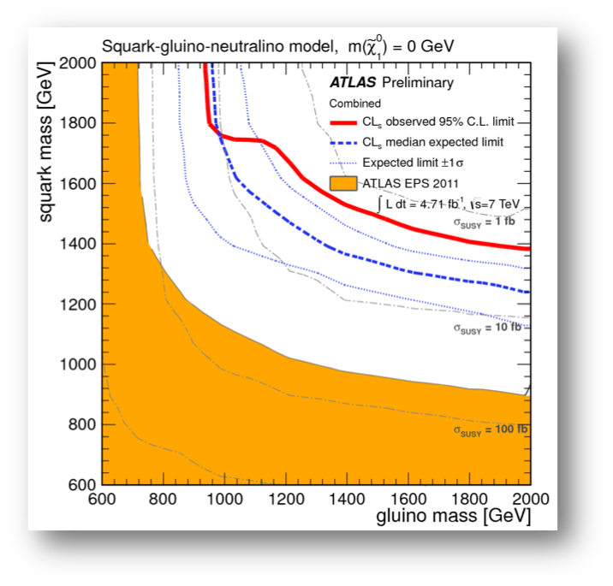
SUSY EXCLUSION PLOTS @ LHC

Slide 16
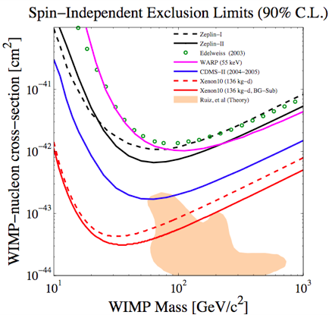
DIREDCT DM SEARCHES: ALSO CONSTRAIN STRONGLY SUSY DM
GRAVITINO DM
R-PARITY VIOLATING
MODEL

Slide 17
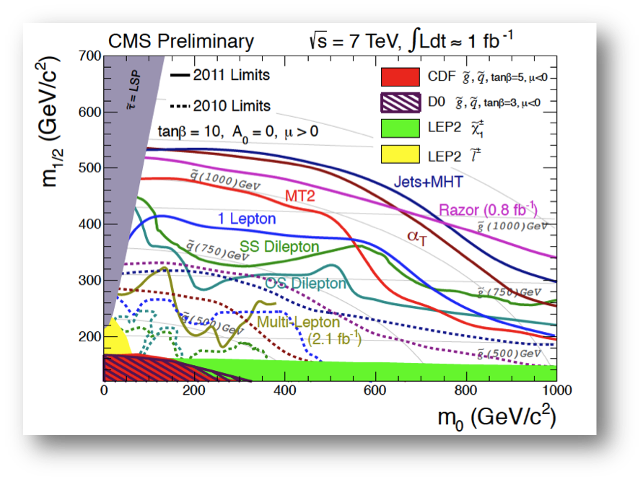

SO…. IS
minimal SUSY
ruled out as
Dark Matter
CANDIDATE?

Slide 18
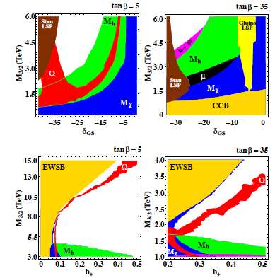

MOTIVATION
FOR STUDYING
…STRINGY
COSMOLOGIES
WMAP allowed
thermal DM
Non-thermal DM characterises
several stringy models, e.g.
Heterotic Strings → very different
parameter spaces for SUSY ….
WMAP constraints can be evaded

Slide 19
MOTIVATION
FOR STUDYING
…STRINGY
COSMOLOGIES
Running Dilaton or Moduli Fields
in String Cosmology increase
cosmologically allowed
parameter space & push even
minimal SUSY partner masses higher ….

Slide 20
MOTIVATION
FOR STUDYING
…STRINGY
COSMOLOGIES
This Talk
Running Dilaton or Moduli Fields
in String Cosmology increase
cosmologically allowed
parameter space & push even
minimal SUSY partner masses higher ….

Slide 21
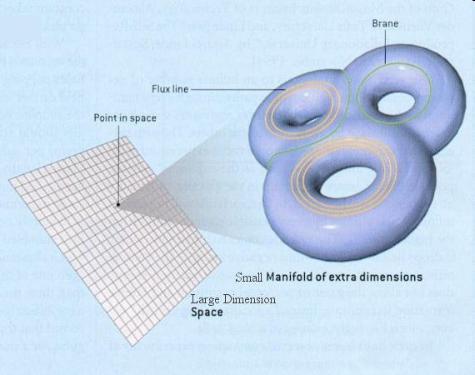
What is String Theory?
Fundamental Excitations
are not point-like but
one-dimensional (strings)
Open
Closed
ONE VERSION :
Strings live in Large
Four space-time dimensions but have extra dimensions
``Curled-up’’ in small-size but of complicated
Geometry spaces

Slide 22
What is String Theory?
Fundamental Excitations
are not point-like but
one-dimensional (strings)
Open
Closed
ONE VERSION :
Strings live in Large
Four space-time dimensions but have extra dimensions
``Curled-up’’ in small-size but of complicated
Geometry spaces
Gravitons
(carrier of Gravitational
Interactions)

Slide 23

What is String Theory?
Fundamental Excitations
are not point-like but
one-dimensional (strings)
Open
Closed
ONE VERSION :
Strings live in Large
Four space-time dimensions but have extra dimensions
``Curled-up’’ in small-size but of complicated
Geometry spaces
Gravitons
(carrier of Gravitational
Interactions)
Gravity Unified
with rest of Interactions

Slide 24
STRING MODULI FIELDS
SCALAR FIELDS WITH POTENTIAL FUNCTIONS CHARACTERIZED BY
CONTINUOUS FAMILIES OF GLOBAL MINIMA
– Their expectation value labels STRING BACKGROUNDS
STRING MODULI INCLUDE:
THE DILATON FIELD, Φ, WHOSE STABILIZED <Φ> is ASSOCIATED WITH THE
STRING COUPLING g_{s} = e^{<Φ>} → 4-d Gauge couplings
We shall consider: non-stabilized dilatons in Non-Equilibrium Cosmologies &
study (dilution) effects on Dark Matter (DM) if Dilaton dominance at DM decoupling
→ effects on Collider Searches for Supersymmetry
(ii) SCALAR FIELDS ASSOCIATED WITH EXTRA DIMENSIONS
with no classical potential (i.e. generated by
string loop corrections, suppressed by powers of g_{s}
and with Planck scale suppressed couplings to matter.
The expectation values of the moduli classically describe
the size and configuration of the curled up extra dimensions.
We shall consider: MASSIVE STABILISED MODULI decaying before Big Bang
Nucleosynthesis (BBN) → significant sources of ``non-thermal’’ Dark Matter
→ effects on collider searches for Supersymmetry.
Lahanas, NEM, Nanopoulos
Lahanas , Spanos
Acharya, Kane, Kuflik …

Slide 25
STRING MODULI FIELDS
SCALAR FIELDS WITH POTENTIAL FUNCTIONS CHARACTERIZED BY
CONTINUOUS FAMILIES OF GLOBAL MINIMA
– Their expectation value labels STRING BACKGROUNDS
STRING MODULI INCLUDE:
THE DILATON FIELD, Φ, WHOSE STABILIZED <Φ> is ASSOCIATED WITH THE
STRING COUPLING g_{s} = e^{<Φ>} → 4-d Gauge couplings
We shall consider: non-stabilized dilatons in Non-Equilibrium Cosmologies &
study (dilution) effects on Dark Matter (DM) if Dilaton dominance at DM decoupling
→ effects on Collider Searches for Supersymmetry
(ii) SCALAR FIELDS ASSOCIATED WITH EXTRA DIMENSIONS
with no classical potential (i.e. generated by
string loop corrections, suppressed by powers of g_{s}
and with Planck scale suppressed couplings to matter.
The expectation values of the moduli classically describe
the size and configuration of the curled up extra dimensions.
We shall consider: MASSIVE STABILISED MODULI decaying before Big Bang
Nucleosynthesis (BBN) → significant sources of ``non-thermal’’ Dark Matter
→ effects on collider searches for Supersymmetry.
Lahanas, NEM, Nanopoulos
Lahanas , Spanos
Acharya, Kane, Kuflik …

Slide 26
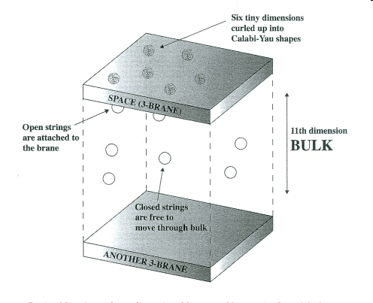
SECOND VERSION OF STRING THEORY (BRANE-THEORY):
Our Universe
Lorentz Invariant

Slide 27
SECOND VERSION OF STRING THEORY (BRANE-THEORY):
Our Universe
Lorentz Invariant
(Standard Model particles)

Slide 28
SECOND VERSION OF STRING THEORY (BRANE-THEORY):
Our Universe
Lorentz Invariant
(Standard Model particles)
(Gravitons)
Gravity Unified
with rest of Interactions

Slide 29
ANTOHER VERSION: COLLIDING BRANE WORLDS :
Colliding Worlds
(Standard Model particles)
(Gravitons)

Slide 30

Brane Worlds
Open string excitations
( SM matter)
Colliding & Bouncing Brane world Cosmology

Slide 31
ANTOHER VERSION: COLLIDING BRANE WORLDS :
Colliding Worlds
Moving Brane Worlds
Target-space
Supersymmetry
Breaking,
(Standard Model particles)
(Gravitons)
Brane Collision (Bounce)
World-sheet Conformal
Invariance violation
Restoration by:
Liouville Dressing,
Non-equilibrium strings
Non-trivial time dependent
(non-stabilized) DILATONS
during RELAXATION

Slide 32
ANTOHER VERSION: COLLIDING BRANE WORLDS :
Colliding Worlds
Moving Brane Worlds
Target-space
Supersymmetry
Breaking,
(Standard Model particles)
(Gravitons)
Brane Collision (Bounce)
World-sheet Conformal
Invariance violation
Restoration by:
Liouville Dressing,
Non-equilibrium strings
Non-trivial time dependent
(non-stabilized) DILATONS
during RELAXATION

Slide 33
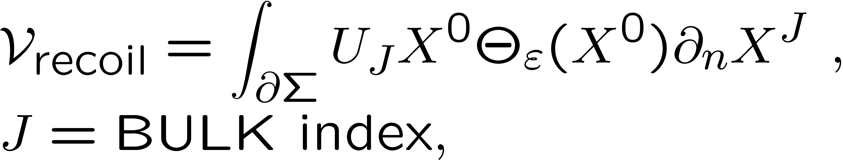
COLLIDING BRANE WORLDS:
BRANE RECOIL (BOUNCE)-INDUCED
DEPARTURES FROM CONFORMAL INVARIANCE
DUE TO RECOILING BRANE WORLDS
DILATON IN THIS CASE:
Liouville – mode dressing → restoration of
world-sheet conformal invariance :
GLOBALLY DESTABILIZED DILATON
….Relevant for Cosmology
``Running’’ Central charge deficit
in identical Brane-Worlds recoil case:
Φ → constant
t >> t_{P}
relaxation
process
Gravanis, NEM

Slide 34
COLLIDING BRANE WORLDS:
BRANE RECOIL (BOUNCE)-INDUCED
DEPARTURES FROM CONFORMAL INVARIANCE
DUE TO RECOILING BRANE WORLDS
Bulk Recoil velocity of Brane World,
non-conformal, anomalous dimension - ε²/2
DILATON IN THIS CASE:
Liouville – mode dressing → restoration of
world-sheet conformal invariance :
GLOBALLY DESTABILIZED DILATON
….Relevant for Cosmology
``Running’’ Central charge deficit
in identical Brane-Worlds recoil case:
Φ → constant
t >> t_{P}
relaxation
process
Gravanis, NEM

Slide 35
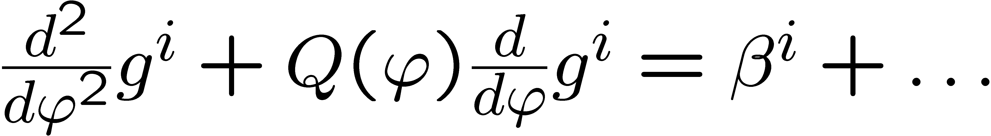
Basic Liouville Equation-Relaxation
World-Sheet
Renormalization Group
(wsRG) of g^{i}
Background fields:
G_{μν} , A_{μ} , Ψ …
NEAR A world sheet RG FIXED POINT: near equilibrium,
e.g. late Universe

Slide 36
TIME-DEPENDENT DILATONS IN ADIABATICALLY MOVING (BOUNCED) BRANES:
Rizos, NEM
Bounced Worlds
FOR FIXED Z WARPED E.D.:
EXACT SOLUTIONS
OF TARGET SPACE
EQS. OF MOTION =
WORLD-SHEET
CONFORMAL INVARIANCE
Z
(Standard Model particles)
(Gravitons)
Moving Branes:
Z = U t → Φ = Φ(t)
Time-dependent
Dilaton backgrounds
Z = 0

Slide 37
TIME-DEPENDENT DILATONS IN ADIABATICALLY MOVING (BOUNCED) BRANES:
Rizos, NEM
Bounced Worlds
FOR FIXED Z WARPED E.D.:
EXACT SOLUTIONS
OF TARGET SPACE
EQS. OF MOTION =
WORLD-SHEET
CONFORMAL INVARIANCE
Z
(Standard Model particles)
(Gravitons)
Moving Branes:
Z = U t → Φ = Φ(t)
Time-dependent
Dilaton backgrounds
Z = 0

Slide 38
TIME-DEPENDENT DILATONS IN ADIABATICALLY MOVING (BOUNCED) BRANES:
Rizos, NEM
Bounced Worlds
FOR FIXED Z WARPED E.D.:
EXACT SOLUTIONS
OF TARGET SPACE
EQS. OF MOTION =
WORLD-SHEET
CONFORMAL INVARIANCE
Z
(Standard Model particles)
(Gravitons)
Moving Branes:
Z = U t → Φ = Φ(t)
Time-dependent
Dilaton backgrounds
Z = 0

Slide 39
GENERIC ASPECTS OF DILATON COSMOLOGIES
NON-TRIVIAL DILATON EFFECTIVE 4-d ACTIONS IN STRING FRAME
Including String Loops:
Canonically Normalize Einstein term by redefining graviton (Einstein Frame)
Assume FRW Cosmic backgrounds, and define FRW time

Slide 40
GENERIC ASPECTS OF DILATON COSMOLOGIES
NON-TRIVIAL DILATON EFFECTIVE 4-d ACTIONS IN STRING FRAME
Including String Loops:
Canonically Normalize Einstein term by redefining graviton (Einstein Frame)
Assume FRW Cosmic backgrounds, and define FRW time

Slide 41
EQUATIONS OF MOTION FOR THE DILATON UNIVERSE
In our bouncing Universe case:

Slide 42
Not to scale

Slide 43
Not to scale

Slide 44
DILATON EFFECTS ON DM
ASSUME DILATON DOMINANCE DURING DM DECOUPLING
ASSUME DILATON POTENTIAL IS EXPONENTIAL WITH Φ ≈ Ln (a(t))
BUT SUCH THAT DILATON MASS VERY LOW SO DECAY IS PROHIBITED
BOTH FEATURES GUARANTEED IN LIOUVILLE MODEL OF COLLIDING BRANE WORLDS
Sufficiently small (time-dependent) dilaton
mass terms O(Q² Φ² ) for sufficiently
low brane-world bounce velocities
no dilaton decays to SM particles,
except massless ones, photons,
during dilaton dominance period.

Slide 45
Dilaton
Domi-
nance
DM
Decouples Radiation
era
Matter
Domi-
nance
Time

Slide 46
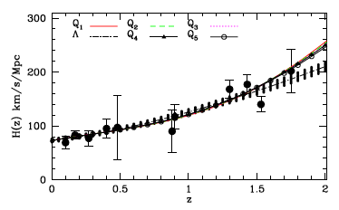
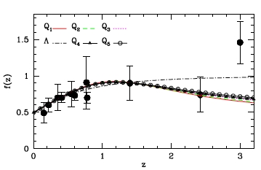
Dilaton
Domi-
nance
DM
Decouples Radiation
era
Matter
Domi-
nance
COSMOLOGY TESTS
CONSISTENT WITH CURRENT
DATA
GROWTH OF GALAXIES
CAN DIFFERENTIATE
DILATON COSMOLOGIES
FROM STANDARD ΛCDM
Basilakos, NEM, Mitsou, Plionis
1107.3532, AP (2012)
Time

Slide 47
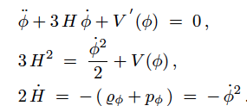

Equations of Motion, under the assumption of Dilaton dominance,
ignore non-critical (non-equilibrium) terms

Slide 48
Equations of Motion, under the assumption of Dilaton dominance,
ignore non-critical (non-equilibrium) terms

Slide 49

Equations of Motion, under the assumption of Dilaton dominance,
ignore non-critical (non-equilibrium) terms
Lahanas, NEM, Nanopoulos
BOLTZMANN EQUATION FOR THERMAL DM SPECIES AFFECTED

Slide 50
Boltzmann equation Modifications for Thermal Dark matter Relics, e.g. Neutralinos
Lahanas, NEM, Nanopoulos
Off-Shell Terms
Time-dependent
Dilaton Source

Slide 51
Boltzmann equation Modifications for Thermal Dark matter Relics, e.g. Neutralinos
Lahanas, NEM, Nanopoulos
Off-Shell Terms
Not important
for near-equilibrium
systems
(e.g. DM decoupling era)
Time-dependent
Dilaton Source

Slide 52
Boltzmann equation Modifications for Thermal Dark matter Relics, e.g. Neutralinos
Lahanas, NEM, Nanopoulos
Off-Shell Terms
Not important
for near-equilibrium
systems
(e.g. DM decoupling era)
Time-dependent
Dilaton Source
Dilaton dominance
in early Universe
affects generically
DM abundance
Lahanas

Slide 53
Boltzmann equation Modifications for Thermal Dark matter Relics, e.g. Neutralinos
Lahanas, NEM, Nanopoulos
Off-Shell Terms
Not important
for near-equilibrium
systems
(e.g. DM decoupling era)
Time-dependent
Dilaton Source
Dilaton dominance
in early Universe
affects generically
DM abundance
Lahanas

Slide 54

Lahanas, NEM, Nanopoulos
O(10) Dilution for Dark matter (e.g. neutralinos)
Baryon Density unchanged
…OR MORE → CAN PUSH SUSY PARTNER
MASSES OUT OF REACH OF LHC !

Slide 55
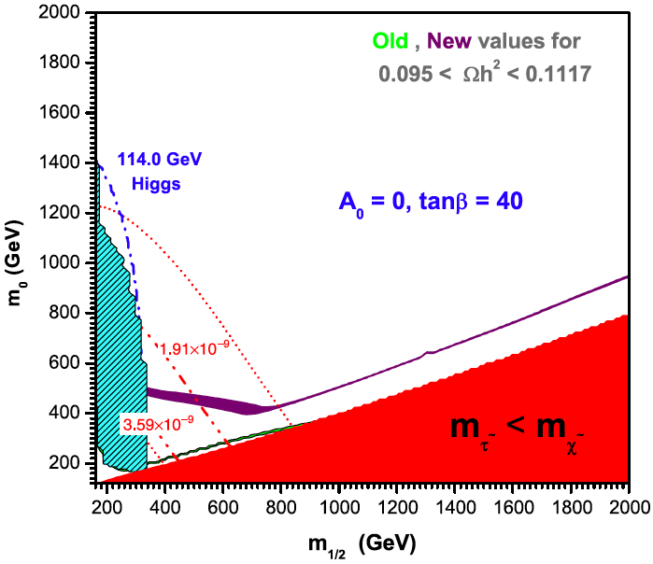
LHC signatures of Dilaton DM Dilution – More room for SUSY
Lahanas, NEM, Nanopoulos
The presence of the time-dependent dilaton affects the relic density calculation, since it modifies the Boltzmann equation
O(10) dilution for dark matter (neutralinos)
➱ more room for Supersymmetry at colliders …
  e.g. Lahanas, NM, Nanopoulos, PLB 649 (2007) 83
LHC signatures also affected
  Higgs + jets + MET
  Z + jets + MET
  2τ + jets + MET
  Dutta et al, PRD 79 (2009) 055002
  [0808.1372 [hep-ph]]
WMAP3 constraint on neutralino relic density
SSC-allowed
ordinary cosmology-allowed

Slide 56
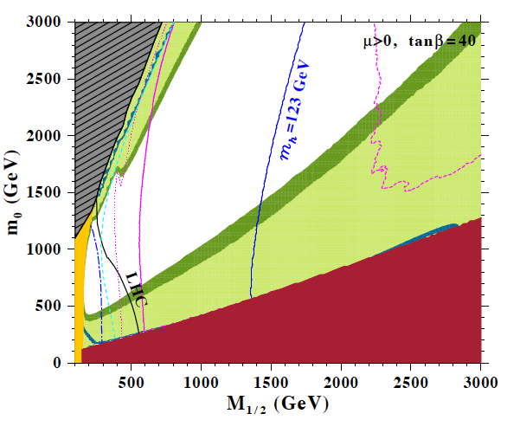
Post LHC 7TeV Run
Lahanas, Spanos 2012
WMAP7 DM bounds
allowed
Neutralino lighter
than WMAP7 bounds
PHENOMENOLOGICAL
DILATON-DEFORMED
MODELS

Slide 57
Post LHC 7TeV Run
Lahanas, Spanos 2012
WMAP7 DM bounds
allowed
Neutralino lighter
than WMAP7 bounds
PHENOMENOLOGICAL
DILATON-DEFORMED
MODELS
NO-DILATON DEFORMATION
WMAP7 ALLOWED

Slide 58
Post LHC 7TeV Run
Lahanas, Spanos 2012
WMAP7 DM bounds
allowed
Neutralino lighter
than WMAP7 bounds
PHENOMENOLOGICAL
DILATON-DEFORMED
MODELS
XENON 100 exclusion
(caution: re-analysis
in presence of dilaton
dominance should be made though)

Slide 59
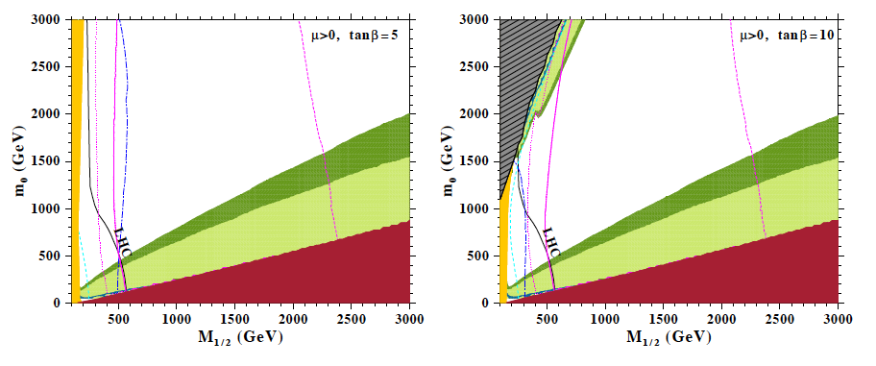
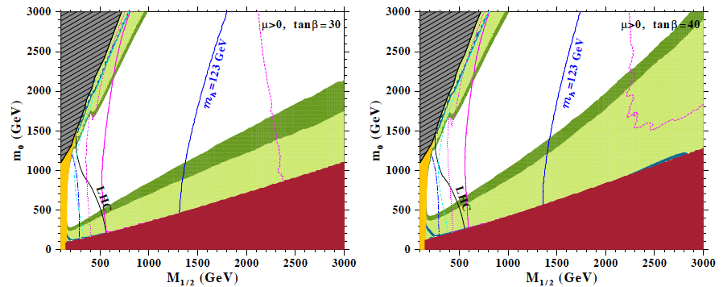
Lahanas, Spanos 2012
Incompatble
with Light
Higgs
Incompatble
with Light
Higgs

Slide 60
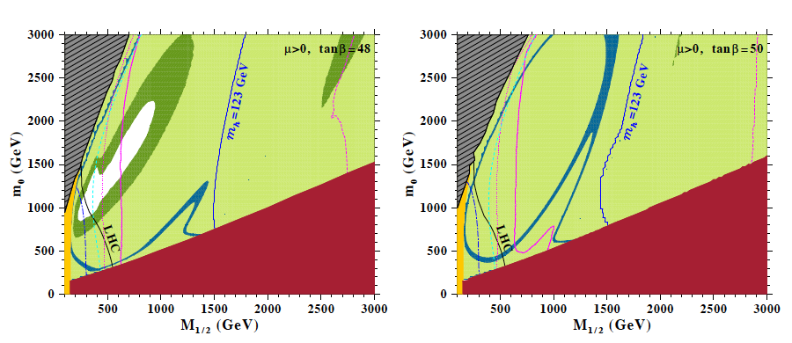

Lahanas, Spanos 2012
Conclusion:
Due to dilaton DM dilution, SUSY models, e.g. CMSSM,
can become compatible with WMAP data and Higgs masses larger
than 123 GeV, for tan β > 25 .

Slide 61
Lahanas, Spanos 2012
Conclusion:
Due to dilaton DM dilution, SUSY models, e.g. CMSSM,
can become compatible with WMAP data and Higgs masses larger
than 123 GeV, for tan β > 25 . There are allowed regions of SUSY
BEYOND LHC reach, e.g. (m₀, M_{1/2}) = (2500, 2600) GeV, tanβ = 48

Slide 62

…Now something different
LORENTZ & CPT VIOLATION
IN STRING UNIVERSE
AND THE
OBSERVED BARYON ASYMMETRY

Slide 63
Generic Concepts
Leptogenesis: physical out of thermal equilibrium processes in the (expanding) Early Universe that produce an asymmetry between leptons & antileptons
Baryogenesis: The corresponding processes that produce an asymmetry between baryons and antibaryons
Ultimate question: why is the Universe made only of matter?

Slide 64

Generic Concepts
Leptogenesis: physical out of thermal equilibrium processes in the (expanding) Early Universe that produce an asymmetry between leptons & antileptons
Baryogenesis: The corresponding processes that produce an asymmetry between baryons and antibaryons
Ultimate question: why is the Universe made only of matter?
escher

Slide 65
CP VIOLATION & BARYON ASYMMETRY
Anomalous Violation of Baryon # (B), C & CP in SM
Tiny CP violation (O(10⁻³)) in Labs: e.g.
But Universe consists only of matter
Kuzmin, Rubakov,
Shaposhnikov
T > 1 GeV
Sakharov : Non-equilibrium physics of early Universe, B, C, CP violation
but CPV in SM does not reproduce
the observed Baryon Asymmetry (assuming CPT)

Slide 66
WHAT IF CPT IS VIOLATED IN THE EARLY UNIVERSE ?
GENERATE Baryon and/or Lepton ASYMMETRY
without need for extra CPV sources, e.g. Heavy Sterile Neutrinos?
CPT Invariance Theorem :
Flat space-times
Lorentz invariance
Locality
Unitarity
Schwinger, Pauli,
Luders, Jost, Bell
revisited by:
Greenberg,
Chaichian, Dolgov,
Novikov…

Slide 67
WHAT IF CPT IS VIOLATED IN THE EARLY UNIVERSE ?
GENERATE Baryon and/or Lepton ASYMMETRY
without need for extra CPV sources, e.g. Heavy Sterile Neutrinos?
X
CPT Invariance Theorem :
Flat space-times
Lorentz invariance
Locality
Unitarity
CPT MAY be Vilolated
if at least one of (i) – (iv)
relaxed (e.g. in Early
Universe geometries …)
If CPTV @
freezeout:

Slide 68
WHAT IF CPT IS VIOLATED IN THE EARLY UNIVERSE ?
GENERATE Baryon and/or Lepton ASYMMETRY
without need for extra CPV sources, e.g. Heavy Sterile Neutrinos?
X
CPT Invariance Theorem :
Flat space-times
Lorentz invariance
Locality
Unitarity
Lorentz Violating Backgrounds in Stringy Cosmologies?

Slide 69
ANTOHER VERSION of BRANE WORLDS with D-PARTICLE
(POINT-LIKE BRANE) DEFECTS :
(Standard Model particles)
(Gravitons)
D-particle defect
J Ellis, NEM, M Westmuckett

Slide 70
ANTOHER VERSION of BRANE WORLDS with D-PARTICLE
(POINT-LIKE BRANE) DEFECTS :
Our Universe
NO LONGER
Lorentz Invariant
Recoil of defect
(Standard Model particles)
(Gravitons)
D-particle defect
J Ellis, NEM, M Westmuckett

Slide 71
Recoil-induced
Lorentz Violation
(locally)
Defect Distribution
may be inhomogeneous
Brane Worlds
Point-like Brane defect
D-FOAM METAUNIVERSE
Colliding Brane world model of Space-Time with point-like space-time defects

Slide 72
Matter/D-foam Interactions

Slide 73
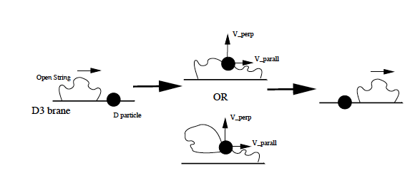
Matter/D-foam Interactions
String Splitting &
(``momentary’’) Capture by the defects
INTEMEDIATE STRING
CREATION/EXCHANGE
PURELY NON-LOCAL EFFECT

Slide 74
CHARGE CONSERVATION
MUST BE RESPECTED
DURING STRING
SPLITTING, INTERNEDIATE
CREATION AND STRETCHING:

Slide 75
CHARGE CONSERVATION
MUST BE RESPECTED
DURING STRING
SPLITTING, INTERNEDIATE
CREATION AND STRETCHING:
ONLY ELECTRICALLY
NEUTRAL EXCITATIONS
(e.g. Photons, Neutrinos)
INTERACT VIA CAPTURE
DOMINANTLY WITH FOAM
ELLIS, NEM, SAKHAROV, NANOPOULOS

Slide 76
CHARGE CONSERVATION
MUST BE RESPECTED
DURING STRING
SPLITTING, INTERNEDIATE
CREATION AND STRETCHING:
ONLY ELECTRICALLY
NEUTRAL EXCITATIONS
(e.g. Photons, Neutrinos)
INTERACT VIA CAPTURE
DOMINANTLY WITH FOAM
DEFECT RECOIL OCCURS
Time Delays due to
Intermediate String Creation
& Oscillations – Subluminal Vacuum Refractive Index
J ELLIS, NEM, NANOPOULOS

Slide 77
Local Lorentz Violation due to
direction of Defect recoil velocities
Induced metric depends
on momenta as well as coordinates
(Finsler type) : e.g. u || X₁
Explicit local breaking of SO(3,1)
down to SO(2,1) rotation and
boosts in transverse directions

Slide 78
Space time Foam situations –
Average over both populations of defects & quantum fluctuations
Isotropic & (in)homogeneous foam
for a brane observer:
Lorentz Invariance
on Average
Violated in flcts

Slide 79

Space time Foam situations –
Average over both populations of defects & quantum fluctuations
Isotropic & (in)homogeneous foam
for a brane observer:
Lorentz Invariance
on Average
Violated in flcts
c.f. Stochastic Foam, through coherent graviton states
leading to light cone fluctuations
Ford (95)

Slide 80
Modified Neutrino dispersion relations due to locally induced metric
Interpret (Dirac) negative energies as corresponding to anti-particles
Momentum-Energy conservation during ν scattering with D-particles
NEM, Sarkar, Tarantino
Phys.Rev. D84 (2011) 044050

Slide 81
D-foam Induced CPTV for Neutrinos

Slide 82
D-foam Induced CPTV for Neutrinos

Slide 83
D-foam Induced CPTV for Neutrinos
One can thus generate a Lepton asymmetry and, then through
B-L conserving processes in the Early Universe a Baryon asymmetry.

Slide 84
D-foam Induced CPTV for Neutrinos
± B₀

Slide 85


D-foam Induced CPTV for Neutrinos
± B₀

Slide 86

BARYOGENESIS VIA LEPTOGENESIS
@ T = T_{d} (decoupling Temp. of Lepton number (L) Violating processes) there is a
constant ratio of net neutrino/antineutrino asymmetry (ΔL) to entropy density ( ~T³)
(Leptogenesis)
Communicated to Baryon sector, and thus generates BAU either
via a B-L conserving symmetry as in GUT models or via B - L conserving
sphaleron processes → BARYOGENESIS

Slide 87
BARYOGENESIS VIA LEPTOGENESIS
@ T = T_{d} (decoupling Temp. of Lepton number (L) Violating processes) there is a
constant ratio of net neutrino/antineutrino asymmetry (ΔL) to entropy density ( ~T³)
(Leptogenesis)
Communicated to Baryon sector, and thus generates BAU either
via a B-L conserving symmetry as in GUT models or via B - L conserving
sphaleron processes → BARYOGENESIS

Slide 88

D-foam Induced CPTV for Neutrinos
One can thus generate a Lepton asymmetry and through B+L conserving
processes in the Early Universe a Baryon asymmetry.
The correct value (observed) for BAU is reproduced for
for D-foam at T_{d} ~ 10¹⁵ GeV
implying that in these scenarios, for σ² < 1, one must have M_{s}/g_{s} > 200 TeV

Slide 89
D-foam Induced CPTV for Neutrinos
One can thus generate a Lepton asymmetry and through B+L conserving
processes in the Early Universe a Baryon asymmetry.
The correct value (observed) for BAU is reproduced for
for D-foam at T_{d} ~ 10¹⁵ GeV
implying that in these scenarios, for σ² < 1, one must have M_{s}/g_{s} > 200 TeV

Slide 90
D-foam Induced CPTV for Neutrinos
One can thus generate a Lepton asymmetry and through B+L conserving
processes in the Early Universe a Baryon asymmetry.
The correct value (observed) for BAU is reproduced for
for D-foam at T_{d} ~ 10¹⁵ GeV
implying that in these scenarios, for σ² < 1, one must have M_{s}/g_{s} > 200 TeV
PHENOMENOLOGY OF EARLY UNIVERSE NEEDS
TO BE CHECKED FOR COMPATIBILITY…. IN PROGRESS

Slide 91
D-foam & Cosmology
NEM, Mitsou, Sarkar, Vergou
Due to Bulk, populations of D-particles do not overclose the Universe – there are +, - contributions (depending on the relative distance) to brane vacuum
energy from bulk D-particles, due to stretched strings between D-particles & the Brane Universe. They can cancel out (average) D-mass contributions on brane.

Slide 92

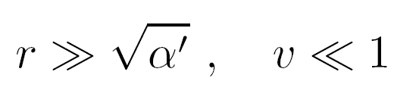
O8
Negative Contributions from nearby bulk
D-particles may also cancel out mass contributions
of D-particles on the brane → avoid Universe
overclosure → no significant restriction of D-foam
populations… e.g. in eras for induced CPT Violation
O8

Slide 93
D-foam & DM Abundances
NEM, Mitsou, Sarkar, Vergou
The presence of D-foam induced
momentum-dependent metric
fluctuations due to interaction
of neutral DM with the D-particle
defects →
modification of Boltzmann Eq.

Slide 94
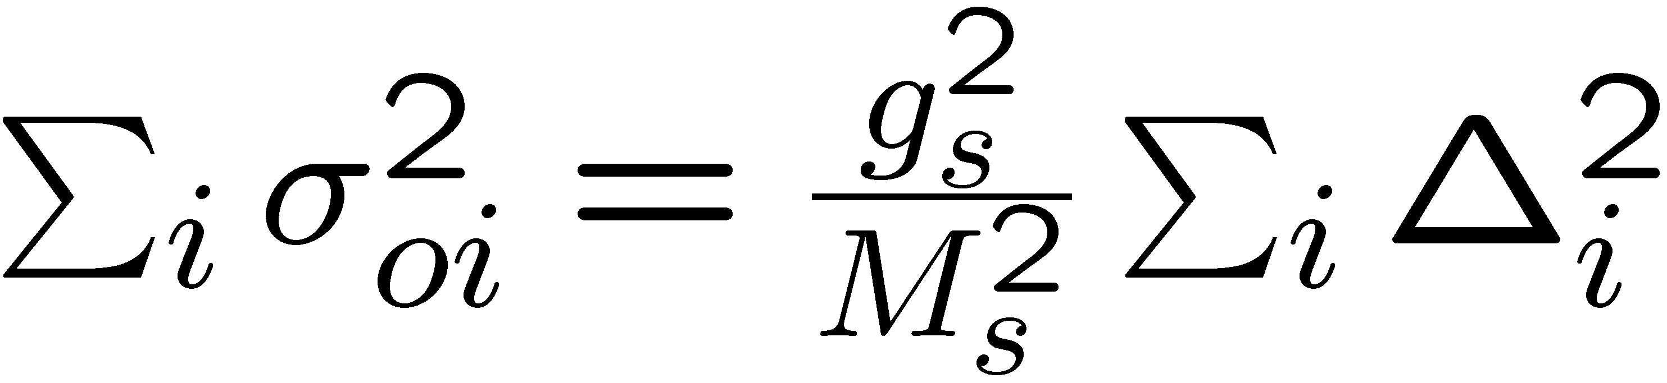
BOTZMANN EQUATION FOR HEAVY SPECIES, m >> p

Slide 95
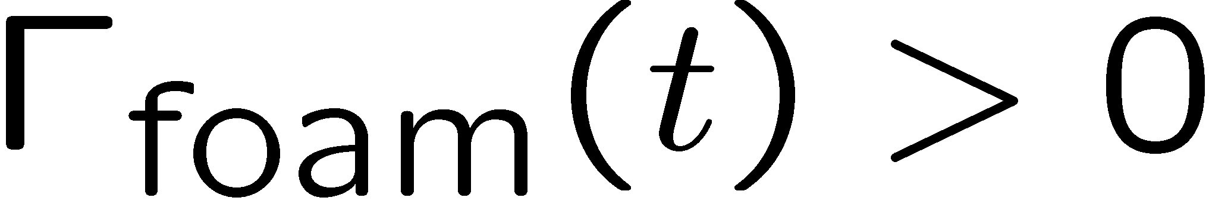
BOTZMANN EQUATION FOR HEAVY SPECIES, m >> p
Foam leads to vacuum
Particle production
(non-trivial vacuum fluctuations)

Slide 96
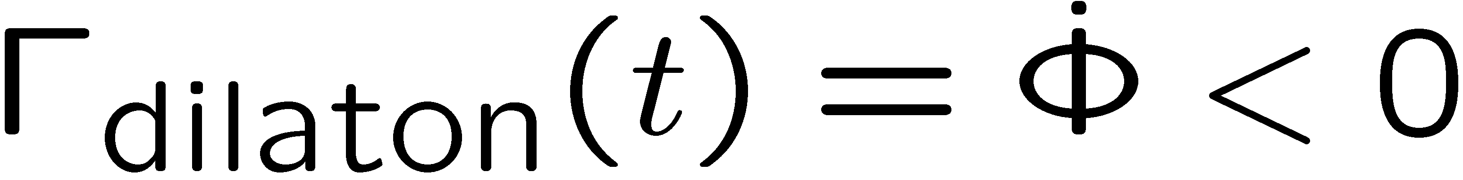
BOTZMANN EQUATION FOR HEAVY SPECIES, m >> p
Foam leads to vacuum
Particle production
(non-trivial vacuum fluctuations)
Opposing effect to Dilaton non-equilibrium effects
Foam dominance restricts available
parameter space, e.g. for SUSY Dark Matter

Slide 97
BOTZMANN EQUATION FOR HEAVY SPECIES, m >> p
Foam leads to vacuum
Particle production
(non-trivial vacuum fluctuations)
Significant effects only for low (TeV)
String scales
Opposing effect to Dilaton non-equilibrium effects
Foam dominance restricts available
parameter space, e.g. for SUSY Dark Matter

Slide 98
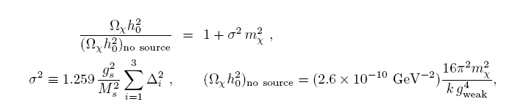
Weakly Interacting Dark Matter Phenomenology and Space-time Foam
NM, Mitsou, Vergou, Sarkar 2010
IF D-FOAM DOMINANCE: INCREASE OF RELIC ABUNDANCE w.r.t. STANDARD COSMOLOGY
Δ = O(1)
dimensionless

Slide 99
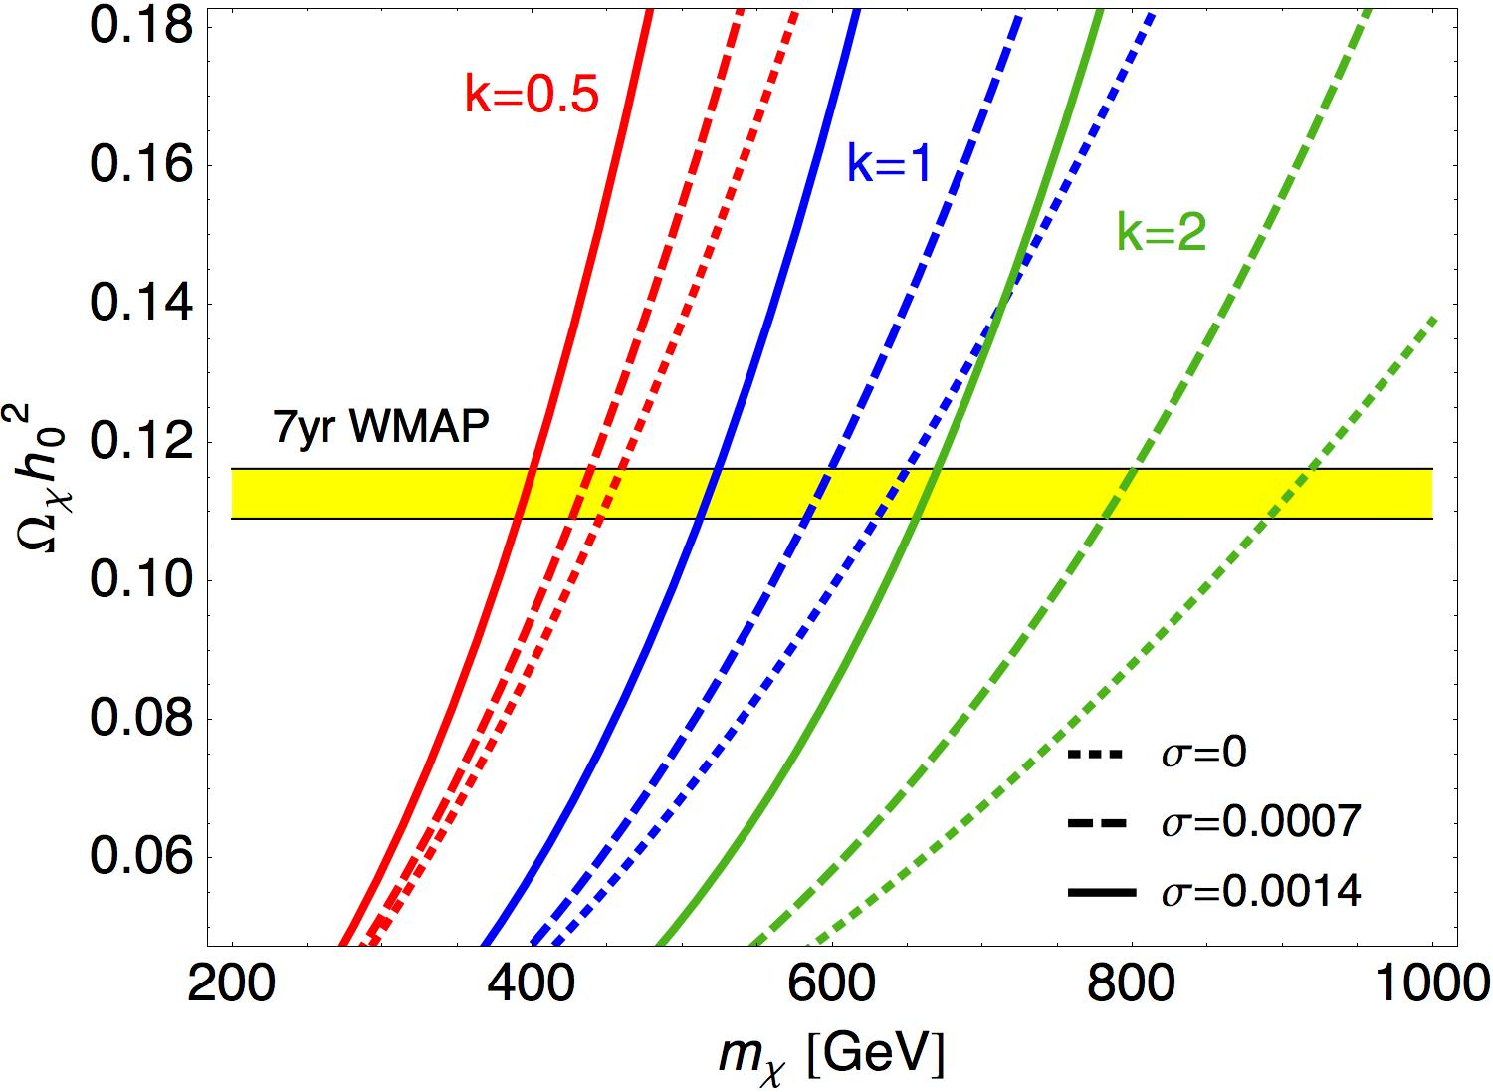
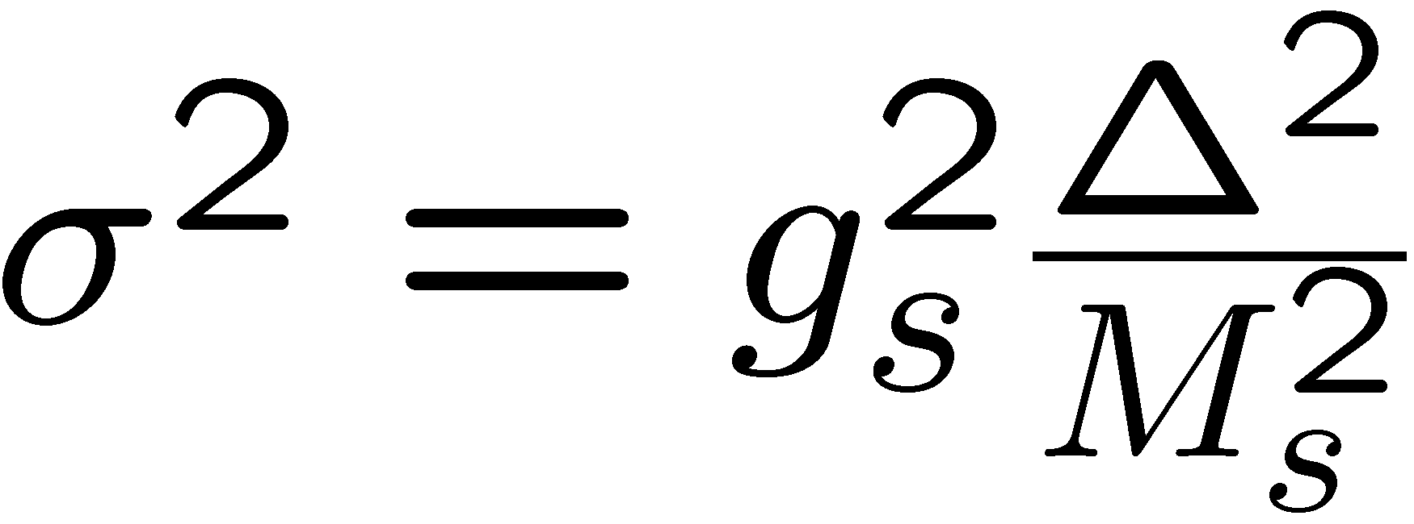
Weakly Interacting Dark Matter Phenomenology and Space-time Foam
NM, Mitsou, Vergou, Sarkar 2010
Foam fluctuations
of order:
Δ = O(1)
dimensionless
Measurable effects
For current or next
Generation expts only if Low String scale O(1-10 TeV)
Cosmologically (WMAP_CMB) allowed regions for WIMP Dark Matter

Slide 100
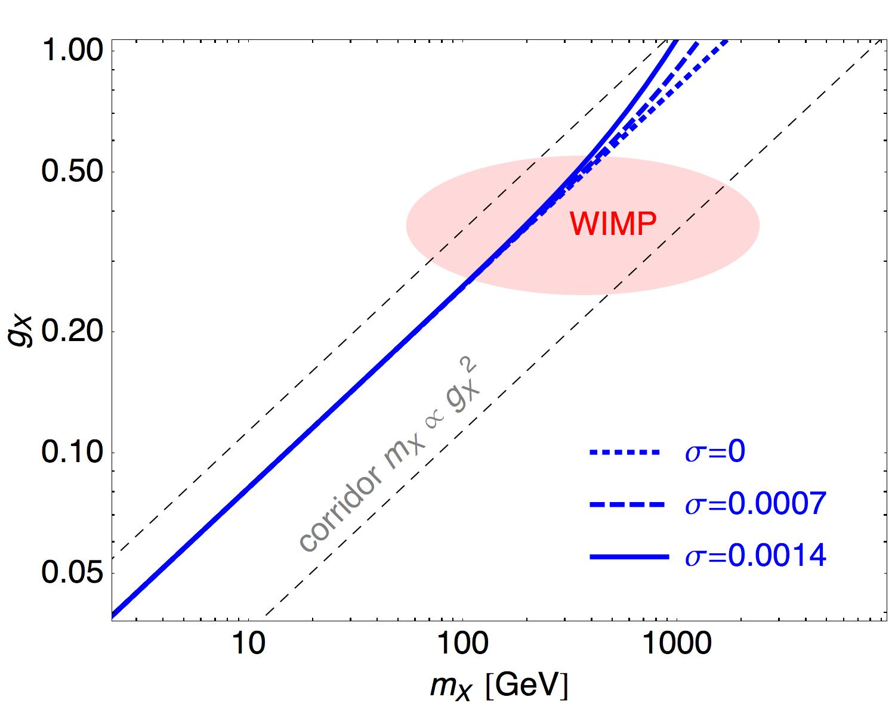
Weakly Interacting Dark Matter Phenomenology and Space-time Foam
Exotic DM Wimp-like
(g_{X}, m_{X} )
Cosmologically (WMAP_CMB) allowed regions for dark Matter

Slide 101
Weakly Interacting Dark Matter Phenomenology and Space-time Foam
Exotic DM Wimp-like
(g_{X}, m_{X} )
Measurable effects
For current or next
Generation expts
Only if Low (TeV)
String scale
Less DM parameter
space available
Cosmologically (WMAP_CMB) allowed regions for dark Matter

Slide 102
Weakly Interacting Dark Matter Phenomenology and Space-time Foam
Exotic DM Wimp-like
(g_{X}, m_{X} )
BUT…
IF D-FOAM IS
RELEVANT FOR
BARYON ASYMMETRY
M_{S}/g_{S} > 200 TeV
…It does not lead to
measurable effects @ LHC
Cosmologically (WMAP_CMB) allowed regions for dark Matter

Slide 103

CONCLUSIONS
No Evidence for DM as yet
We discussed Colliding or Bouncing Brane World Cosmologies that lead to time-dependent dilaton fields at early epochs – before Dark matter Decoupling.
Dilaton dominance in such areas lead to modification of DM abundances → radical effects on Collider searches of new Physics

Slide 104
CONCLUSIONS
No Evidence for DM as yet
We discussed Colliding or Bouncing Brane World Cosmologies that lead to time-dependent dilaton fields at early epochs – before Dark matter Decoupling.
Dilaton dominance in such areas lead to modification of DM abundances → radical effects on Collider searches of new Physics
More room for SUSY, heavier partners allowed → effects in LHC or pushing SUSY beyond the reach of LHC, allowing for Higgs masses > 125 GeV
D-foam scenarios also considered → Local violation of Lorentz symmetry (preservation on average over large populations of D-efects)
→ CPT Violation
→ Leptogenesis →
Baryon Asymmetry
(no need for extra CP Violation)

Slide 105
SPARES

Slide 106
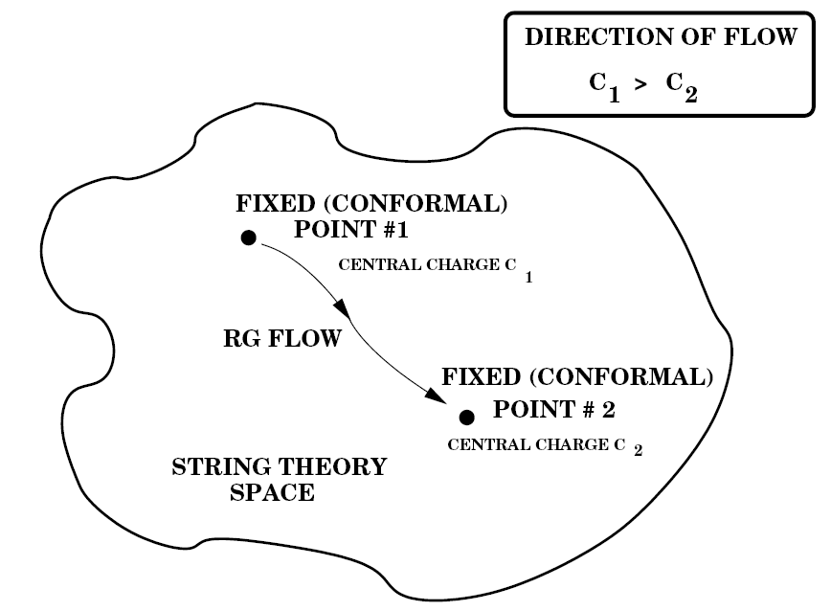
A (non-critical) string theory time Arrow
Ellis, NEM
Nanopoulos
Non-equilibrium Strings
(non-critical), due to
e.g. cosmically catastrophic
events in Early Universe,
for instance brane worlds
collisions:
World-sheet conformal
Invariance is disturbed
Central charge of world-
Sheet theory ``runs’’
To a minimal value
Zamolodchikov’s C-theorem
An H-theorem for CFT
Change in degrees of
Freedom (i.e. entropy)

Slide 107
A (non-critical) string theory time Arrow
Ellis, NEM
Nanopoulos
Non-equilibrium Strings
(non-critical), due to
e.g. cosmically catastrophic
events in Early Universe,
for instance brane worlds
collisions:
World-sheet conformal
Invariance is disturbed
Central charge of world-
Sheet theory ``runs’’
To a minimal value
Zamolodchikov’s C-theorem
An H-theorem for CFT
Change in degrees of
Freedom (i.e. entropy)

Slide 108
A (non-critical) string theory time Arrow
Ellis, NEM
Nanopoulos
Non-equilibrium Strings
(non-critical), due to
e.g. cosmically catastrophic
events in Early Universe,
for instance brane worlds
collisions:
World-sheet conformal
Invariance is disturbed
Central charge of world-
Sheet theory ``runs’’
To a minimal value
Zamolodchikov’s C-theorem
An H-theorem for CFT
Change in degrees of
Freedom (i.e. entropy)
Time as Irreversible
world-sheet Renormalization Group Flow – Time-dependent (non-stabilized) dilaton

Slide 109
D-FOAM & THE DARK SECTOR
O8
O8
Ellis, NM, Westmuckett
Uses 8-Brane stacks to account
For appropriate supersymemtries
if no motion + Orientifold 8-Planes
to compactify bulk 9th space dim.

Slide 110
Interaction of D-particles with
Brane Worlds via stretched
Strings due to relative motion
perpendicularly to branes only
O8
O8

Slide 111
Interaction of D-particles with
Brane Worlds via stretched
Strings due to relative motion
perpendicularly to branes only
O8
Contributions to Brane potentials
(additional contrib. to Dark Energy)
O8

Slide 112
O8
Contributions to Brane potentials
(additional contrib. to Dark Energy)
Velocity-independent terms cancelled by
Orientifold O8 contributions
O8

Slide 113
O8
Contributions to Brane potentials
(additional contrib. to Dark Energy)
Velocity-independent terms cancelled by
Orientifold O8 contributions
O8

Slide 114
O8
Contributions to Brane potentials
(additional contrib. to Dark Energy)
Velocity-independent terms cancelled by
Orientifold O8 contributions
Sign of velocity-dependent terms in
potential depends on D-particle/D-brane
distance. May cancel out over long periods
O8

Slide 115
O8
Contributions to Brane potentials
(additional contrib. to Dark Energy)
Velocity-independent terms cancelled by
Orientifold O8 contributions
Statistically
Sign of velocity-dependent terms in
potential depends on D-particle/D-brane
distance. May cancel out over long periods
O8

Slide 116
O8
Negative Contributions from nearby bulk
D-particles may also cancel out mass contributions
of D-particles on the brane → avoid Universe
overclosure → no significant restriction of D-foam
populations… e.g. in eras for induced CPT Violation
O8

