Slide 1

Facets of Decoherence:
Chiral Magnetic Effect
in Heavy Ion Collisions.
V.I.Shevchenko
NRC Kurchatov Institute
ICNFP, Kolymbari, Crete
30 / 08 / 2013

Slide 2

In memory of
Mikhail Igorevich Polikarpov
28.12.1952 – 18.07.2013

Slide 3
Vacuum of any QFT (and the SM in particular)
is
often described as a special (relativistic etc)
medium
There are two main approaches to study properties
of this (and actually of any) media:
Send test particles and look how they move and interact
Put external conditions and study response
Of particular interest is a question about
the fate of symmetries
under this or that choice of external conditions

Slide 4
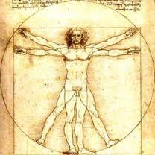
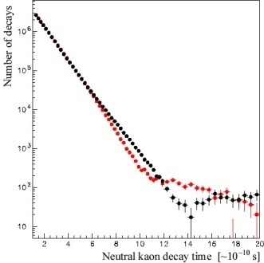

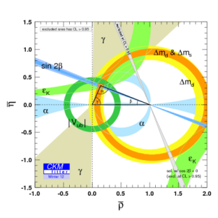

 | Macro | Micro
C
P
T
Matter
dominance
Chirality
Arrows
of time

Slide 5

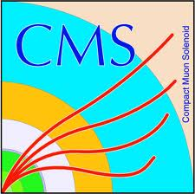


LHC as a tester of symmetries
General purpose experiments
Electroweak gauge symmetry breaking pattern:
Higgs boson and New Physics?
Space-time symmetries: extra dimensions, black holes?
Supersymmetry: particles – superpartners? Dark matter?
Enigma of flavor
New state of matter
CP-violation: new sources?
Baryon asymmetry.
Indirect search of superpartners.
Chiral symmetry of strong interactions: pattern of restoration? Deconfinement. P-parity violation?

Slide 6
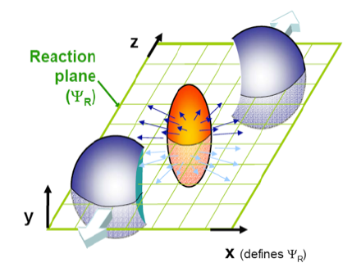
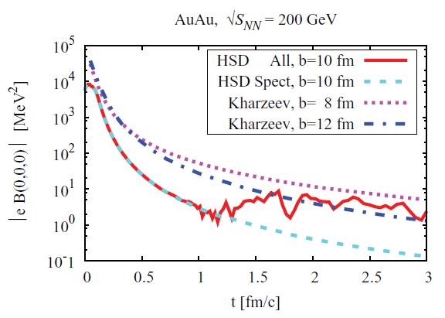
Heavy ions collision experiments → the matter created after collision of electrically charged ions is hot (T ≠ 0), dense (µ ≠ 0) and experience strong abelian fields in the collision region (B ≠ 0) (and all is time-dependent!)
B
Voronyuk, Toneev, Cassing et al, ‘11

Slide 7
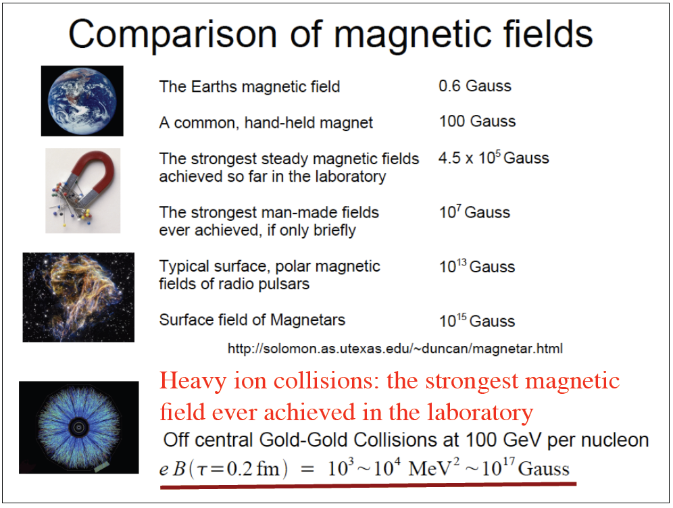
(slide from D.Kharzeev)

Slide 8

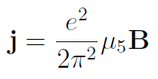


Vilenkin, ‘80 (not in heavy ion collision context);
Kharzeev, Pisarski, Tytgat, ’98;
Halperin, Zhitnitsky, ‘98;
Alekseev, Cheianov, Fröhlich, ’98;
Kharzeev, McLerran, Warringa ’07
Energy
µ_{R}
Many complementary ways
to derive (Chern-Simons,
linear response, triangle loop,
current algebra, etc). At
effective Lagrangian level
µ_{L}
Left-handed
Right-handed
Robust theoretical result
Possible experimental manifestations?

Slide 9
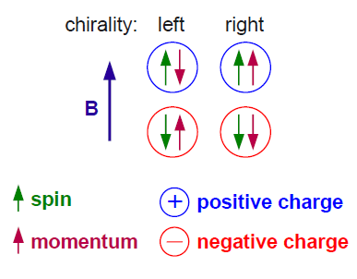
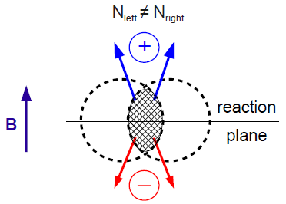
Electric current along the magnetic field
final particles charge distribution asymmetry with respect
to reaction plane for noncentral collisions
chiral magnetic effect
(picture from I.Seluzhenkov)

Slide 10




This CME current is non-dissipative
 | j | σ | E
P | - | + | -
T | - | - | +
 | j | σ_{χ} | B
P | - | - | +
T | - | + | -
No arrow of time, no dissipation, no entropy production
Clear similarity with superconductivity.
But what about P-parity?
Vacuum expectation value of any local P-odd observable has to vanish in vector-like theories such as QCD (C.Vafa, E.Witten, ’84).

Slide 11
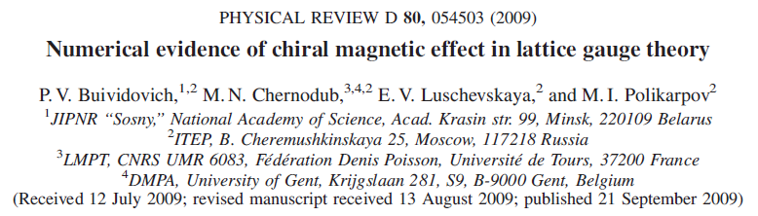
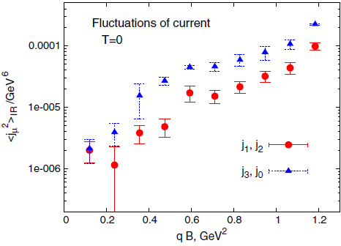
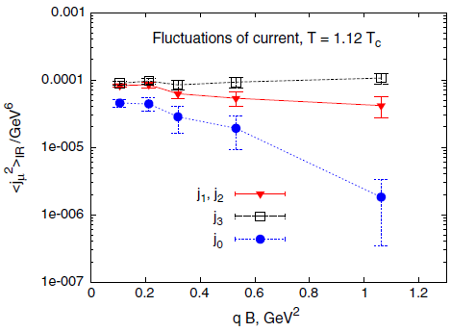
For the period 2008-2013 M.I.Polikarpov’s lattice group sent to arXiv 19 papers about various aspects of QCD in magnetic field. First ever CME-related lattice results were presented in

Slide 12
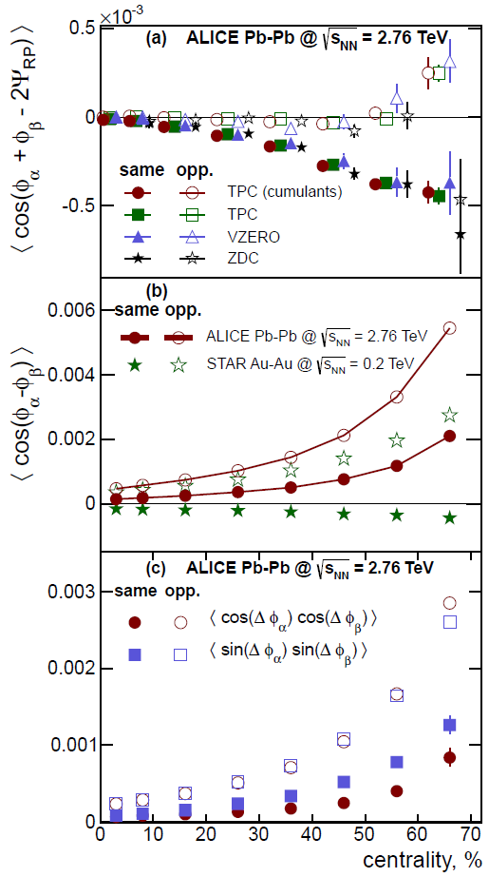


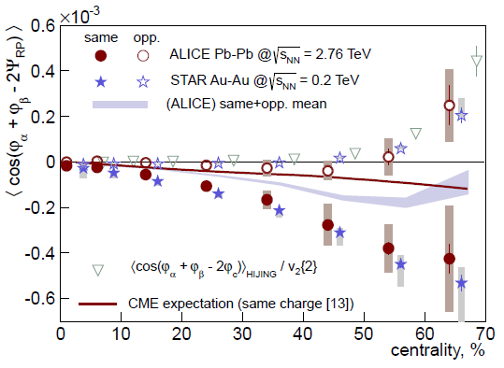
Charge asymmetry in experiment
ALICE, arXiv: 1207.0900

Slide 13
Questions worth to think about:
(the list is by definition subjective and incomplete)
How to proceed in a reliable way from nice qualitative picture of CME to quantitative predictions for charge particle correlations measured in experiments?
What is quantum physics behind µ₅ ?
How to disentangle the genuine nonabelian physics from dynamics of free massless fermions in magnetic field?
How is quantum anomaly in microscopic current encoded in dynamics for macroscopic, effective currents (anomalous hydrodynamics)?
…

Slide 14

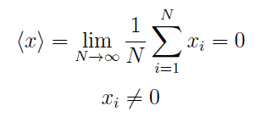


Key message one should carefully distinguish symmetry breaking caused by
dynamics from event-by-event fluctuations
Let’s take 1D system with P-even potential
Measuring coordinate in a single experiment (“event”) one
gets sequence of generally nonzero values with zero mean
Event-by-event P-parity violation?
In QM individual outcome has no meaning
Law of Nature, not inefficiency of our apparatus

Slide 15


Common lore – a measurement is a story about interaction
between two quantum systems when one has a few
degrees of freedom while another one a lot.
Interactions with the medium lead to decoherence and
transition from quantum to classical fluctuations in the
process of continuous measurement.
Quantum fluctuations:
all histories (field
configurations in QFT
context) coexist together
and simultaneously
Classical fluctuations
(statistical, thermal etc):
one random coordinate
at any given moment
of time

Slide 16
There exist various theoretical frameworks to describe quantum measurements in relativistic setting. We have considered two:
Point-like detectors (Unruh-DeWitt)
Filter functions (quantum corridors)

Slide 17
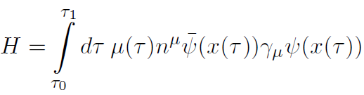
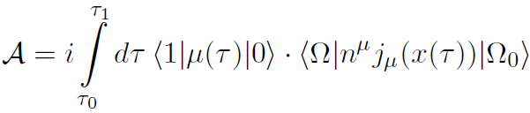
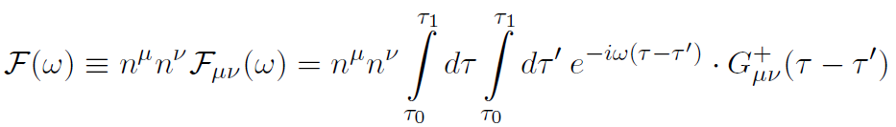
Point-like detectors (Unruh-DeWitt)
Standard Unruh – DeWitt detector coupled to vector current:
Amplitude for this detector to «click»:
Key object – response function:

Slide 18
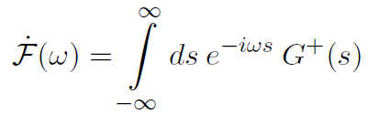
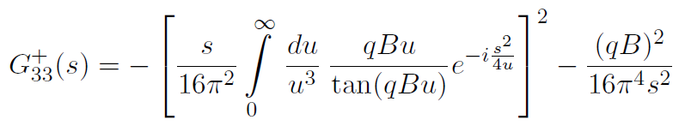
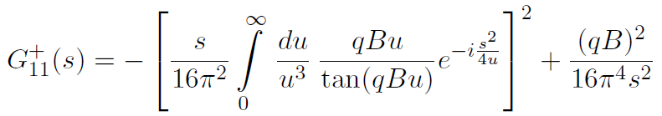
Usually one is interested in detector excitation rate in unit
time. For infinite observation time range it is determined by
the power spectrum of the corresponding Wightman function:
where
The detector is supposed to be at rest. Explicitly one gets

Slide 19
Usually one is interested in detector excitation rate in unit
time. For infinite observation time range it is determined by
the power spectrum of the corresponding Wightman function:
where
The detector is supposed to be at rest. Explicitly one gets

Slide 20
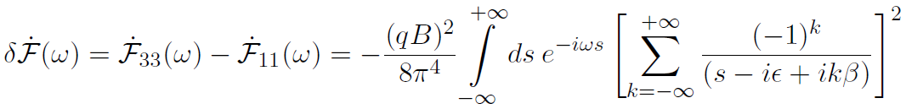

Asymmetry:
The result:
positive, i.e. detector measuring currents along the field
clicks more often than the one in perpendicular direction
caused by the same term in the Green’s function which is
responsible for triangle anomaly
no higher orders in magnetic field, the asymmetry is
quadratic in В for whatever field, weak or strong
inversion of statistics from FD for elementary excitations to
BE for the observable being measured

Slide 21
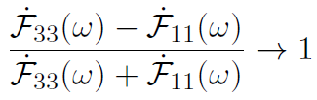
At large magnetic fields
T≠0
B≠0
Fluctuations enhancement along the field and
suppression perpendicular to it by the same amount

Slide 22
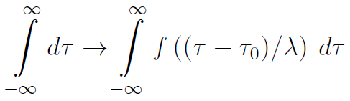



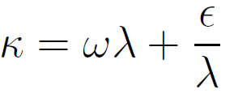
Effects of finite time: detector is in operation for the time λ
Physically, forced by, e.g. finite life time of the magnetic field:
The result:
Due to the energy-time uncertainty relation the asymmetry
shows up even in chirally symmetric case.

Slide 23


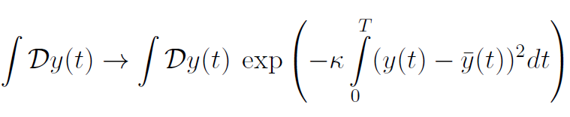



Filter functions (quantum corridors)
Consider 3D quantum system with the potential
for but not invariant
under reflections of only one coordinate.
Let us monitor some P-odd observable, e.g.
where the corridor width is given by
Then the result for another (correlated) P-odd observable is
If the measuring device is switched off

Slide 24


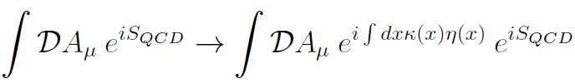

In QFT context the formalism of closed time path functionals
is suitable:
For example, one can define distribution amplitude for
quantum vector current and some pseudoscalar
classical filter field κ(x)
where

Slide 25


Due to triangle anomaly vector and axial currents fluctuations are correlated in external field:
Mean field current is given by
The field κ(x) is similar to dynamical axion field but has
a different meaning here – it describes the classical detector sensitive to P-odd excitations.
the current flows only inside decoherence volume
it is odd in κ and linear in B
it has a maximum value (as a function of κ)
subtle interplay of abelian and nonabelian anomalies

Slide 26
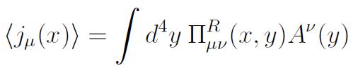





Are there traces of CME at central collisions?
Fluctuation-dissipation theorem: yes, they should be.
Two ways to measure conductivity (in LR-approximation):
according to Ohm:
according to Nyquist:

Slide 27
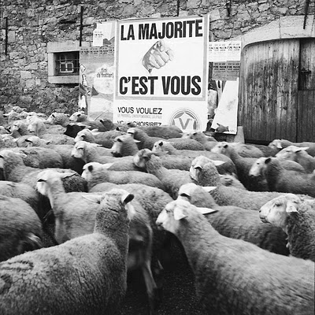
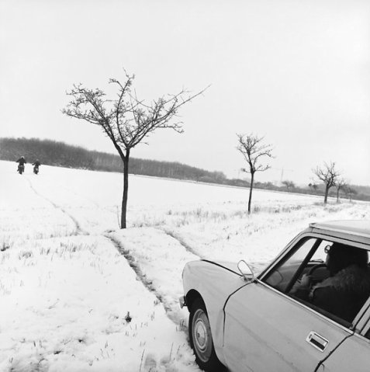
Instead of conclusion
Mikhail Igorevich had great sense of humor. In particular, he was fond of photos by René Maltête (1930–2000) and often used them in his scientific or pedagogical talks to illustrate various physical ideas.
One of his favorite was this:
Another was this one:

Slide 28
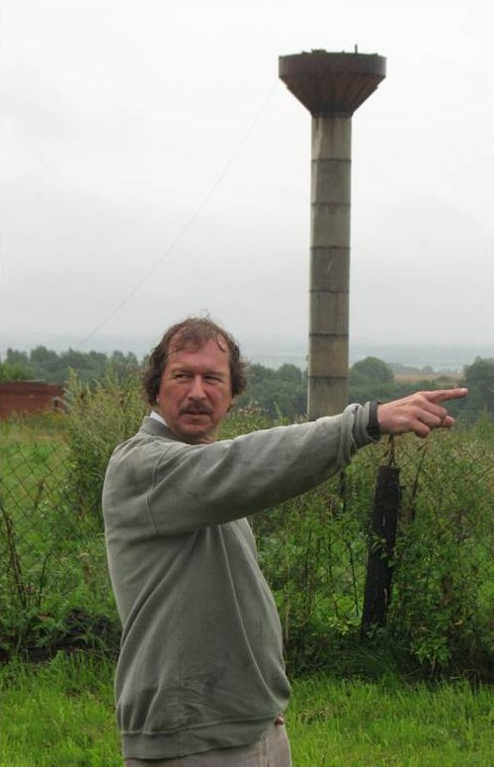

Instead of conclusion
Mikhail Igorevich had great sense of humor. In particular, he was fond of photos by René Maltête (1930–2000) and often used them in his scientific or pedagogical talks to illustrate various physical ideas.
Requiescat in pacem
Покойся с миром

