Slide 1
Hexagonal flow as interplay of elliptic and triangular flows
E. Zabrodin
in collaboration with
L. Bravina, H. Brusheim Johansson, G. Eyyubova,
V. Korotkikh, I. Lokhtin, L. Malinina, S. Petrushanko,
and A. Snigirev
University of Oslo and Moscow State University
International Conference on New Frontiers in Physics ICNFP 2013
Kolumbari, Crete, Greece 31.08.2013

Slide 2
Outline
I. Description of anisotropic flow in relativistic heavy ion collisions:
(a) elliptic and triangular flows
(b) initial fluctuations and higher harmonics
II. HYDJET++ model (hydro + jets)
III. Jets influence on NCQ-scaling and v4/(v2)² ratio at RHIC and LHC
IV. Hexagonal flow v6

Slide 3
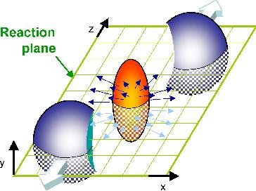
ANISOTROPIC FLOW
S.Voloshin and Y.Zhang, Z.Phys.C70 (1996) 665

Slide 4
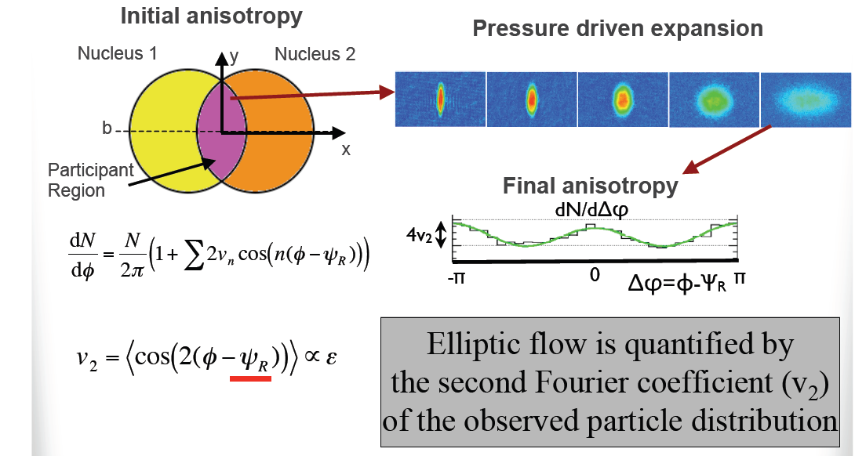
ELLIPTIC FLOW
B. Alver, talk at Rencontres Ions Lourds (2010)

Slide 5
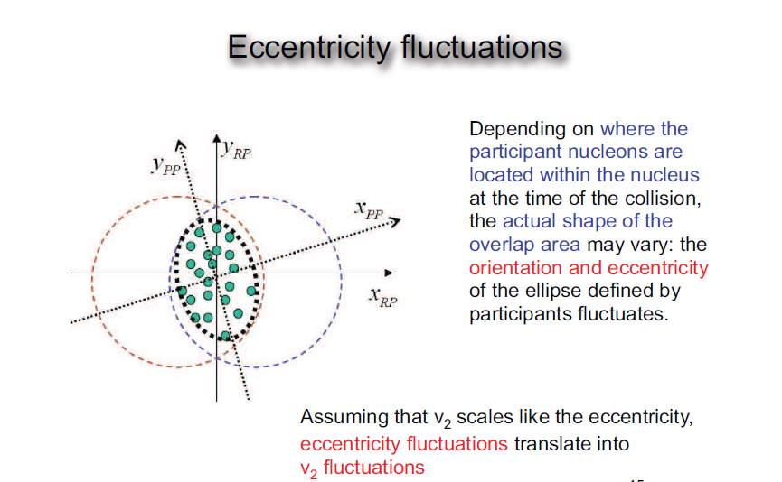
J.-Y. Ollitrault
Eccenttricity fluctuation can be computed in MC Glauber model or derived from experiment by comparing different methods for flow calculation.

Slide 6
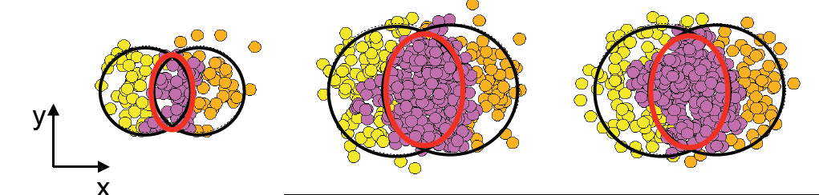
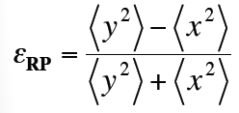
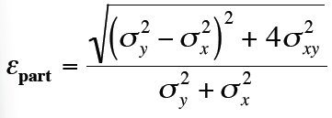
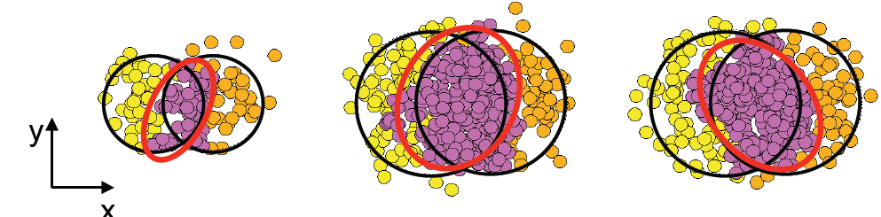
ECCENTRICITY
STANDARD
PARTICIPANT

Slide 7
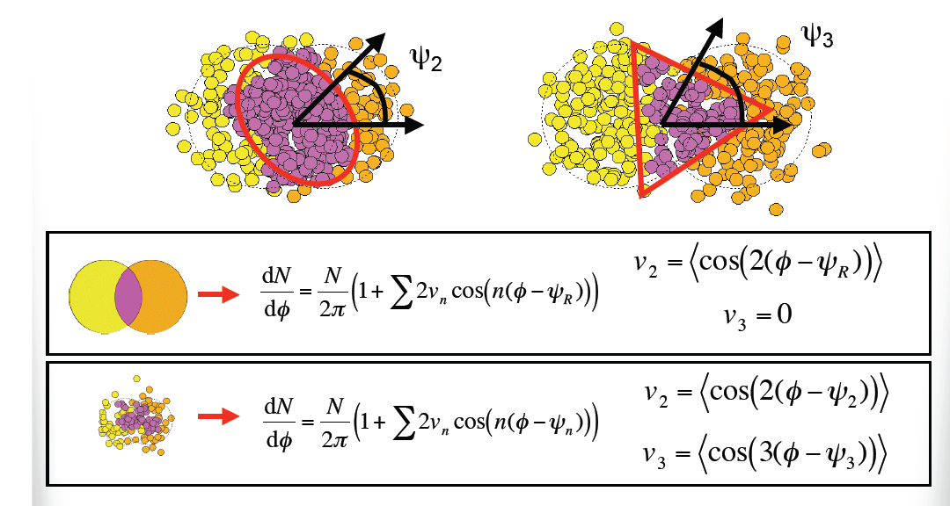
TRIANGULAR FLOW
B. Alver and G.Roland, PRC 81 (2010) 054905
The triangular initial shape leads to triangular hydrodynamic flow

Slide 8
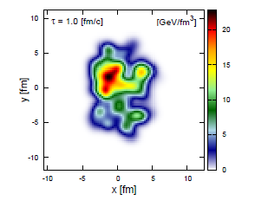
INITAL-STATE FLUCTUATIONS (example)
W.-L. Qian et al., arXiv: 1305.4673 [hep-ph]
Energy distribution of a random NeXuS event

Slide 9
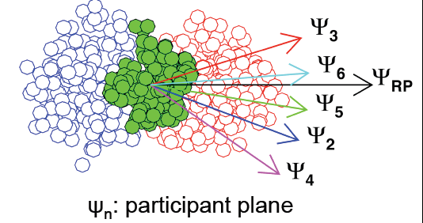
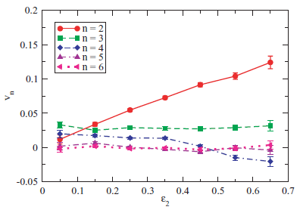
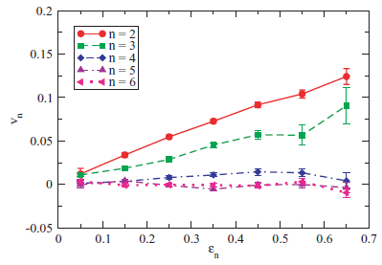
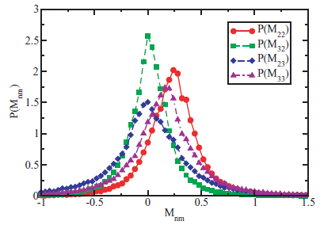

CROSS-TALK BETWEEN FLOW HARMONICS
G.-Y. Qin et al, PRC 82 (2010) 064903
Only the first few flow harmonics of final-state hadrons survive
after hydrodynamic evolution

Slide 10


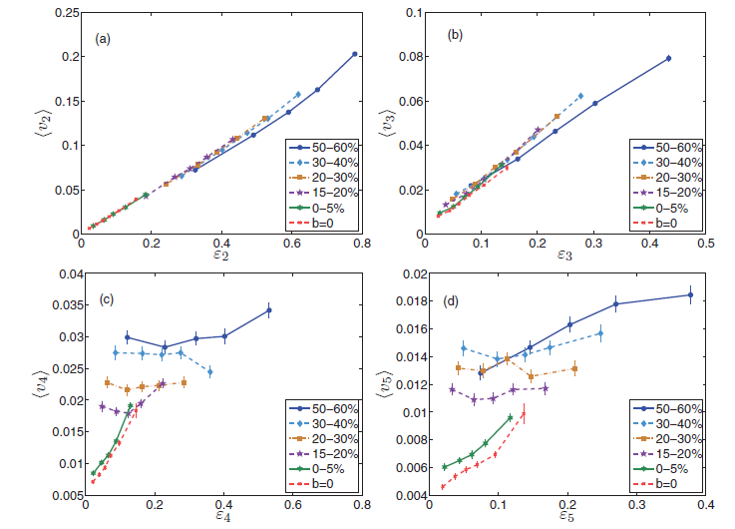
CROSS-TALK BETWEEN FLOW HARMONICS
Z. Qiu and U. Heinz, PRC 84 (2011) 024911
The basic response of v2 and v3 to eccentricities is approx. linear
Higher flow coefficients show poor correlation with the eccentricities
of the same order

Slide 11
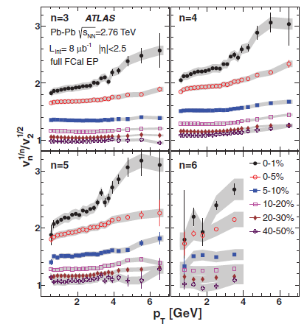
SCALING OF HIGHER ORDER FLOW HARMONICS
J.-Y. Ollitrault :
ATLAS, PRC 86 (2012) 014907

Slide 12
HYDJET++ event generator
I.Lokhtin, L.Malinina, S.Petrushanko, A.Snigirev, I.Arsene, K.Tywoniuk,
Comp. Phys. Commun.180 (2009) 779-799 (arXiv:0809.2708[hep-ph])
● The soft part of HYDJET++ event represents the "thermal" hadronic state.
multiplicities are determined assuming thermal equilibrium
hadrons are produced on the hypersurface represented by a parameterization of relativistic hydrodynamics with given freeze-out conditions
chemical and kinetic freeze-outs are separated
decays of hadronic resonances are taken into account (360 particles from SHARE data table) with “home-made'' decayer
the model reproduces soft hadroproduction features at RHIC and LHC
(particle spectra, elliptic flow, HBT)
● The hard, multi-partonic part of HYDJET++ event is identical to the hard part of Fortran written HYDJET (PYTHIA6.4xx + PYQUEN1.5) => now PYTHIA Pro-Q20 tune !!
PYQUEN event generator is used for simulation of rescattering, radiative and collisional energy loss of hard partons in expanding quark-gluon plasma created in ultrarelativistic heavy ion AA collisions. HYDJET++ includes nuclear shadowing correction for parton distributions (important at LHC!)
Impact-parameter dependent parameterization of nuclear shadowing (K.Tywoniuk, I.Arsene, L.Bravina, A.Kaidalov and E.Zabrodin, Phys. Lett. B 657 (2007) 170)

Slide 13
Model parameters.
1. Thermodynamic parameters at chemical freeze-out: Tch , {µB, µS, µQ}
2. If thermal freeze-out is considered: Tth , µπ-normalisation constant
3. Volume parameters: τ, Δτ, R
-maximal transverse flow rapidity for Bjorken-like parametrization
5. ηmax -maximal space-time longitudinal rapidity which determines the rapidity interval [- η_{max}, η_{max}] in the collision center-of-mass system.
6. Impact parameter range: minimal bmin and maximal bmax impact parameters
7. Flow anisotropy parameters δ(b), ε(b)‏
PYTHYA+PYQUEN obligatory parameters
9. Beam and target nuclear atomic weight A
10. –c.m.s. energy per nucleon pair (PYTHIA initialization at given energy)‏
11. ptmin – minimal pt of parton-parton scattering in PYTHIA event (ckin(3) in /pysubs/)
12. nhsel flag to include jet production in hydro-type event:
0 - jet production off (pure FASTMC event),
1 - jet production on, jet quenching off (FASTMC+njet*PYTHIA events),
2 - jet production & jet quenching on (FASTMC+njet*PYQUEN events),
3 - jet production on, jet quenching off, FASTMC off (njet*PYTHIA events),
4 - jet production & jet quenching on, FASTMC off (njet*PYQUEN events);
13. ishad flag to switch on/off nuclear shadowing

Slide 14
Parameters of energy loss model in PYQUEN
(default, but can be changed from the default values by the user)‏
1. T0 - initial temparature of quark-gluon plasma for central
Pb+Pb collisions at mid-rapidity (initial temperature
for other centralities and atomic numbers will be calculated automatically)‏
at LHC: T0=1 GeV, at RHIC(200 AGeV) T0=0.300 GeV
2. tau0 - proper time of quark-gluon plasma formation
at LHC: tau0=0.1 fm/c, at RHIC(200 AGeV) tau0=0.4 fm/c
3. nf - number of active quark flavours in quark-gluon plasma
(nf=0, 1, 2 or 3) at LHC: nf=0, at RHIC(200 AGeV) nf=2
4. ienglu - flag to fix type of medium-induced partonic energy loss
(ienglu=0 - radiative and collisional loss, ienglu=1 - radiative loss only,
ienglu=2 - collisional loss only, default value is ienglu=0);
ianglu - flag to fix type of angular distribution of emitted gluons
(ianglu=0 - small-angular, ianglu=1 - wide-angular,
ianglu=2 - collinear, default value is ianglu-0).
ienglu=0

Slide 15
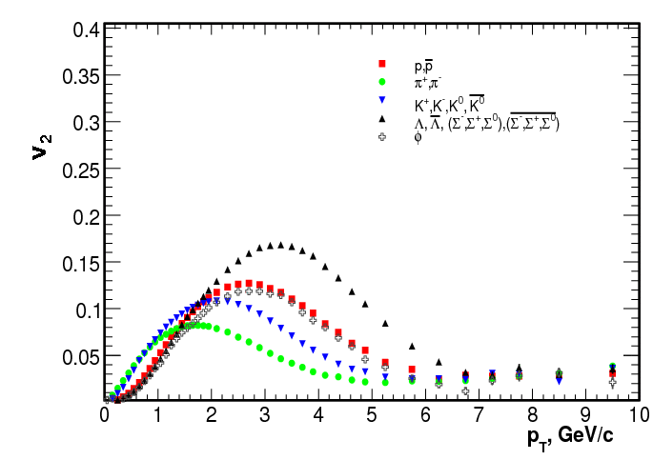
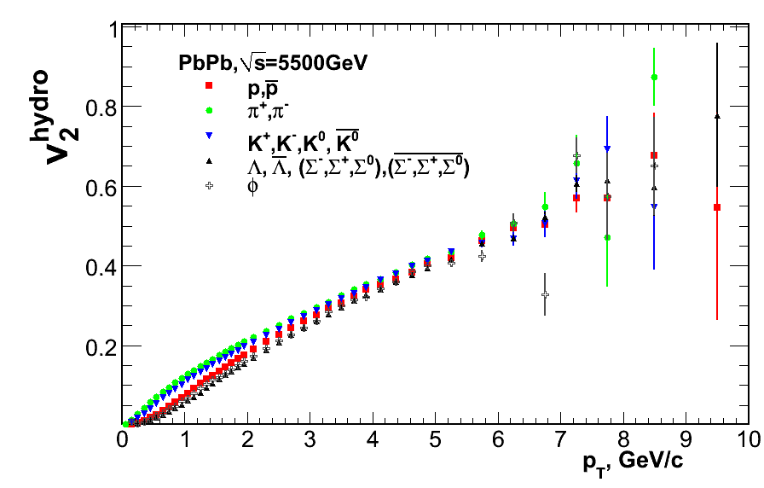
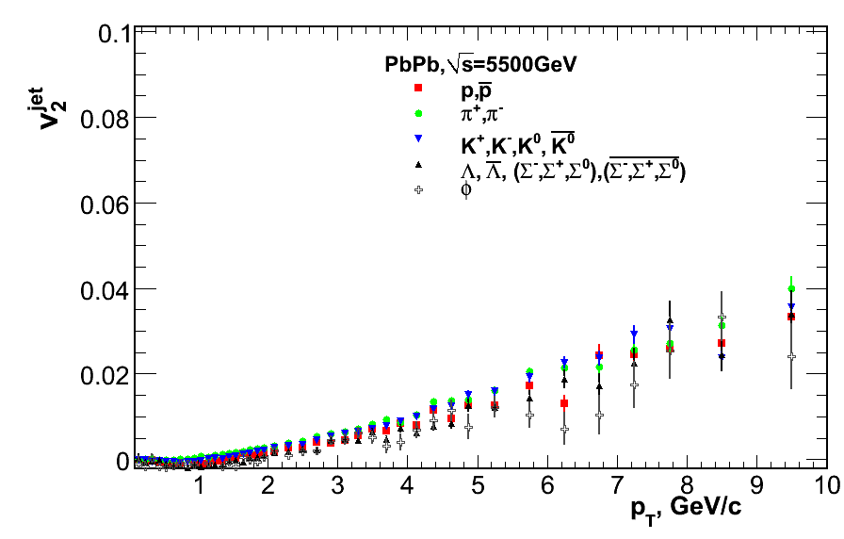
V₂ in HYDJET++ for different particles (centrality 30%)
Mass ordering in soft p_{T} regions then breaks.
Interplay of hydrodynamics and jets
Why?
Hydrodynamics gives mass ordering of v2.
The model possesses crossing of baryon and meson branches.
Hydrodynamics
Jet part +quenching

Slide 16
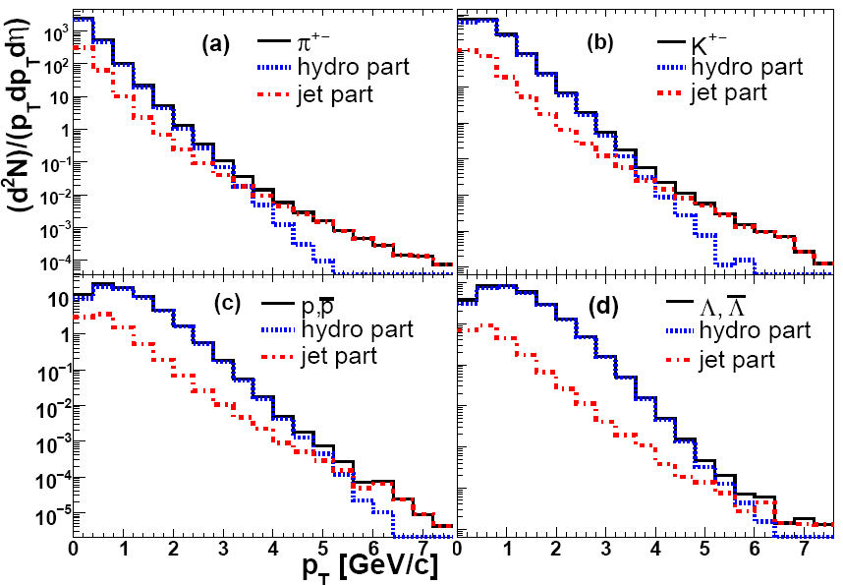
The p_{T} specta of π, K, p, Λ with HYDJET++ model, √s=200GeV
The slope for the hydro part depends strongly on mass:
- the heavier the particle -- the harder the spectrum
The hydro part dies out earlier for light particles than for heavy ones

Slide 17
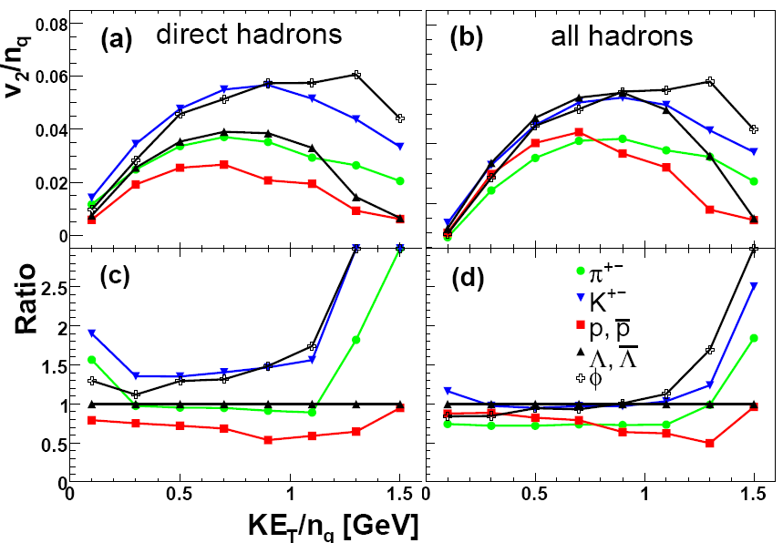
NCQ scaling at LHC
No scaling for Appearance of the approximate
direct particles scaling for all particles
G.Eyyubova et al., PRC 80 (2009) 064907
LHC: NCQ scaling will be only approximate (prediction, 2009)

Slide 18
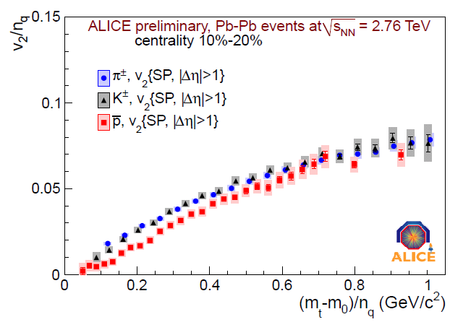
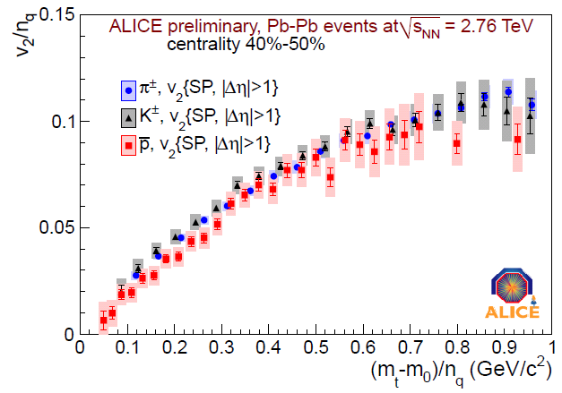
Experimental results (LHC)
ALICE Collaboration, M. Krzewicki et al., JPG 38 (2011) 124047
Semi-sentral collisions Semi-peripheral collisions
The NCQ scaling is indeed only approximate (2011)

Slide 19
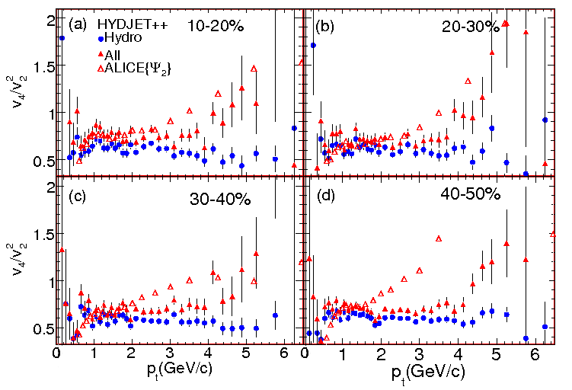
HYDJET++ RESULTS for LHC
Jets !
L.Bravina et al., PRC 87 (2013) 034901
Jets increase the ratio and lead to rise of high-pT tail

Slide 20
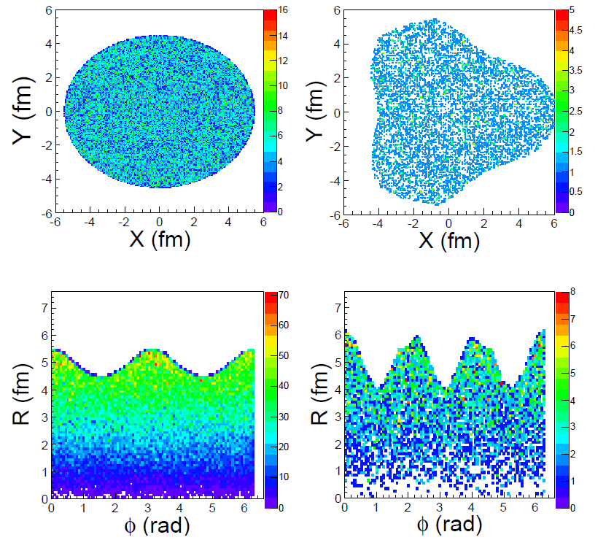
Generation of triangular flow
V2
V3
Hint (Teaney, Ollitrault, …):

Slide 21
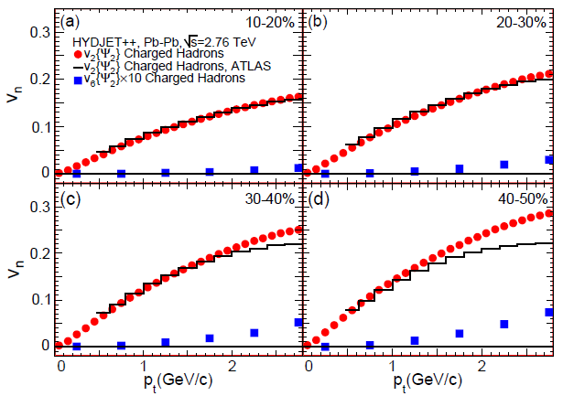
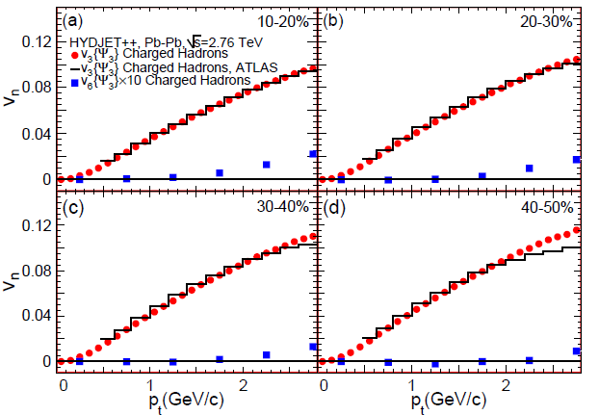
HEXAGONAL FLOW in HYDJET++ AT LHC
L.Bravina et al., to be submitted
V6 is weak
Its high-pt tail increases with rising pT

Slide 22
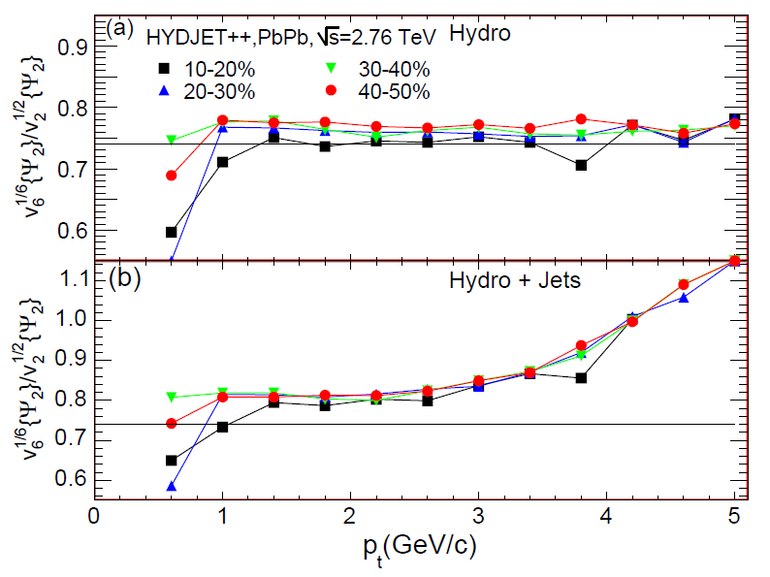
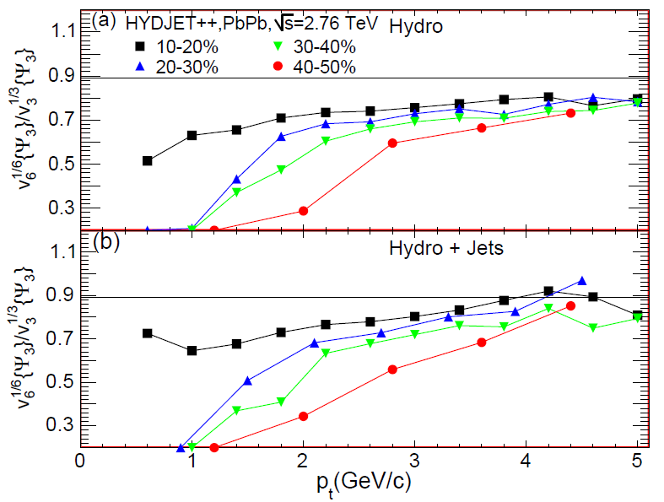
Hexagonal flow:
L.Bravina et al., to be submitted
Scaling?
It would be interesting to study and in experiment

Slide 23
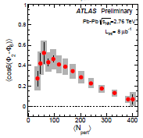
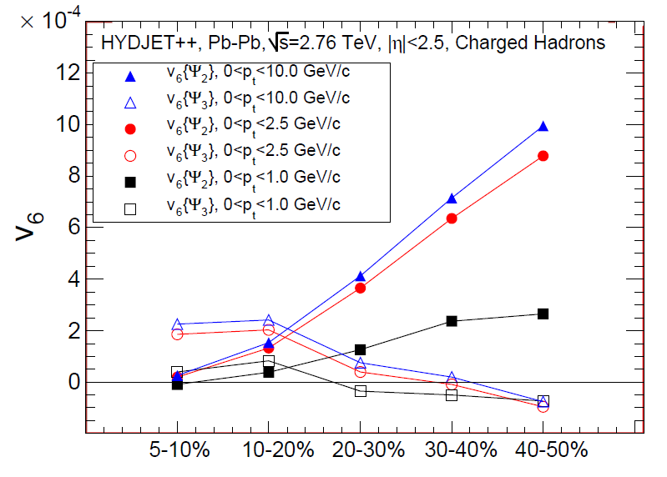
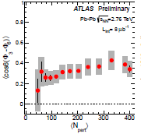
Hexagonal flow: centrality dependence
ATLAS-CONF-2012-049
In line with exp. data

Slide 24
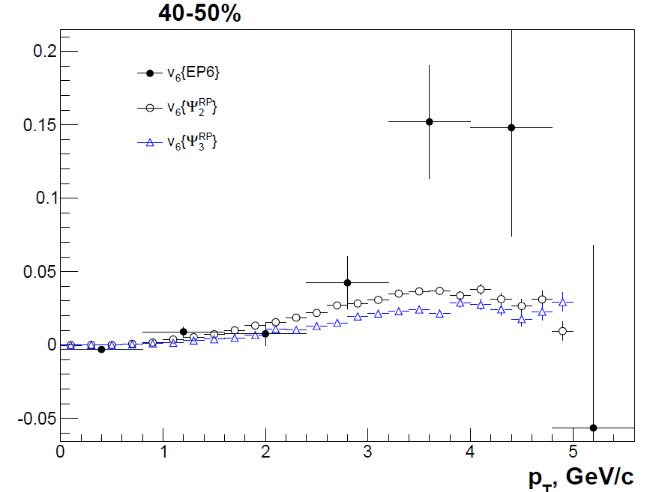
Extraction of V6 (Event Plane method)

Slide 25
Conclusions
The HYDJET++ model allows to investigate flow of hydro and jet parts separately, to look at reconstruction of pure hydro flow and its modification due to jet part.
Non-linearities between eccentricities and flow harmonics of n-th order (n>3) can be understood in terms of elliptic and triangular flow contributions
Scaling of is observed for centralities up to 50%
Jets increase this ratio by 10-15% and lead to rise of the high-pT tail
Centrality dependences v6(v2) and v6(v3) are in line with the
behavior of the plane correlators and
measured experimentally
Difficult to get genuine information about higher eccentricities !

Slide 26
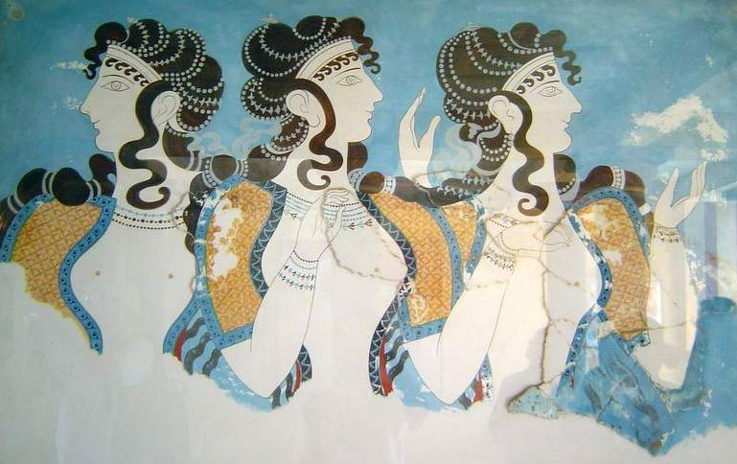
Many thanks to organizers!

Slide 27
Back-up Slides

Slide 28
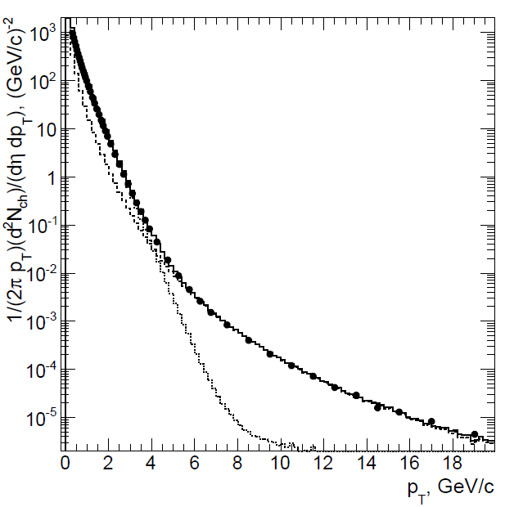
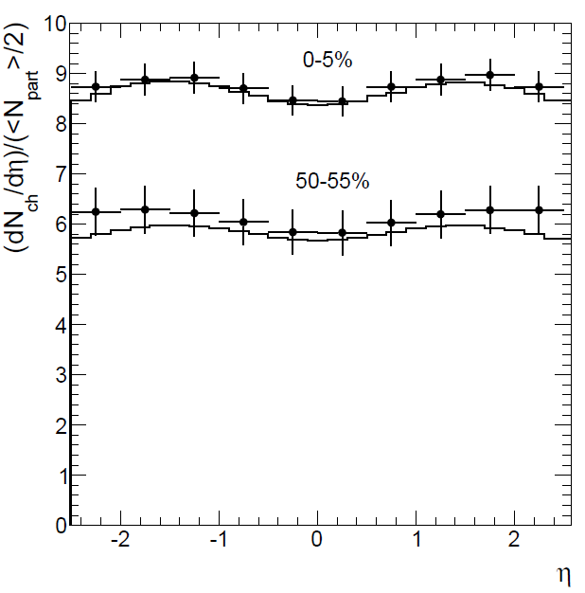
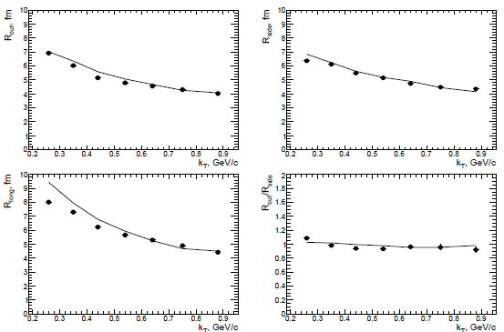
LHC data vs. HYDJET++ model
Transverse momentum
Pb+Pb @ 2.76 ATeV
Rapidity
I. Lokhtin et al., Eur. Phys. J C72 (2012) 2045
Correlation radii (femtoscopy)

Slide 29
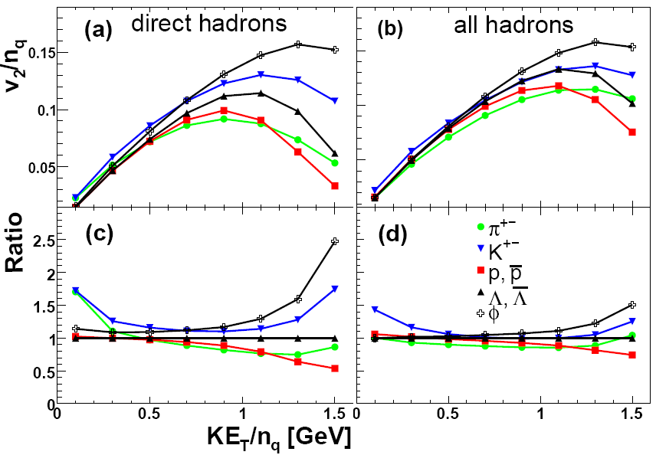
Number-of-constituent-quark scaling at RHIC
Direct particles: scaling is not good. All particles: KE_{T}/n_{q} scaling
G.Eyyubova et al., PRC 80 (2009) 064907
One of the explanations of KE_{T}/n_{q} scaling is partonic origin of the elliptic flow.
However, final state effects (such as resonance decays and jets) may also lead
to appearance of the scaling

Slide 30
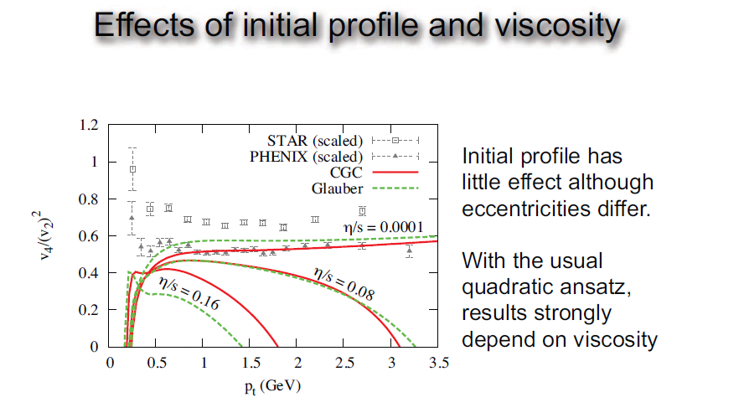
M. Luzum, C. Gombeaud, J.-Y. Ollitrault, PRC 81 (2010) 054910
Viscosity lowers v4 /(v2 )² for a realistic T_{f}
30

Slide 31
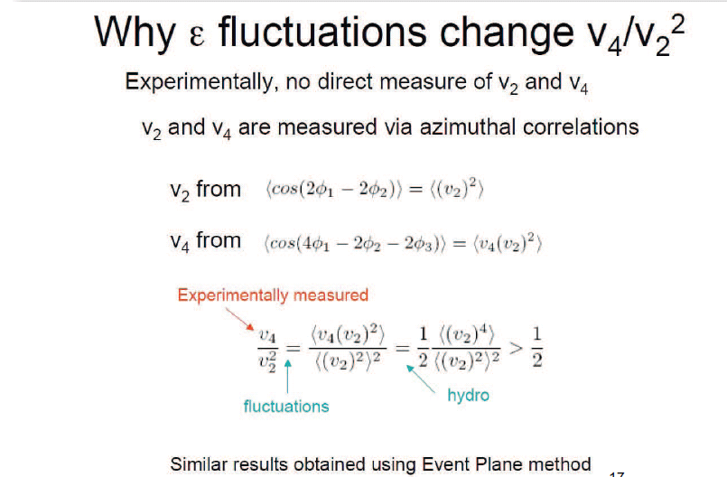

Slide 32
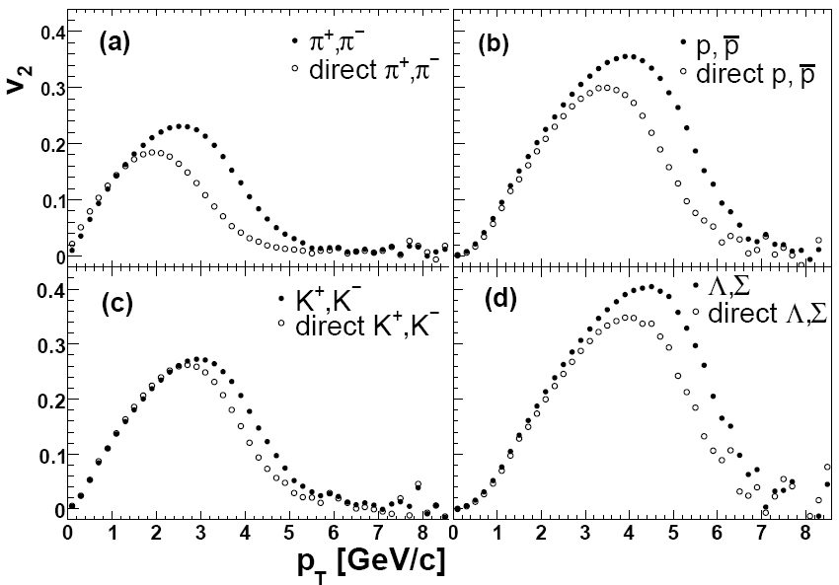
Influence of resonance decays for different type of particles at RHIC
˄
Pions and kaons: the resulting flow is weaker at low-pt and larger at high-pt
Baryons: the resulting flow is stronger than the flow of direct particles

Slide 33
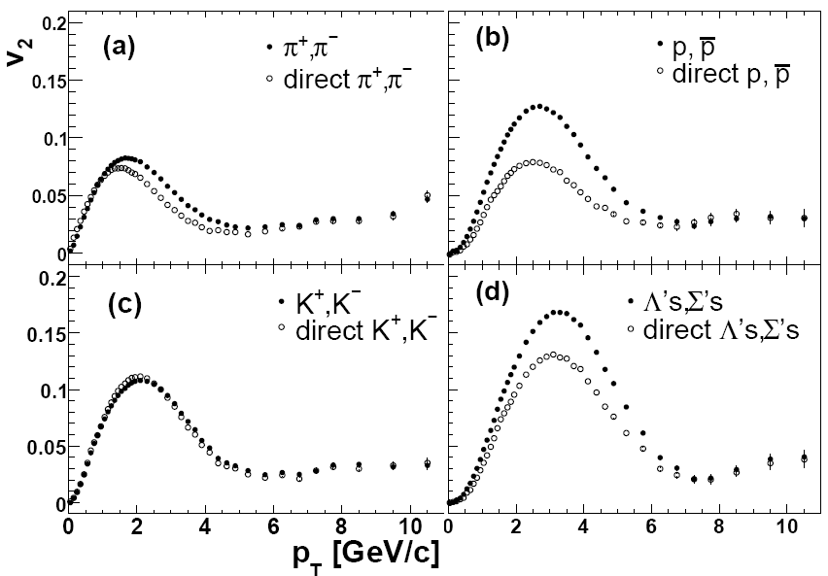
Influence of resonance decays for different type of particles at LHC
˄
Pions: the resulting flow is weaker at low-pt and larger at high-pt
Kaons: both flows almost coincide
Baryons: the resulting flow is stronger than the flow of direct particles

Slide 34
Methods for v₂ calculation
(1) Event plane method
Ψ₂ is the calculated reaction plane angle:
(2) Two particle correlation method
(3) Lee-Yang zero method
Integral v₂ is connected with the first minimum r₀ of the module of the G(ir):
Differential flow is calculated by the formula:

Slide 35
Comparison of Event Plane and Lee-Yang zeroes methods (c=30%)
●- true value
■ - L-Y-Z method
EventPlane method
p_{T}, GeV/c
Lee-Yang zeroes Method
Event Plane method overestimates v₂ at high p_{t} due to non-flow correlation (mostly because of jets).

