Slide 1
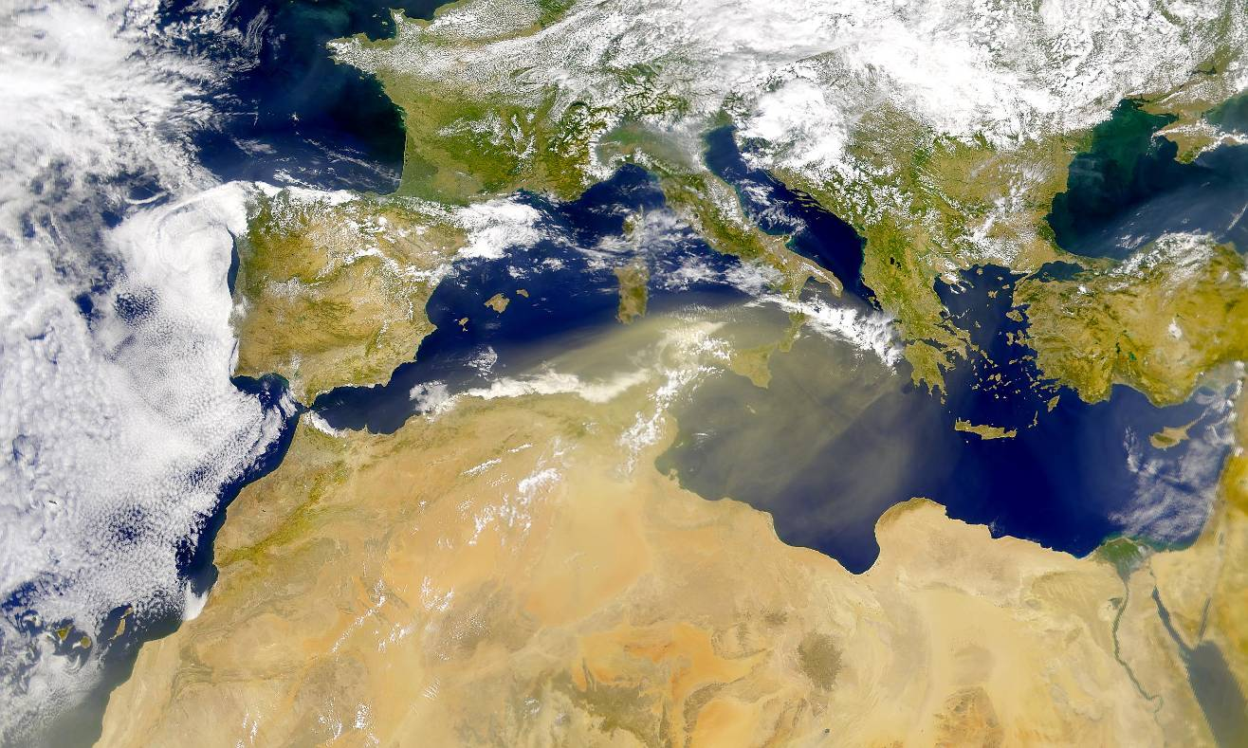
Aerosols and their interaction with climate
and biogeochemical cycles in the Mediterranean basin
F. Solmon
ICTP, ESP (solmon@ictp.it)
F.Dulac, M. Mallet (CNRS), The ICTP ESP group

Slide 2
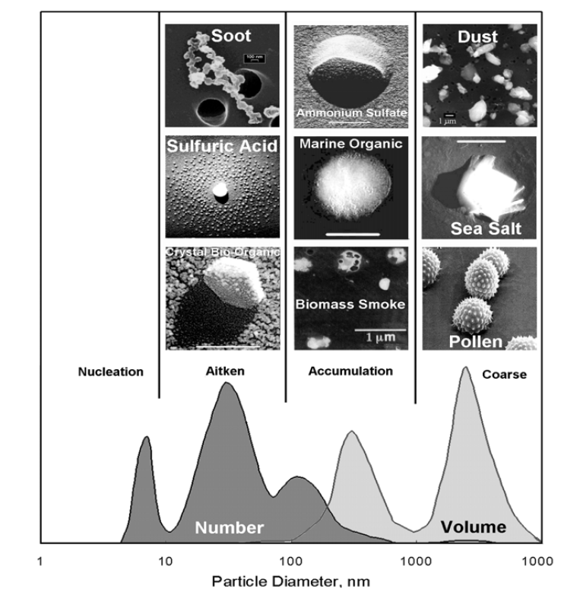
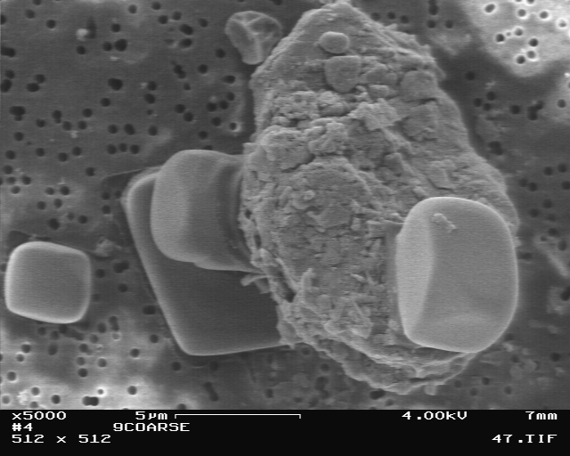
Aerosols ?

Slide 3
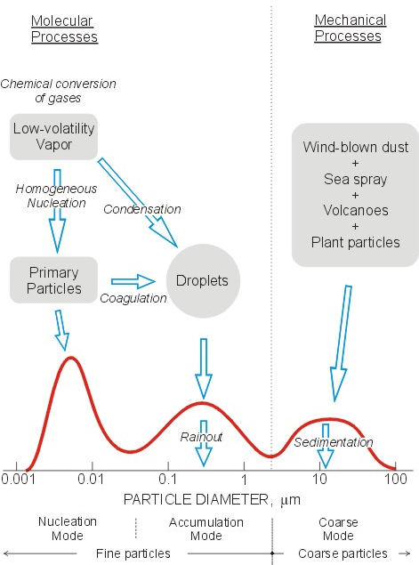
Main proccesses of formation
Notes:
Wide Size range which physical properties diversity to chemical diversity

Slide 4
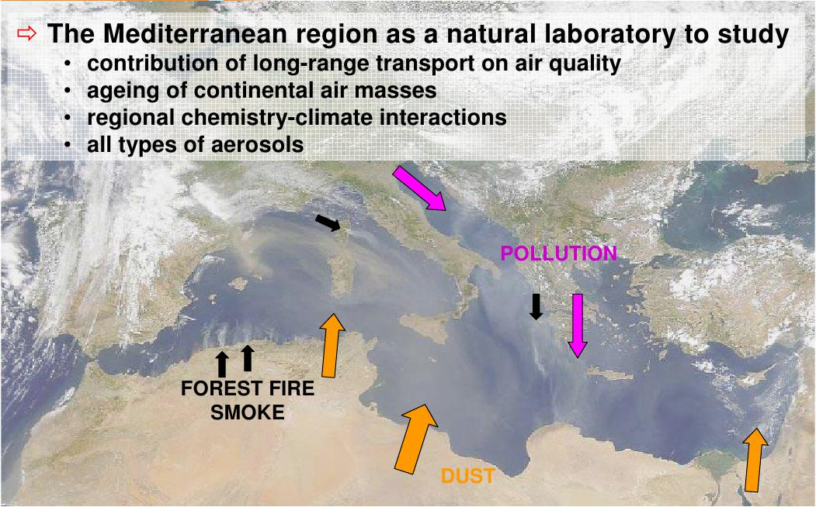
1 : Characterization of the Mediterranean aerosols
Diversity of emissions sources
Notes:
Med : A diversity of particles / aerosols from different sources

Slide 5
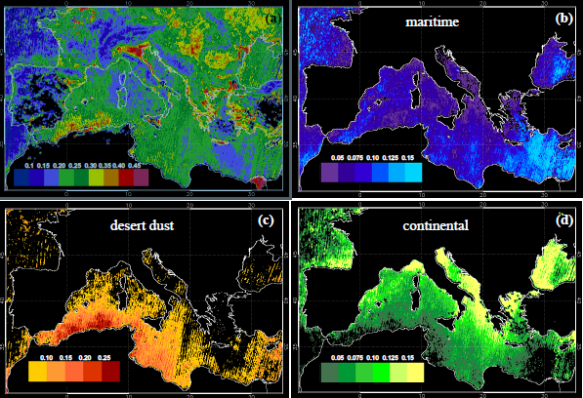
Aerosol optical depths (summer average)
JJA 2001
JJA 2005
Barnaba and Gobi 2004

Slide 6
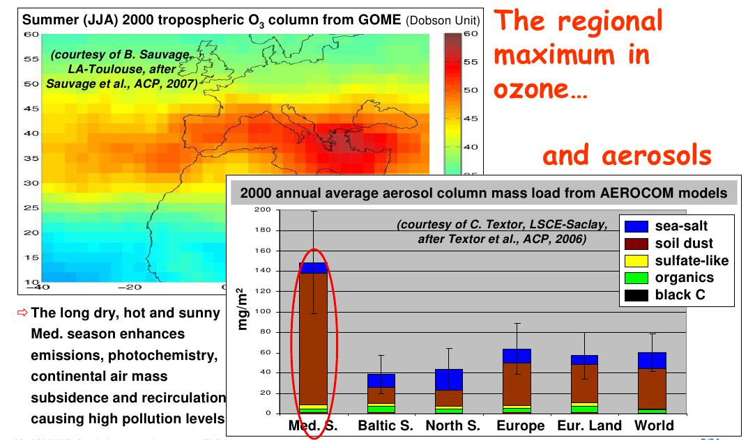

Slide 7
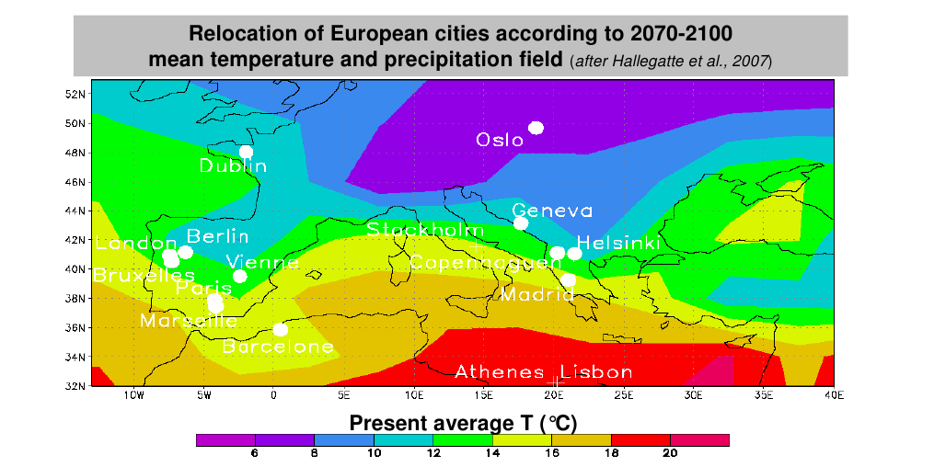
Importance of understanding atmospheric chemistry in Mediterranean region
Notes:
Present day mediterranean atmospheric chemistry : A taste of future european conditions

Slide 8
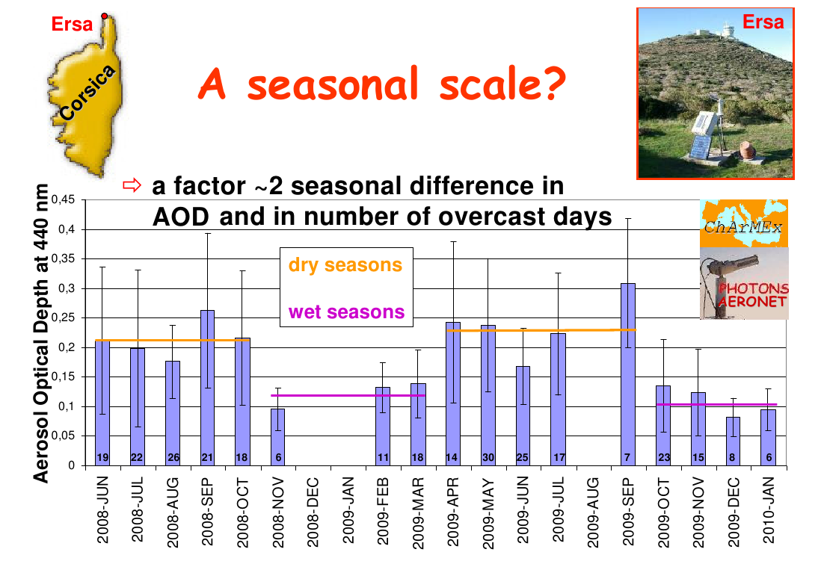
Temporal variability : seasonal scale
Notes:
Seasonal variability 1:
Corsica station ( remote) nfluenced bth by european an dust air masses
Decrit charmex

Slide 9
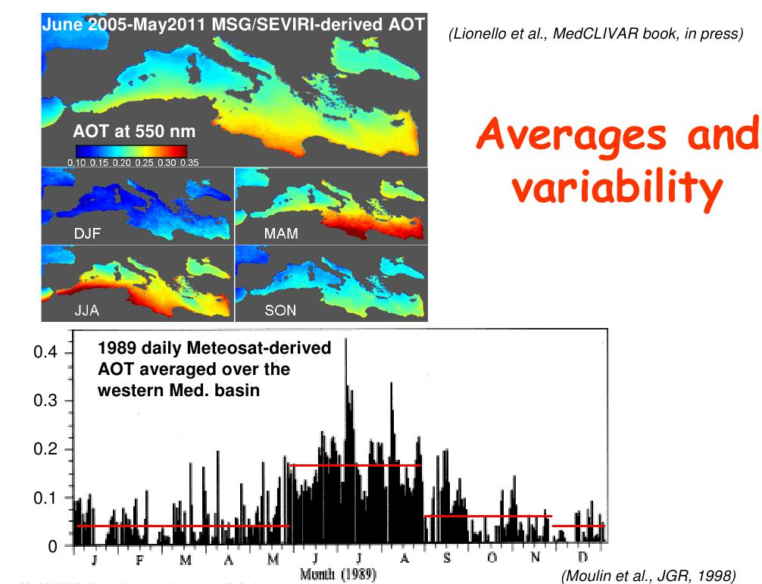
Lionello et al. MedCliVAR book.
Notes:
Another illustration of this variability.

Slide 10
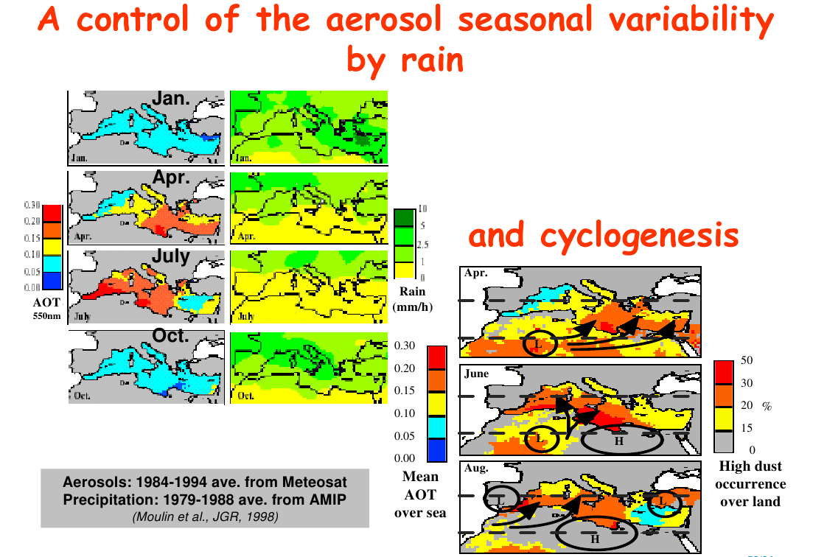

Slide 11
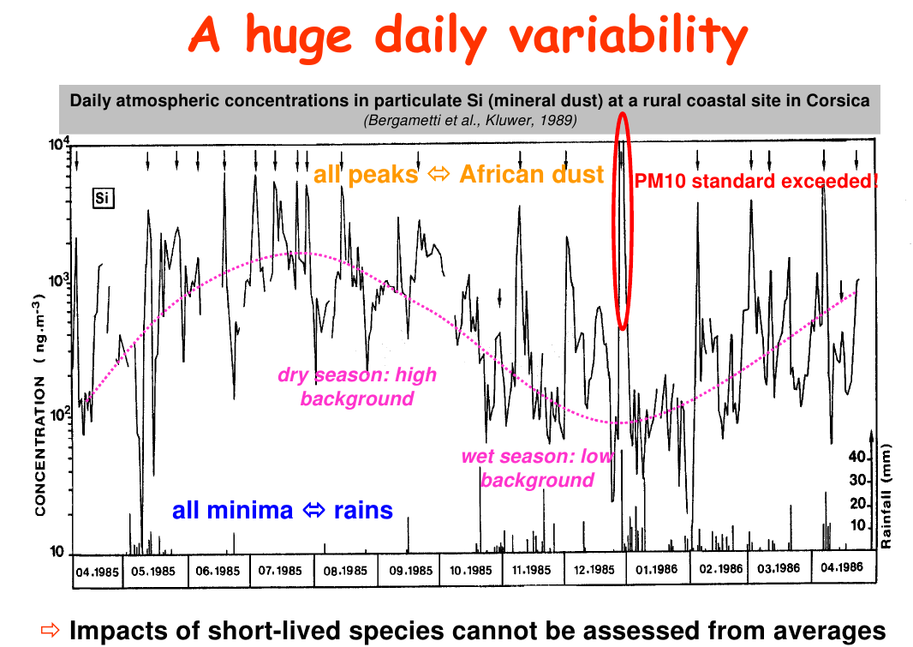
Temporal variability : daily scale
Relevance in term of impacts (air quality)

Slide 12
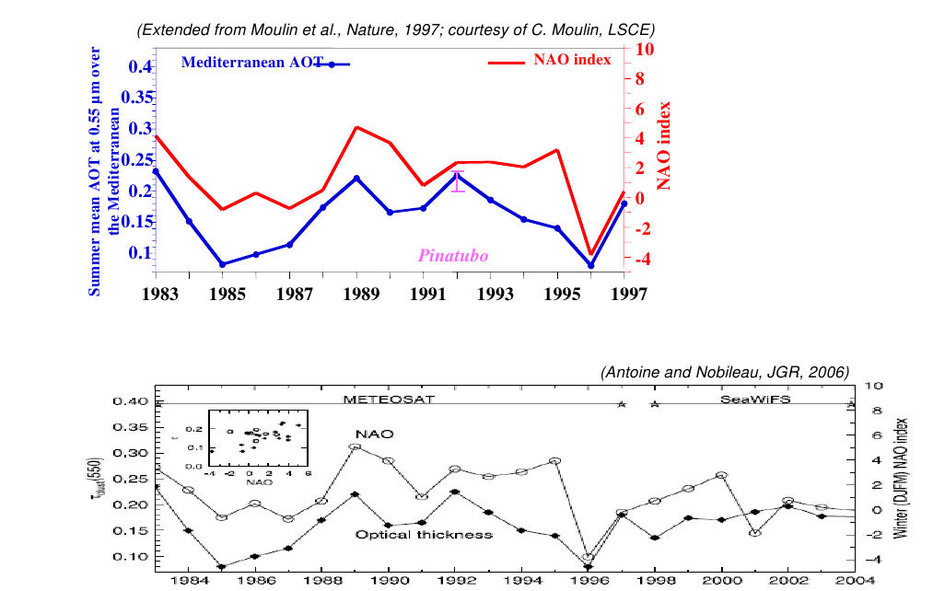
Temporal variability: inter-annual scale
A : Climate control
Notes:
Pinatubo could be etna

Slide 13
Temporal variability: inter-annual scale
B : Emission control
Anthropogenic emission evolution
Notes:
Control on

Slide 14
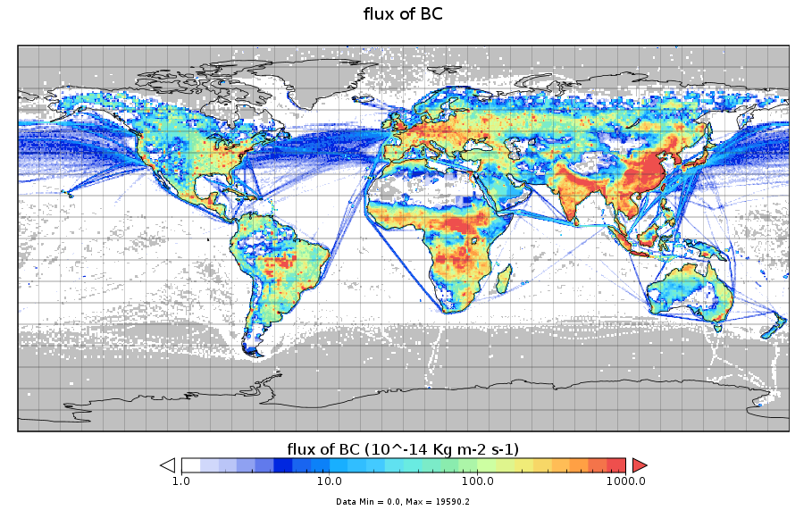
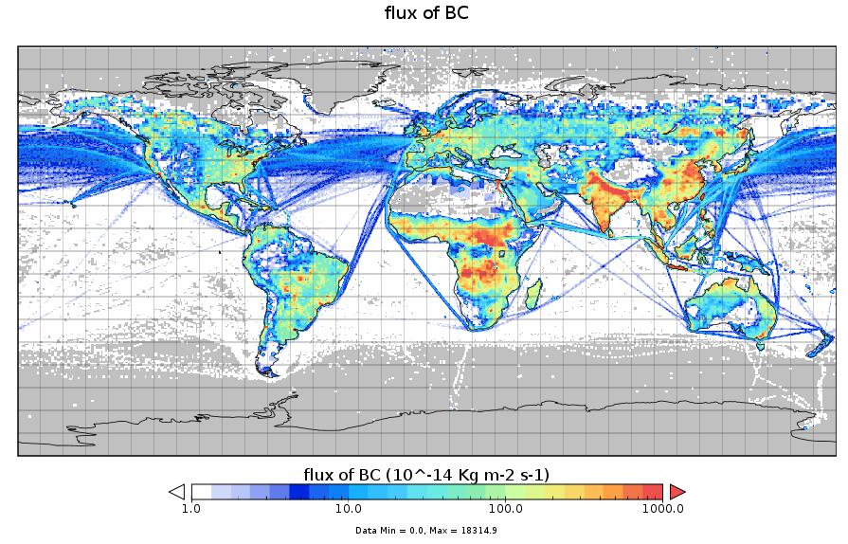
CMIP5 emissions
(Lamarque et al.)
HIST
1990-2010
RCP 4.5
2040-2060

Slide 15
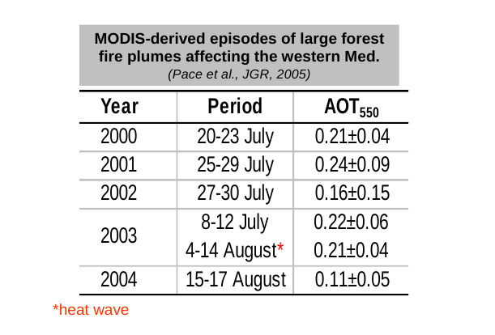
Temporal variability: inter-annual scale
B : Emission control
Anthropogenic emission evolution
Land use change - ecosystem evolution ( partly controlled by climate)
(dust / biomass burning / biogenic emissions )
MODIS observations between 2000 and 2004 show that the summer 2003 forest fire aerosol episode was the longest lasting and covered the largest area (Pace et al., 2005, JGR).
Notes:
Control on

Slide 16
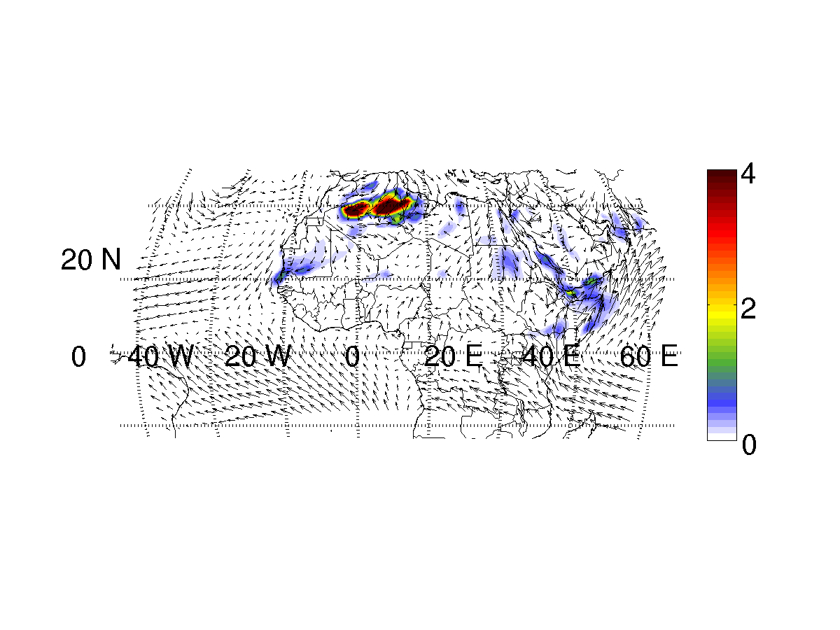
Modelling of atmospheric climate /chemistry/ aerosols in Mediterranean regions : a number of challenges !
Example 1 : Dust modelling
e.g. RegCM : Dust module
Transport
Primary Emissions
Removal terms
Physico – chemical transformations
Particles and chemical species considered
Notes:
After having characterized the variability : how to model this variability

Slide 17
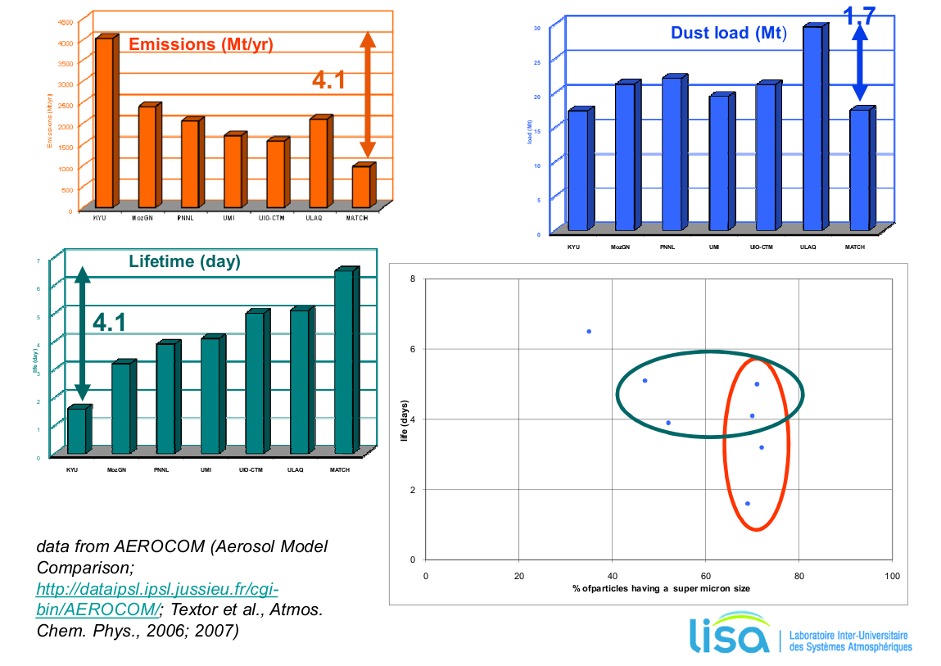
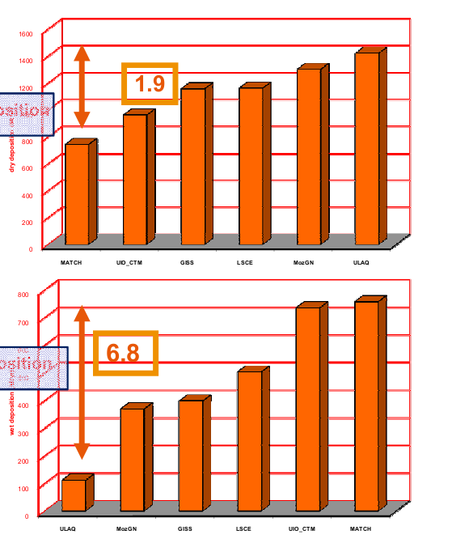
Global dust model intercomparison :
Dry dep. *
Wet dep. *
* Prescribed emissions

Slide 18
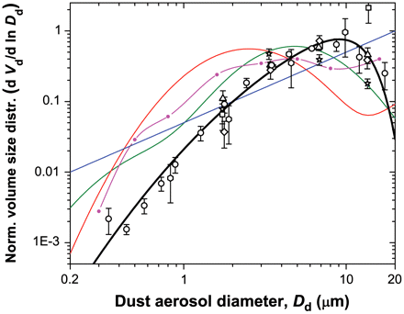
Importance of dust EMISSION size distribution:
Different approaches …
Physically based calculation :
Established from wind tunnel studies
Calculate size distribution from saltation kinetic energy flux and cohesive binding forces in soil aggregates.
Requires parameters that are not easily determined
Prescribed distribution :
From in situ measurements
From a scaling theory (Kok et al., )

Slide 19
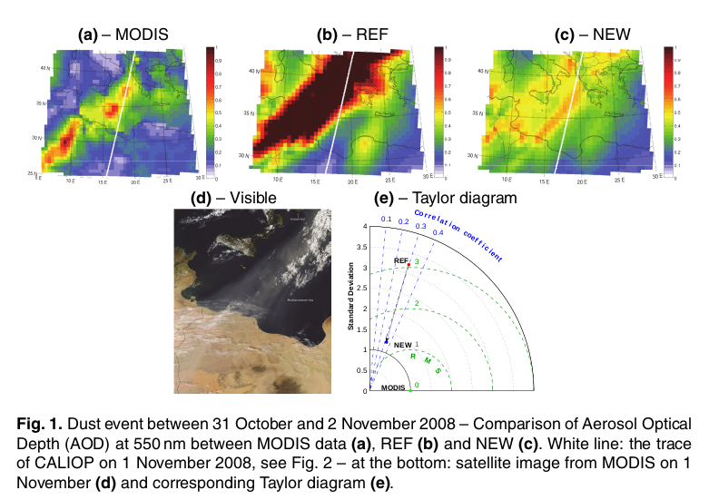
Impact on deposition (and so dust budget)
Impact on optical properties ( extinction and AOD)
RegCM
Nabat et al., ACPD

Slide 20
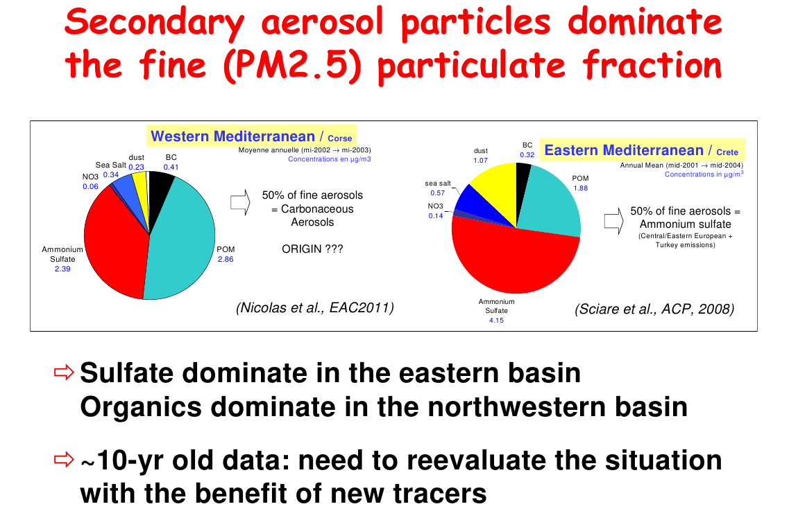
Modelling of atmospheric chemistry/ aerosols in Mediterranean regions : a number of challenges !
Example 2 : Secondary aerosol formation
Relevance of PM2.5 for air quality, ecosystem impact, and climate (direct and indirect effects)
Notes:
After having characterized the variability : how to model this variability

Slide 21
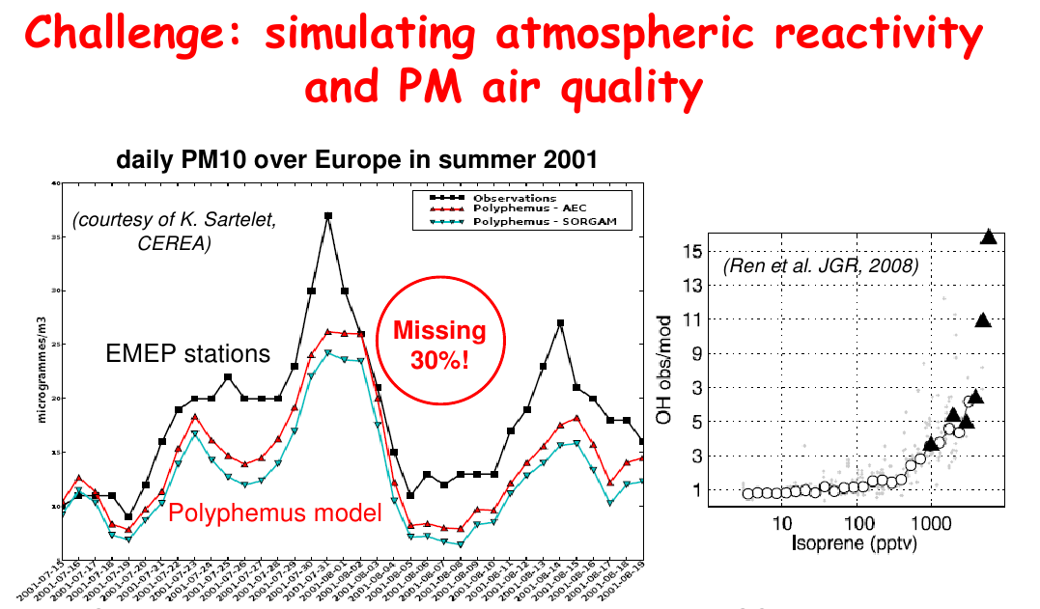
Importance of including photo-oxidation processes
( ozone chemistry / simulation of organic aerosol precursors)
Biogenic emissions of gas-phase precursors
-BVOC from forest/
-DMS and organic from Marine
Notes:
Beside dust aerosols : fine pollution aerosols important

Slide 22
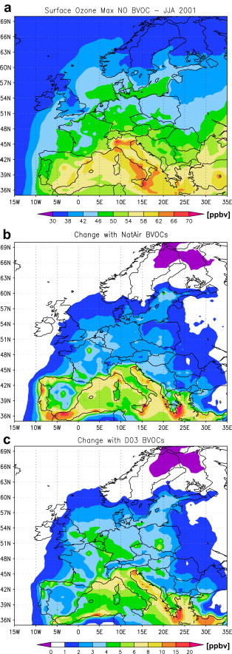
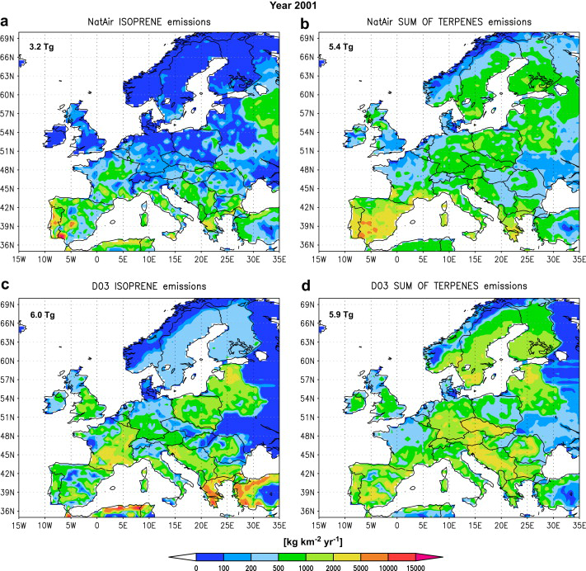
Example : Biogenic emissions from 2 different models and impact on ozone
isoprene
terpenes
Curci et al., 2009

Slide 23
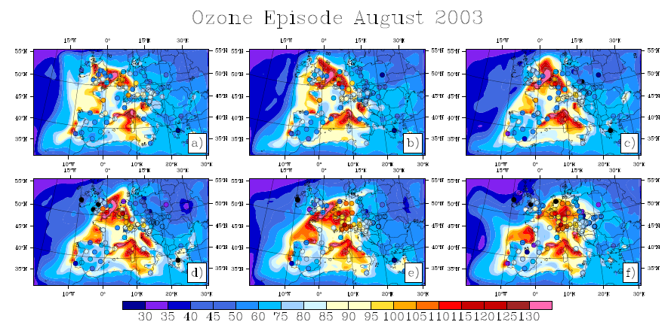
Towards the development of climate chemistry models …
e.g : RegCM4-CHEM ozone simulation of 2003 heat wave
Shalaby et al., 2012 , GMD

Slide 24
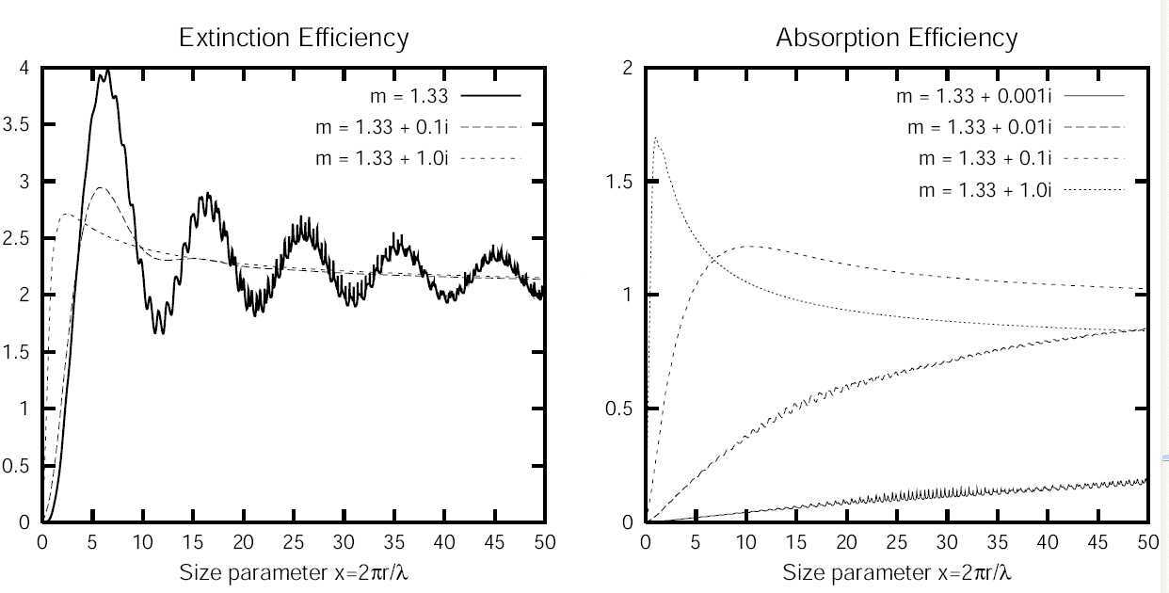
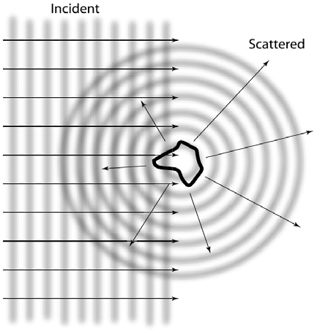
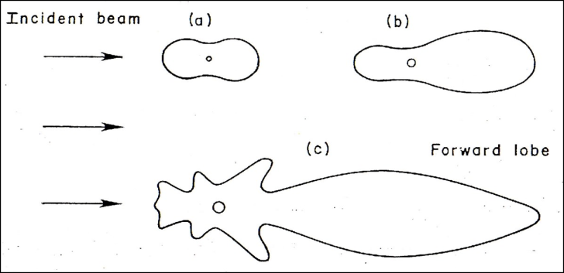
2 : Climatic feedbacks of aerosols in the Mediterranean region
A: Aerosol/radiation interaction : DIRECT EFFECT
Refractive index
absorption
Notes:
Challenge 2 :
We saw the importance of dust aerosol (mass and AOD)
But important also is the fine fraction : health perspective
( health )

Slide 25
Direct effect
Aerosol Short Wave radiative forcing
Incoming solar flux
Outgoing flux
TOA SW Radiative forcing : difference of outgoing fluxes without and with aerosol
All other atmospheric and surface variables being fixed.
> 0. = warming of the system
< 0. = cooling of the system
F₀
absorption scattering
F₀.e^{-AOD}
surface
SRF SW Radiative forcing : difference of net flux at the surface
Always < 0. = cooling of the surface
Aerosol optical depth AOD describes the aerosol extinction due to the sum of absorption and scattering effects.

Slide 26
Dust Long Wave radiative forcing
Atmospheric layers absorb and emit (grey body) in thermal radiation range.
TOA LW Radiative forcing : difference of outgoing fluxes without and with aerosol
All other atmospheric and surface variables being fixed
SRF LW Radiative forcing : difference of net flux at the surface
Always > 0. = relative warming of the surface …

Slide 27
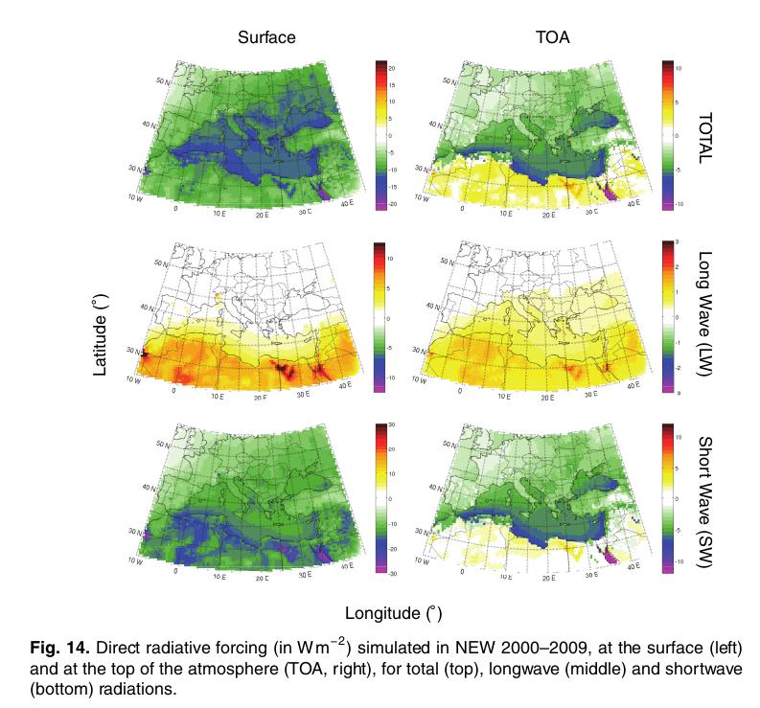
Aerosol Radiative forcing in the Mediterranean region : RegCM simulations

Slide 28
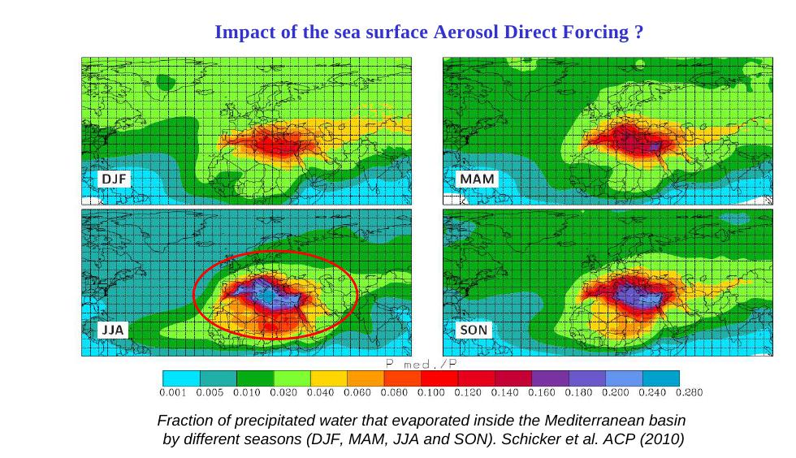
Assessing the Regional climate responses to aerosol forcing …
1 : impact of surface dimming on evaporation, water budget and hydrological cycle in the mediterranean basin ?
Use of coupled ocean-atmosphere regional climate model

Slide 29
2 : perturbation of temperature profiles
Feedback on convection clouds, and regional dynamics
Semi-direct effects
Temperature profile
Convection
Aerosol layer
Stabilisation
Amplitude of the response depends on environment ( convective / unstable vs. Stable , surface albedo, … )
Sensitivity to single scattering albedo ( aerosol composition ).

Slide 30
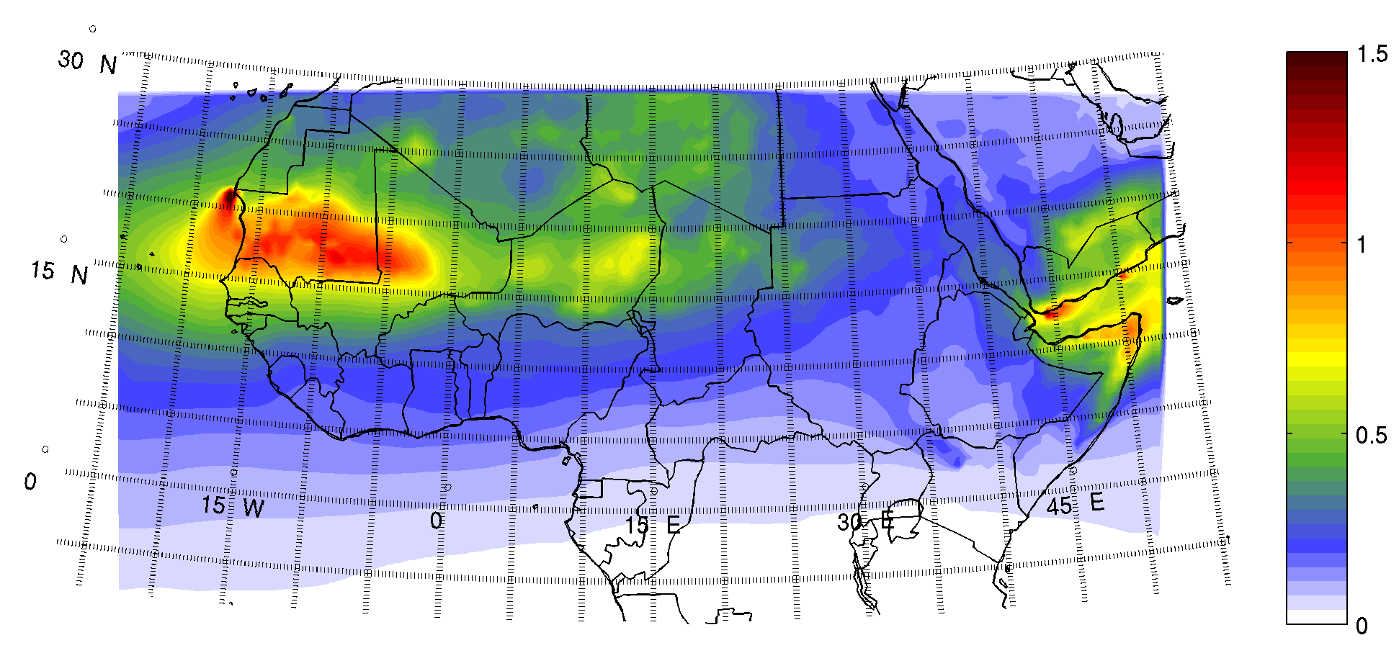
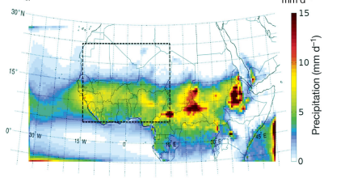
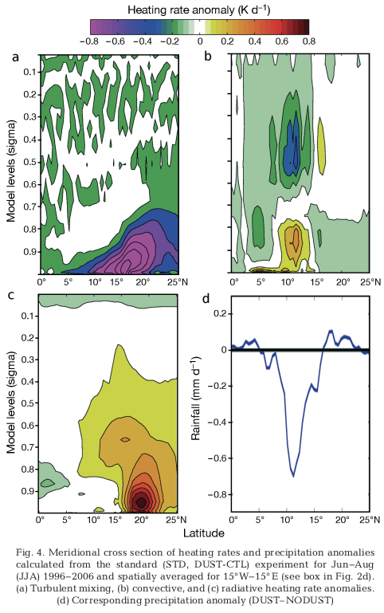
Example , impact in monsoon region
(RegCM
JJA 1996-2006) )

Slide 31
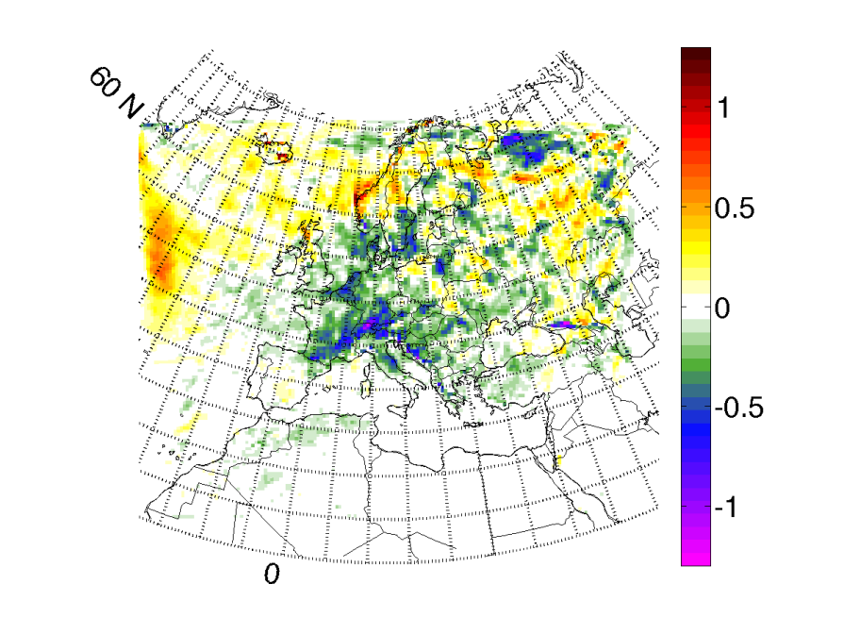
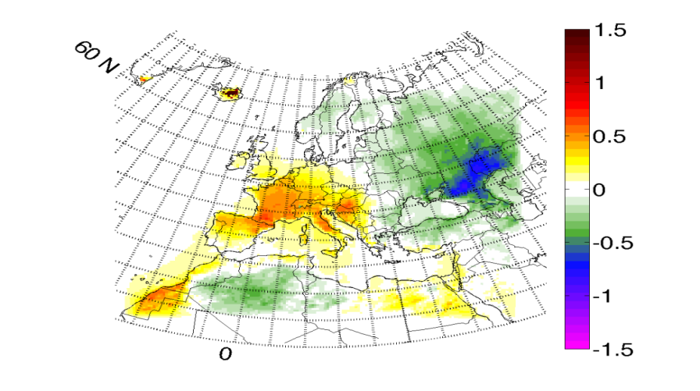
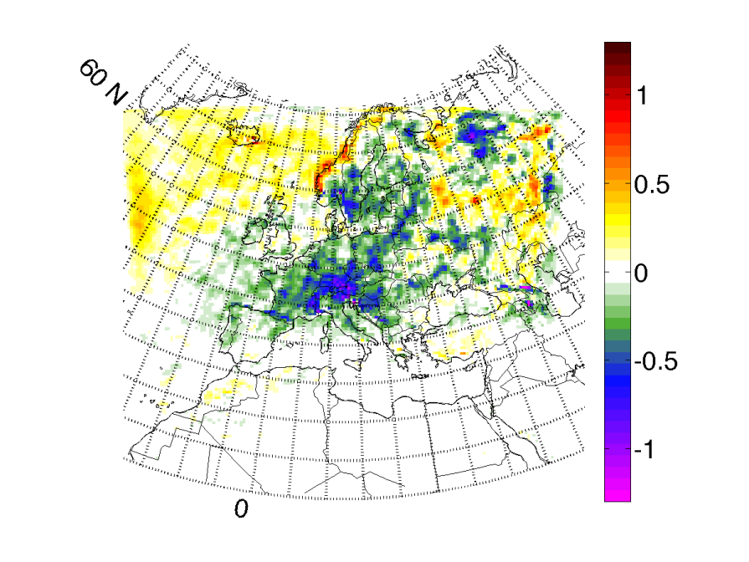
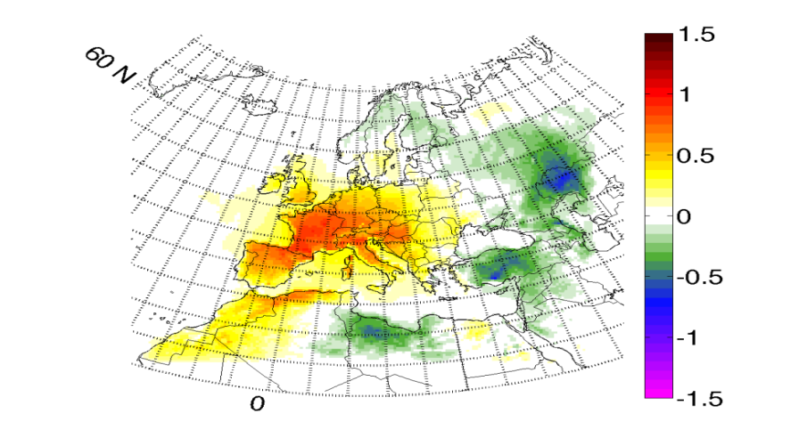
Additional Issues when assessing impact of aerosol with climate models ..
mm/d
K
MEG-CTL
( JJA 2001-2010)
K
CTLp - CTL
( JJA2001-2010)
CTLp:
a random perturbation (limited to 1.E-3.qv, SST) is applied at the boundary during the run.
Not possible to isolate an aerosol physical feedback from internal variability response of the model
Ensemble runs needed / intense calculation

Slide 32
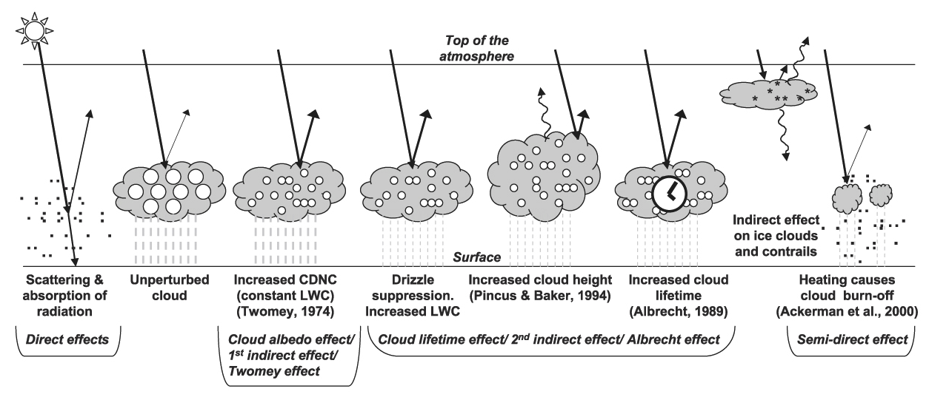
B : Indirect effects …
Aerosol /cloud microphysic interactions
Aerosol deposition on snow
Impact on climate via biogeochemical effects

Slide 33
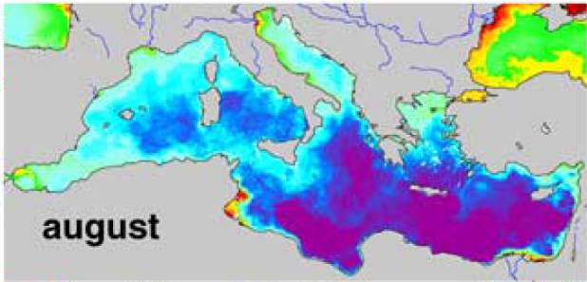
3: Biogeochemical impacts
Mediterranean Sea : the Low Nutrient Low Chlorophyll
VERY POOR BIOMASS IN SEAWATER: HIGHLY TRANSPARENT WATERS
Chla as seen by satelites (ocean color)
Bosc et al., 2004
on average, an ocean with low Chla concentrations because low nutrient concentrations during 6 months of the year
Atmosphere aerosol (Dust + anthropogenic) is an important source of nutrients in nutrients depleted regions (P,N,Fe,..)

Slide 34
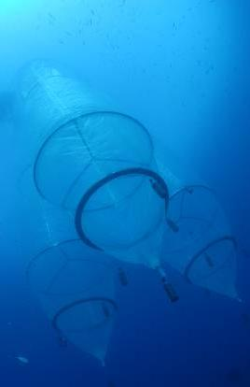
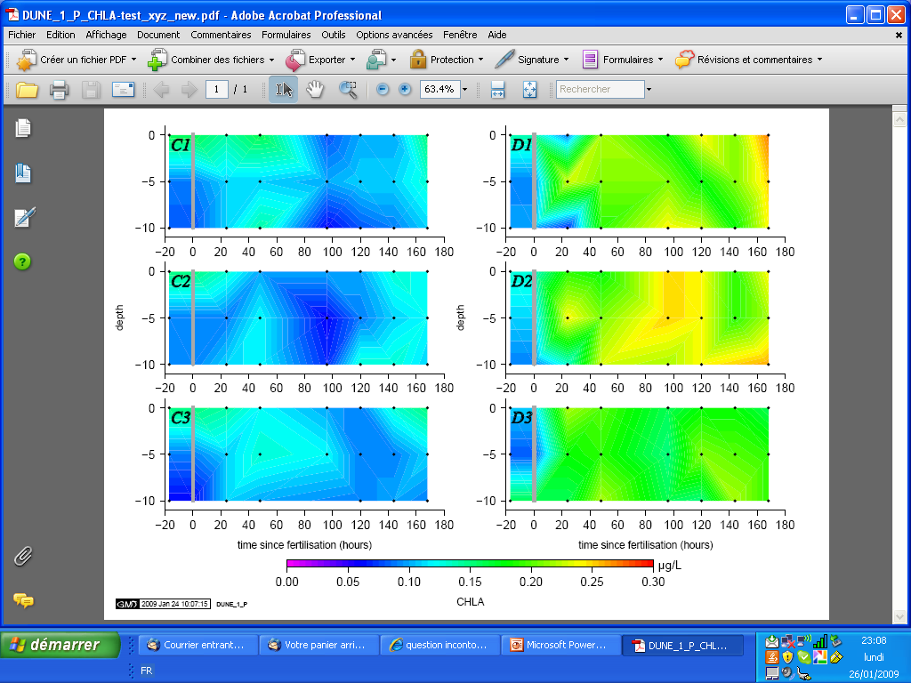
In situ aerosol fertilisation experiments:
+ DUST
seeding
CONTROL
8 days
From C. Guieu
CNRS/LOV
DUNE proj.

Slide 35
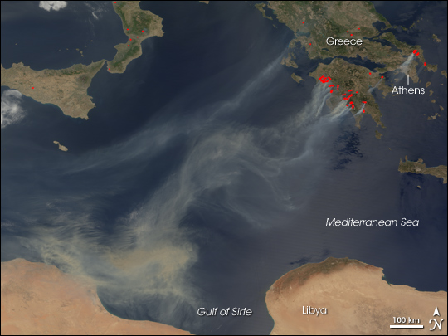
The biogeochemical impact is determined by:
Anthropogenic sources vs.
Natural sources
Atmospheric control
Deposition flux
Chemical state of the nutrient when deposited to ecosystem (solubility, Bioavailability).
Aerosol size distribution
Atmospheric processing

Slide 36
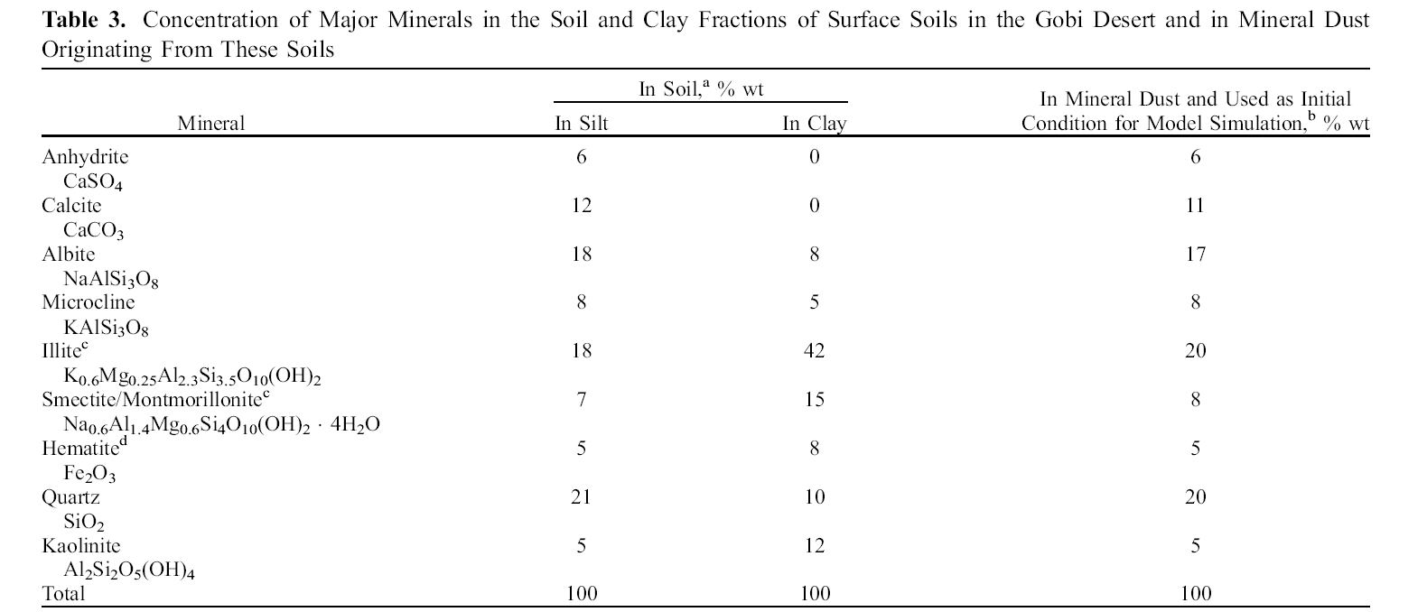
Example : Iron dissolution modelling
Gas phase scheme
Meskhidze et al., 2005
Solmon et al., 2009
O ₃
Anthro.
aerosols
1: Assume an initial mineral composition for the dust
2: Scavenging of soluble gaz species by dust
H₂O
Dust
alkaline
Acidic attack
H₂SO₄, HNO₃, HCl, carbonates
Uptake coeff
Fe
Therm. Equilibrium (HNO3, NH3), ISORROPIA
Alkaline compounds, NH₃
3 : Mineral dissolution (production of dissolved iron)
Kinetics processes (calcite, …, hematite)
pH sensitive
4 : Chemical speciation, Thermo. Equilibrium, pH
Specific mechansims : eg Ca²⁺ / CaSO₄
ISORROPIA

Slide 37
The biogeochemical impact is determined by:
Atmospheric control
Deposition flux
Chemical state of the nutrient when deposited to ecosystem (solubility, Bioavailability).
Aerosol size distribution
Anthropogenic sources vs.
Natural sources
Atmospheric processing
Oceanic control
Biological and nutrient state of the mixed layer
Ocean Mixed Layer processes

Slide 38
OCEAN mixed layer Processing
dissolved forms ~ bioavailable
From C. Guieu
CNRS/LOV
Atmospheric inputs, wet and dry
dissolved forms
ballast effect/
zoo grazing
scavenging (-)
diss./desorp (+)
adsorption (-)
nutrient pool
maintain (+) (Fe)
uptake (-)
POM
passive
adsorption (-)
DOM
ligands
regeneration (+)
phytoplankton
bacteria
POC export
zooplankton
SOLAS Open Science Conference, Barcelona, Spain, 16th - 19th November 2009

Slide 39


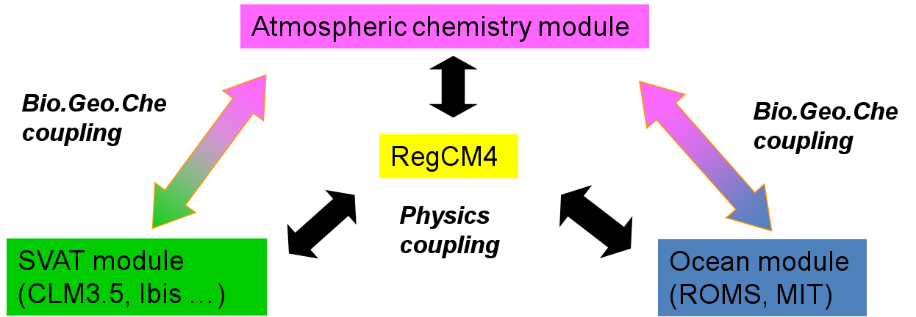
RegCM developments …
Anthropogenic pressures

Slide 40
Thank you

Slide 41
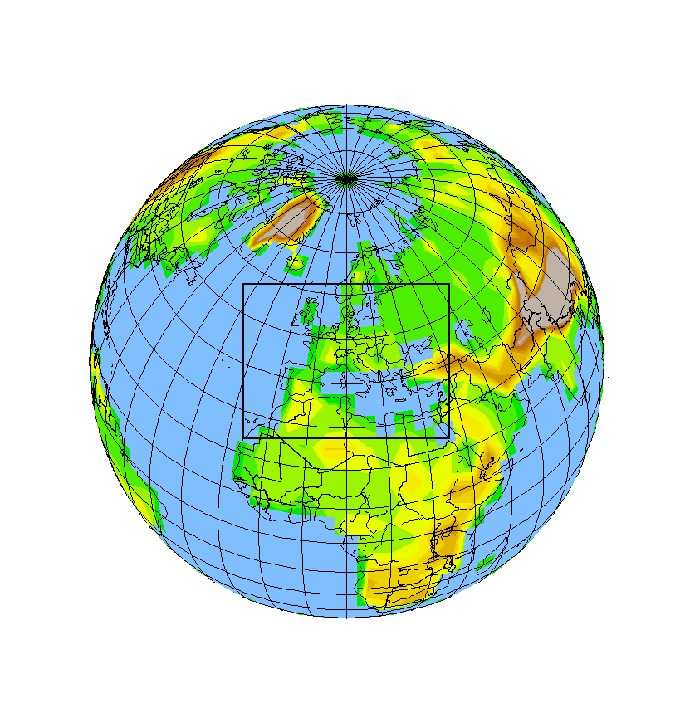
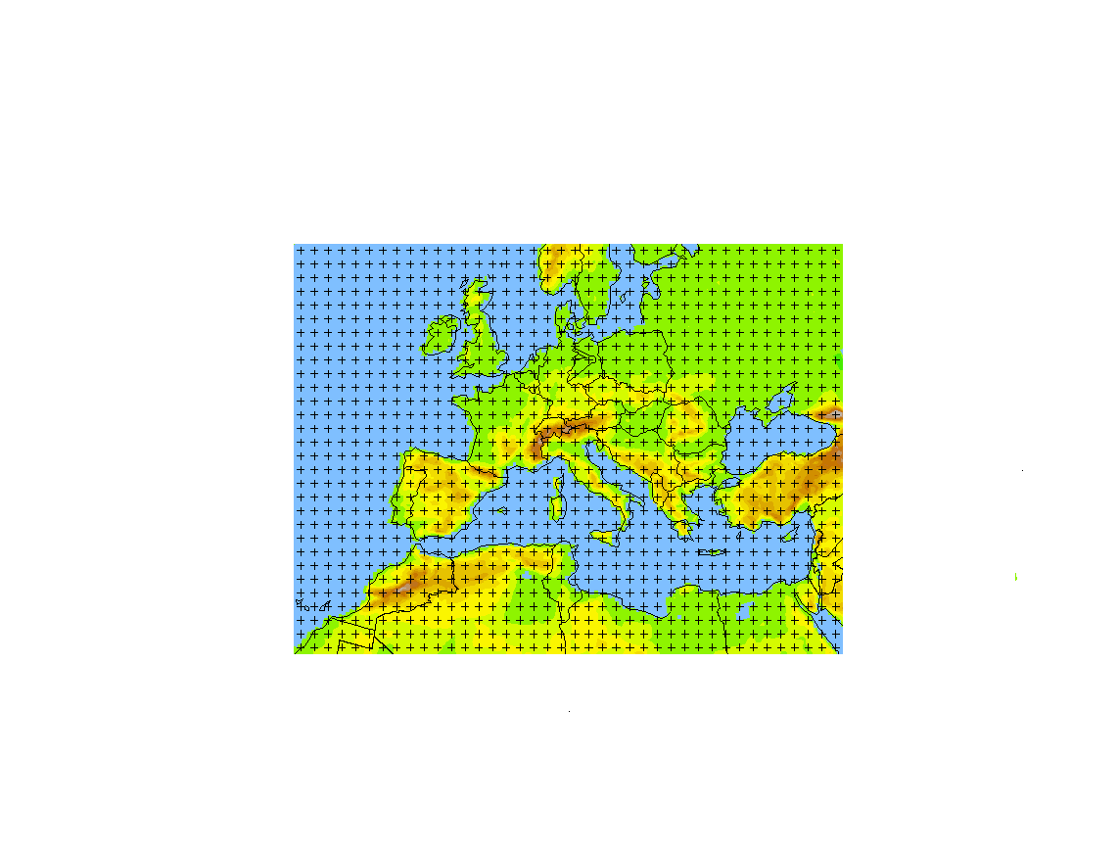
RegCM4 Regional Climate Model
High resolution / limited area / physical downscaling .
Boundary forcing :
Re-analysis :
ERA-I , NCEP
GCM outputs (scenarios) :
In the context of CMIP5/CORDEX
EC-EARTH
HadGEM
ARPEGE
CSIRO
GFD
for RCP4.5, 8.5

Slide 42
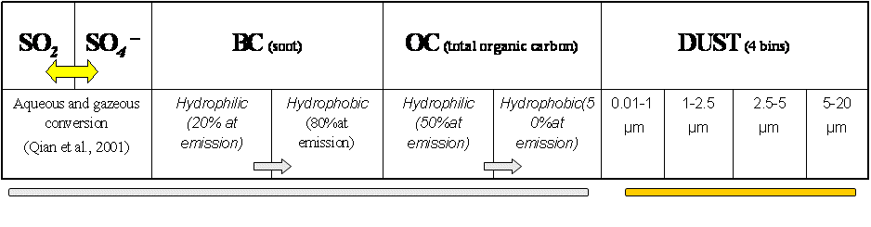
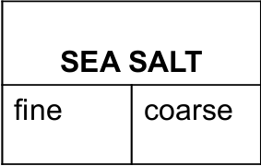
Chemistry/ aerosols in RegCM4
Tracer model / RegCM4
Transport
Primary Emissions
Removal terms
Physico – chemical transformations
Particles and chemical species considered
Simple aerosol scheme
0.6
6
CBMZ gas phase
'SO2',‘SO4','O3','NO2','NO','CO','H2O2‘,'HNO3‘,'N2O5','HCHO','ALD2',‘ISOP','C2H6',
'PAR','ACET','MOH','OLT','OLI','TOLUE','XYL','ETHE','PAN','CH4','MGLY','CRES','OPEN','ISOPRD','ONIT','HCOOH','RCOOH’,'CH3OOH','ETHOOH','ROOH','HONO',‘HNO4','XO2'

Slide 43
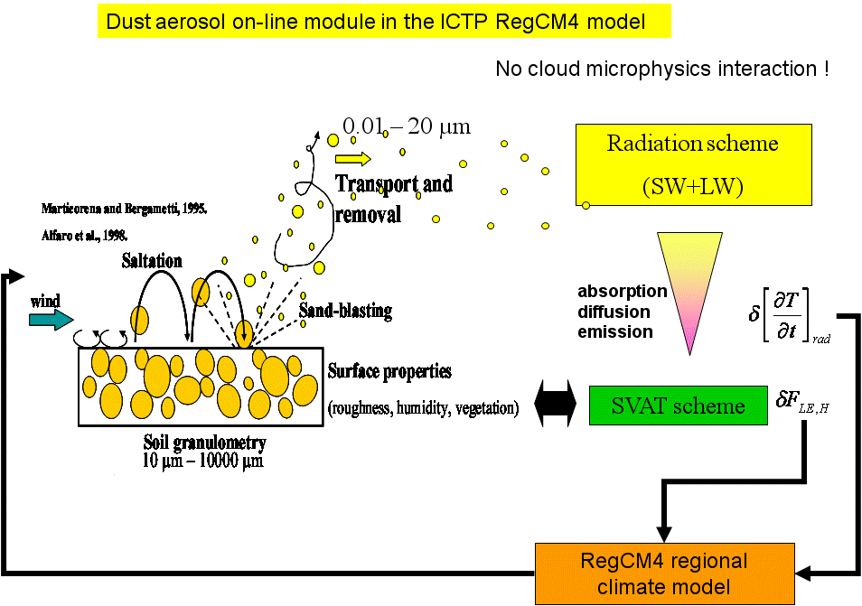

Natural emissions
DUST
Sea-sal t
Biogenic
(isoprene )
MEGAN / CLM3.5

Slide 44
Anthropogenic emissions
CMIP5 emissions historical and RCPs
Chemical boundary conditions
EC-EARTH / CAM runs for RCP4.5, 8.5

Slide 45
Pollen modelling ?
STEP 1 : (fast)
Use of IPSL/ LSCE emissions prescribed directly to RegCM ( period and frequency to be determined) .
Implementation of a pollen tracers : sizing and relevant parameters ( affective diameter, hydrophilic character, etc) to be defined
STEP 2 : ( longer + post-doc required )
Implementation of on-line emission modelling.
- two paths possible
1: activation of CLM 4 interactive vegetation / coupling of phenology dependant functions (same parameterisation than used in IPSL approach).
2 : coupling of ORCHIDEE with RegCM
I would tend to support 1 for intercomparisons

Slide 46
Last point :
Activities for ATOPICA workshop in Trieste
-RegCM
-Chimere
-… ?
Thank you !

Slide 47
Anthropogenic pressures

Slide 48
Dust aerosol on-line module in the ICTP RegCM3 model
No cloud microphysics interaction !
0.01 – 20 µm
Radiation scheme
(SW+LW)
absorption diffusion emission
SVAT scheme
RegCM3 regional climate model

Slide 49

A close up of a field of view of Fine Particles collected on the East Mediterranean Shore. Most particles are either spherical sulfates (similar to ammonium sulfates in appearance) or short aggregates of diesel particles.
Thanks to
Prof. Mamane

Slide 50
Cubes of 3-7 μm sea salt particles, attached to a mineral, from the coarse fraction. Sea salt (Na, Cl) particles were found at both particle size fractions.

Slide 51

Typical Irregular Mineral with very rough porous surfaces collected at the coarse fraction. A spherical 1.5 μm coal fly ash is seen at the top, and a “crushed” spore at the upper left corner.

Slide 52

Oil Combustion Cenosphere rich in Ni and V collected in the coarse fraction. These are typical particles emitted from combustion of heavy oil.

