Slide 1
Communications Services
CERN Data Center Network Changes and Evolution
David Gutiérrez
Co-autors: Carles Kishimoto, Edoardo Martelli
Communication Services / Engineering
www.cern.ch/it

Slide 2

Outline
2010
2011
2012
2013
1
2
3
High performance Brocade routers
External connectivity and Firewall system
Network Architecture for Wigner
1

Slide 3

Data Center Network 2010
2010
2011
2012
Brocade deployment
Force10
100Gbps tests
100Gbps deployment
Data Center
Racks | 841
Systems | 11,320
Cores | 57,651
Raw HDD (TiB) | 61,137
1G NICs | 15,703
10G NICs | 390
ToR Switches | 584
Consumption DC | 2.44 MW
Force10
LCG non-blocking Fabric | 2.88 Tbps
Routers | 24
Linecards | 248
10Gbps Ports | 1100
100Gbps Ports | N/A
2
ToR: Top of the Rack

Slide 4



DC Network 2010
Force10 router
Active
Firewall
Passive
Firewall
Aggregated 10Gbps links
Tier1s
10Gbps link
CORE
Border routers
GPN
Switching fabric
2.88 Tbps
Switching fabric
0.96 Tbps
Backbone
Distribution
. . .
Access ToR sw
LCG
CPU, Disk, Tapes
AFS, Mail, Web, …
3
LCG: LHC Computing Grid GPN: General Purpose Network ToR: Top of the Rack
Notes:
3

Slide 5
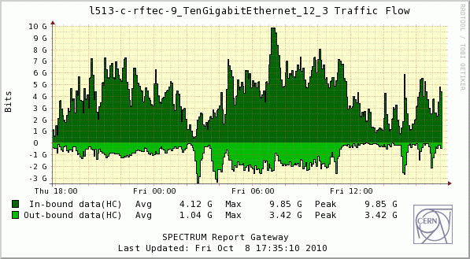
10Gbps Aggregation issues
Hashing is decoupled from link capacity
Flow based hashing
Potential network traffic polarization
Manageability
10G
4x10G
10G
LACP
4
LAG: Link AGgregation ECMP: Equal Cost MultiPath

Slide 6
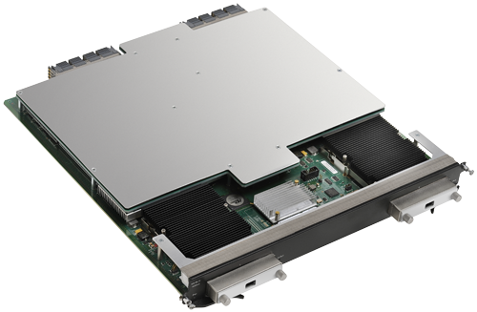
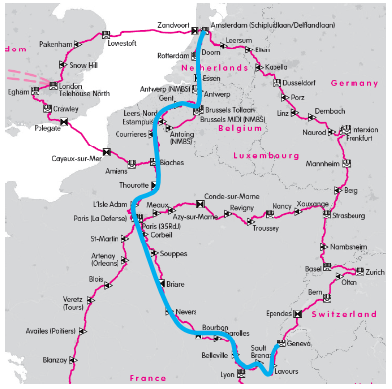
100Gbps fat router interconnects
Technology upgrade where needed
Performance and fairness tests
  100GBase-LR10 CFP (SMF up to 2Km)
Testing 100GbE WAN to:
  Lyon (RENATER) ~120 km
  Amsterdam (AMSIX) ~1650 km
5

Slide 7
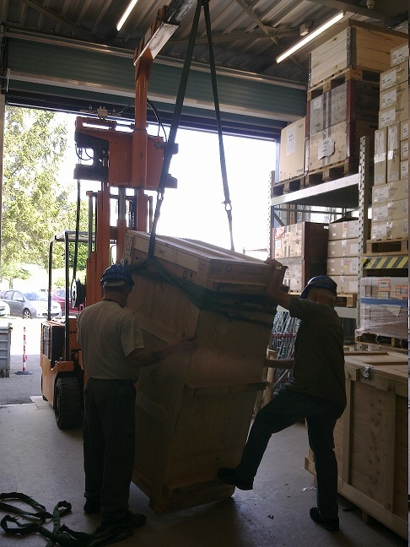
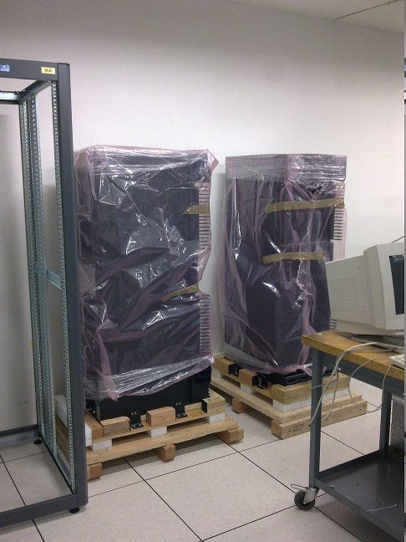
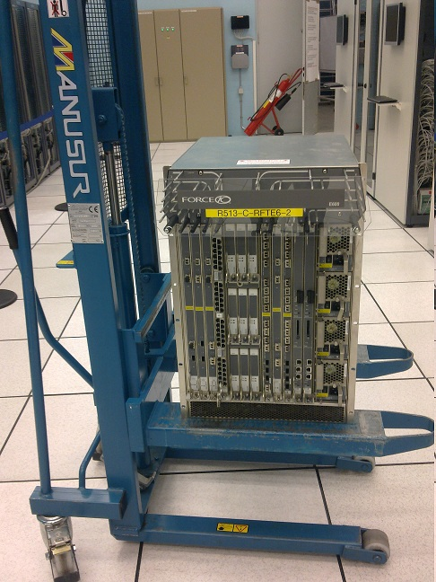
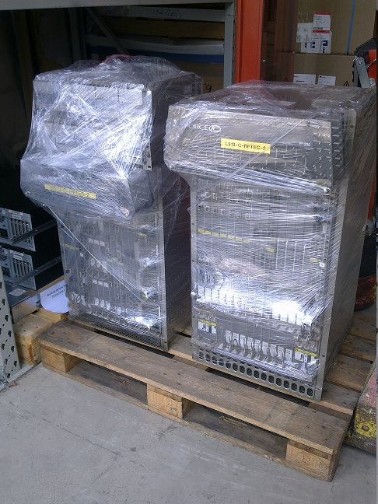
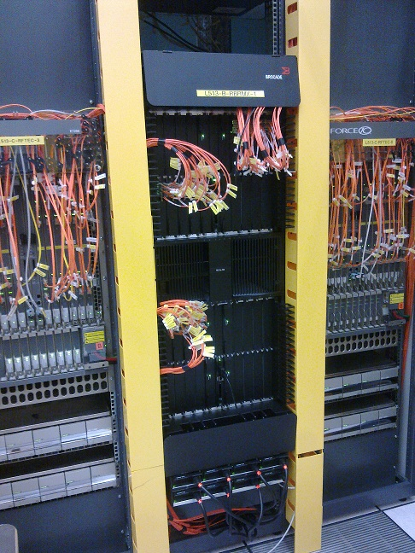
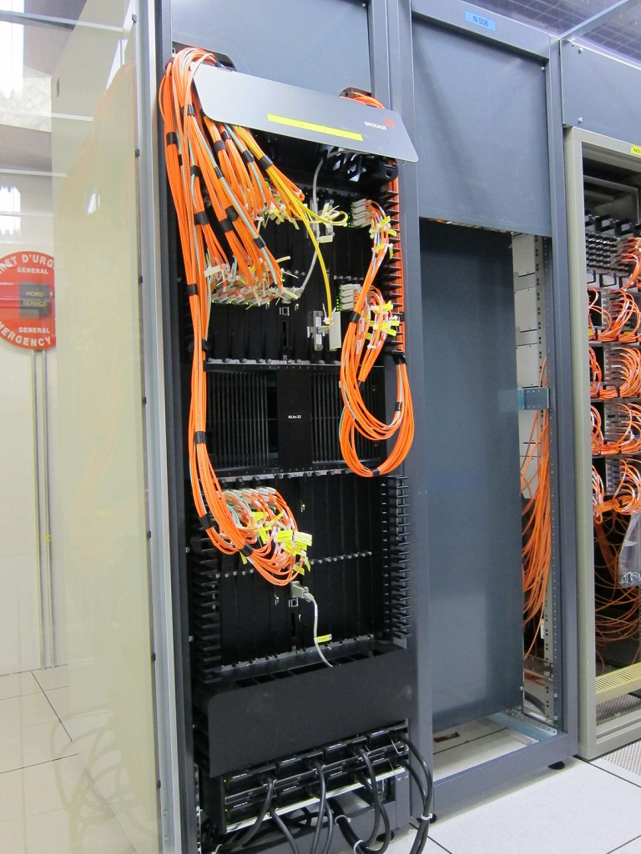
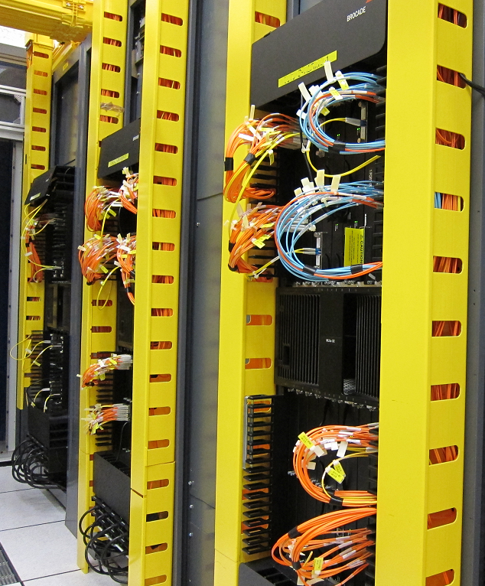
Migration in images
6

Slide 8


DC Network today
Brocade router
Active
Firewall
Passive
Firewall
Aggregated 10Gbps Links
LHCONE
Tier1s
100Gbps Link
CORE
Border routers
GPN
Backbone
Switching fabric
5.28 Tbps
Switching fabric
1.36 Tbps
Distribution
. . .
Access ToR sw
LCG
CPU, Disk, Tapes
AFS, Mail, Web
7
Notes:
7

Slide 9
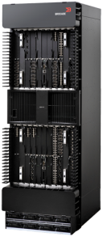
Data Center Network today
2012
2013
Data Center | 2010 | 2012
Power | 2.9 MW | 3.5MW*
Racks | 841 | 1070
Systems | 11,320 | 12,483
Cores | 57,651 | 68,385
Raw HDD (TiB) | 61,137 | 97,698
1G NICs | 15,703 | 16,026
10G NICs | 390 | 1,912
ToR Switches | 584 | 662
Consumption | 2.44 MW | 2.8MW
Data Center L3 Switch | Brocade
LCG non-blocking Fabric | 5.28 Tbps
Routers | 22
Linecards | 230
10Gbps Ports | 1,280
100Gbps Ports | 60
Data Center L2 Switch | HP
1Gbps Ports | 22,776
10Gbps Ports | 4,284
MLXe32 Technical Specs | #
Non-blocking Fabric | 15 Tbps
Linecards | 32
10Gbps Ports | 256
100Gbps Ports | 32
8

Slide 10
Outline
2010
2011
2012
2013
2
3
High performance Brocade routers
External connectivity
Network Architecture for Wigner
9

Slide 11
External connectivity changes
Internet
Géant2
Internet2
US Peers
CIXP
LHCONE
EXTNET
LHCOPN
Active
Firewall
Passive
Firewall
CORE
LCG
GPN
10
CIXP: Cern Internet eXchange Point

Slide 12
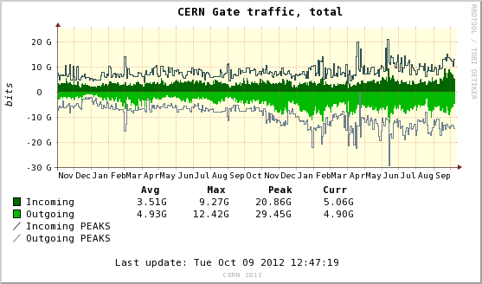
Firewall System Active-Passive
Internet
Géant2
Internet2
US Peers
CIXP
LHCONE
12Gbps
3.8Gbps
20Gbps
1Gbps
20Gbps
Shared with SWITCH
EXTNET
LHCOPN
20Gbps
30Gbps
6Gpbs Stateful
Active
Firewall
Passive
Firewall
CORE
130Gbps
LCG
GPN
11

Slide 13
Firewall System Active-Active
Internet
RENATER
Géant2
Internet2
US Peers
CIXP
LHCONE
12Gbps
3.8Gbps
2Gbps
40Gbps
1Gbps
20Gbps
Shared with SWITCH
EXTNET
LHCOPN
20Gbps
30Gbps
6Gpbs Stateful
Active
Firewall
Active
Firewall
30Gbps
10Gpbs Stateful
CORE
130Gbps
LCG
GPN
12

Slide 14
Outline
2010
2011
2012
2013
3
High performance Brocade routers
External connectivity
Network Architecture for Wigner
13

Slide 15
LCG Resources
Geneva Building 513
Budapest Wigner
Internet/
GeantIP/
Esnet/I2
Firewall
2x100Gbps
CERN Core
Network
Wigner Core
Network
LCG
GPN
LCG
14

Slide 16

Autonomous Operation
Geneva Building 513
Budapest Wigner
Internet/
GeantIP/
Esnet/I2
Internet/
HU access
188.185.0.0/16
AS198797
2001:1459::/32
Firewall
2x100Gbps
Firewall
CERN Core
Network
Wigner Core
Network
dns
radius
ntp
dhcp
LCG
GPN
LCG
GPN
15

Slide 17
LHCOPN and LHCONE traffic
Geneva Building 513
Budapest Wigner
Internet/
GeantIP/
Esnet/I2
Internet/
HU access
188.185.0.0/16
AS198797
2001:1459::/32
Firewall
Firewall
CERN Core
Network
Wigner Core
Network
MPLS
MPLS
dns
radius
ntp
dhcp
MPLS
LCG
GPN
MPLS
LCG
GPN
BGP
BGP
LHCOPN
LHCONE
16
MPLS: MultiProtocol Label Switching

Slide 18
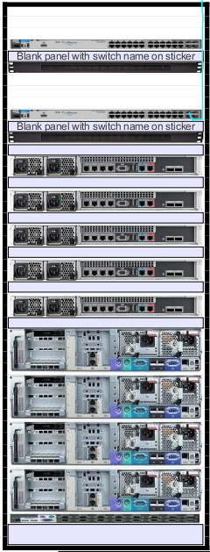
Wigner in numbers
Wigner Data Center | 2013 | 2014
Power | ~900KW | ~1200KW
Racks | 90 | 120
Routers | 6 | 10+Firewall
100Gbps ports | 18 | 18
Switches | 140 | 210
Servers | ~1200 | ~1800
L2 Switch | 2013 | 2014
1Gbps ports | 3072 | 4608
10Gbps ports | 528 | 792
17

Slide 19
Thank you for your attention
Questions?

