Slide 1
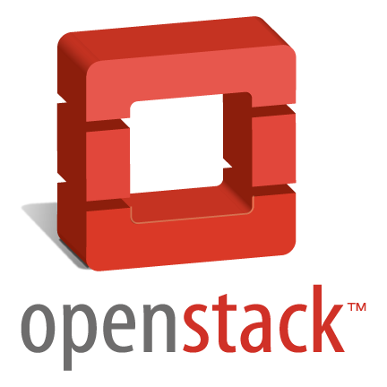
OpenStack Chances and Practice at IHEP
Haibo, Li
lihaibo@ihep.ac.cn
Computing Center, the Institute of High Energy Physics, CAS, China
2012/10/15

Slide 2
Agenda
OpenStack Overview
Why choose OpentStack?
What to do with OpenStack?

Slide 3
What is OpenStack?
“A collection of open source software for building private and public clouds”
Founded in July 2010 by NASA and Rackspace.
Has released six versions.(keeps every 6 months update, “Folsom ” in 2012.10)

Slide 4
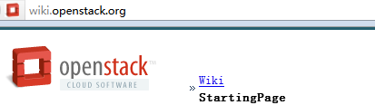

Where to get start?
Official documents
Trystack.org Request a test account

Slide 5
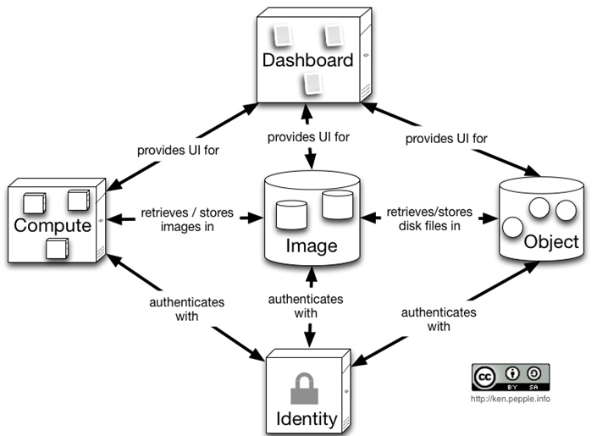
OpenStack Architecture
A stylized and simplified view of the architecture (Essex version)
Each of the constituent services are designed to work together to provide a complete Infrastructure as a Service (IaaS).
This integration is facilitated through public application programming interfaces (APIs) that each service offers (and in turn can consume).
While these APIs allow each of the services to use another service, it also allows an implementer to switch out any service as long as they maintain the API.

Slide 6
Openstack Projects
OpenStack has 5 projects in Essex version.
Compute – “Nova”
A cloud fabric controller, used to start up virtual instances for either a user or a group. It’s also used to configure networking for each instance or project that contains multiple instances for a particular project.
Storage – “Swift”
A system to store objects in a massively scalable large capacity system with built-in redundancy and failover. Object Storage has a variety of applications, such as backing up or archiving data, serving graphic or videos (streaming data to a user’s browser), storing secondary or tertiary static data, developing new applications with data storage integration, storing data when predicting storage capacity is difficult, and creating the elasticity and flexibility of cloud-based storage for your web applications.
6

Slide 7
Openstack Projects (cont.)
Image Service – “Glance”
A lookup and retrieval system for virtual machine images. It can be configured in three ways: using OpenStack Object Store to store images; using Amazon’s Simple Storage Solution (S3) storage directly; or using S3 storage with Object Store as the intermediate for S3 access.
Identity – “Keystone”
Provides authentication and authorization for all the OpenStack services. It also provides a service catalog of services within a particular deployment.
Dashboard – “Horizon”
Provides a modular web-based user interface for all the OpenStack service.

Slide 8
Agenda
OpenStack Overview
Why choose OpentStack?
What to do with OpenStack?

Slide 9
Why choose OpenStack?
Open Source
Apache 2.0 license, NO ‘enterprise’ version
Open Design
Open Design Summit, anyone is able to define core architecture
Open Development
Anyone can involve development process via Launchpad & Github
Open Community
OpenStack Foundation in 2012, Now 190+ companies, 3000+ developers
100% python
Python is an interpreted, interactive, object-oriented, extensible programming language

Slide 10
Agenda
OpenStack Overview
Why choose OpentStack?
What to do with OpenStack?

Slide 11
Infrastructure & Platform
Virtualization Platform (IaaS)
VM manager system
Private cloud with interfaces to customize virtual machines
Realize auto configuration
Integrated with our batch system Torque/PBS
add/remove virtual nodes in a specified job queue dynamically
Manage resources in remote sites.
Monitoring and Dashboard development.

Slide 12

Current Status
Now, we have two openstack environments(based on Essex version):
1)Production environment
Use Dell R510 + ubuntu Juju
Juju is a tool to deploy openstack, similar to
puppet and chef.
Now, almost 100 virtual machines are running.
2)Development environment
Use Dell R510 +scientific linux6.2
http://juju.ubuntu.com/

Slide 13
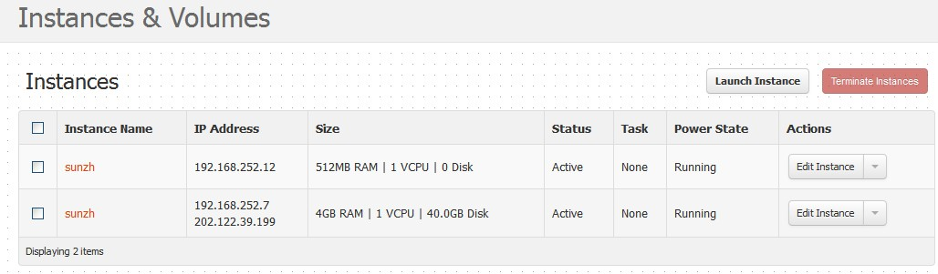
IaaS
How to use the IaaS?
Make a Request (to the administrator an email )
Administrator creates an account (in dashboard )
Login and enjoy it!
To use it:
Create image. There are two types of images: Public image and Customized image. Users can choose one according to their needs.
Launch an instance.
Log on by ssh or vnc.
Now it is merely manual, maybe consider automation later if needed.
Notes:
Then, let’s see how we provide the IaaS?

Slide 14
Integrated with Torque/PBS
Problems:
IHEP computing environment adopts Torque/PBS. Torque process a job according to the task queue, executed sequentially
Two types of nodes:
  Exclusive node
  Shared node
    can share but cannot be preempted.
The Checkpoint function in PBS not well supported network file system.
Result:
stunt to preemptive scheduling & key resources protection insurance

Slide 15
Example
Let’s use an example to explain it.
Assume there are 4 nodes , and two queues, YBJ and BES. YBJ queue owns 1 exclusive node, BES owns 1 exclusive node, and the remaining 2 is sharing. Each node has 8 cores, which has the ability to run 8 jobs simultaneously at most.
Both YBJ and BES have 3 node available at most.
exclusive node
node1
shared node
node2
UI
UI
Job submit
node3
Job submit
……
……
node4
YBJ
queue
BES
queue
If YBJ queue is full , for example needs 10 nodes when BES queue is idle, exclusive node in BES queue (eg, node2) can’t be used by YBJ queue.

Slide 16
Solutions
Introducing OpenStack into Torque:
node1
exclusive node
shared node
node2
UI
UI
Job submit
node3
Job submit
……
……
node4
YBJ
queue
BES
queue
batchcloud
openstack
vm node
Combined OpenStack into our PBS.
Using openstack to manage virtual machines to provide vm nodes. These nodes can be created on-demand in batchcloud, and deallocate the virtual machines to take resource from the low priority jobs in accordance with the scheduling policy. When an urgent job arrives, the batchcloud will do as follows:
Start an instance.
Run Qmgr to add the job to the queue.
Wait for the job completion and release the vm.
What’s more, the shared nodes can be gradually substituted by the vm nodes.

Slide 17
Manage resources in remote sites
Problems:
There are a lot of sites integrated into IHEP BES computing system, especially for some simulation and analysis task.
Each remote site should run some associated software (Grid software、BES software、 Local storage and computing software).
These software need periodic update.
ganga
DIRAC
HKU
U of M
SDU
Result:
Every remote site needs an dedicated administrator to operate locally, however, some sites is small and it is impractical.
Notes:
the University of Minnesota.

Slide 18
Solutions
We are going to use OpenStack to improve the usability.
Openstack dashboard
agent
openstack
pc1
pc2
pc3
pc4
…
Bei Jing
Remote sites
We will install openstack in the remote sites, then create an agent in the remote sites, so the administrator can access and manage using dashboard in Beijing .
Remote sites:
Maintenance system (physical machines && OS)
Beijing local site:
Image install, software update
Vms startup and shutdown
Monitoring all the resource (virtual machine, physical machine, services, CPU, network, storage, etc)

Slide 19
Conclusion
Openstack develops very fast, it provides a good chance for IHEP.
We use openstack to construct our IaaS.
Integrate openstack with our batch system Torque/PBS to improve resource utilization.
Use openstack to manage resources in remote sites to improve the usability.

Slide 20
Thanks!
Q & A

