Slide 1
Cyber-security update
Sebastian Lopienski
CERN Deputy Computer Security Officer
HEPiX Workshop
Beijing, October 2012
Notes:
I do these “update” presentations from time to time. Each time I prepare a new one, and more and more scared…

Slide 2
Fancy learning some Chinese?
人
a person
囚
?
女
a woman
安
?

Slide 3
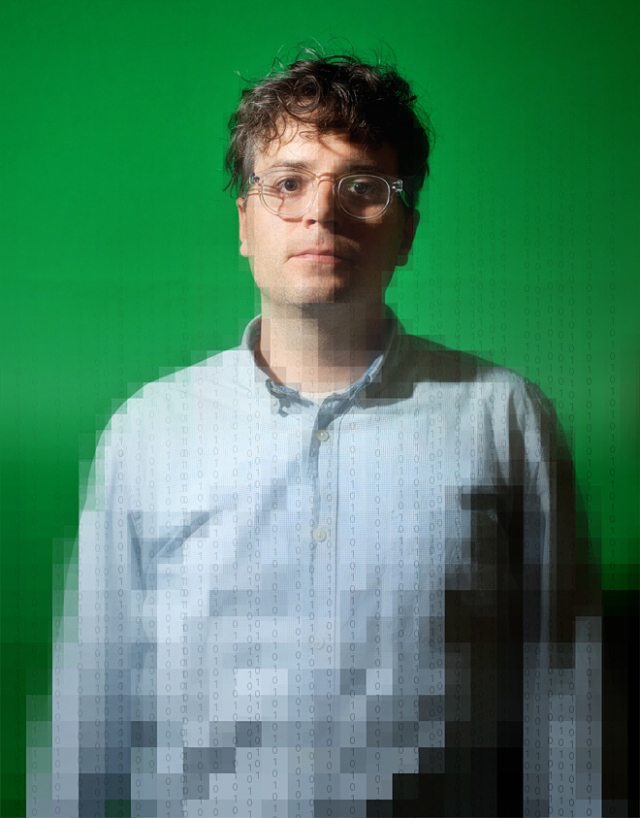
A cloud hack
Digital life of a “Wired” journalist destroyed in one hour:
(http://www.wired.com/gadgetlab/2012/08/apple-amazon-mat-honan-hacking)
  Amazon, Apple, Google, Twitter accounts compromised
  all Apple devices wiped-out remotely
Notes:
Also:
http://www.schneier.com/blog/archives/2012/08/yet_another_ris.html
http://youtu.be/603bceogqfA

Slide 4
A cloud hack
How??
  call Amazon and add a new credit card
    needed: name, billing address, e-mail address
  call again, say you lost password, and add a new e-mail
    needed: name, billing address, current credit card
  reset password - get the new one to this new e-mail address
  login and see all registered credit cards (last 4 digits)
  call Apple, say you lost password, and get a temp one
    needed: name, billing address, last 4 digits of a credit card
  reset Google password - new one sent to Apple e-mail
    (Apple e-mail was registered as an alternate e-mail)
  reset Twitter password - new one sent to Google e-mail
    (Google e-mail was linked to the Twitter account)

Slide 5
A cloud hack
Many security flaws or issues:
Our full dependence on digital
  digital information, devices, cloud services etc…
Interconnected accounts
  Which one of your accounts is the weakest link?
Very weak identity check procedures
  … and often not even followed correctly
  some procedures have changed as an outcome of this case
  “security“ questions with answers often trivial to find
  (remember Sarah Palin’s yahoo account hack in 2008?)
Notes:
http://www.networkworld.com/news/2012/080812-apple-stops-password-resets-after-261496.html

Slide 6
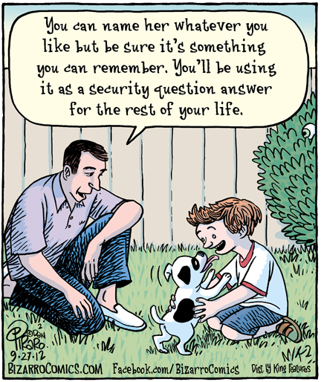
  From http://www.bizarrocomics.com
Notes:
Children warned name of first pet should contain 8 characters and a digit
Popular pet names Rover, Cheryl and Kate could be a thing of the past. Banks are now advising parents to think carefully before naming their child’s first pet. For security reasons, the chosen name should have at least eight characters, a capital letter and a digit. It should not be the same as the name of any previous pet, and must never be written down, especially on a collar as that is the first place anyone would look. Ideally, children should consider changing the name of their pet every 12 weeks.
http://www.newsbiscuit.com/2012/06/08/children-warned-name-of-first-pet-should-contain-8-characters-and-a-digit/

Slide 7
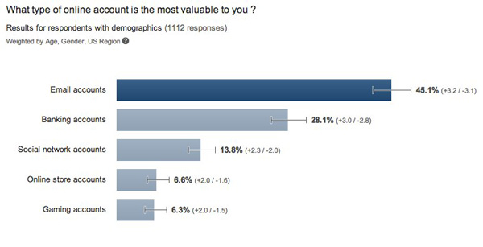
E-mail account before e-bank account?
  From http://elie.im/blog/security/45-of-the-users-found-their-email-accounts-more-valuable-than-their-bank-accounts
Notes:
BTW, why people reply this way?
Because they realise how important their e-mail account is, and how many other services/accounts depend on its security?
Or rather because they believe banks will help them with any e-banking issue (and they are often right), while they are on their own with any e-mail account issues?
See also: http://www.schneier.com/blog/archives/2012/06/e-mail_accounts.html

Slide 8
Outline
Where we are?
  vulnerabilities
  malware
  attacks
Who are they?
  attackers
What is ahead?
  collateral damage
  trust
Notes:
Whan next? / What to expect? / Where will this take us?

Slide 9

Vulnerabilities: Java
  CVE-2012-4681 (August 2012)
a “0-day” (actively exploited, and no patch)
affecting Java 1.6 and 1.7 on various OSes
(now patched)
Blackhole, a widely-used web exploit toolkit, included an exploit for this vulnerability within hours
Why do you need Java in your browser, anyway?? Disable it!

Slide 10
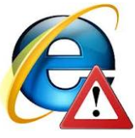
Vulnerabilities: Internet Explorer
  CVE-2012-4969 (September 2012)
a “0-day” (actively exploited and no patch)
affecting IE 6 to 9
(now patched)
Same people as behind the Java vulnerability
Notes:
Do you want to guess how many hundreds of millions of users affected??
http://www.f-secure.com/weblog/archives/00002429.html
German authorities have recommended using an alternative browser.
https://www.bsi.bund.de/ContentBSI/Presse/Pressemitteilungen/Presse2012/Internet%20Explorer%20Warnung%2017092012.html;jsessionid=2AE6AE2A18C4A5C94745AF54ABB45104.2_cid286
BTW, Chrome believed to be more secure that IE or Firefox

Slide 11
Vulnerability market shift
Finding vulnerabilities – difficult, time consuming
Selling to vendors, or publishing (mid 2000)
  limited money – 1s-10s thousands of USD
  shame to vendors
  vulnerabilities eventually patched (good!)
Selling to underground (late 2000)
  busy and active “black market”
  more profitable – 10s-100s thousands of USD
  sometimes buyers are governments or their contractors
  used as 0-day exploits (no patch)
research decoupled from attack
attackers don’t need skills, just money
Notes:
Another threat: a programmer in a software company now has an incentive to plant or leave a security bug, and sell it later
See also:
https://www.owasp.org/images/b/b7/OWASP_BeNeLux_Day_2011_-_T._Zoller_-_Rise_of_the_Vulnerability_Market.pdf
http://www.forbes.com/sites/bruceschneier/2012/05/30/the-vulnerabilities-market-and-the-future-of-security/

Slide 12
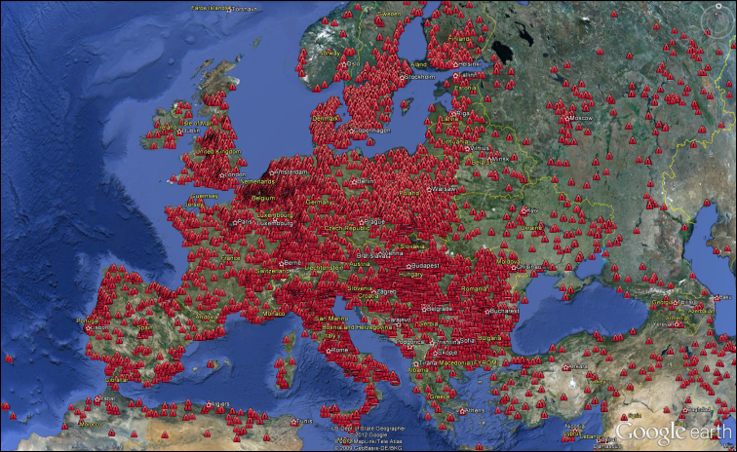
Botnets
(networks of compromised machines)
ZeroAccess - milions of infections (bots)
  From http://www.f-secure.com/weblog/archives/00002430.html
Microsoft took control of a malware hosting domain
- 35M unique IP addresses contacted it within hours
Notes:
US Court allowing Microsoft to take control over 3322.org, hosting 70k subdomains used for hosting malware (found out because some computers were sold with pre-installed Windows infected with Nitol malware) within hours, 35M (!) unique IP contacted these subdomains
http://krebsonsecurity.com/2012/09/malware-dragnet-snags-millions-of-infected-pcs/
BTW, some researchers and law enforcement agencies not happy of MS taking such unilateral actions

Slide 13
Flame malware
(operating since at least 2010, discovered June 2012)
A complex malware designed for espionage:
Key logger, screen capture, audio capture
Collects coordinates from pictures
Scans documents and collects summaries
Scans phones via Bluetooth
No Internet? Stolen data is transferred via USB keys
Comes with many libraries (SSH, SSL, Lua, SQLLite…)
Very big (10s of MB)
Spreads via Microsoft Update,
signed with a brute-forced Microsoft certificate (!!)

Slide 14

Malware vs. anti-malware arms race
Malware samples are usually analyzed in VMs
… so malware tries to detect VMs and debugging
  no audio card? ➔ go into an infinite loop
  slow computer? (=debugging) ➔ do not infect
  Wireshark running? ➔ exit
Conclusion: use a slow VM for your daily work? ☺
  From http://www.f-secure.com/weblog/archives/00002432.html
Notes:
http://www.f-secure.com/weblog/archives/00002408.html
http://www.f-secure.com/weblog/archives/00002432.html
http://www.f-secure.com/weblog/archives/00002067.html

Slide 15
Which OSes affected?
Linux
/Unix
Windows
MacOS
IE 6-9 vulnerability
mobile malware (on Android)
First Windows 8 rootkit detected
Java 1.6 & 1.7 vulnerability
(and malware exploiting it)
Flashback
malware

Slide 16
(Hashes of) passwords lost…
LinkedIn – 6 million hashes stolen
Large-scale password leaks at Last.fm and eHarmony
IEEE – 100k plain-text (!!) passwords on a public FTP
Side notes on hashing:
MD5 or SHA are not for password hashing
  designed for speed ➔ brute-forcing easy even when salted
  use bcrypt instead (http://codahale.com/how-to-safely-store-a-password/)
MD5 broken, SHA-1 considered weak, SHA-2 OK
Keccak hash selected by NIST as SHA-3
  6 years long process!
Notes:
http://ieeelog.com/
http://www.schneier.com/blog/archives/2012/10/keccak_is_sha-3.html
http://codahale.com/how-to-safely-store-a-password/

Slide 17
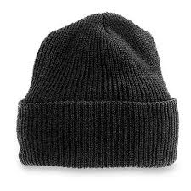
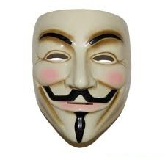
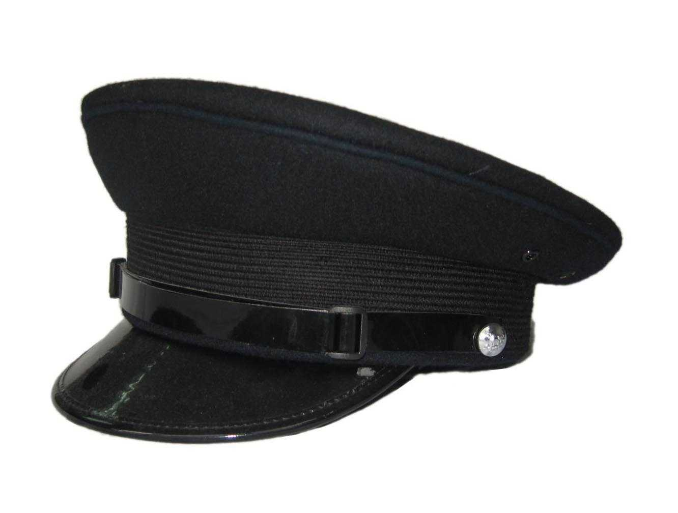
Who are they?
criminals
motivation:
profit
hacktivists
motivation:
ideology,
revenge
governments
motivation:
control,
politics

Slide 18
Criminals
Usual stuff:
Identity theft
Credit-card frauds
Malware targeting e-banking
Scareware, e.g. fake AV, fake police warnings
Ransomware: taking your data hostage (soon: accounts?)
Mobile malware, e.g. sending premium rate SMSes
Denial of Service (DoS)
Spam
etc.
Notes:
Zeus + P2P -> GameOver infections -> banks
http://www.f-secure.com/weblog/archives/00002424.html
http://www.f-secure.com/weblog/archives/00002421.html

Slide 19
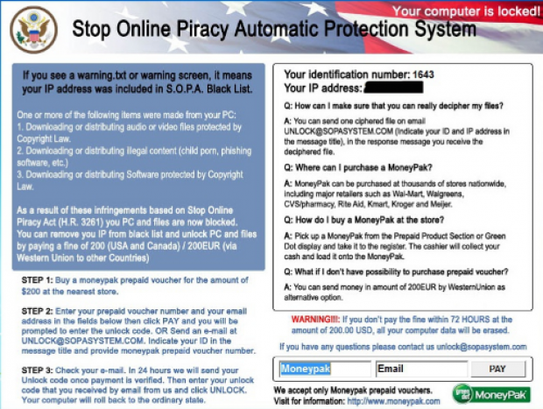
2in1: Scare and demand ransom
SOPA is dead –
but still used
by criminals
to scare people
  From http://www.zdnet.com/sopa-reincarnates-to-hold-your-computer-hostage-7000005684

Slide 20
Hacktivists
“Anonymous”
BTW, some hacktivists may turn criminal
  e.g. selling credit card numbers obtained in an attack

Slide 21
…but governments?

Slide 22
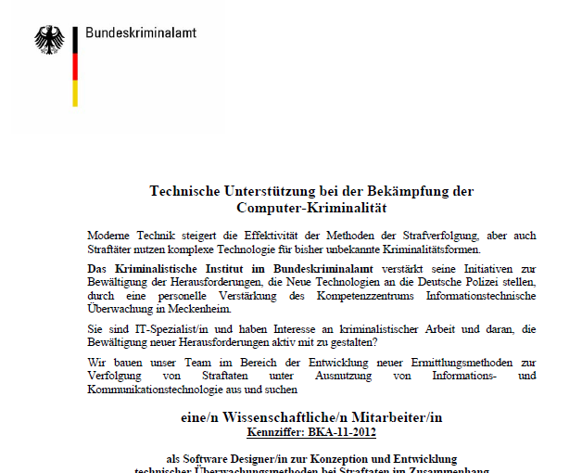
Spying on (some) citizens
German infects criminals’ PCs
with Trojans/backdoors
  buying surveillance services
  for 2M EURO (!)
  or developing in-house
Israel demands e-mail passwords at borders
Syria infects activists’ PCs with Trojans/backdoors
Network encryption? Infect computers or go after services
  From http://www.f-secure.com/weblog/archives/00002423.html
Notes:
Israel Demanding Passwords at the Border
http://www.theaustralian.com.au/australian-it/israel-steps-up-email-border-checks/story-e6frgakx-1226385584079
Israel airport security demands access to tourists' private email accounts
Several U.S. tourists report being asked by airport security personnel for access to their personal email accounts; Israel's Shin Bet security service says it acted within the law.
Israel's Shin Bet security service has been demanding access to personal email accounts of visiting tourists with Arab names, according to the testimony of three U.S. citizens who were interrogated at Ben Gurion Airport and subsequently refused entry into Israel in May.
http://www.haaretz.com/news/diplomacy-defense/israel-airport-security-demands-access-to-tourists-private-email-accounts.premium-1.434509
German infects criminal investigation suspects’ computers with Trojans/backdoors
http://www.f-secure.com/weblog/archives/00002250.html
Syria
http://www.f-secure.com/weblog/archives/00002356.html
can’t wiretap connections because of encryption – so either infects computers, or goes after your data in the cloud:
http://papers.ssrn.com/sol3/papers.cfm?abstract_id=2038871

Slide 23
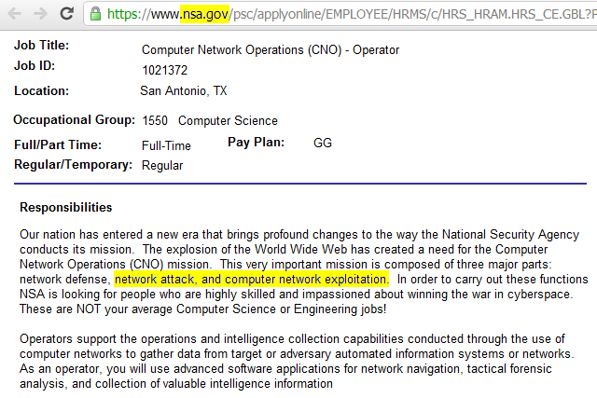
Agencies & contractors turning offensive
  From F-Secure
Notes:
https://twitter.com/mikko/status/203414733804670976

Slide 24
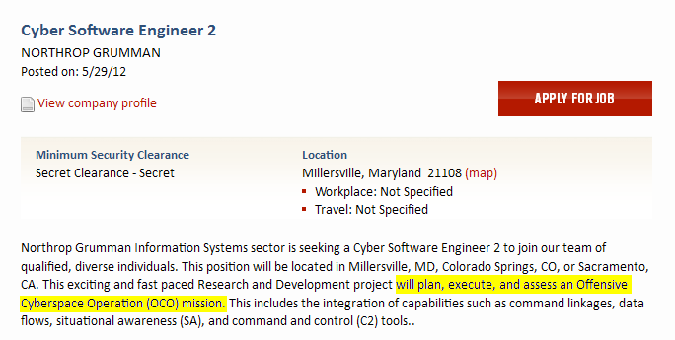
Agencies & contractors turning offensive
Northrop Grumman looks for "Cyber Software Engineer" for “an Offensive Cyberspace Operation mission"
  From http://www.f-secure.com/weblog/archives/00002372.html
Notes:
https://twitter.com/mikko/status/203414733804670976

Slide 25
Nation-states involvement
Espionage
Sabotage
Cyber-defense
Cyber-offense
etc.
Why turning “cyber”?
Cheaper that “traditional”, physical activities
Many assets are digital, anyway
  information, communication channels
Deniability is easier / Attribution is harder

Slide 26
Stuxnet
(the worm that targeted Iranian uranium-enriching centrifuges, discovered 2010)
Estimated development effort:
10 man-years
Result: sabotage
30,000 Iranian computers infected, some HW damage, nuclear program set back by ~2 years
Cui bono?
(New York Times, June 2012: a joint US-Israel operation
“Olympic Games” started by Bush and accelerated by Obama)
☺
Notes:
http://www.nytimes.com/2012/06/01/world/middleeast/obama-ordered-wave-of-cyberattacks-against-iran.html
http://www.f-secure.com/weblog/archives/00002401.html

Slide 27
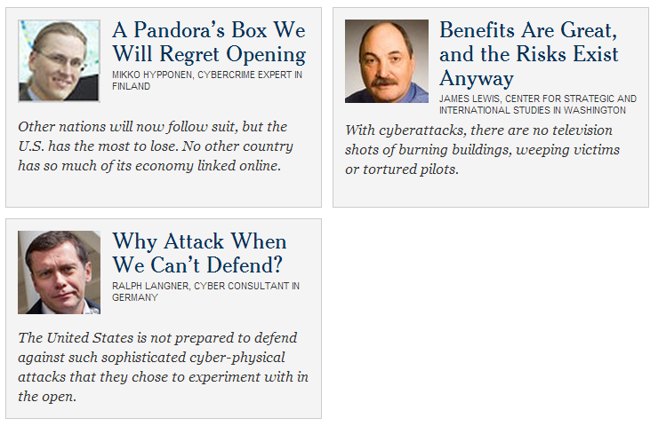
Does Stuxnet make us all more vulnerable?
?
  http://www.nytimes.com/roomfordebate/2012/06/04/do-cyberattacks-on-iran-make-us-vulnerable-12
Notes:
http://www.nytimes.com/roomfordebate/2012/06/04/do-cyberattacks-on-iran-make-us-vulnerable-12
Was the world a safer place since WWII because of nuclear arms??

Slide 28
Stuxnet – Duqu - Flame
Why Stuxnet started spreading (and was consequently detected in 2010)? ➔ because of a programming error
  A “collateral damage”?
Worms Duqu and Flame based on similar techniques
  same authors?
  BTW, Flame seems to be a non-for-profit malware
Security industry is too weak for (not focused on?) fighting government-sponsored malware
(http://www.wired.com/threatlevel/2012/06/internet-security-fail/)
  had samples, but didn’t detect it as a threat
Notes:
http://www.wired.com/threatlevel/2012/06/internet-security-fail/
http://www.schneier.com/blog/archives/2012/06/the_failure_of_3.html

Slide 29
What is the future?
Cyber-arms race
Public cyber-war exercises?
A real cyber-war?
Or mutual deterrence?
  like with nuclear weapons between the US and the Soviets
  probably not anytime soon…
Eventually, cyber disarmament treaties?
Side effect: cyber-arms will leak to criminals/hacktivists
  unlike nuclear arms…
  this will affect everyone
Notes:
longer-term results: arms race
imagine a (cyber)war between two technically advanced nations
NATO Cooperative Cyber Defence Centre of Excellence – The Tallin Manual on what is cyber attack, if cyber espionage is “legal during warfare” etc.:
http://www.ccdcoe.org/249.html
http://www.f-secure.com/weblog/archives/00002417.html
“However, eventually it will become as public as any other defence technology. Maybe we'll eventually see public cyberwar exercises where a country will demonstrate their attack capabilities. Maybe we'll eventually see cyber disarmament programmes.”
http://www.bbc.com/news/technology-18825742
US and China talking about cyber-weapons – not government to government, but via “proxies” (institutes) – but still interesting!
http://www.volokh.com/2012/07/02/us-china-proxy-talks-on-cyberweapons/
http://www.usnews.com/debate-club/should-there-be-an-international-treaty-on-cyberwarfare/an-international-cyberwar-treaty-is-the-only-way-to-stem-the-threat

Slide 30
Some other thoughts
Same old problems:
  SQL injection, passwords stored in clear-text, unpatched software, weak authentication, clicking without thinking etc.
…and answers:
  defense in depth, least privilege principle, secure coding, sandboxing, limited exposure, patching, awareness raising
But we are inherently vulnerable
  how to prevent a targeted attack using 0-day exploit?
  can we trust DNS? CAs? Microsoft/Apple/Adobe/… Update?
“Complexity kills security” – is it always true?
  causing a damage in a complex system – harder?
Notes:
Trusting signatures: Compromised Adobe build server
http://www.f-secure.com/weblog/archives/00002435.html
We’ve been saying for years: complexity kills security
But maybe, it’s the opposite? We’re being attacked and compromised, but causing real damage is hard
precisely because systems are so complex??

Slide 31
Fancy learning some Chinese?
人
a person
囚
a prisoner
(a person in a box)
女
a woman
安
secure
(a woman under a roof)

Slide 32
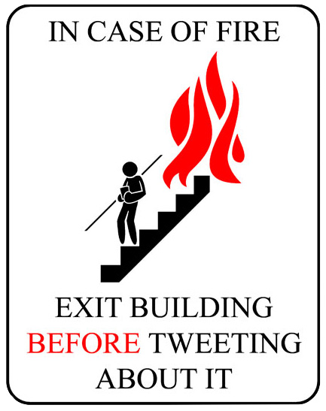
Thank you

