Slide 1
Lucien Boland and Sean Crosby
Research Computing
Notes:
Well thank you, I’m not sure if it is auspicious or inauspicious to be first up after the host nation, but with a busy day and week ahead of us I had probably best to get on with the talk.

Slide 2
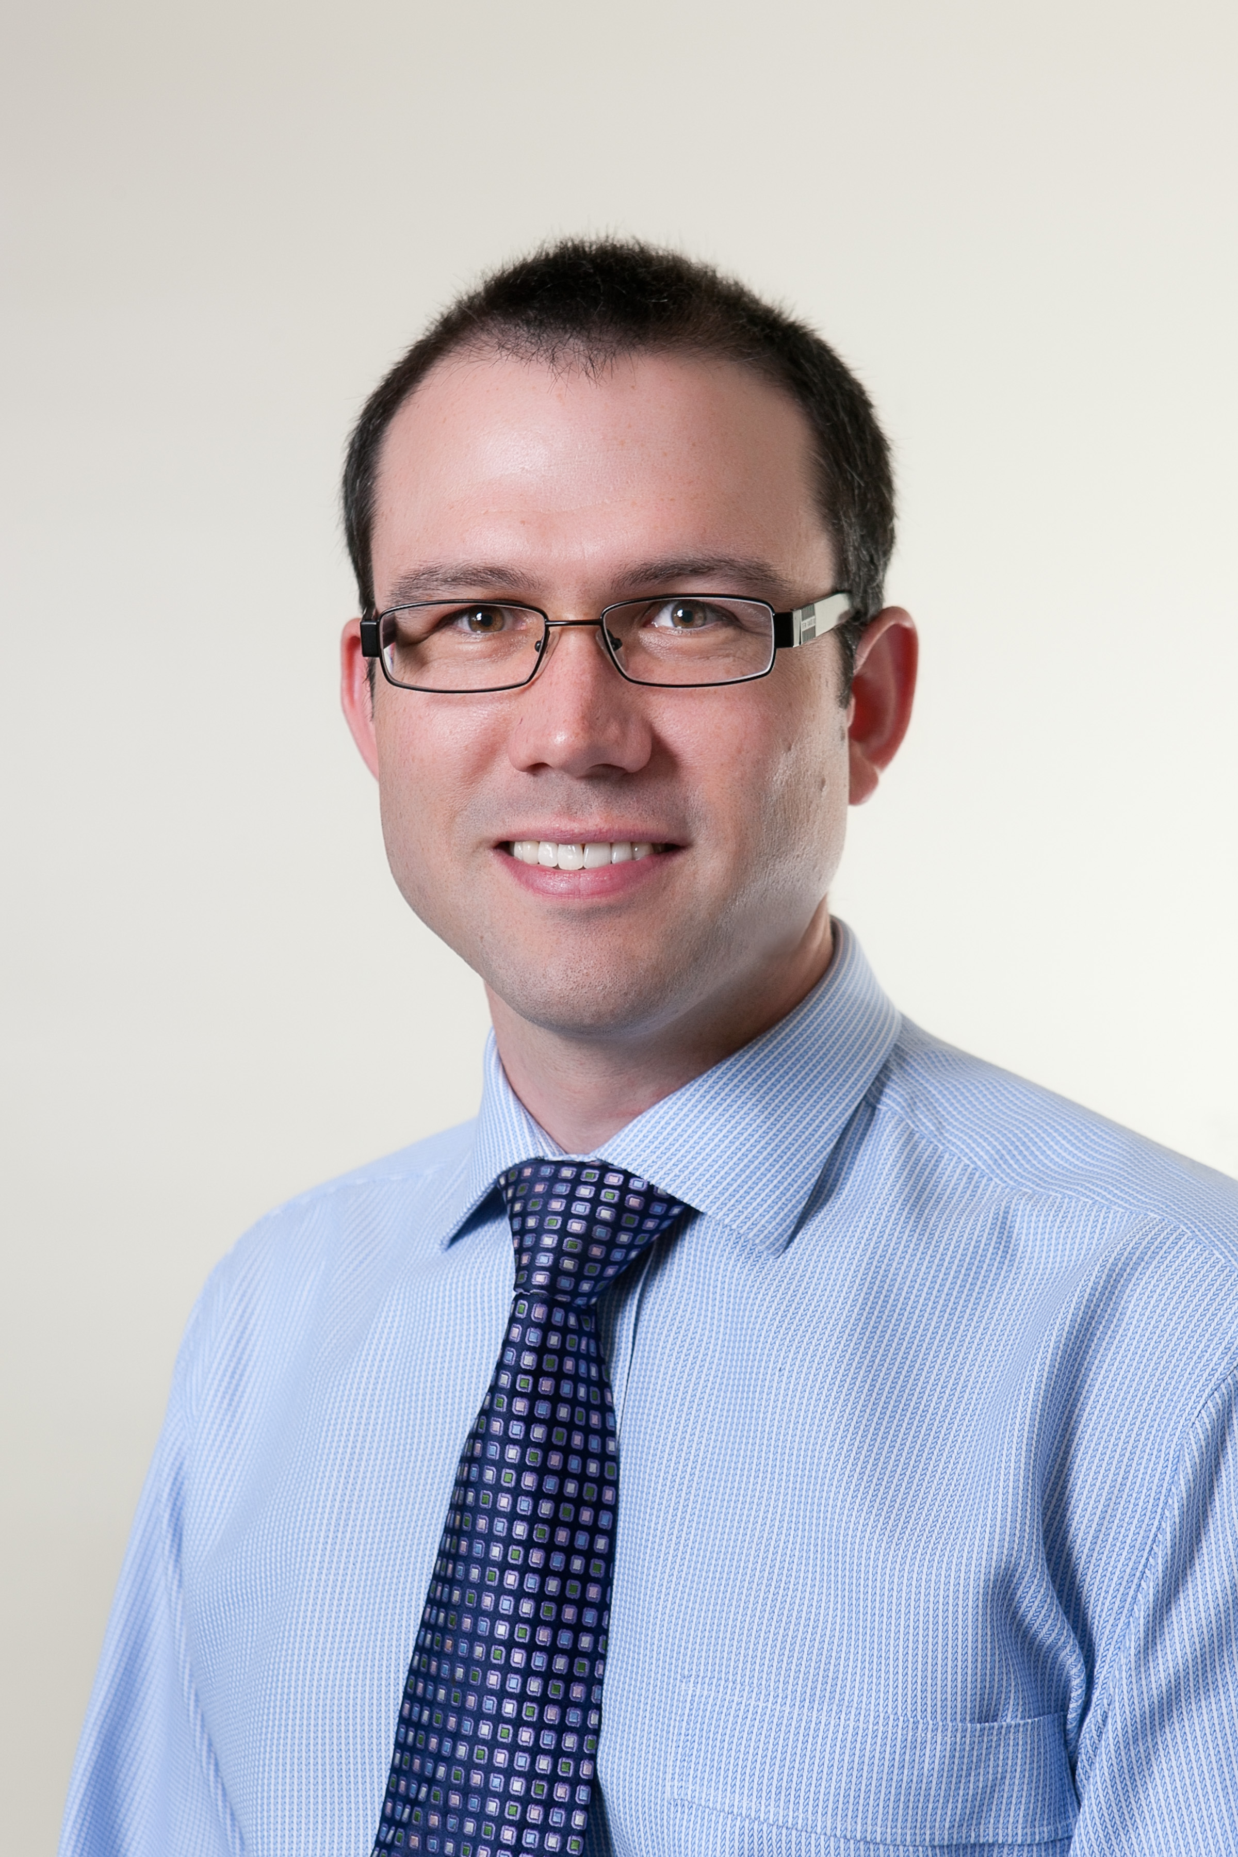
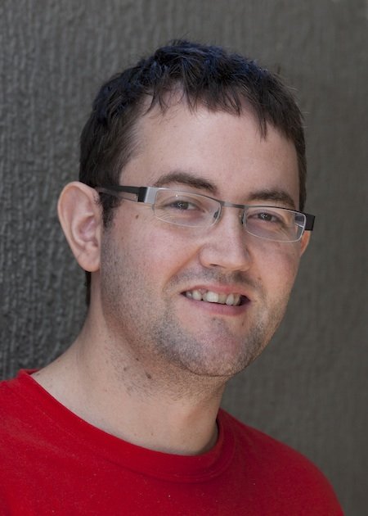
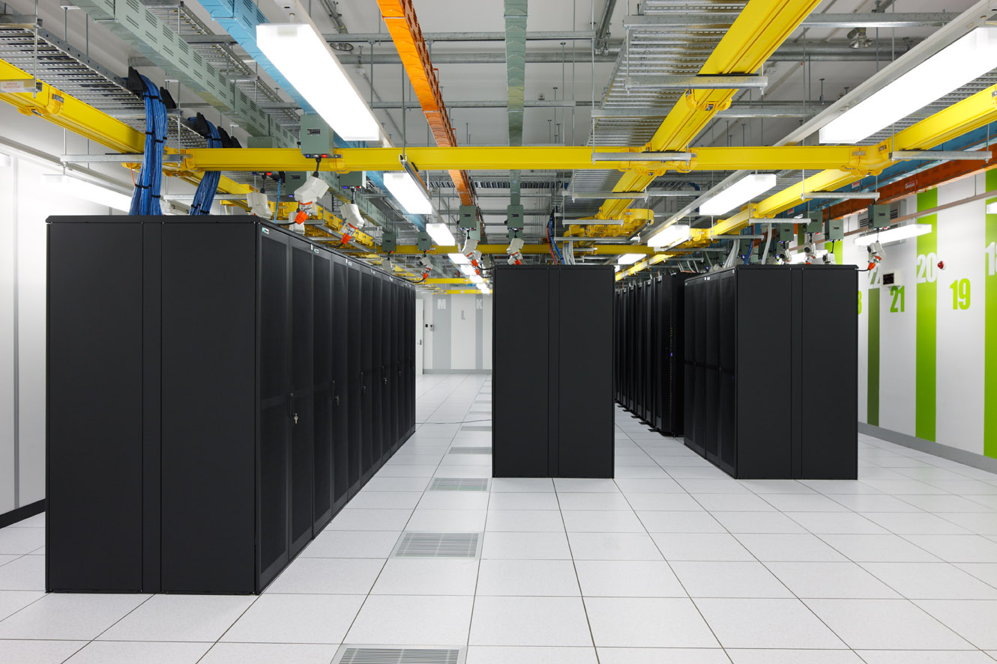
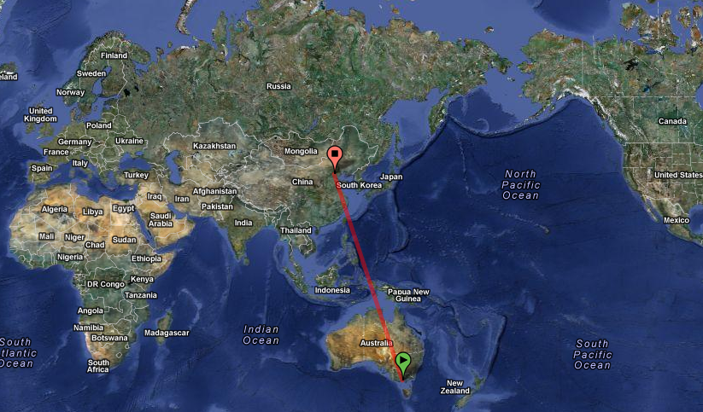

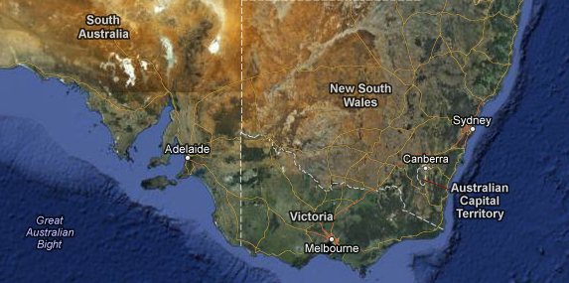
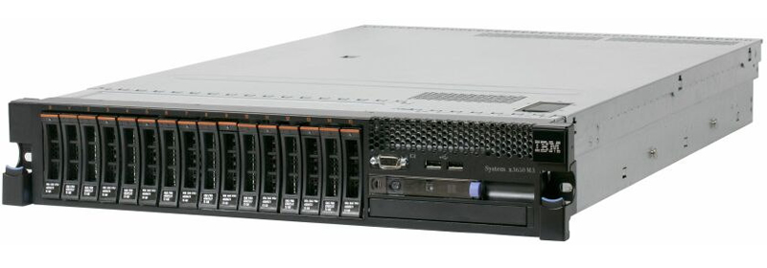






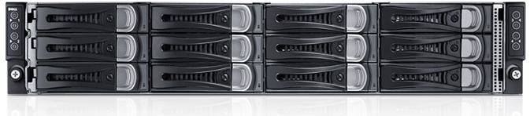


~1 Minute Introduction
Notes:
My name is Lucien Boland and this is my colleague and co-presenter is Sean Crosby.
We come from Australia and work for the Centre of Excellence for Particle Physics at the Terascale. This is a federally funded initiative that links high energy physics researchers from 4 of Australia’s leading Universities – Adeladie, Sydney, Monash and Melbourne.
The central node is located at the University of Melbourne and it is there that we run our main ATLAS only Tier 2 WLCG site.
Melbourne University provides us with rack space in a Tier 3 Research data center where we currently have about 8 racks of equipment from vendors such as IBM, HP and Dell.
Sean and I make up two thirds of the Research Computing team that manage all the HEP research computing resources for our centre. This includes a few smaller torque batch clusters, the ATLAS Tier 2 site and all the additional infrastructure needed to reliably manage these services for our researchers.

Slide 3
2012 - Year of Transition
old staff ➔ new staff
old data hall (4kw/r) ➔ new data hall (16kw/r)
local storage ➔ SAN
KVM ➔ XenServer
Debian/RHEL ➔ SL6
cfengine ➔ puppet
NFS ➔ CVMFS
gLite 3.2 ➔ UMD
Notes:
2012 has really been a year of transition for HEP research computing in Australia.
And I’d like to quickly highlight some of more significant changes.

Slide 4
New staff
rm -rf /melb/home/tjdyce
rm -rf /melb/home/fifieldt
mkdir /melb/home/lucien
mkdir /melb/home/scrosby
mkdir /syd/home/swasnik
Notes:
Firstly, the previous Australian site admins, Tim Dyce and Tom Fifield,have both moved on to other ventures in Japan and Melbourne. An entirely new team consisting of Sean and myself at Melbourne University and Sachin Wasnik at Sydney University has been established.

Slide 5
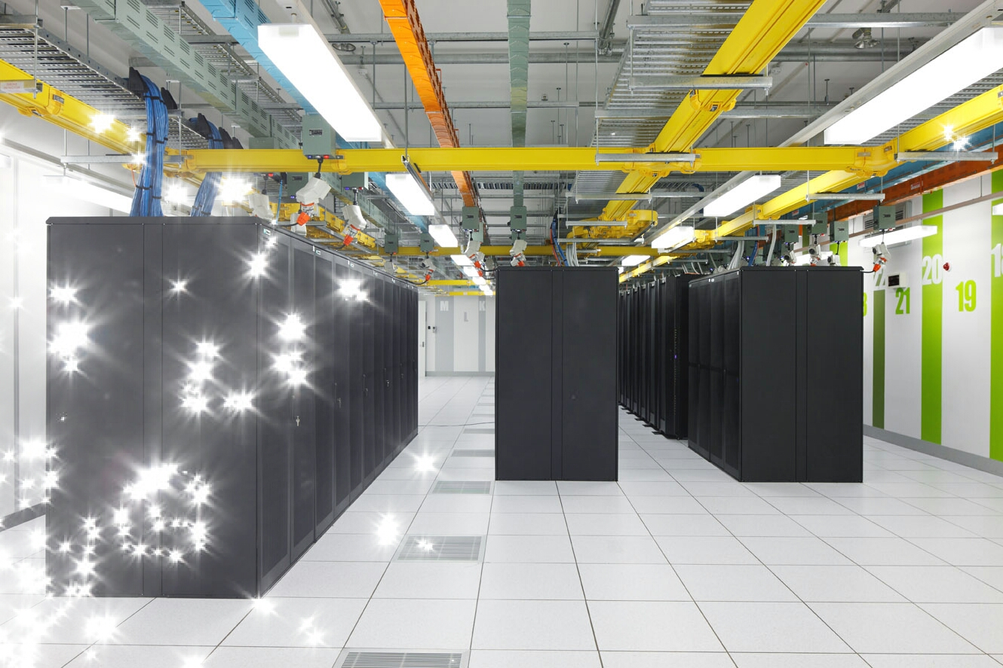
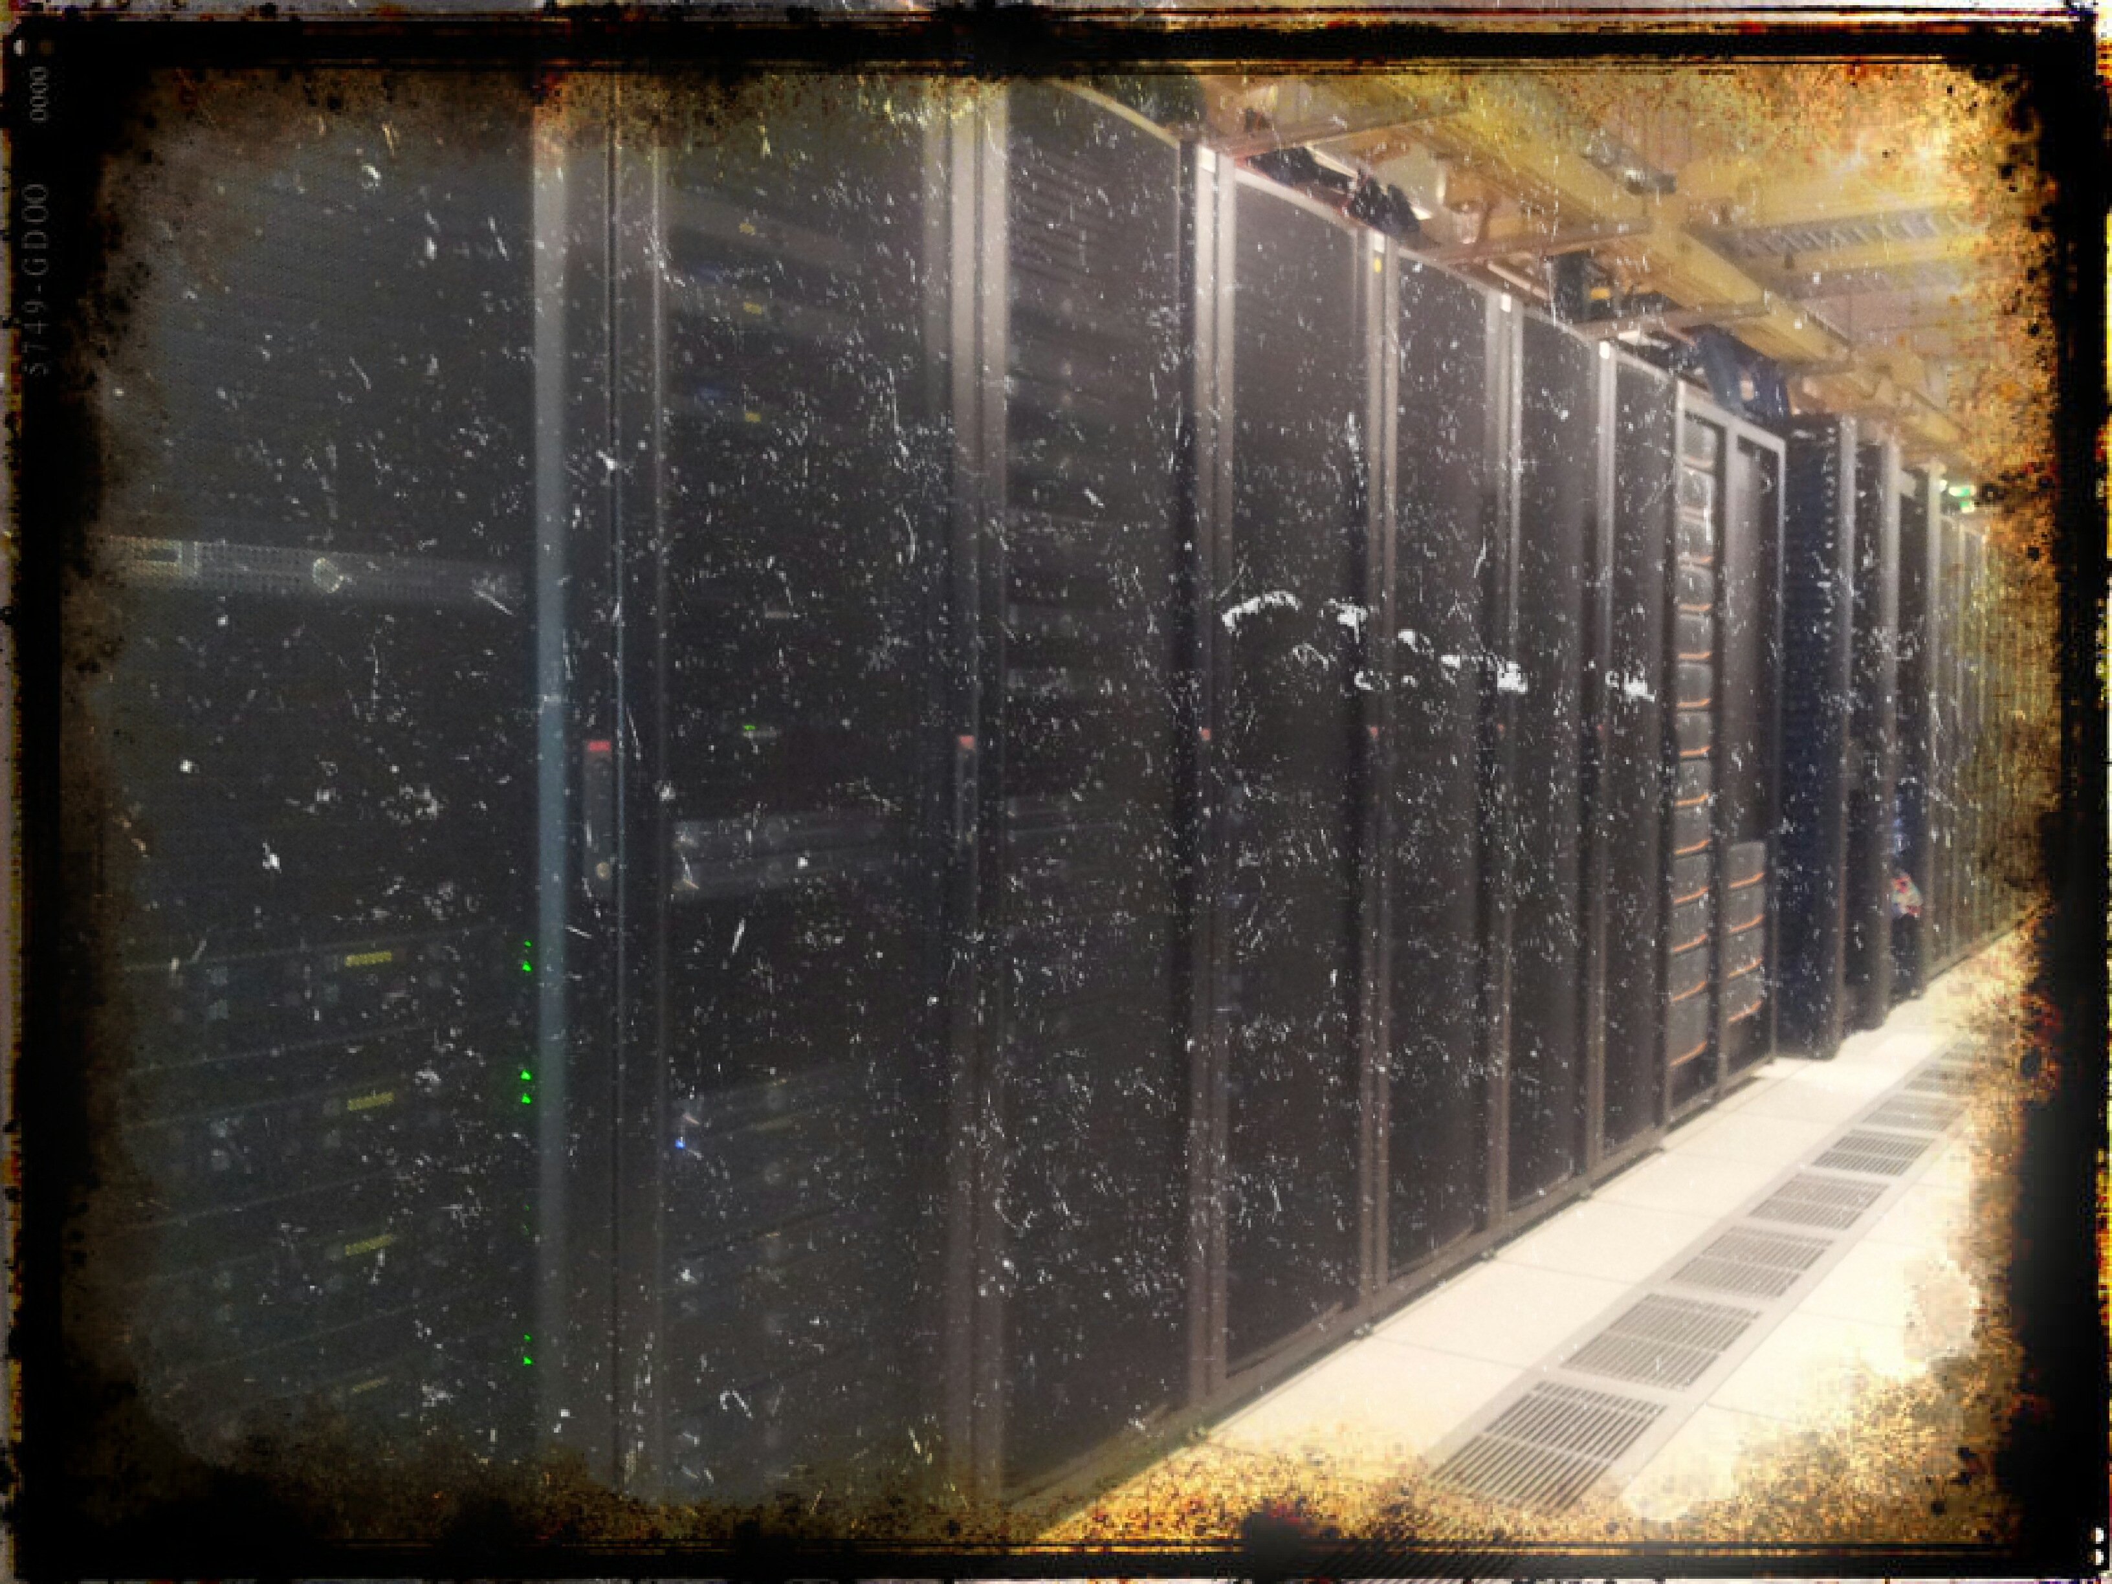
New Data Hall
Data Hall 1 – 4kW / rack
Data Hall 2 – 16kW / rack
Notes:
A another major change for our site this year has been moving from a low density 4 kilo watt /per rack machine room into a new high capacity research data hall supporting 16 kilo watts per rack.

Slide 6
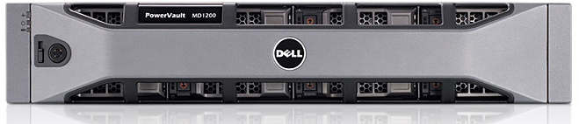
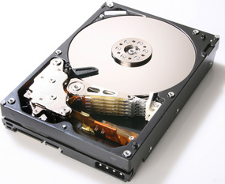
Shared SAN storage
Local disk
Dell MD3600f
Shared Storage
8 TiB
Notes:
We purchased a small but vital shared storage capacity which has allowed us

Slide 7


Citrix XenServer Advanced
Notes:
to move from independent KVM hosts to a highly available VM farm based around the Citrix XenServer Advanced virutalisation platform.

Slide 8



SL6
Debian
RHEL 6
Scientific Linux 6
(and XenServer)
SL 5
Notes:
This in turn allowed us to consolidate our infrastructure and head node operating systems into a single OS release.

Slide 9


Puppet
Notes:
and this was made easier by the move away from cfengine 2 to puppet as our system configuration management tool.

Slide 10
Grid Middleware Upgrades
gLite 3.2 to UMD-1
NFS to CVMFS
DPM NFS testing
Joining federated xrootd cluster
Notes:
On the Grid Middleware front we’re in the final stages of moving from Glite to UMD,
we’re changing from local NFS experimental software repos to the CVMFS software distribution model,
we’ve begun DPM NFS testing to more tightly integrate our Tier2 and Tier3 resources AND
we’re also in preliminary talks about joining a federated xrootd cluster.
I’d now like to hand over to Sean to go into some more details about our status, our future projects and some issues we’ve had along the way.

Slide 11
Tools
Fault Monitoring: Nagios (Puppet)
Perf Monitoring: Ganglia
Network Monitor: Perfsonar
Authentication: Kerberos/OpenLDAP
Logging: rsyslog
Documentation: dokuwiki
Tickets & projects: redmine
Remote Mang: openVPN

Slide 12
Tools
SVN to git
Deprecated hardware for backups

Slide 13
Infrastructure
Virtualization farm
  Dell MD3600f connected to 2 Dell R620s and 2 R710s
  Citrix XenServer Advanced for HA/failover
IPMI SOL – (IMM, DRAC, ILO)
Build – DHCP, PXE, Kickstart, Puppet
Notes:
I’ll now hand over to Sean who will give you a run down of our current status, our planned work and projects for 2013 and some of the is

Slide 14
Cloud Project
Nectar Cloud – Federally funded
1.5 year project to deploy software to run Tier 3 and Tier 2 grid infrastructure on the Australian National Research Cloud (NECTAR).
2 developers started recently
1 developer being sought (close 25 Oct)

Slide 15
2013
Disk growth from 700TB to 800TB
  purchase 300TB (inc. replace old disk)
CPU growth from 6000HEPSPEC to 7000 HEPSPEC

Slide 16
Issues
Delivering disk and CPU
Dell C6145 performance
DPM disk
Dealing with out of warranty equipment

Slide 17
Thanks for Listening

