Slide 1
HIE-EBIS workshop summary
CERN, 16-17.10.2012

Slide 2
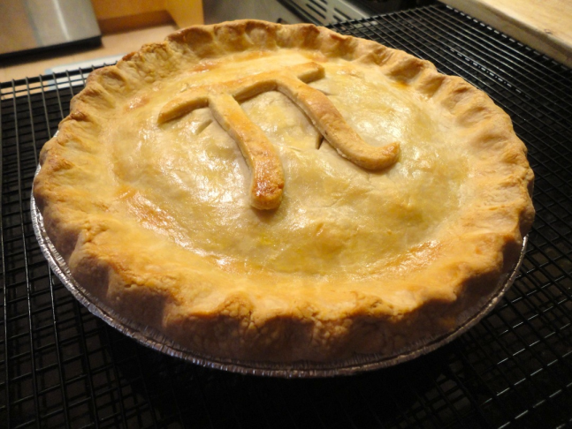
Foreword
Thanks to all the visiting and CERN-internal participants for attending the workshop and sharing your knowledge.
We all learned more about
the pie and the emittance

Slide 3
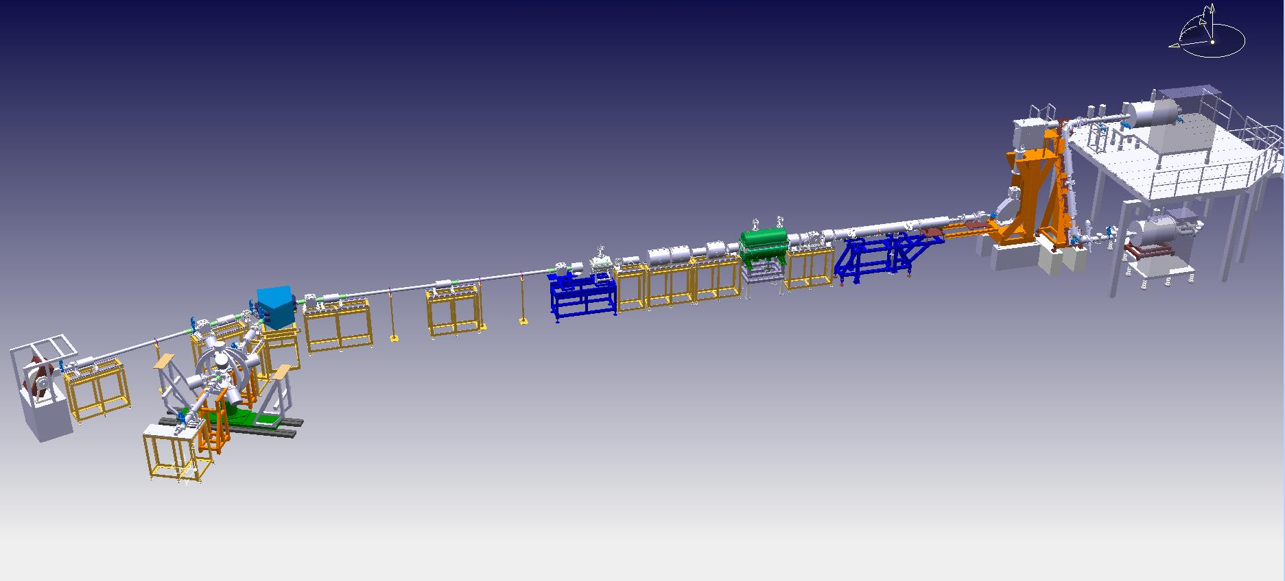
The important things we have learned
1. The electron beam
The priority number one for us is to get the beam parameters close to specified
¹³²Sn @ 5.5 MeV/u
q – irrelevant →
T~100
A/q<4.5 → q>30⁺ →
γ-detectors saturation @ 10 Hz
Not OK: J_{e} x 5/10
OK: 50 Hz st I/ 100 Hz st II →
100 Hz rep rate →

Slide 4
The important things we have learned
1. The electron beam
We find the BNL high density gun project interesting to our application and
would like to contribute in its development and test

Slide 5
The important things we have learned
2. Ion-ion cooling
The ion-ion cooling confirmed to be crucial for the HIE-EBIS application
at high ionization factors
Due to chosen separate vacuum concept we would prefer options with the
neutral gas injection outside of the main trapping region.
The option of externally generated 1+ cooling ions found less favourable

Slide 6
The important things we have learned
3. Vacuum requirements
The vacuum requirements were found to have the most of the points to
be verified on different levels.

Slide 7
The important things we have learned
3. Vacuum requirements. Level 0.
Current requirements to vacuum in HIE-EBIS are based on CBSIM simulations
Taking into account CX process.
These relay on extrapolation of low charge state CX cross-section to higher states
which is questionable and not entirely supported by experiments on VHCI
The results of CBSIM regarding CX will be double checked with other
simulation packages (one by Yaming Zou + other mentioned ) and
experimental data to refine the vacuum requirements regarding CX.

Slide 8
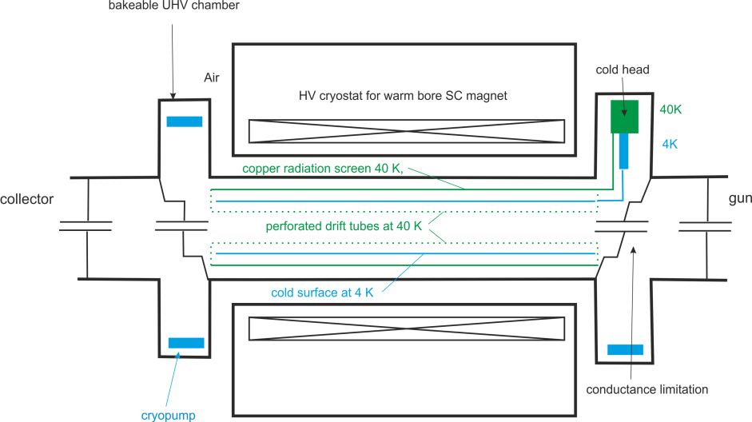
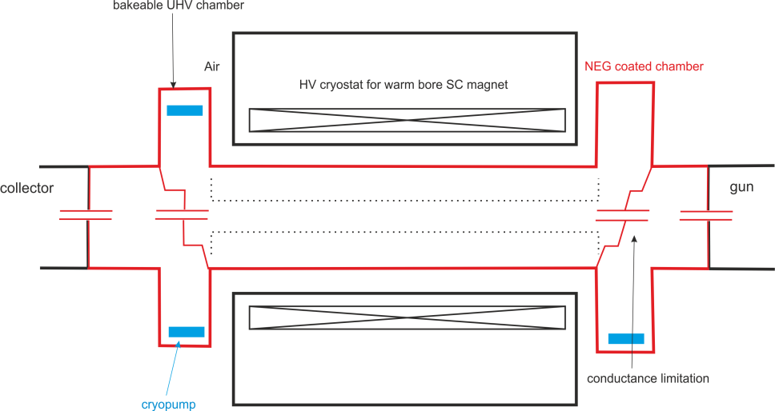
The important things we have learned
3. Vacuum requirements. Level 1.
Basic concept. The final choice of NEG-dominated and Cryo-dominated pumping
To be chosen based on tests with the electron beam regarding RF and potential
losses to the drift tubes.

Slide 9
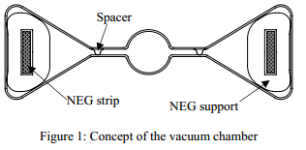
The important things we have learned
3. Vacuum requirements
Level 2. Specific use of technologies.
Thermally floating NEG covered surfaces found questionable in their ability
to assist pumping in the trapping region. Electrically heated strips can be made
rather compact

Slide 10
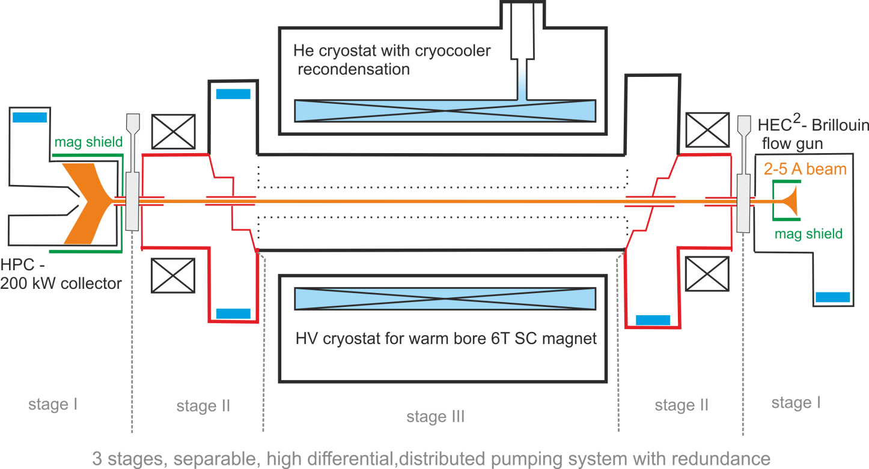
The important things we have learned
3. Vacuum requirements
Level 2. Specific use of technologies.
NEGs are still good option for differential pumping chambers.

Slide 11

The important things we have learned
3. Vacuum requirements
Level 2. Specific use of technologies.
NEG coating of the collector absorbing surface regarding ESD to be verified
regarding the coating stability under massive electron bombardment and
prolonged elevated temperatures.

Slide 12
A bit collaboration options
The HIE-ISOLDE design study group leader Richard Catherall will brief you
into the available collaboration options in the framework of HIE-ISOLDE project.

