Slide 1

Can the development from Dubna be applied for an effective high energy high current charge breeder ?
Evgeny E. Donets
Laboratory of High Energy Physics,
Joint Institute for Nuclear Research,
Dubna, Russia
edonets@jinr.ru
for the JINR ESIS group
HIE-EBIS Workshop
CERN, October 16-17, 2012

Slide 2
B = 3.3 T Q⁻ = 10 nC, E_e=8 KeV; J_e=300 A/cm^2; (Krion-2)
B = 6.0 T Q⁻ = 50 nC E_e=25 KeV, J_e=2000 A/cm^2
(expected Krion-6T)
= 3.0 10¹¹ e.ch.
B = 9.0 T Q⁻ = 150 nC E_e=70 KeV, J_e=12000 A/cm^2 ????
.

Slide 4
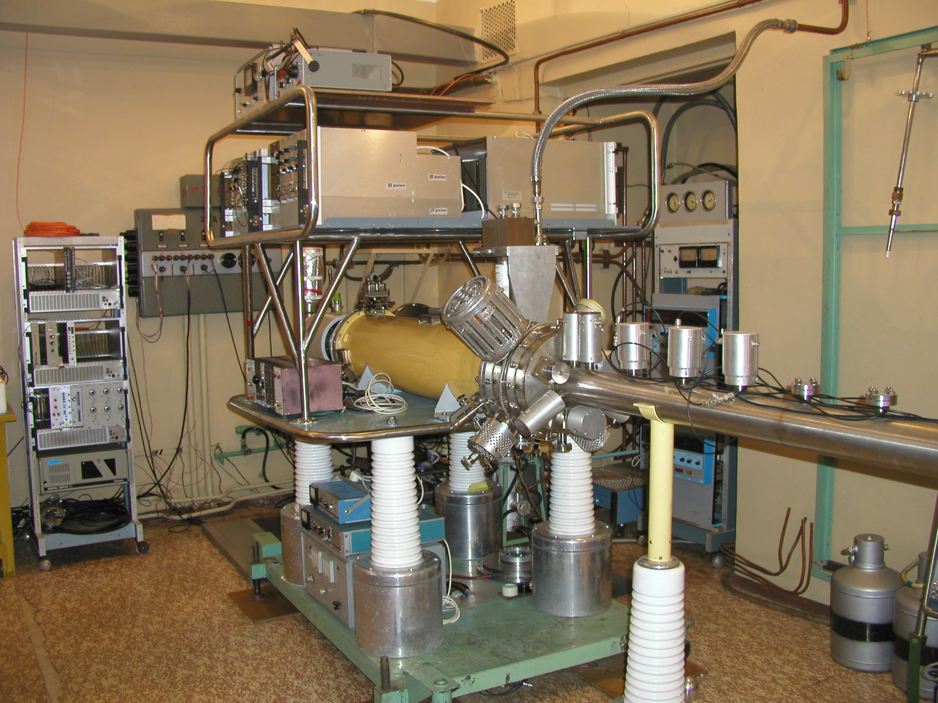

Slide 5
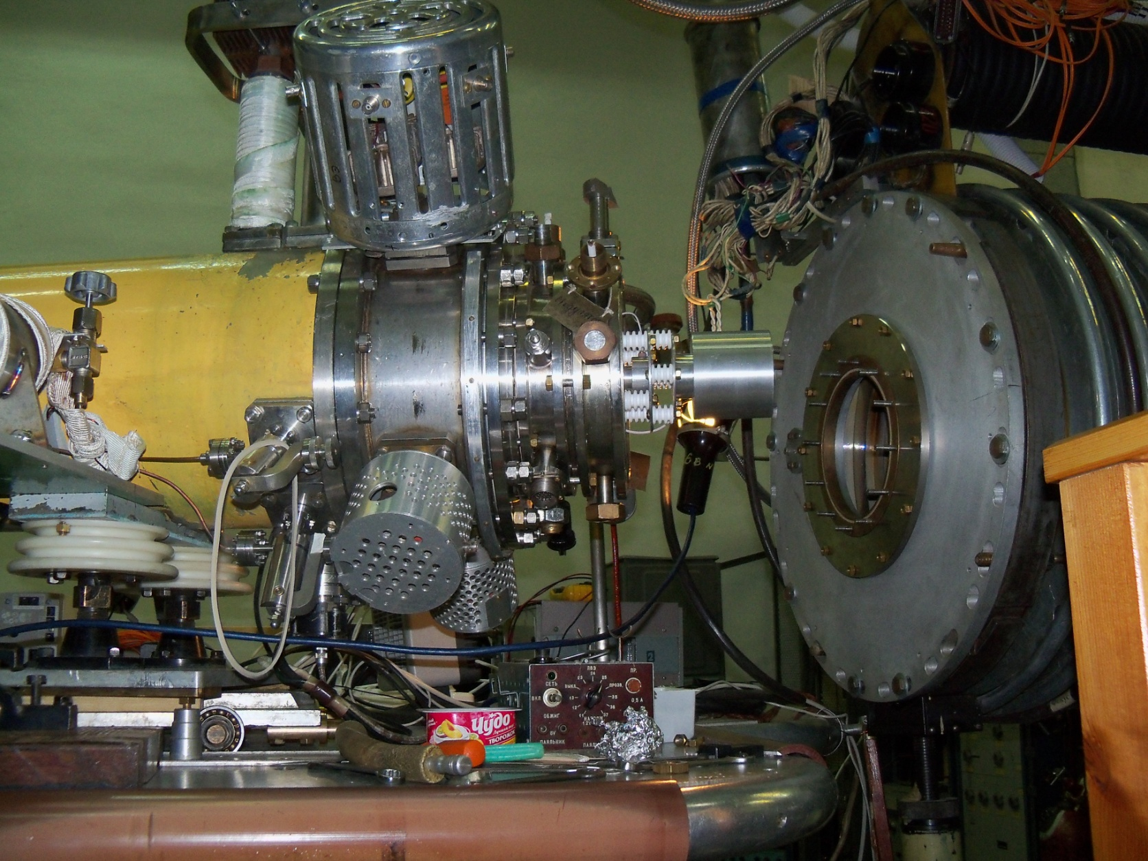
Krion-2 installation on HV terminal of LU-20 (Nuclotron run 2010

Slide 6
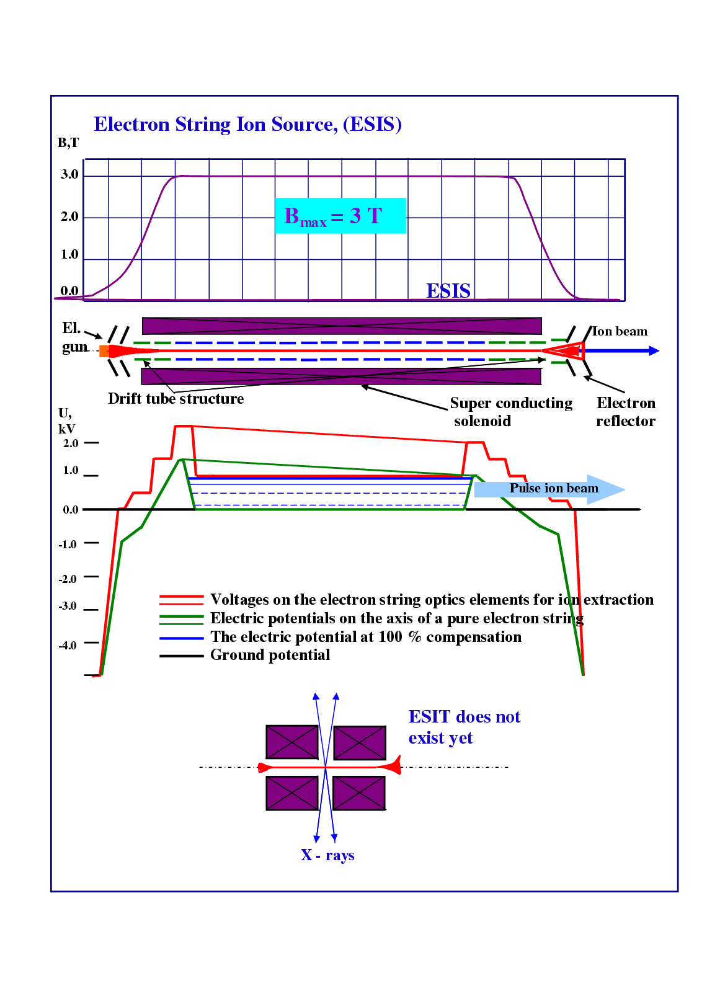
EBIS in the electron reflex mode of operation

Slide 7
Experimental conditions in ionization region (110 cm length): Drift tube temperature 4.2 K , Vacuum P < 10⁻¹² torr, B_max= 3.3 T; IrCr cathode 1-2 mm diameter; e-gun Pierce type, I_emiss.~8-12 mA.
e-string: J= 100 - 270 [A/cm²], ( 5x10¹¹ e/cm³ ) . Number of reflections 100 - 300.
Q_e_total=10^11 e, Consumption power P=50 W!
(Q_e_total=10^11 e in EBIS: P=10 kW )
1 mm
0.2 mm
Total length of the drift tube structure 1.2 m
3 mm

Slide 8
3 temperature terminals : room (anodes), 78 K 3+3 drift tube sections
( injection of neutrals: gases, Ferrocene, Au (evaporation from tungsten wire)),
Ionization region 110 cm , 26 separated druft tubes – 4.2 K.
Cryopumping only ! Works excellent. Turbopumps are not used during operation
(60 days or more). 5-6 days of anodes (mainly) outgassing by e-beam/string after beginning is enough .
1 mm
0.2 mm
Total length of the drift tube structure 1.2 m
3 mm

Slide 9
1) NO any “MEMORY” effect was observed in 4.2 K drift tube sections!
2) Xe remnants were observed: localization 78 K drift tubes in injection region. Xe and more heavy gases (Rn) are partially frosen at 78 K,
and then could decopule drift tube wall under bombardment by other neutrals/ions of new working element.
1 mm
0.2 mm
Total length of the drift tube structure 1.2 m
3 mm

Slide 10
WHY REFLEX MODE?
TO REDUCE CONSUMPTION POWER,
SAVING ALL OTHER
EBIS ADVANTAGES

Slide 11
Q⁻(e-ch./m) EBIS ESIS
10¹¹ 10 KW 50 W (Krion-2)
10¹² 200 KW 200 W (expected
Krion-6T)
10¹³ 5000 KW 2 KW (expected
Krion –Tubular)

Slide 12
EBIS

Slide 13
Electron string is formed in nonlinear process via strong instability of trapped electrons and exists as a dynamic equilibrium of injecting and loosing electrons.
Nonlinear development and partial saturation
(self-suppression) of various intabilities:
Two beam instability (with l=1,2... in linear perturbation theory);
Initial stage of Virtual cathode formation with loss of low energy tail.
Not squeezed state; no low energy electrons.
work is in progress

Slide 14
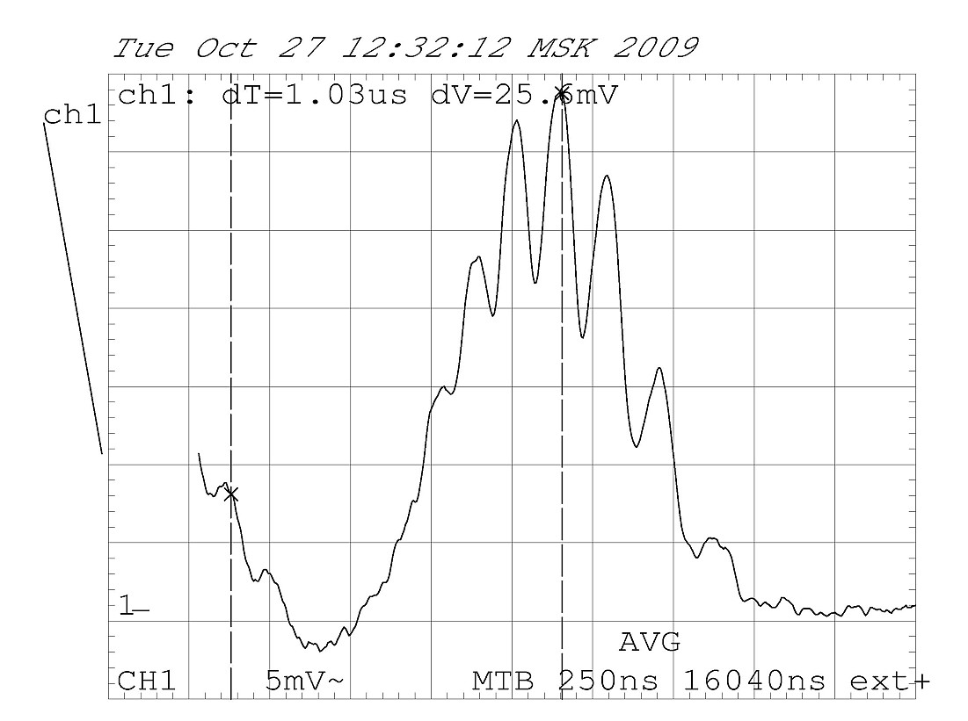
⁸⁴Kr18+

Slide 15
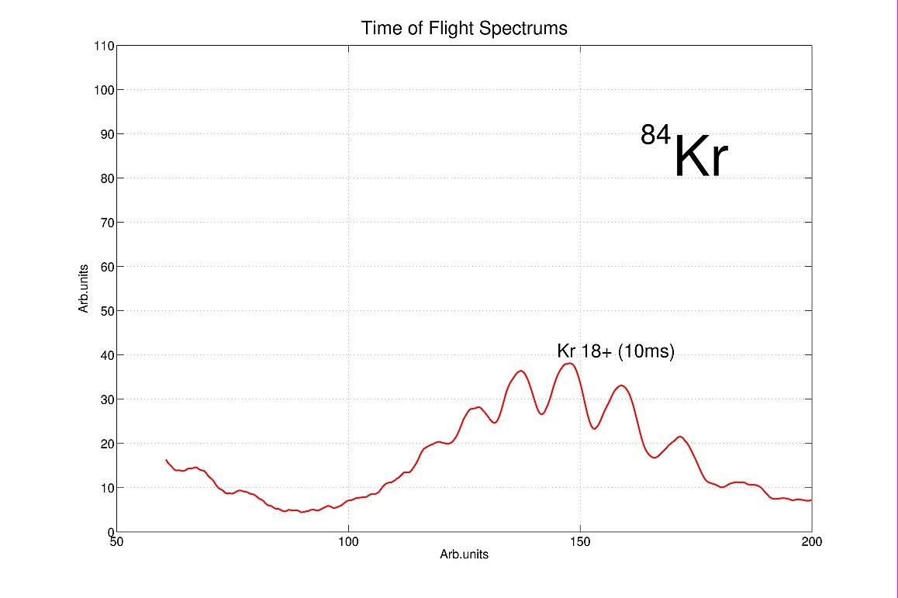

Slide 16
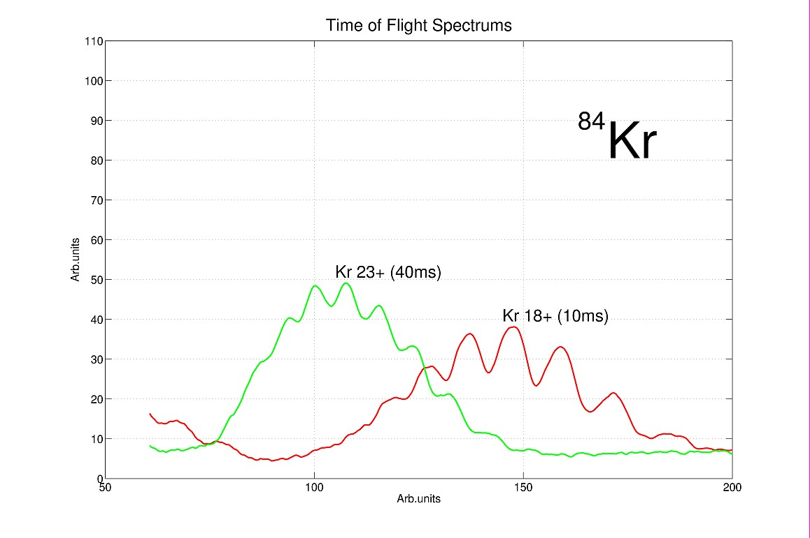

Slide 17
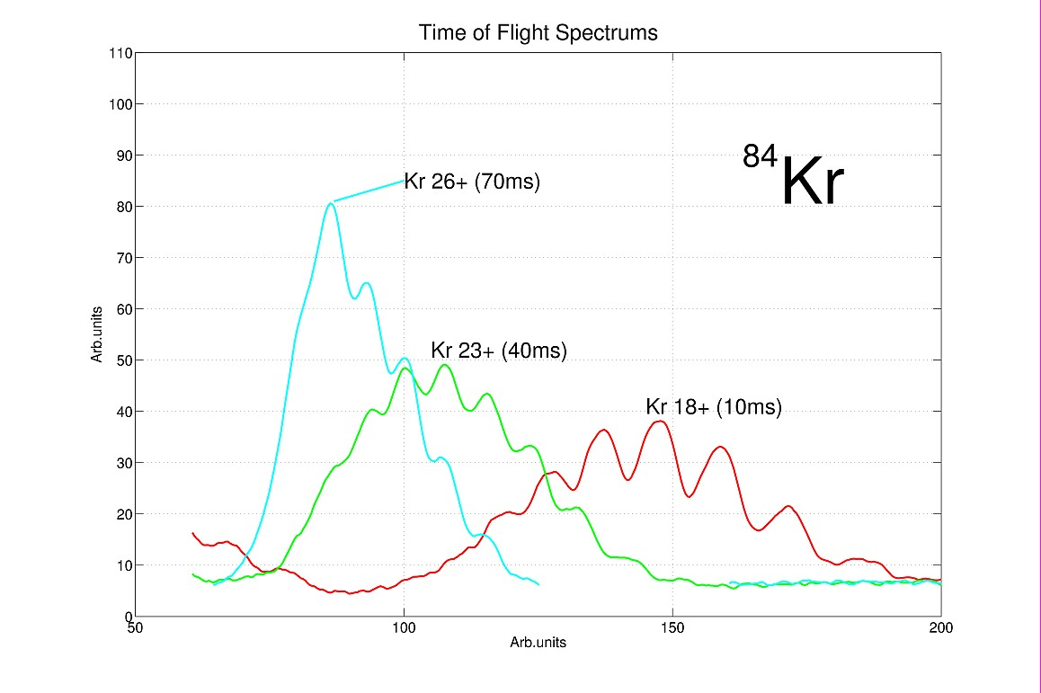

Slide 18
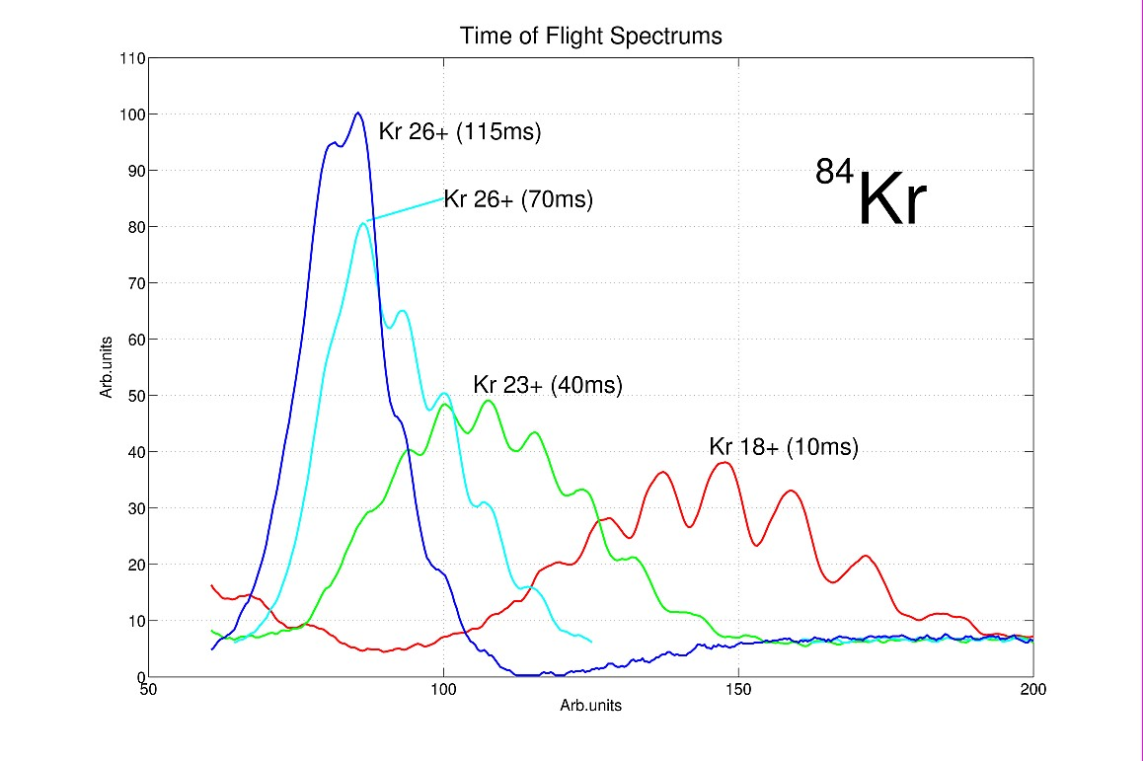

Slide 19
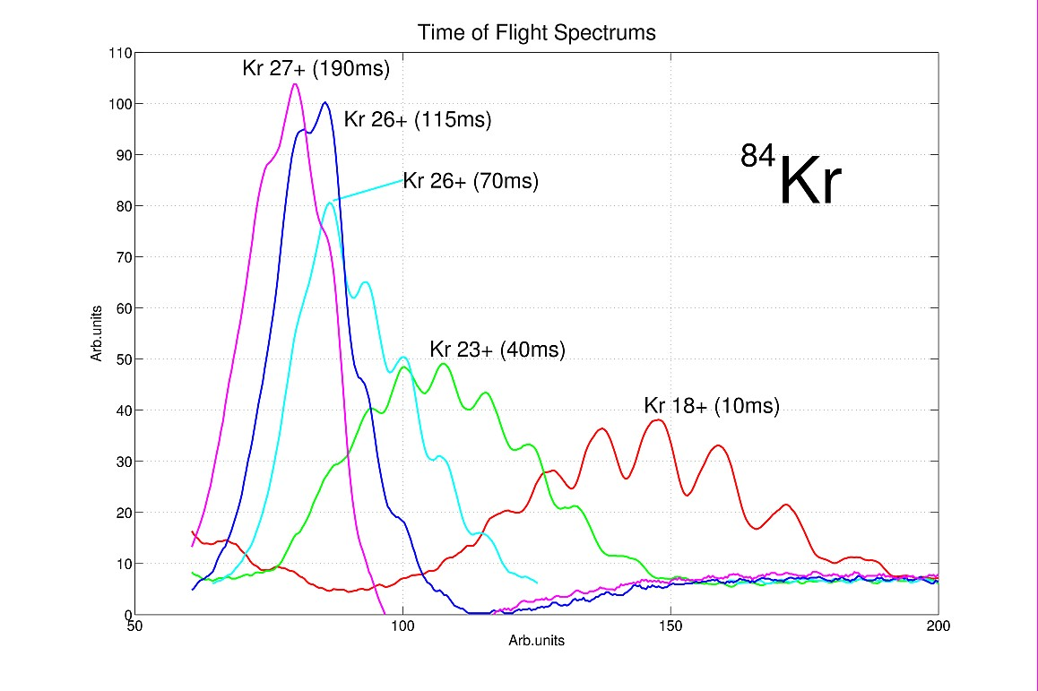

Slide 20
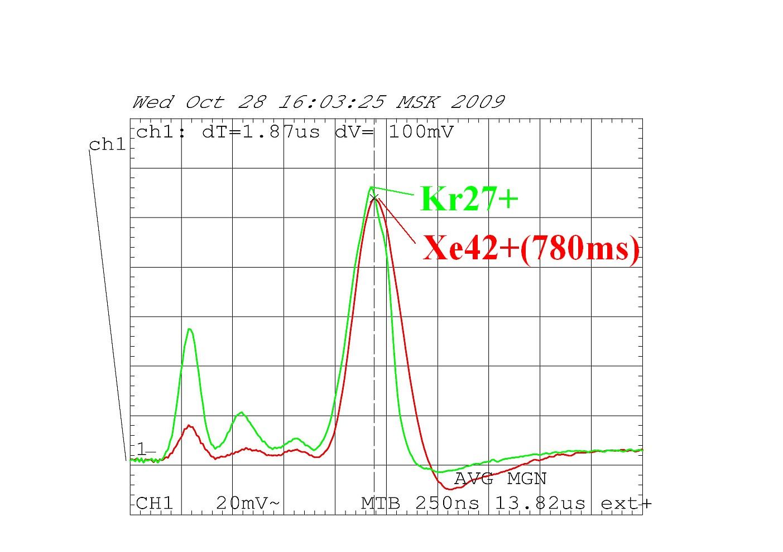
124Xe42+ procuded with Krion-2 ESIS
E=4.5KeV(E_{inj})+1.1KeV(V_{str})
(190 ms), 150 µA
, 120 µA
8 µs

Slide 21
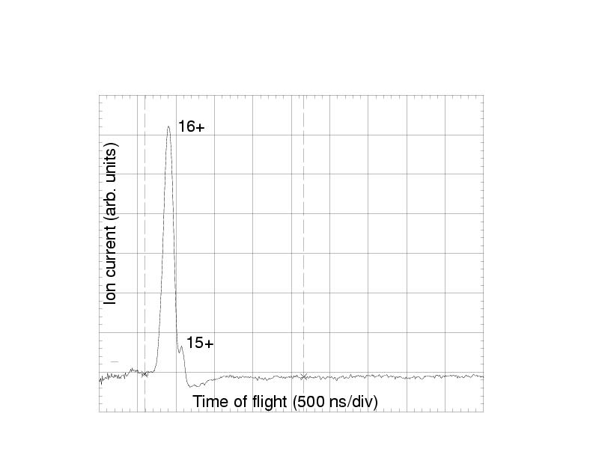
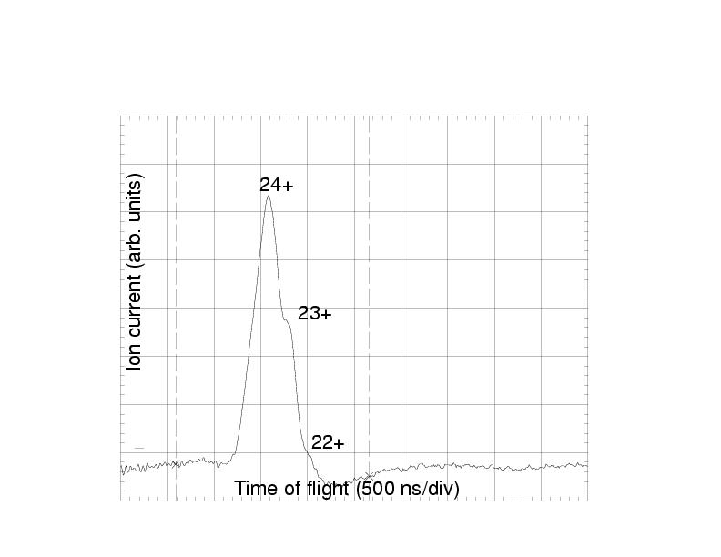
Charge state distribution of Ar ions after 500 ms confinement in an electron string space.
I_{Ar16+} = 200 μA in 8 μs
I(Fe24+) = 150 μA in 8 μs
Charge state distribution of Fe ions after 1100 ms confinement in space of an electron string.

Slide 22
Ion-ion cooling

Slide 23
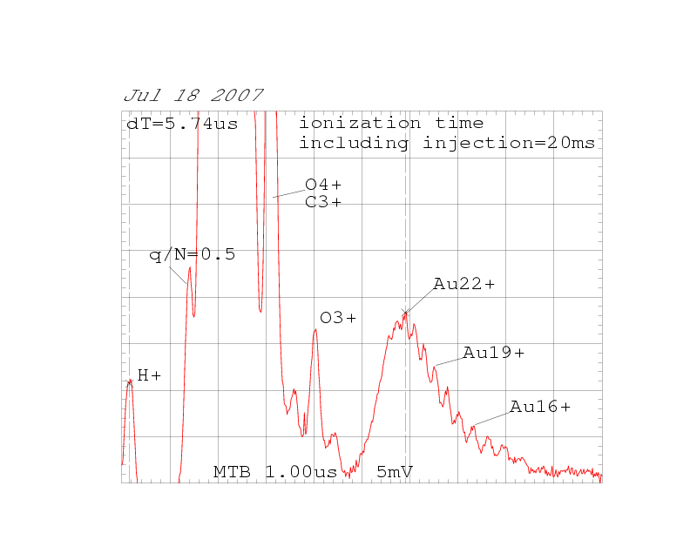
TOF spectra just after Au injection

Slide 24
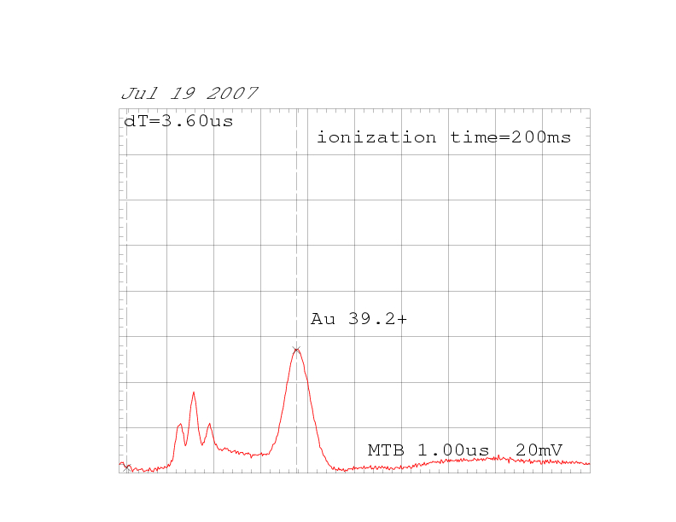

Slide 25
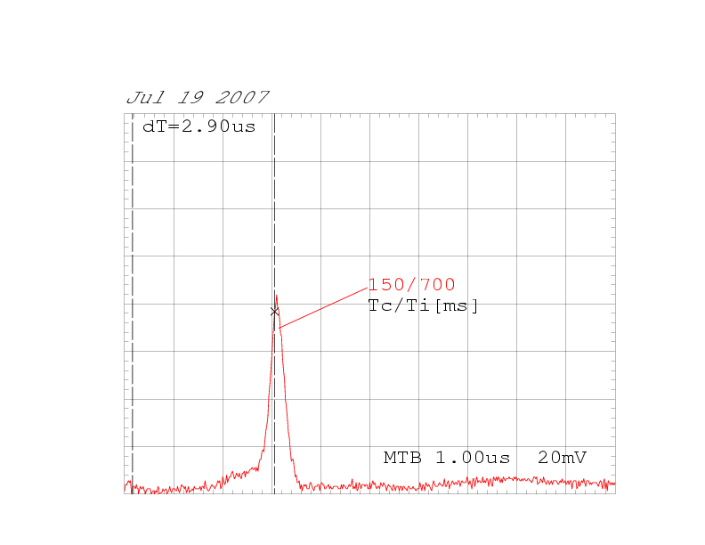
Au TOF spectra, mean q Au = 50.2+
Ionization time Ti = 700 ms

Slide 26
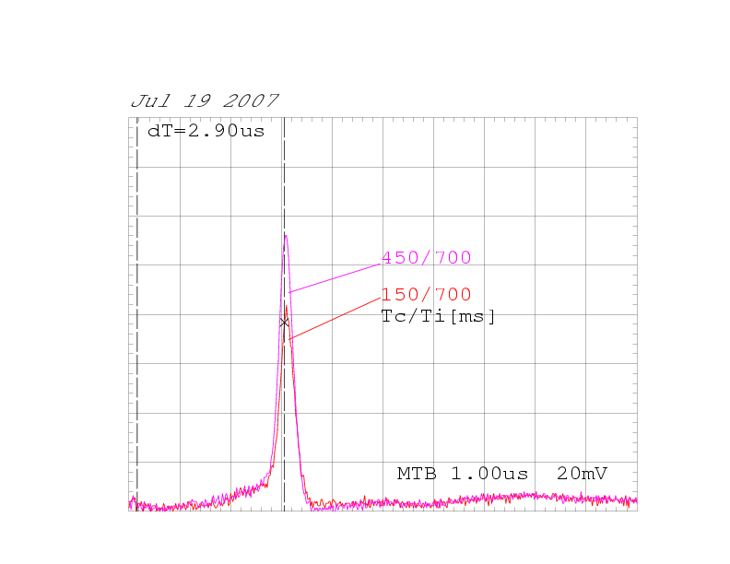
Au TOF spectra, mean q Au = 50.2+

Slide 27
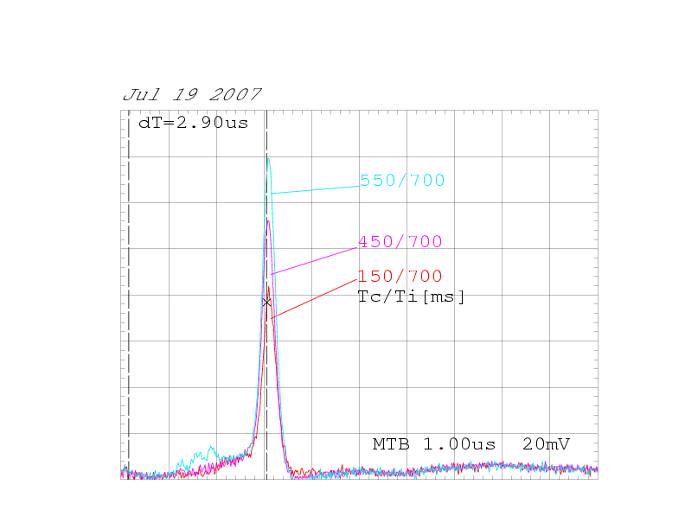
Au TOF spectra, mean q Au = 50.2+

Slide 28
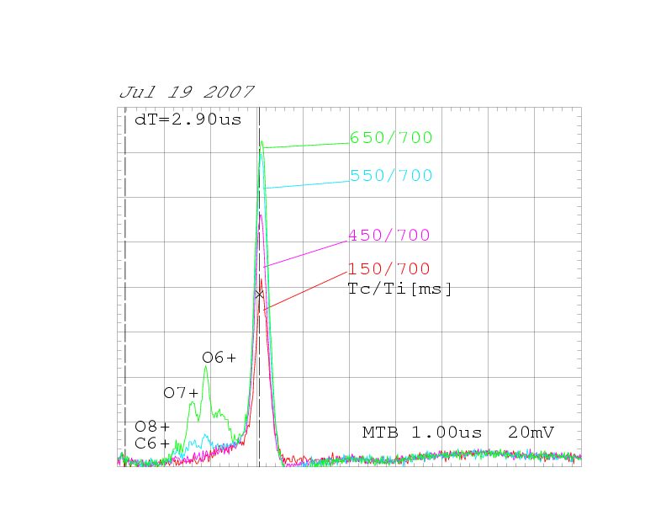
Au TOF spectra, mean q Au = 50.2+

Slide 29
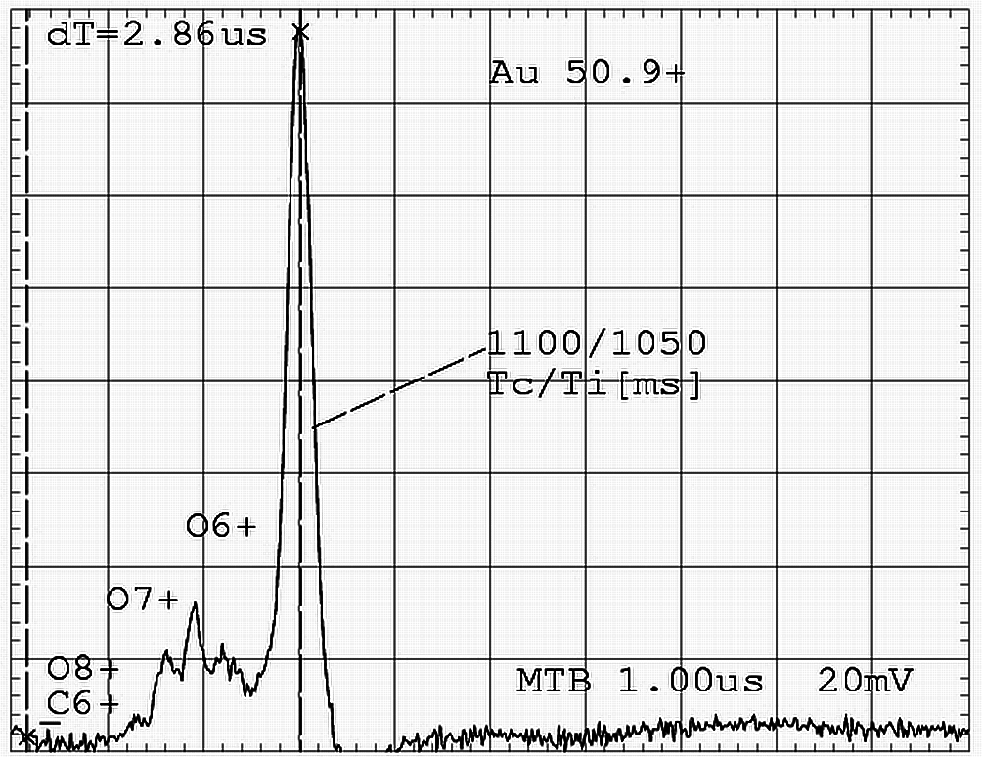
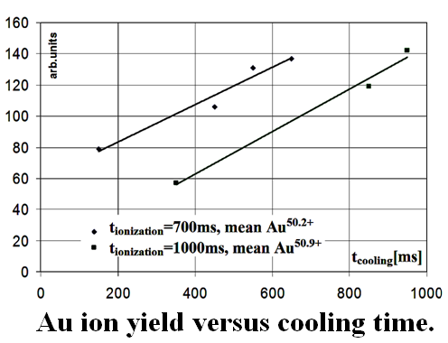
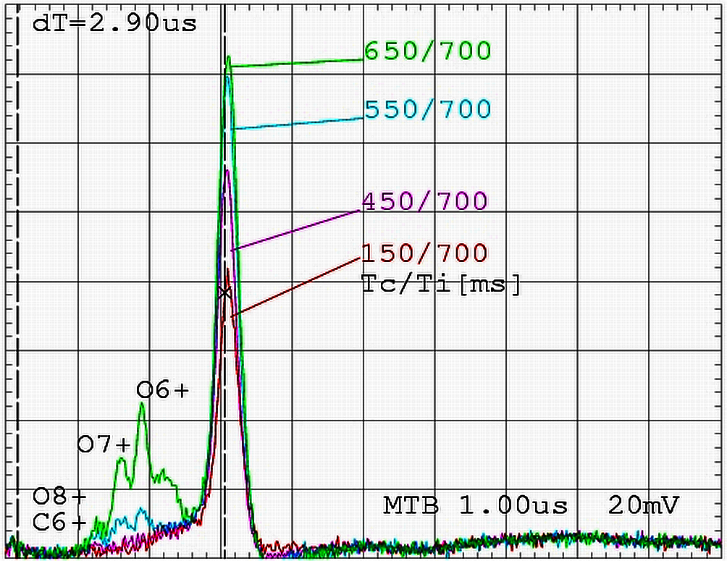
GAS PULSE INJECTION FOR PRODUCTION OF HIGHLY CHARGED IONS
Ion-ion cooling of highly charged ions in ESIS
The Ion-ion cooling with use of C and O coolant ions produced at gas pulse injection permits to increase the Au⁵¹⁺ion yield
by factor 2.
The intensity of Au⁵¹⁺ ions at ion-ion cooling was 10⁸ per pulse.
Ion charge state spectrum after 1,1 s of confinement.
Au ion yield & ion spectra
(q_{Au} = 50.2) for various injection time
of coolant (CO) gas. T_{i} =700 ms -ionization time,
red – cooling gas injection time T_{c} = 150 ms,
magenta - T_{c} = 450 ms,
blue - T_{c} = 550 ms,
green - T_{c} = 650 ms.

Slide 30
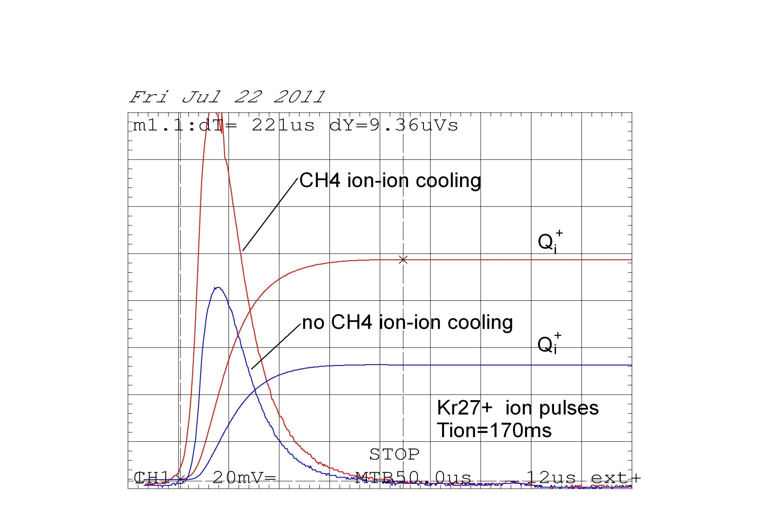
Total Kr27+ ion pulse without ion-ion cooling -(blue) and with use of (CH₄) ion-ion cooling - red.

Slide 31
Preliminary results on ion-ion cooling
Ion-ion cooling effectively works: it allows to reduce ion losses considerably, approaching to the natural limit of trap capacity.
Further plans.
Towards Au69+ intense beams
(with new 6T Krion-6T source):
cooling by the ions (Ar8+ ?) to avoid charge exchange with neutrals of coolant gas,
produced at separate drift tube space of ESIS.

Slide 32
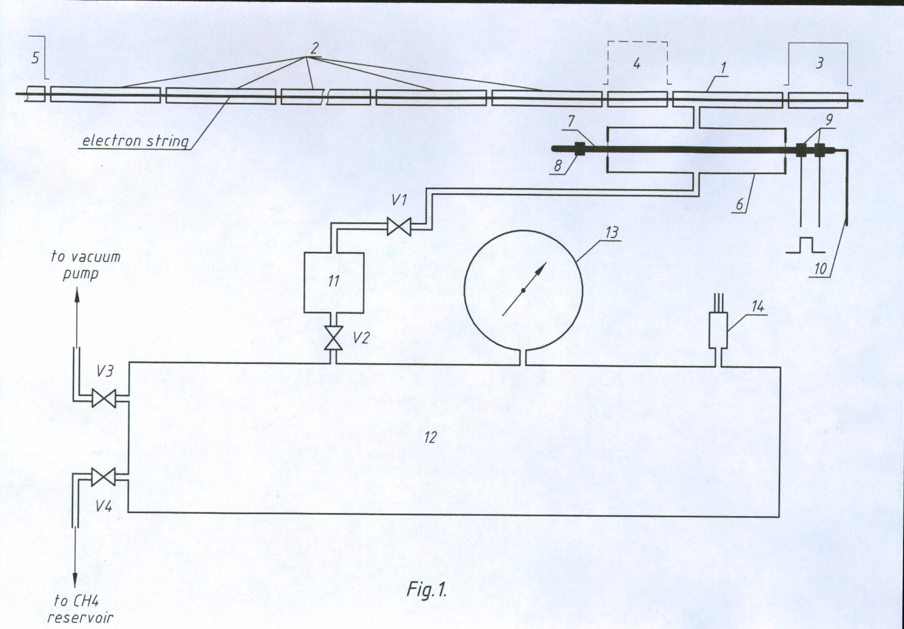
Experimental set-up for pulse injection of methane into Krion-2 ESIS (schematic drawing).
1) Gas injection section (78 K)
2) Drift tube sections at 4.2 K
6) Methane freezing-evaporation cell.
7) The cell rod, covered with aluminized Mylar or graphite.
10) Copper wire, connected to 4.2 K terminal.
11), 12), 13), 14) Elements of the system for isolation of 10¹⁴ molecules of methane.
3.2 cm³
¹¹CH₄
P1 = 338 Tor
P2 = 0.54 Tor
P3= 8.7·10⁻⁴ Tor
i.e. app. 10¹⁴ in 3.2 cm³
2000 cm³
¹²CH₄

Slide 33
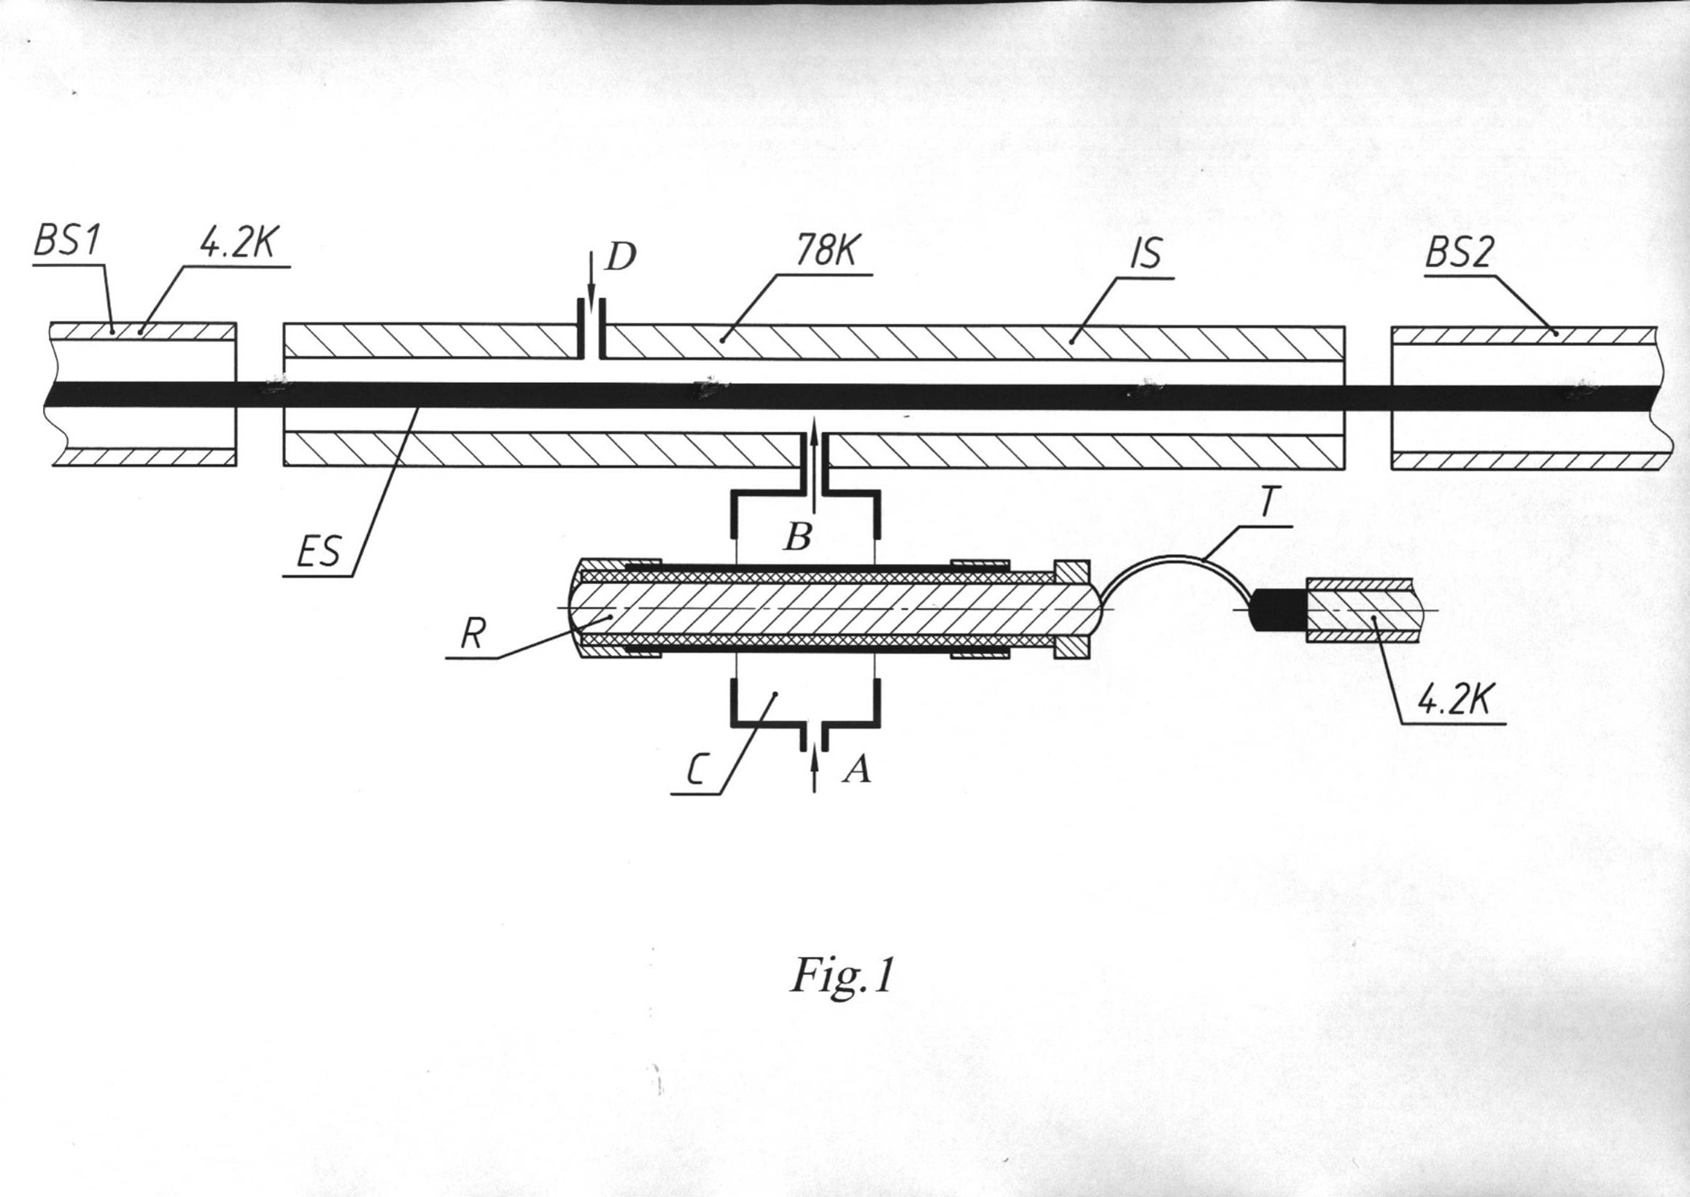
Cryogenic cell for pulse injection of gases
(schematic view)

Slide 34
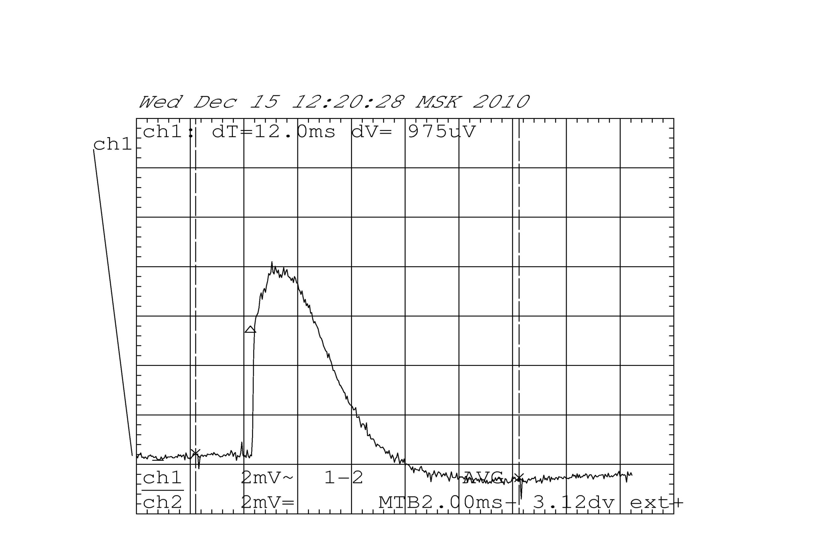
Pulse injection of Argon into the electron string.
3 ms
E.D. Donets 12.09.2011

Slide 36
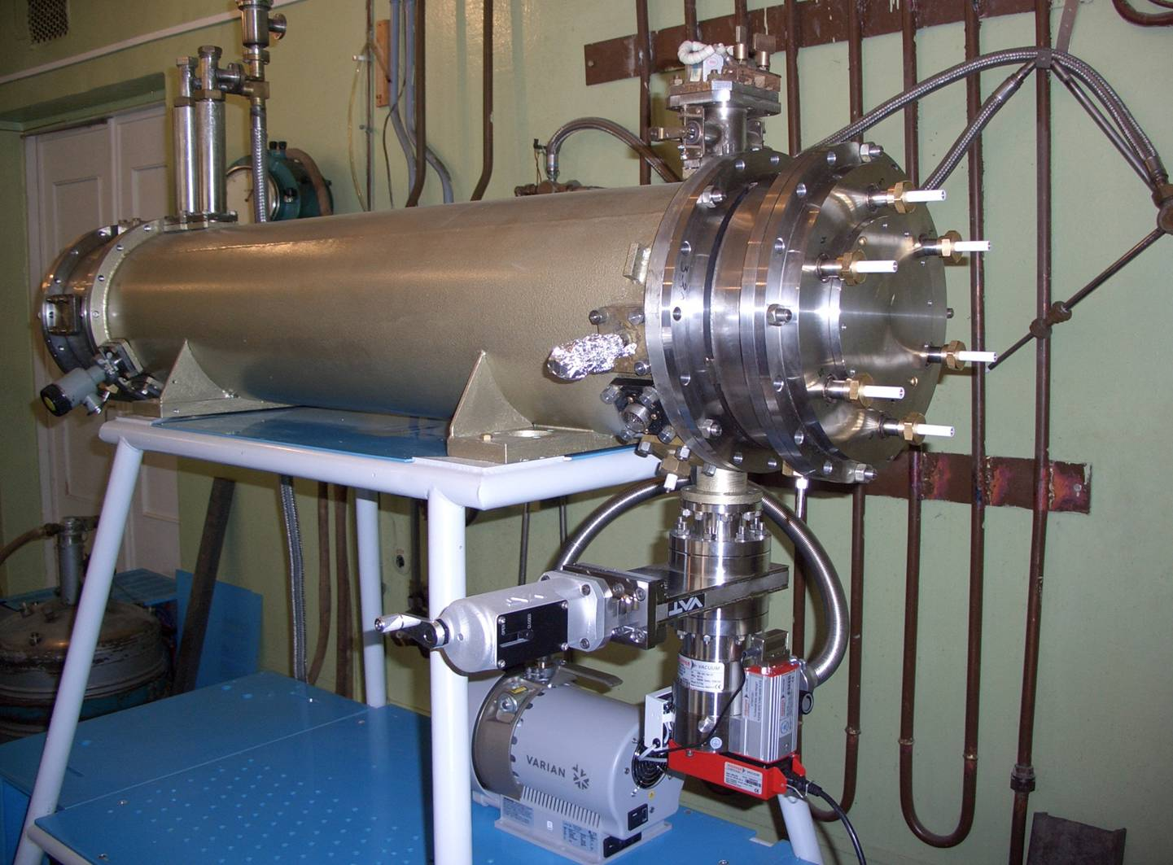

Slide 37
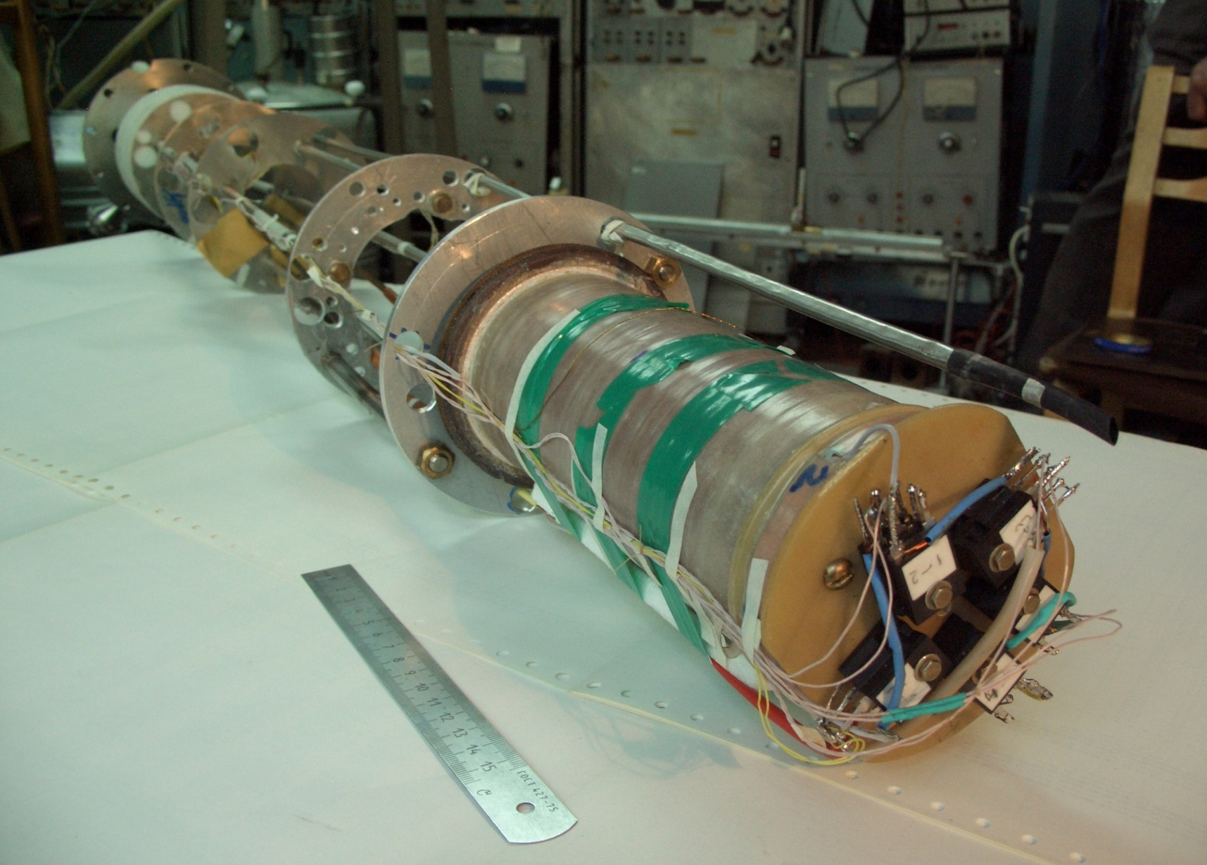
Superconducting test coil (L=19 cm, 32 layers of SC wire) : preparation for testing in a liquid helium.

Slide 38
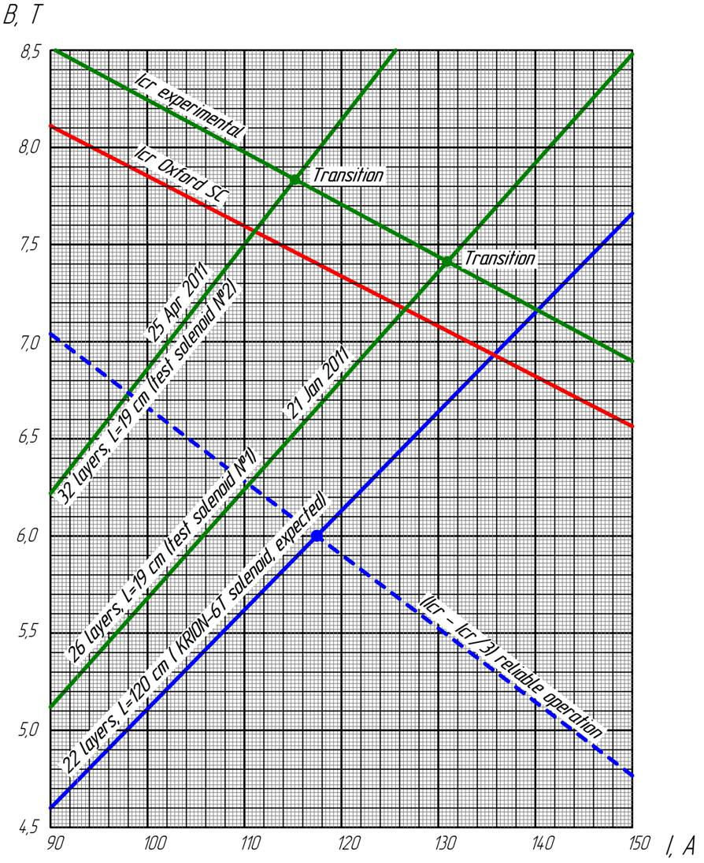
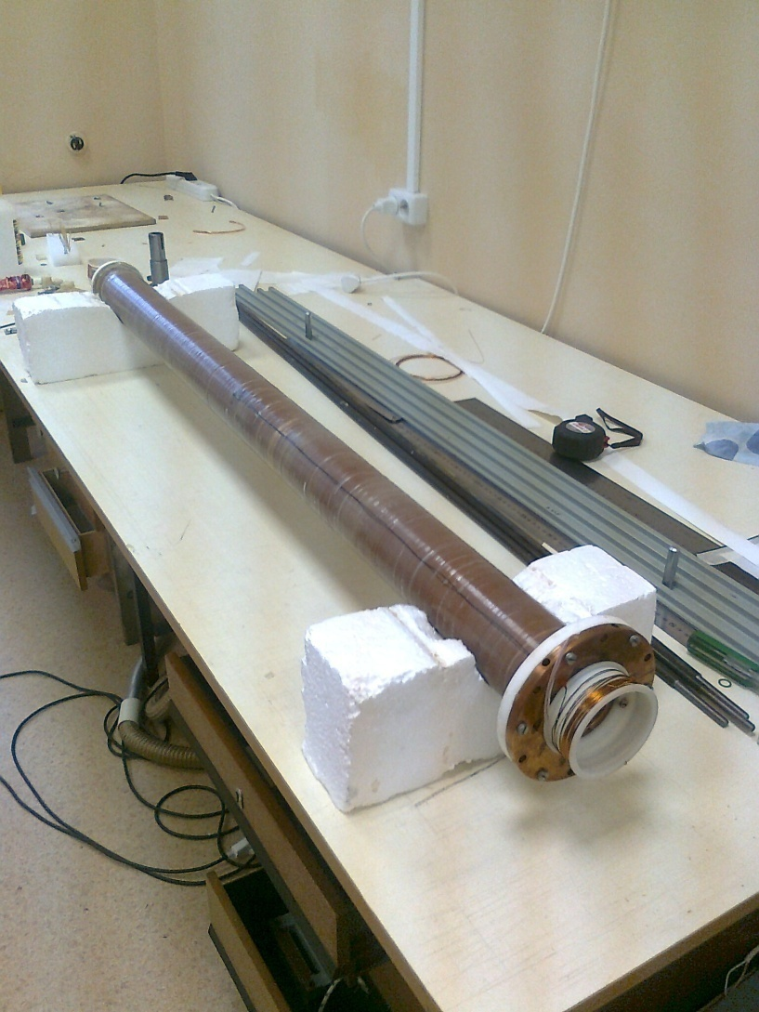
SC solenoid: 1.2 m length, 22 layers; technology was elaborated and manufacturing has been done in ESIS group (VBLHEP,JINR)

Slide 39
Magnetic field versus electron current: expected and experimental data. Latest reached point: 105 A – 5.44 T (04.10.2012)

Slide 40
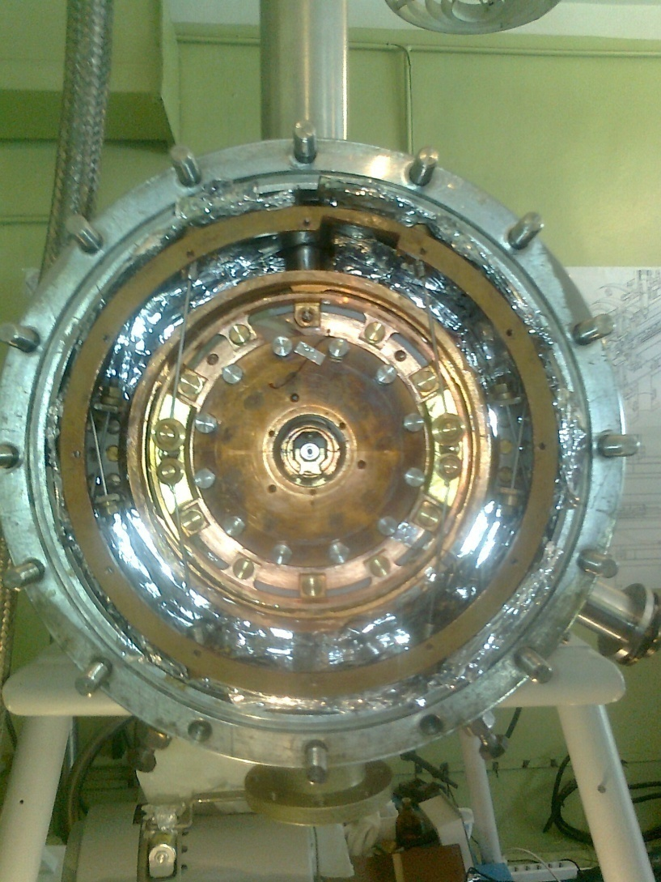
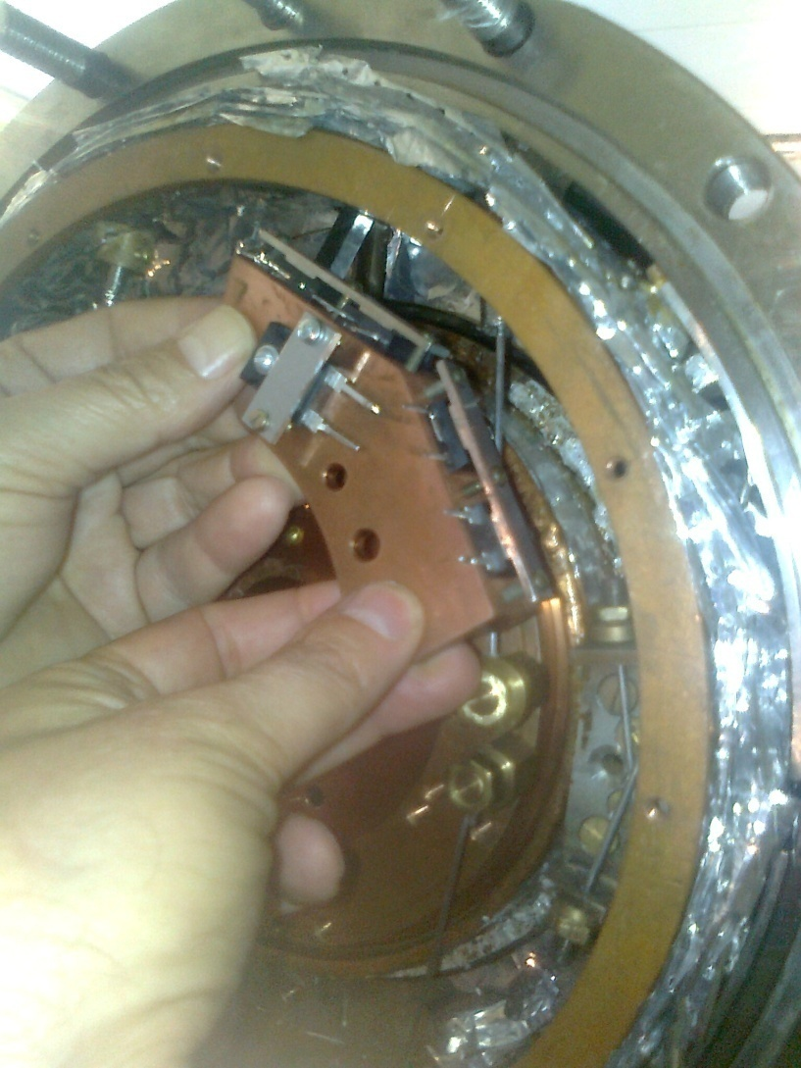
SC solenoid inside of Krion-6T ESIS (left); test assembling of the quench protection system (right).

Slide 41
Nearest future plans:
1) First e-string tests are planned in October 2012.
2) Then, basic studies on e-string and heavy ion production in new range of relevant parameters (electron energy up to 25 KeV, confining magnetic field up to 6 T, et cetera)…
3) … towards Au65+ ÷Au69+ beams production for their possible acceleration on existing LU-20/Nuclotron facility (LU-20 accepts ions with charge state to mass ratio > 1/3) in 2013?

Slide 42
Thank you for your attention!

Slide 43
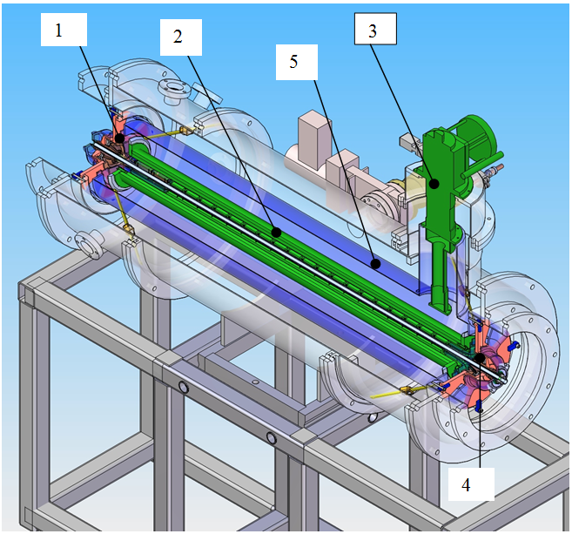
TUBULAR ELECTRON STRING ION SOURCE
1-electron gun, 2- superconducting solenoid, 3-cryo-cooler, 4- reflector electrode,
5- thermal shielding at temperature of 40 К.

Slide 44
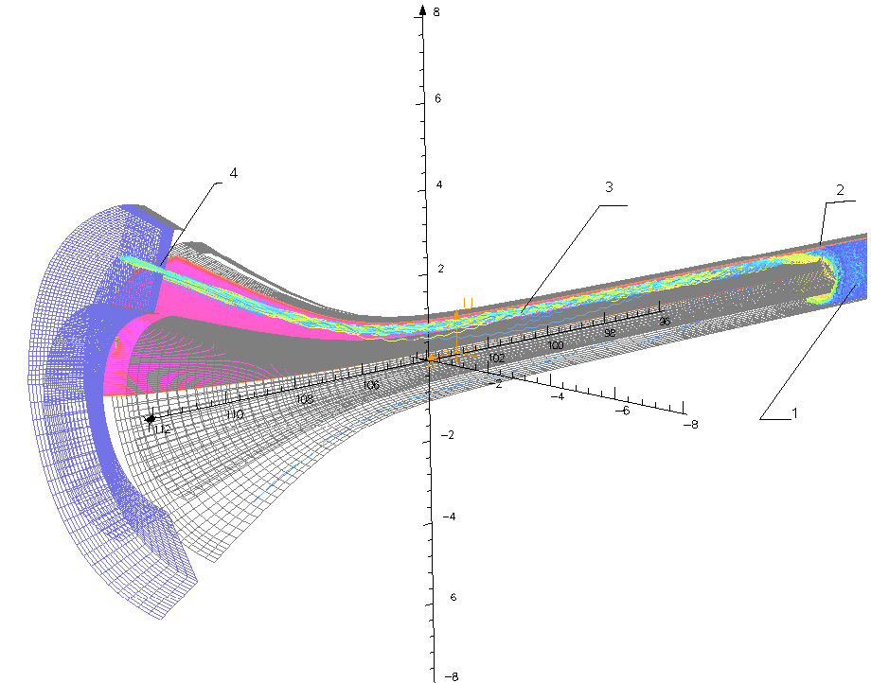
ION OPTICAL SYSTEM
• The method of the off–axis TESIS ion extraction was proposed to get TESIS beam emittance comparable with ESIS one.
OPERA 3D simulation of the ion optic system and the ion off-axis extraction channel.
•The extracted ion beam has an ellipsoidal shape (Δr_{i,} Δy_{i} are radial and azimuthal directions)
Δr_{i}= 2 mm, Δy_{i}=8 mm.
•Normolized radial ε_{r-n} and azimuthal ε_{φ-n} emittances of the extracted ion beam:
ε_{r-n}≅ β_{i}∙Δr_{i}²/4ρ_{i}≅ 0,05π⋅mm⋅mrad,
ε_{φ-n}≅β_{i}∙Δr_{i}∙Δy_{i}/4ρ_{i}≅0,15π⋅mm⋅mrad.
•The radial and azimuthal emittances of the ion beam accelerated to energy of eU_{ac} =25∙Z keV
ε_{r}≅5 π⋅mm⋅mrad and ε_{φ}≅20 π⋅mm⋅mrad.

Slide 45
