Slide 1

HIE-ISOLDE linac upgrade
The REX and ISOLDE facilities
HIE-ISOLDE linac
HEBT and experimental stations
Beam characteristics
D. Voulot, BE/OP, CERN
On behalf of Matthew Alexander Fraser; Fredrik Wenander; Brennan Goddard and the HIE-ISOLDE project team

Slide 2
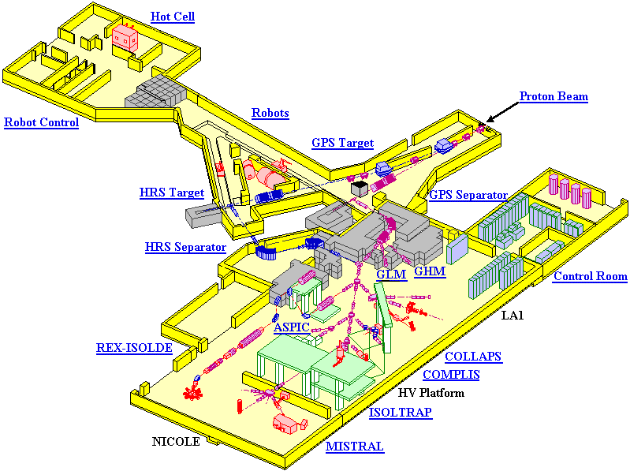
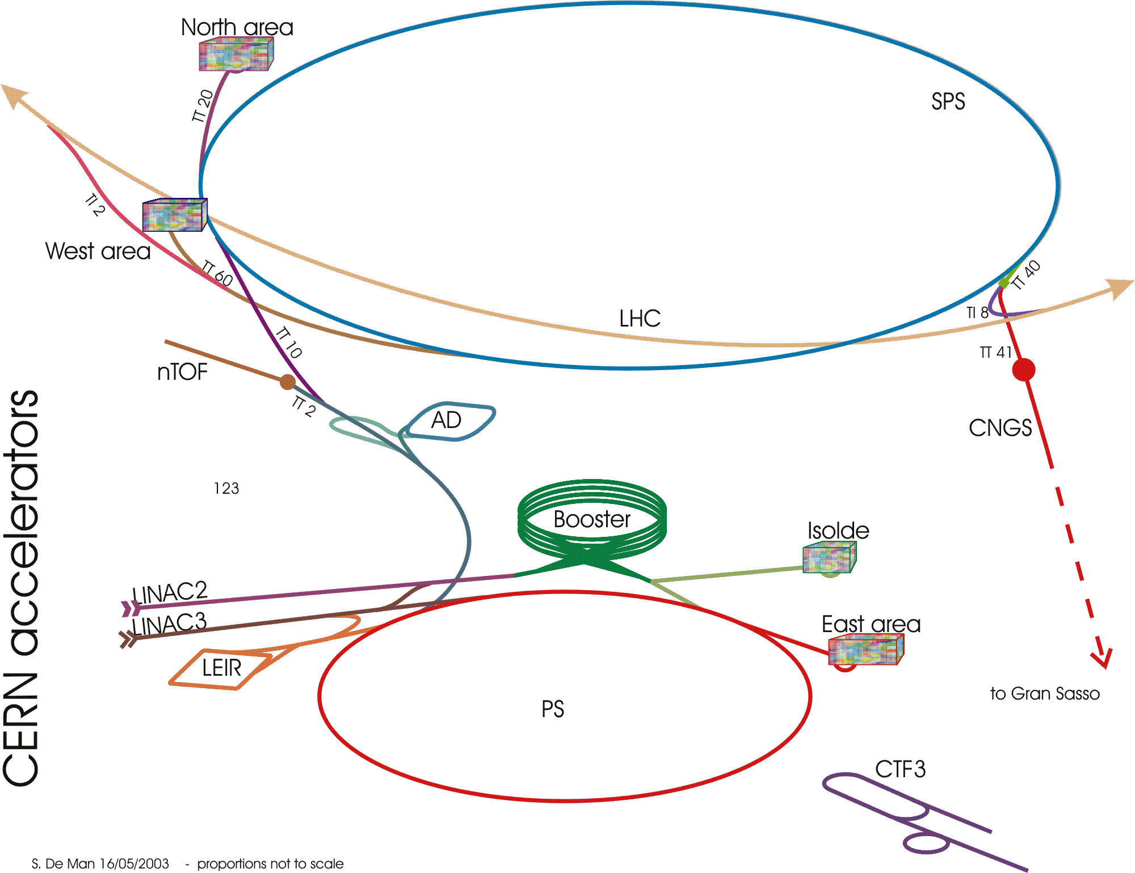
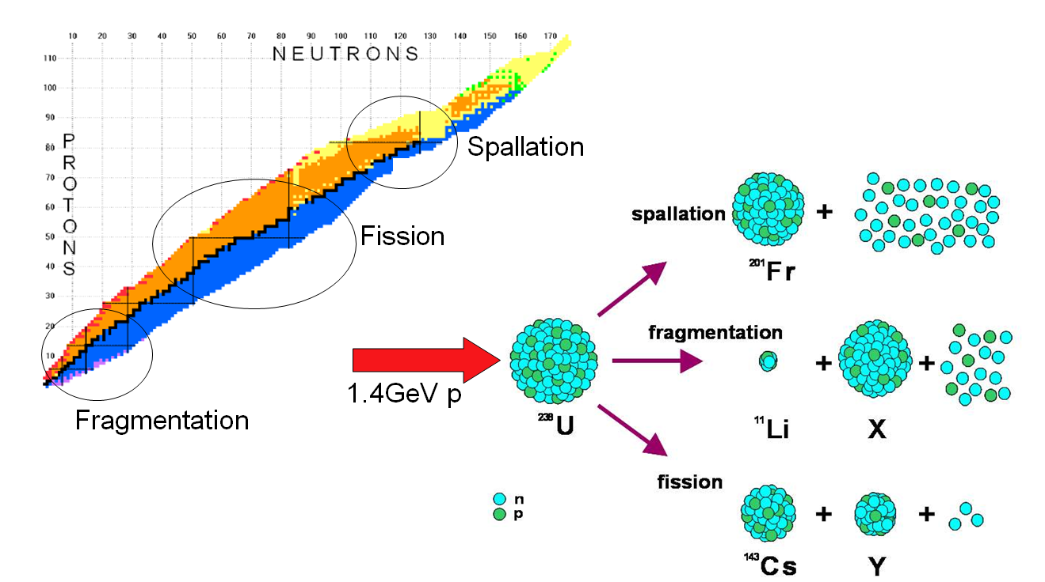
ISOLDE overview

Slide 3
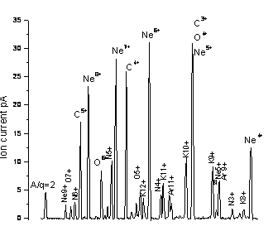
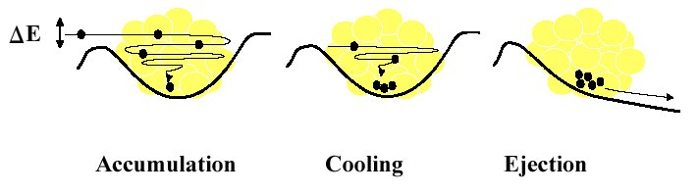
REX-Isolde overview
* charge breeding
* 1+ ions to n+
REXEBIS
Optional stripper
MASS SEPARATOR
9-GAP RESONATOR
7-GAP RESONATORS
IH
RFQ
Rebuncher
ISOLDE beam
60 keV
3.0 MeV/u
2.2 MeV/u
1.2 MeV/u
0.3 MeV/u
REXTRAP
Experiments
* longitudinal accumulation and bunching
* transverse phase space cooling
* 6 cavities
* 300 keV/u to 3 MeV/u

Slide 4
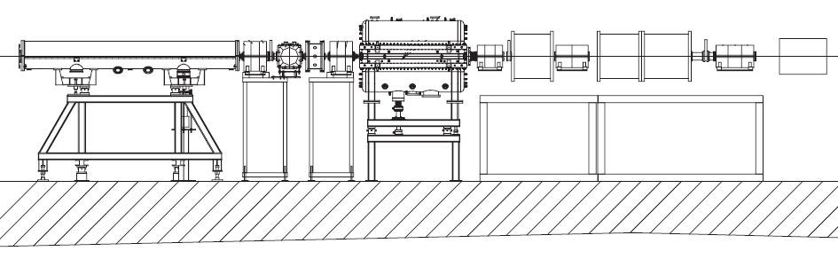
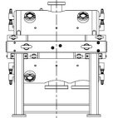
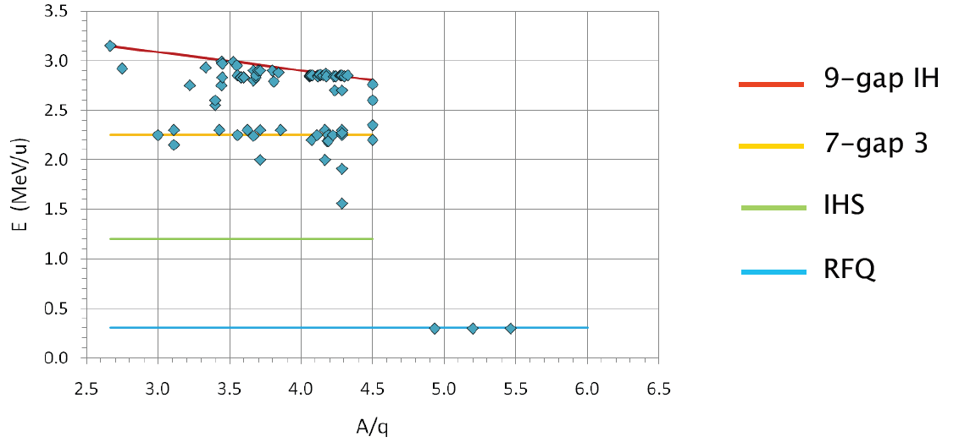
REX linac
IHS
7GP
9GP
5keV/u
RFQ
300keV/u
1.2MeV/u
2.2MeV/u
3MeV/u
3m
Linac:
Length 11 m
Freq. 101 MHz (202 MHz for the 9GP)
Duty cycle 1ms 100 Hz (10%)
Energy max. 3 MeV/u
A/q 2.0 - 4.5
Trans. 90% (lower for highly charged beams)

Slide 5
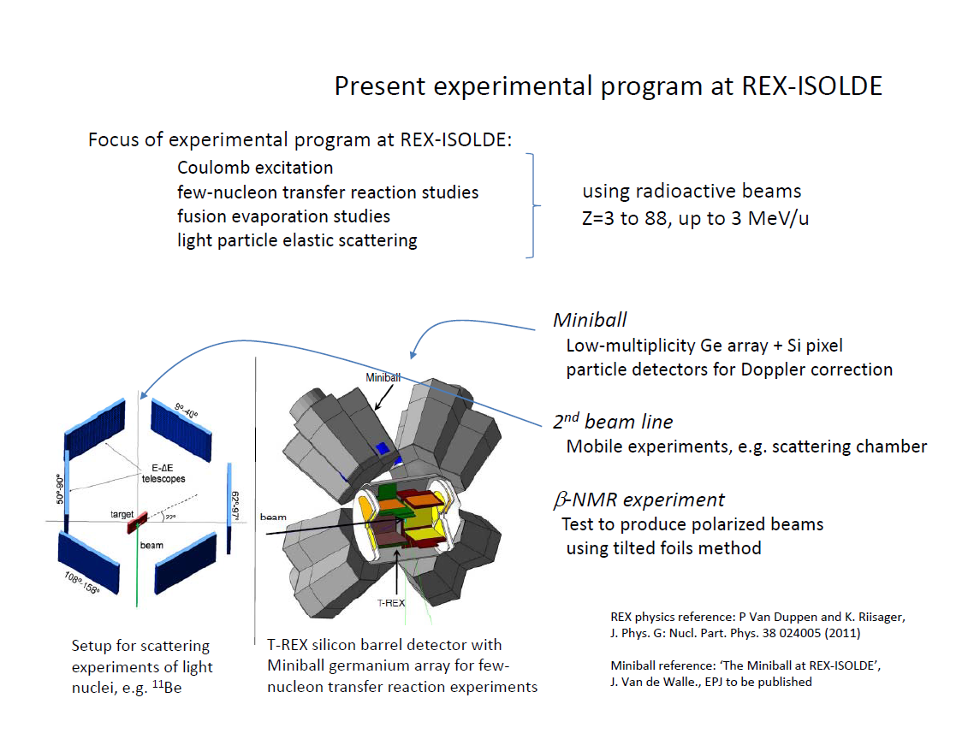

Slide 6
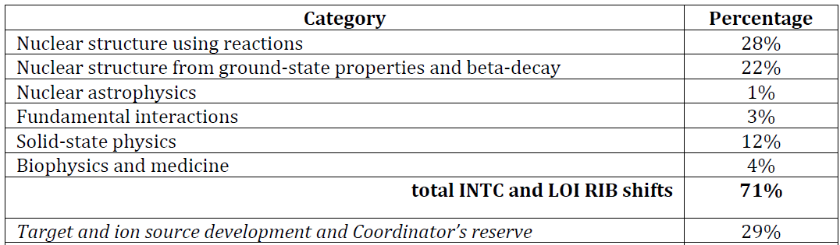
ISOLDE Statistics 2011
ISOLDE Shifts (8h):
  Scheduled: 471.5
  Delivered: 329.5 (+134 for machine development and test)
  REX-ISOLDE: 147 (45%)

Slide 7
HIE-ISOLDE
A general upgrade of ISOLDE: High Intensity and Energy
  High intensity: upgrade of target area, separators and charge breeder (design study)
  High energy: HIE-LINAC
    R&D activities for the linac (started in 2008)
    Approved CERN project 2010
    5.5 MeV/u (stage 1) 2015 / 10 MeV/u (stage 2) 2016-2018
    36.5 MCHF, 50% financed through external collaboration

Slide 8
Motivations
Superconducting linac => “array of small independent resonating cavities, equipped with their own small RF amplifier “
  -> No high power amplifier (< 10W of RF diss. In the cavity)
  -> High accelerating gradient (6 MV/m)
  -> Short + independent cavities = high flexibility
  -> CW operation

Slide 9
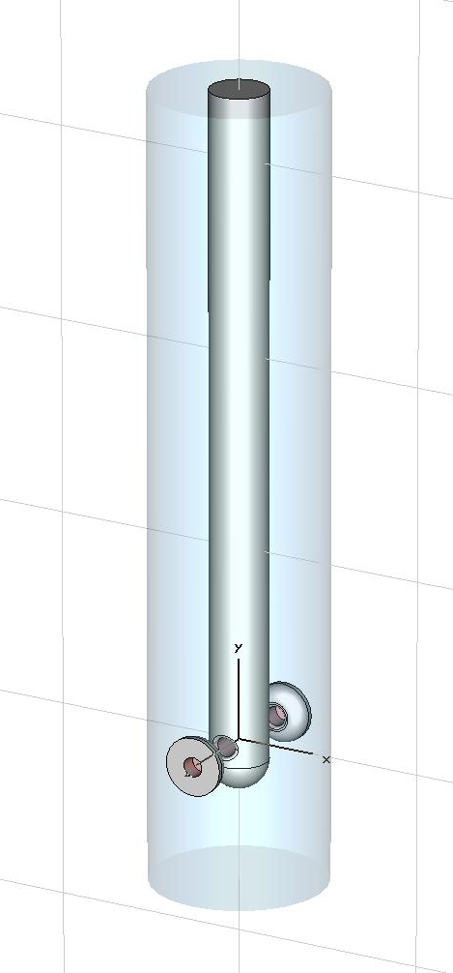
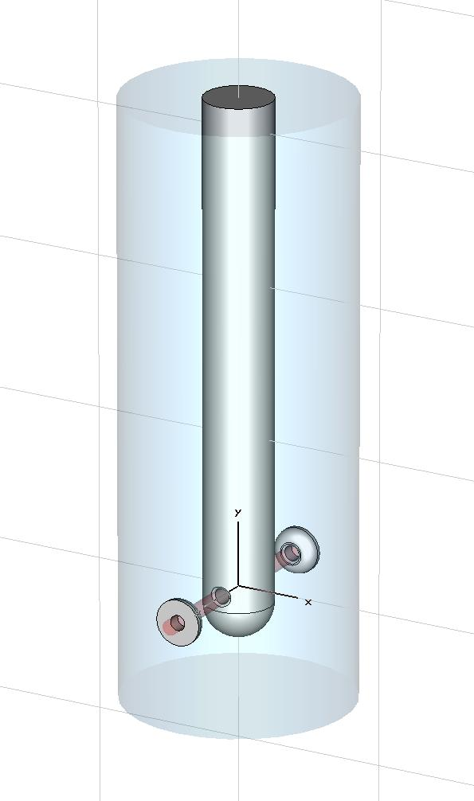
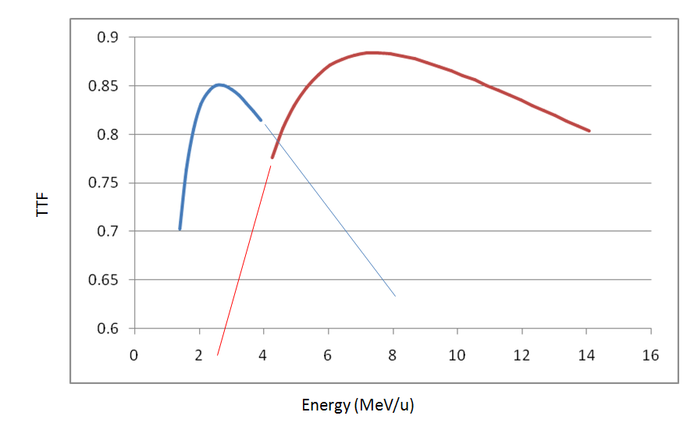
SC quarter-wave cavities
f (MHz) | 101.28 | 101.28
β 0 | 6.3% | 10.3%
Gradient Ea (MV/m) | 6 | 6
Inner Cond. Diam (mm) | 50 | 90
Outer Cond Diam (mm) | 195 | 300
Mechanical Length (mm) | 215 | 320
Gap length (mm) | 50 | 85
Beam Apert. Diam. (mm) | 20 | 20
Rsh/Q (Ohm) | 564 | 548
Q0 min for 6 MV/m at 7W | 3.2 10⁸ | 5 10⁸
TTF max | 0.85 | 0.9
No. of cavities | 12 | 20
Low β
Highβ

Slide 10
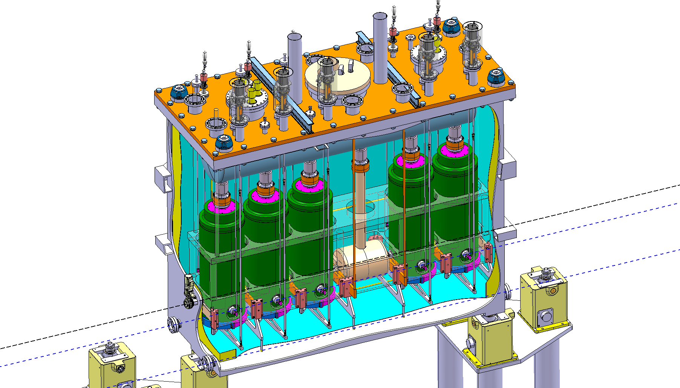
HIE High-beta Cryomodule
QWR
Vacuum vessel
Liq. He reservoir
Supporting frame
Beam
Focusing solenoid
Tuning plates

Slide 11
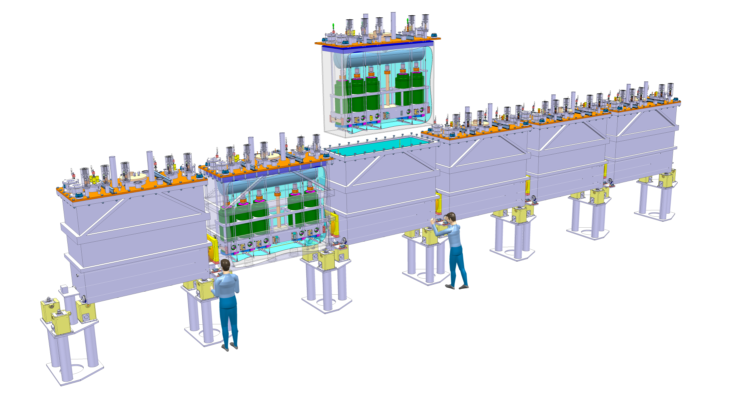
HIE linac (Stage 2b)
16 m
12 low-beta cavities
20 high-beta cavities
39.6 MV accelerating voltage

Slide 12
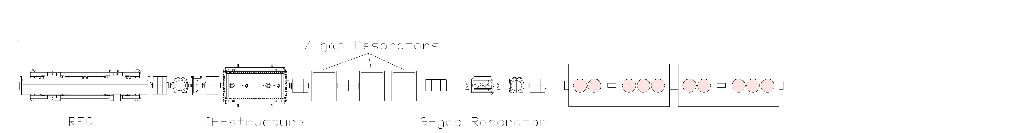
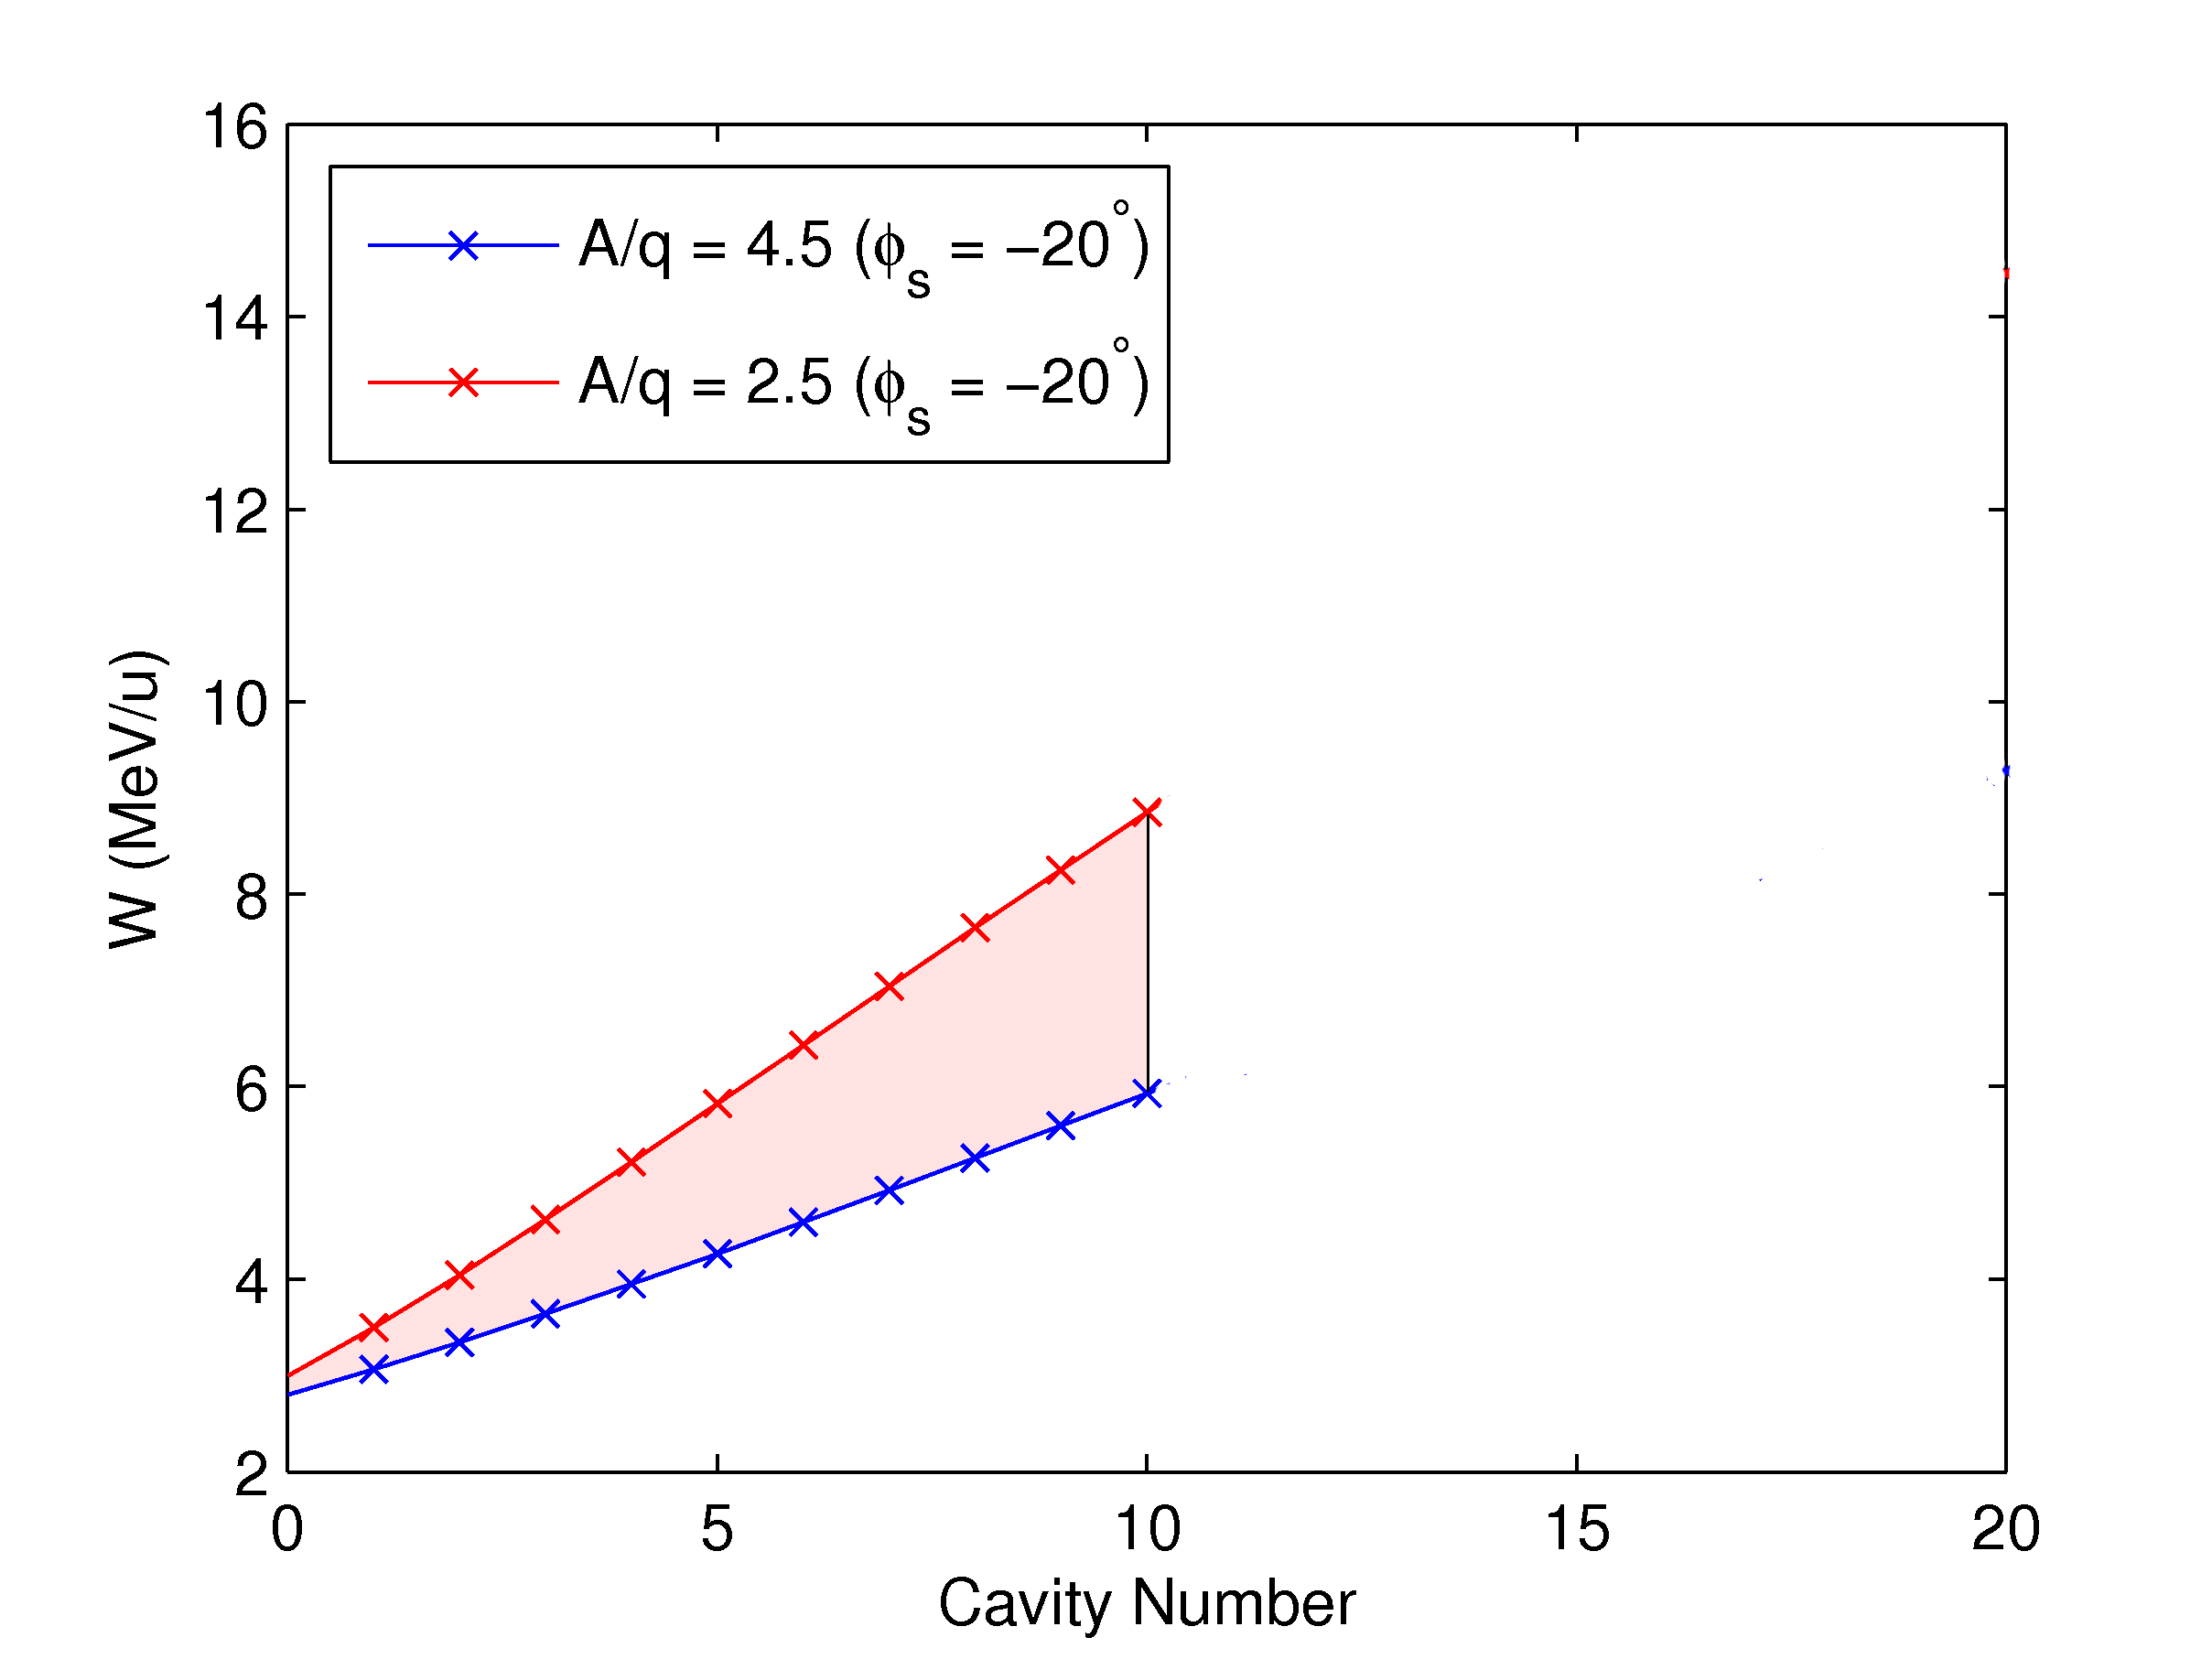
Energy RANGE: STAGE 1
0.3 MeV/u
1.2 MeV/u
2.25 MeV/u
2.8 - 3.0 MeV/u
A/q = 2.5
W = 8.8 MeV/u
βγ = 0.136
A/q = 2.5
W = 3.0 MeV/u
βγ = 0.080
A/q =4.5
W = 5.5 MeV/u
βγ = 0.109
A/q =4.5
W = 2.8 MeV/u
βγ = 0.0773

Slide 13
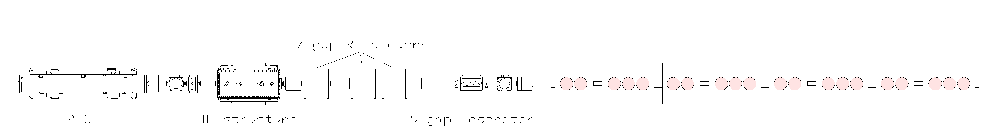
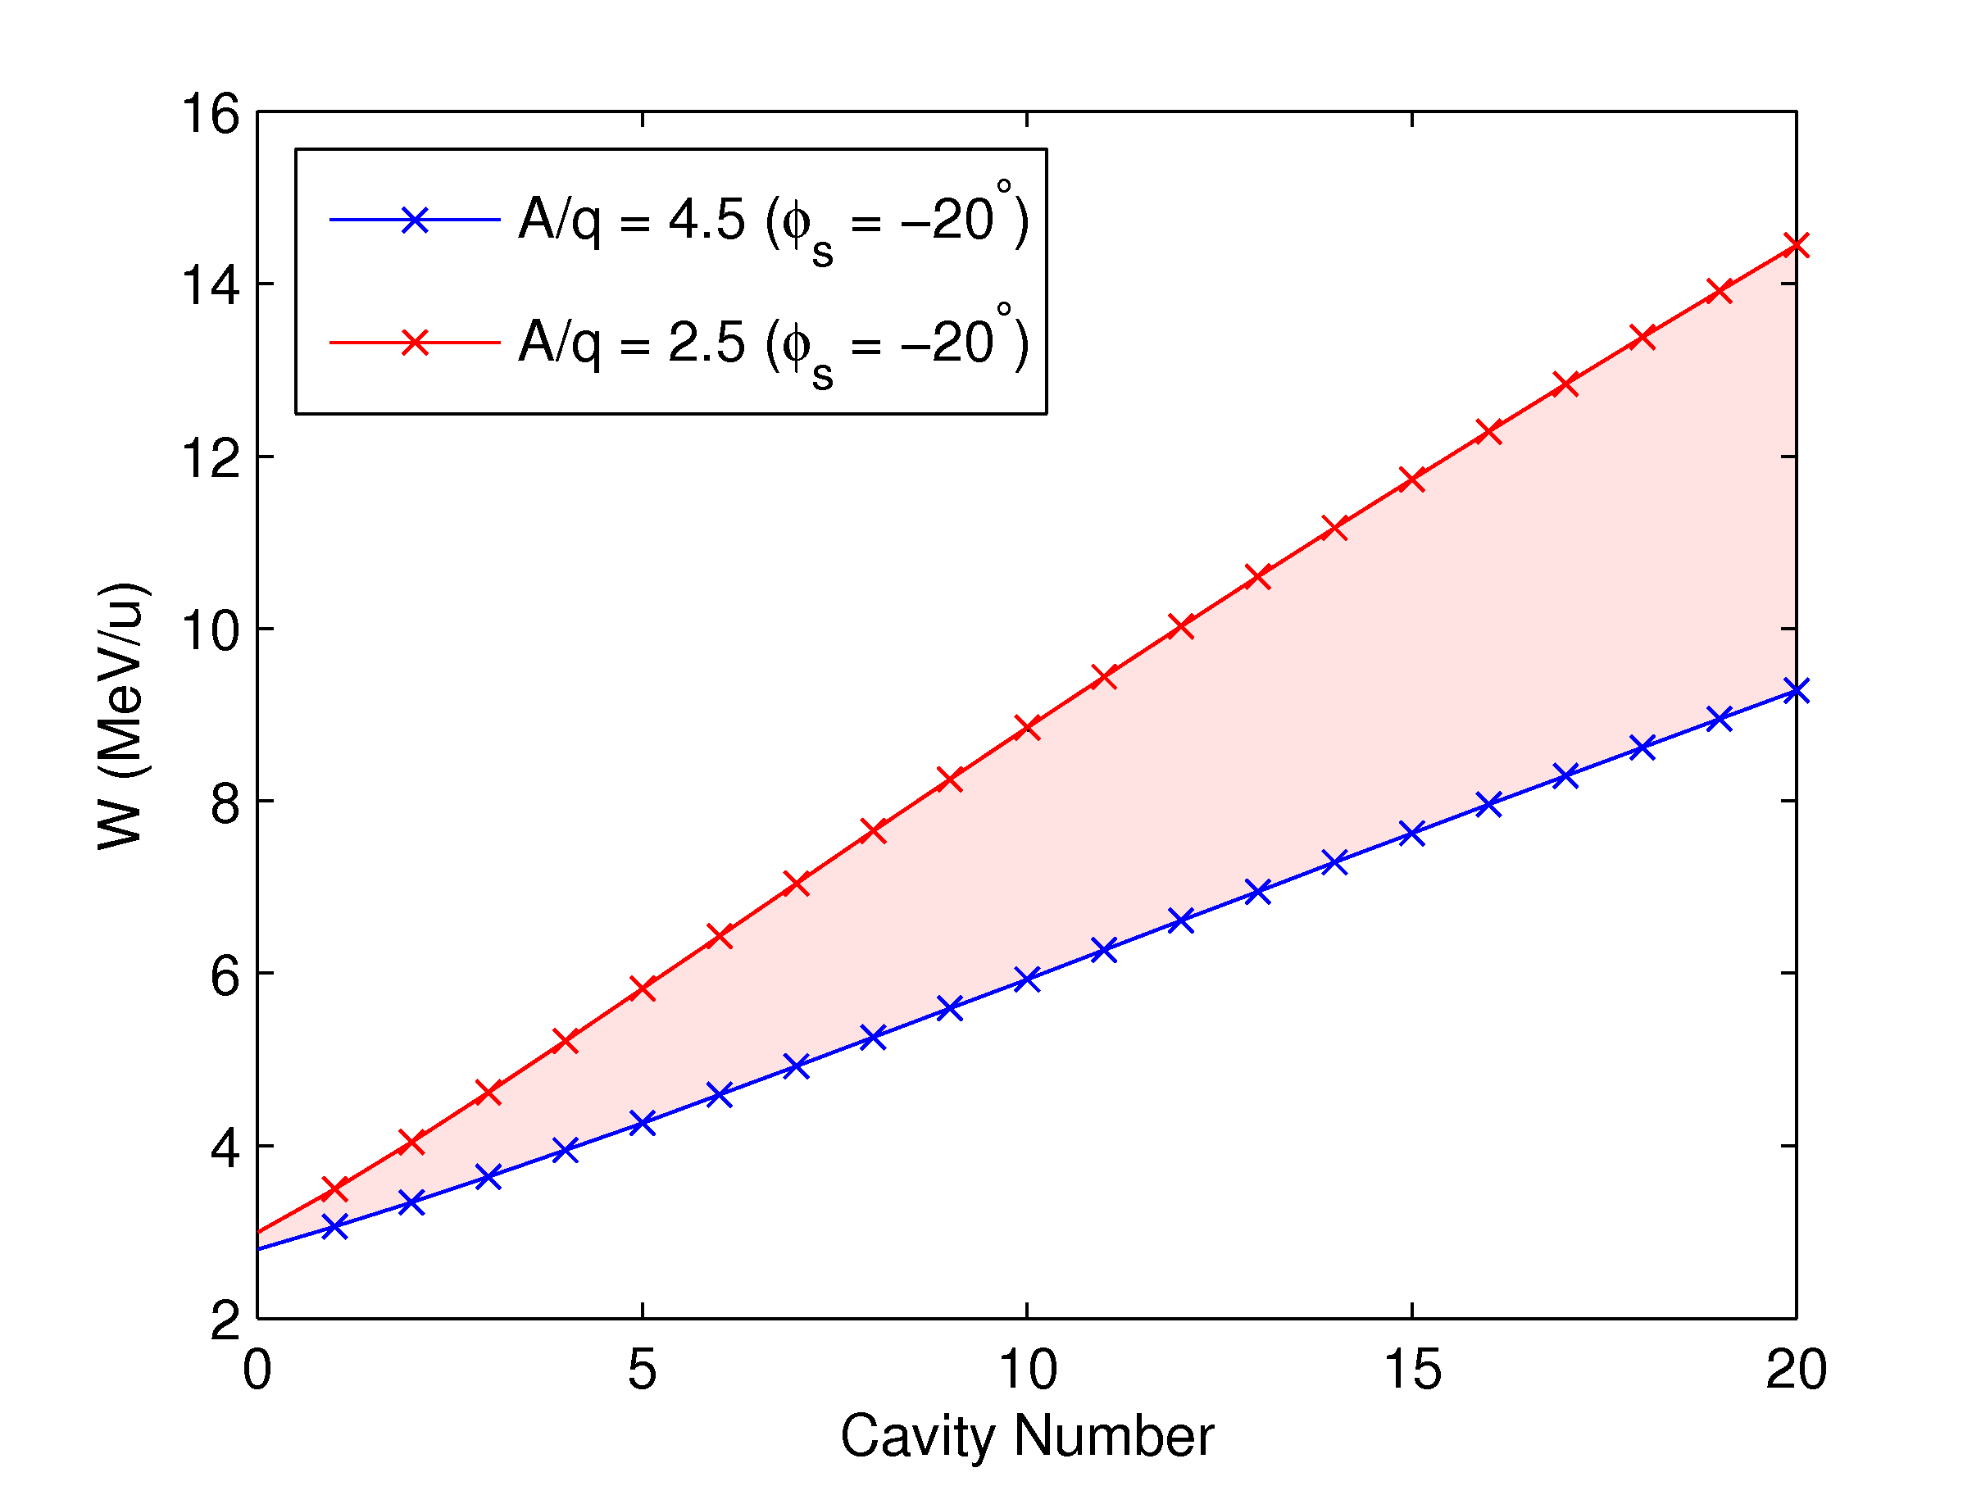
Energy RANGE: STAGE 2a
0.3 MeV/u
1.2 MeV/u
2.25 MeV/u
2.8 - 3.0 MeV/u
A/q = 2.5
W = 14.5 MeV/u
βγ = 0.177
A/q =4.5
W = 9.3 MeV/u
βγ = 0.140
A/q = 2.5
W = 3.0 MeV/u
βγ = 0.080
A/q =4.5
W = 2.8 MeV/u
βγ = 0.0773

Slide 14
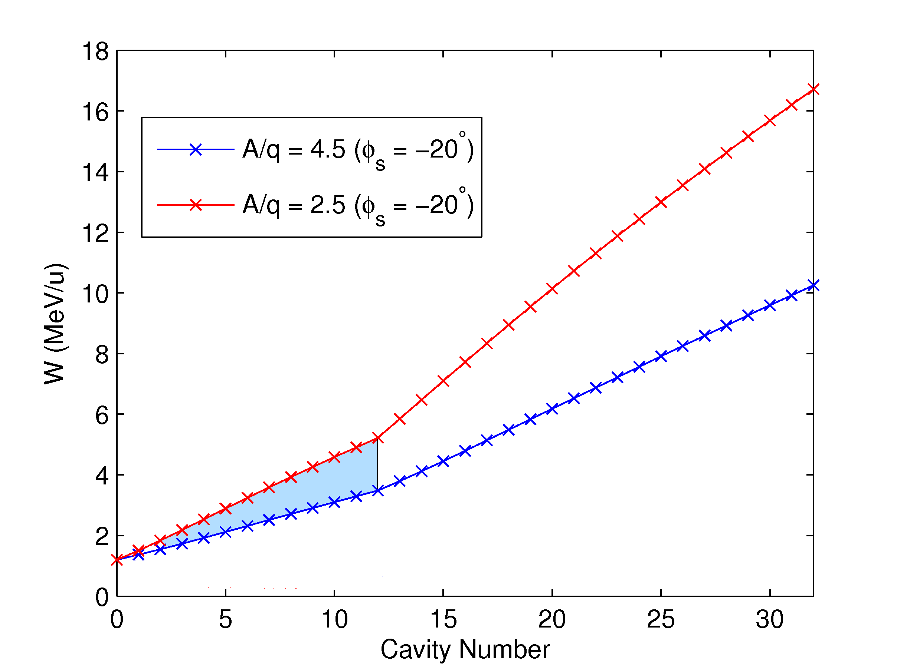
Energy RANGE: STAGE 2b
0.3 MeV/u
1.2 MeV/u
2.5 < A/q < 4.5
W = 1.2 MeV/u
βγ = 0.051

Slide 15
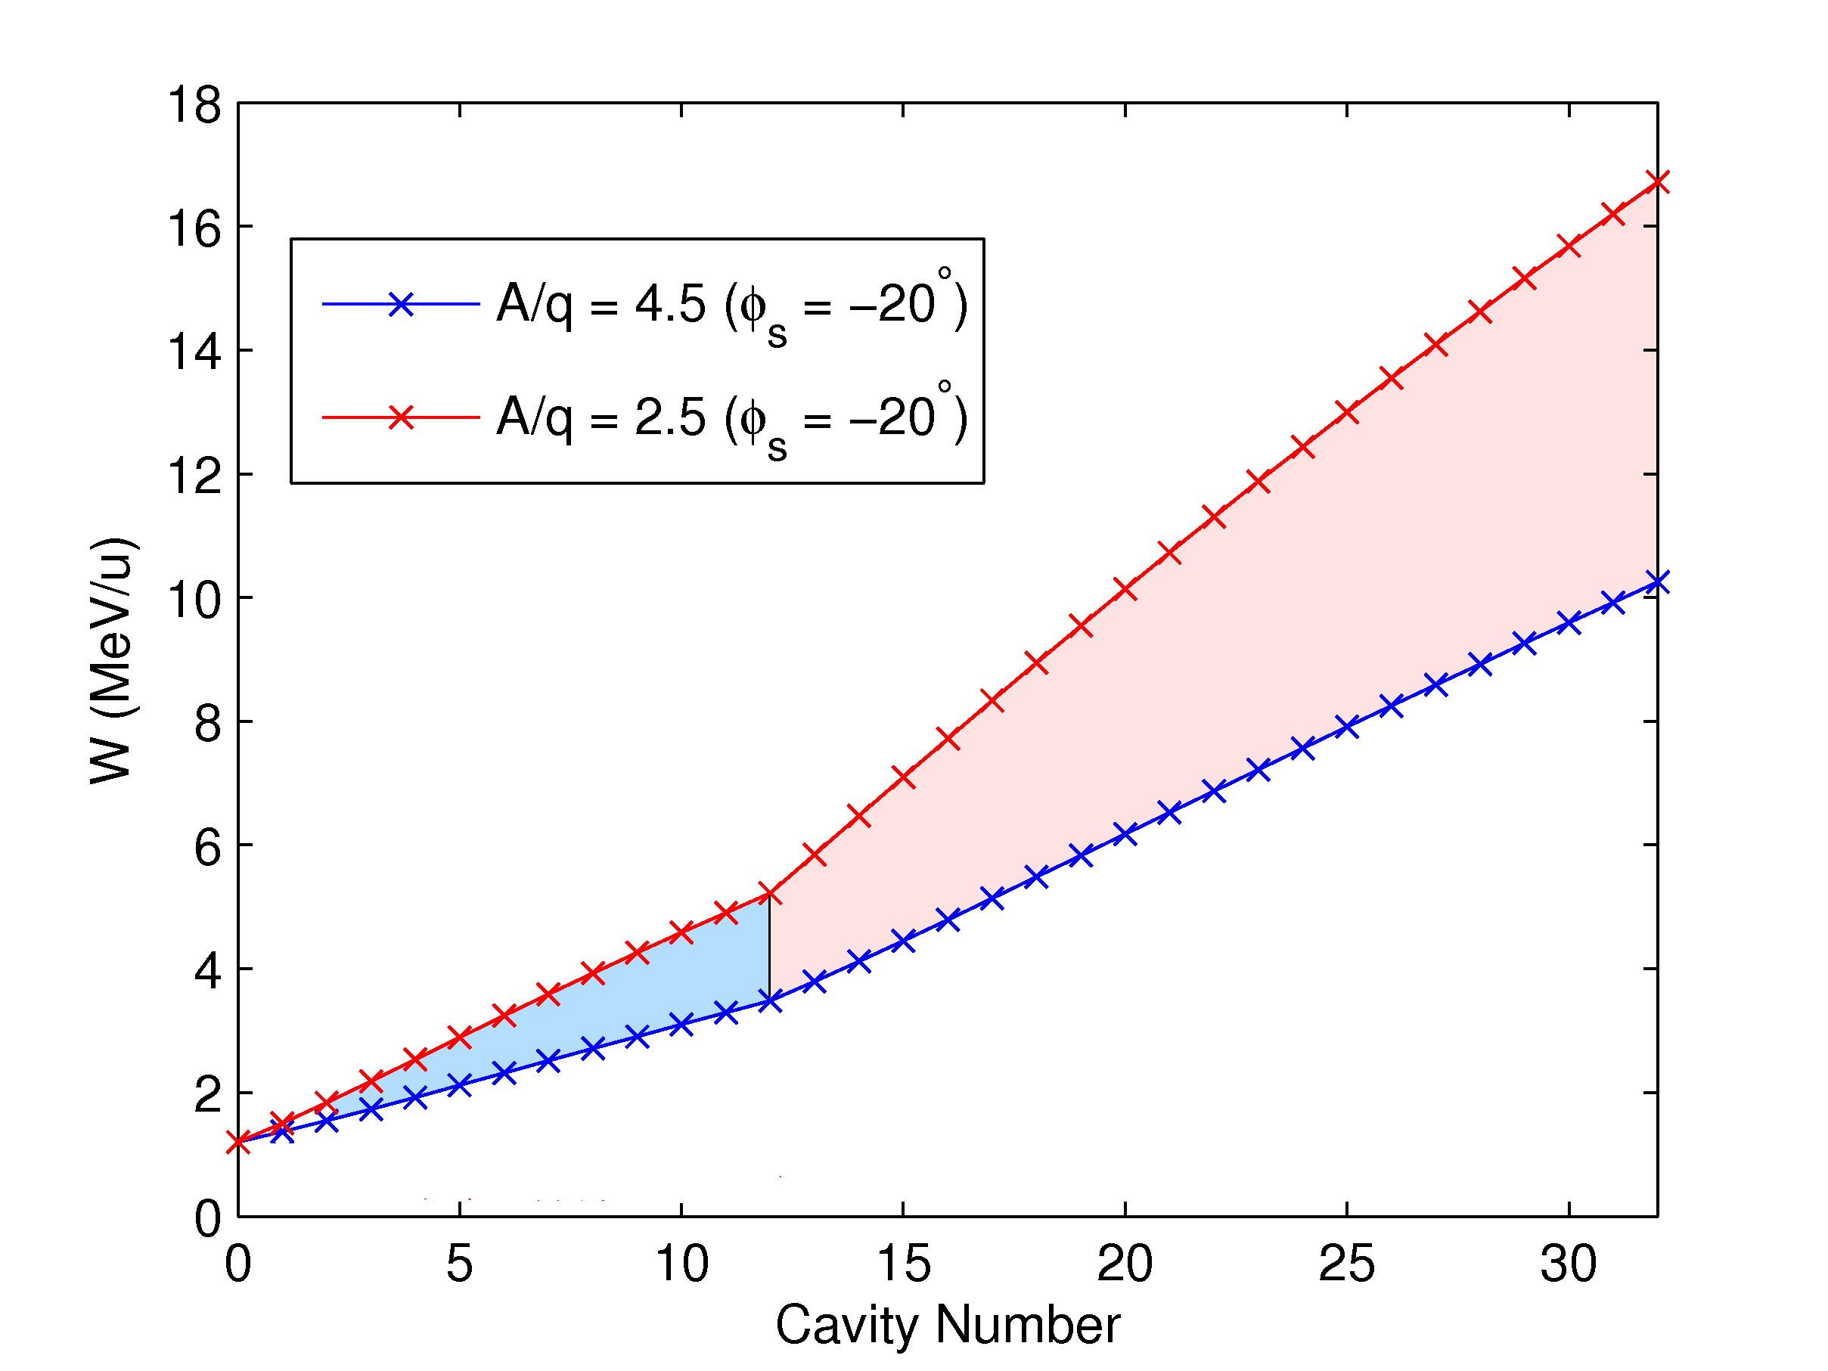
Energy RANGE: STAGE 2b
0.3 MeV/u
1.2 MeV/u
A/q = 4.5
W = 16.8 MeV/u
βγ = 0.187
A/q = 4.5
W = 10.2 MeV/u
βγ = 0.147
Highest rigidity:
W = 10 MeV/u
A/q = 4.5
Bρ = 2 Tm
2.5 < A/q < 4.5
W = 1.2 MeV/u
βγ = 0.051

Slide 16
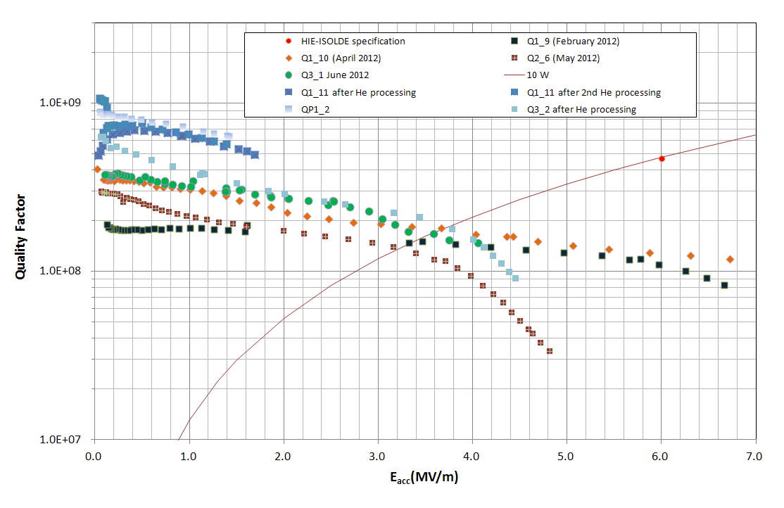
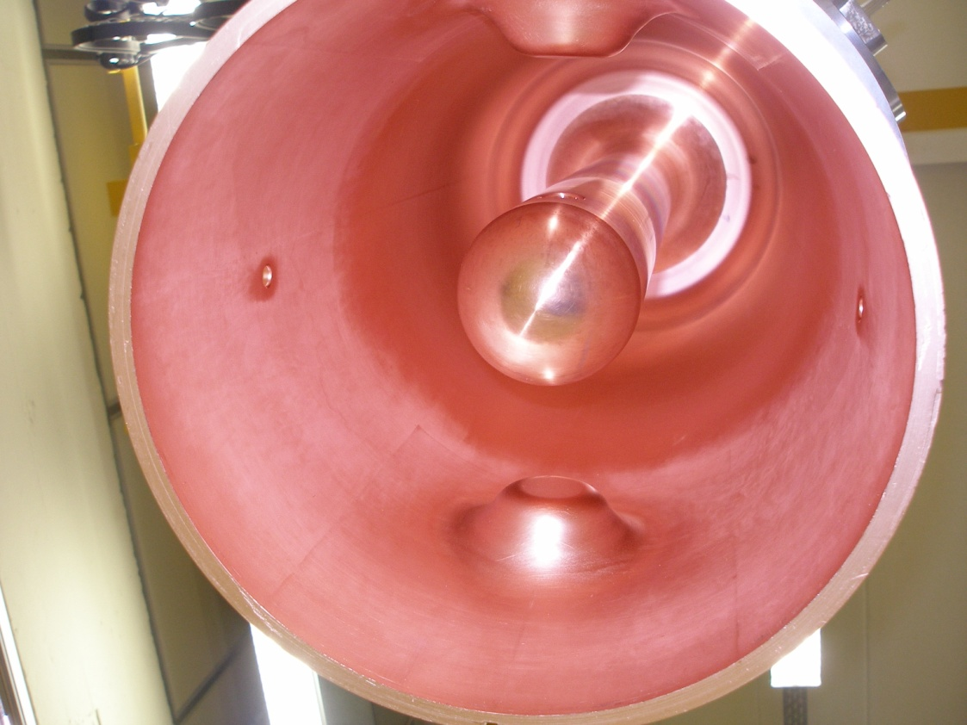
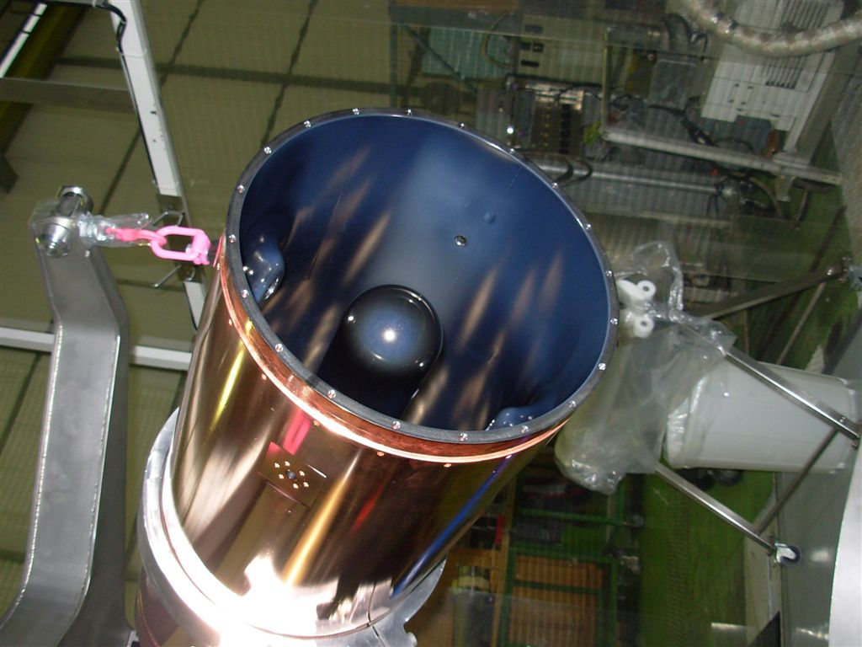
HIE-REX Cavity: Nb sputtered on Cu

Slide 17
Beam characteristics
Characteristic | Value (for A/q = 4.5)
Particle type | Heavy (radioactive) ions (A < 238)
Mass-to-charge state (A/q) acceptance | 2.5 < A/q < 4.5
Transverse emittance (normalised) (mm.mrad) | 0.07 (rms) and 0.3 (90%)
Longitudinal emittance (π ns keV/u) | 0.35 (rms) and 1.5 (86%)
Energy (MeV/u) | 0.3 – 10
Average Beam Current | ~ few particle per sec – 1 nA
Maximum rigidity (T.m) | 2.05
Macro-pulse length (ms) | < 2
Repetition rate (Hz) | < 50

Slide 18
REX time structure
Protons from PSB
RIBs released from ISOL target
Accumulation/cooling/macro bunching (up to 100 Hz)
Charge breeding
Duty cycle of linac matched to charge breeder/ion source
Micro-bunching of EBIS beam pulse by RFQ at 101.28 MHz
μ
μ

Slide 19
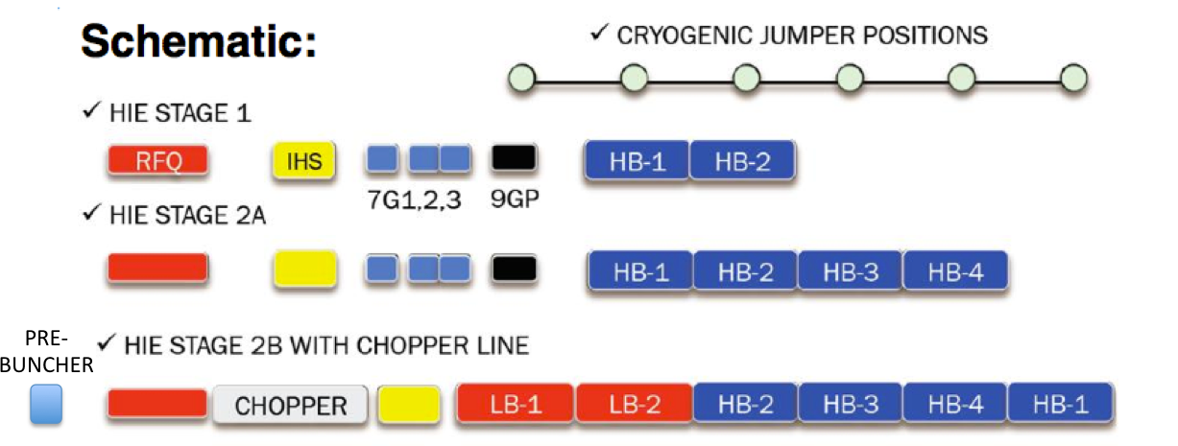
Chopper-buncher
Goal: increase natural bunch spacing from ~10 ns (101.28 MHz) to ~100 ns for physics with TOF systems
Beam chopper (meandering line or sine-wave) pulsed in phase with the beam to remove particles from empty bunches
Multi-harmonic pre-buncher operating at f₀/10 to ‘squeeze’ several bunches in one

Slide 20
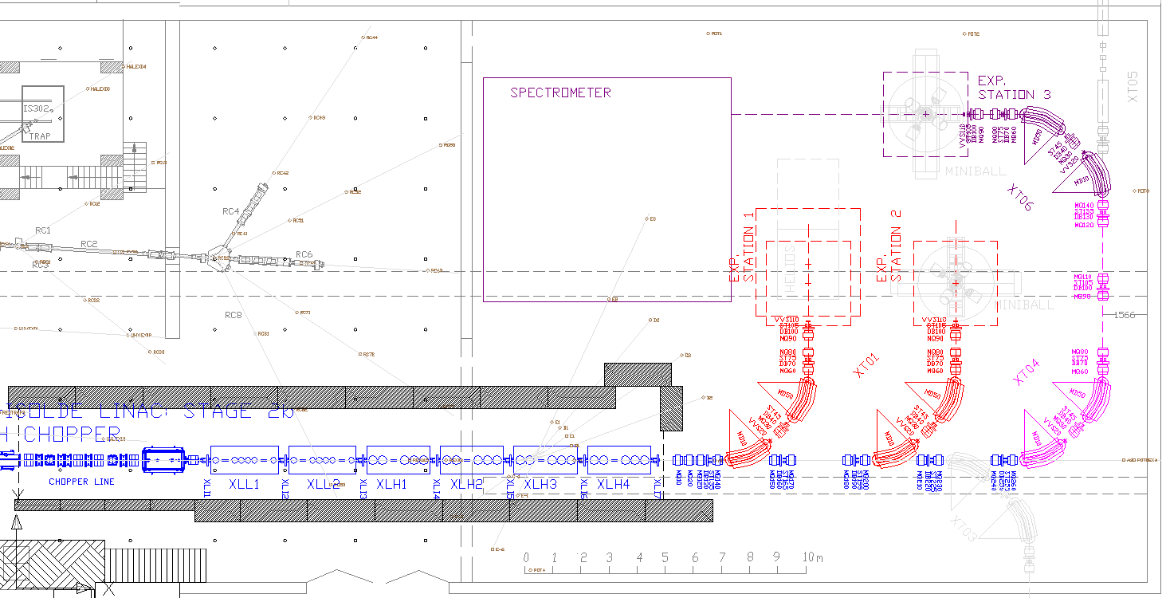
High Energy Transfer lines and experimental stations

Slide 21
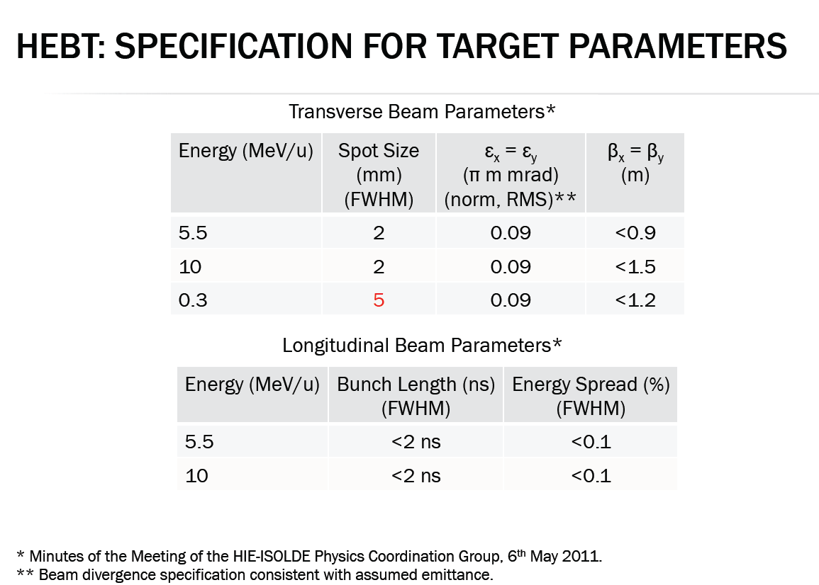

Slide 22
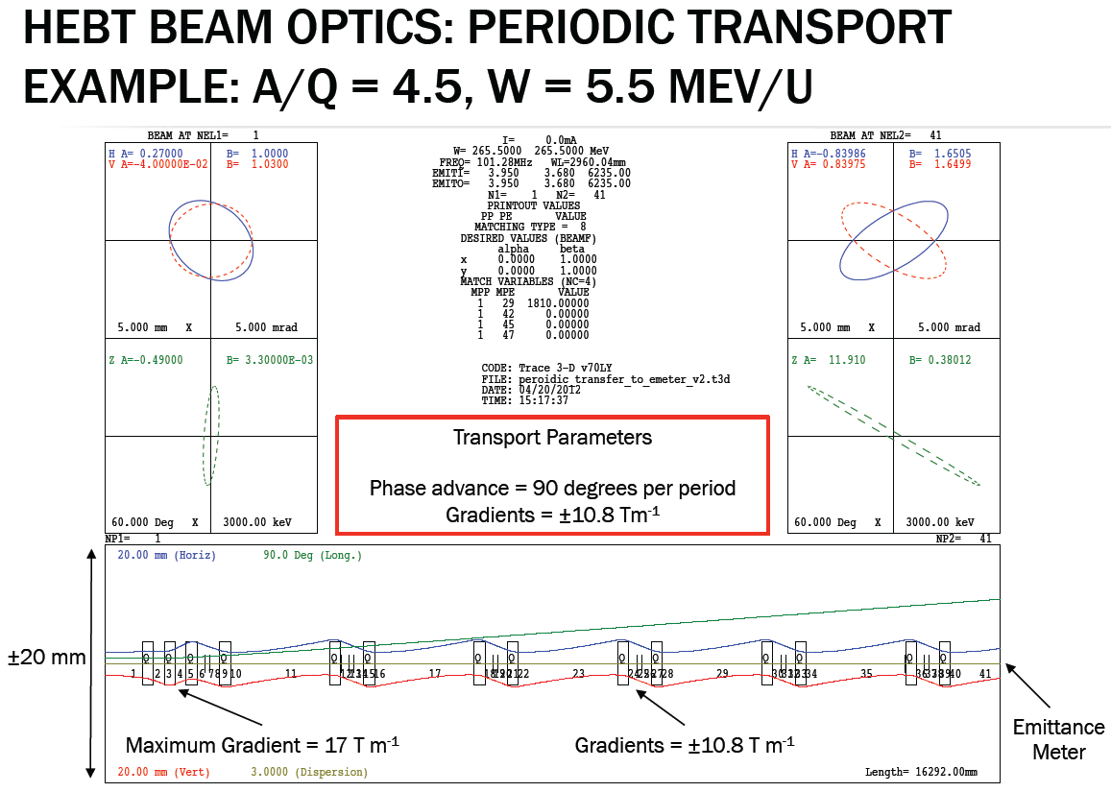

Slide 23
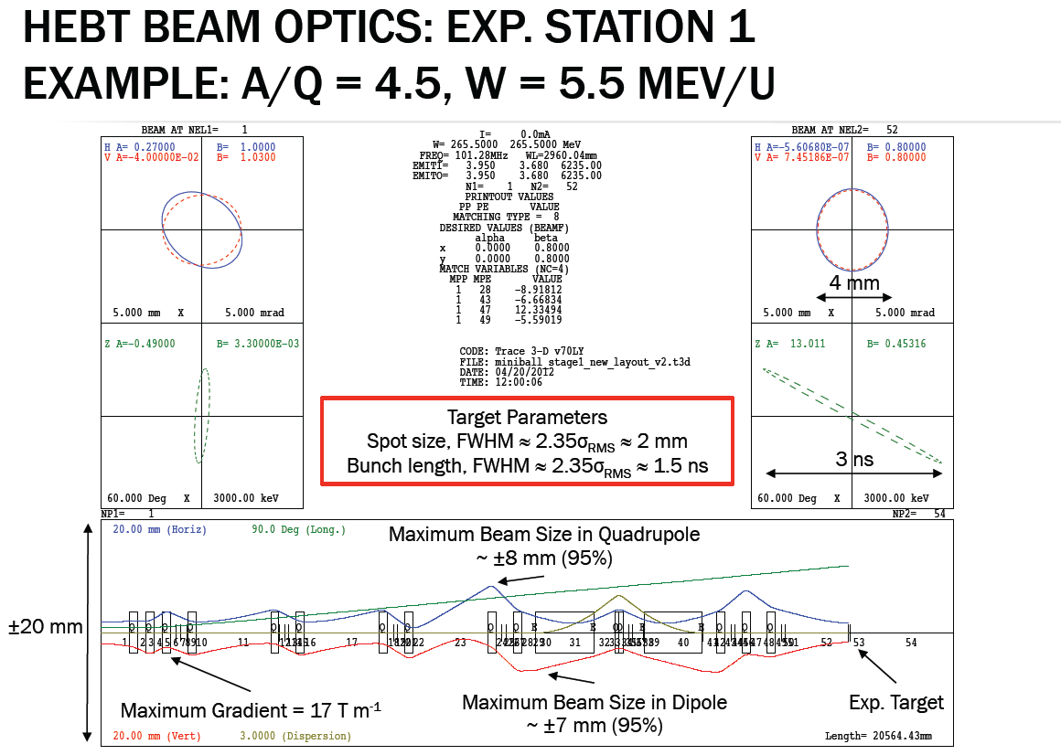

Slide 24
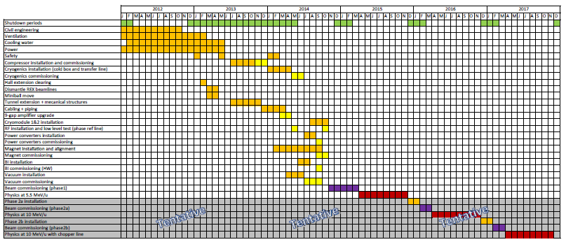
HIE Schedule

Slide 25
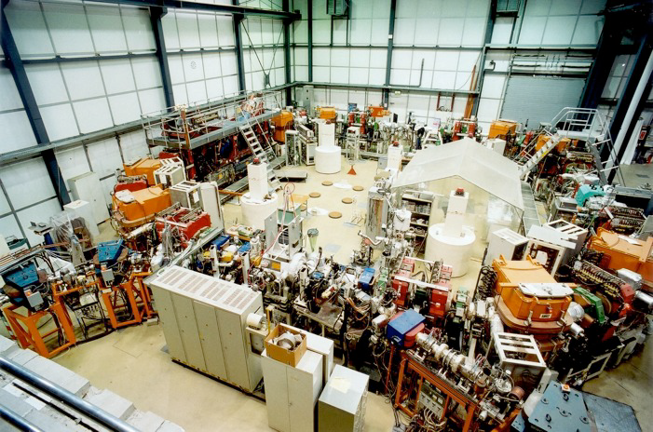
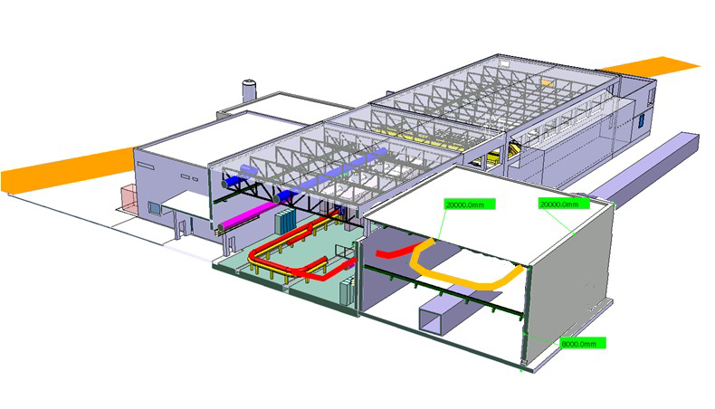
TSR@ISOLDE
Heavy-Ion Storage Ring + HIE-ISOLDE
  No background
  No energy straggling
  Cold beam/Smaller beamsize
  Reduced dead time/CW beam
Approved by research board May 2012
Aiming for start-up in 2015 as an experiment, integration as CERN facility towards 2018
TSR at MPIK Heidelberg
Possible TSR installation

Slide 26
Spare slides

Slide 27
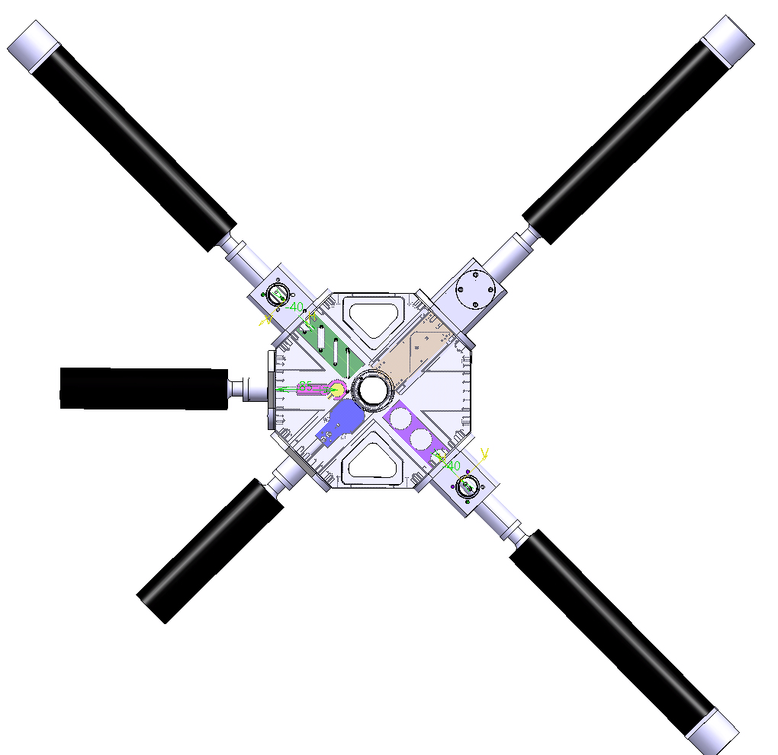
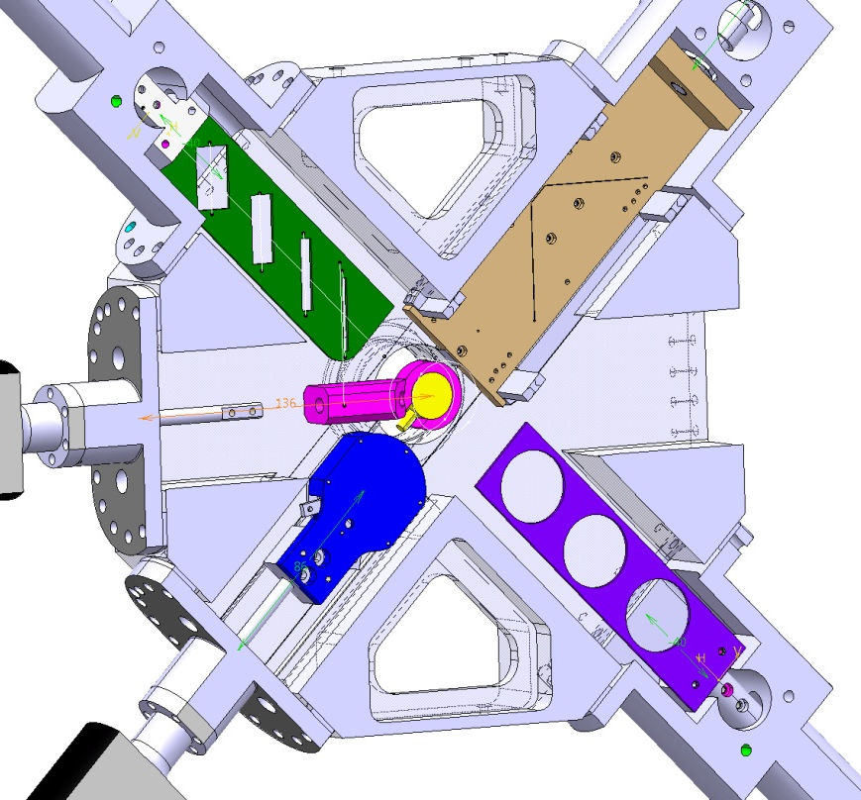
Diagnostic box
TYPE IV
Collimator slit
Type 2
Scanning slit
Silicon
detector
Stripping
foils
FC

Slide 28
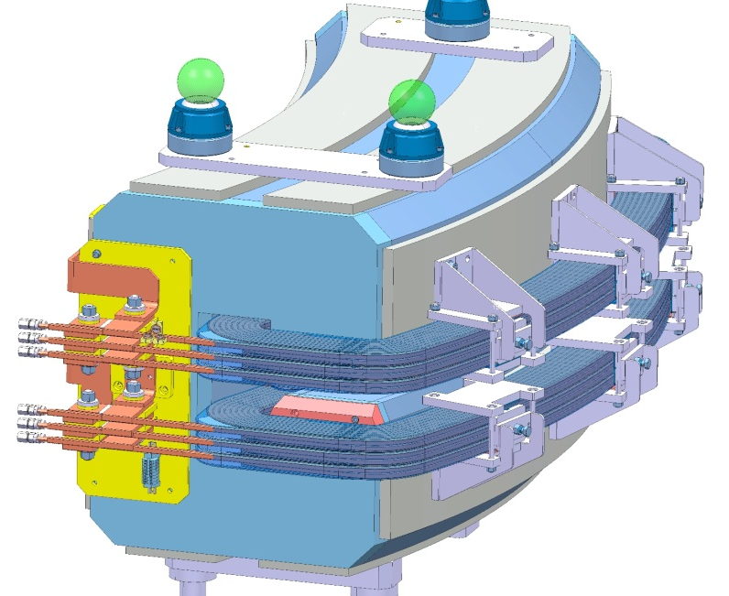
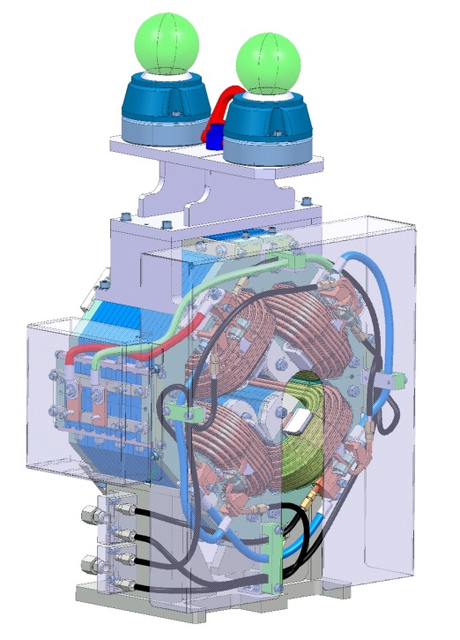
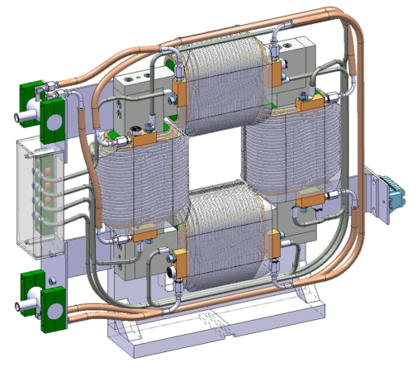
Magnets – present designs

Slide 29
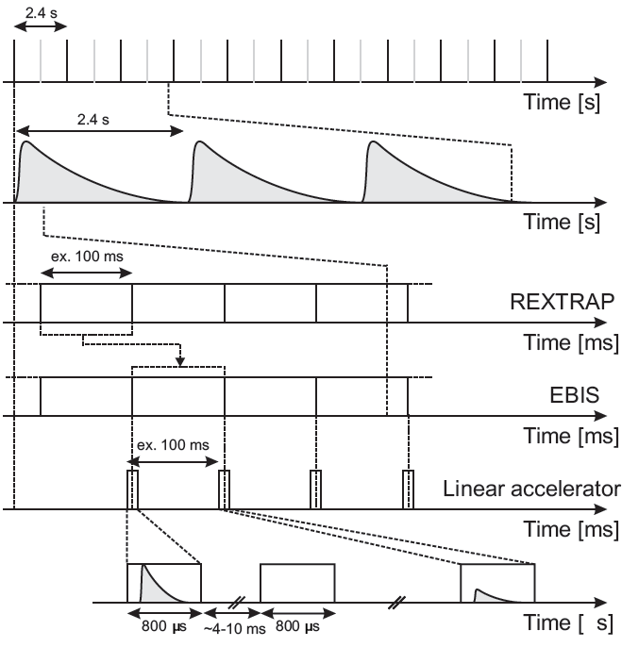
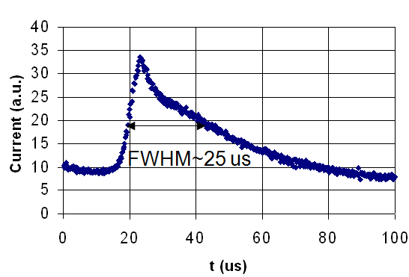
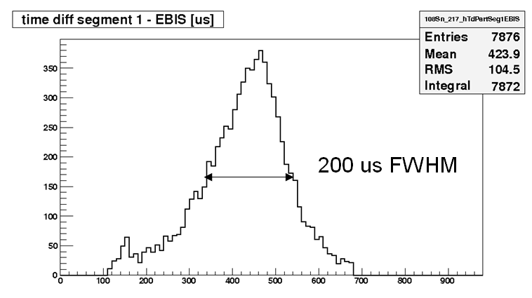
Slow extraction
normal extraction, 14N4+, measured in front of linac
Bunched beam = high instantaneous rate -> dead time
Good signal to noise ratio
Slow extraction, 108Sn, measured at Miniball

Slide 30
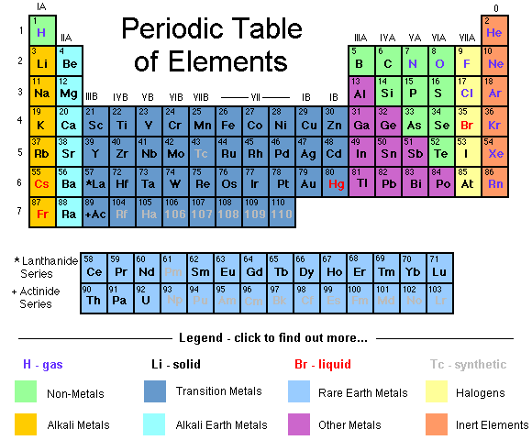
REX beam collection
2001-2012
⁶He ^{8,9,11}Li ^{10,11,12}Be ¹⁰C ¹⁷F ^{21,24,25,26,27,28,29,30}Na ^{28,29,30,31,32}Mg ⁴⁴Ar ^{61,62,63}Mn ^{61,62}Fe ^{66,68}Ni ^{67,68,69,70,71,73}Cu ^{72,74,76,78,80}Zn ⁷⁰Se ^{72,88,92,94,96}Kr ^{93,95,97,99}Rb ^{96,98}Sr 100,102,104,122,123,124,126,128Cd ¹⁰⁸In ^{106,107,108,109,110}Sn ^{138,140,142,144}Xe ^{140,142,148}Ba ¹⁴⁰Nd ¹⁴⁸Pm ^{140,142,153}Sm ¹⁵⁶Eu ^{182,184,186,188}Hg ^{186,188,190,192,194,196,198}Pb ^{196,198,200,202,206}Po ^{202,204,208,220,221}Rn ²²⁴Ra
>100 radioactive isotopes of 31 elements
A selection of stable elements charge bred

