Slide 1
HIE-EBIS design parameters
Andrey Shornikov, HIE-EBIS workshop, CERN, 16-17.10.2012

Slide 2
Outline
Infrastructure and users requests.
Technical parameters of the future EBIS.
Our preliminary view of it.
What we would like to focus on.

Slide 3
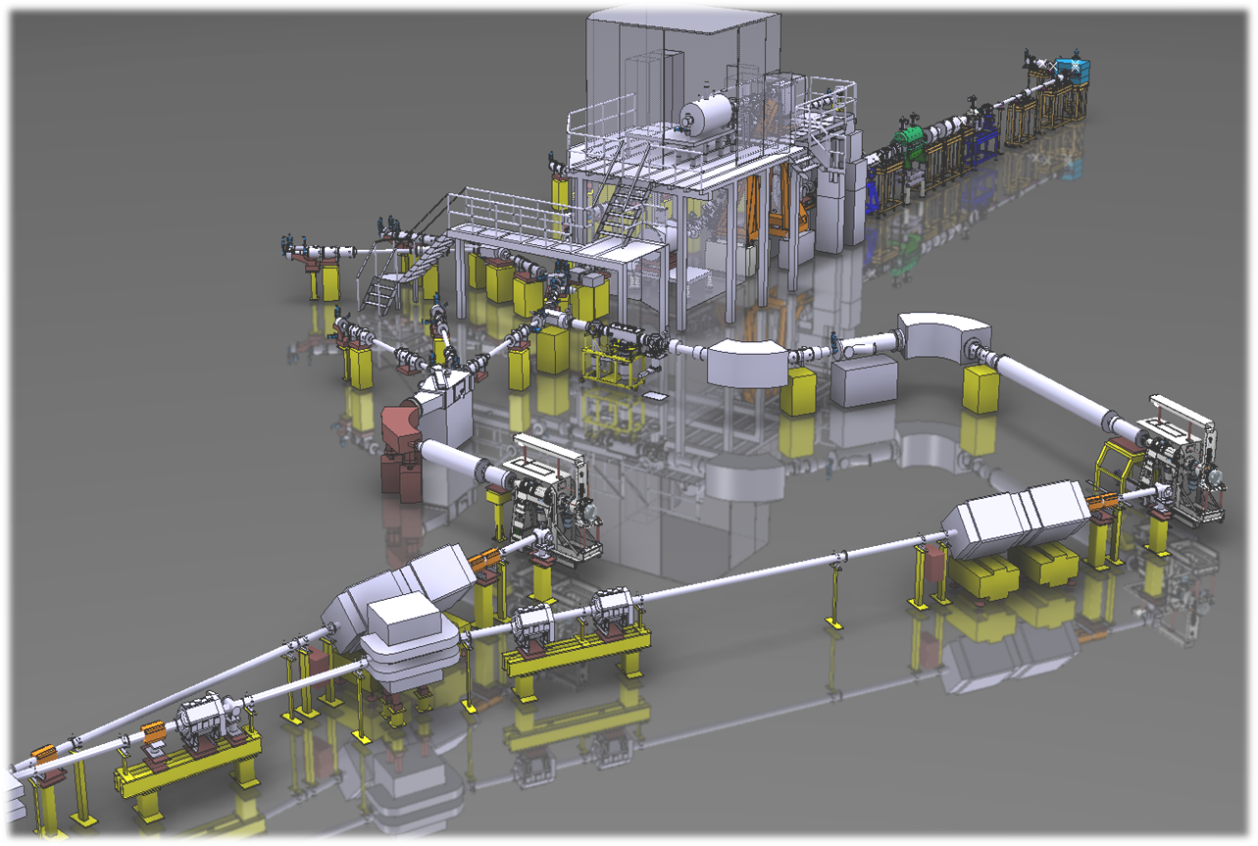
A. HIE-ISOLDE chain
REX-EBIS
users
TSR@ISOLDE
breeding to A/q<4.5
linac
3/5.5/10 MeV/u
REX-trap
accumulating,
bunching, buffer
gas cooling
mass separators
targets
1⁺ cw

Slide 4
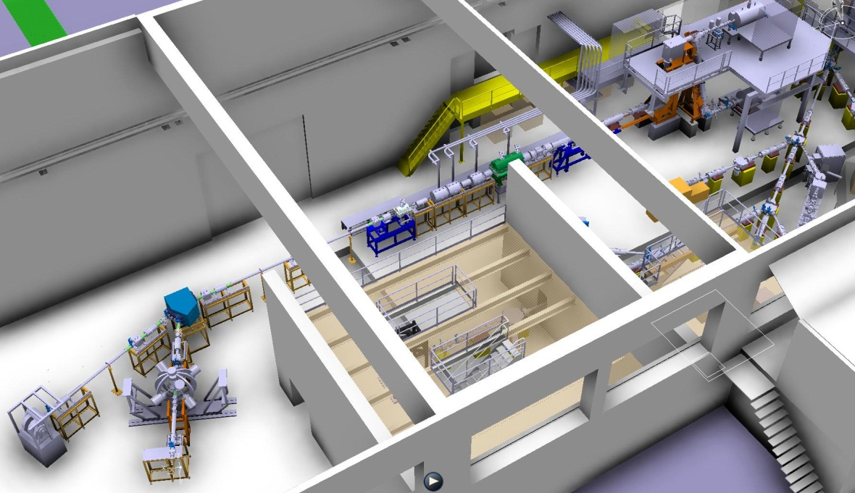
A. Existing users requests
Current users: Coulex and nuclear transfer experiment + visitors
Present: 50 μs pulses with max rep. rate. (50 Hz, linac).
Request:
1.5 ms pulses ;
less particles per pulse, more pulses.
Dream (t>10y):
T_{pulse} = T_{breeding} + 2 EBISes in a push-pull mode = cw output beam.
To EBIS: fast breeding, slow extraction, 2<A/q<4.5.

Slide 5
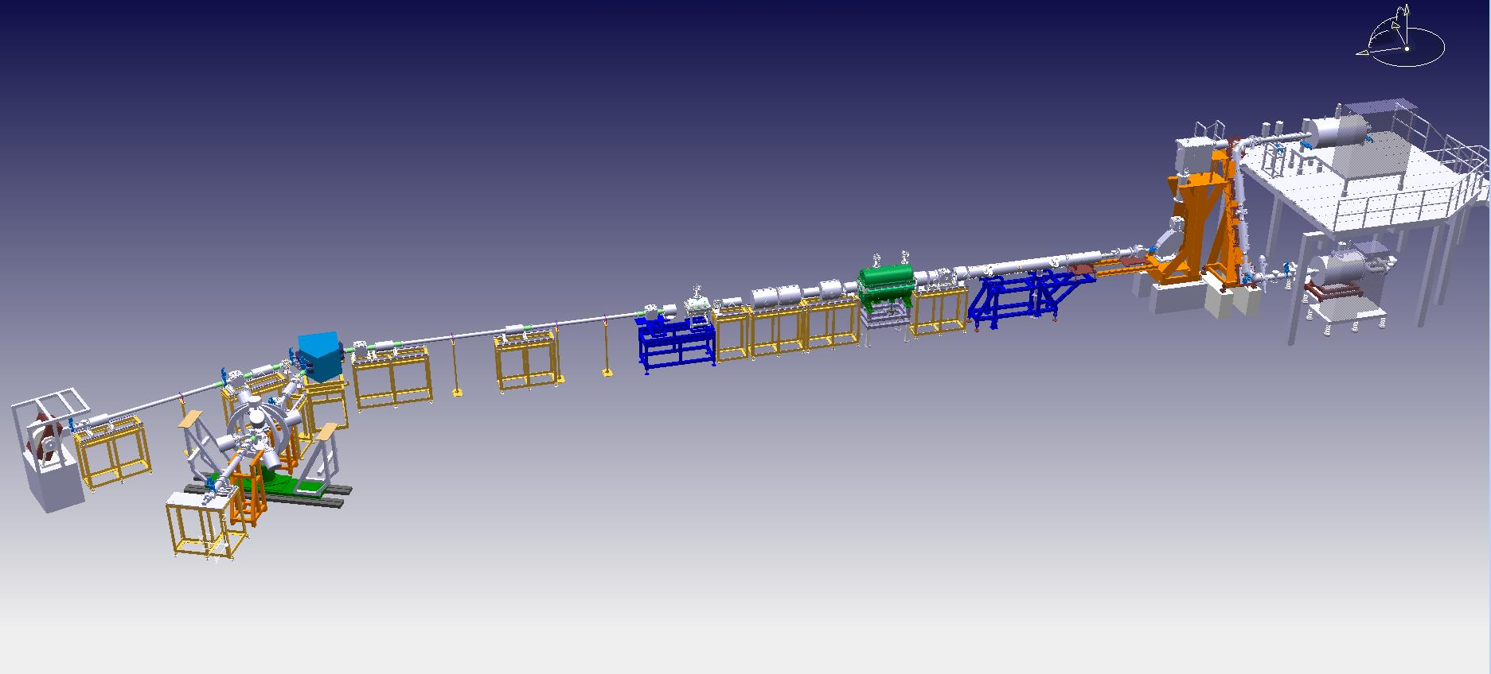
A. Existing users requests
Coulomb excitation of ¹³²Sn on ²⁰⁶Pb target, proposal by Reiter et al. for HIE-ISOLDE.
¹³²Sn @ 5.5 MeV/u
q – irrelevant →
T~100 ms
←↓
A/q<4.5 → q>30⁺ →
γ-detectors saturation @ 10 Hz
REXTRAP capacity limit
Half life limit ↓
100 Hz rep rate →
OK: 50 Hz st I/ 100 Hz st II →
Not OK: J_{e} x 5/10

Slide 6
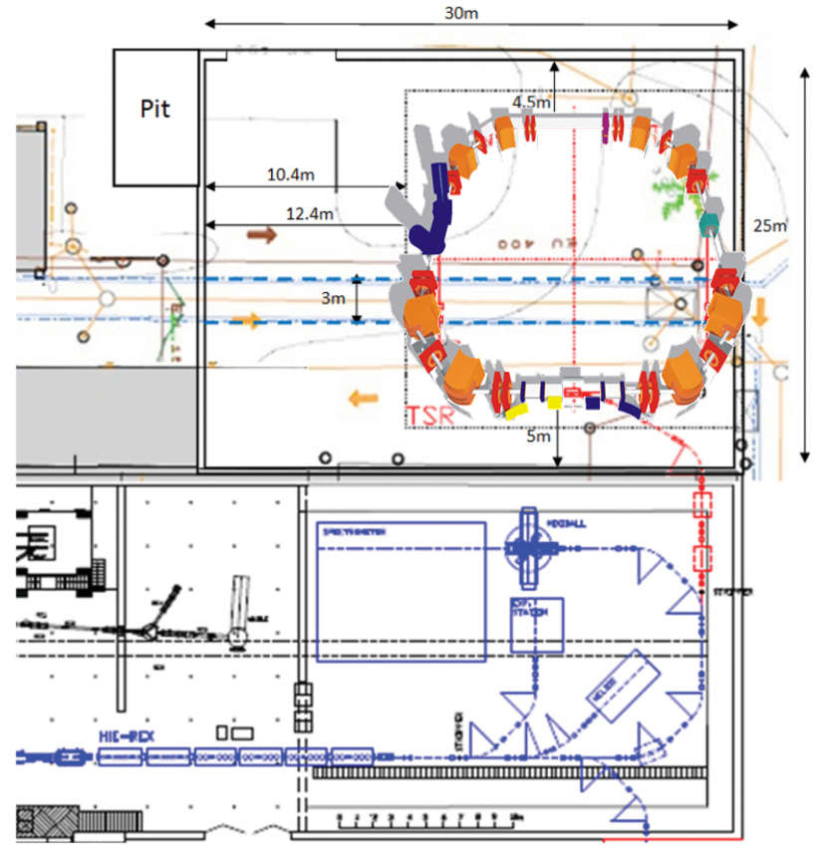
A. Prospective user request: TSR@HIE-ISOLDE
Working for TSR@HIE-ISOLDE injection:
A/q ~ 3 for machine reasons;
H-like and bare up to 60+ for
physics;
Fast extraction <30 μs;
Low rep rate 0.5 Hz<f< 5Hz;
High pulse intensity.

Slide 7
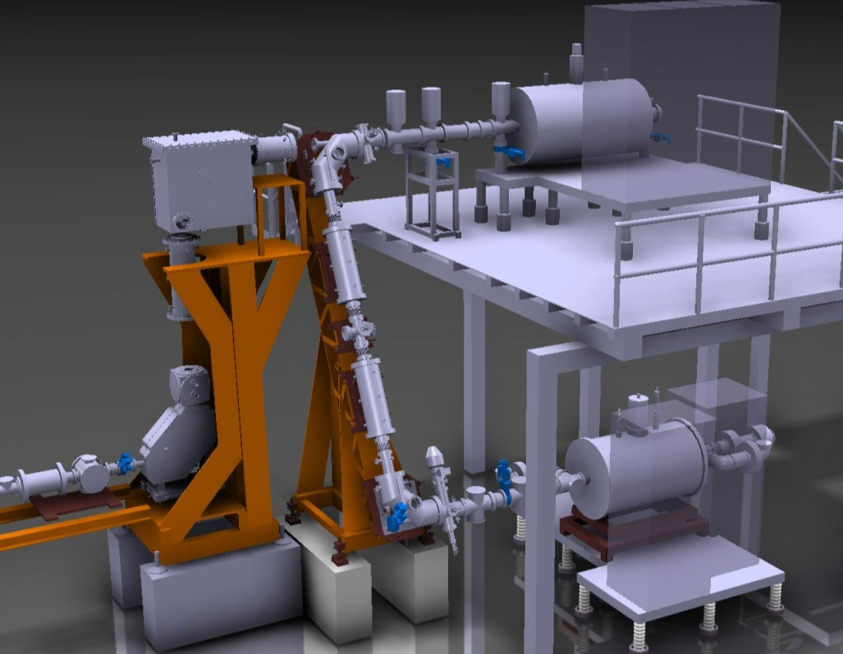
A. EBIS cw injection for TSR@HIE-ISOLDE and very unstable ions for MINIBALL
1.For a few Hz injection of
high intensity beams:
shoot directly to EBIS in cw
due to low REXTRAP capacity of 10⁷⁻⁸ ions.
Charge bred q+ ions
EBIS
Bunched
1+ ions
1+ ions
from
ISOLDE
A/q
separator
2. Short lived isotopes with
τ ~ t_{breeding} should be shot
directly to reduce losses.
REXTRAP
Cleaned q+
beam to linac
EBIS should be capable of effective capturing 10π mm mrad beam in cw.

Slide 8
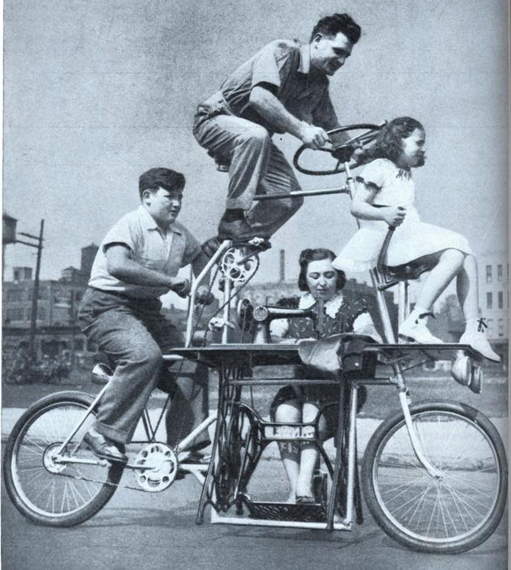
A. General requests
Increased capacity (increase space charge of the EBIS);
Capturing efficiency in cw over 50%, breeding efficiency over 10 % (new optics). Base scenario: keep REXTRAP for most of the cases;
Minimized unscheduled downtime;
Minimized R&D and untested solutions.

Slide 9
B. Technical parameters
Requests:
Z~60, He-like, H-like, bare, 10% of CSD, 0.5-5 Hz
A/q ~ 4.0, 100 Hz
I. P. ~ 50 keV
Competing RR
Jτ ~ 10⁴ C/cm²
τ =0.2-2 s
Jτ ~ 10² C/cm²
τ =10 ms
CX
I-e heating
CW injection
Deep radial SC
Design:
P < 10⁻¹² mbar
I=2-5 A
J=10⁴ A/cm²
Gun bias ~ 150 kV
Compression> 3500, Brillouin gun

Slide 10
B. Operation conditions required
Beam parameters | Value
Energy, keV | 150
Current, A | 3.2
Magnetic field of the main solenoid, T | 6
Cathode temperature, K | 1500
Carthode radius, mm | 6
R_{H} beam, μm | 50
Current density, A/cm² | 40000
Space charge of the beam, V | 150
Geometrical acceptance @ 30kV injection, π mm mrad | 5.0 π
Breeder length, m | ~ 1
Collector power, kW | 200

Slide 11
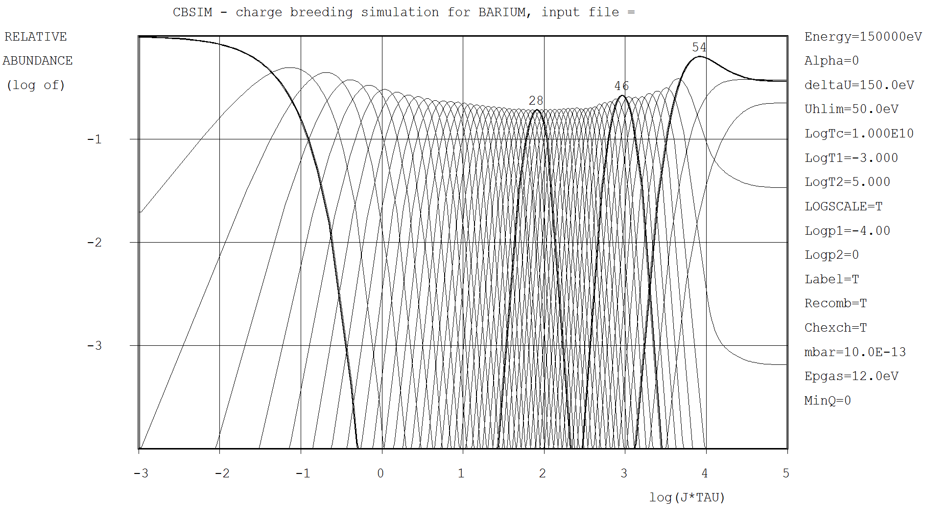
B. Ba example
Heating rate of Ba⁺⁵⁶ in the trap 3.9 keV/s, breeding time ~ 500 ms.
He-, H- like and bare Ba is reachable only with ion-ion cooling
P~1E-12 mbar is sufficient to supress CX.

Slide 12
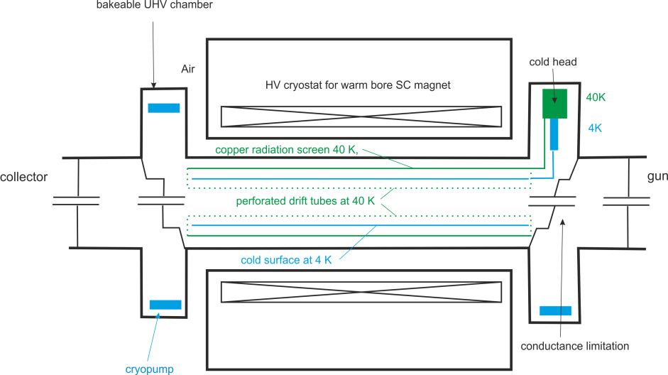
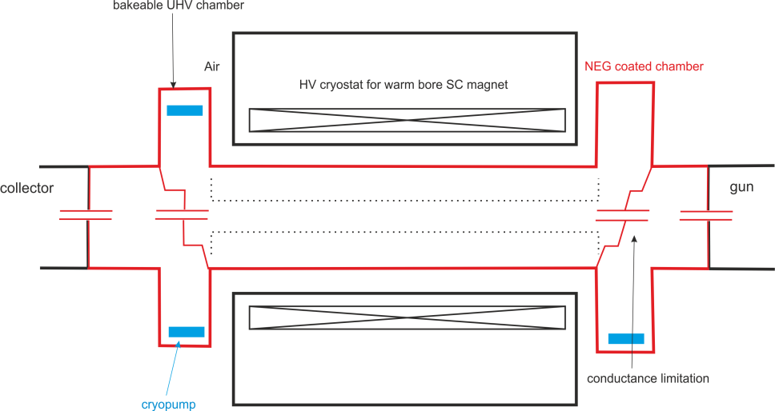
B. Technical parameters. Vacuum
Reliability:
Separate magnet cryostat;
Separable gun chamber;
Redundant pumping.
High current operation:
Differential pumping stages;
High rate distributed pumping.
Goal: reach pressure <10⁻¹² mbar.
Option I
Option II

Slide 13
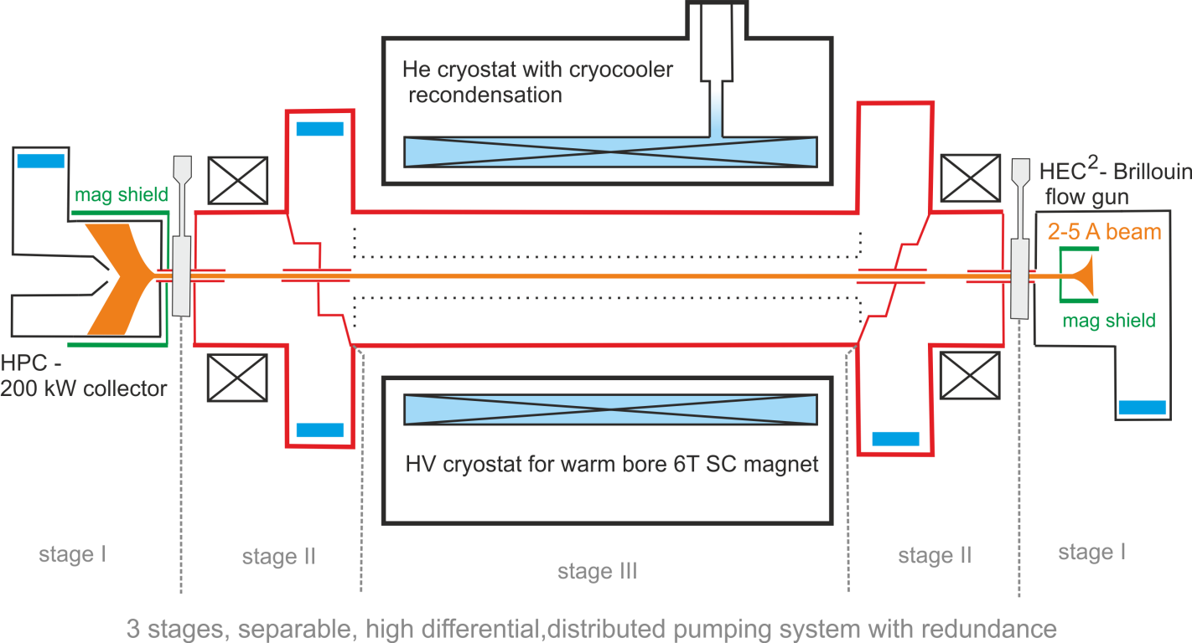
C. Preliminary general layout

Slide 14
D. Focus on
Electron gun/optics/collector – beam dynamics
Vacuum options
Atomic physics processes @10⁴ C/cm²: e-i heating,
i-i cooling, RR, DR, CX, something we are not aware of

Slide 15









Thank you, let’s dig into details!
We are happy to see here expert from
We’d like to thank:
our funding agency for this opportunity
and our administrative officers
for organization
Delphine Rivoiron
Flora Ayda Berrenger
Elodie Kurzen-Brarda

Slide 16
Spares. Option I. Heat loads
Assuming 40K shield D=100 mm, vac tube D=150 mm, length 2 m
From mech. polished Steel to mech. polished Alu/Cu/Ag on Cu
Radiative heat load 18/12/4 W at 40 K @ 35-40 W available on CH
If NEGs have high ε combining will be impossible.

Slide 17
Spares. Option II. Pumping speed
Assuming D=150 mm tube of 2 meters, R(H₂, NEG=Ti-V-Zr)=0.3 l/cm²
The total pumping rate of the trapping region = 2800 l/sec

