Slide 1
Charge breeding at REX-ISOLDE
HIE-EBIS workshop 16-17/10 2012
Fredrik Wenander
CERN

Slide 2

Charge breeders for RIBs worldwide
ISAC, TRIUMF
* ECRIS
* Operation
KoRIA
* ECRIS and EBIS
* Design
REX-ISOLDE, CERN
* EBIS/ECRIS
* Operation/Stopped
TITAN, TRIUMF
* EBIT
* Operational
ARIEL, TRIUMF
* EBIS?
* Planning
EURISOL, Europe
* EBIS/ECRIS
* Design
ReA, MSU
* EBIT
* Commissioning
TRIAC, JAERI
* ECRIS
* Stopped
CARIBU, ANL
* ECRIS/EBIS
* Operation/Commissioning
SPIRAL/SPIRAL2
* ECRIS
* Design
SPES, LNL
* ECRIS
* Design
VECC
* ECRIS
* Commissioning

Slide 3
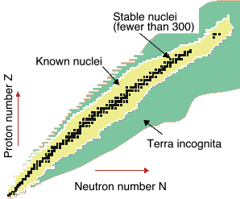
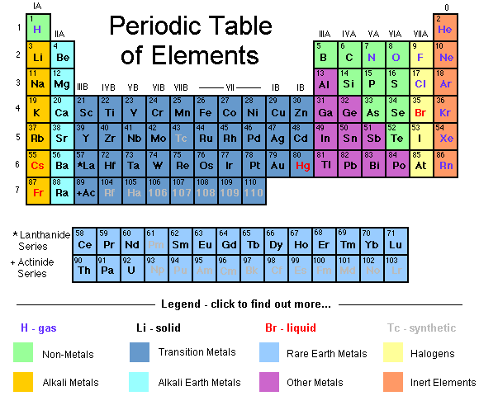
Potential and delivered beams
Proton dripline
Neutron
dripline
REX-ISOLDE beams
Radioactive nuclei: main interest for nuclear physics
radioactive
stable
To this date:
~6000 nuclei believed to ‘exist’
~3000 different nuclides
experimentally observed
Less than 10% stable
32 different radioactive elements for physics
~100 isotopes accelerated
~100 beam times

Slide 4
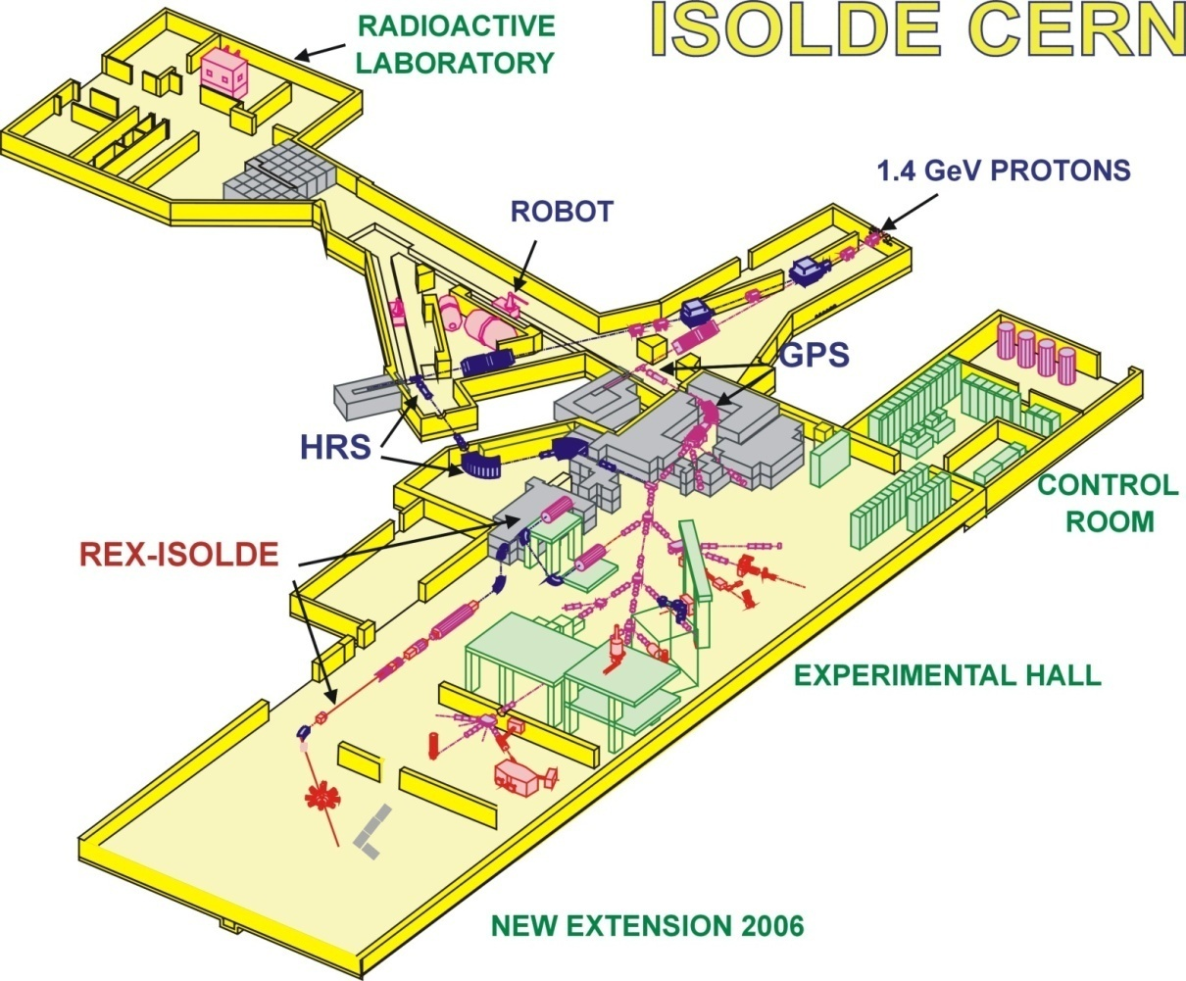


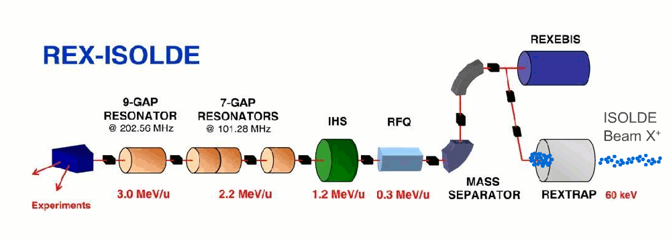
REX-ISOLDE
Post accelerator to 3 MeV/u
Room temperature Linac
First experiment 2001

Slide 5
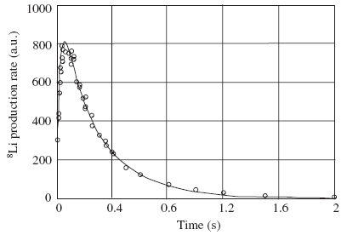
ISOL beam parameters
Ion mass | 4 to >250 | He to >U
Intensity | few to >1E11 ions/s | Large dynamic range
Charge | 1+ | Some (undesired) 2⁺, 3⁺,…
Energy | 30 to 60 keV
Energy spread | few eV
Temporal structure | quasi-cw | Proton impact every n*1.2 s
Release curve
Semi-continuous
depending on release
properties and ionization time
typical tens ms to minutes
(r=rise, f=fast, s=slow)
Extra
⁸Li (T_{1/2} = 840 ms) produced by target fragmentation of tantalum foils

Slide 6
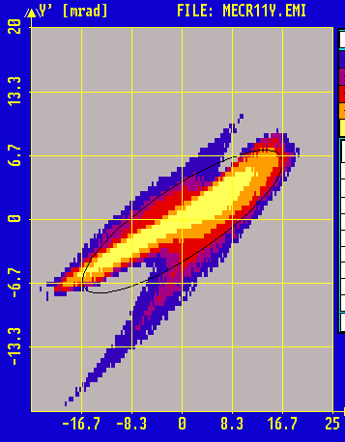
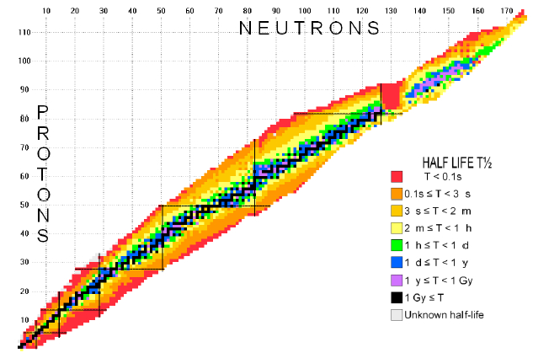
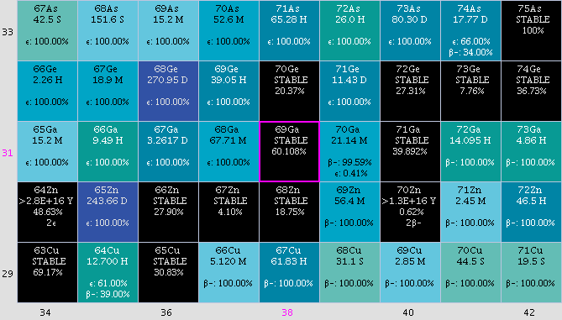
ISOL beam parameters
Transverse emittance | 10-50 mm mrad | 90% at 60 keV
Half-life | >10 ms | Limited by ISOL-system
Selection | Not necessarily isobarically clean | Use e.g. resonant ionizing laser ion source
ISOL magnet
selects A/Q (Q=1)
resonant laser
separation
See also http://ie.lbl.gov/isoexpl/charthlp.htm
Z
N

Slide 7
Breeder criteria
Checklist for ‘normal’ breeder design
0 | Achievable A/Q (3<A/Q<4.5)
1 | High breeding efficiency rare radionuclides limit machine contamination chain of machines
2 | Short breeding / confinement time handle short-lived ions
3 | Clean extracted beams
4 | High ion throughput capacity
5 | Good beam-quality (large α, small ε_{trans}, small ΔE_{extr}) good trapping efficiency high linac/separator transmission η good mass separation
6 | Easy handling and reliable to be used in an accelerator chain on a production basis
η_{target} _{ion} _{source}
η_{ionization}
η_{separation}
η_{CB delay}
η_{breeding}
η_{acceleration}
For HIE-EBIS tougher requirements
η_{detector}

Slide 8
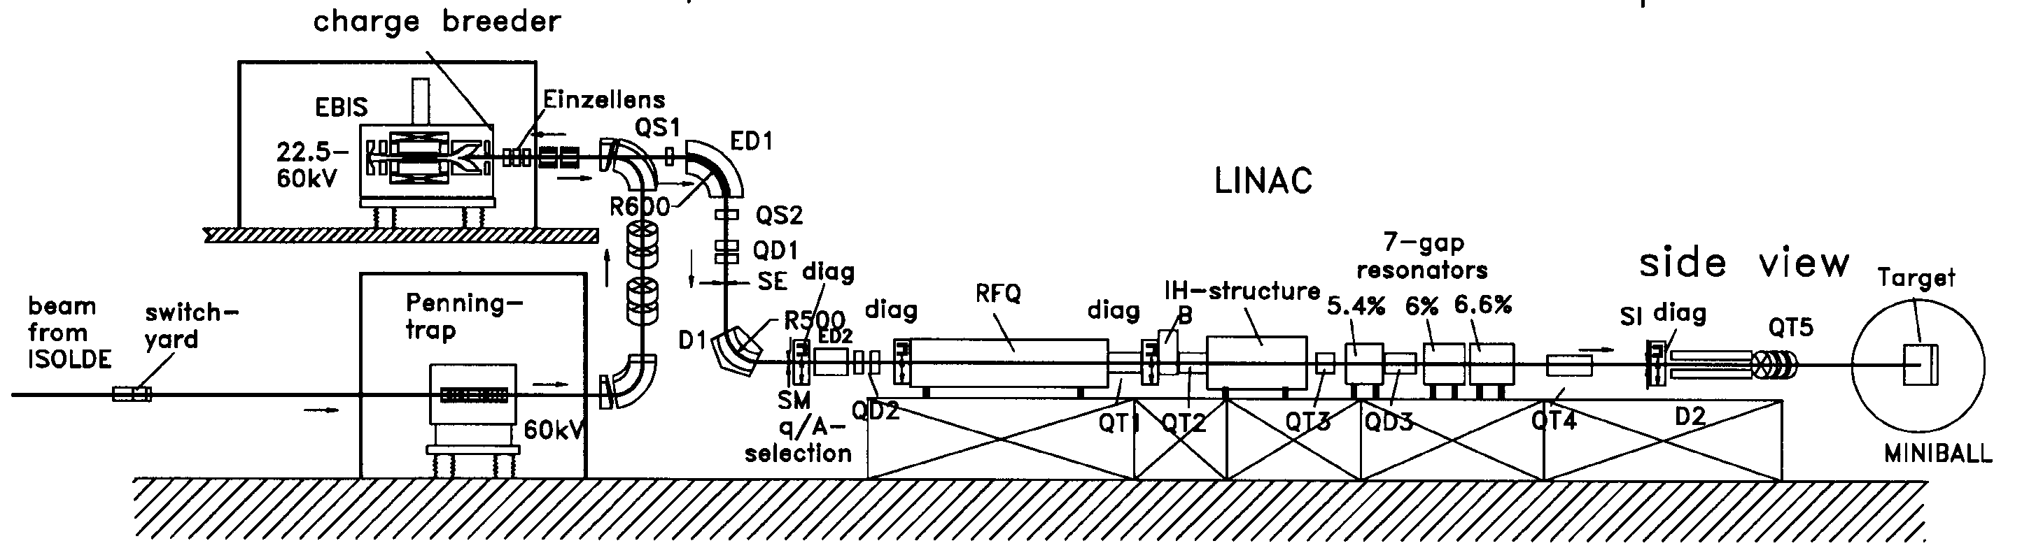
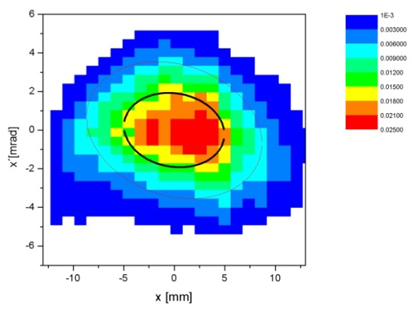
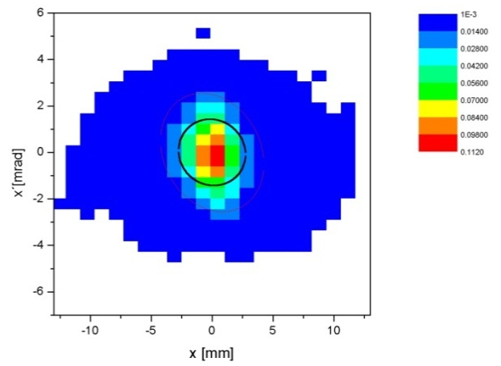
Beam out of REXTRAP
Non-cooled
* Bunching: few us
* Transverse emittance:
~30 -> ~10 π mm.mrad at 30 keV
* ΔE⋅Δt~10 eVus
EBIS
injection
works
Cooled
NB! Usually not isobarically cleaned

Slide 9
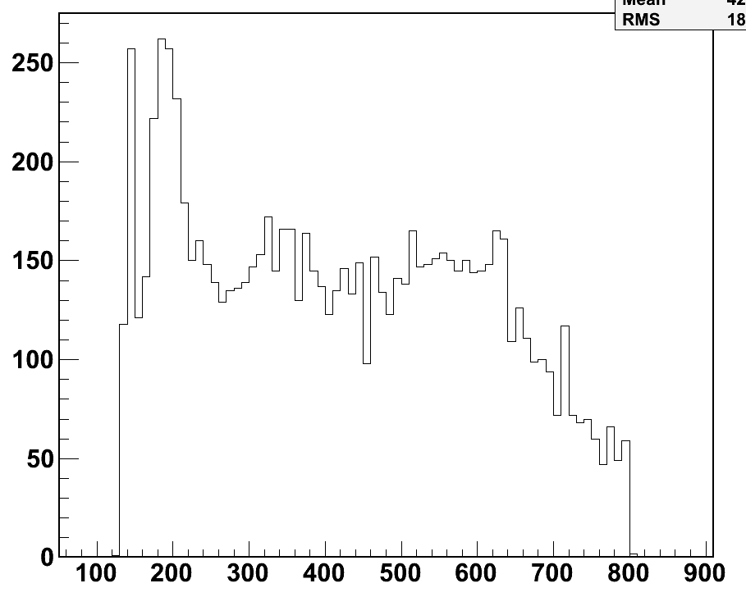
* Only 15 min delivered beam for 24 h beam time ->
+ excellent signal-to-noise ration
- high instantaneous rates (DAQ dead-time, pile-up)
=> implement slow (ms) extraction
REXEBIS extraction times
FWHM~25 us
500 us FWHM
Slow extraction, ¹⁹⁰Pb⁴⁴⁺ measured
with Miniball detector
Self extraction, ¹⁴N⁴⁺
measured before Linac
t (us)
* Beam pulse can be extended from 25 us to >400 us FWHM
(pulse length limited by Linac RF duty cycle to 800 us, from 2015 2 ms)
* Mass and q dependent – no standard settings
(need TOF from experiment for tuning)
See Andrey’s presentation

Slide 10
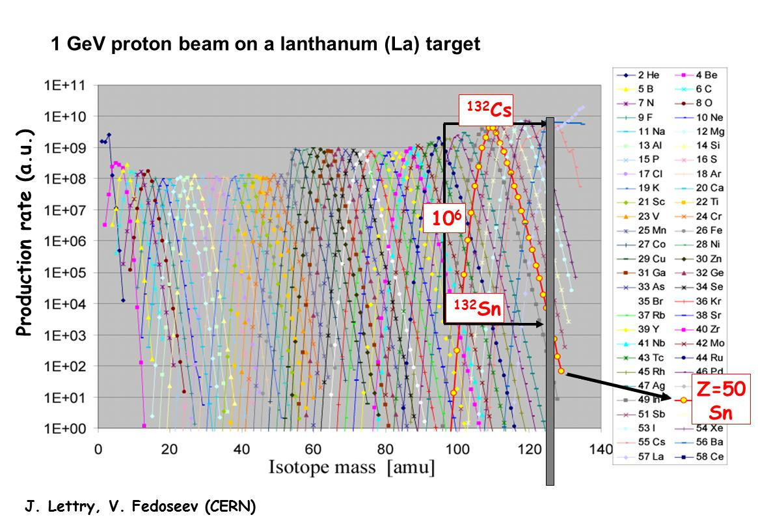
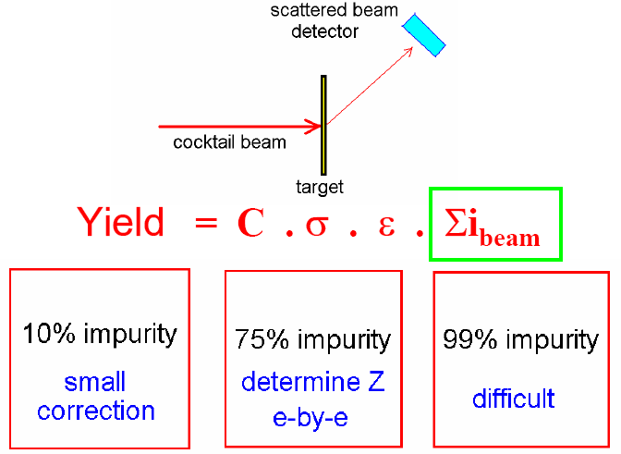
Beam contamination
Can’t see the trees for the forest
Remember: often deal with <1E4 pps => 1.7 fA
Beam impurities:
a. isobaric contamination
from ISOL-target
What’s problem?

Slide 11
Molecular beams
The idea
1. Use chemical properties to separate isobars e.g. ⁹⁶Rb from ⁹⁶Sr
2. Create a molecular sideband (⁹⁶Sr¹⁹F⁺) with gas leak at ISOL-target
3. Molecular ions are extracted and selected in the separator
(A=115 selection)
4. Keep molecules inside trap, break them in EBIS
5. Charge breed as usual and obtain clean ⁹⁶Sr
ISOLDE
separator
F
REX
separator
⁹⁶Sr²⁷⁺ A/q=3.556
¹¹⁵In³²⁺ A/q=3.594
¹¹⁵In³³⁺ A/q=3.484
All elements ionized by the ISOLDE 1+ source
⁹⁶Sr¹⁹F+
¹¹⁵In+
3.54
<A/q<
3.58
A/q=115
Trap
EBIS
Double separation
REX linac
Benefit from larger I_{e}

Slide 12
Mass separator
Nier-spectrometer
After REXEBIS
A/q < 4.5
Emittance ~10-25 mm mrad
(95%) @ 20 kV
ΔE < 50 eV*q ?
Energy of 5 keV/u
(determined by RFQ)
A/q-resolution ~150
Even so, some A/Q contaminants difficult to resolve
⁷Be³⁺ from ¹⁴N⁶⁺ R=450
¹⁸F⁹⁺ from ¹²C⁶⁺ R=19200

Slide 13
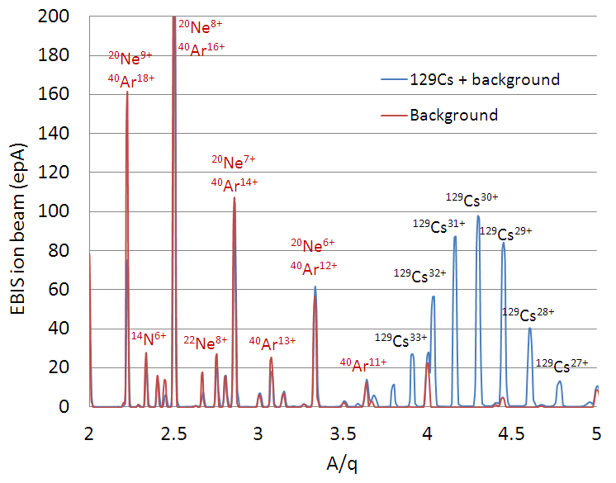

Clean beam?
residual gases in CB
I_{residual} ∝ σ_{0->1+} P_{res gas}
Extracted beams from REXEBIS as function of A/q showing residual gas peaks and
charge bred ¹²⁹Cs. The blue trace is with and the red trace without ¹²⁹Cs being injected.
Isotope toolbox turns 10

Slide 14
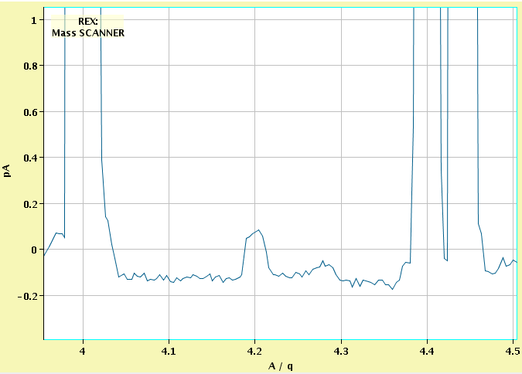
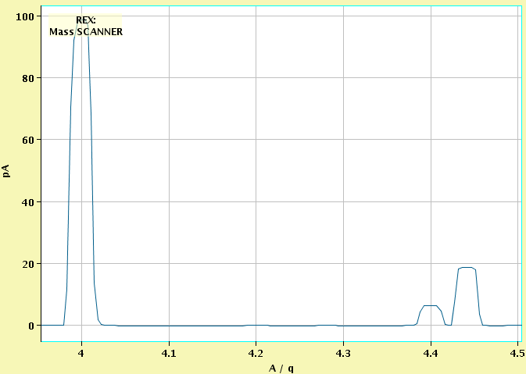
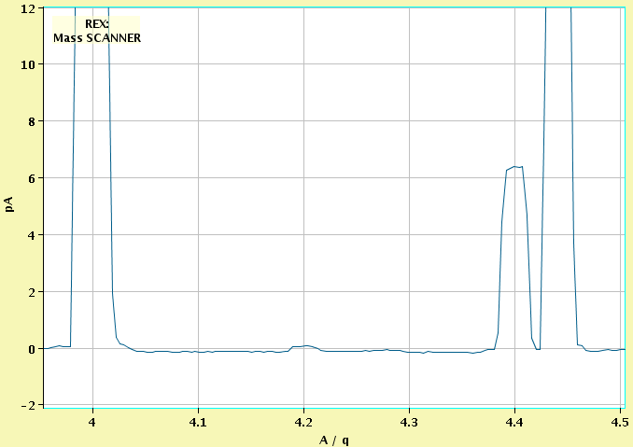
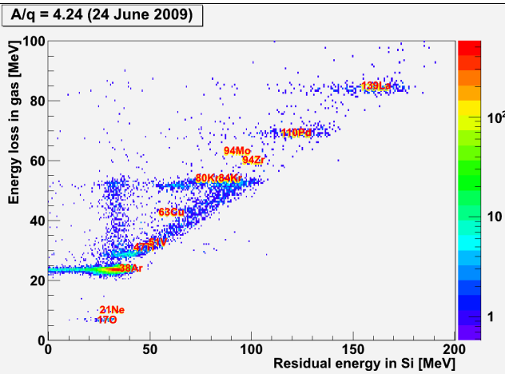
⁴⁰Ar⁹⁺
How pure is the beam really?
¹²C³⁺
¹⁶O⁴⁺
²⁰Ne⁵⁺
⁴⁰Ar¹⁰⁺
²²Ne⁵⁺
⁴⁷Ti¹¹⁺?
⁶⁰Ni¹⁴⁺?
⁹⁰Zr²¹⁺?
* C, O, Ne and Ar partial pressures around
3⋅10⁻¹², 2⋅10⁻¹², 5⋅10⁻¹² and 4⋅10⁻¹³ mbar
²¹Ne⁵⁺
A/q=4.24
Isotope A/q Z Origin
17O 4.250 8 residual gas
21Ne 4.2 10 buffer gas
38Ar 4.222 18 residual gas
47Ti 4.272 22 drift tubes
51V 4.25 23 NEG strips
63Cu 4.2 29 anode and collector
80Kr, 84Kr 4.21, 4.2 36 residual gas
94Zr 4.272 40 NEG strips
139La 4.212 57 cathode
Other elements that can be present at other A/q are:
He, C, N residual gases
B cathode
Fe NEG strips, stainless steel
Ni stainless steel
Cr stainless steel
Mo stainless steel

Slide 15
Continuous injection ‘accu’ mode
+ Collect ions continuously =>
no Penning trap needed
+ Adapted to ISOL ion sources
+ Shorter cycle times
Local ion source
* Na+, K+, Rb+, SrF+ from both local
ion source and from ISOLDE target
* CW operation even used for a run
⁹⁶Sr(F) - continuous injection into EBIS
* CW beam from the RFQ cooler:
EBIS efficiency alone of 5% for
⁸⁷Rb^{17+,} T_{breed} = 29 ms
* Some problems...

Slide 16
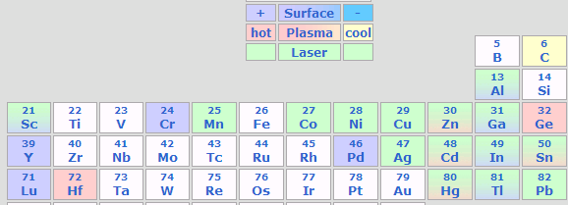
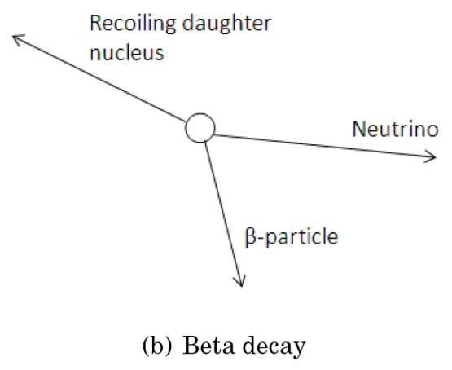
In-EBIS decay
In-trap decay
Be
Tested first time at REX-ISOLDE with
⁶¹Mn (T_{1/2}=675 ms; 1.7x10⁶ atoms/s)
β±-decay
T_{trap} T_{breed} Result
200-1100 ms 28 ms no Fe detected at Miniball
300-1100 ms 298 ms 57(7)% Fe detected
agrees with predictions
Benefit from increased:
1. radial holding voltage
2. higher electron beam

Slide 17
Hot spots in REX
5-10%
1-2%
35-40%
2-5%
40-70%
Losses, in percent of the ISOLDE beam
ISOLDE
* Class C Lab
* Handle 100 LA
Radiation / contamination

Slide 18
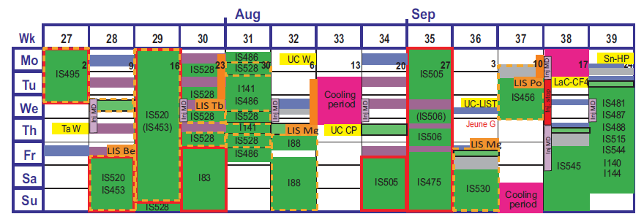
Red boundary = REX run
ISOLDE schedule
Purple = REX setup
* Two separators (GPS and HRS) in parallel
* ~180 shifts scheduled 2012
* In between stable beams from EBIS for:
calibration of detector setups
machine development (beam diagnostics tests, Linac, controls upgrades)
* Running from beginning of April to mid December
* Scheduled 2 weeks machine stop if requested
Consequences of a breakdown
-> cancelled run
(not less statistics but no measurement)

Slide 19
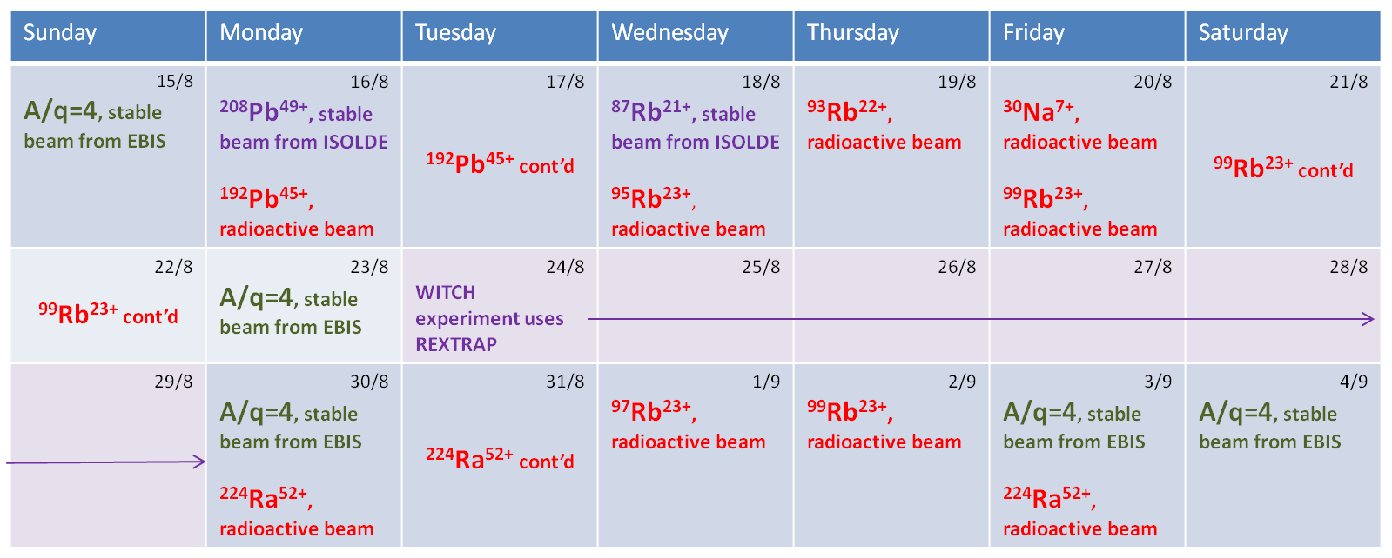
Beam zapping with REX
REX used to be difficult to setup
Since 2010 improved scalability and reproducibility
Beams to the Miniball experiment from ISOLDE target #433, Aug/Sep 2010
At least 16 changes in 15 days!

Slide 20
Conclusions
1. REX breeder system is working extremely well!
2. Penning trap complicates things but:
can be used for isobaric mass separation
crucial for injection into a storage ring after the post-accelerator
3. Effort presently put on Linac energy upgrade
4. Future serious challenges for REXEBIS breeder upgrade

Slide 22
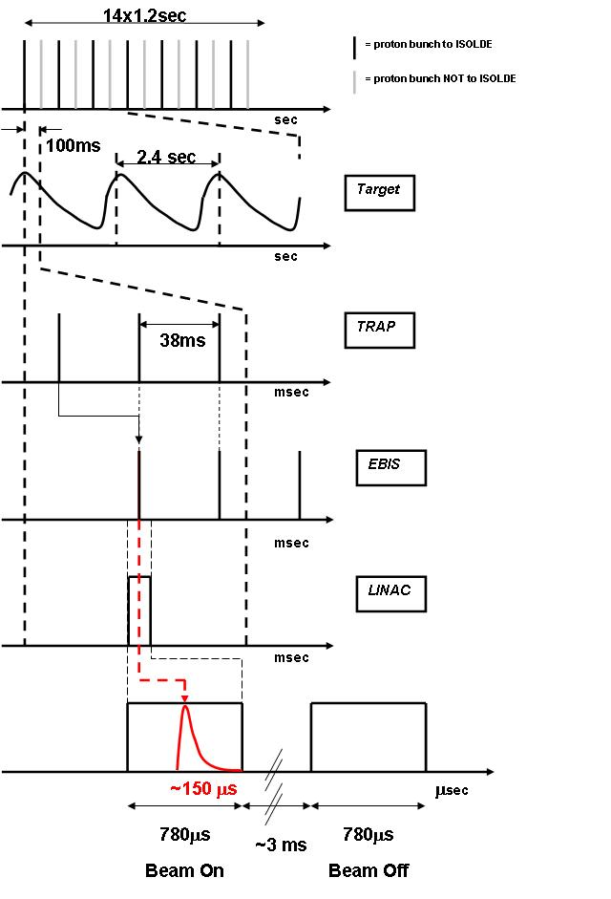
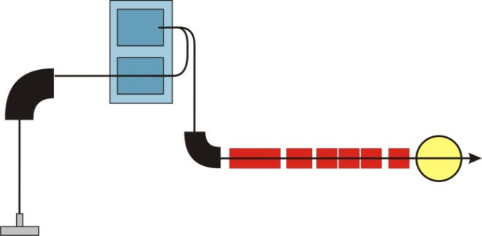
Slide borrowed from J. van de Walle
Time Structure
EBIS
REX
TRAP
1 shift at REX
=
19 min actual measuring time
Trapping
Charge Breeding
Post Acceleration
Bunched beam : high instantaneous rate !
  deadtime …
Good signal/background …

